Slide 1
Where do the
X-rays come from?

Slide 2
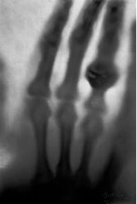
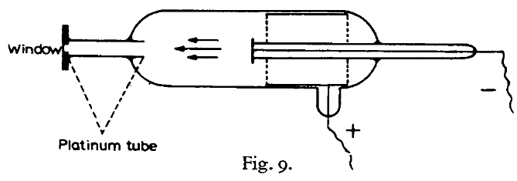
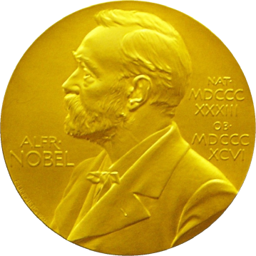
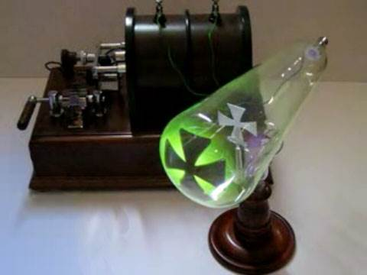
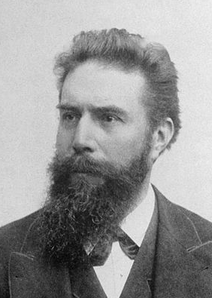
X-rays
(aka “Röntgenstrahlung”)
The discovery soon after this of X-rays by Röntgen (22), the first investigator to use the type of tube described above, is generally considered to be a good example of a lucky discovery.
P.E.A. von Lenard
1906 Nobel Lecture
Röntgen, W. C. (1898)."Ueber eine neue Art von Strahlen", Annalen der Physik 300, 1-11.

Slide 3
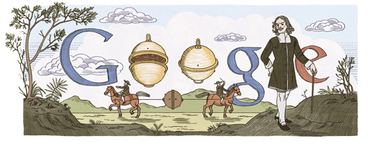
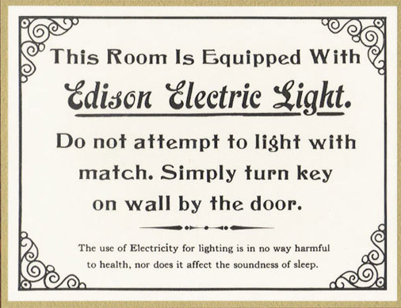
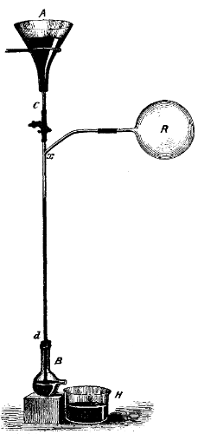
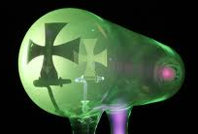
Electricity + vacuum = X-rays
1654 ~10 Torr
Otto von Guericke’s
“Magdeburg hemispheres”
1865 < 10⁻² Torr
Hg “fall tube” pump
Sprengel, H. (1865). "Researches on the vacuum", J. Chem. Soc. 18, 9b-21.
1870s < 10⁻³ Torr
1894 < 10⁻⁵ Torr
Sprengel pump
Redhead, Paul A., ed. Vacuum Science and Technology: Pioneers of the 20th Century. Vol. 2. Springer, 1994.
Benvenuti, C. & Chiggiato, P. (1993). "Obtention of pressures in the 10⁻¹⁴ torr range by means of a Zr-V-Fe non evaporable getter", Vacuum 44, 511-513.
1993 ~10⁻¹⁴ Torr

Slide 4
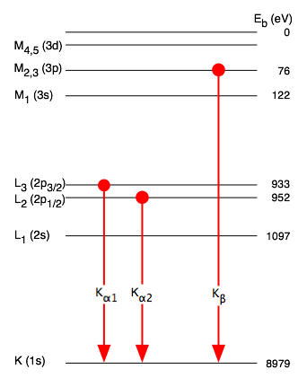
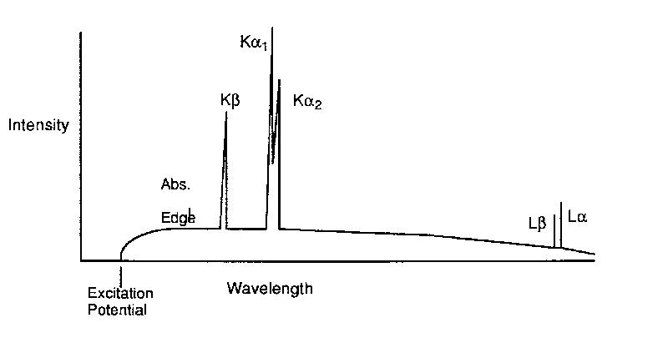
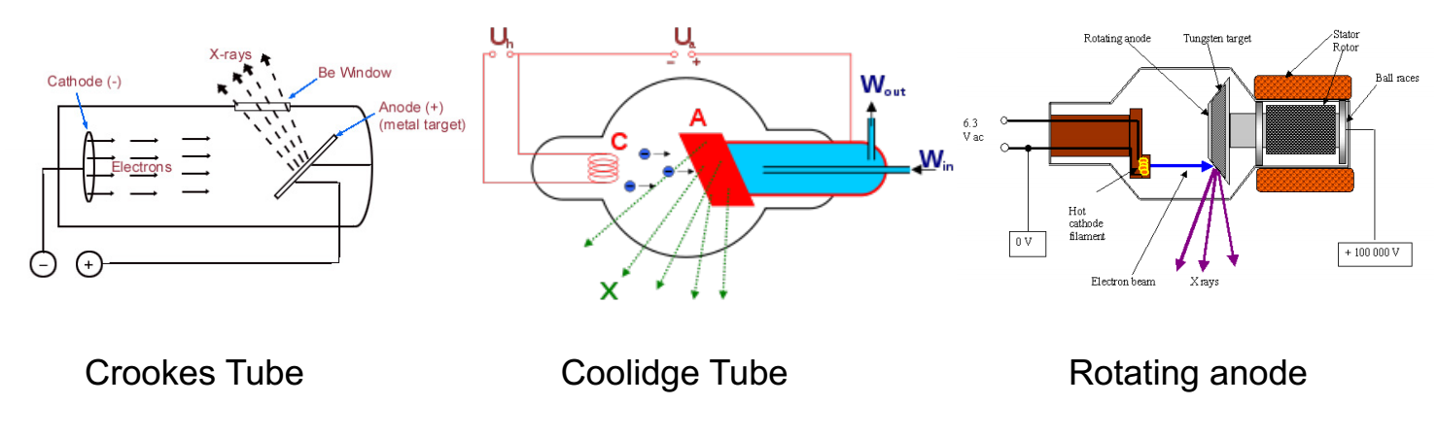
Fluorescent X-ray sources: “sealed tube” and “rotating anode”

Slide 5
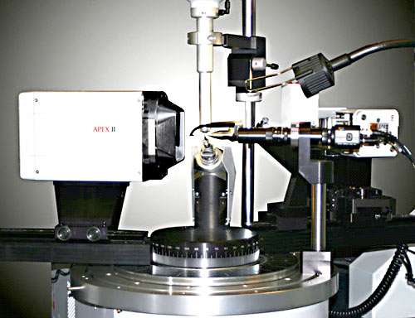
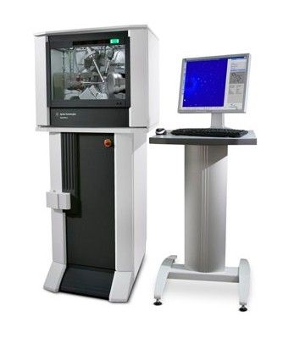
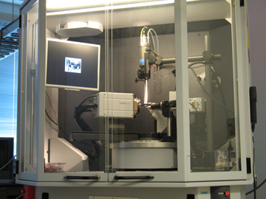
EXPERIMENTAL SETUP – Home Source

Slide 6
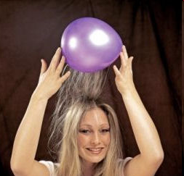
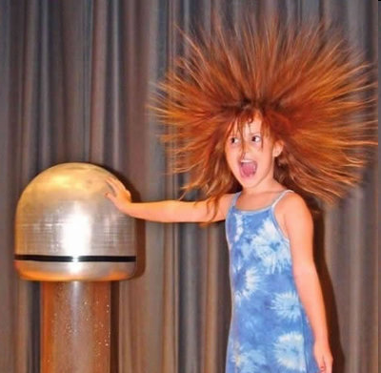
Electric charge
balloon
-
-
-
-
-
-
Wool Sweater
+ + + + + +

Slide 7
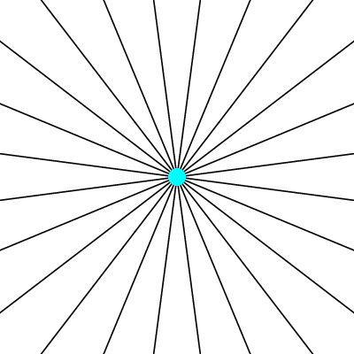
Electric field of a moving charge

Slide 8
Electric field of a moving charge
accelerating charges
make
electromagnetic waves
(light)

Slide 9
Bending Magnet
S
electron beam
X-rays !
N

Slide 10
Two Bending Magnets
S
N
electron beam
N
S
2x X-rays !

Slide 11
Wiggler
8x X-rays !
S
N
S
N
S
N
S
N
N
S
N
S
N
S
N
S

Slide 12
Undulator
> 8x X-rays !
S
N
S
N
S
N
S
N
N
S
N
S
N
S
N
S

Slide 13
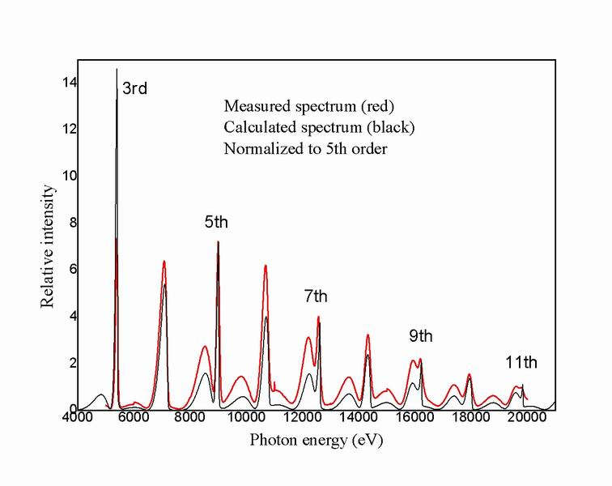
Undulator emission spectrum

Slide 14
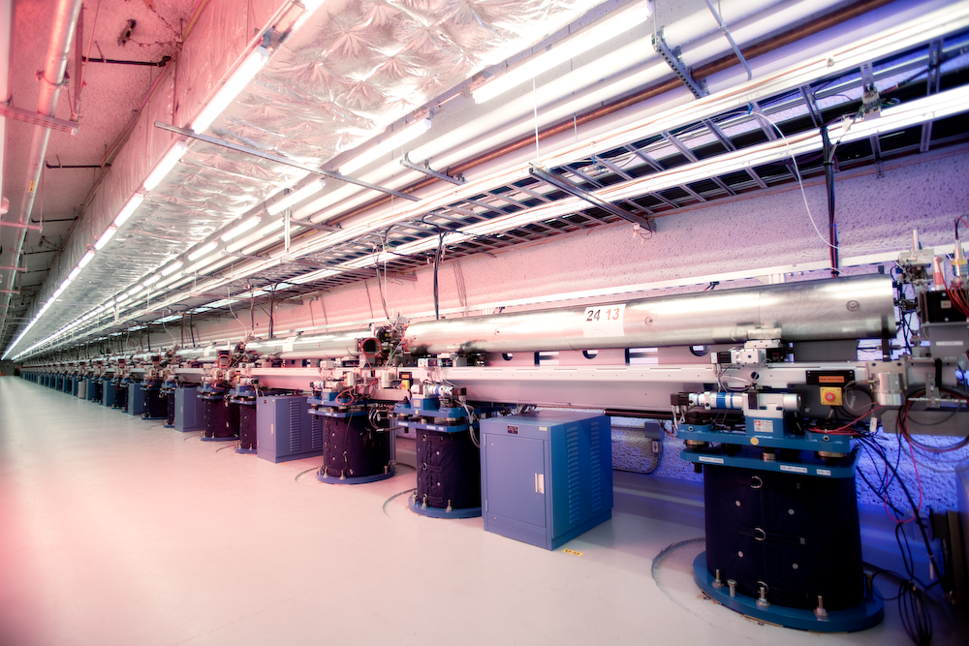
LCLS undulator hall

Slide 15
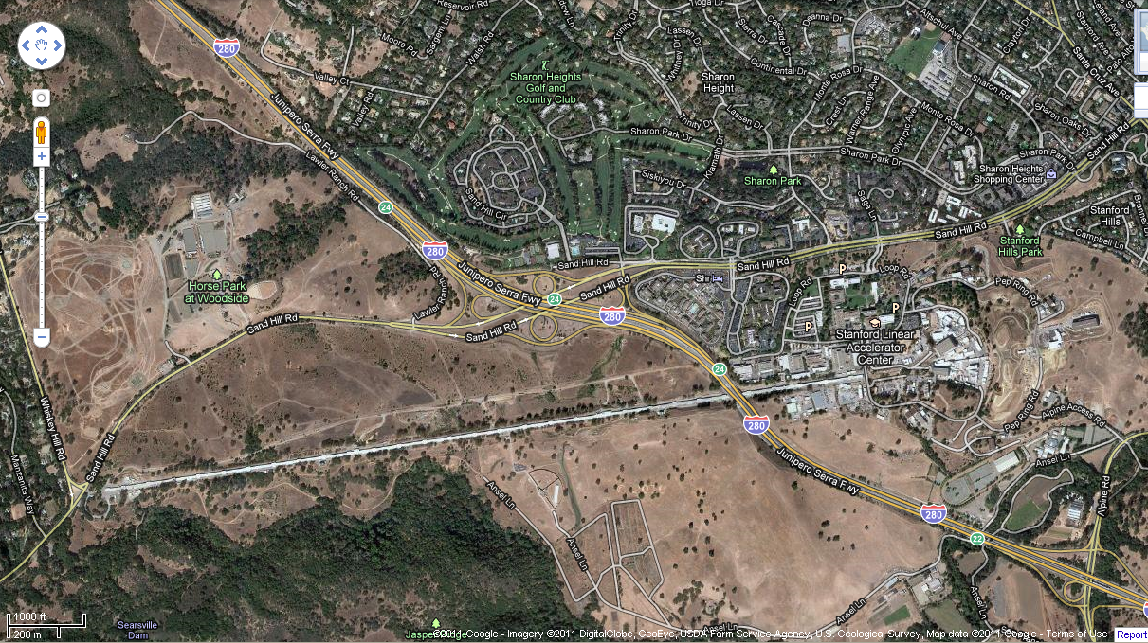
LCLS at SLAC

Slide 16
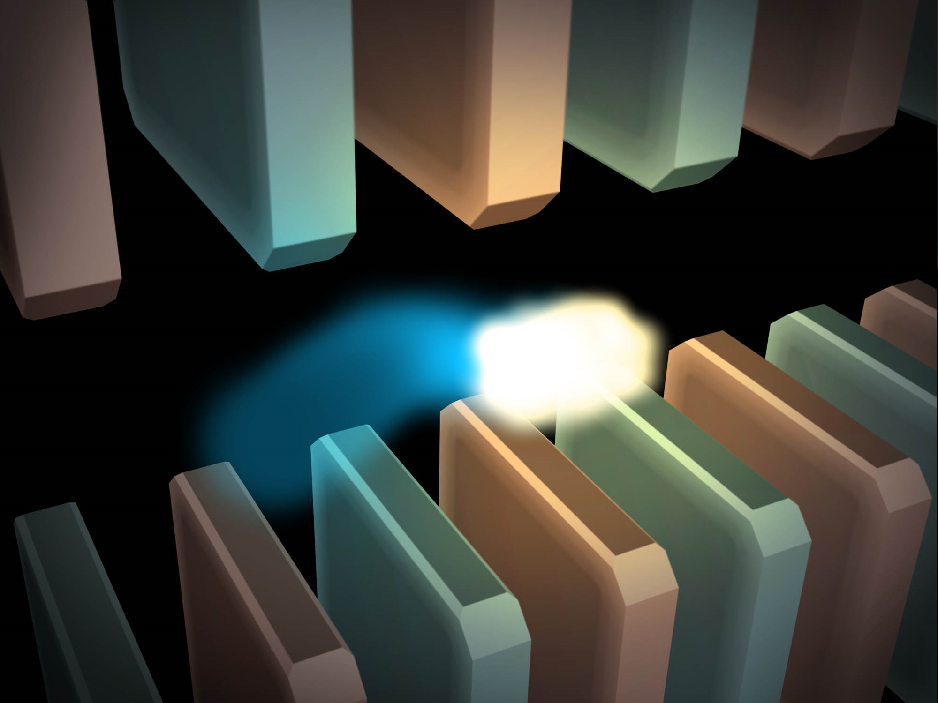
Electric field of a moving charge

Slide 17
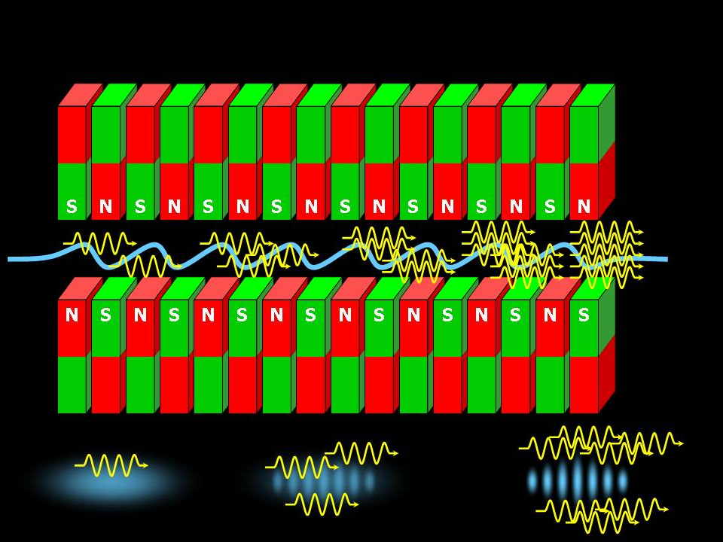
SASE effect

Slide 18
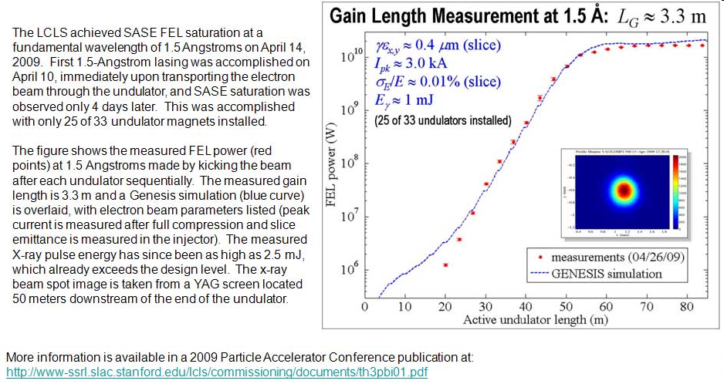
Self-Amplified Stimulated Emission (SASE) effect

Slide 19
Accelerator-based light source terminology
Code name Translation
First Generation Bending Magnet
Second Generation Wiggler
Third Generation Undulator
Fourth Generation Free electron laser

Slide 20
MGy reaction reference
~45 global damage Owen et al. (2006)
10/Å global damage Howells et al. (2009)
5 Se-Met Holton (2007)
4 Hg-S Ramagopal et al. (2004)
4 R-C-COOH Garman et al. (2015)
3 S-S Murray et al. (2002)
1 Br-RNA Olieric et al. (2007)
~1? Cl-C ???
0.5 Mn in PS II Yano et al. (2005)
0.06 putidaredoxin Corbett et al. (2007)
0.02 Fe in myoglobin Denisov et al. (2007)
Radiation Damage World Records
Holton (2009) J. Synchrotron Rad. 16 133-42

Slide 21
what the is a MGy?
http://bl831.als.lbl.gov/
damage_rates.pdf
Holton J. M. (2009) J. Synchrotron Rad. 16 133-42

Slide 22
How long will my crystal last?
synch line type flux beamsize flux density dose max xtal min site
ph/s μm ph/μm2/s rate lifetime lifetime
ALS 4.2.2 MAD 1e12 75x80 1.7e+08 124 kGy/s 4 m 16 s
ALS 5.0.1 mono 2e11 100 2.5e+07 13 kGy/s 39 m 2.6 m
ALS 5.0.2 MAD 1.5e12 100 1.5e+08 76.3 kGy/s 6.6 m 26 s
ALS 5.0.3 mono 3e11 100 3.8e+07 19.4 kGy/s 26 m 1.7 m
ALS 8.2.1 MAD 3.5e11 100 4.5e+07 22.7 kGy/s 22 m 88 s
ALS 8.2.2 MAD 3.5e11 100 4.5e+07 22.7 kGy/s 22 m 88 s
ALS 8.3.1 MAD 9e11 70 2.3e+08 119 kGy/s 4.2 m 17 s
ALS 12.3.1 MAD 2e11 65x90 3.4e+07 17.4 kGy/s 29 m 1.9 m
ALS 12.3.1 ML 4.0e13 65x90 6.8e+09 6.89 MGy/s 4.4 s 0.29 s
SSRL 1-5 MAD 1.7e10 200 4.2e+05 202 Gy/s 41 h 2.8 h
SSRL 7-1 mono 2.6e11 200 6.5e+06 3.09 kGy/s 2.7 h 11 m
SSRL 9-1 mono 3.9e10 200 9.8e+05 463 Gy/s 18 h 72 m
SSRL 9-2 MAD 4.8e11 200 1.2e+07 5.7 kGy/s 88 m 5.8 m
SSRL 11-1 MAD 3.9e11 200 9.8e+06 4.63 kGy/s 1.8 h 7.2 m
SSRL 11-3 mono 2.6e10 200 6.5e+05 302 Gy/s 28 h 1.8 h
SSRL 12-2 MAD 4e12 90x5 8.9e+09 5.01 MGy/s 6 s 0.4 s
SSRL 12-1 MAD 4e12 5x5 1.6e+11 90 MGy/s 0.35 s 22 ms
SSRL 12-1 ML 3e14 5x5 1.1e+13 6.4 GGy/s 5 ms 300 us
APS 24-ID-C MAD 1.3e13 20x60 1.1e+10 5.23 MGy/s 5.7 s 0.38 s
APS "typical" MAD 1.5e12 80 2.3e+08 119 kGy/s 4.2 m 17 s
synch line type flux beamsize flux density dose max xtal min site
ph/s μm ph/μm2/s rate lifetime lifetime

Slide 23
Self-calibrated damage limit
Where:
⟨I⟩_{DL} - average damage-limited intensity (photons/hkl) at a given resolution
10⁵ - converting R from μm to m, r_{e} from m to Å, ρ from g/cm³ to kg/m³ and MGy to Gy
r_{e} - classical electron radius (2.818 x 10⁻¹⁵ m/electron)
h - Planck’s constant (6.626 x 10⁻³⁴ J∙s)
c - speed of light (299792458 m/s)
f_{decayed} - fractional progress toward completely faded spots at end of data set
ρ - density of crystal (~1.2 g/cm³)
R - radius of the spherical crystal (μm)
λ - X-ray wavelength (Å)
f_{NH} - the Nave & Hill (2005) dose capture fraction (1 for large crystals)
n_{ASU} - number of proteins in the asymmetric unit
M_{r} - molecular weight of the protein (Daltons or g/mol)
V_{M} - Matthews’s coefficient (~2.4 Å³/Dalton)
H - Howells’s criterion (10 MGy/Å)
θ - Bragg angle
⟨ƒ_{a}²⟩ - number-averaged squared structure factor per protein atom (electron²)
⟨M_{a}⟩ - number-averaged atomic weight of a protein atom (~7.1 Daltons)
B - average (Wilson) temperature factor (Å²)
μ - attenuation coefficient of sphere material (m⁻¹)
μ_{en} - mass energy-absorption coefficient of sphere material (m⁻¹)
No flux
No symmetry
No exposure time
Holton & Frankel (2010) Acta D 66 393-408.

Slide 24
The number of photons scattered
before crystal is dead
is independent
of data collection time
1 um³ = 10⁵ photons (roomT)
1 um³ = 10⁶ photons (synch)
1 um³ = 10⁸ photons (XFEL)
(synch)
Henderson, 1990; Gonzalez & Nave, 1994; Glaeser et al., 2000; Sliz et al., 2003; Leiros et al., 2006; Owen et al., 2006; Garman & McSweeney, 2006; Garman & Nave, 2009; Holton, 2009

Slide 25

Dose slicing
unacceptable
completeness
N
photons
crystal’s useful life
N
photons
unacceptable
read noise
N
photons

Slide 26
What do I do?
You only have a few small crystals…
Should you:
  Collect 360° from each?
  Collect 10° from each at 36x exposure?
  Glue 36 xtals together, then collect 360° ?
  Glue together and do 12960° ?

Slide 27
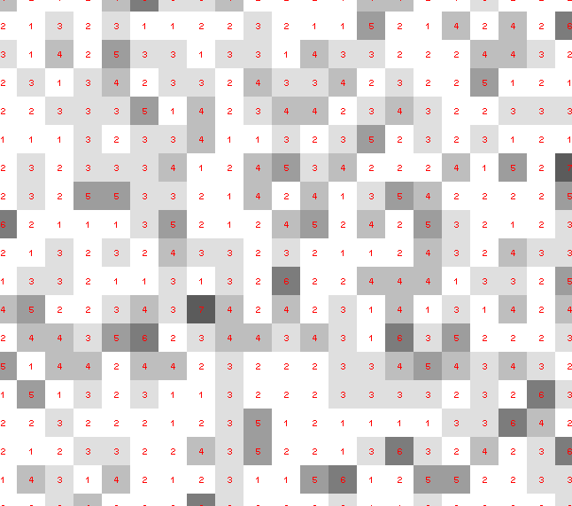
Dose slicing: is that a spot?

Slide 28
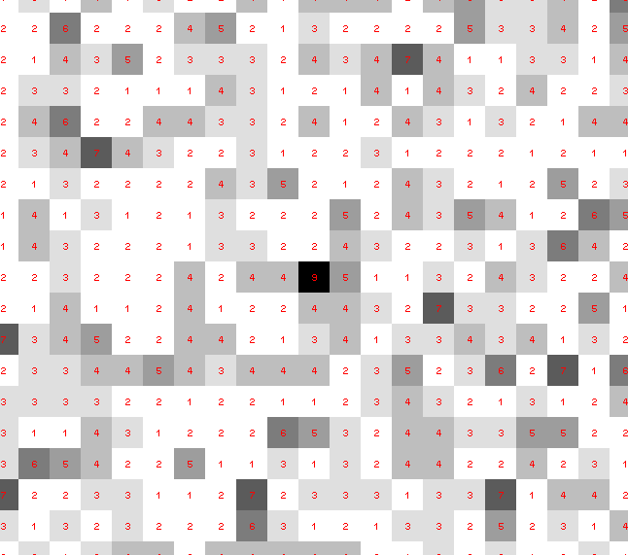
Dose slicing: is that a spot?

Slide 29
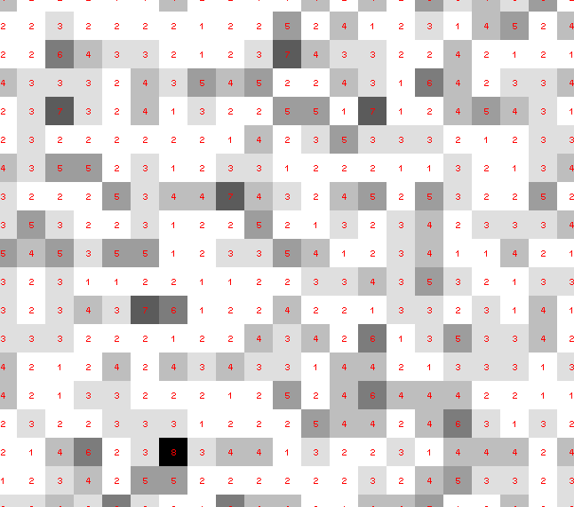
Dose slicing: is that a spot?

Slide 30
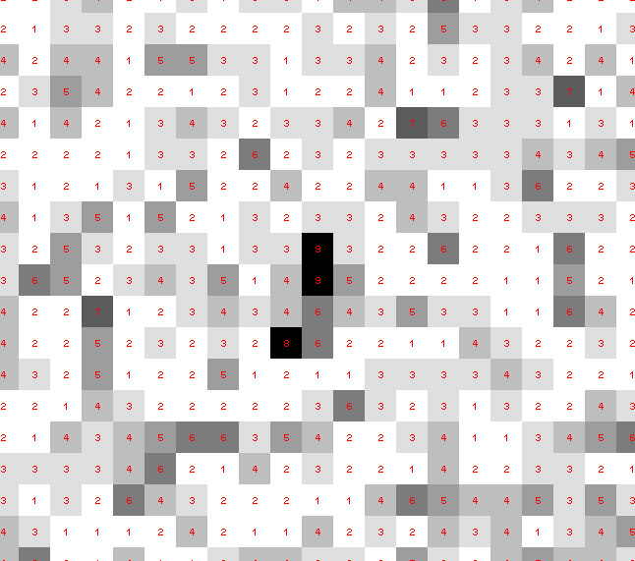
Dose slicing: is that a spot?

Slide 31
Dose slicing: is that a spot?

Slide 32
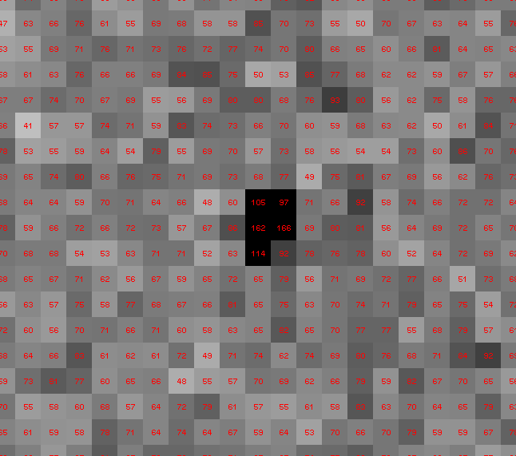
Dose slicing: is that a spot?

Slide 33
“true” resolution limit
CC vs right answer
Resolution (Å)

Slide 34
“true” resolution vs strategy
Dose slice collection scenario
fine | coarse | glue | Glue & fine
3.17700 | 3.14057 | 3.17604 | 3.12086
301,640,334 photons/xtal

Slide 35
processing procedure | resolution limit
 | fine | coarse | glue | glue&fine
XDS/XSCALE | 3.17700 | 3.14057 | 3.17604 | 3.12086
XDS/aimless | 3.16251 | 3.15922 | 3.16675 | 3.12162
XDS/noscale | 3.27289 | 3.15617 | 3.38929 | 3.12162
MOSFLM-defaults | x | x | x | x
MOSFLM-cheat | 3.19755 | 3.18166 | 3.20354 | 3.19755
HKL2000-defaults | x | x | x | x
HKL2000-expert | 3.21803 | 3.12646 | 3.11551 | 3.21803
HKL2000-cheat | 3.16119 | 3.10338 | 3.10338 | 3.16300
DIALS-defaults | x | x | 3.42125 | x
DIALS-expert | 3.10296 | 3.09547 | 3.07653 | 3.08465
d*Trek | ? | ? | 4.34076 | ?
EVAL15 | 3.14352 | 3.10383 | 3.09936 | 3.14105
EVAL15-sadabs | 3.13920 | 3.10797 | 3.10171 | 3.13700

Slide 36
Optimum exposure time?
~1 photon/pixel
  XDS, DIALS
~10 photon/pixel
HKL2000, MOSFLM
~30 photon/pixel
CCD detector

Slide 37
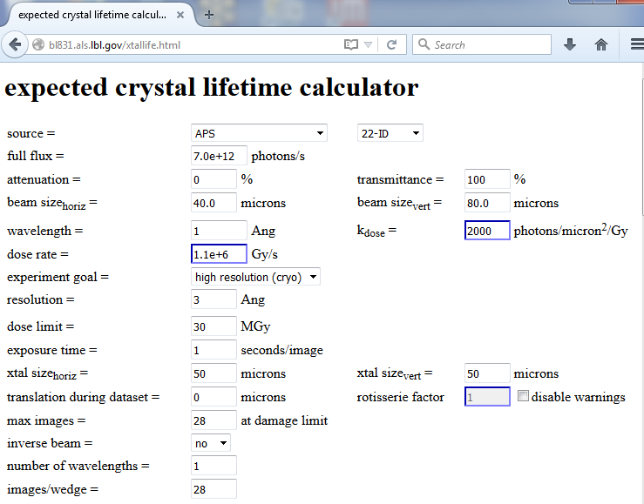

Slide 38

Holton & Frankel (2010) Acta D 66 393-408.

Slide 39
What does all that stuff in the concrete tunnel do?

Slide 40
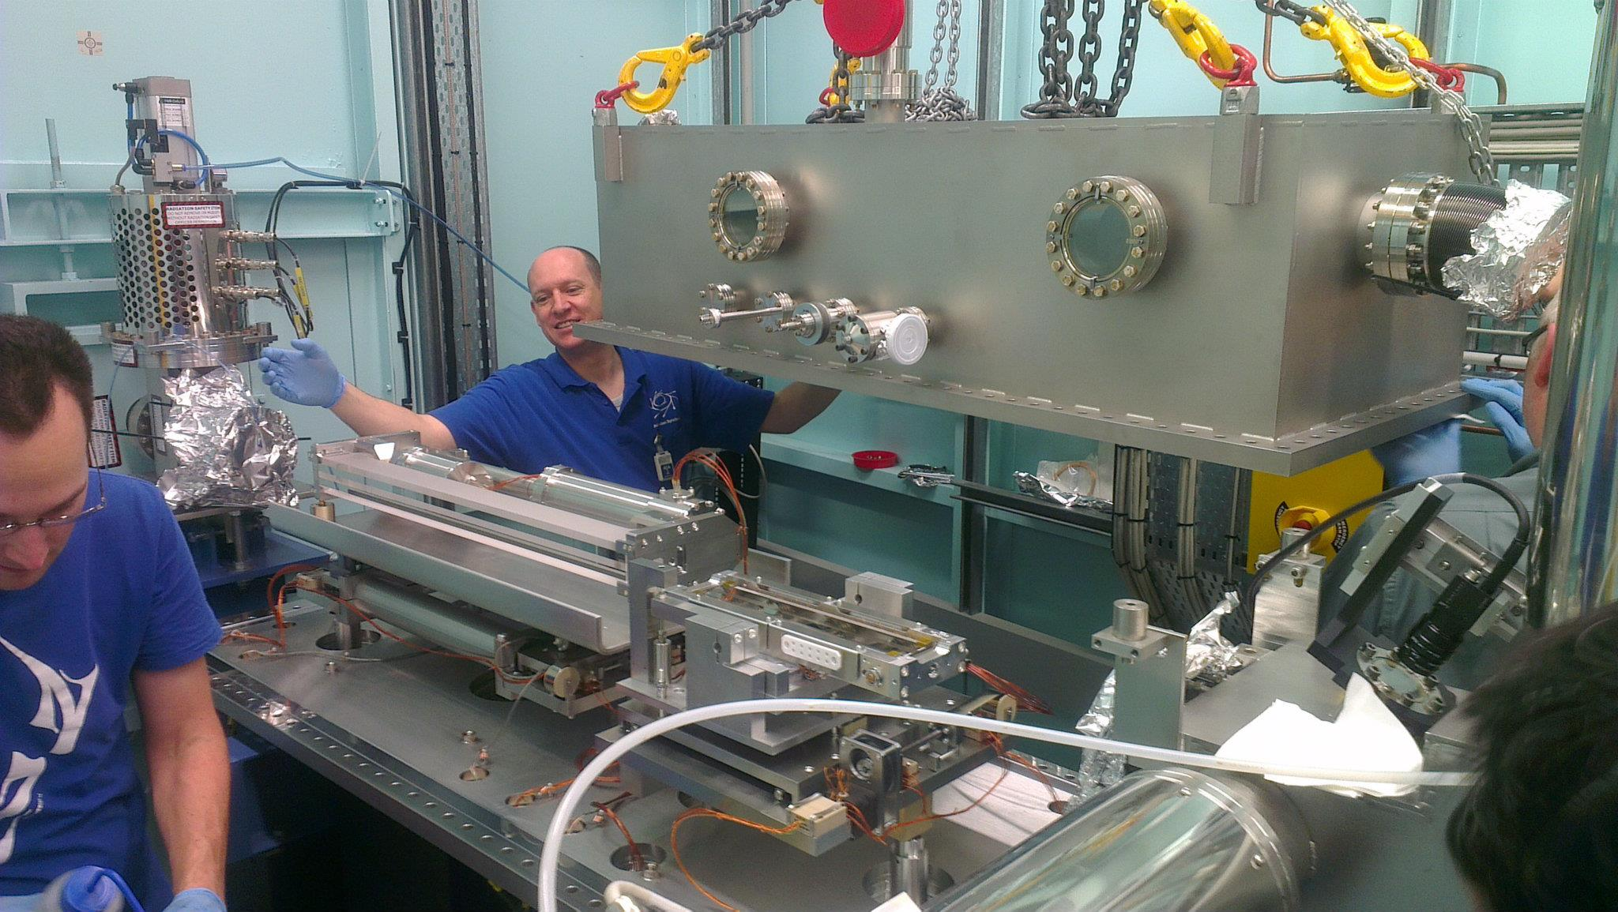
X-ray optics: mirrors
Notes:
Next slide please

Slide 41
Why are the mirrors so long?
Must be < 0.2°
3 mm
1000 mm
Notes:
Next slide please

Slide 42
Monochromators
λ = 1 Å
Si
Notes:
Next slide please

Slide 43
Monochromators
nλ = 2d sin(θ)
λ = 1 Å
λ = 1 Å
Si
d = 3.135 Å
θ = 9.177°
Notes:
Next slide please

Slide 44
Monochromators
nλ = 2d sin(θ)
λ = 1.1 Å
Si
d = 3.135 Å
θ = 9.177°
Notes:
Next slide please

Slide 45
Monochromators
nλ = 2d sin(θ)
λ = 1.1 Å
λ = 1.1 Å
Si
d = 3.135 Å
θ = 10.104°
Notes:
Next slide please

Slide 46
Monochromators
nλ = 2d sin(θ)
λ = 1 Å
λ = 1 Å
Si
d = 3.135 Å
θ = 9.177°
Notes:
Next slide please

Slide 47
Monochromators
Si
λ = 1 Å
λ = 1 Å
Si
d = 3.135 Å
DCM = Double Crystal Monochromator
Notes:
Next slide please

Slide 48
Monochromators
Si
λ = 1.1 Å
λ = 1.1 Å
Si
d = 3.135 Å
DCM = Double Crystal Monochromator
Notes:
Next slide please

Slide 49
Monochromators
nλ = 2d sin(θ)
λ = 1.54 Å
λ = 1.54 Å
Mo/C
d = 24 Å
θ = 1.84°
Multilayer optics
Notes:
Next slide please

Slide 50

The “beam line”
focused
beam
slits
Scatter
guard
Secondary
mirror
Primary
mirror
Source
S
Area Detector
N
Unfocused
beam
slits
Si(111)
monochromator
Sample

Slide 51
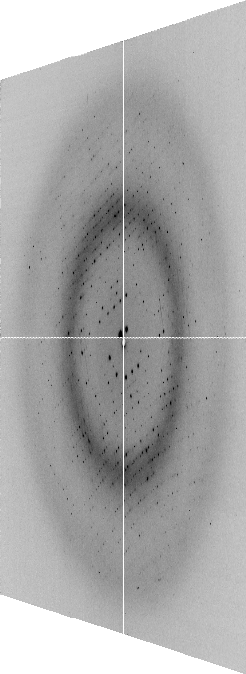
The “beam line”
focused
beam
slits
Scatter
guard
Secondary
mirror
Primary
mirror
Source
S
Area Detector
N
Unfocused
beam
slits
Si(111)
monochromator
Sample
Notes:
Most notable acheivements are high brightness with very little “wasted” light. The discovery made by Howard Padmore? At ALS showed that a 2:1 demagnification cancels nearly all of the spherical abberations in the parabolic/torroid system. 30-50% of the total x-ray intensity passes through the 100um pinhole. The flux through the 100um pinhole at the superbend beamlines is comparable to that of the 5.0.2 wiggler or an APS bending magnet, but only 150 Watts of power must be dissipated by the beamline optics. In contrast, wiggler beamlines must disipate kilowatts. The optics here are much simpler and not exotic in any way. The system is stable and robust. There is never a need to re-focus the beam at a new wavelength. Only a 2-minute automatic tuneup is recommended for very large energy changes (more than 1-2 keV).

Slide 52
X-ray optics
pinhole
Scatter
guard
X-ray
Source
Area Detector
Cite the “beamline paper!”
Know “final” beam properties
Protein Crystal
Notes:
Most notable acheivements are high brightness with very little “wasted” light. The discovery made by Howard Padmore? At ALS showed that a 2:1 demagnification cancels nearly all of the spherical abberations in the parabolic/torroid system. 30-50% of the total x-ray intensity passes through the 100um pinhole. The flux through the 100um pinhole at the superbend beamlines is comparable to that of the 5.0.2 wiggler or an APS bending magnet, but only 150 Watts of power must be dissipated by the beamline optics. In contrast, wiggler beamlines must disipate kilowatts. The optics here are much simpler and not exotic in any way. The system is stable and robust. There is never a need to re-focus the beam at a new wavelength. Only a 2-minute automatic tuneup is recommended for very large energy changes (more than 1-2 keV).

Slide 53
The truth about x-ray beams
Term units significance
Flux photons/s duration of experiment
Beam Size μm match to crystal
Divergence mrad spot size vs distance
Wavelength Å resolution and absorption
Dispersion Δλ/λ spot size
Flux density ph/s/area scattering/damage rate
Fluence ph/area scattering/damage

Slide 54
The truth about x-ray beams
Term units significance
Flux photons/s duration of experiment
Beam Size μm match to crystal
Divergence mrad spot size vs distance
Wavelength Å resolution and absorption
Dispersion Δλ/λ spot size
Flux density ph/s/area scattering/damage rate
Fluence ph/area scattering/damage

Slide 55
The truth about x-ray beams
quantity | units | home source | 12-2
flux | Photons/second | 2.5 x 10⁹ | 2 x 10¹²
exposure | seconds | 400 | 1

Slide 56
The truth about x-ray beams
quantity | units | home source | 12-2
flux | Photons/second | 2.5 x 10⁹ | 2 x 10¹²
exposure | seconds | 400 | 1
Dispersion | wavelength range / wavelength | 0.2% (Kα₁ - Kα₂) | 0.014% (Si111)
Divergence | milliRadian | 4.8 | 1.8 (h) 0.18 (v)
Beam size | microns | 100 | 24 (h) 12 (v)
Spectral brightness | Photons/s/mm²/ mR²/0.1%BW | 5.4 x 10⁹ | 1.5 x 10¹⁷

Slide 57
The truth about x-ray beams
quantity | units | home source | 12-2
flux | Photons/second | 72 x 10⁶ | 2 x 10¹²
exposure | time | 4 hours | 1 second
Dispersion | wavelength range / wavelength | 0.2% (Kα₁ - Kα₂) | 0.014% (Si111)
Divergence | milliRadian | 4.8 | 1.8 (h) 0.18 (v)
Beam size | microns | 17 | 24 (h) 12 (v)
Spectral brightness | Photons/s/mm²/ mR²/0.1%BW | 5.4 x 10⁹ | 1.5 x 10¹⁷

Slide 58
The truth about x-ray beams
quantity | units | home source | 12-2
flux | Photons/second | 1 x 10⁶ | 2 x 10¹²
exposure | time | 10 days | 1 second
Dispersion | wavelength range / wavelength | 0.2% (Kα₁ - Kα₂) | 0.014% (Si111)
Divergence | milliRadian | 0.6 | 1.8 (h) 0.18 (v)
Beam size | microns | 17 | 24 (h) 12 (v)
Spectral brightness | Photons/s/mm²/ mR²/0.1%BW | 5.4 x 10⁹ | 1.5 x 10¹⁷

Slide 59
The truth about x-ray beams
quantity | units | home source | 12-2
flux | Photons/second | 8 x 10⁴ | 2 x 10¹²
exposure | time | 5 months | 1 second
Dispersion | wavelength range / wavelength | 0.014% (Si111) | 0.014% (Si111)
Divergence | milliRadian | 0.6 | 1.8 (h) 0.18 (v)
Beam size | microns | 17 | 24 (h) 12 (v)
Spectral brightness | Photons/s/mm²/ mR²/0.1%BW | 5.4 x 10⁹ | 1.5 x 10¹⁷

Slide 60
The truth about x-ray beams
Term units significance
Flux photons/s duration of experiment
Beam Size μm match to crystal
Divergence mrad spot size vs distance
Wavelength Å resolution and absorption
Dispersion Δλ/λ spot size
Flux density ph/s/area scattering/damage rate
Fluence ph/area scattering/damage

Slide 61
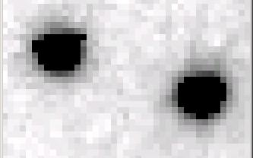
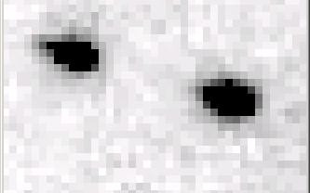
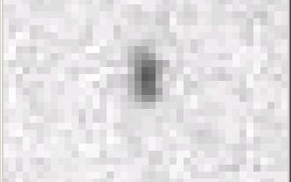
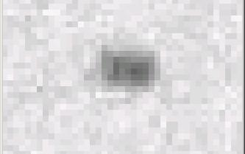
Si(111) vs multilayers
0.014%
Si(111)
spectral
dispersion
1%
multilayer
4 Å
resolution
1.9 Å
Beam Center

Slide 62
spectral dispersion
Ewald sphere
Φ circle
(h,k,l)
λ*
d*
spindle axis
diffracted ray
λ*

Slide 63
spectral dispersion
Ewald sphere
Φ circle
(h,k,l)
λ’*
d*
spindle axis
diffracted ray
λ’*

Slide 64
The truth about x-ray beams
Term units significance
Flux photons/s duration of experiment
Beam Size μm match to crystal
Divergence mrad spot size vs distance
Wavelength Å resolution and absorption
Dispersion Δλ/λ spot size
Flux density ph/s/area scattering/damage rate
Fluence ph/area scattering/damage

Slide 65
beam divergence
Ewald sphere
Φ circle
(h,k,l)
λ*
d*
spindle axis
diffracted ray
λ*

Slide 66
beam divergence
Ewald sphere
Φ circle
(h,k,l)
d*
λ*
diffracted ray
spindle axis
λ*

Slide 67
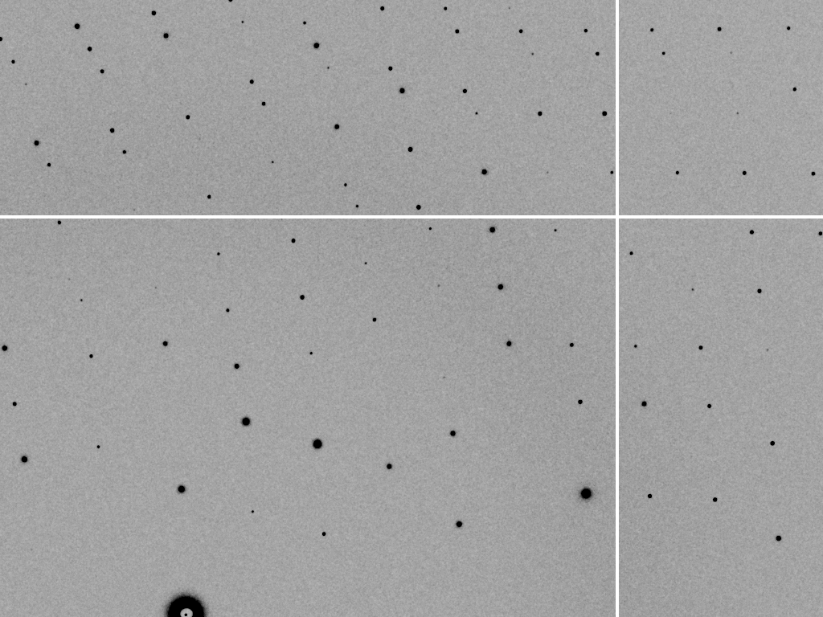
divergence = 0 º

Slide 68
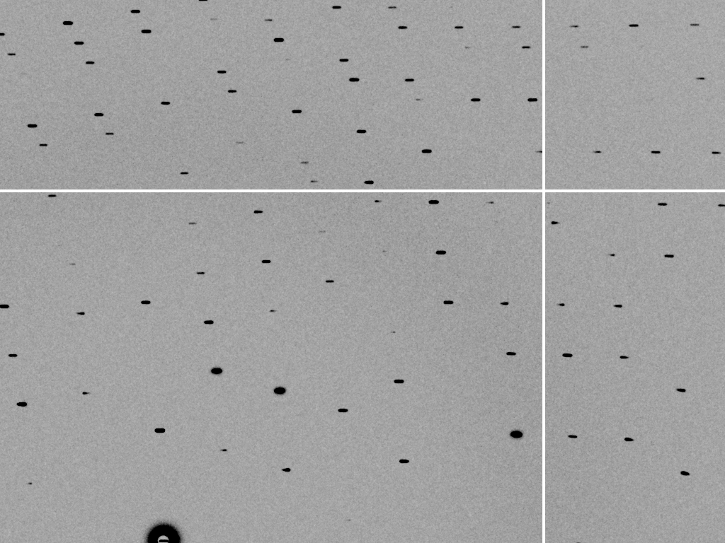
divergence = 0.3 º

Slide 69
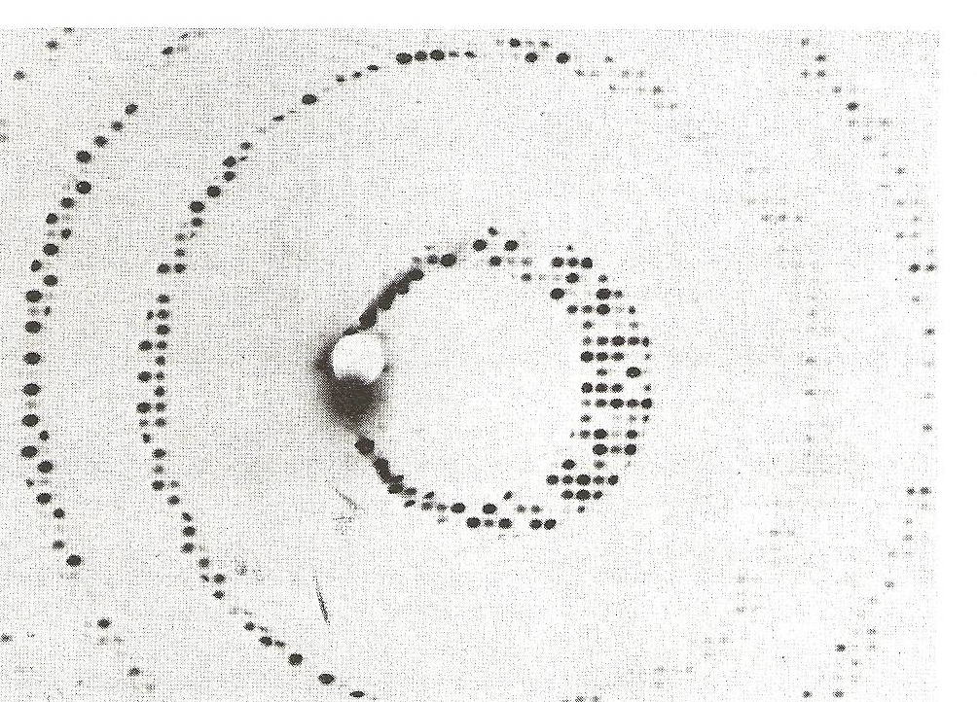
Divergence
Arndt & Wonacott (1977)

Slide 70
The truth about x-ray beams
Term units significance
Flux photons/s duration of experiment
Beam Size μm match to crystal
Divergence mrad spot size vs distance
Wavelength Å resolution and absorption
Dispersion Δλ/λ spot size
Flux density ph/s/area scattering/damage rate
Fluence ph/area scattering/damage

Slide 71
Air absorption
transmittance
Distance from sample (mm)

Slide 72
The truth about x-ray beams
Term units significance
Flux photons/s duration of experiment
Beam Size μm match to crystal
Divergence mrad spot size vs distance
Wavelength Å resolution and absorption
Dispersion Δλ/λ spot size
Flux density ph/s/area scattering/damage rate
Fluence ph/area scattering/damage

Slide 73
Data quality - simple rules:
  Put your crystal into the beam

Slide 74
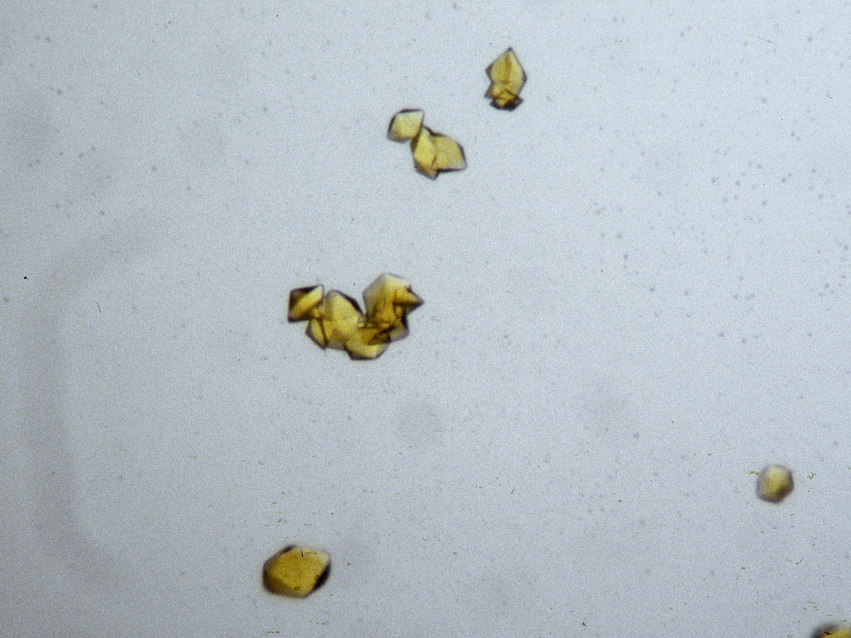
“crystal” = thing you want to shoot
Membrane Protein Expression Center © 2012

Slide 75
Data quality - simple rules:
  Put your crystal into the beam
  Shoot the whole crystal

Slide 76
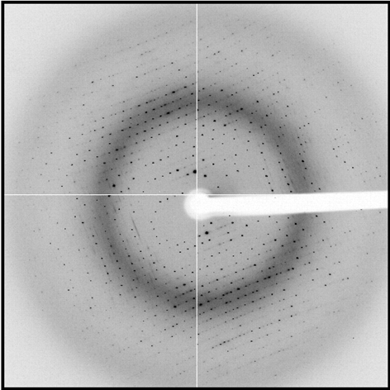
shoot the whole crystal

Slide 77
shoot the whole crystal

Slide 78
shoot the whole crystal

Slide 79
shoot the whole crystal

Slide 80
shoot the whole crystal

Slide 81
How many crystals do you see?
Shoot the crystal (singular)

Slide 82
mosaic spread
Ewald sphere
Φ circle
(h,k,l)
λ*
d*
diffracted ray
d*
spindle axis
λ*

Slide 83
mosaic spread
Ewald sphere
Φ circle
(h,k,l)
d*
diffracted rays
d*
spindle axis

Slide 84

mosaic spread = 0 º

Slide 85

mosaic spread = 0.1º

Slide 86

mosaic spread = 0.2º

Slide 87

mosaic spread = 0.4º

Slide 88

mosaic spread = 0.6º

Slide 89

mosaic spread = 0.8º

Slide 90

mosaic spread = 1.0º

Slide 91

mosaic spread = 1.5º

Slide 92

mosaic spread = 2.0º

Slide 93

mosaic spread = 2.5º

Slide 94

mosaic spread = 3.2º

Slide 95

mosaic spread = 6.4º

Slide 96

mosaic spread = 12.8º

Slide 97
Data quality - simple rules:
  Put your crystal into the beam
  Shoot the whole crystal
  Shoot nothing but the crystal

Slide 98
“crystal” = thing you want to shoot
Membrane Protein Expression Center © 2012

Slide 99
shoot nothing but the crystal

Slide 100
shoot nothing but the crystal

Slide 101
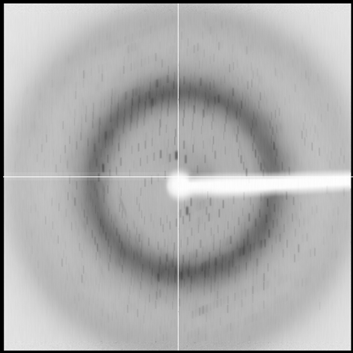
shoot nothing but the crystal

Slide 102
shoot nothing but the crystal

Slide 103
shoot nothing but the crystal

Slide 104
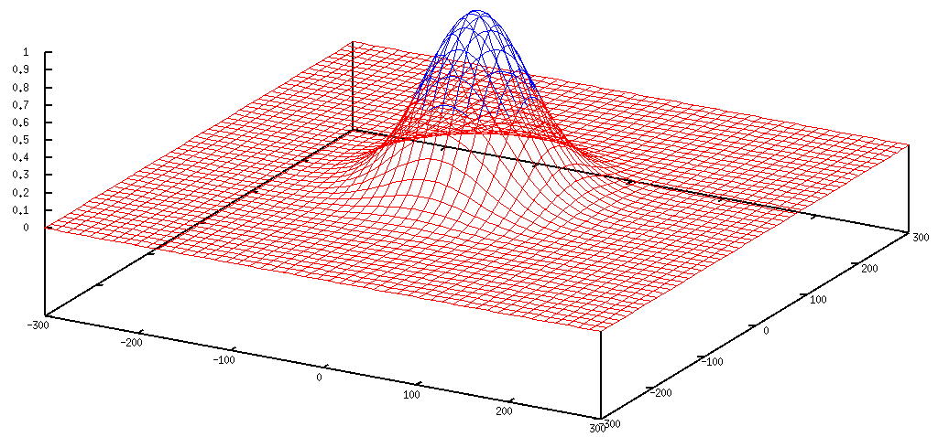
Gaussian beam
50% of flux
the other 50%

Slide 105
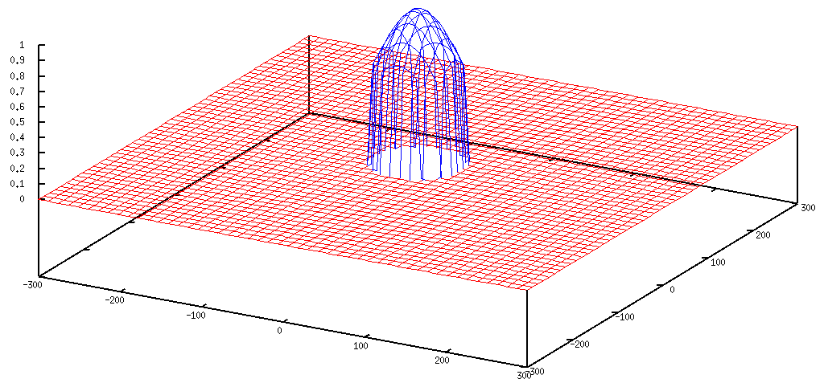
Collimated beam
100% of flux
0%

Slide 106
Tipping point for µfocus:
10 µm
~1 mrad =0.06°
~10 mm

Slide 107
Data quality - simple rules:
  Put your crystal into the beam
  Shoot the whole crystal
  Shoot nothing but the crystal
  Back off!

Slide 108
Background scattering

Slide 109
Mosquito tips cost $0.15 each
So do Pilatus pixels!
We bought 6,224,001
Use them!
(they are reusable)

Slide 110
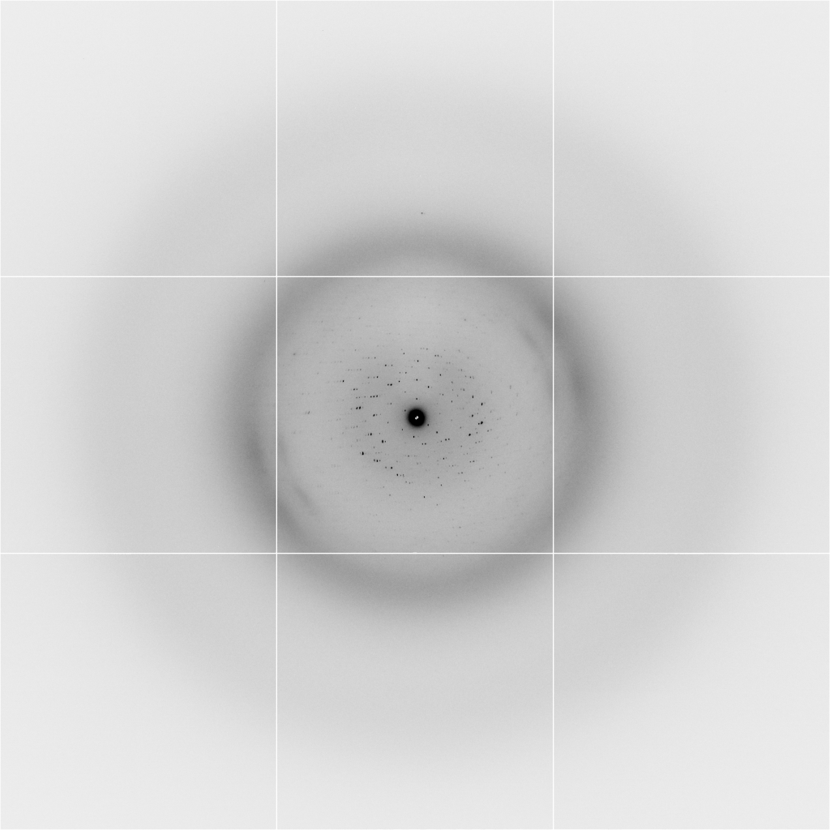
Background scattering
$100,000.00
$100,000.00
$100,000.00
real estate is
expensive
use it!
$100,000.00
$100,000.00
$100,000.00
$100,000.00
$100,000.00

Slide 111
Fine Slicing
background
background
Pflugrath, J. W. (1999)."The finer things in X-ray diffraction data collection", Acta Cryst. D 55, 1718-1725.

Slide 112

Optimal exposure time
(faint spots)
t_{hr} Optimal exposure time for data set (s)
t_{ref} exposure time of reference image (s)
bg_{ref} background level near weak spots on
reference image (ADU)
bg₀ ADC offset of detector (ADU)
bg_{hr} optimal background level (via t_{hr})
σ₀ rms read-out noise (ADU)
gain ADU/photon
m multiplicity of data set (including partials)
adjust exposure
so this is ~100

Slide 113
Data quality - simple rules:
  Put your crystal into the beam
  Shoot the whole crystal
  Shoot nothing but the crystal
  Back off!
  The crystal must rotate

Slide 114
The crystal rotates!

Slide 115
The crystal rotates!
Membrane Protein Expression Center © 2012

Slide 116
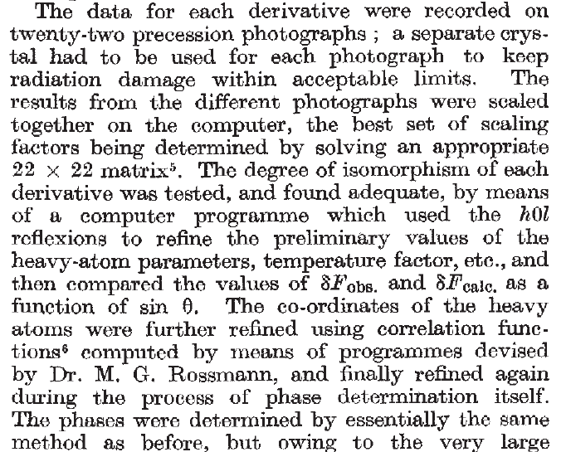
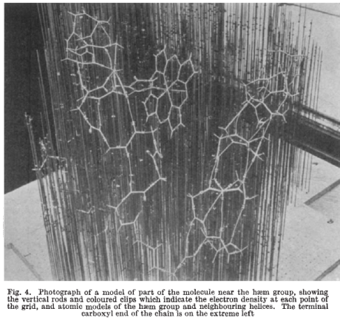
Multi-crystal strategies
Kendrew et al. (1960) "Structure of Myoglobin” Nature 185, 422-427.

Slide 117
Basic Principles
“Hell, there are NO RULES here - we're trying to accomplish something.”
Thomas A. Edison – inventor
“You’ve got to have an ASSAY.”
Arthur Kornberg – Nobel Laureate
“Control, control, you must learn CONTROL!”
Yoda – Jedi Master

Slide 118
Summary
X-rays come from: vac. + elec. + $$$
photons/area
Divergence
Dispersion
Collimation
1 um³ = 10⁶ photons
assay, control and open mind

Slide 119
Optimum resolution cutoff is:
Too optimistic: add nothing but noise
Too pessimistic: series-termination error
Happy medium?
Simulate:
  Random atoms, compute F²
  Add Gaussian noise, RMS = 1
  Truncate
  Subtract “right” map, RMS difference

Slide 120
Optimal resolution cutoff
Error in map (rms e⁻)
Resolution cutoff (Å)

Slide 121
Optimal resolution cutoff
Correlation Coefficient
Resolution cutoff (Å)

Slide 122
Optimal resolution cutoff
Correlation Coefficient
Resolution cutoff (Å)

Slide 123
Optimal resolution cutoff
Error in map (rms e⁻)
Resolution cutoff (Å)

Slide 124
Wilson Plot
2
log( intensity )
8
2.2 1.6 1.3 1.1 1.0 0.9 0.85 0.8 0.75 0.7
resolution (Å)

Slide 125
Optimum resolution cutoff is:
0.0 Å

Slide 126
Trick Question:
What is the space group?
a = 63 b = 63 c = 63
α = 90 β = 90 γ = 90

Slide 127
What you know when:
Autoindexing: Lattice (14)
Scaling: Point Group (43)
Refinement: Space Group (84)

Slide 128
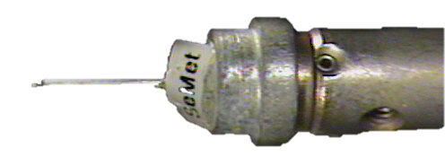
There are 16 different “beam centers”
Origin
Beam Y
Beam X

Slide 129
There are 16 different “beam centers”
Origin
Beam X
Beam Y

Slide 130
There are 16 different “beam centers”
Beam Y
Beam X
Origin

Slide 131
There are 16 different “beam centers”
Origin
Beam Y
Beam X

Slide 132


There are 16 different “beam centers”
Cameraman
View
Origin
Beam
View
Beam Y
Beam X

Slide 133
There are 16 different “beam centers”
Origin?
Origin?
Origin?
Origin?
Origin?
Origin?
Origin?
Origin?

Slide 134
There are 16 different “beam centers”
Xbeam, Ybeam
Ybeam, Xwidth – Xbeam
Xwidth-Xbeam, Ywidth-Ybeam
Ybeam, Xbeam
Xbeam, Ywidth-Ybeam
Xbeam, Ybeam-Ywidth
Xbeam, -Ybeam
Xwidth-Xbeam, Ybeam
Xwidth-Xbeam, Ywidth-Ybeam
Xwidth-Xbeam, Ybeam-Ywidth
Xwidth-Xbeam, -Ybeam
Xbeam, Ybeam
Xbeam, Ywidth-Ybeam
Xbeam, Ybeam-Ywidth
Xbeam, -Ybeam

