Slide 1
Where do the
X-rays come from?

Slide 2
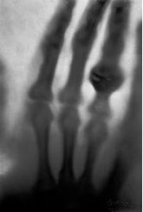
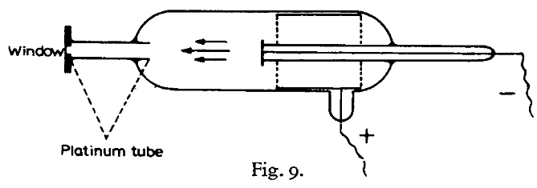
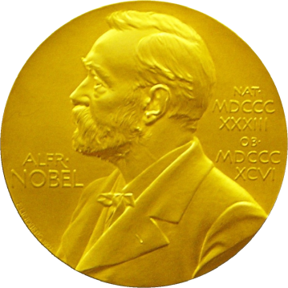
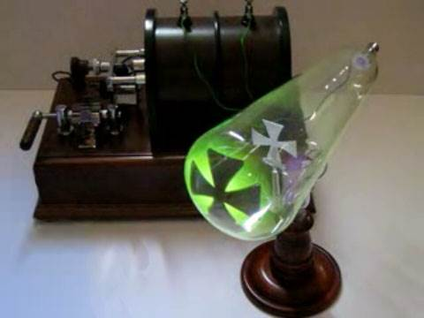
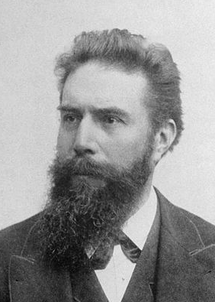
X-rays
(aka “Röntgenstrahlung”)
The discovery soon after this of X-rays by Röntgen (22), the first investigator to use the type of tube described above, is generally considered to be a good example of a lucky discovery.
P.E.A. von Lenard
1906 Nobel Lecture
Röntgen, W. C. (1898)."Ueber eine neue Art von Strahlen", Annalen der Physik 300, 1-11.

Slide 3
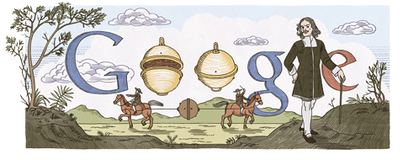
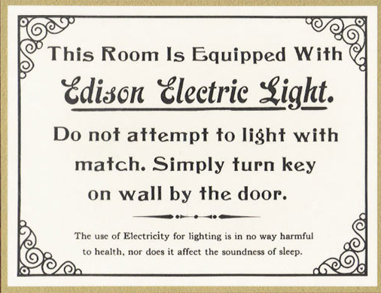
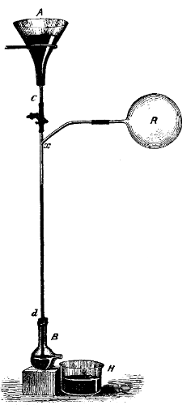
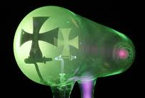
Electricity + vacuum = X-rays
1654 ~10 Torr
Otto von Guericke’s
“Magdeburg hemispheres”
1865 < 10⁻² Torr
Hg “fall tube” pump
Sprengel, H. (1865). "Researches on the vacuum", J. Chem. Soc. 18, 9b-21.
1870s < 10⁻³ Torr
1894 < 10⁻⁵ Torr
Sprengel pump
Redhead, Paul A., ed. Vacuum Science and Technology: Pioneers of the 20th Century. Vol. 2. Springer, 1994.
Benvenuti, C. & Chiggiato, P. (1993). "Obtention of pressures in the 10⁻¹⁴ torr range by means of a Zr-V-Fe non evaporable getter", Vacuum 44, 511-513.
1993 ~10⁻¹⁴ Torr

Slide 4
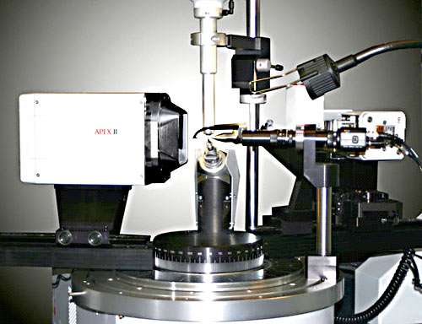
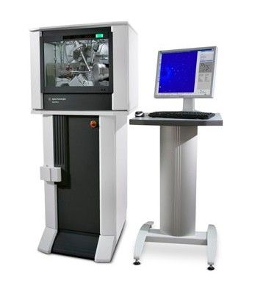
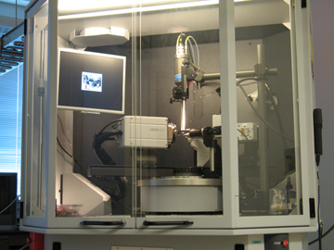
EXPERIMENTAL SETUP – Home Source

Slide 5
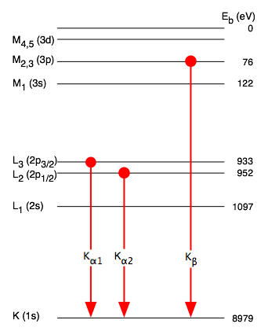
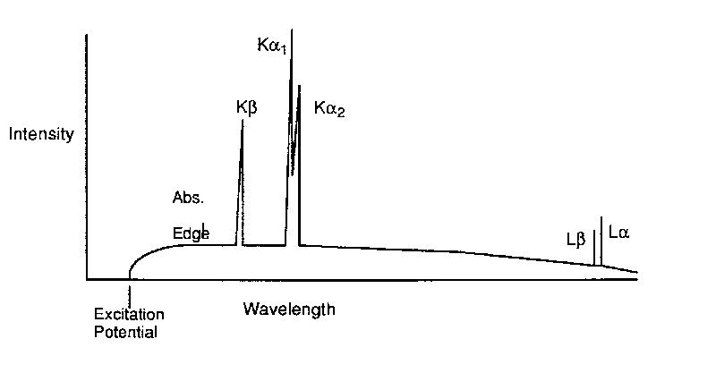
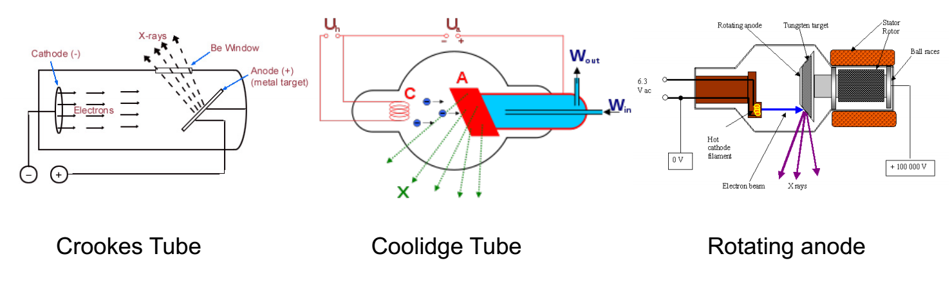
ANODE and FILTERING

Slide 6
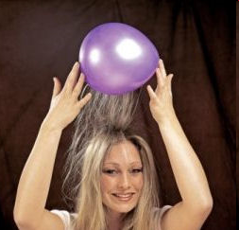
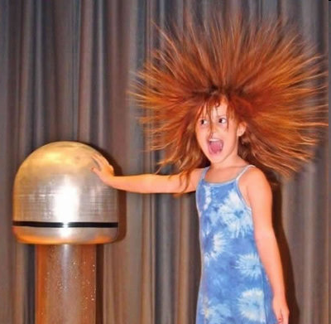
Electric charge
balloon
-
-
-
-
-
-
Wool Sweater
+ + + + + +

Slide 7
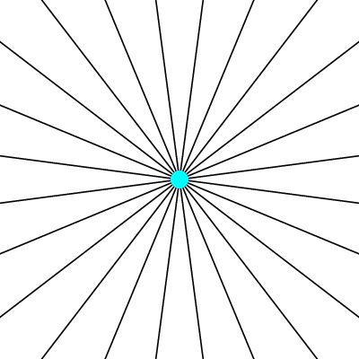
Electric field of a moving charge

Slide 8
Electric field of a moving charge
accelerating charges
make
electromagnetic waves
(light)

Slide 9
Bending Magnet
S
electron beam
X-rays !
N

Slide 10
Two Bending Magnets
S
N
electron beam
N
S
2x X-rays !

Slide 11
Wiggler
8x X-rays !
S
N
S
N
S
N
S
N
N
S
N
S
N
S
N
S

Slide 12
Undulator
> 8x X-rays !
S
N
S
N
S
N
S
N
N
S
N
S
N
S
N
S

Slide 13
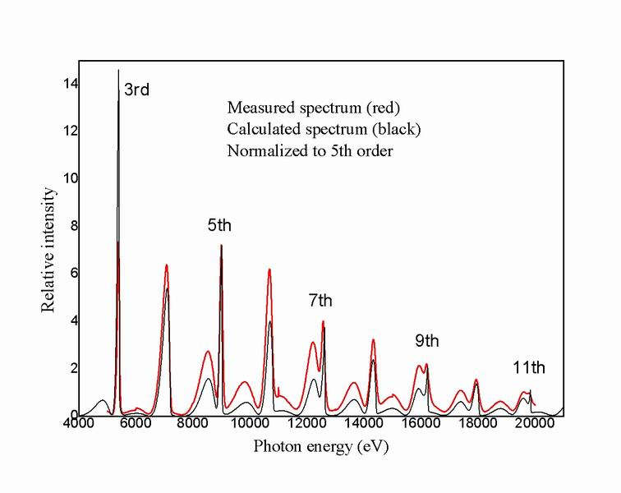
Undulator emission spectrum

Slide 14
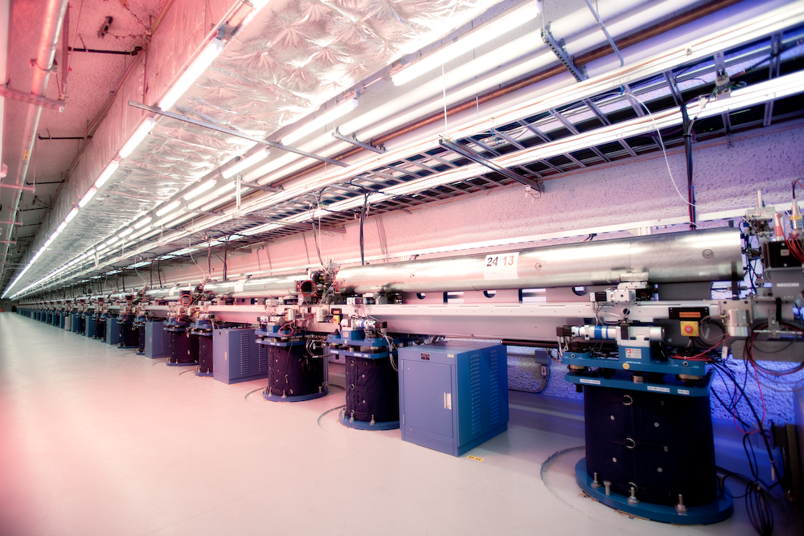
LCLS undulator hall

Slide 15
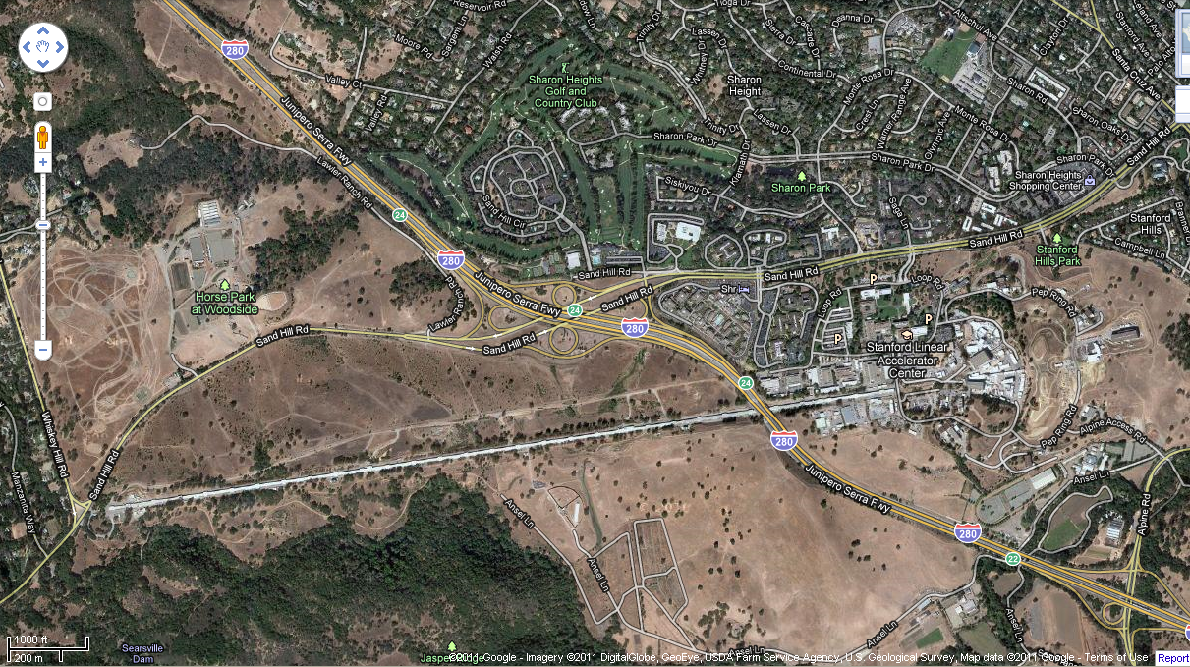
LCLS at SLAC

Slide 16
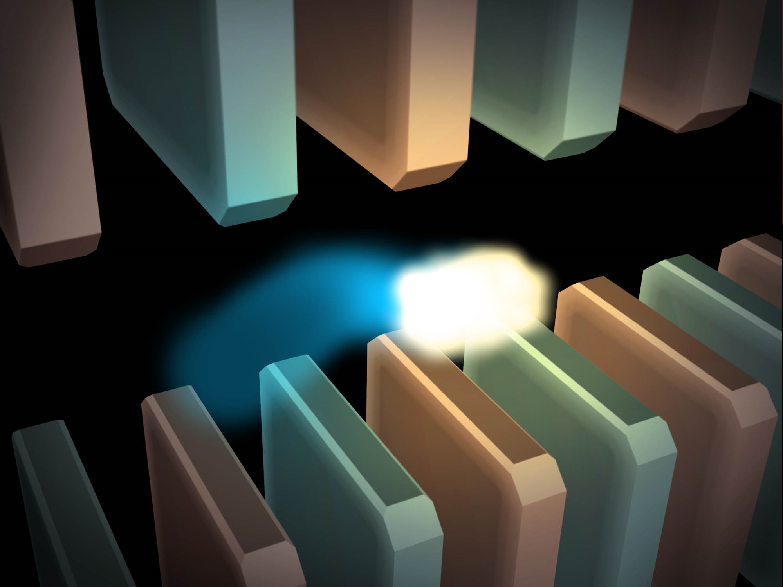
Electric field of a moving charge

Slide 17
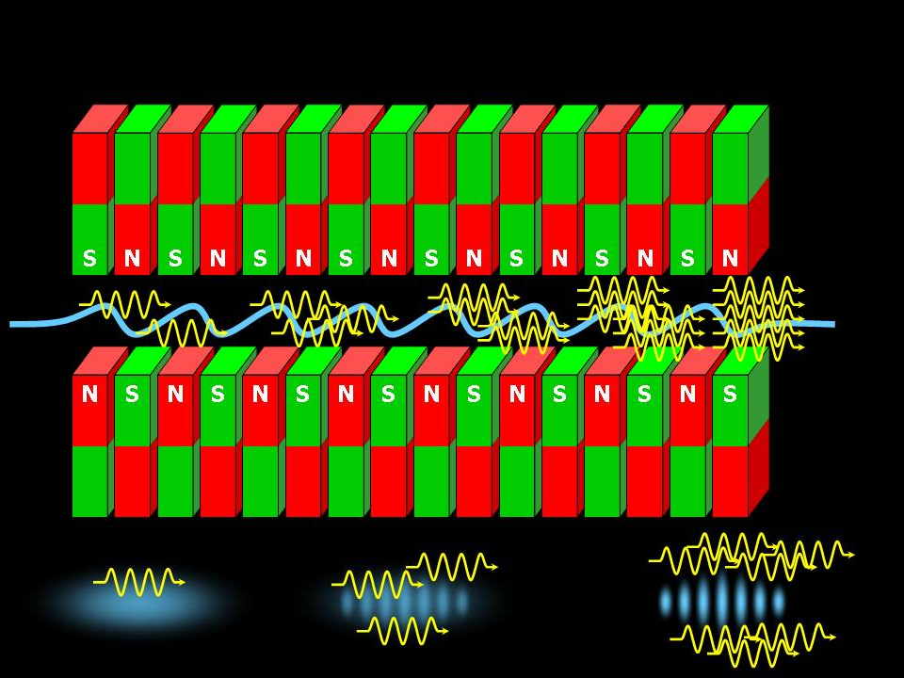
SASE effect

Slide 18
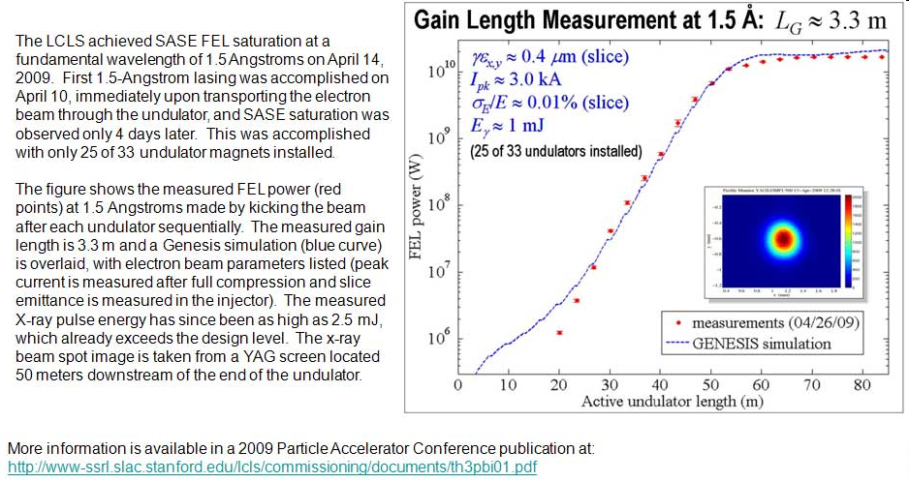
Self-Amplified Stimulated Emission (SASE) effect

Slide 19
Accelerator-based light source terminology
Code name Translation
First Generation Bending Magnet
Second Generation Wiggler
Third Generation Undulator
Fourth Generation Free electron laser

Slide 20
What does all that stuff in the concrete tunnel do?

Slide 21
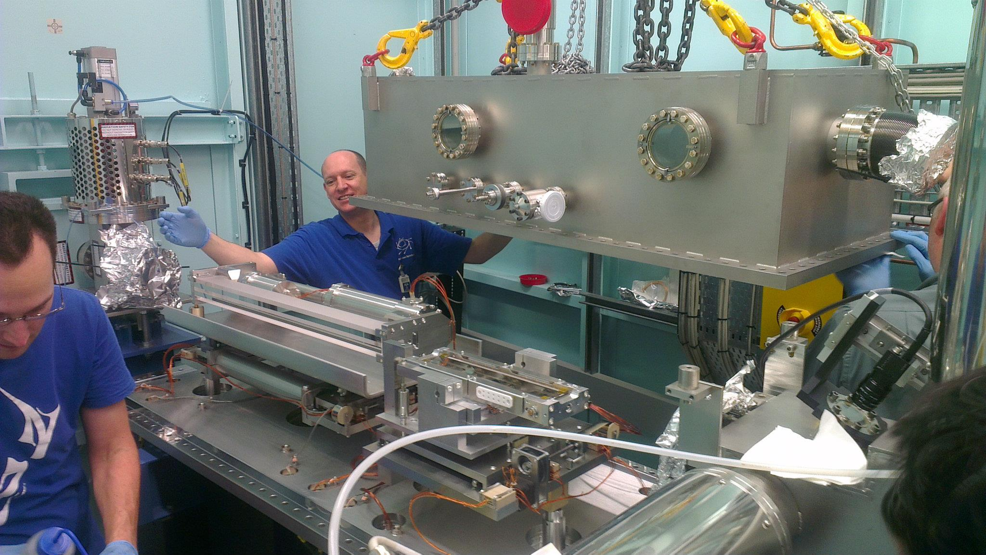
X-ray optics: mirrors
Notes:
Next slide please

Slide 22
Why are the mirrors so long?
Must be < 0.2°
3 mm
1000 mm
Notes:
Next slide please

Slide 23
Monochromators
λ = 1 Å
Si
Notes:
Next slide please

Slide 24
Monochromators
nλ = 2d sin(θ)
λ = 1 Å
λ = 1 Å
Si
d = 3.135 Å
θ = 9.177°
Notes:
Next slide please

Slide 25
Monochromators
nλ = 2d sin(θ)
λ = 1.1 Å
Si
d = 3.135 Å
θ = 9.177°
Notes:
Next slide please

Slide 26
Monochromators
nλ = 2d sin(θ)
λ = 1.1 Å
λ = 1.1 Å
Si
d = 3.135 Å
θ = 10.104°
Notes:
Next slide please

Slide 27
Monochromators
nλ = 2d sin(θ)
λ = 1 Å
λ = 1 Å
Si
d = 3.135 Å
θ = 9.177°
Notes:
Next slide please

Slide 28
Monochromators
Si
λ = 1 Å
λ = 1 Å
Si
d = 3.135 Å
DCM = Double Crystal Monochromator
Notes:
Next slide please

Slide 29
Monochromators
Si
λ = 1.1 Å
λ = 1.1 Å
Si
d = 3.135 Å
DCM = Double Crystal Monochromator
Notes:
Next slide please

Slide 30
Monochromators
nλ = 2d sin(θ)
λ = 1.54 Å
λ = 1.54 Å
Mo/C
d = 24 Å
θ = 1.84°
Multilayer optics
Notes:
Next slide please

Slide 31
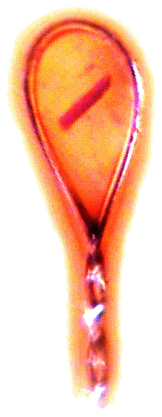
The “beam line”
focused
beam
slits
Scatter
guard
Secondary
mirror
Primary
mirror
Source
Area Detector
Unfocused
beam
slits
Si(111)
monochromator
Sample

Slide 32
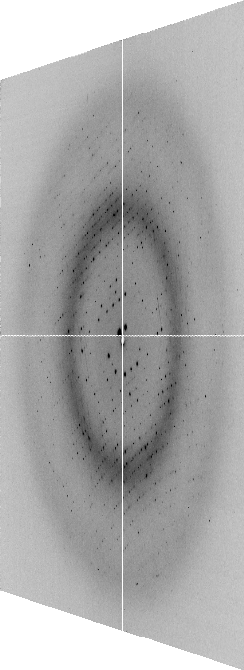
The “beam line”
focused
beam
slits
Scatter
guard
Secondary
mirror
Primary
mirror
Source
Area Detector
Unfocused
beam
slits
Si(111)
monochromator
Sample
Notes:
Most notable acheivements are high brightness with very little “wasted” light. The discovery made by Howard Padmore? At ALS showed that a 2:1 demagnification cancels nearly all of the spherical abberations in the parabolic/torroid system. 30-50% of the total x-ray intensity passes through the 100um pinhole. The flux through the 100um pinhole at the superbend beamlines is comparable to that of the 5.0.2 wiggler or an APS bending magnet, but only 150 Watts of power must be dissipated by the beamline optics. In contrast, wiggler beamlines must disipate kilowatts. The optics here are much simpler and not exotic in any way. The system is stable and robust. There is never a need to re-focus the beam at a new wavelength. Only a 2-minute automatic tuneup is recommended for very large energy changes (more than 1-2 keV).

Slide 33
X-ray optics
pinhole
Scatter
guard
X-ray
Source
Area Detector
Cite the “beamline paper!”
Protein Crystal
Notes:
Most notable acheivements are high brightness with very little “wasted” light. The discovery made by Howard Padmore? At ALS showed that a 2:1 demagnification cancels nearly all of the spherical abberations in the parabolic/torroid system. 30-50% of the total x-ray intensity passes through the 100um pinhole. The flux through the 100um pinhole at the superbend beamlines is comparable to that of the 5.0.2 wiggler or an APS bending magnet, but only 150 Watts of power must be dissipated by the beamline optics. In contrast, wiggler beamlines must disipate kilowatts. The optics here are much simpler and not exotic in any way. The system is stable and robust. There is never a need to re-focus the beam at a new wavelength. Only a 2-minute automatic tuneup is recommended for very large energy changes (more than 1-2 keV).

Slide 34
The truth about x-ray beams
Term units significance
Flux photons/s duration of experiment
Beam Size μm match to crystal
Divergence mrad spot size vs distance
Wavelength Å resolution and absorption
Dispersion Δλ/λ spot size
Flux density ph/s/area scattering/damage rate
Fluence ph/area scattering/damage

Slide 35
The truth about x-ray beams
Term units significance
Flux photons/s duration of experiment
Beam Size μm match to crystal
Divergence mrad spot size vs distance
Wavelength Å resolution and absorption
Dispersion Δλ/λ spot size
Flux density ph/s/area scattering/damage rate
Fluence ph/area scattering/damage

Slide 36
The truth about x-ray beams
quantity | units | home source | MX2
flux | Photons/second | 2.5 x 10⁹ | 2 x 10¹²
exposure | seconds | 400 | 1

Slide 37
The truth about x-ray beams
quantity | units | home source | MX2
flux | Photons/second | 2.5 x 10⁹ | 2 x 10¹²
exposure | seconds | 400 | 1
Dispersion | wavelength range / wavelength | 0.2% (Kα₁ - Kα₂) | 0.014% (Si111)
Divergence | milliRadian | 4.8 | 1.8 (h) 0.18 (v)
Beam size | microns | 100 | 24 (h) 12 (v)
Spectral brightness | Photons/s/mm²/ mR²/0.1%BW | 5.4 x 10⁹ | 1.5 x 10¹⁷

Slide 38
The truth about x-ray beams
quantity | units | home source | MX2
flux | Photons/second | 72 x 10⁶ | 2 x 10¹²
exposure | time | 4 hours | 1 second
Dispersion | wavelength range / wavelength | 0.2% (Kα₁ - Kα₂) | 0.014% (Si111)
Divergence | milliRadian | 4.8 | 1.8 (h) 0.18 (v)
Beam size | microns | 17 | 24 (h) 12 (v)
Spectral brightness | Photons/s/mm²/ mR²/0.1%BW | 5.4 x 10⁹ | 1.5 x 10¹⁷

Slide 39
The truth about x-ray beams
quantity | units | home source | MX2
flux | Photons/second | 1 x 10⁶ | 2 x 10¹²
exposure | time | 10 days | 1 second
Dispersion | wavelength range / wavelength | 0.2% (Kα₁ - Kα₂) | 0.014% (Si111)
Divergence | milliRadian | 0.6 | 1.8 (h) 0.18 (v)
Beam size | microns | 17 | 24 (h) 12 (v)
Spectral brightness | Photons/s/mm²/ mR²/0.1%BW | 5.4 x 10⁹ | 1.5 x 10¹⁷

Slide 40
The truth about x-ray beams
quantity | units | home source | MX2
flux | Photons/second | 8 x 10⁴ | 2 x 10¹²
exposure | time | 5 months | 1 second
Dispersion | wavelength range / wavelength | 0.014% (Si111) | 0.014% (Si111)
Divergence | milliRadian | 0.6 | 1.8 (h) 0.18 (v)
Beam size | microns | 17 | 24 (h) 12 (v)
Spectral brightness | Photons/s/mm²/ mR²/0.1%BW | 5.4 x 10⁹ | 1.5 x 10¹⁷

Slide 41
The number of photons scattered
before crystal is dead
is independent
of data collection time
1 um³ = 10⁶ photons
Henderson, 1990; Gonzalez & Nave, 1994; Glaeser et al., 2000; Sliz et al., 2003; Leiros et al., 2006; Owen et al., 2006; Garman & McSweeney, 2006; Garman & Nave, 2009; Holton, 2009

Slide 42
The truth about x-ray beams
Term units significance
Flux photons/s duration of experiment
Beam Size μm match to crystal
Divergence mrad spot size vs distance
Wavelength Å resolution and absorption
Dispersion Δλ/λ spot size
Flux density ph/s/area scattering/damage rate
Fluence ph/area scattering/damage

Slide 43
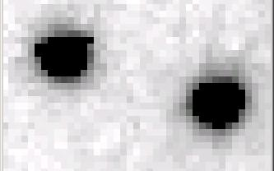
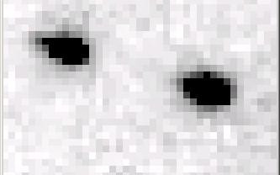
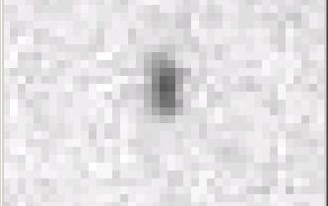
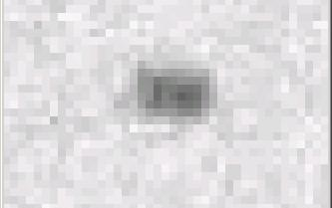
Si(111) vs multilayers
0.014%
Si(111)
spectral
dispersion
1%
multilayer
4 Å
resolution
1.9 Å

Slide 44
spectral dispersion
Ewald sphere
Φ circle
(h,k,l)
λ*
d*
spindle axis
diffracted ray
λ*

Slide 45
spectral dispersion
Ewald sphere
Φ circle
(h,k,l)
λ’*
d*
spindle axis
diffracted ray
λ’*

Slide 46
The truth about x-ray beams
Term units significance
Flux photons/s duration of experiment
Beam Size μm match to crystal
Divergence mrad spot size vs distance
Wavelength Å resolution and absorption
Dispersion Δλ/λ spot size
Flux density ph/s/area scattering/damage rate
Fluence ph/area scattering/damage

Slide 47
beam divergence
Ewald sphere
Φ circle
(h,k,l)
λ*
d*
spindle axis
diffracted ray
λ*

Slide 48
beam divergence
Ewald sphere
Φ circle
(h,k,l)
d*
λ*
diffracted ray
spindle axis
λ*

Slide 49
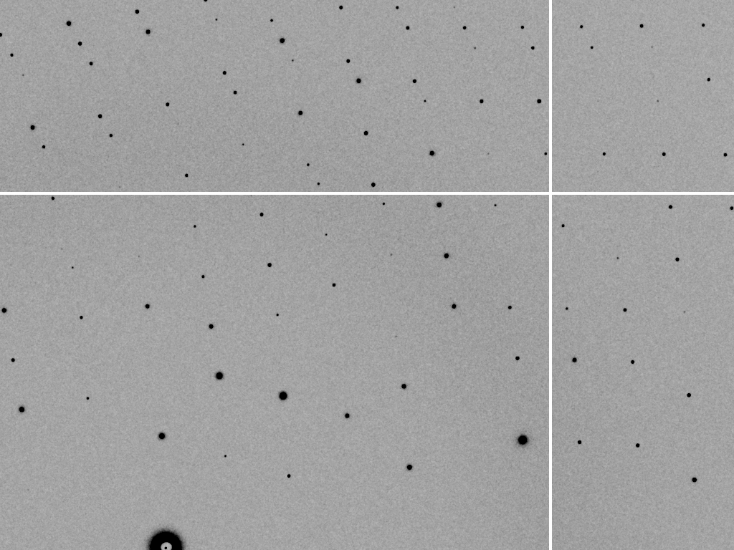
divergence = 0 º

Slide 50
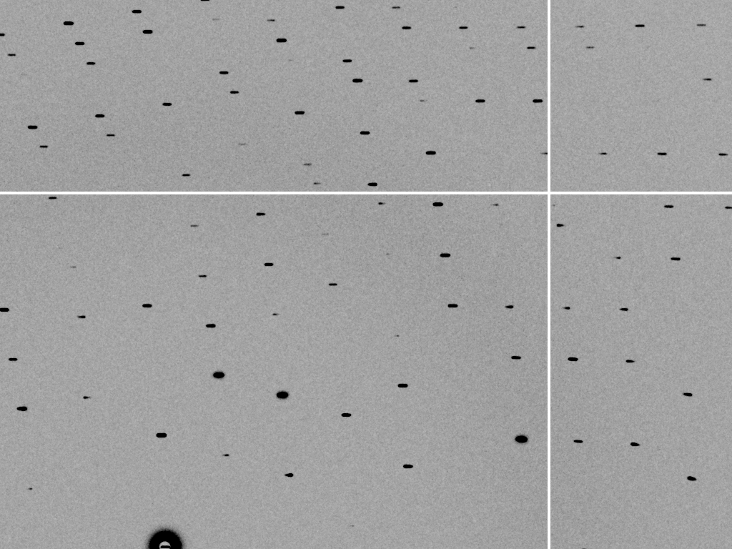
divergence = 0.3 º

Slide 51
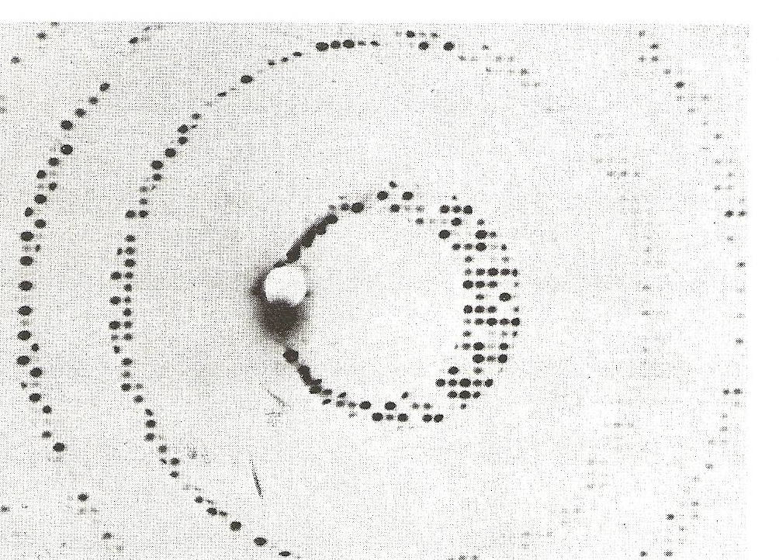
Divergence
Arndt & Wonacott (1977)

Slide 52
The truth about x-ray beams
Term units significance
Flux photons/s duration of experiment
Beam Size μm match to crystal
Divergence mrad spot size vs distance
Wavelength Å resolution and absorption
Dispersion Δλ/λ spot size
Flux density ph/s/area scattering/damage rate
Fluence ph/area scattering/damage

Slide 53
Air absorption
transmittance
Distance from sample (mm)

Slide 54
The truth about x-ray beams
Term units significance
Flux photons/s duration of experiment
Beam Size μm match to crystal
Divergence mrad spot size vs distance
Wavelength Å resolution and absorption
Dispersion Δλ/λ spot size
Flux density ph/s/area scattering/damage rate
Fluence ph/area scattering/damage

Slide 55
Data quality - simple rules:
  Put your crystal into the beam

Slide 56
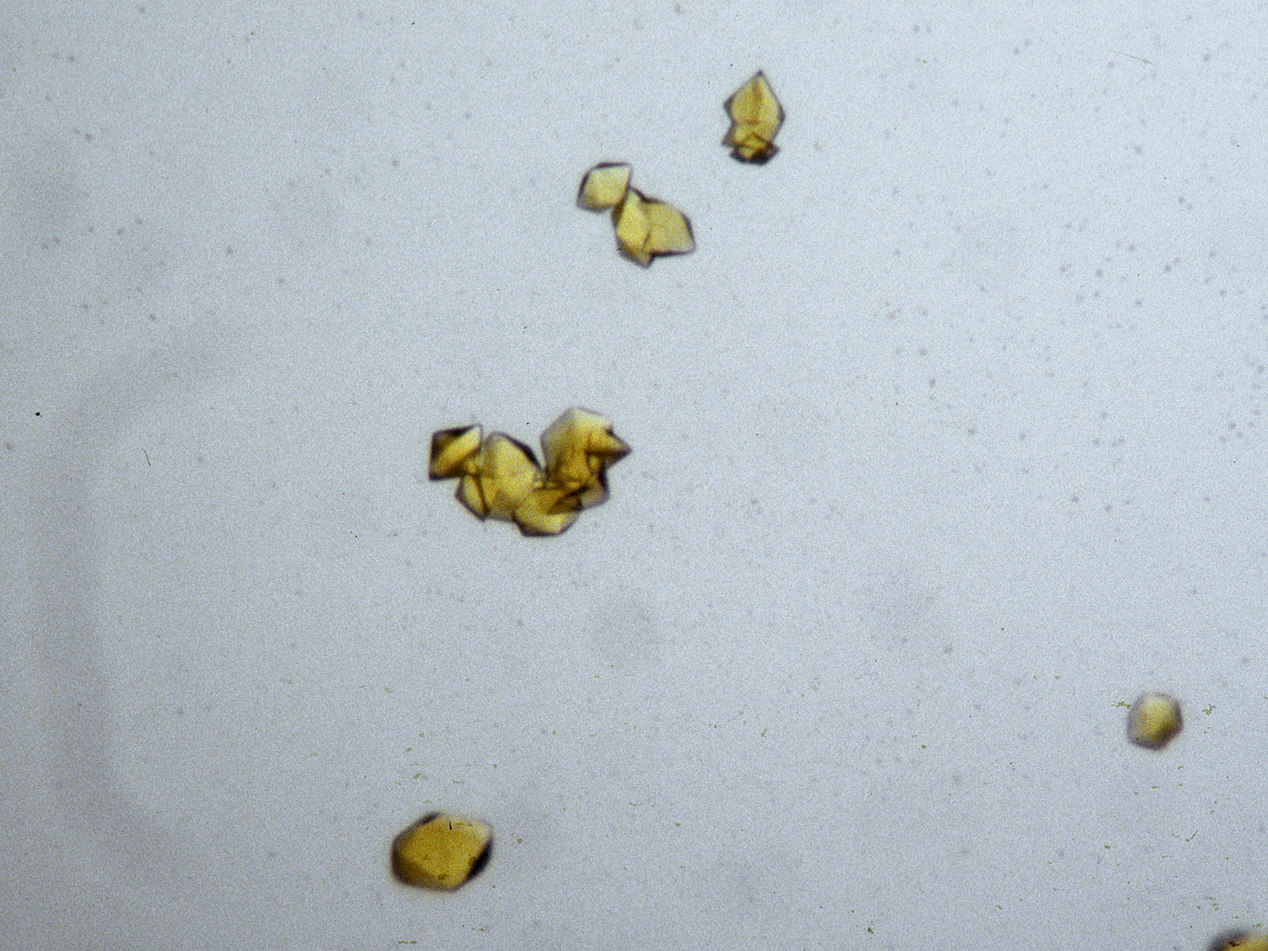
“crystal” = thing you want to shoot
Membrane Protein Expression Center © 2012

Slide 57
Data quality - simple rules:
  Put your crystal into the beam
  Shoot the whole crystal

Slide 58
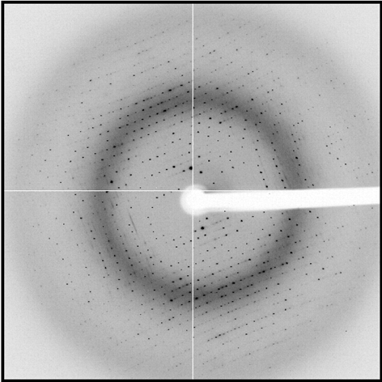
shoot the whole crystal

Slide 59
shoot the whole crystal

Slide 60
shoot the whole crystal

Slide 61
shoot the whole crystal

Slide 62
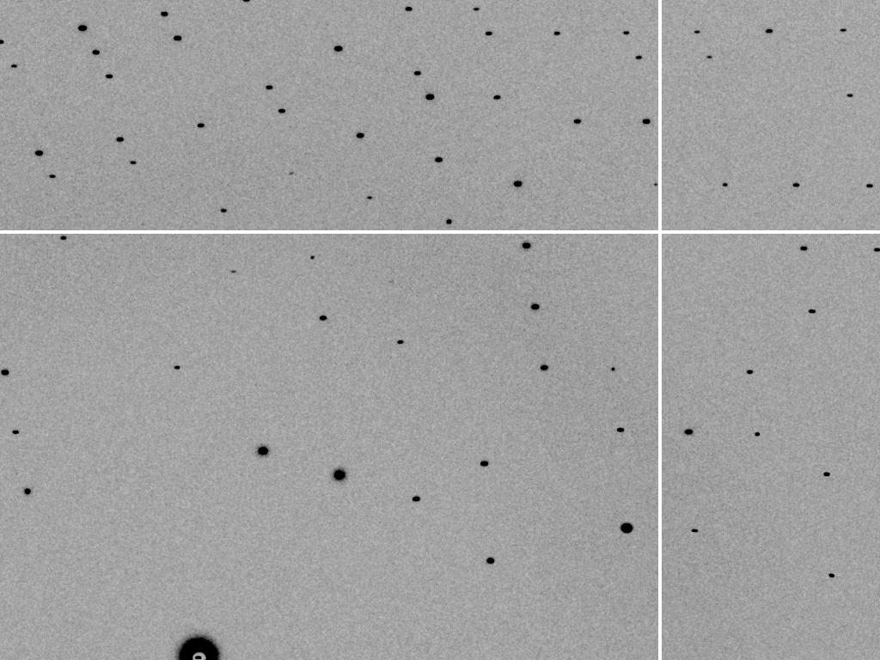
mosaic spread = 0 º

Slide 63
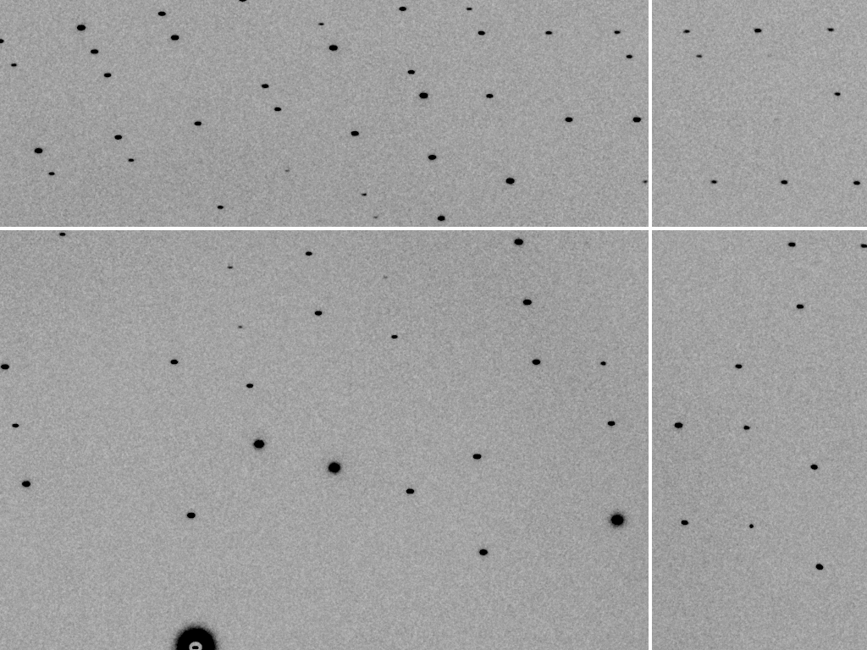
mosaic spread = 0.1º

Slide 64
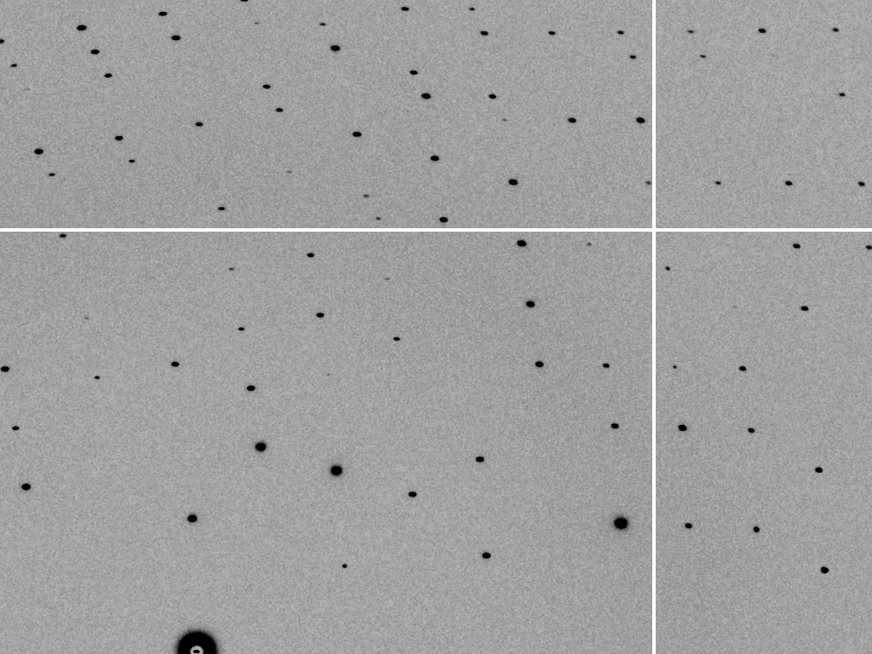
mosaic spread = 0.2º

Slide 65
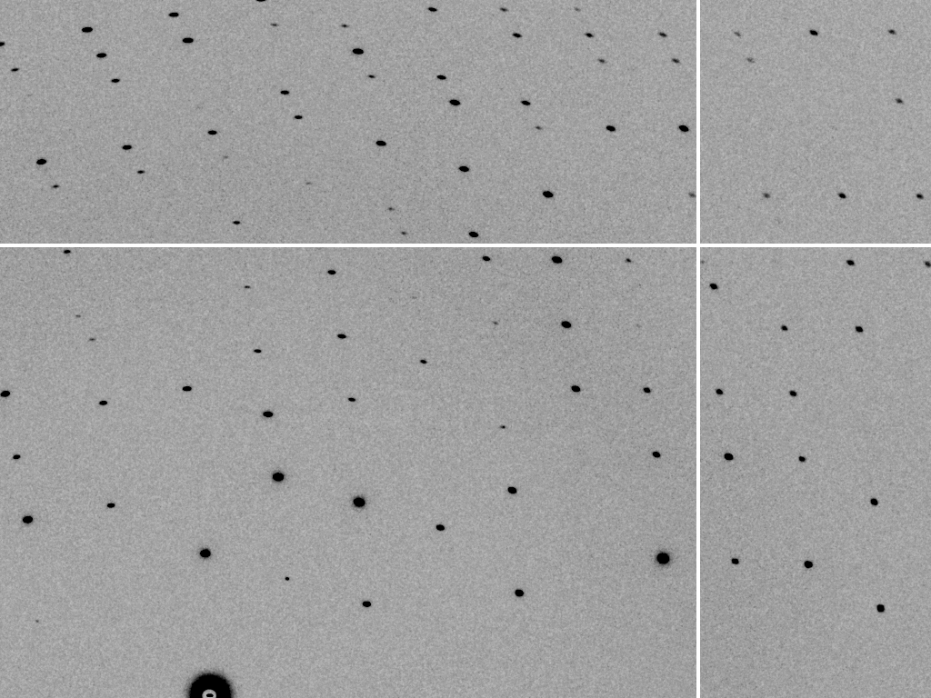
mosaic spread = 0.4º

Slide 66

mosaic spread = 0.6º

Slide 67
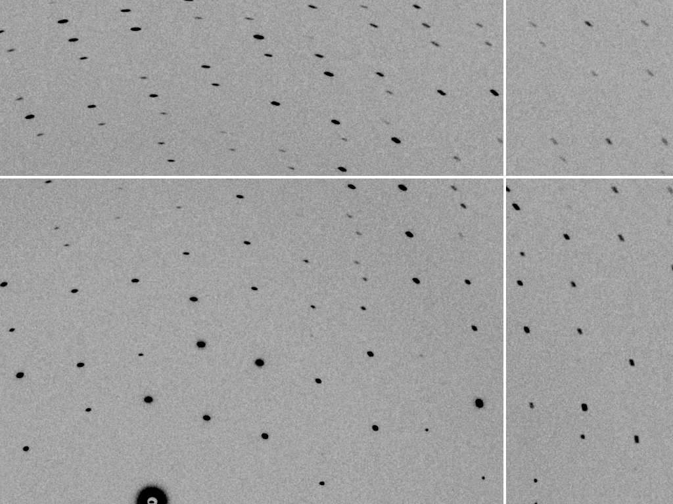
mosaic spread = 0.8º

Slide 68
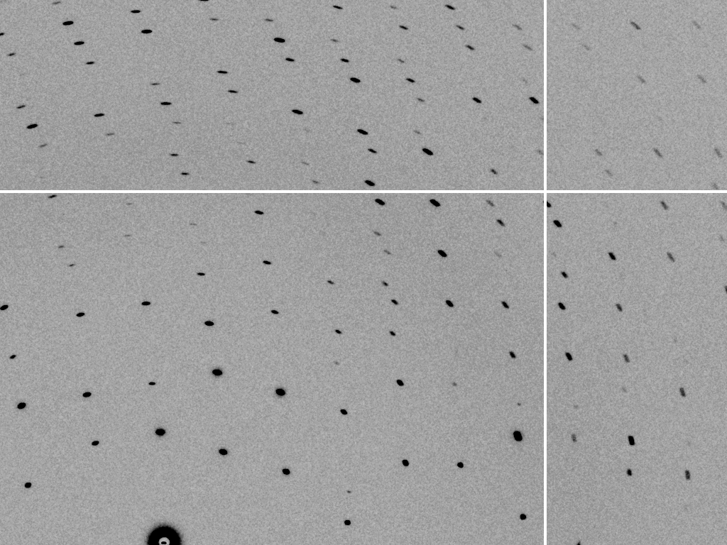
mosaic spread = 1.0º

Slide 69
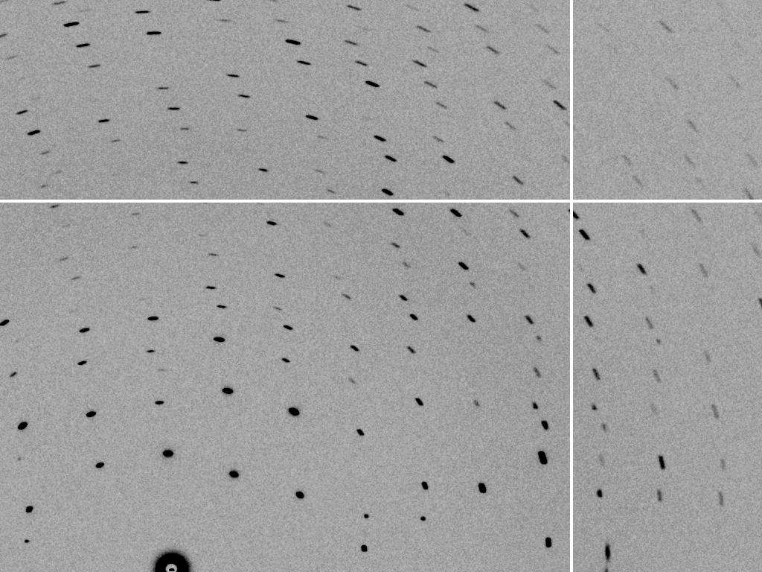
mosaic spread = 1.5º

Slide 70
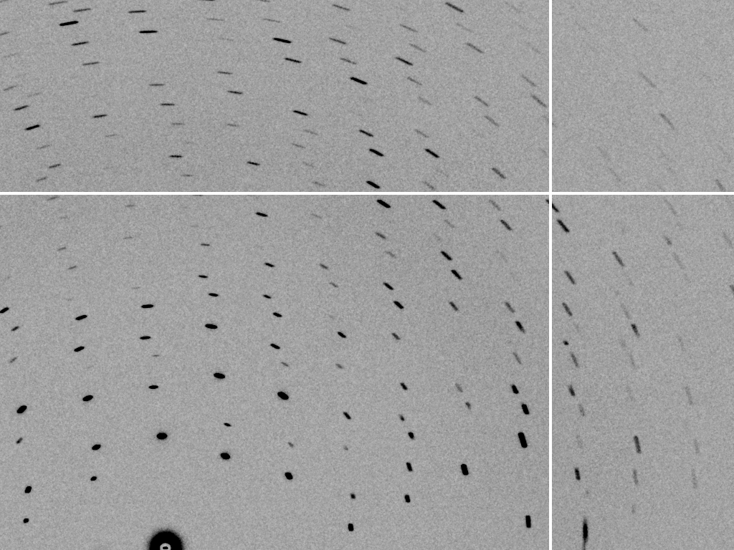
mosaic spread = 2.0º

Slide 71
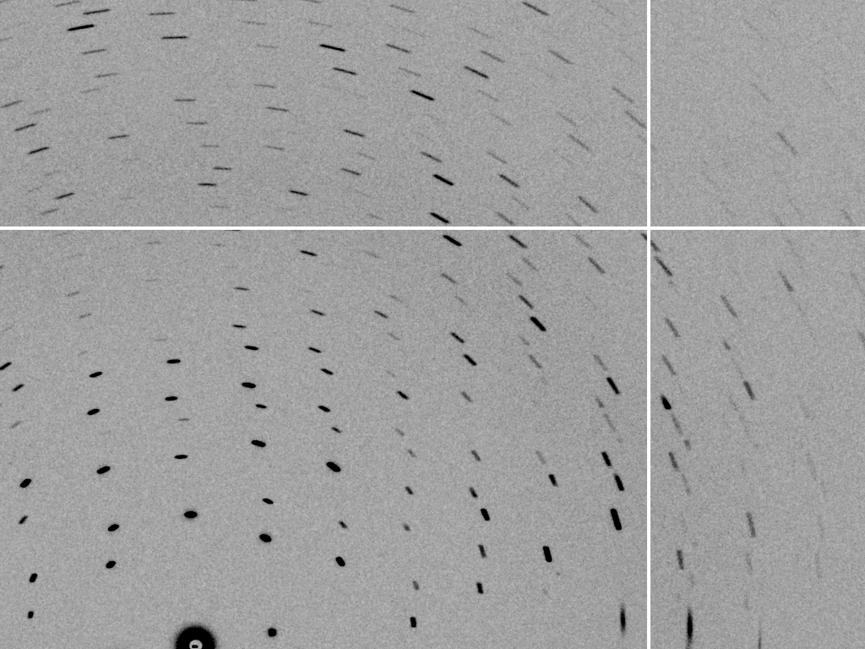
mosaic spread = 2.5º

Slide 72
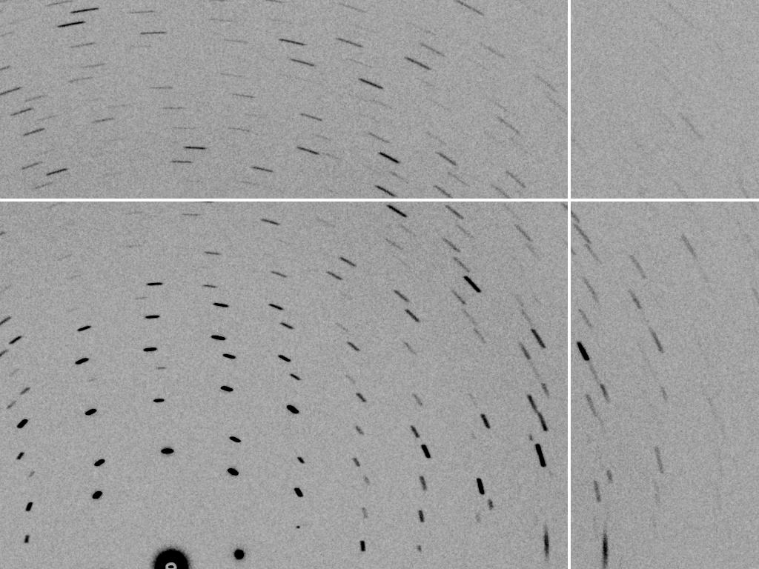
mosaic spread = 3.2º

Slide 73
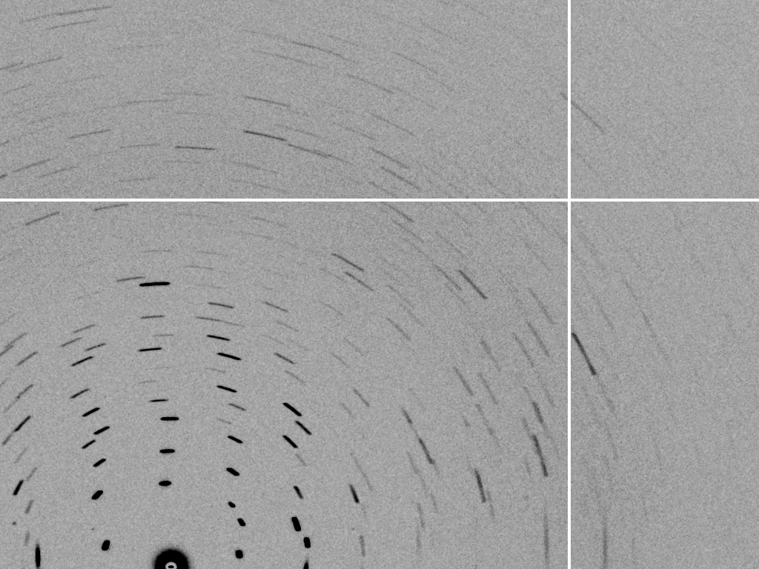
mosaic spread = 6.4º

Slide 74
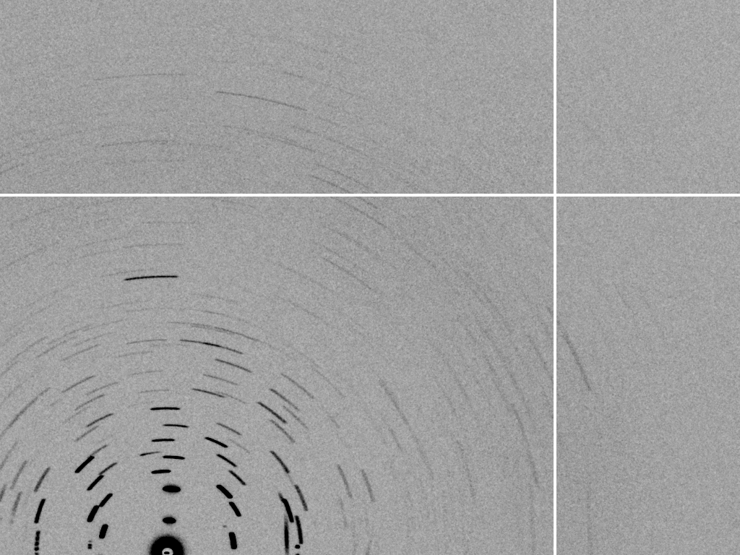
mosaic spread = 12.8º

Slide 75
How many crystals do you see?
Shoot the crystal (singular)

Slide 76
mosaic spread
Ewald sphere
Φ circle
(h,k,l)
λ*
d*
diffracted ray
d*
spindle axis
λ*

Slide 77
mosaic spread
Ewald sphere
Φ circle
(h,k,l)
d*
diffracted rays
d*
spindle axis

Slide 78
shoot the whole crystal

Slide 79
Data quality - simple rules:
  Put your crystal into the beam
  Shoot the whole crystal
  Shoot nothing but the crystal

Slide 80
“crystal” = thing you want to shoot
Membrane Protein Expression Center © 2012

Slide 81
shoot nothing but the crystal

Slide 82
shoot nothing but the crystal

Slide 83
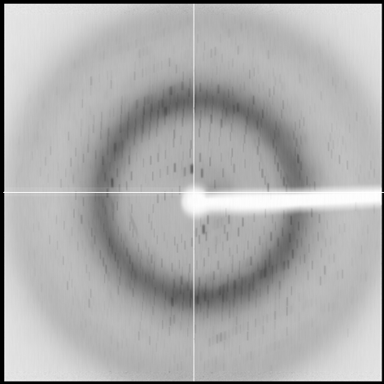
shoot nothing but the crystal

Slide 84
shoot nothing but the crystal

Slide 85
shoot nothing but the crystal

Slide 86
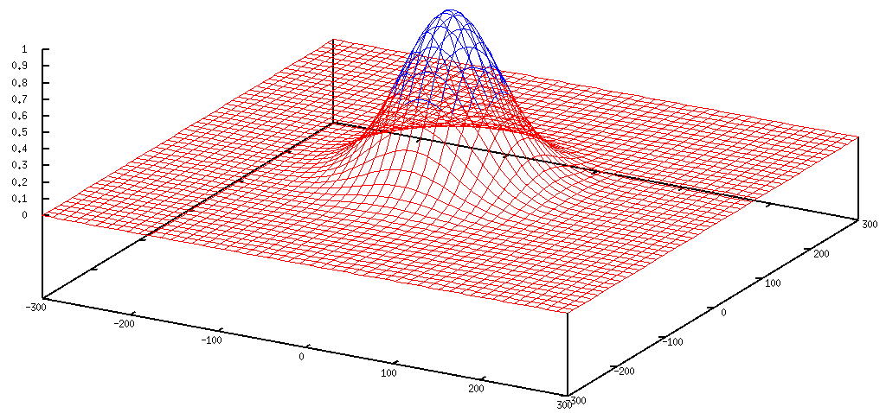
Gaussian beam
50% of flux
the other 50%

Slide 87

Collimated beam
100% of flux
0%

Slide 88
Data quality - simple rules:
  Put your crystal into the beam
  Shoot the whole crystal
  Shoot nothing but the crystal
  Back off!

Slide 89
Mosquito tips cost $0.15 each
So do Pilatus pixels!
We bought 6,224,001
Use them!
(they are reusable)

Slide 90
Background scattering

Slide 91

Background scattering
$100,000.00
$100,000.00
$100,000.00
real estate is
expensive
use it!
$100,000.00
$100,000.00
$100,000.00
$100,000.00
$100,000.00

Slide 92
Fine Slicing
background
background
Pflugrath, J. W. (1999)."The finer things in X-ray diffraction data collection", Acta Cryst. D 55, 1718-1725.

Slide 93

Optimal exposure time
(faint spots)
t_{hr} Optimal exposure time for data set (s)
t_{ref} exposure time of reference image (s)
bg_{ref} background level near weak spots on
reference image (ADU)
bg₀ ADC offset of detector (ADU)
bg_{hr} optimal background level (via t_{hr})
σ₀ rms read-out noise (ADU)
gain ADU/photon
m multiplicity of data set (including partials)
adjust exposure
so this is ~100

Slide 94
Data quality - simple rules:
  Put your crystal into the beam
  Shoot the whole crystal
  Shoot nothing but the crystal
  Back off!
  The crystal must rotate

Slide 95
The crystal rotates!

Slide 96
The crystal rotates!
Membrane Protein Expression Center © 2012

Slide 97


Multi-crystal strategies
Kendrew et al. (1960) "Structure of Myoglobin” Nature 185, 422-427.

Slide 98
Basic Principles
“Hell, there are NO RULES here - we're trying to accomplish something.”
Thomas A. Edison – inventor
“You’ve got to have an ASSAY.”
Arthur Kornberg – Nobel Laureate
“Control, control, you must learn CONTROL!”
Yoda – Jedi Master

Slide 99
Summary
X-rays come from: vac. + elec. + $$$
photons/area
Divergence
Dispersion
Collimation
1 um³ = 10⁶ photons
assay, control and open mind

