Slide 1
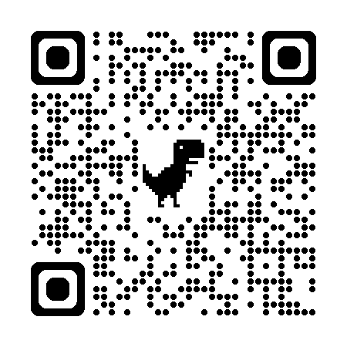
Acknowledgements
https://bl831.als.lbl.gov/~jamesh/powerpoint/RapiDataXDStutorial_2025.pptx
Robert Stroud James Fraser Nevan Krogan
Paul Adams John Tainer Greg Hura Nick Sauter
Aina Cohen Art Lyubimov Jeney Wierman
UCSF LBNL SLAC
ALS 8.3.1: TomAlberTron
NIH NIGMS R01 GM124149 (Holton)
NIH NIAID P50 AI150476 (Krogan)
NIH NIGMS P30 GM124169 (Adams)
DOE-BER IDAT (Hura)
NIH NIGMS P30 GM133894 (Hodgson)
The Advanced Light Source is supported by the Director, Office of Science, Office of Basic Energy Sciences, Materials Sciences Division, of the US Department of Energy under contract No. DE-AC02-05CH11231 at Lawrence Berkeley National Laboratory.

Slide 2
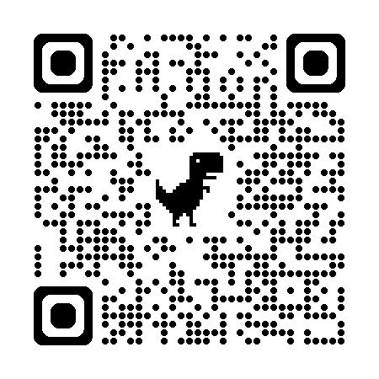
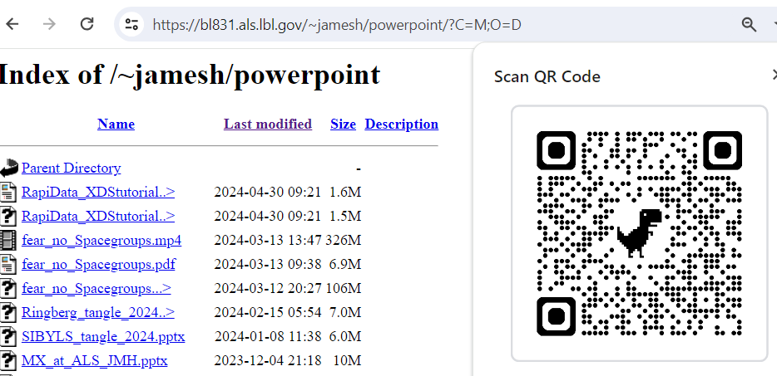
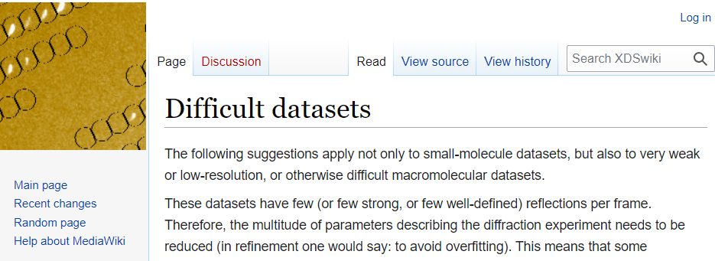
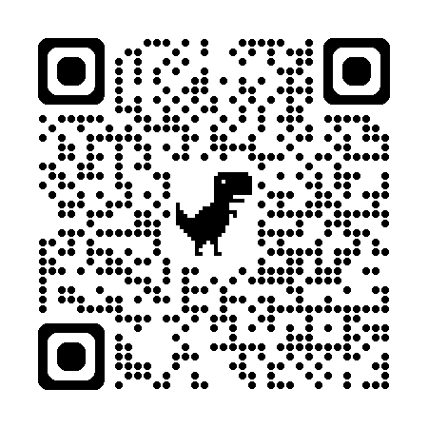
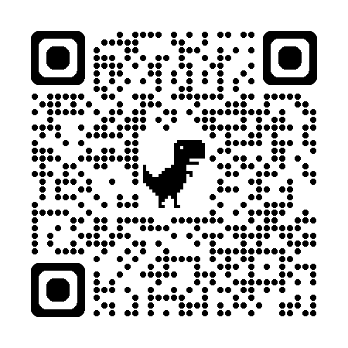
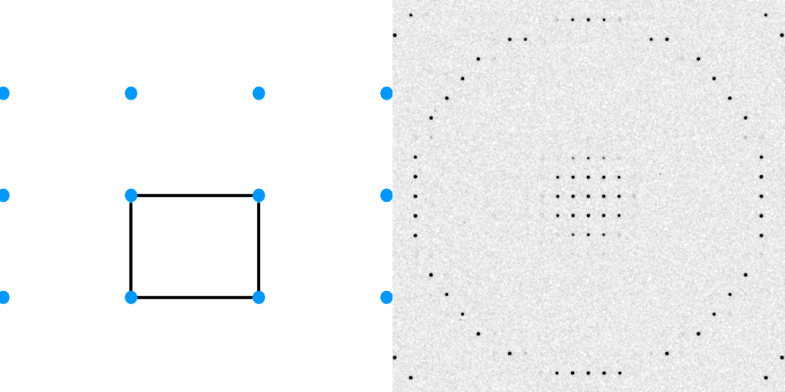
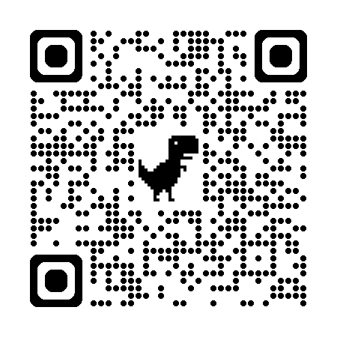
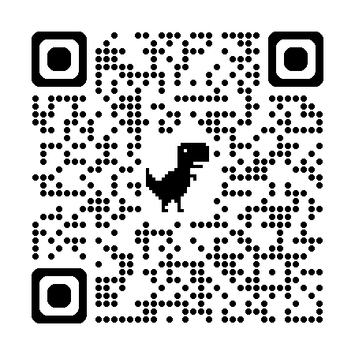
Useful links
Fear no Space Groups
phasertng

Slide 3
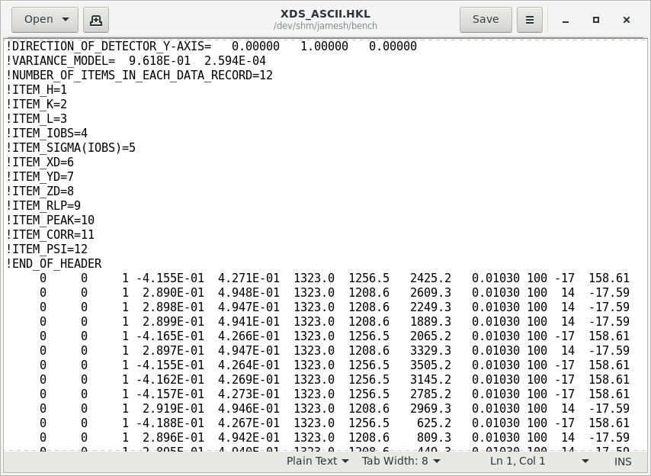
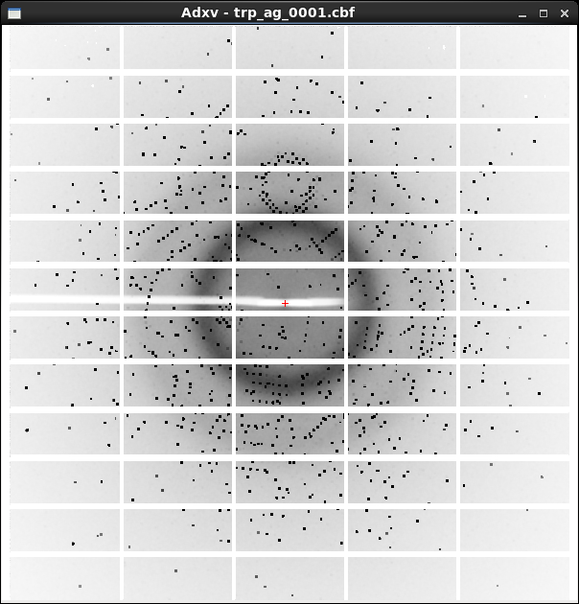
XDS X-ray diffraction data reduction engine
List of spot intensities (text)
Diffraction image data

Slide 4
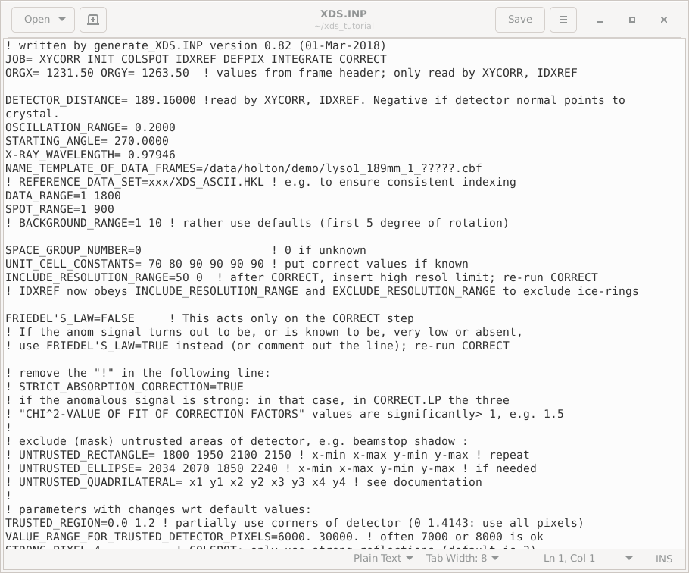
XDS native user interface: a text file!

Slide 5
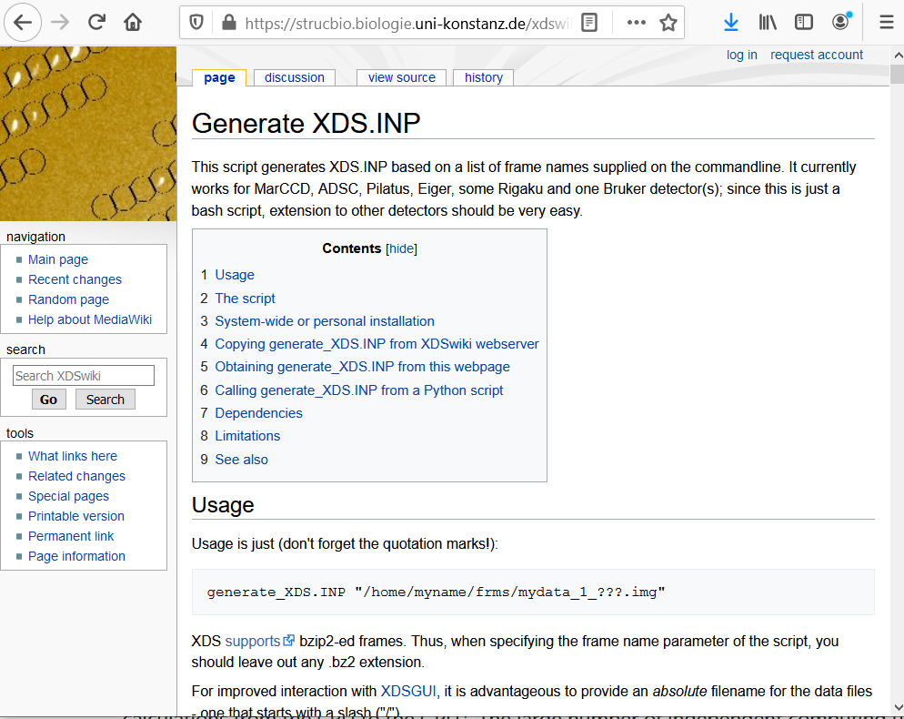

Slide 6
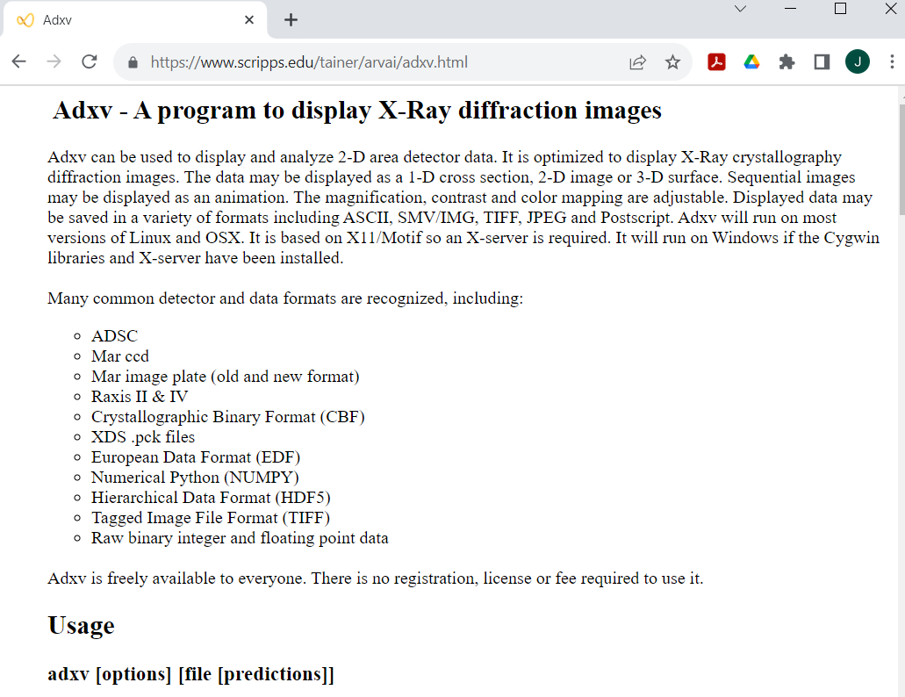
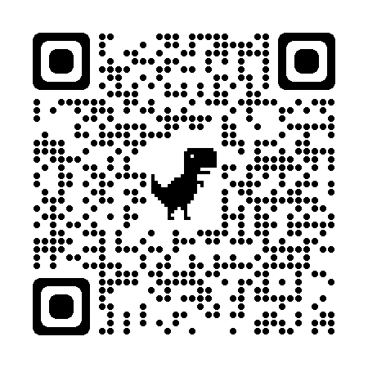
A better image viewer

Slide 7
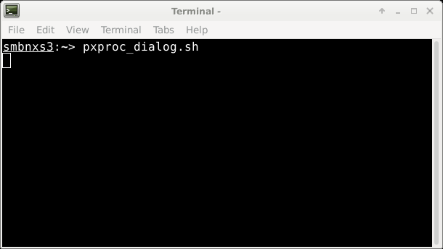
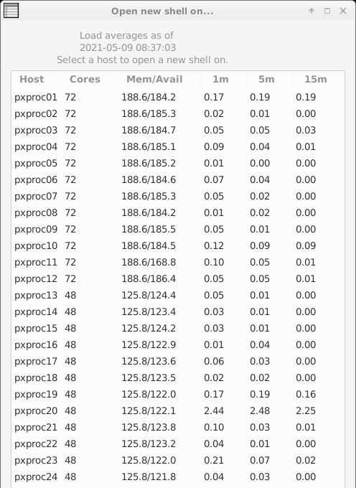
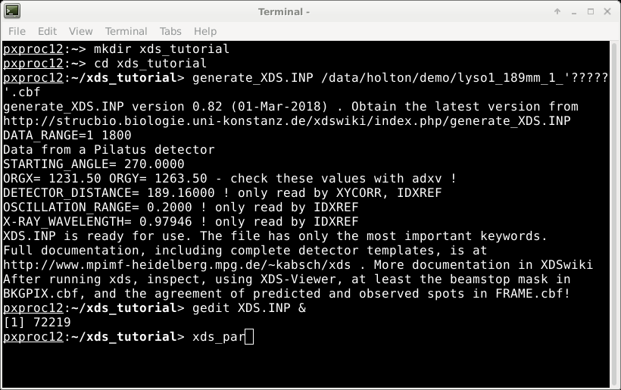
XDS native user interface

Slide 8
Cursor
does not move
with mouse
The “prompt”
Mouse
can be used
To select and paste
But all pasted text
Goes to the cursor

Slide 9
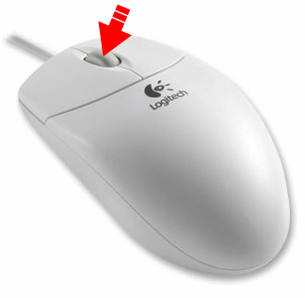
too… much… typing!
1) Make sure X11 is running
2) Select some text with mouse
3) Move mouse over to your terminal
4) Hit middle mouse button
5) No keyboard required!

Slide 10
How to start XDS
prompt
Do not type!
smbnxs:~> ssh pxproc27
pxproc:~> cd /data/$USER
pxproc:~> mkdir xds_tutorial
pxproc:~> cd xds_tutorial
pxproc:~> ln –sf /data/holton/demo .
pxproc:~> xdsgui
Space!
underscore
Space!
Enter
Space!
period!

Slide 11
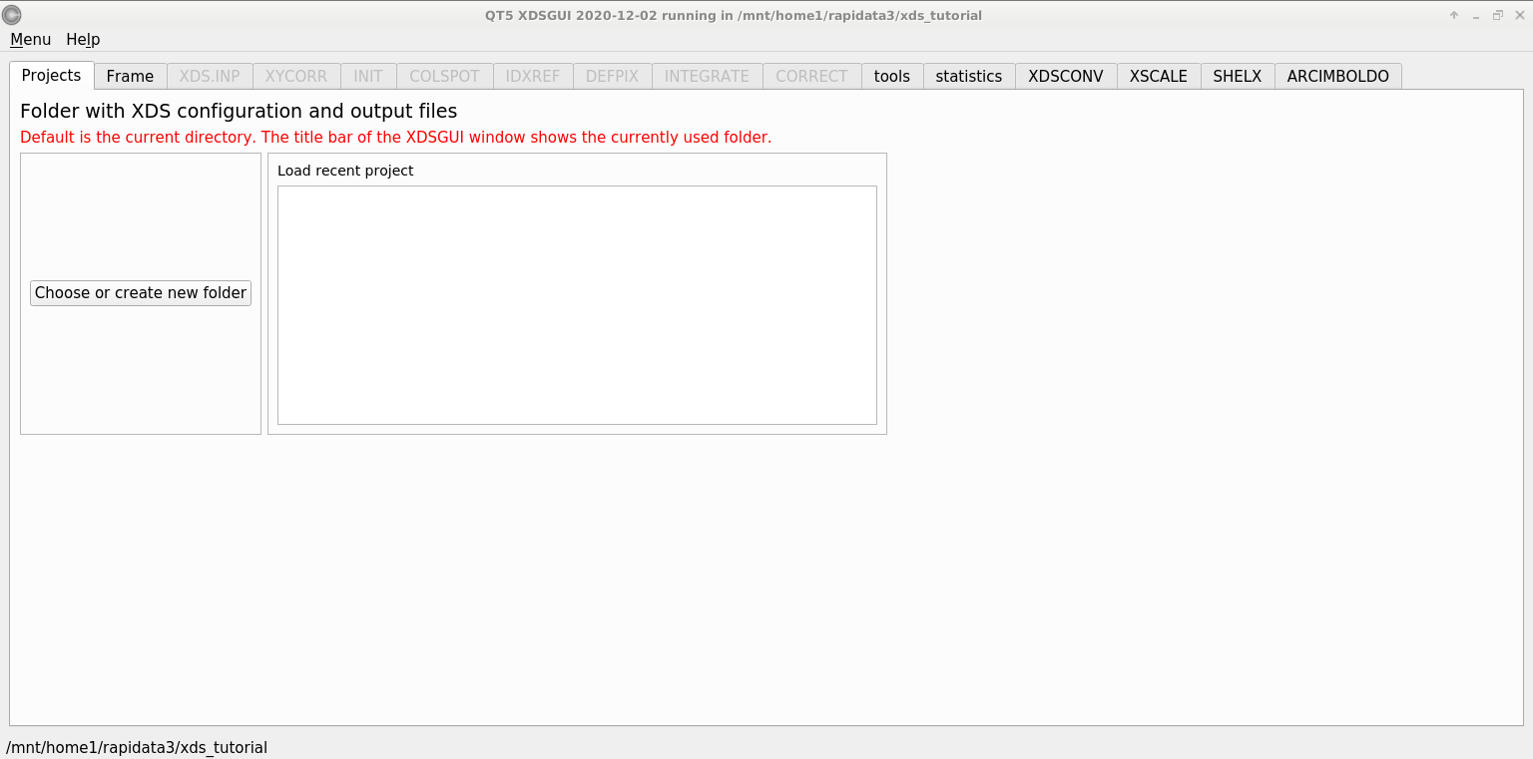
xdsgui – a graphical interface for XDS

Slide 12
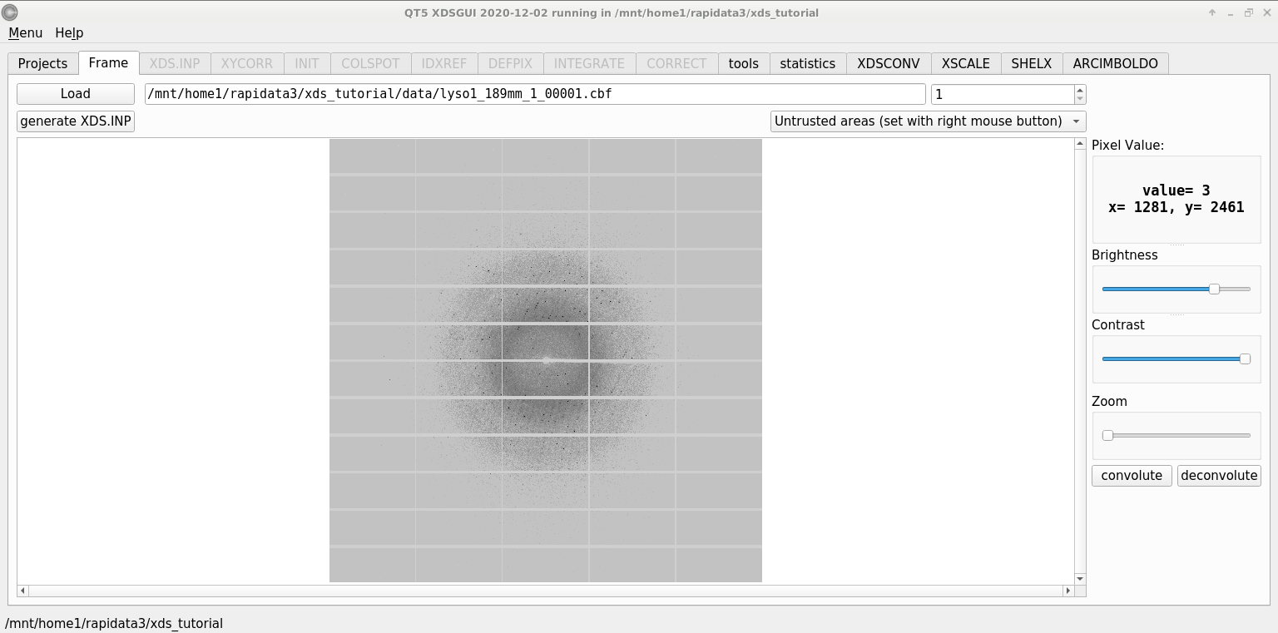
xdsgui – load an image
/data/holton/demo/1rb5_1_00001.cbf

Slide 13
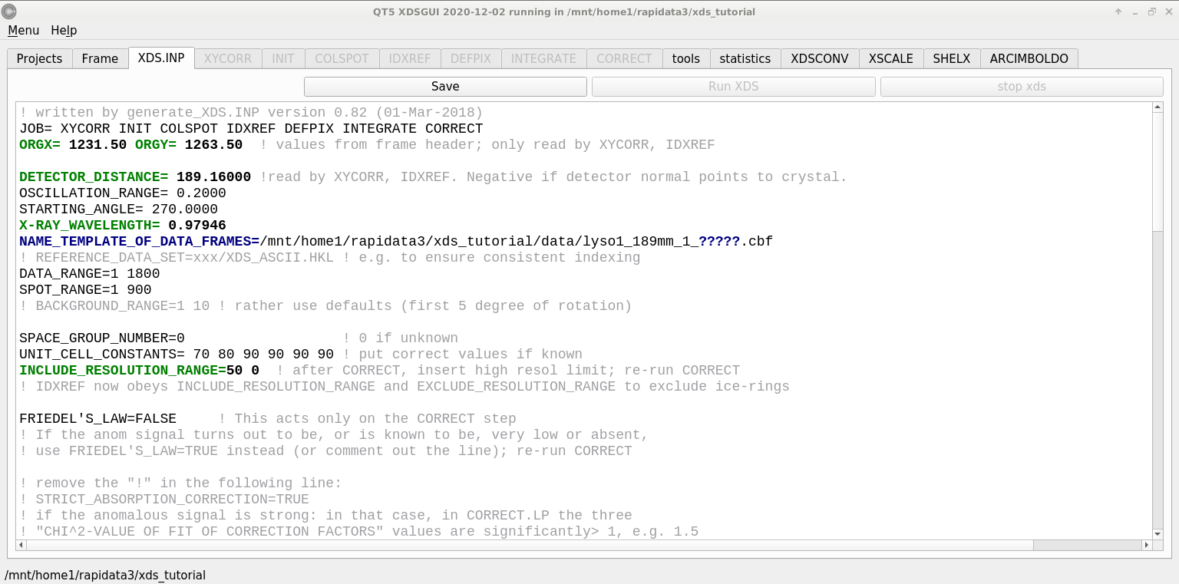
xdsgui – a GUI for text!
/data/holton/demo/1rb5_1_?????.cbf

Slide 14
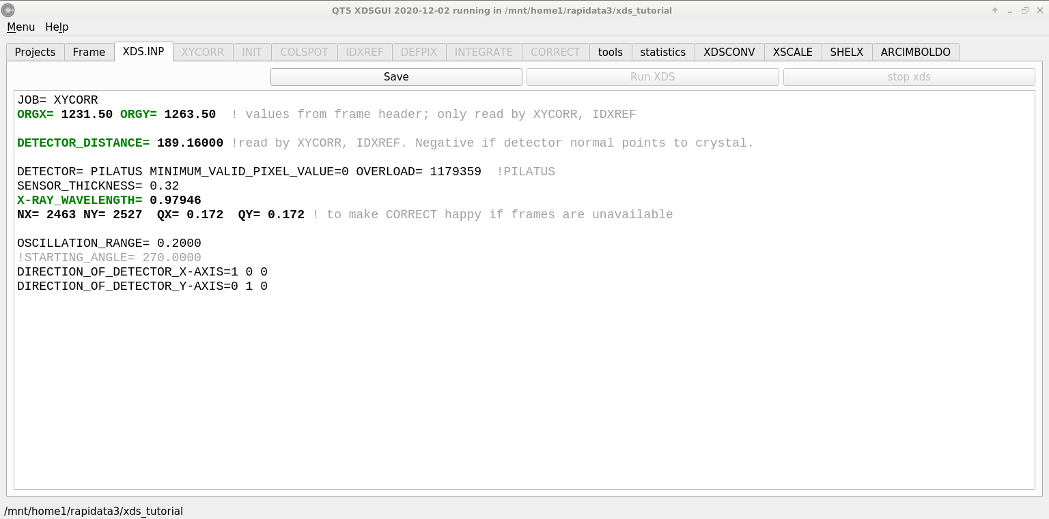
XYCORR– setting things up

Slide 15
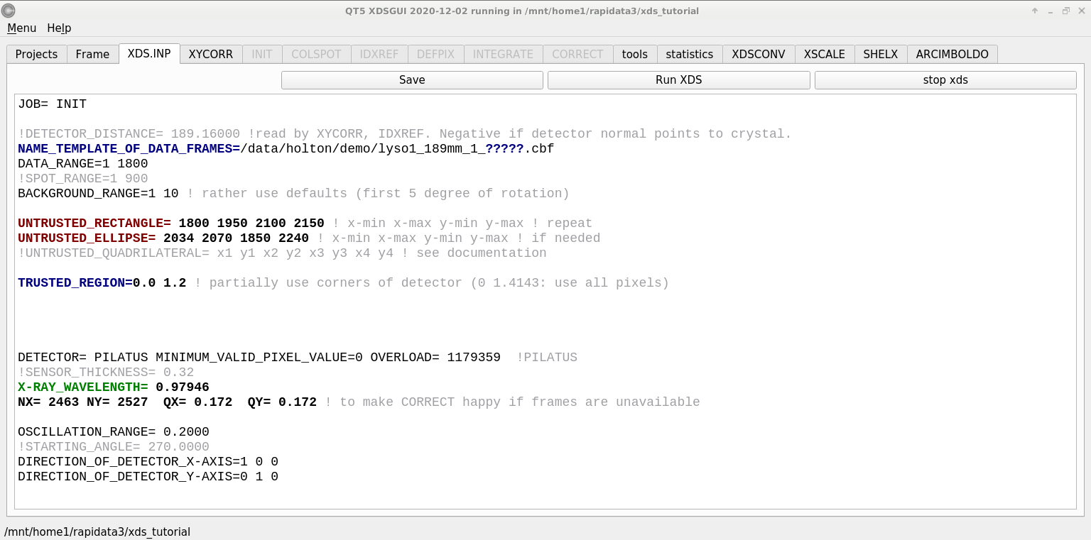
INIT – look at the background

Slide 16
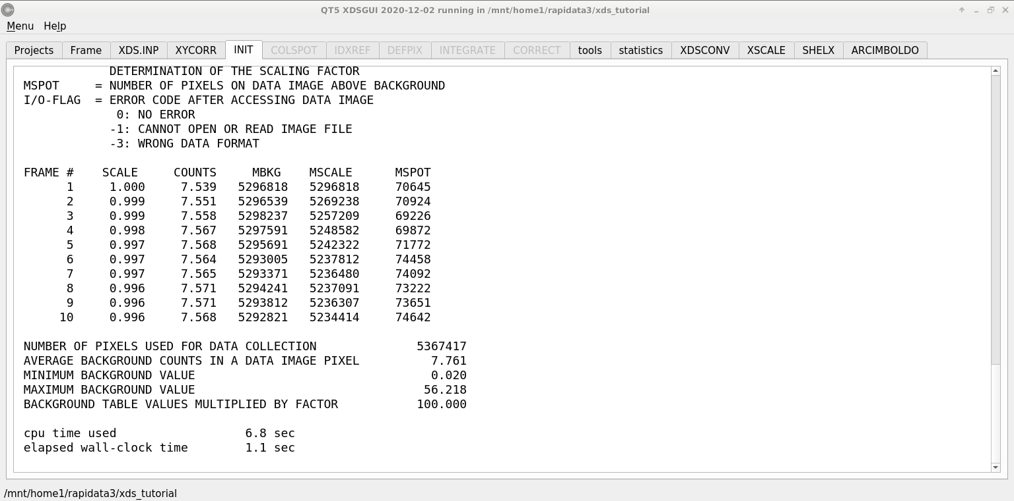
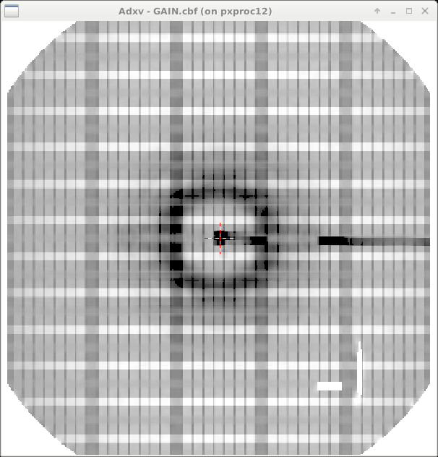
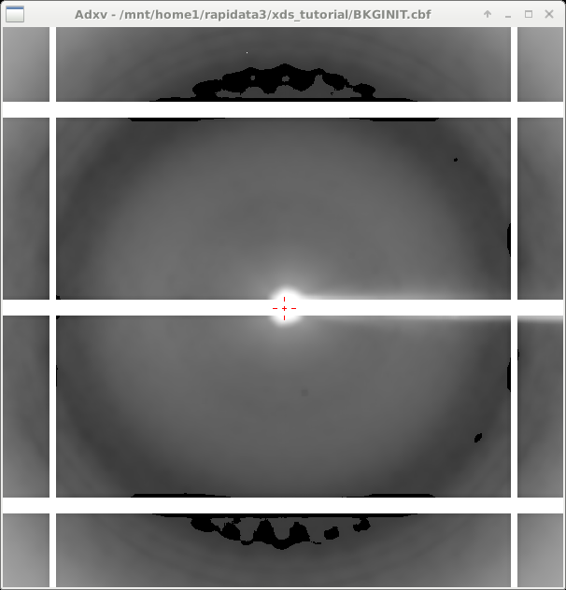
INIT – look at the background

Slide 17
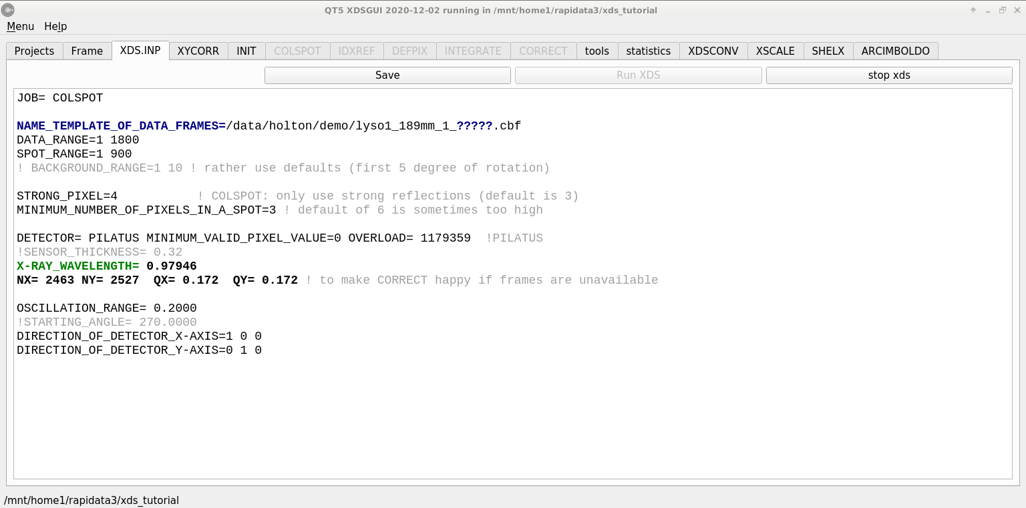
COLSPOT – the spot picker

Slide 18
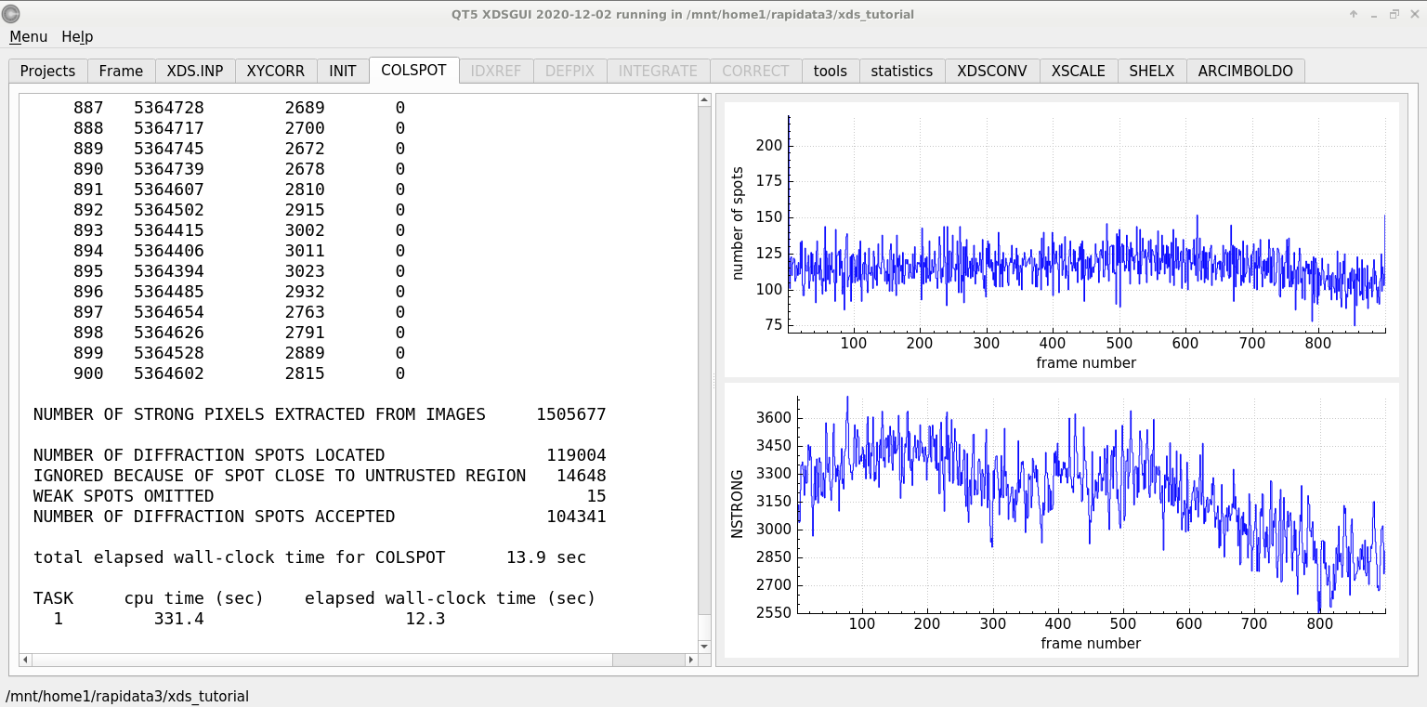
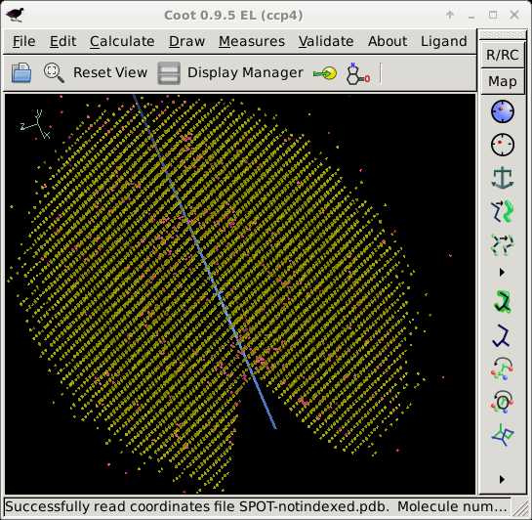
COLSPOT – the spot picker

Slide 19
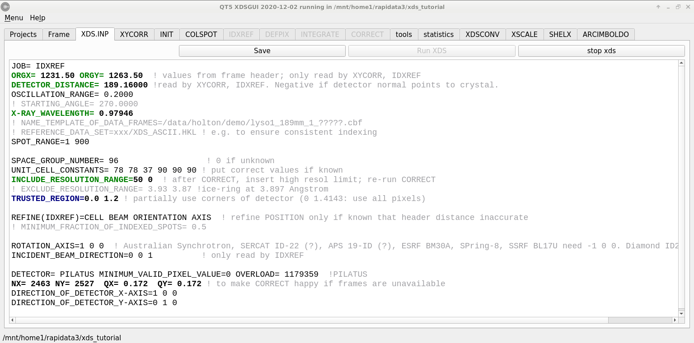
IDXREF – auto-indexing

Slide 20
XPARM.XDS
First image number
Starting phi
Delta-phi
spindle vector
XPARM.XDS VERSION Feb 5, 2021 BUILT=20210323
1 270.0000 0.2000 0.999971 0.007404 -0.001831
0.979460 0.000711 0.000291 1.020970
96 78.8215 78.8215 37.1784 90.000 90.000 90.000
36.338257 9.327419 -69.320709
26.357738 70.532730 23.307367
30.559622 -16.002089 13.866352
1 2463 2527 0.172000 0.172000
1231.500000 1263.500000 189.160004
1.000000 0.000000 0.000000
0.000000 1.000000 0.000000
0.000000 0.000000 1.000000
1 1 2463 1 2527
0.00 0.00 0.00 1.00000 0.00000 0.00000 0.00000 1.00000 0.00000
beam vector
wavelen
space
group
number
unit cell
a
b
c
cell vectors
real space
det panels
pixels
pixel size
origin
distance
x
y
z
Detector fast/slow
Panel #

Slide 21
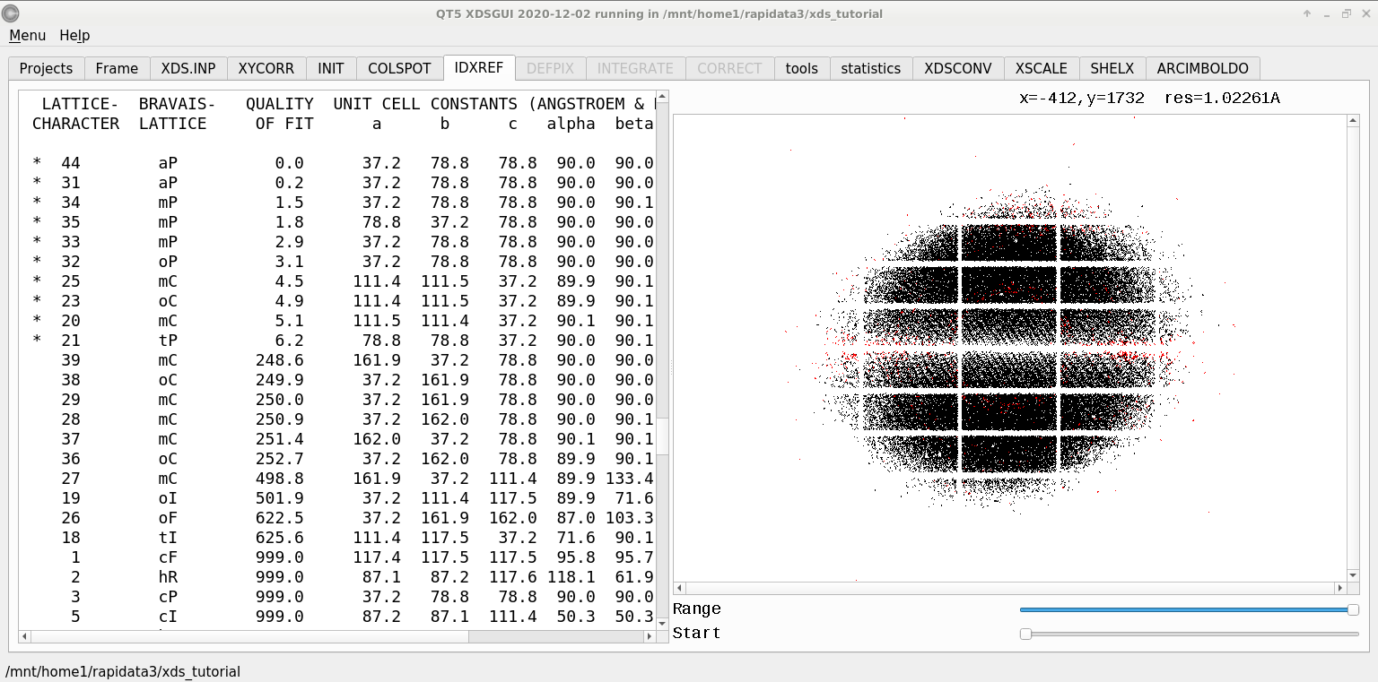
IDXREF – auto-indexing
BRAVAIS- POSSIBLE SPACE-GROUPS FOR PROTEIN CRYSTALS
TYPE [SPACE GROUP NUMBER,SYMBOL]
aP [1,P1]
mP [3,P2] [4,P2(1)]
mC,mI [5,C2]
oP [16,P222] [17,P222(1)] [18,P2(1)2(1)2] [19,P2(1)2(1)2(1)]
oC [21,C222] [20,C222(1)]
oF [22,F222]
oI [23,I222] [24,I2(1)2(1)2(1)]
tP [75,P4] [76,P4(1)] [77,P4(2)] [78,P4(3)] [89,P422] [90,P42(1)2]
[91,P4(1)22] [92,P4(1)2(1)2] [93,P4(2)22] [94,P4(2)2(1)2]
[95,P4(3)22] [96,P4(3)2(1)2]
tI [79,I4] [80,I4(1)] [97,I422] [98,I4(1)22]
hP [143,P3] [144,P3(1)] [145,P3(2)] [149,P312] [150,P321] [151,P3(1)12]
[152,P3(1)21] [153,P3(2)12] [154,P3(2)21] [168,P6] [169,P6(1)]
[170,P6(5)] [171,P6(2)] [172,P6(4)] [173,P6(3)] [177,P622]
[178,P6(1)22] [179,P6(5)22] [180,P6(2)22] [181,P6(4)22] [182,P6(3)22]
hR [146,R3] [155,R32]
cP [195,P23] [198,P2(1)3] [207,P432] [208,P4(2)32] [212,P4(3)32]
[213,P4(1)32]
cF [196,F23] [209,F432] [210,F4(1)32]
cI [197,I23] [199,I2(1)3] [211,I432] [214,I4(1)32]

Slide 22
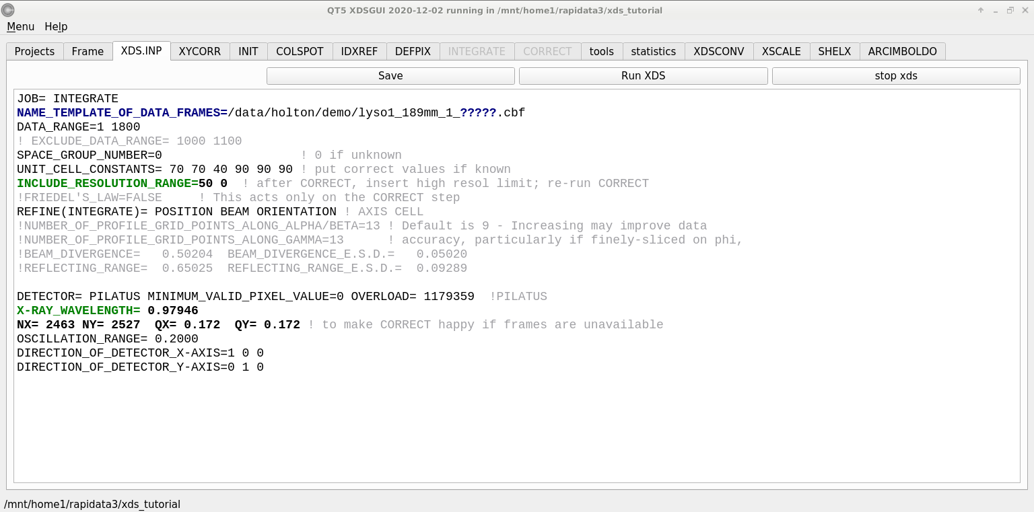
INTEGRATE – measure the spots!

Slide 23
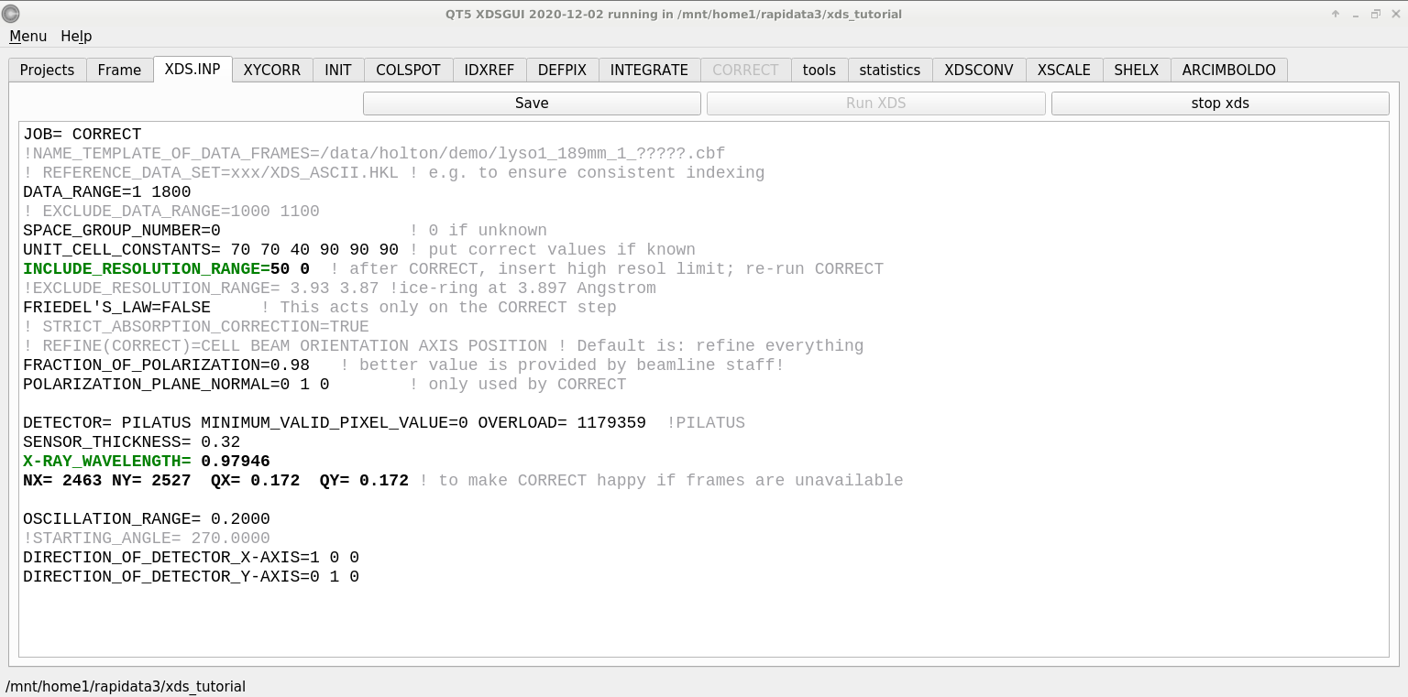
CORRECT – scale all the “factors”

Slide 24
Beam center vs “origin”
origin
direct beam

Slide 25
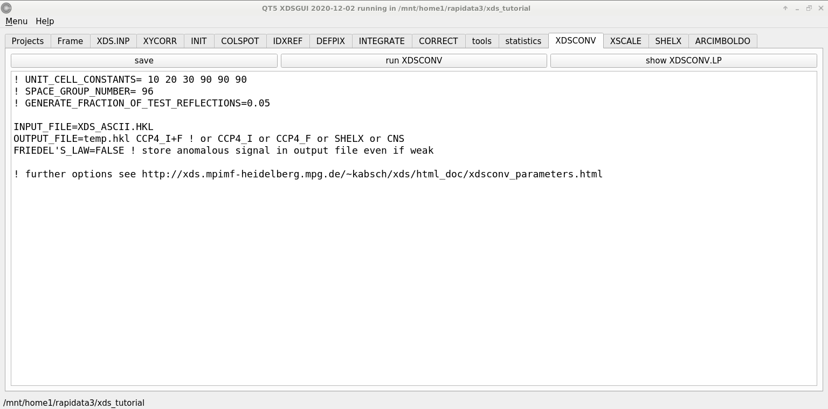
xdsconv – make an “mtz” file
output_file_name.mtz

Slide 26
Adding noise
1² + 1² = 1.4²
3² + 1² = 3.2²
σ_{total}² = σ₁² + σ₂²

Slide 27
Adding noise
1² + 1² = 1.4²
3² + 1² = 3.2²
σ_{total}² = σ₁² + σ₂²

Slide 28
Adding noise
1² + 1² = 1.4²
3² + 1² = 3.2²
10² + 1² = 10.05²

Slide 29
signal vs noise
“If you don’t have good data, then you must learn statistics.”
-James Holton

Slide 30
Sources of error for anomalous differences
Shutter jitter (rms 0.5 ms)
Beam flicker (0.15%/sqrt(Hz))
Attenuation correction (< 2%)
Radiation damage (1%/MGy)
Detector calibration (3%)

Slide 31
anomalous signal
ΔF
F
√
# sites
MW (Da)
≈ 1.2 f”
Crick, F. H. C. & Magdoff, B. S. (1956) Acta Crystallogr. 9, 901-908.
Hendrickson, W. A. & Teeter, M. M. (1981) Nature 290, 107-113.

Slide 32
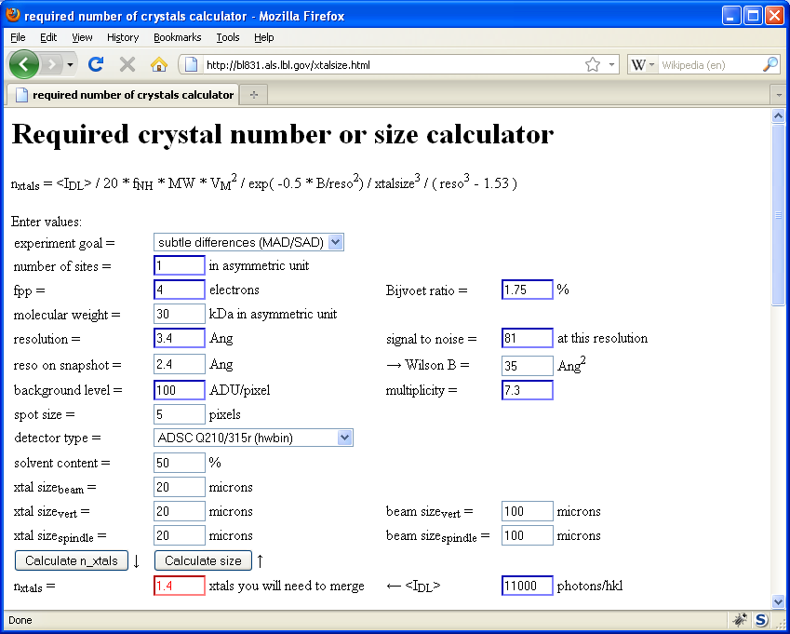
Holton & Frankel (2010) Acta D 66 393-408.

Slide 33
xdsconv – make an “mtz” file

Slide 34
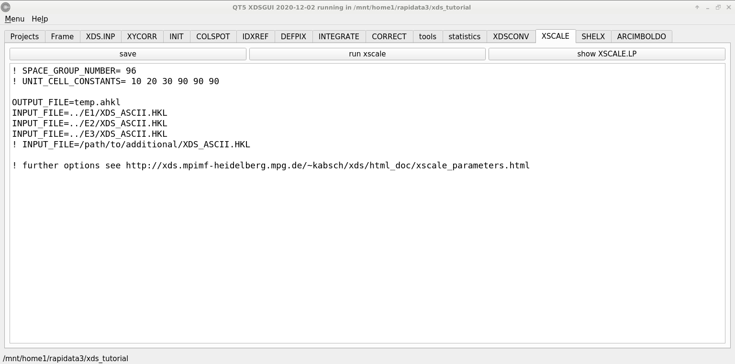
xscale – merge multiple runs

Slide 35
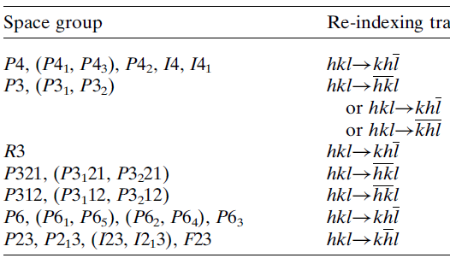
Re-indexing cheat sheet
Dauter, Z. (1999). "Data-collection strategies." Acta Cryst. D 55(10): 1703-1717.

Slide 36
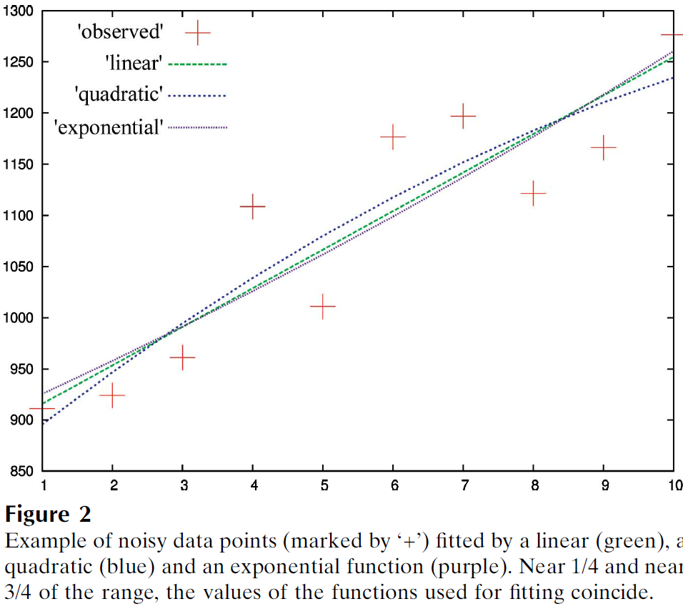
Zero-dose extrapolation (ZDE)
Diederichs, K. (2006). "Some aspects of quantitative analysis and correction of radiation damage." Acta Cryst. D 62(1): 96-101.
OUTPUT_FILE= multi-merge.hkl
INPUT_FILE= ../xds_1/XDS_ASCII.HKL
CRYSTAL_NAME= ip
INPUT_FILE= ../xds_2/XDS_ASCII.HKL
! same crystal, but translated
CRYSTAL_NAME= ip

Slide 37
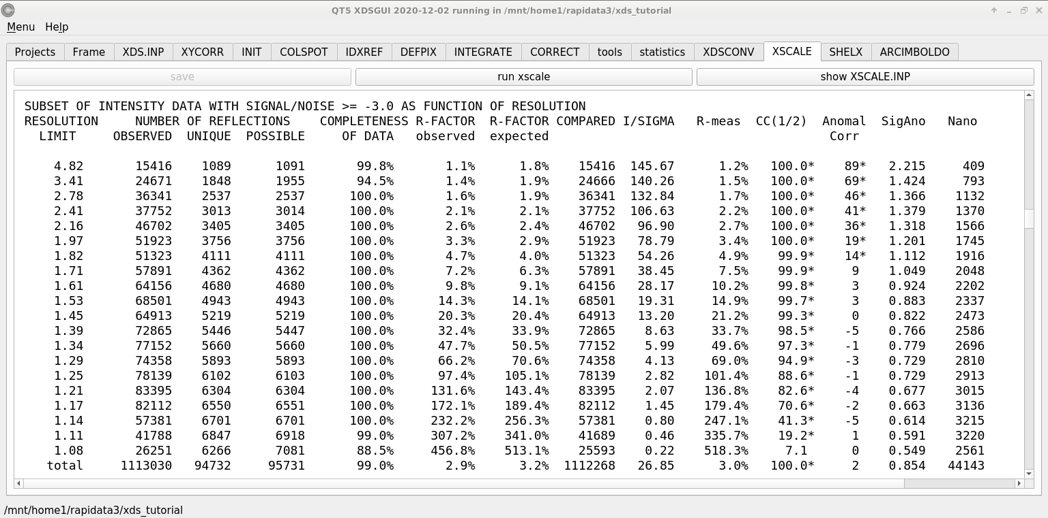
xscale – final stats

Slide 38
XDS: CORRECT.LP or XSCALE.LP
SUBSET OF INTENSITY DATA WITH SIGNAL/NOISE >= -3.0 AS FUNCTION OF RESOLUTION
RESOLUTION NUMBER OF REFLECTIONS COMPLETENESS R-FACTOR R-FACTOR COMPARED I/SIGMA R-meas CC(1/2) Anomal SigAno Nano
LIMIT OBSERVED UNIQUE POSSIBLE OF DATA observed expected Corr
6.39 4103 2517 3135 80.3% 1.7% 1.8% 3018 33.77 2.3% 99.9* 21* 1.012 533
4.54 7339 4970 5544 89.6% 2.6% 2.6% 4585 22.56 3.6% 99.8* 9 0.914 796
3.72 9442 6724 7186 93.6% 2.8% 2.9% 5327 19.99 4.0% 99.7* 9 0.859 877
3.22 11077 7997 8486 94.2% 4.8% 4.9% 6094 12.27 6.8% 99.3* -1 0.784 913
2.88 12408 8851 9595 92.2% 10.0% 10.1% 7068 6.01 14.2% 97.8* -2 0.799 1012
2.63 13673 9561 10662 89.7% 20.8% 20.8% 8185 3.10 29.4% 88.8* -4 0.776 1274
2.44 14360 9852 11510 85.6% 34.5% 34.7% 8981 1.90 48.8% 75.9* 2 0.765 1525
2.28 9501 6495 12416 52.3% 61.8% 59.6% 5991 1.14 87.3% 53.5* -2 0.722 1031
2.15 4567 3307 13210 25.0% 120.5% 120.3% 2520 0.59 170.4% 21.9* 4 0.693 408
total 86470 60274 81744 73.7% 6.7% 6.7% 51769 8.97 9.5% 99.5* 2 0.804 8369

Slide 39
XDS: CORRECT.LP or XSCALE.LP
******************************************************************************
CORRECTION PARAMETERS FOR THE STANDARD ERROR OF REFLECTION INTENSITIES
******************************************************************************
The variance v0(I) of the intensity I obtained from counting statistics is
replaced by v(I)=a*(v0(I)+b*I^2). The model parameters a, b are chosen to
minimize the discrepancies between v(I) and the variance estimated from
sample statistics of symmetry related reflections. This model implicates
an asymptotic limit ISa=1/SQRT(a*b) for the highest I/Sigma(I) that the
experimental setup can produce (Diederichs (2010) Acta Cryst D66, 733-740).
a b ISa
3.806E+00 1.080E-04 49.32

Slide 40
CCP4: aimless log
$TABLE: Analysis against resolution, XDSdataset:
$GRAPHS:I/sigma, Mean Mn(I)/sd(Mn(I)):0|0.216023x0|137.14:2,13,14:
:Rmerge, Rfull, Rmeas, Rpim v Resolution:0|0.216023x0|1.70834:2,4,5,6,7:
:Average I, RMSdeviation and Sd:0|0.216023x0|1650.8:2,10,11,12:
:Fractional bias:0|0.216023x0|0:2,15:
$$
N 1/d^2 Dmid Rmrg Rfull Rcum Rmeas Rpim Nmeas AvI RMSdev sd I/RMS Mn(I/sd) FrcBias $$ $$
1 0.0064 12.55 0.020 0.020 0.020 0.021 0.006 13115 1651 57 42 29.2 137.1 -
2 0.0191 7.24 0.027 0.027 0.024 0.028 0.008 24753 1171 47 42 25.0 105.2 -
3 0.0318 5.61 0.038 0.038 0.029 0.040 0.012 32197 857 46 43 18.4 79.6 -
4 0.0445 4.74 0.034 0.034 0.031 0.035 0.010 37743 1212 57 53 21.4 91.2 -
5 0.0572 4.18 0.036 0.036 0.032 0.038 0.011 42642 1181 59 57 19.9 83.8 -
6 0.0699 3.78 0.049 0.049 0.036 0.052 0.015 47224 883 59 57 15.1 65.1 -
7 0.0826 3.48 0.065 0.065 0.040 0.068 0.020 51052 685 59 58 11.7 50.9 -
8 0.0953 3.24 0.096 0.096 0.045 0.100 0.029 54636 448 56 56 8.0 35.0 -
9 0.1080 3.04 0.151 0.151 0.050 0.158 0.046 58072 268 53 53 5.1 22.7 -
10 0.1207 2.88 0.229 0.229 0.056 0.240 0.070 60731 171 51 51 3.3 15.4 -
11 0.1334 2.74 0.314 0.314 0.063 0.329 0.097 63807 125 51 51 2.4 11.3 -
12 0.1461 2.62 0.406 0.406 0.070 0.425 0.125 66241 98 51 52 1.9 8.7 -
13 0.1588 2.51 0.537 0.537 0.078 0.562 0.166 68272 76 53 53 1.4 6.5 -
14 0.1715 2.41 0.685 0.685 0.084 0.727 0.237 54170 61 53 54 1.1 4.4 -
15 0.1843 2.33 0.886 0.886 0.088 0.950 0.333 39781 48 55 56 0.9 3.1 -
16 0.1970 2.25 1.249 1.249 0.092 1.355 0.508 29754 35 57 59 0.6 2.1 -

Slide 41
CCP4: aimless log
$TABLE: Correlations CC(1/2) within dataset, XDSdataset:
$GRAPHS: Anom & Imean CCs v resolution:0|0.216023x0|1:2,4,7:
: RMS correlation ratio :0|0.216023x0|2.20344:2,6:
$$
N 1/d^2 Dmid CCanom Nanom RCRanom CC1/2 NImean $$ $$
1 0.0064 12.55 0.659 499 2.203 1.000 669
2 0.0191 7.24 0.550 975 1.853 1.000 1155
3 0.0318 5.61 0.527 1295 1.798 1.000 1479
16 0.1970 2.25 0.037 2123 1.038 0.711 2275
17 0.2097 2.18 0.043 1682 1.044 0.460 1877

Slide 42
Resolution cutoff?

Slide 43
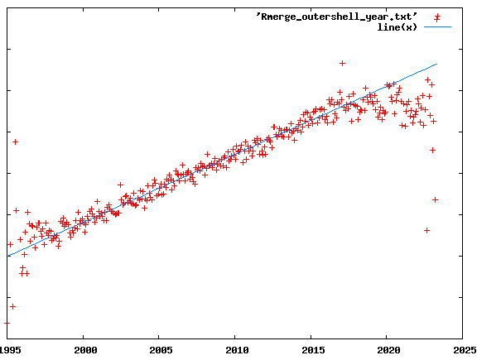
R_{merge} at the resolution limit in PDB
0.8
0.7
0.6
0.5
0.4
0.3
0.2
0.1
0
Average outer-shell R_{merge}
Year

Slide 44
Expected R_{merge} as I_{obs} → 0

Slide 45
Optimum resolution cutoff is:
Too optimistic: add nothing but noise
Too pessimistic: series-termination error
Happy medium?
Simulate:
Random atoms, compute F²
Add Gaussian noise, RMS = 1
Truncate
Subtract “right” map, RMS difference

Slide 46
Optimal resolution cutoff
Error in map (rms e⁻)
Resolution cutoff (Å)

Slide 47
Optimal resolution cutoff
Correlation Coefficient
Resolution cutoff (Å)

Slide 48
Optimal resolution cutoff
Correlation Coefficient
Resolution cutoff (Å)

Slide 49
Wilson Plot
2
log( intensity )
8
2.2 1.6 1.3 1.1 1.0 0.9 0.85 0.8 0.75 0.7
resolution (Å)

Slide 50
Optimum resolution cutoff is:
0.0 Å

Slide 51
scattering
x-ray beam
sample
detector
detector

Slide 52
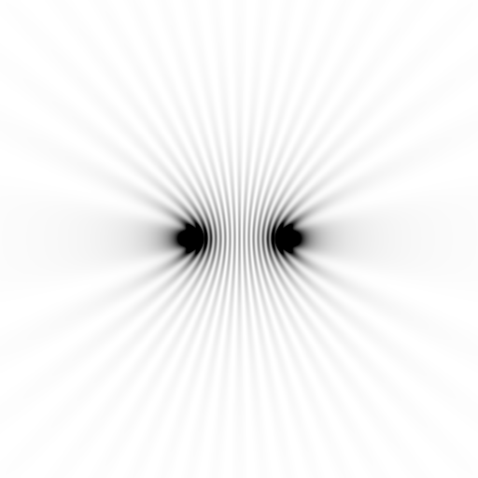
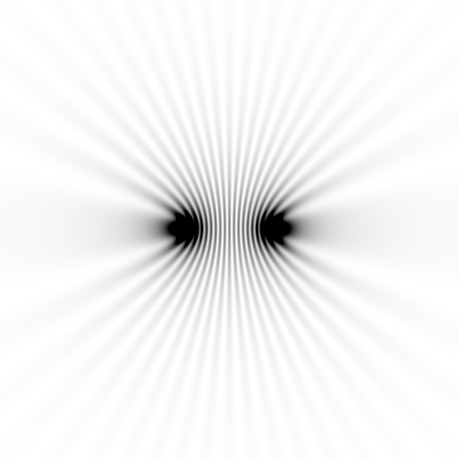
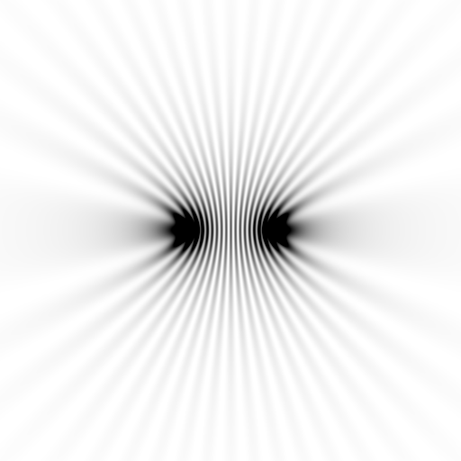
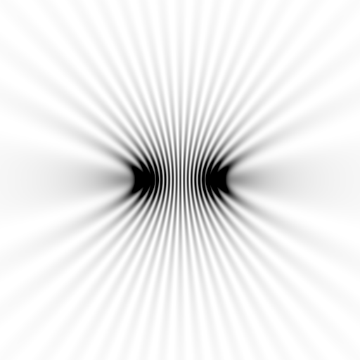
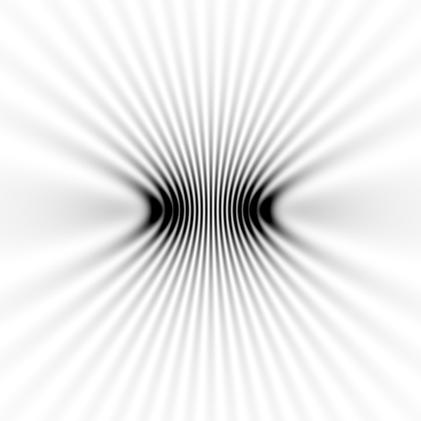
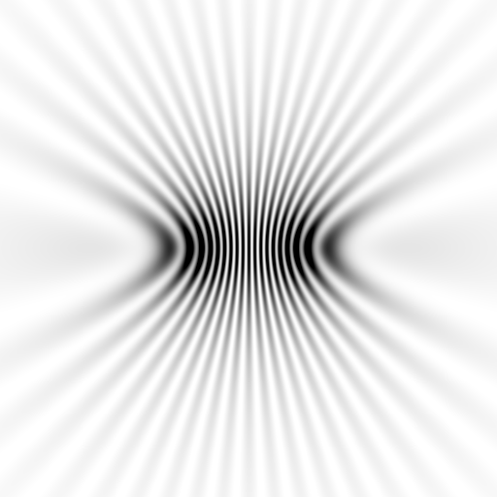
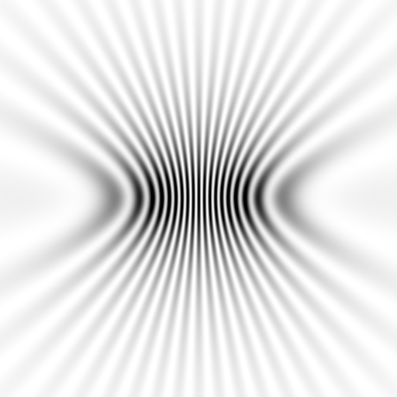
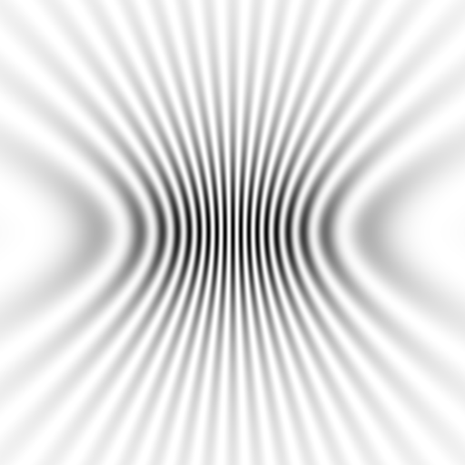
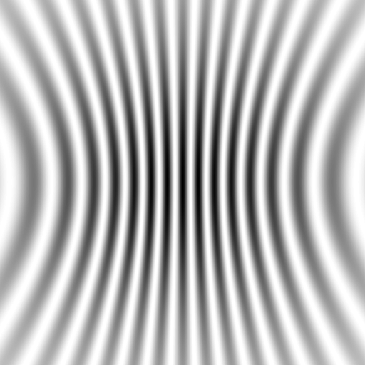

Slide 53
scattering
x-ray beam
sample
detector

Slide 54
scattering
x-ray beam
sample
detector

Slide 55
scattering
x-ray beam
sample
detector

Slide 56
Bragg’s Law
to detector
nλ = 2d sin(θ)
atom #1
θ
d
to source
atom #2
d∙sin(θ)

Slide 57
Bragg’s Law
to detector
nλ = 2d sin(θ)
atom #1
θ
to source
d
atom #2
d∙sin(θ)

Slide 59
scattering from a structure
sample
detector
direct beam
+

Slide 60
forward Fourier Transform
inverse Fourier Transform
no phase

Slide 61
inverse Fourier Transform
scattering from a structure
colored by phase
sample
detector

Slide 62
scattering from a lattice
colored by phase
sample
detector
beam center
+

Slide 63
scattering from a lattice
colored by phase
sample
detector

Slide 64
scattering from a lattice
colored by phase
sample
detector

Slide 65
scattering from a crystal structure
colored by phase
sample
detector
beam center
+

Slide 66
Major Phasing techniques
Molecular Replacement
Multiple Isomorphous Replacement
Multiwavelength Anomalous Diffraction
Single-wavelength Anomalous Diffraction

Slide 67
inverse Fourier Transform
no phase

Slide 68
inverse Fourier Transform
no phase

Slide 69
Major Phasing techniques
Molecular Replacement
Multiple Isomorphous Replacement
Multiwavelength Anomalous Diffraction
Single-wavelength Anomalous Diffraction

Slide 70
anomalous scattering
x-ray beam
sample
detector

Slide 71
anomalous scattering
x-ray beam
sample
detector

Slide 72
anomalous scattering
x-ray beam
sample
detector

Slide 73
anomalous scattering
x-ray beam
sample
detector

Slide 74
anomalous scattering
x-ray beam
sample
detector

