Slide 1
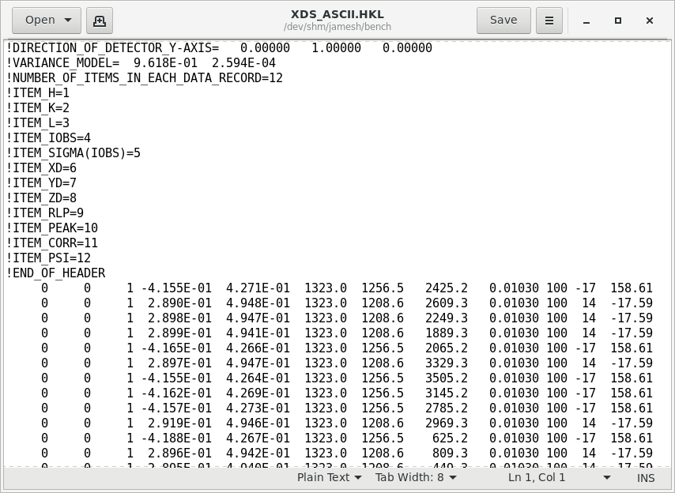
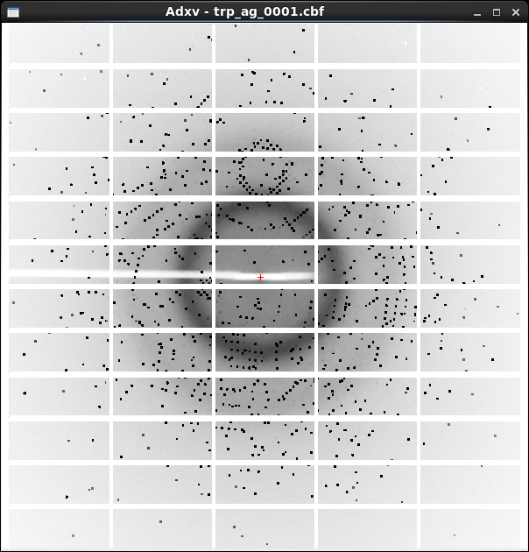
XDS X-ray diffraction data reduction engine
List of spot intensities (text)
Diffraction image data

Slide 2
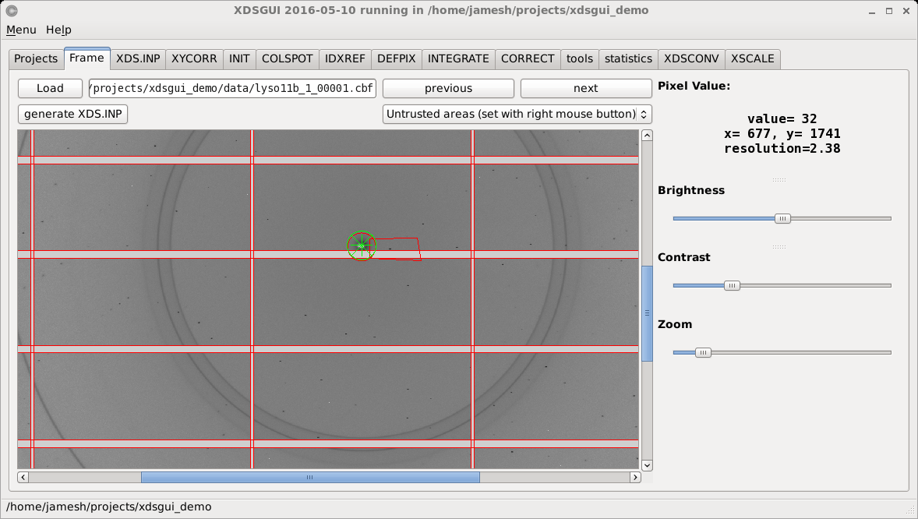
xdsgui – a graphical interface for XDS

Slide 3
XDS and xdsgui demo
prompt
Do not type!
underscore
~]$ cd
~]$ mkdir xds_tutorial
~]$ cd xds_tutorial
~]$ ln –sf /data/holton/demo .
~]$ pxproc_dialog.sh
~]$ ssh pxproc23
@pxproc23 ~]$ cd xds_tutorial
]$ xdsgui
Space!
Enter
Space!

