Slide 1
Acknowledgements
Robert Stroud James Fraser Nevan Krogan
Paul Adams John Tainer Greg Hura Nick Sauter
Aina Cohen Art Lyubimov Jeney Wierman
UCSF LBNL SLAC
ALS 8.3.1: TomAlberTron
NIH NIAID P50 AI150476
NIH NIGMS P30 GM124169
DOE-BER Integrated Diffraction Analysis Technologies (IDAT)
NIH NIGMS P30 GM133894
The Advanced Light Source is supported by the Director, Office of Science, Office of Basic Energy Sciences, Materials Sciences Division, of the US Department of Energy under contract No. DE-AC02-05CH11231 at Lawrence Berkeley National Laboratory.

Slide 2
ber
structural
bio
portal.org

Slide 3
Powerpoint file available:
https://bl831.als.lbl.gov/~jamesh/powerpoint/RapiData_XDS_2022.pptx
JMHolton@lbl.gov

Slide 4
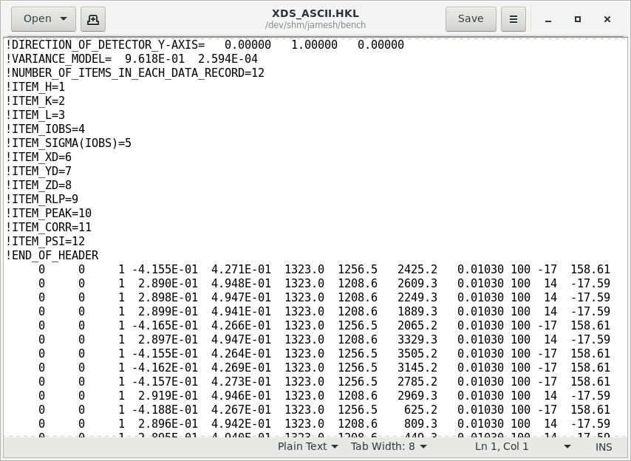
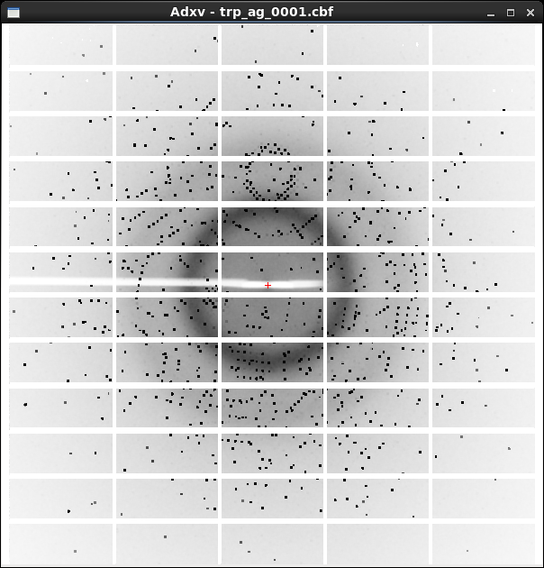
XDS X-ray diffraction data reduction engine
List of spot intensities (text)
Diffraction image data

Slide 5
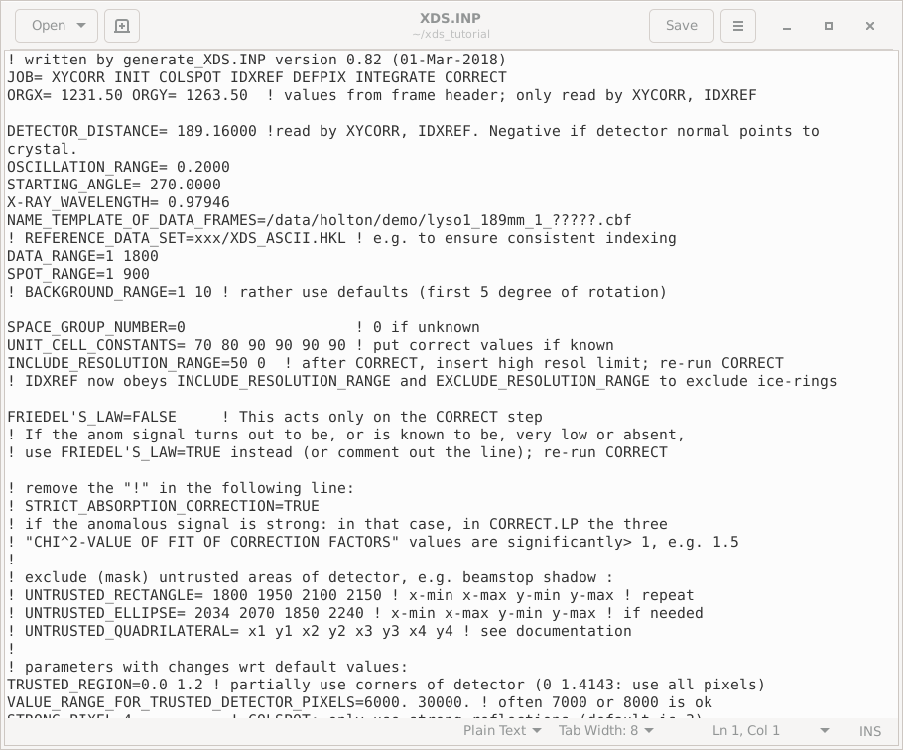
XDS native user interface: a text file!

Slide 6
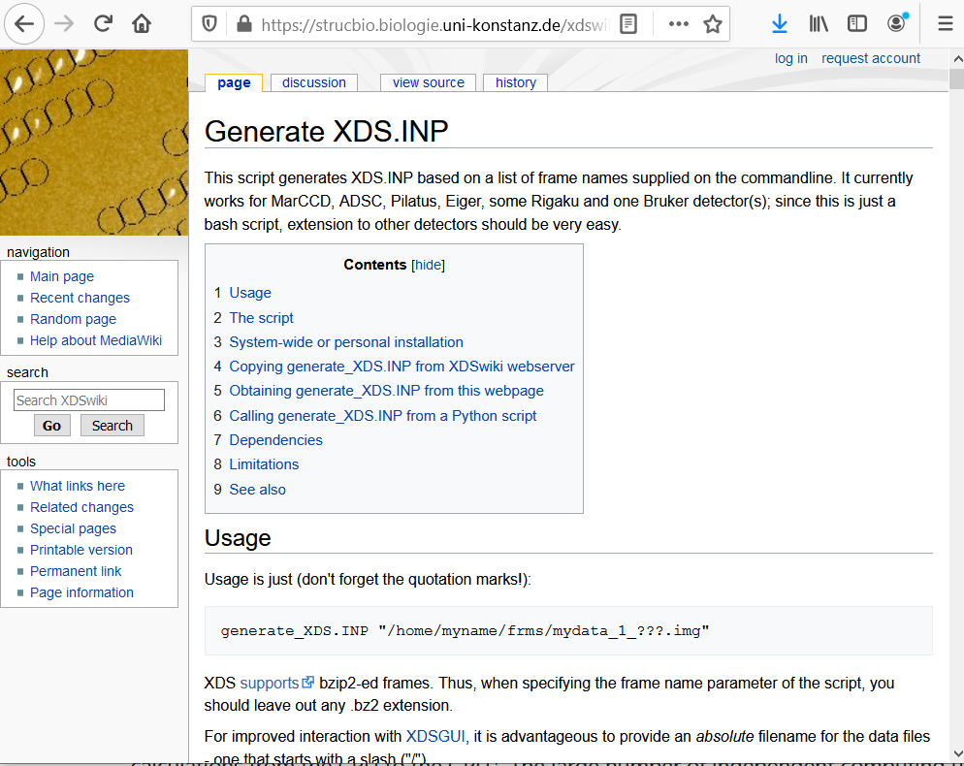

Slide 7
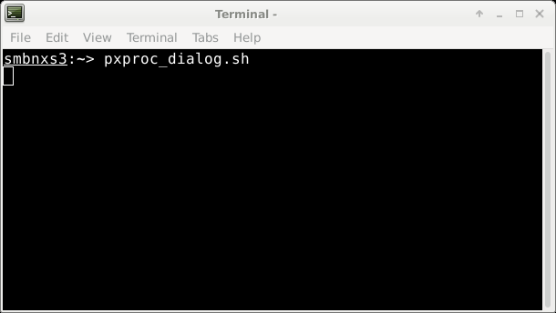
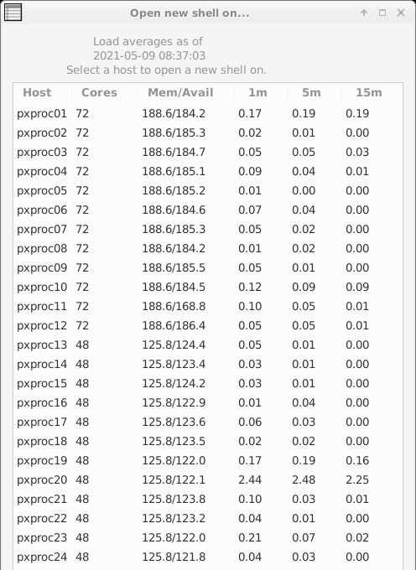
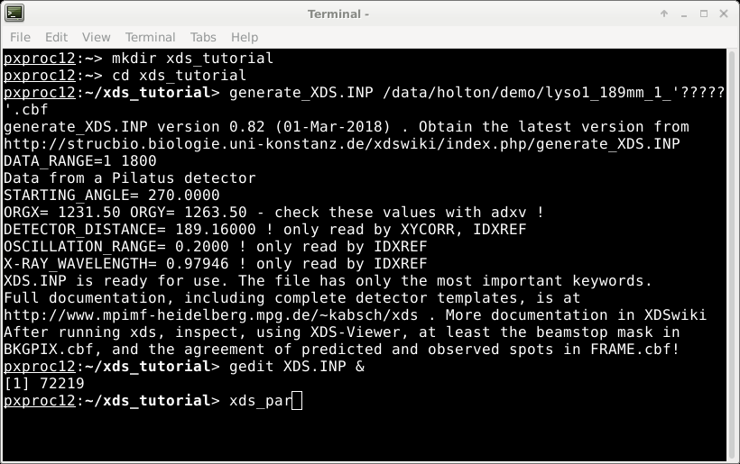
XDS native user interface

Slide 8
Cursor
does not move
with mouse
The “prompt”
Mouse
can be used
To select and paste
But all pasted text
Goes to the cursor

Slide 9
How to start XDS
prompt
Do not type!
underscore
~]$ cd
~]$ mkdir xds_tutorial
~]$ cd xds_tutorial
~]$ ln –sf /data/holton/demo .
~]$ pxproc_dialog.sh
~]$ ssh pxproc12
@pxproc ~]$ cd xds_tutorial
]$ xdsgui
Space!
Enter
Space!

Slide 10
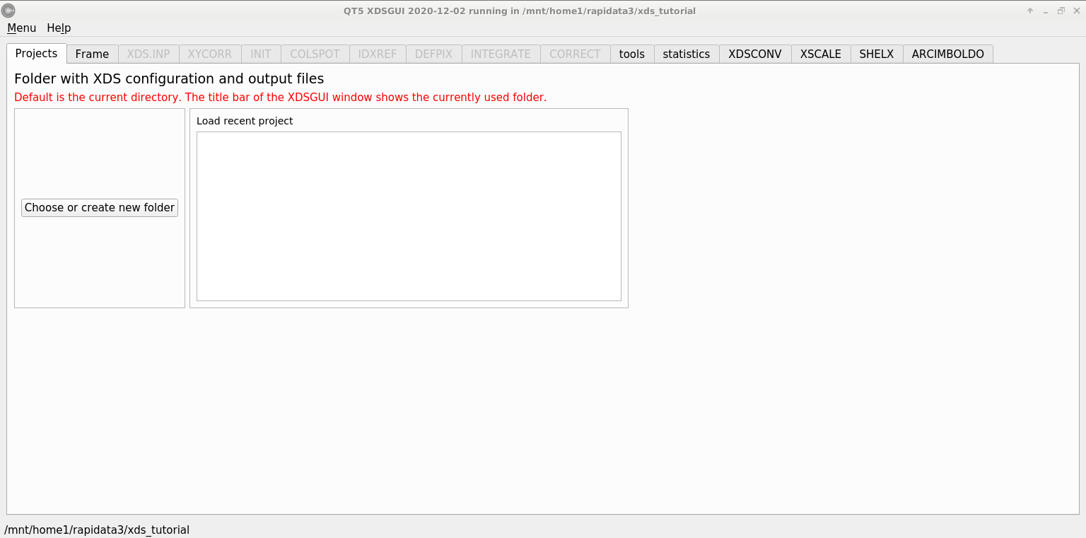
xdsgui – a graphical interface for XDS

Slide 11
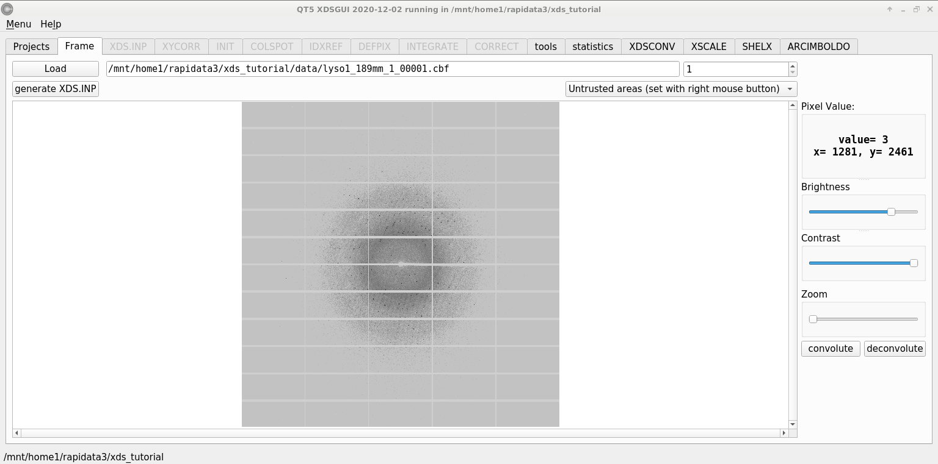
xdsgui – load an image

Slide 12
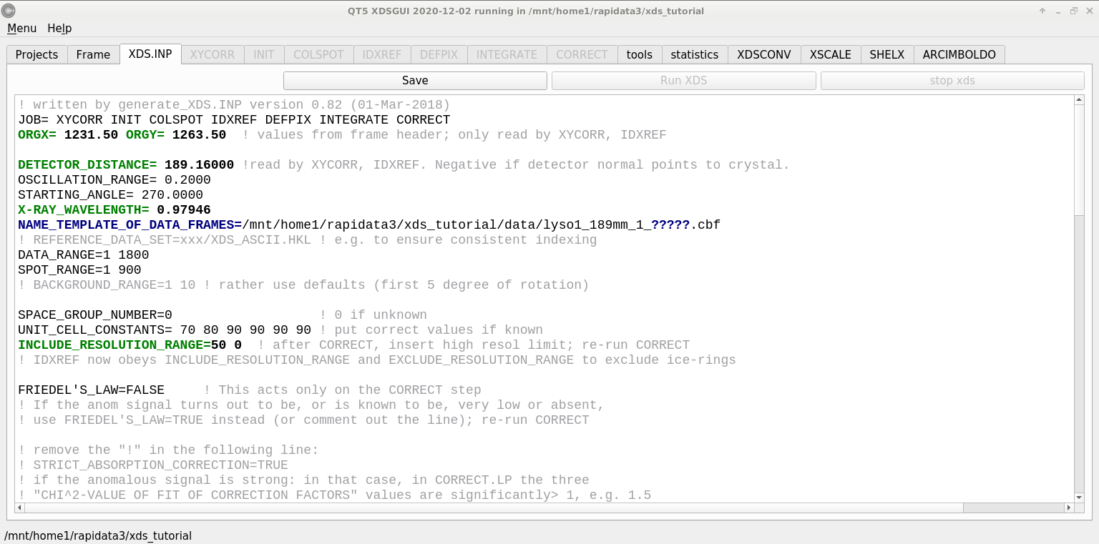
xdsgui – a GUI for text!

Slide 13
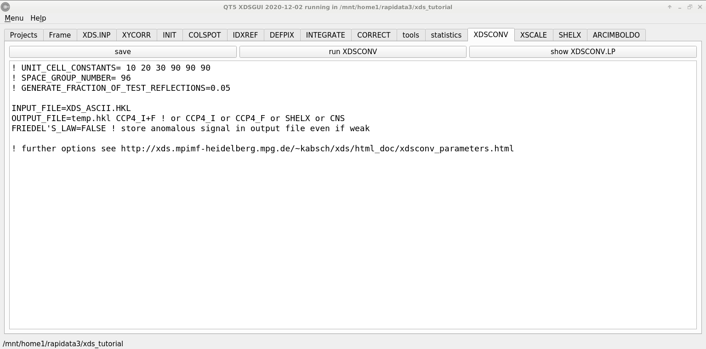
xdsconv – make an “mtz” file
output_file_name.mtz

Slide 14
xdsgui – nuts, bolts, bells & whistles

Slide 15
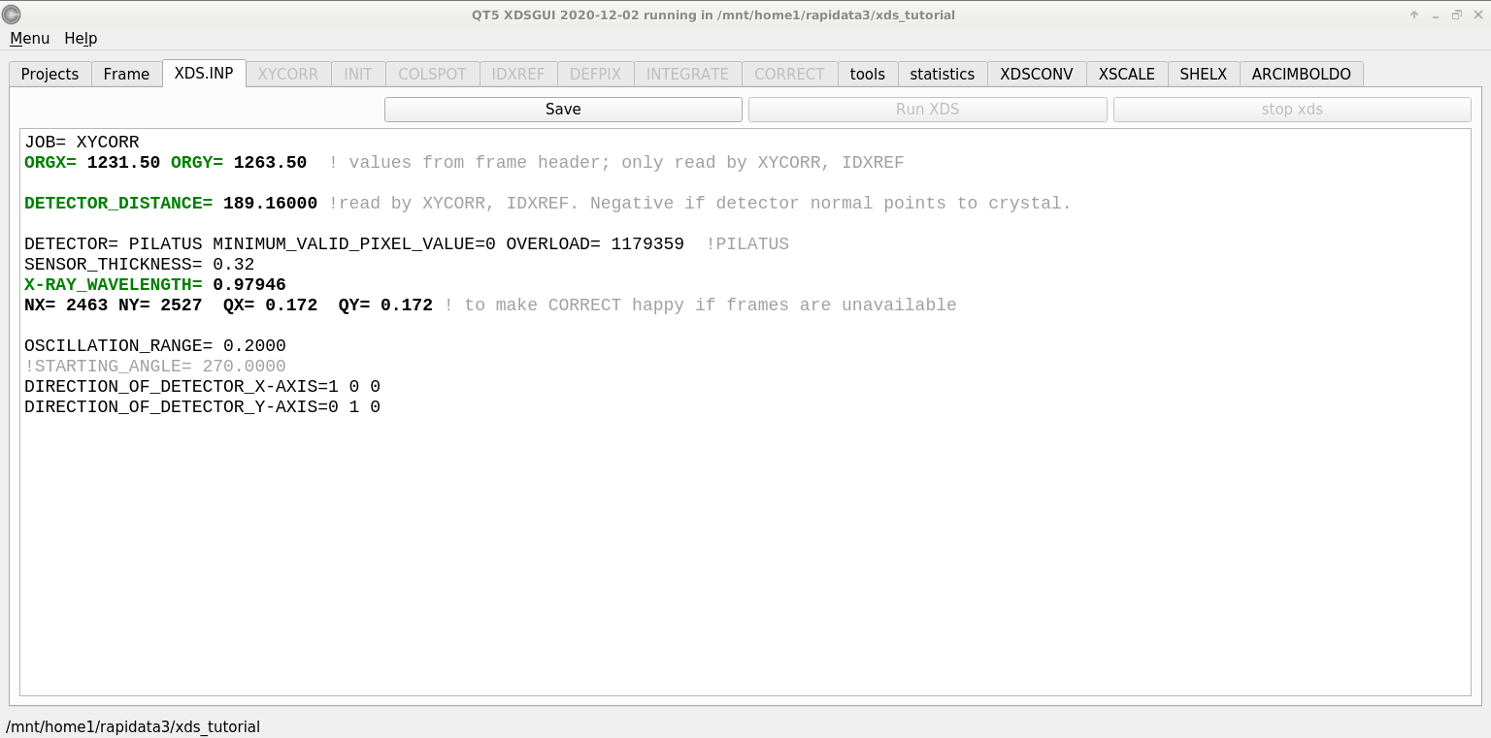
XYCORR– setting things up

Slide 16
Beam center vs “origin”
direct beam

Slide 17
Beam center vs “origin”
origin
direct beam

Slide 18
Correct beam center
155.063 155.647
159.353 155.063
159.301 155.011
1512.73 1554.57
155.063 159.356 -250
ADXV
HKL2000
MOSFLM
XDS
DIALS

Slide 19
XYCORR– setting things up

Slide 20
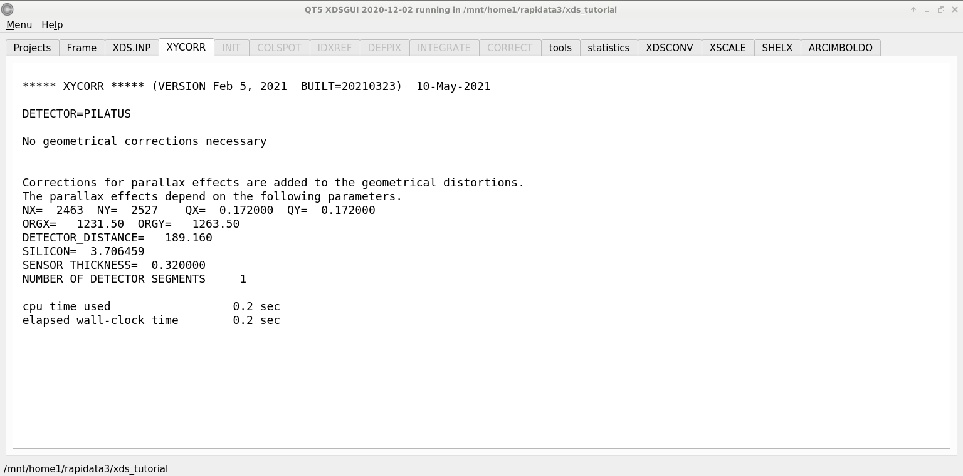
XYCORR– setting things up

Slide 21
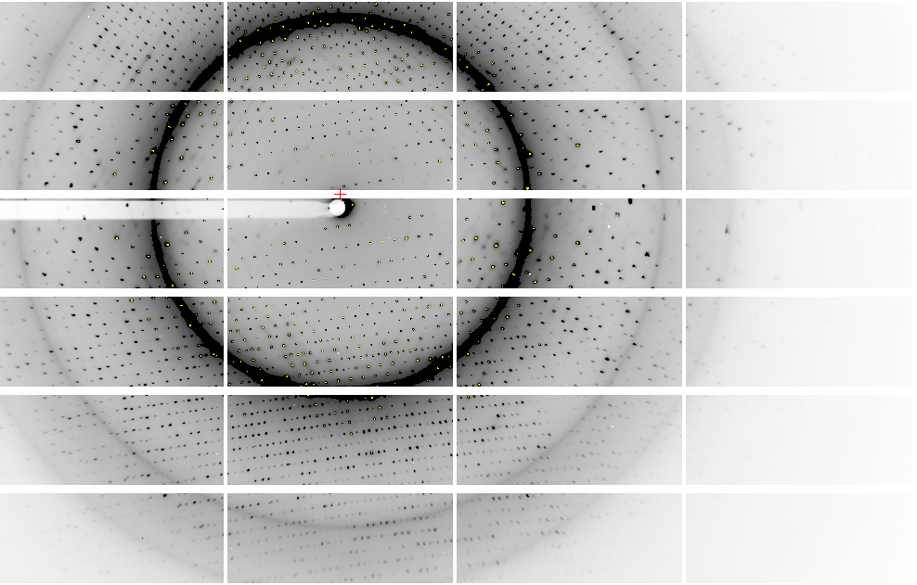
Pilatus: 1-module shift

Slide 22
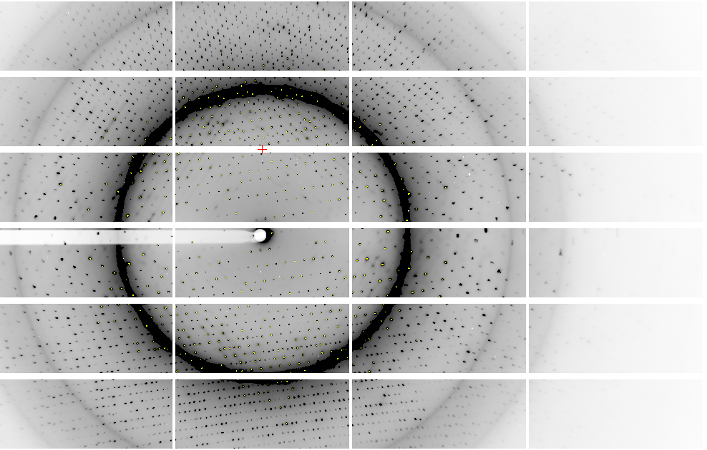
Pilatus: 1-module shift

Slide 23
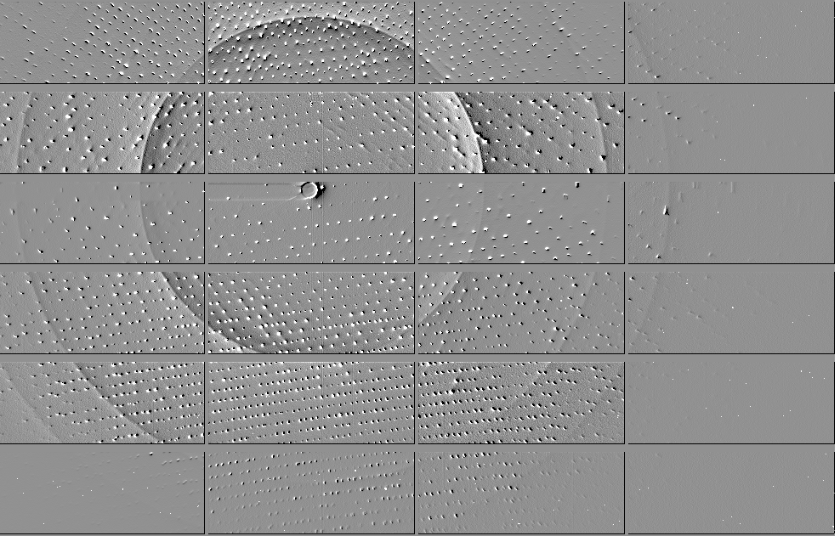
Pilatus: 1-module shift

Slide 24
Detector pixels are 3D
51 μm
172 μm
75 μm
8%
side
loss
53%
side
loss
76%
side
loss
photon
17%
loss
photon
31 μm thick
Pilatus
320 μm thick
Eiger
Typical CCD
26% loss
450 μm thick
Arrival angle of 2 Å spot: 29°
Mean Penetration depth 12 keV:
17.5 μm Gd₂O₂S 237 μm Si
15%
loss

Slide 25
XYCORR– setting things up

Slide 26
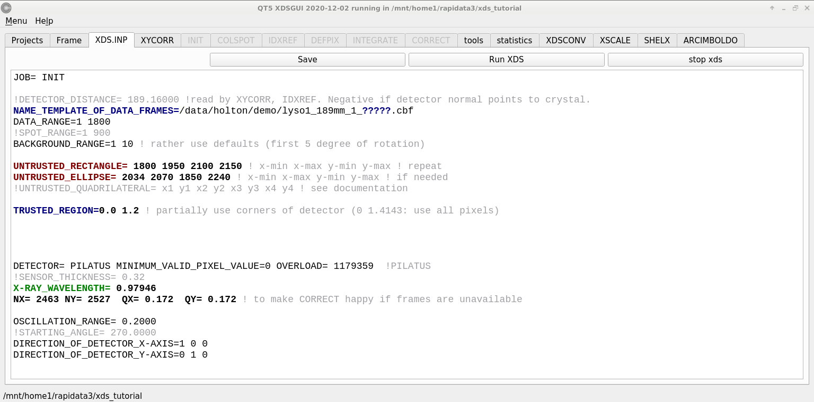
INIT – look at the background

Slide 27
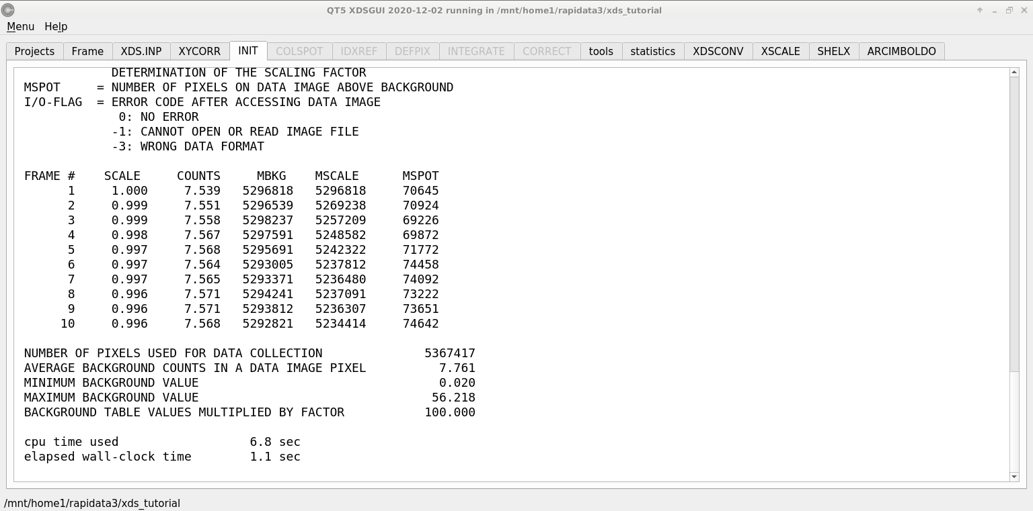
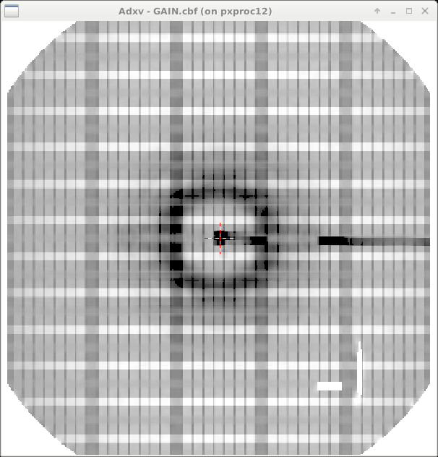
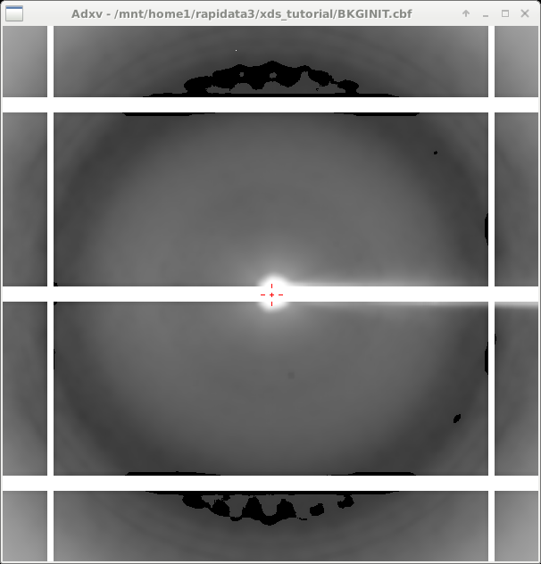
INIT – look at the background

Slide 28
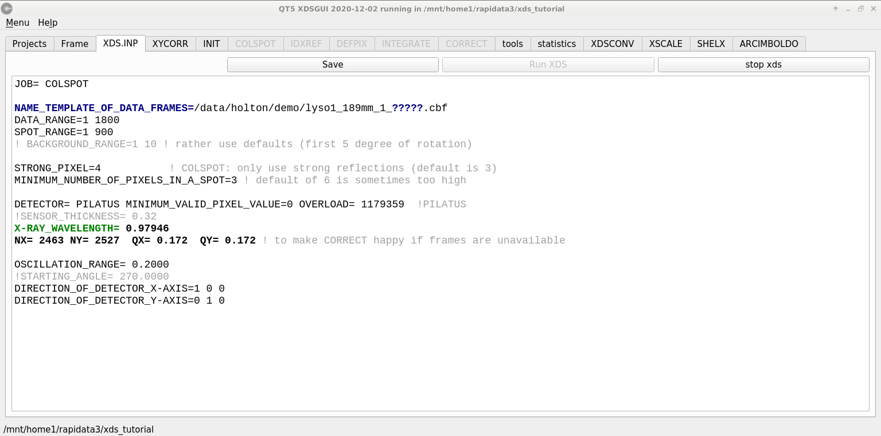
COLSPOT – the spot picker

Slide 29
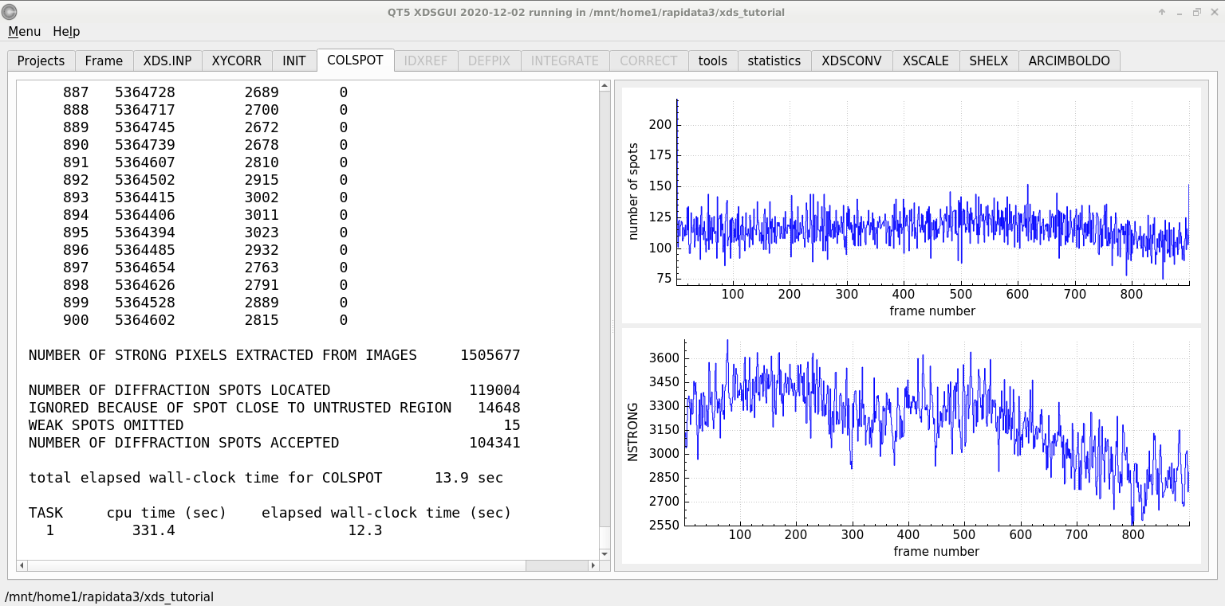
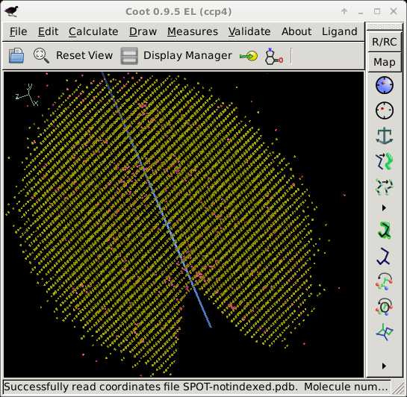
COLSPOT – the spot picker

Slide 30
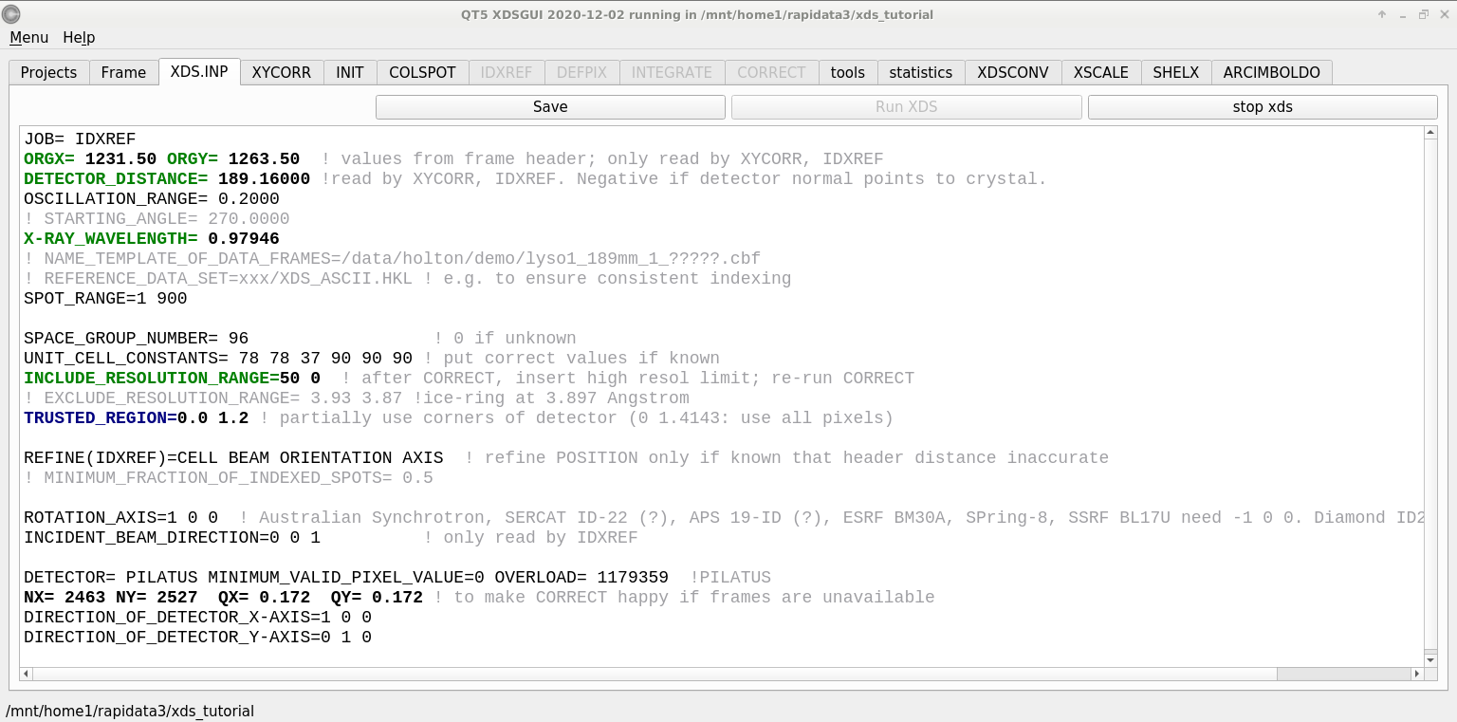
IDXREF – auto-indexing

Slide 31
XPARM.XDS
First image number
Starting phi
Delta-phi
spindle vector
XPARM.XDS VERSION Feb 5, 2021 BUILT=20210323
1 270.0000 0.2000 0.999971 0.007404 -0.001831
0.979460 0.000711 0.000291 1.020970
96 78.8215 78.8215 37.1784 90.000 90.000 90.000
36.338257 9.327419 -69.320709
26.357738 70.532730 23.307367
30.559622 -16.002089 13.866352
1 2463 2527 0.172000 0.172000
1231.500000 1263.500000 189.160004
1.000000 0.000000 0.000000
0.000000 1.000000 0.000000
0.000000 0.000000 1.000000
1 1 2463 1 2527
0.00 0.00 0.00 1.00000 0.00000 0.00000 0.00000 1.00000 0.00000
beam vector
wavelen
space
group
number
unit cell
a
b
c
cell vectors
real space
det panels
pixels
pixel size
origin
distance
x
y
z
Detector fast/slow
Panel #

Slide 32
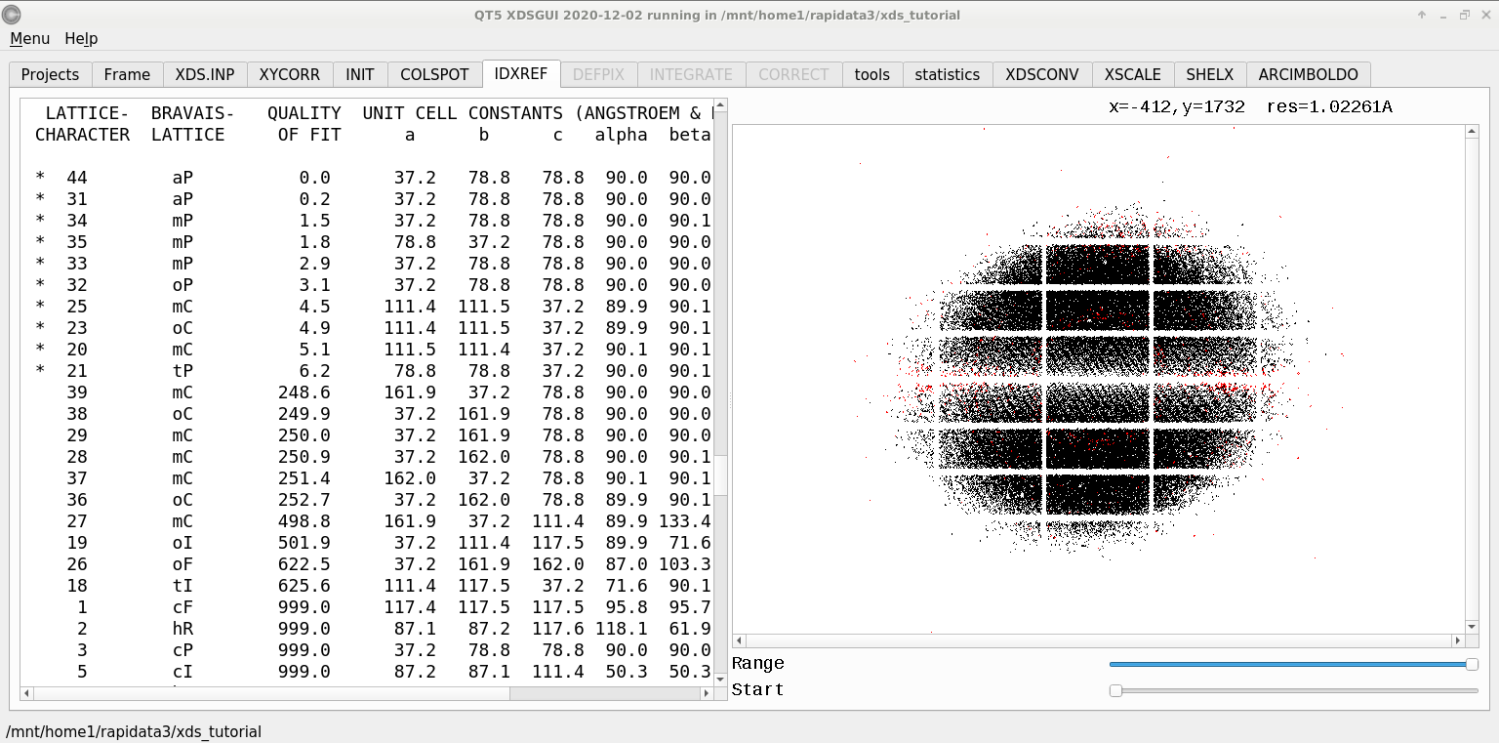
IDXREF – auto-indexing
BRAVAIS- POSSIBLE SPACE-GROUPS FOR PROTEIN CRYSTALS
TYPE [SPACE GROUP NUMBER,SYMBOL]
aP [1,P1]
mP [3,P2] [4,P2(1)]
mC,mI [5,C2]
oP [16,P222] [17,P222(1)] [18,P2(1)2(1)2] [19,P2(1)2(1)2(1)]
oC [21,C222] [20,C222(1)]
oF [22,F222]
oI [23,I222] [24,I2(1)2(1)2(1)]
tP [75,P4] [76,P4(1)] [77,P4(2)] [78,P4(3)] [89,P422] [90,P42(1)2]
[91,P4(1)22] [92,P4(1)2(1)2] [93,P4(2)22] [94,P4(2)2(1)2]
[95,P4(3)22] [96,P4(3)2(1)2]
tI [79,I4] [80,I4(1)] [97,I422] [98,I4(1)22]
hP [143,P3] [144,P3(1)] [145,P3(2)] [149,P312] [150,P321] [151,P3(1)12]
[152,P3(1)21] [153,P3(2)12] [154,P3(2)21] [168,P6] [169,P6(1)]
[170,P6(5)] [171,P6(2)] [172,P6(4)] [173,P6(3)] [177,P622]
[178,P6(1)22] [179,P6(5)22] [180,P6(2)22] [181,P6(4)22] [182,P6(3)22]
hR [146,R3] [155,R32]
cP [195,P23] [198,P2(1)3] [207,P432] [208,P4(2)32] [212,P4(3)32]
[213,P4(1)32]
cF [196,F23] [209,F432] [210,F4(1)32]
cI [197,I23] [199,I2(1)3] [211,I432] [214,I4(1)32]

Slide 33
Trick Question: What is the space group?
a = 63 b = 63 c = 63
α = 90 β = 90 γ = 90

Slide 34
What you know when:
Autoindexing: Lattice (14)
Scaling: Point Group (43)
Phasing: Space Group (84)

Slide 35
Pitfalls: sub-space groups
P622
What else?
P6₁22 P6₅22 P6₂22 P6₄22 P6₃22
P6 P6₁ P6₅ P6₂ P6₄ P6₃
P3₁2 P321 P3₁12 P3₁21 P3₂12 P3₂21
P3 P3₁ P3₂
P2 P2₁ C2 C222 C222₁
P1
zanuda

Slide 36
Asymmetric Unit (ASU)
Unit Cell
Smallest part of the crystal
that you can use to build up the rest of the crystal
with translation symmetry only
Smallest part of the crystal
that you can use to build up the rest of the crystal
with symmetry operations
“NCS ASU”
Builds ASU with Non-crystallographic symmetry operations

Slide 37
Frequency of Space Groups in PDB
13007 | P2₁2₁2₁ | 566 | R32 | 191 | P6₃22 | 74 | P4₃22 | 36 | P3₂12
9629 | P2₁ | 491 | P6₅22 | 187 | P2₁3 | 71 | P4₁22 | 30 | P622
5300 | C2 | 474 | P6₁ | 161 | P6 | 70 | P6₄ | 24 | F4₁32
3021 | P2₁2₁2 | 421 | P6₅ | 144 | P42₁2 | 70 | P6₂22 | 22 | P4₃32
2543 | C222₁ | 353 | P4₁ | 142 | I23 | 67 | P6₄22 | 22 | P422
2109 | P1 | 351 | P6₃ | 132 | F432 | 66 | F222 | 22 | P23
2030 | P4₃2₁2 | 286 | P3₁ | 124 | P321 | 63 | P6₂ | 19 | P3₁12
1565 | P3₂21 | 257 | I422 | 115 | I4₁ | 59 | P4₁32 | 18 | P4₂22
1359 | P4₁2₁2 | 253 | P4₂2₁2 | 103 | P3 | 46 | P222₁ | 18 | I4₁32
1198 | P3₁21 | 249 | I4 | 99 | I2₁3 | 43 | P4 | 16 | P432
1147 | I222 | 246 | P4₃ | 94 | C222 | 43 | I432 | 8 | P4₂32
825 | R3 | 239 | I4₁22 | 93 | P2 | 40 | P4₂ | 3 | P222
620 | P6₁22 | 193 | P3₂ | 82 | I2₁2₁2₁ | 37 | F23 | 2 | P312

Slide 38
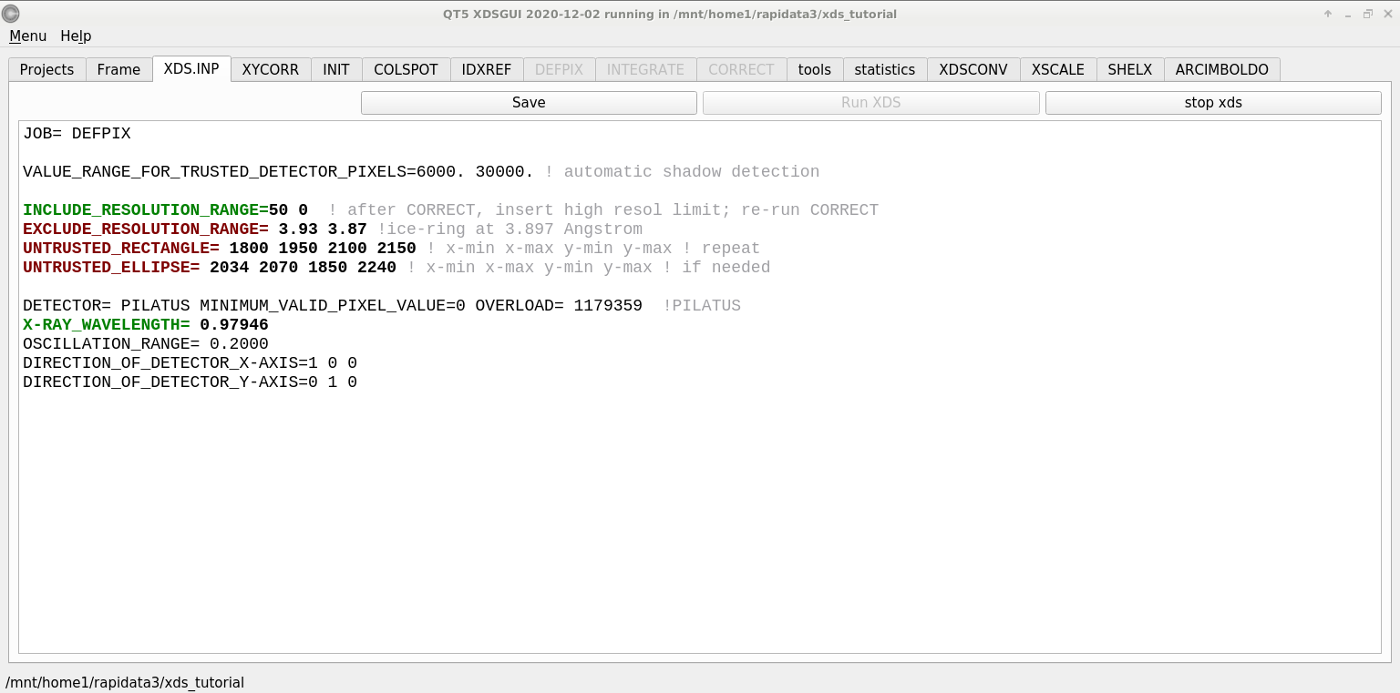
DEFPIX – pixels good and bad

Slide 39
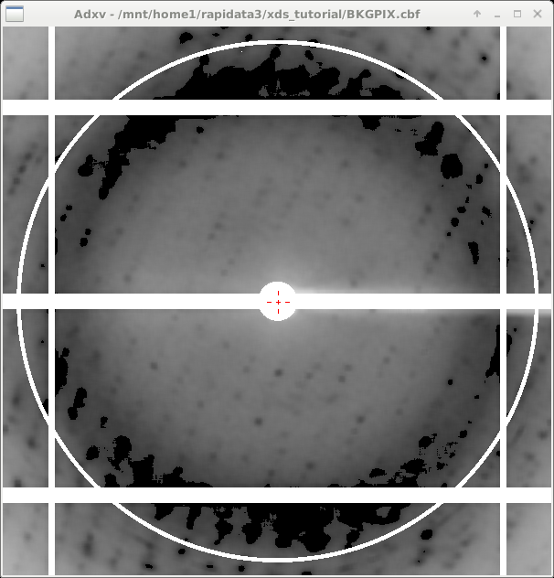
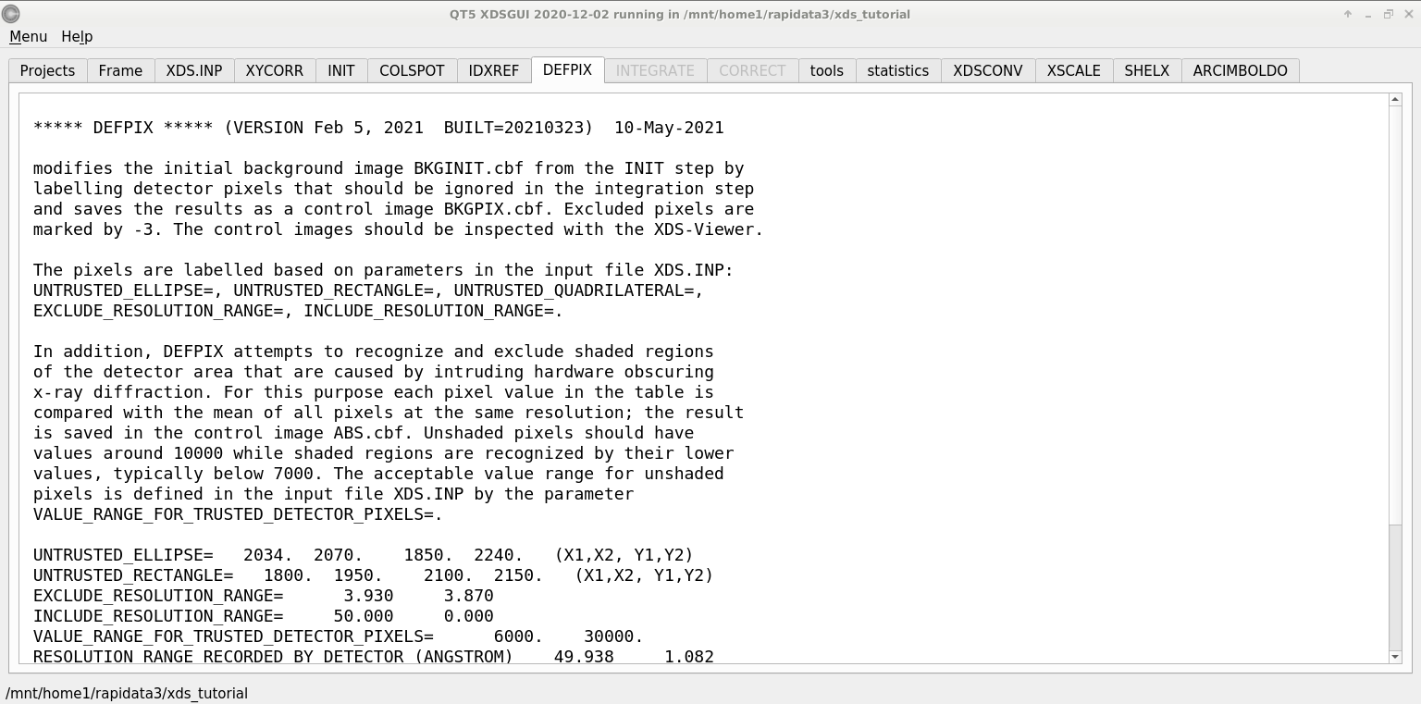
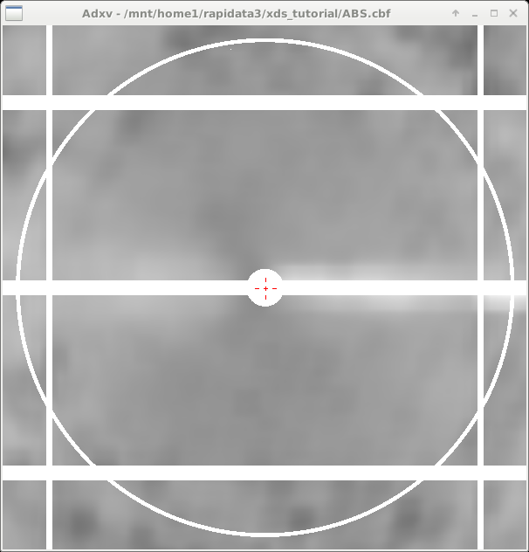
DEFPIX – pixels good and bad

Slide 40
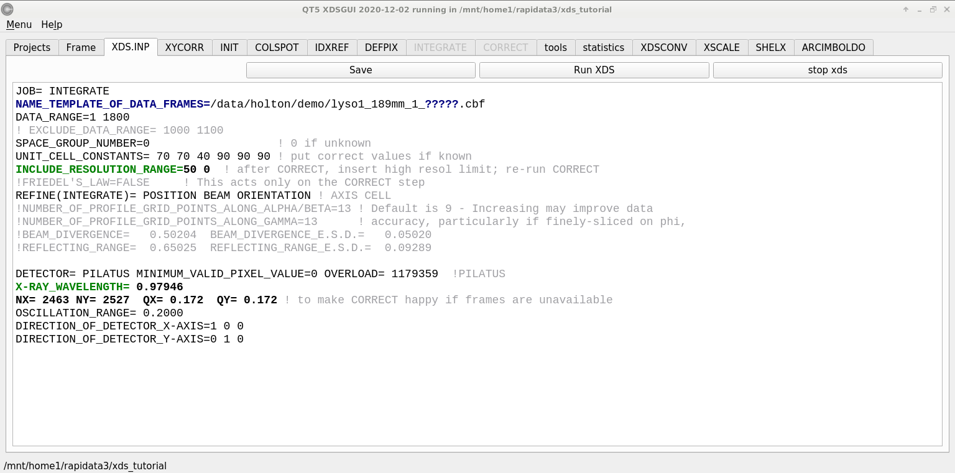
INTEGRATE – measure the spots!

Slide 41
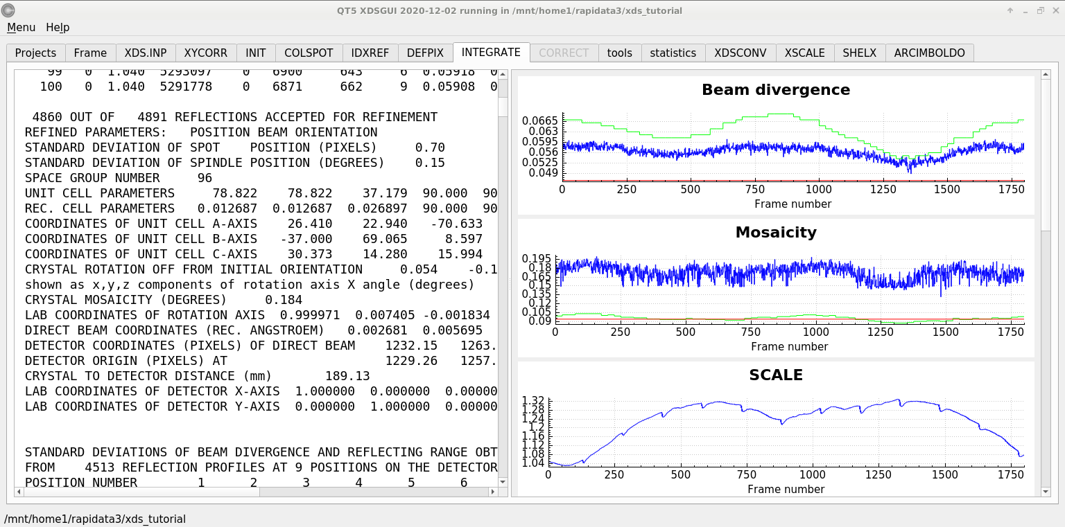
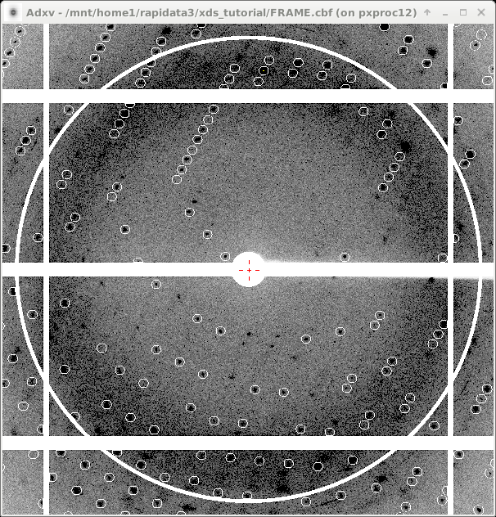
INTEGRATE – measure the spots!

Slide 42
Ewald’s “mosaic” picture

Slide 43
Ewald’s “mosaic” picture

Slide 44
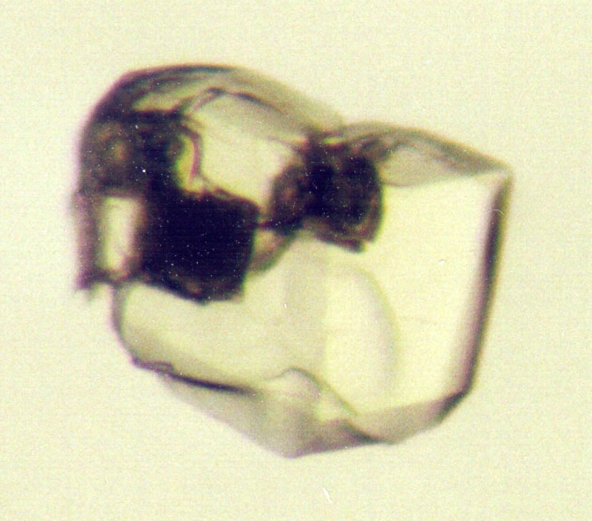
Ewald’s “mosaic” picture
What is
this stuff?

Slide 45
Darwin’s original picture

Slide 46
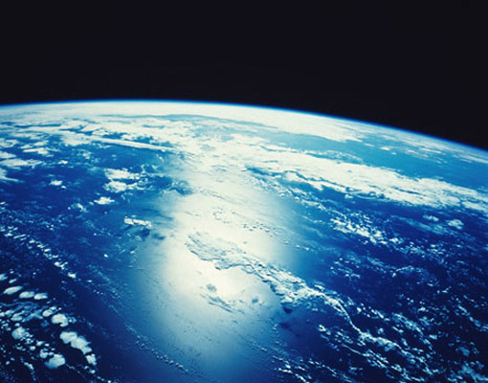
“mosaicity” with visible light

Slide 47
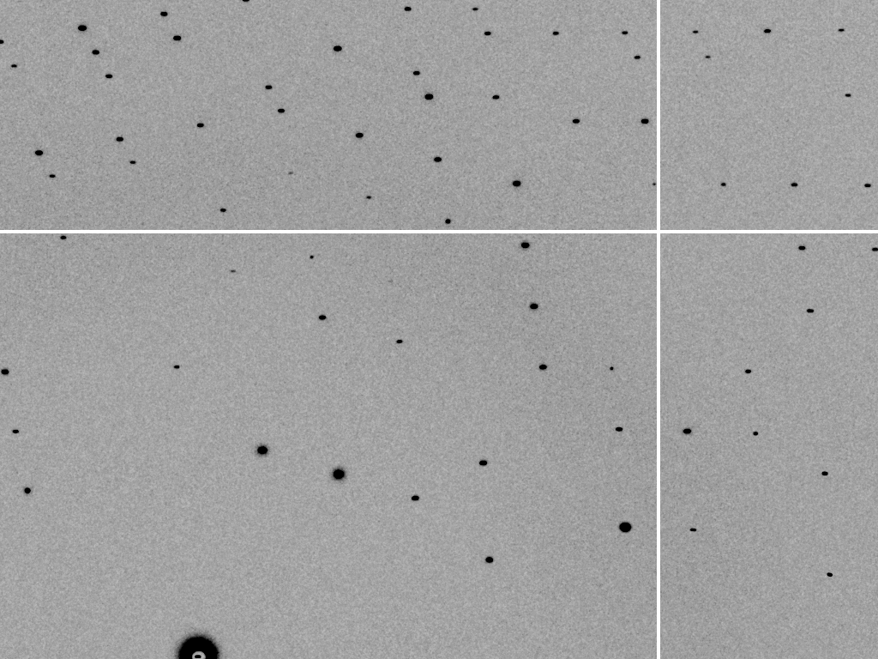
mosaic spread = 0 º

Slide 48
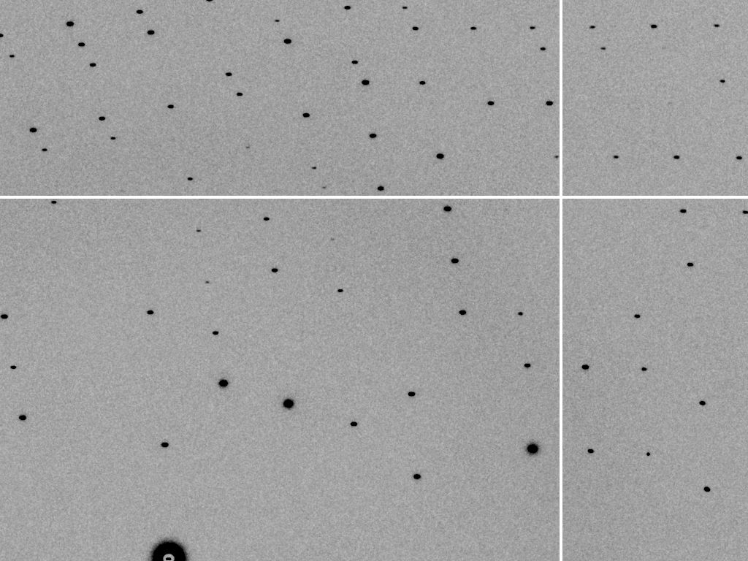
mosaic spread = 0.1º

Slide 49
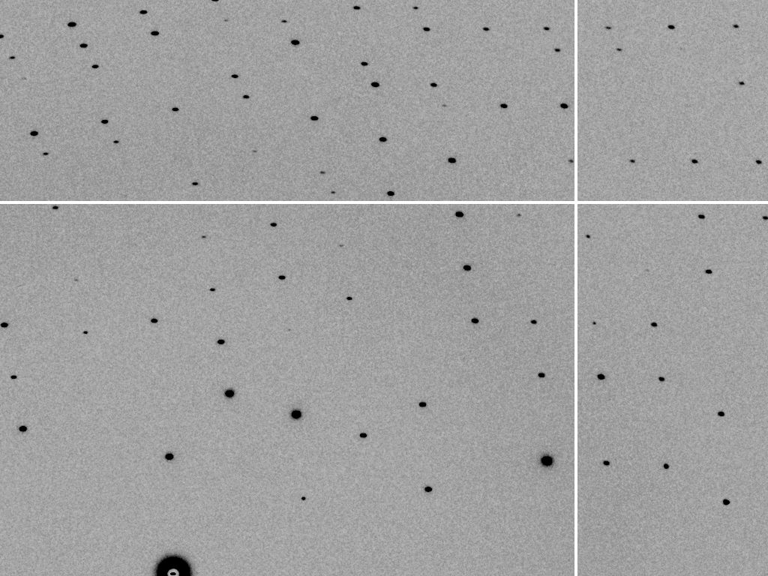
mosaic spread = 0.2º

Slide 50
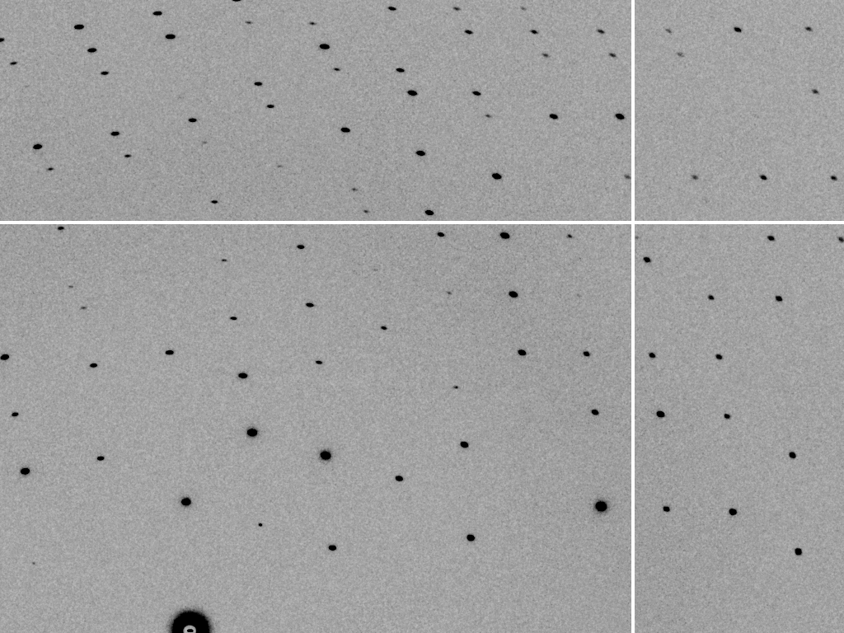
mosaic spread = 0.4º

Slide 51
mosaic spread = 0.6º

Slide 52
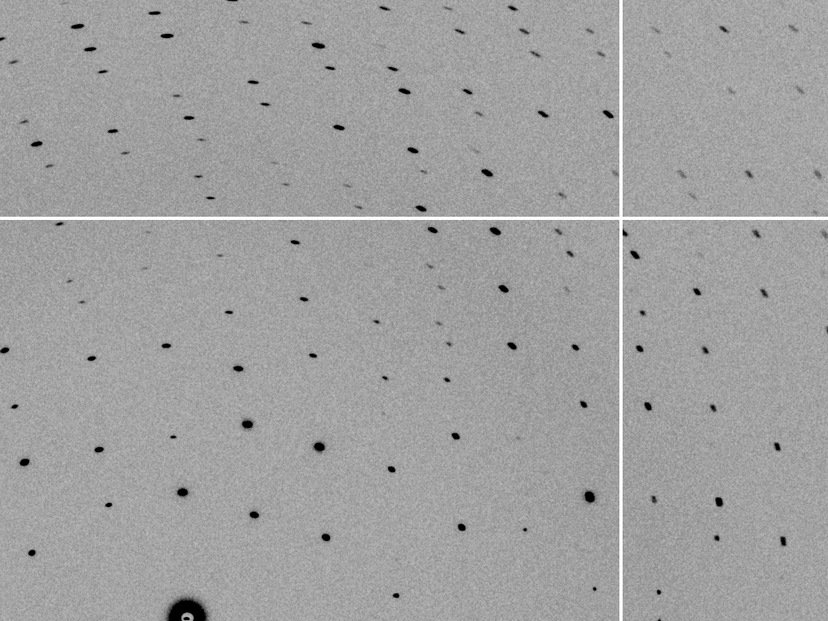
mosaic spread = 0.8º

Slide 53
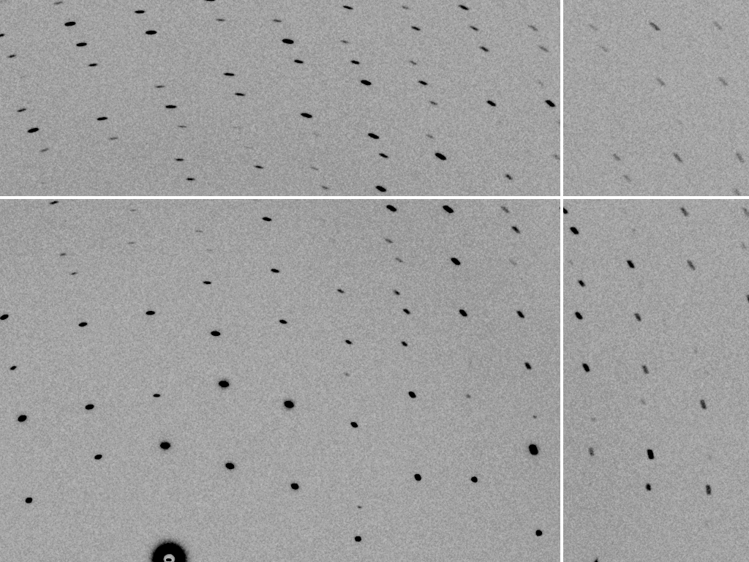
mosaic spread = 1.0º

Slide 54
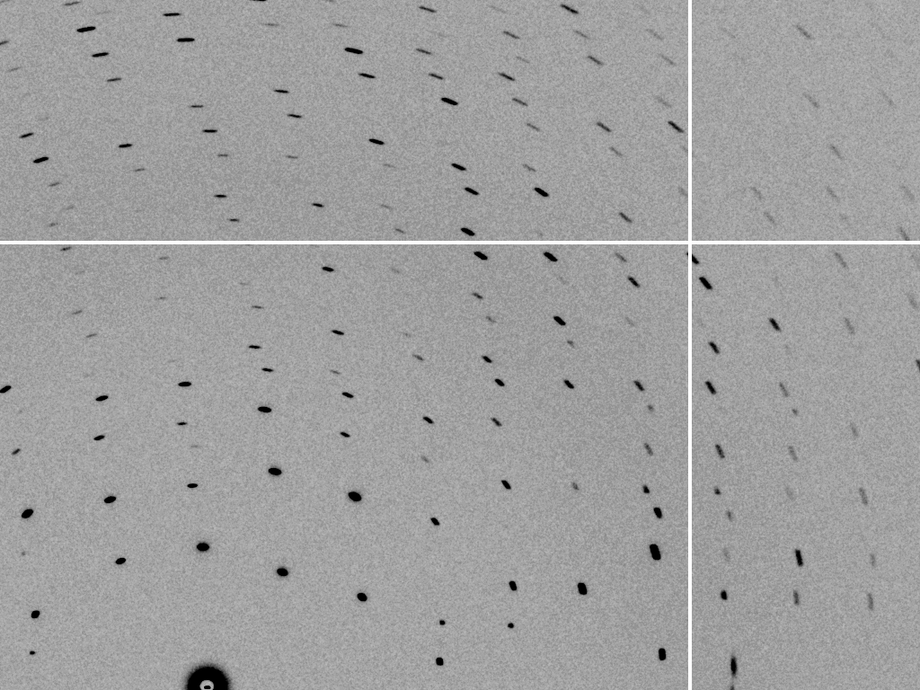
mosaic spread = 1.5º

Slide 55
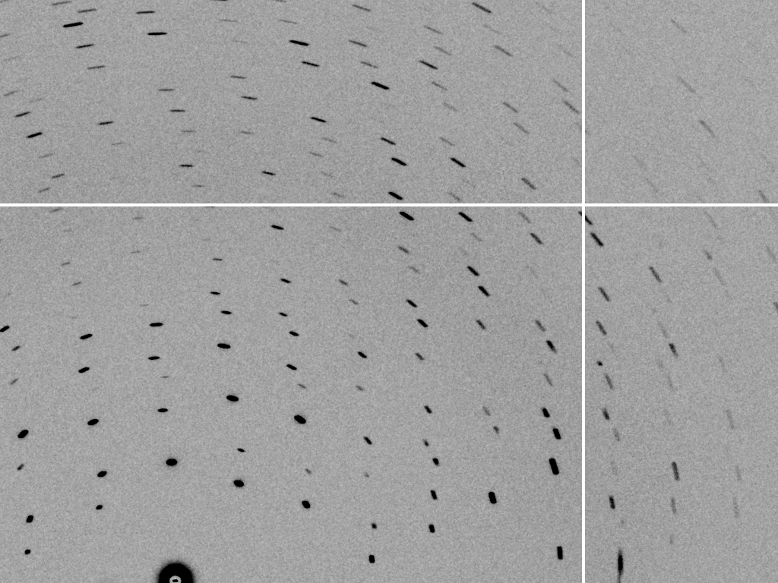
mosaic spread = 2.0º

Slide 56
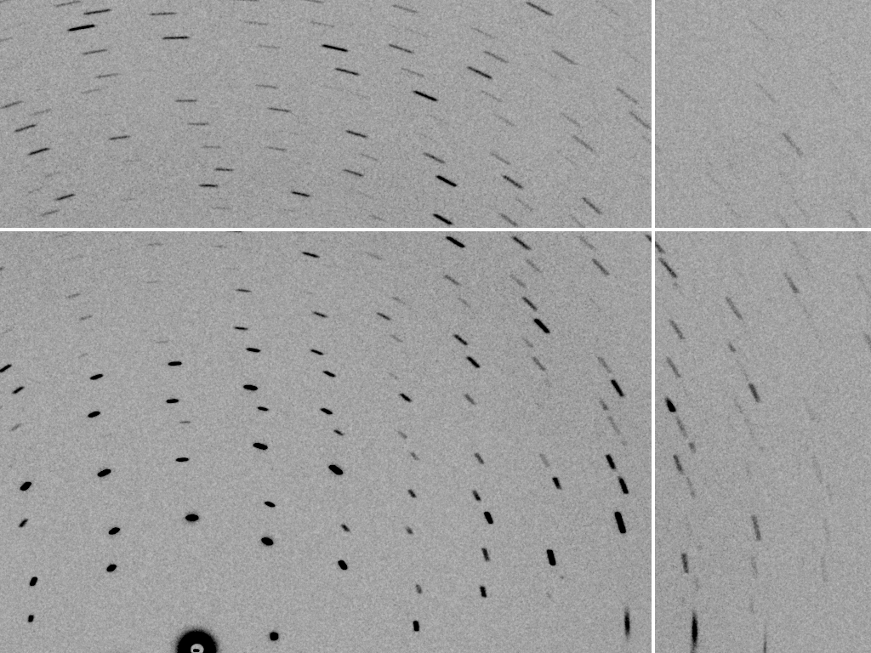
mosaic spread = 2.5º

Slide 57
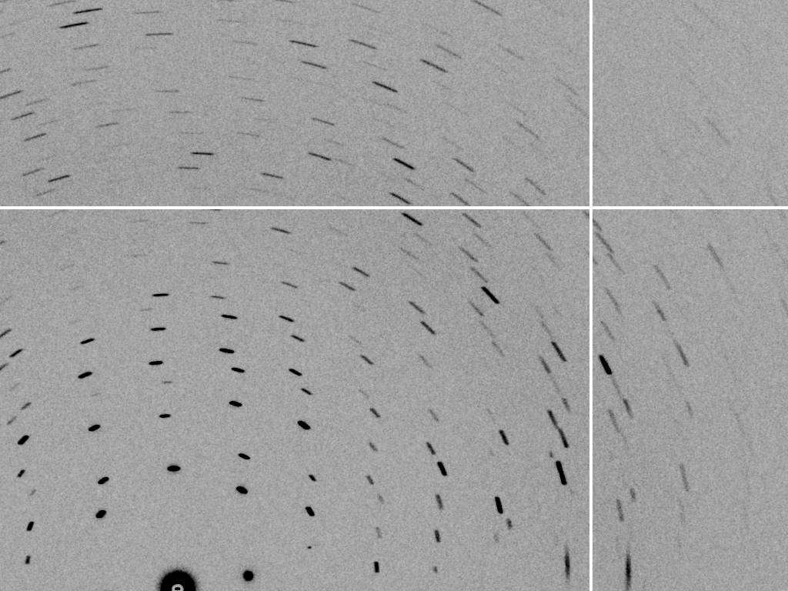
mosaic spread = 3.2º

Slide 58
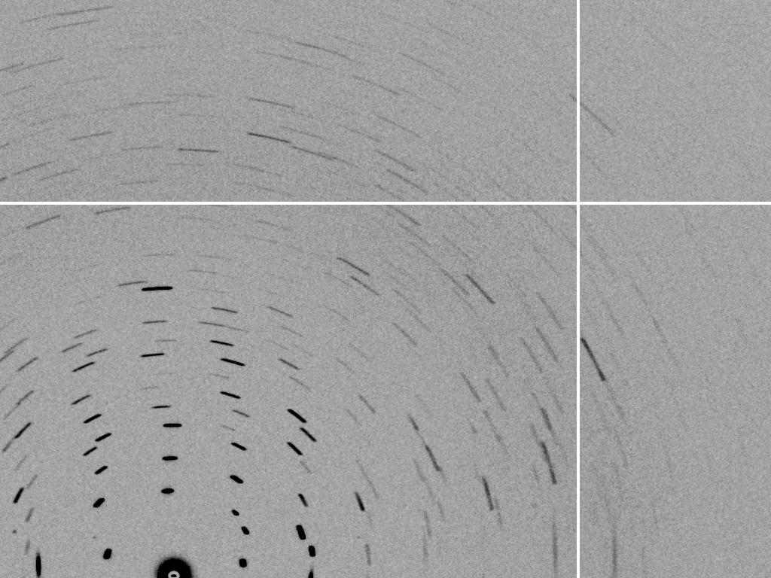
mosaic spread = 6.4º

Slide 59
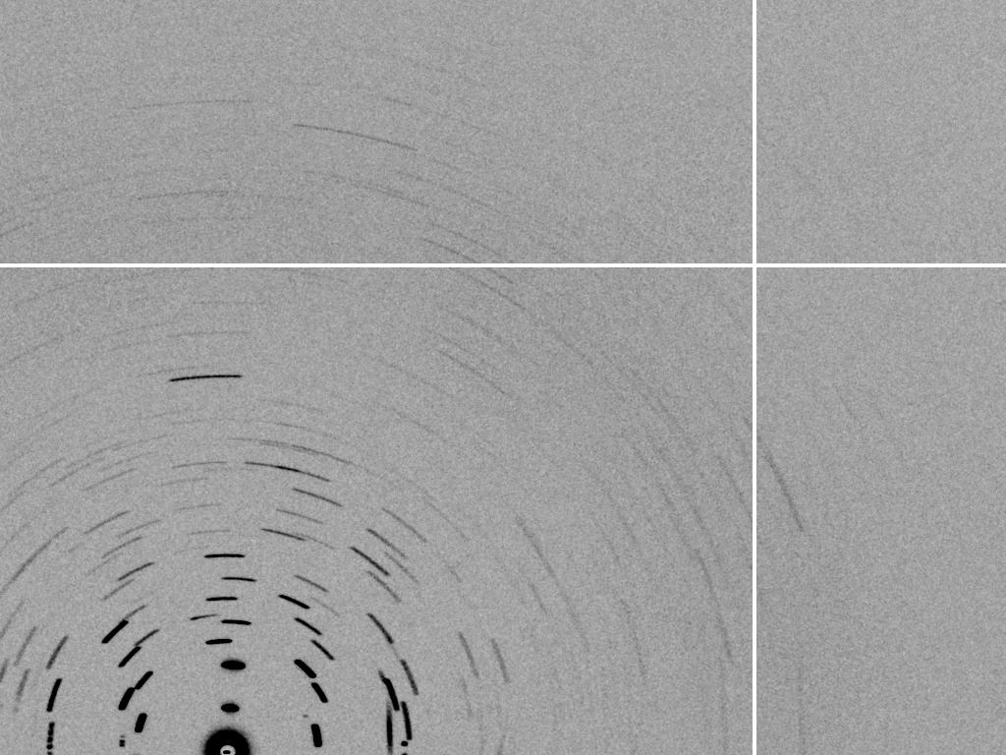
mosaic spread = 12.8º

Slide 60
Spot Shape
Ewald sphere
(h,k,l)

Slide 61
Spot Shape
Ewald sphere
(h,k,l)
d*

Slide 62
Spot Shape
Ewald sphere
(h,k,l)
spindle axis
d*

Slide 63
Spot Shape
Ewald sphere
Φ circle
(h,k,l)
spindle axis

Slide 64
Spot Shape
Ewald sphere
Φ circle
(h,k,l)
spindle axis

Slide 65
Spot Shape
Ewald sphere
Φ circle
(h,k,l)
diffracted ray
spindle axis

Slide 66
Spot Shape
Ewald sphere
Φ circle
(h,k,l)
λ*
d*
spindle axis
diffracted ray
λ*

Slide 67
Spot Shape
Ewald sphere
Φ circle
(h,k,l)
λ*
d*
spindle axis
diffracted ray
θ
λ*
λ = 2 d sin(θ)

Slide 68
mosaic spread
Ewald sphere
Φ circle
(h,k,l)
λ*
d*
diffracted ray
d*
spindle axis
λ*

Slide 69
mosaic spread
Ewald sphere
Φ circle
(h,k,l)
d*
diffracted rays
d*
spindle axis

Slide 70
INTEGRATE – measure the spots!

Slide 71
beam divergence
Ewald sphere
Φ circle
(h,k,l)
λ*
d*
spindle axis
diffracted ray
λ*

Slide 72
beam divergence
Ewald sphere
Φ circle
(h,k,l)
d*
λ*
diffracted ray
spindle axis
λ*

Slide 73
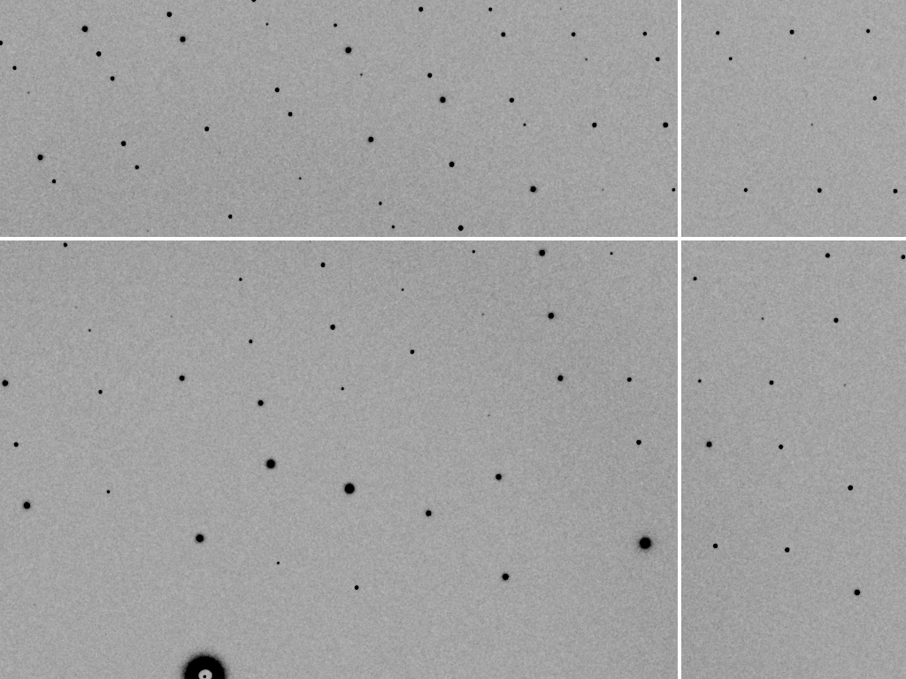
divergence = 0 º

Slide 74
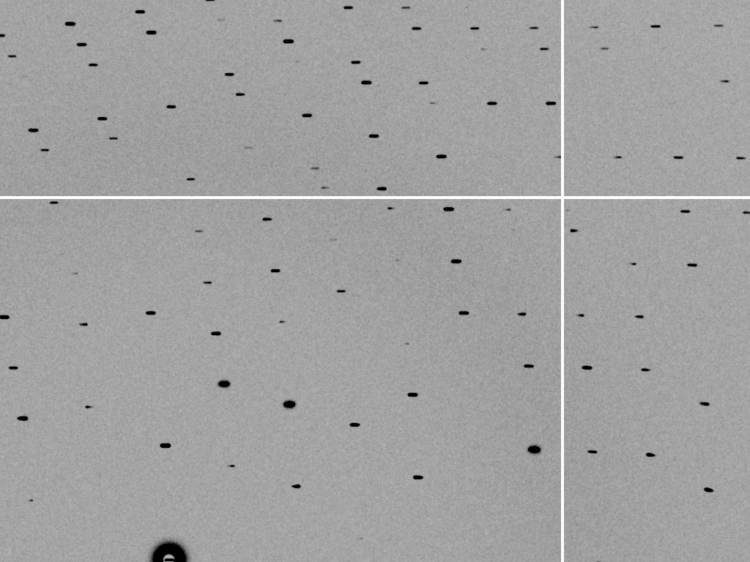
divergence = 0.3 º

Slide 75
spectral dispersion
Ewald sphere
Φ circle
(h,k,l)
λ*
d*
spindle axis
diffracted ray
λ*

Slide 76
spectral dispersion
Ewald sphere
Φ circle
(h,k,l)
λ’*
d*
spindle axis
diffracted ray
λ’*

Slide 77
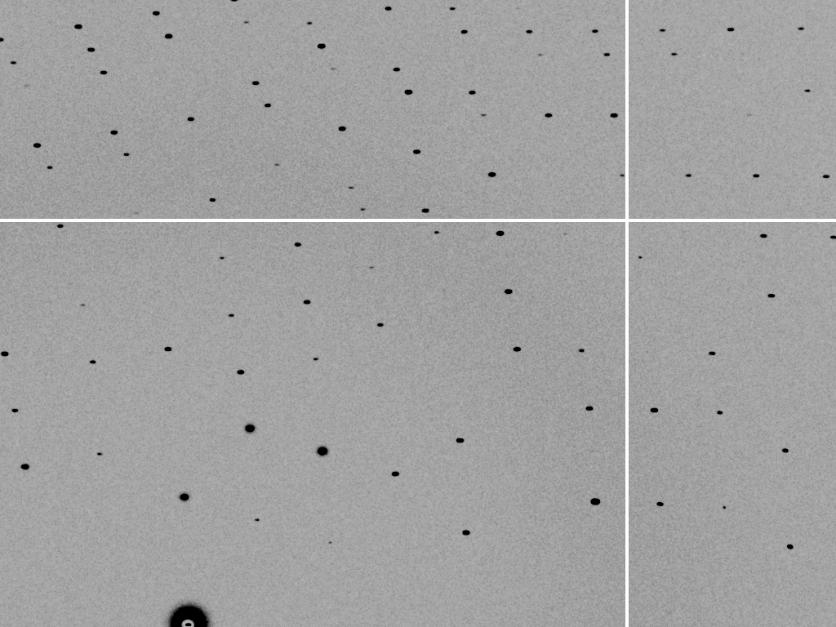
dispersion = 0

Slide 78
dispersion = 0.014% (Si 111)

Slide 79
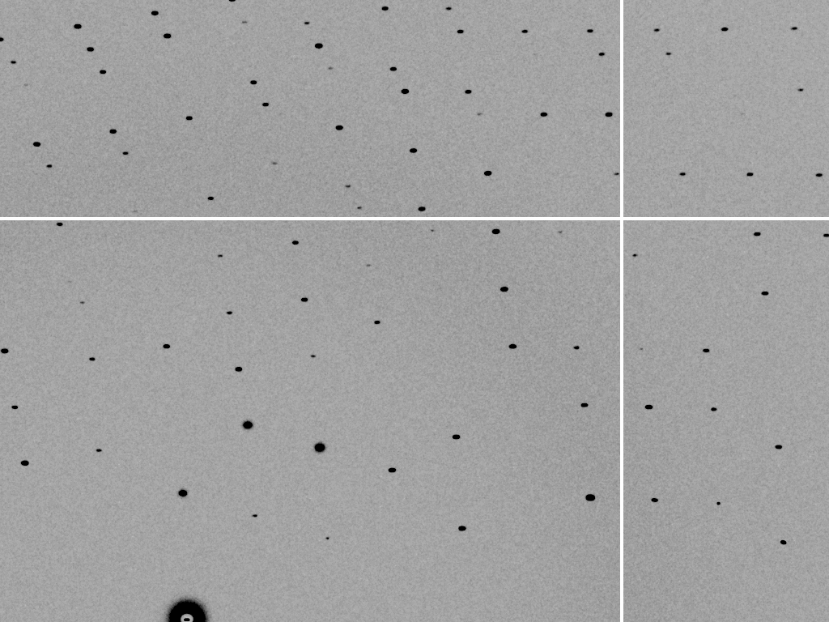
dispersion = 0.25% (CuK_{α})

Slide 80
dispersion = 0.6%

Slide 81
dispersion = 1.3%

Slide 82
dispersion = 2.6%

Slide 83
dispersion = 5.1%

Slide 84
spot shape
Ewald sphere
Ewald sphere
Ewald sphere
Ewald sphere
Φ circle
Φ circle
Φ circle
Φ circle
(h,k,l)
(h,k,l)
(h,k,l)
(h,k,l)
λ’*
λ*
d*
d*
d*
λ*
d*
spindle axis
spindle axis
spindle axis
diffracted rays
d*
spindle axis
diffracted ray
diffracted ray
diffracted ray
λ’*
λ*
λ*

Slide 85
CORRECT – scale all the “factors”

Slide 86
Polarization factor
1.0
0.45
+

Slide 87
Lorentz factor
1.2x
3x
550x
10x
+
50x

Slide 88
The “Lorentz zone”

Slide 89
A few other corrections…
Meisburger, et. al. Nat Commun 11, 1271 (2020). https://doi.org/10.1038

Slide 90
attenuation factor
μ_{solvent}
t_{so}
t_{xo}
t_{si}
t_{xi}
μ_{xtal}
t_{so}
t_{xo}
t_{si}
t_{xi}
t_{so}
t_{xo}
I_{T}
I_{beam}
t_{si}
t_{xi}
A = = exp[-μ_{xtal}(t_{xi}+ t_{xo})
-μ_{solvent}(t_{si} + t_{so})]
Bouguer, P. (1729). Essai d'optique sur la gradation de la lumière.
Lambert, J. H. (1760). Photometria: sive De mensura et gradibus luminis, colorum et umbrae. E. Klett.
Beer, A. (1852)."Bestimmung der Absorption des rothen Lichts in farbigen Flüssigkeiten", Ann. Phys. Chem 86, 78-90.

Slide 91
B factor from image gazing
B = 500

Slide 92
B factor from image gazing
B = 20

Slide 93
CORRECT – after all the “factors”

Slide 94
xdscc12 – any outlier images?

Slide 95
xdsstat – radiation damage “limit”

Slide 96
xdsconv – make an “mtz” file

Slide 97
xscale – merge multiple runs

Slide 98
CORRECT – scale all the “factors”

Slide 99
Re-indexing cheat sheet
Dauter, Z. (1999). "Data-collection strategies." Acta Cryst. D 55(10): 1703-1717.

Slide 100
Zero-dose extrapolation (ZDE)
Diederichs, K. (2006). "Some aspects of quantitative analysis and correction of radiation damage." Acta Cryst. D 62(1): 96-101.
OUTPUT_FILE= multi-merge.hkl
INPUT_FILE= ../xds_1/XDS_ASCII.HKL
CRYSTAL_NAME= ip
INPUT_FILE= ../xds_2/XDS_ASCII.HKL
! same crystal, but translated
CRYSTAL_NAME= ip

Slide 101
xscale – final stats

Slide 102
XDS: CORRECT.LP or XSCALE.LP
SUBSET OF INTENSITY DATA WITH SIGNAL/NOISE >= -3.0 AS FUNCTION OF RESOLUTION
RESOLUTION NUMBER OF REFLECTIONS COMPLETENESS R-FACTOR R-FACTOR COMPARED I/SIGMA R-meas CC(1/2) Anomal SigAno Nano
LIMIT OBSERVED UNIQUE POSSIBLE OF DATA observed expected Corr
6.39 4103 2517 3135 80.3% 1.7% 1.8% 3018 33.77 2.3% 99.9* 21* 1.012 533
4.54 7339 4970 5544 89.6% 2.6% 2.6% 4585 22.56 3.6% 99.8* 9 0.914 796
3.72 9442 6724 7186 93.6% 2.8% 2.9% 5327 19.99 4.0% 99.7* 9 0.859 877
3.22 11077 7997 8486 94.2% 4.8% 4.9% 6094 12.27 6.8% 99.3* -1 0.784 913
2.88 12408 8851 9595 92.2% 10.0% 10.1% 7068 6.01 14.2% 97.8* -2 0.799 1012
2.63 13673 9561 10662 89.7% 20.8% 20.8% 8185 3.10 29.4% 88.8* -4 0.776 1274
2.44 14360 9852 11510 85.6% 34.5% 34.7% 8981 1.90 48.8% 75.9* 2 0.765 1525
2.28 9501 6495 12416 52.3% 61.8% 59.6% 5991 1.14 87.3% 53.5* -2 0.722 1031
2.15 4567 3307 13210 25.0% 120.5% 120.3% 2520 0.59 170.4% 21.9* 4 0.693 408
total 86470 60274 81744 73.7% 6.7% 6.7% 51769 8.97 9.5% 99.5* 2 0.804 8369

Slide 103
XDS: CORRECT.LP or XSCALE.LP
******************************************************************************
CORRECTION PARAMETERS FOR THE STANDARD ERROR OF REFLECTION INTENSITIES
******************************************************************************
The variance v0(I) of the intensity I obtained from counting statistics is
replaced by v(I)=a*(v0(I)+b*I^2). The model parameters a, b are chosen to
minimize the discrepancies between v(I) and the variance estimated from
sample statistics of symmetry related reflections. This model implicates
an asymptotic limit ISa=1/SQRT(a*b) for the highest I/Sigma(I) that the
experimental setup can produce (Diederichs (2010) Acta Cryst D66, 733-740).
a b ISa
3.806E+00 1.080E-04 49.32

Slide 104
CCP4: aimless log
$TABLE: Analysis against resolution, XDSdataset:
$GRAPHS:I/sigma, Mean Mn(I)/sd(Mn(I)):0|0.216023x0|137.14:2,13,14:
:Rmerge, Rfull, Rmeas, Rpim v Resolution:0|0.216023x0|1.70834:2,4,5,6,7:
:Average I, RMSdeviation and Sd:0|0.216023x0|1650.8:2,10,11,12:
:Fractional bias:0|0.216023x0|0:2,15:
$$
N 1/d^2 Dmid Rmrg Rfull Rcum Rmeas Rpim Nmeas AvI RMSdev sd I/RMS Mn(I/sd) FrcBias $$ $$
1 0.0064 12.55 0.020 0.020 0.020 0.021 0.006 13115 1651 57 42 29.2 137.1 -
2 0.0191 7.24 0.027 0.027 0.024 0.028 0.008 24753 1171 47 42 25.0 105.2 -
3 0.0318 5.61 0.038 0.038 0.029 0.040 0.012 32197 857 46 43 18.4 79.6 -
4 0.0445 4.74 0.034 0.034 0.031 0.035 0.010 37743 1212 57 53 21.4 91.2 -
5 0.0572 4.18 0.036 0.036 0.032 0.038 0.011 42642 1181 59 57 19.9 83.8 -
6 0.0699 3.78 0.049 0.049 0.036 0.052 0.015 47224 883 59 57 15.1 65.1 -
7 0.0826 3.48 0.065 0.065 0.040 0.068 0.020 51052 685 59 58 11.7 50.9 -
8 0.0953 3.24 0.096 0.096 0.045 0.100 0.029 54636 448 56 56 8.0 35.0 -
9 0.1080 3.04 0.151 0.151 0.050 0.158 0.046 58072 268 53 53 5.1 22.7 -
10 0.1207 2.88 0.229 0.229 0.056 0.240 0.070 60731 171 51 51 3.3 15.4 -
11 0.1334 2.74 0.314 0.314 0.063 0.329 0.097 63807 125 51 51 2.4 11.3 -
12 0.1461 2.62 0.406 0.406 0.070 0.425 0.125 66241 98 51 52 1.9 8.7 -
13 0.1588 2.51 0.537 0.537 0.078 0.562 0.166 68272 76 53 53 1.4 6.5 -
14 0.1715 2.41 0.685 0.685 0.084 0.727 0.237 54170 61 53 54 1.1 4.4 -
15 0.1843 2.33 0.886 0.886 0.088 0.950 0.333 39781 48 55 56 0.9 3.1 -
16 0.1970 2.25 1.249 1.249 0.092 1.355 0.508 29754 35 57 59 0.6 2.1 -

Slide 105
CCP4: aimless log
$TABLE: Correlations CC(1/2) within dataset, XDSdataset:
$GRAPHS: Anom & Imean CCs v resolution:0|0.216023x0|1:2,4,7:
: RMS correlation ratio :0|0.216023x0|2.20344:2,6:
$$
N 1/d^2 Dmid CCanom Nanom RCRanom CC1/2 NImean $$ $$
1 0.0064 12.55 0.659 499 2.203 1.000 669
2 0.0191 7.24 0.550 975 1.853 1.000 1155
3 0.0318 5.61 0.527 1295 1.798 1.000 1479
16 0.1970 2.25 0.037 2123 1.038 0.711 2275
17 0.2097 2.18 0.043 1682 1.044 0.460 1877

Slide 106
CC = 0.999

Slide 107
CC = 0.0

Slide 108
CC = 0.9

Slide 109
CC = 0.8

Slide 110
CC = 0.7

Slide 111
CC = 0.6

Slide 112
CC = 0.5

Slide 113
CC = 0.4

Slide 114
CC = 0.3

Slide 115
CC = 0.2

Slide 116
CC = 0.1

Slide 117
CC = 0.1

Slide 118
CC = 0.0

Slide 119
Summary
XYCORR
INIT
COLSPOT
IDXREF
DEFPIX
INTEGRATE
CORRECT

Slide 120
Supply & Demand:

Slide 121
Nov 2020- Dec 2021
20-Nov
20-Dec
21-Jan
21-Feb
21-Mar
21-Apr
21-May
21-Jun
21-Jul
21-Aug
21-Sep
21-Oct
21-Nov
21-Dec

Slide 122
Nov 2022- Dec 2023
assuming here that basis schedules from 2021 will repeat
22-Nov
22-Dec
23-Jan
23-Feb
23-Mar
23-Apr
23-May
23-Jun
23-Jul
23-Aug
23-Sep
23-Oct
23-Nov
23-Dec

Slide 123
Nov 2023- Dec 2024
assuming here that basis schedules from 2021 will repeat
23-Nov
23-Dec
24-Jan
24-Feb
24-Mar
24-Apr
24-May
24-Jun
24-Jul
24-Aug
24-Sep
24-Oct
24-Nov
24-Dec

Slide 124
100% SeMet incorporation
Trivial to solve

Slide 125
100% S -Met incorporation
Impossible to solve

Slide 126
Systematic error does not “average out”
Unless you can randomize their source

Slide 127
Pilatus: subtract smooth baseline
~3x10⁵ photon/pixel → 0.3% error
Bragg
glitch
“tree rings”
Pick-up tool mark
Gollwitzer & Krumrey (2014)
J. Appl. Cryst. 47, 378
oxygen
inclusions
1% high
average
1% low

Slide 128
Fractional error
^{mult >} (—)²
~3%
<ΔF/F>

Slide 129
anomalous signal
ΔF
F
√
# sites
MW (Da)
≈ 1.2 f”
World record!
ΔF/F = 0.5%
Wang, Dauter & Dauter (2006) Acta Cryst. D 62, 1475-1483.
Crick, F. H. C. & Magdoff, B. S. (1956) Acta Crystallogr. 9, 901-908.
Hendrickson, W. A. & Teeter, M. M. (1981) Nature 290, 107-113.

Slide 130
Holton & Frankel (2010) Acta D 66 393-408.

Slide 131
what the is a MGy?
1 MGy = 10⁶ J/kg
http://bl831.als.lbl.gov/
damage_rates.pdf
Holton J. M. (2009) J. Synchrotron Rad. 16 133-42

Slide 132
How long will my crystal last?
synch line type flux beamsize flux density dose max xtal min site
ph/s μm ph/μm2/s rate lifetime lifetime
ALS 4.2.2 MAD 2.2e11 75x80 3.7e+07 27.3 kGy/s 18 m 73 s
ALS 5.0.1 mono 1.6e11 100 2.0e+07 10.4 kGy/s 48 m 3.2 m
ALS 5.0.2 MAD 8e11 100 1.0e+08 51.8 kGy/s 9.6 m 39 s
ALS 5.0.3 mono 1.7e11 100 2.2e+07 11 kGy/s 45 m 3 m
ALS 8.2.1 MAD 1.8e11 100 2.3e+07 11.7 kGy/s 43 m 2.9 m
ALS 8.2.2 MAD 2.3e11 100 2.9e+07 14.9 kGy/s 34 m 2.2 m
ALS 8.3.1 MAD 9e11 70 2.3e+08 119 kGy/s 4.2 m 17 s
ALS 8.3.1 typical 6e11 70 1.6e+08 115 kGy/s 4.3 m 17 s
ALS 12.3.1 MAD 1.8e11 100 2.3e+07 11.7 kGy/s 43 m 2.9 m
ALS 12.3.1 ML 4.0e12 100 5.1e+08 513 kGy/s 58 s 3.9 s
APS 8-BM MAD 1e11 200 2.5e+06 1.27 kGy/s 6.6 h 26 m
APS 14-BM-C mono 5.8e10 200 1.4e+06 738 Gy/s 11 h 45 m
APS 14-BM-D MAD 3.3e9 200 8.2e+04 42 Gy/s 8.3 d 13 h
APS 14-ID-B MAD 6.0e10 200 1.5e+06 763 Gy/s 11 h 44 m
APS 17-BM MAD 1.1e11 200 2.8e+06 1.4 kGy/s 6 h 24 m
APS 17-ID MAD 2.3e11 200 5.8e+06 2.93 kGy/s 2.8 h 11 m
APS 19-BM MAD 2.0e11 70x60 4.8e+07 24.2 kGy/s 21 m 83 s
APS 19-ID MAD 1.3e13 80x40 4.1e+09 2.07 MGy/s 15 s 0.97 s
APS 19-ID typical 5.5e11 100x100 5.5e+07 28 kGy/s 18 m 71 s
APS 22-BM MAD 7e12 80x40 2.2e+09 1.23 MGy/s 24 s 1.6 s
APS 22-ID MAD 7e12 80x40 2.2e+09 1.23 MGy/s 24 s 1.6 s
APS 22-ID typical 1.5e12 80 2.3e+08 119 kGy/s 4.2 m 17 s
APS 23-ID-B MAD 1e13 75x25 5.3e+09 3.01 MGy/s 10 s 0.66 s
APS 23-ID typical 1.5e12 80 2.3e+08 119 kGy/s 4.2 m 17 s
APS 24-ID-C MAD 1.3e13 20x60 1.1e+10 5.23 MGy/s 5.7 s 0.38 s
APS 24-ID-E MAD 0.5e13 20x100 2.5e+09 1.19 MGy/s 25 s 1.7 s
APS 31-ID MAD 2e12 70 4.1e+08 194 kGy/s 2.6 m 10 s

Slide 134
Holton & Frankel (2010) Acta D 66 393-408.

Slide 135
MGy reaction reference
~45 global damage Owen et al. (2006)
10/Å global damage Howells et al. (2009)
5 Se-Met Holton (2007)
4 Hg-S Ramagopal et al. (2004)
4 R-C-COOH Garman et al. (2015)
3 S-S Murray et al. (2002)
1 Br-RNA Olieric et al. (2007)
~1? Cl-C ???
0.5 Mn in PS II Yano et al. (2005)
0.06 putidaredoxin Corbett et al. (2007)
0.02 Fe in myoglobin Denisov et al. (2007)
Radiation Damage World Records
Holton (2009) J. Synchrotron Rad. 16 133-42

Slide 136
Life-halving concentration
molar, at the Se edge based on RADDOSE
Na | 44
Mg | 27
P | 9
S | 7
Cl | 5
K | 3.3
Ca | 2.7
Fe | 1.0
Cu | 0.67
Zn | 0.58
As | 0.44
Se | 0.42
Br | 2.9
I | 0.47
Gd | 0.21
Ta | 0.13
Pt | 0.17
Au | 0.16
Hg | 0.16
U | 0.23

Slide 137
Life-halving concentration
molar, at the Se edge based on RADDOSE
Na | 44
Mg | 27
P | 9
S | 7
Cl | 5
K | 3.3
Ca | 2.7
Fe | 1.0
Cu | 0.67
Zn | 0.58
As | 0.44
Se | 0.42
Br | 2.9
I | 0.47
Gd | 0.21
Ta | 0.13
Pt | 0.17
Au | 0.16
Hg | 0.16
U | 0.23

Slide 138
The number of photons scattered
before crystal is dead
is independent
of flux & time
1 um³ = 10⁵ photons (roomT)
1 um³ = 10⁶ photons (synch)
1 um³ = 10⁸ photons (XFEL)
(synch)
Henderson, 1990; Gonzalez & Nave, 1994; Glaeser et al., 2000; Sliz et al., 2003; Leiros et al., 2006; Owen et al., 2006; Garman & McSweeney, 2006; Garman & Nave, 2009; Holton, 2009

