Slide 1
Acknowledgements
Robert Stroud James Fraser Nevan Krogan
Paul Adams John Tainer Greg Hura Nick Sauter
Aina Cohen Art Lyubimov Jeney Wierman
UCSF LBNL SLAC
ALS 8.3.1: TomAlberTron
NIH NIGMS R01 GM124149
NIH NIGMS P50 GM082250
NIH NIGMS P30 GM124169
NIH NIGMS R01 GM117126
DOE-BER Integrated Diffraction Analysis Technologies (IDAT)
Plexxikon, Inc.
NIH NIGMS P41 GM103393
NSF DBI-1625906
The Advanced Light Source is supported by the Director, Office of Science, Office of Basic Energy Sciences, Materials Sciences Division, of the US Department of Energy under contract No. DE-AC02-05CH11231 at Lawrence Berkeley National Laboratory.

Slide 2
ber
structural
bio
portal.org

Slide 3
Powerpoint file available:
https://bl831.als.lbl.gov/~jamesh/powerpoint/RapiData_XDS_2021.pptx
JMHolton@lbl.gov

Slide 4
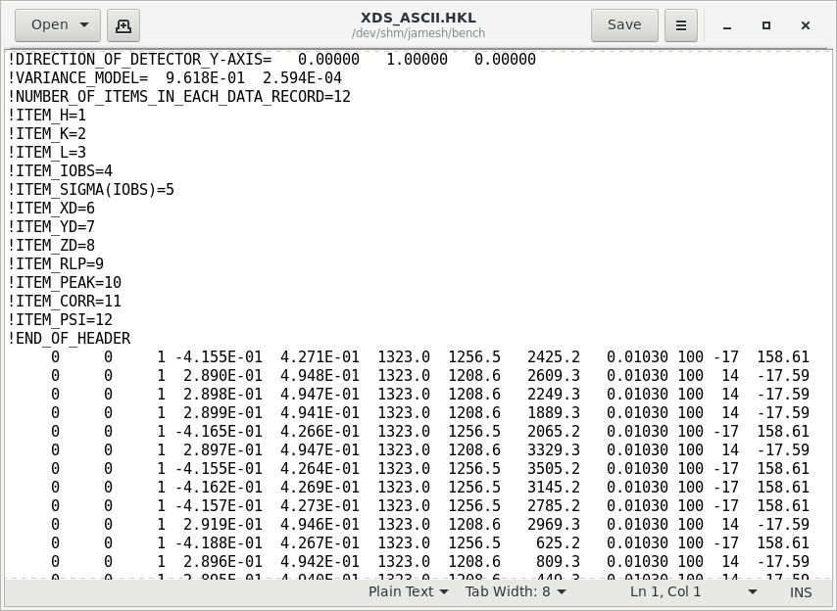
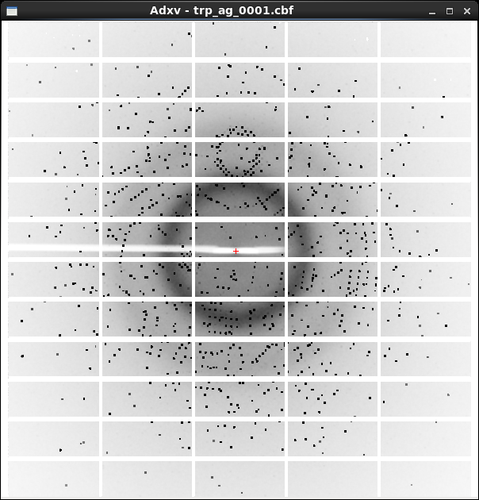
XDS X-ray diffraction data reduction engine
List of spot intensities (text)
Diffraction image data

Slide 5
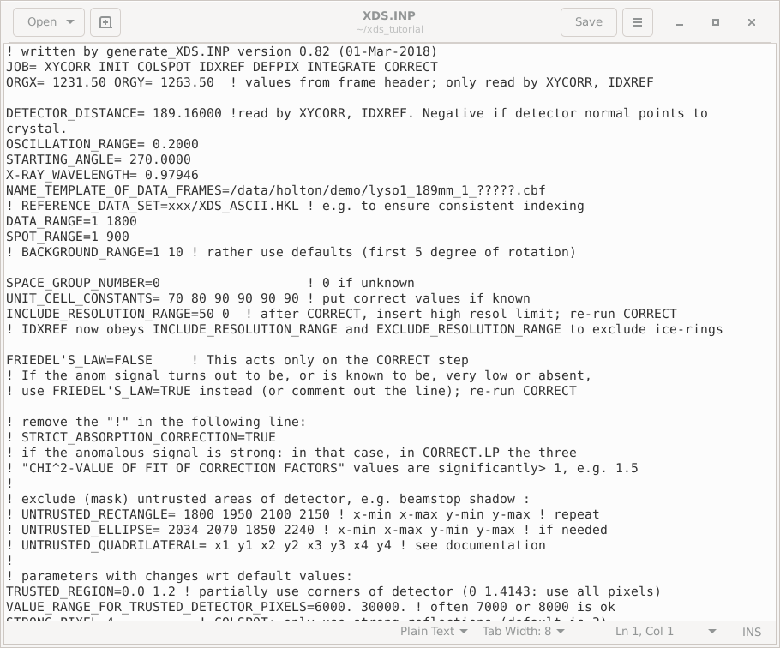
XDS native user interface: a text file!

Slide 6
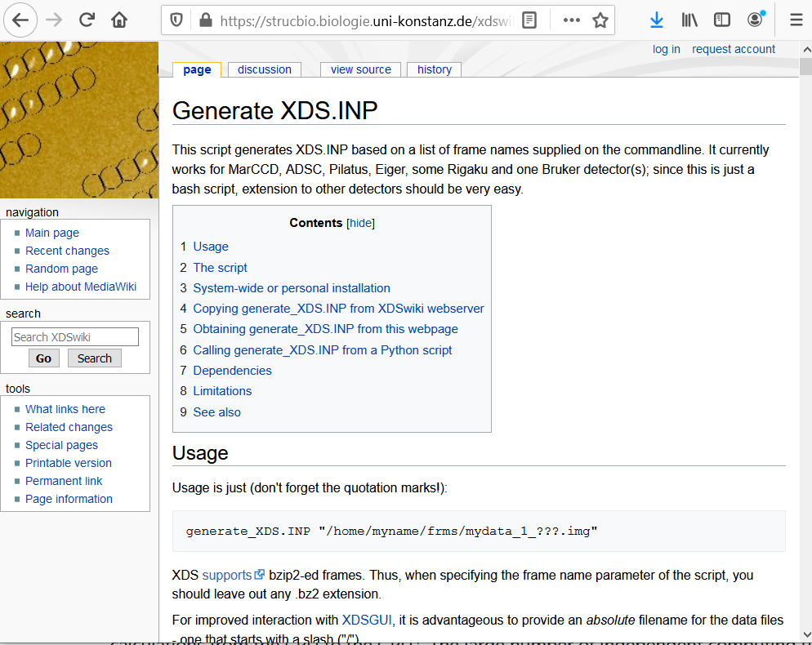

Slide 7
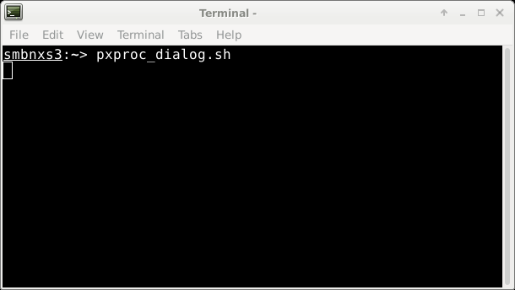
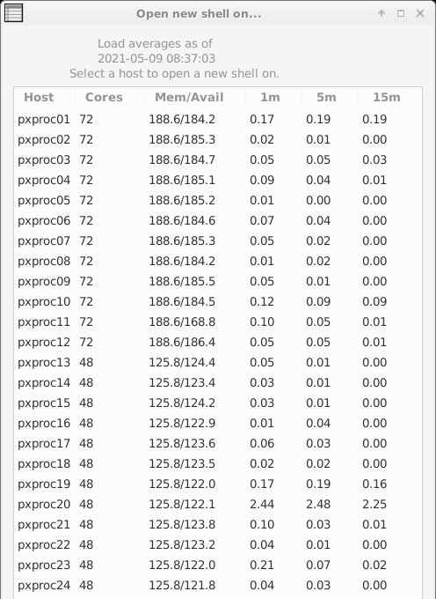
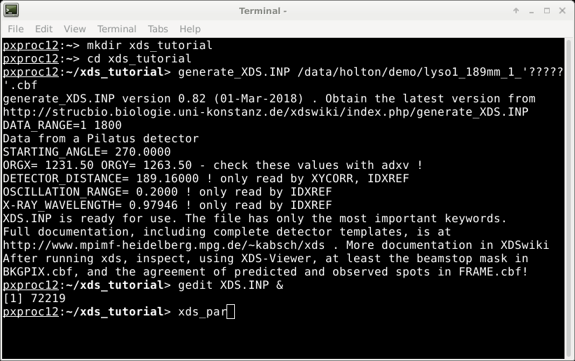
XDS native user interface

Slide 8
Cursor
does not move
with mouse
The “prompt”
Mouse
can be used
To select and paste
But all pasted text
Goes to the cursor

Slide 9
How to start XDS
prompt
Do not type!
underscore
~]$ cd
~]$ mkdir xds_tutorial
~]$ cd xds_tutorial
~]$ ln –sf /data/holton/demo .
~]$ pxproc_dialog.sh
~]$ ssh pxproc12
@pxproc ~]$ cd xds_tutorial
]$ xdsgui
Space!
Enter
Space!

Slide 10
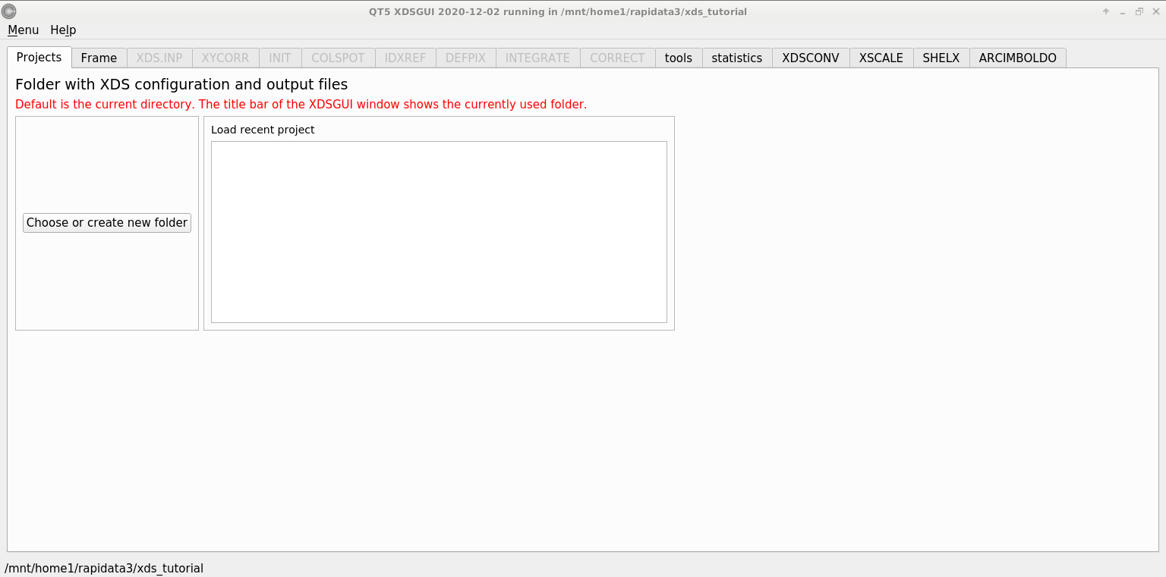
xdsgui – a graphical interface for XDS

Slide 11
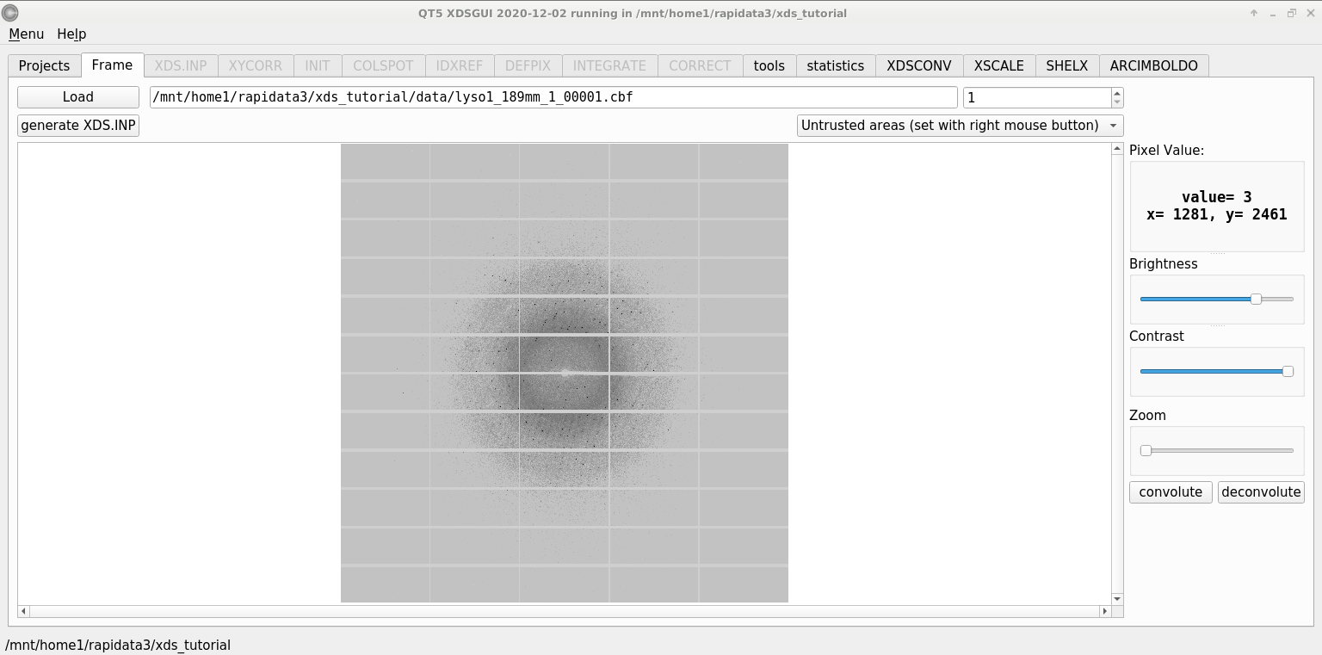
xdsgui – load an image

Slide 12
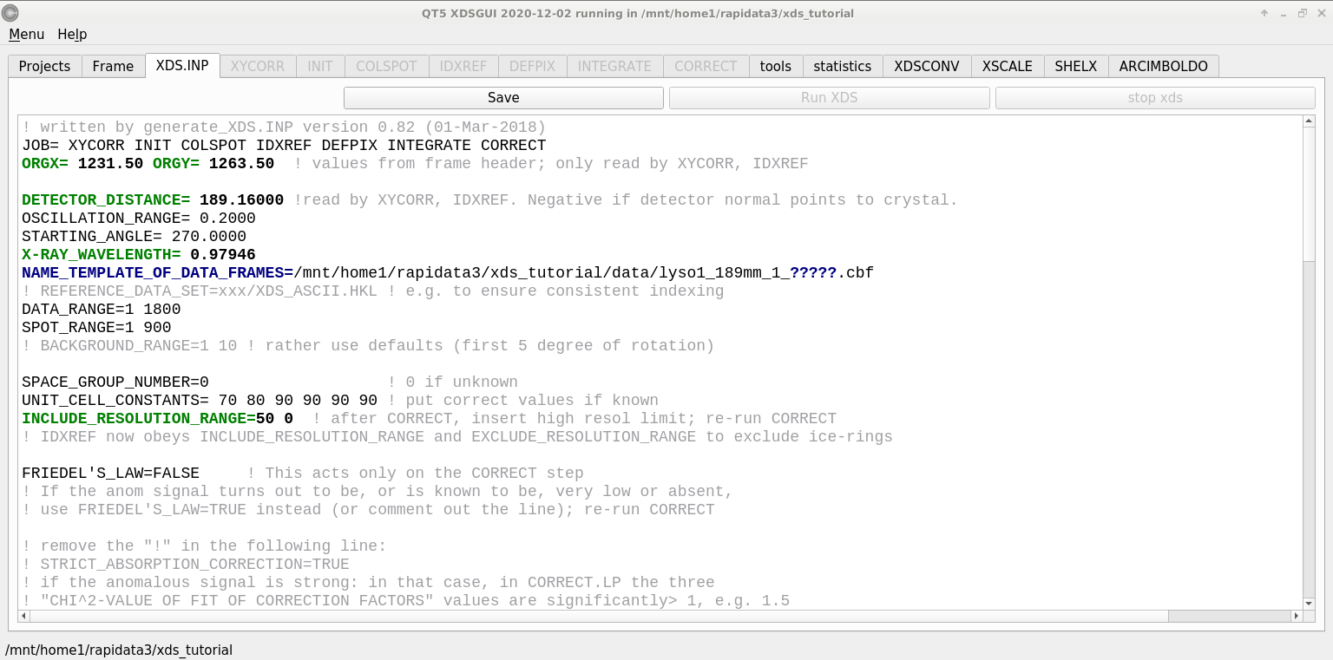
xdsgui – a GUI for text!

Slide 13
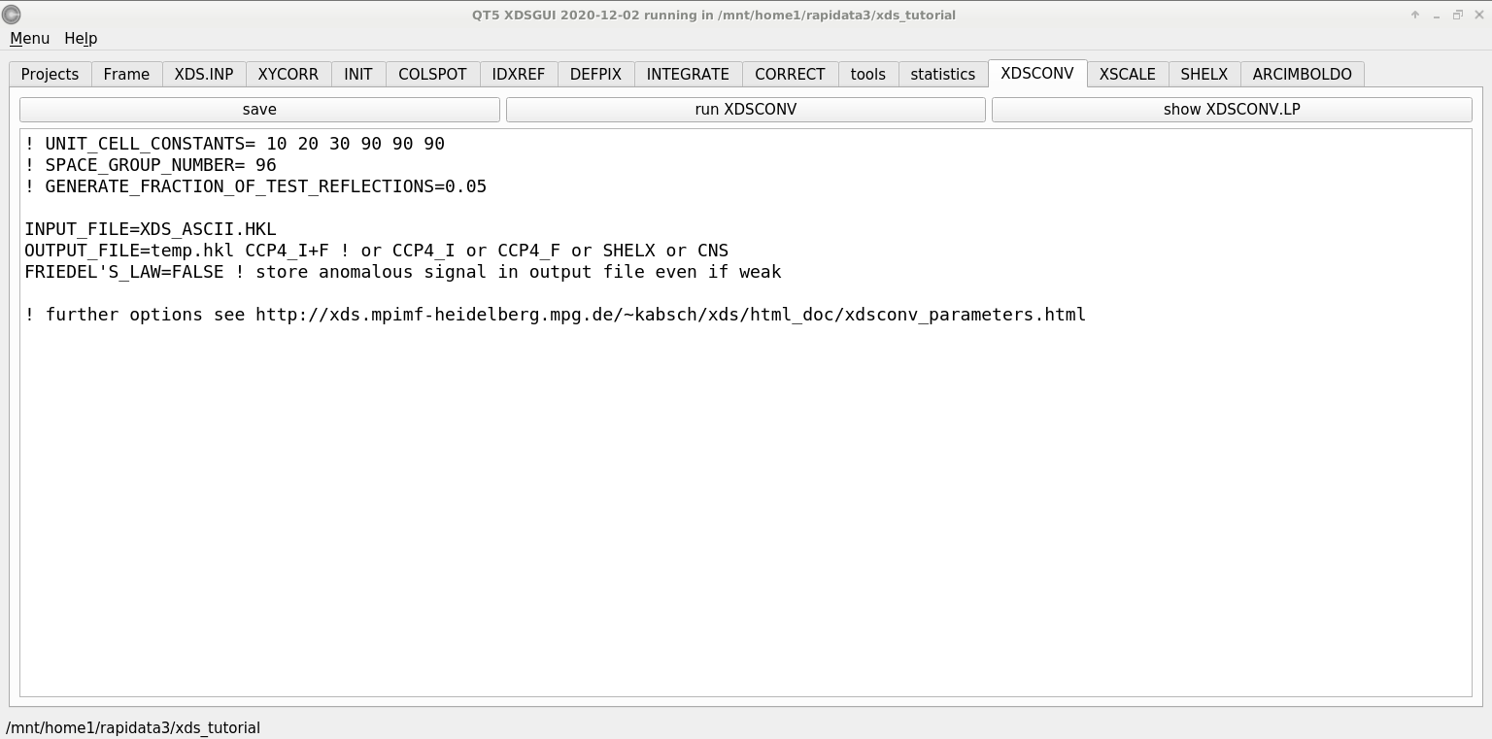
xdsconv – make an “mtz” file
output_file_name.mtz

Slide 14
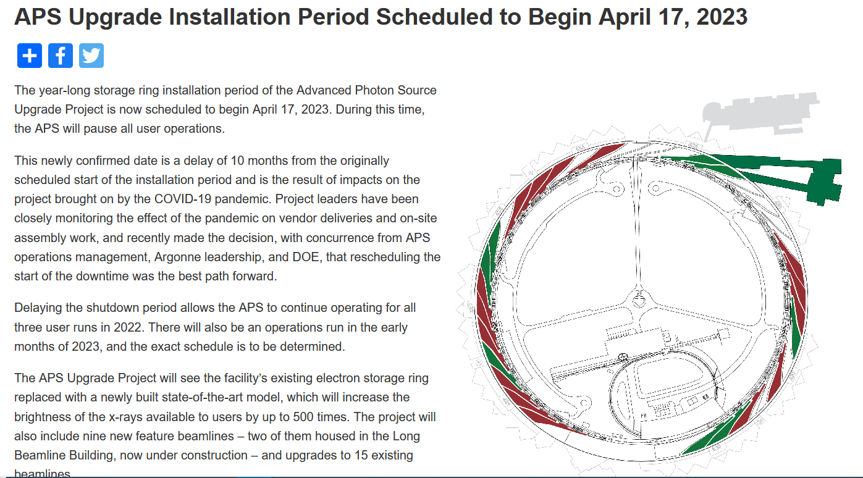
Supply & Demand:

Slide 15
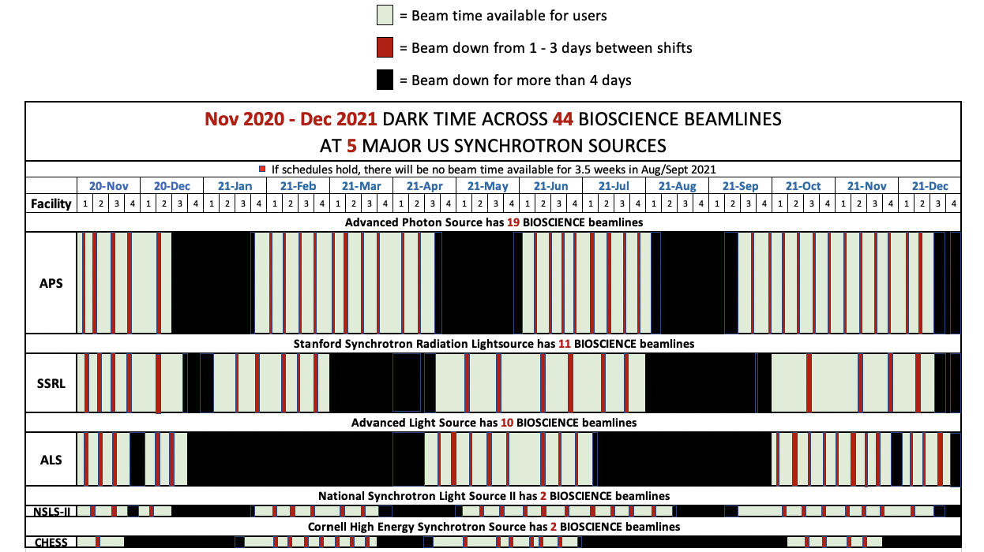
Nov 2020- Dec 2021
20-Nov
20-Dec
21-Jan
21-Feb
21-Mar
21-Apr
21-May
21-Jun
21-Jul
21-Aug
21-Sep
21-Oct
21-Nov
21-Dec

Slide 16
Nov 2022- Dec 2023
assuming here that basis schedules from 2021 will repeat
22-Nov
22-Dec
23-Jan
23-Feb
23-Mar
23-Apr
23-May
23-Jun
23-Jul
23-Aug
23-Sep
23-Oct
23-Nov
23-Dec

Slide 17
Nov 2023- Dec 2024
assuming here that basis schedules from 2021 will repeat
23-Nov
23-Dec
24-Jan
24-Feb
24-Mar
24-Apr
24-May
24-Jun
24-Jul
24-Aug
24-Sep
24-Oct
24-Nov
24-Dec

Slide 18
xdsgui – nuts, bolts, bells & whistles

Slide 19
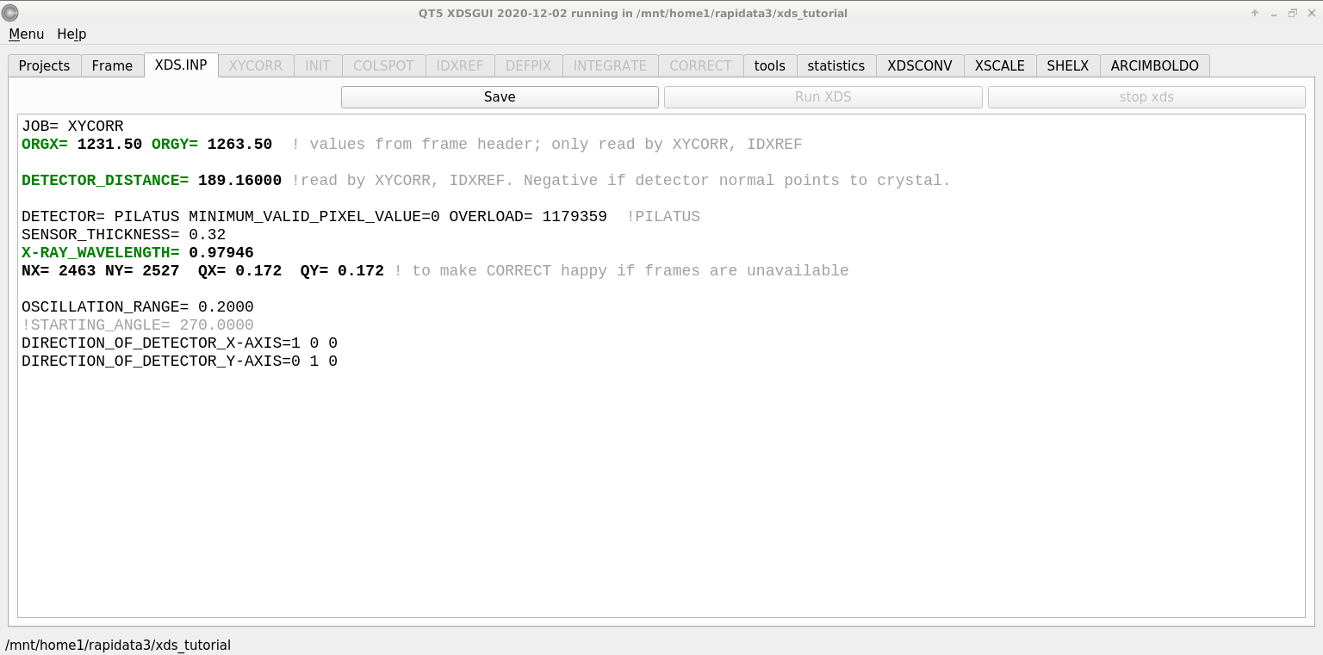
XYCORR– setting things up

Slide 20
Beam center vs “origin”
direct beam

Slide 21
Beam center vs “origin”
origin
direct beam

Slide 22
Correct beam center
155.063 155.647
159.353 155.063
159.301 155.011
1512.73 1554.57
155.063 159.356 -250
ADXV
HKL2000
MOSFLM
XDS
DIALS

Slide 23
XYCORR– setting things up

Slide 24
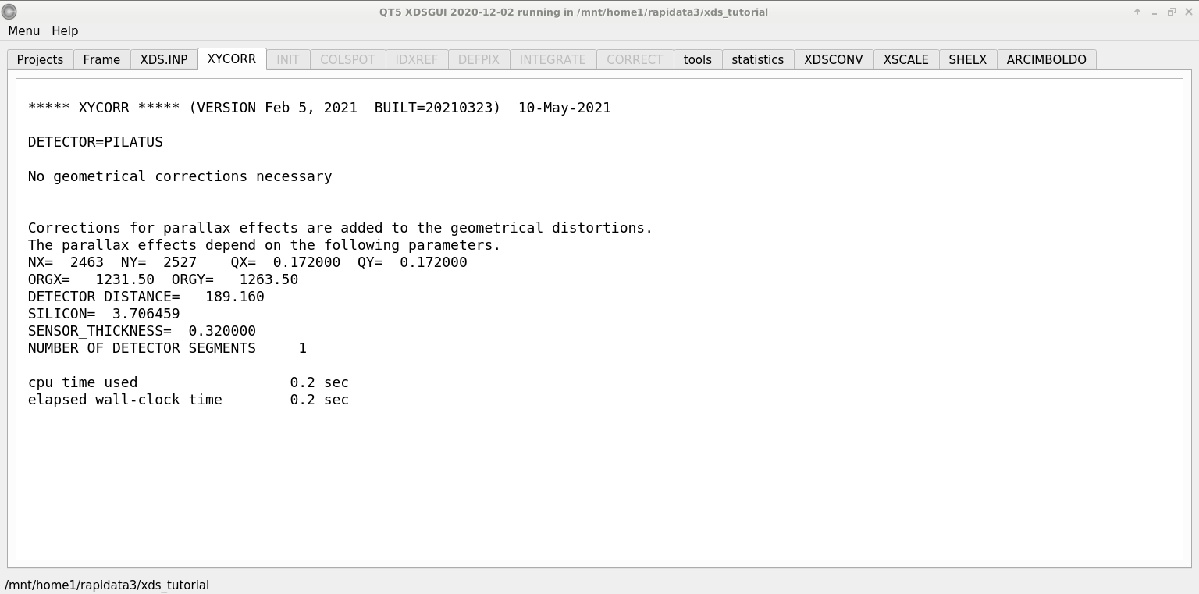
XYCORR– setting things up

Slide 25
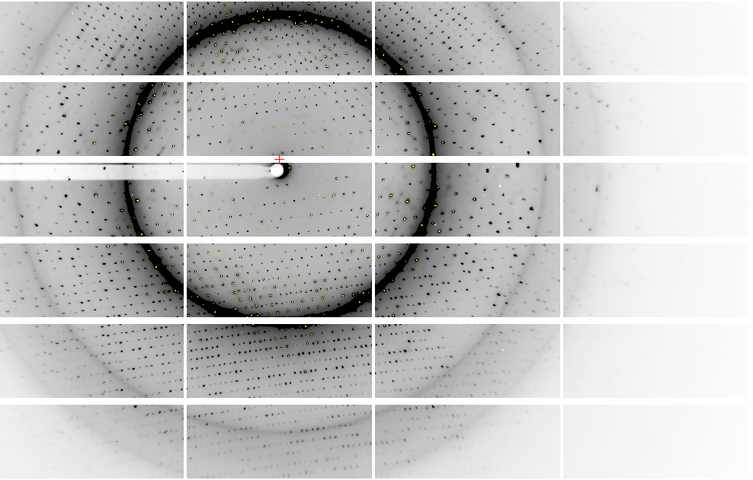
Pilatus: 1-module shift

Slide 26
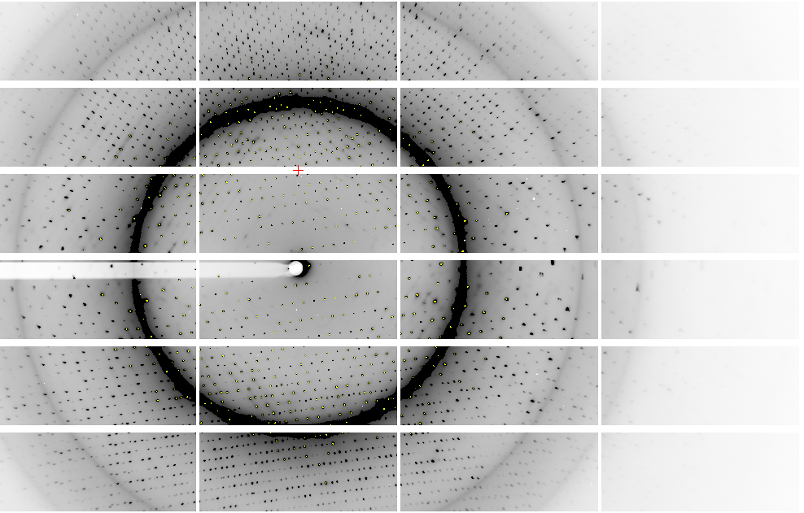
Pilatus: 1-module shift

Slide 27
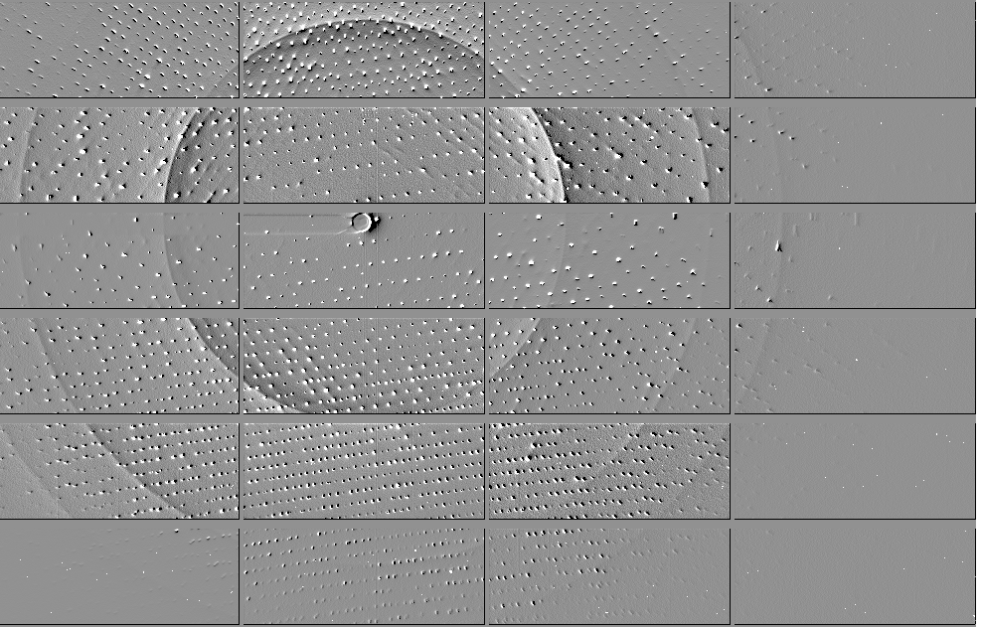
Pilatus: 1-module shift

Slide 28
Detector pixels are 3D
51 μm
172 μm
75 μm
8%
side
loss
53%
side
loss
76%
side
loss
photon
17%
loss
photon
31 μm thick
Pilatus
320 μm thick
Eiger
Typical CCD
26% loss
450 μm thick
Arrival angle of 2 Å spot: 29°
Mean Penetration depth 12 keV:
17.5 μm Gd₂O₂S 237 μm Si
15%
loss

Slide 29
XYCORR– setting things up

Slide 30
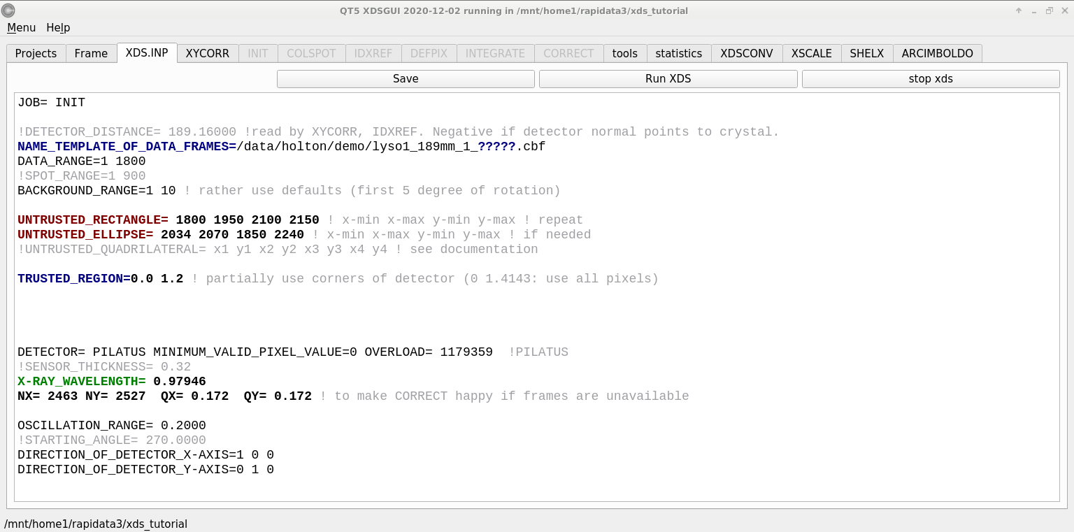
INIT – look at the background

Slide 31
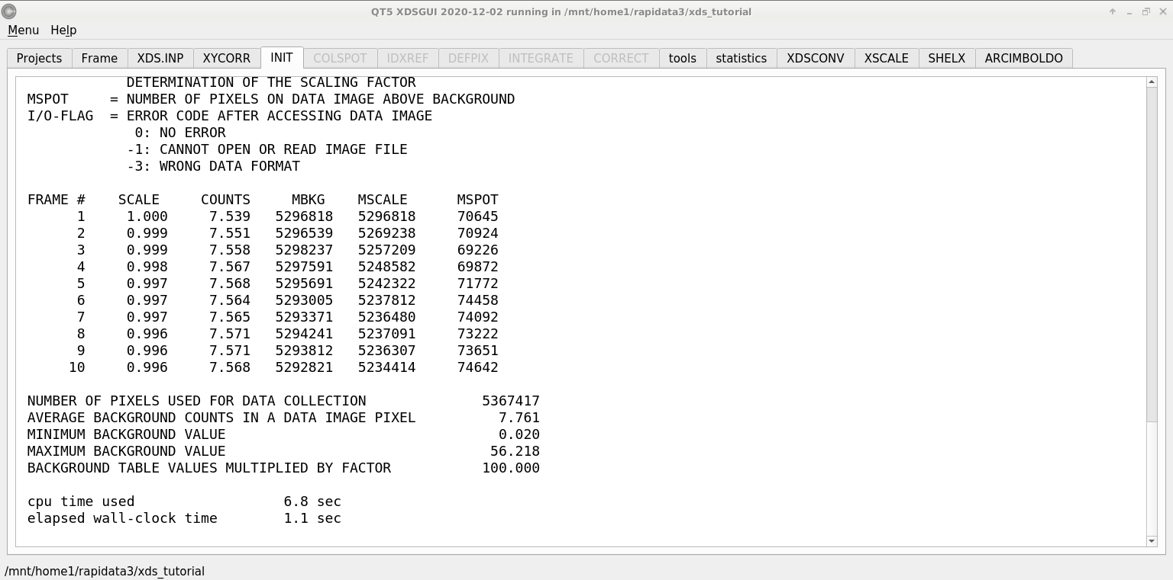
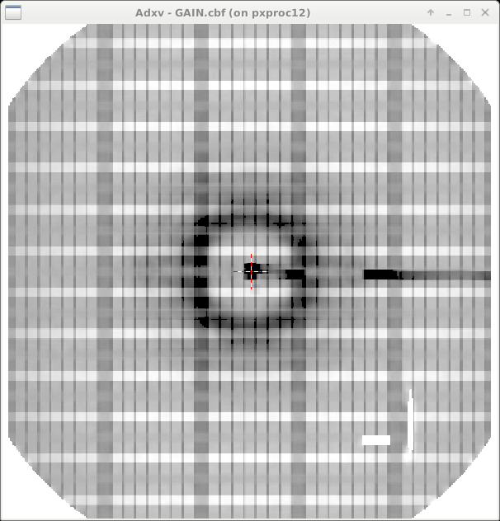
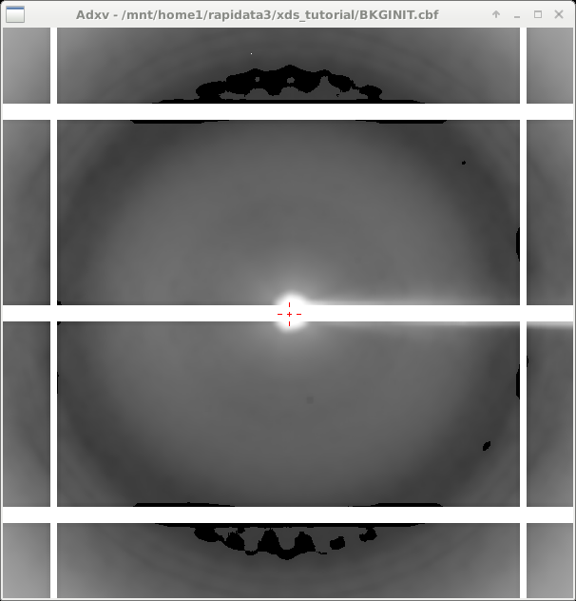
INIT – look at the background

Slide 32
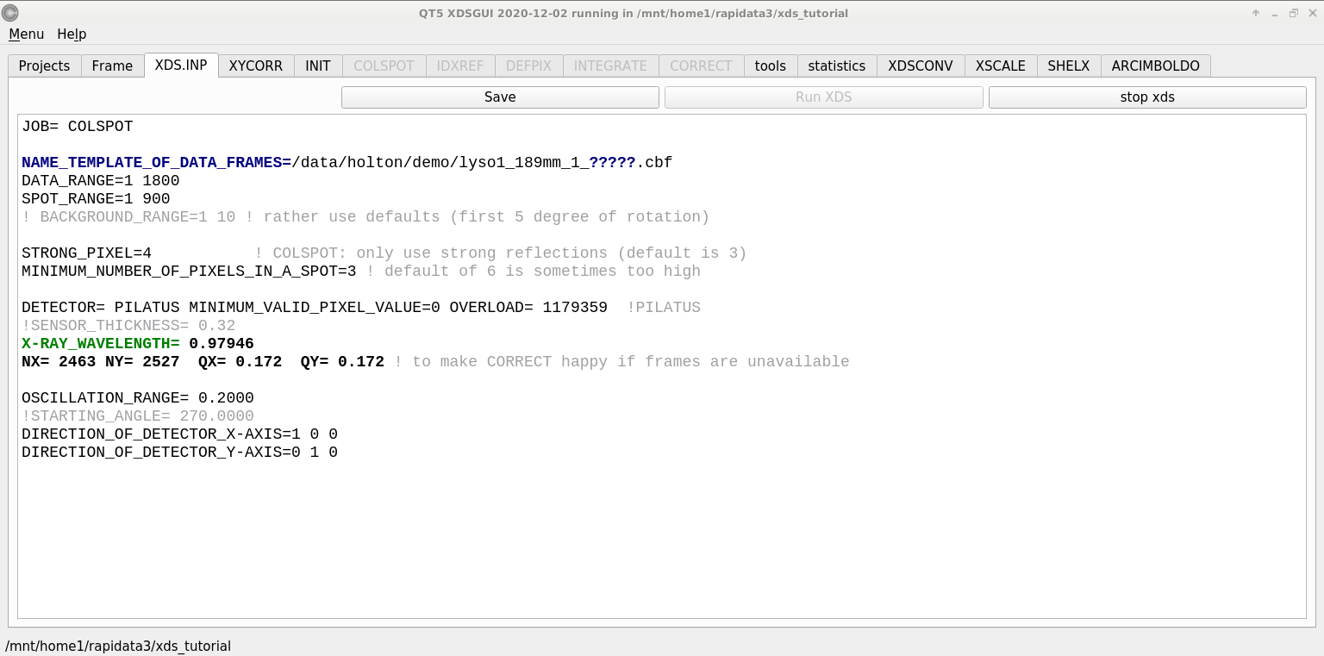
COLSPOT – the spot picker

Slide 33
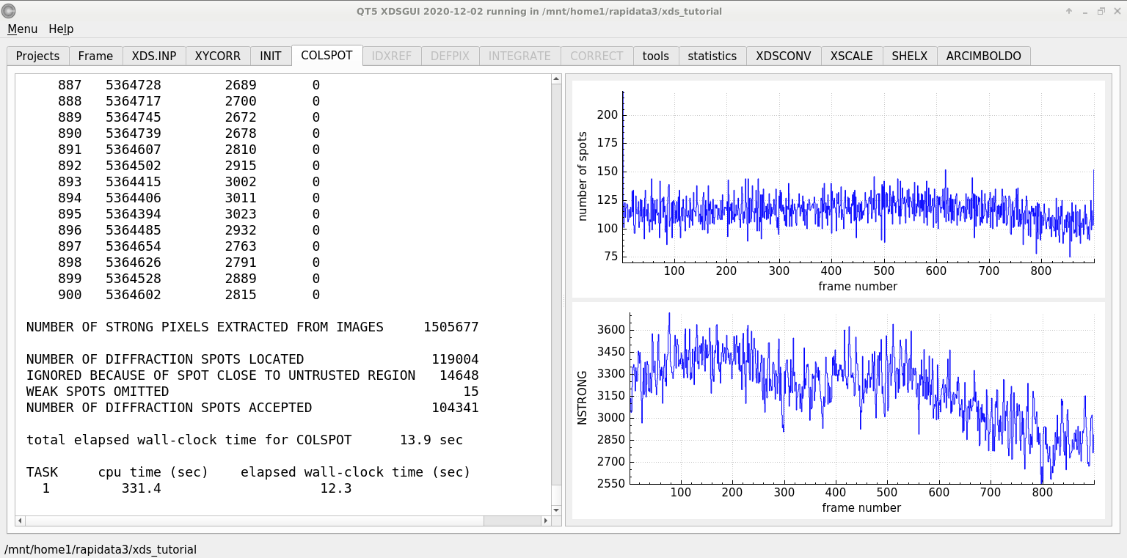
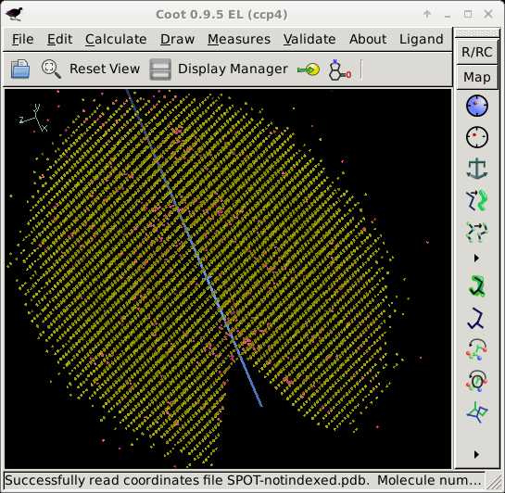
COLSPOT – the spot picker

Slide 34
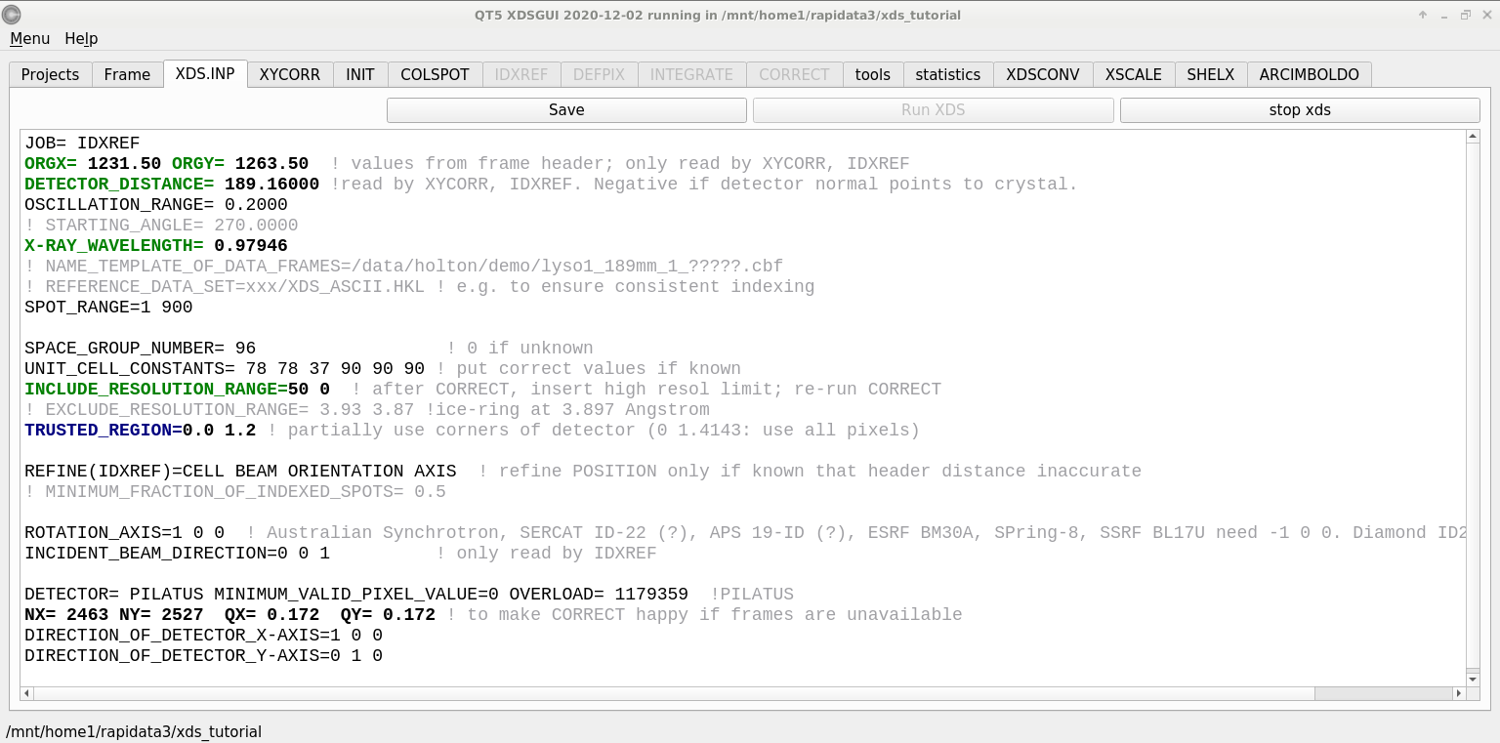
IDXREF – auto-indexing

Slide 35
XPARM.XDS
First image number
Starting phi
Delta-phi
spindle vector
XPARM.XDS VERSION Feb 5, 2021 BUILT=20210323
1 270.0000 0.2000 0.999971 0.007404 -0.001831
0.979460 0.000711 0.000291 1.020970
96 78.8215 78.8215 37.1784 90.000 90.000 90.000
36.338257 9.327419 -69.320709
26.357738 70.532730 23.307367
30.559622 -16.002089 13.866352
1 2463 2527 0.172000 0.172000
1231.500000 1263.500000 189.160004
1.000000 0.000000 0.000000
0.000000 1.000000 0.000000
0.000000 0.000000 1.000000
1 1 2463 1 2527
0.00 0.00 0.00 1.00000 0.00000 0.00000 0.00000 1.00000 0.00000
beam vector
wavelen
space
group
number
unit cell
a
b
c
cell vectors
real space
det panels
pixels
pixel size
origin
distance
x
y
z
Detector fast/slow
Panel #

Slide 36
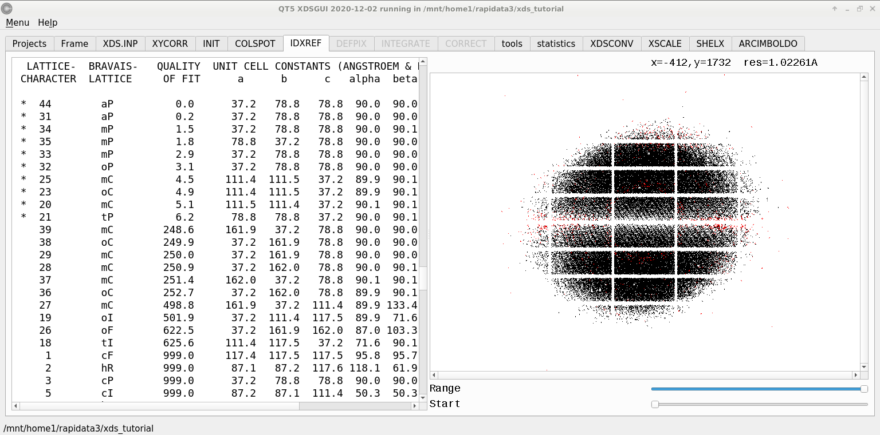
IDXREF – auto-indexing
BRAVAIS- POSSIBLE SPACE-GROUPS FOR PROTEIN CRYSTALS
TYPE [SPACE GROUP NUMBER,SYMBOL]
aP [1,P1]
mP [3,P2] [4,P2(1)]
mC,mI [5,C2]
oP [16,P222] [17,P222(1)] [18,P2(1)2(1)2] [19,P2(1)2(1)2(1)]
oC [21,C222] [20,C222(1)]
oF [22,F222]
oI [23,I222] [24,I2(1)2(1)2(1)]
tP [75,P4] [76,P4(1)] [77,P4(2)] [78,P4(3)] [89,P422] [90,P42(1)2]
[91,P4(1)22] [92,P4(1)2(1)2] [93,P4(2)22] [94,P4(2)2(1)2]
[95,P4(3)22] [96,P4(3)2(1)2]
tI [79,I4] [80,I4(1)] [97,I422] [98,I4(1)22]
hP [143,P3] [144,P3(1)] [145,P3(2)] [149,P312] [150,P321] [151,P3(1)12]
[152,P3(1)21] [153,P3(2)12] [154,P3(2)21] [168,P6] [169,P6(1)]
[170,P6(5)] [171,P6(2)] [172,P6(4)] [173,P6(3)] [177,P622]
[178,P6(1)22] [179,P6(5)22] [180,P6(2)22] [181,P6(4)22] [182,P6(3)22]
hR [146,R3] [155,R32]
cP [195,P23] [198,P2(1)3] [207,P432] [208,P4(2)32] [212,P4(3)32]
[213,P4(1)32]
cF [196,F23] [209,F432] [210,F4(1)32]
cI [197,I23] [199,I2(1)3] [211,I432] [214,I4(1)32]

Slide 37
Trick Question: What is the space group?
a = 63 b = 63 c = 63
α = 90 β = 90 γ = 90

Slide 38
What you know when:
Autoindexing: Lattice (14)
Scaling: Point Group (43)
Phasing: Space Group (84)

Slide 39
Pitfalls: sub-space groups
P622
What else?
P6₁22 P6₅22 P6₂22 P6₄22 P6₃22
P6 P6₁ P6₅ P6₂ P6₄ P6₃
P3₁2 P321 P3₁12 P3₁21 P3₂12 P3₂21
P3 P3₁ P3₂
P2 P2₁ C2 C222 C222₁
P1
zanuda

Slide 40
Asymmetric Unit (ASU)
Unit Cell
Smallest part of the crystal
that you can use to build up the rest of the crystal
with translation symmetry only
Smallest part of the crystal
that you can use to build up the rest of the crystal
with symmetry operations
“NCS ASU”
Builds ASU with Non-crystallographic symmetry operations

Slide 41
Frequency of Space Groups in PDB
13007 | P2₁2₁2₁ | 566 | R32 | 191 | P6₃22 | 74 | P4₃22 | 36 | P3₂12
9629 | P2₁ | 491 | P6₅22 | 187 | P2₁3 | 71 | P4₁22 | 30 | P622
5300 | C2 | 474 | P6₁ | 161 | P6 | 70 | P6₄ | 24 | F4₁32
3021 | P2₁2₁2 | 421 | P6₅ | 144 | P42₁2 | 70 | P6₂22 | 22 | P4₃32
2543 | C222₁ | 353 | P4₁ | 142 | I23 | 67 | P6₄22 | 22 | P422
2109 | P1 | 351 | P6₃ | 132 | F432 | 66 | F222 | 22 | P23
2030 | P4₃2₁2 | 286 | P3₁ | 124 | P321 | 63 | P6₂ | 19 | P3₁12
1565 | P3₂21 | 257 | I422 | 115 | I4₁ | 59 | P4₁32 | 18 | P4₂22
1359 | P4₁2₁2 | 253 | P4₂2₁2 | 103 | P3 | 46 | P222₁ | 18 | I4₁32
1198 | P3₁21 | 249 | I4 | 99 | I2₁3 | 43 | P4 | 16 | P432
1147 | I222 | 246 | P4₃ | 94 | C222 | 43 | I432 | 8 | P4₂32
825 | R3 | 239 | I4₁22 | 93 | P2 | 40 | P4₂ | 3 | P222
620 | P6₁22 | 193 | P3₂ | 82 | I2₁2₁2₁ | 37 | F23 | 2 | P312

Slide 42
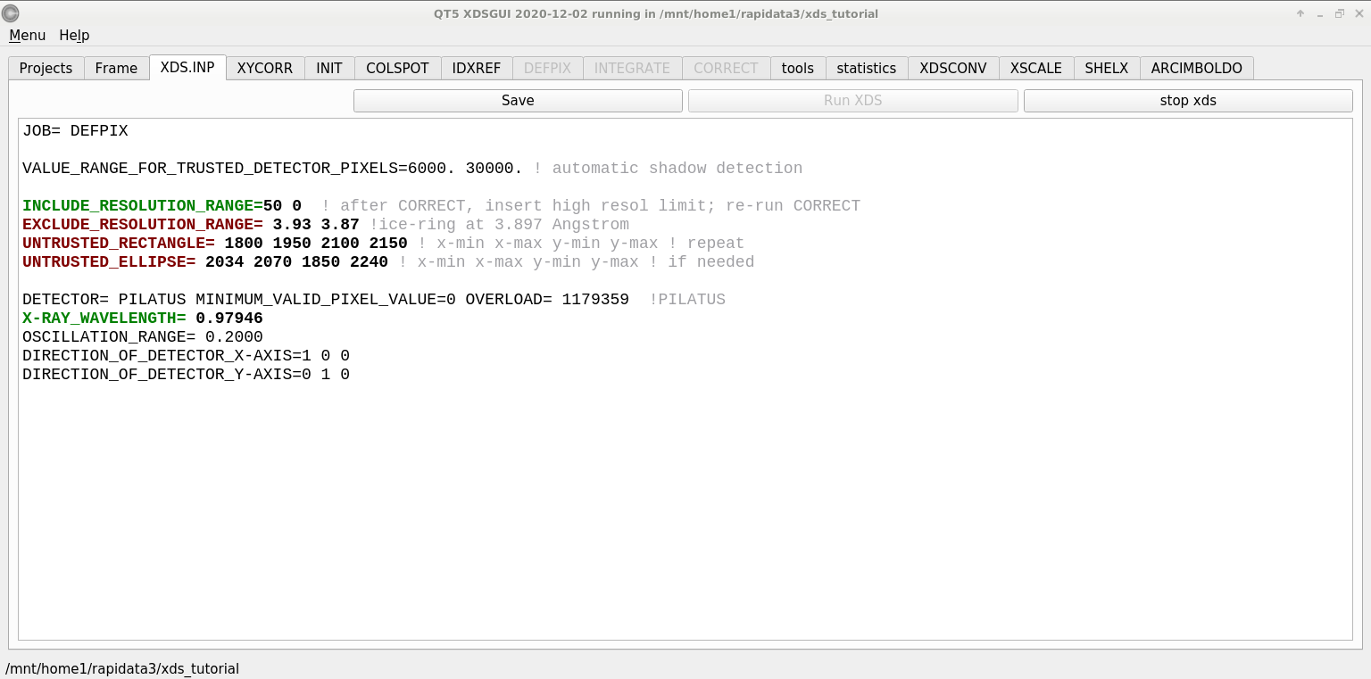
DEFPIX – pixels good and bad

Slide 43
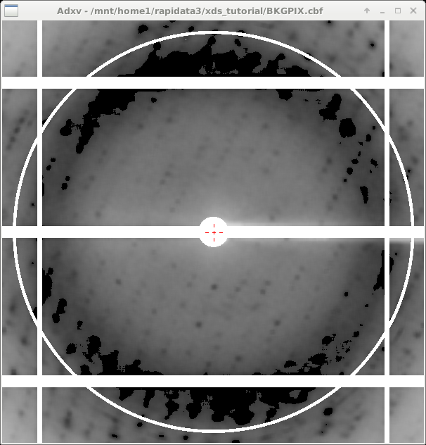
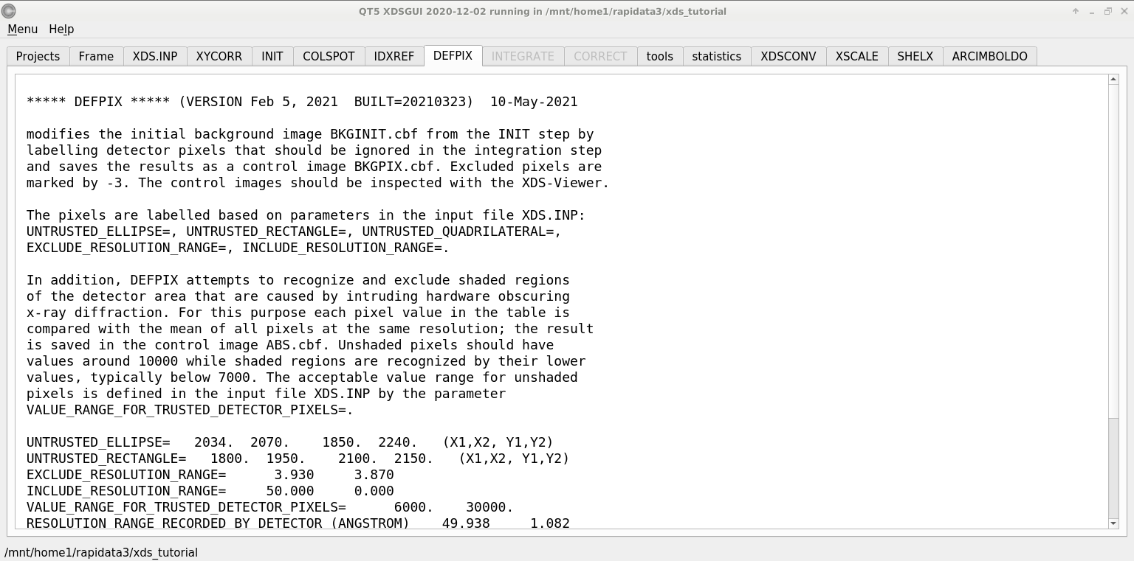
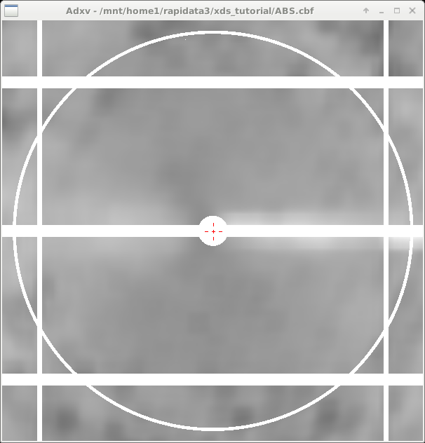
DEFPIX – pixels good and bad

Slide 44
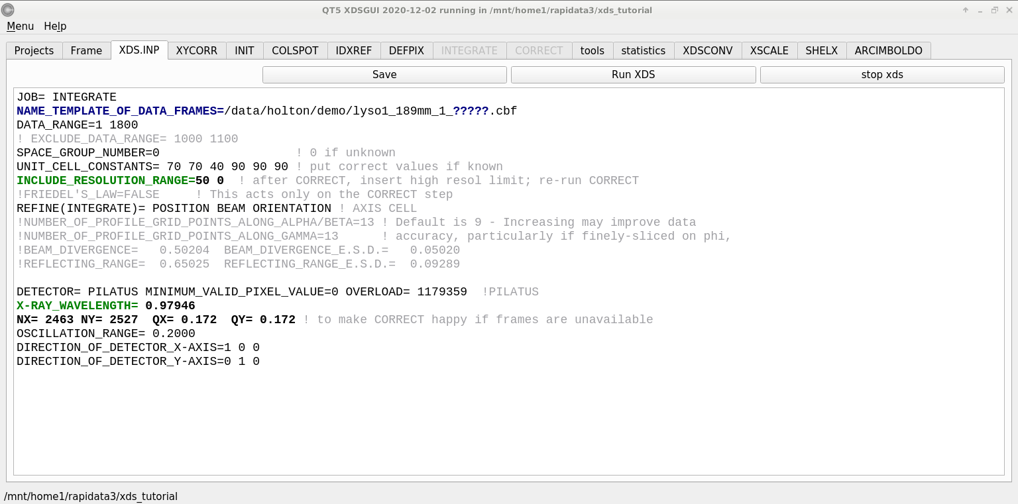
INTEGRATE – measure the spots!

Slide 45
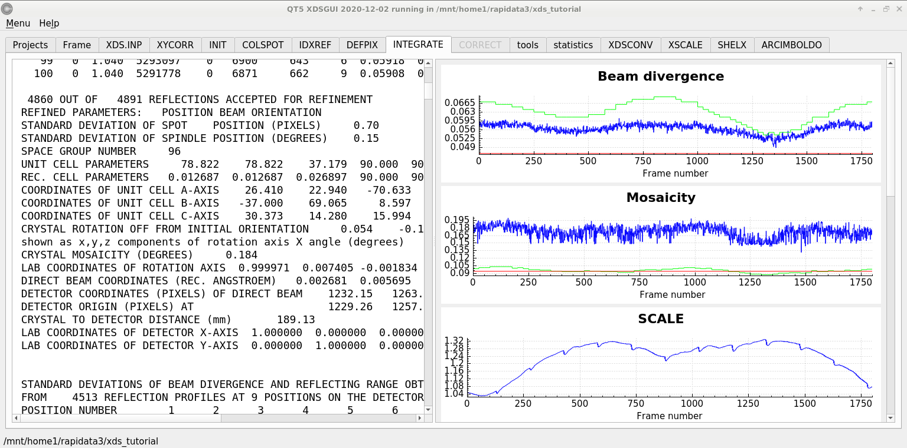
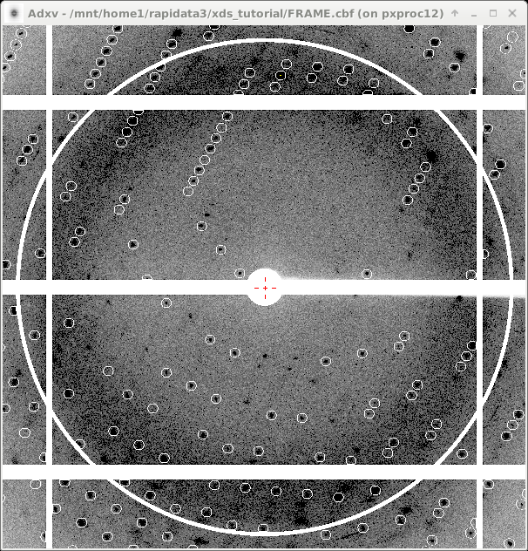
INTEGRATE – measure the spots!

Slide 46
Ewald’s “mosaic” picture

Slide 47
Ewald’s “mosaic” picture

Slide 48
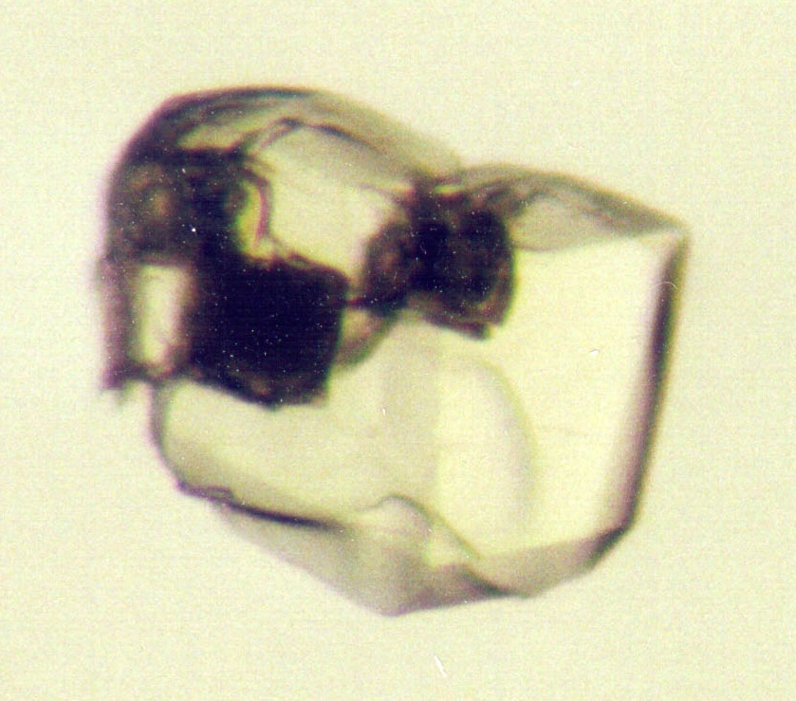
Ewald’s “mosaic” picture
What is
this stuff?

Slide 49
Darwin’s original picture

Slide 50
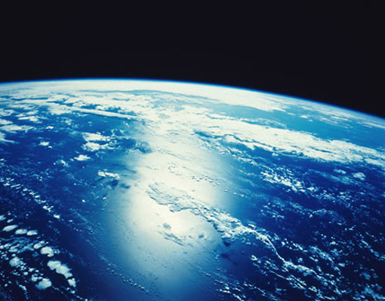
“mosaicity” with visible light

Slide 51
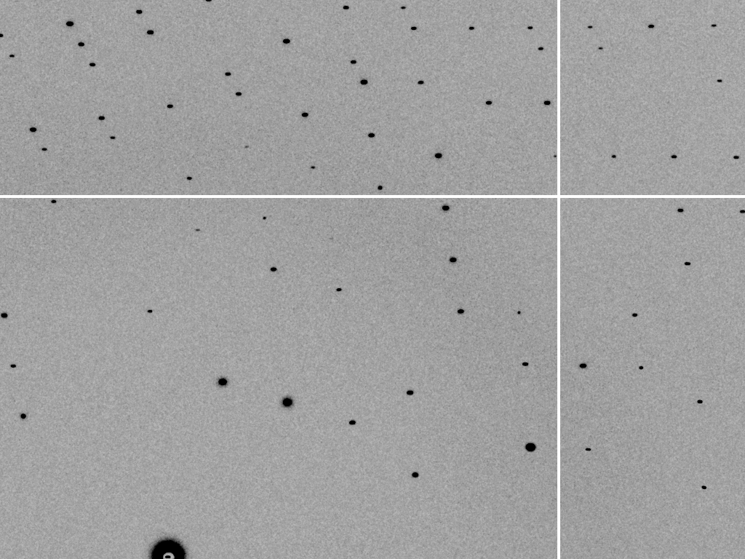
mosaic spread = 0 º

Slide 52
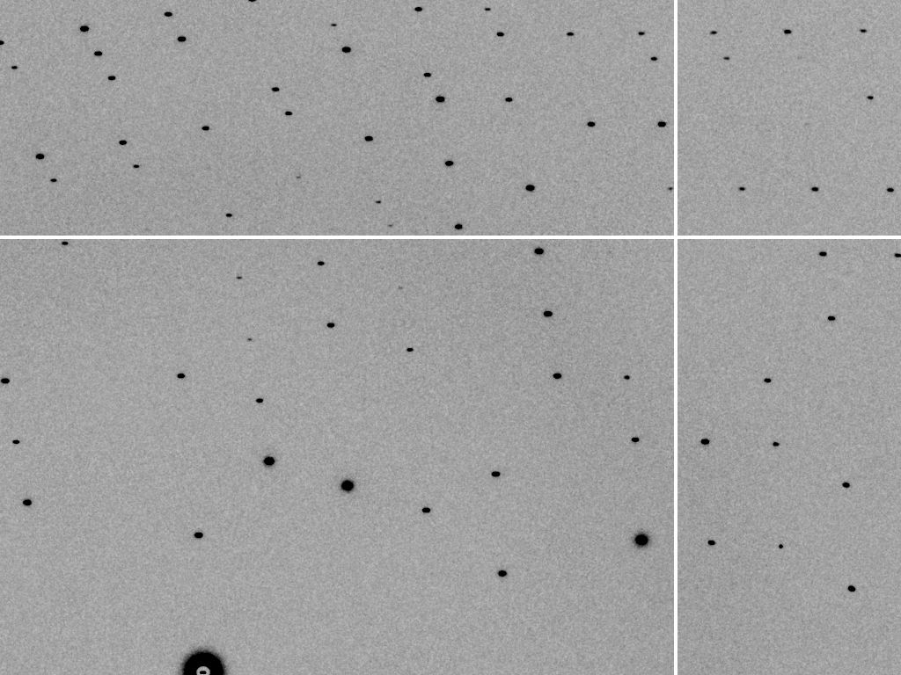
mosaic spread = 0.1º

Slide 53
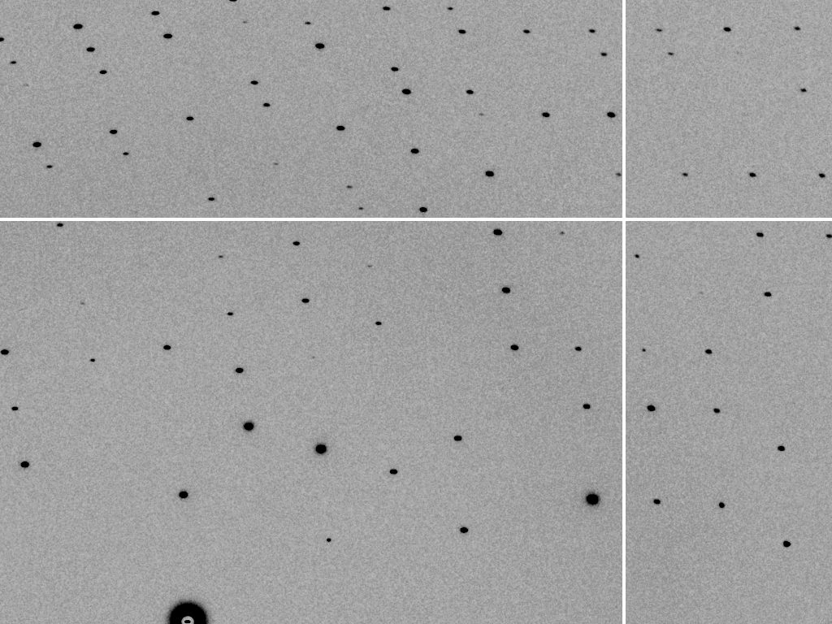
mosaic spread = 0.2º

Slide 54
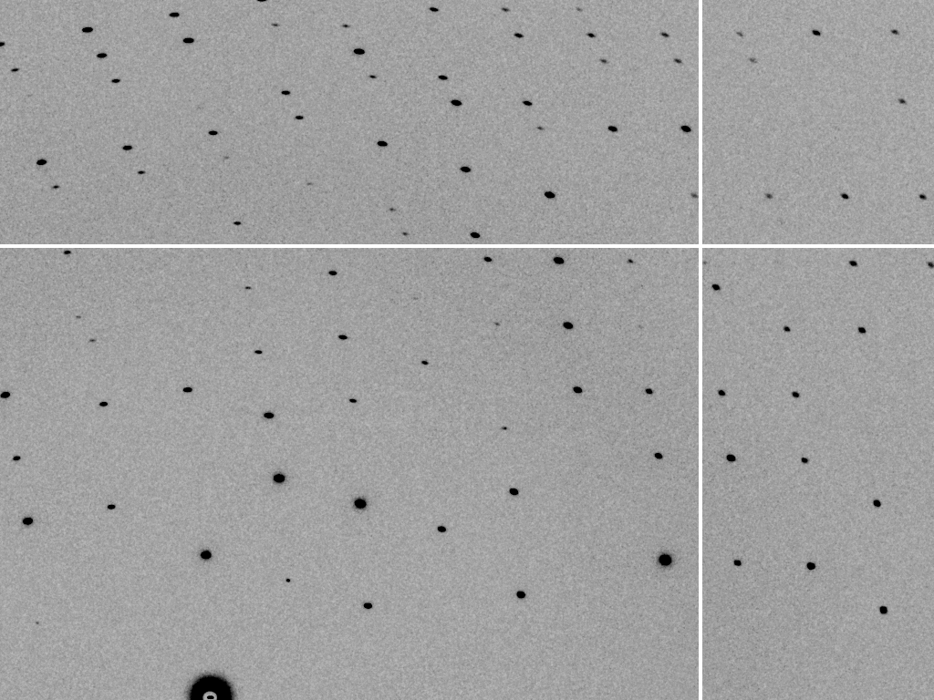
mosaic spread = 0.4º

Slide 55
mosaic spread = 0.6º

Slide 56
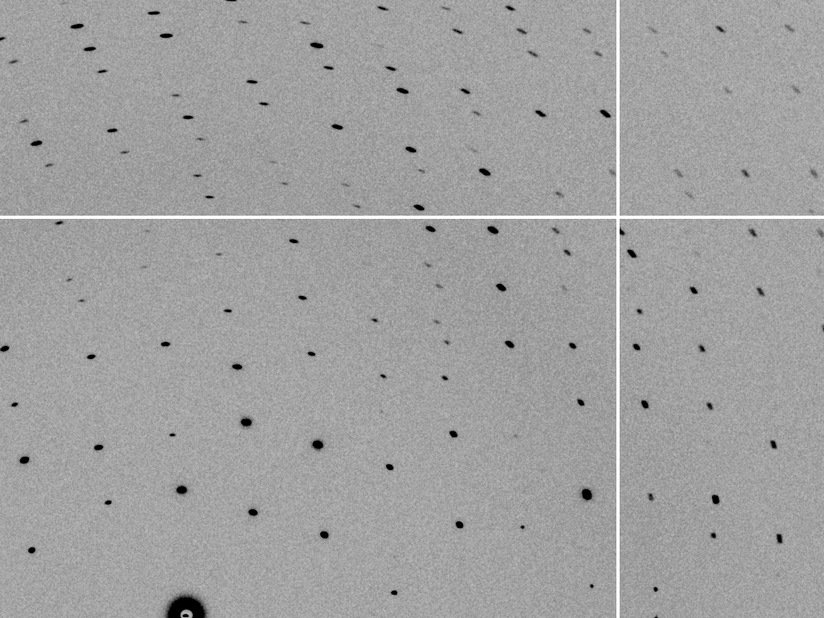
mosaic spread = 0.8º

Slide 57
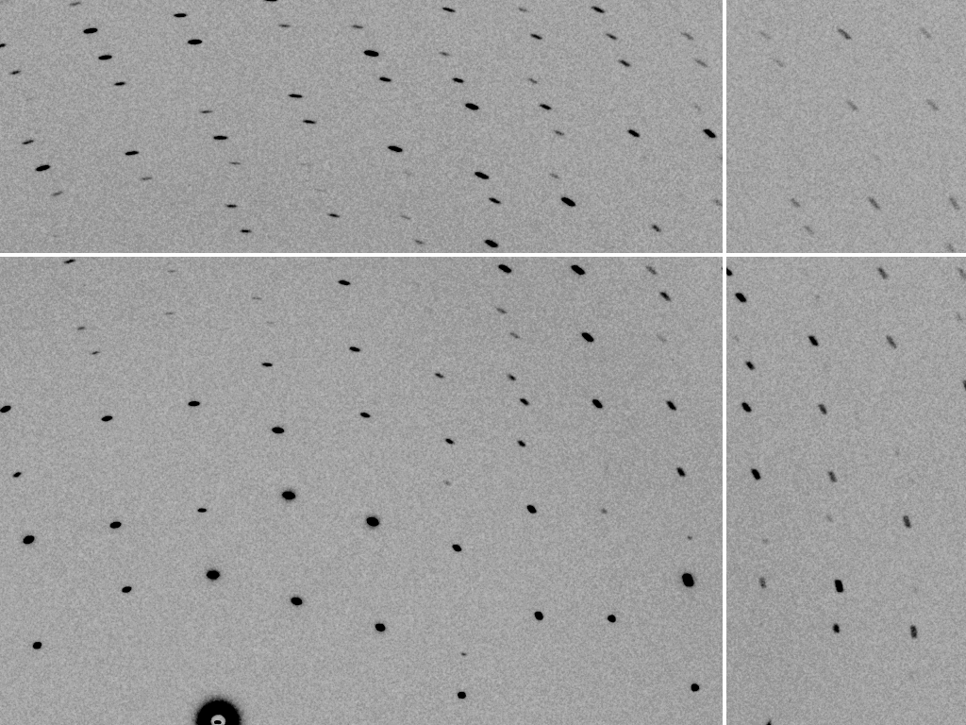
mosaic spread = 1.0º

Slide 58
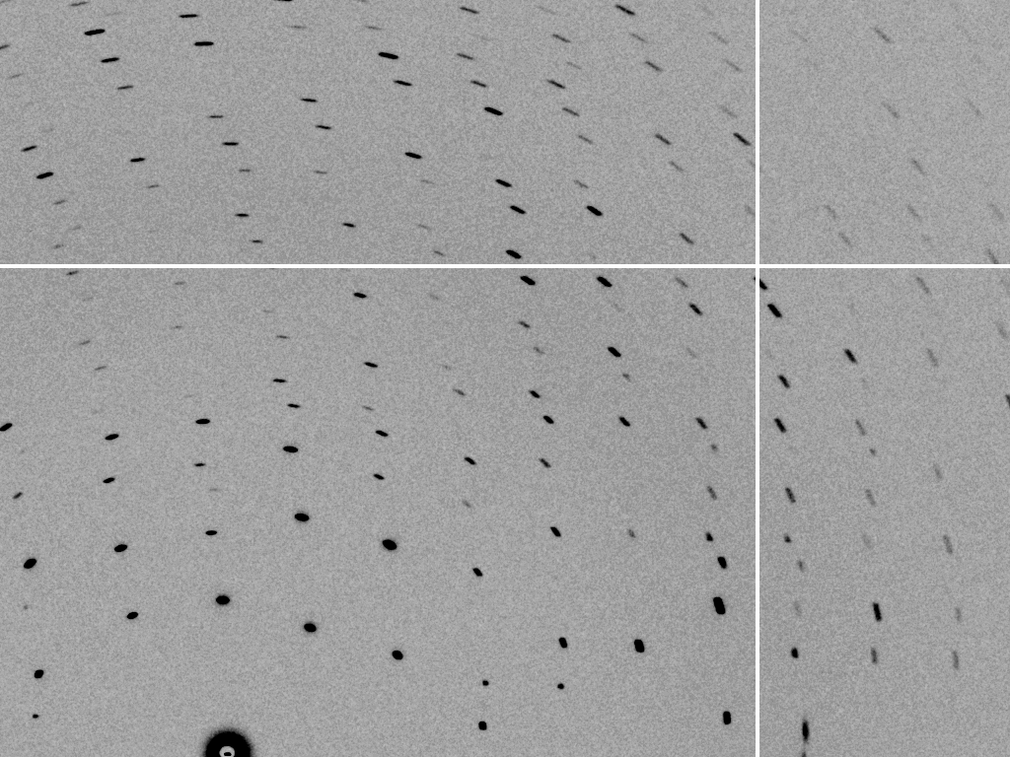
mosaic spread = 1.5º

Slide 59
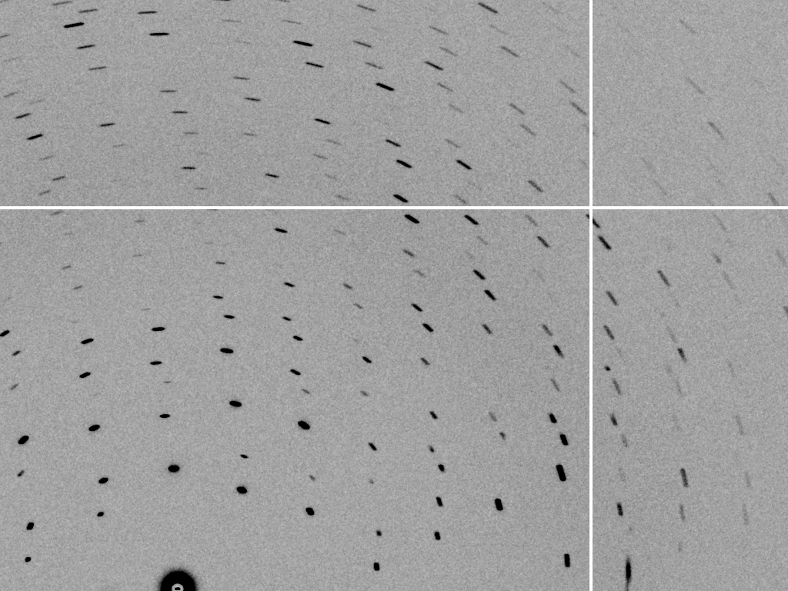
mosaic spread = 2.0º

Slide 60
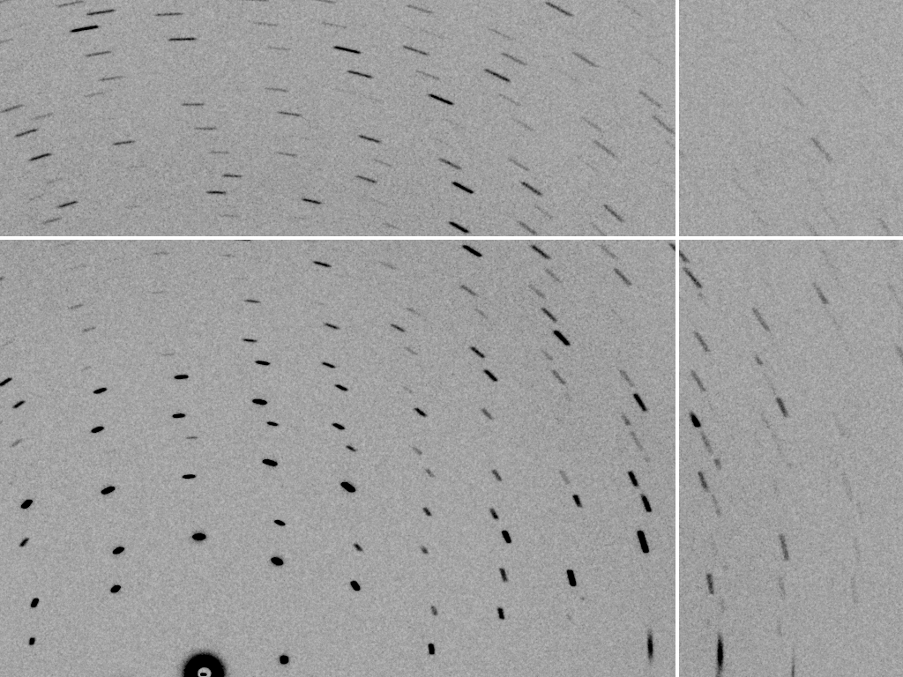
mosaic spread = 2.5º

Slide 61
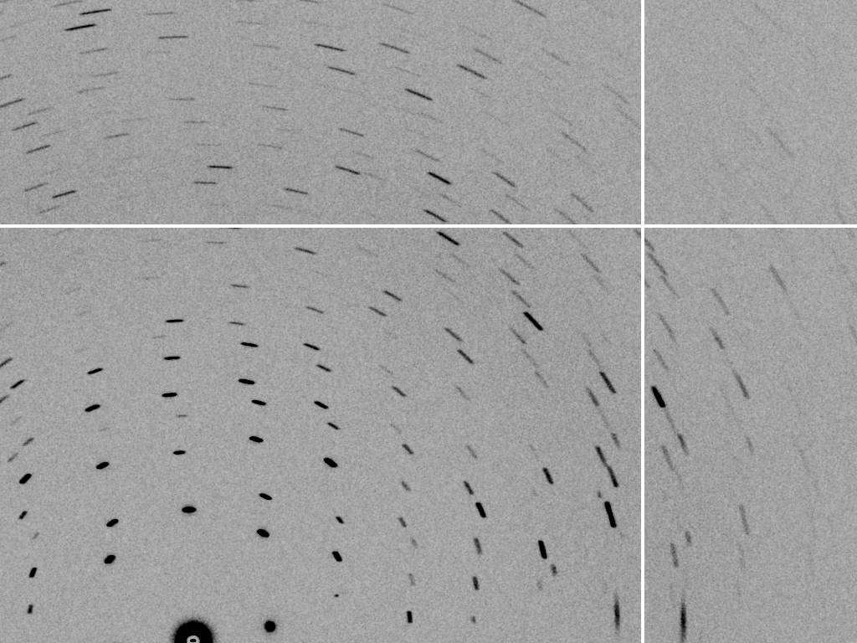
mosaic spread = 3.2º

Slide 62
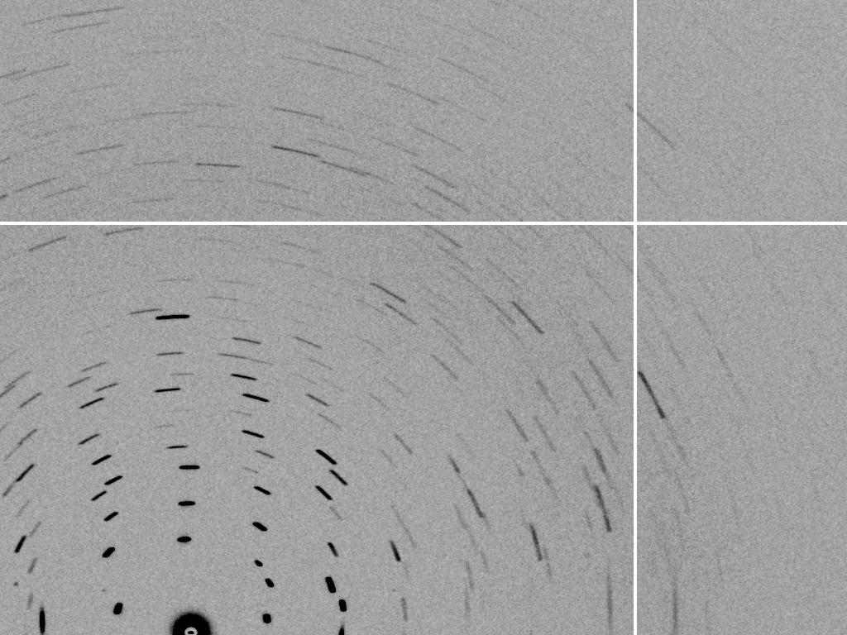
mosaic spread = 6.4º

Slide 63
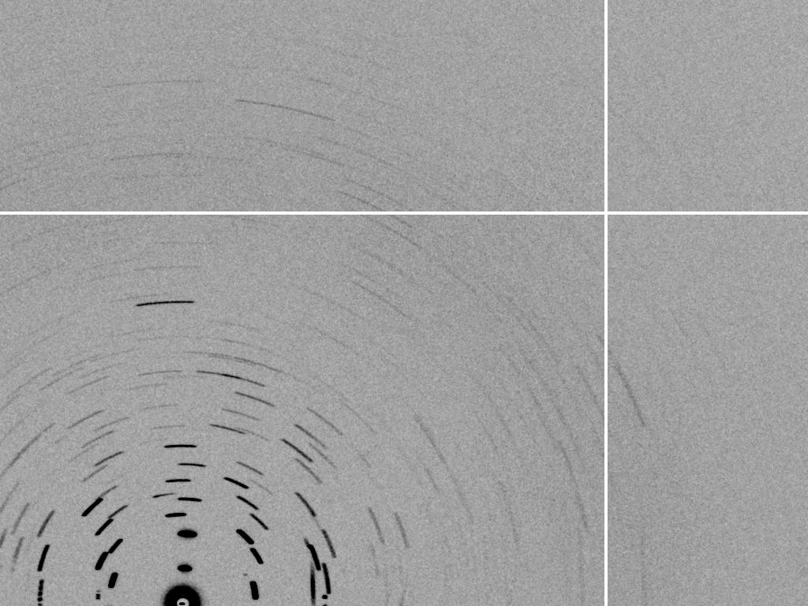
mosaic spread = 12.8º

Slide 64
Spot Shape
Ewald sphere
(h,k,l)

Slide 65
Spot Shape
Ewald sphere
(h,k,l)
d*

Slide 66
Spot Shape
Ewald sphere
(h,k,l)
spindle axis
d*

Slide 67
Spot Shape
Ewald sphere
Φ circle
(h,k,l)
spindle axis

Slide 68
Spot Shape
Ewald sphere
Φ circle
(h,k,l)
spindle axis

Slide 69
Spot Shape
Ewald sphere
Φ circle
(h,k,l)
diffracted ray
spindle axis

Slide 70
Spot Shape
Ewald sphere
Φ circle
(h,k,l)
λ*
d*
spindle axis
diffracted ray
λ*

Slide 71
Spot Shape
Ewald sphere
Φ circle
(h,k,l)
λ*
d*
spindle axis
diffracted ray
θ
λ*
λ = 2 d sin(θ)

Slide 72
mosaic spread
Ewald sphere
Φ circle
(h,k,l)
λ*
d*
diffracted ray
d*
spindle axis
λ*

Slide 73
mosaic spread
Ewald sphere
Φ circle
(h,k,l)
d*
diffracted rays
d*
spindle axis

Slide 74
INTEGRATE – measure the spots!

Slide 75
beam divergence
Ewald sphere
Φ circle
(h,k,l)
λ*
d*
spindle axis
diffracted ray
λ*

Slide 76
beam divergence
Ewald sphere
Φ circle
(h,k,l)
d*
λ*
diffracted ray
spindle axis
λ*

Slide 77
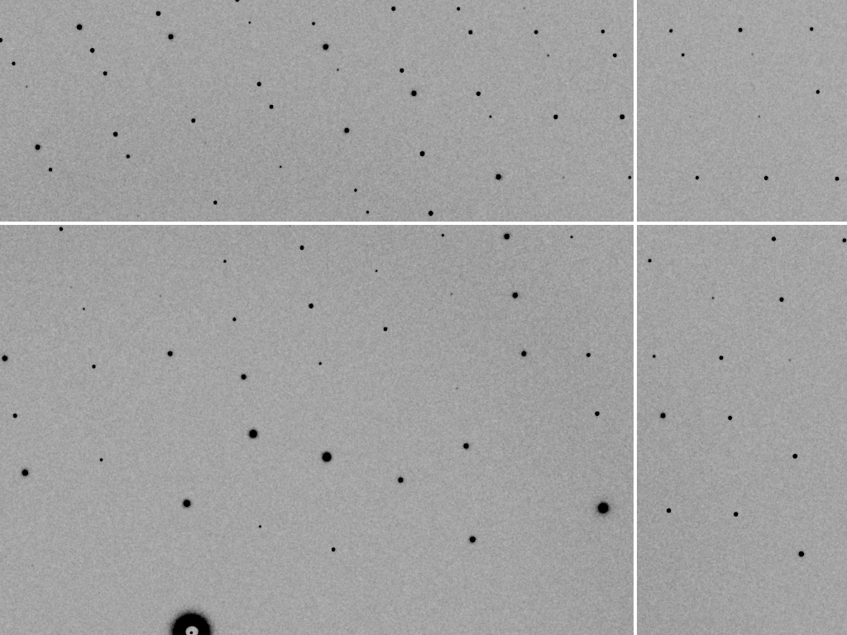
divergence = 0 º

Slide 78
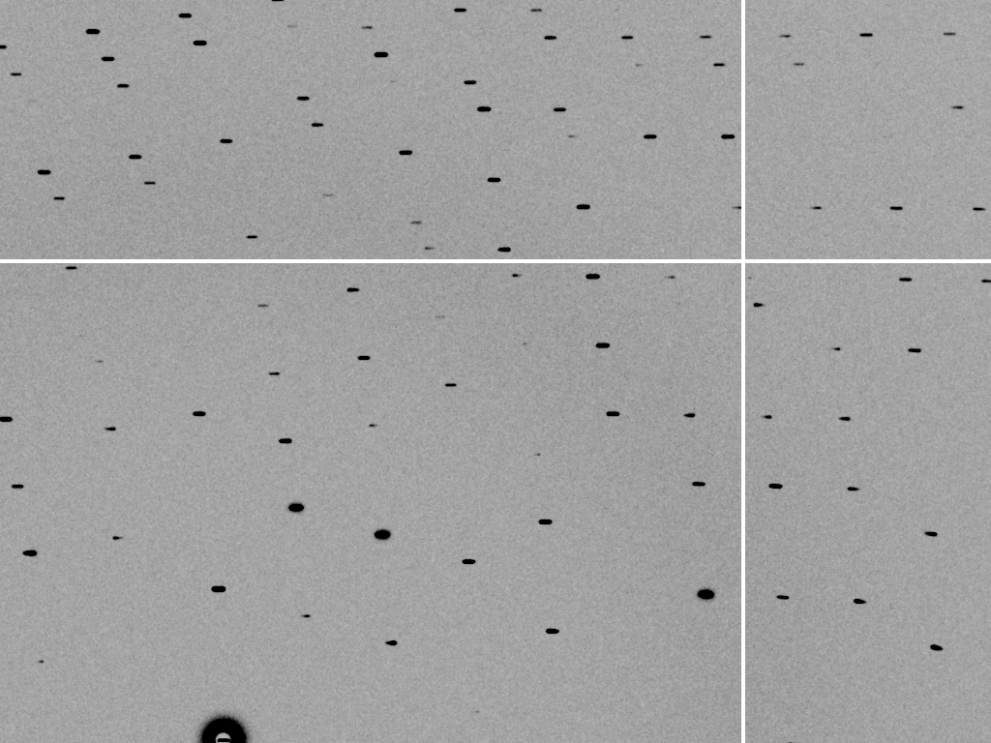
divergence = 0.3 º

Slide 79
spectral dispersion
Ewald sphere
Φ circle
(h,k,l)
λ*
d*
spindle axis
diffracted ray
λ*

Slide 80
spectral dispersion
Ewald sphere
Φ circle
(h,k,l)
λ’*
d*
spindle axis
diffracted ray
λ’*

Slide 81
dispersion = 0

Slide 82
dispersion = 0.014% (Si 111)

Slide 83
dispersion = 0.25% (CuK_{α})

Slide 84
dispersion = 0.6%

Slide 85
dispersion = 1.3%

Slide 86
dispersion = 2.6%

Slide 87
dispersion = 5.1%

Slide 88
spot shape
Ewald sphere
Ewald sphere
Ewald sphere
Ewald sphere
Φ circle
Φ circle
Φ circle
Φ circle
(h,k,l)
(h,k,l)
(h,k,l)
(h,k,l)
λ’*
λ*
d*
d*
d*
λ*
d*
spindle axis
spindle axis
spindle axis
diffracted rays
d*
spindle axis
diffracted ray
diffracted ray
diffracted ray
λ’*
λ*
λ*

Slide 89
CORRECT – scale all the “factors”

Slide 90
Polarization factor
1.0
0.45
+

Slide 91
Lorentz factor
1.2x
3x
550x
10x
+
50x

Slide 92
The “Lorentz zone”

Slide 93
A few other corrections…
Meisburger, et. al. Nat Commun 11, 1271 (2020). https://doi.org/10.1038

Slide 94
attenuation factor
μ_{solvent}
t_{so}
t_{xo}
t_{si}
t_{xi}
μ_{xtal}
t_{so}
t_{xo}
t_{si}
t_{xi}
t_{so}
t_{xo}
I_{T}
I_{beam}
t_{si}
t_{xi}
A = = exp[-μ_{xtal}(t_{xi}+ t_{xo})
-μ_{solvent}(t_{si} + t_{so})]
Bouguer, P. (1729). Essai d'optique sur la gradation de la lumière.
Lambert, J. H. (1760). Photometria: sive De mensura et gradibus luminis, colorum et umbrae. E. Klett.
Beer, A. (1852)."Bestimmung der Absorption des rothen Lichts in farbigen Flüssigkeiten", Ann. Phys. Chem 86, 78-90.

Slide 95
B factor from image gazing
B = 500

Slide 96
B factor from image gazing
B = 20

Slide 97
CORRECT – after all the “factors”

Slide 98
xdscc12 – any outlier images?

Slide 99
xdsstat – radiation damage “limit”

Slide 100
xdsconv – make an “mtz” file

Slide 101
xscale – merge multiple runs

Slide 102
CORRECT – scale all the “factors”

Slide 103
Re-indexing cheat sheet
Dauter, Z. (1999). "Data-collection strategies." Acta Cryst. D 55(10): 1703-1717.

Slide 104
Zero-dose extrapolation (ZDE)
Diederichs, K. (2006). "Some aspects of quantitative analysis and correction of radiation damage." Acta Cryst. D 62(1): 96-101.
OUTPUT_FILE= multi-merge.hkl
INPUT_FILE= ../xds_1/XDS_ASCII.HKL
CRYSTAL_NAME= ip
INPUT_FILE= ../xds_2/XDS_ASCII.HKL
! same crystal, but translated
CRYSTAL_NAME= ip

Slide 105
xscale – final stats

Slide 106
XDS: CORRECT.LP or XSCALE.LP
SUBSET OF INTENSITY DATA WITH SIGNAL/NOISE >= -3.0 AS FUNCTION OF RESOLUTION
RESOLUTION NUMBER OF REFLECTIONS COMPLETENESS R-FACTOR R-FACTOR COMPARED I/SIGMA R-meas CC(1/2) Anomal SigAno Nano
LIMIT OBSERVED UNIQUE POSSIBLE OF DATA observed expected Corr
6.39 4103 2517 3135 80.3% 1.7% 1.8% 3018 33.77 2.3% 99.9* 21* 1.012 533
4.54 7339 4970 5544 89.6% 2.6% 2.6% 4585 22.56 3.6% 99.8* 9 0.914 796
3.72 9442 6724 7186 93.6% 2.8% 2.9% 5327 19.99 4.0% 99.7* 9 0.859 877
3.22 11077 7997 8486 94.2% 4.8% 4.9% 6094 12.27 6.8% 99.3* -1 0.784 913
2.88 12408 8851 9595 92.2% 10.0% 10.1% 7068 6.01 14.2% 97.8* -2 0.799 1012
2.63 13673 9561 10662 89.7% 20.8% 20.8% 8185 3.10 29.4% 88.8* -4 0.776 1274
2.44 14360 9852 11510 85.6% 34.5% 34.7% 8981 1.90 48.8% 75.9* 2 0.765 1525
2.28 9501 6495 12416 52.3% 61.8% 59.6% 5991 1.14 87.3% 53.5* -2 0.722 1031
2.15 4567 3307 13210 25.0% 120.5% 120.3% 2520 0.59 170.4% 21.9* 4 0.693 408
total 86470 60274 81744 73.7% 6.7% 6.7% 51769 8.97 9.5% 99.5* 2 0.804 8369

Slide 107
XDS: CORRECT.LP or XSCALE.LP
******************************************************************************
CORRECTION PARAMETERS FOR THE STANDARD ERROR OF REFLECTION INTENSITIES
******************************************************************************
The variance v0(I) of the intensity I obtained from counting statistics is
replaced by v(I)=a*(v0(I)+b*I^2). The model parameters a, b are chosen to
minimize the discrepancies between v(I) and the variance estimated from
sample statistics of symmetry related reflections. This model implicates
an asymptotic limit ISa=1/SQRT(a*b) for the highest I/Sigma(I) that the
experimental setup can produce (Diederichs (2010) Acta Cryst D66, 733-740).
a b ISa
3.806E+00 1.080E-04 49.32

Slide 108
CCP4: aimless log
$TABLE: Analysis against resolution, XDSdataset:
$GRAPHS:I/sigma, Mean Mn(I)/sd(Mn(I)):0|0.216023x0|137.14:2,13,14:
:Rmerge, Rfull, Rmeas, Rpim v Resolution:0|0.216023x0|1.70834:2,4,5,6,7:
:Average I, RMSdeviation and Sd:0|0.216023x0|1650.8:2,10,11,12:
:Fractional bias:0|0.216023x0|0:2,15:
$$
N 1/d^2 Dmid Rmrg Rfull Rcum Rmeas Rpim Nmeas AvI RMSdev sd I/RMS Mn(I/sd) FrcBias $$ $$
1 0.0064 12.55 0.020 0.020 0.020 0.021 0.006 13115 1651 57 42 29.2 137.1 -
2 0.0191 7.24 0.027 0.027 0.024 0.028 0.008 24753 1171 47 42 25.0 105.2 -
3 0.0318 5.61 0.038 0.038 0.029 0.040 0.012 32197 857 46 43 18.4 79.6 -
4 0.0445 4.74 0.034 0.034 0.031 0.035 0.010 37743 1212 57 53 21.4 91.2 -
5 0.0572 4.18 0.036 0.036 0.032 0.038 0.011 42642 1181 59 57 19.9 83.8 -
6 0.0699 3.78 0.049 0.049 0.036 0.052 0.015 47224 883 59 57 15.1 65.1 -
7 0.0826 3.48 0.065 0.065 0.040 0.068 0.020 51052 685 59 58 11.7 50.9 -
8 0.0953 3.24 0.096 0.096 0.045 0.100 0.029 54636 448 56 56 8.0 35.0 -
9 0.1080 3.04 0.151 0.151 0.050 0.158 0.046 58072 268 53 53 5.1 22.7 -
10 0.1207 2.88 0.229 0.229 0.056 0.240 0.070 60731 171 51 51 3.3 15.4 -
11 0.1334 2.74 0.314 0.314 0.063 0.329 0.097 63807 125 51 51 2.4 11.3 -
12 0.1461 2.62 0.406 0.406 0.070 0.425 0.125 66241 98 51 52 1.9 8.7 -
13 0.1588 2.51 0.537 0.537 0.078 0.562 0.166 68272 76 53 53 1.4 6.5 -
14 0.1715 2.41 0.685 0.685 0.084 0.727 0.237 54170 61 53 54 1.1 4.4 -
15 0.1843 2.33 0.886 0.886 0.088 0.950 0.333 39781 48 55 56 0.9 3.1 -
16 0.1970 2.25 1.249 1.249 0.092 1.355 0.508 29754 35 57 59 0.6 2.1 -

Slide 109
CCP4: aimless log
$TABLE: Correlations CC(1/2) within dataset, XDSdataset:
$GRAPHS: Anom & Imean CCs v resolution:0|0.216023x0|1:2,4,7:
: RMS correlation ratio :0|0.216023x0|2.20344:2,6:
$$
N 1/d^2 Dmid CCanom Nanom RCRanom CC1/2 NImean $$ $$
1 0.0064 12.55 0.659 499 2.203 1.000 669
2 0.0191 7.24 0.550 975 1.853 1.000 1155
3 0.0318 5.61 0.527 1295 1.798 1.000 1479
16 0.1970 2.25 0.037 2123 1.038 0.711 2275
17 0.2097 2.18 0.043 1682 1.044 0.460 1877

Slide 110
Summary
XYCORR
INIT
COLSPOT
IDXREF
DEFPIX
INTEGRATE
CORRECT

Slide 111
100% SeMet incorporation
Trivial to solve

Slide 112
100% S -Met incorporation
Impossible to solve

Slide 113
Systematic error does not “average out”
Unless you can randomize their source

Slide 114
Pilatus: subtract smooth baseline
~3x10⁵ photon/pixel → 0.3% error
Bragg
glitch
“tree rings”
Pick-up tool mark
Gollwitzer & Krumrey (2014)
J. Appl. Cryst. 47, 378
oxygen
inclusions
1% high
average
1% low

Slide 115
Fractional error
^{mult >} (—)²
~3%
<ΔF/F>

Slide 116
anomalous signal
ΔF
F
√
# sites
MW (Da)
≈ 1.2 f”
World record!
ΔF/F = 0.5%
Wang, Dauter & Dauter (2006) Acta Cryst. D 62, 1475-1483.
Crick, F. H. C. & Magdoff, B. S. (1956) Acta Crystallogr. 9, 901-908.
Hendrickson, W. A. & Teeter, M. M. (1981) Nature 290, 107-113.

Slide 117
Holton & Frankel (2010) Acta D 66 393-408.

Slide 118
what the is a MGy?
1 MGy = 10⁶ J/kg
http://bl831.als.lbl.gov/
damage_rates.pdf
Holton J. M. (2009) J. Synchrotron Rad. 16 133-42

Slide 119
How long will my crystal last?
synch line type flux beamsize flux density dose max xtal min site
ph/s μm ph/μm2/s rate lifetime lifetime
ALS 4.2.2 MAD 2.2e11 75x80 3.7e+07 27.3 kGy/s 18 m 73 s
ALS 5.0.1 mono 1.6e11 100 2.0e+07 10.4 kGy/s 48 m 3.2 m
ALS 5.0.2 MAD 8e11 100 1.0e+08 51.8 kGy/s 9.6 m 39 s
ALS 5.0.3 mono 1.7e11 100 2.2e+07 11 kGy/s 45 m 3 m
ALS 8.2.1 MAD 1.8e11 100 2.3e+07 11.7 kGy/s 43 m 2.9 m
ALS 8.2.2 MAD 2.3e11 100 2.9e+07 14.9 kGy/s 34 m 2.2 m
ALS 8.3.1 MAD 9e11 70 2.3e+08 119 kGy/s 4.2 m 17 s
ALS 8.3.1 typical 6e11 70 1.6e+08 115 kGy/s 4.3 m 17 s
ALS 12.3.1 MAD 1.8e11 100 2.3e+07 11.7 kGy/s 43 m 2.9 m
ALS 12.3.1 ML 4.0e12 100 5.1e+08 513 kGy/s 58 s 3.9 s
APS 8-BM MAD 1e11 200 2.5e+06 1.27 kGy/s 6.6 h 26 m
APS 14-BM-C mono 5.8e10 200 1.4e+06 738 Gy/s 11 h 45 m
APS 14-BM-D MAD 3.3e9 200 8.2e+04 42 Gy/s 8.3 d 13 h
APS 14-ID-B MAD 6.0e10 200 1.5e+06 763 Gy/s 11 h 44 m
APS 17-BM MAD 1.1e11 200 2.8e+06 1.4 kGy/s 6 h 24 m
APS 17-ID MAD 2.3e11 200 5.8e+06 2.93 kGy/s 2.8 h 11 m
APS 19-BM MAD 2.0e11 70x60 4.8e+07 24.2 kGy/s 21 m 83 s
APS 19-ID MAD 1.3e13 80x40 4.1e+09 2.07 MGy/s 15 s 0.97 s
APS 19-ID typical 5.5e11 100x100 5.5e+07 28 kGy/s 18 m 71 s
APS 22-BM MAD 7e12 80x40 2.2e+09 1.23 MGy/s 24 s 1.6 s
APS 22-ID MAD 7e12 80x40 2.2e+09 1.23 MGy/s 24 s 1.6 s
APS 22-ID typical 1.5e12 80 2.3e+08 119 kGy/s 4.2 m 17 s
APS 23-ID-B MAD 1e13 75x25 5.3e+09 3.01 MGy/s 10 s 0.66 s
APS 23-ID typical 1.5e12 80 2.3e+08 119 kGy/s 4.2 m 17 s
APS 24-ID-C MAD 1.3e13 20x60 1.1e+10 5.23 MGy/s 5.7 s 0.38 s
APS 24-ID-E MAD 0.5e13 20x100 2.5e+09 1.19 MGy/s 25 s 1.7 s
APS 31-ID MAD 2e12 70 4.1e+08 194 kGy/s 2.6 m 10 s

Slide 121
Holton & Frankel (2010) Acta D 66 393-408.

Slide 122
MGy reaction reference
~45 global damage Owen et al. (2006)
10/Å global damage Howells et al. (2009)
5 Se-Met Holton (2007)
4 Hg-S Ramagopal et al. (2004)
4 R-C-COOH Garman et al. (2015)
3 S-S Murray et al. (2002)
1 Br-RNA Olieric et al. (2007)
~1? Cl-C ???
0.5 Mn in PS II Yano et al. (2005)
0.06 putidaredoxin Corbett et al. (2007)
0.02 Fe in myoglobin Denisov et al. (2007)
Radiation Damage World Records
Holton (2009) J. Synchrotron Rad. 16 133-42

Slide 123
Life-halving concentration
molar, at the Se edge based on RADDOSE
Na | 44
Mg | 27
P | 9
S | 7
Cl | 5
K | 3.3
Ca | 2.7
Fe | 1.0
Cu | 0.67
Zn | 0.58
As | 0.44
Se | 0.42
Br | 2.9
I | 0.47
Gd | 0.21
Ta | 0.13
Pt | 0.17
Au | 0.16
Hg | 0.16
U | 0.23

Slide 124
Life-halving concentration
molar, at the Se edge based on RADDOSE
Na | 44
Mg | 27
P | 9
S | 7
Cl | 5
K | 3.3
Ca | 2.7
Fe | 1.0
Cu | 0.67
Zn | 0.58
As | 0.44
Se | 0.42
Br | 2.9
I | 0.47
Gd | 0.21
Ta | 0.13
Pt | 0.17
Au | 0.16
Hg | 0.16
U | 0.23

Slide 125
The number of photons scattered
before crystal is dead
is independent
of flux & time
1 um³ = 10⁵ photons (roomT)
1 um³ = 10⁶ photons (synch)
1 um³ = 10⁸ photons (XFEL)
(synch)
Henderson, 1990; Gonzalez & Nave, 1994; Glaeser et al., 2000; Sliz et al., 2003; Leiros et al., 2006; Owen et al., 2006; Garman & McSweeney, 2006; Garman & Nave, 2009; Holton, 2009

Slide 126
Dose slicing
unacceptable
completeness
N
photons
crystal’s useful life
N
photons
unacceptable
read noise
N
photons

Slide 127
Dose slicing: is that a spot?

Slide 128
Dose slicing: is that a spot?

Slide 129
Dose slicing: is that a spot?

Slide 130
Dose slicing: is that a spot?

Slide 131
Dose slicing: is that a spot?

Slide 132
Dose slicing: is that a spot?

Slide 133
What if?
You only have a few small crystals…
Should you:
Collect 360° from each?
Collect 10° from each at 36x exposure?
Glue 36 xtals together, then collect 360° ?
Glue, and do 12960° faint exposures?

Slide 134
“true” resolution limit
CC vs right answer
Resolution (Å)

Slide 135
“true” resolution vs strategy
Dose slice collection scenario
fine | coarse | glue | Glue & fine
3.17700 | 3.14057 | 3.17604 | 3.12086
301,640,334 photons/xtal

Slide 136
processing procedure | resolution limit
 | fine | coarse | glue | glue&fine
XDS/XSCALE | 3.17700 | 3.14057 | 3.17604 | 3.12086
XDS/aimless | 3.16251 | 3.15922 | 3.16675 | 3.12162
XDS/noscale | 3.27289 | 3.15617 | 3.38929 | 3.12162
MOSFLM-defaults | x | x | x | x
MOSFLM-cheat | 3.19755 | 3.18166 | 3.20354 | 3.19755
HKL2000-defaults | x | x | x | x
HKL2000-expert | 3.21803 | 3.12646 | 3.11551 | 3.21803
HKL2000-cheat | 3.16119 | 3.10338 | 3.10338 | 3.16300
DIALS-defaults | x | x | 3.42125 | x
DIALS-expert | 3.10296 | 3.09547 | 3.07653 | 3.08465
d*Trek | ? | ? | 4.34076 | ?
EVAL15 | 3.14352 | 3.10383 | 3.09936 | 3.14105
EVAL15-sadabs | 3.13920 | 3.10797 | 3.10171 | 3.13700

Slide 137
Minimum exposure time:
~1 photon/pixel
PAD w XDS, DIALS
~10 photon/pixel
PAD w HKL2k, MOSFLM
~30 photon/pixel
CCD detector
adjust exposure
so this is ~15
(Rayonix)

Slide 138
scattering
x-ray beam
sample
detector

Slide 139
scattering
x-ray beam
sample
detector

Slide 140
scattering
x-ray beam
sample
detector

Slide 141
Bragg’s Law
to detector
nλ = 2d sin(θ)
atom #1
θ
d
to source
atom #2
d∙sin(θ)

Slide 142
Bragg’s Law
to detector
nλ = 2d sin(θ)
atom #1
θ
to source
d
atom #2
d∙sin(θ)

Slide 143
anomalous scattering
x-ray beam
sample
detector

Slide 144
anomalous scattering
x-ray beam
sample
detector

Slide 145
anomalous scattering
x-ray beam
sample
detector

Slide 146
anomalous scattering
x-ray beam
sample
detector

Slide 147
anomalous scattering
x-ray beam
sample
detector

Slide 148
scattering
x-ray beam
sample
detector
detector

Slide 151
scattering from a structure
sample
detector
beam center
+

Slide 152
forward Fourier Transform
inverse Fourier Transform
no phase
+

Slide 153
inverse Fourier Transform
scattering from a structure
colored by phase
sample
detector
+

Slide 154
scattering from a lattice
colored by phase
sample
detector
beam center
+

Slide 155
scattering from a lattice
colored by phase
sample
detector
beam center
+

Slide 156
scattering from a lattice
colored by phase
sample
detector
beam center
+

Slide 157
scattering from a crystal structure
colored by phase
sample
detector
beam center
+

Slide 158
lysozyme: real and reciprocal
+
+

Slide 159
Diffraction from a 3D lattice
+
real space
reciprocal space

Slide 160
Diffraction from a 3D lattice
+
real space
reciprocal space

Slide 161
Expected R_{merge} as I_{obs} → 0

Slide 162
Averaging Gaussian error
Average value
Number of samples averaged

Slide 163
Averaging Gauss/Gauss error
Average value
Number of samples averaged

Slide 164
R_{merge} at the resolution limit in PDB
Average outer-shell R_{merge}
Year

Slide 165
Optimum resolution cutoff is:
Too optimistic: add nothing but noise
Too pessimistic: series-termination error
Happy medium?
Simulate:
Random atoms, compute F²
Add Gaussian noise, RMS = 1
Truncate
Subtract “right” map, RMS difference

Slide 166
Optimal resolution cutoff
Error in map (rms e⁻)
Resolution cutoff (Å)

Slide 167
Optimal resolution cutoff
Correlation Coefficient
Resolution cutoff (Å)

Slide 168
Optimal resolution cutoff
Correlation Coefficient
Resolution cutoff (Å)

Slide 169
Wilson Plot
2
log( intensity )
8
2.2 1.6 1.3 1.1 1.0 0.9 0.85 0.8 0.75 0.7
resolution (Å)

Slide 170
Optimum resolution cutoff is:
0.0 Å

