Slide 1
Acknowledgements
SIBYLS: Scott Classen John Tainer
ALS 8.3.1 creator: Tom Alber
8.3.1 PRT head: Jamie Cate
Integrated Diffraction Analysis Technologies (IDAT)
Center for Structure of Membrane Proteins (CSMP)
Membrane Protein Expression Center II (MPEC)
Center for HIV Accessory and Regulatory Complexes (HARC)
W. M. Keck Foundation
Plexxikon, Inc.
M D Anderson CRC
University of California Berkeley
University of California San Francisco
University of California Campus-Laboratory Collaboration Grant
Henry Wheeler
The Advanced Light Source is supported by the Director, Office of Science, Office of Basic Energy Sciences, Materials Sciences Division, of the US Department of Energy under contract No. DE-AC02-05CH11231 at Lawrence Berkeley National Laboratory.

Slide 2
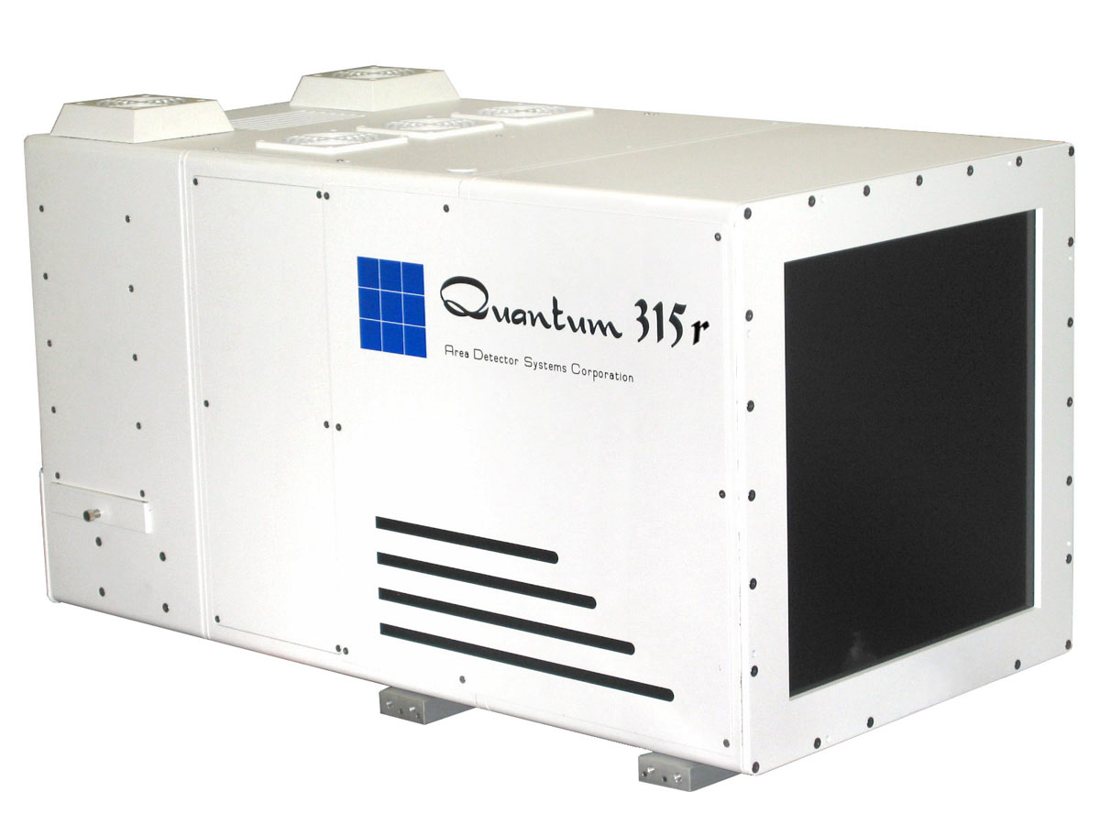
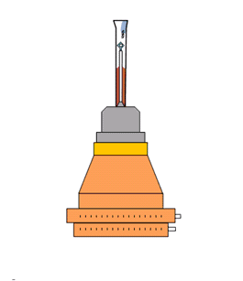
What is a “streak camera”?

Slide 3
What is a “streak camera”?

Slide 4
Same total photons, different detectors
Incident beam transmittance (%)
100 20 10 6.7 5
Integrated photons in spot
Exposure time (seconds) for 1° osc

Slide 5
Same total photons, different detectors
Incident beam transmittance (%)
100 20 10 6.7 5
Integrated photons in spot
Exposure time (seconds) for 1° osc

Slide 6
What could be better than photon-counting?
Dead times:
1000 ns Oxford
200 ns Pilatus
Count rate (photons/s)
phi position (degrees)

Slide 7
What could be better than photon-counting?
Dead times:
1000 ns Oxford
200 ns Pilatus
Count rate (photons/s)
phi position (degrees)

Slide 8
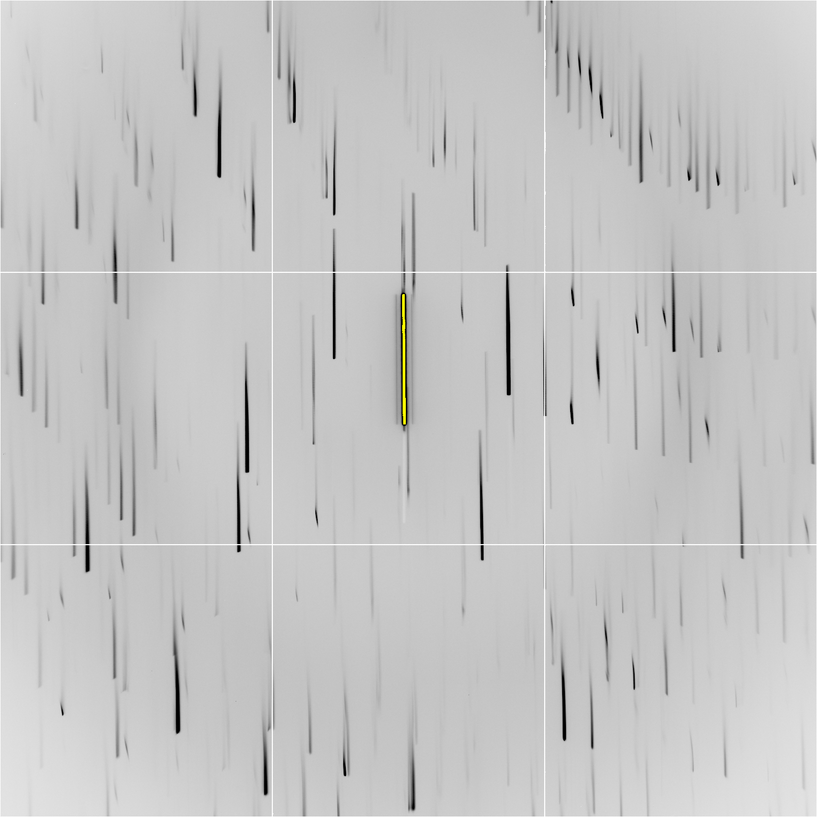

Slide 10
Individual spots at 768 kGy/s
Intensity (photons)
Dose (kGy)

Slide 11
Individual spots at 768 kGy/s
Intensity (photons)
Dose (kGy)

Slide 12
Individual spots at 768 kGy/s
Intensity (photons)
Dose (kGy)

Slide 13
Individual spots at 768 kGy/s
Intensity (photons)
Dose (kGy)

Slide 14
Individual spots at 768 kGy/s
Intensity (photons)
Dose (kGy)

Slide 15
Individual spots at 768 kGy/s
Intensity (photons)
Dose (kGy)

Slide 16
Individual spots at 768 kGy/s
Intensity (photons)
Dose (kGy)

Slide 17
xtal24big
Real time still at 674 kGy/s

Slide 18
Double-tap: no dark progression at 675 kGy/s
Intensity (photons)
Dose (kGy)

Slide 19
Double-tap: no dark progression at 675 kGy/s
Intensity (photons)
Dose (kGy)

Slide 20
xtal12
Double tap: 0.4 s on + 1 s off + on again

Slide 21
xtal13
Double tap: 0.4 s on + 1 s off + on again

Slide 22
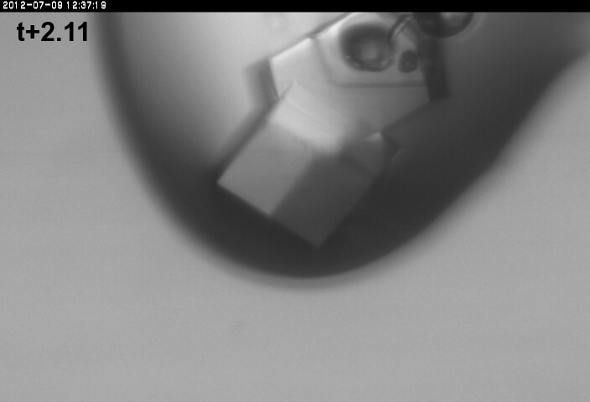
xtal13
Double tap: 0.4 s on + 1 s off + on again

Slide 23
xtal14
Double tap: 0.4 s on + 1 s off + on again

Slide 24
Xtal15 slow
Double tap lite: 5 s on + 12.6 s off + on again

Slide 25
Xtal15 fast
Double tap lite: 5 s on + 12.6 s off + on again

Slide 26
Individual spots at 44.3 kGy/s
Intensity (photons)
Time (seconds)

Slide 27
Individual spots at 44.3 kGy/s
Intensity (photons)
Time (seconds)

Slide 28
Individual spots at 44.3 kGy/s
Intensity (photons)
Time (seconds)

Slide 29
Slow wiggle

Slide 30
Dose rate: same hkl, same xtal
Intensity (photons)
Dose (kGy)

Slide 31
Dose rate: same hkl, same xtal
Intensity (photons)
Dose (kGy)

Slide 32
Dose rate: same hkl, same xtal
Intensity (photons)
Dose (kGy)

Slide 33
Dose rate: same hkl, same xtal
Intensity (photons)
Dose (kGy)

Slide 34
Dose rate: same hkl, same xtal
Intensity (photons)
Dose (kGy)

Slide 35
Dose rate: same hkl, same xtal
Intensity (photons)
Dose (kGy)

Slide 36
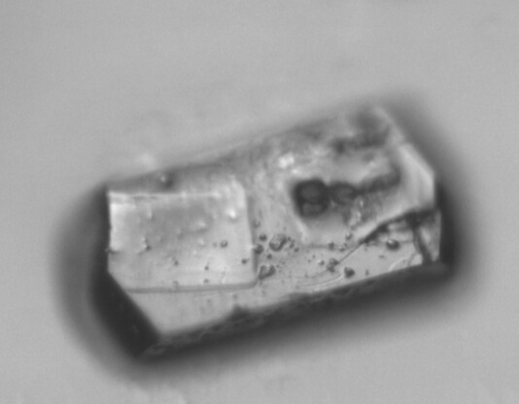
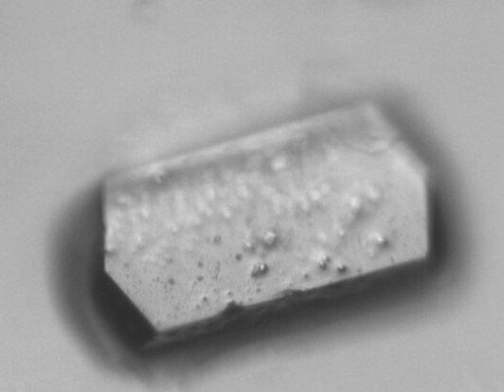
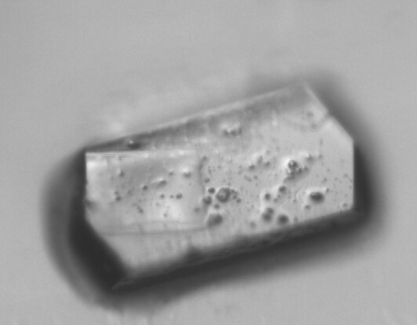
Xtal12 before & after
morphological dose-rate effect?
110 kGy/s
720 kGy/s

Slide 37
Xtal4_t1
Solvent “reaction” at 764 kGy/s

Slide 38
xtal4_t2
Solvent “reaction” at 764 kGy/s

Slide 39
xtal5_t1
Crystal “shrinks?” at 764 kGy/s

Slide 40
xtal5_t2
Crystal “shrinks?” at 764 kGy/s

Slide 41
xtal16

Slide 42
xtal17

Slide 43
xtal18

Slide 44
Xtal24big_t2

Slide 45
How much H₂ are we making?
Meents et al. (2010) claimed:
"400 molecules of H2 for every 12.5 keV photon“
= 3.3x10⁻⁷ mol/J
200 kGy to 100 um³ = 0.24 J
= 1.2x10⁻⁸ mol H₂
100 um³ of water = 6.7x10⁻⁸ mol
→ 18% of water has reacted!

Slide 46
Xtal5_t1 graph

Slide 47
Xtal5_t1 graph
Spot intensity
seconds

Slide 48
Room Temperature Damage (powder)
fraction of starting intensity
sin(θ)/λ
dose (kGy)

Slide 49
Cryo Temperature Damage (powder)
fraction of starting intensity
sin(θ)/λ
dose (MGy)

Slide 50
Room temperature damage rate
dose at half intensity (MGy)
dose rate (kGy/s)

Slide 51
Room temperature damage rate
dose at half intensity (MGy)
dose rate (kGy/s)

Slide 52
Room temperature damage rate
dose at half intensity (MGy)
dose rate (kGy/s)

Slide 53
Room temperature damage rate
dose at half intensity (MGy)
dose rate (kGy/s)

Slide 54
Room temperature damage rates
dose at half intensity (MGy)
dose rate (kGy/s)

Slide 55
Dose-rate dependence of damage
maximum useful dose (MGy)
dose rate (kGy/s)

Slide 56
Dose-rate dependence of damage
maximum useful dose (MGy)
dose rate (kGy/s)

Slide 57
Dose-rate dependence of damage
maximum useful dose (MGy)
dose rate (kGy/s)

