Slide 1
Acknowledgements
http://bl831.als.lbl.gov/~jamesh/powerpoint/RD11_noniso_2020.pptx
Robert Stroud James Fraser
Paul Adams John Tainer Greg Hura Nick Sauter
Aina Cohen Jenny Wierman Art Lyubimov Sabine Hollatz
UCSF LBNL SLAC
ALS 8.3.1: TomAlberTron
NIH NIGMS R01 GM124149 NIAID P50 AI150476
NIH NIGMS P30 GM124169 R01 GM117126
DOE-BER Integrated Diffraction Analysis Technologies (IDAT)
Plexxikon, Inc. Relay Therapeutics
NIH NIGMS P30 GM133894, NSF DBI-1625906
The Advanced Light Source is supported by the Director, Office of Science, Office of Basic Energy Sciences, Materials Sciences Division, of the US Department of Energy under contract No. DE-AC02-05CH11231 at Lawrence Berkeley National Laboratory.

Slide 2
Non-isomorphism
ancient enemy? or blessing in disguise?

Slide 3
Non-isomorphism
is annoying
means you:
can’t merge
can’t
add
can’t
subtract
Caused by:
rad dam
humidity
temperature
Growth conditions
Cryo-cooling
Everything

Slide 4
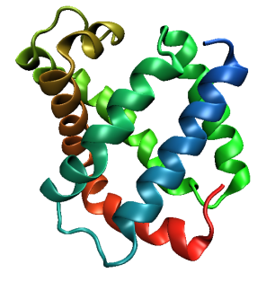
Same structure, different cell
0.5% cell change → 15%
Crick & Magdoff (1956) “theory method isomorphous replacement”, Acta Cryst. 9, 901-8.

Slide 5
Same structure, different cell
0.5% cell change → 15%
Crick & Magdoff (1956) “theory method isomorphous replacement”, Acta Cryst. 9, 901-8.

Slide 6
Uniform stretch
5% change → 0%

Slide 7
Uniform stretch
5% change → 0%

Slide 8
Same cell, rotated protein
0.5° rotation → 16%
Crick & Magdoff (1956) “theory method isomorphous replacement”, Acta Cryst. 9, 901-8.

Slide 9
Same cell, rotated protein
0.5° rotation → 16%
Crick & Magdoff (1956) “theory method isomorphous replacement”, Acta Cryst. 9, 901-8.

Slide 10
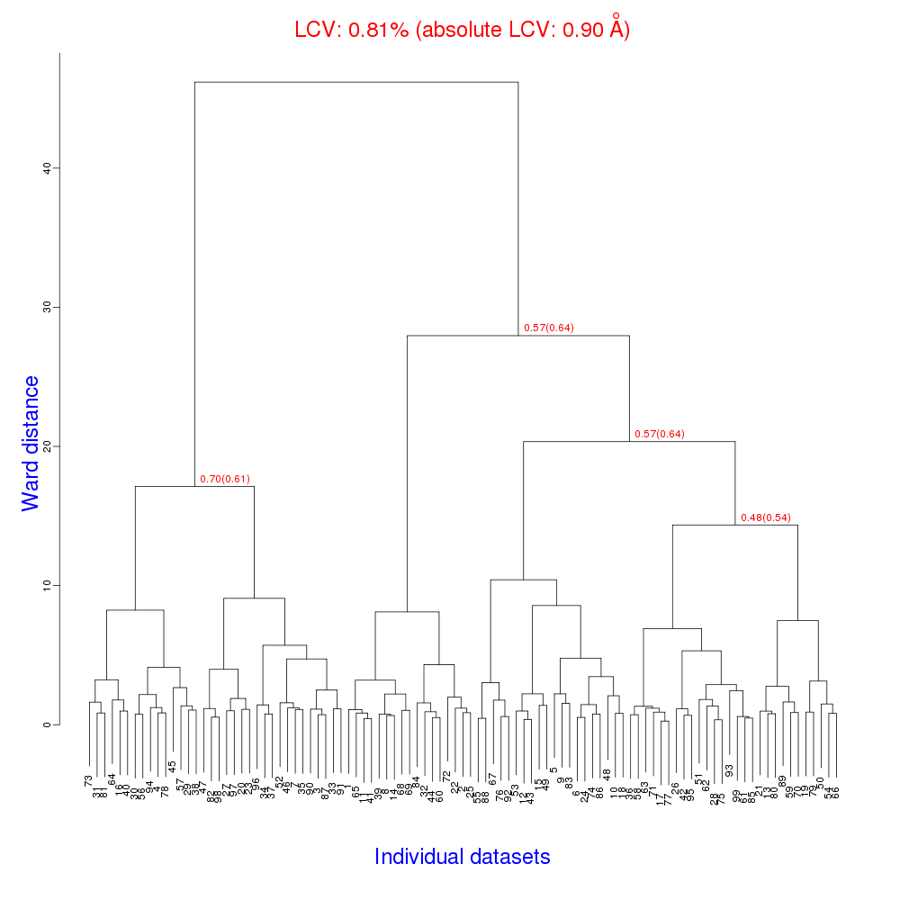
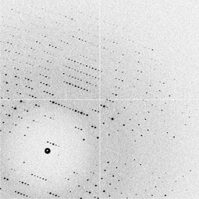
Cell clustering: 100 datasets
Reality:
Perfect isomorphism
(simulated data)
Holton, J. (2019). Acta Cryst. D 75, 113-122.

Slide 11
Take home:
Cell change ≠ nonisomorphism

Slide 12
Micro-focus challenge
5 µm xtals
5 µm beam
~ 5 img / xtal
P2₁2₁2₁
XDS thinks:
P422
Holton, J. (2019). Acta Cryst. D 75, 113-122.

Slide 13
Magdoff & Crick (1955) “Ribonuclease II. Accuracy of measurement and shrinkage”, Acta Cryst. 8, 461-8.
Crick & Magdoff (1956) “The theory of the method of isomorphous replacement for protein crystals”, Acta Cryst. 9, 901-8.

Slide 14
Non-isomorphism in lysozyme
Dear James
The story of the two forms of lysozyme crystals goes back to about 1964 when it was found that the diffraction patterns from different crystals could be placed in one of two classes depending on their intensities. This discovery was a big set back at the time and I can remember a lecture title being changed from the 'The structure of lysozyme' to 'The structure of lysozyme two steps forward and one step back'. Thereafter the crystals were screened based on intensities of the (11,11,l) rows to distinguish them (e.g. 11,11,4 > 11,11,5 in one form and vice versa in another). Data were collected only for those that fulfilled the Type II criteria. (These reflections were easy to measure on the linear diffractometer because crystals were mounted to rotate about the diagonal axis). As I recall both Type I and Type II could be found in the same crystallisation batch . Although sometimes the external morphology allowed recognition this was not infallible.
The structure was based on Type II crystals. Later a graduate student Helen Handoll examined Type I. The work, which was in the early days and before refinement programmes, seemed to suggest that the differences lay in the arrangement of water or chloride molecules (Lysozyme was crystallised from NaCl). But the work was never written up. Keith Wilson at one stage was following this up as lysozyme was being used to test data collection strategies but I do not know the outcome.
An account of this is given in International Table Volume F (Rossmann and Arnold edited 2001) p760.
Tony North was much involved in sorting this out and if you wanted more info he would be the person to contact. I hope this is helpful. Do let me know if you need more.
Best wishes
Louise

Slide 15
Non-isomorphism in lysozyme
Structure factor (e⁻)
Johnson’s ratio

Slide 16
Non-isomorphism in lysozyme
Structure factor (e⁻)
Johnson’s ratio

Slide 17
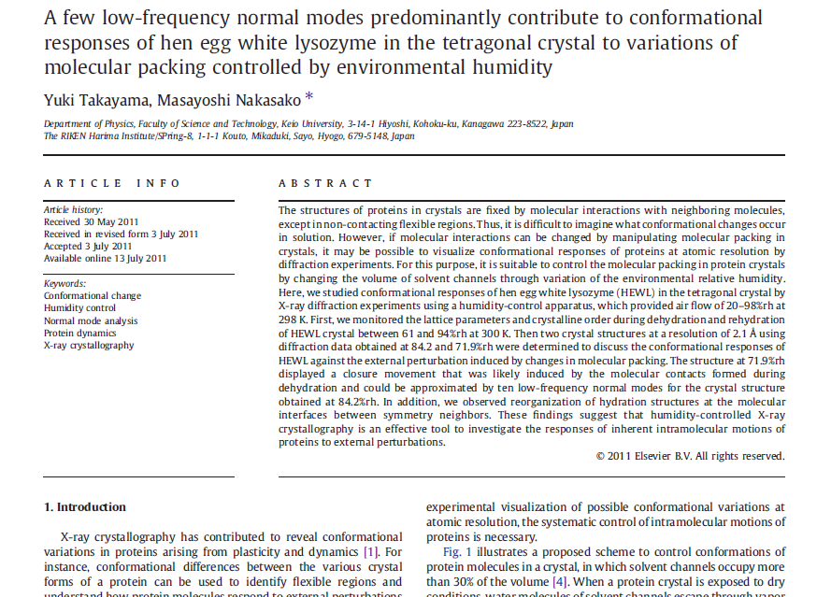

Slide 18
Non-isomorphism in lysozyme
RMSD = 1.70 Å
Δcell = 0.7 %
R_{iso} = 44.5%
RMSD = 0.18 Å
RH: 84.2%
vs 71.9%
3aw6
3aw7

Slide 19
Elastic deformation = non-isomorphism

Slide 20
Elastic deformation = non-isomorphism

Slide 21
Take home:
Molecular movement
might be functionally relevant

Slide 22
Non-isomorphism in lysozyme
RH 84.2% vs 71.9%
RMSD = 0.18 Å
R_{iso} = 44.5%

Slide 23
Plastic deformation = poor diffraction

Slide 24
Plastic deformation = poor diffraction

Slide 25
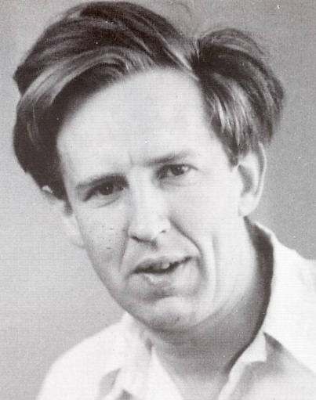
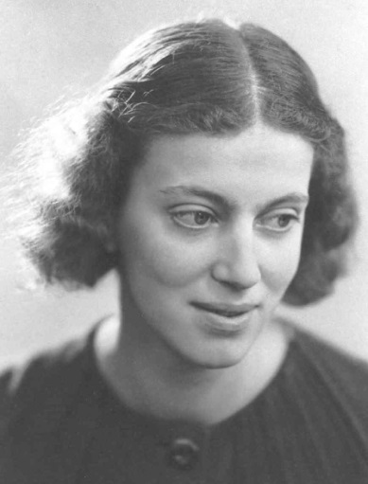
First diffraction from protein xtal
1934
Bernal, J. & Crowfoot, D. (1934). "X-ray photographs of crystalline pepsin", Nature 133, 794-795.

Slide 26
Dehydration: 1934
and 2020?
= 1.5 μL
100 μm
= 1.0 nL
2 mm
= 1.0 pL
10 μm
= 1.0 fL
1 μm

Slide 27
opened drop: you have ~30 seconds!
equilibrated drop

Slide 28
X-ray scattering “rules”:
Optimum: support thickness = crystal thickness
1 μm crystal ≈ 1 μm water
≈ 1 μm plastic
≈ 0.1 μm glass
≈ 1000 μm air
~ 50 mm He
≈ 370 mm sat water vapor @ 4C

Slide 29
Hygrostatic gradients
high
water activity
low
jet
loop

Slide 30
Take home:
Worry about humidity

Slide 31
Take home:
Worry about everything

Slide 32
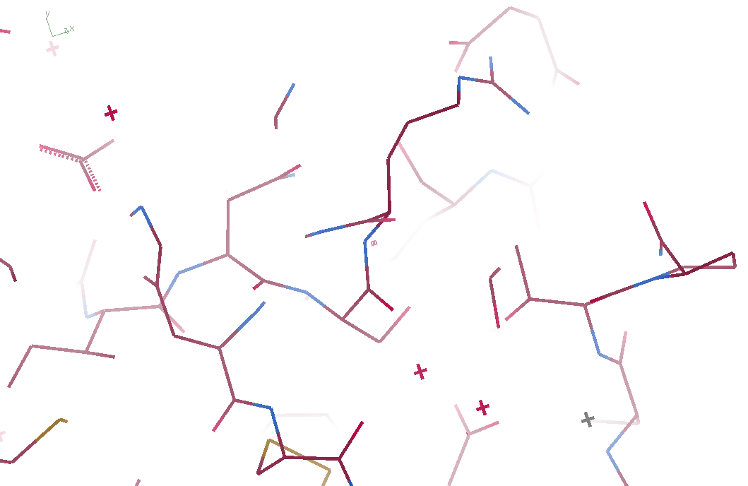
3aw6

Slide 33
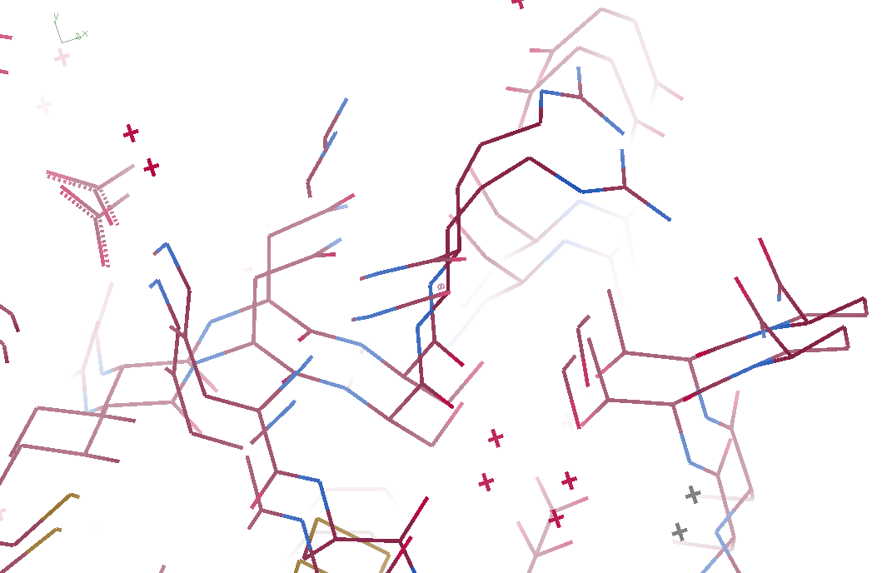
3aw6 3aw7

Slide 34
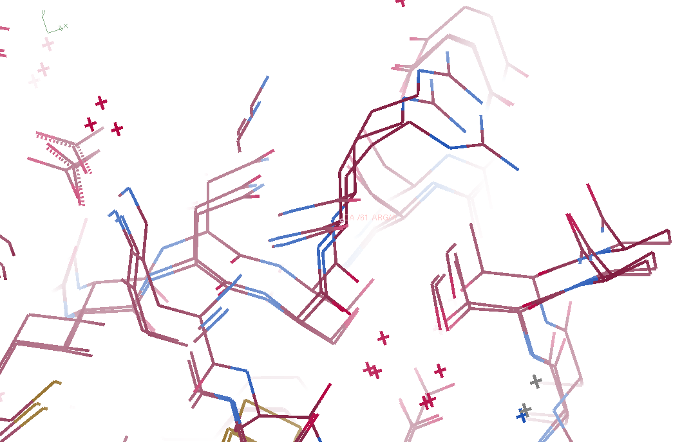
3aw6, 3aw7, “bent” 3aw6

Slide 35
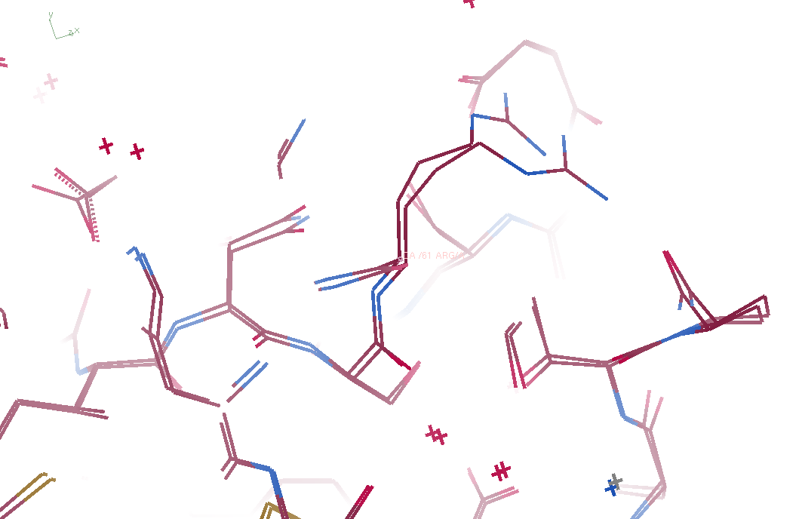
3aw7, “bent” 3aw6

Slide 36
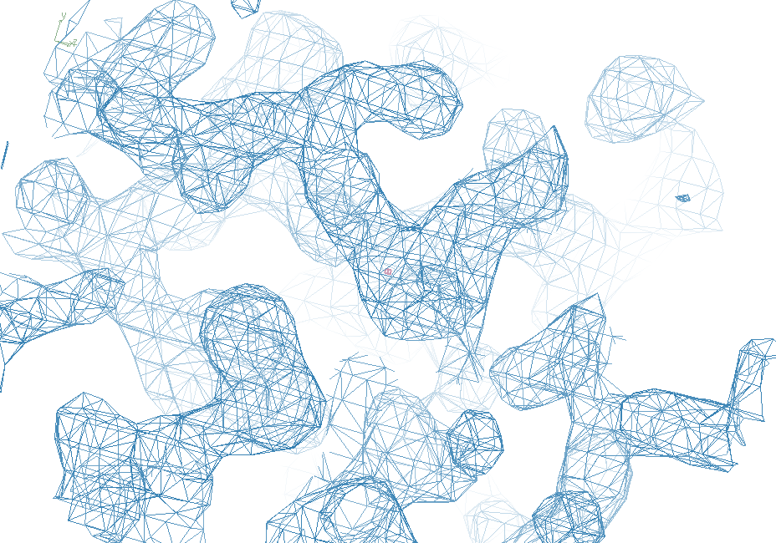
3aw6

Slide 37
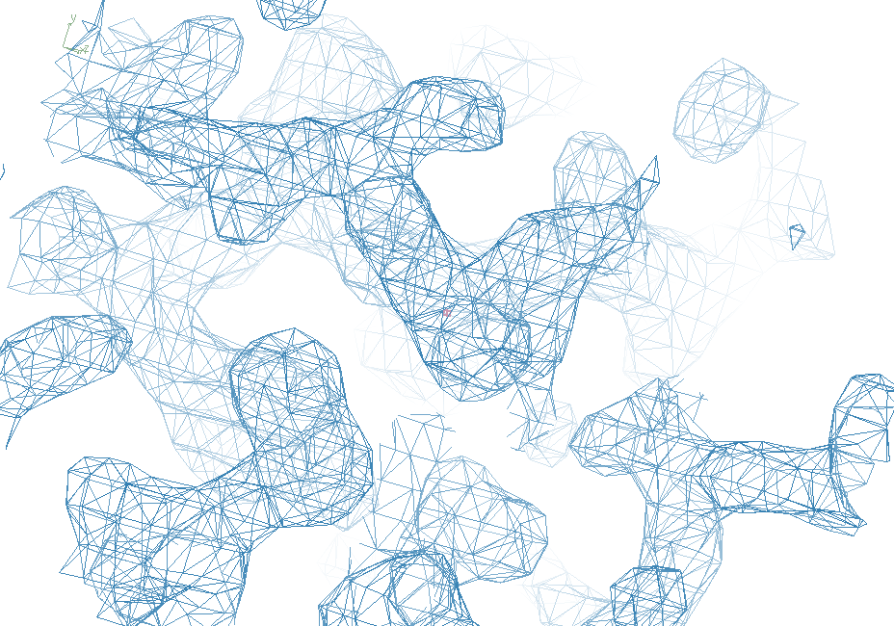
“bent” 3aw7

Slide 38
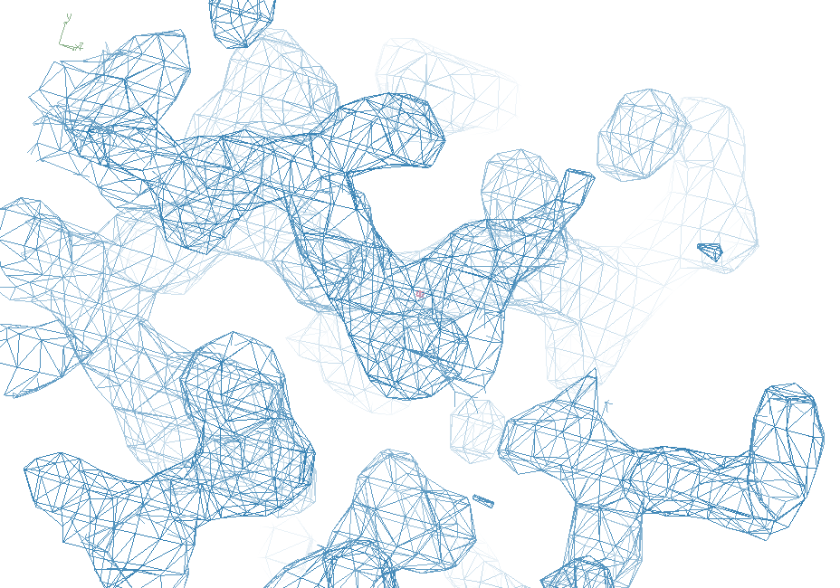
3aw7

Slide 39
Take home:
Align maps before subtraction

Slide 40
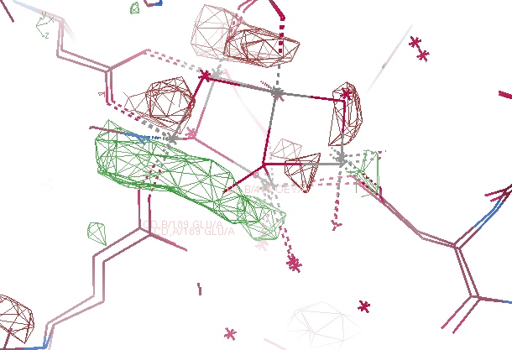
Fo – Fo map
5ws6 - 5ws5
Suga, M., et al., site of O=O bond formation in PSII
caught by XFEL. Nature, 2017. 543: p. 131.

Slide 41
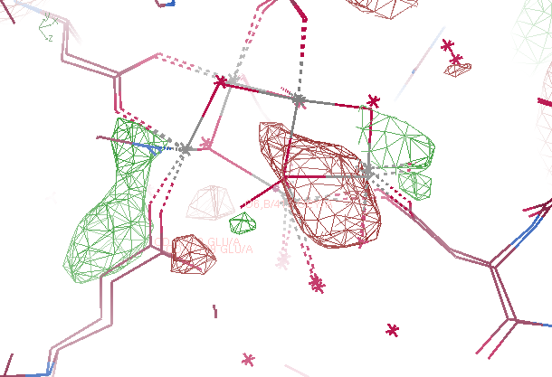
Fo – Fo map
5ws6 - 5ws5

Slide 42
Major caveat:
Map “sigma” is meaningless
how to avoid sharp edges?

Slide 43
“map bender” procedure
Convert to fractional coordinates
Basis functions: spatial sin waves

Slide 44
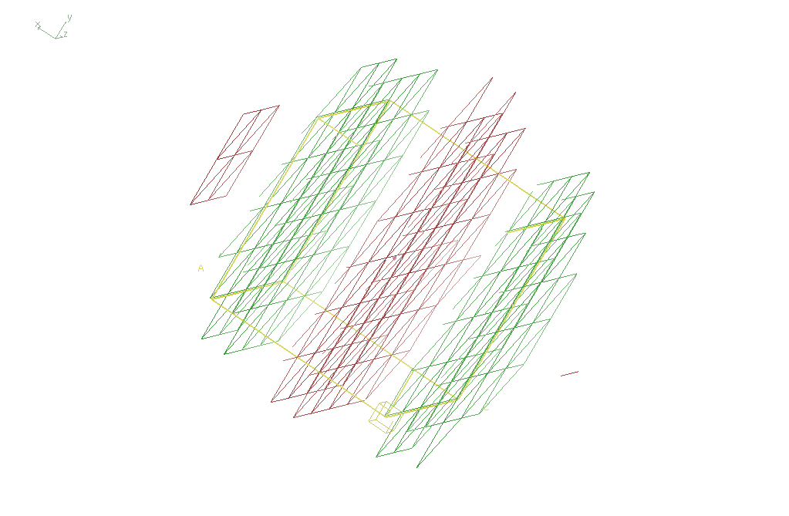
Basis function 1 0 0

Slide 45
“map bender” procedure
Convert to fractional coordinates
Basis functions: spatial sin waves
Repeats with unit cell
Low-order h,k,l indices first
Fit function to Δx vs x,y,z across P1 cell
Repeat with Δy, Δz
Apply to PDB file and interpolate map grid
Usually 3-5 orders comparable to LSQ

Slide 46
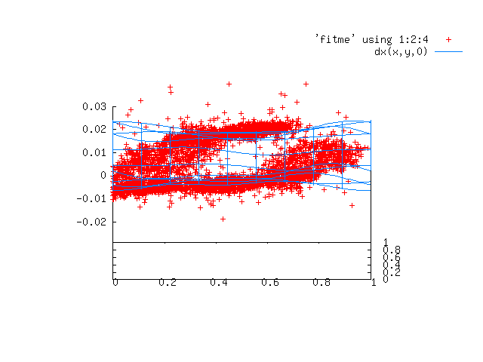

Slide 47
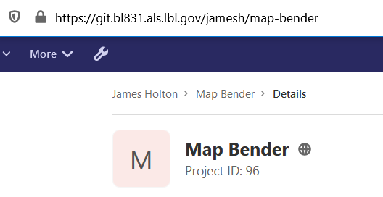
Downloading “map bender”

Slide 48
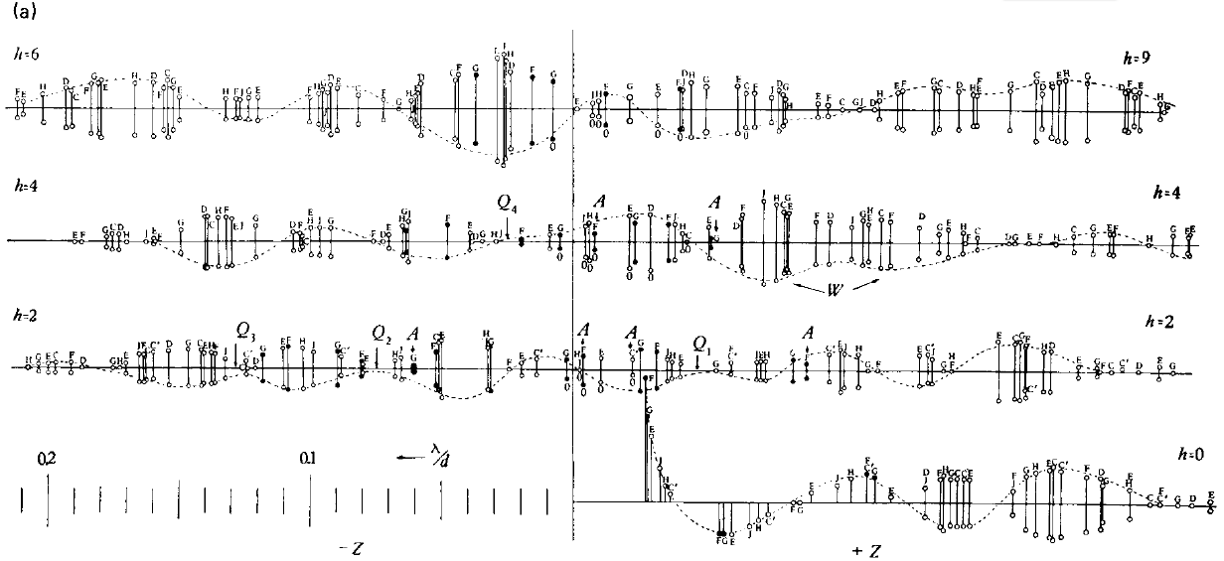
Bragg’s “minimum wavelength principle”
Perutz (1985). “Early Days of Cryst…” Methods in Enzymology, Vol. 114, 3-18.
Bragg & Perutz (1952)."external form haemoglobin I", Acta Cryst. 5, 277-283.

Slide 49
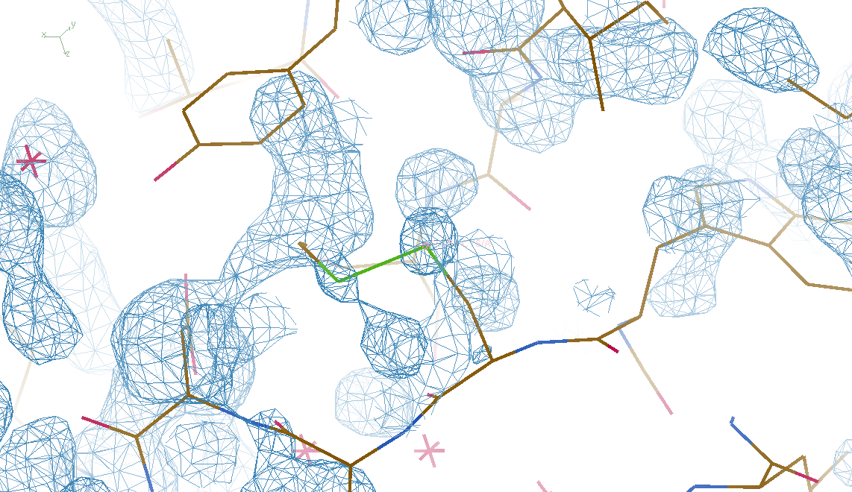
DMMULTI – fake data 4 deg rotation: 8 “xtals”: before
CC = 0.02

Slide 50
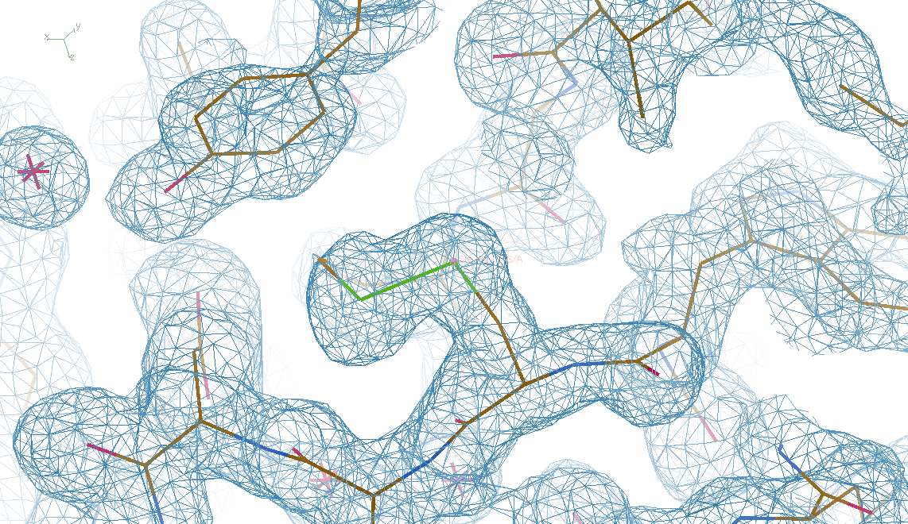
DMMULTI – fake data 4 deg rotation: 8 “xtals”: after
CC = 0.8

Slide 51
S-SAD merging 20 xtals
Knott et al. (2017). "Guide-bound CRISPR-Cas13a." Nature S&MB 24, 825
20 xtals

Slide 52
Systematic vs random error
intensity
observation

Slide 53
URLs & Summary
https://bl831.als.lbl.gov/~jamesh/powerpoint/
RD11_noniso_2020.pptx
https://git.bl831.als.lbl.gov/jamesh/map-bender
Cell does not always tell
Damage, humidity & everything else
May reveal function
Align before subtract
Ignore & merge?

Slide 54
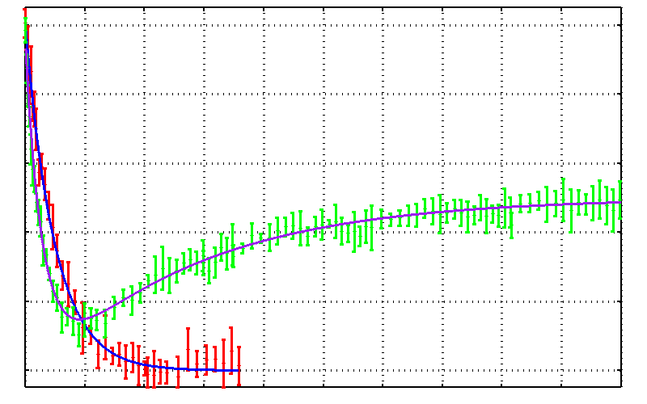
damage repair?
25mM SeMet in 50 mM bis-tris
Half-dose = 17.0 ± 0.7 MGy
25% glycerol
Half-dose = 10 ± 0.4 MGy
25% threhalose
Drift!
0.0 0.2 0.4 0.6 0.8 1.0
Fraction Se-Met undamaged
Reverse half-dose = 93 ± 5 MGy
0 100 200 300 400 500
Absorbed Dose (MGy)

Slide 55
False “Damage reversal”: from drift
X-ray beam
crystal

Slide 56
False “Damage reversal”: from beam profile
X-ray beam
crystal

Slide 57
False “Damage reversal”: from beam profile
Cold beam
Hot beam
crystal

Slide 58
False “Damage reversal”: from beam profile
Cold beam
Hot beam
crystal

Slide 59
False “Damage reversal”: from beam profile
Cold beam
Hot beam
crystal

Slide 60
False “Damage reversal”: from beam profile
Cold beam
Hot beam
crystal

Slide 61
Gaussian beam
50% of flux
the other 50%

Slide 62
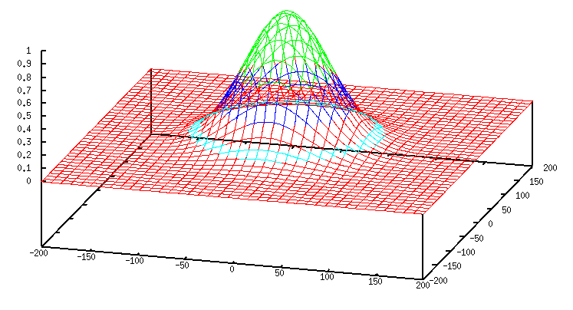
Gaussian beam
50% of flux
25% of flux
12.5 % of flux
6.3 % of flux
6.3%

Slide 63
Collimated beam
100% of flux
0%

Slide 64
Non-Gaussian beam

Slide 65
Reaction progression
$$f_{left}\left(D_{voxel}\right)= 2^{− \frac{D_{voxel}}{D_{1/2,s}}}$$
Stuff still un-reacted
“true”, unweighted dose of single voxel

Slide 66
“fading” weight
$$w_{fade}\left(D_{voxel}\right)=2^{− \frac{D_{voxel}}{D_{1/2,g}}}$$
Contribution relative to starting value
“true”, unweighted dose of single voxel

Slide 67
“hit rate” weight
xtal
$$w_{hit}\left(r\right)=\left\{\begin{aligned}\frac{L_{xtal}−r}{r}, &r<L_{xtal} \\ 0, &r≥L_{xtal}\end{aligned}\right.$$

Slide 68
“hit rate” weight
$$w_{hit}\left(r\right)=\left\{\begin{aligned}\frac{L_{xtal}−r}{r}, &r<L_{xtal} \\ 0, &r≥L_{xtal}\end{aligned}\right.$$

Slide 69
“hit rate” weight
xtal
$$w_{hit}\left(r\right)=\left\{\begin{aligned}\frac{L_{xtal}−r}{r}, &r<L_{xtal} \\ 0, &r≥L_{xtal}\end{aligned}\right.$$

Slide 70
“hit rate” weight
xtal
$$w_{hit}\left(r\right)=\left\{\begin{aligned}\frac{L_{xtal}−r}{r}, &r<L_{xtal} \\ 0, &r≥L_{xtal}\end{aligned}\right.$$

Slide 71
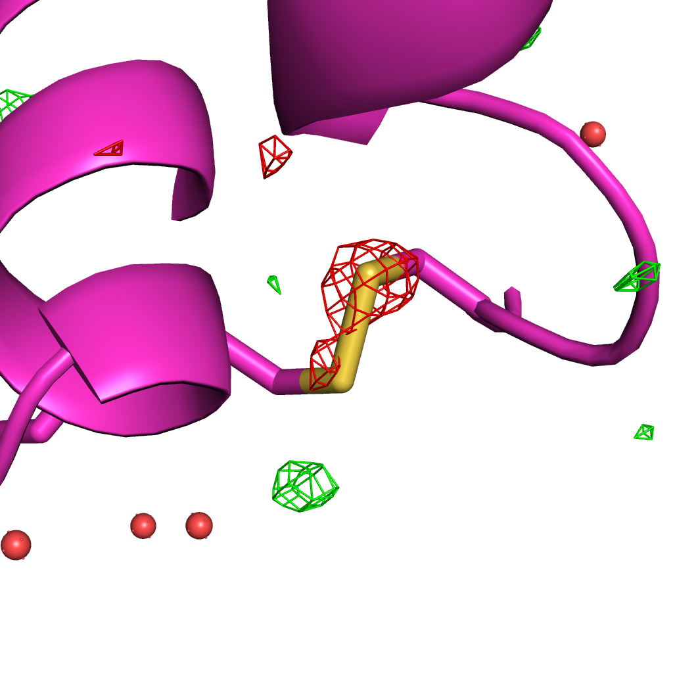
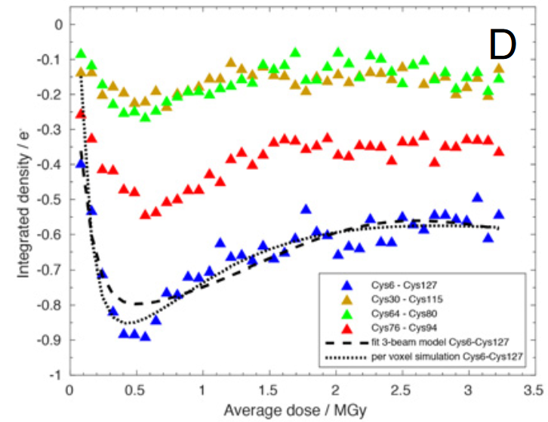
Illumination contrast appears to “reverse” damage
Room temperature high-dose rate series
0.35 MGy
Cys127
Cys6
de la Mora, et al. (2020) PNAS USA 117, 4142-4151

Slide 72
What is the dose?

Slide 73
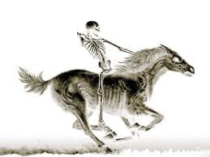
What is the dose?

Slide 74
What is the dose?

Slide 75
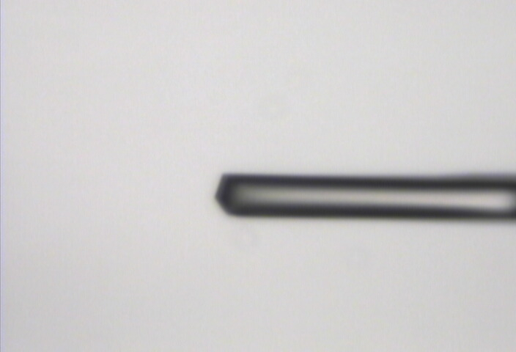
“Cleanup beam” method for flat dose profile
normalized photons/area
position relative to beam center (μm)

Slide 76
“Cleanup beam” method for flat dose profile
normalized photons/area
position relative to beam center (μm)

Slide 77
“Cleanup beam” method for flat dose profile
normalized photons/area
position relative to beam center (μm)

Slide 78
“Cleanup beam” method for flat dose profile
normalized photons/area
position relative to beam center (μm)

Slide 79
“Cleanup beam” method for flat dose profile
normalized photons/area
position relative to beam center (μm)

Slide 80
Exponential spot fading: flat dose
integrated spot intensity
dose (MGy)

Slide 81
Beam Shape Dichotomy
Flat-top beam
Uniform dose in illuminated region
Sharp edges: most sensitive to drift
Gaussian beam
No sharp edges
High dose contrast
Best of both?
“dose flattening”

Slide 82
dose flattening: two shots
beam1
beam2
Flux density (x10⁶ ph/µm²)
Position (FWHM)

Slide 83
dose flattening: two shots
beam1
beam2
Flux density (x10⁶ ph/µm²)
Position (FWHM)

Slide 84
dose flattening: two shots
beam1
beam2
Flux density (x10⁶ ph/µm²)
Position (FWHM)

Slide 85
dose flattening: two shots
beam1
beam2
Flux density (x10⁶ ph/µm²)
Position (FWHM)

Slide 86
dose flattening: two shots
beam1
beam2
Flux density (x10⁶ ph/µm²)
Position (FWHM)

Slide 87
dose flattening: two shots
beam1
beam2
Flux density (x10⁶ ph/µm²)
Position (FWHM)

Slide 88
dose flattening: two shots
beam1
beam2
Flux density (x10⁶ ph/µm²)
Position (FWHM)

Slide 89
dose flattening: two shots
beam1
beam2
Flux density (x10⁶ ph/µm²)
Position (FWHM)

Slide 90
dose flattening: two shots
beam1
beam2
0.849 FWHM
Flux density (x10⁶ ph/µm²)
FWHM
Position (FWHM)

Slide 91
dose flattening: 3 shots
0.798 FWHM
Flux density (x10⁶ ph/µm²)
Position (FWHM)

Slide 92
dose flattening: 3 shots
0.781 FWHM
12%
Flux density (x10⁶ ph/µm²)
Position (FWHM)

Slide 93
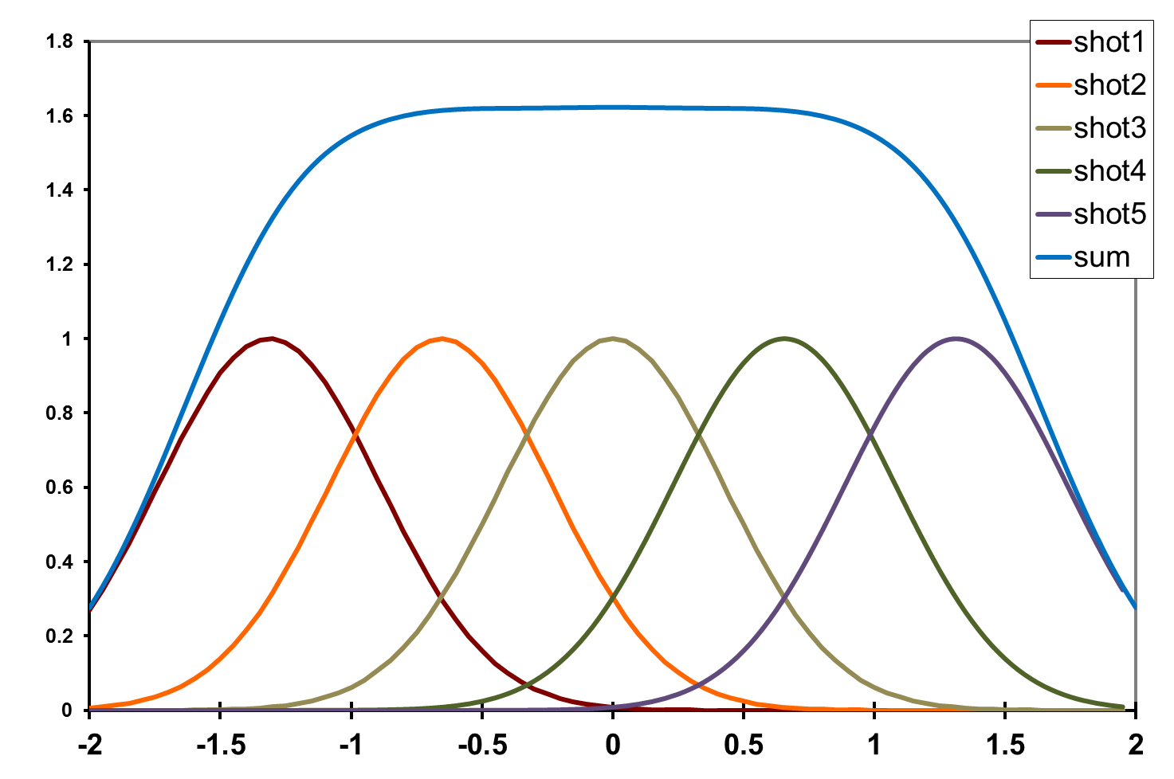
dose flattening: 5 shots
0.656 FWHM
Flux density (x10⁶ ph/µm²)
Position (FWHM)

Slide 94
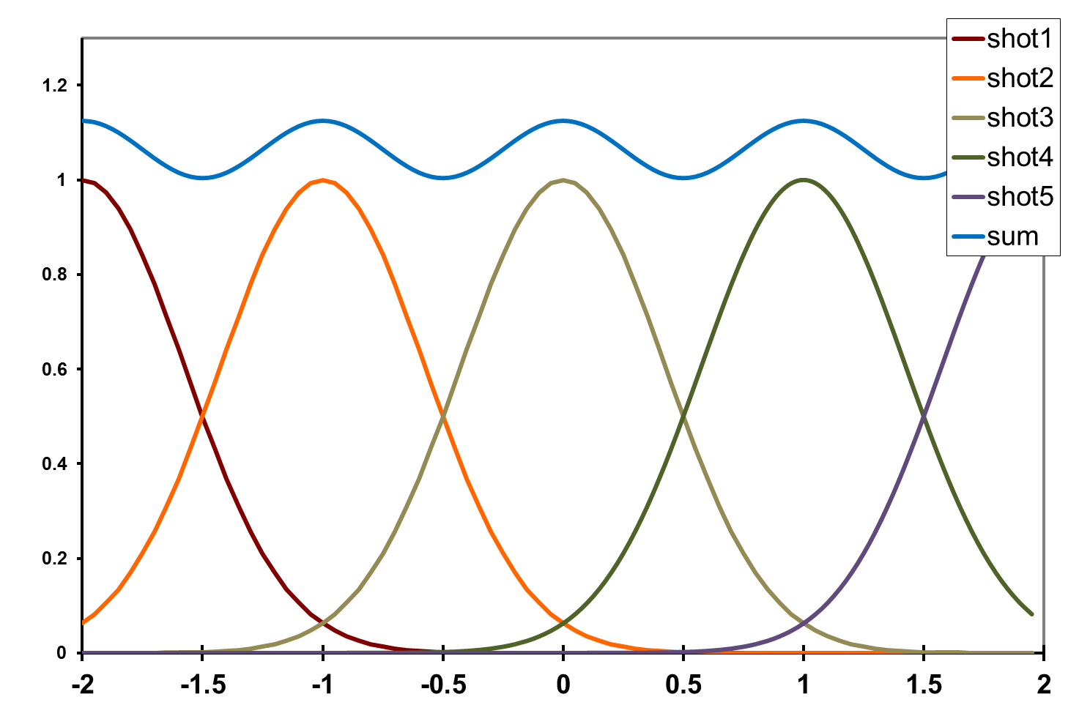
dose flattening: shot train
12%
1.0 FWHM
Flux density (x10⁶ ph/µm²)
Position (FWHM)

Slide 95
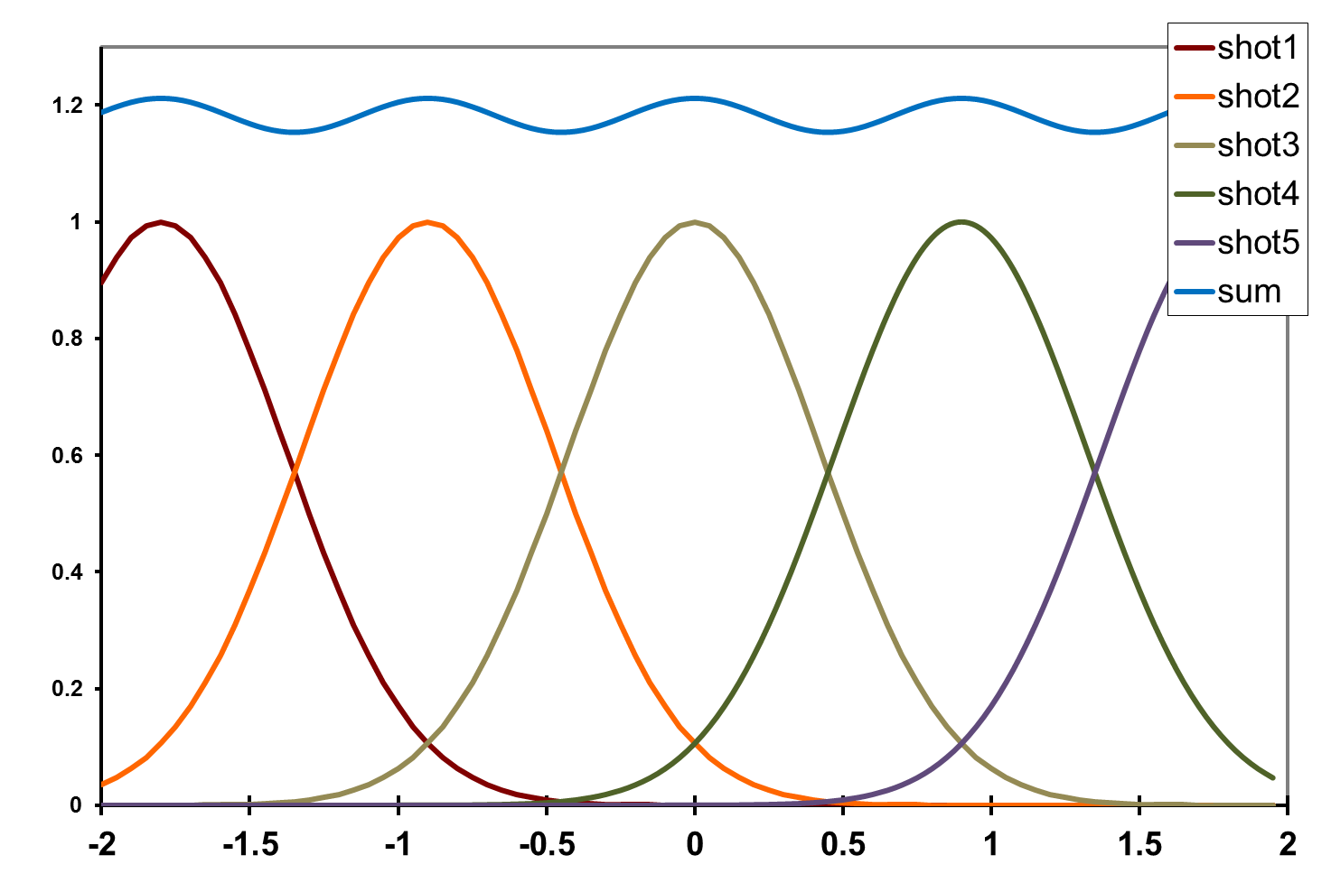
dose flattening: shot train
4.5%
0.9 FWHM
Flux density (x10⁶ ph/µm²)
Position (FWHM)

Slide 96
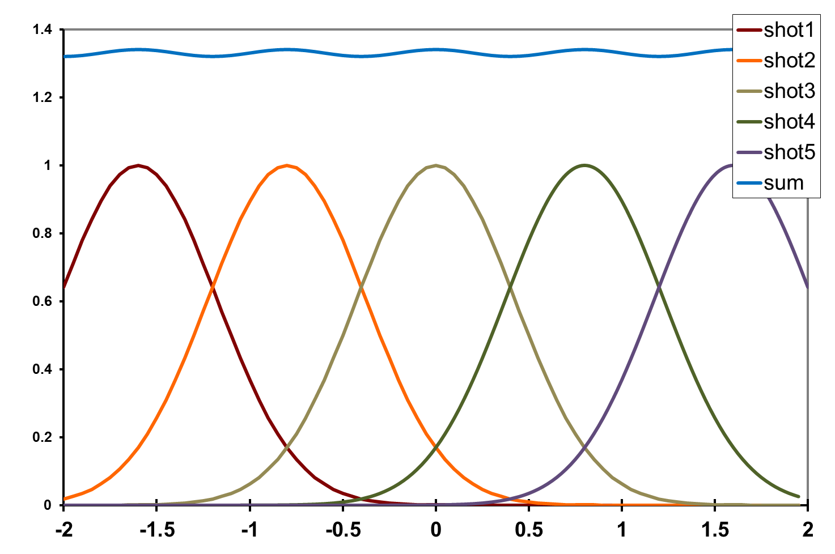
dose flattening: shot train
1.5%
0.8 FWHM
Flux density (x10⁶ ph/µm²)
Position (FWHM)

Slide 97
Summary
http://bl831.als.lbl.gov/~jamesh/powerpoint/
RD11_noniso_2020.pptx
“dose contrast” avoided with dose flattening
0.8 FWHM = very flat

Slide 98
Multi-crystal merge preparation
Take each pair of datasets
“othercell” to find all possible re-indexings
Apply all re-indexing operators in turn
Evaluate best agreement (R, CC)
Cluster by acceptable distance (20-30%)
Re-index clusters to common lattice
Apply xscale_isocluster, CODGAS, others?

Slide 99
Multi-crystal problem
< 20% = merge
% diff
% diff
% diff
% diff

Slide 100
Multi-crystal problem
< 20% = merge
comparisons
= (sets² )/2
* symops
Need
HPC

Slide 101
Trick Question: What is the space group?
a = 63 b = 63 c = 63
α = 90 β = 90 γ = 90

Slide 102
Pitfalls: sub-space groups
P622
What else?
P6₁22 P6₅22 P6₂22 P6₄22 P6₃22
P6 P6₁ P6₅ P6₂ P6₄ P6₃
P3₁2 P321 P3₁12 P3₁21 P3₂12 P3₂21
P3 P3₁ P3₂
P2 P2₁ C2 C222 C222₁
P1

Slide 103
Multi-crystal strategies
Kendrew et al. (1960) "Structure of Myoglobin” Nature 185, 422-427.

Slide 104
Multi-crystal strategies
Kendrew et al. (1960) "Structure of Myoglobin” Nature 185, 422-427.

