Slide 1
Acknowledgements
Robert Stroud James Fraser Paul Adams John Tainer
Chris Nielsen Clemens Schulze-Briese Aina Cohen Ana Gonzalez
UCSF LBNL SLAC
ALS 8.3.1: TomAlberTron
UC Multicampus Research Programs and Initiatives (MRPI)
NIH NIGMS R01 GM124149
NIH NIGMS P30 GM124169
Integrated Diffraction Analysis Technologies (IDAT)
Plexxikon, Inc.
Synchrotron Radiation Structural Biology Resource (SLAC)
The Advanced Light Source is supported by the Director, Office of Science, Office of Basic Energy Sciences, Materials Sciences Division, of the US Department of Energy under contract No. DE-AC02-05CH11231 at Lawrence Berkeley National Laboratory.

Slide 2
Painting with X-rays
Virtual beams to match any sample
(Some assembly required)

Slide 3
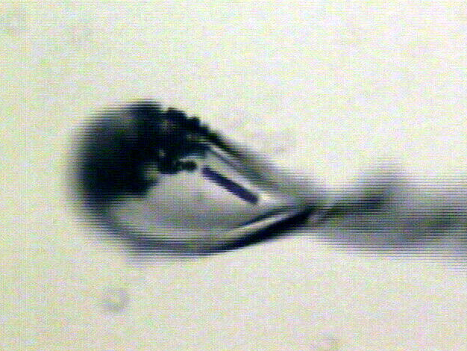
Beam size?

Slide 4
“dose contrast” effects
before

Slide 5
“dose contrast” effects
after

Slide 6
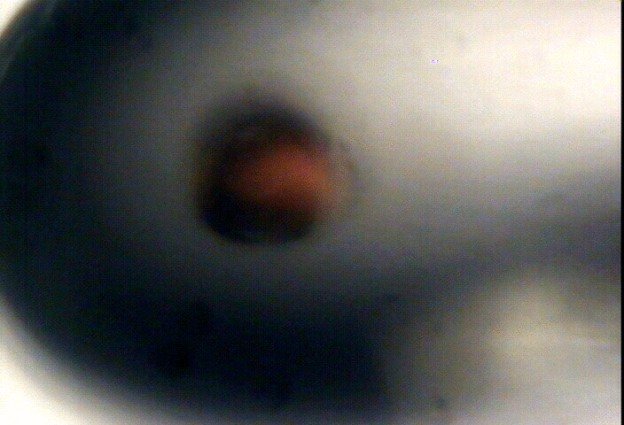
“dose contrast” effects

Slide 7
“dose contrast” effects

Slide 8
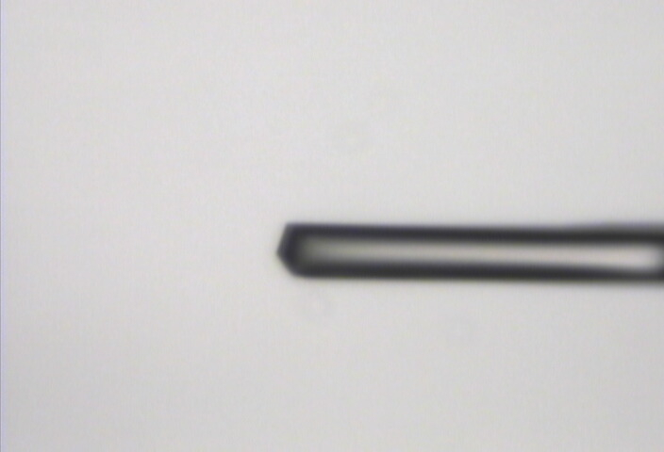
“Cleanup beam” method for flat dose profile
normalized photons/area
position relative to beam center (μm)

Slide 9
“Cleanup beam” method for flat dose profile
normalized photons/area
position relative to beam center (μm)

Slide 10
“Cleanup beam” method for flat dose profile
normalized photons/area
position relative to beam center (μm)

Slide 11
“Cleanup beam” method for flat dose profile
normalized photons/area
position relative to beam center (μm)

Slide 12
“Cleanup beam” method for flat dose profile
normalized photons/area
position relative to beam center (μm)

Slide 13
Exponential spot fading: flat dose
integrated spot intensity
dose (MGy)

Slide 14
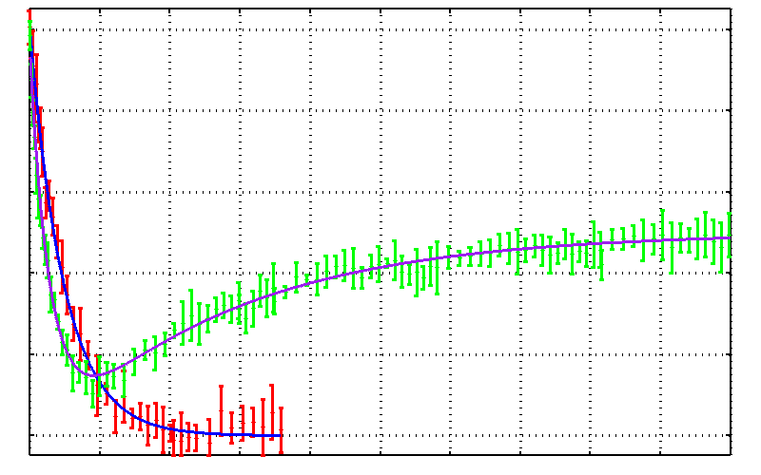
No dose flattening: damage repair?
25mM SeMet in 50 mM bis-tris
Half-dose = 17.0 ± 0.7 MGy
25% glycerol
Half-dose = 10 ± 0.4 MGy
25% threhalose
Drift!
0.0 0.2 0.4 0.6 0.8 1.0
Fraction Se-Met undamaged
Reverse half-dose = 93 ± 5 MGy
0 100 200 300 400 500
Absorbed Dose (MGy)

Slide 15
Gaussian beam
50% of flux
the other 50%

Slide 16
Collimated beam
100% of flux
0%

Slide 17
Falling into “the drift”
normalized photons/area
position relative to beam center (μm)

Slide 18
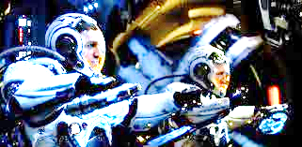
Falling into “the drift”
normalized photons/area
position relative to beam center (μm)

Slide 19
Beam Shape Dichotomy
Flat-top beam
Uniform dose in illuminated region
Sharp edges: most sensitive to drift
Gaussian beam
No sharp edges
High dose contrast
Best of both?
“dose flattening”

Slide 20
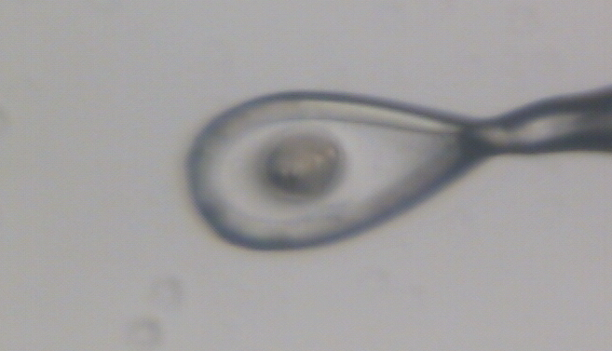
Dose contrast: differential expansion
Protein crystal in sucrose, NaWO4 and oil

Slide 21
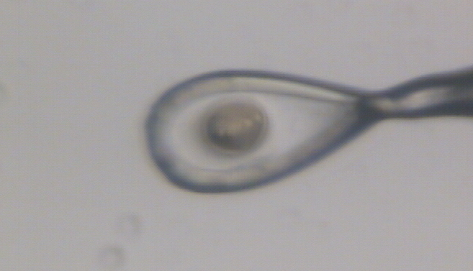
Dose contrast: differential expansion
Protein crystal in sucrose, NaWO4 and oil

Slide 22
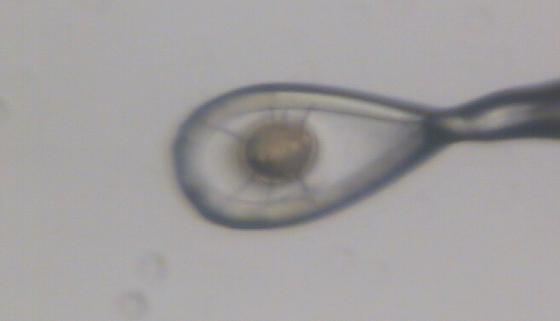
Dose contrast: differential expansion
Protein crystal in sucrose, NaWO4 and oil

Slide 23
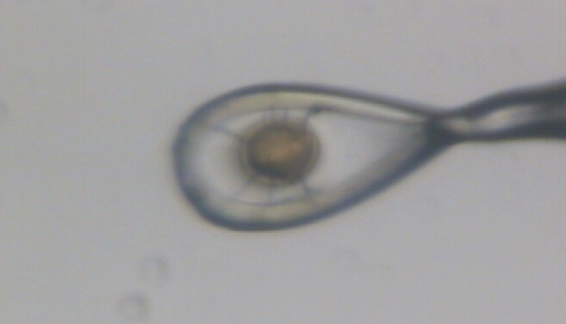
Dose contrast: differential expansion
Protein crystal in sucrose, NaWO4 and oil

Slide 24
dose flattening: two shots
beam1
beam2
Flux density (x10⁶ ph/µm²)
Position (FWHM)

Slide 25
dose flattening: two shots
beam1
beam2
Flux density (x10⁶ ph/µm²)
Position (FWHM)

Slide 26
dose flattening: two shots
beam1
beam2
Flux density (x10⁶ ph/µm²)
Position (FWHM)

Slide 27
dose flattening: two shots
beam1
beam2
Flux density (x10⁶ ph/µm²)
Position (FWHM)

Slide 28
dose flattening: two shots
beam1
beam2
Flux density (x10⁶ ph/µm²)
Position (FWHM)

Slide 29
dose flattening: two shots
beam1
beam2
Flux density (x10⁶ ph/µm²)
Position (FWHM)

Slide 30
dose flattening: two shots
beam1
beam2
Flux density (x10⁶ ph/µm²)
Position (FWHM)

Slide 31
dose flattening: two shots
beam1
beam2
Flux density (x10⁶ ph/µm²)
Position (FWHM)

Slide 32
dose flattening: two shots
beam1
beam2
0.849 FWHM
Flux density (x10⁶ ph/µm²)
FWHM
Position (FWHM)

Slide 33
dose flattening: 3 shots
0.798 FWHM
Flux density (x10⁶ ph/µm²)
Position (FWHM)

Slide 34
dose flattening: 3 shots
0.781 FWHM
12%
Flux density (x10⁶ ph/µm²)
Position (FWHM)

Slide 35
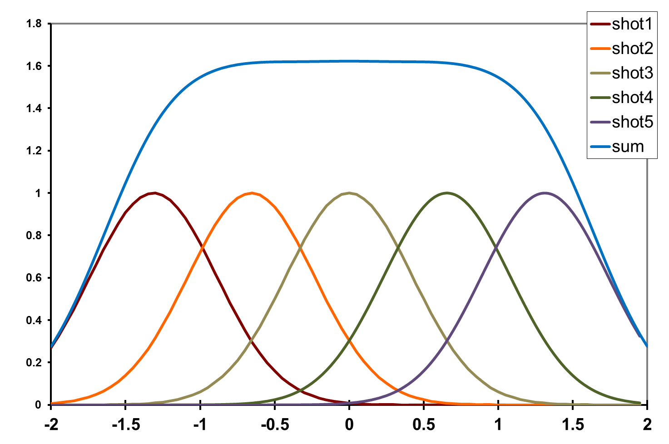
dose flattening: 5 shots
0.656 FWHM
Flux density (x10⁶ ph/µm²)
Position (FWHM)

Slide 36
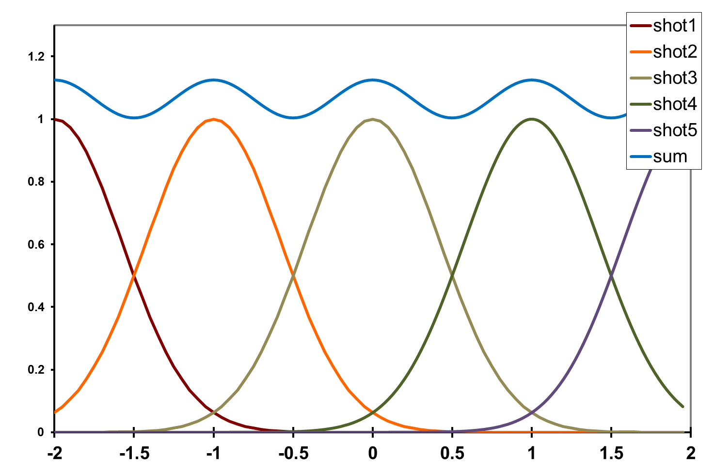
dose flattening: shot train
12%
1.0 FWHM
Flux density (x10⁶ ph/µm²)
Position (FWHM)

Slide 37
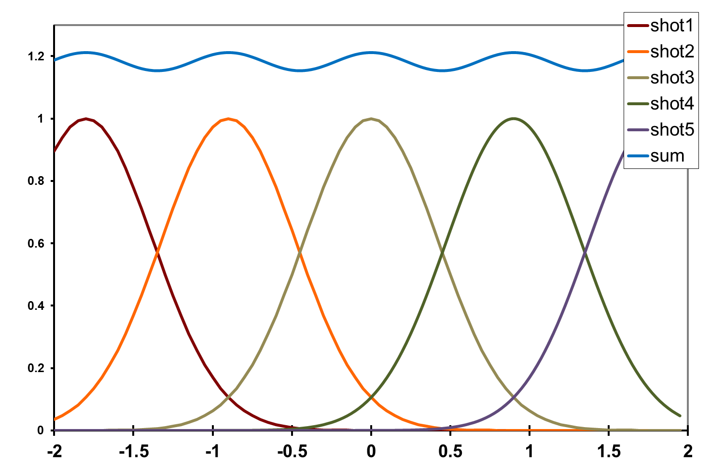
dose flattening: shot train
4.5%
0.9 FWHM
Flux density (x10⁶ ph/µm²)
Position (FWHM)

Slide 38
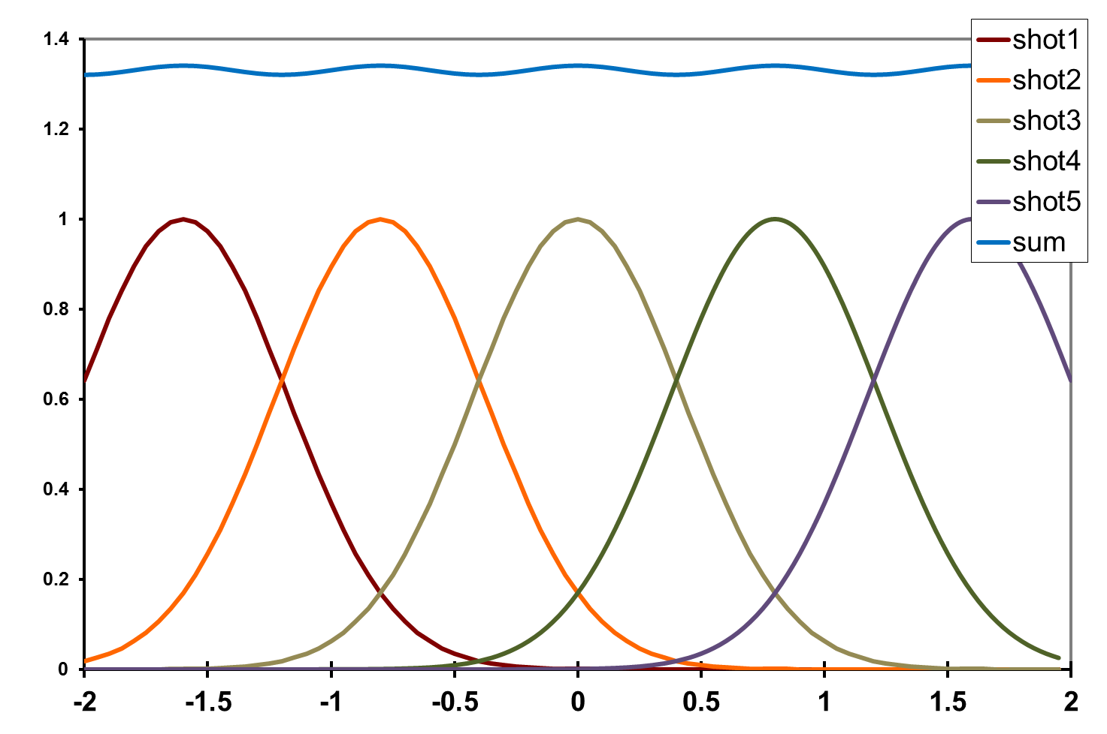
dose flattening: shot train
1.5%
0.8 FWHM
Flux density (x10⁶ ph/µm²)
Position (FWHM)

Slide 39
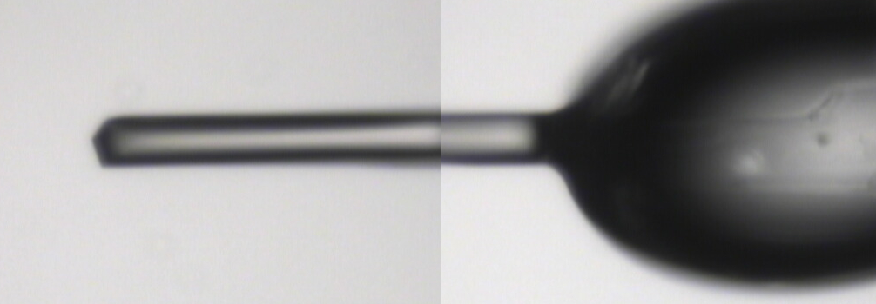
~0 MGy

Slide 40
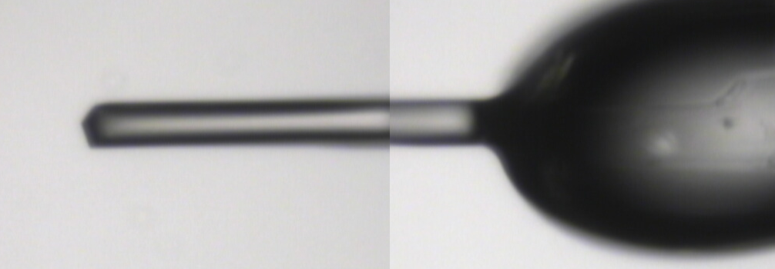
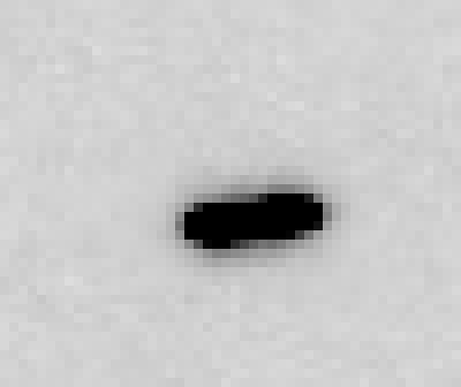
5 MGy

Slide 41
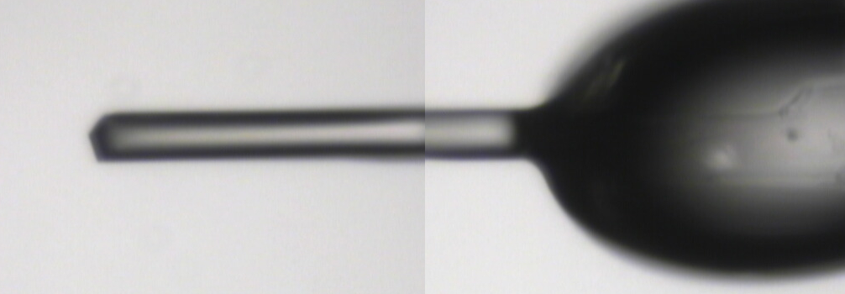
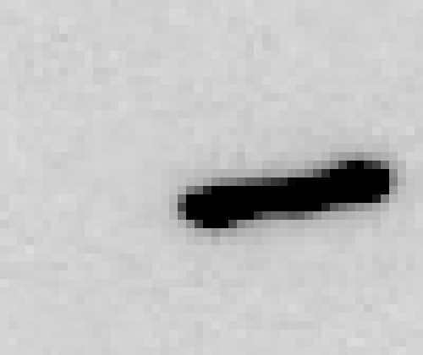
11 MGy

Slide 42
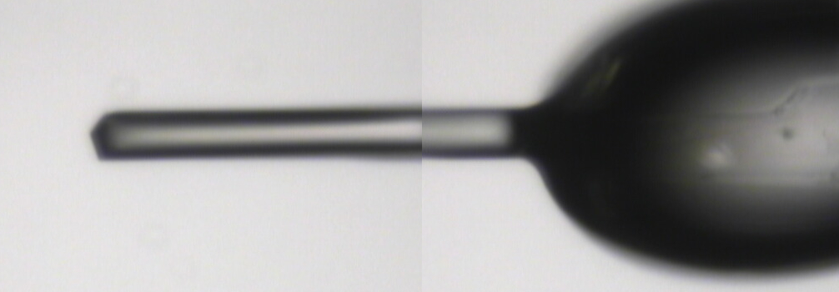
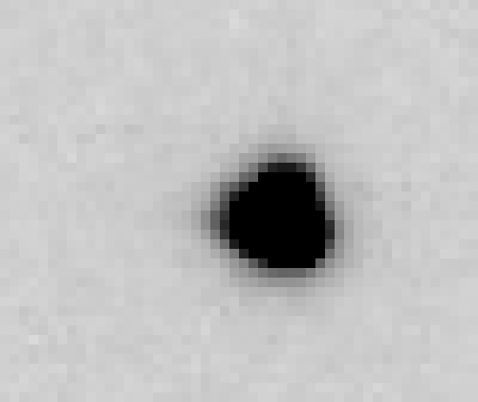
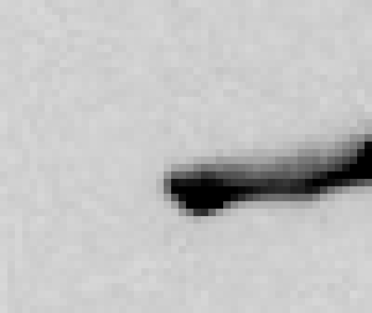
16 MGy

Slide 43
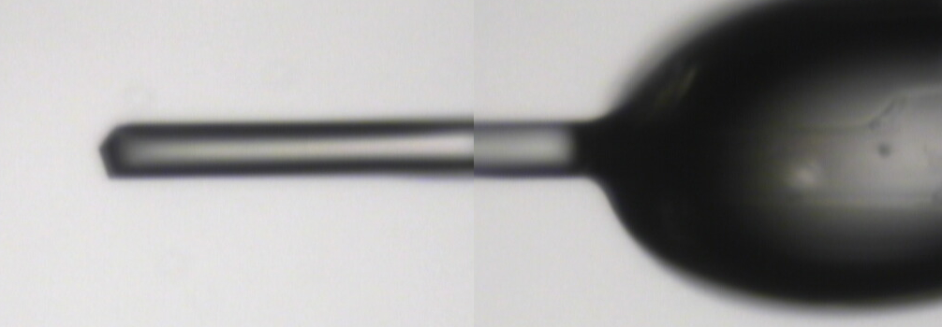
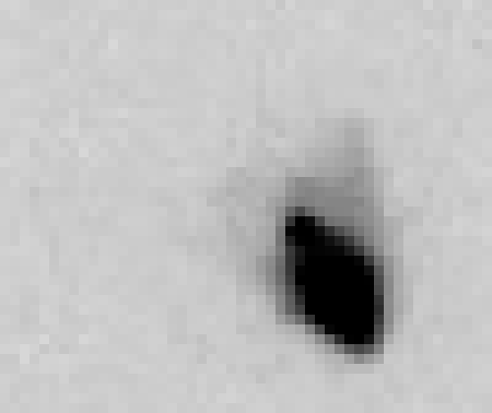
22 MGy

Slide 44
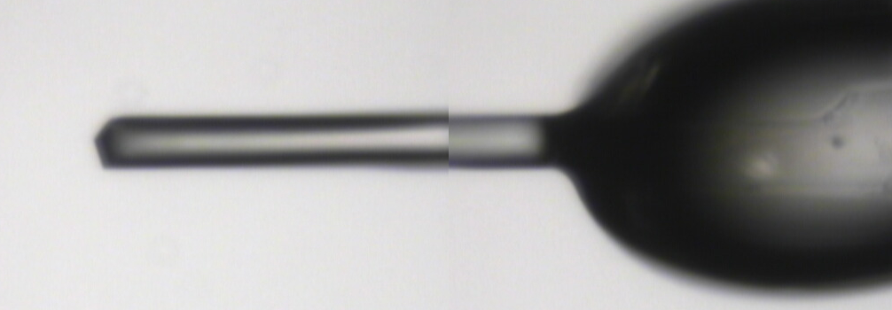
26 MGy

Slide 45
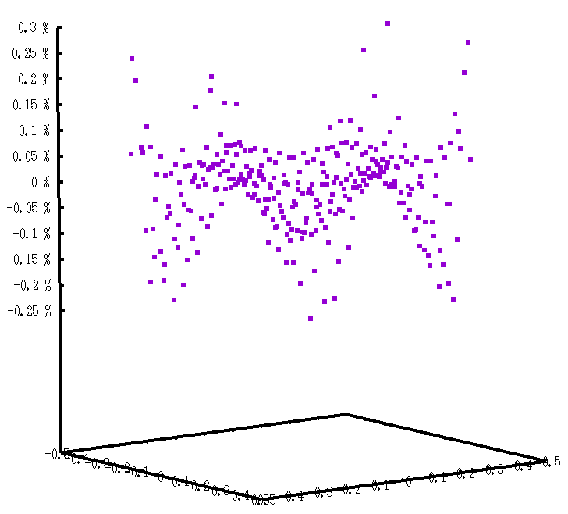
In 2D: hexagonal pattern
Avg dose = 180% peak
0.3%
0.2%
0.1%
0
-0.1%
-0.2%
-0.3%
122%
exposure
0.9 FWHM
Position (FWHM)

Slide 46
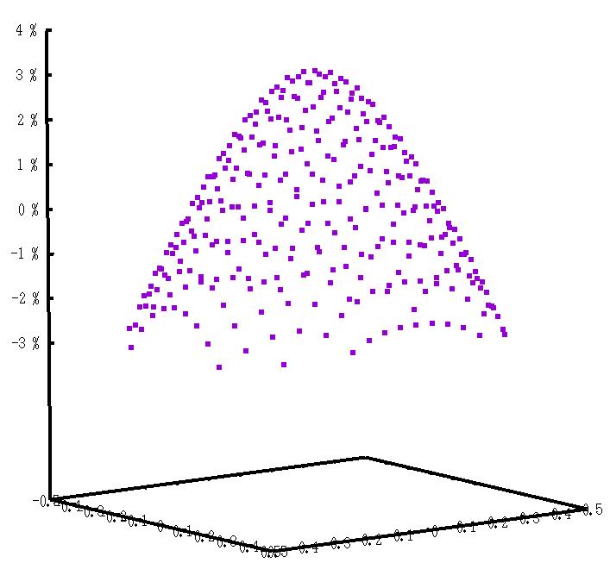
In 2D: hexagonal pattern
Avg dose = 164% peak
3%
2%
1%
0
-1%
-2%
-3%
100%
exposure
0.89 FWHM
Position (FWHM)

Slide 47
In 2D: moving train
Avg dose = 120% +/- 1.5% peak
0.8 FWHM
Position (FWHM)

Slide 48
“rastering” to find the crystal
X-ray beam
ice
Membrane
protein crystal

Slide 49
“rastering” for flat dose

Slide 50
“rastering” for virtual beam

Slide 51
Sample is 3D

Slide 52
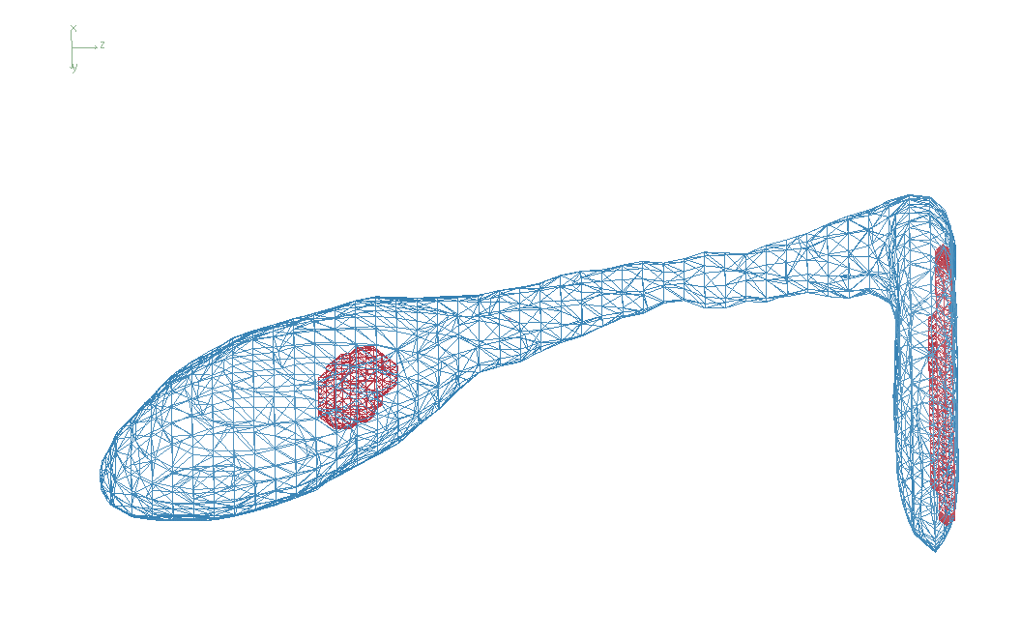
3D mapping of sample

Slide 53
Sample is 3D

Slide 54
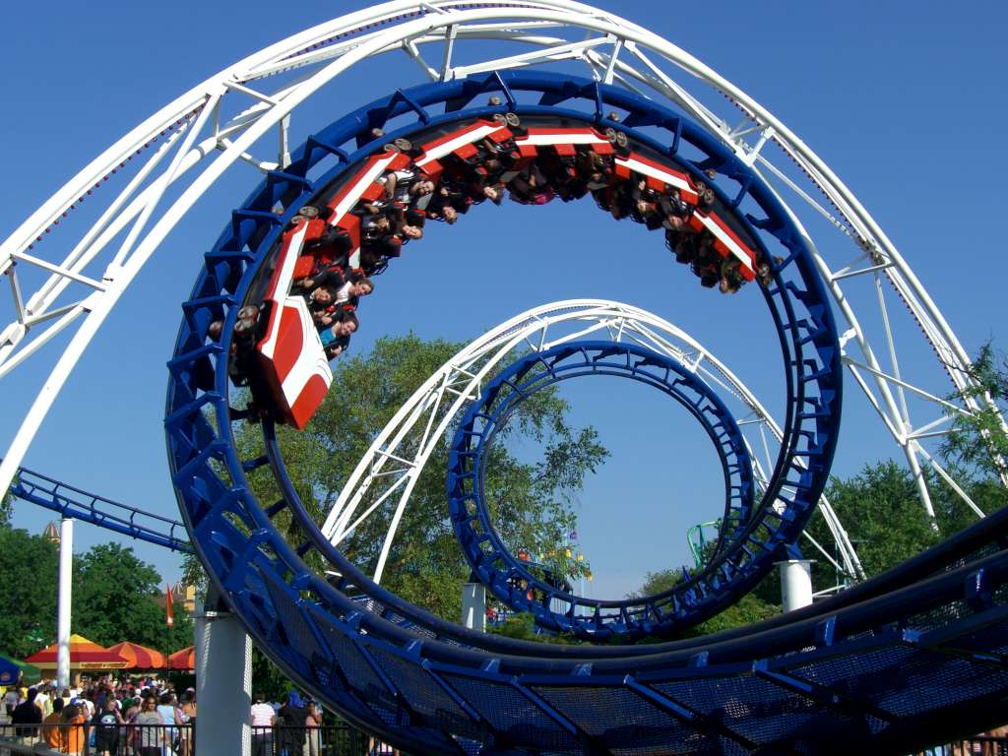
2-motor scans offset data
360°
phi
0°
position

Slide 55
2-motor scans offset data
360°
phi
0°
position

Slide 56
“rastering” for flat dose

Slide 57
How many images?
360° / 0.1° * ( 100 µm / 1 µm )²
⁼ 36x10⁶
28,000 ph/image

Slide 58
The Entropy Limit
bits
s
= log₂(N_{pixels}) * flux * t_{sample} * 1.2x10⁻⁵
minimum data rate with no information loss
N_{pixels} = 4150*4371 for Eiger
flux = photons/s onto the sample
t_{sample} = sample thickness in µm
1.2x10⁻⁵ = 10⁻⁴ cm/µm * cross section of oxygen (0.2 cm²/g)
* density of protein crystal (1.2 g/cm³ )
* ~1/2 of total scattering intersects detector
E.G. 34 GByte/s for 10¹³ photons/s and 100 µm thick

Slide 59
How to loose information
long exposures
>1 photon/image = order of arrivals
Wide phi slice
sum over angle
Large beams
sum over area
Pink/divergent beam
sum over lambda/angle
Background
non-crystal stuff
Systematics
Dose contrast

Slide 60
How long will it take?
Damage & diffraction = flux / area
Gy/s = ph/s /2000 / um²
Example: 30 MGy, 1 mm² area, flux= 10¹² ph/s
1x1 μm beam: 60 ms
100x100 μm beam: 600 s x 10x10 shots =
1x1 mm beam: 60,000 s x 1 shot = 17 hours
x 1000x1000 shots =
17 hours
17 hours
10¹³ ph/s → 1.7 h/mm²
10¹³ ph/s @ RT → 40 s/mm²
Holton (2009)."beginner's guide rad dam", J. Synch. Rad. 16, 133-142.

Slide 61
The number of photons scattered
before crystal is dead
is independent
of flux & time
1 um³ = 10⁵ photons (roomT)
1 um³ = 10⁶ photons (synch)
1 um³ = 10⁸ photons (XFEL)
(synch)
Henderson, 1990; Gonzalez & Nave, 1994; Glaeser et al., 2000; Sliz et al., 2003; Leiros et al., 2006; Owen et al., 2006; Garman & McSweeney, 2006; Garman & Nave, 2009; Holton, 2009

Slide 62
Dose slicing
low
completeness
N
photons
crystal’s useful life
N
photons
too much
read noise
N
photons

Slide 63
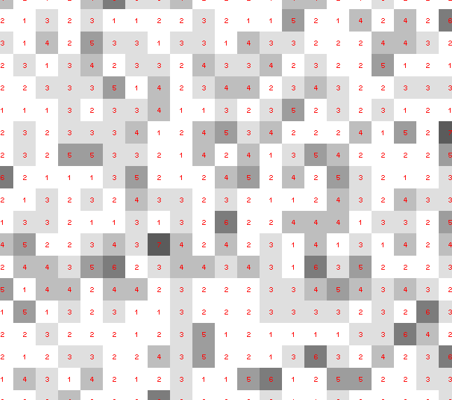
Dose slicing: is that a spot?

Slide 64
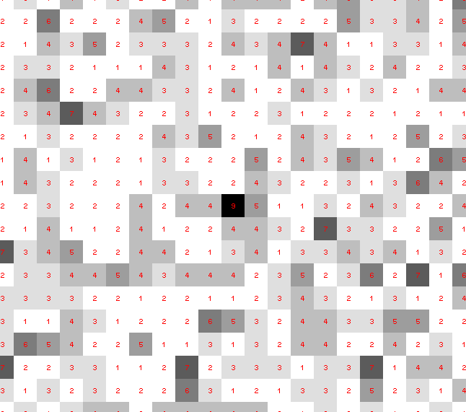
Dose slicing: is that a spot?

Slide 65
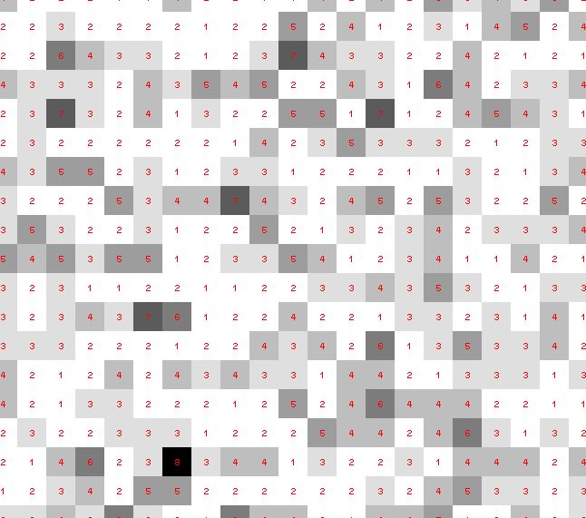
Dose slicing: is that a spot?

Slide 66
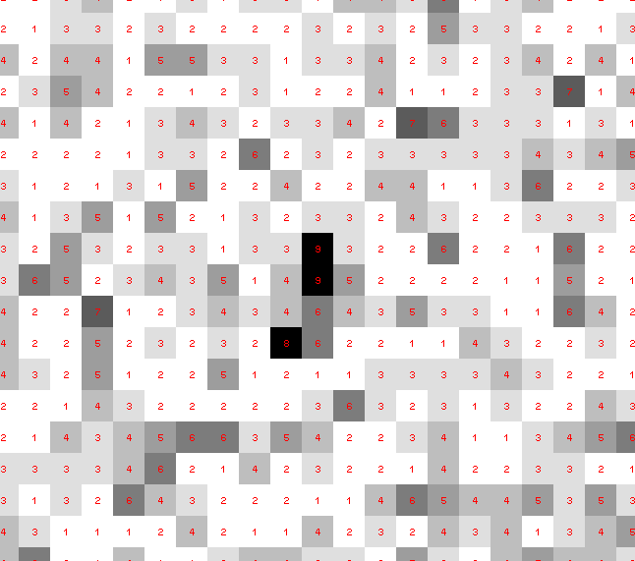
Dose slicing: is that a spot?

Slide 67
Dose slicing: is that a spot?

Slide 68
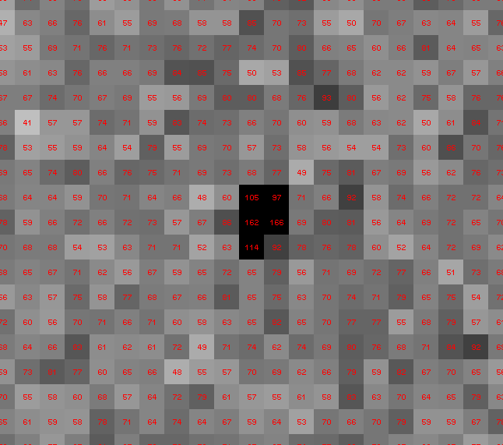
Dose slicing: is that a spot?

Slide 69
What if?
You only have a few small crystals…
Should you:
Collect 360° from each?
Collect 10° from each at 36x exposure?
Glue 36 xtals together, then collect 360° ?

Slide 70
“true” resolution limit
CC vs right answer
Resolution (Å)

Slide 71
“true” resolution vs strategy
Dose slice collection scenario
fine | coarse | glue
3.17700 | 3.14057 | 3.17604
301,640,334 photons/xtal

Slide 72
How to loose information
long exposures
>1 photon/image = order of arrivals
Wide phi slice
sum over angle
Large beams
sum over profile area
Pink/divergent beam
sum over lambda/angle
Background
non-crystal stuff
Systematics
Dose contrast, drift, read-out gap

Slide 73
Summary
http://bl831.als.lbl.gov/~jamesh/powerpoint/
RD10_painting_2018.pptx
“dose contrast” avoided with flat beams
0.8 FWHM = very flat
data beam can be virtual
Don’t fall into “the drift”!
Long exposures = lossy compression
Rastering as data collection?

