Slide 1
Recent Developments
ALS Superbend 8.3.1

Slide 2
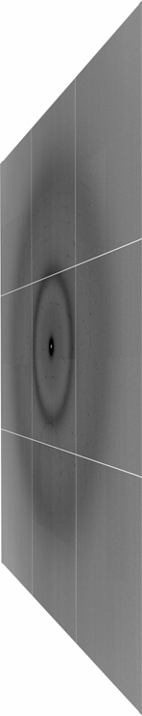
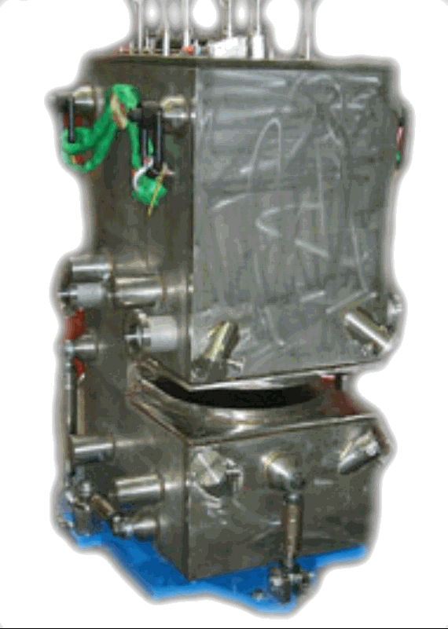
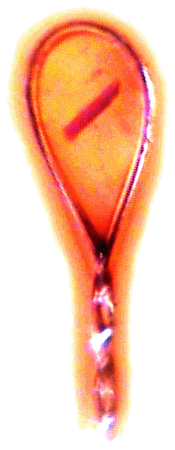
ALS 8.3.1 optics
Superbend
Pt & Rh
on invar
Plane
Parabolic
M1 mirror
Pt & Rh
on Si
Torroidal
M2 mirror
100 μm
aperture
Scatter
guard
ADSC Quantum 315r
convergence
angle slits
two flat
Si(111)
monochromator
Protein Crystal
MacDowell et. al. (2004) J. Sync. Rad. 11 447-455
Notes:
2
Most notable acheivements are high brightness with very little “wasted” light. The discovery made by Howard Padmore? At ALS showed that a 2:1 demagnification cancels nearly all of the spherical abberations in the parabolic/torroid system. 30-50% of the total x-ray intensity passes through the 100um pinhole. The flux through the 100um pinhole at the superbend beamlines is comparable to that of the 5.0.2 wiggler or an APS bending magnet, but only 150 Watts of power must be dissipated by the beamline optics. In contrast, wiggler beamlines must disipate kilowatts. The optics here are much simpler and not exotic in any way. The system is stable and robust. There is never a need to re-focus the beam at a new wavelength. Only a 2-minute automatic tuneup is recommended for very large energy changes (more than 1-2 keV).

Slide 3
ALS 8.3.1 optics
Superbend
Pt & Rh
on invar
Plane
Parabolic
M1 mirror
Pt & Rh
on Si
Torroidal
M2 mirror
100 μm
aperture
Scatter
guard
ADSC Quantum 315r
convergence
angle slits
two flat
Si(111)
monochromator
Protein Crystal
MacDowell et. al. (2004) J. Sync. Rad. 11 447-455
Notes:
3
Most notable acheivements are high brightness with very little “wasted” light. The discovery made by Howard Padmore? At ALS showed that a 2:1 demagnification cancels nearly all of the spherical abberations in the parabolic/torroid system. 30-50% of the total x-ray intensity passes through the 100um pinhole. The flux through the 100um pinhole at the superbend beamlines is comparable to that of the 5.0.2 wiggler or an APS bending magnet, but only 150 Watts of power must be dissipated by the beamline optics. In contrast, wiggler beamlines must disipate kilowatts. The optics here are much simpler and not exotic in any way. The system is stable and robust. There is never a need to re-focus the beam at a new wavelength. Only a 2-minute automatic tuneup is recommended for very large energy changes (more than 1-2 keV).

Slide 4
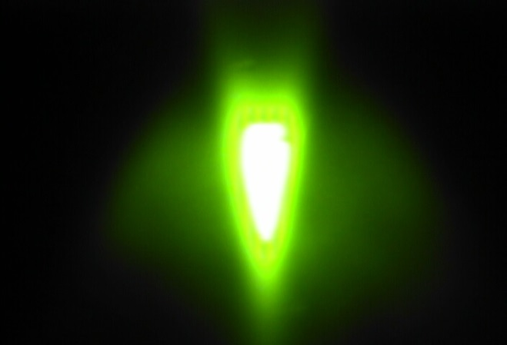
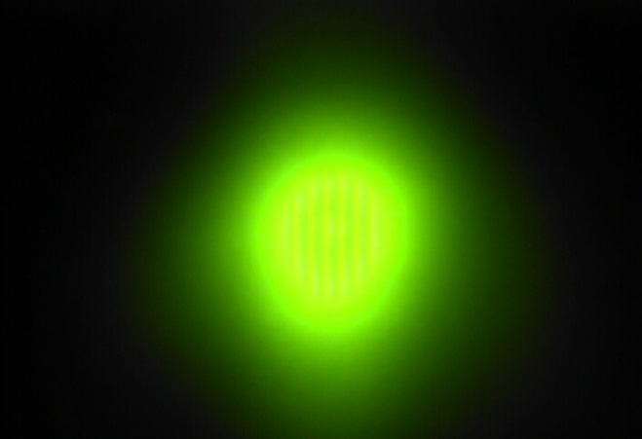
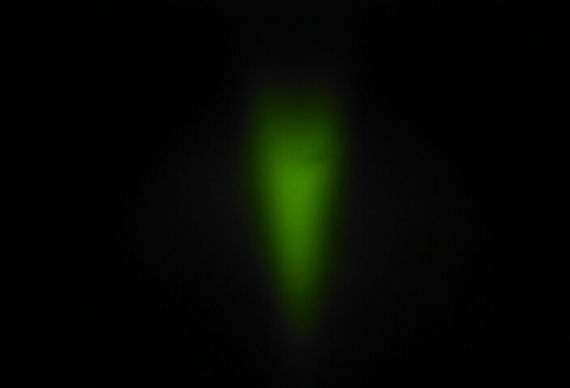
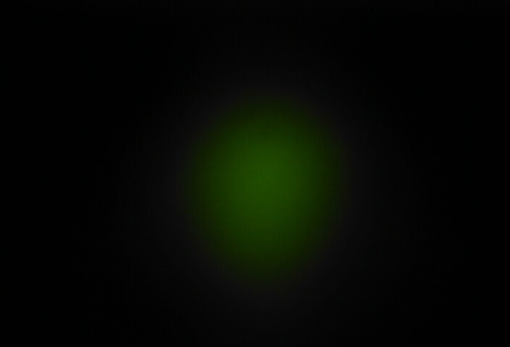
Lattice | New | Old
Unattenuated
120 μm Cu filter
Vert x Horiz FWHM (μm) | 60 x 176 | 137 x 183
Flux (10¹¹ Ph/s) | 3.0 | 2.1
Flicker (%/√Hz) | 0.37 | 0.66
11.1 keV, convergence slits “wide” (3 x 0.3 mRad), pixel = 0.83 μm, FWHM from knife edge

Slide 5
Beam Flicker
normalized flux
time (seconds)

Slide 6
Beam Flicker
pinhole
removed
normalized flux
time (seconds)

Slide 7
Beam Flicker
1/f noise or “flicker noise”
comes from everything

Slide 8
Beam Flicker
1/f noise or “flicker noise”
comes from everything

Slide 9
Beam Flicker
1/f noise or “flicker noise”
comes from everything

Slide 10
Beam Flicker
1/f noise or “flicker noise”
comes from everything

Slide 11
Beam Flicker
1/f noise or “flicker noise”
comes from everything

Slide 12
Beam Flicker
1/f noise or “flicker noise”
comes from everything

Slide 13
Beam Flicker
1/f noise or “flicker noise”
comes from everything

Slide 14
Beam Flicker
1/f noise or “flicker noise”
comes from everything

Slide 15
Beam Flicker
1/f noise or “flicker noise”
comes from everything

Slide 16
Beam Flicker
1/f noise or “flicker noise”
comes from everything

Slide 17
Minimum exposure time
Overall I/σ(I)
Same dose
for each
data set
Exposure time (ms)

Slide 18
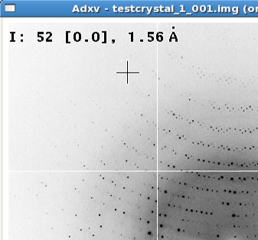
Optimal exposure time
(faint spots)
t_{hr} Optimal exposure time for data set (s)
t_{ref} exposure time of reference image (s)
bg_{ref} background level near weak spots on
reference image (ADU)
bg₀ ADC offset of detector (ADU)
bg_{hr} optimal background level (via t_{hr})
σ₀ rms read-out noise (ADU)
gain ADU/photon
m multiplicity of data set (including partials)
adjust exposure
so this is ~100

Slide 19
Lattice | New | Old
Unattenuated
120 μm Cu filter
Vert x Horiz FWHM (μm) | 60 x 176 | 137 x 183
Flux (10¹¹ Ph/s) | 3.0 | 2.1
Flicker (%/√Hz) | 0.37 | 0.66
11.1 keV, convergence slits “wide” (3 x 0.3 mRad), pixel = 0.83 μm, FWHM from knife edge

Slide 20
Damage is done
by photons/area
proportional to dose (MGy)
not time
not heat

Slide 21
The number of photons scattered by a given crystal before it is dead
is independent
of data collection time

Slide 22
Types of Rad Damage
Global
Specific

Slide 23
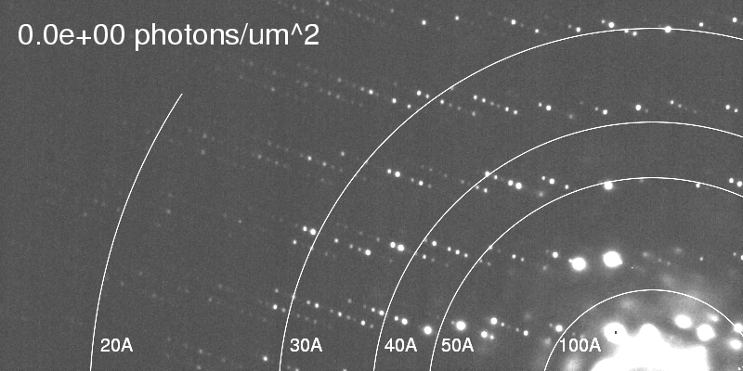
Global damage
Howells, et al. (2009) J. Electron Spectrosc. Relat. Phenom. 170, 4-12.

Slide 24
Global damage
10³
100
maximum tolerable dose (MGy)
10
1
1 2 3 5 7 10 20 40 70 100
resolution (Å)
Howells et al. (2009) J. Electron. Spectrosc. Relat. Phenom. 170 4-12

Slide 25
Global damage
10³
10 MGy/Å
100
maximum tolerable dose (MGy)
10
1
1 2 3 5 7 10 20 40 70 100
resolution (Å)
Howells et al. (2009) J. Electron. Spectrosc. Relat. Phenom. 170 4-12

Slide 26
10 MGy/Å
what the is a MGy?
http://bl831.als.lbl.gov/
damage_rates.pdf
Holton J. M. (2009) J. Synchrotron Rad. 16 133-42

Slide 27
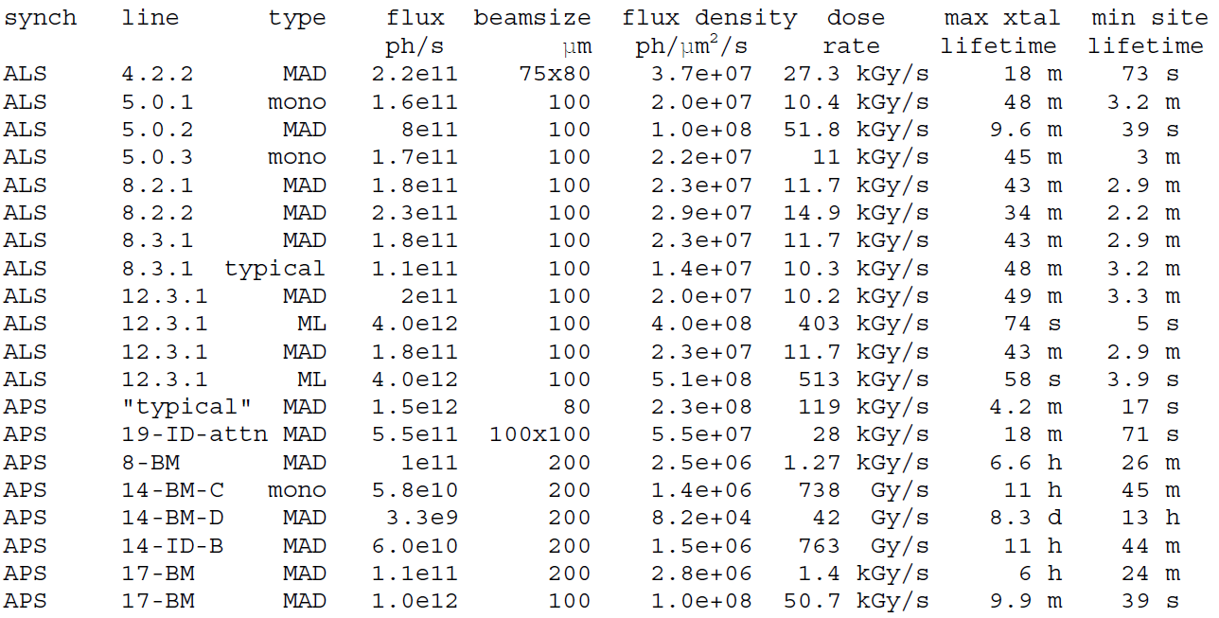
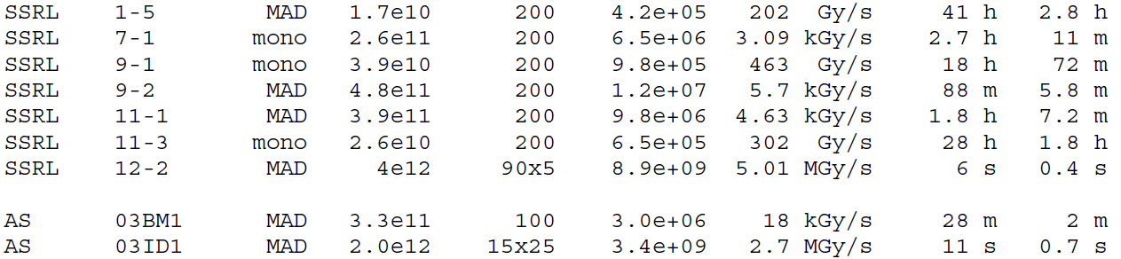
How long will my crystal last?

Slide 28
Dose-doubling concentration
molar, at the Se edge based on RADDOSE
Na | 44
Mg | 27
P | 9
S | 7
Cl | 5
K | 3.3
Ca | 2.7
Fe | 1.0
Cu | 0.67
Zn | 0.58
As | 0.44
Se | 0.42
Br | 2.9
I | 0.47
Gd | 0.21
Ta | 0.13
Pt | 0.17
Au | 0.16
Hg | 0.16
U | 0.23

Slide 29
Dose-doubling concentration
molar, at the Se edge based on RADDOSE
Na | 44
Mg | 27
P | 9
S | 7
Cl | 5
K | 3.3
Ca | 2.7
Fe | 1.0
Cu | 0.67
Zn | 0.58
As | 0.44
Se | 0.42
Br | 2.9
I | 0.47
Gd | 0.21
Ta | 0.13
Pt | 0.17
Au | 0.16
Hg | 0.16
U | 0.23

Slide 30
R_{iso} vs dose
R_{iso} (%)
change in dose (MGy)
data taken from Banumathi, et al. (2004) Acta Cryst. D 60, 1085-1093.

Slide 31
R_{iso} vs dose
R_{iso} ≈ 0.7 %/MGy
R_{iso} (%)
change in dose (MGy)
data taken from Banumathi, et al. (2004) Acta Cryst. D 60, 1085-1093.

Slide 32
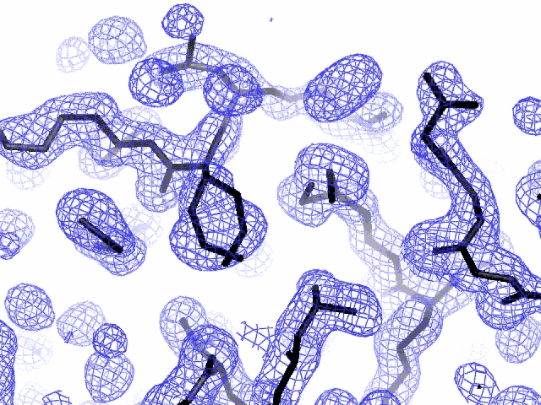
Specific damage
final, refined phases

Slide 33
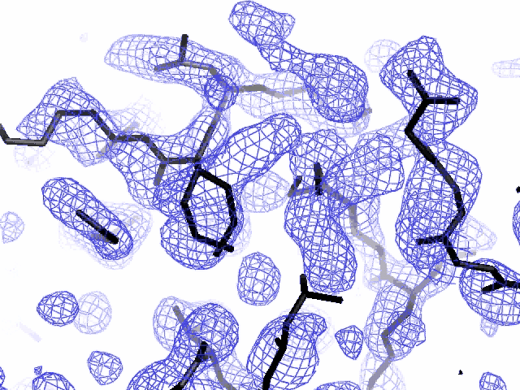
Specific damage
experimentally-obtained phases

Slide 34
Specific damage
Holton, J. M. (2007) J. Synch. Rad. 14, 51-72.

Slide 35
Specific damage
1.0
fraction
unconverted
0.0
Holton, J. M. (2007) J. Synch. Rad. 14, 51-72.

Slide 36
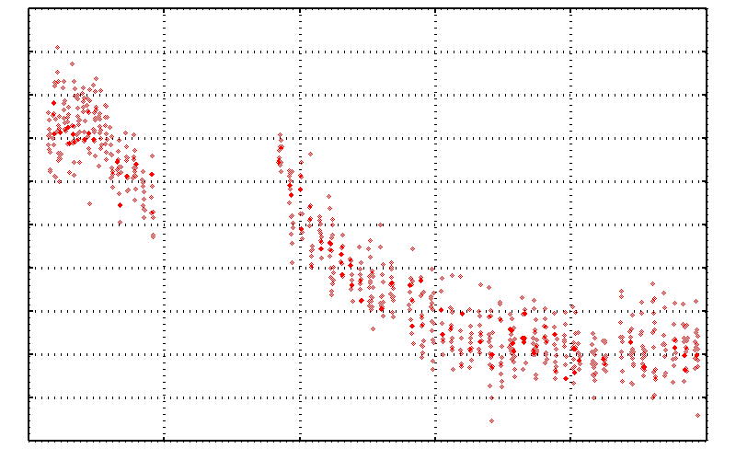
No Damage in the Dark!
-CH₂-Se-CH₃
4.6 5.0 5.4 5.8 6.2 6.6
Peak absorbance (electrons)
-CH₂ Se-CH₃
0 5 10 15 20 25
Experiment time (hours)
Holton (2007) JSR 14, 51

Slide 37
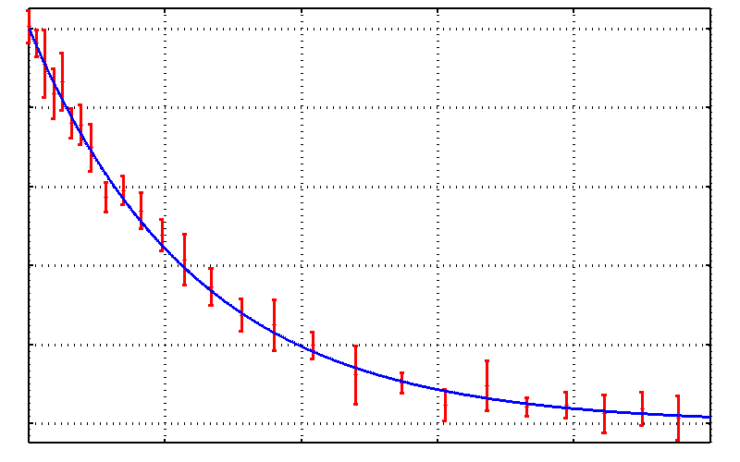
No Damage in the Dark!
-CH₂-Se-CH₃
radiation damage is
FAST!
0.0 0.2 0.4 0.6 0.8 1.0
Fraction unconverted
-CH₂ Se-CH₃
0 20 40 60 80 100
Absorbed Dose (MGy)
Holton (2007) JSR 14, 51

Slide 38
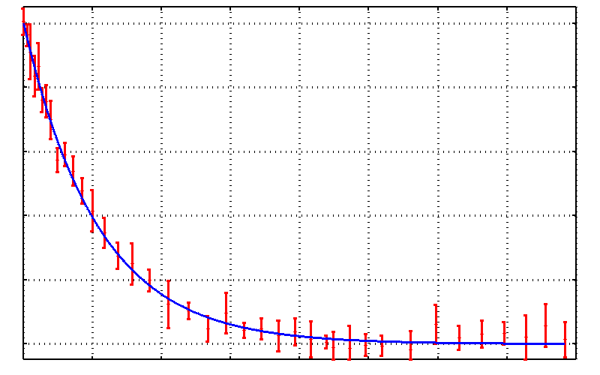
Damage is fast!
-CH₂-Se-CH₃
0.0 0.2 0.4 0.6 0.8 1.0
Fraction unconverted
100% Se-C bonds broken
-CH₂ Se-CH₃
0 50 100 150 200 250 300 350 400
fluence (10¹⁵ photons/mm²)
Holton (2007) JSR 14, 51

Slide 39
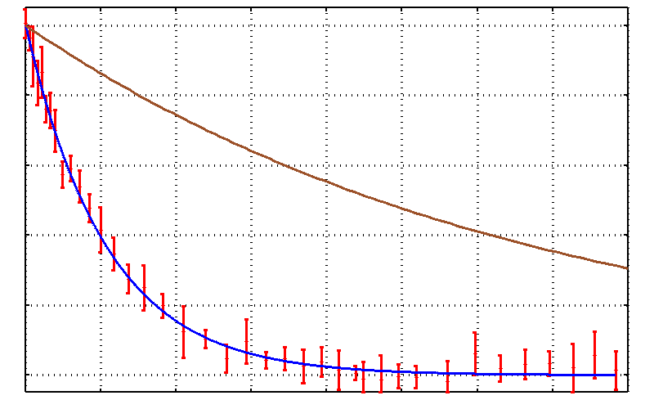
Damage is fast!
-CH₂-Se-CH₃
fraction of Se atoms hit
0.0 0.2 0.4 0.6 0.8 1.0
Fraction unconverted
50% Se atoms hit
100% Se-C bonds broken
-CH₂ Se-CH₃
0 50 100 150 200 250 300 350 400
fluence (10¹⁵ photons/mm²)
Holton (2007) JSR 14, 51

Slide 40
Specific damage “rate”
world records:
MGy reaction reference
~45 global damage Owen et al. (2006)
5 Se-Met Holton (2007)
4 Hg-S Ramagopal et al. (2004)
3 S-S Murray et al. (2002)
1 Br-RNA Olieric et al. (2007)
? Cl-C ???
0.5 Mn in PS II Yano et al. (2005)
0.02 Fe in myoglobin Denisov et al. (2007)
Holton (2009) J. Synchrotron Rad. 16 133-42

Slide 41
How long will my crystal last?

Slide 42
Self-calibrated damage limit
4
Where:
⟨I⟩_{DL} - average damage-limited intensity (photons/hkl) at a given resolution
10⁵ - converting R from μm to m, r_{e} from m to Å, ρ from g/cm³ to kg/m³ and MGy to Gy
r_{e} - classical electron radius (2.818 x 10⁻¹⁵ m/electron)
h - Planck’s constant (6.626 x 10⁻³⁴ J∙s)
c - speed of light (299792458 m/s)
f_{decayed} - fractional progress toward completely faded spots at end of data set
ρ - density of crystal (~1.2 g/cm³)
R - radius of the spherical crystal (μm)
λ - X-ray wavelength (Å)
f_{NH} - the Nave & Hill (2005) dose capture fraction (1 for large crystals)
n_{ASU} - number of proteins in the asymmetric unit
M_{r} - molecular weight of the protein (Daltons or g/mol)
V_{M} - Matthews’s coefficient (~2.4 Å³/Dalton)
H - Howells’s criterion (10 MGy/Å)
θ - Bragg angle
⟨ƒ_{a}²⟩ - number-averaged squared structure factor per protein atom (electron²)
⟨M_{a}⟩ - number-averaged atomic weight of a protein atom (~7.1 Daltons)
B - average (Wilson) temperature factor (Å²)
μ - attenuation coefficient of sphere material (m⁻¹)
μ_{en} - mass energy-absorption coefficient of sphere material (m⁻¹)
Holton & Frankel (2010) Acta D 66 393-408.

Slide 43
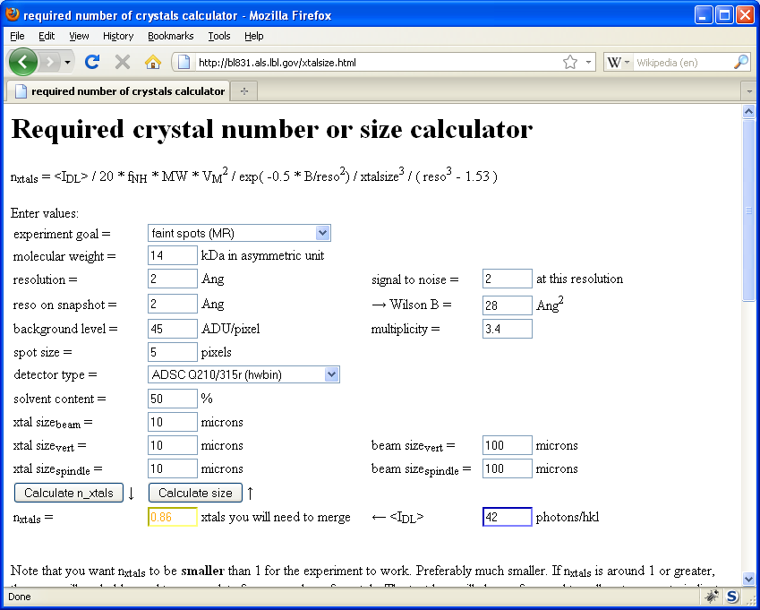
Holton & Frankel (2010) Acta D 66 393-408.

Slide 44
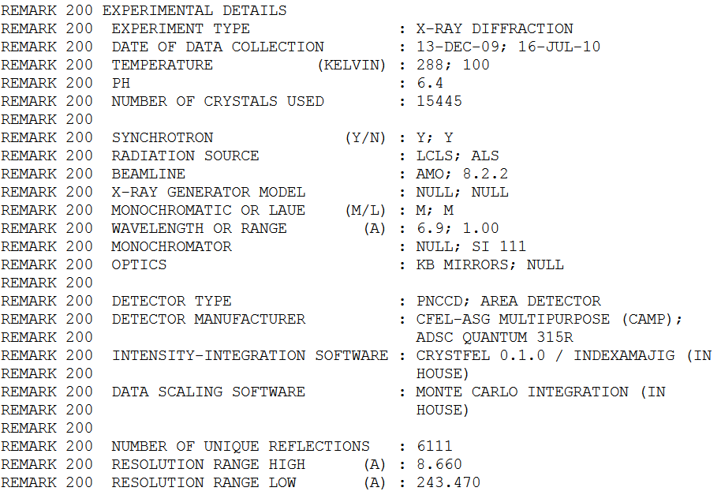
Multi-crystal future?

Slide 45
140-fold multiplicity
16 crystals, 360° each, inverse beam, 7235 eV AS MX1
SUBSET OF INTENSITY DATA WITH SIGNAL/NOISE >= -3.0 AS FUNCTION OF RESOLUTION
RESOLUTION NUMBER OF REFLECTIONS COMPLETENESS R-FACTOR R-FACTOR COMPARED I/SIGMA R-meas CC(1/2) Anomal SigAno Nano
LIMIT OBSERVED UNIQUE POSSIBLE OF DATA observed expected Corr
9.17 188919 1061 1071 99.1% 3.9% 4.8% 188919 257.47 3.9% 100.0* 91* 5.024 450
6.49 356827 1933 1933 100.0% 5.2% 5.5% 356827 214.33 5.2% 100.0* 86* 3.836 882
5.30 466503 2515 2515 100.0% 7.2% 7.0% 466503 165.13 7.2% 100.0* 76* 3.257 1175
4.59 548405 2974 2974 100.0% 7.2% 6.6% 548405 175.42 7.3% 100.0* 67* 2.589 1403
4.10 615117 3353 3355 99.9% 7.7% 6.7% 615117 174.13 7.7% 100.0* 59* 2.264 1594
3.74 684947 3734 3737 99.9% 9.4% 8.3% 684947 143.09 9.4% 100.0* 49* 1.953 1783
3.47 743557 4051 4051 100.0% 11.2% 10.1% 743557 120.17 11.2% 100.0* 39* 1.696 1942
3.24 799722 4366 4366 100.0% 14.1% 13.9% 799722 91.14 14.1% 100.0* 30* 1.333 2103
3.06 839252 4598 4603 99.9% 19.5% 20.2% 839252 65.79 19.5% 100.0* 23* 1.117 2214
2.90 891398 4904 4908 99.9% 29.0% 31.7% 891398 44.85 29.1% 99.9* 17* 1.008 2369
2.77 931622 5148 5151 99.9% 40.5% 44.8% 931622 32.58 40.6% 99.8* 11* 0.901 2493
2.65 969629 5384 5387 99.9% 52.8% 58.8% 969629 25.16 52.9% 99.8* 10* 0.866 2605
2.54 997213 5574 5574 100.0% 67.4% 76.0% 997213 19.47 67.6% 99.6* 2 0.804 2705
2.45 1031222 5889 5889 100.0% 88.9% 101.2% 1031222 14.58 89.2% 99.2* 4 0.831 2859
2.37 788617 6008 6008 100.0% 109.3% 125.5% 788617 9.97 109.7% 98.1* 5 0.829 2925
2.29 614145 6252 6252 100.0% 138.2% 161.4% 614145 6.87 138.9% 96.1* 1 0.760 3037
2.22 470283 6481 6481 100.0% 197.1% 231.7% 470283 4.03 198.6% 83.5* -1 0.721 3159
2.16 259836 6629 6631 100.0% 227.3% 268.7% 259831 2.41 230.8% 46.9* -1 0.677 3224
2.10 36259 4169 6807 61.2% 154.4% 169.4% 36229 1.28 163.6% 47.0* -2 0.660 1999
2.05 13567 3372 7037 47.9% 170.1% 187.0% 13503 0.68 196.5% 25.7* 3 0.629 1578
total 12247040 88395 94730 93.3% 15.7% 16.4% 12246941 54.30 15.8% 100.0* 12* 1.217 42499

Slide 46
140-fold multiplicity: 16 crystals, 360° each, inverse beam, 7235 eV
RESOLUTION COMPLETENESS R-FACTOR I/SIGMA R-meas CC(1/2) Anomal SigAno Nano
LIMIT OF DATA observed Corr
9.17 99.1% 3.9% 257.47 3.9% 100.0* 91* 5.024 450
6.49 100.0% 5.2% 214.33 5.2% 100.0* 86* 3.836 882
5.30 100.0% 7.2% 165.13 7.2% 100.0* 76* 3.257 1175
4.59 100.0% 7.2% 175.42 7.3% 100.0* 67* 2.589 1403
4.10 99.9% 7.7% 174.13 7.7% 100.0* 59* 2.264 1594
3.74 99.9% 9.4% 143.09 9.4% 100.0* 49* 1.953 1783
3.47 100.0% 11.2% 120.17 11.2% 100.0* 39* 1.696 1942
3.24 100.0% 14.1% 91.14 14.1% 100.0* 30* 1.333 2103
3.06 99.9% 19.5% 65.79 19.5% 100.0* 23* 1.117 2214
2.90 99.9% 29.0% 44.85 29.1% 99.9* 17* 1.008 2369
2.77 99.9% 40.5% 32.58 40.6% 99.8* 11* 0.901 2493
2.65 99.9% 52.8% 25.16 52.9% 99.8* 10* 0.866 2605
2.54 100.0% 67.4% 19.47 67.6% 99.6* 2 0.804 2705
2.45 100.0% 88.9% 14.58 89.2% 99.2* 4 0.831 2859
2.37 100.0% 109.3% 9.97 109.7% 98.1* 5 0.829 2925
2.29 100.0% 138.2% 6.87 138.9% 96.1* 1 0.760 3037
2.22 100.0% 197.1% 4.03 198.6% 83.5* -1 0.721 3159
2.16 100.0% 227.3% 2.41 230.8% 46.9* -1 0.677 3224
2.10 61.2% 154.4% 1.28 163.6% 47.0* -2 0.660 1999
2.05 47.9% 170.1% 0.68 196.5% 25.7* 3 0.629 1578
total 93.3% 15.7% 54.30 15.8% 100.0* 12* 1.217 42499

Slide 47
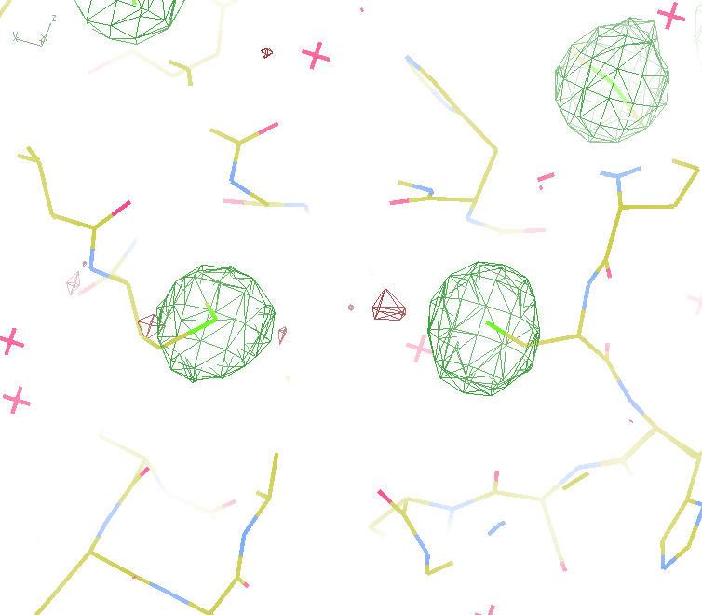
140-fold multiplicity
18 σ
16 σ
Phased anomalous difference Fourier
data Courtesy of Tom Peat & Janet Newman

Slide 48
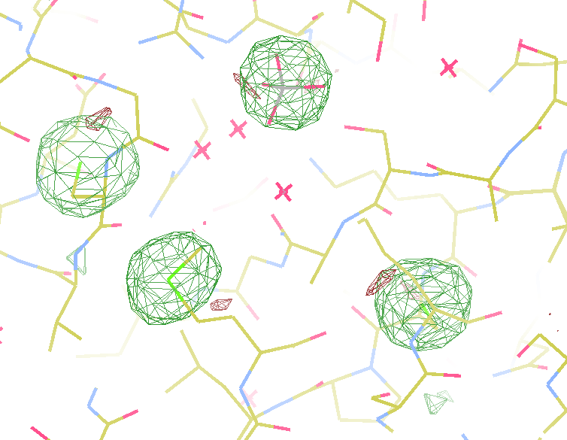
140-fold multiplicity
15σ = PO₄
Phased anomalous difference Fourier
data Courtesy of Tom Peat & Janet Newman

Slide 49
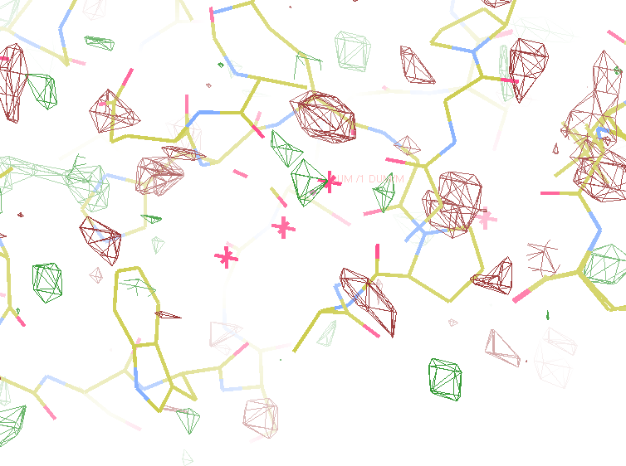
140-fold multiplicity
~2σ = Mg?
Phased anomalous difference Fourier
data Courtesy of Tom Peat & Janet Newman

Slide 50
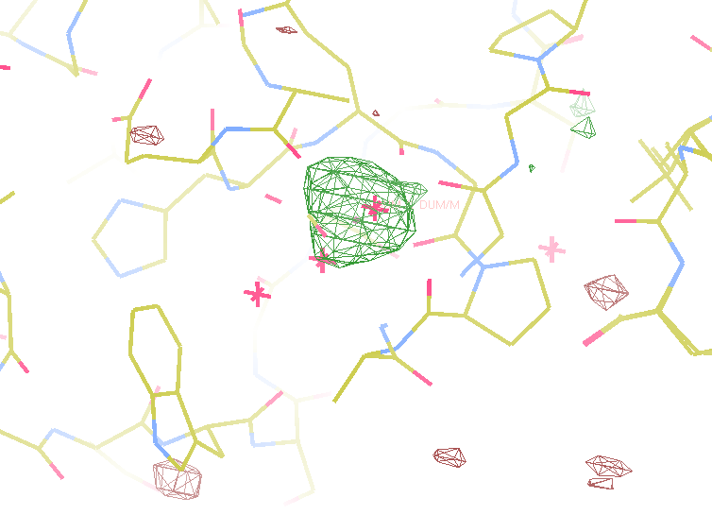
140-fold multiplicity
8.2σ = Mg?
DELFAN residual anomalous difference
data Courtesy of Tom Peat & Janet Newman

Slide 51
Discerning Na⁺ from Mg⁺⁺
DELFAN peak height (σ)
N
O
F
Ne
Na
Mg
f’’ (electrons)

Slide 52
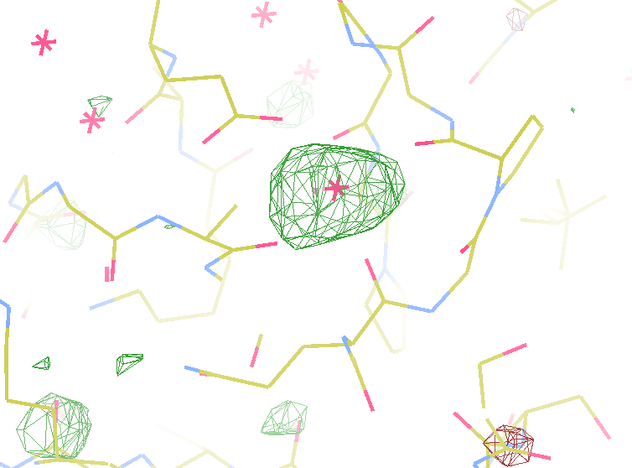
140-fold multiplicity
7.4σ = Na
DELFAN residual anomalous difference
data Courtesy of Tom Peat & Janet Newman

Slide 53
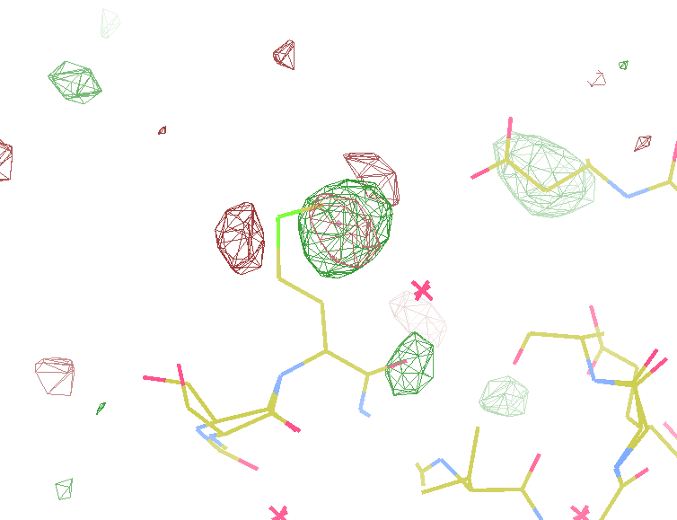
140-fold multiplicity
7.3σ = S
DELFAN residual anomalous difference
data Courtesy of Tom Peat & Janet Newman

Slide 54
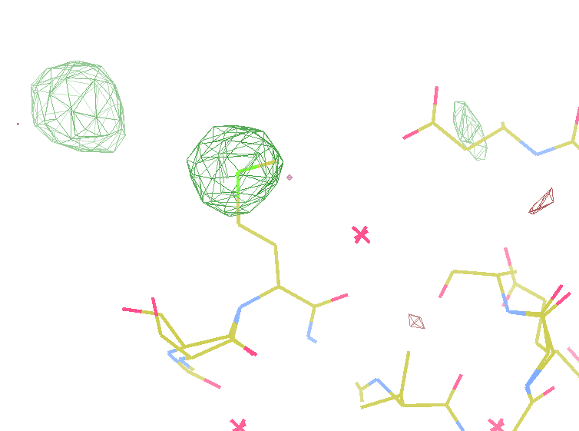
140-fold multiplicity
12σ = S
Phased anomalous difference Fourier
data Courtesy of Tom Peat & Janet Newman

Slide 55
Suggested anomalous protocol:
360° in < 5 MGy
move detector
4X exposure
goto 2
2 wavelengths are better than 1
- (peak + inf)/2, and remote
If you must do one, do 7235 eV

Slide 56
Lattice | New | Old
Unattenuated
120 μm Cu filter
Vert x Horiz FWHM (μm) | 60 x 176 | 137 x 183
Flux (10¹¹ Ph/s) | 3.0 | 2.1
Flicker (%/√Hz) | 0.37 | 0.66
11.1 keV, convergence slits “wide” (3 x 0.3 mRad), pixel = 0.83 μm, FWHM from knife edge

Slide 57
in-situ diffraction systems
25 μm wall
~50 μm tape
~50 μm tape
PDMS
PDMS
250 μm
100 μm
200 μm
1000 μm
25 μm wall
MiTeGen
MicroRT™
Fluidigm
Topaz® DC
Microlytic
Crystal Former™
NatX-ray
CrystalQuick™ X
MiTeGen
in-situ-1
http://www.mitegen.com/products/micrort/micrort.shtml
http://www.fluidigm.com/home/fluidigm/docs/Datasheet_1.96DC.pdf
Ng, J. et al. (2008). Acta Cryst. D 64, 189-197.
Soliman, A. et al. (2011). Acta Cryst. D 67, 646-656.
http://www.mitegen.com/mic_catalog.php?c=insituplates
Notes:
Next slide please

Slide 58
X-ray scattering “rules”:
1 μm crystal ≈ 1 μm water
≈ 1 μm plastic
≈ 0.1 μm glass
≈ 1000 μm air

Slide 59
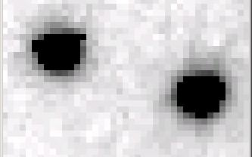
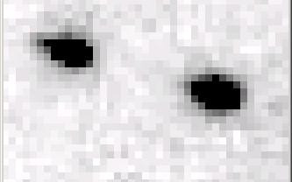
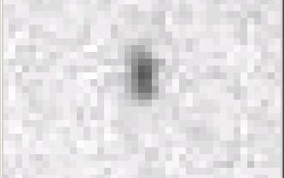
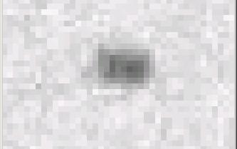
Si(111) vs multilayers
0.014%
Si(111)
spectral
dispersion
1%
multilayer
4 Å
resolution
1.9 Å

Slide 60
Wide-bandpass MX?
Mono | Si(111) | multilayer | Difference (%) | good
Energy (eV) | 11111 | 12027.5 | +8.2 | Same
Scale | 1.0000 | 1.0964 | +9.6 | Yes
R_{merge} (%) | 7.5 | 8.4 | +12 | No
R_{anom} (%) | 5.6 | 5.5 | -1.8 | Same
I/sd | 13.2 | 12.3 | -6.8 | Same
I/sd (1.5Å) | 2.3 | 1.8 | -21.7 | No
Ano Patt | 5.96 | 4.75 | -20.3 | Same
Ano Phased | 41 | 39.33 | -4.1 | Same
FOM | 0.238 | 0.192 | -19.3 | Same
CC | 0.555 | 0.647 | -6.1 | Yes
R_{cryst} (%) | 26.70 | 26.48 | -0.2 | Same
Ligand peak | 8.213 | 8.250 | +0.4 | Same

Slide 61
Adjustable bandpass
0.0007 % (8 hours)
Existing mono
Ge(11 1 1)
Si(111)
6 mm
3 mm
Ge(11 1 1)
Si(111)
16.26°
d = 0.51 Å
2θ = 147.478°
For 12660 eV

Slide 62
Adjustable bandpass
0.014 % (30 min)
Existing mono
Si(111)
Ge(11 1 1)
3 mm
Ge(11 1 1)
Si(111)

Slide 63
Adjustable bandpass
1 % (~1 second)
Existing mono
Ge(11 1 1)
3 mm
ML
Ge(11 1 1)
ML

Slide 64
Adjustable bandpass
0.0007 % (8 hours)
Existing mono
Ge(11 1 1)
6 mm
3 mm
ML
Ge(11 1 1)
ML
16.26°
d = 0.51 Å
2θ = 147.478°
For 12660 eV

Slide 65
We’d love to use multiple crystals
but we have a problem with
non-isomorphism

Slide 66
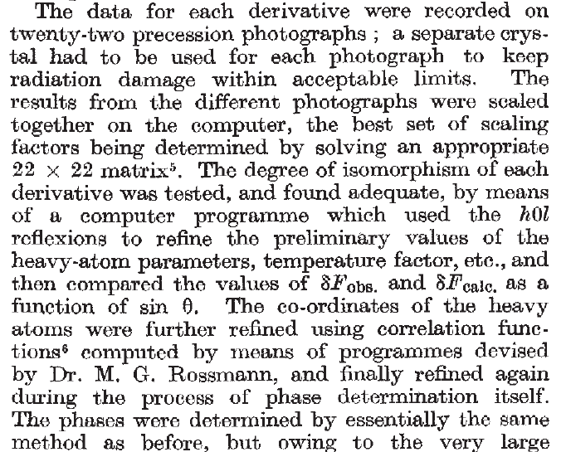
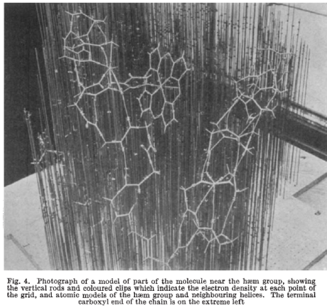
Multi-crystal strategies
Kendrew et al. (1960) "Structure of Myoglobin” Nature 185, 422-427.

Slide 67
Non-isomorphism in lysozyme
Dear James
The story of the two forms of lysozyme crystals goes back to about 1964 when it was found that the diffraction patterns from different crystals could be placed in one of two classes depending on their intensities. This discovery was a big set back at the time and I can remember a lecture title being changed from the 'The structure of lysozyme' to 'The structure of lysozyme two steps forward and one step back'. Thereafter the crystals were screened based on intensities of the (11,11,l) rows to distinguish them (e.g. 11,11,4 > 11,11,5 in one form and vice versa in another). Data were collected only for those that fulfilled the Type II criteria. (These reflections were easy to measure on the linear diffractometer because crystals were mounted to rotate about the diagonal axis). As I recall both Type I and Type II could be found in the same crystallisation batch . Although sometimes the external morphology allowed recognition this was not infallible.
The structure was based on Type II crystals. Later a graduate student Helen Handoll examined Type I. The work, which was in the early days and before refinement programmes, seemed to suggest that the differences lay in the arrangement of water or chloride molecules (Lysozyme was crystallised from NaCl). But the work was never written up. Keith Wilson at one stage was following this up as lysozyme was being used to test data collection strategies but I do not know the outcome.
An account of this is given in International Table Volume F (Rossmann and Arnold edited 2001) p760.
Tony North was much involved in sorting this out and if you wanted more info he would be the person to contact. I hope this is helpful. Do let me know if you need more.
Best wishes
Louise

Slide 68
Non-isomorphism in lysozyme
Structure factor (e⁻)
Johnson’s ratio

Slide 69
Non-isomorphism in lysozyme
Structure factor (e⁻)
Johnson’s ratio

Slide 70
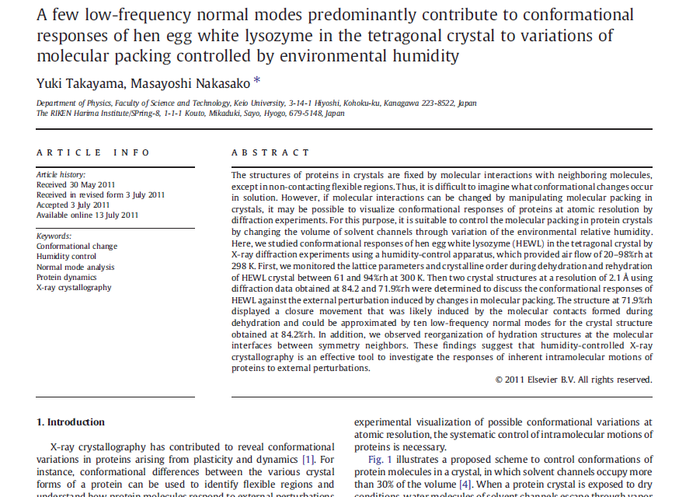

Slide 71
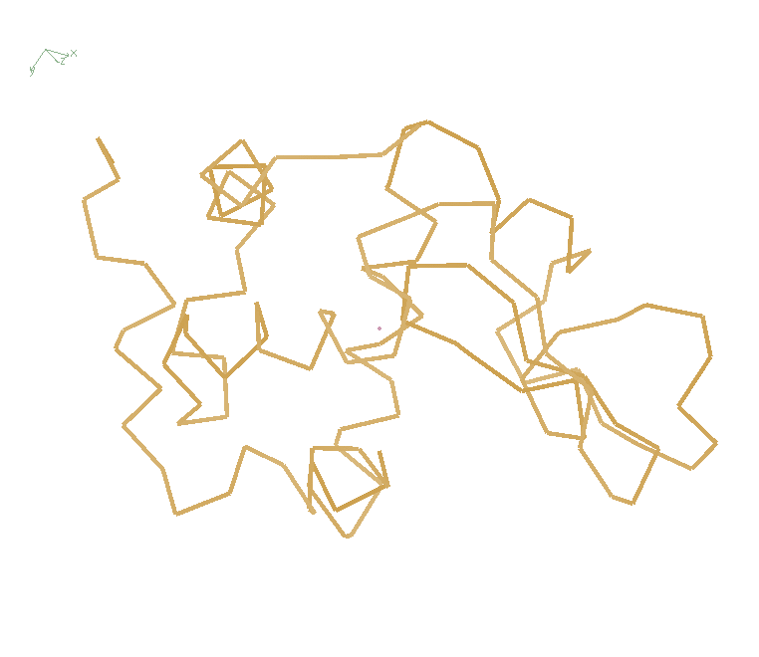
Non-isomorphism in lysozyme
RH 84.2% vs 71.9%
RMSD = 0.18 Å
R_{iso} = 44.5%

Slide 72
Non-isomorphism in lysozyme
Dear James
The story of the two forms of lysozyme crystals goes back to about 1964 when it was found that the diffraction patterns from different crystals could be placed in one of two classes depending on their intensities. This discovery was a big set back at the time and I can remember a lecture title being changed from the 'The structure of lysozyme' to 'The structure of lysozyme two steps forward and one step back'. Thereafter the crystals were screened based on intensities of the (11,11,l) rows to distinguish them (e.g. 11,11,4 > 11,11,5 in one form and vice versa in another). Data were collected only for those that fulfilled the Type II criteria. (These reflections were easy to measure on the linear diffractometer because crystals were mounted to rotate about the diagonal axis). As I recall both Type I and Type II could be found in the same crystallisation batch . Although sometimes the external morphology allowed recognition this was not infallible.
The structure was based on Type II crystals. Later a graduate student Helen Handoll examined Type I. The work, which was in the early days and before refinement programmes, seemed to suggest that the differences lay in the arrangement of water or chloride molecules (Lysozyme was crystallised from NaCl). But the work was never written up. Keith Wilson at one stage was following this up as lysozyme was being used to test data collection strategies but I do not know the outcome.
An account of this is given in International Table Volume F (Rossmann and Arnold edited 2001) p760.
Tony North was much involved in sorting this out and if you wanted more info he would be the person to contact. I hope this is helpful. Do let me know if you need more.
Best wishes
Louise

Slide 73
Non-isomorphism = dehydration?
= 1 nL
100 μm

Slide 74
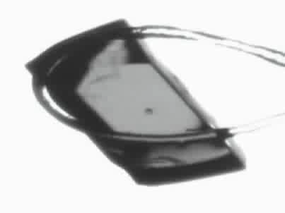
Response to dehydration
www.proteros.de

Slide 75
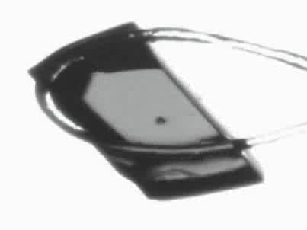
Response to dehydration
www.proteros.de

Slide 76
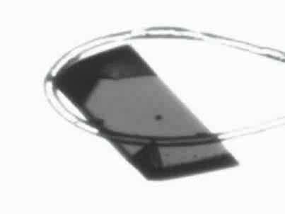
Response to dehydration
www.proteros.de

Slide 77
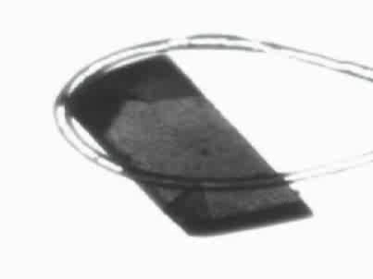
Response to dehydration
www.proteros.de

Slide 78
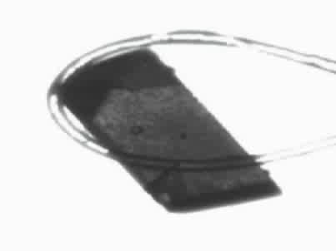
Response to dehydration
www.proteros.de

Slide 79
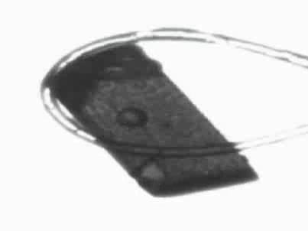
Response to dehydration
www.proteros.de

Slide 80
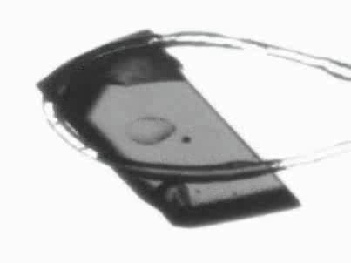
Response to dehydration
www.proteros.de

Slide 81
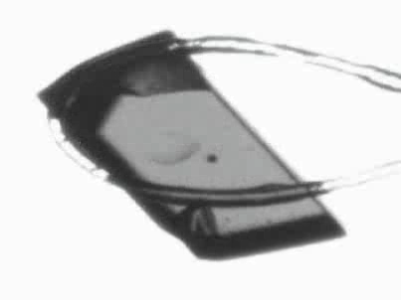
Response to dehydration
www.proteros.de

Slide 82
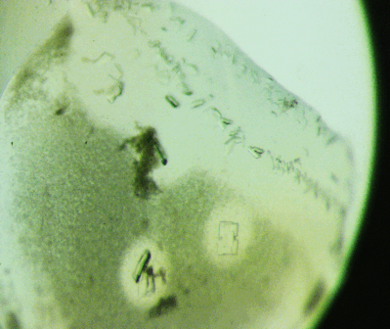
Ostwald Ripening
http://xray.bmc.uu.se/terese/tutorial6.html

Slide 83
… but does it work for membrane proteins?
CCP4BB:
“We used it for a large membrane protein complex and diffraction improved from ~7 to 2.7 A. The crystal is fished out and put into mother liquor solution in the button, sealed with dialysis membrane and the button is then placed into about 5 mls of mother liquor with slightly higher PEG concentration. Then you just exchange outside buffer every day or so for solutions containing higher concentrations of PEG. We went from ~9 to 30 % PEG4000 in about a week. You can easily observe crystal under microscope and if it cracks - you went too far/too quickly with PEG and need to use a bit less next time. Also, this method allows you to control all other components of the dehydrating solution - we needed to decrease salt concentration at the same time as increasing PEG. You can also introduce/increase cryo-protectant concentration at the same time. With these crystals, otherwise excellent dehydration machines already mentioned did not work, possibly because the process had to be really slow.”
Efremov, R. G. & Sazanov, L. A. (2011)."Structure of the membrane domain of respiratory complex I", Nature 476, 414-420.
“To improve diffraction properties, crystals were slowly cooled to 4 C, placed into micro-dialysis buttons, and mother liquor was exchanged by dialysis for 0.1 M sodium acetate (pH 4.8), 0.15 M sodium tartrate (pH 5.0), 30% PEG4000, 0.1% sodium cholate and 12.5% glycerol over a period of 5 days.”

Slide 84
opened drop: you have ~30 seconds!
equilibrated drop

Slide 85
opened drop: you have ~30 seconds!
oil

Slide 86
oiled drop: you have ~3 hours
oil

Slide 87
Dabbing to remove excess
clean surface

Slide 88
Dabbing to remove excess
clean surface

Slide 89
Dabbing to remove excess
clean surface

Slide 90
Dabbing to remove excess
clean surface

Slide 91
Dabbing to remove excess
clean surface

Slide 92
Dabbing to remove excess
clean surface

Slide 93
Dabbing to remove excess
clean surface

Slide 94
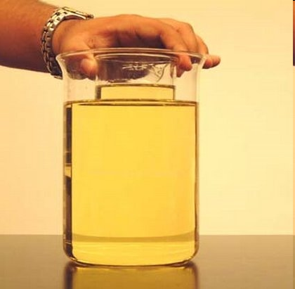
My crystal “dissolved” in the oil!
no, it didn’t…

Slide 95
plunge cooling
warm, moist air
ice
cold N₂
liquid N₂
foam insulation

Slide 96
plunge cooling
warm, moist air
ice
cold N₂
liquid N₂
foam insulation

Slide 97
Warkentin method
liquid N₂
foam insulation
Warkentin (2006) J. Appl. Crystallogr. 39, 805-811.

Slide 98
Elastic deformation
= non-isomorphism

Slide 99
Elastic deformation
= non-isomorphism

Slide 100
Plastic deformation
= poor diffraction

Slide 101
Plastic deformation
= poor diffraction

Slide 102
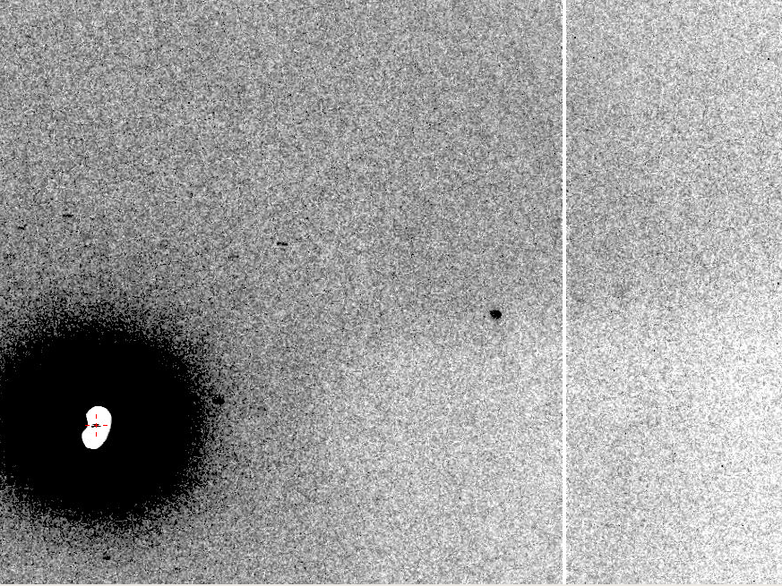
Now What?
10 Å

Slide 103
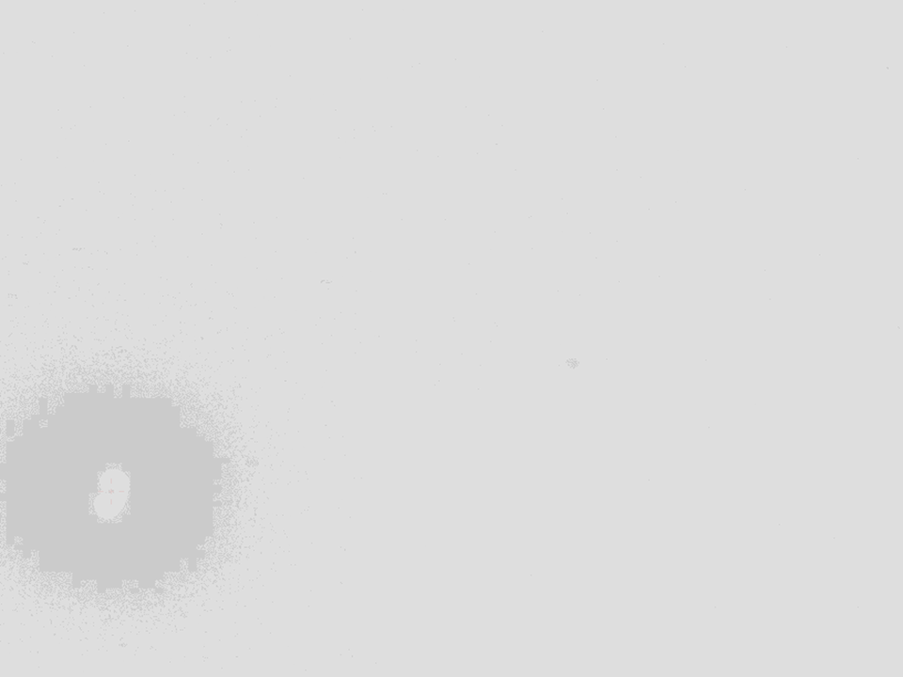
Ways to improve diffraction
New crystal form
Purify
  - add a column
  - heat shock
Bind something
  - Known ligand
  - Silver bullets
Change the clone
  - chop off floppy bits
  - homolog
  - Ala -> Lys mutants
Make Protein Sit Still!!!
Newman J. (2006) Acta Cryst. D62 27-31.

Slide 104
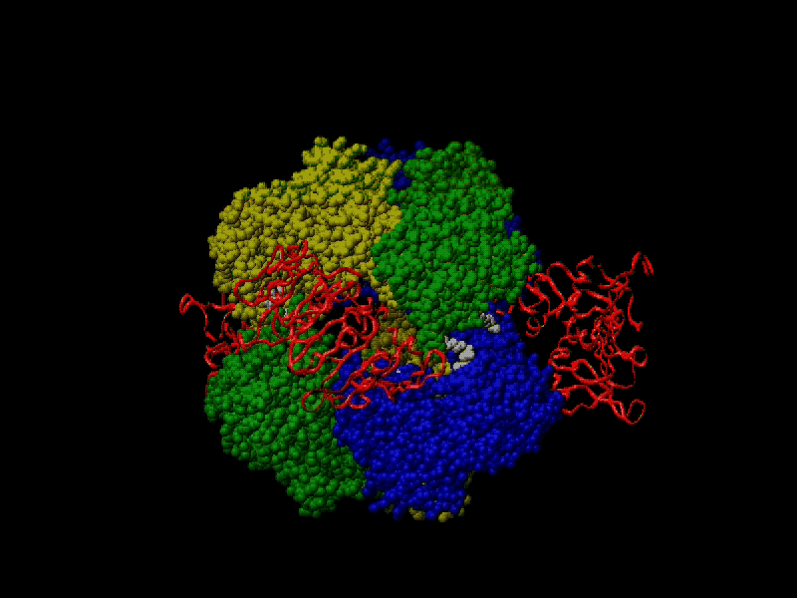
Proteins move
Beernink, Endrizzi, Alber & Schachman (1999). PNAS USA 96, 5388-5393.

Slide 105
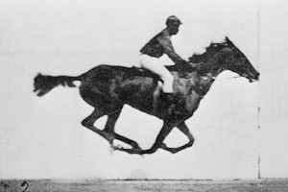
Muybridge’s galloping horse (1878)

Slide 106
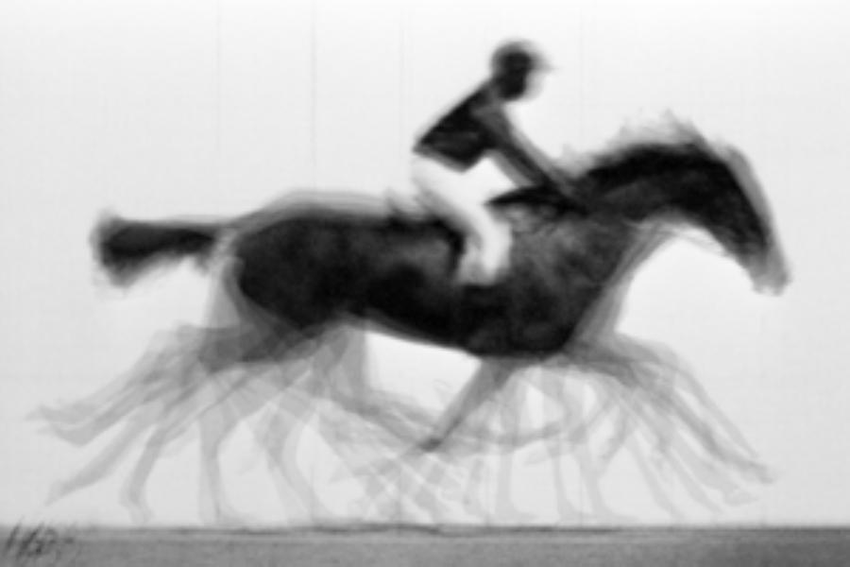
average structure: galloping horse

Slide 107
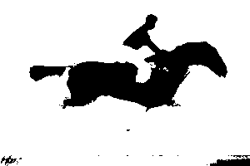
average structure: galloping horse
1 “sigma” contour

Slide 108






Horse: real and reciprocal

Slide 109












Supporting a model with data

Slide 110

Molecular Dynamics Simulation
using real
crystal’s lattice
1aho
Scorpion toxin
0.96 Å resolution
64 residues
Solvent: H₂0 + acetate
Cerutti et al. (2010).J. Phys. Chem. B 114, 12811-12824.

Slide 111

30 conformers from 24,000

Slide 112

Electron density from 24,000 conformers

Slide 113

Regular model with real data!

Slide 114



Molecular Dynamics vs Observation
1aho 64-residue scorpion toxin in water to 1.0 Å resolution
refined_vs_Fsim.pdb
1aho.cif
1aho.pdb
F_{calc}
F_{sim}
F_{obs}
F_{calc}
R_{vault} = 0.69
R_{cryst}= 0.137
R_{iso} =
R_{cryst}= 0.116
R_{vault} = 0.48 to 4 Å
rmsd = 1.05 Å
LSQ rmsd = 0.43Å

Slide 115

Molecular Dynamics vs Observation
Sodium acetate trihydrate
5 atoms
3 waters
0.9 Å resolution
C2/c
R_{vault} = 0.01

Slide 116

Molecular Dynamics vs Observation
fav8
8 residues
4 waters
1.0 Å resolution
P1

Slide 117



Molecular Dynamics vs Observation
“fav8” 8-residue aromatic peptide with 4 waters to 1.0 Å resolution
refined_vs_Fsim.pdb
fav8.fcf
fav8.cif
F_{calc}
F_{sim}
F_{obs}
F_{calc}
R_{cryst}= 0.13
R_{vault}= 0.23
R_{cryst}= 0.16
R_{vault} = 0.20 to 2Å
R1 = 0.041
With 4σ cutoff!
rmsd = 0.20 Å
LSQ rmsd = 0.091Å & 0.15 Å

Slide 118

MD-predicted water structure
Simulated
density
Janowski et al (2013) JACS 135, 7938-7948

Slide 119

MD-predicted water structure
Simulated
density
2mF_{o}-DF_{c}
Janowski et al (2013) JACS 135, 7938-7948

Slide 120

MD-predicted Val rotamer
Janowski et al (2013) JACS 135, 7938-7948

Slide 121


MD-predicted Val rotamer
confs | R_{work} | R_{free}
one | 4.11% | 5.84%
A & B | 3.89% | 5.53%
Janowski et al (2013) JACS 135, 7938-7948

Slide 122
Molecular Dynamics Simulation
using real
crystal’s lattice
1aho
Scorpion toxin
0.96 Å resolution
64 residues
Solvent: H₂0 + acetate
Cerutti et al. (2010).J. Phys. Chem. B 114, 12811-12824.

Slide 123

Electron density from 24,000 conformers

Slide 124

MLFSOM simulation

Slide 125

Map from simulated data
1.0 Å data
R_{cryst}= 0.137
R_{free} = 0.159
1 “sigma” 2F_{sim}-F_{c}
2.5 “sigma” F_{sim}-F_{c}

Slide 126

The “right” difference map
1.0 Å data
R_{cryst}= 0.137
R_{free} = 0.159
1 “sigma” 2F_{sim}-F_{c}
F_{right} – (2F_{sim}-F_{c})

Slide 127

Real data!
1.0 Å data
R_{cryst}= 0.116
R_{free} = 0.135
1 “sigma” 2F_{sim}-F_{c}
2.5 “sigma” F_{sim}-F_{c}

Slide 128

Ringer: systematic map sampling
Lang et al. (2010) Protein Sci. 19, 1420-31.
Fraser, et al. (2009) Nature 462, 669-73.

Slide 129
Ringer: systematic map sampling
electron density (e⁻/Å³)
χ₁ angle (degrees)

Slide 130
Ringer: systematic map sampling
electron density (e⁻/Å³)
χ₁ angle (degrees)

Slide 131
Ringer: systematic map sampling
electron density (e⁻/Å³)
χ₁ angle (degrees)

Slide 132
Ringer: systematic map sampling
electron density (e⁻/Å³)
χ₁ angle (degrees)

Slide 133
Disorder is not noise

Slide 134
"error bar" for electron density
structure factor (e⁻/cell)
electron density (e⁻/Å³)
spot index
fractional coordinate

Slide 135
"error bar" for electron density
structure factor (e⁻/cell)
electron density (e⁻/Å³)
spot index
fractional coordinate

Slide 136
"error bar" for electron density
structure factor (e⁻/cell)
electron density (e⁻/Å³)
spot index
fractional coordinate

Slide 137
"error bar" for electron density
structure factor (e⁻/cell)
electron density (e⁻/Å³)
spot index
fractional coordinate

Slide 138
"error bar" for electron density
structure factor (e⁻/cell)
electron density (e⁻/Å³)
spot index
fractional coordinate

Slide 139
"error bar" for electron density
structure factor (e⁻/cell)
electron density (e⁻/Å³)
spot index
fractional coordinate

Slide 140
"error bar" for electron density
structure factor (e⁻/cell)
electron density (e⁻/Å³)
spot index
fractional coordinate

Slide 141
"error bar" for electron density
structure factor (e⁻/cell)
electron density (e⁻/Å³)
spot index
fractional coordinate

Slide 142
"error bar" for electron density
Refinement
Against
Perturbed
Input
Data
electron density (e⁻/Å³)
fractional coordinate

Slide 143
How does the “error” compare to “sigma”?
normalized counts
Electron Number Density (e⁻/Å³)

Slide 144
How does the “error” compare to “sigma”?
normalized counts
Electron Number Density (e⁻/Å³)

Slide 145
1 “sigma” is not a good criterion
normalized counts
Electron Number Density (e⁻/Å³)

Slide 146

1.0 “sigma” multi-conformer (4nx4)

Slide 147

7x noise multi-conformer (4nx4)

Slide 148

1.0 “sigma” no ligand built (2pxr)

Slide 149

1.0 “sigma” multi-conformer (4nx4)

Slide 150

7x noise multi-conformer (4nx4)
R_{cryst}/R_{free} =
0.1467/0.1944

Slide 151

7x noise no ligand built (2pxr)
R_{cryst}/R_{free} =
0.1474/0.2032

Slide 152
Summary
http://bl831.als.lbl.gov/END/RAPID/
http://bl831.als.lbl.gov/xtalsize.html
http://bl831.als.lbl.gov/~jamesh/powerpoint/Plexxikon_2014.ppt
There is “life” below 1 “sigma”
100 ADU/pixel
10 μm for lysozyme
Anomalous = “Attenu-wait” at 7235 eV
The future is 4D models?

Slide 153
Classes of error in MX
Dependence on signal
none sqrt proportional
CCD
Read-out
Photon
counting
Detector calibration
attenuation
partiality
Non-isomorphism
Radiation damage
none
1/sqrt
1/prop.
Time
Beam flicker
Shutter jitter
Sample vibration

Slide 154
attenuation factor
μ
I_{T}
I_{beam}
A = = exp(-μt)
t
Bouguer, P. (1729). Essai d'optique sur la gradation de la lumière.
Lambert, J. H. (1760). Photometria: sive De mensura et gradibus luminis, colorum et umbrae. E. Klett.
Beer, A. (1852)."Bestimmung der Absorption des rothen Lichts in farbigen Flüssigkeiten", Ann. Phys. Chem 86, 78-90.

Slide 155
attenuation factor
μ
t_{out}
t_{in}
I_{T}
I_{beam}
I_{T}
I_{beam}
A = = exp(-μ(t_{in}+ t_{out}))
A = = exp(-μt)
t
Bouguer, P. (1729). Essai d'optique sur la gradation de la lumière.
Lambert, J. H. (1760). Photometria: sive De mensura et gradibus luminis, colorum et umbrae. E. Klett.
Beer, A. (1852)."Bestimmung der Absorption des rothen Lichts in farbigen Flüssigkeiten", Ann. Phys. Chem 86, 78-90.

Slide 156
attenuation factor
t_{out}
t_{in}
μ
t_{out}
t_{in}
t_{out}
I_{T}
I_{beam}
t_{in}
A = = exp(-μ(t_{in}+ t_{out}))
Bouguer, P. (1729). Essai d'optique sur la gradation de la lumière.
Lambert, J. H. (1760). Photometria: sive De mensura et gradibus luminis, colorum et umbrae. E. Klett.
Beer, A. (1852)."Bestimmung der Absorption des rothen Lichts in farbigen Flüssigkeiten", Ann. Phys. Chem 86, 78-90.

Slide 157
attenuation factor
μ_{solvent}
t_{so}
t_{xo}
t_{si}
t_{xi}
μ_{xtal}
t_{so}
t_{xo}
t_{si}
t_{xi}
t_{so}
t_{xo}
I_{T}
I_{beam}
t_{si}
t_{xi}
A = = exp[-μ_{xtal}(t_{xi}+ t_{xo})
-μ_{solvent}(t_{si} + t_{so})]
Bouguer, P. (1729). Essai d'optique sur la gradation de la lumière.
Lambert, J. H. (1760). Photometria: sive De mensura et gradibus luminis, colorum et umbrae. E. Klett.
Beer, A. (1852)."Bestimmung der Absorption des rothen Lichts in farbigen Flüssigkeiten", Ann. Phys. Chem 86, 78-90.

Slide 158
Where do photons go?
Protein
1A x-rays
Transmitted (98%)
beamstop
attenuation correction cannot be > ~2%
for 100 μm xtal at 1 Å

Slide 159
Classes of error in MX
Dependence on signal
none sqrt proportional
CCD
Read-out
Photon
counting
Detector calibration
attenuation
partiality
Non-isomorphism
Radiation damage
none
1/sqrt
1/prop.
Time
Beam flicker
Shutter jitter
Sample vibration

Slide 160
Beam Flicker
1/f noise or “flicker noise”
comes from everything

Slide 161
Beam Flicker
1/f noise or “flicker noise”
comes from everything

Slide 162
Beam Flicker
1/f noise or “flicker noise”
comes from everything

Slide 163
Beam Flicker
1/f noise or “flicker noise”
comes from everything

Slide 164
Beam Flicker
1/f noise or “flicker noise”
comes from everything

Slide 165
Beam Flicker
1/f noise or “flicker noise”
comes from everything

Slide 166
Beam Flicker
1/f noise or “flicker noise”
comes from everything

Slide 167
Beam Flicker
1/f noise or “flicker noise”
comes from everything

Slide 168
Beam Flicker
1/f noise or “flicker noise”
comes from everything

Slide 169
Beam Flicker
1/f noise or “flicker noise”
comes from everything

Slide 170
Beam Flicker
normalized flux
time (seconds)

Slide 171
Beam Flicker
pinhole
removed
normalized flux
time (seconds)

Slide 172
Beam Flicker
CC to correct model
flicker noise (%/√Hz)

Slide 173
Classes of error in MX
Dependence on signal
none sqrt proportional
CCD
Read-out
Photon
counting
Detector calibration
attenuation
partiality
Non-isomorphism
Radiation damage
none
1/sqrt
1/prop.
Time
Beam flicker
Shutter jitter
Sample vibration

Slide 174
Shutter Jitter
open
closed
shutter jitter

Slide 175
Shutter Jitter
PHIZ from MOSFLM (deg)
frame number

Slide 176
Shutter Jitter
PHIZ from MOSFLM (deg)
frame number

Slide 177
Shutter Jitter
shutter timing error (ms)
rms 0.47 ms
frame number

Slide 178
Shutter Jitter
CC to correct model
rms timing error (% exposure)

Slide 179
Classes of error in MX
Dependence on signal
none sqrt proportional
CCD
Read-out
Photon
counting
Detector calibration
attenuation
partiality
Non-isomorphism
Radiation damage
none
1/sqrt
1/prop.
Time
Beam flicker
Shutter jitter
Sample vibration

Slide 180
xtal vibration noise
diffracted beam
incident beam
see: Alkire et al. (2008)."Is your cold-stream working for you or against you? An in-depth look at temperature and sample motion", J. Appl. Cryst. 41, 1122-1133.

Slide 181
xtal vibration noise
diffracted beam
incident beam
see: Alkire et al. (2008)."Is your cold-stream working for you or against you? An in-depth look at temperature and sample motion", J. Appl. Cryst. 41, 1122-1133.

Slide 182
xtal vibration noise
diffracted beam
incident beam
see: Alkire et al. (2008)."Is your cold-stream working for you or against you? An in-depth look at temperature and sample motion", J. Appl. Cryst. 41, 1122-1133.

Slide 183
xtal vibration noise
diffracted beam
incident beam
see: Alkire et al. (2008)."Is your cold-stream working for you or against you? An in-depth look at temperature and sample motion", J. Appl. Cryst. 41, 1122-1133.

Slide 184
xtal vibration noise
diffracted beam
incident beam
see: Alkire et al. (2008)."Is your cold-stream working for you or against you? An in-depth look at temperature and sample motion", J. Appl. Cryst. 41, 1122-1133.

Slide 185
xtal vibration noise
diffracted beam
incident beam
see: Alkire et al. (2008)."Is your cold-stream working for you or against you? An in-depth look at temperature and sample motion", J. Appl. Cryst. 41, 1122-1133.

Slide 186
xtal vibration noise
diffracted beam
incident beam
see: Alkire et al. (2008)."Is your cold-stream working for you or against you? An in-depth look at temperature and sample motion", J. Appl. Cryst. 41, 1122-1133.

Slide 187
xtal vibration noise
incident beam
see: Alkire et al. (2008)."Is your cold-stream working for you or against you? An in-depth look at temperature and sample motion", J. Appl. Cryst. 41, 1122-1133.

Slide 188
xtal vibration noise
diffracted beam
incident beam
see: Alkire et al. (2008)."Is your cold-stream working for you or against you? An in-depth look at temperature and sample motion", J. Appl. Cryst. 41, 1122-1133.

Slide 189
xtal vibration noise
incident beam
see: Alkire et al. (2008)."Is your cold-stream working for you or against you? An in-depth look at temperature and sample motion", J. Appl. Cryst. 41, 1122-1133.

Slide 190
Classes of error in MX
Dependence on signal
none sqrt proportional
CCD
Read-out
Photon
counting
Detector calibration
attenuation
partiality
Non-isomorphism
Radiation damage
none
1/sqrt
1/prop.
Time
Beam flicker
Shutter jitter
Sample vibration

Slide 191
Detector calibration
air
plastic
Gd₂O₂S:Tb
fibers

Slide 192
Detector calibration
x-rays
air
plastic
Gd₂O₂S:Tb
fibers

Slide 193
Detector calibration
x-rays
air
plastic
Gd₂O₂S:Tb
fibers

Slide 194
Detector calibration
x-rays
air
plastic
Gd₂O₂S:Tb
fibers

Slide 195
Detector calibration
x-rays
air
plastic
Gd₂O₂S:Tb
fibers

Slide 196
Detector calibration
x-rays
air
plastic
Gd₂O₂S:Tb
fibers

Slide 197
Detector calibration
x-rays
air
plastic
Gd₂O₂S:Tb
fibers

Slide 198

Detector calibration: 7247 eV
target:
oil
distance:
900 mm
2θ: 12°

Slide 199

Detector calibration: 7235 eV
target:
oil
distance:
900 mm
2θ: 12°

Slide 200

Detector calibration: ALS 8.3.1

Slide 201

Detector calibration errors: detector 2

Slide 202

Detector calibration errors: detector 3

Slide 203
Detector calibration
megapixels
calibration error (%)

Slide 204
Detector calibration
good!
good!
calibration error (%)
bad!
photon energy (keV)

Slide 205

7247 eV

Slide 206

7235 eV

Slide 207

Detector calibration
7223 eV

Slide 208
Calibration Error

Slide 209
Calibration Error

Slide 210

Calibration Error

Slide 211

Calibration Error

Slide 212
Calibration Error
down

Slide 213
Calibration Error
down
up

Slide 214
Calibration Error
down
up
R_{separate}

Slide 215
Calibration Error
odd
even
R_{mixed}

Slide 216
Calibration Error
separate:
2.5%

Slide 217
Calibration Error
separate:
mixed:
2.5%
0.9%

Slide 218
Calibration Error
separate:
mixed:
2.5%
0.9%
2.5%²-0.9%² = 2.3%²

Slide 219

Detector calibration errors
Pixel arrays are not immune!
Dan Schuette PhD Thesis (2008) Fig 6.22 page 198, Gruner Lab, Cornell University.

Slide 220

Calibration Error: Q315r vs Pilatus
3.5
3.0
2.5
2.0
1.5
1.0
0.5
Q315r
average change in spot intensity (%)
Pilatus
anomalous mates
> 100 mm apart
0.1 1 10 100
distance between spots (mm)
Holton, Frankel, Gonzalez, Waterman and Wang (2010) in preparation

Slide 221
What is holding us back?
( if not rad dam! )
Weak spots (high-res)
  background
MAD/SAD (small differences)
  fractional errors

Slide 222
What is holding us back?
( if not rad dam! )
Weak spots (high-res)
  background
  solution: use as few pixels as possible
MAD/SAD (small differences)
  fractional errors
  solution: use as many pixels as possible

Slide 223

Holton & Frankel (2010) Acta D 66 393-408.

Slide 224

Holton & Frankel (2010) Acta D 66 393-408.

Slide 225
Holton & Frankel (2010) Acta D 66 393-408.

Slide 226
Holton & Frankel (2010) Acta D 66 393-408.

Slide 227
anomalous signal
ΔF
F
√
# sites
MW (Da)
≈ 1.2 f”
World record!
ΔF/F = 0.5%
Wang, Dauter & Dauter (2006) Acta Cryst. D 62, 1475-1483.
Crick, F. H. C. & Magdoff, B. S. (1956) Acta Crystallogr. 9, 901-908.
Hendrickson, W. A. & Teeter, M. M. (1981) Nature 290, 107-113.

Slide 228
Fractional error
^{mult >} (—)²
~3%
<ΔF/F>

Slide 229
Holton & Frankel (2010) Acta D 66 393-408.

Slide 230
Dose slicing
unacceptable
damage
N
photons
crystal’s useful life
N
photons
unacceptable
read noise
N
photons

