Slide 1
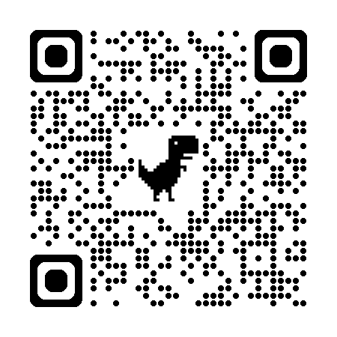
Acknowledgements
https://bl831.als.lbl.gov/~jamesh/powerpoint/PSI_2025.pptx
James Fraser Nevan Krogan
Paul Adams John Tainer Greg Hura Nick Sauter
Pavel Afonine Tom Terwilliger Nigel Moriarty, Dorothee Liebschner Helen Ginn
Aina Cohen
UCSF LBNL SLAC
ALS 8.3.1: TomAlberTron
NIH NIGMS R01 GM124149 (Holton)
NIH NIAID P50 AI150476 (Krogan)
NIH NIGMS P30 GM124169 (Adams)
DOE-BER IDAT (Hura)
NIH NIGMS P30 GM133894 (Hodgson)
The Advanced Light Source is supported by the Director, Office of Science, Office of Basic Energy Sciences, Materials Sciences Division, of the US Department of Energy under contract No. DE-AC02-05CH11231 at Lawrence Berkeley National Laboratory.

Slide 2
https://bl831.als.lbl.gov/~jamesh/powerpoint/PSI_2025.pptx
The last Å
between prediction and reality
Because: the future of crystallography has alternate conformations
Single-conf models
poor resolution
Low signal/noise
Phase Problem
Dynamics?
Mechanism?
Small signal?
Overlapping states?

Slide 3
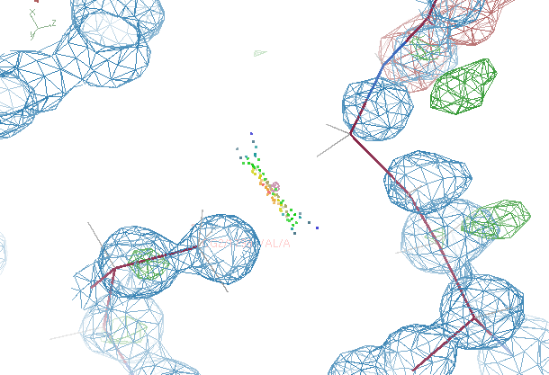
The last Å between prediction and reality
Bond length
σ = 0.005 Å

Slide 4
The last Å: near, but far
ATOM 122 N LEU A 13 -3.244 25.808 19.998 1.00 16.96 N
ATOM 123 CA LEU A 13 -2.877 25.448 21.355 1.00 15.29 C
ATOM 124 C LEU A 13 -2.792 23.966 21.561 1.00 17.54 C
ATOM 125 O LEU A 13 -1.814 23.493 22.143 1.00 16.35 O
ATOM 126 CB LEU A 13 -3.907 26.164 22.268 1.00 18.72 C
ATOM 127 CG LEU A 13 -3.577 25.982 23.738 1.00 21.19 C
ATOM 128 CD1 LEU A 13 -2.283 26.820 24.019 1.00 19.43 C
ATOM 129 CD2 LEU A 13 -4.702 26.474 24.639 1.00 24.65 C
ATOM 130 N SER A 14 -3.677 23.149 20.979 1.00 15.96 N
ATOM 131 CA SER A 14 -3.646 21.711 21.061 1.00 18.26 C
ATOM 132 C SER A 14 -2.373 21.203 20.360 1.00 18.71 C
ATOM 133 O SER A 14 -1.747 20.315 20.930 1.00 17.47 O
ATOM 134 CB SER A 14 -4.875 21.077 20.419 1.00 17.62 C
ATOM 135 OG ASER A 14 -4.825 19.665 20.388 0.50 20.89 O
ATOM 136 OG BSER A 14 -6.027 21.408 21.164 0.50 18.67 O
ATOM 137 N LYS A 15 -2.045 21.772 19.215 1.00 18.03 N
ATOM 138 CA LYS A 15 -0.799 21.361 18.555 1.00 18.12 C
ATOM 139 C LYS A 15 0.446 21.707 19.351 1.00 18.81 C
ATOM 140 O LYS A 15 1.400 20.948 19.411 1.00 17.77 O
ATOM 141 CB LYS A 15 -0.700 22.034 17.177 1.00 14.49 C
ATOM 142 CG LYS A 15 -1.727 21.368 16.256 1.00 16.12 C
ATOM 143 CD LYS A 15 -1.663 22.147 14.936 1.00 19.40 C
ATOM 144 CE ALYS A 15 -2.725 21.614 13.986 0.50 17.42 C
ATOM 145 CE BLYS A 15 -1.750 21.211 13.750 0.50 17.01 C
ATOM 146 NZ ALYS A 15 -2.346 21.674 12.559 0.50 18.61 N
ATOM 147 NZ BLYS A 15 -3.052 20.513 13.741 0.50 18.76 N

Slide 5
The last Å: near, but far
ATOM 122 N LEU A 13 -3.000 26.000 20.000 1.00 16.96 N
ATOM 123 CA LEU A 13 -3.000 25.000 21.000 1.00 15.29 C
ATOM 124 C LEU A 13 -3.000 24.000 22.000 1.00 17.54 C
ATOM 125 O LEU A 13 -2.000 23.000 22.000 1.00 16.35 O
ATOM 126 CB LEU A 13 -4.000 26.000 22.000 1.00 18.72 C
ATOM 127 CG LEU A 13 -4.000 26.000 24.000 1.00 21.19 C
ATOM 128 CD1 LEU A 13 -2.000 27.000 24.000 1.00 19.43 C
ATOM 129 CD2 LEU A 13 -5.000 26.000 25.000 1.00 24.65 C
ATOM 130 N SER A 14 -4.000 23.000 21.000 1.00 15.96 N
ATOM 131 CA SER A 14 -4.000 22.000 21.000 1.00 18.26 C
ATOM 132 C SER A 14 -2.000 21.000 20.000 1.00 18.71 C
ATOM 133 O SER A 14 -2.000 20.000 21.000 1.00 17.47 O
ATOM 134 CB SER A 14 -5.000 21.000 20.000 1.00 17.62 C
ATOM 135 OG ASER A 14 -5.000 20.000 20.000 0.50 20.89 O
ATOM 136 OG BSER A 14 -6.000 21.000 21.000 0.50 18.67 O
ATOM 137 N LYS A 15 -2.000 22.000 19.000 1.00 18.03 N
ATOM 138 CA LYS A 15 -1.000 21.000 19.000 1.00 18.12 C
ATOM 139 C LYS A 15 0.000 22.000 19.000 1.00 18.81 C
ATOM 140 O LYS A 15 1.000 21.000 19.000 1.00 17.77 O
ATOM 141 CB LYS A 15 -1.000 22.000 17.000 1.00 14.49 C
ATOM 142 CG LYS A 15 -2.000 21.000 16.000 1.00 16.12 C
ATOM 143 CD LYS A 15 -2.000 22.000 15.000 1.00 19.40 C
ATOM 144 CE ALYS A 15 -3.000 22.000 14.000 0.50 17.42 C
ATOM 145 CE BLYS A 15 -2.000 21.000 14.000 0.50 17.01 C
ATOM 146 NZ ALYS A 15 -2.000 22.000 13.000 0.50 18.61 N
ATOM 147 NZ BLYS A 15 -3.000 21.000 14.000 0.50 18.76 N

Slide 6
R-factor Gap small vs macro molecules
Publication criterion for chemical crystallography:
Model-data difference < error in data
R1 < 2*R_{sigma}
R1 = F_{o} vs F_{c} for I/σ(I) > 3
R_{sigma} = <σ(I)>/<I>
There are no PDB entries that pass this test!
Holton et al. (2014) "The R-factor gap", FEBS J. 281, 4046-4060.

Slide 7
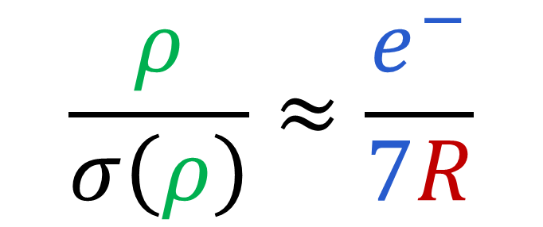
Map Noise: R factors matter via Parseval’s Theorem
$$\frac{ρ}{σ\left(ρ\right)}≈\frac{e^{−}}{7R}$$
e⁻ number of electrons in peak
7 number of electrons in typical atom
R R_{iso} or R_{free}
ρ electron density peak
σ rms deviation expected

Slide 8
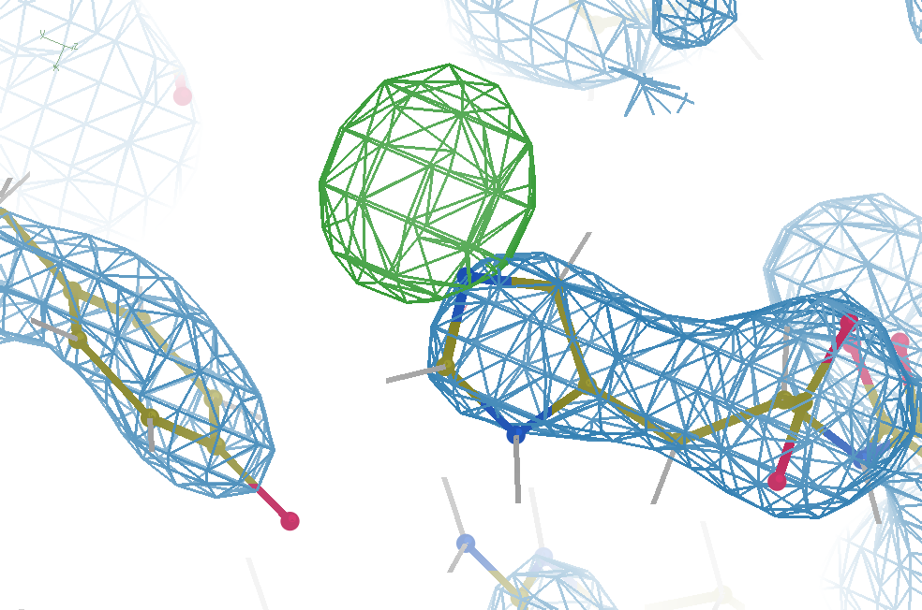
Hydrogen: visible at 3.5 Å resolution!
R_{work} = 0.04
R_{free} = 0.05
6σ = 1 e⁻
cut at 5 Å :
R_{free} = 0.01
Simulation:
Realistic noise
“perfect” model

Slide 9
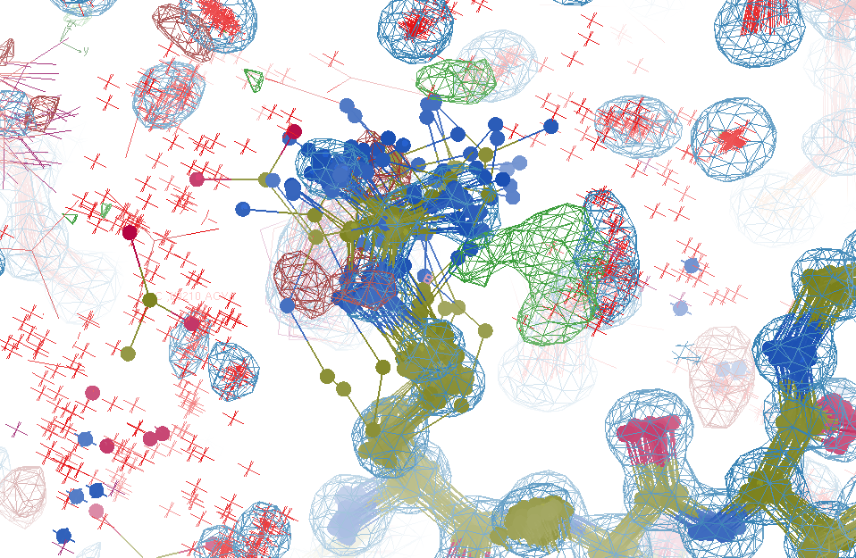
R_{work}: 0.0823
R_{free}: 0.1106
bond: 0.014 Å
angle: 1.92°
Real Data
1.2 σ
48-copy ensemble
3 params
per observation
MoPro: 1.15
Clash: 0.49
Cβdev: 20
Rota: 1.7%
Rama: 0.03%
reso: 1.0 Å
6σ

Slide 10
Over-Fitting data
Map density
position

Slide 11
Over-Fitting data
Map density
position

Slide 12
Over-Fitting data
Map density
position

Slide 13
Over-Fitting data
R_{work} ≈ 0
N_{params}= N_{obs}
Map density
position

Slide 14
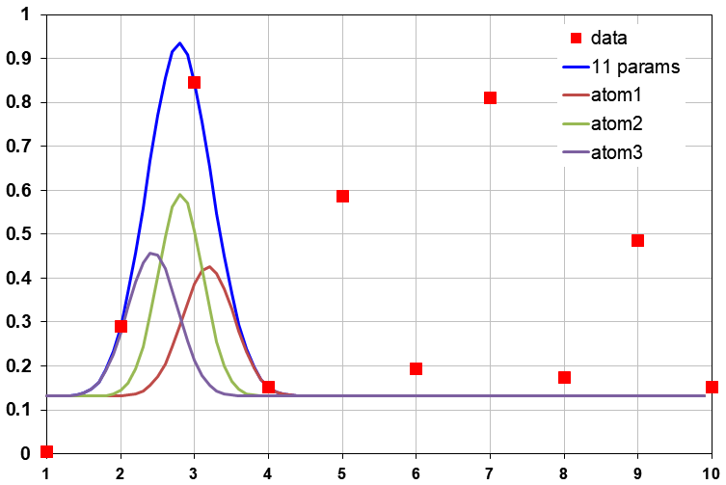
Under-Fitting data
R_{work} > 0
N_{params}> N_{obs}
Map density
position

Slide 15
R_{work}: 0.0823
R_{free}: 0.1106
bond: 0.014 Å
angle: 1.92°
under-fitting:
R_{work} > 0
MoPro: 1.15
Clash: 0.49
Cβdev: 20
Rota: 1.7%
Rama: 0.03%
reso: 1.0 Å
6σ

Slide 16
Limiting factors in
Serial Crystallography
Texture
Non-isomorphism
Tangling

Slide 17
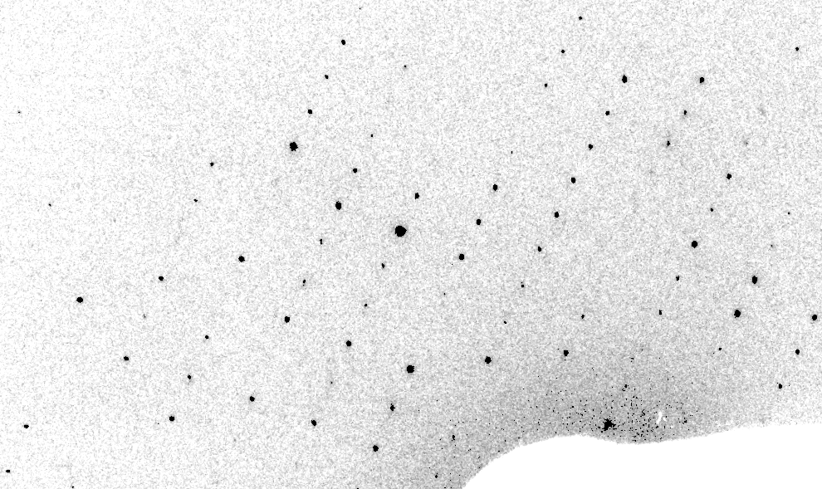
Real XFEL still
Lyubimov et al. (2016).
eLife 5, e18740.

Slide 18
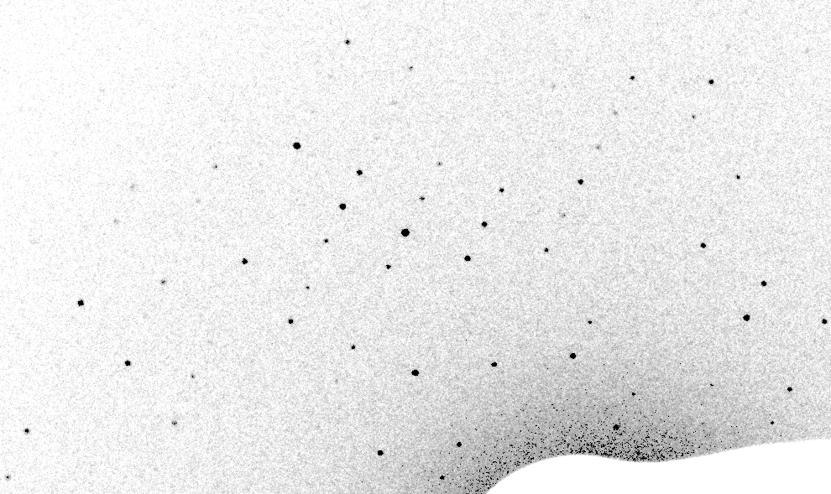
Best-fit Simulation of XFEL still

Slide 19
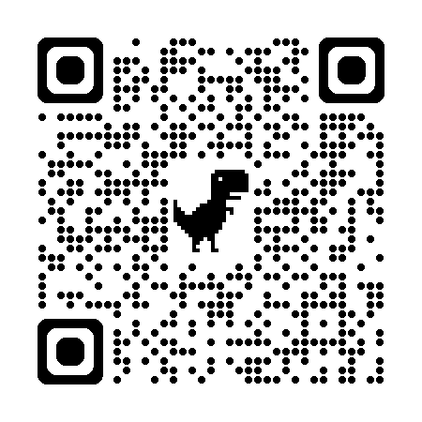
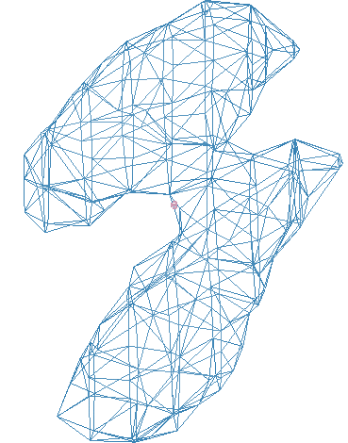
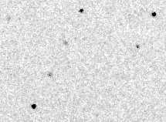
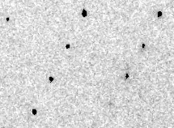
Simulation fit to XFEL still
phix
https://pmc.ncbi.nlm.nih.gov/articles/PMC11801403/
phiy
phiz
real
VS
“texture”
phix
phiy
phiz

Slide 20
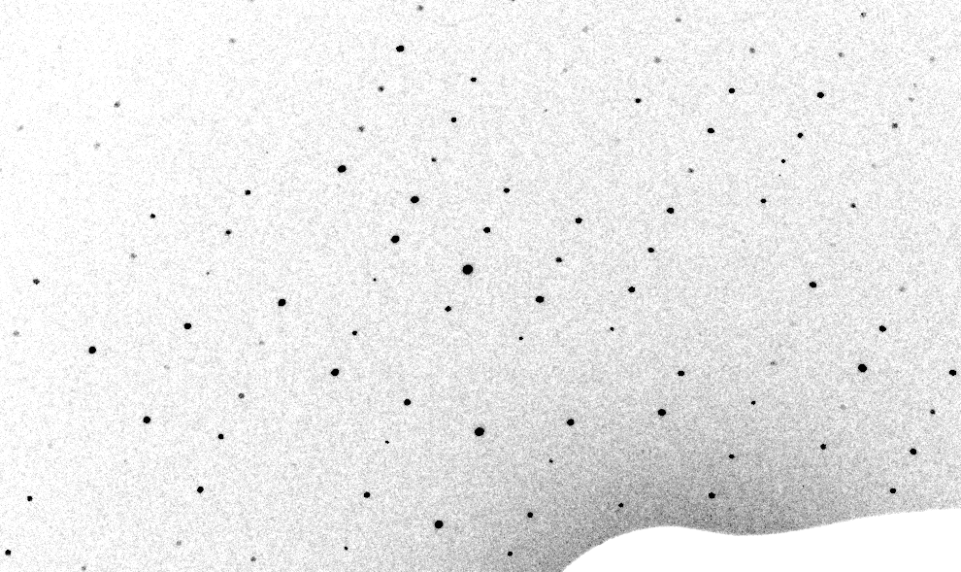
3-cluster texture simulation

Slide 21
Real XFEL still
Lyubimov et al. (2016).
eLife 5, e18740.

Slide 22
Mosaic (1-cluster texture) simulation

Slide 23
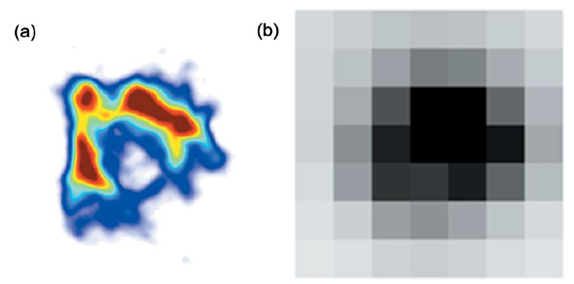
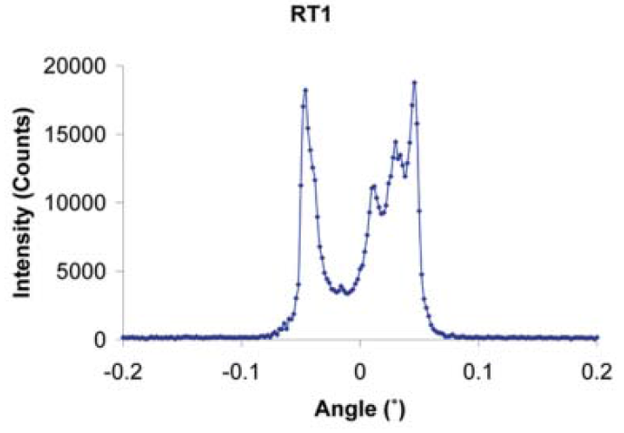
The true nature of “mosaic spread”
Any function can be approximated by a family of Gaussians
Lovelace JJ, Murphy CR, Pahl R, Brister K & Borgstahl GEO (2006)."Tracking reflections through cryogenic cooling with topography", J. Appl. Cryst. 39, 425-432.

Slide 24
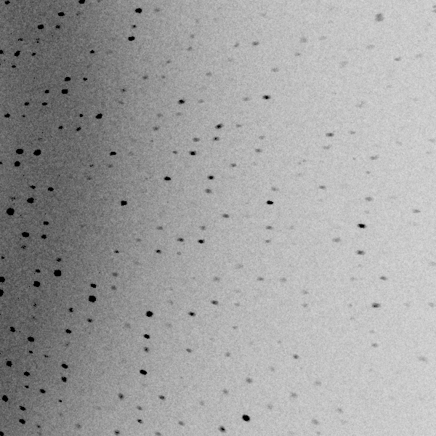
3 domains within 1°

Slide 25
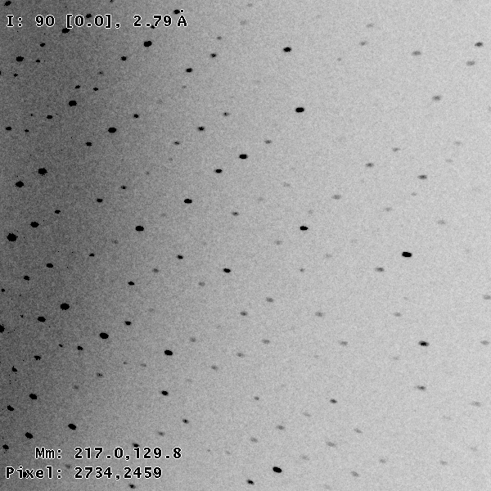
3 domains within 0.2°

Slide 26
Texture sufficient for poor stats
500 images Results from iota: cctbx & prime
texture | 1 cluster | 3 clusters
R_{true}* | 4% | 16%
*Agreement with F value fed into simulation

Slide 27
Texture sufficient for poor stats
500 images Results from iota: cctbx & prime
texture | 1 cluster | 3 clusters
R_{true}* | 4% | 16%
R_{merge} | 23% | 66%
*Agreement with F value fed into simulation

Slide 28
Texture sufficient for poor stats
500 images Results from iota: cctbx & prime
texture | 1 cluster | 3 clusters
R_{true}* | 4% | 16%
R_{merge} | 23% | 66%
I/σ | 32 (1.1) | 19 (1.2)
*Agreement with F value fed into simulation

Slide 29
Texture sufficient for poor stats
500 images Results from iota: cctbx & prime
texture | 1 cluster | 3 clusters
R_{true}* | 4% | 16%
R_{merge} | 23% | 66%
I/σ | 32 (1.1) | 19 (1.2)
CC_{1/2} | 99 (69) | 99 (58)
*Agreement with F value fed into simulation

Slide 30
Texture sufficient for poor stats
500 images Results from iota: cctbx & prime
texture | 1 cluster | 3 clusters
R_{true}* | 4% | 16%
R_{merge} | 23% | 66%
I/σ | 32 (1.1) | 19 (1.2)
CC_{1/2} | 99 (69) | 99 (58)
resolution | 1.55 | 1.94
*Agreement with F value fed into simulation

Slide 31
Fitting multiple clusters is stable!
Fraction pixels predicted
Best of
262,140 trials
Angle about y axis (°)

Slide 32
Prediction:
Incorporating texture
in serial data processing will
reduce image count requirement
from ~1e4 to ~100
Why? Because rotation data lack texture error

Slide 33
Limiting factors in
Serial Crystallography
Texture
Non-isomorphism
Tangling

Slide 34
non-isomorphism

Slide 35
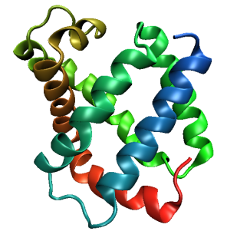
Same structure, different cell
0.5% cell change → 15%
Crick & Magdoff (1956) “theory method isomorphous replacement”, Acta Cryst. 9, 901-8.

Slide 36
Same structure, different cell
0.5% cell change → 15%
Crick & Magdoff (1956) “theory method isomorphous replacement”, Acta Cryst. 9, 901-8.

Slide 37
Same cell, rotated protein
0.5° rotation → 16%
Crick & Magdoff (1956) “theory method isomorphous replacement”, Acta Cryst. 9, 901-8.

Slide 38
Same cell, rotated protein
0.5° rotation → 16%
Crick & Magdoff (1956) “theory method isomorphous replacement”, Acta Cryst. 9, 901-8.

Slide 39
Uniform stretch
5% change → 0% R

Slide 40
Uniform stretch
5% change → 0% R

Slide 41
non-isomorphism correction must:
be periodic
be continuous
preserve scale & zoom
preserve bonds, angles

Slide 42
“map bender” procedure
Convert to fractional coordinates
Basis functions: spatial sin waves

Slide 43
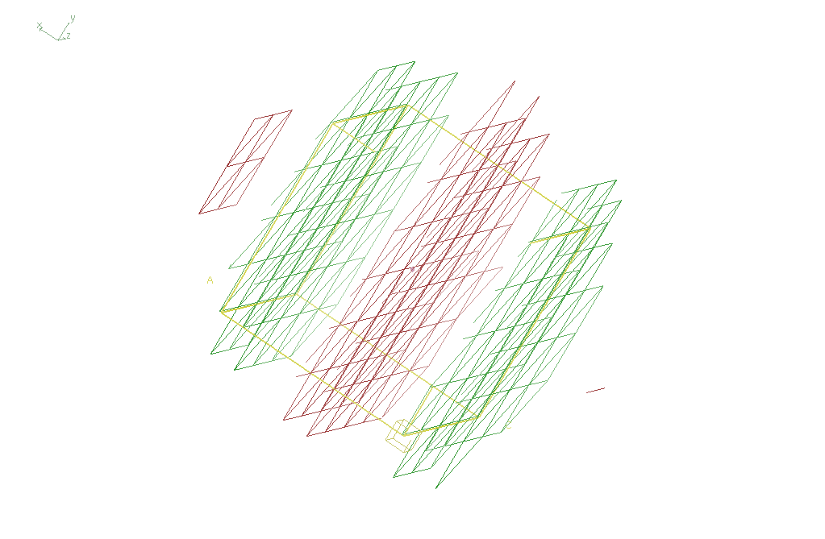
Basis function 1 0 0

Slide 44
“map bender” procedure
Convert to fractional coordinates
Basis functions: spatial sin waves
  Repeats with unit cell
  Low-order h,k,l indices first
Fit function to Δx vs x,y,z across P1 cell
Repeat with Δy, Δz
Apply to PDB file and interpolate map grid
Usually 3-5 orders comparable to LSQ

Slide 45
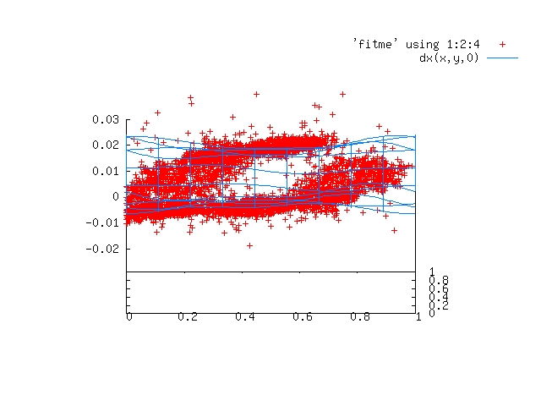

Slide 46
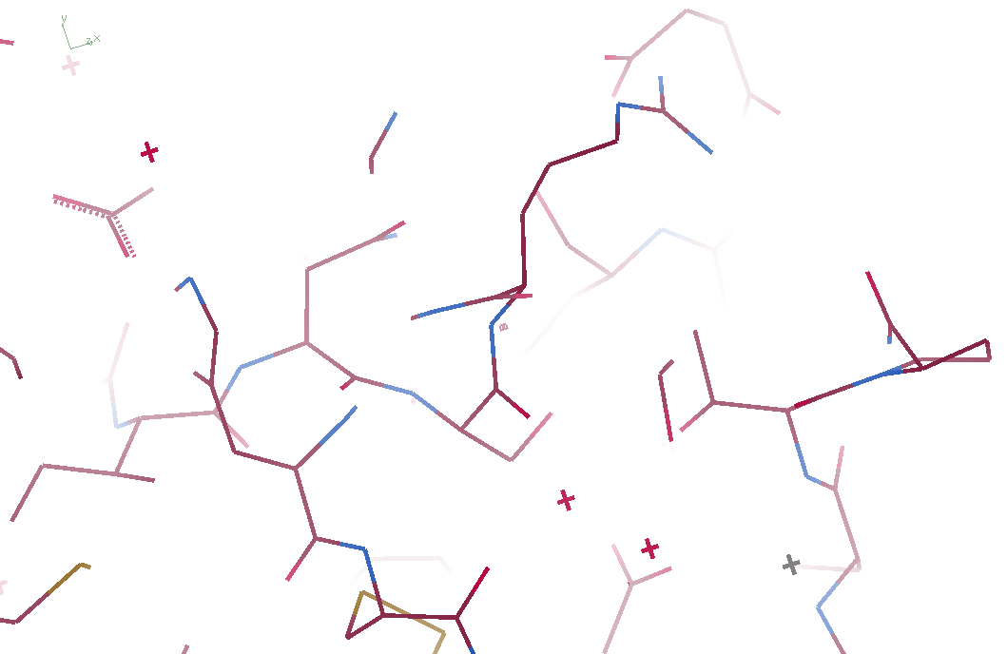
3aw6

Slide 47
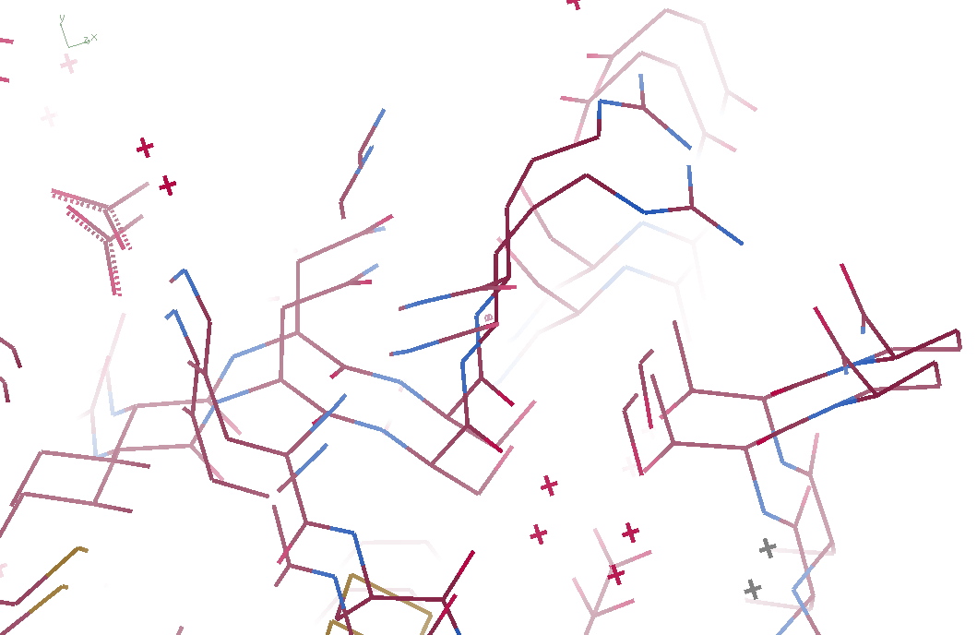
3aw6 3aw7

Slide 48
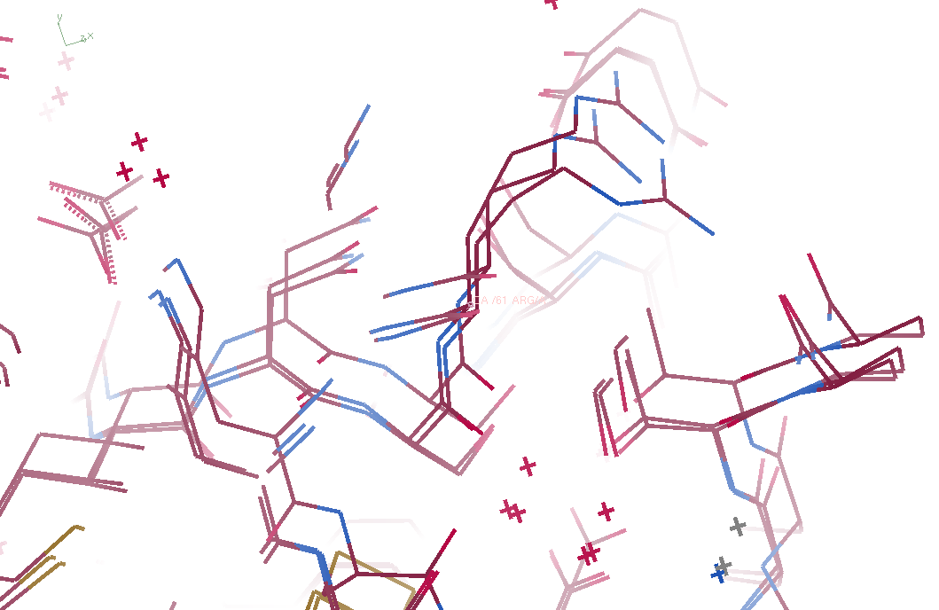
3aw6, 3aw7, “bent” 3aw6

Slide 49
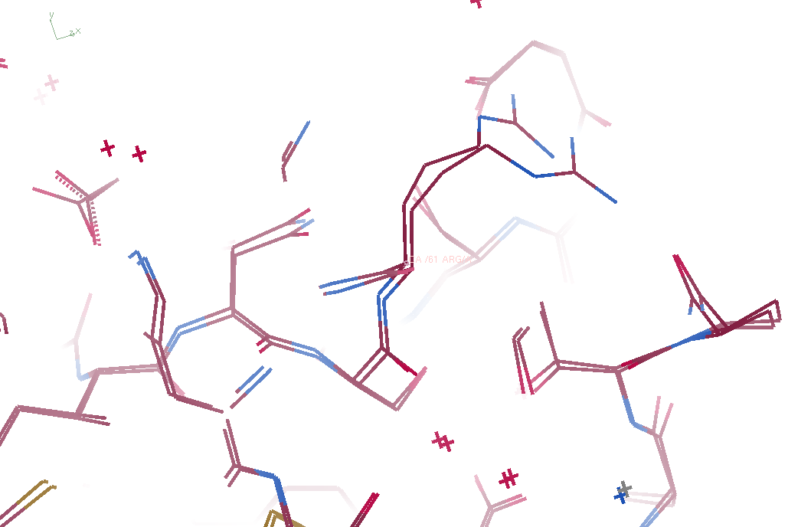
3aw7, “bent” 3aw6

Slide 50
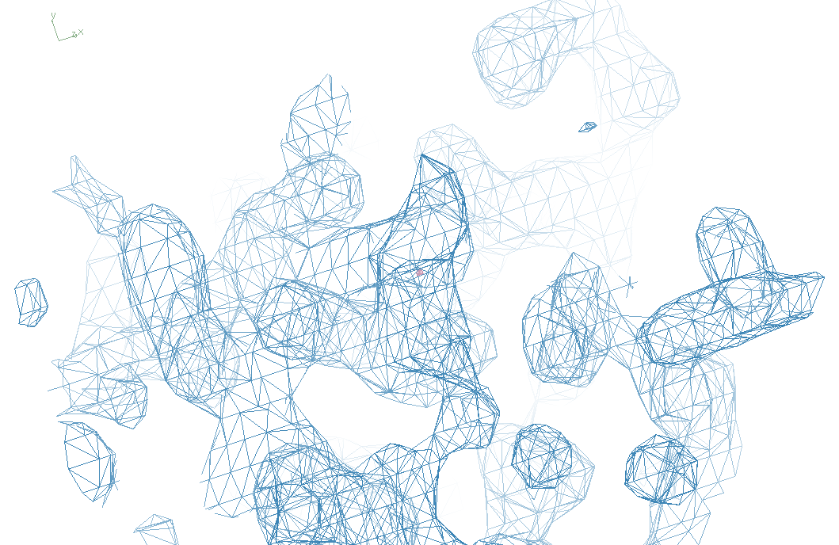
3aw6

Slide 51
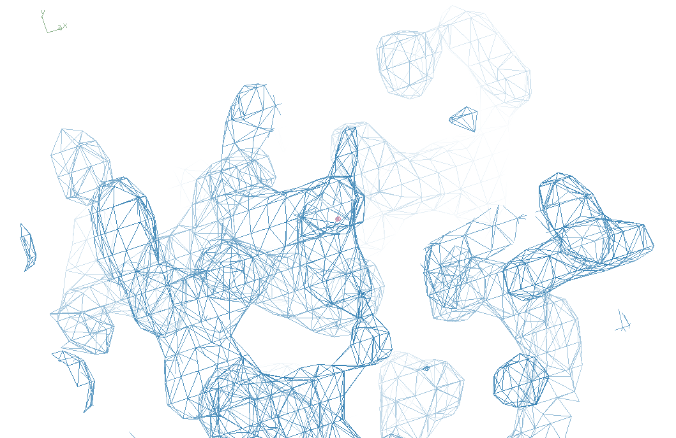
“bent” 3aw7

Slide 52
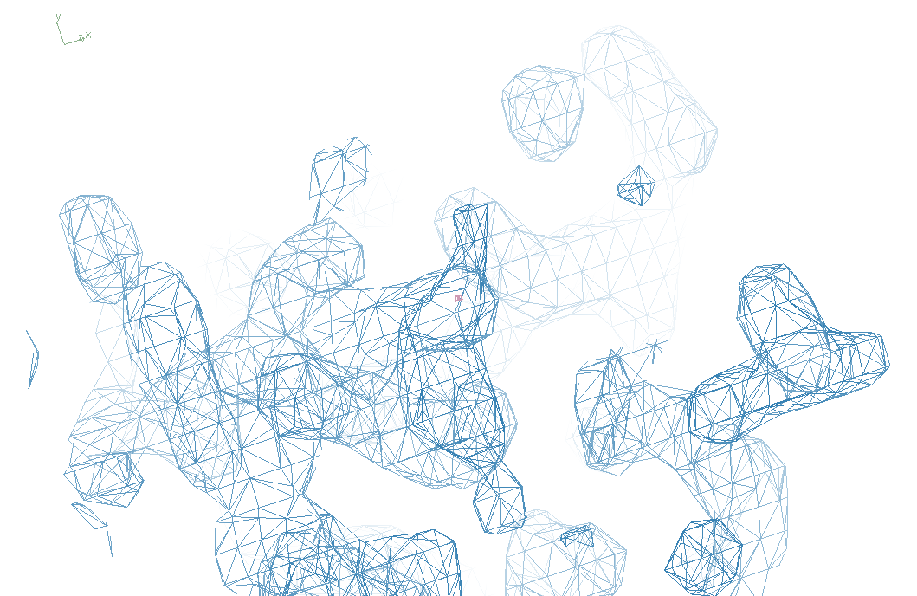
3aw7

Slide 53
Prediction:
Correcting non-isomorphism
will allow
infinite averaging
allowing arbitrary signal/noise
arbitrary resolution
Why? Because it works for cryoEM

Slide 54
Limiting factors in
Serial Crystallography
Texture
Non-isomorphism
Tangling

Slide 55

The UNTANGLE Challenge
best.pdb
refme.mtz
(simulated)
11) Build better than the best:
as-good or better wE, R_{free} as best.pdb
alternate mechanism ensemble
$1000
https://github.com/jmholton/UnTangle

Slide 56
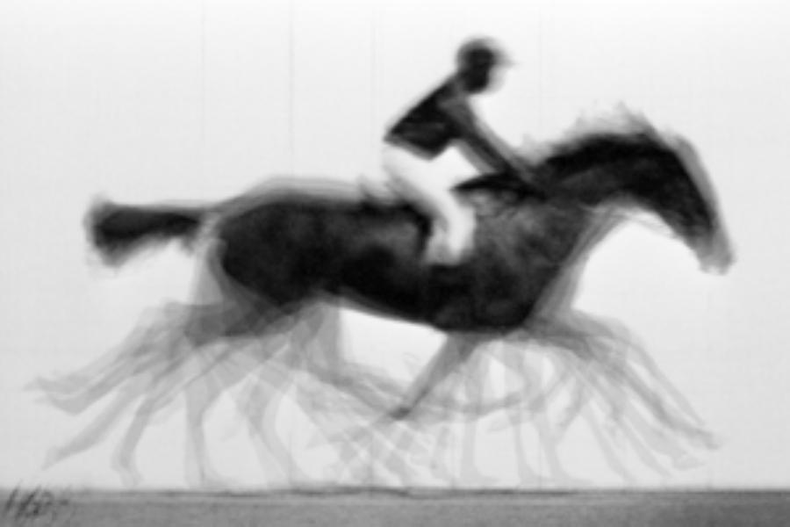
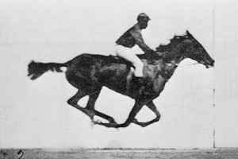
The UNTANGLE Challenge
best.pdb
refme.mtz
(simulated)
11) Build better than the best:
as-good or better wE, R_{free} as best.pdb
alternate mechanism ensemble
10) Recover best.pdb from refme.mtz
true phases, auto-building allowed
no cheating (don’t use best.pdb as guide)
Prove: true ensemble is
unique and recoverable
$1000
$500
https://github.com/jmholton/UnTangle

Slide 57
Muybridge’s galloping horse (1872)

Slide 58
average structure: galloping horse

Slide 59
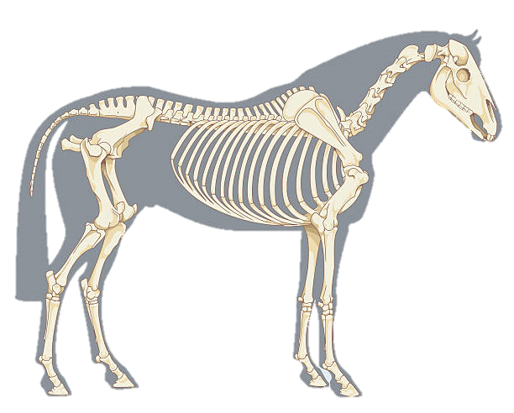
Horses have bones
+/- 0.01

Slide 60
Differences & Similarities
horse
molecule
~2 m
Stiff backbone
Bone sigma ~ 1 mm
4 joints/leg
Continuous angle
No torision
Concerted motion
no steric clashes
~100 Å
Stiff backbone
Bond sigma = 0.01 Å
0-4 chi angles
Angle sigma ~ 1°
Rotamers
Concerted motion
no steric clashes

Slide 61
Horses have bones

Slide 62

Muybridge’s galloping horse 0

Slide 63
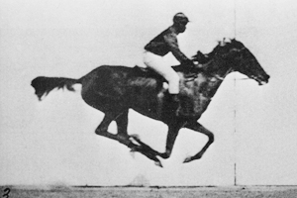
Muybridge’s galloping horse 1

Slide 64
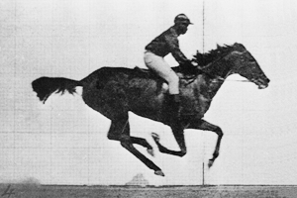
Muybridge’s galloping horse 2

Slide 65
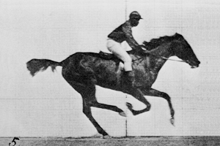
Muybridge’s galloping horse 3

Slide 66
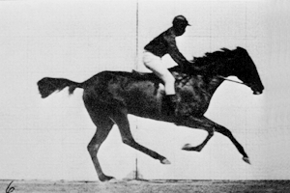
Muybridge’s galloping horse 4

Slide 67
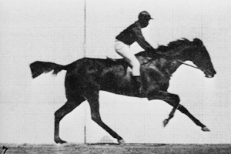
Muybridge’s galloping horse 5

Slide 68
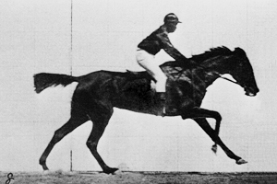
Muybridge’s galloping horse 6

Slide 69
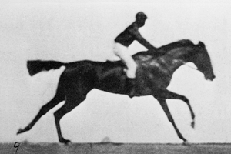
Muybridge’s galloping horse 7

Slide 70
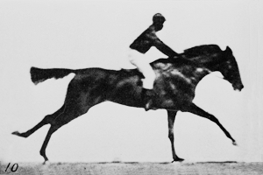
Muybridge’s galloping horse 8

Slide 71
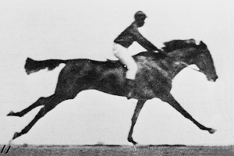
Muybridge’s galloping horse 9

Slide 72
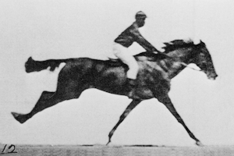
Muybridge’s galloping horse 10

Slide 73
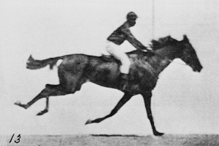
Muybridge’s galloping horse 11

Slide 74
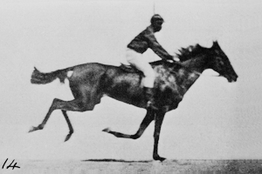
Muybridge’s galloping horse 12

Slide 75
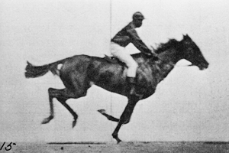
Muybridge’s galloping horse 13

Slide 76
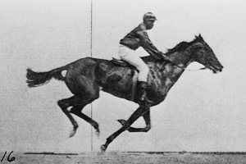
Muybridge’s galloping horse 14

Slide 77
ensemble refine ???
A solution exists!
But ensemble refine
will fail to find it

Slide 78
R_{work}: 0.0823
R_{free}: 0.1106
bond: 0.014 Å
angle: 1.92°
under-fitting:
R_{work} > 0
MoPro: 1.15
Clash: 0.49
Cβdev: 20
Rota: 1.7%
Rama: 0.03%
reso: 1.0 Å
6σ

Slide 79
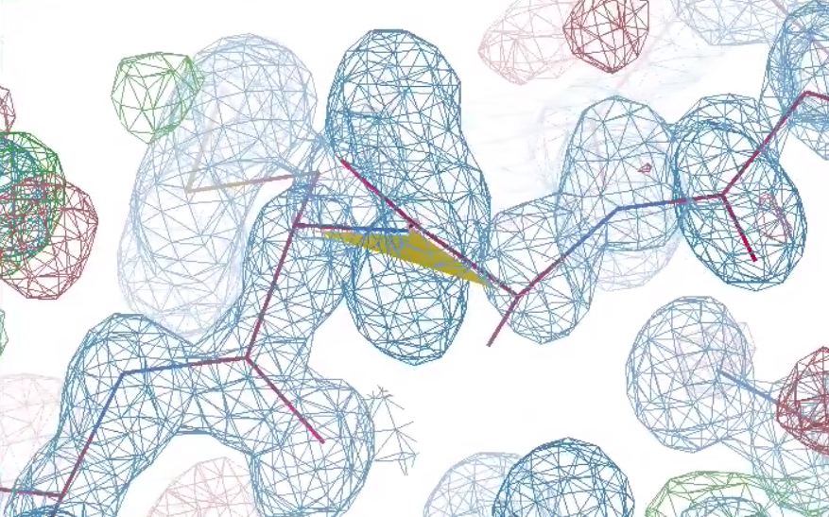
What is holding this back?
1 member of 48-copy
ensemble
R_{work}: 0.0823
R_{free}: 0.1106
bond: 0.014 Å
angle: 1.92°
MoPro: 1.15
Clash: 0.49
Cβdev: 20
Rota: 1.7%
Rama: 0.03%
reso: 1.0 Å
30°
peptide
bond twist

Slide 80
Why does ensemble refinement suck?
(3 parameters/observation and R_{work} still high!)
The chains are “tangled”

Slide 81
What do you mean, “tangled”?
Ground Truth
Local Minimum

Slide 82
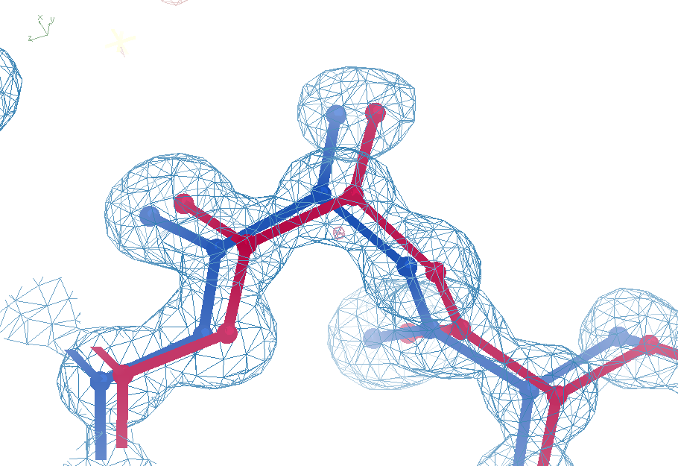
Sim challenge data
Ala39
-0.2σ
wE=18.2
N-C_{α}
bond
-0.3σ
0.8σ
angle
A B conformers

Slide 83
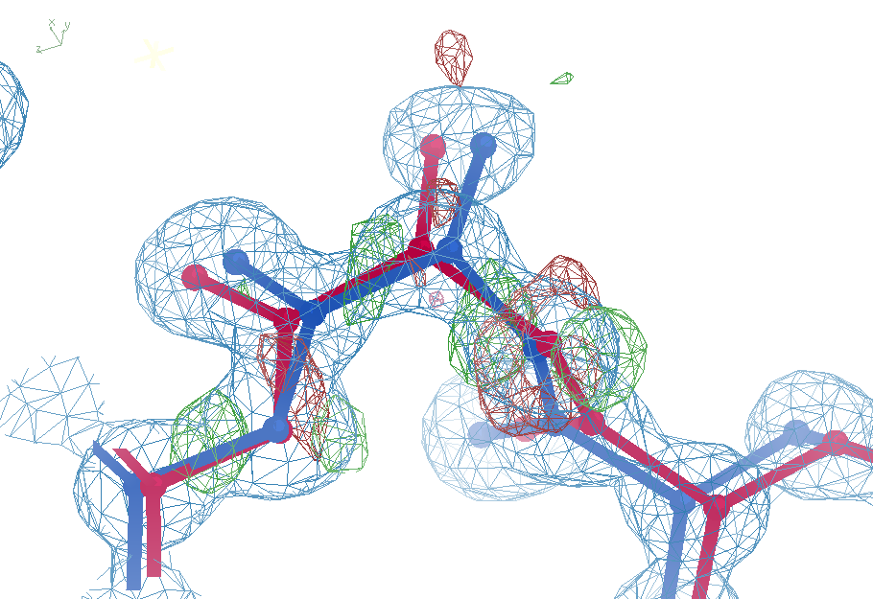

Sim challenge data: “otw39”
Ala39
+11σ
wE=63.5
N-C_{α}
bond
-9σ
It’s a TRAP!
5σ
angle
A B conformers

Slide 84
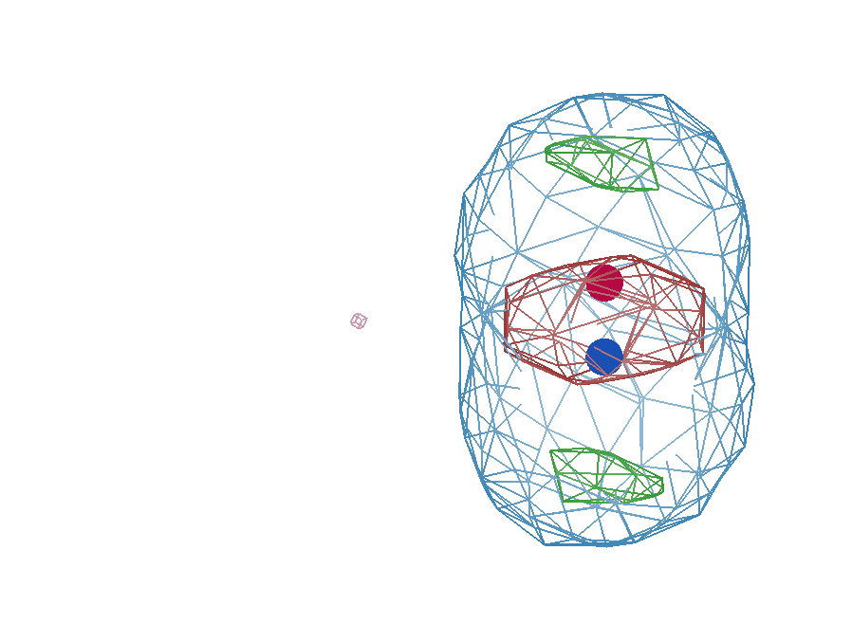
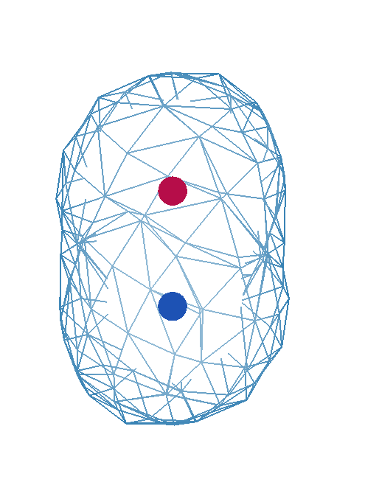
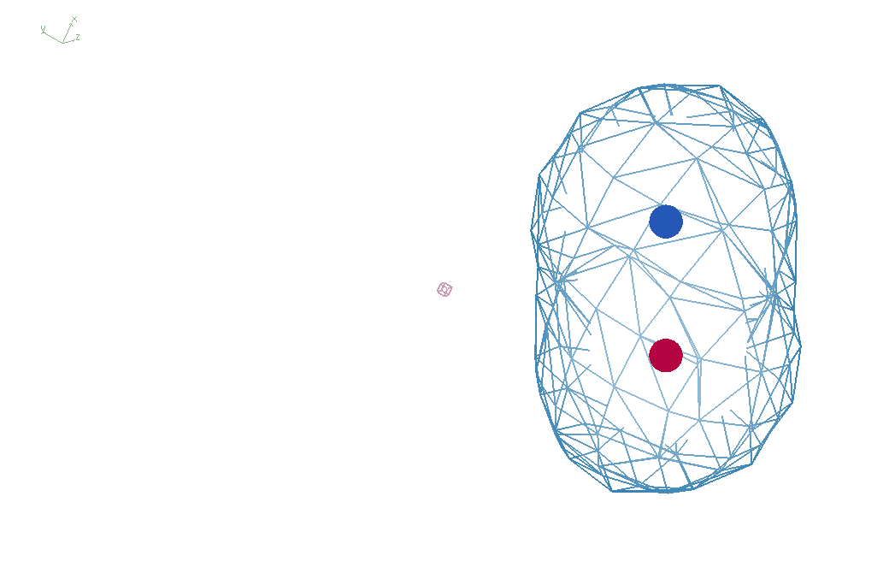
It takes two to tangle
density
fit
Chemical
strain
energy
A
A
B
B
B
A
tangled
barrier
untangled

Slide 85


Refine from right answer
R = 0.8%
rms bond = 0.0002

Slide 86

Refine from wrong starting point
R = 7.07%
rms bond = 0.001

Slide 87
UNTANGLE: sim-data Ground Truth
As simple as possible:
  2 conformers
  50:50 occupancy
Accessible
  64 residues
  78 waters
Every chance of success
  1.0 Å reso
  “one thing wrong”
  flat bulk solvent
  no false outliers
  phenix, refmac, shelxl
  clear score
  Experimental error only
  perfect phases

Slide 88
verified Score sheet
wE | R_{work} | R_{free} | method
185 | 20.6 | 21.4 | Alphafold2
109.6 | 8.87 | 9.44 | Phenix.ensemble_refine
97.3 | 8.84 | 9.27 | qFit best
91.7 | 3.64 | 4.27 | manual
80.5 | 4.31 | 4.75 | lotswrong
65.2 | 6.35 | 6.93 | Amber24
54.6 | 5.87 | 6.57 | single conf w aniso B
33.5 | 2.94 | 3.32 | One thing wrong: Ala39
23.5 | 2.95 | 3.31 | One thing wrong: Val1
21.4 | 3.12 | 3.48 | Rectified Simulated annealing
18.1 | 17.9 | 18.4 | Phenix autobuild
18.2 | 2.79 | 3.14 | best (ground truth)

Slide 89
verified Score sheet
wE | R_{work} | R_{free} | method
185 | 20.6 | 21.4 | Alphafold2
109.6 | 8.87 | 9.44 | Phenix.ensemble_refine
97.3 | 8.84 | 9.27 | qFit best
91.7 | 3.64 | 4.27 | manual
80.5 | 4.31 | 4.75 | lotswrong
65.2 | 6.35 | 6.93 | Amber24
54.6 | 5.87 | 6.57 | single conf w aniso B
33.5 | 2.94 | 3.32 | One thing wrong: Ala39
23.5 | 2.95 | 3.31 | One thing wrong: Val1
21.4 | 3.12 | 3.48 | Rectified Simulated Annealing
18.1 | 17.9 | 18.4 | Phenix autobuild
18.2 | 2.79 | 3.14 | best (ground truth)

Slide 90

sim data
Arg62
wE=63.5
2.8 Å
4σ
C_{γ}-C_{δ}
bond
2.7σ torsion
A B conformers

Slide 91

sim data
Arg62
wE=50.7
2.8 Å
2σ
angle
A B conformers

Slide 92

sim data
Arg62
wE=18.2
3.0 Å
0.3σ
C_{γ}-C_{δ}
bond
1σ
angle
1.6σ torsion
A B conformers

Slide 93

Tyr14
sim data
wE=33.1
3.0 Å
A B conformers

Slide 94

Tyr14
sim data
wE=18.2
3.2 Å
A B conformers

Slide 95

Cys16
sim data
wE=21.4
2.7σ
angle
A B conformers

Slide 96

Cys16
sim data
wE=18.2
1.5σ
angle
A B conformers

Slide 97
wE score: key concepts
sqrt()
erf()
Energy ↔ dev/sigma ↔ Probability
Probability outlier is not noise
  “clip” energy to tolerate real outliers
  Not so sharp transition to outlier
Tighter Non-bond (Lennard-Jones)

Slide 98

Statistical Potential
$$E={\left(\frac{v−v0}{σ}\right)}^{2}$$
E “energy”
v model value
v₀ ideal value
σ rms deviation expected
1 x 6σ ← 40x 1σ
1 x 6σ ≈ 36x 1σ
Outlier problem:
solution: weight by
“probability its not noise”

Slide 99

Probability that it’s not noise
erf()
←68%→
← 95% →
-1σ 0 1σ 2σ 3σ

Slide 100






Probability that it’s not noise
$$Pnn={\operatorname{erf}\left(\left|\frac{v−v0}{σ\sqrt{2}}\right|\right)}^{Nthings}$$
P_{nn} probability
v-v₀ deviation from ideal
σ rms deviation expected
erf() integral of a Gaussian
N_{things} number of trials
erf($1.0/\sqrt{2}$) = 68%
${\text{erf}\text{(}1.0/\sqrt{2}\text{)}}^{10}$ = 2%
erf($2.0/\sqrt{2}$) = 95%
${\text{erf}\text{(}2.0/\sqrt{2}\text{)}}^{10}$ = 63%
${\text{erf}\text{(}4.0/\sqrt{2}\text{)}}^{10,000}$ = 53%

Slide 101
New Untangling Ideas!
Variable Labels - Tronrud
ROPE - Ginn
phenix.create_alt_conf - Terwilliger
Rectified Simulated Annealing
Bespoke harmonic restraints in MD

Slide 102




Tronrud’s
“Variable Labels” proposal
New ideas!
unimplemented

Slide 103

New tools!
Helen Ginn ROPE-based program
GUI showing both conformers A and B and bonds drawn between them according to the following rules:
good geometry, for
or
bad geometry, for
or
good geometry, for
or
bad geometry, for
or
Conformer A
Helen
wE = 18.6
Conformer B
“best”: wE = 18.2
This indicates the bottom atom conformers need untangling. Clicking on the atoms flips the conformers over right to the end of the chain.

Slide 104
GUI showing both conformers A and B and bonds drawn between them according to the following rules:
good geometry, for
or
bad geometry, for
or
good geometry, for
or
bad geometry, for
or
Conformer A
Conformer B
This indicates the bottom atom conformers need untangling. Clicking on the atoms flips the conformers over right to the end of the chain.

Slide 105


New Tools!
Tom
Terwilliger
phenix.holton_geometry_validation test.pdb
phenix.create_alt_conf phenix_autobuild.pdb refme.mtz \
nproc=48
phenix.refine \
model.pdb refme.mtz \
main.number_of_mac=10 \
fit_altlocs_method=masking \
ordered_solvent=true \
include_altlocs=true \
ordered_solvent.mode=every_macro_cycle_after_first \
refine_oat=true
Pavel Afonine

Slide 106

Better than the best?
Ala39
wE=17.2
A B conformers

Slide 107

best?
Ala39
wE=18.2
A B conformers

Slide 108
verified Score sheet
wE | R_{work} | R_{free} | method
185 | 20.6 | 21.4 | Alphafold2
109.6 | 8.87 | 9.44 | Phenix.ensemble_refine
97.3 | 8.84 | 9.27 | qFit best
91.7 | 3.64 | 4.27 | manual
80.5 | 4.31 | 4.75 | lotswrong
65.2 | 6.35 | 6.93 | Amber24
54.6 | 5.87 | 6.57 | single conf w aniso B
33.5 | 2.94 | 3.32 | One thing wrong: Ala39
23.5 | 2.95 | 3.31 | One thing wrong: Val1
21.4 | 3.12 | 3.48 | Rectified Simulated Annealing
18.1 | 17.9 | 18.4 | Phenix autobuild
18.2 | 2.79 | 3.14 | best (ground truth)

Slide 109

“rectified” Simulated Annealing
Default simulated annealing in phenix
Run score on result
Run score on starting model
Probe difference map
Atom by atom: is worse? Move it back
Iterate
Parallel seeds and temperatures
https://github.com/jmholton/rectified_simulated_annealing

Slide 110

Long-range traps from rectified SA
wE=21.4
Match ground-truth
swapped relative
To ground truth

Slide 111

best.pdb
wE=18.2
Match ground-truth
Nothing
swapped relative
To ground truth

Slide 112
verified Score sheet
wE | R_{work} | R_{free} | method
185 | 20.6 | 21.4 | Alphafold2
109.6 | 8.87 | 9.44 | Phenix.ensemble_refine
97.3 | 8.84 | 9.27 | qFit best
91.7 | 3.64 | 4.27 | manual
80.5 | 4.31 | 4.75 | lotswrong
65.2 | 6.35 | 6.93 | Amber24
54.6 | 5.87 | 6.57 | single conf w aniso B
33.5 | 2.94 | 3.32 | One thing wrong: Ala39
23.5 | 2.95 | 3.31 | One thing wrong: Val1
21.4 | 3.12 | 3.48 | Rectified Simulated Annealing
18.1 | 17.9 | 18.4 | Phenix autobuild
18.2 | 2.79 | 3.14 | best (ground truth)

Slide 113

Molecular Dynamics of crystals
65
60
55
50
45
40
35
unrestrained
R_{free} (%)
restrained
Time (ns)

Slide 114
“bespoke” harmonic restraints in MD
A
A
or
B
B
Stays tangled
agnostic

Slide 115

Reference point with too-low weight

Slide 116
Real Data
1.2 σ
6σ

Slide 117

“bespoke” harmonic restraints in MD
Reference points at density centroids
Random alt-loc assignment (at first)
Harmonic weight = e- density
0.5 ns run – average ASU density
F_{obs}-F_{calc} difference map
update weights (green=more ; red=less)
Re-discover nearest reference points
Release very bad restraints: grow back?
Reduce all weights by ~1%
iterate
https://github.com/jmholton/bespoke_amber_restraints

Slide 118

Less than 2% of atoms need restraints
7
6
5
4
3
2
1
0
R_{free} = 27%
no X-ray term!
?
Restraint weight (kcal/Å²)
1.8%
1 10 100 1000 10000 1e5 1e6
Sorted atom count

Slide 119

Most-challenged restraint

Slide 120

“flying” MD snapshot

Slide 121


Slide 122

Solved, but weird, problem!
Vacuum bubbles at 10k atm
Bespoke restraints
No restraints

Slide 123

Restraints lead to “sloshing”
sparse restraints
without alignment
No restraints

Slide 124
Future improvements
https://bl831.als.lbl.gov/~jamesh/powerpoint/PSI_2025.pptx
All-outlier score (not just worst)
Density score (not just R_{free})
Sigma(I) generation
More realistic ground truth
Bespoke MD restraint tool kit
Tronrud’s Variable Labels

Slide 125
Summary
https://bl831.als.lbl.gov/~jamesh/powerpoint/PSI_2025.pptx
Main barrier: tangled ensemble
Recover underlying ensemble
  Might be required!
Rfree < 3% → single e⁻
  Not over-fitting
Weighted E scoring function
  Probability its not noise
$1000
$500

Slide 126
verified Score sheet
wE | R_{work} | R_{free} | method
185 | 20.6 | 21.4 | Alphafold2
109.6 | 8.87 | 9.44 | Phenix.ensemble_refine
97.3 | 8.84 | 9.27 | qFit best
91.7 | 3.64 | 4.27 | manual
80.5 | 4.31 | 4.75 | lotswrong
65.2 | 6.35 | 6.93 | Amber24
54.6 | 5.87 | 6.57 | single conf w aniso B
33.5 | 2.94 | 3.32 | One thing wrong: Ala39
23.5 | 2.95 | 3.31 | One thing wrong: Val1
21.4 | 3.12 | 3.48 | Rectified Simulated Annealing
18.1 | 17.9 | 18.4 | Phenix autobuild
18.2 | 2.79 | 3.14 | best (ground truth)

Slide 127
wE score: key concepts
sqrt()
erf()
Energy ↔ dev/sigma ↔ Probability
Probability outlier is not noise
  “clip” energy to tolerate real outliers
  Not so sharp transition to outlier
Tighter Non-bond (Lennard-Jones)

Slide 128


“clip” for tolerating true outliers
clip(E) $=\left\{\begin{matrix}E, if E<10 \\ 10+\log\left(E\right)−log⁡(10)\end{matrix}\right.$
Statistical Energy
$$E={\left(\frac{v−v0}{σ}\right)}^{2}$$
10
wE
Colloquially:
OK! OK! Its an outlier! Let’s not agonize about it
N=10
5
N=10,000
10σ vs 10.1σ not more important
than 3.3σ vs 3.0σ
0
3
6
8
max sigma deviate

Slide 129

Glu32
Genuine outlier
in ground truth
real data
-80°
Torsion outlier

Slide 130

Cys12
Genuine outlier
in ground truth
real data
-107°
torsion outlier
A B conformers

Slide 131
wE score: key concepts
sqrt()
erf()
Energy ↔ dev/sigma ↔ Probability
Probability outlier is not noise
  “clip” energy to tolerate real outliers
  Not so sharp transition to outlier
Tighter Non-bond (Lennard-Jones)

Slide 132


Probability that it’s not noise softer
$${Pnn}^{soft}=1−2^{\left({\left(\frac{\left|v−v0\right|}{σ_{P50}}\right)}^{5}\right)}$$
1
P_{nn} probability
v-v₀ deviation from ideal
σ rms deviation expected
inverf() inverse erf()
N_{things} number of trials
P
N=1
0.5
N=1 soft
$$σ_{P50}=$$
$$\sqrt{2} \text{inverf}\left({0.5}^{1/{N_{things}}}\right)$$
N=10,000
soft
N=10,000
0
1
2
3
4
5
6
max sigma deviate

Slide 133

Probability that it’s not noise average/sum of N_{things}
χ² test
N_{things}
Probability
That its
Gaussian
tie breaker

Slide 134
wE score: key concepts
sqrt()
erf()
Energy ↔ dev/sigma ↔ Probability
Probability outlier is not noise
  “clip” energy to tolerate real outliers
  Not so sharp transition to outlier
Tighter Non-bond (Lennard-Jones)

Slide 135
wE scoring function
  Statistical potential
    bonds, angles, planes, torsions, chiral
  Lennard-Jones vdW
    non-bond and clashes
  Probability -> σ dev
    - Rota, rama
  Peptide bond
    σ → 4°
  C_{β}dev
    σ = 0.05 Å
4
2
van der Waals
Phenix/refmac
0
Energy
-1
1
2
3
4
5
Atomic separation (Å)

Slide 136





weighted Energy scoring function
$$=\sum{w_{avg}\left\langle E\right\rangle +}w_{max}max\left(clip\left(E\right)\right)$$
wE
validation types
phenix.holton_geometry_validation
$$w_{max}=\text{P}\text{nn}max\left(clip\left(E\right)\right)$$
10
$$w_{avg}=χ^{2}\left(\sum{E}\right)$$
wE
N=10
5
N=10,000
N_{bonds}
$$E={\left(\frac{v−v0}{σ}\right)}^{2}$$
max() = worst outlier
0
clip(E) $=\left\{\begin{matrix}E, if E<10 \\ 10+\log\left(E\right)−log⁡(10)\end{matrix}\right.$
3
6
8
max sigma deviate

Slide 137


UNTANGLE scoring function
$$score=wE+{\left(\frac{Rfree−σ_{R}}{σ_{R}}\right)}^{2}$$
score UNTANGLE Challenge score
wE weighted energy avg + worst
σ_{R} experimental error (2%)
https://github.com/jmholton/UnTangle

Slide 138

One-atom trap
Ser40
wE=18.8
A B conformers

Slide 139

One-atom trap
Ser40
wE=18.2
A B conformers

