Slide 1
A Second Golden Age of Structural Biology
The Last
Å

Slide 2
Acknowledgements
Robert Stroud James Fraser Nevan Krogan
Paul Adams John Tainer Greg Hura Nick Sauter
Aina Cohen Art Lyubimov Jeney Wierman
UCSF LBNL SLAC
ALS 8.3.1: TomAlberTron
NIH NIGMS R01 GM124149
NIH NIGMS P50 AI150476
NIH NIGMS P30 GM124169
NIH NIGMS R01 GM117126
DOE-BER Integrated Diffraction Analysis Technologies (IDAT)
Plexxikon, Inc.
NIH NIGMS P41 GM103393
NSF DBI-1625906
The Advanced Light Source is supported by the Director, Office of Science, Office of Basic Energy Sciences, Materials Sciences Division, of the US Department of Energy under contract No. DE-AC02-05CH11231 at Lawrence Berkeley National Laboratory.

Slide 3
Structural Biology in 10 years…

Slide 4
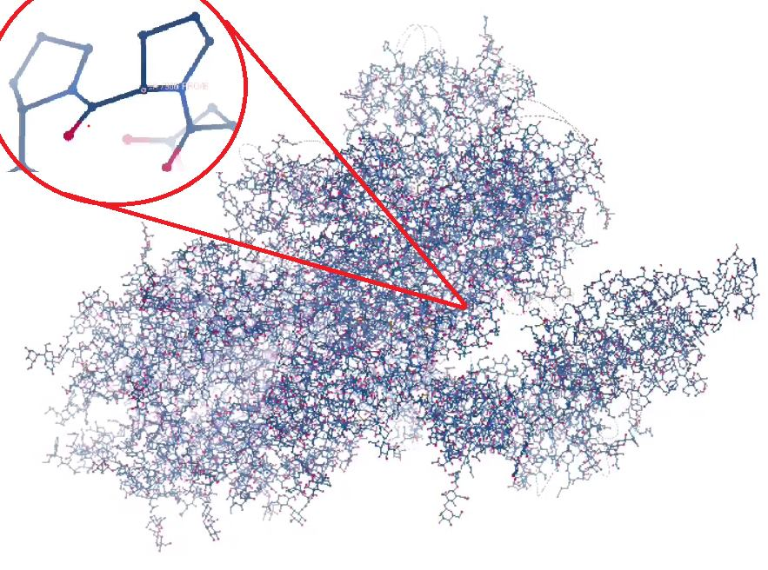
COVID vaccine
PDBID: 6vsb
Feb 10, 2020
3.5 Å cryoEM

Slide 5
Porcine Coronavirus Impact

Slide 6
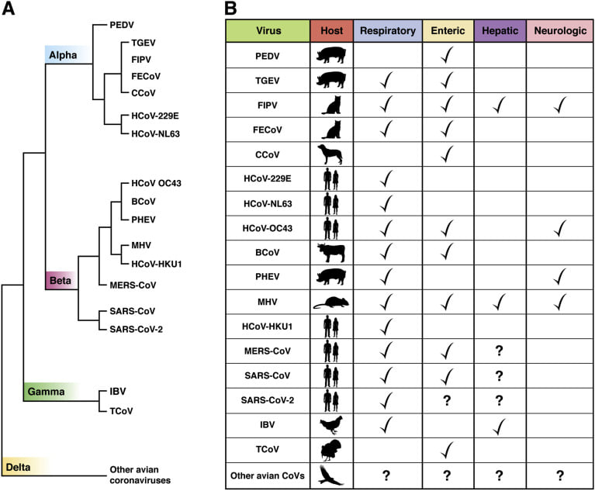
https://www.ncbi.nlm.nih.gov/pmc/articles/PMC7184994/
https://jamanetwork.com/.../jamanetwo.../fullarticle/2767009

Slide 7
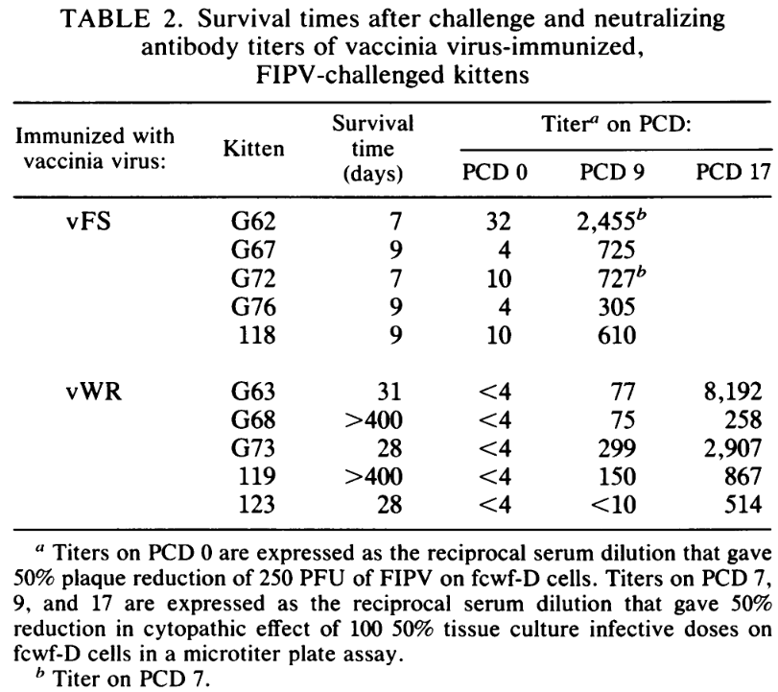
There is no feline coronavirus vaccine
(not yet)
candidate
vaccine
control
1990
https://journals.asm.org/doi/epdf/10.1128/jvi.64.3.1407-1409.1990

Slide 8
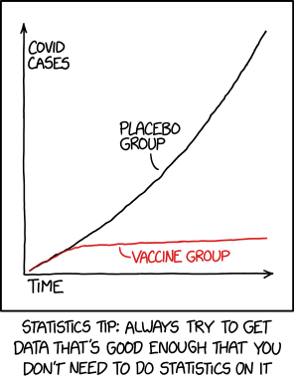
2021
https://www.explainxkcd.com/wiki/index.php/2400:_Statistics

Slide 9
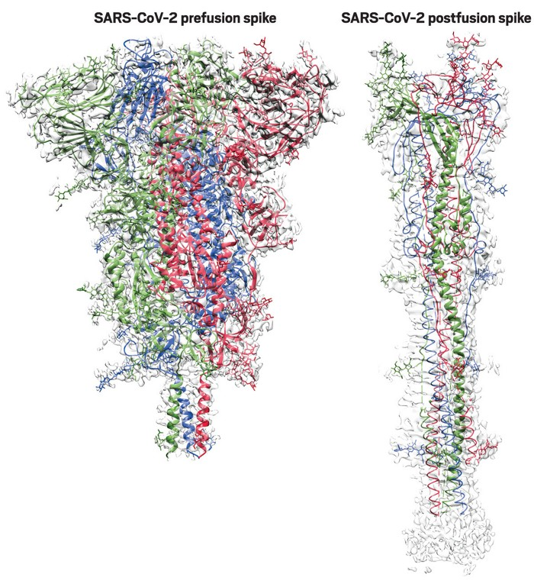
key structural dynamical insight
https://cen.acs.org/pharmaceuticals/vaccines/tiny-tweak-behind-COVID-19/98/i38

Slide 10
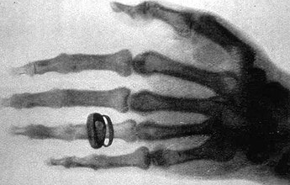
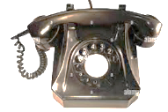
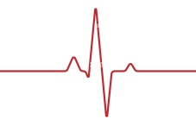
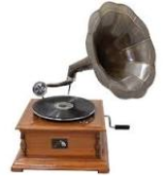
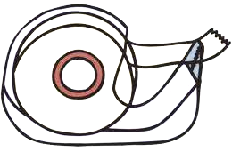
X-rays
hormones
Pavlov
electron
DNA
bakelite
tunguska
1901 1902 1903 1904 1905 1906 1907 1908 1909 1910
conv.
plasma
relativity
victrola
Genes on
Chromasomes
novocaine
X-ray
diffraction
Russia
vs
Ukra
Curie
Bohr
polymer
1911 1912 1913 1914 1915 1916 1917 1918 1919 1920
Titanic
Word War I
Pandemic
Vitamin A
“Nature
of chem
Bond”
Neutron
mass
spec
Svedberg
kleenex
Lucy
1921 1922 1923 1924 1925 1926 1927 1928 1929 1930
“how-to”
“giant
hereditary
molecule”
penicillin (1941)
e-
scope
insulin
Vitamin K
USSR

Slide 11
X-ray
diffraction
Russia
vs
Ukra
Curie
Bohr
1911 1912 1913 1914 1915 1916 1917 1918 1919 1920
Titanic
Word War I
Pandemic
“Nature
of chem
Bond”
mass
spec
Svedberg
kleenex
Lucy
1921 1922 1923 1924 1925 1926 1927 1928 1929 1930
BBC
“how-to”
penicillin
e-
scope
insulin
USSR
vitamins
Neutron
1931 1932 1933 1934 1935 1936 1937 1938 1939 1940
plexiglas
Hindenberg

Slide 12
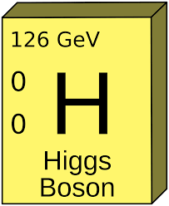
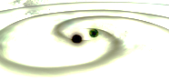
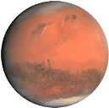
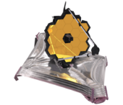
firefox
wikipedia
iPhone
iPod
ribosome
iPad
2001 2002 2003 2004 2005 2006 2007 2008 2009 2010
9/11
16k PDBs: Protein Structure Initiative ->
LHC
Pandemic
grav wave
Quasi
Xtals
100k
PDBs
Rosetta
cryoEM
H₂O
150k
PDBs
Pandemic
2011 2012 2013 2014 2015 2016 2017 2018 2019 2020
PSI ends
pluto
zika
AlphaFold
AlphaFold2
CRISPR
Pandemic
ALS-U
2021 2022 2023 2024 2025 2026 2027 2028 2029 2030
CASP15
APS-U
Diamond & Soleil

Slide 13
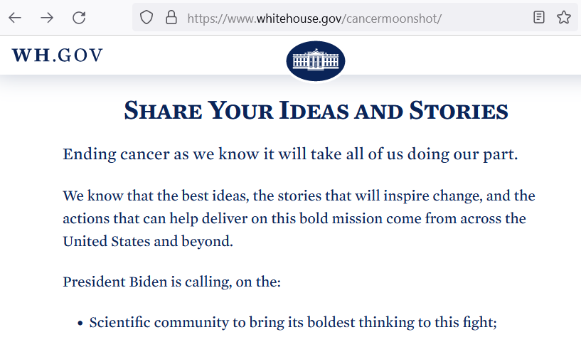
Cancer Moonshot – ideas?

Slide 14
What is a trillion dollars?
80 T
5.0 T
4.5 T
3.6 T
1 T
~1 T
700 G
300 G
45 G
5.6 G
gross world product
CARES + HEROES Acts
USA Federal Budget (2019)
USA health care (2018)
Apple Inc. (2018)
3 yr∙life∙salary cancer & heart
USA Department of Defense
NASA Apollo program (adj $)
National Institutes of Health
mentions "cancer"

Slide 15
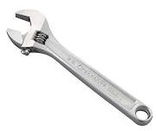
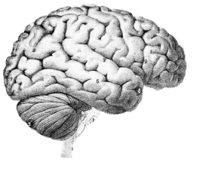
A trillion dollars for NIH
Fund all applications (5 yr)
1000 XFELs & 10⁵ Titan Krios
$10 M / biologist
PI, postdoc, student, tech
Q: would that solve
all your problems?
?

Slide 16
Critical Challenges in Structural Biology
$$$
Predicting crystallization outcomes
Getting crystals to diffract better
Is the ligand there or not?
Anisotropic diffraction
Radiation damage
Phase problem
Metals (anaerobic)
What is “resolution”
Serial crystallography (processing)
Non-isomorphism & multi-crystal methods
?

Slide 17
How to end a pandemic?
R_{e} < 1
Until # cases < 1
i.e. 90% effective for ~16 weeks
Need ~10⁹ tests/day

Slide 18
Seven billion tests for seven billion dollars (How to end a pandemic in 16 weeks)
Problem
$1000/test is infeasible
PPE
Centralization -> logistics
Specialized equipment
Specialized skills
Antibodies unreliable?
Solution
$1 test
Self-test
decentralize
Pre-distributed hw
YouTube training
Robust reagents

Slide 19
Massively Manufacturable Fluorimeter
sample
cover
AA battery
cutting guide
Excitation stage
Emission
stage
Sample
holder
Final ball
lens
2nd filter
Focal
spot at
sample
AAA
battery
cutting
guide

Slide 20
1/2” ID black rubber tubing
3/8” ID black rubber tubing
smart
phone
lens
1 cm
dia.
acrylic
ball bearing
Blue
filter
Green
filter
smart
phone
lens
sample
flash
LED
CMOS sensor
flash
LED
Rubber gasket
(disk with hole in middle)
CMOS sensor

Slide 21
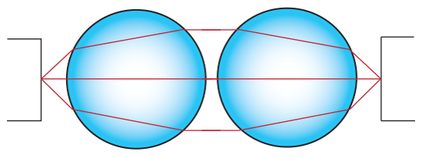
Optics for < $1 ?
6 mm dia glass beads
$0.001 / each
https://www.amazon.com/gp/product/B074C4FPWK/

Slide 22
Goals of Methods Development
Impossible → Expensive
Expensive → Cheaper
Difficult → Easier

Slide 23
Critical Challenges in Structural Biology
$$$
Predicting crystallization outcomes
Getting crystals to diffract better
Is the ligand there or not?
Anisotropic diffraction
Radiation damage
Phase problem
Metals (anaerobic)
What is “resolution”
Serial crystallography (processing)
Non-isomorphism & multi-crystal methods

Slide 24
If I had a trillion dollars …
Predict crystallization conditions
from sequence
10x
$ 500 M
$ 131 B
$ 527 B
$ 335 B
$ 1.0 T
Re-do all structures in PDB
Buy Google
Buy Facebook
10 zettaflops
Success? → impact?

Slide 25
If I had a trillion dollars …
Solve Phase Problem
(brute force)
10²¹ flops ( $0.03 / Gflop )
5 CPU*min per guess: (autobuild)
2 phase values / hkl
1 year run time
89 hkls = 10²⁷ combinations
50 Å cell, P2₁2₁2₁ → 10 Å resolution
Success? → impact?

Slide 26
Magic Microscope
Visualize a single molecule
spatial resolution 1 Å
temporal resolution: ~100 fs
Watch same molecule indefinitely
No damage to molecule/patient
Ability to tap / tug
Handheld & common
Q: what would you look at first?
Q2: how long before end of disease?
second

Slide 27
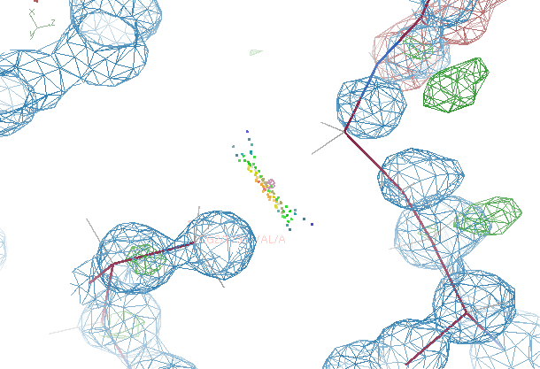
The last Å between prediction and observation

Slide 28
R-factor Gap small vs macro molecules
Publication criterion for chemical crystallography:
R1 < 2*R_{sigma}
R1 = F_{o} vs F_{c} for I/σ(I) > 3
R_{sigma} = <σ(I)>/<I>
There are no PDB entries that pass this test!
Holton et al. (2014) "The R-factor gap", FEBS J. 281, 4046-4060.

Slide 29
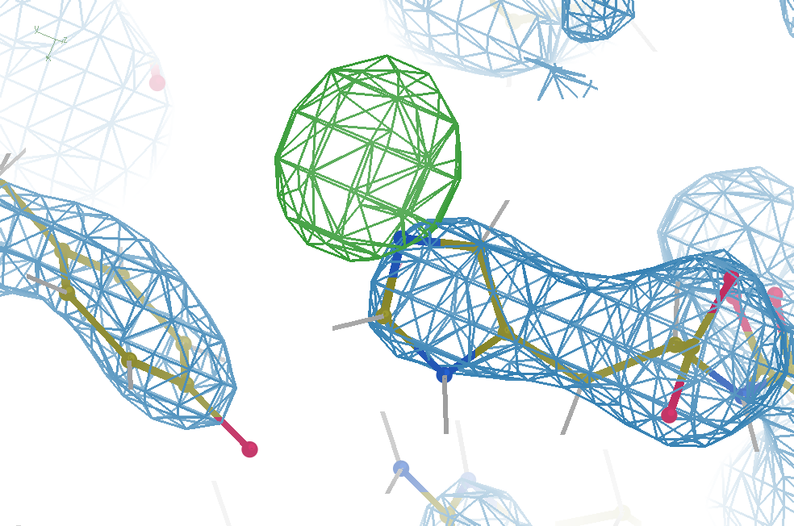
Hydrogen: visible at 3.5 Å resolution!
R_{work} = 0.04
R_{free} = 0.05
d_{min} = 3.5 Å
6σ = 1 e⁻
Simulation:
Realistic noise
“perfect” model

Slide 30
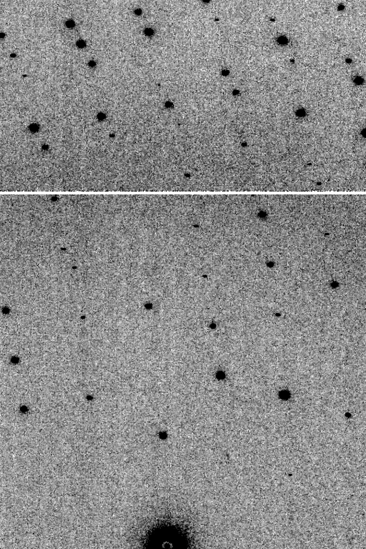
Is it Real? Or is it MLFSOM
simulated
real
Holton et al (2014) "R-factor gap", FEBS Journal 281, 4046-4060.

Slide 31
Big Question:
Why doesn’t this work
with real data?

Slide 32
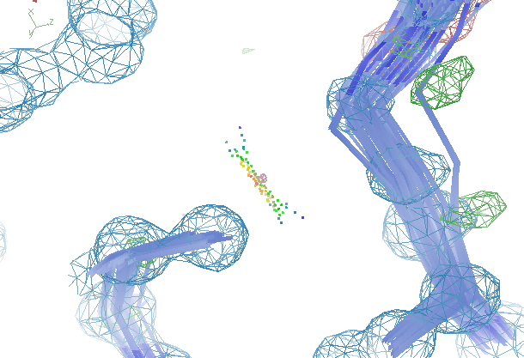
The last Å between prediction and observation

Slide 33
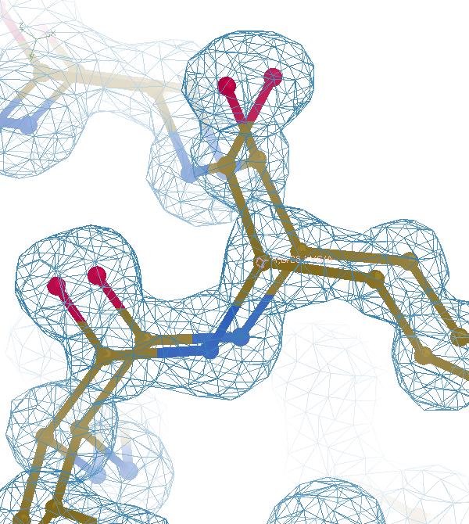

Slide 35
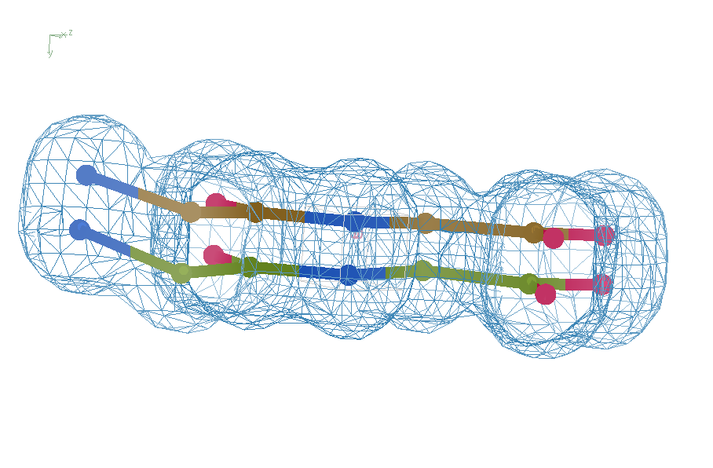
Right answer
R = 0.8%
rms bond = 0.0002

Slide 36
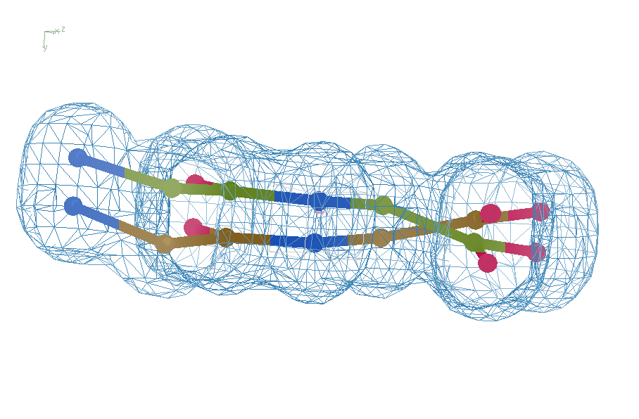
Crossed chains
R = 7.07%
rms bond = 0.001

Slide 37
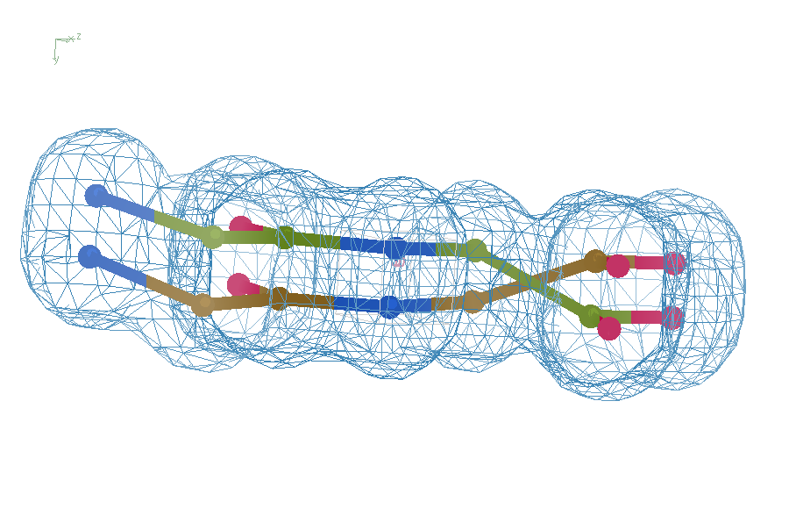
high x-ray weight
R = 1.2%
rms bond = 0.06

Slide 38
Right answer
R = 0.8%
rms bond = 0.0002

Slide 39
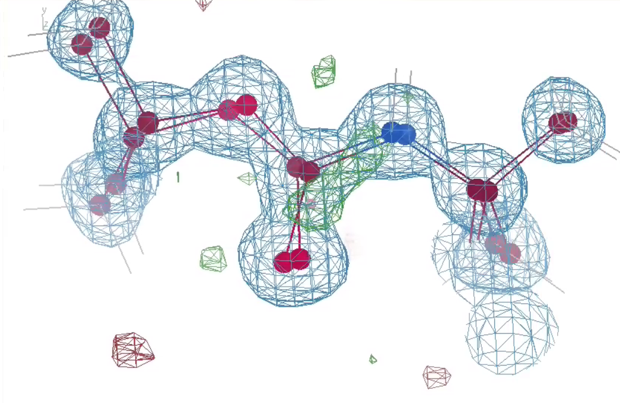
Crossed chains (real data)

Slide 40
What if … ?
Exactly two conformations
50:50
Geometry/energy excellent
Solvent model-able
Can correct assignments be found?
If so, what would R_{free} be?
~4%

Slide 41
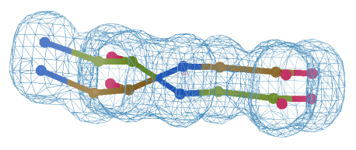
flipme.pdb
Refine
Score & Sort
control
Multiply together:
R_{work} Clashscore
VdW_Energy Cβ_{dev}
Worst & average Z-scores:
rama rotamer
sin(ω)
bonds angles planes
Chirals dihedrals
Flip_1
Flip_2
Flip_3 …
Flip_4 …

Slide 42
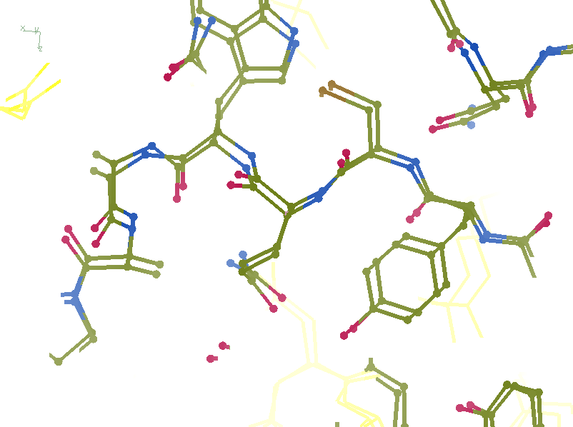
R_{work}: 0.1226
R_{free}: 0.1385
bond: 0.0319
Angle: 3.57
MoPro: 2.12
Clash: 6.52
Cβdev: 11
Rota: 2.78
Rama: 1.61

Slide 43
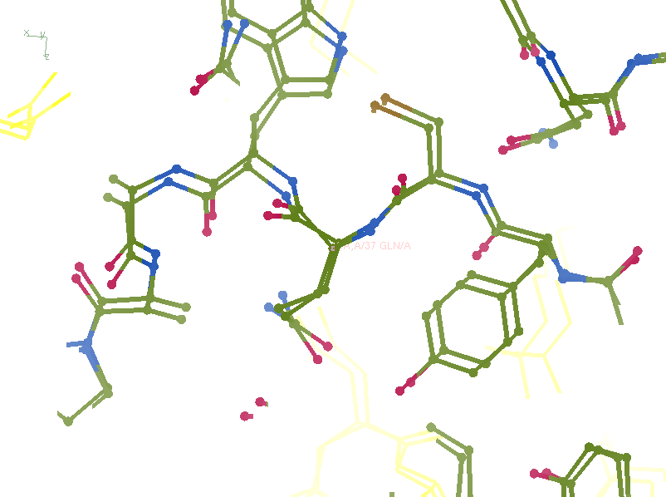
R_{work}: 0.1107
R_{free}: 0.1250
bond: 0.024
Angle: 4.11
MoPro: 0.89
Clash: 0.54
Cβdev: 1
Rota: 0.93
Rama: 0

Slide 44
Take home:
Ensemble refinement gets tangled
Fixing this could reveal true ensemble
not fixing it means: stuck forever

Slide 45
Non-isomorphism
is annoying
means you:
can’t merge
can’t
add
can’t
subtract
Caused by:
rad dam
humidity
temperature
Growth conditions
Cryo-cooling
Everything

Slide 46
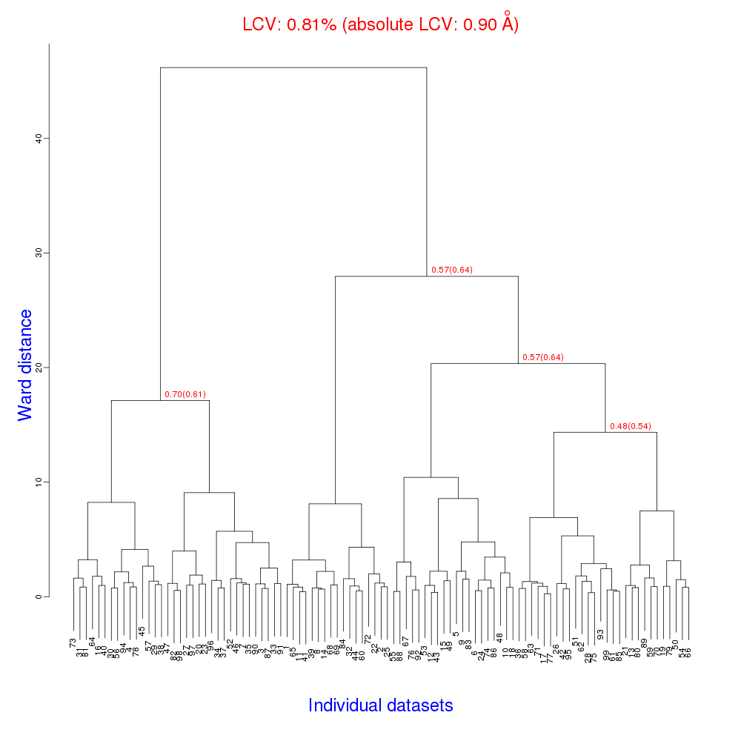
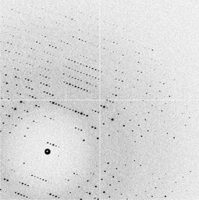
Cell clustering: 100 datasets
Reality:
Perfect isomorphism
(simulated data)
Holton, J. (2019). Acta Cryst. D 75, 113-122.

Slide 47
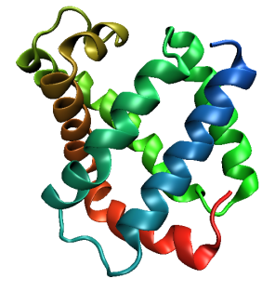
Same structure, different cell
0.5% cell change → 15%
Crick & Magdoff (1956) “theory method isomorphous replacement”, Acta Cryst. 9, 901-8.

Slide 48
Same structure, different cell
0.5% cell change → 15%
Crick & Magdoff (1956) “theory method isomorphous replacement”, Acta Cryst. 9, 901-8.

Slide 49
Uniform stretch
5% change → 0%

Slide 50
Uniform stretch
5% change → 0%

Slide 51
Hygrostatic gradients
high
water activity
low
jet
loop

Slide 52
Non-isomorphism in lysozyme
RMSD = 1.70 Å
Δcell = 0.7 %
R_{iso} = 44.5%
RMSD = 0.18 Å LSQ
RH: 84.2%
vs 71.9%
3aw6
3aw7

Slide 53
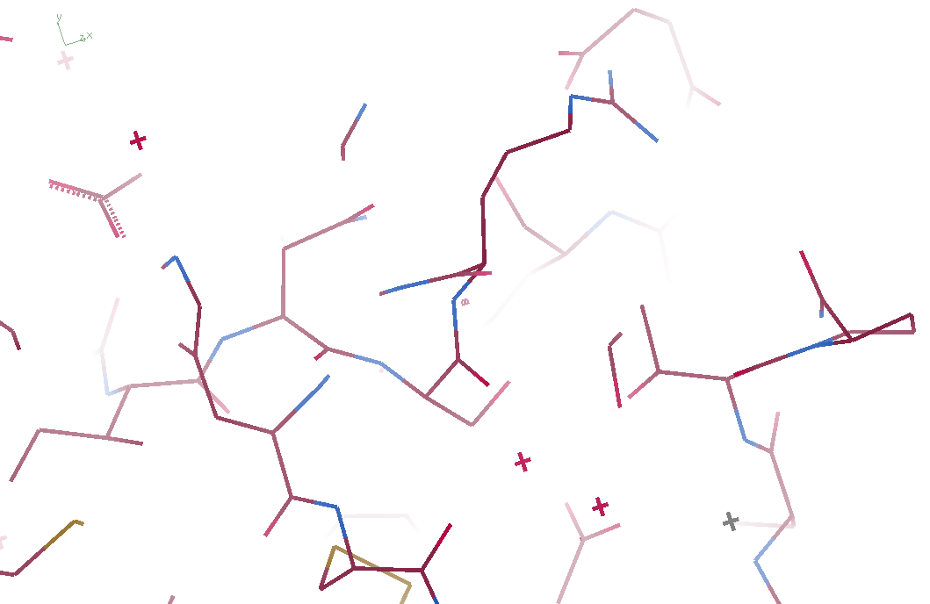
3aw6

Slide 54
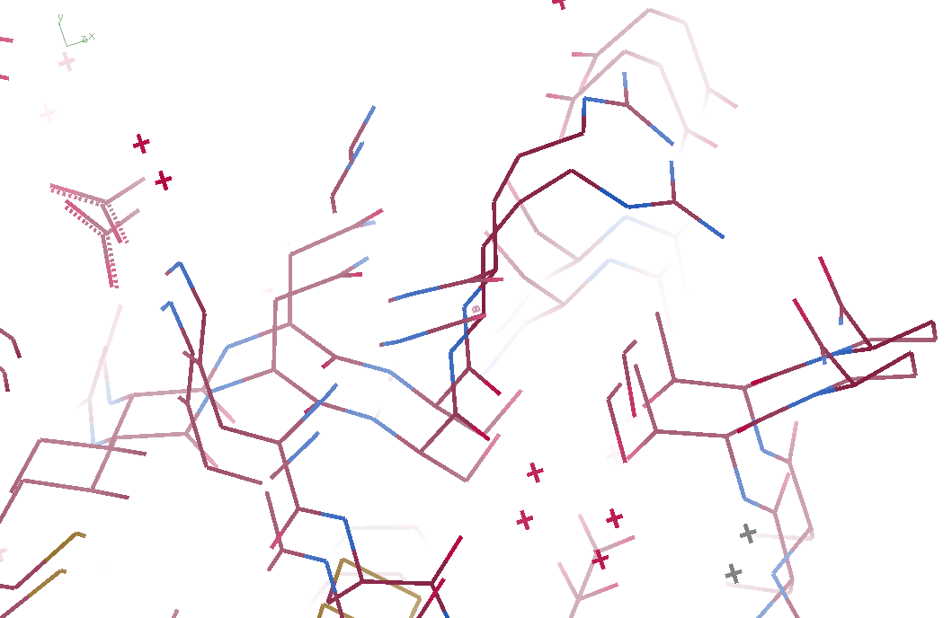
3aw6 3aw7

Slide 55
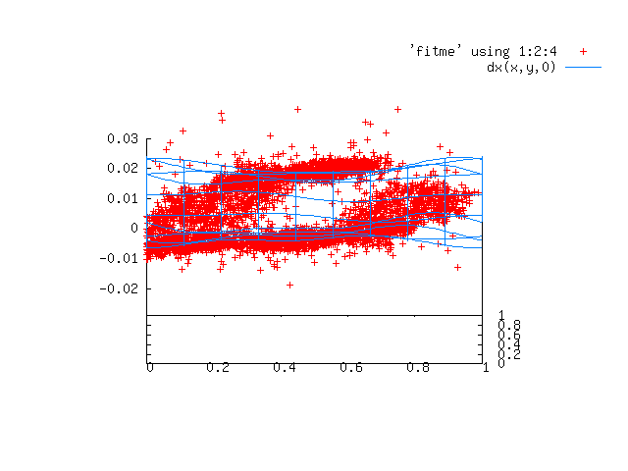
Periodic Spatial Distortion Vector Field

Slide 56
3aw6 3aw7

Slide 57
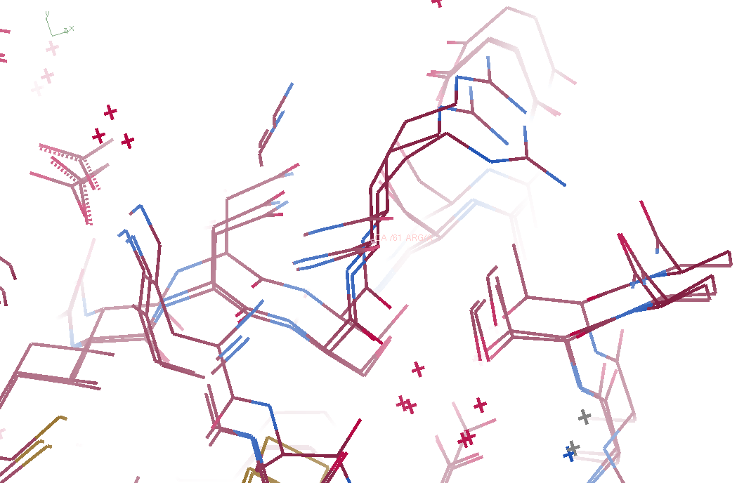
3aw6, 3aw7, “bent” 3aw6

Slide 58
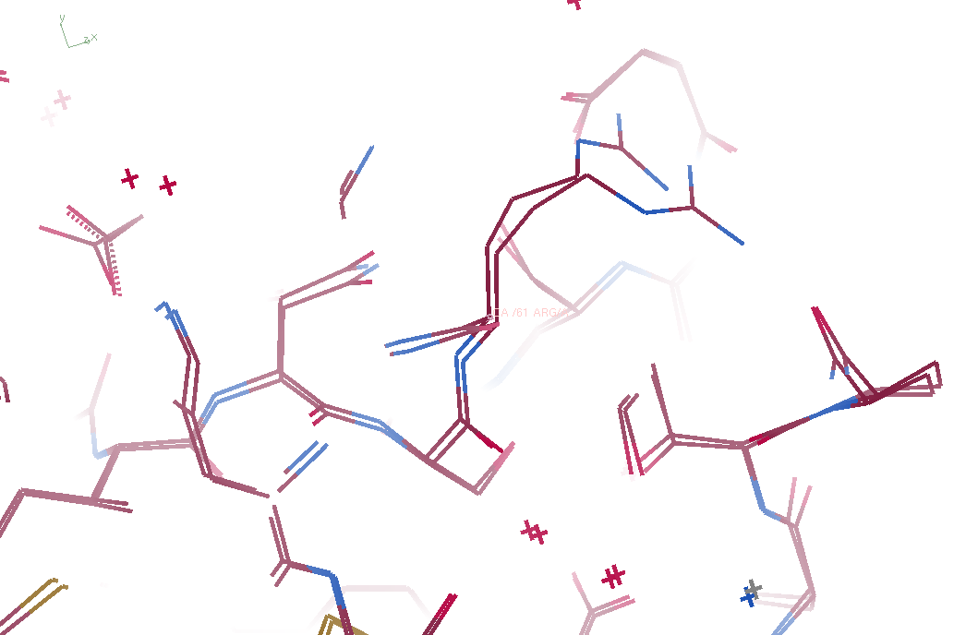
3aw7, “bent” 3aw6

Slide 59
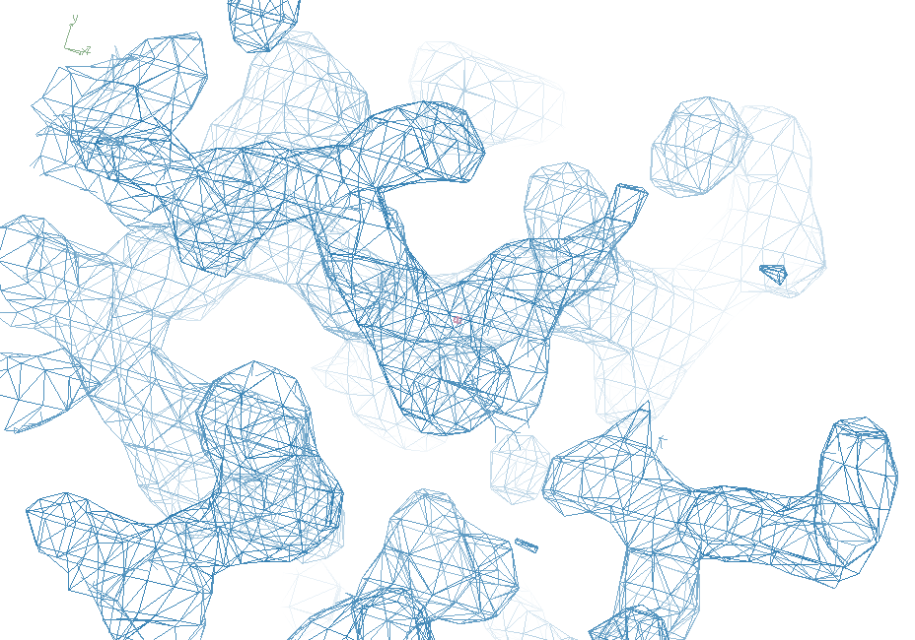
3aw7

Slide 60
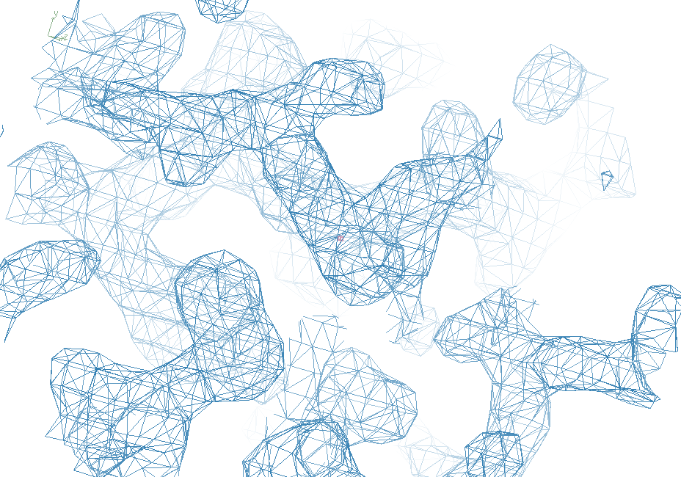
“bent” 3aw7

Slide 61
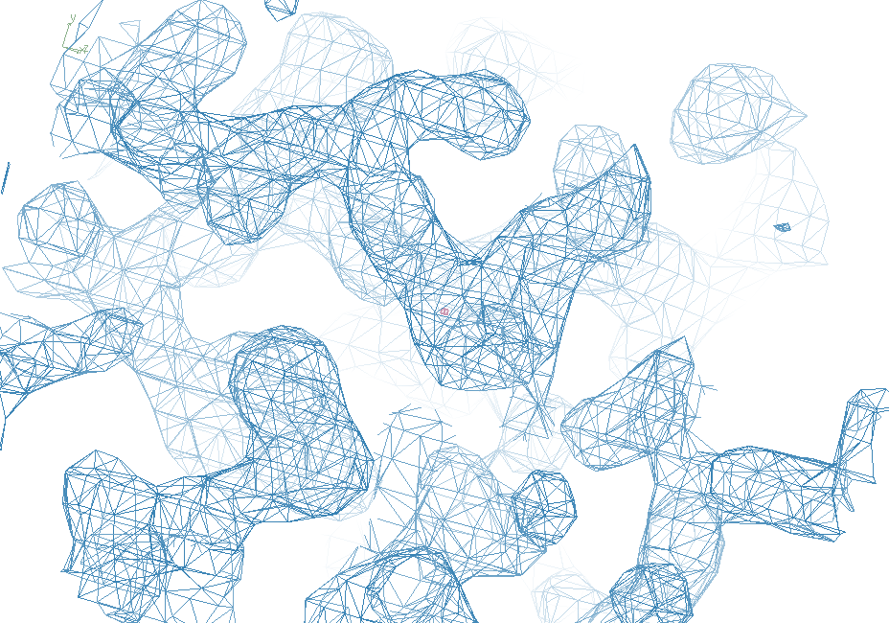
3aw6

Slide 62
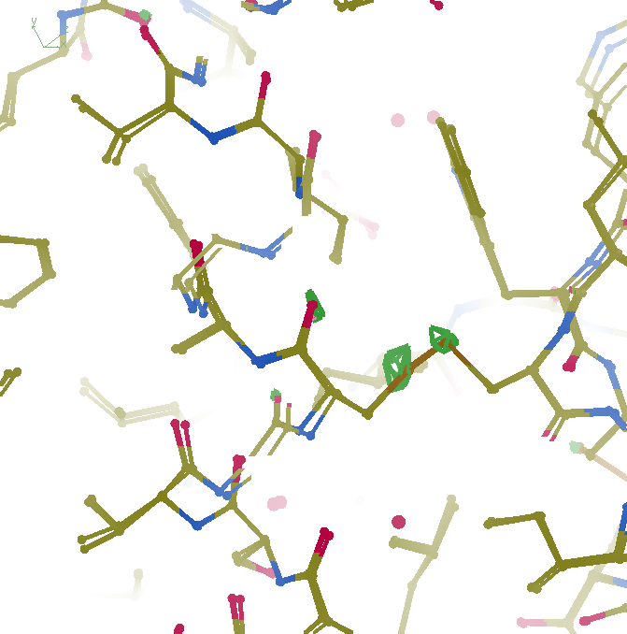
F_{obs}-F_{obs} difference
3σ 1.8 Å
“unbent”

Slide 63
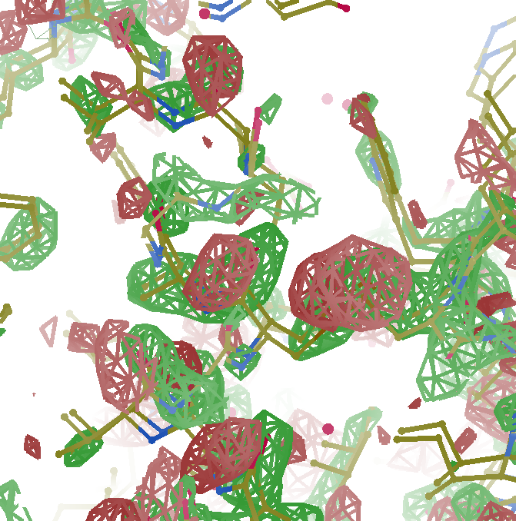
F_{obs}-F_{obs} difference
3σ 1.8 Å
old way

Slide 64
Take home:
Non-isomorphism
is correctable
(in real space)

Slide 65
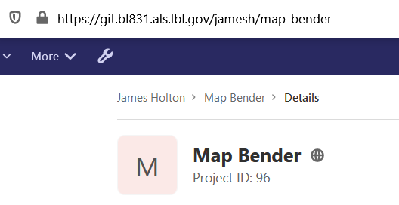
Downloading “map bender”

Slide 66
0 Gy

Slide 67
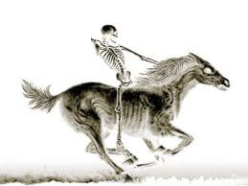
100 MGy

Slide 68
What is the dose?
50 MGy ?

Slide 69
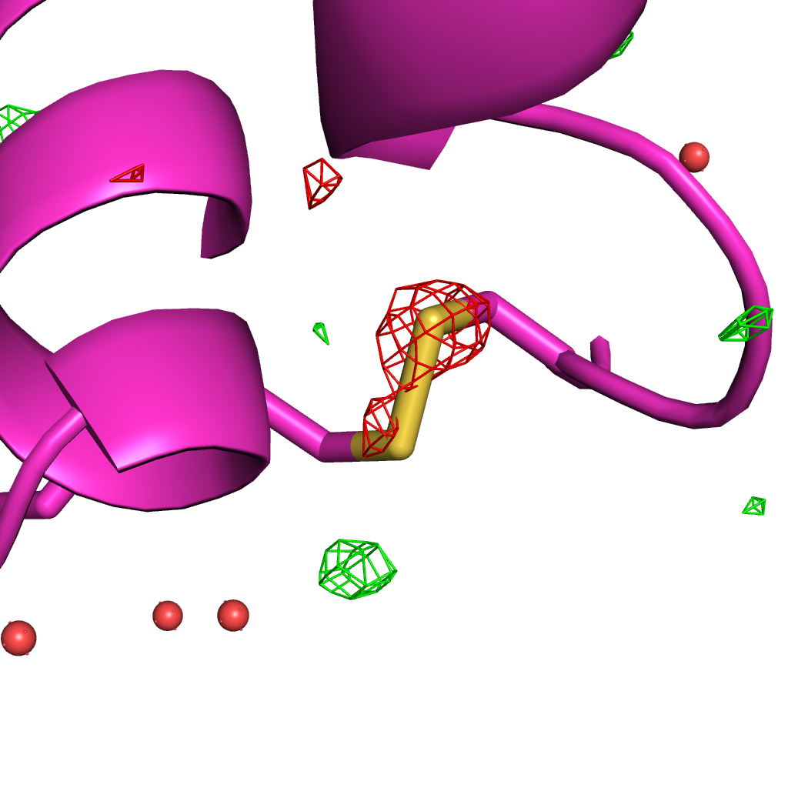
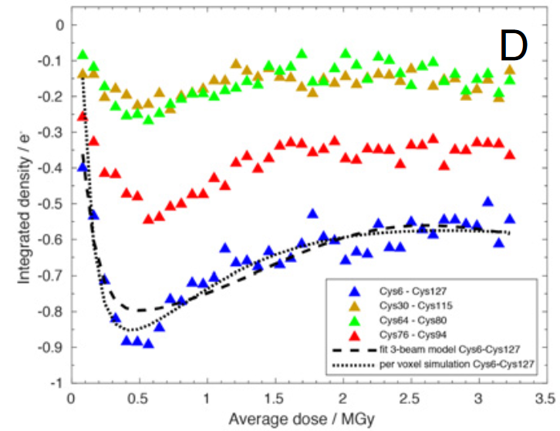
Systematic error: Illumination contrast appears to “reverse” damage
Room temperature high-dose rate series
0.35 MGy
Cys127
Cys6
de la Mora, et al. (2020) PNAS USA 117, 4142-4151

Slide 70
False “Damage reversal”: from beam profile
X-ray beam
crystal

Slide 71
False “Damage reversal”: from beam profile
Cold beam
Hot beam
crystal

Slide 72
False “Damage reversal”: from beam profile
Cold beam
Hot beam
crystal

Slide 73
False “Damage reversal”: from beam profile
Cold beam
Hot beam
crystal

Slide 74
False “Damage reversal”: from beam profile
Cold beam
Hot beam
crystal

Slide 75
False “Damage reversal”: from beam profile
Cold beam
Hot beam
crystal

Slide 76
False “Damage reversal”: from drift
X-ray beam
crystal

Slide 77
Systematic error: Illumination contrast appears to “reverse” damage
Room temperature high-dose rate series
1
cold
occupancy
hot
observed
0
time
de la Mora, et al. (2020) PNAS USA 117, 4142-4151

Slide 78
MGy reaction reference
~45 global damage Owen et al. (2006)
10/Å global damage Howells et al. (2009)
5 Se-Met Holton (2007)
4 Hg-S Ramagopal et al. (2004)
4 R-C-COOH Garman et al. (2015)
3 S-S Murray et al. (2002)
1 Br-RNA Olieric et al. (2007)
~1? Cl-C ???
0.5 Mn in PS II Yano et al. (2005)
0.06 putidaredoxin Corbett et al. (2007)
0.02 Fe in myoglobin Denisov et al. (2007)
Radiation Damage World Records
Holton (2009) J. Synchrotron Rad. 16 133-42

Slide 79
Take home:
“dose contrast”
makes rad dam
Hard to correct

Slide 80
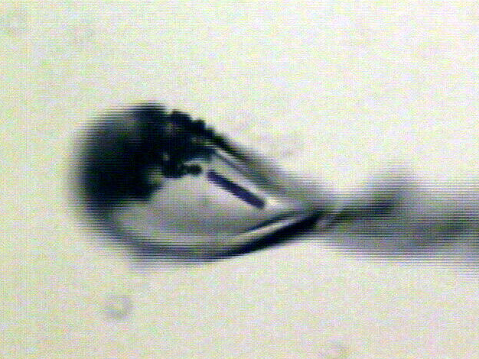
“rastering” to find the crystal
X-ray beam
ice
Membrane
protein crystal

Slide 81
“painting” for flat dose

Slide 82
“painting” for virtual beam

Slide 83
Painting with X-rays
0°
img_000045

Slide 84
Painting with X-rays
0.2°
img_000100

Slide 85
Painting with X-rays
30°
img_015000

Slide 86
Painting with X-rays
90°
img_045000

Slide 87
Painting with X-rays
360°
img_180000

Slide 88
Painting with X-rays
1080°
img_540000

Slide 89
Beam Shape Dichotomy
Flat-top beam
Uniform dose in illuminated region
Sharp edges: sensitive to drift
Gaussian beam
Softer edges
High dose contrast
Best of both?
“dose flattening”

Slide 90
How many images?
360° / 0.1° * ( 100 µm / 1 µm )²
⁼ 36x10⁶
28,000 photons/image

Slide 91
Lossless data rate
bits
s
= log₂(pixels) * flux * thick * 1.2x10⁻⁵
where: bits/s = entropy-limited compressed data rate
pixels = number of pixels in the detector
flux = photons/s onto the sample thick = sample thickness in microns
EG: 1e12 ph/s * 100um thick = 3.4 GBytes/s
The 1.2e-5 scattered photons per incident photon can be derived form the cross section of oxygen (0.2 cm^2/g) and the rough density of protein crystals (1.2 g/cm^3), and the fact that about half of all scattered photons hit a flat detector: 0.2*1.2*1e-4/2 = 1.155e-5 That is, flux*thickness*1.2e-5 is the rate of photon arrivals and log2(pixels) is the number of bits required to store the location of one photon in the entropy-limited regime. Lossless compression cannot be better than this because individual photon arrivals are genuinely random.

Slide 92
How to lose information
long exposures
>1 photon/image = order of arrivals
Wide phi slice
sum over angle
Large beams
sum over profile area
Pink/divergent beam
sum over lambda/angle
Background
non-crystal stuff
Systematics
Dose contrast, drift, read-out gap

Slide 93
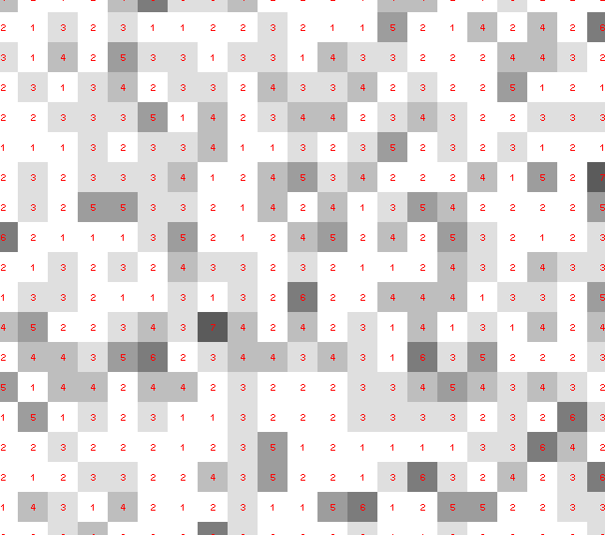
Dose slicing: is that a spot?

Slide 94
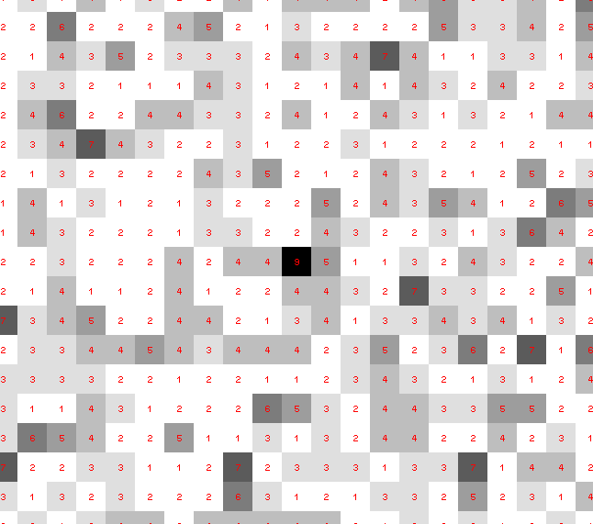
Dose slicing: is that a spot?

Slide 95
Dose slicing: is that a spot?

Slide 96
Dose slicing: is that a spot?

Slide 97
Dose slicing: is that a spot?

Slide 98
Dose slicing: is that a spot?

Slide 99
Single Photons Carry Information
About Radiation Damage
4
4
photons
photons
0
0
4
4
photons
photons
0
0
time
time

Slide 100
Take home:
“dose flattening”
makes rad dam
correctable
(if we can use weak images)

Slide 101
Magic Microscope
Visualize a single molecule
spatial resolution 1 Å
temporal resolution: ~100 fs
Watch same molecule indefinitely
No damage to molecule/patient
Ability to tap / tug
Handheld & common
Q: what would you look at first?
Q2: how long before end of disease?
second

Slide 102
Second Golden Age of Structural Biology
Biology priority
The Last Å
Trillion-dollar scale
stepping stones

