Slide 1
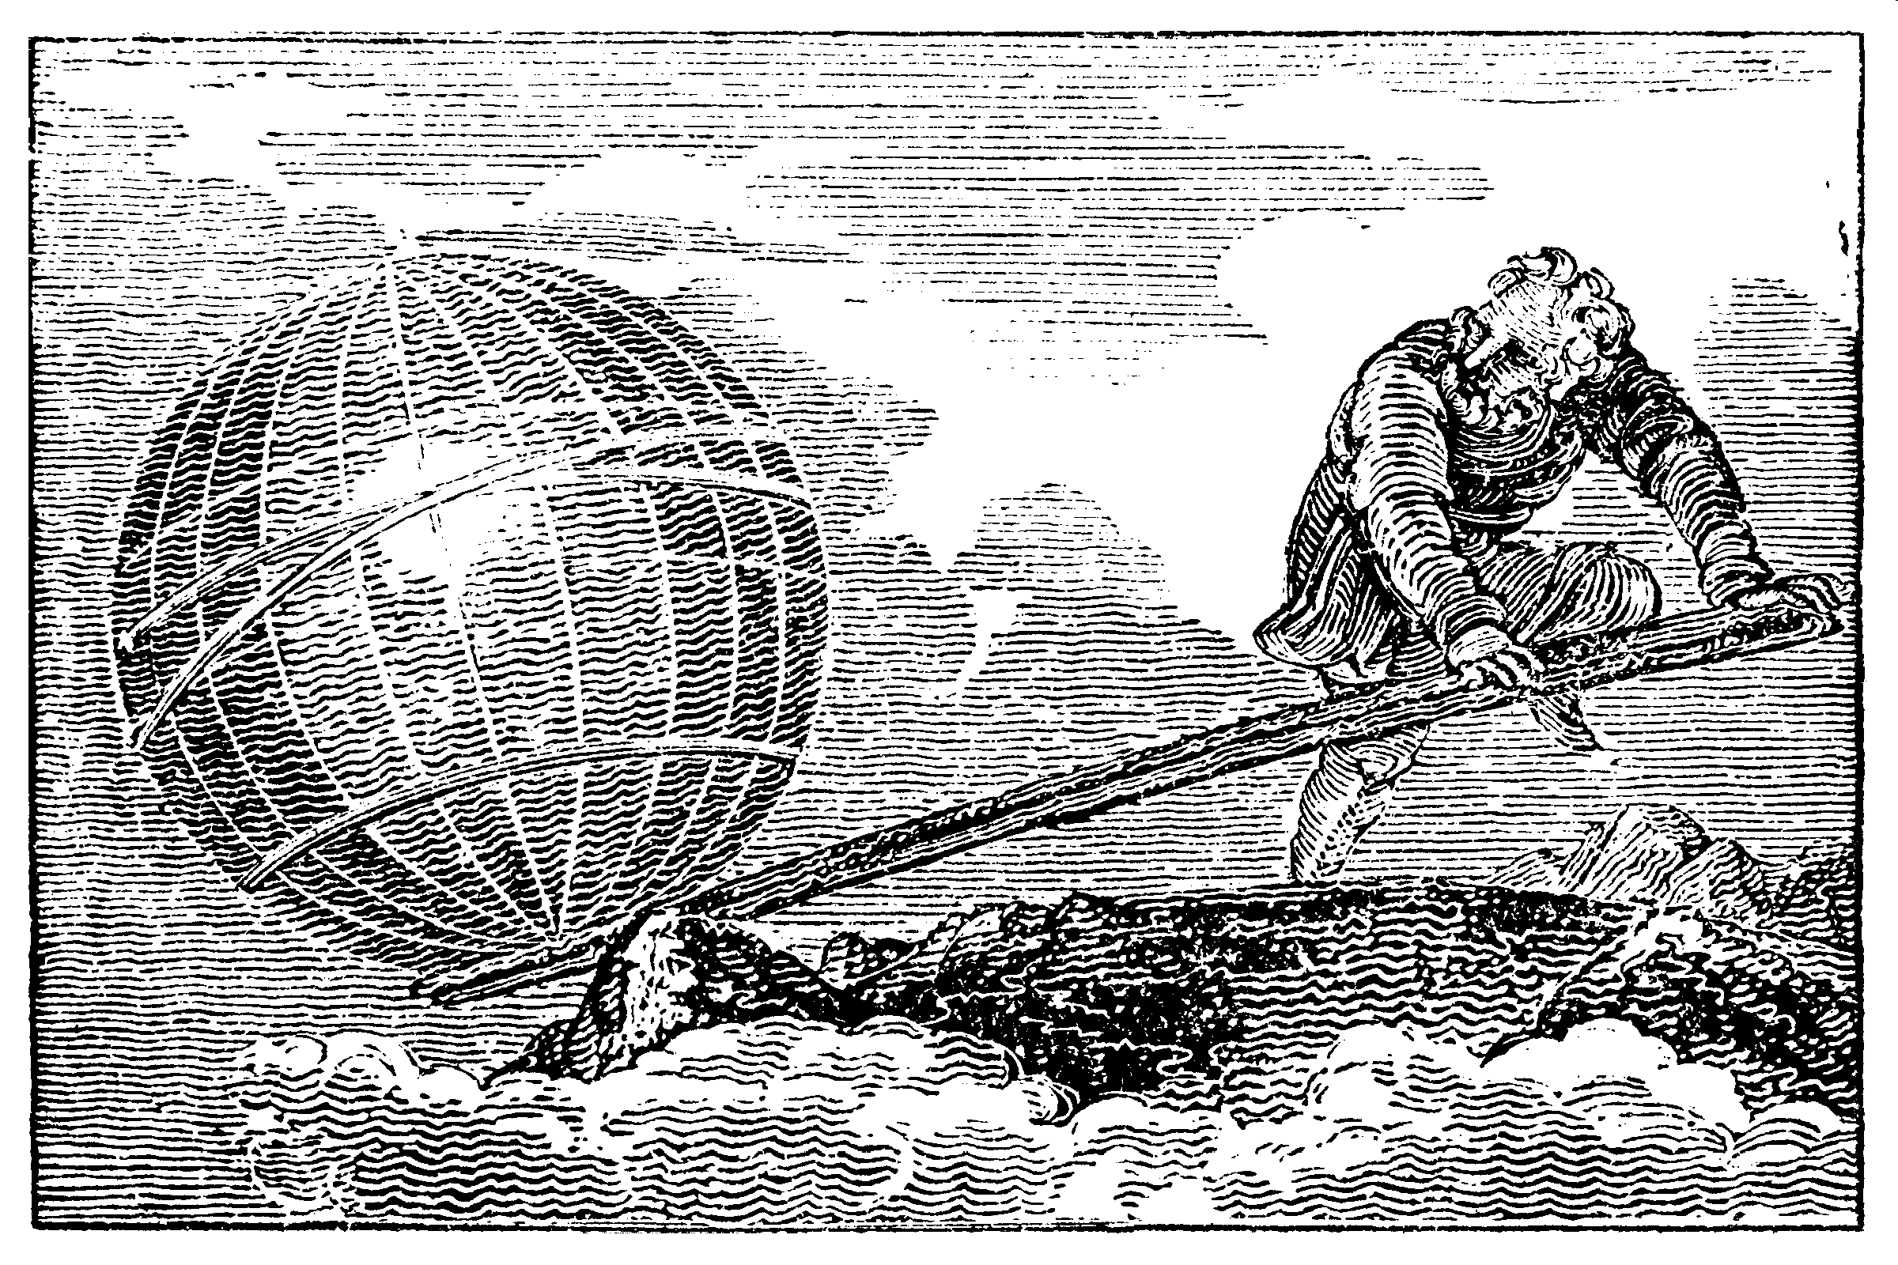
Anything is possible … with the right tools.

Slide 2
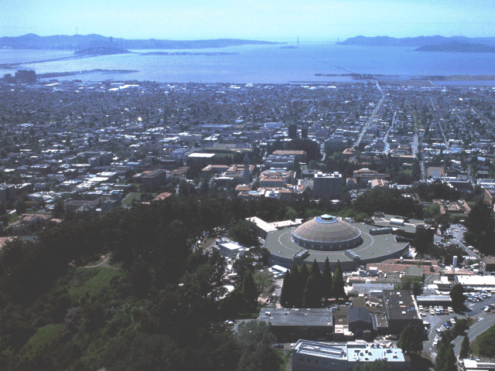
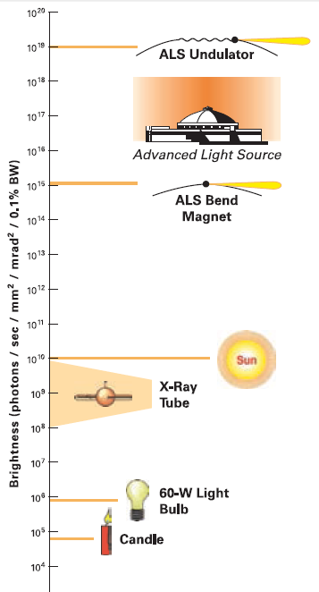
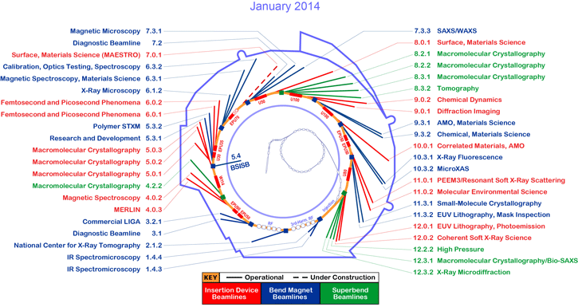
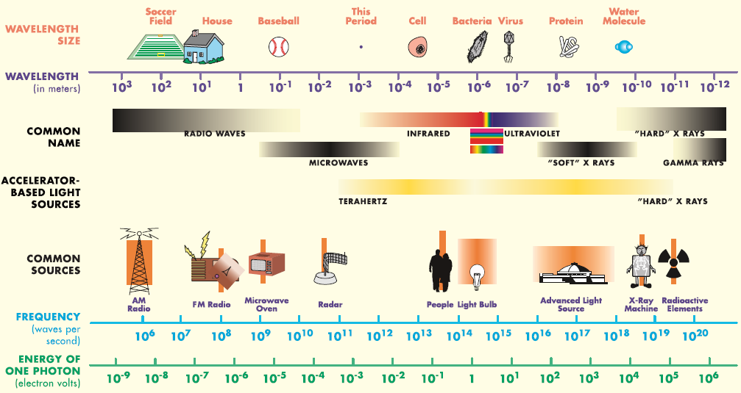
Advanced Light Source
200 m circ. | 12 sectors
200 staff | 44 beamlines

Slide 3
The truth about x-ray beams
Term units significance
Flux photons/s duration of experiment
Beam Size μm match to sample
Divergence mrad spot size vs distance
Wavelength Å resolution and absorption
Dispersion Δλ/λ spot size
Flux density ph/s/area scattering/damage rate
Fluence ph/area scattering/damage

Slide 4
The truth about x-ray beams
quantity | units | home source | ALS 8.3.1
flux | Photons/second | 2.5 x 10⁹ | 3 x 10¹¹
exposure | seconds | 120 | 1

Slide 5
The truth about x-ray beams
quantity | units | home source | ALS 8.3.1
flux | Photons/second | 2.5 x 10⁹ | 3 x 10¹¹
exposure | seconds | 120 | 1
Dispersion | wavelength range / wavelength | 0.2% (Kα₁ - Kα₂) | 0.014% (Si111)
Divergence | milliRadian | 4.8 | 2 (h) 0.3 (v)
Beam size | microns | 100 | 60 (h) 100 (v)
Spectral brightness | Photons/s/mm²/ mR²/0.1%BW | 5.4 x 10⁹ | 6 x 10¹⁴

Slide 6
The truth about x-ray beams
quantity | units | home source | ALS 8.3.1
flux | Photons/second | 1.8 x 10⁸ | 3 x 10¹¹
exposure | seconds | 28 min | 1 second
Dispersion | wavelength range / wavelength | 0.014% (Si111) | 0.014% (Si111)
Divergence | milliRadian | 4.8 | 2 (h) 0.3 (v)
Beam size | microns | 100 | 60 (h) 100 (v)
Spectral brightness | Photons/s/mm²/ mR²/0.1%BW | 5.4 x 10⁹ | 6 x 10¹⁴

Slide 7
The truth about x-ray beams
quantity | units | home source | ALS 8.3.1
flux | Photons/second | 3 x 10⁷ | 3 x 10¹¹
exposure | seconds | 2.8 hours | 1 second
Dispersion | wavelength range / wavelength | 0.014% (Si111) | 0.014% (Si111)
Divergence | milliRadian | 0.8 | 2 (h) 0.3 (v)
Beam size | microns | 100 | 60 (h) 100 (v)
Spectral brightness | Photons/s/mm²/ mR²/0.1%BW | 5.4 x 10⁹ | 6 x 10¹⁴

Slide 8
The truth about x-ray beams
quantity | units | home source | ALS 8.3.1
flux | Photons/second | 2 x 10⁷ | 3 x 10¹¹
exposure | seconds | 4 hours | 1 second
Dispersion | wavelength range / wavelength | 0.014% (Si111) | 0.014% (Si111)
Divergence | milliRadian | 0.8 | 2 (h) 0.3 (v)
Beam size | microns | 77 | 60 (h) 100 (v)
Spectral brightness | Photons/s/mm²/ mR²/0.1%BW | 5.4 x 10⁹ | 6 x 10¹⁴

Slide 9
The truth about x-ray beams
quantity | units | home source | ALS 8.3.1
flux | Photons/second | 2 x 10⁷ | 3 x 10¹¹
exposure | time | 13 years | 1 hour
Dispersion | wavelength range / wavelength | 0.014% (Si111) | 0.014% (Si111)
Divergence | milliRadian | 0.8 | 2 (h) 0.3 (v)
Beam size | microns | 77 | 60 (h) 100 (v)
Spectral brightness | Photons/s/mm²/ mR²/0.1%BW | 5.4 x 10⁹ | 6 x 10¹⁴

Slide 10
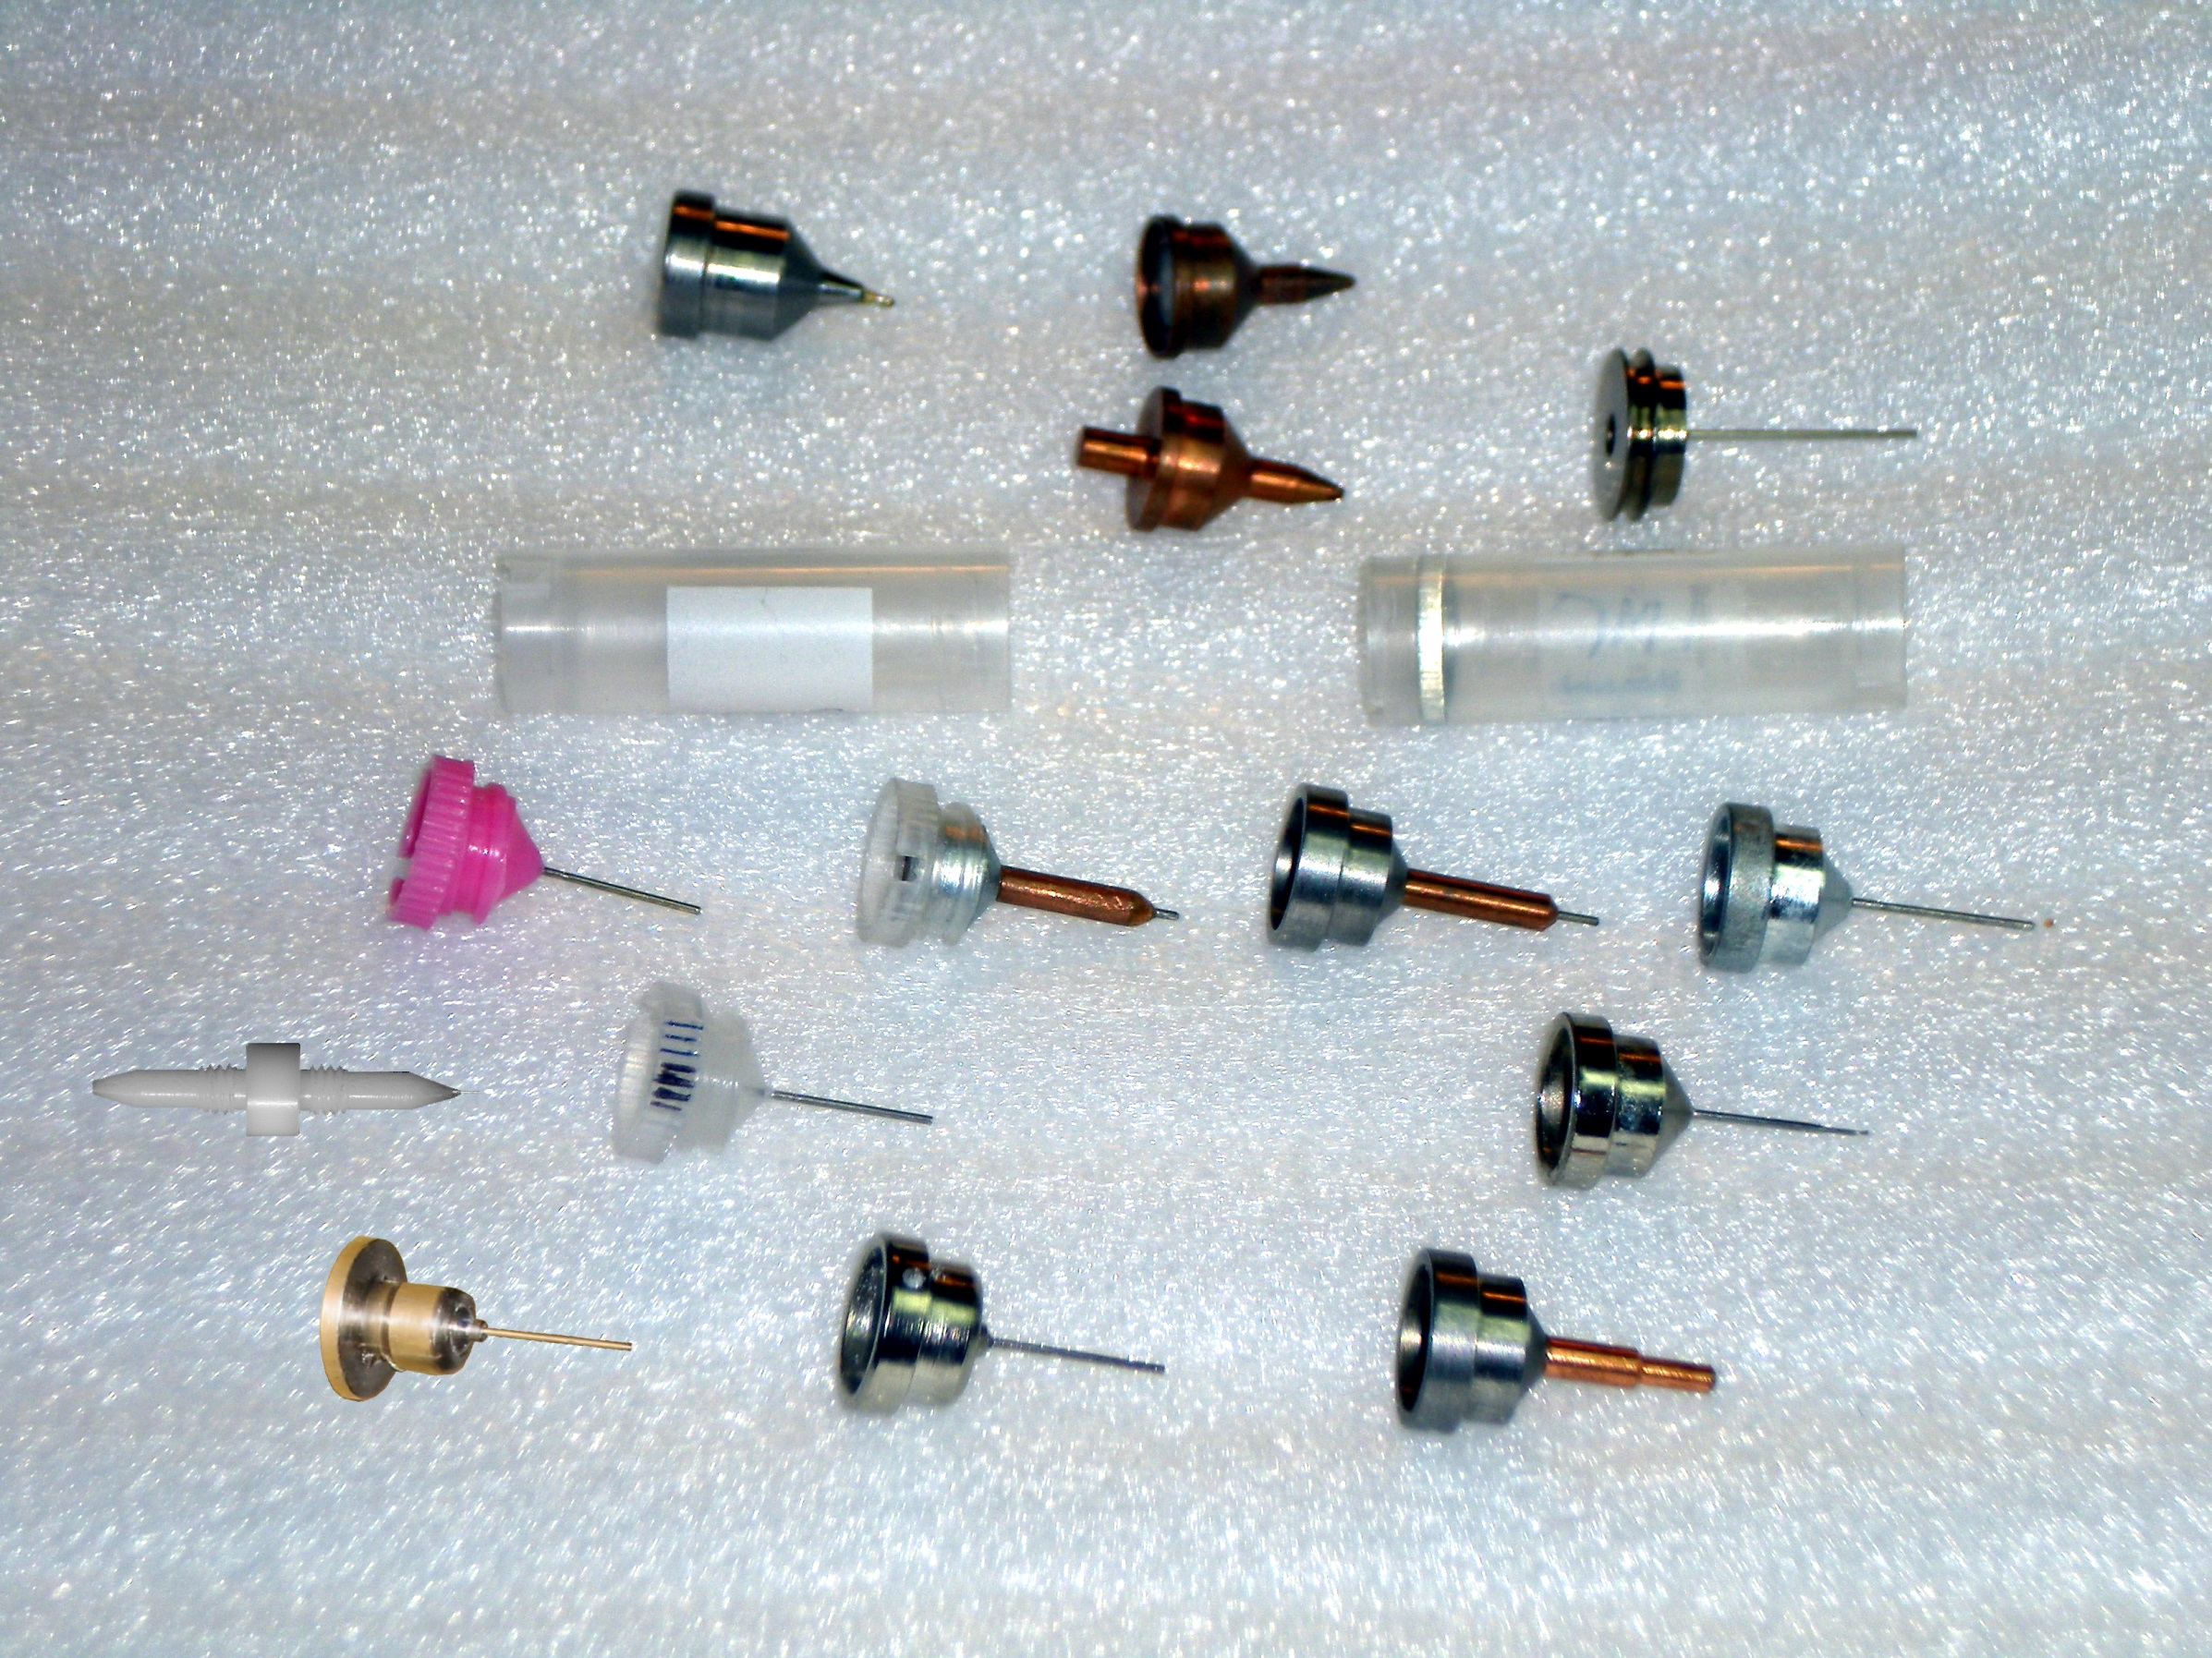
you must choose, but choose wisely!
Caltech
SSRL
Yale
Hampton screw cap
Hampton magnetic
H. colored
H. copper
H. magnetic
H. hybrid
H. screw cap
Syrrx
SPring-8
Oxford
SPINE
MiTeGen RT

Slide 11
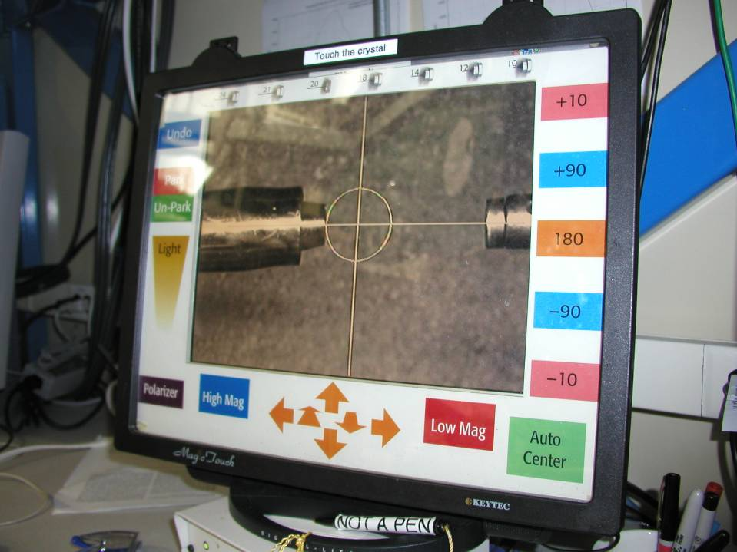
Touch screen

Slide 12

Zero-parallax microscope
Styrofoam™ backlight
backstop
mirror
pinhole
microscope
Notes:
Next slide please

Slide 13
Zero-parallax microscope
Styrofoam™ backlight
backstop
mirror
pinhole
microscope
Notes:
Inspired by the ESRF microcrystal camera, the superbend endstations are all equipped with zero-paralax optics. The user sees their sample from the point of view of the x-ray beam. Sample alignment is not only more stable but more intuitive than an off-axis camera. Placing the crystal into the microscope crosshairs gaurantees that it will be hit by the beam.

Slide 14
Zero-parallax microscope
Styrofoam™ backlight
backstop
mirror
pinhole
microscope
Notes:
Inspired by the ESRF microcrystal camera, the superbend endstations are all equipped with zero-paralax optics. The user sees their sample from the point of view of the x-ray beam. Sample alignment is not only more stable but more intuitive than an off-axis camera. Placing the crystal into the microscope crosshairs gaurantees that it will be hit by the beam.

Slide 15
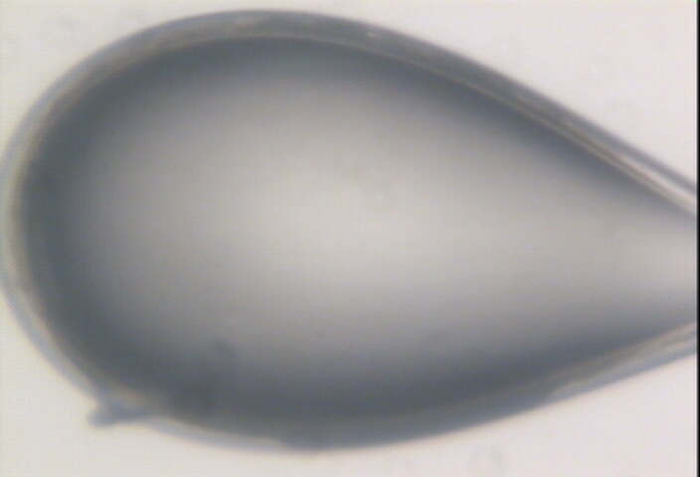

Slide 16
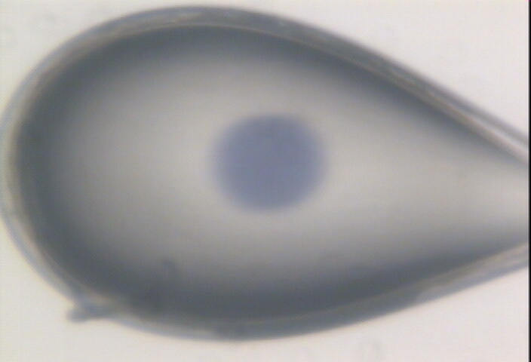

Slide 17
Zero-parallax microscope
Styrofoam™ backlight
backstop
mirror
pinhole
microscope
Notes:
Inspired by the ESRF microcrystal camera, the superbend endstations are all equipped with zero-paralax optics. The user sees their sample from the point of view of the x-ray beam. Sample alignment is not only more stable but more intuitive than an off-axis camera. Placing the crystal into the microscope crosshairs gaurantees that it will be hit by the beam.

Slide 18
Zero-parallax microscope
Styrofoam™ backlight
backstop
mirror
pinhole
microscope
Notes:
Inspired by the ESRF microcrystal camera, the superbend endstations are all equipped with zero-paralax optics. The user sees their sample from the point of view of the x-ray beam. Sample alignment is not only more stable but more intuitive than an off-axis camera. Placing the crystal into the microscope crosshairs gaurantees that it will be hit by the beam.

Slide 19
Semi-transparent beam stop
Phosphor attenuator
gold
ZnS
gold

Slide 20
Semi-transparent beam stop
Phosphor attenuator
gold
ZnS
gold

Slide 21
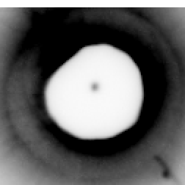
Semi-transparent beam stop
Phosphor attenuator
gold
ZnS
gold

Slide 22
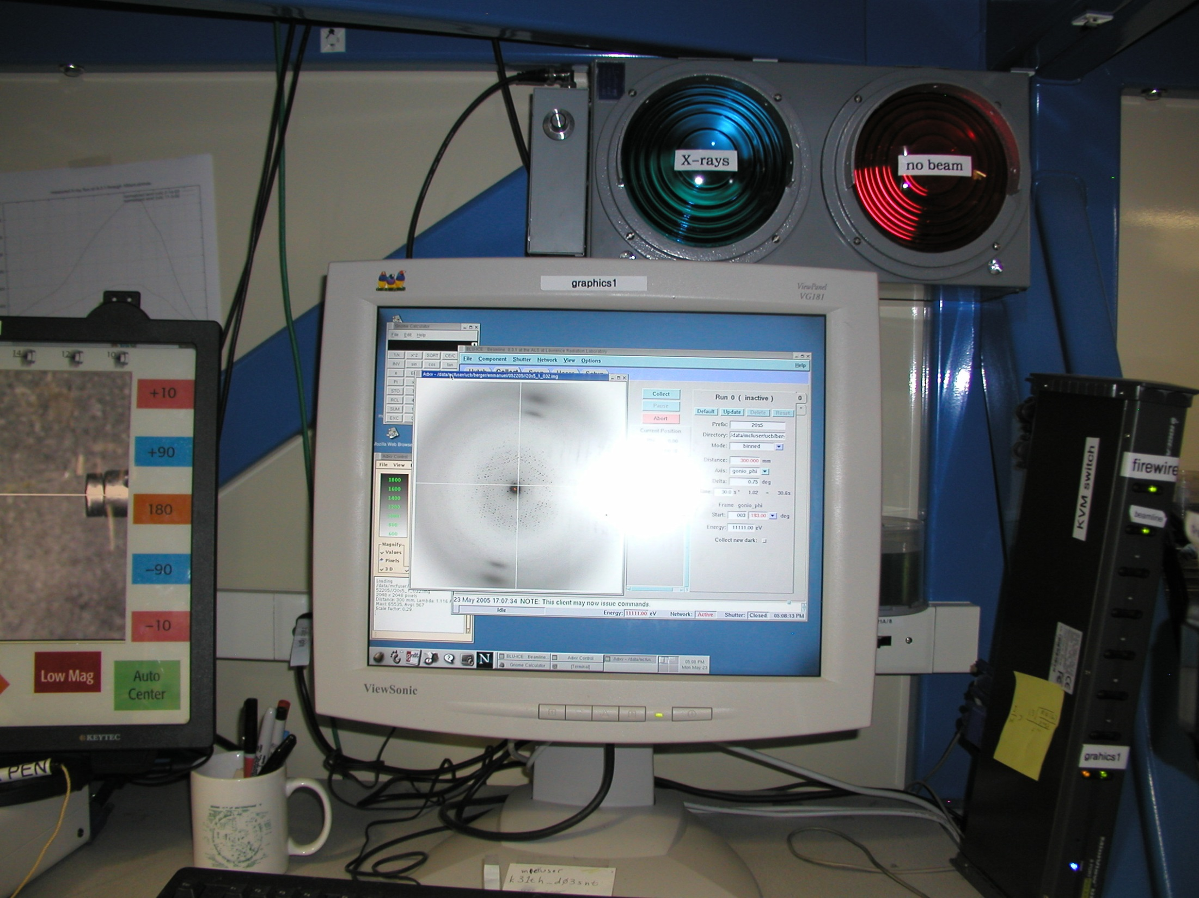
Traffic light

Slide 23
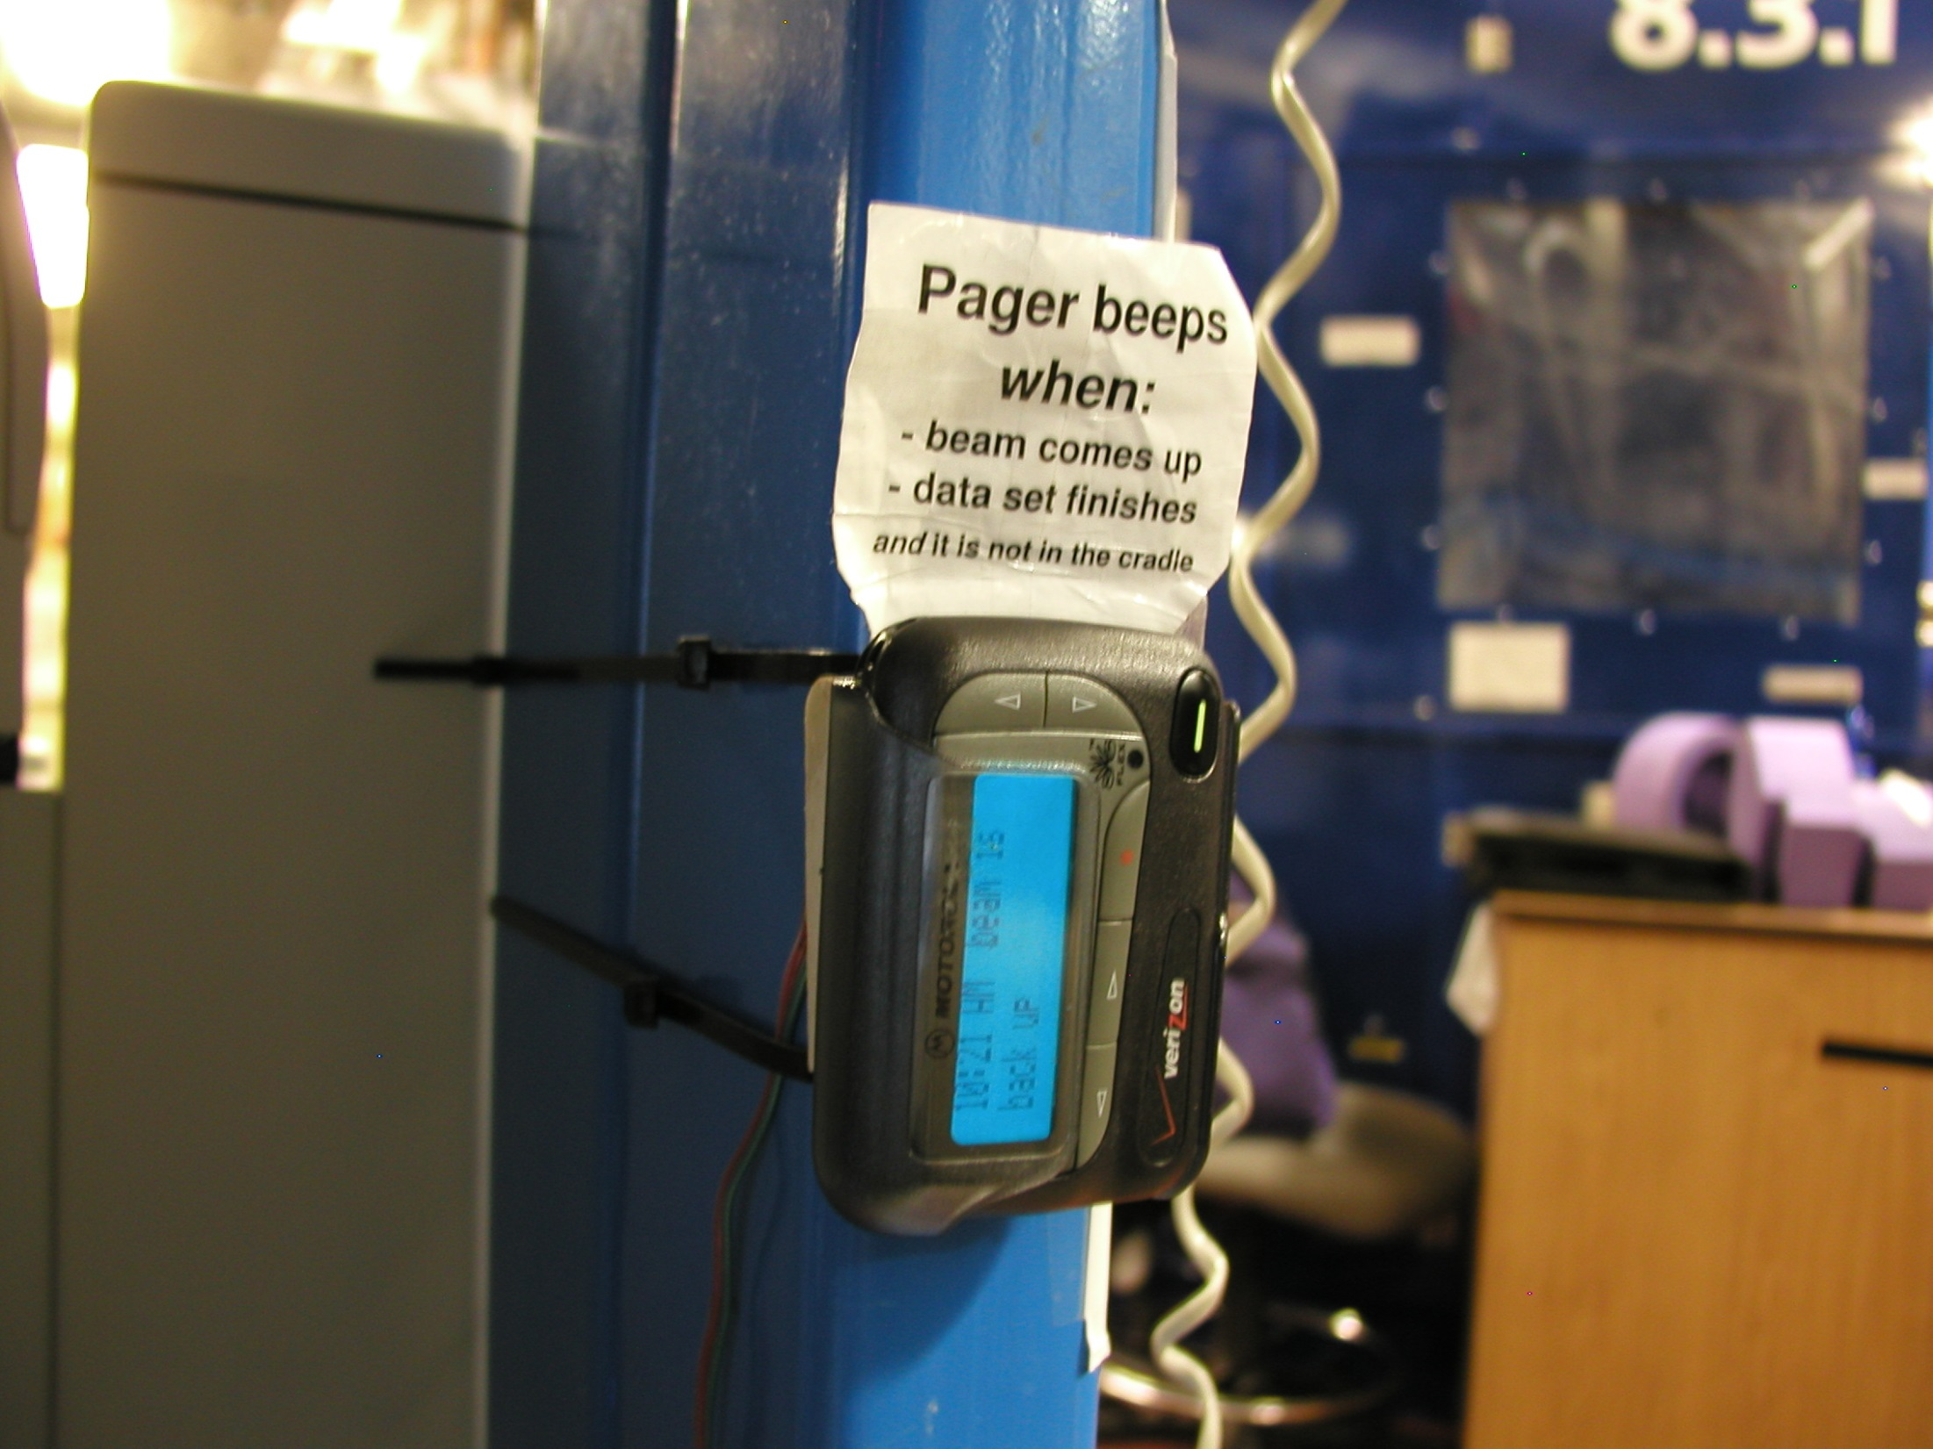
Beamline pager

Slide 24
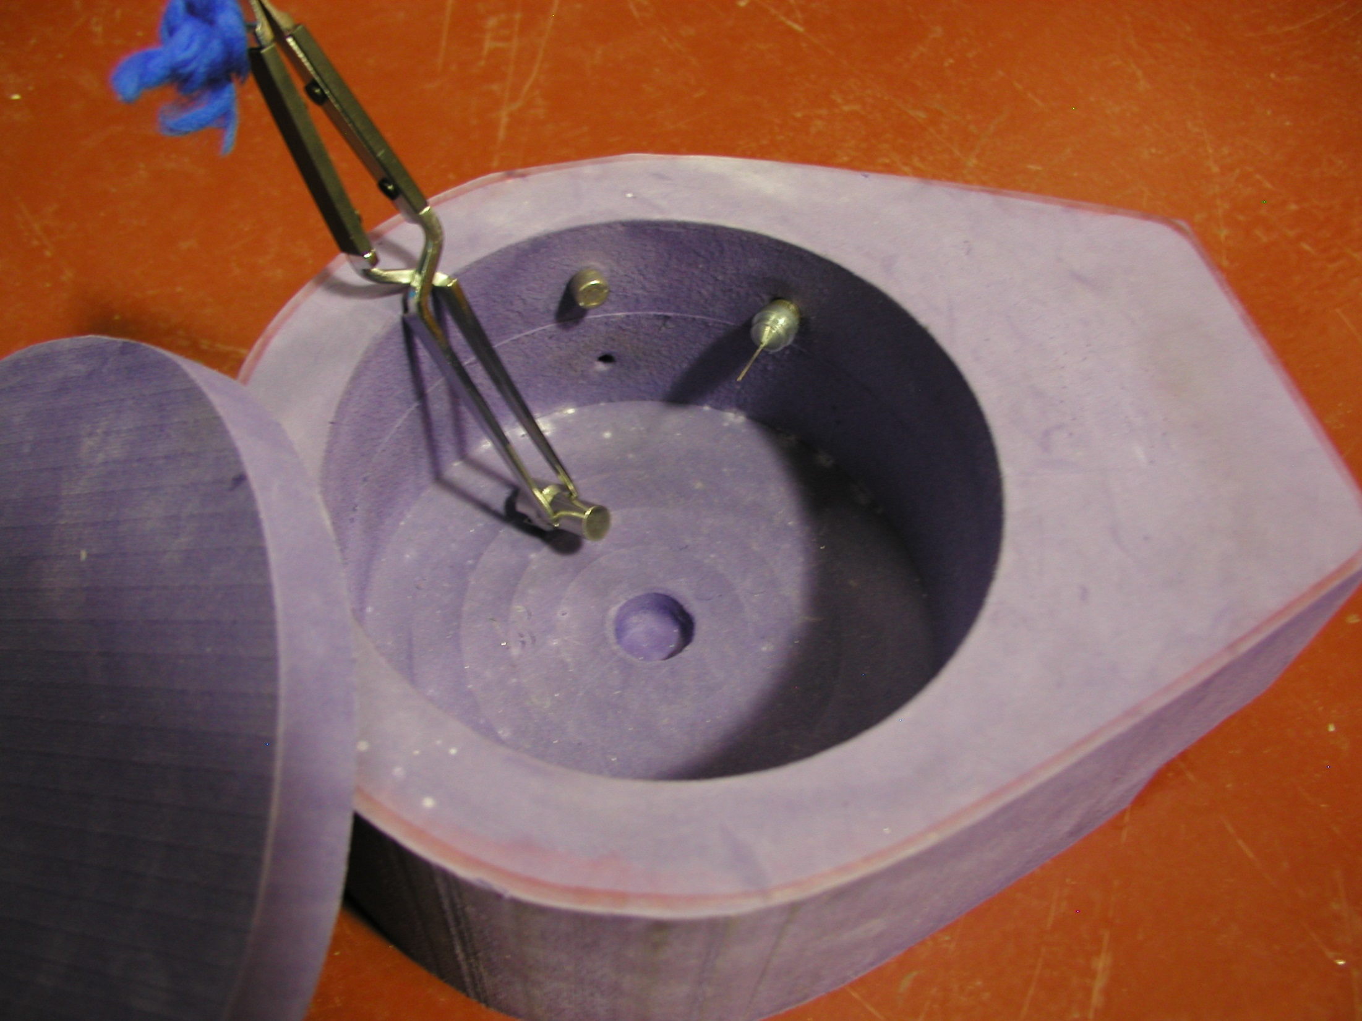
Foam dewars

Slide 25
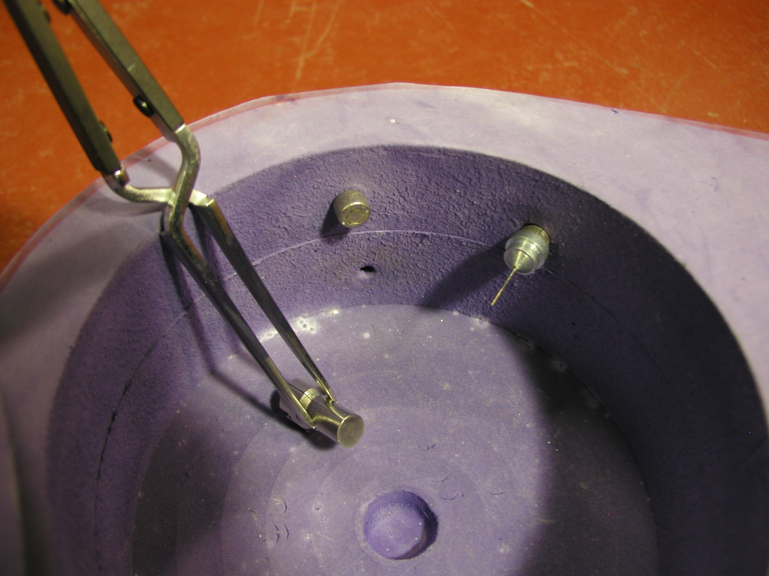
Foam dewars

Slide 26
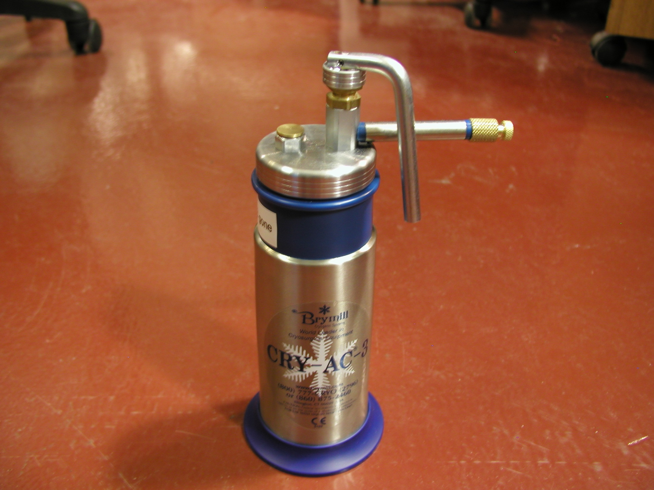
Ice-B-gone

Slide 27
X-ray rules of thumb: absorption and background scattering
1 μm crystal ≈ 1 μm water
≈ 1 μm plastic
≈ 0.1 μm glass
≈ 1000 μm air

Slide 28
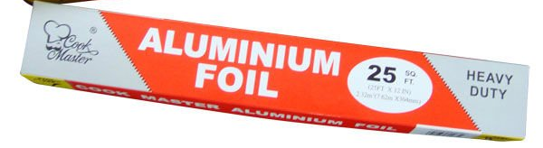
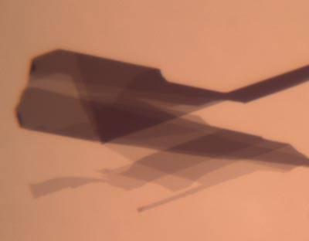
What we really need
Thin
Light
Tight
Cheap
GRAPHENE

Slide 29
Crystallography
a tool for structural biology

Slide 30
Crystallography
a tool for structural biology

Slide 31
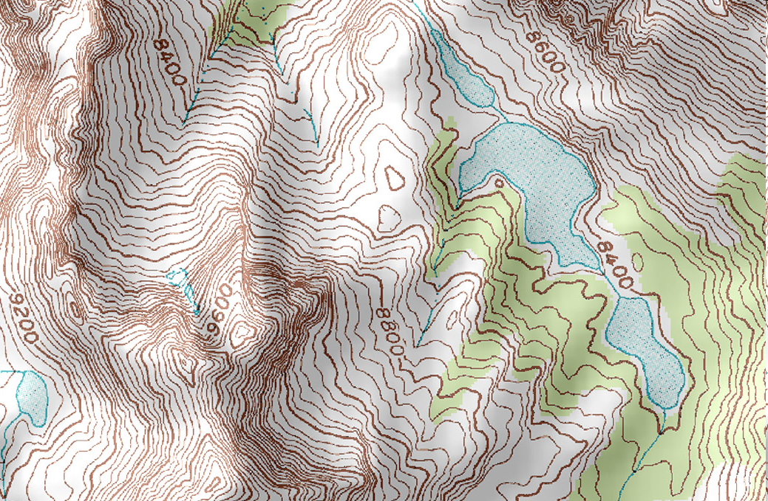
Geography

Slide 32
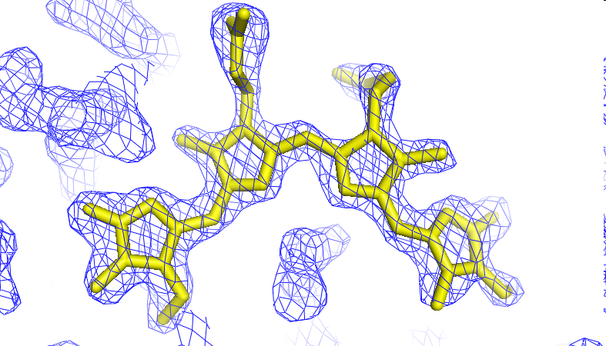
X-rays “see” electrons

Slide 33
How big is an atom?
C
N
O
H
S
U
1 Ångstrom (Å)
1 nanometer (10⁻⁹ m)

Slide 34
How big is an atom?
U
S
C
N
O
H
as seen by X-rays

Slide 35
Where do photons go?
Protein
1A x-rays
Transmitted (98%)
beamstop

Slide 36
Elastic scattering

Slide 37
Elastic scattering

Slide 38

Where do photons go?
Protein
1A x-rays
elastic scattering (6%)
Transmitted (98%)
beamstop

Slide 39
Elastic scattering

Slide 40
Inelastic scattering

Slide 41
Where do photons go?
Protein
1A x-rays
elastic scattering (6%)
Transmitted (98%)
beamstop

Slide 42
Where do photons go?
Protein
1A x-rays
elastic scattering (6%)
Transmitted (98%)
beamstop
inelastic scattering (7%)

Slide 43
Where do photons go?
Protein
1A x-rays
elastic scattering (6%)
Transmitted (98%)
beamstop
inelastic scattering (7%)
Re-emitted (99%)
Absorbed (~0%)

Slide 44
Photoelectric absorption

Slide 45
Photoelectric absorption
e⁻
+

Slide 46
Fluorescence
+

Slide 47
Fluorescence
e⁻
+

Slide 48
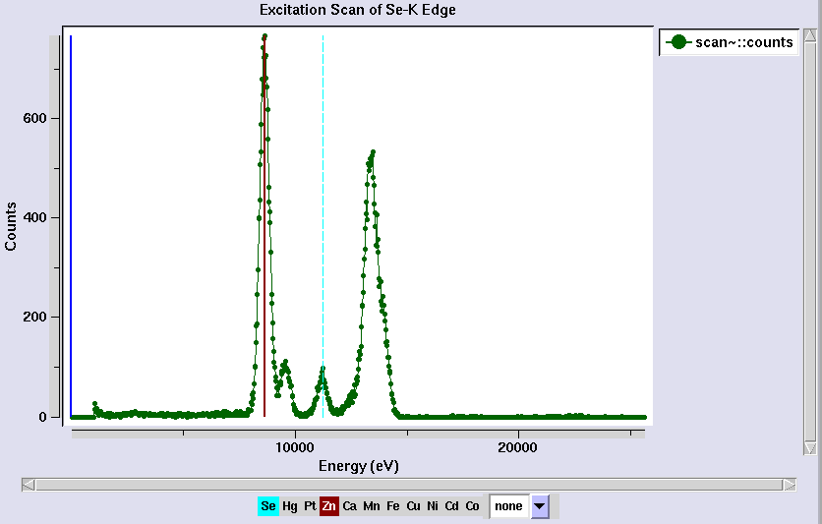
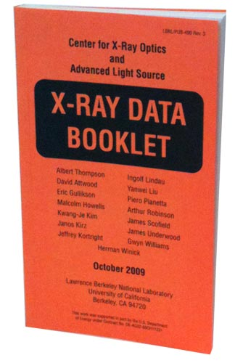
Metal identification

Slide 49
Where do photons go?
Protein
1A x-rays
elastic scattering (6%)
Transmitted (98%)
beamstop
inelastic scattering (7%)
Re-emitted (99%)
Absorbed (~0%)

Slide 50
Where do photons go?
Protein
1A x-rays
elastic scattering (6%)
Transmitted (98%)
beamstop
inelastic scattering (7%)
Photoelectric (87%)
Re-emitted (99%)
Absorbed (~0%)

Slide 51
Where do photons go?
Protein
1A x-rays
elastic scattering (6%)
Transmitted (98%)
beamstop
inelastic scattering (7%)
Photoelectric (87%)
Re-emitted (99%)
Absorbed (~0%)
Re-emitted (~0%)
Absorbed (99%)

Slide 52
Where do photons go?
Protein
1A x-rays
elastic scattering (6%)
Transmitted (98%)
beamstop
inelastic scattering (7%)
Photoelectric (87%)
Re-emitted (99%)
Absorbed (~0%)
Re-emitted (~0%)
Absorbed (99%)
useful/absorbed energy: 7.3%

Slide 53
scattering
x-ray beam
sample
detector
detector

Slide 54
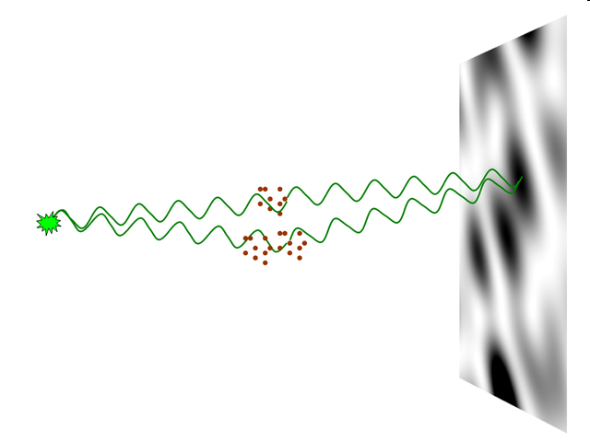
nearBragg program
http://bl831.als.lbl.gov/~jamesh/nearBragg/
“assumption-free” total scattering
no Fourier Transform
no unit cells
no “mosaicity”
arbitrary “atoms”
arbitrary “source”
coherent or not

Slide 55
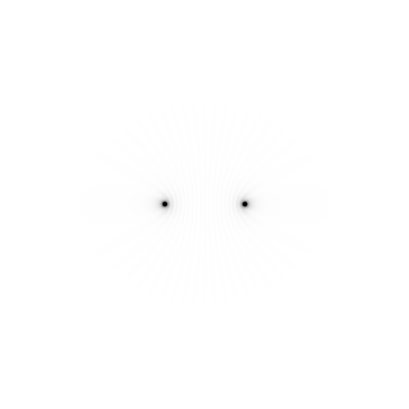
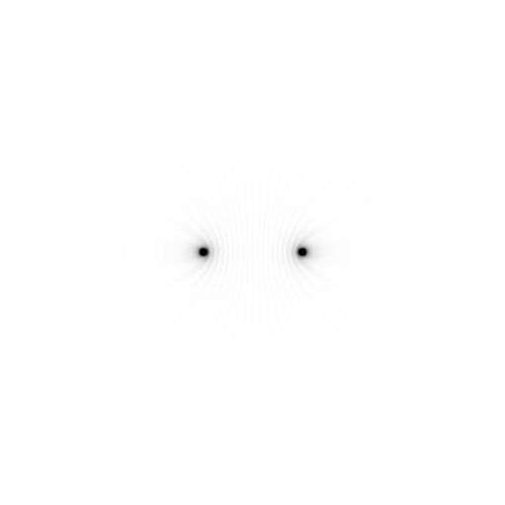
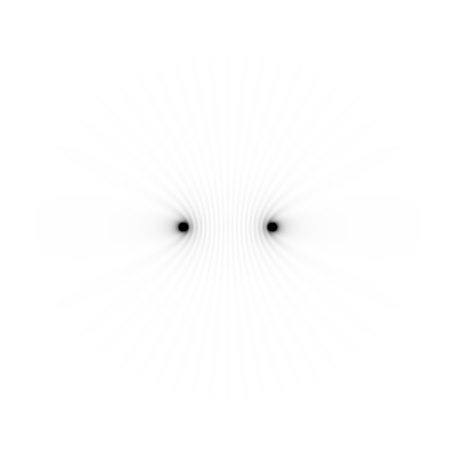
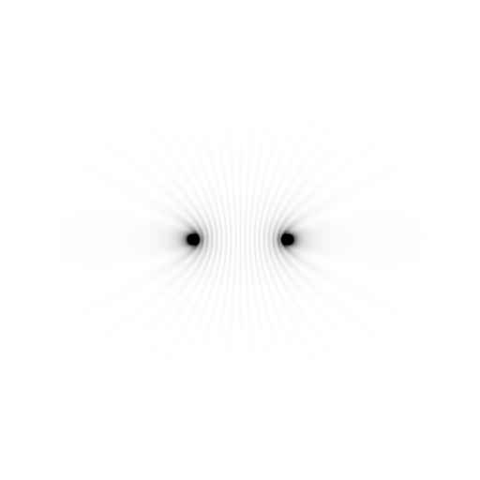
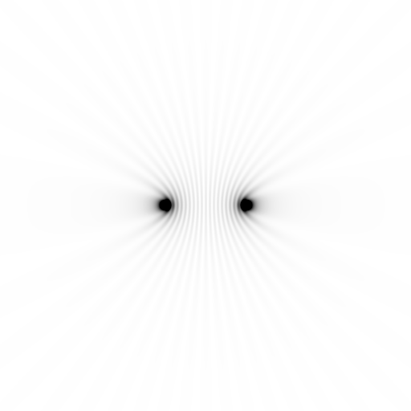
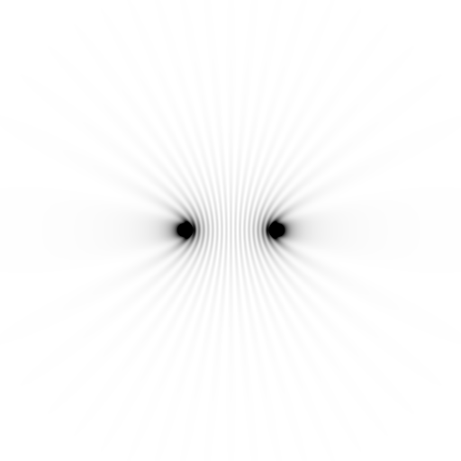
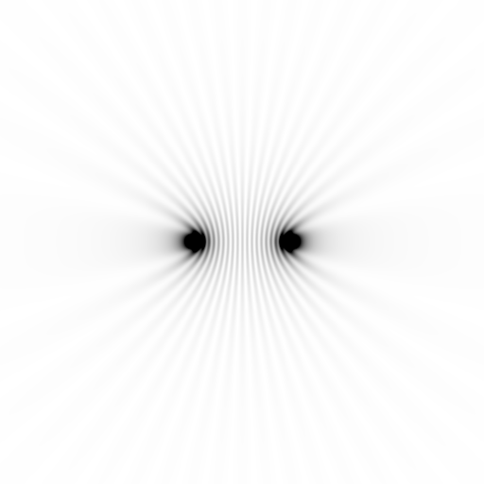
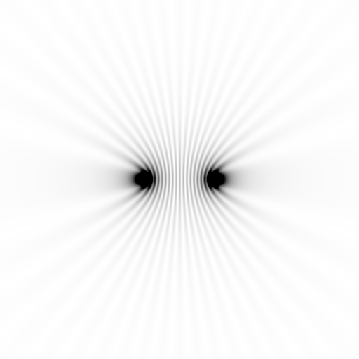
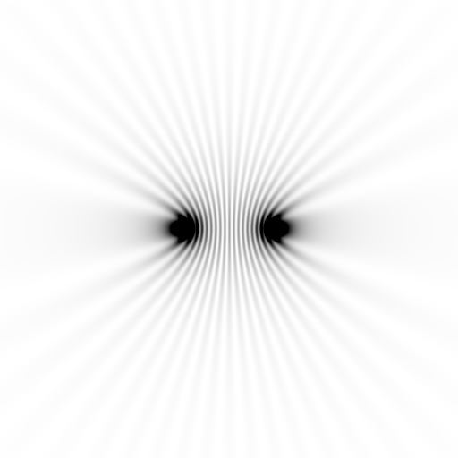
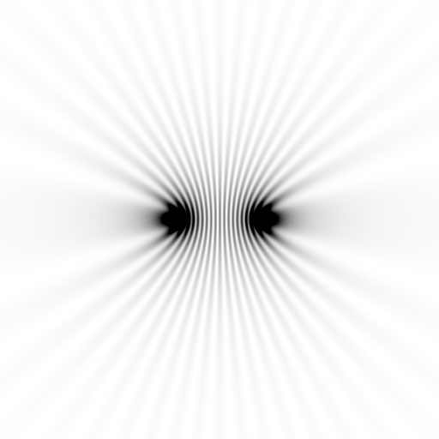
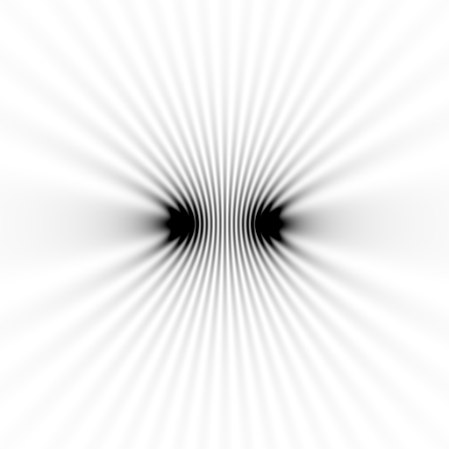
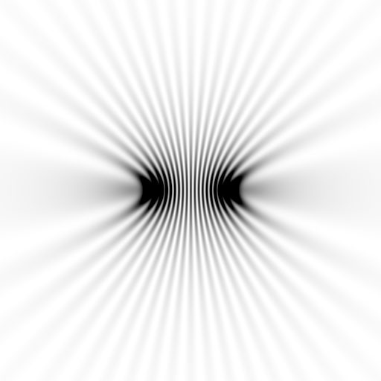
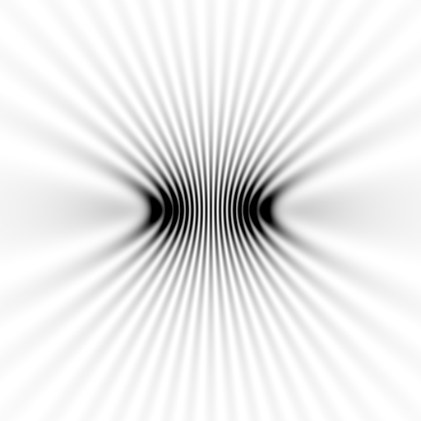
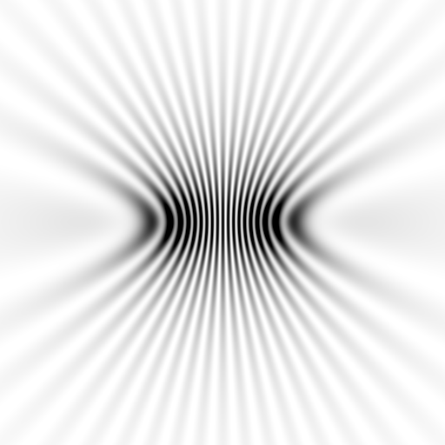
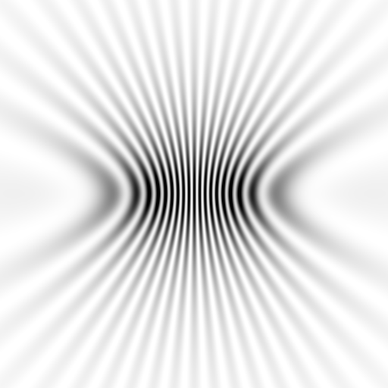
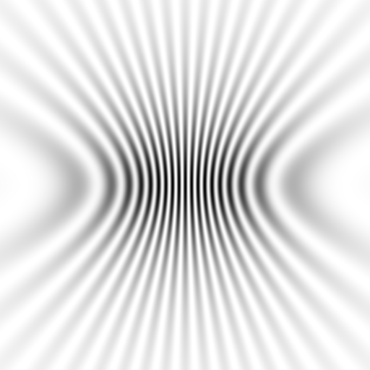
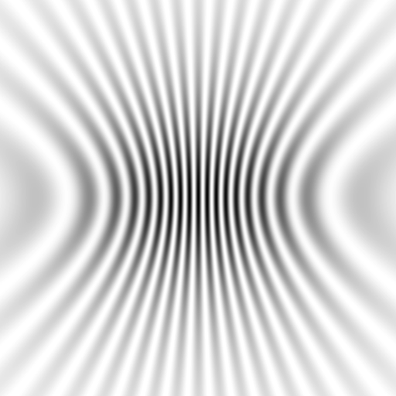
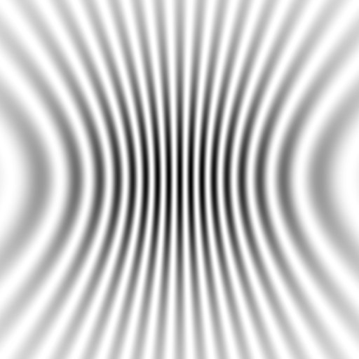
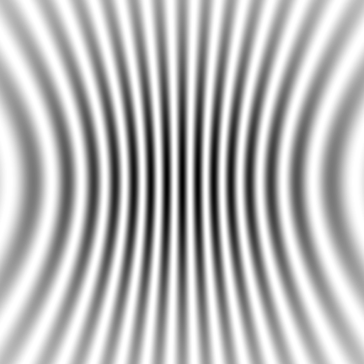
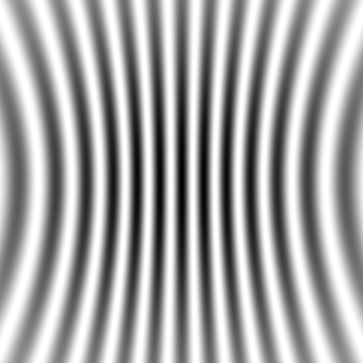



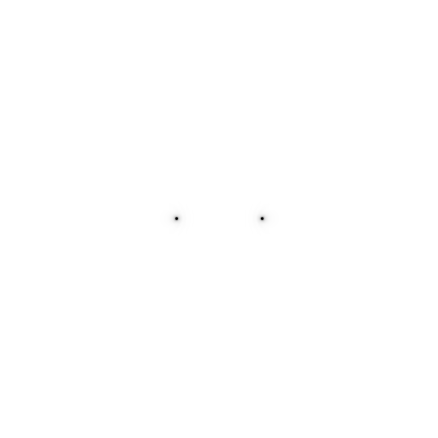
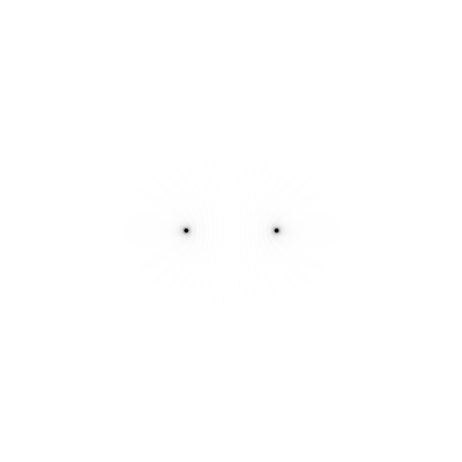
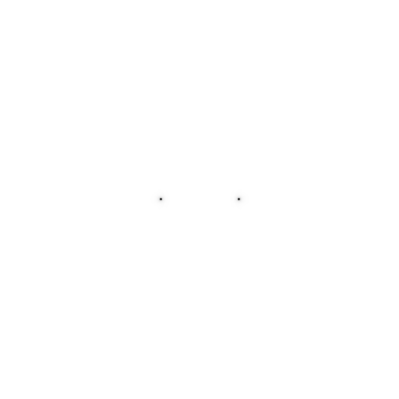

Slide 56
scattering
x-ray beam
sample
detector

Slide 57
scattering
x-ray beam
sample
detector

Slide 58
scattering
x-ray beam
sample
detector

Slide 59
Bragg’s Law
to detector
nλ = 2d sin(θ)
atom #1
θ
d
to source
atom #2
d∙sin(θ)

Slide 60
Bragg’s Law
to detector
nλ = 2d sin(θ)
atom #1
θ
to source
d
atom #2
d∙sin(θ)

Slide 61
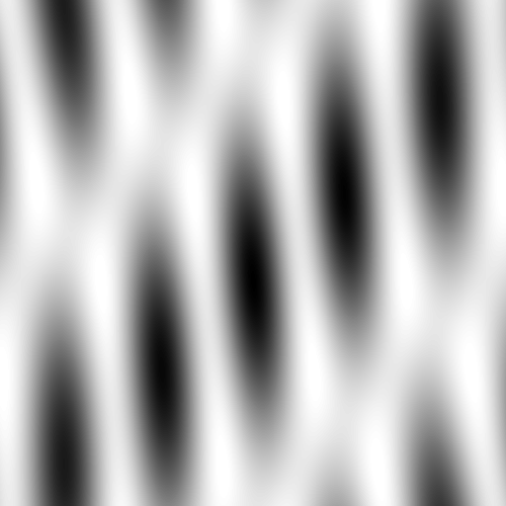



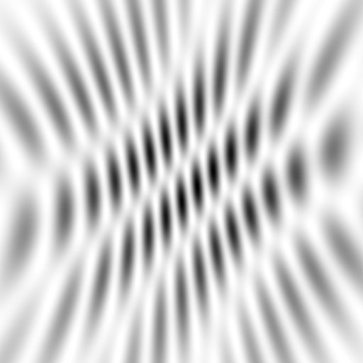
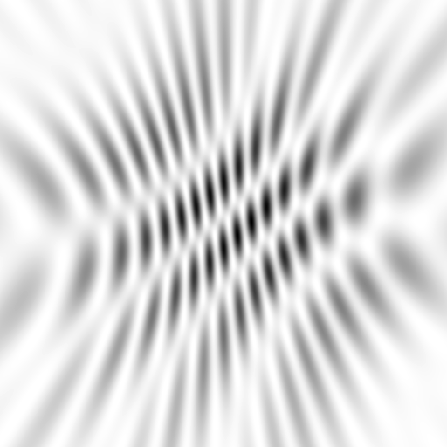
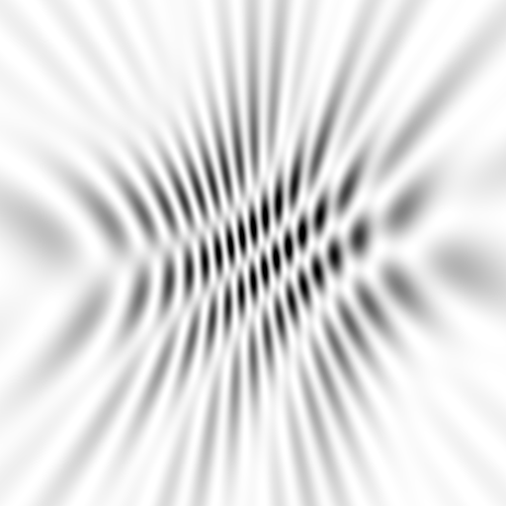
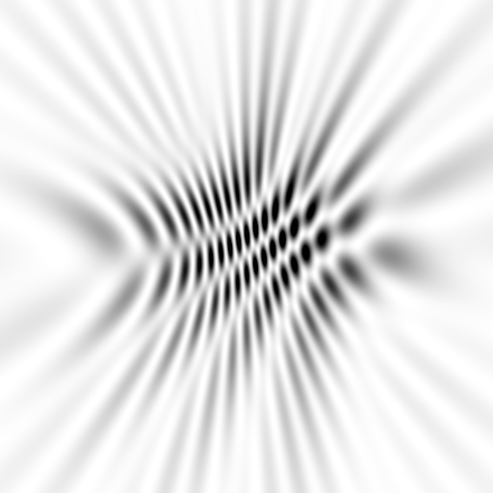



















Slide 62










scattering from a structure
sample
detector

Slide 63

forward Fourier Transform
inverse Fourier Transform
no phase

Slide 64











inverse Fourier Transform
scattering from a structure
colored by phase
sample
detector

Slide 65




scattering from a lattice
colored by phase
sample
detector

Slide 66

scattering from a lattice
colored by phase
sample
detector

Slide 67

scattering from a lattice
colored by phase
sample
detector

Slide 68

scattering from a crystal structure
colored by phase
sample
detector

Slide 69

Promise of Single-molecule Imaging
R. Neutze et al., Nature 406, pp. 752-757 (2000)

Slide 70

lysozyme: real and reciprocal

Slide 71

lysozyme: thermal motion

Slide 72


Snapshot from single virus particle
2 keV LCLS 200 fs Mimi virus single-shot.
_{200 nm}
_{Reconstructed image}
_{Resolution 20nm}
_{TEM}
Seibert, et al. (2011). Nature 470, 78-81.
Notes:
what limits single-particle resolution ?
get 100 times more photons/shot if correctly focussed beam
get 100 times more with submicron beam focus on CXI chamber
Problem – scattering goes from N^2 to N (Wilson statistics).
So use a-priori information – modelling Axel Brummer
Make beam smaller than jet to elliminate streak
₇₂

Slide 73

Single-molecule imaging result
2.5 eV 0.1 s Michelin P255/70R18 LTX A/S 112T BSW
to what
resolution
is this
interesting?
_{200 nm}
_{Resolution ~2 mm}
Notes:
what limits single-particle resolution ?
get 100 times more photons/shot if correctly focussed beam
get 100 times more with submicron beam focus on CXI chamber
Problem – scattering goes from N^2 to N (Wilson statistics).
So use a-priori information – modelling Axel Brummer
Make beam smaller than jet to elliminate streak
₇₃

Slide 74

Muybridge’s galloping horse (1878)

Slide 75

Muybridge’s multi-camera

Slide 76

not enough signal

Slide 77


brighter light

Slide 78
even brighter

Slide 79

very bright light

Slide 80

a “crystal” of horses

Slide 81

realistic “crystal” of horses

Slide 82

average structure: galloping horse

Slide 83

Muybridge’s galloping horse (1878)
“Time-resolved” diffraction
Real space
reciprocal

Slide 84

Muybridge’s galloping horse (1878)
Diffract and Destroy
Real space
reciprocal

Slide 85

Muybridge’s galloping horse (1878)
Average electron density
Real space
reciprocal

Slide 86















Supporting a model with data

Slide 87
That’ll be in 20 years
What can we do now?

Slide 88

Molecular Dynamics Simulation
using real
crystal’s lattice
1aho
Scorpion toxin
0.96 Å resolution
64 residues
Solvent: H₂0 + acetate
Cerutti et al. (2010).J. Phys. Chem. B 114, 12811-12824.

Slide 89

30 conformers from 24,000

Slide 90

Electron density from 24,000 conformers

Slide 91

Electron density from 24,000 conformers

Slide 92


Molecular Dynamics vs Observation
1aho 64-residue scorpion toxin in water to 1.0 Å resolution
refined_vs_Fsim.pdb
F_{calc}
F_{sim}
R_{cryst}= 0.137

Slide 93

Molecular Dynamics vs Observation
1aho 64-residue scorpion toxin in water to 1.0 Å resolution
refined_vs_Fsim.pdb
1aho.cif
1aho.pdb
F_{calc}
F_{sim}
F_{obs}
F_{calc}
R_{free} = 0.69
R_{cryst}= 0.137
R_{free} =
R_{cryst}= 0.116
R_{free} = 0.48 to 4 Å
rmsd = 1.05 Å
LSQ rmsd = 0.43Å

Slide 94

Molecular Dynamics vs Observation
RMSD
1.05 Å

Slide 95

Molecular Dynamics vs Observation
RMSD
0.45 Å
aligned

Slide 96

Molecular Dynamics vs Observation
Sodium acetate trihydrate
5 atoms
3 waters
0.9 Å resolution
C2/c
R_{vault} = 0.03

Slide 97

Molecular Dynamics vs Observation
fav8
8 residues
4 waters
1.0 Å resolution
P1

Slide 98



Molecular Dynamics vs Observation
“fav8” 8-residue aromatic peptide with 4 waters to 1.0 Å resolution
refined_vs_Fsim.pdb
fav8.fcf
fav8.cif
F_{calc}
F_{sim}
F_{obs}
F_{calc}
R_{cryst}= 0.13
R_{free}= 0.23
R_{cryst}= 0.16
R_{free} = 0.20 to 2Å
R1 = 0.041
With 4σ cutoff!
rmsd = 0.20 Å
LSQ rmsd = 0.091Å & 0.15 Å

Slide 99

MD-predicted water structure
Simulated
density
Janowski et al (2013) JACS 135, 7938-7948

Slide 100

MD-predicted water structure
Simulated
density
2mF_{o}-DF_{c}
Janowski et al (2013) JACS 135, 7938-7948

Slide 101

MD-predicted Val rotamer
Janowski et al (2013) JACS 135, 7938-7948

Slide 102


MD-predicted Val rotamer
confs | R_{work} | R_{free}
one | 4.11% | 5.84%
A & B | 3.89% | 5.53%
Janowski et al (2013) JACS 135, 7938-7948

Slide 103
Molecular Dynamics Simulation
using real
crystal’s lattice
1aho
Scorpion toxin
0.96 Å resolution
64 residues
Solvent: H₂0 + acetate
Cerutti et al. (2010).J. Phys. Chem. B 114, 12811-12824.

Slide 104

MLFSOM simulation

Slide 105


Simulated diffraction image
MLFSOM

Slide 106
Simulated diffraction image
MLFSOM
simulated
real

Slide 107

Simulated diffraction image
(2008)
simulated
real

Slide 108
Simulated | statistic | Real
5.4% | R_{merge} | 6.2%
18.9 | I/sd | 16.2
1.9 | I/sd (1.4 Ǻ) | 1.6
1.7 4.0 0.020 | SDCORR | 1.0 2.2 0.065
36.8 | PADFPH | 31.46
3.871 | mlphare f” | 3.476
0.178 | FOM | 0.192
0.545 | FOMDM | 0.664
0.6270 | CC(1H87) | 0.6090
0.170 | R_{cryst} | 0.184
0.205 | R_{free} | 0.231

Slide 109
Electron density from 24,000 conformers

Slide 110

2F_{sim}-F_{calc} and F_{sim}-F_{calc} maps
1.0 Å data
R_{cryst}= 0.137
R_{free} = 0.159
1 “sigma” 2F_{sim}-F_{c}
2.5 “sigma” F_{sim}-F_{c}

Slide 111

2F_{sim}-F_{calc} and (F_{sim} Φ_{sim}) - (F_{calc} Φ_{calc}) maps
1.0 Å data
R_{cryst}= 0.137
R_{free} = 0.159
1 “sigma” 2F_{sim}-F_{c}
F_{right} – (2F_{sim}-F_{c})

Slide 112

Regular model with real data!
1.0 Å data
R_{cryst}= 0.116
R_{free} = 0.135
1 “sigma” 2F_{sim}-F_{c}
2.5 “sigma” F_{sim}-F_{c}

Slide 113

How many conformers are there?

Slide 114

How many conformers are there?
40 explain density to 3% error

Slide 115

How many conformers are there?
8 explain density to 3% error

Slide 116
The Future of Structural Biology
Will be noisy
Averaging destroys resolution
Multi-crystal data – isomorphism
structures of the future must be 4D
There is “life” below 1 σ

Slide 117
PowerPoint File available:
http://bl831.als.lbl.gov/
~jamesh/powerpoint/
NanoGM_Xray_2014.pptx

Slide 118
Acknowledgements
8.3.1 PRT: Tom Alber
National Institutes of Health (STTR)
Center for Structure of Membrane Proteins
Center for HIV Accessory and Regulatory Complexes
Membrane Protein Expression Center II (MPEC)
Center for HIV Accessory and Regulatory Complexes (HARC)
W. M. Keck Foundation
Plexxikon, Inc.
M D Anderson CRC
Alberta Synchrotron Institute
University of California Berkeley
University of California San Francisco
National Science Foundation
University of California Campus-Laboratory Collaboration Grant
Henry Wheeler
The Advanced Light Source is supported by the Director, Office of Science, Office of Basic Energy Sciences, Materials Sciences Division, of the US Department of Energy under contract No. DEAC02- 05CH11231 at Lawrence Berkeley National Laboratory.

Slide 119
Major Phasing techniques
Molecular Replacement
Multiple Isomorphous Replacement
Multiwavelength Anomalous Diffraction
Single-wavelength Anomalous Diffraction

Slide 120
inverse Fourier Transform
no phase

Slide 121


inverse Fourier Transform
no phase

Slide 122
Major Phasing techniques
Molecular Replacement
Multiple Isomorphous Replacement
Multiwavelength Anomalous Diffraction
Single-wavelength Anomalous Diffraction

Slide 123
anomalous scattering
x-ray beam
sample
detector

Slide 124
anomalous scattering
x-ray beam
sample
detector

Slide 125
anomalous scattering
x-ray beam
sample
detector

Slide 126
anomalous scattering
x-ray beam
sample
detector

Slide 127
anomalous scattering
x-ray beam
sample
detector

Slide 128
Major Phasing techniques
Molecular Replacement
Multiple Isomorphous Replacement
Multiwavelength Anomalous Diffraction
Single-wavelength Anomalous Diffraction

Slide 129


Molecular Replacement
correct structure and intensities
?
http://www.ysbl.york.ac.uk/~cowtan/fourier/coeff.html

Slide 130


Molecular Replacement
use something similar as a starting model

Slide 131

Model Building
current model is missing something

Slide 132
Model Building
phases from model

Slide 133


Model Building
missing bits show up in “difference map”

Slide 134


Model Building
missing bits show up better in F_{O} + (F_{O} - F_{C}) map

Slide 135

Resolution
http://bl831.als.lbl.gov/~jamesh/movies/resolution.mpeg

Slide 136

Resolution: low-angle cutoff
http://bl831.als.lbl.gov/~jamesh/movies/lo_cut.mpeg

Slide 137

R-factor
http://bl831.als.lbl.gov/~jamesh/movies/rfactor.mpeg

Slide 138

Figure of Merit
http://bl831.als.lbl.gov/~jamesh/movies/dephase.mpeg

Slide 139

Overloads
http://bl831.als.lbl.gov/~jamesh/movies/overloads.mpeg

Slide 140

Completeness: missing wedge
http://bl831.als.lbl.gov/~jamesh/movies/osc.mpeg

Slide 141

Completeness: random deletion
http://bl831.als.lbl.gov/~jamesh/movies/completeness.mpeg

Slide 142

Model Refinement

Slide 143
Accelerator-based light source terminology
Code name Translation
First Generation Bending Magnet
Second Generation Wiggler
Third Generation Undulator
Fourth Generation Free electron laser

Slide 144


Electric charge
balloon
-
-
-
-
-
-
Wool Sweater
+ + + + + +

Slide 145

Electric field of a moving charge

Slide 146
Electric field of a moving charge
accelerating charges
make
electromagnetic waves
(light)

Slide 147
Bending Magnet
S
electron beam
X-rays !
N

Slide 148



ALS 8.3.1 optics
MacDowell et. al. (2004) J. Sync. Rad. 11 447-455
Superbend
pinhole
Scatter
guard
Plane
Parabolic
mirror
Torroidal
mirror
ADSC Quantum 315r
divergence
slits
Si(111)
monochromator
Protein Crystal
Notes:
Next slide please

Slide 149
ALS 8.3.1 optics
MacDowell et. al. (2004) J. Sync. Rad. 11 447-455
Superbend
pinhole
Scatter
guard
Plane
Parabolic
mirror
Torroidal
mirror
ADSC Quantum 315r
divergence
slits
Si(111)
monochromator
Protein Crystal
Notes:
Most notable acheivements are high brightness with very little “wasted” light. The discovery made by Howard Padmore? At ALS showed that a 2:1 demagnification cancels nearly all of the spherical abberations in the parabolic/torroid system. 30-50% of the total x-ray intensity passes through the 100um pinhole. The flux through the 100um pinhole at the superbend beamlines is comparable to that of the 5.0.2 wiggler or an APS bending magnet, but only 150 Watts of power must be dissipated by the beamline optics. In contrast, wiggler beamlines must disipate kilowatts. The optics here are much simpler and not exotic in any way. The system is stable and robust. There is never a need to re-focus the beam at a new wavelength. Only a 2-minute automatic tuneup is recommended for very large energy changes (more than 1-2 keV).

Slide 150

X-ray optics: mirrors
Notes:
Next slide please

Slide 151
Why are the mirrors so long?
Must be < 0.2°
3 mm
1000 mm
Notes:
Next slide please

Slide 152

Monochromator: silicon crystals
Notes:
Next slide please

Slide 153
Monochromators
λ = 1 Å
Si
Notes:
Next slide please

Slide 154
Monochromators
nλ = 2d sin(θ)
λ = 1 Å
λ = 1 Å
Si
d = 3.135 Å
θ = 9.177°
Notes:
Next slide please

Slide 155
Monochromators
nλ = 2d sin(θ)
λ = 1.1 Å
Si
d = 3.135 Å
θ = 9.177°
Notes:
Next slide please

Slide 156
Monochromators
nλ = 2d sin(θ)
λ = 1.1 Å
λ = 1.1 Å
Si
d = 3.135 Å
θ = 10.104°
Notes:
Next slide please

Slide 157
Monochromators
nλ = 2d sin(θ)
λ = 1 Å
λ = 1 Å
Si
d = 3.135 Å
θ = 9.177°
Notes:
Next slide please

Slide 158
Monochromators
Si
λ = 1 Å
λ = 1 Å
Si
d = 3.135 Å
Double Crystal Monochromator
Notes:
Next slide please

Slide 159
Monochromators
Si
λ = 1.1 Å
λ = 1.1 Å
Si
d = 3.135 Å
Double Crystal Monochromator
Notes:
Next slide please

Slide 160

ALS 4.2.2 optics
Superbend
Plane
parabolic
mirror
Sample
slits
Plane
Parabolic
mirror
Westbrook Noir 1
divergence
slits
sagital
monochromator
Protein Crystal
Notes:
Most notable acheivements are high brightness with very little “wasted” light. The discovery made by Howard Padmore? At ALS showed that a 2:1 demagnification cancels nearly all of the spherical abberations in the parabolic/torroid system. 30-50% of the total x-ray intensity passes through the 100um pinhole. The flux through the 100um pinhole at the superbend beamlines is comparable to that of the 5.0.2 wiggler or an APS bending magnet, but only 150 Watts of power must be dissipated by the beamline optics. In contrast, wiggler beamlines must disipate kilowatts. The optics here are much simpler and not exotic in any way. The system is stable and robust. There is never a need to re-focus the beam at a new wavelength. Only a 2-minute automatic tuneup is recommended for very large energy changes (more than 1-2 keV).

Slide 161
Monochromators
Si
λ = 1.1 Å
λ = 1.1 Å
Si
d = 3.135 Å
Double Crystal Monochromator
Notes:
Next slide please

Slide 162
Monochromators
nλ = 2d sin(θ)
λ = 1.54 Å
λ = 1.54 Å
Mo/C
d = 24 Å
θ = 1.84°
Multilayer optics
Notes:
Next slide please

Slide 163
ALS 12.3.1 optics
Superbend
pinhole
Scatter
guard
Plane
Parabolic
mirror
Torroidal
mirror
ADSC Quantum 315r
divergence
slits
Si(111)
monochromator
Protein Crystal
2 x 10⁷ ph/s/μm² ≈ 3000 s/xtal
Notes:
Most notable acheivements are high brightness with very little “wasted” light. The discovery made by Howard Padmore? At ALS showed that a 2:1 demagnification cancels nearly all of the spherical abberations in the parabolic/torroid system. 30-50% of the total x-ray intensity passes through the 100um pinhole. The flux through the 100um pinhole at the superbend beamlines is comparable to that of the 5.0.2 wiggler or an APS bending magnet, but only 150 Watts of power must be dissipated by the beamline optics. In contrast, wiggler beamlines must disipate kilowatts. The optics here are much simpler and not exotic in any way. The system is stable and robust. There is never a need to re-focus the beam at a new wavelength. Only a 2-minute automatic tuneup is recommended for very large energy changes (more than 1-2 keV).

Slide 164
ALS 12.3.1 optics
Superbend
pinhole
Scatter
guard
Plane
Parabolic
mirror
Torroidal
mirror
ADSC Quantum 315r
divergence
slits
1% ML
monochromator
Protein Crystal
4 x 10⁸ ph/s/μm² ≈ 160 s/xtal
Notes:
Most notable acheivements are high brightness with very little “wasted” light. The discovery made by Howard Padmore? At ALS showed that a 2:1 demagnification cancels nearly all of the spherical abberations in the parabolic/torroid system. 30-50% of the total x-ray intensity passes through the 100um pinhole. The flux through the 100um pinhole at the superbend beamlines is comparable to that of the 5.0.2 wiggler or an APS bending magnet, but only 150 Watts of power must be dissipated by the beamline optics. In contrast, wiggler beamlines must disipate kilowatts. The optics here are much simpler and not exotic in any way. The system is stable and robust. There is never a need to re-focus the beam at a new wavelength. Only a 2-minute automatic tuneup is recommended for very large energy changes (more than 1-2 keV).

Slide 165

ALS 12.3.1 double endstation

Slide 166
Two Bending Magnets
S
N
electron beam
N
S
2x X-rays !

Slide 167
Wiggler
8x X-rays !
S
N
S
N
S
N
S
N
N
S
N
S
N
S
N
S

Slide 168


ALS 5.0.2 optics
pinhole
Scatter
guard
Plane
Parabolic
mirror
Torroidal
mirror
16-pole wiggler
ADSC Quantum 315
divergence
slits
Si(111)
monochromator
Protein Crystal
1.5 x 10⁸ ph/s/μm² ≈ 400 s/xtal
Notes:
Most notable acheivements are high brightness with very little “wasted” light. The discovery made by Howard Padmore? At ALS showed that a 2:1 demagnification cancels nearly all of the spherical abberations in the parabolic/torroid system. 30-50% of the total x-ray intensity passes through the 100um pinhole. The flux through the 100um pinhole at the superbend beamlines is comparable to that of the 5.0.2 wiggler or an APS bending magnet, but only 150 Watts of power must be dissipated by the beamline optics. In contrast, wiggler beamlines must disipate kilowatts. The optics here are much simpler and not exotic in any way. The system is stable and robust. There is never a need to re-focus the beam at a new wavelength. Only a 2-minute automatic tuneup is recommended for very large energy changes (more than 1-2 keV).

Slide 169
Undulator
> 8x X-rays !
S
N
S
N
S
N
S
N
N
S
N
S
N
S
N
S

Slide 170

Undulator emission spectrum

Slide 171

LCLS undulator hall

Slide 172

LCLS at SLAC

Slide 173

Electric field of a moving charge

Slide 174

SASE effect

Slide 175

Self-Amplified Stimulated Emission (SASE) effect

Slide 176

100 fs damage “threshold”
Lomb et al. (2011) Phys Rev B 84, 214111

Slide 177
Snapshot from single virus particle
2 keV LCLS 200 fs Mimi virus single-shot.
_{200 nm}
_{Reconstructed image}
_{Resolution 20nm}
_{TEM}
Seibert, et al. (2011). Nature 470, 78-81.
Notes:
what limits single-particle resolution ?
get 100 times more photons/shot if correctly focussed beam
get 100 times more with submicron beam focus on CXI chamber
Problem – scattering goes from N^2 to N (Wilson statistics).
So use a-priori information – modelling Axel Brummer
Make beam smaller than jet to elliminate streak
₁₇₇

Slide 178
Single-molecule imaging result
2.5 eV 0.1 s Michelin P255/70R18 LTX A/S 112T BSW
to what
resolution
is this
interesting?
_{200 nm}
_{Resolution ~2 mm}
Notes:
what limits single-particle resolution ?
get 100 times more photons/shot if correctly focussed beam
get 100 times more with submicron beam focus on CXI chamber
Problem – scattering goes from N^2 to N (Wilson statistics).
So use a-priori information – modelling Axel Brummer
Make beam smaller than jet to elliminate streak
₁₇₈

Slide 179
Accelerator-based light source terminology
Code name Translation
First Generation Bending Magnet
Second Generation Wiggler
Third Generation Undulator
Fourth Generation Free electron laser

Slide 180
lysozyme: real and reciprocal

Slide 181
lysozyme: thermal motion

Slide 182
ALS 8.3.1 optics
MacDowell et. al. (2004) J. Sync. Rad. 11 447-455
pinhole
Scatter
guard
X-ray
Source
ADSC Quantum 315r
Protein Crystal
Notes:
Most notable acheivements are high brightness with very little “wasted” light. The discovery made by Howard Padmore? At ALS showed that a 2:1 demagnification cancels nearly all of the spherical abberations in the parabolic/torroid system. 30-50% of the total x-ray intensity passes through the 100um pinhole. The flux through the 100um pinhole at the superbend beamlines is comparable to that of the 5.0.2 wiggler or an APS bending magnet, but only 150 Watts of power must be dissipated by the beamline optics. In contrast, wiggler beamlines must disipate kilowatts. The optics here are much simpler and not exotic in any way. The system is stable and robust. There is never a need to re-focus the beam at a new wavelength. Only a 2-minute automatic tuneup is recommended for very large energy changes (more than 1-2 keV).

Slide 183


Slide 184

How do I get one of those maps?
0. Purify
protein
3. Calculate
e⁻ density
1. Grow
crystals
5. Refine
models
2. Collect
data
4. Build
model

Slide 185

X-ray data are 3D!

Slide 186


How do I get one of those maps?
Elves examine images and
set-up data processing
Elves run…
mosflm
scala
solve
mlphare
dm
arp/warp
Holton, J. & Alber, T. (2004) PNAS USA 101 1537-42.

Slide 187
Auger emission
+

Slide 188
Auger emission
e⁻
++

Slide 189
Sample atoms

Slide 190
Sample atoms

Slide 191
Primary ionization
e⁻
+

Slide 192
Secondary ionizations
e⁻
e⁻
+
e⁻
e⁻
+
+
+
+
+
e⁻
e⁻

Slide 193
Ionization track
e⁻
e⁻
e⁻
e⁻
+
e⁻
+
+
+
e⁻
e⁻
+
+
+
+
+
e⁻
+
e⁻
e⁻

Slide 196

The Future of Structural Biology
10 Å

Slide 197

What is the structure of “disorder” ?
a grand challenge for structural biology in the 21st century

Slide 198
Big Question:
AD 1872
When a horse gallops, is there ever a moment where all four hooves leave the ground?

Slide 199

Muybridge’s galloping horse (1878)
Sum(intensity) – Sum(density) = diffuse scatter
Real space
reciprocal

Slide 200

Muybridge’s galloping horse (1878)
F_{incoh} – F_{coherent} with density phases
Real space
reciprocal

Slide 201

Muybridge’s galloping horse (1878)
RMS variation in density
Real space
reciprocal

Slide 202

average structure: 1-sigma contour

Slide 203

21st Century Big Question: how do biomolecules work?
Beernink, Endrizzi, Alber & Schachman (1999). PNAS USA 96, 5388-5393.

Slide 204
Averaging destroys resolution
10 Å

Slide 205
Great! We have lots of crystals
but we have a problem with
non-isomorphism

Slide 206
Non-isomorphism in lysozyme
Dear James
The story of the two forms of lysozyme crystals goes back to about 1964 when it was found that the diffraction patterns from different crystals could be placed in one of two classes depending on their intensities. This discovery was a big set back at the time and I can remember a lecture title being changed from the 'The structure of lysozyme' to 'The structure of lysozyme two steps forward and one step back'. Thereafter the crystals were screened based on intensities of the (11,11,l) rows to distinguish them (e.g. 11,11,4 > 11,11,5 in one form and vice versa in another). Data were collected only for those that fulfilled the Type II criteria. (These reflections were easy to measure on the linear diffractometer because crystals were mounted to rotate about the diagonal axis). As I recall both Type I and Type II could be found in the same crystallisation batch . Although sometimes the external morphology allowed recognition this was not infallible.
The structure was based on Type II crystals. Later a graduate student Helen Handoll examined Type I. The work, which was in the early days and before refinement programmes, seemed to suggest that the differences lay in the arrangement of water or chloride molecules (Lysozyme was crystallised from NaCl). But the work was never written up. Keith Wilson at one stage was following this up as lysozyme was being used to test data collection strategies but I do not know the outcome.
An account of this is given in International Table Volume F (Rossmann and Arnold edited 2001) p760.
Tony North was much involved in sorting this out and if you wanted more info he would be the person to contact. I hope this is helpful. Do let me know if you need more.
Best wishes
Louise

Slide 207
Non-isomorphism in lysozyme
Structure factor (e⁻)
Johnson’s ratio

Slide 208
Non-isomorphism in lysozyme
Structure factor (e⁻)
Johnson’s ratio

Slide 209


Slide 210
Non-isomorphism in lysozyme
Dear James
The story of the two forms of lysozyme crystals goes back to about 1964 when it was found that the diffraction patterns from different crystals could be placed in one of two classes depending on their intensities. This discovery was a big set back at the time and I can remember a lecture title being changed from the 'The structure of lysozyme' to 'The structure of lysozyme two steps forward and one step back'. Thereafter the crystals were screened based on intensities of the (11,11,l) rows to distinguish them (e.g. 11,11,4 > 11,11,5 in one form and vice versa in another). Data were collected only for those that fulfilled the Type II criteria. (These reflections were easy to measure on the linear diffractometer because crystals were mounted to rotate about the diagonal axis). As I recall both Type I and Type II could be found in the same crystallisation batch . Although sometimes the external morphology allowed recognition this was not infallible.
The structure was based on Type II crystals. Later a graduate student Helen Handoll examined Type I. The work, which was in the early days and before refinement programmes, seemed to suggest that the differences lay in the arrangement of water or chloride molecules (Lysozyme was crystallised from NaCl). But the work was never written up. Keith Wilson at one stage was following this up as lysozyme was being used to test data collection strategies but I do not know the outcome.
An account of this is given in International Table Volume F (Rossmann and Arnold edited 2001) p760.
Tony North was much involved in sorting this out and if you wanted more info he would be the person to contact. I hope this is helpful. Do let me know if you need more.
Best wishes
Louise

Slide 211

Non-isomorphism in lysozyme
RH 84.2% vs 71.9%
RMSD = 0.18 Å
R_{iso} = 44.5%

Slide 212
Non-isomorphism = dehydration?
= 1 nL
100 μm

Slide 213
Elastic deformation
= non-isomorphism

Slide 214
Elastic deformation
= non-isomorphism

Slide 215
Plastic deformation
= poor diffraction

Slide 216
Plastic deformation
= poor diffraction

Slide 217
The Future of Structural Biology
Problem:
XFELs cannot solve the “resolution problem”
overfitting
non-isomorphism
radiation damage
What can we do?
4D modelling
probe weak density
more accurate data
humidity control during growth

Slide 218
The Future of Structural Biology
Problem:
XFELs cannot solve the “resolution problem”
overfitting
non-isomorphism
radiation damage
small & fast = noisy
What can we do?
4D modelling
probe weak density
more accurate data
humidity control during growth

Slide 219
average structure: 1-sigma contour

Slide 220
Disorder is not “noise”

Slide 221

Ringer: systematic map sampling
Lang et al. (2010) Protein Sci. 19, 1420-31.
Fraser, et al. (2009) Nature 462, 669-73.

Slide 222
Ringer: systematic map sampling
electron density (e⁻/Å³)
χ₁ angle (degrees)

Slide 223
Ringer: systematic map sampling
electron density (e⁻/Å³)
χ₁ angle (degrees)

Slide 224
Ringer: systematic map sampling
electron density (e⁻/Å³)
χ₁ angle (degrees)

Slide 225
Ringer: systematic map sampling
electron density (e⁻/Å³)
χ₁ angle (degrees)

Slide 226
Independent estimates of F₀₀₀
PDB | Method | F₀₀₀ | diff
3DKE | Matthews et. al. (2008) | 121700 | +6.7%
 | END map estimate | 130500
2NVH | Matthews et. al. (2006) | 92800 | +3.0%
 | END map estimate | 95656
1AHO | Cerutti et. al. (2010) | 23177 | -5.0%
 | END map estimate | 22020
Lang et al. (2014) PNAS USA 111, 237-242.
--

Slide 227
Ringer: systematic map sampling
electron density (e⁻/Å³)
χ₁ angle (degrees)

Slide 228
Ringer: systematic map sampling
electron density (e⁻/Å³)
χ₁ angle (degrees)

Slide 229
"error bar" for electron density
structure factor (e⁻/cell)
electron density (e⁻/Å³)
spot index
fractional coordinate
Lang et al. (2014) PNAS USA 111, 237-242.

Slide 230
"error bar" for electron density
structure factor (e⁻/cell)
electron density (e⁻/Å³)
spot index
fractional coordinate
Lang et al. (2014) PNAS USA 111, 237-242.

Slide 231
"error bar" for electron density
structure factor (e⁻/cell)
electron density (e⁻/Å³)
spot index
fractional coordinate
Lang et al. (2014) PNAS USA 111, 237-242.

Slide 232
"error bar" for electron density
structure factor (e⁻/cell)
electron density (e⁻/Å³)
spot index
fractional coordinate
Lang et al. (2014) PNAS USA 111, 237-242.

Slide 233
"error bar" for electron density
structure factor (e⁻/cell)
electron density (e⁻/Å³)
spot index
fractional coordinate
Lang et al. (2014) PNAS USA 111, 237-242.

Slide 234
"error bar" for electron density
structure factor (e⁻/cell)
electron density (e⁻/Å³)
spot index
fractional coordinate
Lang et al. (2014) PNAS USA 111, 237-242.

Slide 235
"error bar" for electron density
structure factor (e⁻/cell)
electron density (e⁻/Å³)
spot index
fractional coordinate
Lang et al. (2014) PNAS USA 111, 237-242.

Slide 236
"error bar" for electron density
structure factor (e⁻/cell)
electron density (e⁻/Å³)
spot index
fractional coordinate
Lang et al. (2014) PNAS USA 111, 237-242.

Slide 237
"error bar" for electron density
Refinement
Against
Perturbed
Input
Data
electron density (e⁻/Å³)
fractional coordinate
Lang et al. (2014) PNAS USA 111, 237-242.

Slide 238
How does the “error” compare to “sigma”?
normalized counts
Electron Number Density (e⁻/Å³)
Lang et al. (2014) PNAS USA 111, 237-242.

Slide 239
How does the “error” compare to “sigma”?
normalized counts
Electron Number Density (e⁻/Å³)
Lang et al. (2014) PNAS USA 111, 237-242.

Slide 240
1 “sigma” is not a good criterion
normalized counts
Electron Number Density (e⁻/Å³)
Lang et al. (2014) PNAS USA 111, 237-242.

Slide 241

two kinds of wands
Hampton magnetic
Hampton screw top

Slide 242

CryoTongs

Slide 243

proper seating in tongs

Slide 244

tongs held by magnet

Slide 245
Foam dewars

Slide 246






you must choose, but choose wisely!
SSRL/SAM
ESRF/SPINE
Uni-puck
SPring-8 SPACE
Rigaku
ALS/BCSB

Slide 247






working with canes

Slide 248

working with canes

Slide 249
dewar ice
warm, moist air
ice
cold N₂
liquid N₂
foam insulation

Slide 250


dewar ice is charged

Slide 251

drizzling/annealing tool

Slide 252
Ice-B-Gone

Slide 253
What’s wrong with a little ice?
1) makes the crystal hard to see
2) adds annoying rings to the diffraction pattern
3) indicative of crystal warming up at some point

Slide 254
plunge cooling
warm, moist air
ice
cold N₂
liquid N₂
foam insulation

Slide 255
plunge cooling
warm, moist air
ice
cold N₂
liquid N₂
foam insulation

Slide 256
Warkentin method
liquid N₂
foam insulation
Warkentin (2006) J. Appl. Crystallogr. 39, 805-811.

Slide 257
dewar ice
warm, moist air
ice
cold N₂
liquid N₂
HEAT
foam insulation
HEAT

Slide 258
dewar ice
warm, moist air
ice
cold N₂
HEAT
HEAT
liquid N₂
vacuum insulation

