Slide 1
Acknowledgements
Robert Stroud James Fraser John Spence
Chris Nielsen Clemens Schulze-Briese Aina Cohen Ana Gonzalez
UCSF LBNL SLAC
ALS 8.3.1 creator: Tom Alber
Center for Structure of Membrane Proteins (CSMP)
Membrane Protein Expression Center II (MPEC)
Center for HIV Accessory and Regulatory Complexes (HARC)
UC Multicampus Research Programs and Initiatives (MRPI)
UCSF Program for Breakthrough Biomedical Research (PBBR) Integrated Diffraction Analysis Technologies (IDAT)
Plexxikon, Inc.
M D Anderson CRC
Synchrotron Radiation Structural Biology Resource (SLAC)
The Advanced Light Source is supported by the Director, Office of Science, Office of Basic Energy Sciences, Materials Sciences Division, of the US Department of Energy under contract No. DE-AC02-05CH11231 at Lawrence Berkeley National Laboratory.

Slide 2
The “success rate” of structure determination
100 s/dataset
200 days/year
~150 beamlines
~26,000,000 datasets/year
~10,000 PDB depositions/year

Slide 3
Grand Challenges in Structural Biology
Current MX success rate: 2-4%
Phase Problem
use native material
Amplitude Problem
aka “disorder”
R-factor Gap
Information content of data vs models

Slide 4
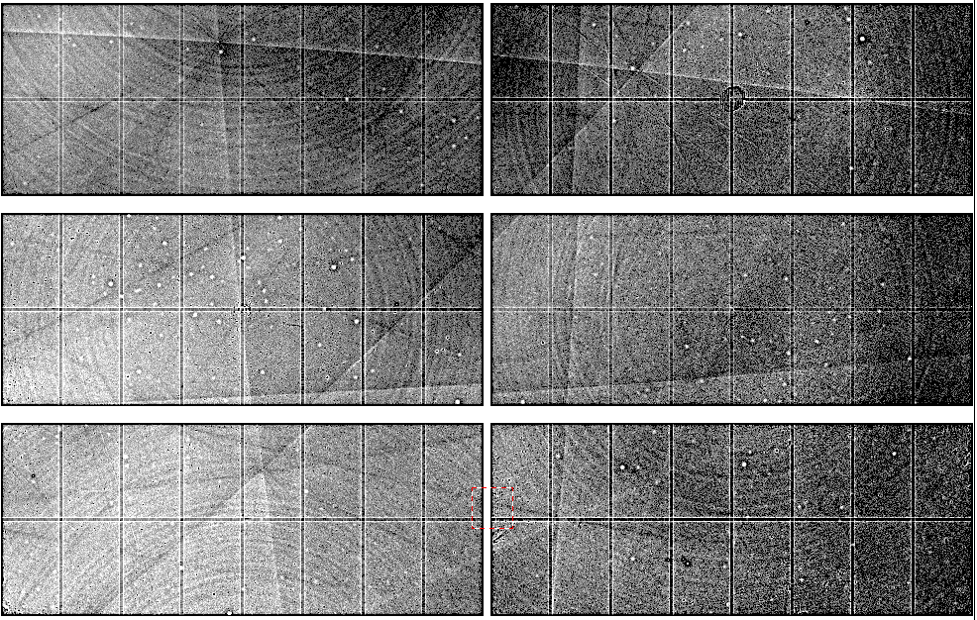
Native element phasing requires better detectors
Bragg
glitch
“tree rings”
Pick-up tool mark
oxygen
inclusions
1% high
average
1% low

Slide 5
Threshold of a revolution in phasing
CCD
& early PADs
new PADs
(uncalibrated)
Goal
Solve-able proteins (%)
Required signal-to-noise (I/σ)

Slide 6
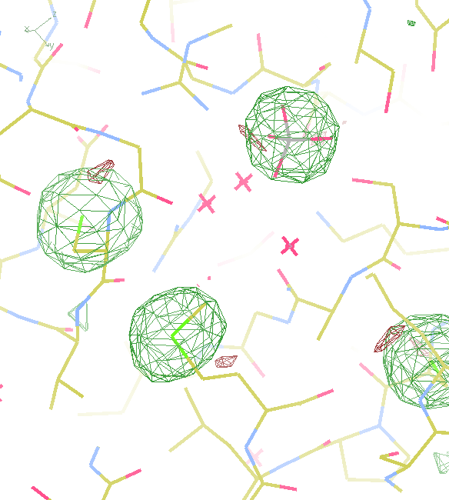
A
B
15σ = PO₄
18σ = S
16σ = S
8.2σ = Na
DELFAN
residual anomalous difference
Phased anomalous difference

Slide 7
2472.7 2473.5
Anomalous f” (electrons)
Photon Energy (eV)
Bohic et al. Anal. Chem. 2008; 80(24):9557. doi: 10.1021/ac801817k

Slide 8
Single-spot limit
CCD
& early PAD
Solve-able proteins (%)
Required signal-to-noise (I/σ)

Slide 9
Si(111)
52.87deg
Si(111)
2 Multilayer mirrors
d=2nm, W/B4C
KB Horiz focus
KB vertical focus
Si(111)
Detector
Detector
λ = 5 Å
h,k,l
sample
injector
-h,-k,-l
Si(111)
Detector
Detector
~ 1m
Si(111)
Si(111)
Notes:
Proposed 5-crystal monochromator for colliding-beam crystallography. The generation of two opposing Ewald spheres means that for every h,k,l index reflected from the protein crystal, the Friedel mate is reflected in the opposite direction, allowing for very accurate anomalous difference measurements. The wavelength need not be set precisely at the sulfur or phosphorous edge, but merely at a wavelength where the f” of those elements are strong. For fs-class pulses, the distances above will have to be precise to withing ~3 microns, and for accurate reproduction of the partiality of the Friedel mates, the angular precision of the colliding beams must be within ~1% of the sample crystal’s rocking width, or ~100 microrads.

Slide 10
(h,k,l)
Ewald sphere 2
λ*
diffracted ray
d*
θ
λ*
λ*
θ
d*
diffracted ray
λ*
Ewald sphere
1
(-h,-k,-l)

Slide 11
Grand Challenges in Structural Biology
Current MX success rate: 2-4%
Phase Problem
use native material
Amplitude Problem
aka “disorder”
R-factor Gap
Information content of data vs models

Slide 12
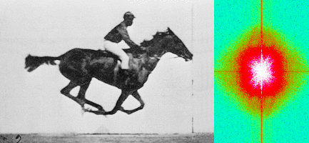
Muybridge’s galloping horse (1878)
“Time-resolved” diffraction
Real space
reciprocal

Slide 13
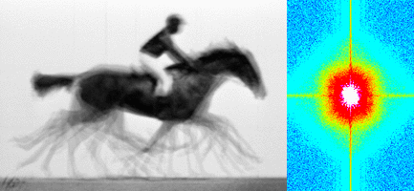
Muybridge’s galloping horse (1878)
Average electron density
Real space
reciprocal

Slide 14
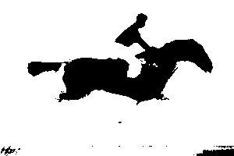
Muybridge’s galloping horse (1878)
1 “σ” contour level
Real space
reciprocal

Slide 15
lysozyme: real and reciprocal

Slide 16
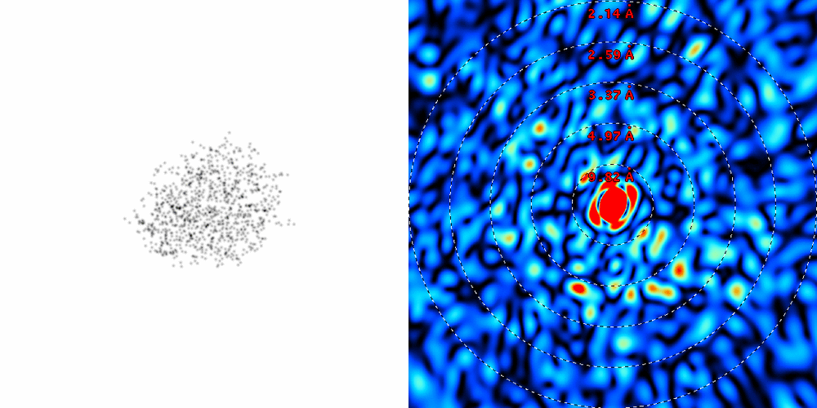
lysozyme: thermal motion
RMS displacement from B factors

Slide 17
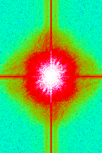
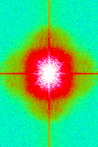
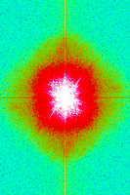
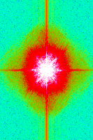
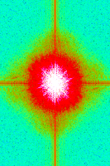
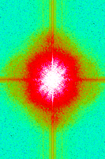
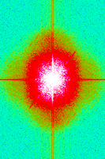
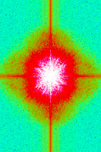
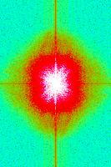
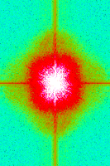
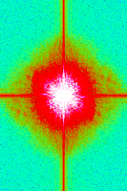
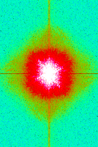
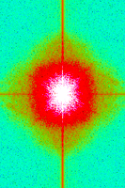
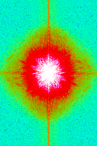
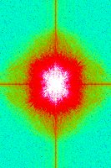
Supporting a model with data

Slide 18
Muybridge’s galloping horse (1878)
Average electron density
Real space
reciprocal

Slide 19
Grand Challenges in Structural Biology
Current MX success rate: 2-4%
Phase Problem
use native material
Amplitude Problem
aka “disorder”
R-factor Gap
… in the details

Slide 20
“R-factor Gap” for macromolecules
R_{merge} = 3%
R_{work} = 20%
R_{free} = 24%
Experimental
error
“systematic”
error
20% of carbon atom = 1.2 e⁻
5% of carbon atom = 0.3 e⁻
Closing the R-factor gap will enable study of 1-electron changes

Slide 21
“R-factor Gap” for macromolecules
Publication criterion for chemical crystallography:
R1 < 2*R_{sigma}
R1 = F_{o} vs F_{c} for I/σ(I) > 3
R_{sigma} = <σ(I)>/<I>
There are no PDB entries that pass this test!
Holton et al. (2014) "The R-factor gap", FEBS J. 281, 4046-4060.

Slide 22
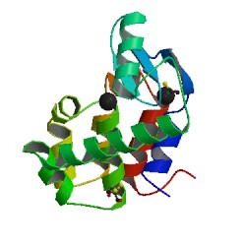
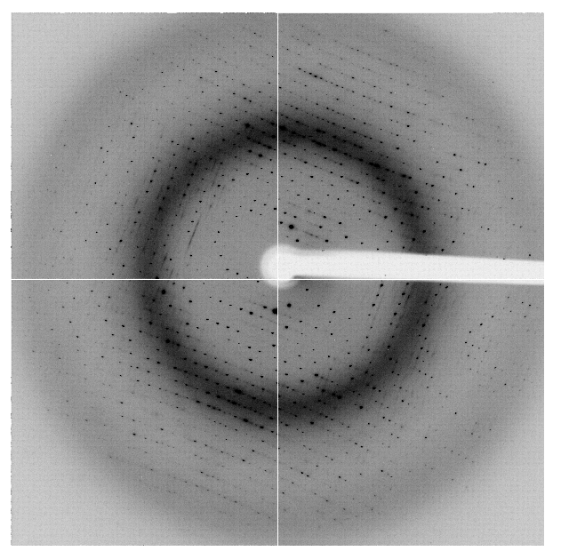
“R-factor Gap” for macromolecules
single-conformer PDB file
R_{merge} = 6%
R_{work} = 7%
R_{free} = 8%
MLFSOM
Elves
1H87; conf “A”
Holton et al. (2014) "The R-factor gap", FEBS J. 281, 4046-4060.

Slide 23
“R-factor Gap” for macromolecules
multi-conformer PDB file
R_{merge} = 6%
R_{work} = 17%
R_{free} = 20%
MLFSOM
Elves
1H87
Holton et al. (2014) "The R-factor gap", FEBS J. 281, 4046-4060.

Slide 24
“R-factor Gap” for macromolecules
multi-conformer PDB file
R_{merge} = 6%
R_{work} = 7%
R_{free} = 8%
MLFSOM
Elves
1H87
Holton et al. (2014) "The R-factor gap", FEBS J. 281, 4046-4060.

Slide 25
“R-factor Gap” for macromolecules
MX data quality is not limiting
Hypotheses:
Hidden systematic error?
Model-building problem?
Representation problem?

Slide 26
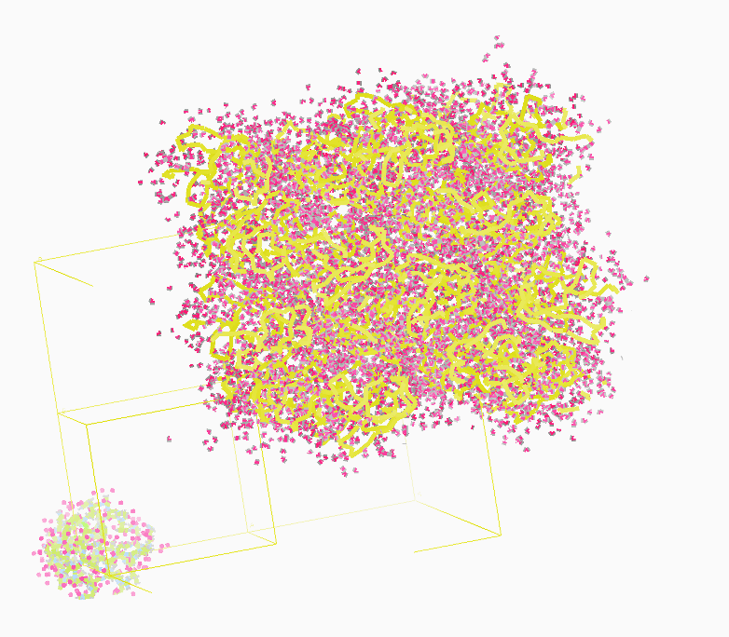
Molecular Dynamics Simulation
using real
crystal’s lattice
1aho
Scorpion toxin
0.96 Å resolution
64 residues
Solvent: H₂0 + acetate
Room temperature
Cerutti et al. (2010).J. Phys. Chem. B 114, 12811-12824.

Slide 27
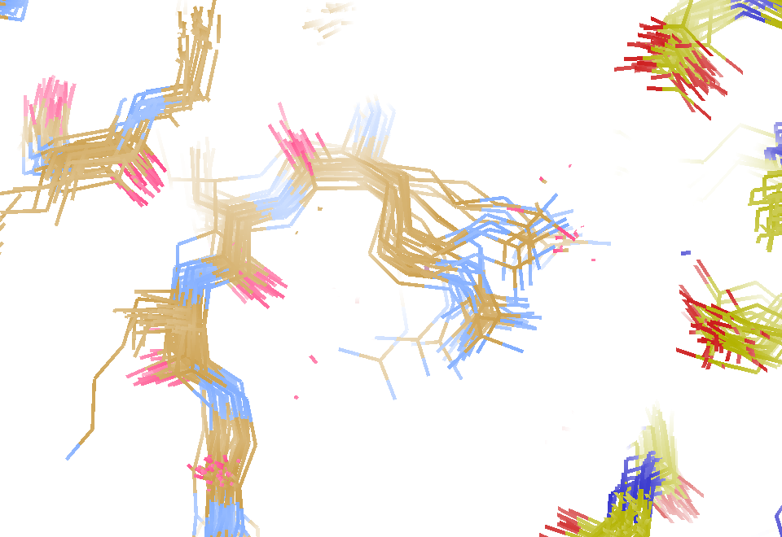
MD simulation: 30 conformers from 24,000
Cerutti et al. (2010).J. Phys. Chem. B 114, 12811-12824.

Slide 28
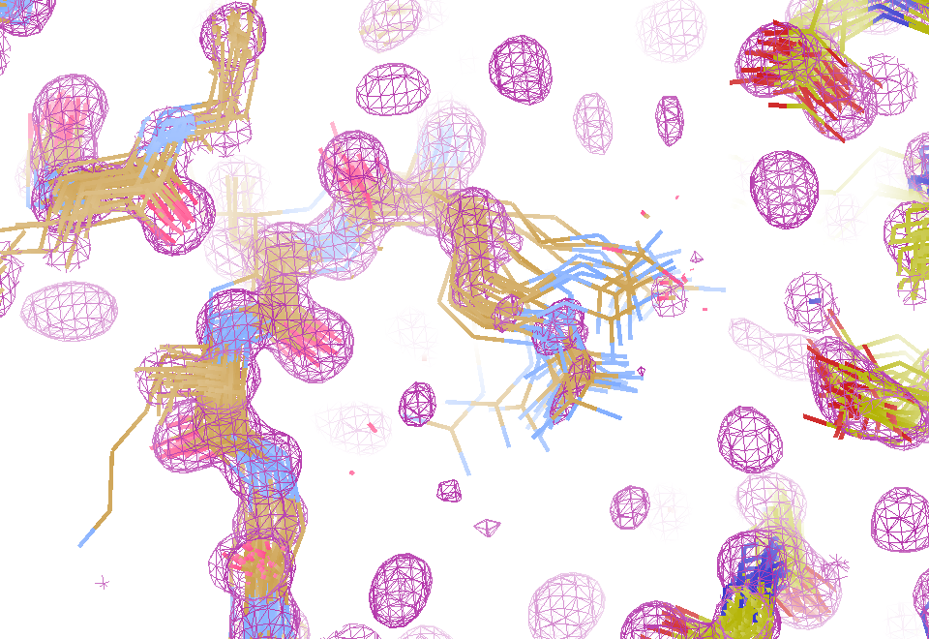
Electron density from 24,000 conformers

Slide 29
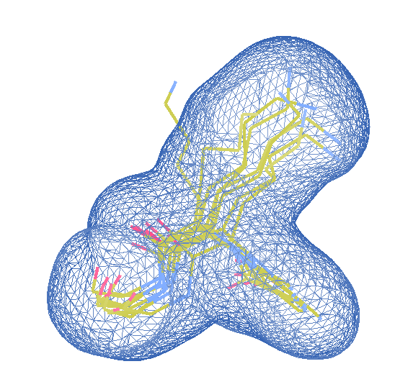
How many “conformers” are needed?
Answer: 8
R_{work} = 0.0297
R_{free} = 0.0293
vs F_{sim}

Slide 30
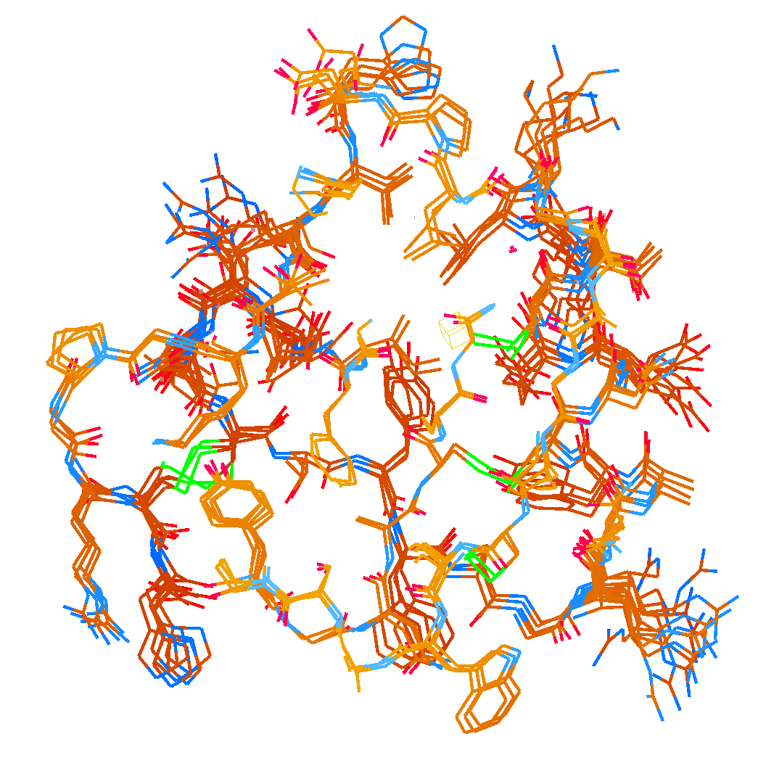
How many “conformers” are needed?
Answer: 2-14
R_{work} = 0.0441
R_{free} = 0.0516
vs F_{sim}
No solvent!

Slide 31
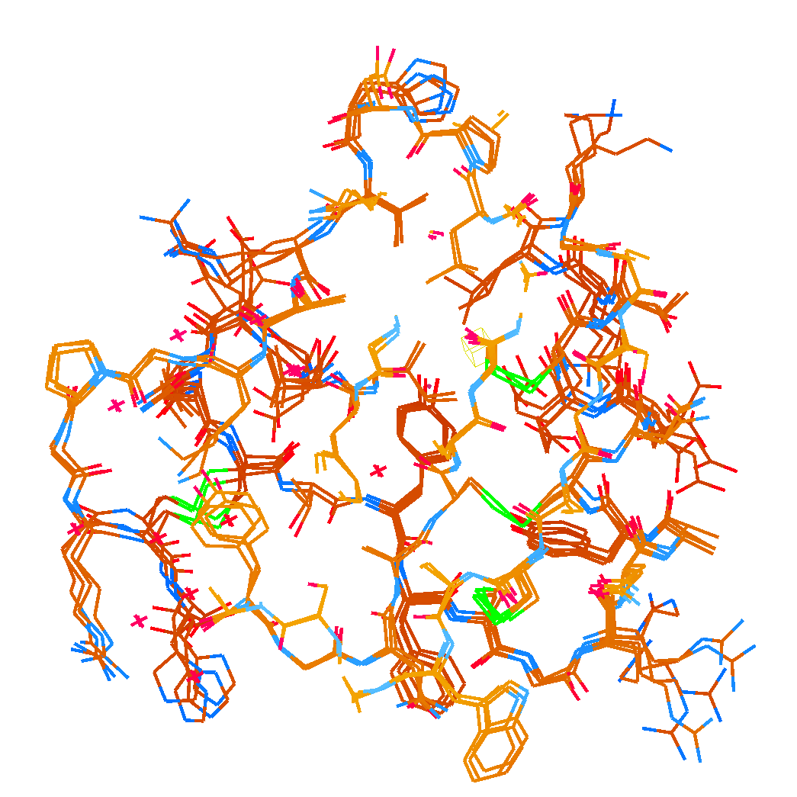
How many “conformers” are needed?
Answer: 1-7
R_{work} = 0.1546
R_{free} = 0.1749
vs F_{obs}
as deposited:
R_{work} = 0.203
R_{free} = 0.224

Slide 32
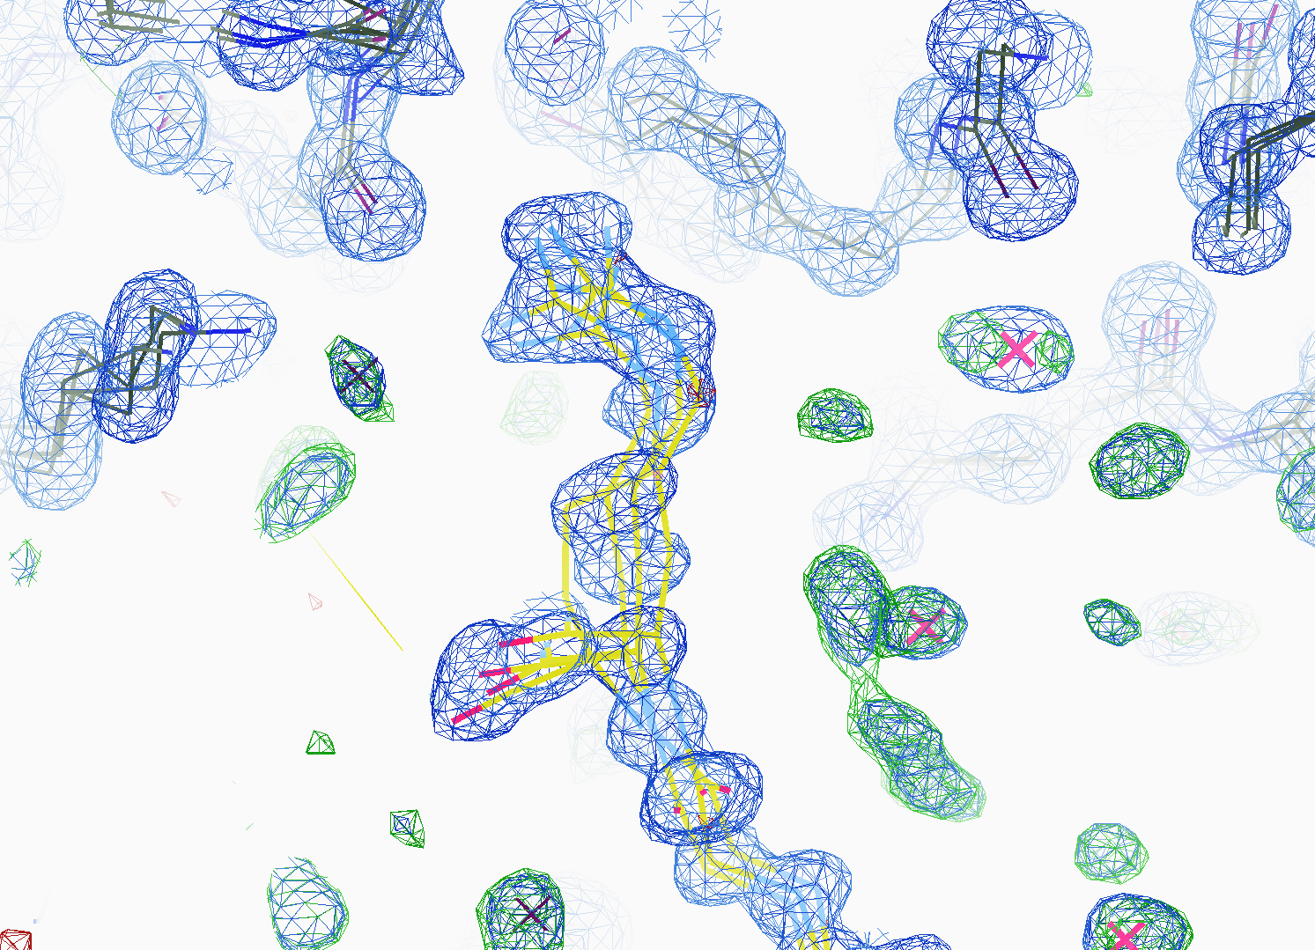
How many “conformers” are needed?
All difference
features
are in
the solvent!
X-ray data

Slide 33
Grand Challenges in Structural Biology
Phase Problem
better detector calibration
soft X-ray data collection
Amplitude Problem
Revolution in sample handling
Models for “disorder”/function
R-factor Gap
Quantum leap in model building
Improved solvent models
Generalized dynamical representation

Slide 34
Funding opportunities?
Phase Problem
Collaboration with detector group?
SINBAD colliding-beam diffractometer
Amplitude Problem
“Big Data” - Image Deposition Database?
Joint Structure – Function methods dev
R-factor Gap
International competitions
Large scale MD simulation
Pan-scale model development
Solar-powered desalination (mangroves?)

Slide 35
MLFSOM simulation

Slide 36
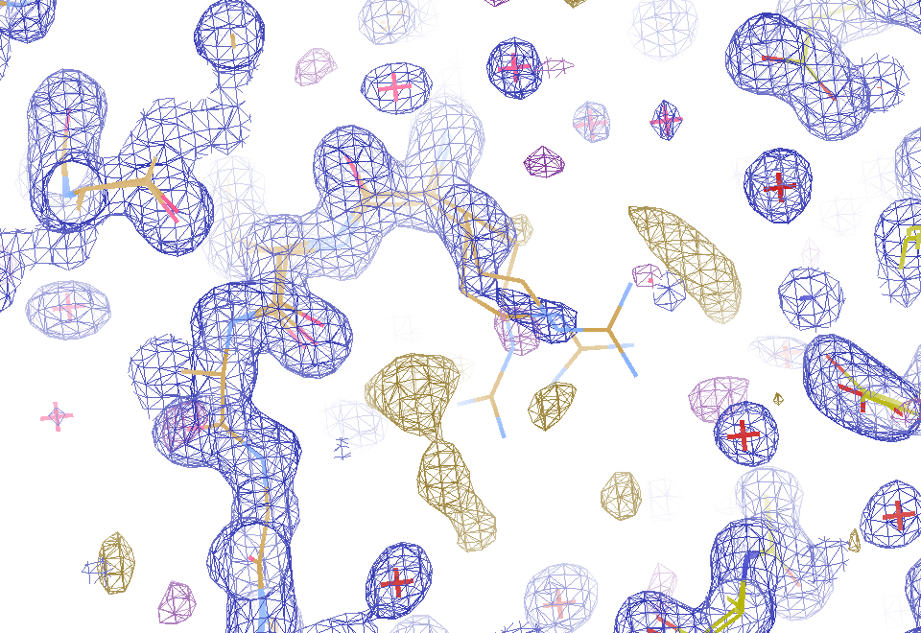
2F_{sim}-F_{calc} and F_{sim}-F_{calc} maps
1.0 Å data
R_{work} = 0.137
R_{free} = 0.159
1 “sigma” 2F_{sim}-F_{c}
2.5 “sigma” F_{sim}-F_{c}

Slide 37
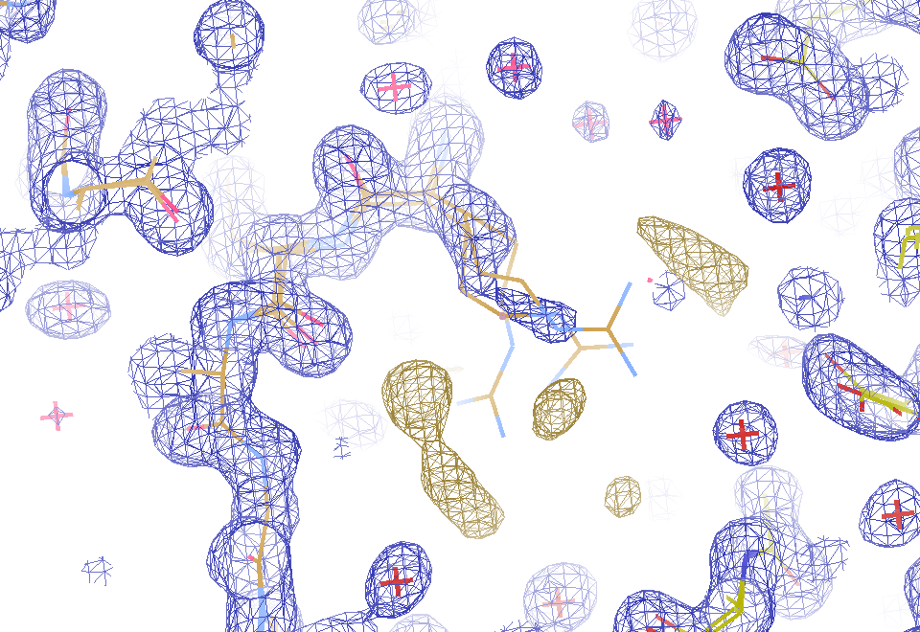
2F_{sim}-F_{calc} and (F_{sim} Φ_{sim}) - (F_{calc} Φ_{calc}) maps
1.0 Å data
R_{work} = 0.137
R_{free} = 0.159
1 “sigma” 2F_{sim}-F_{c}
F_{right} – (2F_{sim}-F_{c})

Slide 38
MD simulation: 30 conformers from 24,000
Cerutti et al. (2010).J. Phys. Chem. B 114, 12811-12824.

Slide 39
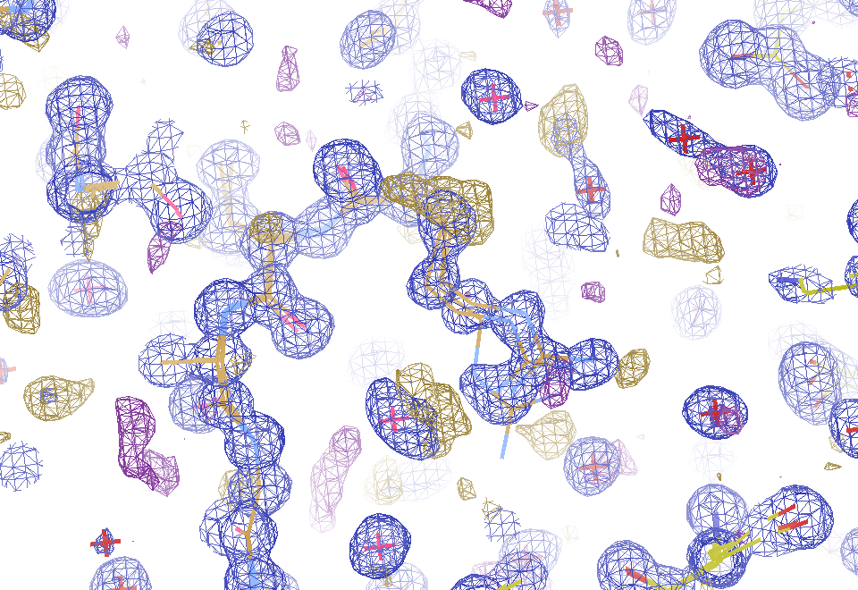
Conventional model vs X-ray data
1.0 Å data
R_{work} = 0.116
R_{free} = 0.135
1 “sigma” 2F_{obs}-F_{c}
2.5 “sigma” F_{obs}-F_{c}

Slide 40
Conventional model vs F_{sim}
1.0 Å data
R_{work} = 0.137
R_{free} = 0.159
1 “sigma” 2F_{sim}-F_{c}
2.5 “sigma” F_{sim}-F_{c}

Slide 41
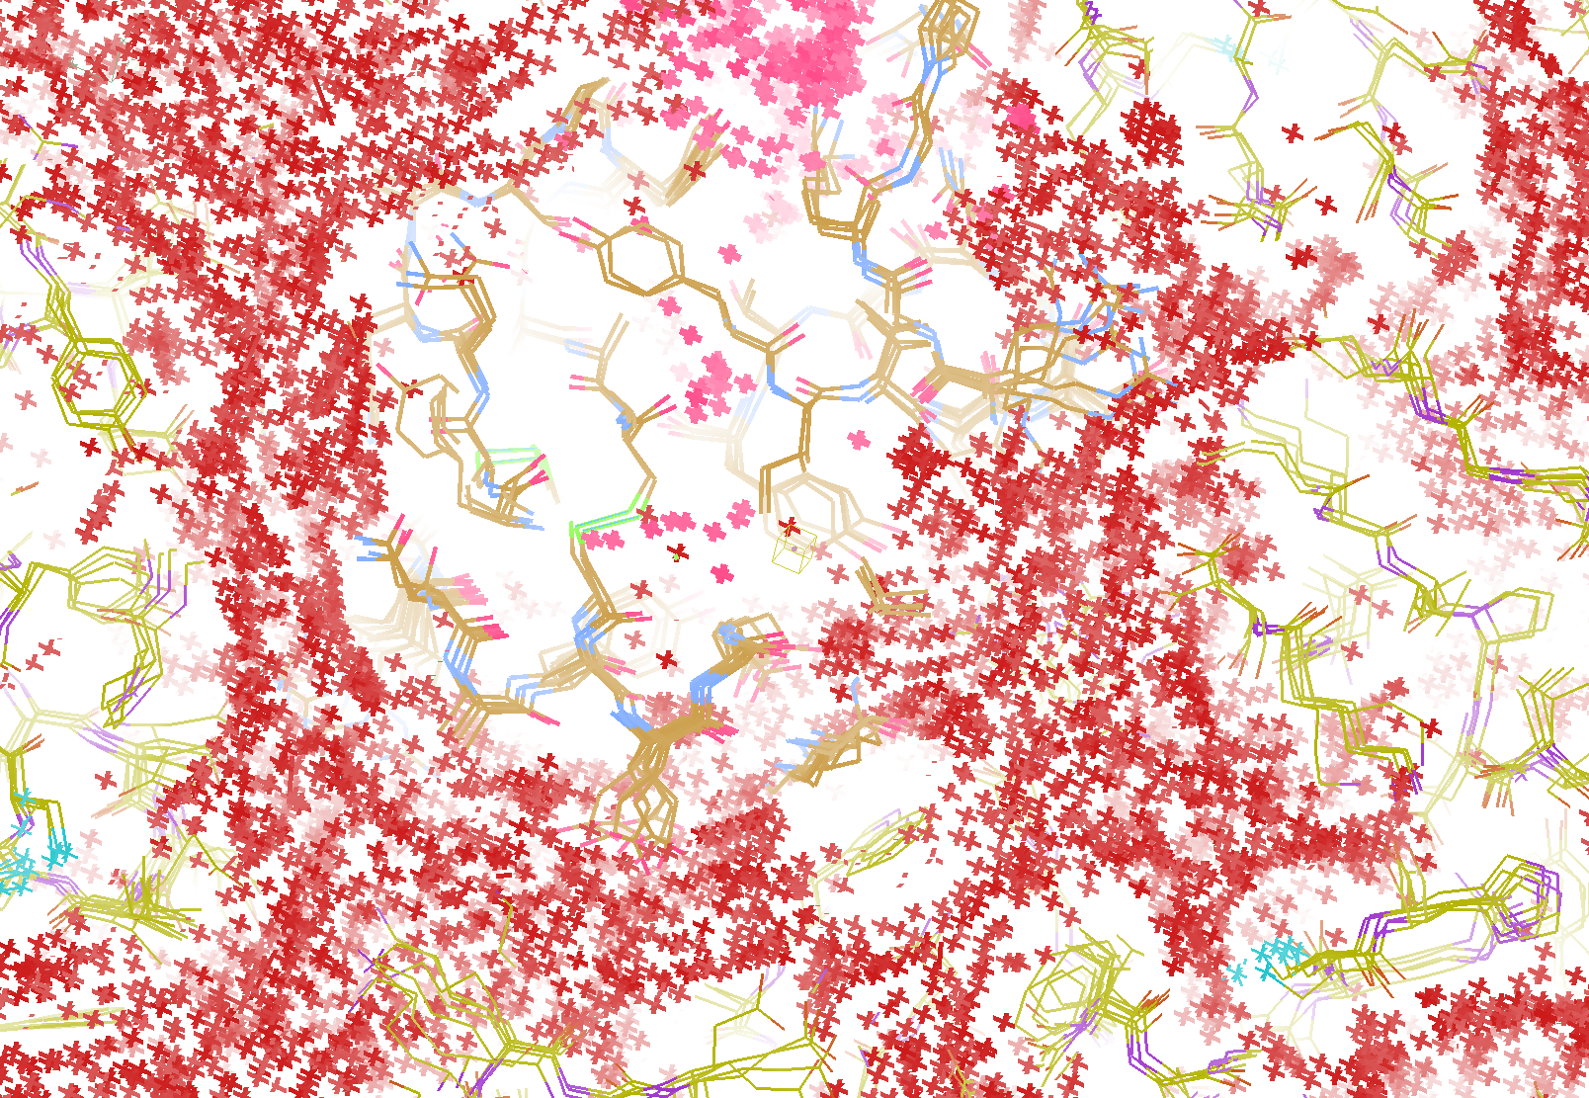
How do you model solvent?
R_{work} = 0.0309
R_{free} = 0.0678
vs F_{sim}
Problem: diverges with more cycles

Slide 42
RISM model for “bulk” solvent
Method | R_{work} | R_{free}
Default refmac5: flat bulk solvent | .1784 | .1898
RISM – self-consistent density field based on electrostatics | .1640 | .1808
Explicit MD solvent, protein fixed | .1523 | .1690
RISM – protein fixed multi-conformer weighted | .1578 | .1739
Explicit – protein fixed multi-conformer weighted | .1440 | .1666

Slide 43
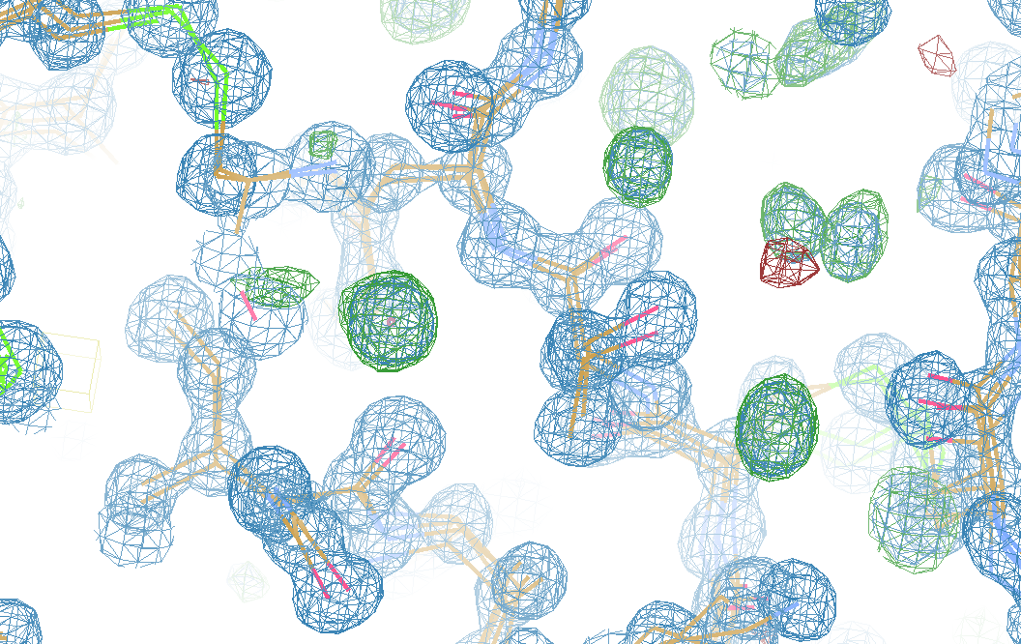
What is “still missing”?

Slide 44
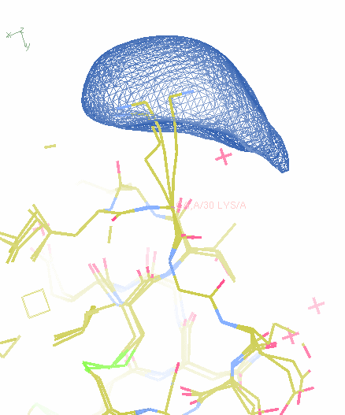
What if we knew “everything”?
How to
describe it?

Slide 45
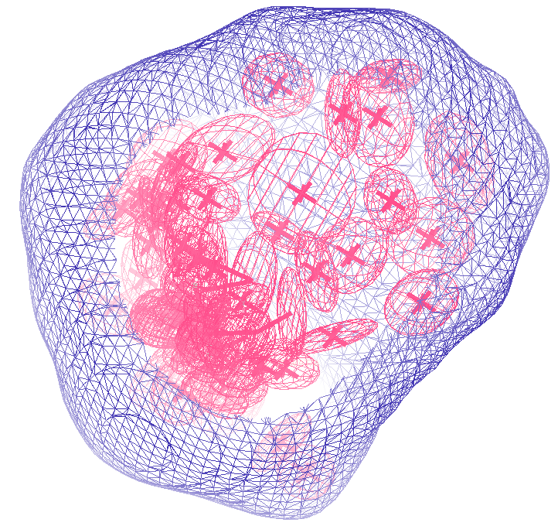
How many “conformers” are needed?
Answer: 40
R_{work} = 0.0506
R_{free} = 0.0556
vs F_{sim}

Slide 46
Molecular Dynamics Simulation
using real
crystal’s lattice
1aho
Scorpion toxin
0.96 Å resolution
64 residues
Solvent: H₂0 + acetate
Room temperature
Cerutti et al. (2010).J. Phys. Chem. B 114, 12811-12824.

Slide 47
Electron density from 24,000 conformers

Slide 48
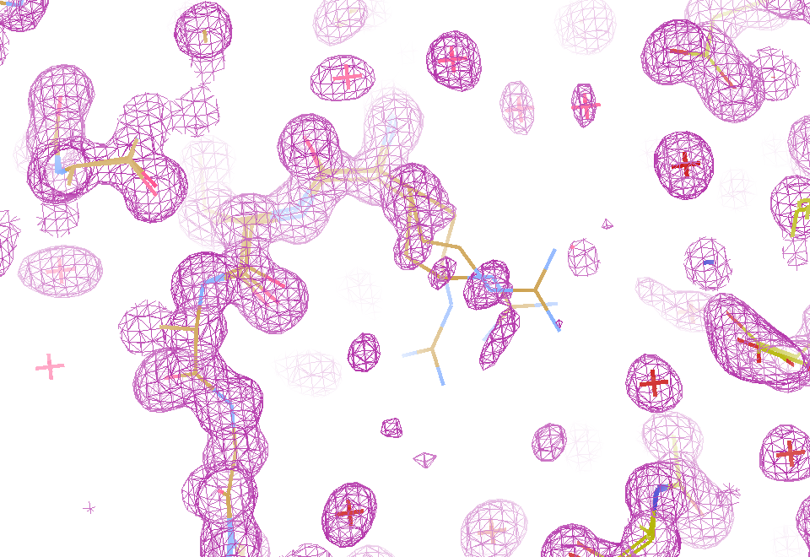
Electron density from 24,000 conformers

Slide 49
How many waters are there?
R_{free} : F_{sim} vs F_{obs} (%)
Water molecules / unit cell

Slide 50
How many waters are there?
R_{free} : F_{sim} vs F_{obs} (%)
Water molecules / unit cell

Slide 51
Supporting a model with data

Slide 52
Table 1: Spatial Heterogeneity dominates all other sources of error in diffraction simulations
Source of error | realistic simulation | No SHSSS | Perfect detector
Photon counting | + | + | +
Shutter jitter | + | + | -
Beam flicker | + | + | -
Sample absorption | + | + | -
Radiation damage | + | + | -
Imperfect spindle | + | + | -
vignette | + | + | -
Corner correction | + | + | -
SHSSS | + | - | -
R_{meas} (∞-10 Å) | 2.8% | 0.7% | 0.7%
I/σ asymptotic | 26.8 | 74.2 | 81.0

Slide 53
How do you model solvent?
Electron number density (e⁻/Å³)
x along line y=z=0 (Å)

Slide 54
How do you model solvent?
Electron number density (e⁻/Å³)
x along line y=z=0 (Å)

Slide 55
How do you model solvent?
Electron number density (e⁻/Å³)
x along line y=z=0 (Å)

Slide 56
How do you model solvent?
Electron number density (e⁻/Å³)
x along line y=z=0 (Å)

Slide 57
How do you model solvent?
Electron number density (e⁻/Å³)
x along line y=z=0 (Å)

Slide 58
Solvent boundary problem

Slide 59
Solvent boundary problem

Slide 60
Solvent boundary problem

Slide 61
Solvent boundary problem

Slide 62
Current implementation

Slide 63
Better implementation?

