Slide 1
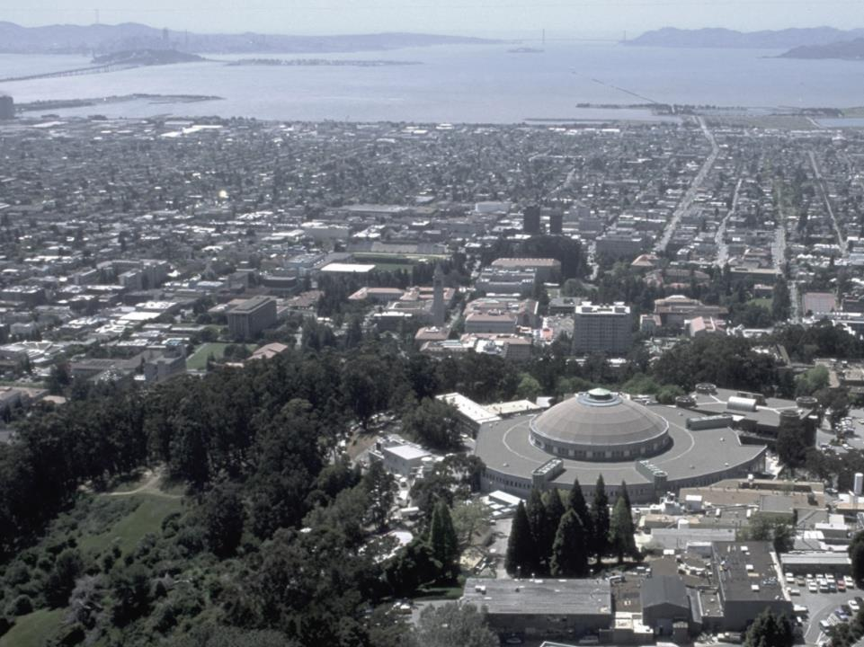
BioSci @ Advanced Light Source
8.2.1
MX
Berkeley
Center for
Structural
Biology MX
8.2.2
8.3.1
UC
SF
8.3.2
TomAlberTron
MX
Micro -CT
5.0.2
5.0.3
5.0.1
5.4 infrared
MBC 4.2.2
MX
ALS
Biosciences
2023
3.2.1 XFP
12.3.1 SIBYLS SAXS
2.1 NCXT
2.0.1 Gemini MX

Slide 2
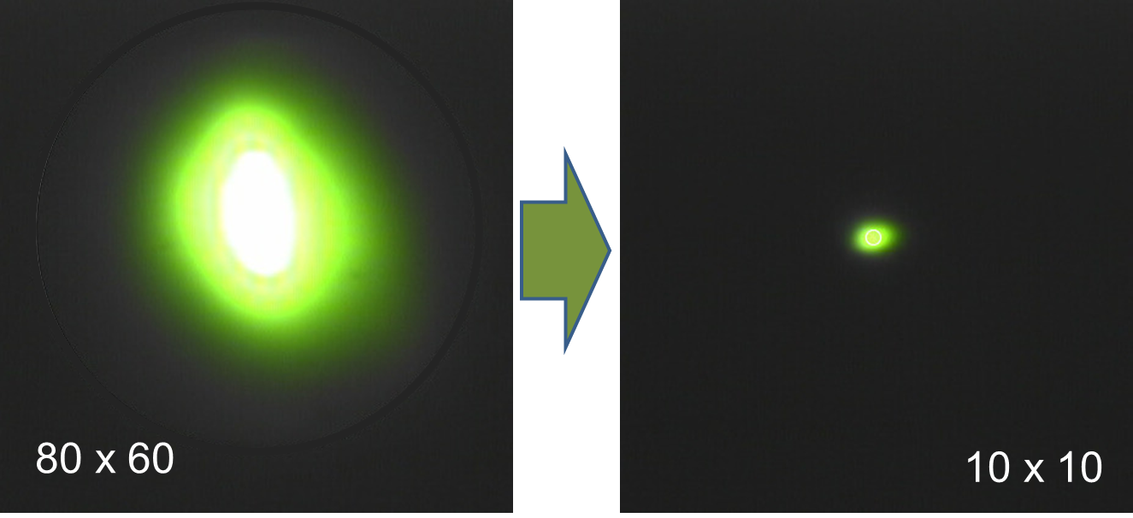
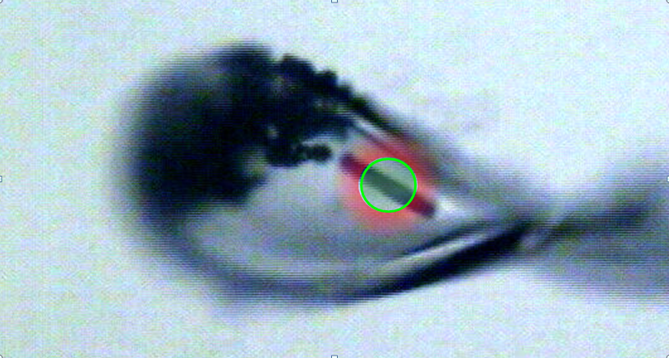
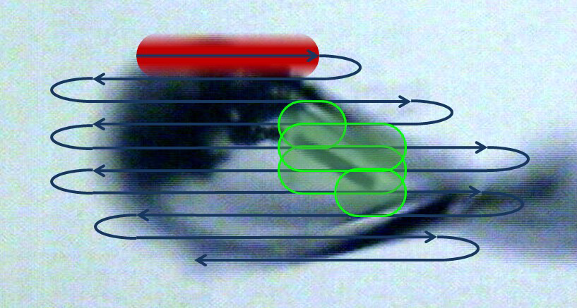
Why small beam? : 100x information Rad dam correction, accurate drug imaging, time resolution
Old way
Average image
Radiation damage uncorrectable
increases with time
Bits ~ 1/size²
Time & space info for damage correction
New way
$650M to make the beam smaller
MBIB

Slide 3
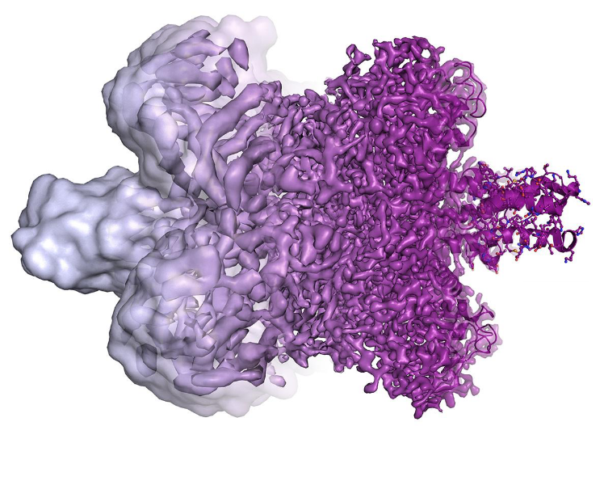
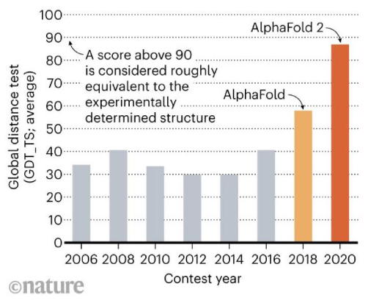
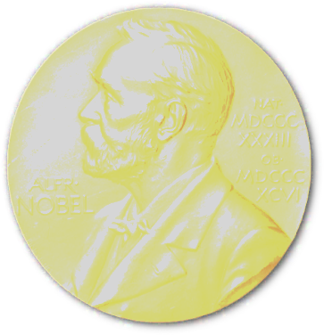
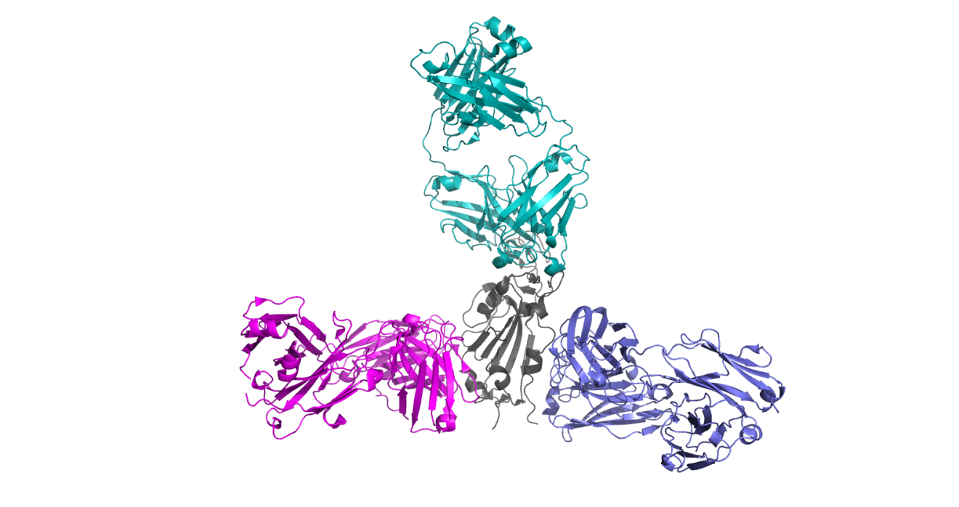
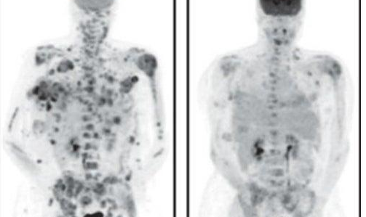
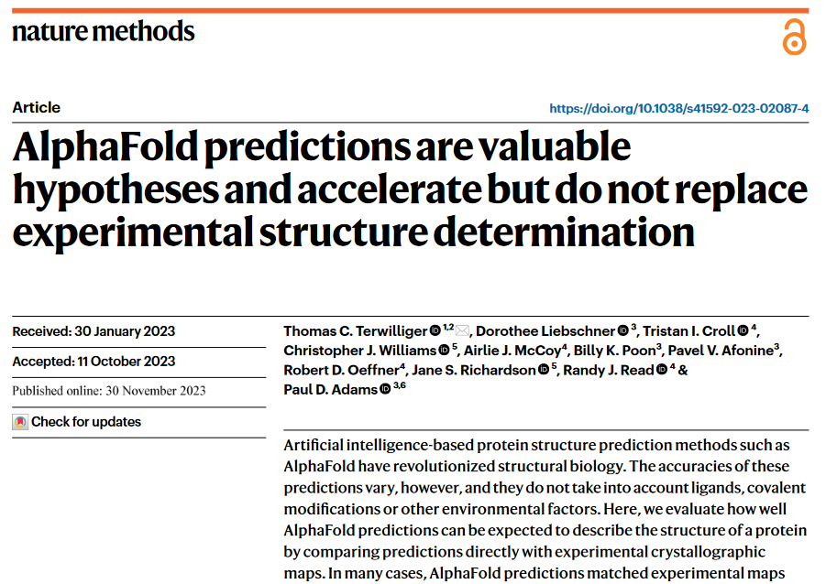
ALS Bioscience Highlights & Future
6
8.3.1
6
Cryo
EM
2
SLS
Doudna
CRISPR PDBs
EM “Resolution Revolution”
Structure Prediction Revolution
COVID-19
Antibodies
& Drugs
Director’s
Award
Drugs for cancer HIV & more

Slide 4
ALS-U : default outcome for Biosciences
Trucks driving through work area
Re-run 20 years of cabling
$650M spent
> 1 year downtime
40 cm move

Slide 5
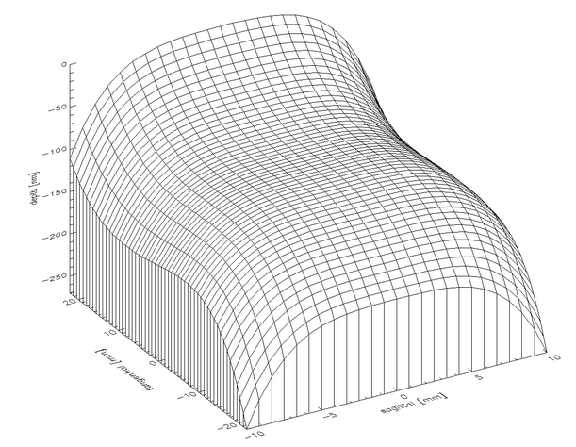
Mono xtal surface impacts slope errors

Slide 6
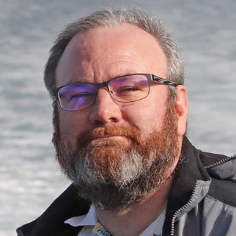
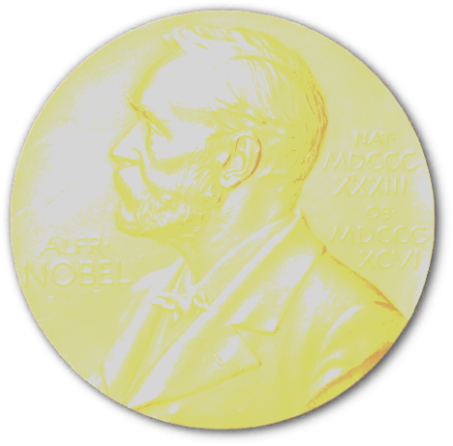
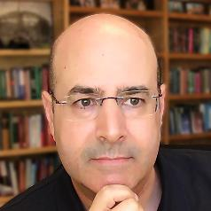
Crystallography: best tech for visualizing chemistry of biology ligands, metabolites & engineering function
High-profile programs at ALS PX beamlines
30x brightness possible @ALS-U
current optics: less intensity at ALS-U
Better optics are now possible!
Atomic resolution imaging of:
metabolites – JBEI, JGI
engineering function – JBEI
Nanomaterials – MF
Physiological temperature
CRISPR structures
ALS
8.3.1
cryoEM
SLS
wide range of uses
diverse community
free to academic
>170 pubs/year
$650M to make the beam smaller
MBIB
ALS
Notes:
Small beam → more information – less blurring in time & space
Potentially 5x performance @ALS

