Slide 1
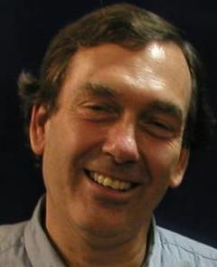
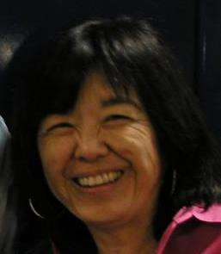
What is ALS Beamline 8.3.1 ?
Macromolecular Crystallography (MX)
Multi-wavelength to solve phase problem
Technology development
Unique variable temperature capabilities
Staff: Holton, Meigs, Tanamachi
Landmark and highly productive facility
1st ALS SuperBend beamline – constructed 2001
1 of 10 in USA with >1000 PDBs/10 years running
Others: 2 at SSRL, 7 at APS
8% of all membrane protein structures
996 distinct users from 57 institutions
1407 structures, 636 pubs, 227 high-impact
45% MRPI
20% MRPI
Notes:
ALS 8.3.1 is a very productive facility. Our focus is on maximizing efficiency of the user experience.
The MRPI funds are not just to maintain this facility, but to upgrade it. The new detector is 50x faster, more sensitive and more accurate than the existing detector, and an optics upgrade will match these capabilities.
We will exceed the modern standard of screening and data collection by offering completely automated mail-in raster-based screening
This will position ALS 8.3.1 as the centerpiece of structural biology for the UC system

Slide 2
What is “MRPI”?
Multi-campus Research Programs and Initiatives
Offered by: UC Office of Research and Graduate Studies
Wide range of fields
Nanotech, Arts, Climate, Gender Studies, Sustainability, Health
Total Budget: $9.5M, we got $2.6M
ALS 8.3.1 MRPI Project Goals:
Upgrade ALS 8.3.1 to latest technology
Open up access to all UC structural biology labs
Transition to sustainable funding sources
Notes:
Brief description of what MRPI is. The University of California seeks to support collaboration between campuses in ways that benefit the entire system the most.
Funding was very limited, and it is extremely remarkable that we got this and our budget was not cut.

Slide 3
ALS 8.3.1 total funding: July 2017
Inter-
Agency
Agreement
UC
Office of the
President
MRPI
$140k
$405
R01 GM124149
$217k
$145k
LBNL
full-cost recovery
Plexxikon
Inc.
$240k
Sandler
$0
$156k
LBNL sub-contract
original direct costs: $1.2M
Now $700K after cost-saving measures
Notes:
Estimated Direct-cost balance of accounts supporting operations at ALS 8.3.1. The National Institutes of Health has been very supportive including my first R01 that will be awarded imminently. Plexxikon is an Emeryville-based pharmaceutical company that has been supporting us for 15 years and has an ongoing 5-year contract. UCSF has also put up internal funds with the help of the Sandler Foundation, but the entire UC system has contributed MRPI (Multi-Campus Research Programs and Initiatives). This unfortunately only allows direct costs, and we thank the LBNL directorate for making $240k available for full-cost recovery, but this account will be depleted in September 2017. This is what we must renew if MRPI is to continue into its final year, ending Dec 2018.

Slide 4
On-site users from new campuses
Fisher, Andrew | UC Davis
Wilson, David | UC Davis
Matthews, Melissa | UC Davis
Hurlburt, Nicholas | UC Davis
Lal, Neeraj | UC Davis
Feng, Yinghui | UC Davis
Liu, Yuandong | UC Davis
Monteleone, Leanna | UC Davis
McPherson, Alex | UC Irvine
Egea, Pascal | UCLA
Jose Rodriguez | UCLA (Aug 25)
Podust, Larissa | UC San Diego
Pereira, Caibe Alves | UC San Diego
Rubin, Seth | UC Santa Cruz
Tripathi, Sarvind | UC Santa Cruz
Marceau, Aimee | UC Santa Cruz
Guiley, Keelan | UC Santa Cruz
Partch, Carrie | UC Santa Cruz
Goularte, Nicolette | UC Santa Cruz
Luu, Jansen | UC Santa Cruz
Liban, Tyler | UC Santa Cruz
Heisler, Joel | UC Santa Cruz
Liwang, Andy | UC Santa Cruz
Parameshwaran, Ramanan | UC Santa Cruz
Fedechkin, Stas | UC Santa Cruz
Notes:
Since access to 8.3.1 was opened up by the MRPI award, a growing number of new users have been coming to 8.3.1. Those shown here have been on-site and traveled to LBNL to use the facility. Now that we have remote operation capabilities we expect this list to grow sharply.

Slide 5
MRPI–supported technical highlights
What was made possible by the first $240,000?
Dectris Pilatus3 6M installed - May 2016
Faster, lower noise, better data
Complete control system update
New data collection methods
Overhaul of data archiving infrastructure
New hardware and methods produce 10x more data
First remote data collection – Apr 2017

Slide 6
Molecular motor at atomic resolution
Oren Rosenberg UC San Francisco
Long-time 8.3.1 user makes good: Chan-Zuckerberg funding
Rosenberg O. S. et al. (2015). Cell 161, 501
Notes:
Oren Rosenberg has been using ALS 8.3.1 to collect his MX data since before he became faculty at UCSF. He has been a very productive researcher and occasionally direct collaboration with ALS 8.3.1 staff has resulted in co-authored publications such as this one. Rosenberg just recently was designated a Chan-Zuckerberg researcher and considers 8.3.1 an irreplaceable resource vital to his ongoing work. We look forward to continuing that relationship.

Slide 7
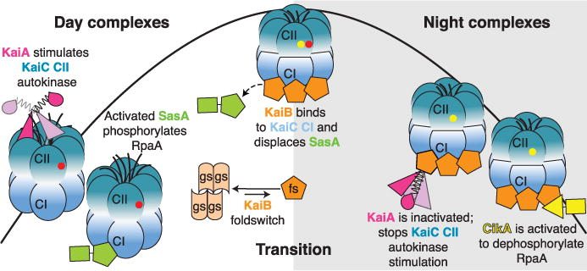
Bacterial circadian clock revealed
Carrie Partch UC Santa Cruz
New MRPI user, high-profile paper, enabled by 8.3.1
Tseng, et al. and C. L. Partch (2017). Science 355(6330): 1174-1180.
Notes:
It takes an average of 18 months after data collection before papers make it into print. So we are just now seeing our first MRPI users publishing high-profile papers. An excellent example is Dr. Partch’s work revealing circadian rythms at the bacterial level.

Slide 8
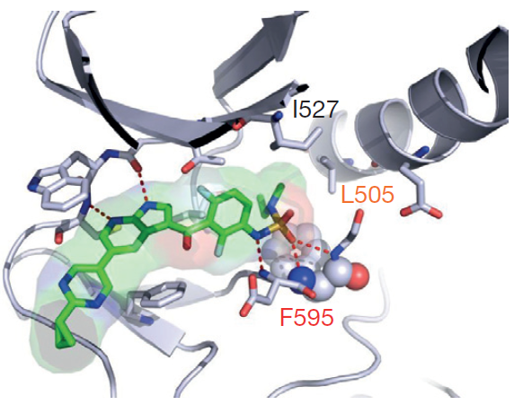
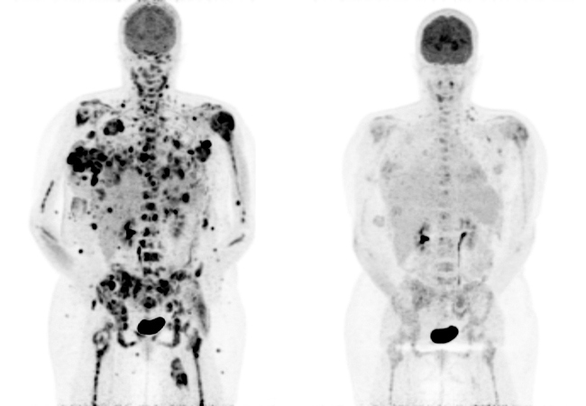
Cure for Cancer
Zelboraf® for BRAF positive metastatic melanoma
PLX3397 for Tenosynovial Giant Cell Tumor (TGCT)
15
days
→
Near-exclusive use of 8.3.1, $935M justification for MRPI
Zhang C, et al. (2015) Nature. 526, 583-6.
Notes:
The title may sound ostentatious, but we really did play a central role in finding a cure for one very nasty type of cancer. This was one of the few clinical trials that was stopped early so that the patients in the control group could be treated. Plexxikon now has a promising new candidate for TGCT, and still others in the pipline. I mention this here because Plexxikon almost exclusively uses ALS 8.3.1, and we have a 16-year relationship with them. The sale of Plexxikon to Daiichi Sankyo brought nearly $1B into the California economy, and was a significant justification for the MRPI program.

Slide 9
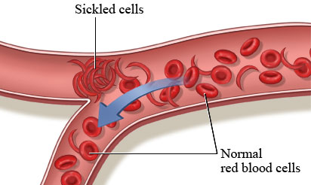
First drug for sickle cell disease?
Industrial use of 8.3.1, major global health impact
Metcalf, B., C. et al. (2017). ACS Med. Chem. Letters 8(3): 321-326.
Notes:
Plexxikon is not our only industrial partner. Global Blood will soon appear in LBL Today and other news media because they not only developed but released into the public domain what could be the first “drug” for sickle cell anemia, a historically important but surprisingly neglected disease. Global Blood preferes 8.3.1 because of our highly interactive setup for doing science on-the-fly as they collect data.

Slide 10
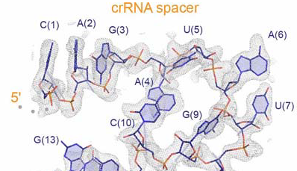
CRISPR-Cas complex
Jennifer Doudna UC Berkeley
MRPI user, multi-crystal technology - cornerstone of new P30
Knott, G. J. et al. Nature Struct. Mol. Bio. (accepted)
Notes:
MRPI is currently the only access mechanism UCB has for ALS 8.3.1. Not only is this an example of a new high-profile result for CRISPR, it is an excellent demonstration of the multi-crystal combinatorial merging technology that is enabling support grants like the P30, which does now allow for technology development.

Slide 11
Long-term funding plans
NIH support requested since MRPI
2016: P41 $7.0M, score = 26, deferred to P30
2017: P30 $1.8M score = 24, pending
New NIH PAR-17-045 R01s for technology development
Awards since MRPI start
IAA $750k awarded to LBNL
R01 $217k/y to Holton
LBNL indirect cost-saving plans
Move Meigs position to UCSF (pending P30)
Large equipment purchased by UCSF

Slide 12
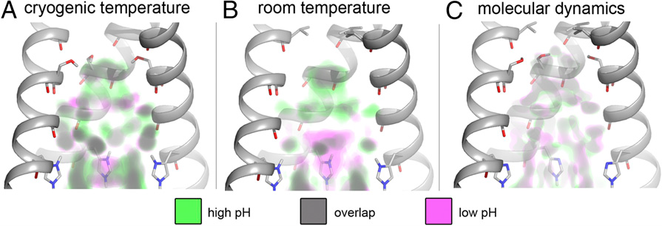
Influenza virus channel flow patterns visualized
William DeGrado UC San Francisco
8.3.1 multi-temperature capabilities and data accuracy
Thomaston, J. et al. (2015). PNAS 112(46): 14260-14265.

Slide 13
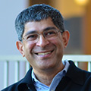
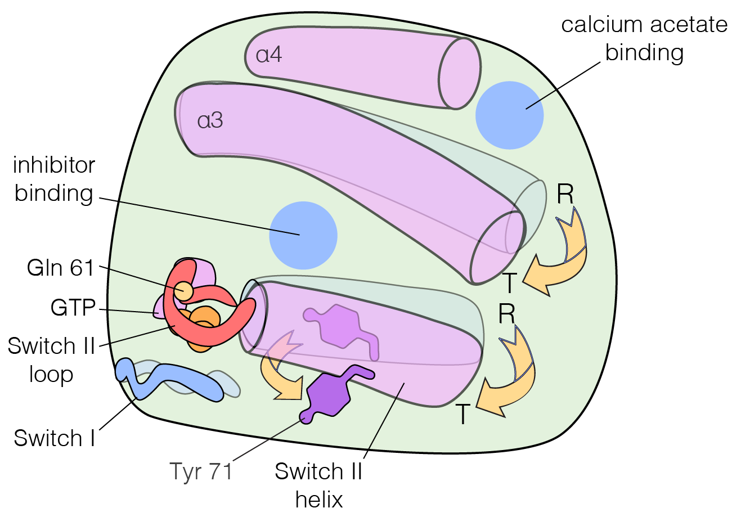
Ras switching mechanism revealed
John Kuriyan UC Berkeley
unique multi-temperature capabilities
Bandaru, P., N. H. et al. (2017). eLife 6: e27810.
Notes:
Ras is the first oncogene ever discovered and is at the root of modern cancer biology. Until now, noone had ever seen how it switches on and off. This requires that the molecule be observed at the temperature at which it operates. This is challenging because the crystals last 1/100th as long, but with the right equipment, strategies and support available at 8.3.1 we can now begin to mine the 100,000 cryo-structures in the PDB for their functional motions.

