Slide 1
University of California MRPI Multicampus Research Programs and Initiatives
Offered by: UC Office of Research and Graduate Studies
Wide range of fields: Nanotech, Arts, Climate, Gender Studies, Sustainability, Health
Total Budget: $9.5M / 2 years
2-4 year projects
We asked for: $2.6M / 4 years
Funded in full! One of only 2 science awards
Notes:
Brief description of what MRPI is. The University of California seeks to support collaboration between campuses in ways that benefit the entire system the most.
Funding was very limited, and it is extremely remarkable that we got this and our budget was not cut.

Slide 2
UCOP MRPI: LBNL sub-contract
What is full-cost recovery account paying for?
Proposed budget: Jan 2015 – Dec 2018
90% George Meigs
20% Jane Tanamachi
$80,000 / year equipment
$1,210,189 direct costs
Actual & planned: Sep 2015 – Dec 2018
45% George Meigs
20% Jane Tanamachi
25% Scott Classen for year 3
$100,000 back to UCSF for year 3
$693,417 direct costs
Notes:
Award was fully funded as of Jan 2015.

Slide 3
UCOP MRPI Award status
https://proposalcentral.altum.com
Notes:
Award was fully funded as of Jan 2015. LBNL delayed start until Sep 2015.

Slide 4
UCOP MRPI Budget
https://proposalcentral.altum.com
Notes:
Award was fully funded as of Jan 2015. LBNL delayed start until Sep 2015.

Slide 5
8.3.1 beam time distribution: 2017
Plexxikon
UC San Diego
5%
General User
Program
UC Davis
7.1%
7.1%
26.5%
UC Santa Cruz
25%
7.1%
UC Irvine
7.1%
9%
Staff/Development
7.1%
UCLA
9%
7.1%
18.5%
UC Berkeley

Slide 6
On-site users from new campuses
Fisher, Andrew | UC Davis
Wilson, David | UC Davis
Matthews, Melissa | UC Davis
Hurlburt, Nicholas | UC Davis
Lal, Neeraj | UC Davis
Feng, Yinghui | UC Davis
Liu, Yuandong | UC Davis
Monteleone, Leanna | UC Davis
McPherson, Alex | UC Irvine
Egea, Pascal | UCLA
Podust, Larissa | UC San Diego
Pereira, Caibe Alves | UC San Diego
Rubin, Seth | UC Santa Cruz
Tripathi, Sarvind | UC Santa Cruz
Marceau, Aimee | UC Santa Cruz
Guiley, Keelan | UC Santa Cruz
Partch, Carrie | UC Santa Cruz
Goularte, Nicolette | UC Santa Cruz
Luu, Jansen | UC Santa Cruz
Liban, Tyler | UC Santa Cruz
Heisler, Joel | UC Santa Cruz
Liwang, Andy | UC Santa Cruz
Parameshwaran, Ramanan | UC Santa Cruz
Fedechkin, Stas | UC Santa Cruz

Slide 7
Technical Highlights to date
What was made possible by first $240,000?
Dectris Pilatus3 6M installation - May 2016
25 Hz framing, 2 ms dead time, previously 0.3 Hz
0.8% calibration error, previously 2.5%
Repaired and re-installed 6 times, 10% replaced
Complete control system update
Shutterless data collection
“Rastering” automated sample alignment
Re-write 64k lines of code
Overhaul of data archiving infrastructure
LTO4 to LTO6, support USB3 user hard drives
First remote data collection – Apr 2017

Slide 8
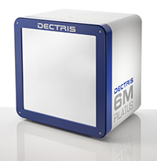
ALS 8.3.1: The 6th detector

Slide 9
ALS 8.3.1 data collection history
images x 10⁶

Slide 10
How does 8.3.1 help LBNL?
Visible, productive facility
“1000 structure club”
Unique capabilities
Room temperature data collection
In-situ data collection
Absorption contrast sample imaging
Unique ergonomics
Specialized for interactive science
Intuitive, streamlined workflow
High level of side-by-side support

Slide 11
Long-term funding plans
NIH support requested since MRPI
P41 $7.0M, score = 26, not funded at Council
P30 $1.8M score = 24, pending
Awards since MRPI start
IAA $750k awarded to LBNL
LBNL Indirect cost-saving plans
Move Meigs position to UCSF
Large equipment purchased by UCSF
Notes:
MRPI is not renewable
It was a temporary solution to enable ALS 8.3.1 to upgrade and justify renewable funding from NIH
Our X02 application was approved, and our full P41 was submitted
In summary, we expect to more than make up for the indirect costs incurred to the Lab my MRPI in our first few years of P41 funding.

Slide 12
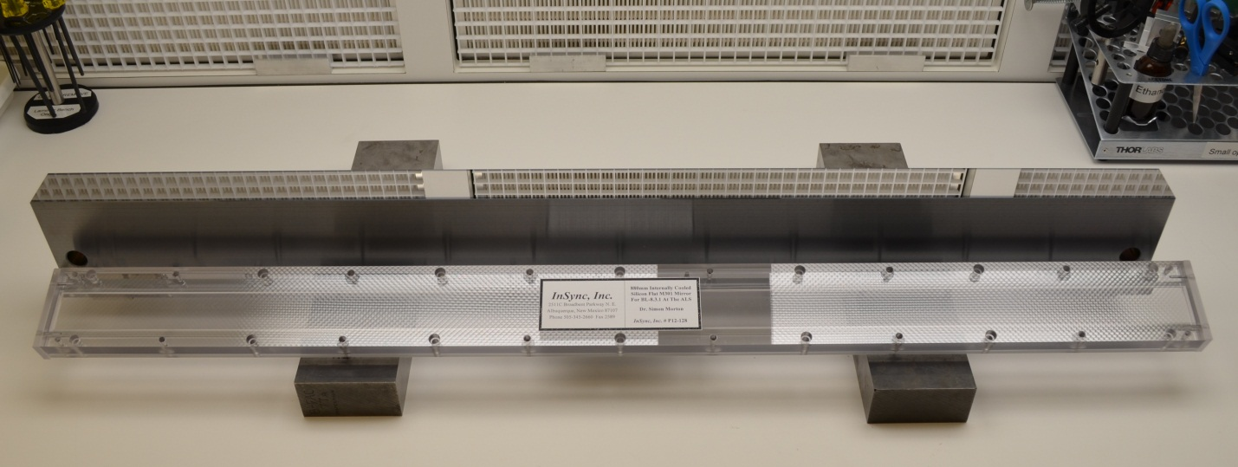
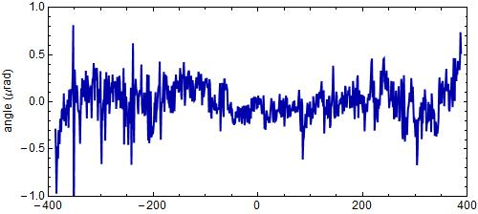
“The flattest thing we have ever seen”
Flux upgrade: 4.6x = 300s data sets
Old mirror: 800 nRad
New mirror: < 200 nRad
- LBNL Metrology Group

Slide 13
Getting ready for remote
“8-shooter” adjustable beam size
rotary
pinholes:
300
100
75
50
30
25
10
“small”

Slide 14
Threshold of a revolution in phasing
Current
technology
Goal
Solve-able proteins (%)
ALS 8.3.1
Required signal-to-noise (I/σ)

Slide 15
Measured success rate: ALS 8.3.1
1250
1000
750
500
250
0
images x 10⁶
PDB entries
Notes:
Of the 1275 PDB deposits involving ALS 8.3.1, 1038 of them mention a data collection date. The timeline between collection and deposition for each PDB entry is shown in blue. For example, in April 2004 only 46 PDBs had been deposited, but the data for 252 had already been collected. The red line indicates the cumulative number of images collected at a given date. The kink in the red line in mid-2003 is coincident with an optics upgrade that tripled the flux. In 2014 another flux upgrade brought another factor of 4.5.

Slide 16
The 100 structure/year club
PDBs | Sync | BL | Flux
2829 | APS | 19-ID | 1.3E+13
2110 | NSLS | X29A | 2.9E+11
1830 | APS | 22-ID | 7.0E+12
1651 | SLS | X06SA | 4.0E+12
1517 | SLS | X10SA | 2.5E+12
1475 | ESRF | ID29 | 1.0E+13
1447 | SSRF | BL17U | 4.0E+12
1384 | ESRF | ID14-4 | 5.0E+12
PDBs | Sync | BL | Flux
1384 | ESRF | ID14-4 | 5.0E+12
1362 | ESRF | ID23-1 | 4.0E+12
1285 | SSRL | BL11-1 | 4.0E+11
1282 | APS | 24-ID-C | 1.3E+13
1153 | ESRF | ID14-1 | 1.0E+11
1137 | SSRL | BL9-2 | 7.0E+11
1122 | ALS | 8.3.1 | 1.8E+11
1042 | APS | 17-ID | 7.0E+11
1026 | NSLS | X25 | 2.4E+11
8% of all membrane
protein structures!
USA
Europe
Decommissioned

Slide 17
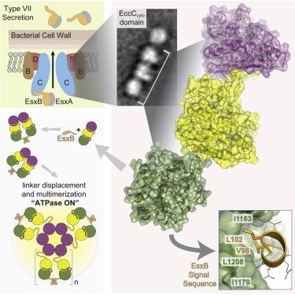
BL 8.3.1 User Science Highlights
Rosenberg OS, Dovala D, Li X, Connolly L, Bendebury A, Finer-Moore J, Holton J, Cheng Y, Stroud RM & Cox JS (2015)."Substrates Control Multimerization and Activation of the Multi-Domain ATPase Motor of Type VII Secretion", Cell 161, 501

Slide 18
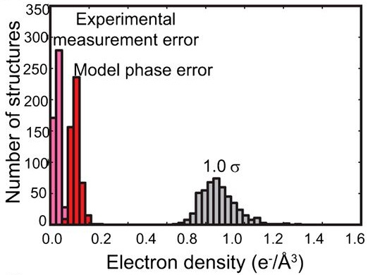
BL 8.3.1 User Science Highlights
Lang PT, Holton JM, Fraser JS & Alber T (2014)."Protein structural ensembles are revealed by redefining X-ray electron density noise", Proc. Nat. Acad. Sci. USA 111, 237.

Slide 19
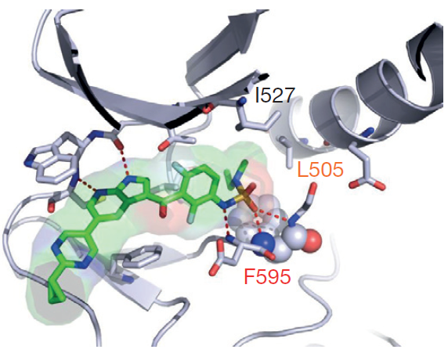
BL 8.3.1 User Science Highlights
Zhang C, Spevak W, Zhang Y, Burton EA, Ma Y, Habets G, et al. (2015) “RAF inhibitors that evade paradoxical MAPK pathway activation” Nature. 526, 583-6.

Slide 20
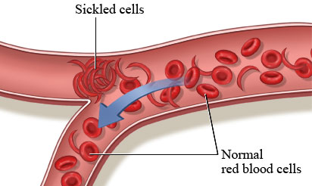
BL 8.3.1 User Science Highlights
Metcalf, B., C. Chuang, K. Dufu, M. P. Patel, A. Silva-Garcia, C. Johnson, Q. Lu, J. R. Partridge, L. Patskovska, Y. Patskovsky, S. C. Almo, M. P. Jacobson, L. Hua, Q. Xu, S. L. Gwaltney, C. Yee, J. Harris, B. P. Morgan, J. James, D. Xu, A. Hutchaleelaha, K. Paulvannan, D. Oksenberg and Z. Li (2017). "Discovery of GBT440, an Orally Bioavailable R-State Stabilizer of Sickle Cell Hemoglobin." ACS Medicinal Chemistry Letters 8(3): 321-326.

Slide 21
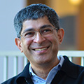
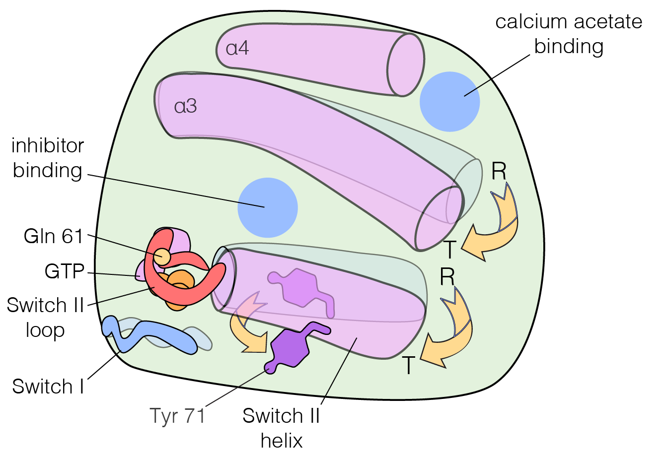
BL 8.3.1 User Science Highlights
Bandaru, P., N. H. Shah, M. Bhattacharyya, J. P. Barton, Y. Kondo, J. C. Cofsky, C. L. Gee, A. K. Chakraborty, T. Kortemme, R. Ranganathan and J. Kuriyan (2017). "Deconstruction of the Ras switching cycle through saturation mutagenesis." eLife 6: e27810.

Slide 22
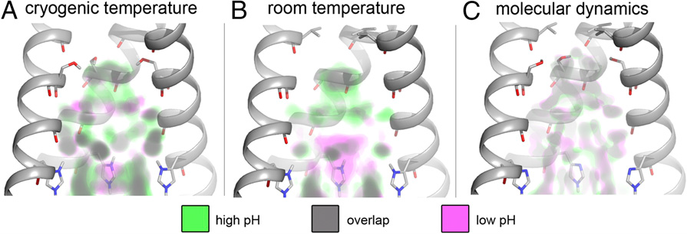
BL 8.3.1 User Science Highlights
Thomaston, J. L., M. Alfonso-Prieto, R. A. Woldeyes, J. S. Fraser, M. L. Klein, G. Fiorin and W. F. DeGrado (2015). "High-resolution structures of the M2 channel from influenza A virus reveal dynamic pathways for proton stabilization and transduction." PNAS 112(46): 14260-14265.

Slide 23
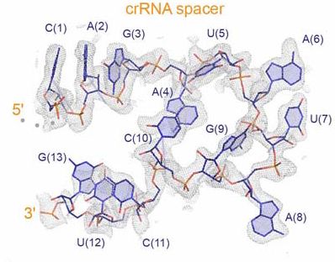
BL 8.3.1 User Science Highlights
Knott, G. J., A. East-Seletsky, J. C. Cofsky, J. M. Holton, E. Charles, M. R. O’Connell & J. A. Doudna, “Structure of a divergent RNA-targeting Type VI-A CRISPR-Cas complex”, Nature Struct. Mol. Bio. (submitted)

Slide 24
BL 8.3.1 User Science Highlights
Podust. 2 papers…

Slide 25
MRPI Reviewer comments:
Scoring range: 1 Exceptional (Best) - 9 Poor (Worst)
Overall Score: 1.2
Primary Reviewer (154338) Reviewer Summary: The proposed project aligns well with MRPI priorities. Funding would enhance UC’s systemwide research capacity. A significant outcome would be the equal access of all UC campuses to 8.3.1. This would provide new research opportunities and strengthen UC’s competitiveness.
Excellence Beamline 8.3.1 has a track record of achievement. It is one out of only thirteen beamlines worldwide that carries the distinction of solving over 1000 structures. The upgrade would have a tremendous impact on the entire structural biology community in the state of California. … Competitiveness The upgrade would position UC at the forefront of structural biology. The improved access and enhanced capabilities would attract the highest caliber faculty, students, and postdocs. … Given the increased number of researchers that will be able to utilize the beamline, the proposed upgrade should be expected to lead to increased extramural funding.
Notes:
Reviewers were exceedingly favorable of our proposal. Point-by-point they supported how well-matched this project is to the goals set forth by UC in the MRPI program. Full reviewer comments in attached PDF files.

