Slide 1
What is “MRPI”?
Multi-campus Research Programs and Initiatives
Offered by: UC Office of Research and Graduate Studies
Wide range of fields
Nanotech, Arts, Climate, Gender Studies, Sustainability, Health
ALS 8.3.1 MRPI Project Goals:
Upgrade ALS 8.3.1 to latest technology
Open up access to all UC structural biology labs
Transition to sustainable funding sources
Notes:
Brief description of what MRPI is. The University of California seeks to support collaboration between campuses in ways that benefit the entire system the most.
Funding was very limited, and it is extremely remarkable that we got this and our budget was not cut.

Slide 2
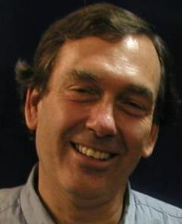
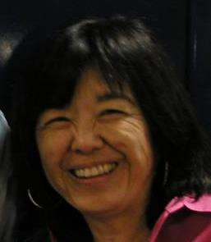
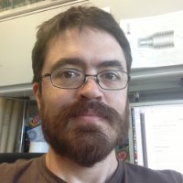
What is ALS Beamline 8.3.1 ?
Macromolecular Crystallography (MX)
MAD, 1x10¹² ph/s, Pilatus 6M
Technology development
Room temp, Elves, multi-crystal
Staff: Holton, Meigs, Tanamachi, Classen*
Landmark and highly productive facility
1st ALS SuperBend beamline – constructed 2001
1 of 10 in USA with >1000 PDBs/10 years running
8% of all membrane protein structures
996 distinct users from 57 institutions
1407 structures, 636 pubs, 227 high-impact
45% MRPI
20% MRPI
25% * 6 month
Notes:
ALS 8.3.1 is a very productive facility. Our focus is on maximizing efficiency of the user experience.
The MRPI funds are not just to maintain this facility, but to upgrade it. The new detector is 50x faster, more sensitive and more accurate than the existing detector, and an optics upgrade will match these capabilities.
We will exceed the modern standard of screening and data collection by offering completely automated mail-in raster-based screening
This will position ALS 8.3.1 as the centerpiece of structural biology for the UC system

Slide 3
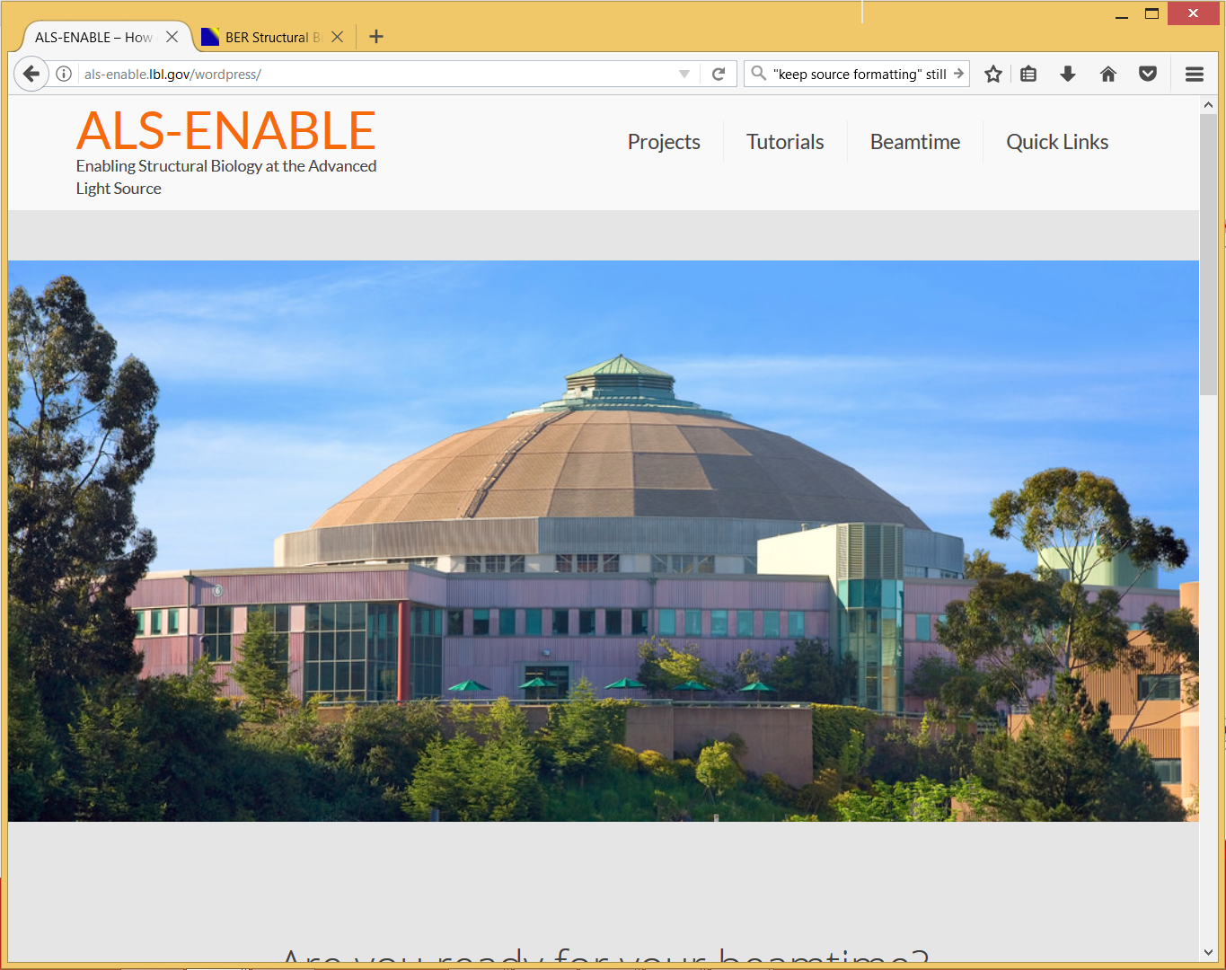

Slide 4
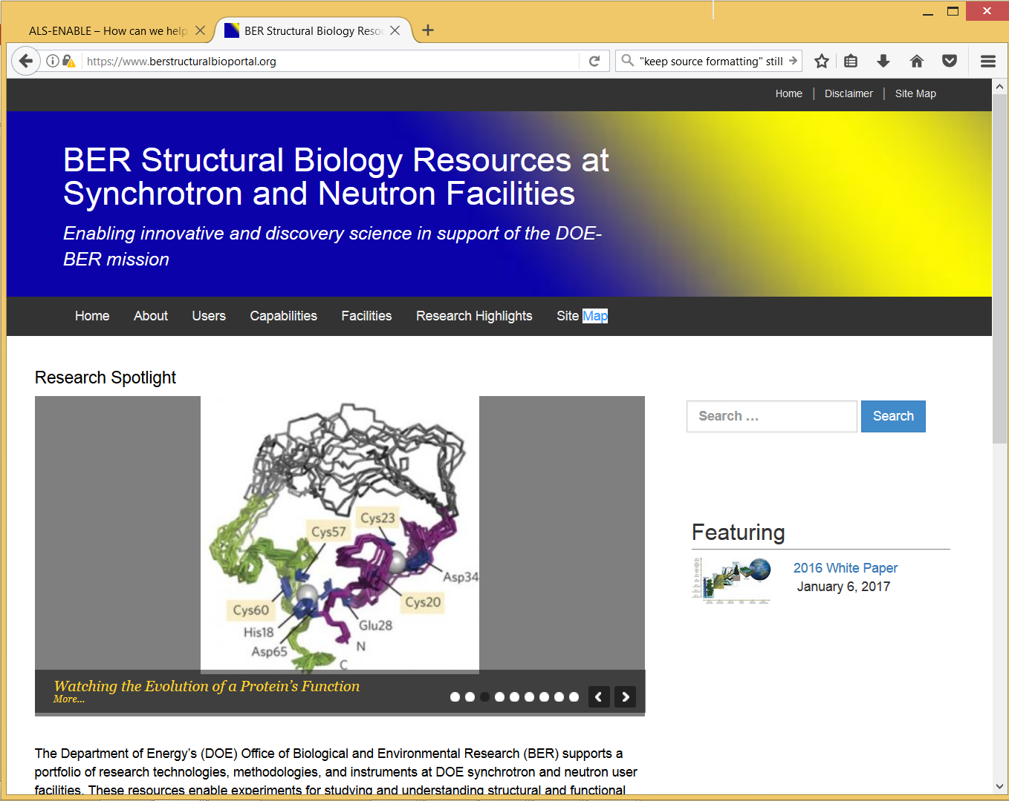

Slide 5
Maximum Data Quality Workshop
Update on the Instrument
Made possible by:
UC Office of the President, Multicampus Research Programs and Initiatives (MRPI) grant MR‐15‐328599

Slide 6
It’s Official

Slide 7
Apr 20 2016

Slide 8
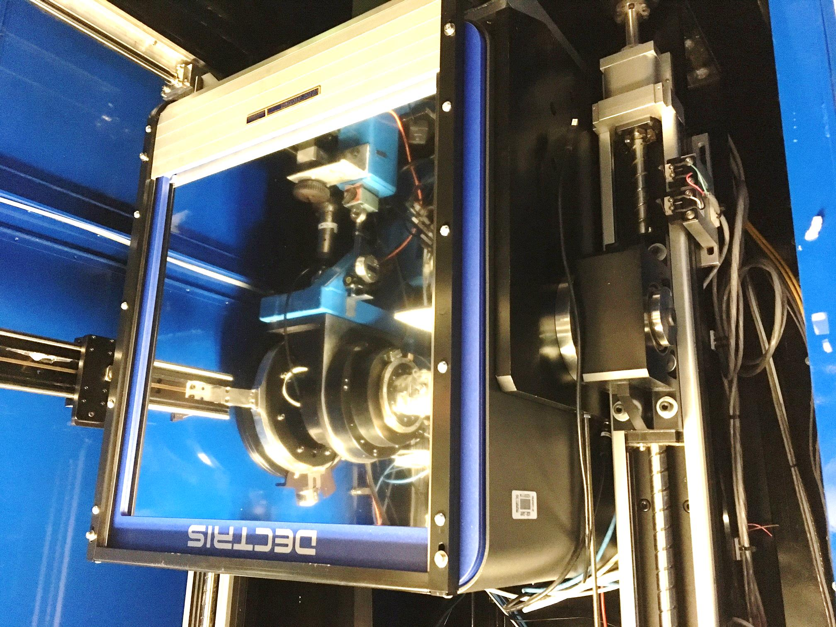

Slide 9
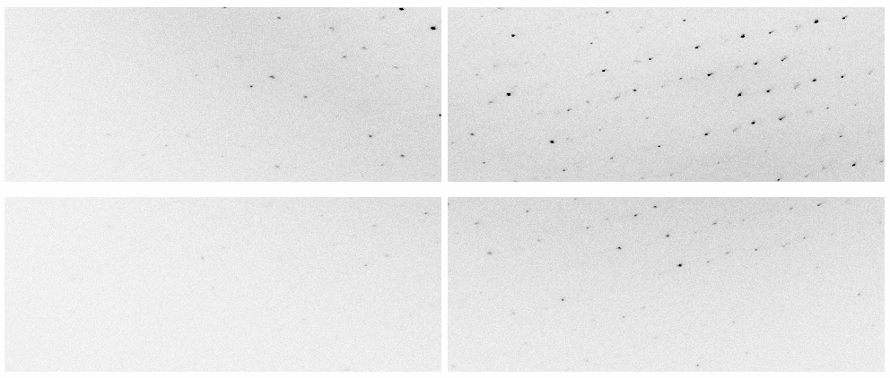
New Pilatus³ 6M at ALS 8.3.1
Apr 20 2016

Slide 10
New Pilatus³ 6M at ALS 8.3.1
13:41 9-22-2016 Plexxkon’s first Pilatus shift

Slide 11
MRPI Technical Highlights
Dectris Pilatus3 6M installation - May 2016
25 Hz framing, 2 ms dead time, previously 0.3 Hz
0.8% calibration error, previously 2.5%
Repaired and re-installed 6 times, 10% replaced
Complete control system update: true-BLU-ICE
Shutterless data collection
“Rastering” automated sample alignment
Re-write 64k lines of code
Overhaul of data archiving infrastructure
LTO4 to LTO6, support USB3 user hard drives
First remote data collection – Apr 2017

Slide 12
ALS 8.3.1 data collection history
images x 10⁶

Slide 13
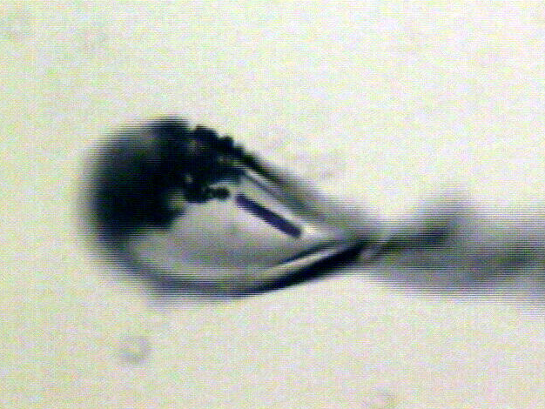
Shutterless rastering now available
X-ray beam
ice
Membrane
protein crystal

Slide 14
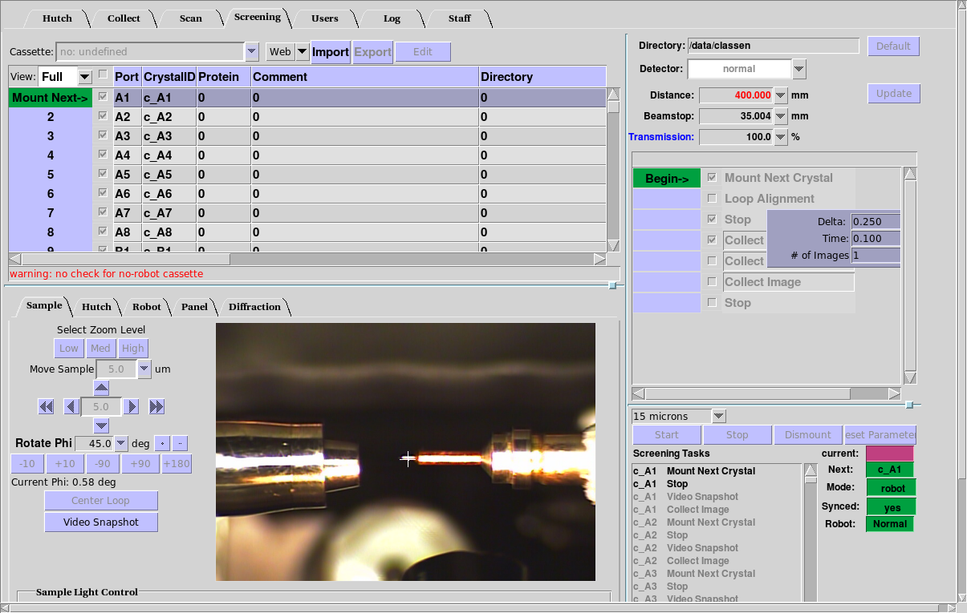
BLU-ICE “screening tab” almost integrated

Slide 15
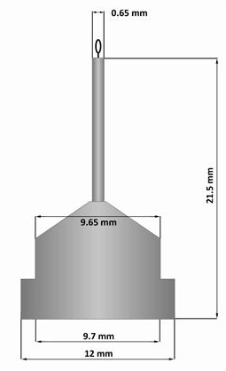
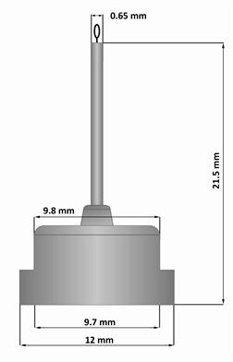
Pin compatibility
SLAC
ALS
SPINE

Slide 16
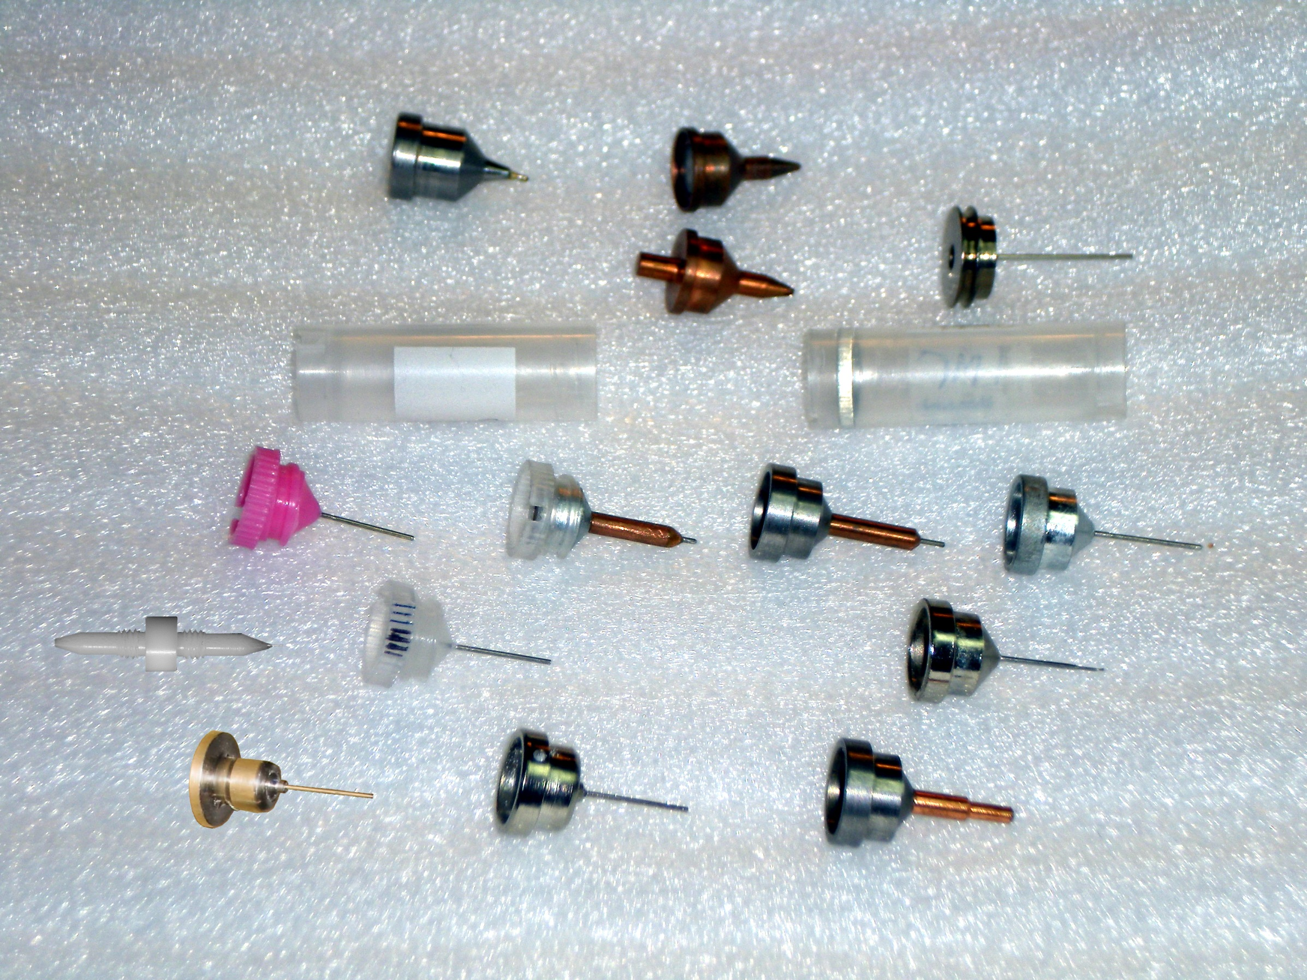
What if we didn’t have to choose?
Caltech
SSRL
Yale
Hampton screw cap
Hampton magnetic
H. colored
H. copper
H. magnetic
H. hybrid
H. screw cap
Syrrx
SPring-8
Oxford
SPINE
MiTeGen RT

Slide 17
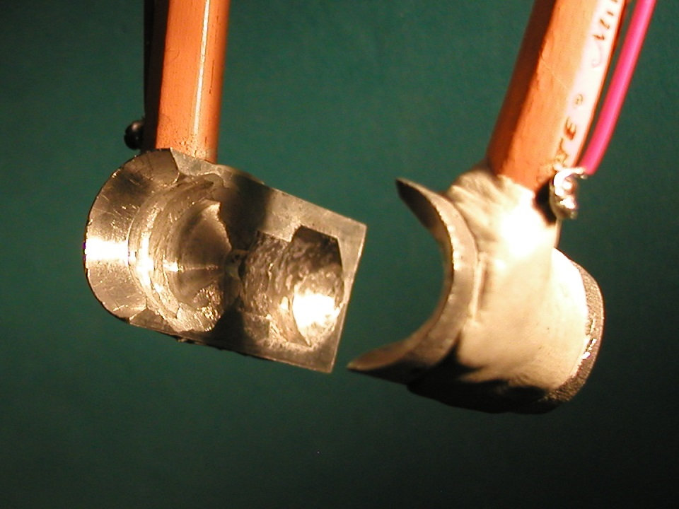
SuperTong

Slide 18
“infinite capacity” sample carousel

Slide 19
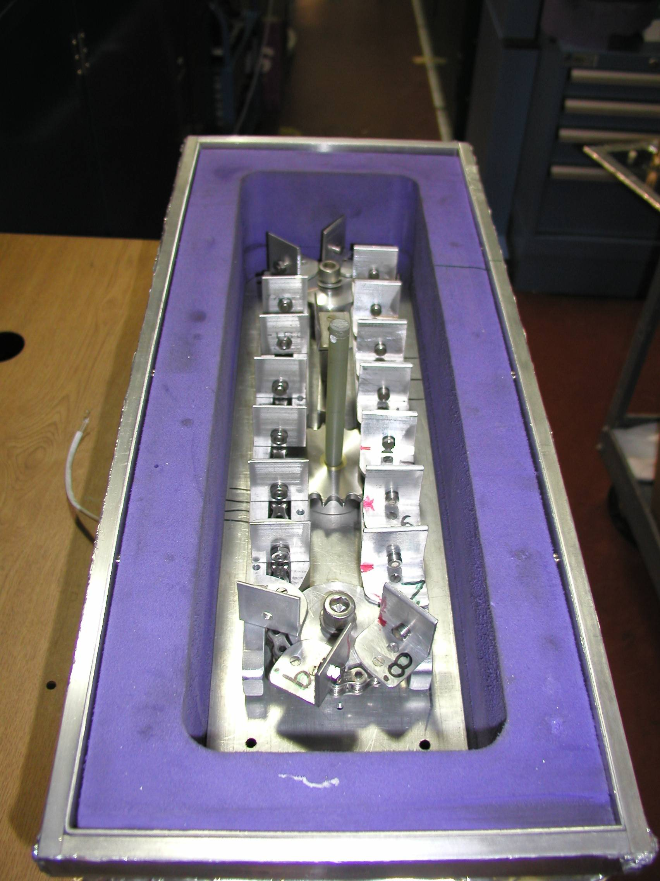
Carousel open

Slide 20
SBS
format
crystallization
tray
mirror
pinhole
microscope
Notes:
Inspired by the ESRF microcrystal camera, the superbend endstations are all equipped with zero-paralax optics. The user sees their sample from the point of view of the x-ray beam. Sample alignment is not only more stable but more intuitive than an off-axis camera. Placing the crystal into the microscope crosshairs gaurantees that it will be hit by the beam.

Slide 21
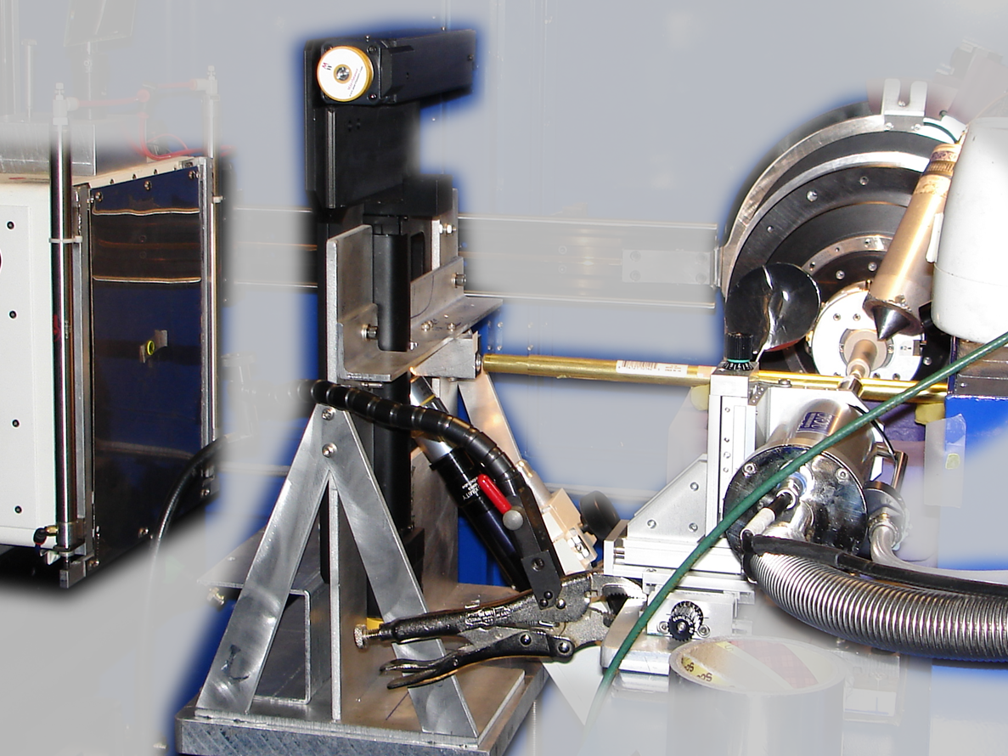
Notes:
non-rotating tray goniometer stage installed in ALS 8.3.1. Note that the “normal” cryo-pin goniometer on the left is still in place and a brass flight tube has been added to contain the air scatter from the main beam on its way to the tray goniometer.

Slide 22
in-situ diffraction trays
~50 μm tape
~50 μm tape
~50 μm tape
PDMS
PDMS
250 μm
100 μm
25 μm
200 μm
1000 μm
Fluidigm
Topaz® DC
Microlytic
Crystal Former™
NatX-ray
CrystalQuick™ X
MiTeGen
in-situ-1
CrystalDirect
Notes:
Next slide please

Slide 23
scattering/absorptoin “rules”:
1 μm crystal ≈ 1 μm water
≈ 1 μm plastic
≈ 0.1 μm glass
≈ 1000 μm air
Optimum: support thickness = crystal thickness

Slide 24
Match crystal to beam
Resolution (Å)
too big
too small
just right
X-ray beam size (μm)

Slide 25
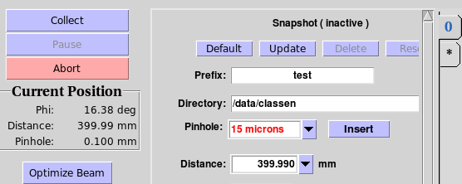
“8-shooter” adjustable beam size
rotary
pinholes:
300
100
75
50
30
25
15

Slide 26
Crystal lifetime vs pinhole
pinhole (µm) | beam size | Cryo (min) | Room T (s)
100 | 60x80 | 4 | 1.7
75 | 60x78 | 5 | 2.0
50 | 60x54 | 8 | 3.4
30 | 54x34 | 6 | 2.3
20 | 44x24 | 6 | 2.4
15 | 40x19 | 7 | 2.8
10 | 34x14 | 10 | 4.1

Slide 27
PAD full vs partial
Summed intensity
iteration

Slide 28
Optimal exposure time (anomalous on a PAD)
2.03 ms
intensity
time

Slide 29
Optimal exposure time (anomalous on a PAD)
Pilatus S
>0.2 s/frame
Upgrade:
>0.1 s/frame
t_{mad} Optimal exposure time (s)
t_{ro} read-out time (s)
2.03 ms on Pilatus³ S
0.95 ms on Pilatus³ X
8.3.1 is too
hot for Pilatus
Attenuate for MAD

Slide 30
% exposure_time.com
The last tune up was at 11111.0 eV (1.11587 A) convergance: 2 x 0.35
with Dose Rate 47280 Gy/s
Based on a Dose Rate of 4.73e+04 Grays/Sec at 2 mRad with slits 100.00% flux, the Dose Rate now at 2.0000 mRad, or 100.00% flux, is 4.73e+04 Grays/Sec
What is the current, or expected dose rate (Gy/s) [4.73e+04] : -->
Expected 1/2 life dose of typical protein crystals
Native 2e+7
MAD 5e+6
S SAD 3e+6
Br/I/RNA 1e+6
RT 2e+5
What is the Max total dose YOU want: [2e+7] -->
Total time for dataset must not exceed 422.8 seconds
How many frames will be in this data set [1800]: -->
Based on these parameters, the exposure time can be up to 0.235 seconds/frame, or 4.73e+04 Gy/s

Slide 31
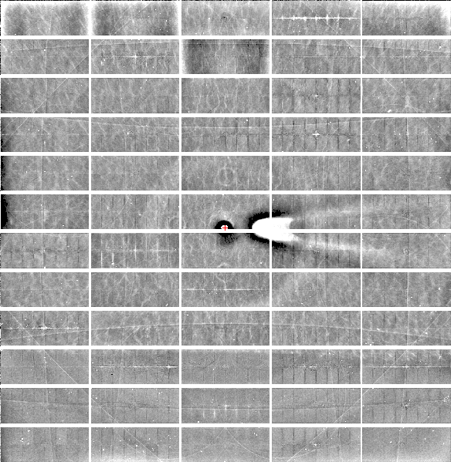
Relative Pixel
Calibration
ALS 8.3.1
Pilatus3 6M
0.9793 Å x-rays
RMS = 0.8%
1% high
average
1% low

Slide 32
Threshold of a revolution in phasing
CCD
old Pilatus
Goal
Solve-able proteins (%)
8.3.1’s Pilatus
Required signal-to-noise (I/σ)

Slide 33
S-SAD merging 20 xtals
Knott et al. (2017). "Guide-bound CRISPR-Cas13a." Nature S&MB online

Slide 34
Systematic vs random error
intensity
observation

Slide 35
ALS 8.3.1 capabilities
200s data sets in shutterless mode
Support for room temperature
in-situ screening from trays
15-100 μm beam sizes
True BLU-ICE interface
Excellent detector calibration
Infinite capacity sample carousel
Automated data backup
Remote operation

Slide 36
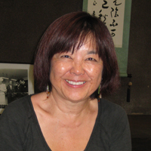
How do I get time on ALS 8.3.1?
Check for available shifts on the schedule:
http://bl831.als.lbl.gov/
Contact Jane Tanamachi!
JTanamachi@LBL.GOV
510-495-2404
No proposals, no reviews, no kidding

Slide 37
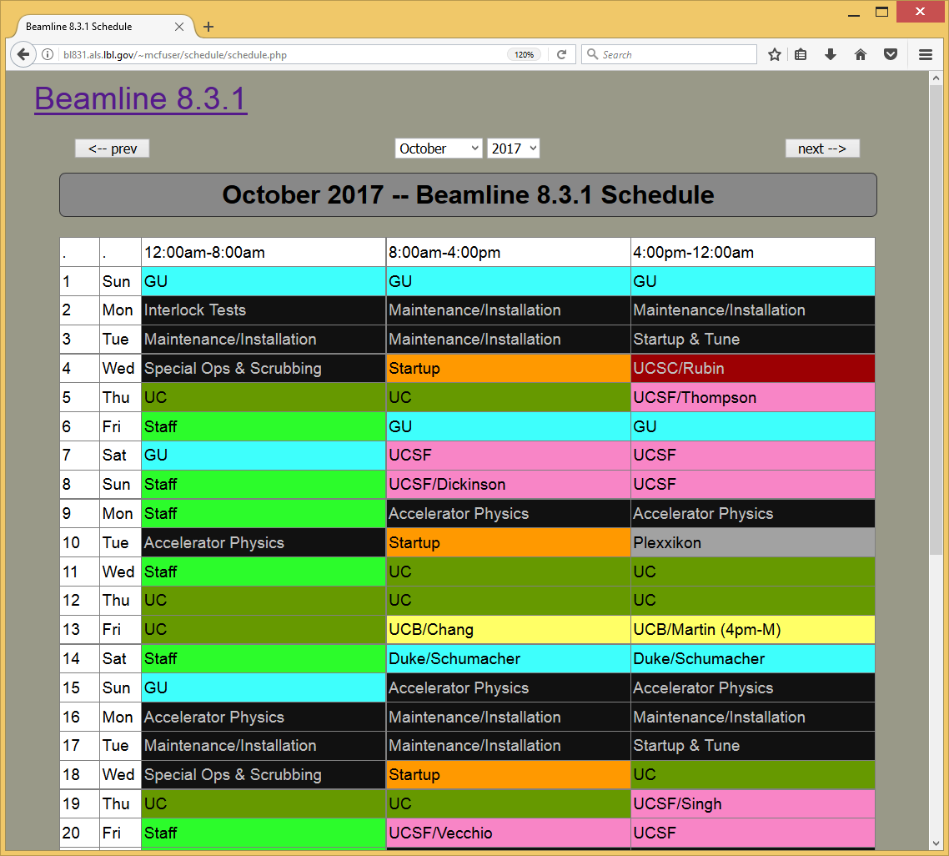
BL8.3.1 online schedule

Slide 38
ALS 8.3.1 beam time allocation 2017-18
PRT Member | allocation | Details
General Users | 25% | Mandated by DOE
Staff | 9% | development & testing
Plexxikon | 5% | 5-year contract
UC | 35.5% total | MRPI
UCSF | 18.5% | Sandler, ETAC & NIH IAA
UCB | 7.1% | Same as other UCs
Total | 600 shifts | 200 days/year

Slide 39
Please Acknowledge!
UC Office of the President, Multicampus Research Programs and Initiatives (MRPI) grant MR‐15‐328599
and NIGMS:
P30 GM124169
R01 GM124149
http://bl831.als.lbl.gov/~jamesh/powerpoint/
MRPI_intro_2017.pptx
MRPI_raddam_2017.pptx

Slide 40
Please email !
Has MRPI support led to any additional extramural funds being brought into UC?
Describe in lay terms one major accomplishment or success of your project to date.
JTanamachi@LBL.GOV

