Slide 1
Maximum Data Quality Workshop
Update on the Instrument
Made possible by:
UC Office of the President, Multicampus Research Programs and Initiatives (MRPI) grant MR‐15‐328599

Slide 2
MRPI Technical Highlights
Dectris Pilatus3 6M installation - May 2016
25 Hz framing, 2 ms dead time, previously 0.3 Hz
0.8% calibration error, previously 2.5%
Repaired and re-installed 6 times, 10% replaced
Complete control system update
Shutterless data collection
“Rastering” automated sample alignment
Re-write 64k lines of code
Overhaul of data archiving infrastructure
LTO4 to LTO6, support USB3 user hard drives
First remote data collection – Apr 2017

Slide 3
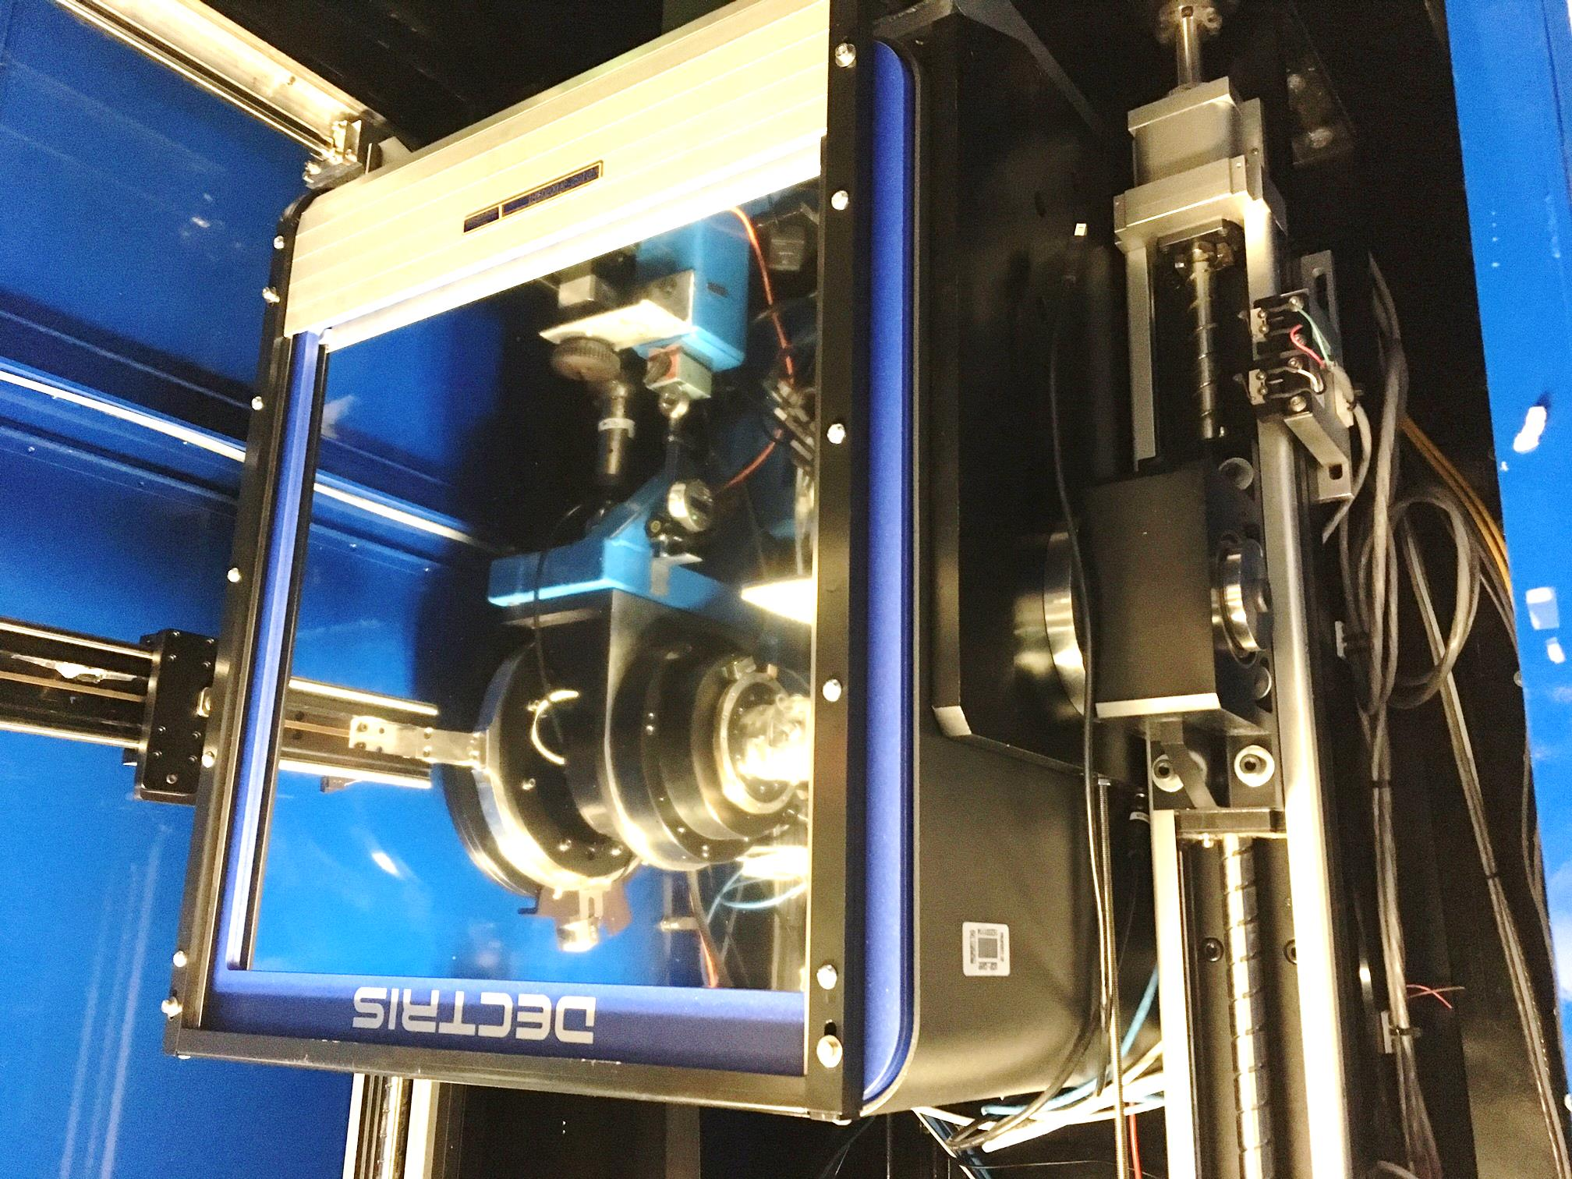
Pilatus³ S 6M
Pixel Array
Detector
6x10⁶ pixels
$0.15/each
Single-photon
counting
25 Hz images

Slide 4
ALS 8.3.1 data collection history
images x 10⁶

Slide 5
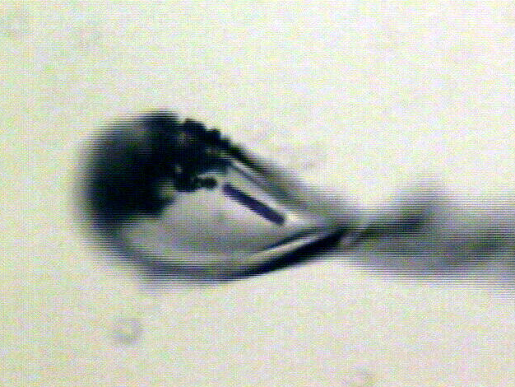
Shutterless rastering now available
X-ray beam
ice
Membrane
protein crystal

Slide 6
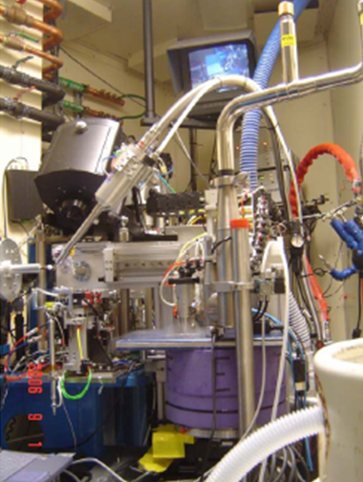
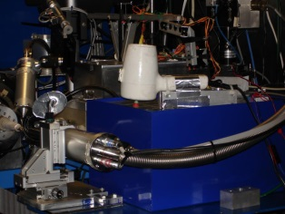
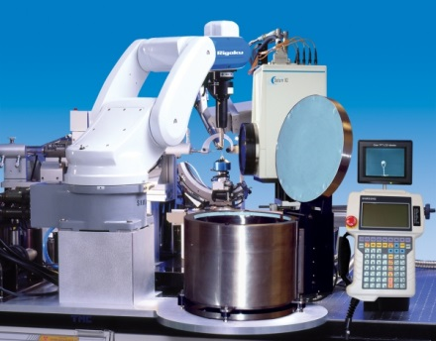
ALS robots
8.2.1
ACTOR
Berkeley
Auto-
Mounter
8.2.2
8.3.1
Cool Hand Luke
5.0.2
5.0.3
5.0.1
MBC 4.2.2
ACTOR
ALS MX robots
Stanford
Auto-
Mounter
12.3.1 SIBYLS

Slide 7
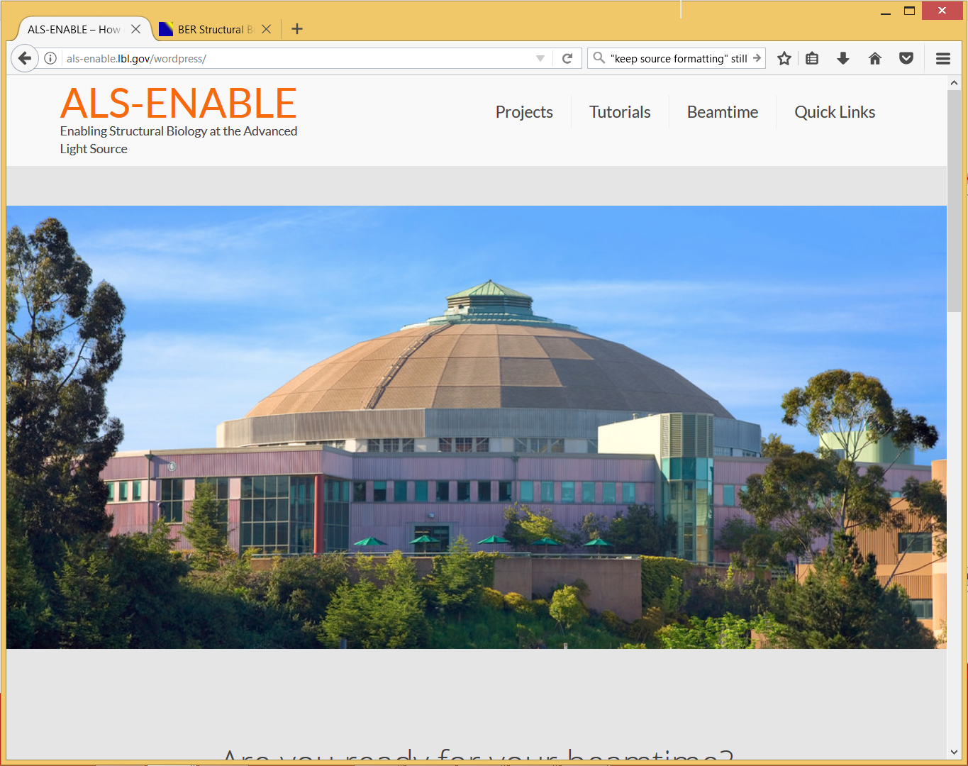
als-enable.lbl.gov

Slide 8
ber
structural
bio
portal.org

Slide 9
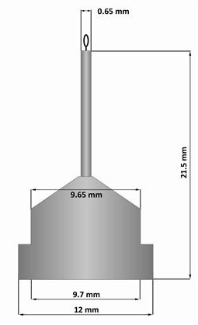
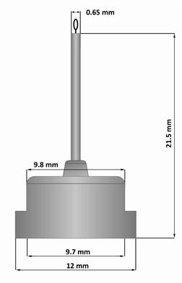
Pin compatibility
SLAC
ALS
SPINE

Slide 10
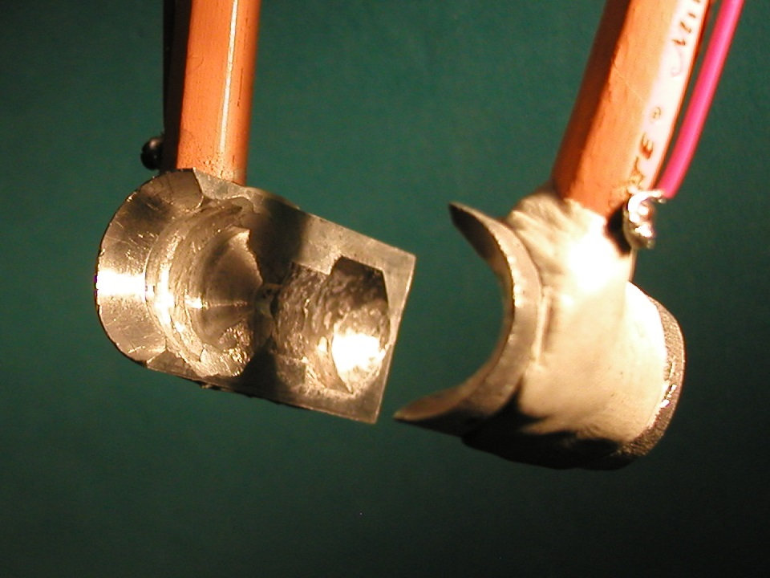
SuperTong

Slide 11
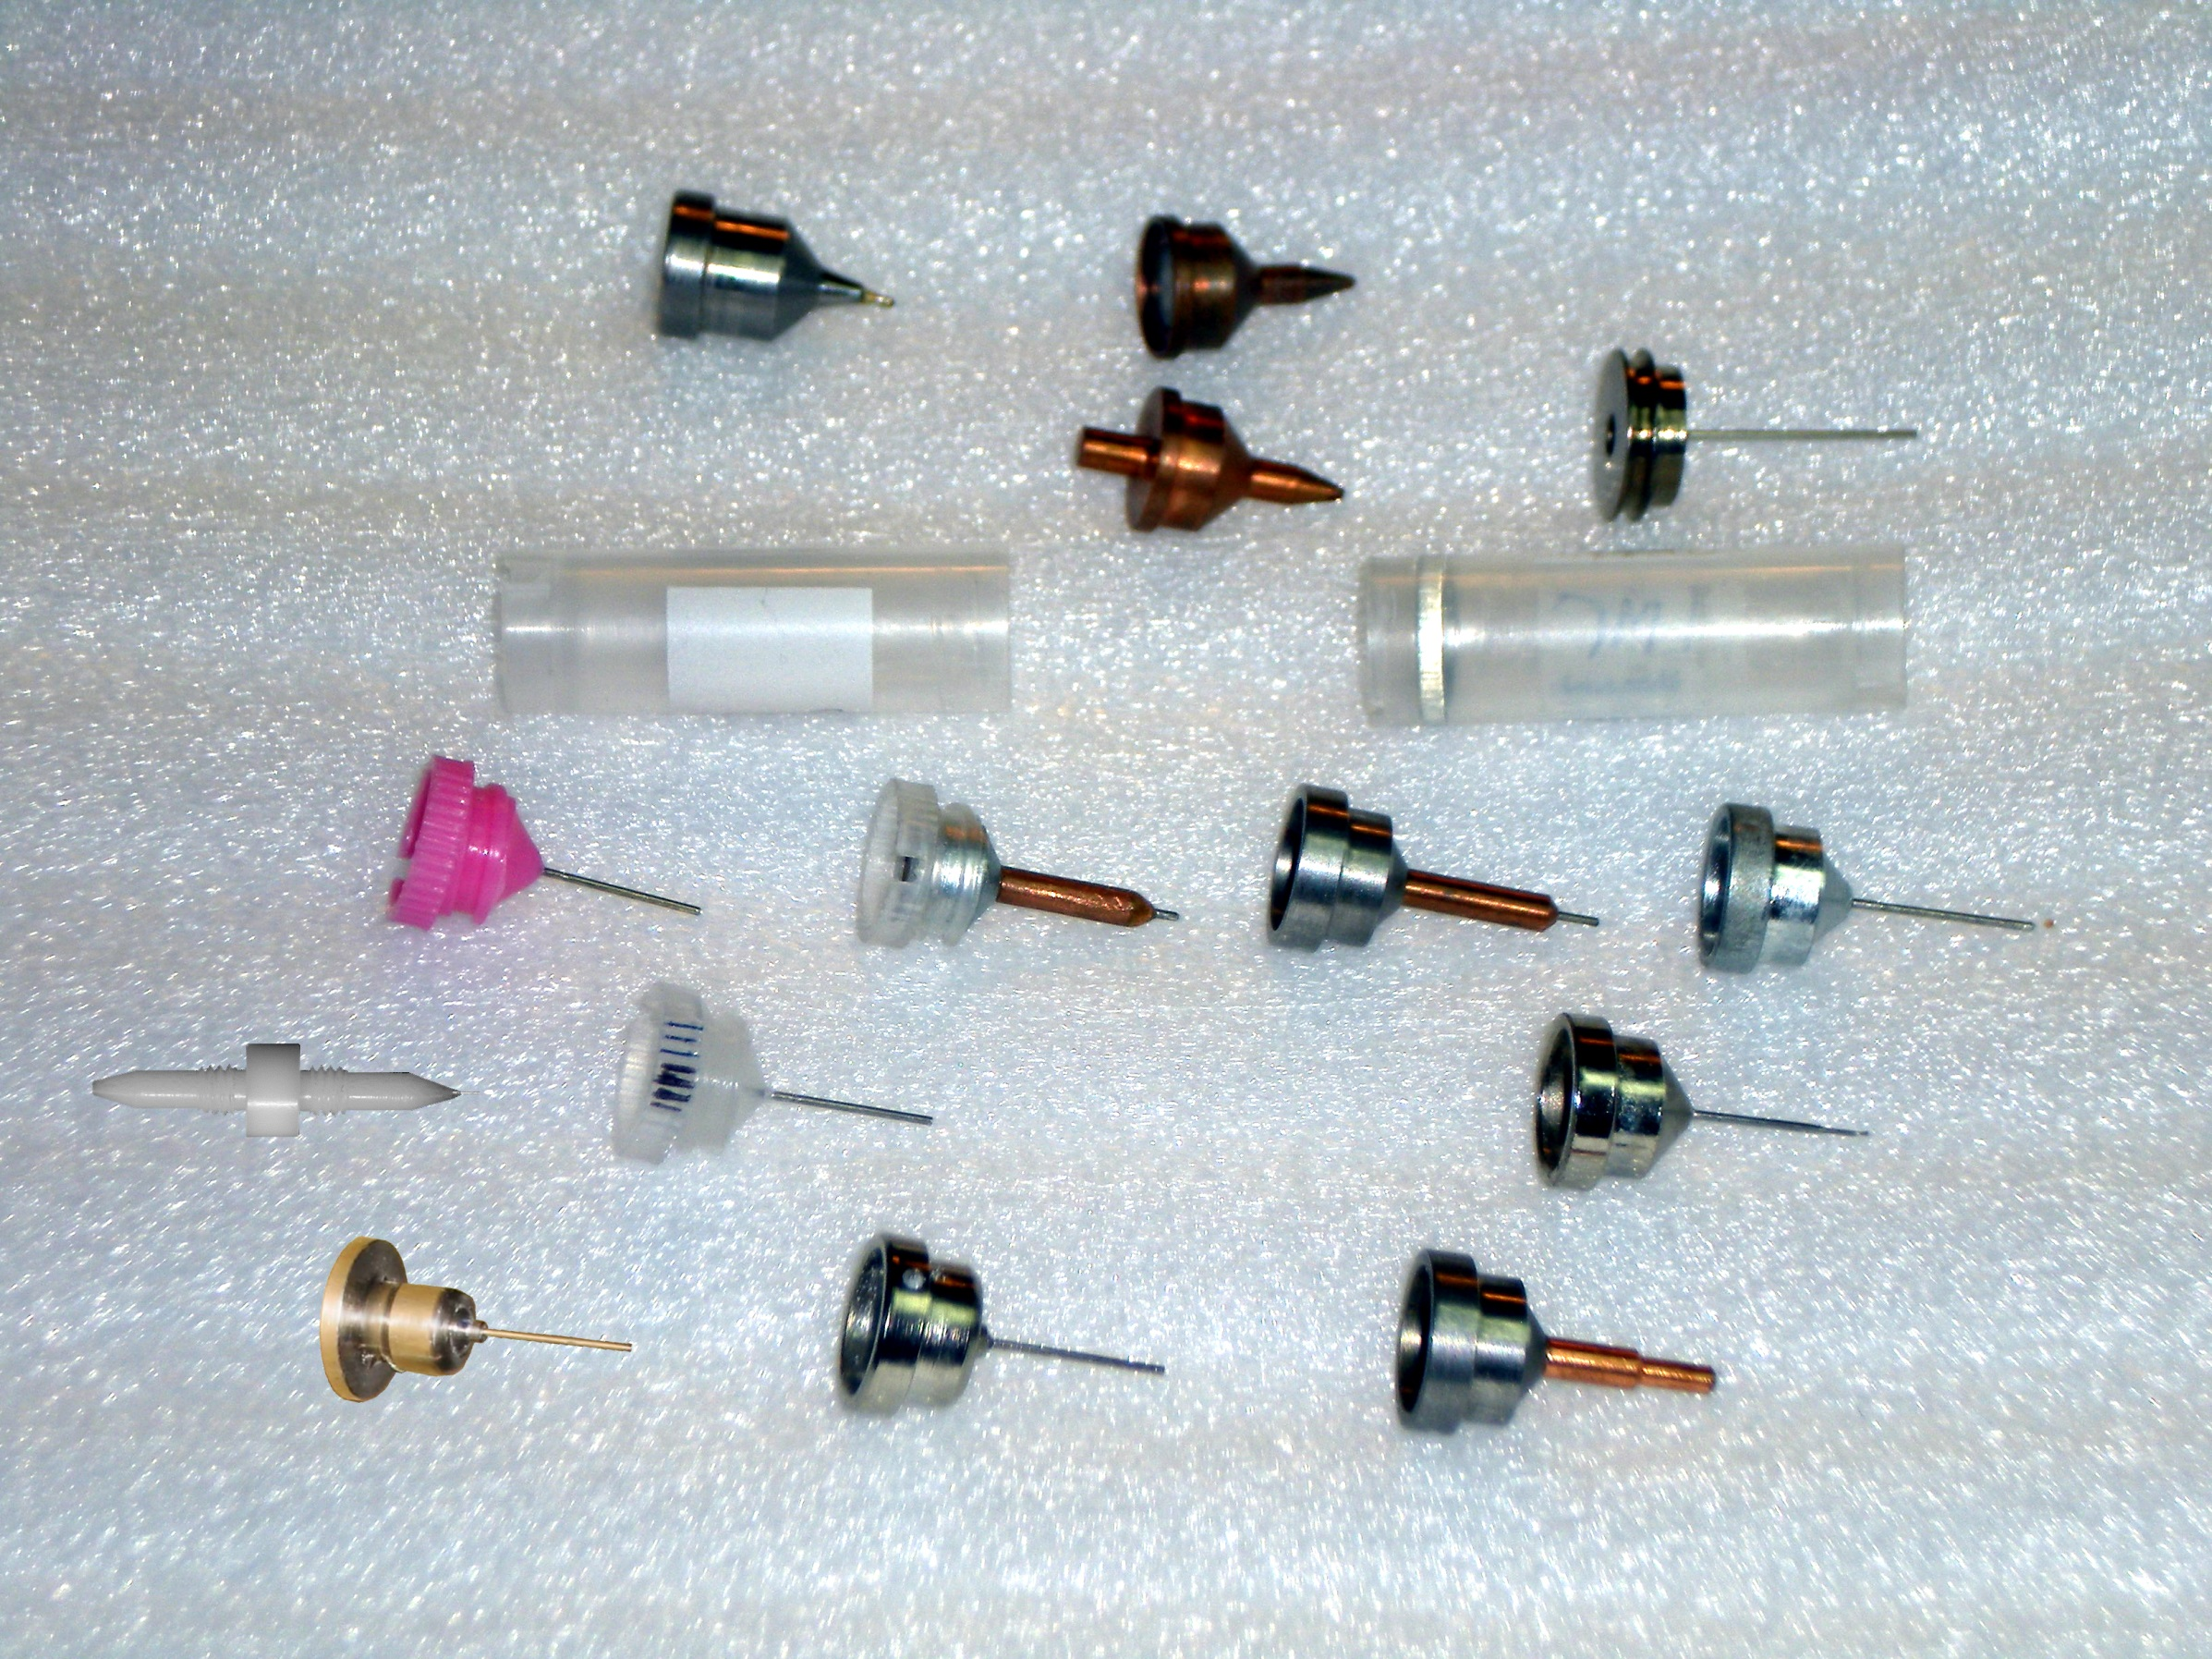
What if we didn’t have to choose?
Caltech
SSRL
Yale
Hampton screw cap
Hampton magnetic
H. colored
H. copper
H. magnetic
H. hybrid
H. screw cap
Syrrx
SPring-8
Oxford
SPINE
MiTeGen RT

Slide 12
“infinite capacity” sample carousel

Slide 13
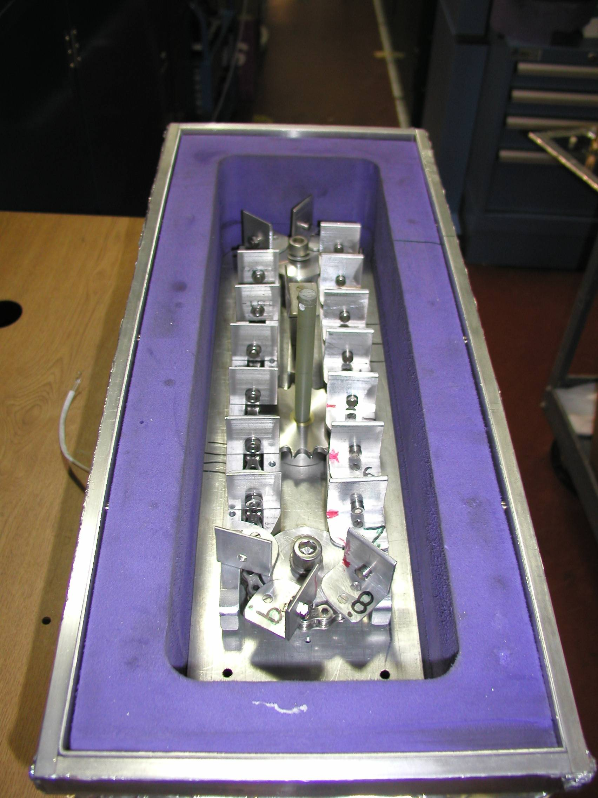
Carousel open

Slide 14
SBS
format
crystallization
tray
mirror
pinhole
microscope
Notes:
Inspired by the ESRF microcrystal camera, the superbend endstations are all equipped with zero-paralax optics. The user sees their sample from the point of view of the x-ray beam. Sample alignment is not only more stable but more intuitive than an off-axis camera. Placing the crystal into the microscope crosshairs gaurantees that it will be hit by the beam.

Slide 15
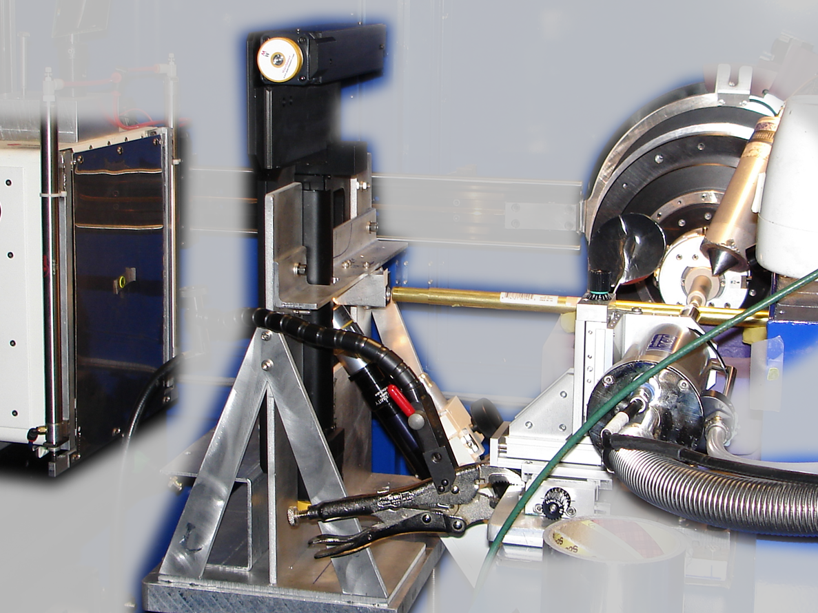
Notes:
non-rotating tray goniometer stage installed in ALS 8.3.1. Note that the “normal” cryo-pin goniometer on the left is still in place and a brass flight tube has been added to contain the air scatter from the main beam on its way to the tray goniometer.

Slide 16
in-situ diffraction trays
~50 μm tape
~50 μm tape
~50 μm tape
PDMS
PDMS
250 μm
100 μm
25 μm
200 μm
1000 μm
Fluidigm
Topaz® DC
Microlytic
Crystal Former™
NatX-ray
CrystalQuick™ X
MiTeGen
in-situ-1
CrystalDirect
Notes:
Next slide please

Slide 17
scattering/absorptoin “rules”:
1 μm crystal ≈ 1 μm water
≈ 1 μm plastic
≈ 0.1 μm glass
≈ 1000 μm air
Optimum: support thickness = crystal thickness

Slide 18
Match crystal to beam
Resolution (Å)
too big
too small
just right
X-ray beam size (μm)

Slide 19
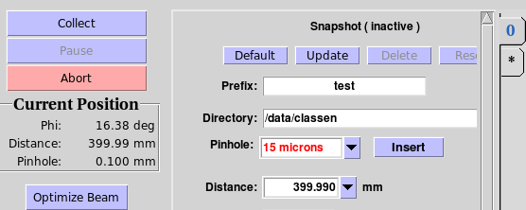
“8-shooter” adjustable beam size
rotary
pinholes:
300
100
75
50
30
25
15

Slide 20
Crystal lifetime vs pinhole
pinhole (µm) | beam size | Cryo (min) | Room T (s)
100 | 60x80 | 4 | 1.7
75 | 60x78 | 5 | 2.0
50 | 60x54 | 8 | 3.4
30 | 54x34 | 6 | 2.3
20 | 44x24 | 6 | 2.4
15 | 40x19 | 7 | 2.8
10 | 34x14 | 10 | 4.1

Slide 21
Optimal exposure time (anomalous on a PAD)
2.03 ms
intensity
time

Slide 22
Optimal exposure time (anomalous on a PAD)
Pilatus S
>0.2 s/frame
Upgrade:
>0.1 s/frame
t_{mad} Optimal exposure time (s)
t_{ro} read-out time (s)
2.03 ms on Pilatus³ S
0.95 ms on Pilatus³ X
8.3.1 is too
hot for Pilatus
Attenuate for MAD

Slide 23
% exposure_time.com
The last tune up was at 11111.0 eV (1.11587 A) convergance: 2 x 0.35
with Dose Rate 47280 Gy/s
Based on a Dose Rate of 4.73e+04 Grays/Sec at 2 mRad with slits 100.00% flux, the Dose Rate now at 2.0000 mRad, or 100.00% flux, is 4.73e+04 Grays/Sec
What is the current, or expected dose rate (Gy/s) [4.73e+04] : -->
Expected 1/2 life dose of typical protein crystals
Native 2e+7
MAD 5e+6
S SAD 3e+6
Br/I/RNA 1e+6
RT 2e+5
What is the Max total dose YOU want: [2e+7] -->
Total time for dataset must not exceed 422.8 seconds
How many frames will be in this data set [1800]: -->
Based on these parameters, the exposure time can be up to 0.235 seconds/frame, or 4.73e+04 Gy/s

Slide 24
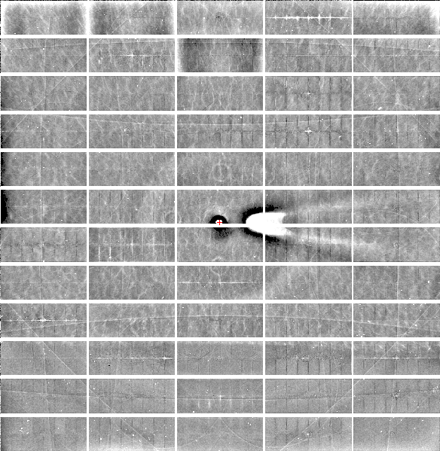
Relative Pixel
Calibration
ALS 8.3.1
Pilatus3 6M
0.9793 Å x-rays
RMS = 0.8%
1% high
average
1% low

Slide 25
S-SAD merging 20 xtals
Knott et al. (2017). "Guide-bound CRISPR-Cas13a." Nature S&MB online

Slide 26
Systematic vs random error
intensity
observation

Slide 27
ALS 8.3.1 capabilities
200s data sets in shutterless mode
Support for room temperature
in-situ screening from trays
15-100 μm beam sizes
True BLU-ICE interface
Excellent detector calibration
Infinite capacity sample carousel
Automated data backup
Remote operation

Slide 28
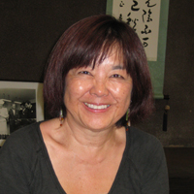
How do I get time on ALS 8.3.1?
Check for available shifts on the schedule:
http://bl831.als.lbl.gov/
Contact Jane Tanamachi!
JTanamachi@LBL.GOV
510-495-2404
No proposals, no reviews, no kidding

Slide 29
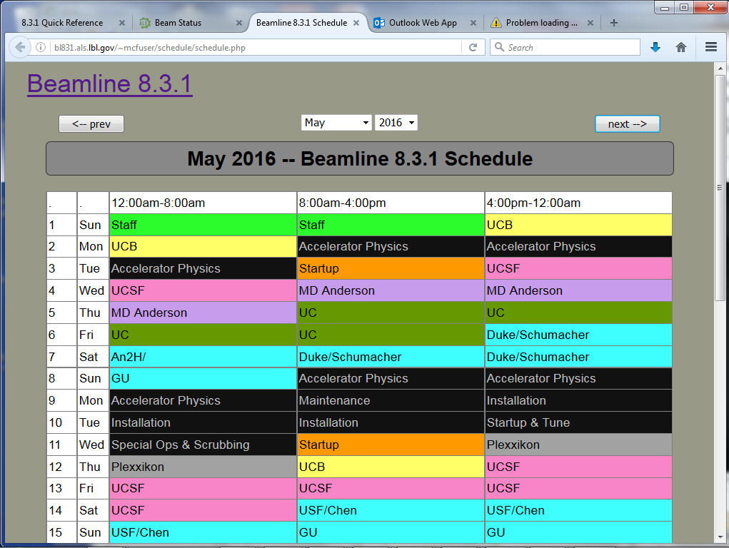
BL8.3.1 online schedule

Slide 30
ALS 8.3.1 beam time allocation
PRT Member | allocation | Details
General Users | 25% | Mandated by DOE
Staff | 9% | development & testing
Plexxikon | 5% | 5-year contract just renewed
UC | 35.5% total | MRPI ends Dec 2018
UCSF | 18.5% | Sandler, ETAC & NIH IAA
UCB | 7.1% | Same as other UCs
Total | 600 shifts | 200 days/year

Slide 31
Please Acknowledge!
UC Office of the President, Multicampus Research Programs and Initiatives (MRPI) grant MR‐15‐328599

Slide 32
Please email !
Has MRPI support led to any additional extramural funds being brought into UC?
Describe in lay terms one major accomplishment or success of your project to date.
JTanamachi@LBL.GOV

Slide 33
non-isomorphism

Slide 34
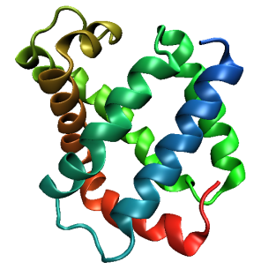
Same structure, different cell
0.5% cell change → 15%
Crick & Magdoff (1956) “theory method isomorphous replacement”, Acta Cryst. 9, 901-8.

Slide 35
Same structure, different cell
0.5% cell change → 15%
Crick & Magdoff (1956) “theory method isomorphous replacement”, Acta Cryst. 9, 901-8.

Slide 36
Same cell, rotated protein
0.5° rotation → 16%
Crick & Magdoff (1956) “theory method isomorphous replacement”, Acta Cryst. 9, 901-8.

Slide 37
Same cell, rotated protein
0.5° rotation → 16%
Crick & Magdoff (1956) “theory method isomorphous replacement”, Acta Cryst. 9, 901-8.

Slide 38
Uniform stretch
5% change → 0%

Slide 39
Uniform stretch
5% change → 0%

Slide 40
Non-isomorphism in lysozyme
RMSD = 1.70 Å
Δcell = 0.7 %
R_{iso} = 44.5%
RMSD = 0.18 Å
3aw6
3aw7
RH: 84.2%
vs 71.9%

Slide 41
Hygrostatic gradients
high
water activity
low
jet
loop

Slide 42
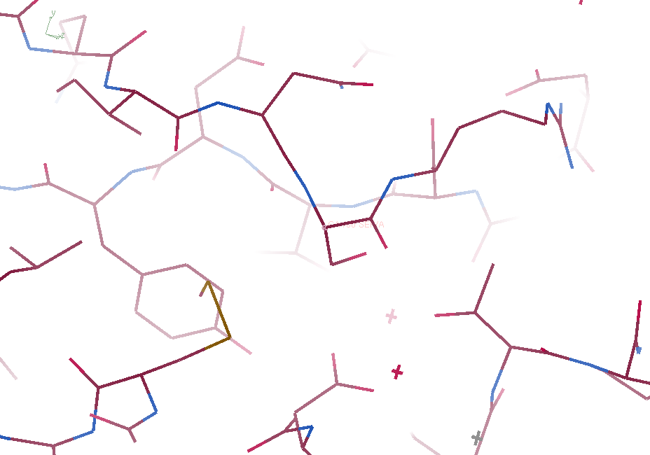
3aw6

Slide 43
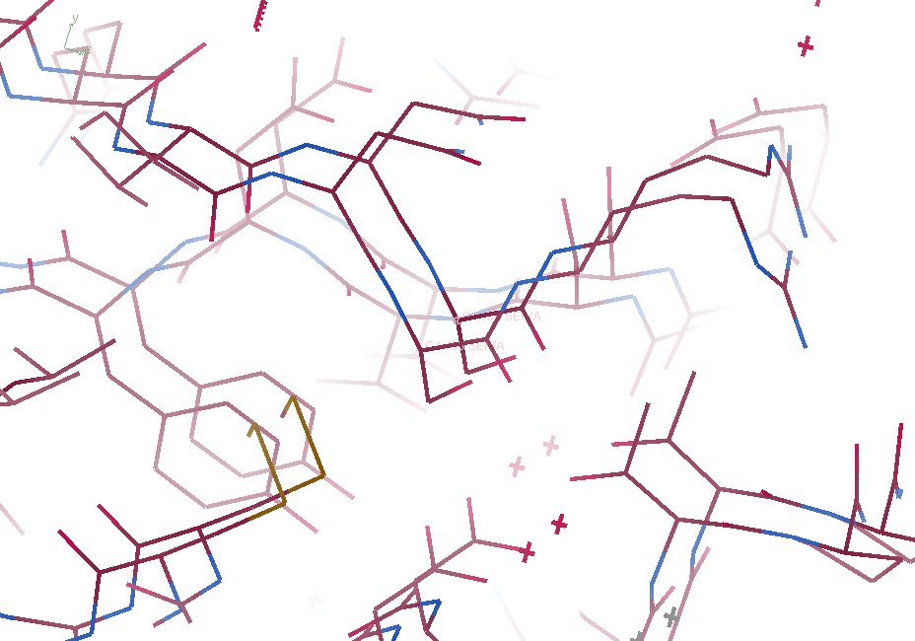
3aw6 3aw7

Slide 44
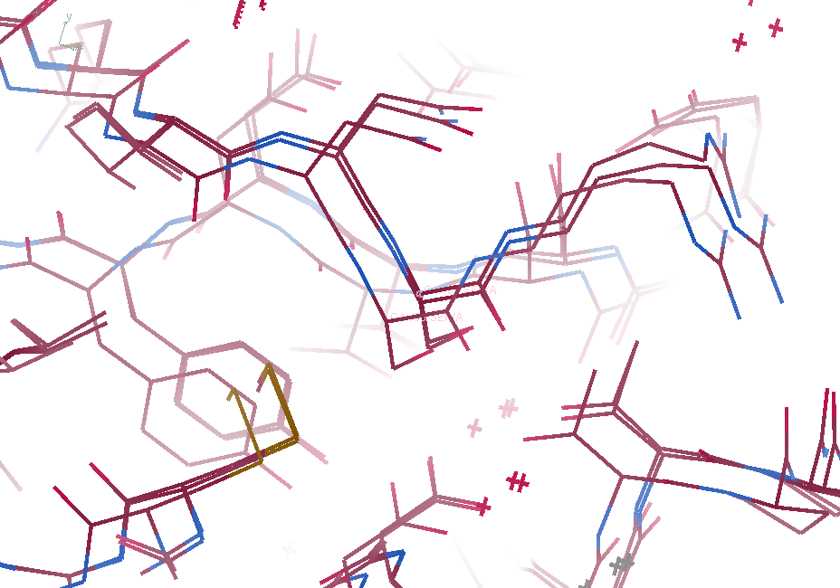
3aw6, 3aw7, “bent” 3aw7

Slide 45
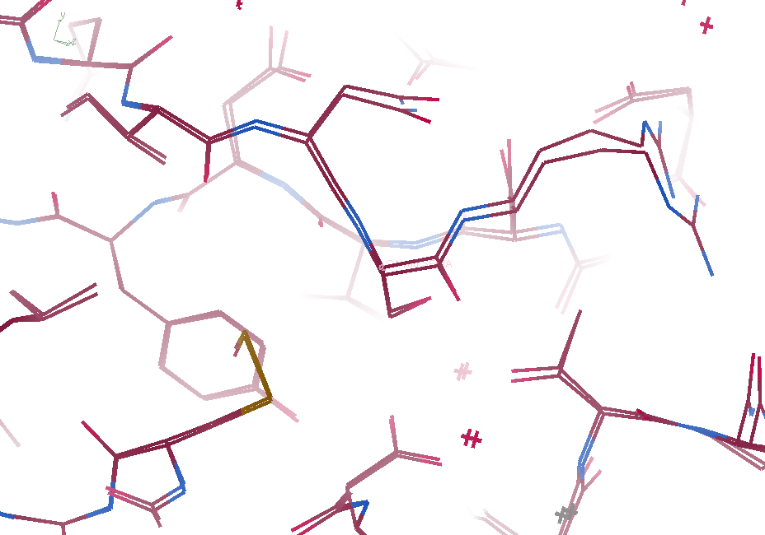
3aw6, “bent” 3aw7

Slide 46
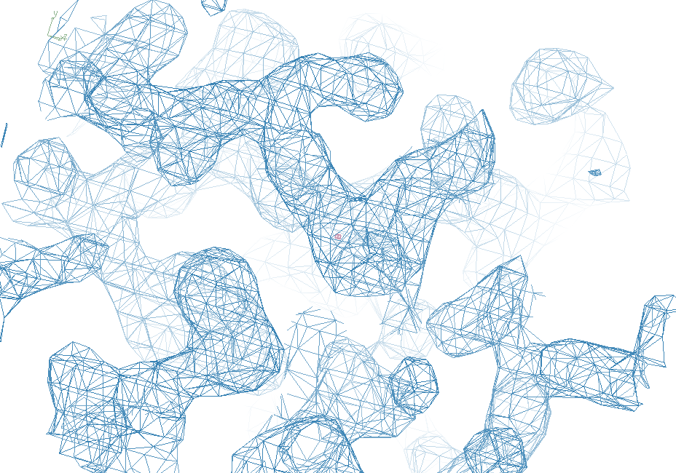
3aw6

Slide 47
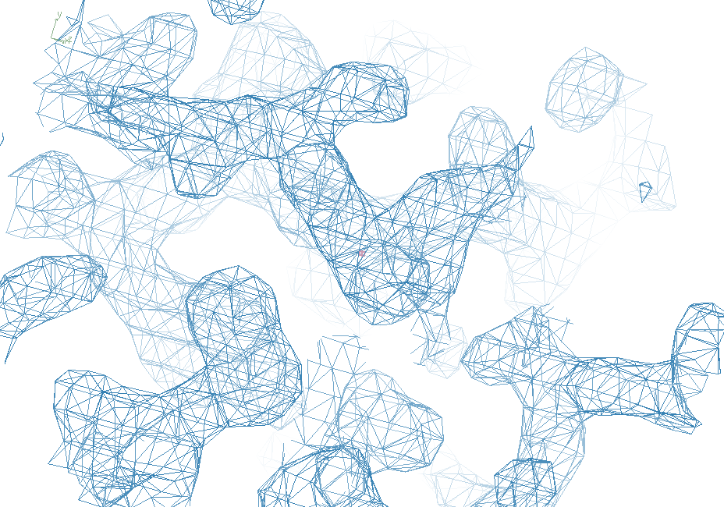
“bent” 3aw7

Slide 48
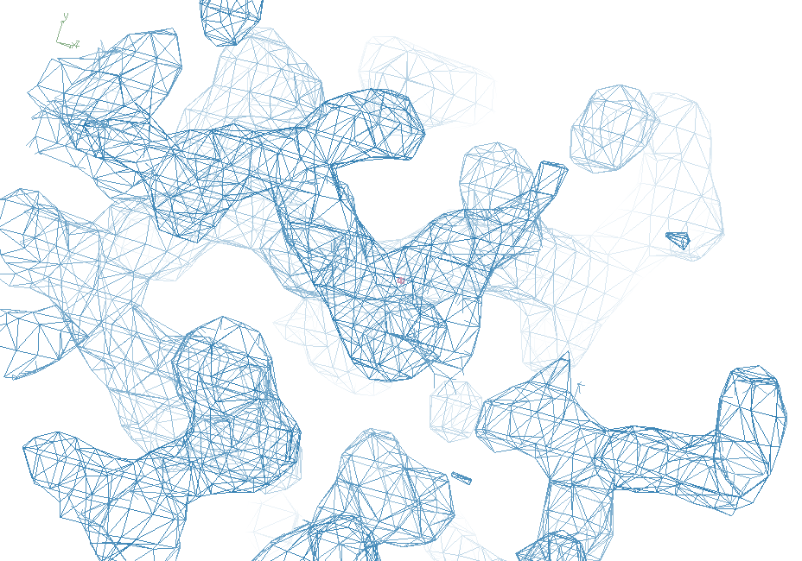
3aw7

Slide 49
“map bender” procedure
Convert to fractional coordinate shifts

Slide 50
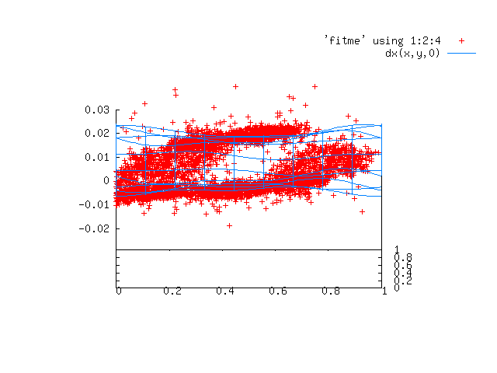

Slide 51
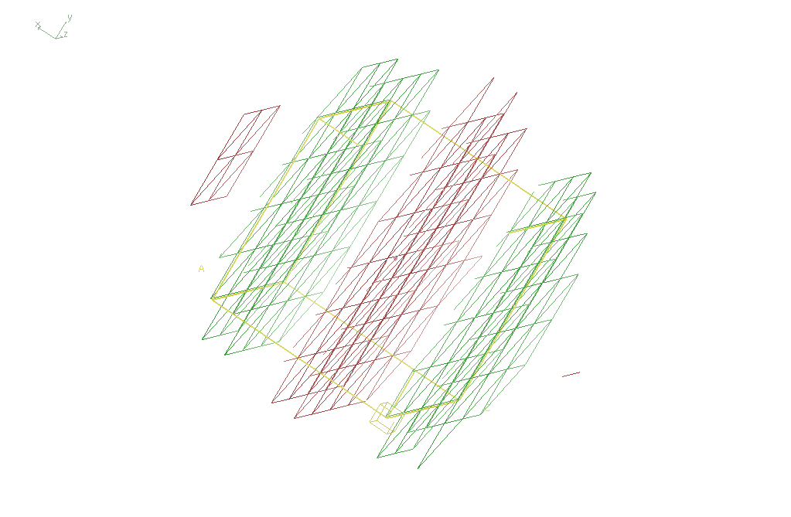
Basis function 1 0 0

Slide 52
“map bender” procedure
Convert to fractional coordinate shifts
Basis functions: spatial sin waves
Repeats with unit cell
Low-order h,k,l indices first
Fit function to Δx vs x,y,z across P1 cell
Repeat with Δy, Δz
Apply to PDB file and interpolate map grid
Usually 3-5 orders comparable to LSQ

Slide 53
Photosystem O=O bond?
Suga, M., et al., site of O=O bond formation in PSII
caught by XFEL. Nature, 2017. 543: p. 131.

Slide 54
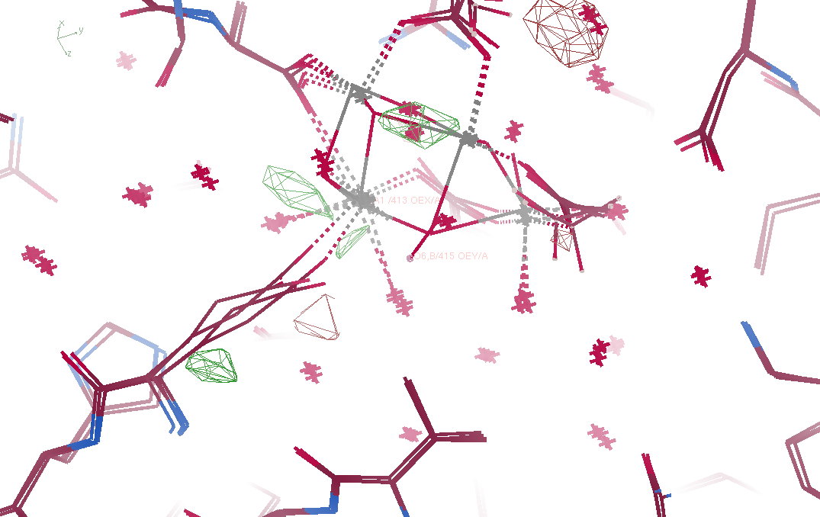
Fo – Fc maps
5ws5 vs 5ws6

Slide 55
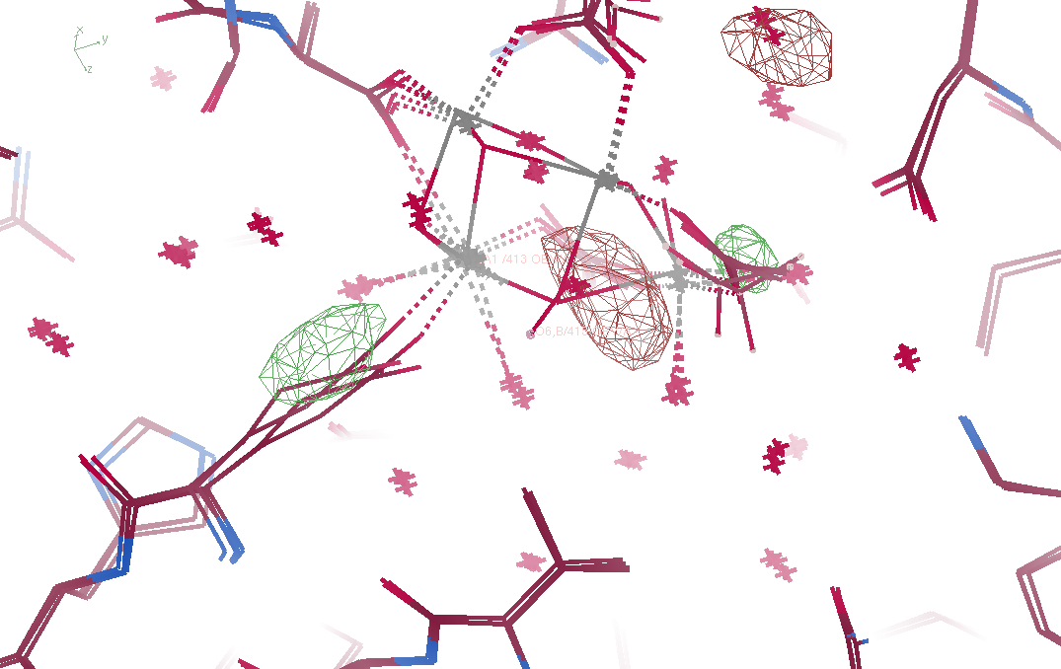
Fo – Fo maps
5ws5 vs 5ws6

