Slide 1
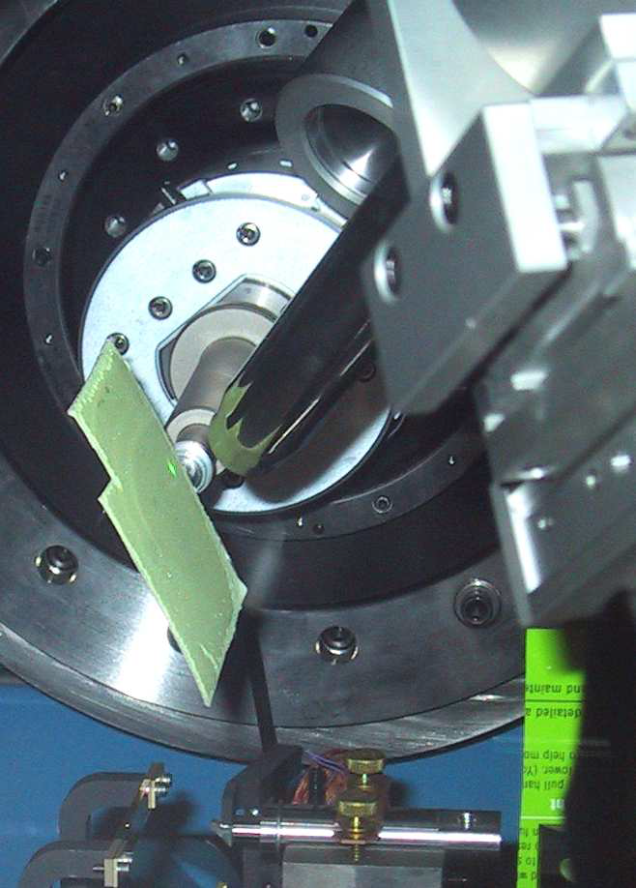
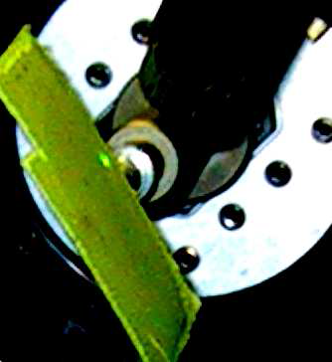
ALS BL 8.3.1
Tom-A-Tron
L
B
E
R
First Light!
June 8 2001

Slide 2
Measured success rate: ALS 8.3.1
1250
1000
750
500
250
0
images x 10⁶
PDB entries
Notes:
Of the 1275 PDB deposits involving ALS 8.3.1, 1038 of them mention a data collection date. The timeline between collection and deposition for each PDB entry is shown in blue. For example, in April 2004 only 46 PDBs had been deposited, but the data for 252 had already been collected. The red line indicates the cumulative number of images collected at a given date. The kink in the red line in mid-2003 is coincident with an optics upgrade that tripled the flux. In 2014 another flux upgrade brought another factor of 4.5.

Slide 3
The 100 structure/year club
PDBs | Sync | BL | Flux
2829 | APS | 19-ID | 1.3E+13
2110 | NSLS | X29A | 2.9E+11
1830 | APS | 22-ID | 7.0E+12
1651 | SLS | X06SA | 4.0E+12
1517 | SLS | X10SA | 2.5E+12
1475 | ESRF | ID29 | 1.0E+13
1447 | SSRF | BL17U | 4.0E+12
1384 | ESRF | ID14-4 | 5.0E+12
PDBs | Sync | BL | Flux
1384 | ESRF | ID14-4 | 5.0E+12
1362 | ESRF | ID23-1 | 4.0E+12
1285 | SSRL | BL11-1 | 4.0E+11
1282 | APS | 24-ID-C | 1.3E+13
1153 | ESRF | ID14-1 | 1.0E+11
1137 | SSRL | BL9-2 | 7.0E+11
1122 | ALS | 8.3.1 | 1.8E+11
1042 | APS | 17-ID | 7.0E+11
1026 | NSLS | X25 | 2.4E+11
8% of all membrane
protein structures!
USA
Europe
Decommissioned

Slide 4
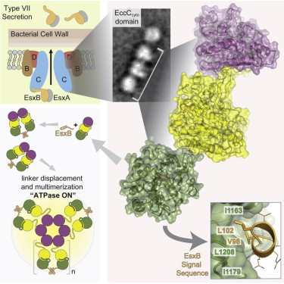
BL 8.3.1 User Science Highlights
Rosenberg OS, Dovala D, Li X, Connolly L, Bendebury A, Finer-Moore J, Holton J, Cheng Y, Stroud RM & Cox JS (2015)."Substrates Control Multimerization and Activation of the Multi-Domain ATPase Motor of Type VII Secretion", Cell 161, 501

Slide 5
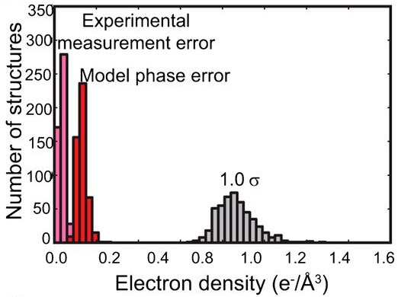
BL 8.3.1 User Science Highlights
Lang PT, Holton JM, Fraser JS & Alber T (2014)."Protein structural ensembles are revealed by redefining X-ray electron density noise", Proc. Nat. Acad. Sci. USA 111, 237.

Slide 6
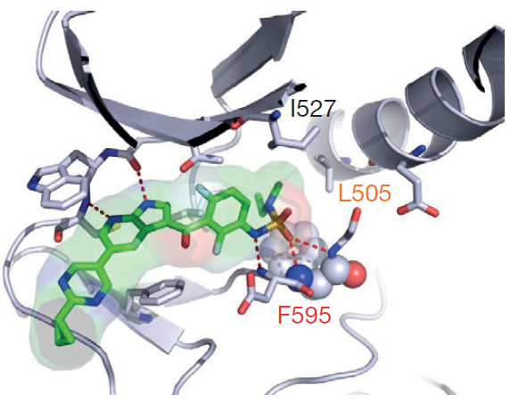
BL 8.3.1 User Science Highlights
Zhang C, Spevak W, Zhang Y, Burton EA, Ma Y, Habets G, et al. (2015) “RAF inhibitors that evade paradoxical MAPK pathway activation” Nature. 526, 583-6.

Slide 7




8.3.1 beam time distribution 2010
Plexxikon
General User
Program
8%
5%
26.5%
25%
UC Berkeley
9%
26.5%
Staff/Development
9%
26.5%

Slide 8
BL8.3.1 Beam Time Allocation (%)
Year | 2010 | 2011 | 2012 | 2013 | 2014 | 2015
Gen. Users | 25 | 25 | 25 | 25 | 25 | 25
R&D | 9 | 9 | 9 | 9 | 9 | 9
Plexxikon | 10 | 8 | 8 | 6 | 6 | 6
MD Anderson | 10 | 5 | 3 | 5 | 8 | 8
UCSF | 23 | 26.5 | 27.5 | 27.5 | 26 | 18.5
UCB | 23 | 26.5 | 27.5 | 27.5 | 26 | 9.7
Total | 100 | 100 | 100 | 100 | 100 | 100

Slide 9
BL8.3.1 PRT member contributions ($k)
Year | 2010 | 2011 | 2012 | 2013 | 2014 | 2015
Gen. Users | 0 | 0 | 0 | 0 | 0 | 0
R&D | 0 | 0 | 0 | 0 | 0 | 0
Plexxikon | 250 | 250 | 250 | 125 | 125 | 125
MD Anderson | 116 | 75 | 75 | 130 | 130 | 130
UCSF | 180 | 180 | 180 | 180 | 180 | 967
UCB | 0 | 0 | 0 | 0 | 0 | 248
Total | 546 | 505 | 505 | 435 | 435 | 1585

Slide 10
BL8.3.1 Non-salary direct costs ($k)
Year | 2010 | 2011 | 2012 | 2013 | 2014 | 2015
general Purchases | 89 | 24 | 66 | 13 | 16 | 24
Cryojet | 37
New Computers | 30
New M1 mirror |  |  |  |  | 105
M1 mirror mount |  |  |  |  | 60
Mono access |  |  |  |  | 5

Slide 11
BL8.3.1 Staff Effort
Year | 2010 | 2011 | 2012 | 2013 | 2014 | 2015
sci: James Holton | 0.9 | 0.9 | 0.9 | 0.9 | 0.6 | 0.75
tec: George Meigs | 0.9 | 0.9 | 0.9 | 0.9 | 1.0 | 1.0
adm: Jane Tanamachi | 0.2 | 0.2 | 0.2 | 0.2 | 0.2 | 0.2
Total | 2.00 | 2.00 | 2.00 | 2.00 | 1.80 | 1.95

Slide 12
BL8.3.1 Publication Record
Year | 2010 | 2011 | 2012 | 2013 | 2014 | 2015
Refereed | 48 | 38 | 47 | 48 | 36 | 15
High Impact | 20 | 16 | 16 | 16 | 16 | 5

Slide 13
BL8.3.1 Financial Support: 2016
Award | dates | source
$2,578,000 | 01/01/15 – 12/31/18 | MRPI: University of California Office of the President (not renewable, no overhead)
$357,492 | 12/15/14 – 12/15/16 | UCSF-PBBR: Program for Breakthrough Biomedical Research (not renewable)
$750,000 | 08/22/14 – 09/30/19 | National Institutes of Health Inter-Agency Agreement (non renewable)
$625,000 | 05/01/12 – 04/30/16 | Plexxikon Inc.
$130,000 | 08/12/15 – 08/11/16 | M. D. Anderson Cancer Research Center
Planned:
$6,567,804 | 04/01/16 – 03/31/21 | NIH P41 – X-ray Structural Biology Resource
$500,000 | 05/01/16 – 04/30/21 | Plexxikon Inc.
$620,000 | 08/12/16 – 08/11/18 | M. D. Anderson Cancer Research Center

Slide 14
BL8.3.1 PRT member contributions ($k)
Year | 2010 | 2011 | 2012 | 2013 | 2014 | 2015
Gen. Users | 0 | 0 | 0 | 0 | 0 | 0
R&D | 0 | 0 | 0 | 0 | 0 | 0
Plexxikon | 250 | 250 | 250 | 125 | 125 | 125
MD Anderson | 116 | 75 | 75 | 130 | 130 | 130
UCSF | 180 | 180 | 180 | 180 | 180 | 967
UCB | 0 | 0 | 0 | 0 | 0 | 248
Total | 546 | 505 | 505 | 435 | 435 | 1585

Slide 15
BL8.3.1 Beam Time Allocation (%)
Year | 2010 | 2011 | 2012 | 2013 | 2014 | 2015
Gen. Users | 25 | 25 | 25 | 25 | 25 | 25
R&D | 9 | 9 | 9 | 9 | 9 | 9
Plexxikon | 10 | 8 | 8 | 6 | 6 | 6
MD Anderson | 10 | 5 | 3 | 5 | 8 | 8
UCSF | 23 | 26.5 | 27.5 | 27.5 | 26 | 18.5
UCB | 23 | 26.5 | 27.5 | 27.5 | 26 | 9.7
Total | 100 | 100 | 100 | 100 | 100 | 100

Slide 16






8.3.1 beam time distribution: 2016
Plexxikon
General User
Program
6%
5%
UC Davis
6.2%
26.5%
UC Santa Cruz
25%
6.2%
6.2%
UC Irvine
9%
6.2%
Staff/Development
UCLA
9%
9.7%
18.5%
UC Berkeley

Slide 17
Grand Challenges in Structural Biology for the 21st Century
Phase Problem
native elements - universally
Amplitude Problem
    Improving resolution
R-factor Gap
    Publishing / being right

Slide 18

Grand Challenges in Structural Biology for the 21st Century
Phase Problem
detector calibration
Amplitude Problem
    disorder
R-factor Gap
    Limited representation

Slide 19
Grand Challenges in Structural Biology for the 21st Century
Phase Problem
detector calibration
Amplitude Problem
    disorder
R-factor Gap
    Limited representation

Slide 20

Pilatus: subtract smooth baseline
~3x10⁵ photon/pixel
Bragg
glitch
“tree rings”
Pick-up tool mark
oxygen
inclusions
1% high
average
1% low

Slide 21
SHSSS: necessary and sufficient
Source of error | realistic simulation | No SHSSS | Perfect detector
Photon counting | + | + | +
Shutter jitter | + | + | -
Beam flicker | + | + | -
Sample absorption | + | + | -
Radiation damage | + | + | -
Imperfect spindle | + | + | -
vignette | + | + | -
Corner correction | + | + | -
SHSSS | + | - | -
R_{meas} (∞-10 Å) | 2.8% | 0.7% | 0.7%
I/σ asymptotic | 26.8 | 74.2 | 81.0
Holton et al (2014) "R-factor gap", FEBS Journal 281, 4046-4060.

Slide 22
Threshold of a revolution in phasing
Current
technology
Goal
Solve-able proteins (%)
Required signal-to-noise (I/σ)

Slide 23
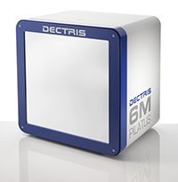
ALS 8.3.1: The 6th detector

Slide 24
Grand Challenges in Structural Biology
Phase Problem
Calibrate it out boost the signal average over it
Amplitude Problem
R-factor Gap
http://bl831.als.lbl.gov/~jamesh/powerpoint/Janelia_thresholds_2015.pptx

Slide 25
Grand Challenges in Structural Biology
Phase Problem
Calibrate it out boost the signal average over it
Amplitude Problem
R-factor Gap
http://bl831.als.lbl.gov/~jamesh/powerpoint/Janelia_thresholds_2015.pptx

Slide 26
2472.7 2473.5
Anomalous f” (electrons)
Photon Energy (eV)
Bohic et al. Anal. Chem. 2008; 80(24):9557. doi: 10.1021/ac801817k

Slide 27
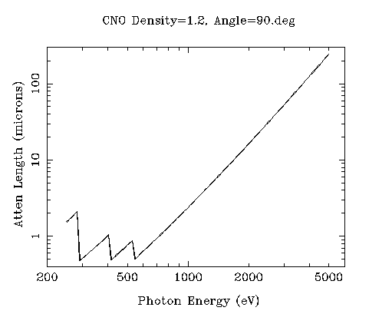
“sweet spot” for sample size ?
Ca
Ar
Cl
K
S
P
2 Å
2sin(90°)
Mg
C
Na
Se
Ne
3 Å
2sin(90°)
N
O
F
4 Å
2sin(90°)

Slide 28
ALS-U: Small, soft beams

Slide 29
ALS-U: Small, soft beams
Diamond
($100, reusable)

Slide 30
ALS-U: Small, soft beams
oil
Diamond
($100, reusable)

Slide 31
ALS-U: Small, soft beams
oil
Diamond
($100, reusable)

Slide 32
ALS-U: Small, soft beams
oil
λ=2d sinθ
2.5 Å data
with 5 Å X-rays
Only analytic absorption correction:
International Tables for Crystallography, Vol. C, 2nd ed., chapter 6.3

Slide 33
(h,k,l)
Ewald sphere 2
λ*
diffracted ray
d*
θ
λ*
λ*
θ
d*
diffracted ray
λ*
Ewald sphere
1
(-h,-k,-l)

Slide 34
Si(111)
52.87deg
Si(111)
2 Multilayer mirrors
d=2nm, W/B4C
KB Horiz focus
KB vertical focus
Si(111)
Detector
Detector
λ = 5 Å
h,k,l
sample
injector
-h,-k,-l
Si(111)
Detector
Detector
~ 1m
Si(111)
Si(111)
Notes:
Proposed 5-crystal monochromator for colliding-beam crystallography. The generation of two opposing Ewald spheres means that for every h,k,l index reflected from the protein crystal, the Friedel mate is reflected in the opposite direction, allowing for very accurate anomalous difference measurements. The wavelength need not be set precisely at the sulfur or phosphorous edge, but merely at a wavelength where the f” of those elements are strong. For fs-class pulses, the distances above will have to be precise to withing ~3 microns, and for accurate reproduction of the partiality of the Friedel mates, the angular precision of the colliding beams must be within ~1% of the sample crystal’s rocking width, or ~100 microrads.

Slide 35
Grand Challenges in Structural Biology
Phase Problem
Calibrate it out boost the signal average over it
Amplitude Problem
R-factor Gap
http://bl831.als.lbl.gov/~jamesh/powerpoint/Janelia_thresholds_2015.pptx

Slide 36

Non-isomorphism in lysozyme
RMSD = 0.18 Å
Δcell = 0.7 %
R_{iso} = 44.5%
3aw6
3aw7
RH: 84.2%
vs 71.9%

Slide 37
X-ray Data Sets
Singular values & vectors
data
set
h,k,l | structure factors (F)
 | #1 | #2 | #3 | #4
5,3,4 | 523.7 | 559.8 | 579.9 | 603.2
5,4,4 | 168.2 | 166.6 | 177.2 | 196.1
5,5,4 | 34.9 | 26.4 | 19.2 | 17.3
6,1,4 | 305.7 | 301.1 | 298.1 | 296.3
6,2,4 | 353.0 | 353.9 | 356.2 | 366.9
6,3,4 | 300.9 | 285.3 | 273.5 | 259.4
6,3,5 | 223.8 | 226.3 | 234.6 | 251.4
… | … | … | … | …
h,k,l | 100% | 17 % | 13 % | 9 %
 | 1st | 2nd | 3rd | 4th
5,3,4 | -1.46 | -0.02 | 1.84 | -0.72
5,4,4 | -0.88 | -0.29 | -0.34 | 0.15
5,5,4 | -0.42 | -0.65 | 1.02 | 1.47
6,1,4 | -0.90 | -0.85 | 1.44 | -0.40
6,2,4 | -1.20 | -0.37 | 0.67 | 0.01
6,3,4 | -0.75 | 0.31 | 0.48 | 0.00
6,3,5 | -0.75 | -0.85 | 0.72 | -0.82
… | … | … | … | …
value
vector
Singular value decomp.
SVD
-0.68
-0.24
0.32 …
CC1
Data sets
Positioned
in
“Correlation
Space”
Correlation
Coefficients
CC1 CC2 CC3
CC2
data set #1
data set #2
data set #3
CC3

Slide 38
Grand Challenges in Structural Biology
Phase Problem
detector calibration
Amplitude Problem
    disorder
R-factor Gap
    Limited representation

Slide 39
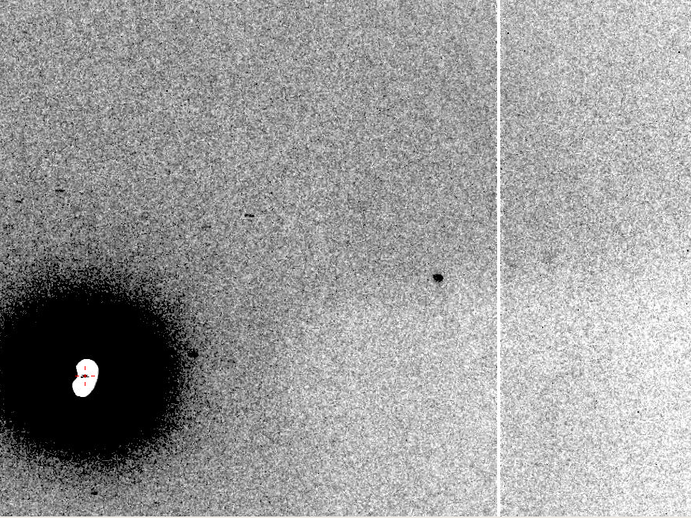
The Amplitude Problem
10 Å

Slide 40

lysozyme: real and reciprocal

Slide 41
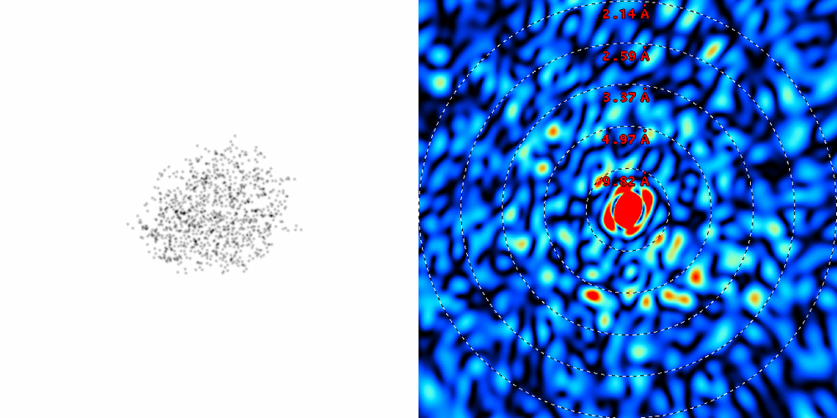
lysozyme: thermal motion

Slide 42
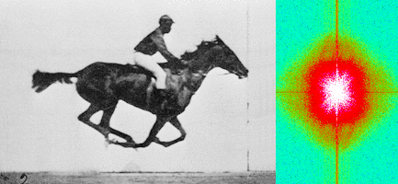
Muybridge’s galloping horse (1878)
“Time-resolved” diffraction
Real space
reciprocal

Slide 43
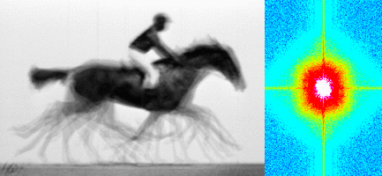
Muybridge’s galloping horse (1878)
Average electron density
Real space
reciprocal

Slide 44
Bigger is better, but not by much
B = 20
B = 60
B = 0
B = 170
B = 330
B = 560
Resolution (Å)
B = 850
Crystal diameter (micron)

Slide 45
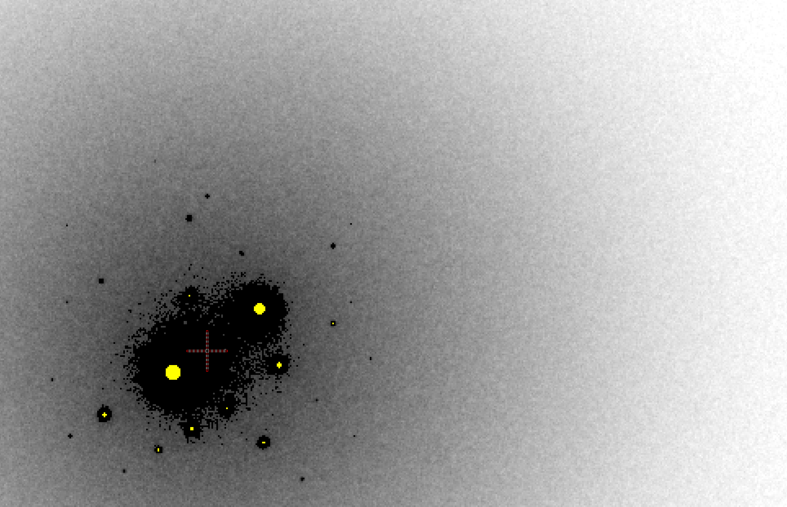
B factor from image analysis
B = 500

Slide 46
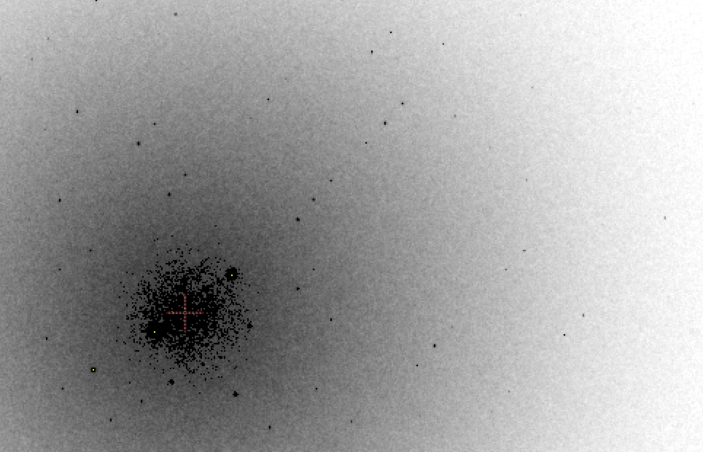
B factor from image analysis
B = 20

Slide 47

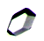
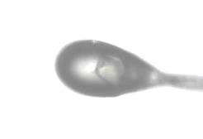

Dissecting the Amplitude Problem
purify
protein
grow
crystal
traditional
approach
cryo
MX
B factor
AUORA
auto optical
re-alignment
low
micro
beam
XFEL

Slide 48

Zero-parallax simplifies alignment
Styrofoam™ backlight
backstop
prism
pinhole
microscope

Slide 49
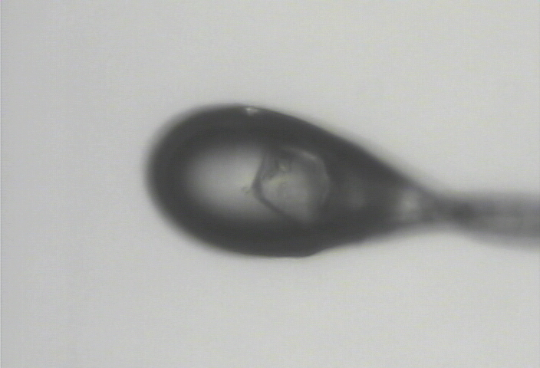
Zero-parallax simplifies alignment
visible light

Slide 50
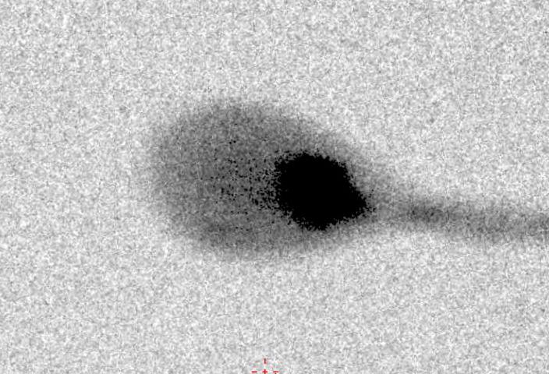
Zero-parallax simplifies alignment
X-ray

Slide 51
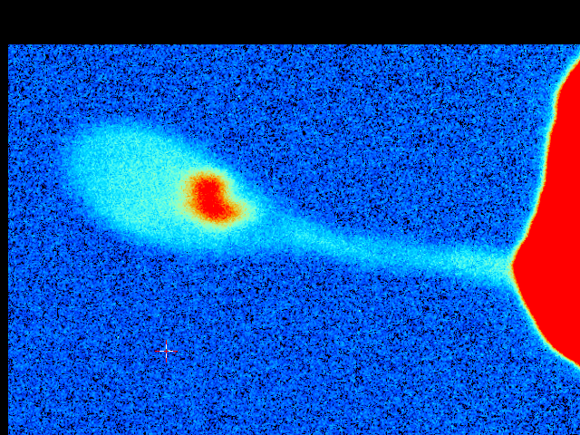


Cone-Beam Online X-ray
Absorption Radiography
(CBOXAR)
3%
2%
1%
0
MX
area
detector
beam center
crystal in loop
Cu foil
X-ray excited
fluorescent
X-ray source
x-ray beam

Slide 52
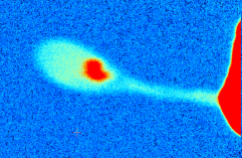
Dissecting the Amplitude Problem
purify
protein
grow
crystal
traditional
approach
cryo
MX
CBOXAR
& raster
B factor
AUORA
auto optical
re-alignment
low
micro
beam
XFEL

Slide 53
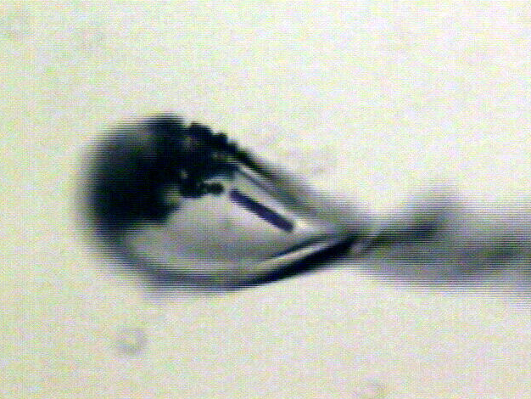
“rastering” to find the crystal
X-ray beam
ice
Membrane
protein crystal

Slide 54
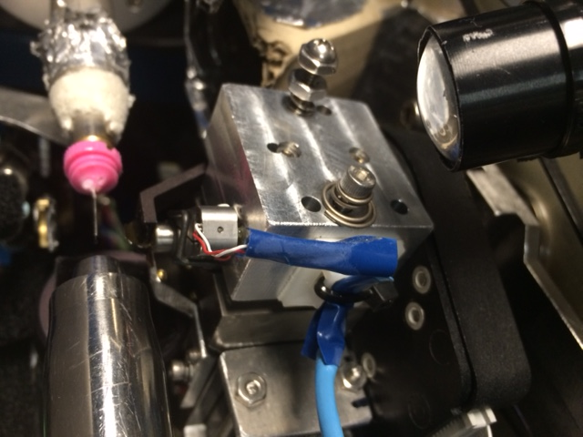
“8-shooter” adjustable beam size
rotary
pinholes:
300
100
75
50
30
25
10
“small”

Slide 55
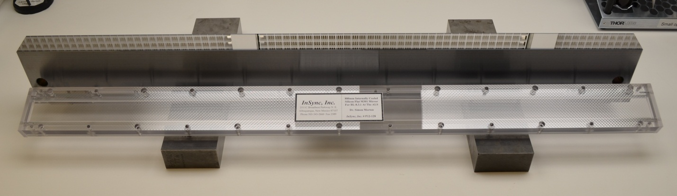
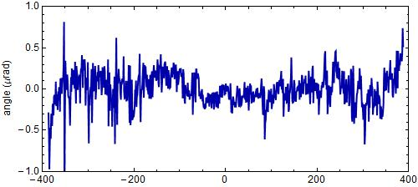
“The flattest thing we have ever seen”
- LBNL Metrology Group
Old mirror: 800 nRad
New mirror: < 200 nRad
Dec 17 2014
Flux at
460%

Slide 56
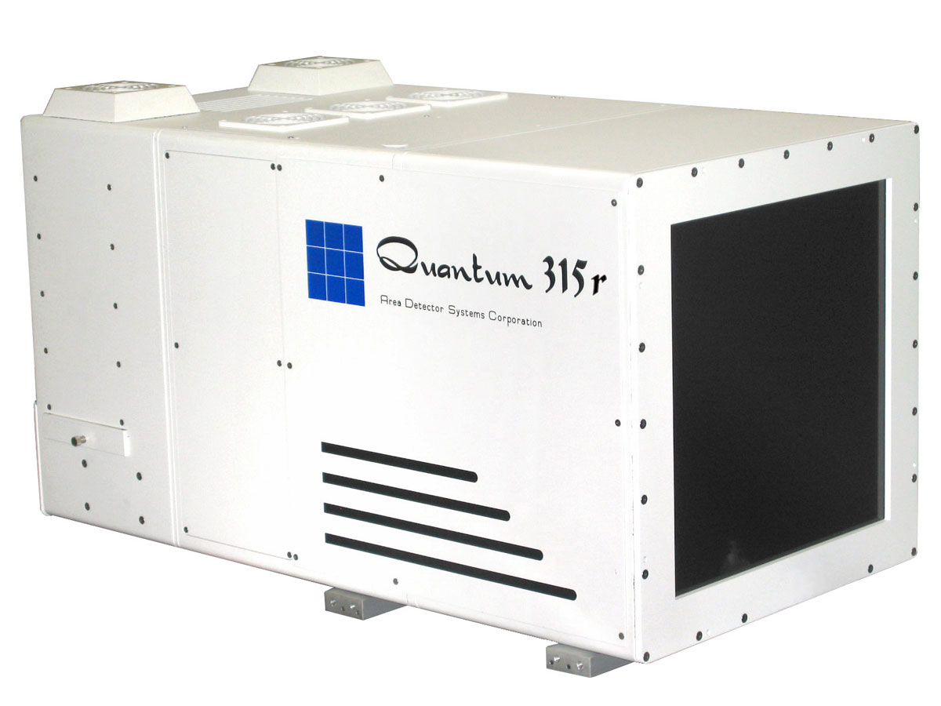
Low cost, portable rastering solution
Collaboration: 8.3.1 and MBC beamlines
Existing
Retractable
Front cover
Sample crystal
In cryo-loop
(not to scale)
Existing MX detector
0.4 frames/s
Photon/noise = 0.4
New
CMOS detector
($70,000)
20 frames/s
photon/noise = 2
http://researchdetectors.com/cmos_1m.html

Slide 57
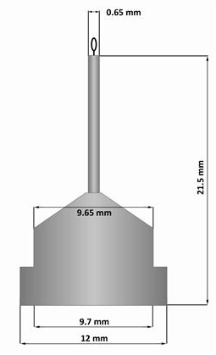
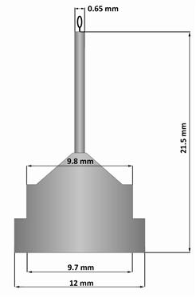
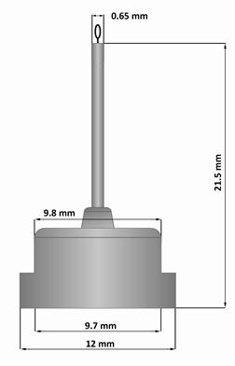
Pin compatibility
SLAC
ALS
SPINE

Slide 58
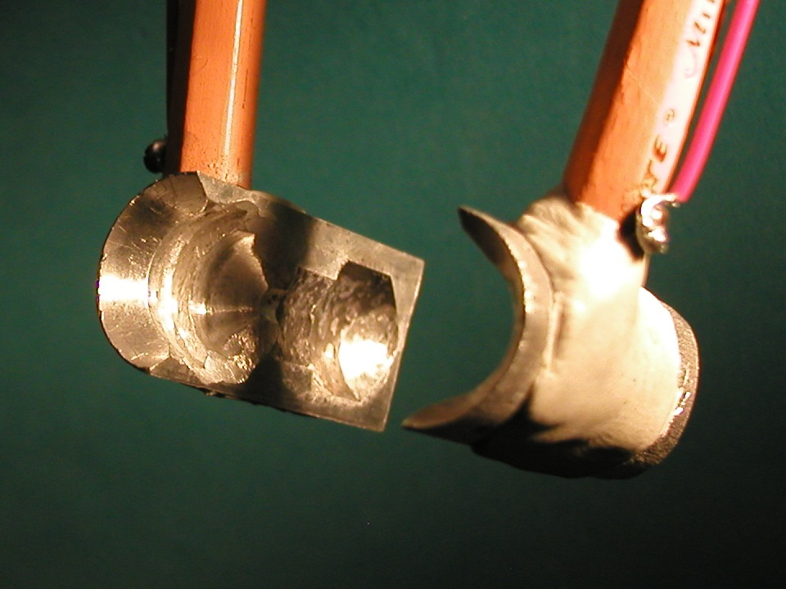
SuperTong

Slide 59
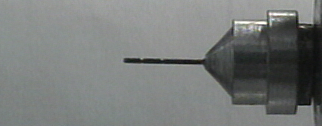
Hampton Pin
SuperTong

Slide 60
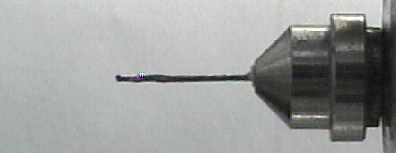
Syrrx Pin
SuperTong

Slide 61
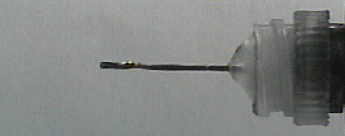
plastic Pin
SuperTong

Slide 62
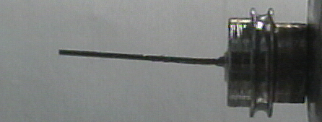
Yale Pin
SuperTong

Slide 63
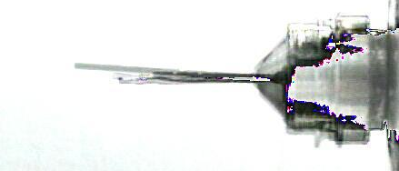
SuperTong
SuperTong

Slide 64
“infinite capacity” sample carousel

Slide 65
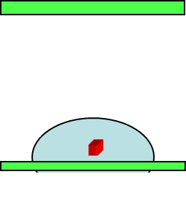
Dissecting the Amplitude Problem
purify
protein
grow
crystal
traditional
approach
in-situ MX
Control for handling
cryo
MX
CBOXAR
& raster
B factor
high
AUORA
auto optical
re-alignment
low
micro
beam
XFEL

Slide 66
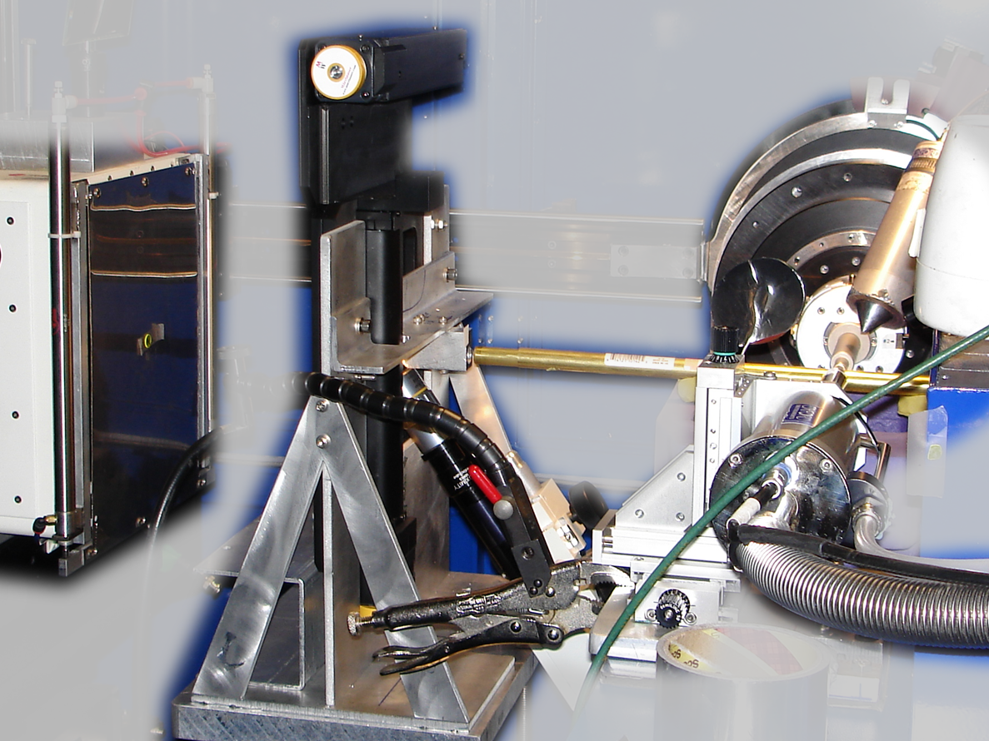
Notes:
non-rotating tray goniometer stage installed in ALS 8.3.1. Note that the “normal” cryo-pin goniometer on the left is still in place and a brass flight tube has been added to contain the air scatter from the main beam on its way to the tray goniometer.

Slide 67

Dissecting the Amplitude Problem
purify
protein
grow
crystal
traditional
approach
in-situ MX
Control for handling
RT MX
Control for cryo
cryo
MX
+
CBOXAR
& raster
B factor
high
Rapid RT
high multiplicity
AUORA
auto optical
re-alignment
low
micro
beam
XFEL

Slide 68
Dissecting the Amplitude Problem
design
new clone /
conditions
purify
protein
XFP
xtal packing
interfaces
grow
crystal
traditional
approach
in-situ MX
Control for handling
-
RT MX
Control for cryo
cryo
MX
+
CBOXAR
& raster
B factor
high
Rapid RT
high multiplicity
AUORA
auto optical
re-alignment
low
micro
beam
XFEL
XFEL

Slide 69
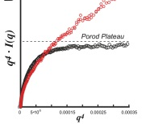
Dissecting the Amplitude Problem
SAXS
order/disorder
In solution
design
new clone /
conditions
purify
protein
XFP
xtal packing
interfaces
grow
crystal
traditional
approach
in-situ MX
Control for handling
-
RT MX
Control for cryo
cryo
MX
+
CBOXAR
& raster
B factor
high
Rapid RT
high multiplicity
AUORA
auto optical
re-alignment
low
micro
beam
XFEL
XFEL

Slide 70
Grand Challenges in Structural Biology
Phase Problem
detector calibration
Amplitude Problem
    disorder
R-factor Gap
    Limited representation

Slide 71

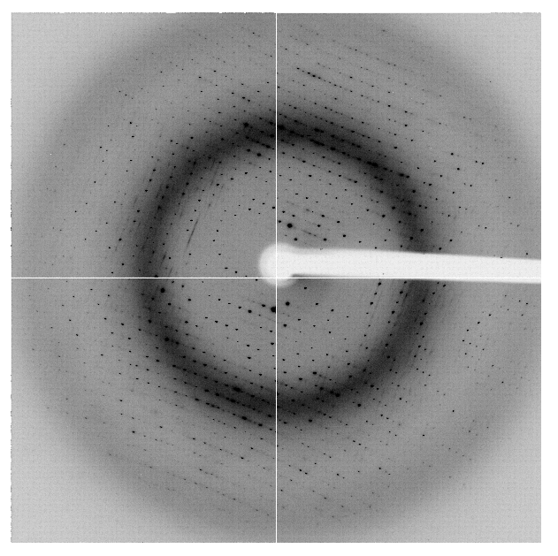
“R-factor Gap” for macromolecules
single-conformer PDB file
R_{merge} = 6%
R_{work} = 7%
R_{free} = 8%
MLFSOM
Elves
1H87; conf “A”
Holton et al. (2014) "The R-factor gap", FEBS J. 281, 4046-4060.

Slide 72
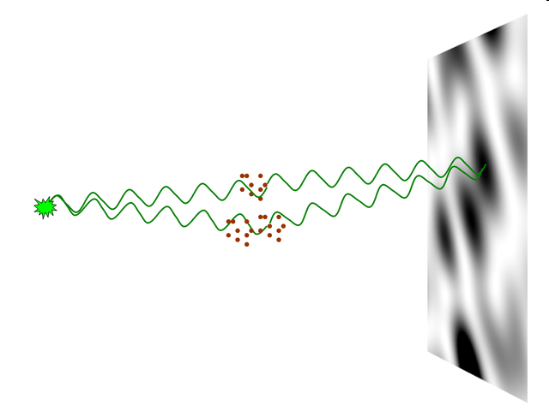
nearBragg program
http://bl831.als.lbl.gov/~jamesh/nearBragg/
“assumption-free” total scattering
no Fourier Transform
no unit cells
no “mosaicity”
arbitrary “atoms”
arbitrary “source”
coherent or not

Slide 73
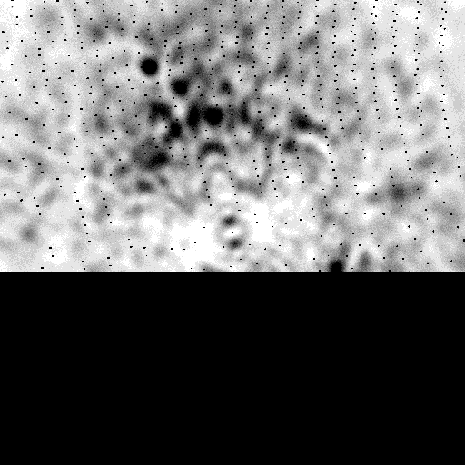
Simulation of diffuse scatter
http://bl831.als.lbl.gov/example_data_sets/Illuin/lyso_DS

Slide 74
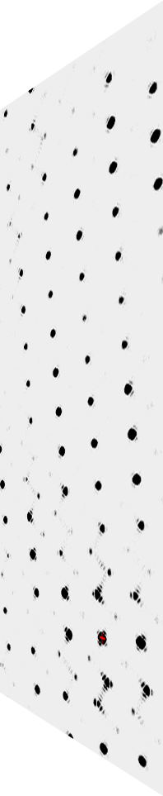
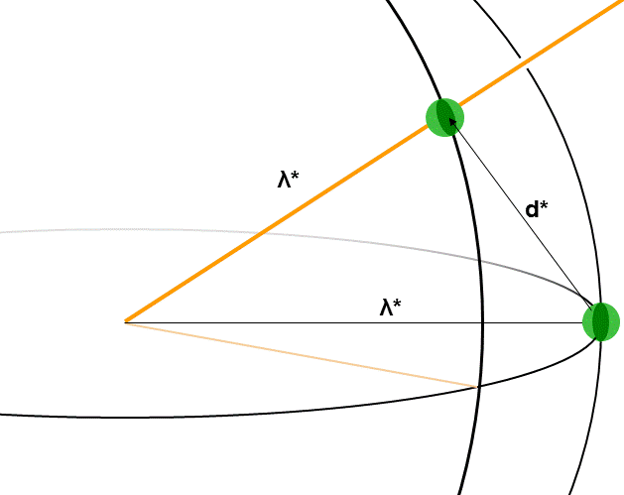
fastBragg program
http://bl831.als.lbl.gov/~jamesh/fastBragg/
Optimized for nanocrystals
Square or round
Takes h,k,l and F
Supports 1 unit cell
no “mosaicity”
arbitrary “source”
arbitrary “phi” steps

Slide 75
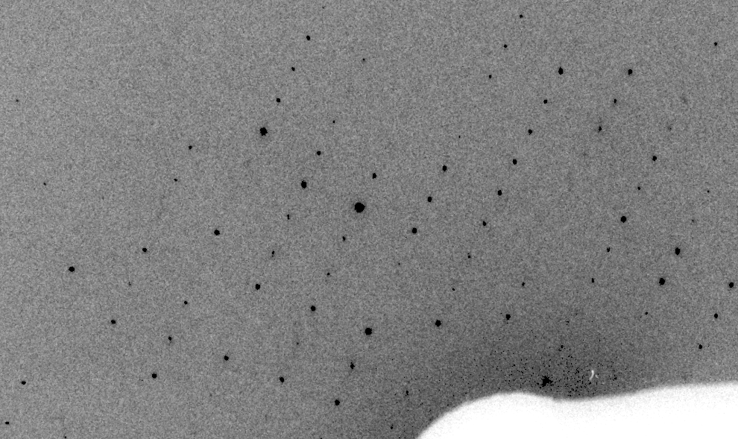
Simulation of XFEL stills
real

Slide 76
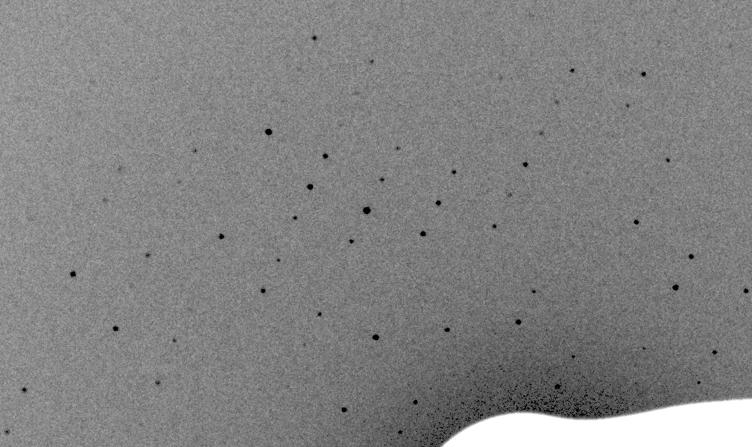
Simulation of XFEL stills
fake

Slide 77
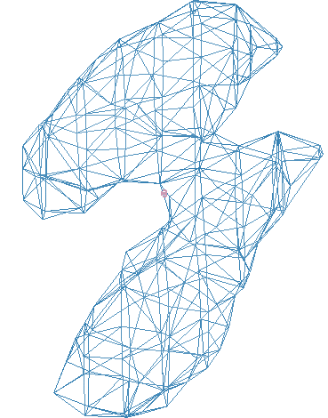
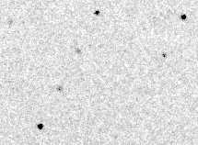
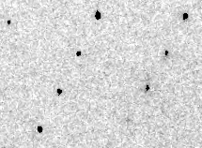
Simulation of XFEL stills
phix
phiy
phiz
real
VS
phix
phiy
phiz

Slide 78
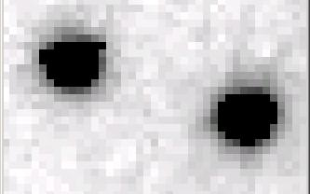
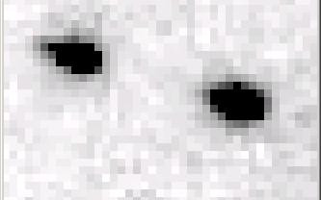
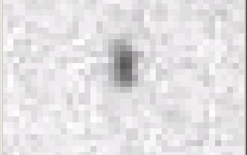
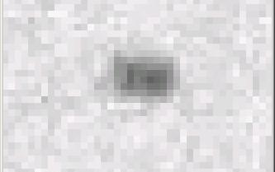
Si(111) vs multilayers
0.014%
Si(111)
spectral
dispersion
1%
multilayer
4 Å
resolution
1.9 Å

Slide 79


Is it Real? Or is it MLFSOM
simulated
real

Slide 80

Global Challenge: Se phasing
Trivial to solve
100% SeMet incorporation
MLFSOM
simulation

Slide 81

Global Challenge: Se phasing
Impossible to solve
100% S -Met incorporation
MLFSOM
simulation

Slide 82

Global Challenge → new software

Slide 83

New software → benefits users

Slide 84

Holton & Frankel (2010) Acta D 66 393-408.

Slide 85


Slide 86


Slide 87
Grand Challenges in Structural Biology
Phase Problem
Calibrate it out boost the signal average over it
Non-isomorphism phasing (NIP)
Amplitude Problem
Disorder > everything Dissect sample prep
“Meta-beamline”
R-factor Gap
1 electron =chemistry validate dynamics
2D data vs 4D models
http://bl831.als.lbl.gov/~jamesh/powerpoint/MOU_831_2016.pptx

Slide 88
Concluding remarks
8.3.1 finances stabilizing
Need new scientist
Poised for major hardware upgrades
Pilatus, multilayer
Focus on biggest problems
Phases, amplitudes, systematics

