Slide 1
The “success rate” of structural biology
100 s/dataset
200 days/year
~150 beamlines
~26,000,000 datasets/year
9333 PDBs in 2015

Slide 2
Data from ALS 8.3.1 2001-2005
non-isomorphous
Unsolved?
R_{iso} vs PDB deposit
Published
best R_{cryst} after rigid-body refinement

Slide 3
What are the problems?
Phase Problem
native elements - universally
Amplitude Problem
    Improving resolution
R-factor Gap
    Publishing / being right

Slide 4

Principle barrier to Phase Problem
Pilatus detector: deviation from smooth baseline
Bragg
glitch
“tree rings”
Pick-up tool mark
oxygen
inclusions
1% high
average
1% low

Slide 5
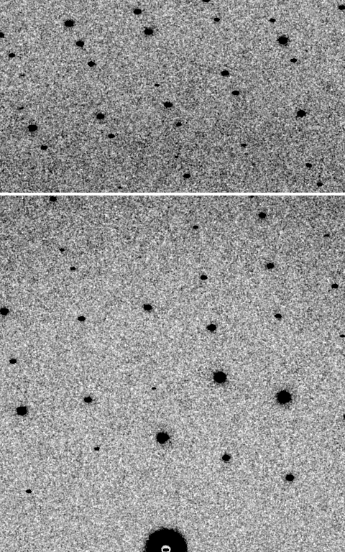
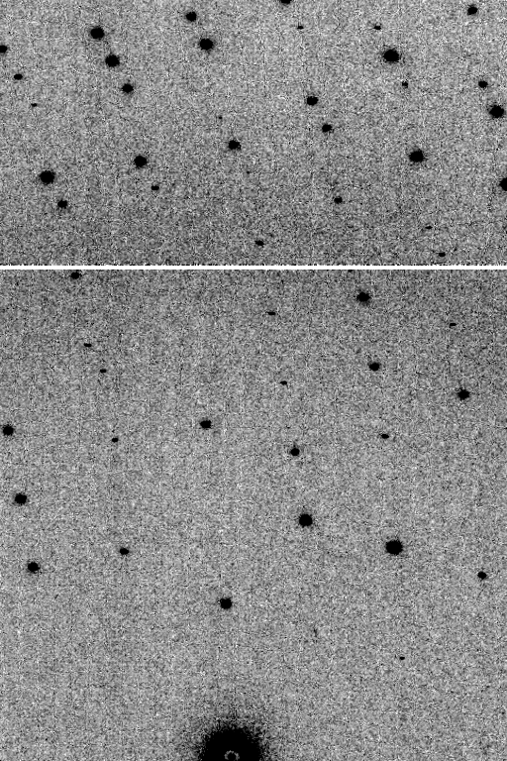
Is it Real? Or is it MLFSOM
simulated
real
Holton et al (2014) "R-factor gap", FEBS Journal 281, 4046-4060.

Slide 6
Threshold of a revolution in phasing
Source of error | realistic simulation | No SHSSS | Perfect detector
Photon counting | + | + | +
Shutter jitter | + | + | -
Beam flicker | + | + | -
Sample absorption | + | + | -
Radiation damage | + | + | -
Imperfect spindle | + | + | -
vignette | + | + | -
Corner correction | + | + | -
SHSSS | + | - | -
R_{meas} (∞-10 Å) | 2.8% | 0.7% | 0.7%
I/σ asymptotic | 26.8 | 74.2 | 81.0
Holton et al (2014) "R-factor gap", FEBS Journal 281, 4046-4060.

Slide 7
Threshold of a revolution in phasing
Current
technology
Goal
Solve-able proteins (%)
Required signal-to-noise (I/σ)

Slide 8
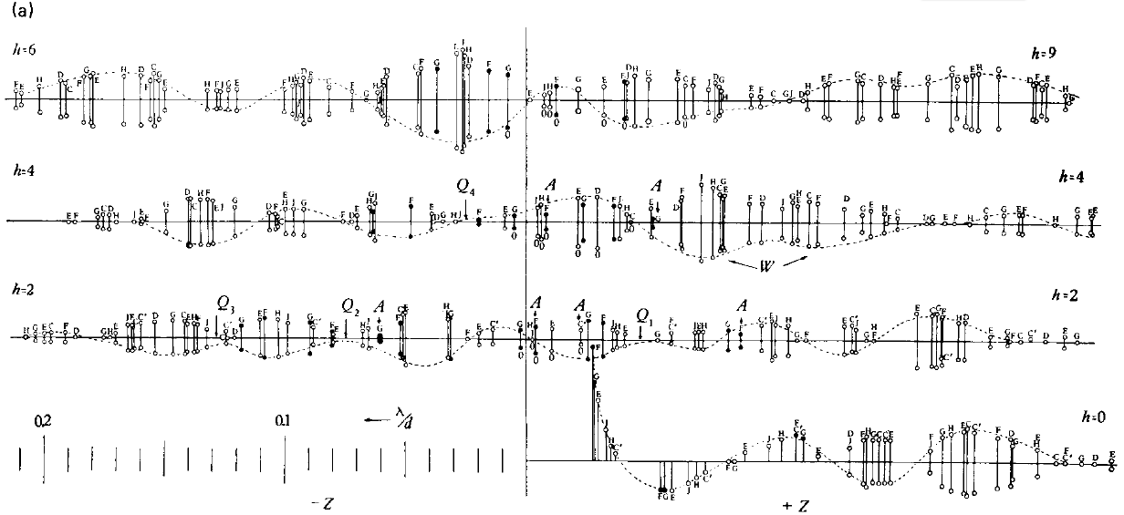
Phasing with Bragg’s
“minimum wavelength principle”
Perutz (1985). “Early Days of Cryst…” Methods in Enzymology, Vol. 114, 3-18.
Bragg & Perutz (1952)."external form haemoglobin I", Acta Cryst. 5, 277-283.

Slide 9

Non-isomorphism in lysozyme
RMSD = 0.18 Å
Δcell = 0.7 %
R_{iso} = 44.5%
3aw6
3aw7
RH: 84.2%
vs 71.9%

Slide 10
Structure factor (electrons)
Correlation to 2nd & 3rd singular vectors

Slide 11
Structure factor (electrons)
Correlation to 2nd & 3rd singular vectors

Slide 12
Structure factor (electrons)
Correlation to 2nd & 3rd singular vectors

Slide 13
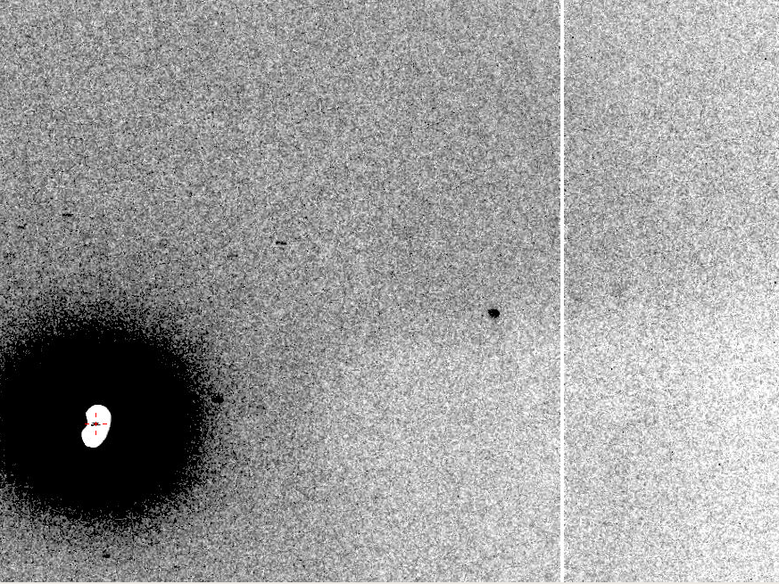
The Amplitude Problem
10 Å

Slide 14
resolution dependence of global damage
10³
10 MGy/Å
100
maximum tolerable dose (MGy)
10
1
1 2 3 5 7 10 20 40 70 100
resolution (Å)
Howells et al. (2009) J. Electron. Spectrosc. Relat. Phenom. 170 4-12

Slide 15
Radiation Damage
World Records
MGy reaction reference
~45 global damage Owen et al. (2006)
5 Se-Met Holton (2007)
4 Hg-S Ramagopal et al. (2004)
4 R-C-COOH Garman et al. (2015)
3 S-S Murray et al. (2002)
1 Br-RNA Olieric et al. (2007)
~1? Cl-C ???
0.5 Mn in PS II Yano et al. (2005)
0.02 Fe in myoglobin Denisov et al. (2007)
Holton (2009) J. Synchrotron Rad. 16 133-42

Slide 16
The number of photons scattered
before crystal is dead
is independent
of data collection time
1 um³ = 10⁶ photons (synch)
1 um³ = 10⁸ photons (XFEL)
(synch)
Henderson, 1990; Gonzalez & Nave, 1994; Glaeser et al., 2000; Sliz et al., 2003; Leiros et al., 2006; Owen et al., 2006; Garman & McSweeney, 2006; Garman & Nave, 2009; Holton, 2009

Slide 17
Self-calibrated damage limit
Where:
⟨I⟩_{DL} - average damage-limited intensity (photons/hkl) at a given resolution
10⁵ - converting R from μm to m, r_{e} from m to Å, ρ from g/cm³ to kg/m³ and MGy to Gy
r_{e} - classical electron radius (2.818 x 10⁻¹⁵ m/electron)
h - Planck’s constant (6.626 x 10⁻³⁴ J∙s)
c - speed of light (299792458 m/s)
f_{decayed} - fractional progress toward completely faded spots at end of data set
ρ - density of crystal (~1.2 g/cm³)
R - radius of the spherical crystal (μm)
λ - X-ray wavelength (Å)
f_{NH} - the Nave & Hill (2005) dose capture fraction (1 for large crystals)
n_{ASU} - number of proteins in the asymmetric unit
M_{r} - molecular weight of the protein (Daltons or g/mol)
V_{M} - Matthews’s coefficient (~2.4 Å³/Dalton)
H - Howells’s criterion (10 MGy/Å)
θ - Bragg angle
⟨ƒ_{a}²⟩ - number-averaged squared structure factor per protein atom (electron²)
⟨M_{a}⟩ - number-averaged atomic weight of a protein atom (~7.1 Daltons)
B - average (Wilson) temperature factor (Å²)
μ - attenuation coefficient of sphere material (m⁻¹)
μ_{en} - mass energy-absorption coefficient of sphere material (m⁻¹)
No flux
No symmetry
Holton & Frankel (2010) Acta D 66 393-408.

Slide 18
Bigger is better, but not by much
B = 20
B = 60
B = 0
B = 170
B = 330
B = 560
Resolution (Å)
B = 850
Crystal diameter (micron)

Slide 19
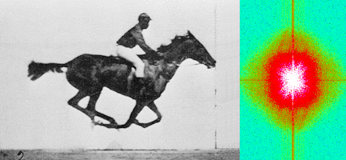
Muybridge’s galloping horse (1878)
“Time-resolved” diffraction
Real space
reciprocal

Slide 20
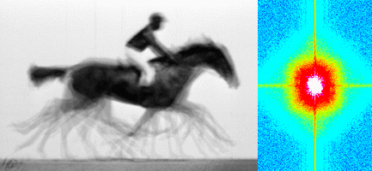
Muybridge’s galloping horse (1878)
Average electron density
Real space
reciprocal

Slide 21
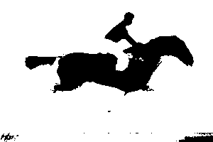
Muybridge’s galloping horse (1878)
Average electron density: 1 sigma contour
Real space
reciprocal

Slide 22

lysozyme: real and reciprocal

Slide 23
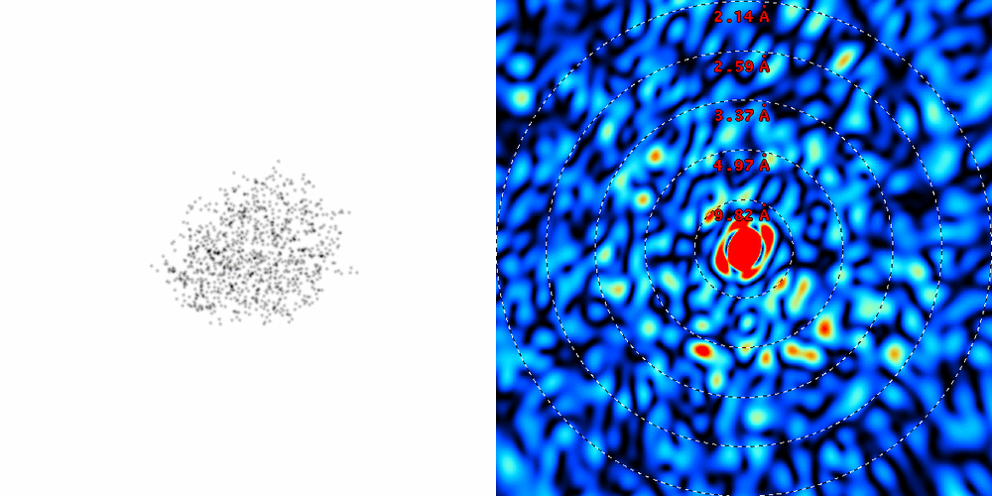
lysozyme: thermal motion

Slide 24
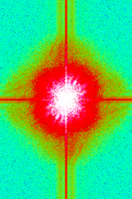
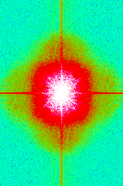
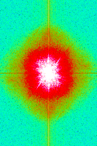
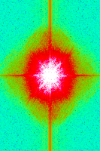
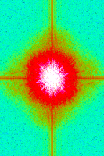
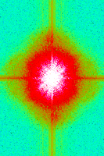
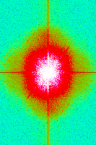
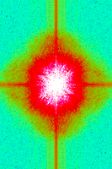
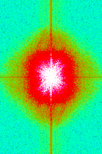
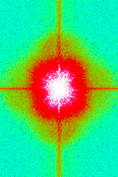
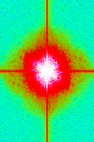
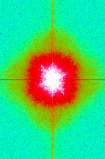
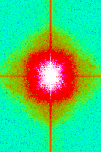
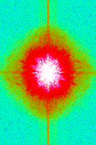
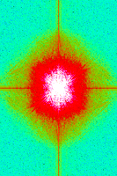
Single-image model refinement
Supporting a 4D model with 2D data

Slide 25
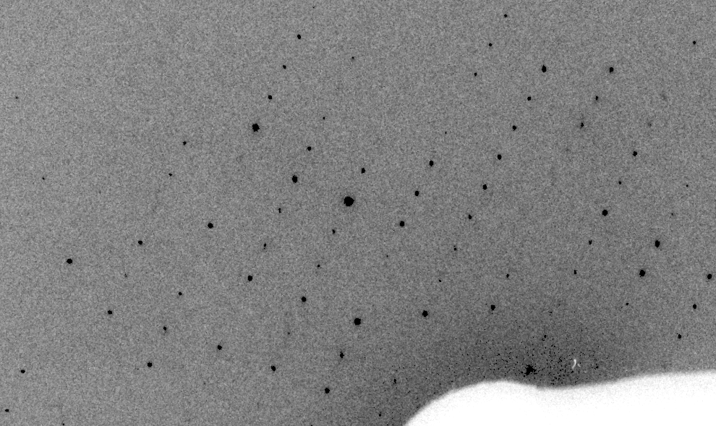
Real XFEL still

Slide 26
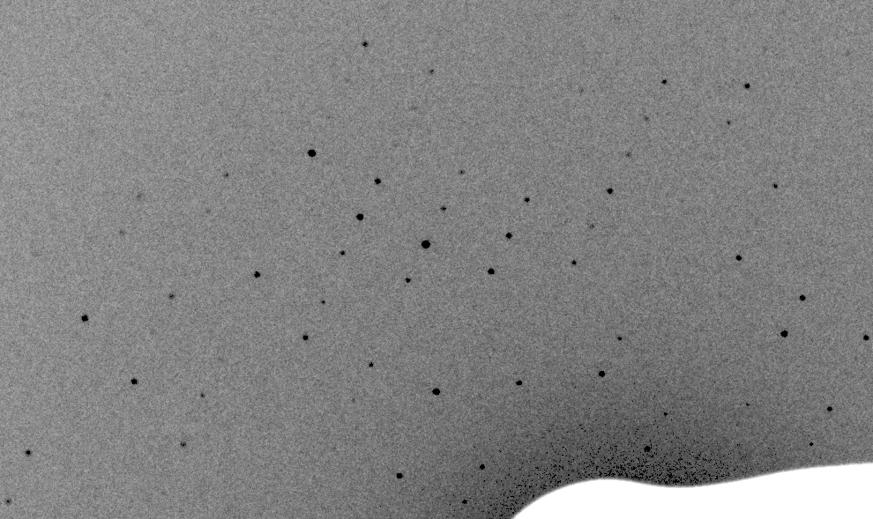
Simulation of XFEL still

Slide 27
XFEL: “fit” simulation to reality
Dispersion
Divergence
Mosaicity
Wavelength
Unit cell parameters (3)
Crystal orientation (3)
Mosaic domain size (3)
Beam center (2)
Beam direction (2)
Detector distance

Slide 28
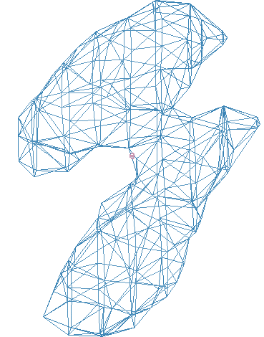
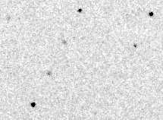
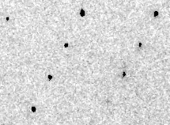
Simulation of XFEL still
phix
phiy
phiz
real
VS
phix
phiy
phiz

Slide 29
“R-factor Gap” for macromolecules
Publication criterion for chemical crystallography:
R1 < 2*R_{sigma}
R1 = F_{o} vs F_{c} for I/σ(I) > 3
R_{sigma} = <σ(I)>/<I>
There are no PDB entries that pass this test!
Holton et al. (2014) "The R-factor gap", FEBS J. 281, 4046-4060.

Slide 30
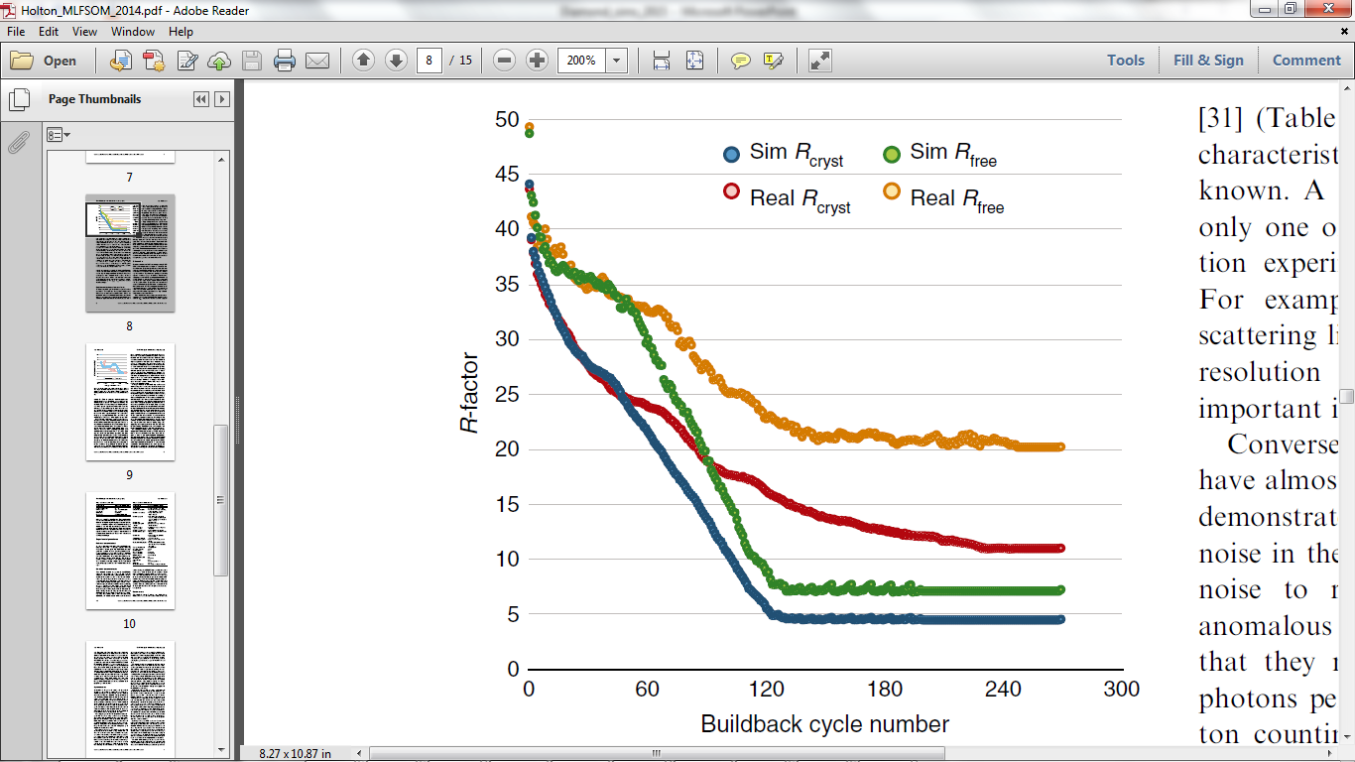
The R-factor Gap
Holton et al. (2014) "The R-factor gap", FEBS J. 281, 4046-4060.

Slide 31
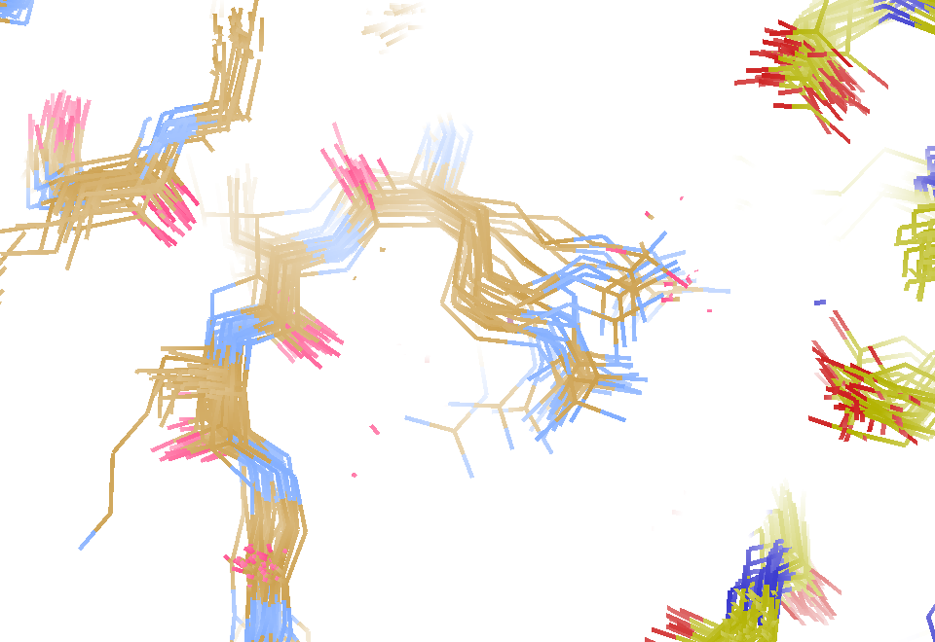
MD simulation: 30 conformers from 24,000
Cerutti et al. (2010).J. Phys. Chem. B 114, 12811-12824.

Slide 32
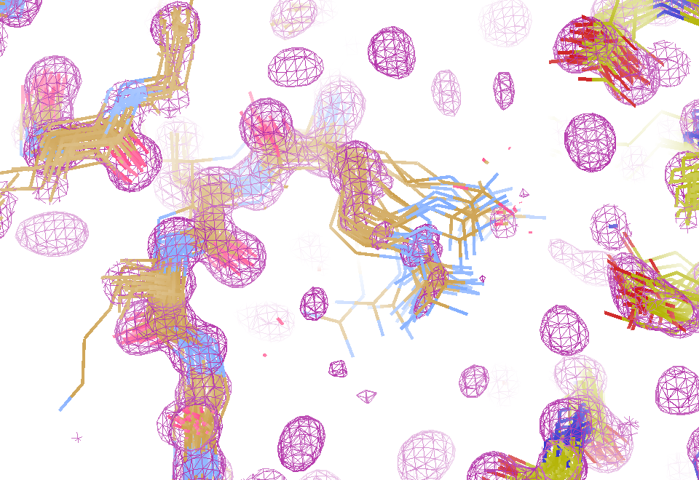
Electron density from 24,000 conformers

Slide 33
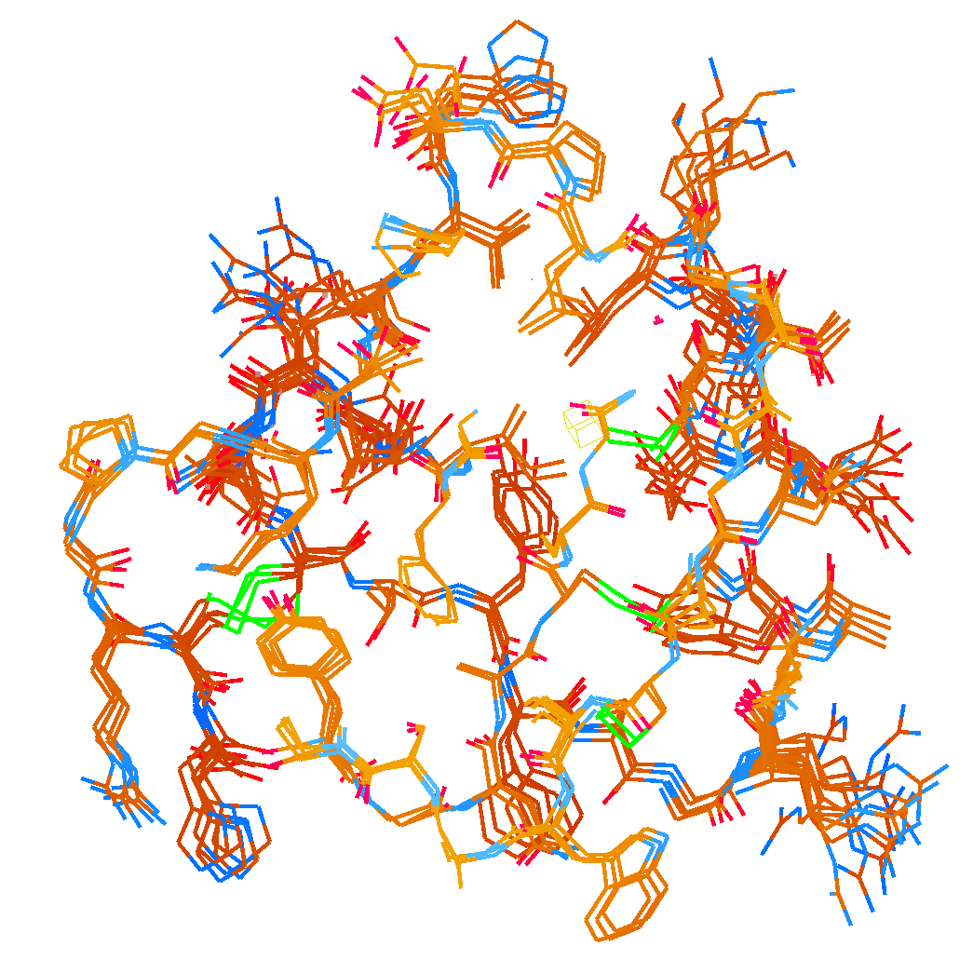
How many “conformers” are needed?
Answer: 2-14
R_{work} = 0.0441
R_{free} = 0.0516
vs F_{sim}
No solvent!

Slide 34
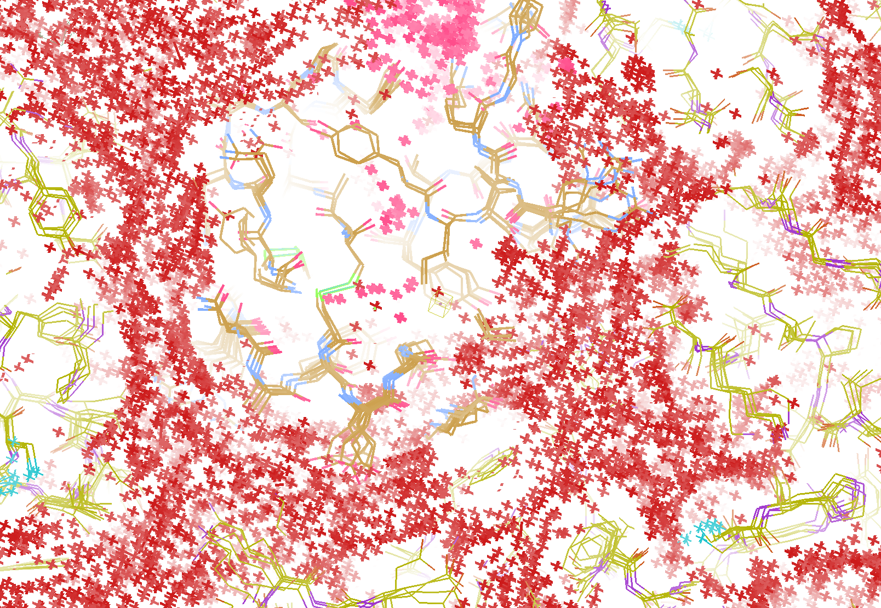
How do you model solvent?
R_{work} = 0.0309
R_{free} = 0.0678
vs F_{sim}
Problem: diverges with more cycles

Slide 35
Grand Challenges in Structural Biology
Phase Problem
Better detector calibration
Amplitude Problem
    Get around averaging (better models)
R-factor Gap
    Better models for “disorder” (function)
    If we had right answer, it would blow up!

Slide 36
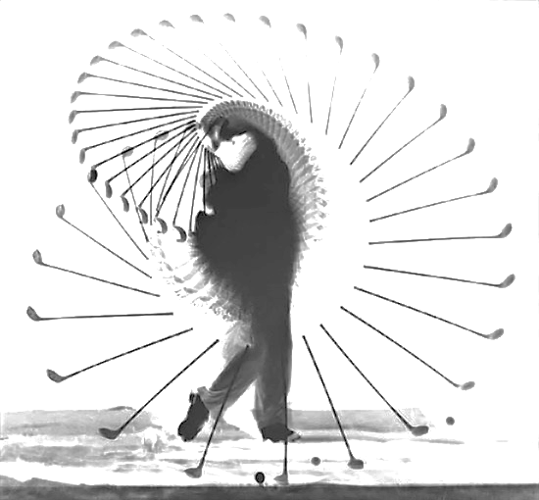
The Future of Structural Biology
We need
better
data
We need
better
models
grand challenge for the 21st century

Slide 37
Acknowledgements
Robert Stroud James Fraser Aina Cohen Ana Gonzalez
Axel Brunger Monarin Uervirojnangkoorn Artem Lyubimov Nick Sauter
UCSF LBNL SLAC
ALS 8.3.1 creator: Tom Alber
UC Multicampus Research Programs and Initiatives (MRPI)
UCSF Program for Breakthrough Biomedical Research (PBBR)
one-time NIH-DOE Inter-agency agreement (IAA)
Integrated Diffraction Analysis Technologies (IDAT)
Plexxikon, Inc.
M D Anderson CRC
Synchrotron Radiation Structural Biology Resource (SLAC)
The Advanced Light Source is supported by the Director, Office of Science, Office of Basic Energy Sciences, Materials Sciences Division, of the US Department of Energy under contract No. DE-AC02-05CH11231 at Lawrence Berkeley National Laboratory.

Slide 38

100% SeMet incorporation
Trivial to solve

Slide 39

100% S -Met incorporation
Impossible to solve

Slide 40
Phase Problem: Se vs S
correlation coefficient
1.0 - fraction Se

Slide 41
Phase Problem: Se vs S
correlation coefficient
1.0 - fraction Se

Slide 42
Phase Problem: Se vs S
correlation coefficient
1.0 - fraction Se

Slide 43
Phase Problem: Se vs S
correlation coefficient
1.0 - fraction Se

Slide 44
Phase Problem: Se vs S
correlation coefficient
1.0 - fraction Se

Slide 45
Damage is done
by dose (MGy)
proportional to photons/area
not time
not heat
Sliz P, Harrison SC & Rosenbaum G (2003). Structure 11, 13-19.
Garman EF & McSweeney SM (2006). J. Sync. Rad. 14, 1-3.
Owen RL, Rudino-Pinera E & Garman EF (2006). PNAS 103, 4912-4917.
Leiros et al. (2006). Acta Cryst. D 62, 125-132.
Holton JM (2007). J. Synch Rad. 14, 51-72.

Slide 46
resolution dependence of global damage
10³
100
maximum tolerable dose (MGy)
10
1
1 2 3 5 7 10 20 40 70 100
resolution (Å)
Howells et al. (2009) J. Electron. Spectrosc. Relat. Phenom. 170 4-12

Slide 47

URLs & Summary
http://bl831.als.lbl.gov/~jamesh/powerpoint/
IGBMC_XFELsim_2016.pptx
http://bl831.als.lbl.gov/~jamesh/bin_stuff/
http://bl831.als.lbl.gov/~jamesh/mlfsom/
MLFSOM for rotation data
nonBragg for background
nanoBragg for stills
nearBragg for coherence
Phasing limit is calibration
Resolution limited by “disorder”

Slide 48
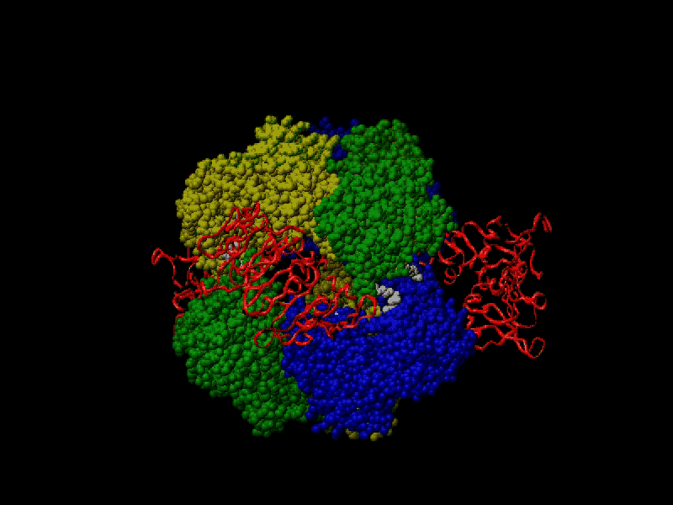
Proteins move!
Your crystal may be trying to tell you something…
Beernink, Endrizzi, Alber & Schachman (1999). PNAS USA 96, 5388-5393.

Slide 49
X-ray Data Sets
Singular values & vectors
data
set
h,k,l | structure factors (F)
 | #1 | #2 | #3 | #4
5,3,4 | 523.7 | 559.8 | 579.9 | 603.2
5,4,4 | 168.2 | 166.6 | 177.2 | 196.1
5,5,4 | 34.9 | 26.4 | 19.2 | 17.3
6,1,4 | 305.7 | 301.1 | 298.1 | 296.3
6,2,4 | 353.0 | 353.9 | 356.2 | 366.9
6,3,4 | 300.9 | 285.3 | 273.5 | 259.4
6,3,5 | 223.8 | 226.3 | 234.6 | 251.4
… | … | … | … | …
h,k,l | 100% | 17 % | 13 % | 9 %
 | 1st | 2nd | 3rd | 4th
5,3,4 | -1.46 | -0.02 | 1.84 | -0.72
5,4,4 | -0.88 | -0.29 | -0.34 | 0.15
5,5,4 | -0.42 | -0.65 | 1.02 | 1.47
6,1,4 | -0.90 | -0.85 | 1.44 | -0.40
6,2,4 | -1.20 | -0.37 | 0.67 | 0.01
6,3,4 | -0.75 | 0.31 | 0.48 | 0.00
6,3,5 | -0.75 | -0.85 | 0.72 | -0.82
… | … | … | … | …
value
vector
Singular value decomp.
SVD
-0.68
-0.24
0.32 …
CC1
Data sets
Positioned
in
“Correlation
Space”
Correlation
Coefficients
CC1 CC2 CC3
CC2
data set #1
data set #2
data set #3
CC3

Slide 50
