Slide 1

PowerPoint File available:
http://bl831.als.lbl.gov/~jamesh/powerpoint/
LBLSCW_SvN_2017.pptx

Slide 2
Acknowledgements
Robert Stroud James Fraser Aina Cohen Ana Gonzalez
Nick Sauter Axel Brunger Monarin Uervirojnangkoorn
Artem Lyubimov
UCSF LBNL SLAC
ALS 8.3.1 creator: Tom Alber
UC Multicampus Research Programs and Initiatives (MRPI)
UCSF Program for Breakthrough Biomedical Research (PBBR)
one-time NIH-DOE Inter-agency agreement (IAA)
GM117126 to Sauter (DIALS)
Integrated Diffraction Analysis Technologies (IDAT)
Plexxikon, Inc.
Synchrotron Radiation Structural Biology Resource (SLAC)
The Advanced Light Source is supported by the Director, Office of Science, Office of Basic Energy Sciences, Materials Sciences Division, of the US Department of Energy under contract No. DE-AC02-05CH11231 at Lawrence Berkeley National Laboratory.

Slide 3
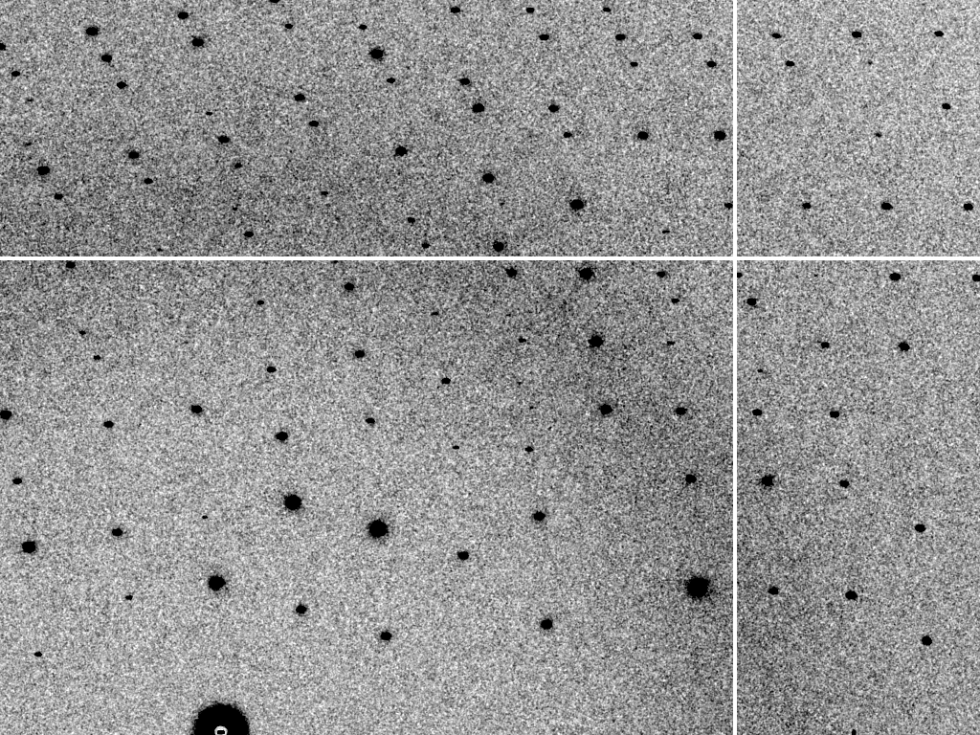
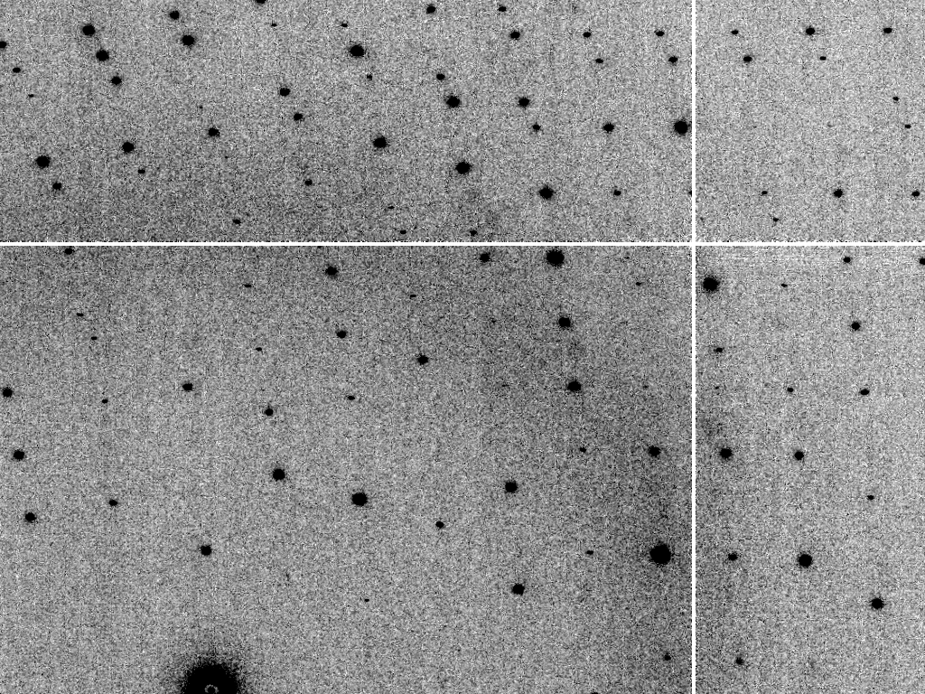
At-scale diffraction simulation
simulated
real
MLFSOM
Holton et al (2014) “R-factor gap", FEBS Journal 281, 4046-4060.

Slide 4
Simulated | statistic | Real
5.4% | R_{merge} | 6.2%
18.9 | I/sd | 16.2
1.9 | I/sd (1.4 Ǻ) | 1.6
1.7 4.0 0.020 | SDCORR | 1.0 2.2 0.065
36.8 | PADFPH | 31.46
3.871 | mlphare f” | 3.476
0.178 | FOM | 0.192
0.545 | FOMDM | 0.664
0.6270 | CC(1H87) | 0.6090
0.170 | R_{cryst} | 0.184
0.205 | R_{free} | 0.231

Slide 5
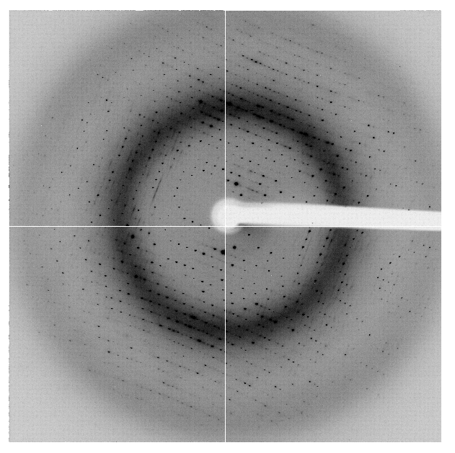

The R-factor Gap
R_{merge} = 6%
R_{cryst} = 17%
R_{free} = 20%
real
data
Elves
R_{merge} = 6%
R_{cryst} = 7%
R_{free} = 8%
MLFSOM
Elves
single-conformer PDB file
Holton et al (2014) “R-factor gap", FEBS Journal 281, 4046-4060.
Notes:
Typically, when atomic models are refined against macromolecular crystallographic data, the model-data agreement statistics (Rcryst and Rfree) are many times higher than the internal self-consistency of the observations (exemplified by Rmerge here). The diffraction image simulation program MLFSOM includes all known sources of experimental error (including the systematic errors of sample absorption and detector calibration), and when the simulated images are processed with common data reduction packages such as Elves, the data quality statistics (such as Rmerge, I/sigma, and phasing power) obtained are essentially identical to those obtained from real data. The only exceptions are Rcryst and Rfree, which rapidly refine down to where the calculated and “observed” structure factors agree to within experimental error. Essentially, this result implies that experimental noise is not the cause of the large disagreements that persist between observed spot intensities and our molecular models. Indeed, if this were the case, then averaging over many crystals should result in significantly lower Rcryst/Rfree.

Slide 6

Systematic Error vs Random Noise

Slide 7
Three types of error
Relative
  Proportional to signal
    Shutter jitter, beam flicker, vibration, calibration
    Partiality, isomorphism, F_{obs} vs F_{calc} (R_{work} & R_{free})
Photon count
  Proportional to sqrt(signal)
Baseline
  Independent of signal
    Detector read-out noise

Slide 8
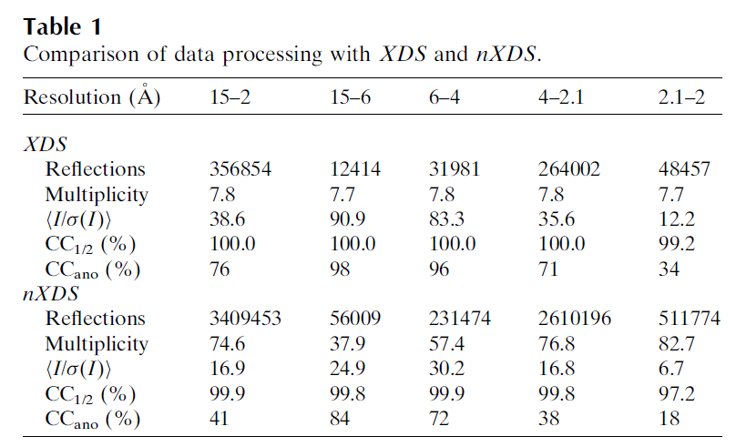
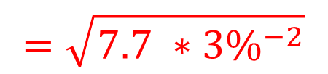
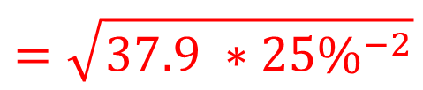
Partiality > 25% error per spot!
$$=\sqrt{7.7 ∗{3\%}^{−2}}$$
$$=\sqrt{37.9 ∗{25\%}^{−2}}$$
Kabsch W (2014)."Processing of X-ray snapshots from crystals in random orientations", Acta Cryst D 70, 2204-2216.

Slide 9
What is “partiality”?
Ewald sphere

Slide 10
What is “partiality”?
Ewald sphere

Slide 11
The “partiality problem”
0.006°
1 μm xtal
1 Å x-rays

Slide 12
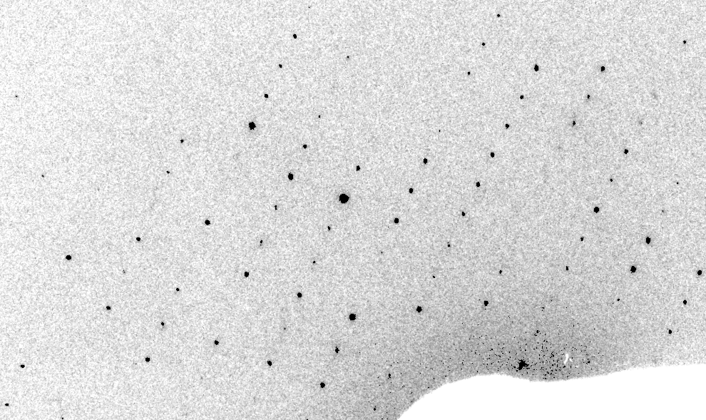
Real XFEL still
Lyubimov et al. (2016).
eLife 5, e18740.

Slide 13
XFEL: “fit” simulation to reality
Dispersion
Divergence
Mosaicity
Wavelength
Unit cell parameters (3)
Crystal orientation (3)
Mosaic domain size (3)
Beam center (2)
Beam direction (2)
Detector distance

Slide 14
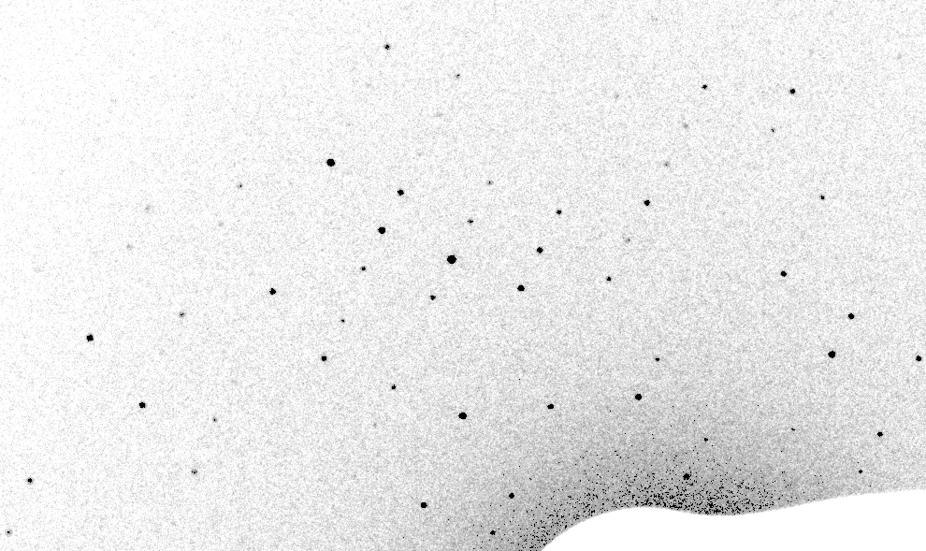
Simulation of XFEL still
Lyubimov et al. (2016).
eLife 5, e18740.

Slide 15
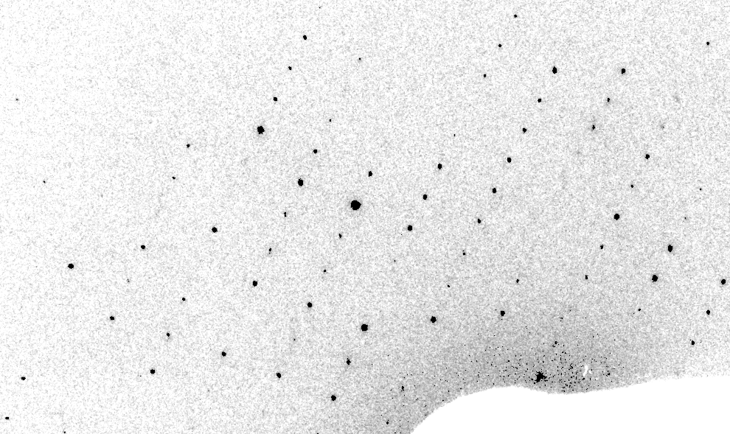
Real XFEL still
Lyubimov et al. (2016).
eLife 5, e18740.

Slide 16
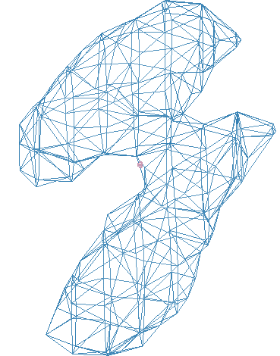
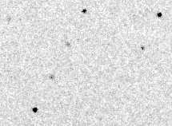
Simulation of XFEL still
phix
phiy
phiz
real
VS
phix
phiy
phiz

Slide 17
Fitting individual “mosaic domains”
Fraction pixels predicted
Best of
262,140 trials
Angle about y axis (°)

Slide 18
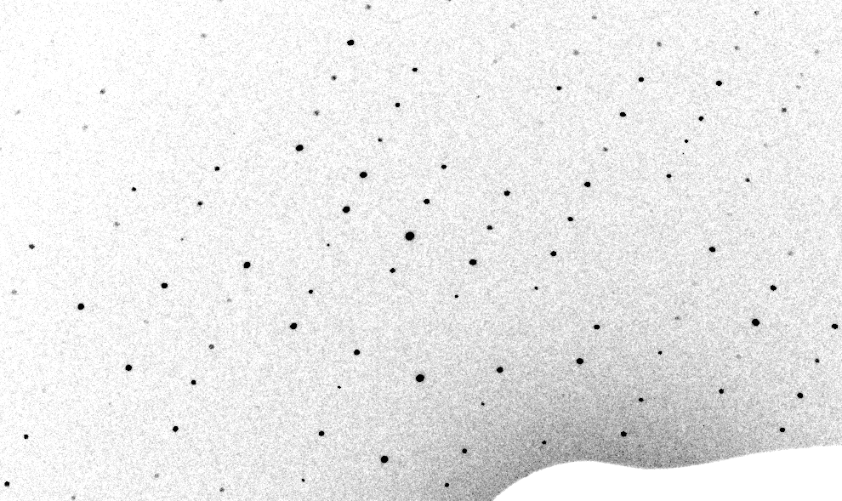
3-domain Simulation of XFEL still

Slide 19
Real XFEL still
Lyubimov et al. (2016).
eLife 5, e18740.

Slide 20
1-domain Simulation of XFEL still

Slide 21
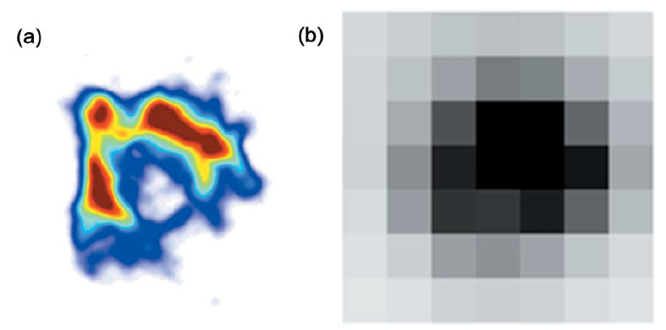
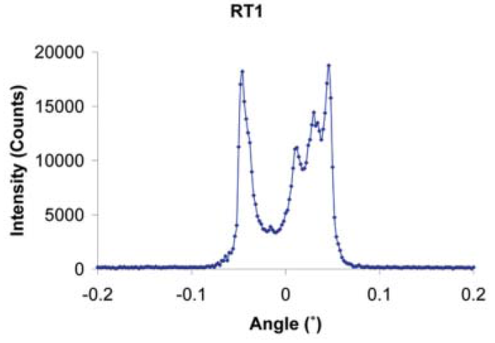
The true nature of “mosaic spread”
Any function can be approximated by a family of Gaussians
Lovelace JJ, Murphy CR, Pahl R, Brister K & Borgstahl GEO (2006)."Tracking reflections through cryogenic cooling with topography", J. Appl. Cryst. 39, 425-432.

Slide 22
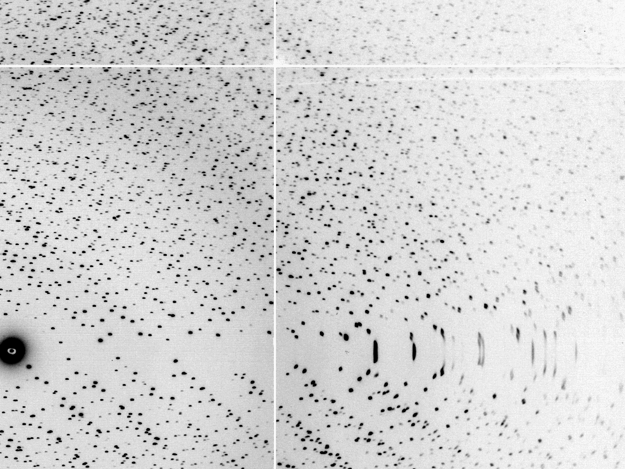
The “Lorentz zone”

Slide 23
Coming Soon in CCTBX / DIALS!
At-scale simulation coupled to
data processing
https://github.com/cctbx

Slide 24
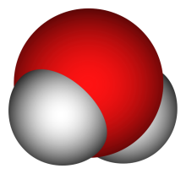
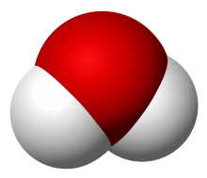
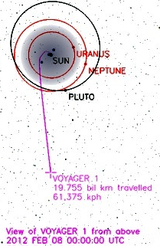
Can’t we just rotate the crystal?
9 nm
= 90 km/s
100 fs
1°
1 μm
(90 km/s)²
0.5 μm
17.26 km/s
= 1.5 x 10¹⁵ G
= 0.5 nN

Slide 25
Can’t we just rotate the crystal?
NO
Why do we want to
rotate the crystal?

Slide 26
Can’t we just widen the bandpass?

Slide 27
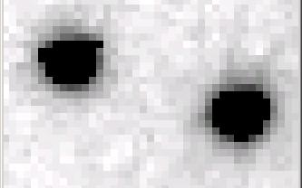
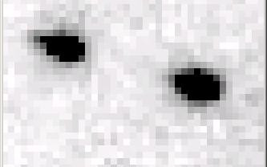
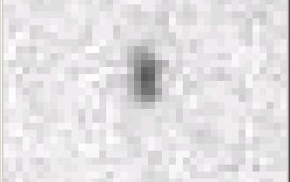
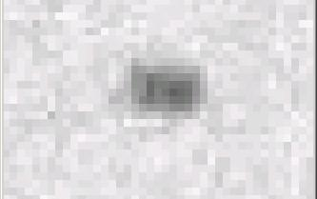
Si(111) vs multilayers
0.014%
Si(111)
spectral
dispersion
1%
multilayer
4 Å
resolution
1.9 Å

Slide 28
Wide-bandpass MX?
Mono | Si(111) | multilayer | Difference (%) | good
Energy (eV) | 11111 | 12027.5 | +8.2 | Same
Scale | 1.0000 | 1.0964 | +9.6 | Yes
R_{merge} (%) | 7.5 | 8.4 | +12 | No
R_{anom} (%) | 5.6 | 5.5 | -1.8 | Same
I/sd | 13.2 | 12.3 | -6.8 | Same
I/sd (1.5Å) | 2.3 | 1.8 | -21.7 | No
Ano Patt | 5.96 | 4.75 | -20.3 | Same
Ano Phased | 41 | 39.33 | -4.1 | Same
FOM | 0.238 | 0.192 | -19.3 | Same
CC | 0.555 | 0.647 | -6.1 | Yes
R_{cryst} (%) | 26.70 | 26.48 | -0.2 | Same
Ligand peak | 8.213 | 8.250 | +0.4 | Same

Slide 29
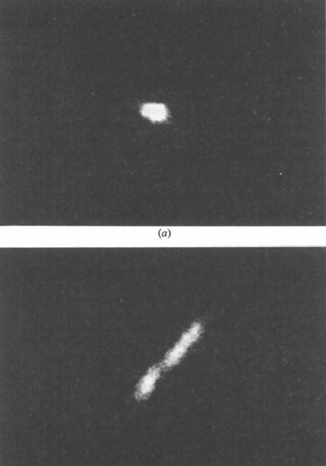

Wide bandpass reveals mosaicity from a still
low mosaic
high mosaic
Δ_{radial} = 2ηD/cos²2θ
Snell EH, Weisgerber S, Helliwell JR, Holzer K & Schroer K (1995)."Improvements in lysozyme protein crystal perfection through microgravity growth", Acta crystallographica. Section D, Biological crystallography 51, 1099-1102.

Slide 30
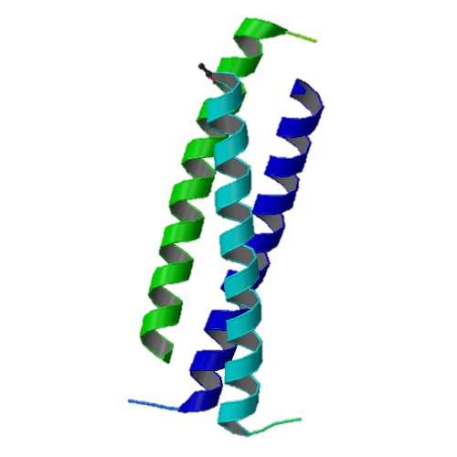
Narrow bandpass does not improve anomalous signal
h,k,l = 5,5,0
Si(333)
Si(333)
vertical
divergence
(240 μRad)
Al
absorber
100 μm
pinhole
1rb5

Slide 31
The “nanocrystal advantage”
2
I_{spot} = k N_{cells}
caveat: 100% error!
Ewald sphere
range

Slide 32
signal vs noise
“If you don’t have
good data,
then you have
no data at all.”
-Sung-Hou Kim

Slide 33
signal vs noise
easy
hard
impossible

Slide 34
signal vs noise
easy
hard
impossible
threshold of “solvability”

Slide 35
signal vs noise
“If you don’t have
good data,
then you must
learn statistics.”
-James Holton

Slide 36
Adding noise

Slide 37
Adding noise
1² + 1² = 1.4²

Slide 38
Adding noise
1² + 1² = 1.4²
3² + 1² = 3.2²
σ_{total}² = σ₁² + σ₂²

Slide 39
Adding noise
1² + 1² = 1.4²
3² + 1² = 3.2²
σ_{total}² = σ₁² + σ₂²

Slide 40
Adding noise
1² + 1² = 1.4²
3² + 1² = 3.2²
σ_{total}² = σ₁² + σ₂²

Slide 41
Adding noise
1² + 1² = 1.4²
3² + 1² = 3.2²
10² + 1² = 10.05²

Slide 42
Reducing error with averaging
^{mult >} (—)²
error
<ΔF/F>

Slide 43
Multiplicity required to phase
Monte Carlo
  100% /obs → 10,000 fold
nXDS
  25% /obs → 625 fold
Synchrotron
  3% /obs → 9 fold
  Assuming ΔF/F ~ 1%
Beam time:
$2/s

Slide 44

100% SeMet incorporation
Trivial to solve

Slide 45

100% S -Met incorporation
Impossible to solve

Slide 46
Phase Problem: Se vs S
correlation coefficient
fraction Sulfur

Slide 47
Phase Problem: Se vs S
correlation coefficient
fraction Sulfur

Slide 48
Phase Problem: Se vs S
correlation coefficient
fraction Sulfur

Slide 49
Phase Problem: Se vs S
correlation coefficient
fraction Sulfur

Slide 50
Phase Problem: Se vs S
correlation coefficient
fraction Sulfur

Slide 51
MR simulation
corrupted model
Correlation coefficient to correct density
Rmsd from perfect search model (Å)

Slide 52
The transitions are sharp!
How can we predict success/failure?
Know Thy Experiment

Slide 53
What if…
You only have a few small crystals?
Should you:
  Collect 360° from each?
  Collect 10° from each at 36x exposure?
  Glue 36 xtals together, then collect 360° ?
  Glue together and do 12960° ?
  http://bl1231.als.lbl.gov/~jamesh/dose_slice/results.html

Slide 54
The number of photons scattered
before crystal is dead
is independent
of data collection time
1 um³ = 10⁵ photons (roomT)
1 um³ = 10⁶ photons (synch)
1 um³ = 10⁸ photons (XFEL)
(synch)
Henderson, 1990; Gonzalez & Nave, 1994; Glaeser et al., 2000; Sliz et al., 2003; Leiros et al., 2006; Owen et al., 2006; Garman & McSweeney, 2006; Garman & Nave, 2009; Holton, 2009

Slide 55

Dose slicing
unacceptable
damage
N
photons
crystal’s useful life
N
photons
unacceptable
read noise
N
photons

Slide 56
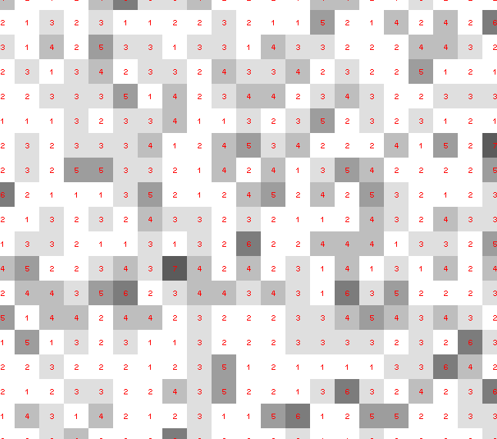
Dose slicing: is that a spot?

Slide 57
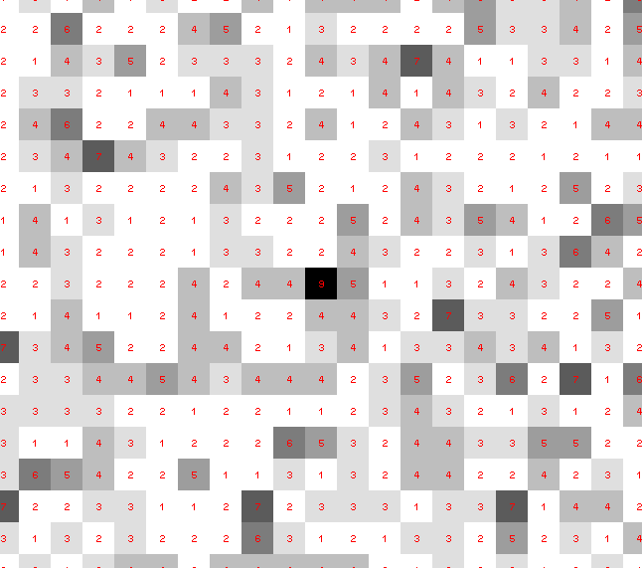
Dose slicing: is that a spot?

Slide 58
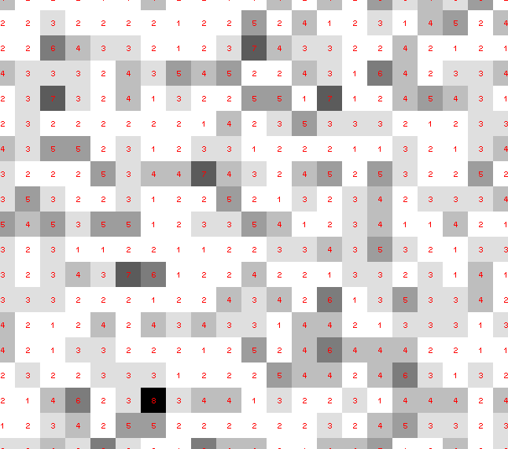
Dose slicing: is that a spot?

Slide 59
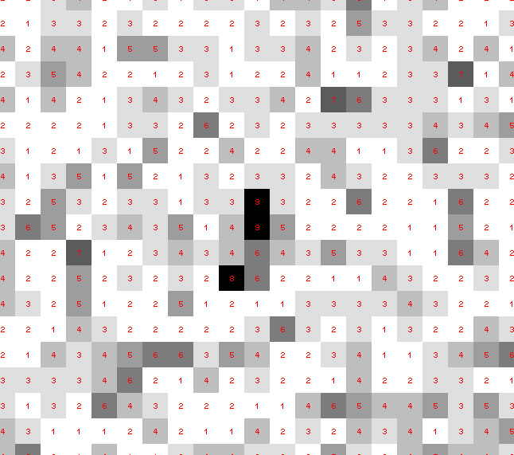
Dose slicing: is that a spot?

Slide 60
Dose slicing: is that a spot?

Slide 61
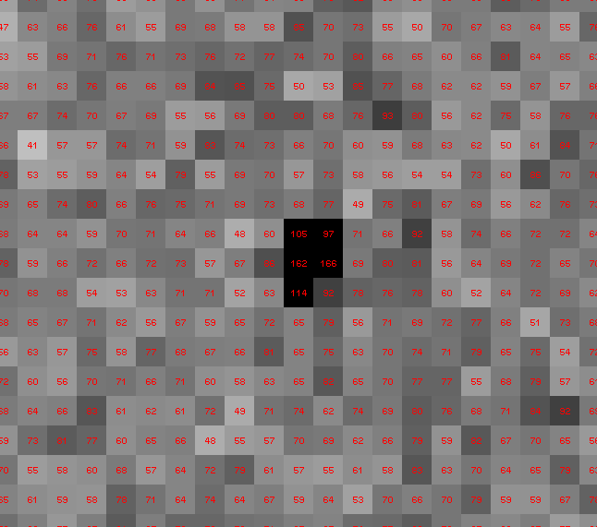
Dose slicing: is that a spot?

Slide 62
“true” resolution limit
CC vs right answer
Resolution (Å)

Slide 63
“true” resolution vs strategy
Dose slice collection scenario
fine | coarse | glue | Glue & fine
3.17700 | 3.14057 | 3.17604 | 3.12086
301,640,334 photons/xtal

Slide 64
processing procedure | resolution limit
 | fine | coarse | glue | glue&fine
XDS/XSCALE | 3.17700 | 3.14057 | 3.17604 | 3.12086
XDS/aimless | 3.16251 | 3.15922 | 3.16675 | 3.12162
XDS/noscale | 3.27289 | 3.15617 | 3.38929 | 3.12162
MOSFLM-defaults | x | x | x | x
MOSFLM-cheat | 3.19755 | 3.18166 | 3.20354 | 3.19755
HKL2000-defaults | x | x | x | x
HKL2000-expert | 3.21803 | 3.12646 | 3.11551 | 3.21803
HKL2000-cheat | 3.16119 | 3.10338 | 3.10338 | 3.16300
DIALS-defaults | x | x | 3.42125 | x
DIALS-expert | 3.10296 | 3.09547 | 3.07653 | 3.08465
d*Trek | ? | ? | 4.34076 | ?
EVAL15 | 3.14352 | 3.10383 | 3.09936 | 3.14105
EVAL15-sadabs | 3.13920 | 3.10797 | 3.10171 | 3.13700

Slide 65
X-ray scattering “rules”:
Optimum: support thickness = crystal thickness
1 μm crystal ≈ 1 μm water
≈ 1 μm plastic
≈ 0.1 μm glass
≈ 1000 μm air
~ 50 mm He
≈ 370 mm sat water vapor @ 4C

Slide 66
"error bar" for electron density
structure factor (e⁻/cell)
spot index

Slide 67
"error bar" for electron density
structure factor (e⁻/cell)
electron density (e⁻/Å³)
spot index
fractional coordinate

Slide 68
"error bar" for electron density
structure factor (e⁻/cell)
electron density (e⁻/Å³)
spot index
fractional coordinate

Slide 69
"error bar" for electron density
structure factor (e⁻/cell)
electron density (e⁻/Å³)
spot index
fractional coordinate

Slide 70
"error bar" for electron density
structure factor (e⁻/cell)
electron density (e⁻/Å³)
spot index
fractional coordinate

Slide 71
"error bar" for electron density
structure factor (e⁻/cell)
electron density (e⁻/Å³)
spot index
fractional coordinate

Slide 72
"error bar" for electron density
structure factor (e⁻/cell)
electron density (e⁻/Å³)
spot index
fractional coordinate

Slide 73
"error bar" for electron density
structure factor (e⁻/cell)
electron density (e⁻/Å³)
spot index
fractional coordinate

Slide 74
"error bar" for electron density
structure factor (e⁻/cell)
electron density (e⁻/Å³)
spot index
fractional coordinate

Slide 75
"error bar" for electron density
structure factor (e⁻/cell)
electron density (e⁻/Å³)
spot index
fractional coordinate

Slide 76
"error bar" for electron density
structure factor (e⁻/cell)
electron density (e⁻/Å³)
spot index
fractional coordinate

Slide 77
"error bar" for electron density
structure factor (e⁻/cell)
electron density (e⁻/Å³)
spot index
fractional coordinate

Slide 78
"error bar" for electron density
Refinement
Against
Perturbed
Input
Data
electron density (e⁻/Å³)
fractional coordinate

Slide 79
How does the “error” compare to “sigma”?
normalized counts
Electron Number Density (e⁻/Å³)

Slide 80
How does the “error” compare to “sigma”?
normalized counts
Electron Number Density (e⁻/Å³)

Slide 81
How does the “error” compare to “sigma”?
normalized counts
Electron Number Density (e⁻/Å³)

Slide 82
What is the “error” in 2Fo-Fc “sigma” units?
normalized counts
traditional “sigma” units (multples of rms(ρ-⟨ρ⟩) relative to ⟨ρ⟩)

Slide 83
What is the “error” in Fo-Fc “sigma” units?
normalized counts
traditional “sigma” units (multples of rms(ρ-⟨ρ⟩) relative to ⟨ρ⟩)

Slide 84
Tradition
electron density (e⁻/Å³)
fractional coordinate

Slide 85
Break with Tradition
electron density (e⁻/Å³)
fractional coordinate

Slide 86
Optimum resolution cutoff is:
Too optimistic: add nothing but noise
Too pessimistic: series-termination error
Happy medium?
Simulate:
  Random atoms, compute F²
  Add Gaussian noise, RMS = 1
  Truncate
  Subtract “right” map, RMS difference

Slide 87
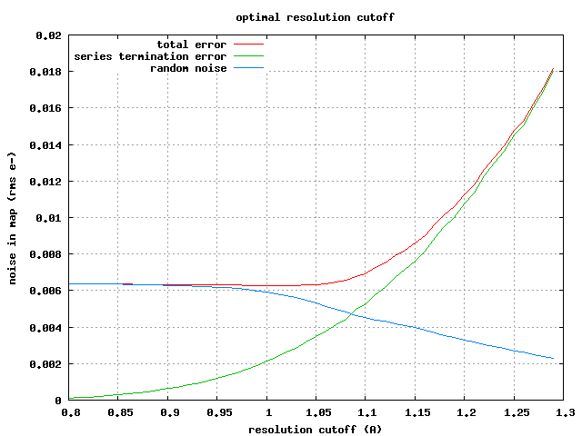

Slide 88
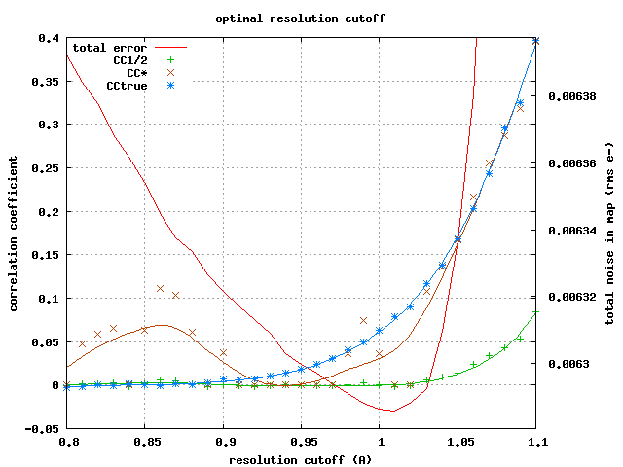

Slide 89
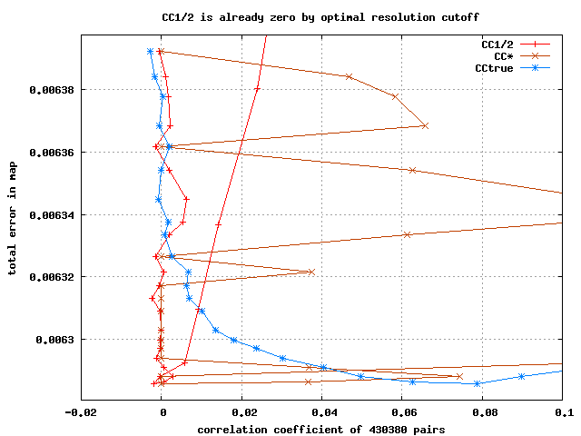

Slide 90
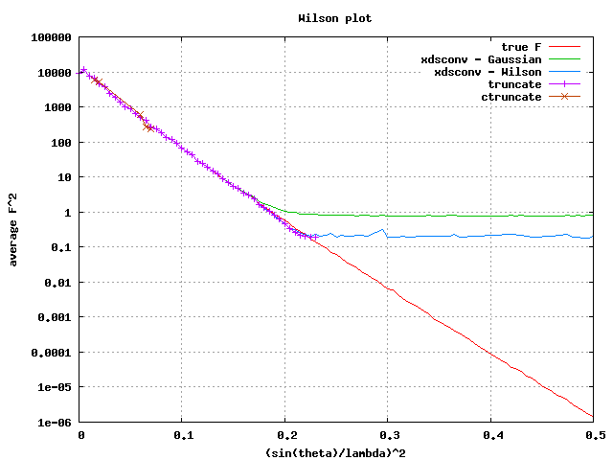

Slide 92
Optimum resolution cutoff is:
0.0 Å

Slide 93
At the beamline…
Resolution
  problem: background
  solution: use as few pixels as possible
Phases
  problem: fractional errors
  solution: use as many pixels as possible

Slide 94
anomalous signal
ΔF
F
√
# sites
MW (Da)
≈ 1.2 f”
World record!
ΔF/F = 0.5%
Wang, Dauter & Dauter (2006) Acta Cryst. D 62, 1475-1483.
Crick, F. H. C. & Magdoff, B. S. (1956) Acta Crystallogr. 9, 901-908.
Hendrickson, W. A. & Teeter, M. M. (1981) Nature 290, 107-113.

Slide 95
Fractional error
^{mult >} (—)²
~3%
<ΔF/F>

Slide 96
Can you count to 1,000,000 ?
sqrt(1,000,000)
1,000,000
Theoretically:
= 0.1%
R_{meas} ≈ 0.1% ?
ISa = 1000
In reality:
ISa ~ 33
R_{meas =} ≈ 3%
sqrt(1,000)
1,000
= 3%
photon
spot
> 1000 is a waste!

Slide 97
Threshold of a revolution in phasing
Current
technology
Goal
Solve-able proteins (%)
Required signal-to-noise (I/σ)

Slide 98
Threshold of a revolution in phasing
Source of error | realistic simulation | No SHSSS | Perfect detector
Photon counting | + | + | +
Shutter jitter | + | + | -
Beam flicker | + | + | -
Sample absorption | + | + | -
Radiation damage | + | + | -
Imperfect spindle | + | + | -
vignette | + | + | -
Corner correction | + | + | -
SHSSS | + | - | -
R_{meas} (∞-10 Å) | 2.8% | 0.7% | 0.7%
I/σ asymptotic | 26.8 | 74.2 | 81.0
Holton et al (2014) "R-factor gap", FEBS Journal 281, 4046-4060.

Slide 99

Pilatus: subtract smooth baseline
~3x10⁵ photon/pixel
Bragg
glitch
“tree rings”
Pick-up tool mark
oxygen
inclusions
1% high
average
1% low

Slide 100
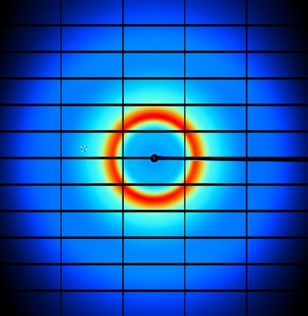
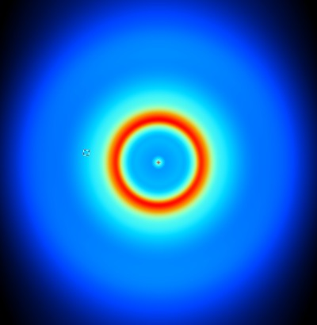
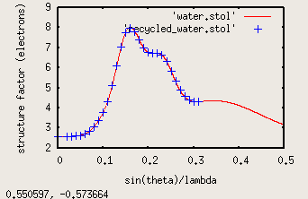
nonBragg extracts background
spot remover
Flux
Exposure
Density
Thickness
Gain, offset

Slide 101
Phasing success vs Figure of Merit
Adjusting:
Solvent content
Resolution
SDfac Sdadd
Cycles of dm
“mode”
“scheme”
NCS radius
NCS cycles
Phase blur
Correlation to final map
FOM from “dm”
http://cxidb.org/id54-SfjMJjaBny/id-54.html http://cxidb.org/id55-BWuBDSUrBy/id-55.html
Hunter et al. (2016)."Selenium anomalous phasing XFEL", Nature Comm. 7, 13388.

Slide 102
Gaussian vs Poisson distributions
frequency
Long-term average:
1 photon/pixel
Number of counts/pixel

Slide 103
Central limit theorem fails on weak images
frequency
Expect: ~6
“9-sigma outliers”
On 6x10⁶ pixel detector
at 1 photon/pixel
Number of counts/pixel

Slide 104
R_{iso} vs dose
R_{iso} ≈ 0.7 %/MGy
R_{iso} (%)
change in dose (MGy)
data taken from Banumathi, et al. (2004) Acta Cryst. D 60, 1085-1093.

