Slide 1
Acknowledgements
Robert Stroud James Fraser John Spence
Chris Nielsen Clemens Schulze-Briese Aina Cohen Ana Gonzalez
UCSF LBNL SLAC
ALS 8.3.1 creator: Tom Alber
Center for Structure of Membrane Proteins (CSMP)
Membrane Protein Expression Center II (MPEC)
Center for HIV Accessory and Regulatory Complexes (HARC)
UC Multicampus Research Programs and Initiatives (MRPI)
UCSF Program for Breakthrough Biomedical Research (PBBR) Integrated Diffraction Analysis Technologies (IDAT)
Plexxikon, Inc.
M D Anderson CRC
Synchrotron Radiation Structural Biology Resource (SLAC)
The Advanced Light Source is supported by the Director, Office of Science, Office of Basic Energy Sciences, Materials Sciences Division, of the US Department of Energy under contract No. DE-AC02-05CH11231 at Lawrence Berkeley National Laboratory.

Slide 2

Grand Challenges in Structural Biology
Phase Problem
spots, but no maps
Amplitude Problem
    Crystals, but no spots
R-factor Gap
    Can’t/shouldn’t publish

Slide 3
Grand Challenges in Structural Biology
Phase Problem
systematic error
Amplitude Problem
    disorder
R-factor Gap
    models

Slide 4
Grand Challenges in Structural Biology
Phase Problem
systematic error
Amplitude Problem
    disorder
R-factor Gap
    models

Slide 5
Threshold of a revolution in phasing
CCD
& early PADs
new PADs
(uncalibrated)
Goal
Solve-able proteins (%)
Required signal-to-noise (I/σ)

Slide 6
Can you count to 1,000,000 ?
sqrt(1,000,000)
1,000,000
Theoretically:
= 0.1%
R_{meas} ≈ 0.1% ?
ISa = 1000
In reality:
ISa ~ 33
R_{meas =} ≈ 3%
sqrt(1,000)
1,000
= 3%
photon
spot
> 1000 is a waste!

Slide 7
Threshold of a revolution in phasing
Source of error | realistic simulation | No SHSSS | Perfect detector
Photon counting | + | + | +
Shutter jitter | + | + | -
Beam flicker | + | + | -
Sample absorption | + | + | -
Radiation damage | + | + | -
Imperfect spindle | + | + | -
vignette | + | + | -
Corner correction | + | + | -
SHSSS | + | - | -
R_{meas} (∞-10 Å) | 2.8% | 0.7% | 0.7%
I/σ asymptotic | 26.8 | 74.2 | 81.0
Holton et al (2014) "R-factor gap", FEBS Journal 281, 4046-4060.

Slide 8
Spatial Heterogeneity in Sharp Spot Sensitivity
Relative spot intensity
Spot centroid position (pixels)

Slide 9
SHSSS!
The dominant source of error for anomalous difference measurements
Spatial
Heterogeneity in
Sharp
Spot
Sensitivity
Flat
Field

Slide 10
SHSSS!
The dominant source of error for anomalous difference measurements
Spatial
Heterogeneity in
Sharp
Spot
Sensitivity
Flat
Field
90%
110%
x 1.11 =
100%
x 0.91 =
100%

Slide 11
SHSSS!
The dominant source of error for anomalous difference measurements
Spatial
Heterogeneity in
Sharp
Spot
Sensitivity
Sharp
Spot
20%
110%
x 1.11 =
22%
x 0.91 =
100%

Slide 12
SHSSS!
The dominant source of error for anomalous difference measurements
Spatial
Heterogeneity in
Sharp
Spot
Sensitivity
Sharp
Spot
90%
30%
Integral: 127.3
x 1.11 =
100%
x 0.91 =
27.3%

Slide 13
SHSSS!
The dominant source of error for anomalous difference measurements
Spatial
Heterogeneity in
Sharp
Spot
Sensitivity
Sharp
Spot
20%
110%
Integral: 122.2
x 1.11 =
22.2%
x 0.91 =
100%

Slide 14
SHSSS!
The dominant source of error for anomalous difference measurements
Spatial
Heterogeneity in
Sharp
Spot
Sensitivity
Sharp
Spot
90%
30%
Integral: 127.3
x 1.11 =
100%
x 0.91 =
27.3%

Slide 15
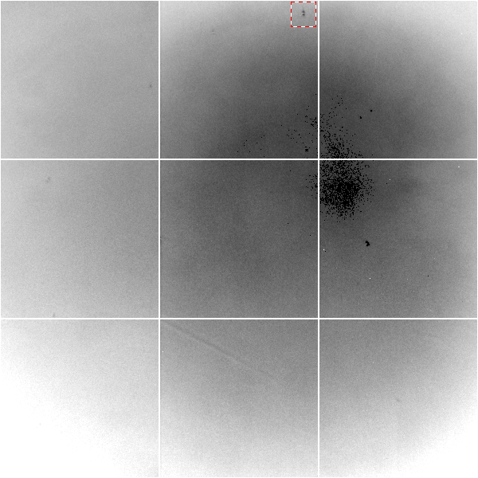
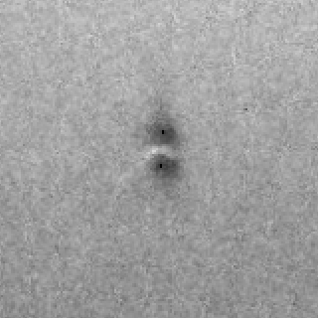
Gd edge-contrast map of ADSC Q315r detector
10% high
average
10% low

Slide 16
Gadox calibration vs energy
same = good!
Relative absorption depth
bad!
photon energy (keV)

Slide 17
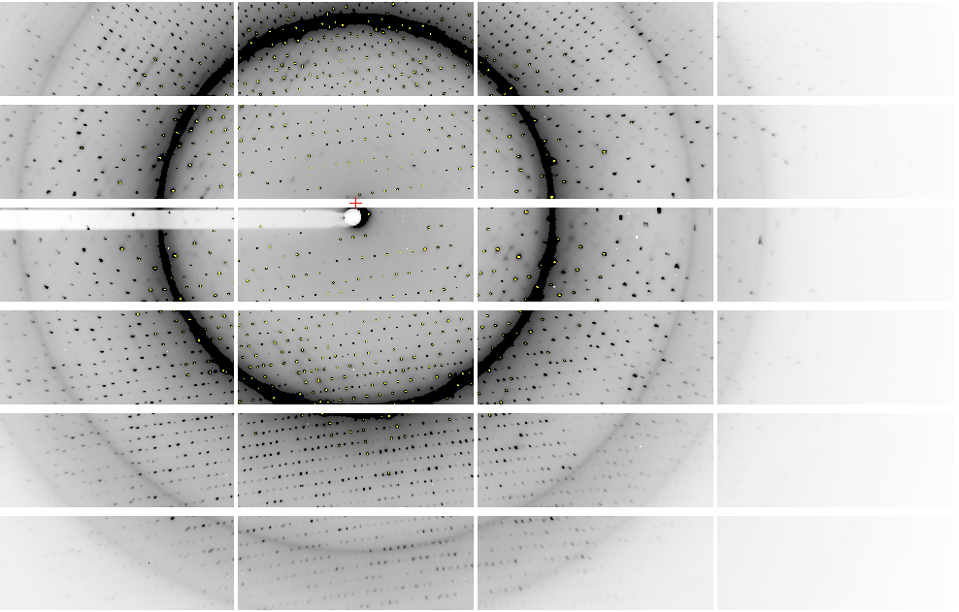
Pilatus: 1-module shift

Slide 18
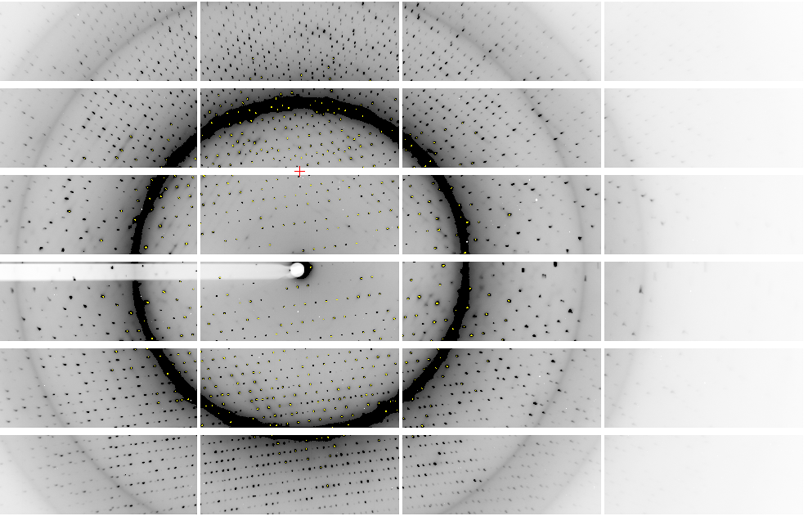
Pilatus: 1-module shift

Slide 19
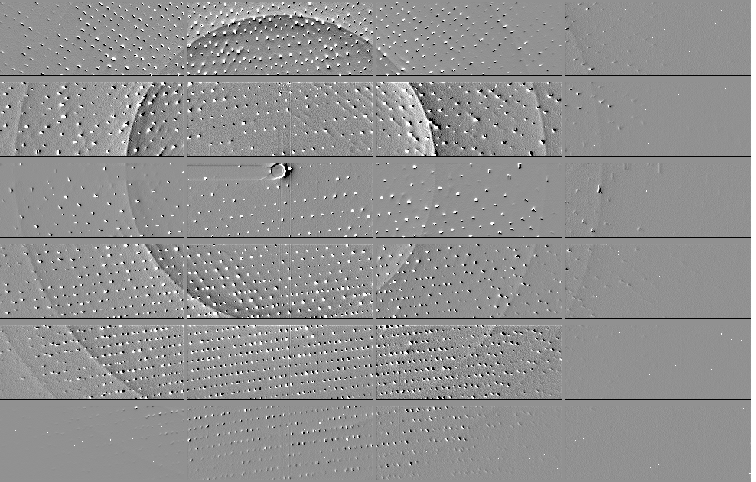
Pilatus: 1-module shift

Slide 20
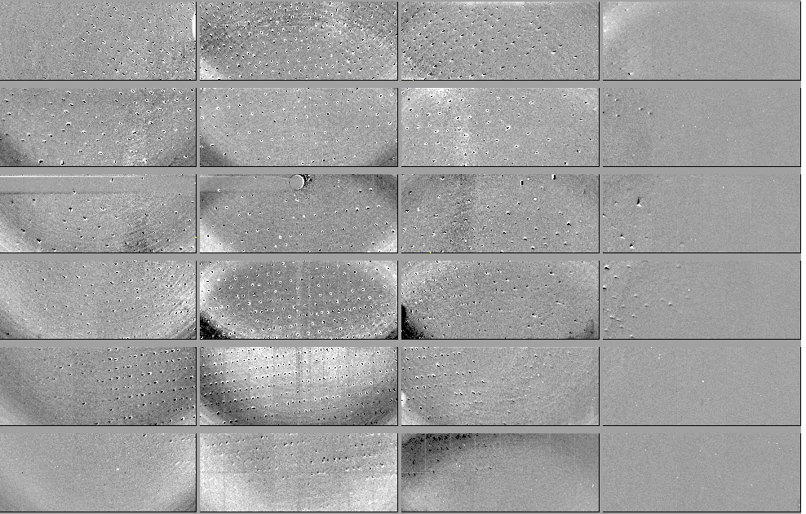
Pilatus: 1-module shift - aligned

Slide 21
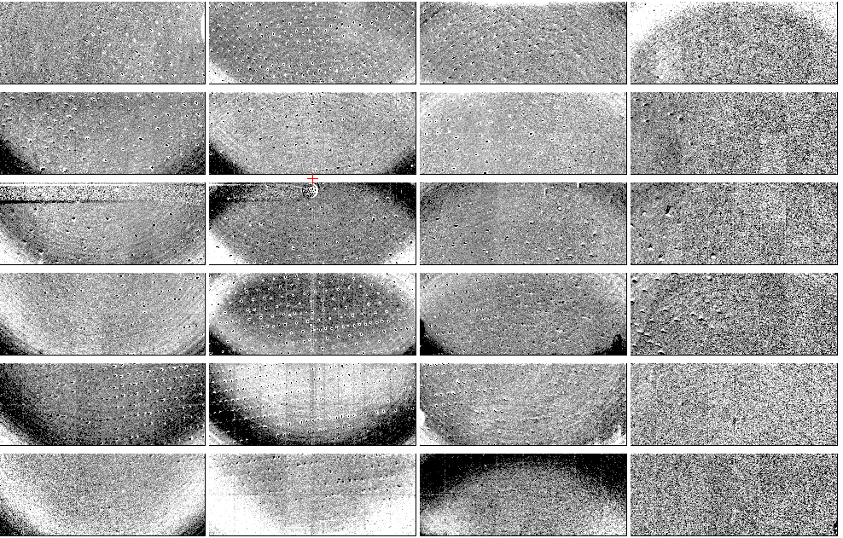
Pilatus: 1-module shift - ratio
3% high
average
3% low

Slide 22
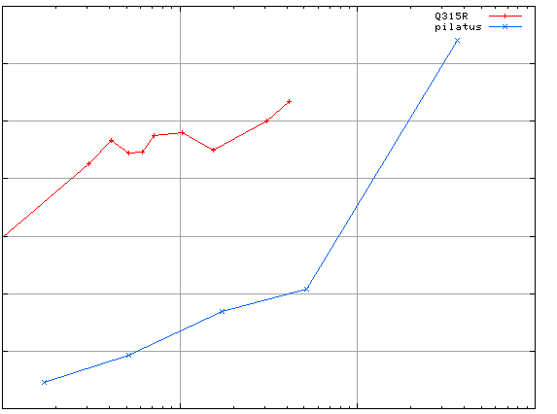
3.5
3.0
2.5
2.0
1.5
1.0
0.5
CCD detector
different
modules
anomalous mates are always on
different modules
SHSSS
Systematic component of R_{sseparate} (%)
Pilatus
SN001
Pilatus
SN113
0.1 1 10 100
distance between spots (mm)

Slide 23
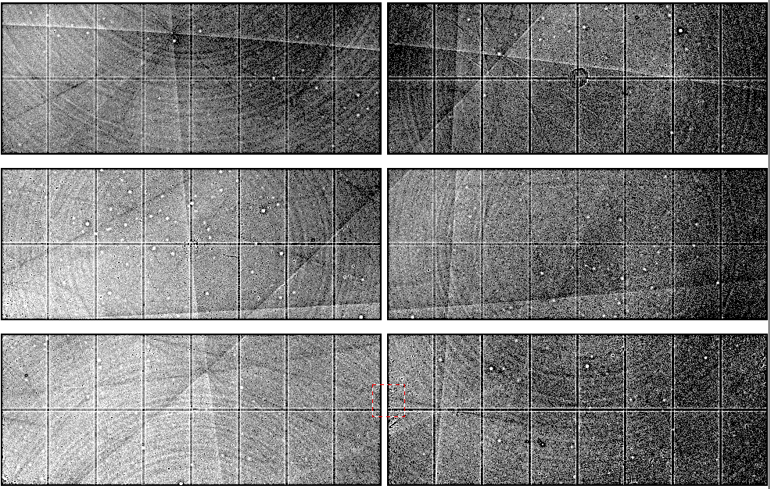
Native element phasing requires better detectors
~3x10⁵ photon/pixel Pilatus detector
Bragg
glitch
“tree rings”
Pick-up tool mark
oxygen
inclusions
1% high
average
1% low

Slide 24

Systematic error does not “average out”

Slide 25
140-fold multiplicity: 16 crystals, 360° each, inverse beam, 7235 eV
RESOLUTION COMPLETENESS R-FACTOR I/SIGMA R-meas CC(1/2) Anomal SigAno Nano
LIMIT OF DATA observed Corr
9.17 99.1% 3.9% 257.47 3.9% 100.0* 91* 5.024 450
6.49 100.0% 5.2% 214.33 5.2% 100.0* 86* 3.836 882
5.30 100.0% 7.2% 165.13 7.2% 100.0* 76* 3.257 1175
4.59 100.0% 7.2% 175.42 7.3% 100.0* 67* 2.589 1403
4.10 99.9% 7.7% 174.13 7.7% 100.0* 59* 2.264 1594
3.74 99.9% 9.4% 143.09 9.4% 100.0* 49* 1.953 1783
3.47 100.0% 11.2% 120.17 11.2% 100.0* 39* 1.696 1942
3.24 100.0% 14.1% 91.14 14.1% 100.0* 30* 1.333 2103
3.06 99.9% 19.5% 65.79 19.5% 100.0* 23* 1.117 2214
2.90 99.9% 29.0% 44.85 29.1% 99.9* 17* 1.008 2369
2.77 99.9% 40.5% 32.58 40.6% 99.8* 11* 0.901 2493
2.65 99.9% 52.8% 25.16 52.9% 99.8* 10* 0.866 2605
2.54 100.0% 67.4% 19.47 67.6% 99.6* 2 0.804 2705
2.45 100.0% 88.9% 14.58 89.2% 99.2* 4 0.831 2859
2.37 100.0% 109.3% 9.97 109.7% 98.1* 5 0.829 2925
2.29 100.0% 138.2% 6.87 138.9% 96.1* 1 0.760 3037
2.22 100.0% 197.1% 4.03 198.6% 83.5* -1 0.721 3159
2.16 100.0% 227.3% 2.41 230.8% 46.9* -1 0.677 3224
2.10 61.2% 154.4% 1.28 163.6% 47.0* -2 0.660 1999
2.05 47.9% 170.1% 0.68 196.5% 25.7* 3 0.629 1578
total 93.3% 15.7% 54.30 15.8% 100.0* 12* 1.217 42499

Slide 26
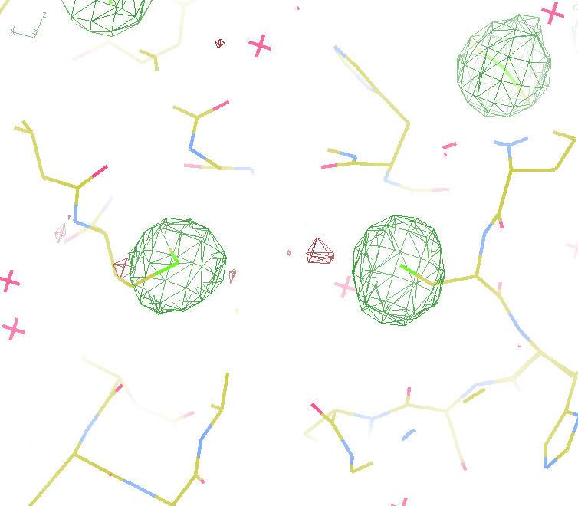
140-fold multiplicity
18 σ
16 σ
Phased anomalous difference Fourier

Slide 27
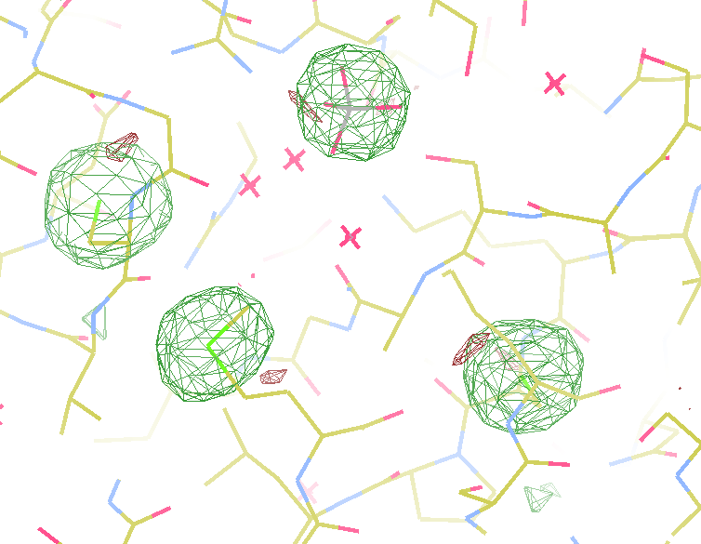
140-fold multiplicity
15σ = PO₄
Phased anomalous difference Fourier

Slide 28
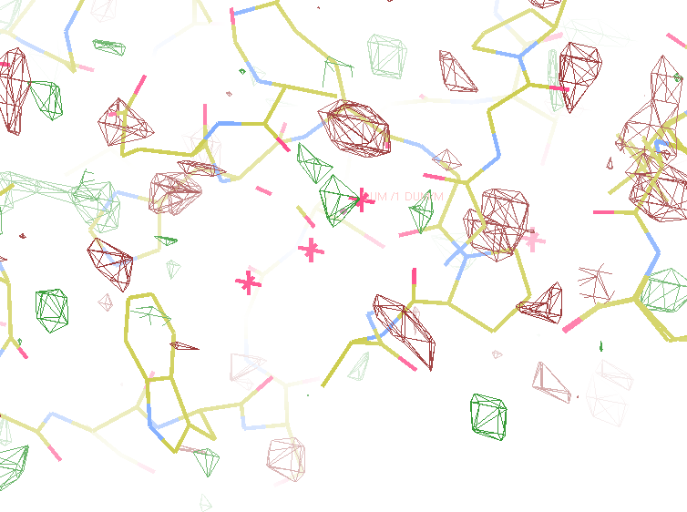
140-fold multiplicity
~2σ = Mg?
Phased anomalous difference Fourier

Slide 29
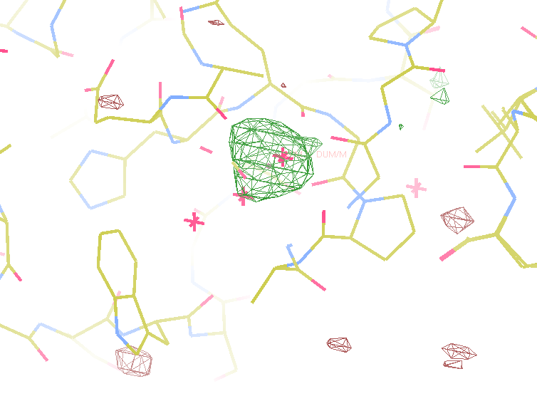
140-fold multiplicity
8.2σ = Mg?
DELFAN residual anomalous difference

Slide 30
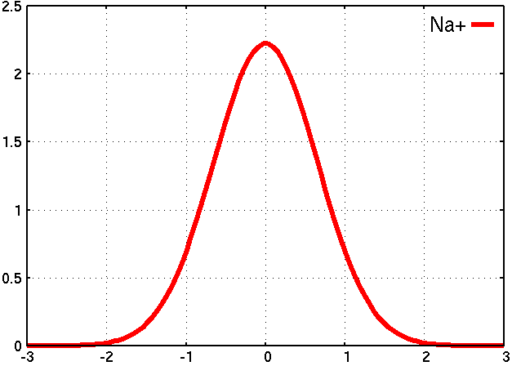
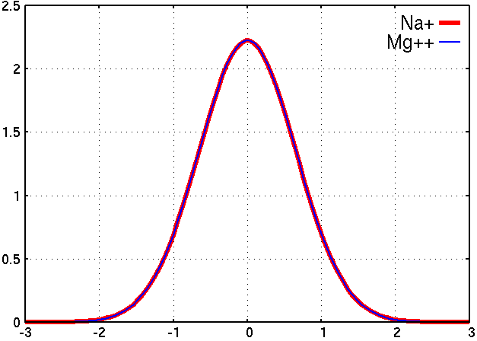
Metal site: is it Mg⁺⁺ ? Or Na⁺ ?
Electron density (e⁻/ Å³)
Position (Å)
A
B

Slide 31
Metal site: is it Mg⁺⁺ ? Or Na⁺ ?
DELFAN peak height (σ)
N
O
F
Ne
Na
Mg
f’’ (electrons)

Slide 32
2472.7 2473.5
Anomalous f” (electrons)
Photon Energy (eV)
Bohic et al. Anal. Chem. 2008; 80(24):9557. doi: 10.1021/ac801817k

Slide 33
Single-spot limit
CCD
& early PAD
Solve-able proteins (%)
Required signal-to-noise (I/σ)

Slide 34
Darwin’s Formula
V_{xtal}
λ³ L
I_{spot} = I_{beam} r_{e}²
P A | F₀e^{-Bs2} |²
V_{cell}
ωV_{cell}
I_{spot} - photons/spot (fully-recorded)
I_{beam} - incident (photons/s/m² )
r_{e} - classical electron radius (2.818x10⁻¹⁵ m)
V_{xtal} - volume of crystal (in m³)
V_{cell} - volume of unit cell (in m³)
λ - x-ray wavelength (in meters!)
ω - rotation speed (radians/s)
L - Lorentz factor (speed/speed)
P - polarization factor
A - attenuation correction
F₀ - structure factor at T = 0
B - Debye-Waller-Ott factor
s - 0.5/d-spacing
C. G. Darwin (1914)

Slide 35
Damage limited crystal size (synchrotron)
wavelength dependence
Å
Å
crystal diameter (μm)

Slide 36
Where do photons go?
100 μm
thick
protein
97%
transmitted
1 Å x-rays
beamstop
attenuation correction
error cannot be > ~3%

Slide 37
Where do photons go?
100 μm
thick
protein
2%
transmitted
5 Å x-rays
beamstop
attenuation correction
error can be ~98%

Slide 38
Where do photons go?
1 μm
thick
protein
96%
transmitted
5 Å x-rays
beamstop
attenuation correction
error cannot be > ~4%

Slide 39
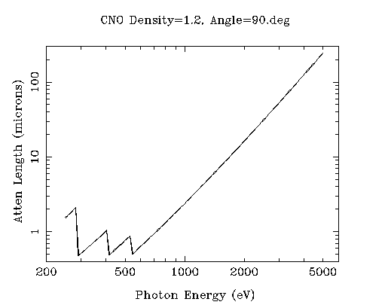
“sweet spot” for sample size ?
Ca
Ar
Cl
K
S
P
2 Å
2sin(90°)
Mg
C
Na
Se
Ne
3 Å
2sin(90°)
N
O
F
4 Å
2sin(90°)

Slide 40
Dose-rate dependence of damage
maximum useful dose (MGy)
dose rate (kGy/s)

Slide 41
The “partiality problem”
0.006°
1 μm xtal
1 Å x-rays

Slide 42
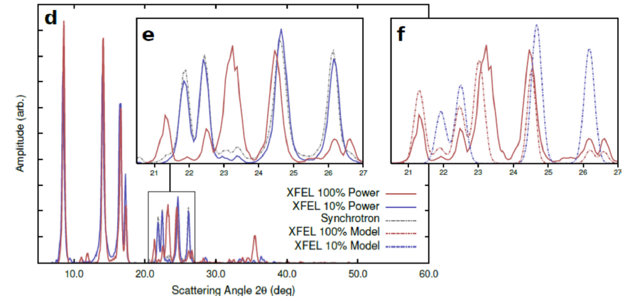
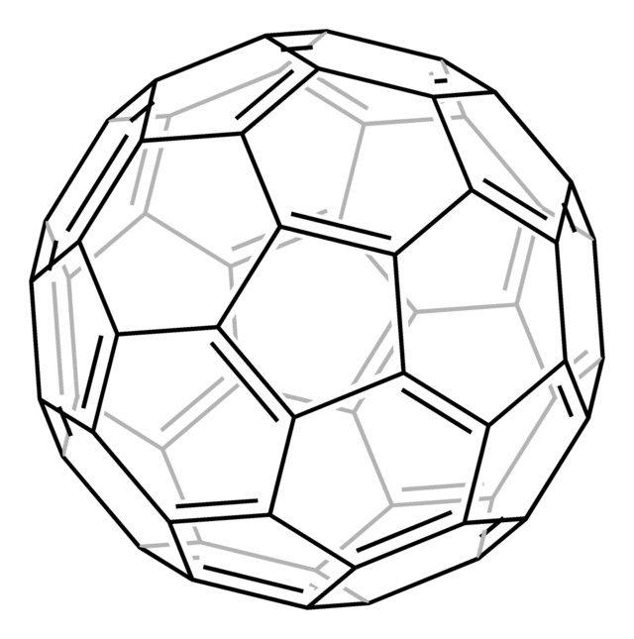
New damage at high fluence?
Abbey et al. (2012)."Femtosecond X-ray Laser induced transient electronic phase change observed in fullerene C60", arXiv:1209.5168.

Slide 43
(h,k,l)
Ewald sphere 2
λ*
diffracted ray
d*
θ
λ*
λ*
θ
d*
diffracted ray
λ*
Ewald sphere
1
(-h,-k,-l)

Slide 44
Si(111)
52.87deg
Si(111)
2 Multilayer mirrors
d=2nm, W/B4C
KB Horiz focus
KB vertical focus
Si(111)
Detector
Detector
λ = 5 Å
h,k,l
sample
injector
-h,-k,-l
Si(111)
Detector
Detector
~ 1m
Si(111)
Si(111)
Notes:
Proposed 5-crystal monochromator for colliding-beam crystallography. The generation of two opposing Ewald spheres means that for every h,k,l index reflected from the protein crystal, the Friedel mate is reflected in the opposite direction, allowing for very accurate anomalous difference measurements. The wavelength need not be set precisely at the sulfur or phosphorous edge, but merely at a wavelength where the f” of those elements are strong. For fs-class pulses, the distances above will have to be precise to withing ~3 microns, and for accurate reproduction of the partiality of the Friedel mates, the angular precision of the colliding beams must be within ~1% of the sample crystal’s rocking width, or ~100 microrads.

Slide 45
Fractional error
^{mult >} (—)²
~3%
<ΔF/F>

Slide 46
Fractional error at XFEL
^{mult >} (—)²
~100%
<ΔF/F>
Gd lyso: ΔF/F = 8.7% → mult = 132

Slide 47
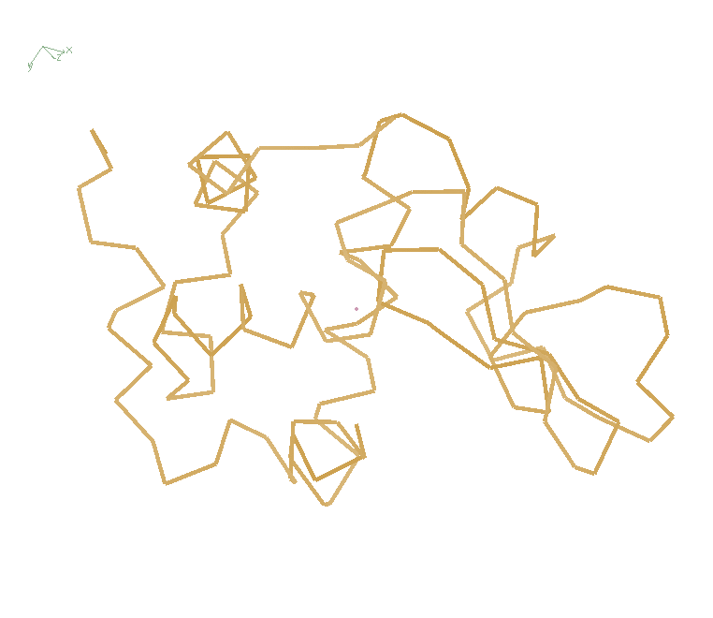
Non-isomorphism in lysozyme
PDB:
3aw6
3aw7
Δa = 0.8%
RH 84.2% vs 71.9%
RMSD = 0.18 Å
R_{iso} = 44.5%

Slide 48
Scattering/absorption “rules”:
1 μm crystal ≈ 1 μm water
≈ 1 μm plastic
≈ 0.1 μm glass
≈ 1000 μm air
~ 50 mm He
≈ 370 mm water vapor @ 4C

Slide 49
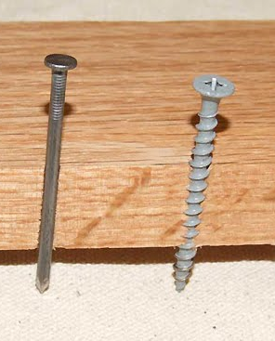
Alternative tools?
Assume:
50% absorption: 1 mJ/xtal
Zero-dose extrapolation
Linear to half-reaction point (5% error)
XFEL worthy?
Size (μm) | D_{1/2} (MGy) | example
30 | 30 | Cryo MX
118 | 0.5 | PS II
160 | 0.2 | RT MX
350 | 0.02 | Myoglobin

Slide 50
Grand Challenges in Structural Biology
Phase Problem
spots, but no maps
Amplitude Problem
    Crystals, but no spots
R-factor Gap
    Can’t/shouldn’t publish

Slide 51
Darwin’s Formula
V_{xtal}
λ³ L
I_{spot} = I_{beam} r_{e}²
P A | F₀e^{-Bs2} |²
V_{cell}
ωV_{cell}
I_{spot} - photons/spot (fully-recorded)
I_{beam} - incident (photons/s/m² )
r_{e} - classical electron radius (2.818x10⁻¹⁵ m)
V_{xtal} - volume of crystal (in m³)
V_{cell} - volume of unit cell (in m³)
λ - x-ray wavelength (in meters!)
ω - rotation speed (radians/s)
L - Lorentz factor (speed/speed)
P - polarization factor
A - attenuation factor
F₀ - structure factor at T = 0
B - Debye-Waller-Ott factor
s - 0.5/d-spacing
C. G. Darwin (1914)

Slide 52
Darwin’s Formula
V_{xtal}
λ³ L
I_{spot} = I_{beam} r_{e}²
P A | F₀e^{-Bs2} |²
V_{cell}
ωV_{cell}
I_{spot} - photons/spot (fully-recorded)
I_{beam} - incident (photons/s/m² )
r_{e} - classical electron radius (2.818x10⁻¹⁵ m)
V_{xtal} - volume of crystal (in m³)
V_{cell} - volume of unit cell (in m³)
λ - x-ray wavelength (in meters!)
ω - rotation speed (radians/s)
L - Lorentz factor (speed/speed)
P - polarization factor
A - attenuation factor
F₀ - structure factor at T = 0
B - Debye-Waller-Ott factor
s - 0.5/d-spacing
C. G. Darwin (1914)

Slide 53
Darwin’s Formula
V_{xtal}
λ³ L
I_{spot} = I_{beam} r_{e}²
P A | F₀e^{-Bs2} |²
V_{cell}
ωV_{cell}
I_{spot} - photons/spot (fully-recorded)
I_{beam} - incident (photons/s/m² )
r_{e} - classical electron radius (2.818x10⁻¹⁵ m)
V_{xtal} - volume of crystal (in m³)
V_{cell} - volume of unit cell (in m³)
λ - x-ray wavelength (in meters!)
ω - rotation speed (radians/s)
L - Lorentz factor (speed/speed)
P - polarization factor
A - attenuation factor
F₀ - structure factor at T = 0
B - Debye-Waller-Ott factor
s - 0.5/d-spacing
C. G. Darwin (1914)

Slide 54
Cryo damage
10³
100
maximum tolerable dose (MGy)
10
1
1 2 3 5 7 10 20 40 70 100
resolution (Å)
Howells et al. (2009) J. Electron. Spectrosc. Relat. Phenom. 170 4-12

Slide 55
Cryo damage
10³
10 MGy/Å
100
maximum tolerable dose (MGy)
10
1
1 2 3 5 7 10 20 40 70 100
resolution (Å)
Howells et al. (2009) J. Electron. Spectrosc. Relat. Phenom. 170 4-12

Slide 56
Self-calibrated damage limit
Where:
⟨I⟩_{DL} - average damage-limited intensity (photons/hkl) at a given resolution
10⁵ - converting R from μm to m, r_{e} from m to Å, ρ from g/cm³ to kg/m³ and MGy to Gy
r_{e} - classical electron radius (2.818 x 10⁻¹⁵ m/electron)
h - Planck’s constant (6.626 x 10⁻³⁴ J∙s)
c - speed of light (299792458 m/s)
f_{decayed} - fractional progress toward completely faded spots at end of data set
ρ - density of crystal (~1.2 g/cm³)
R - radius of the spherical crystal (μm)
λ - X-ray wavelength (Å)
f_{NH} - the Nave & Hill (2005) dose capture fraction (1 for large crystals)
n_{ASU} - number of proteins in the asymmetric unit
M_{r} - molecular weight of the protein (Daltons or g/mol)
V_{M} - Matthews’s coefficient (~2.4 Å³/Dalton)
H - Howells’s criterion (10 MGy/Å)
θ - Bragg angle
⟨ƒ_{a}²⟩ - number-averaged squared structure factor per protein atom (electron²)
⟨M_{a}⟩ - number-averaged atomic weight of a protein atom (~7.1 Daltons)
B - average (Wilson) temperature factor (Å²)
μ - attenuation coefficient of sphere material (m⁻¹)
μ_{en} - mass energy-absorption coefficient of sphere material (m⁻¹)
No flux
No symmetry
Holton & Frankel (2010) Acta D 66 393-408.

Slide 57
Self-calibrated damage limit
Where:
⟨I⟩_{DL} - average damage-limited intensity (photons/hkl) at a given resolution
10⁵ - converting R from μm to m, r_{e} from m to Å, ρ from g/cm³ to kg/m³ and MGy to Gy
r_{e} - classical electron radius (2.818 x 10⁻¹⁵ m/electron)
h - Planck’s constant (6.626 x 10⁻³⁴ J∙s)
c - speed of light (299792458 m/s)
f_{decayed} - fractional progress toward completely faded spots at end of data set
ρ - density of crystal (~1.2 g/cm³)
R - radius of the spherical crystal (μm)
λ - X-ray wavelength (Å)
f_{NH} - the Nave & Hill (2005) dose capture fraction (1 for large crystals)
n_{ASU} - number of proteins in the asymmetric unit
M_{r} - molecular weight of the protein (Daltons or g/mol)
V_{M} - Matthews’s coefficient (~2.4 Å³/Dalton)
H - Howells’s criterion (10 MGy/Å)
θ - Bragg angle
⟨ƒ_{a}²⟩ - number-averaged squared structure factor per protein atom (electron²)
⟨M_{a}⟩ - number-averaged atomic weight of a protein atom (~7.1 Daltons)
B - average (Wilson) temperature factor (Å²)
μ - attenuation coefficient of sphere material (m⁻¹)
μ_{en} - mass energy-absorption coefficient of sphere material (m⁻¹)
Holton & Frankel (2010) Acta D 66 393-408.

Slide 58
Bigger is better, but not by much
B = 20
B = 60
B = 0
B = 170
B = 330
B = 560
Resolution (Å)
B = 850
Crystal diameter (micron)

Slide 59
Predicting resolution limits
Synchrotron Resolution (Å)
Home Lab Resolution (Å)

Slide 60
Predicting resolution limits
XFEL Resolution (Å)
Synchrotron Resolution (Å)

Slide 61
Resolution (Å)
too big
too small
just right
X-ray beam size (μm)

Slide 62
Diffraction Take-Home Lesson:
Disorder
Trumps
Everything!

Slide 63
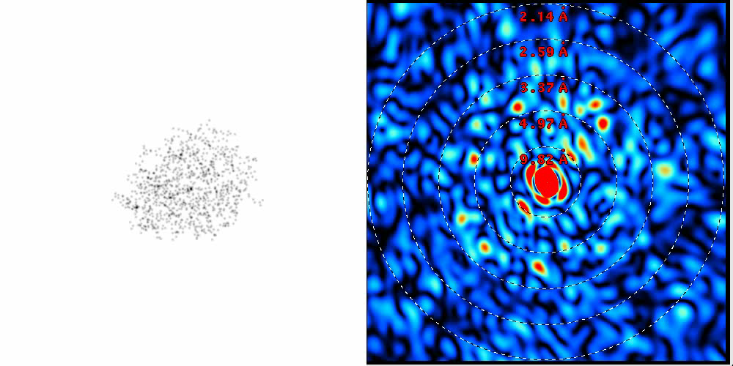
lysozyme: real and reciprocal

Slide 64
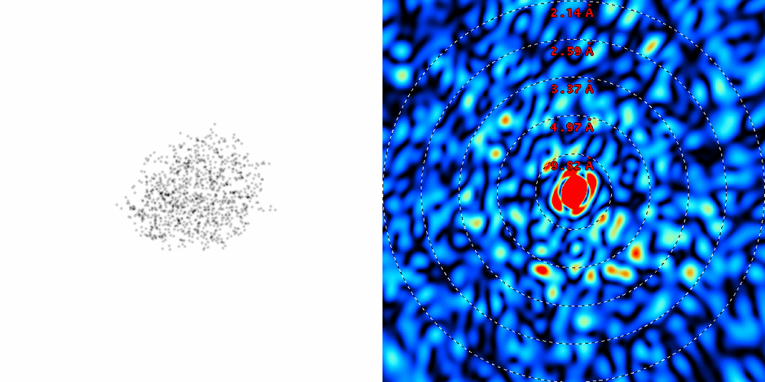
lysozyme: thermal motion

Slide 65
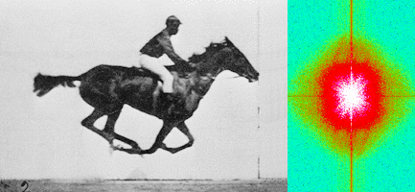
Muybridge’s galloping horse (1878)
“Time-resolved” diffraction
Real space
reciprocal

Slide 66
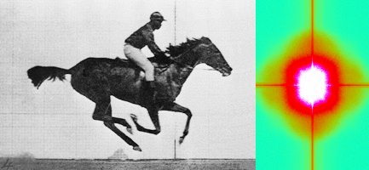
Muybridge’s galloping horse (1878)
Average intensity
Real space
reciprocal

Slide 67
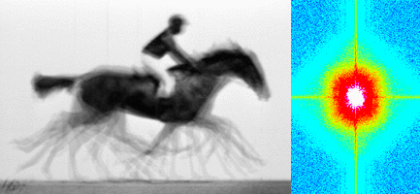
Muybridge’s galloping horse (1878)
Average electron density
Real space
reciprocal

Slide 68
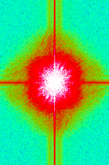
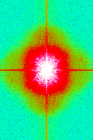
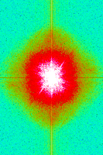
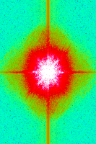
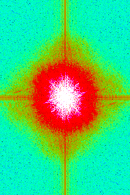
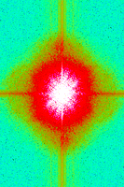
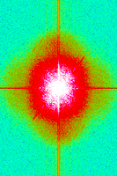
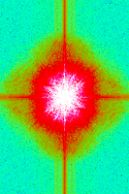
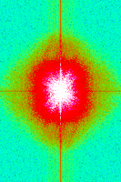
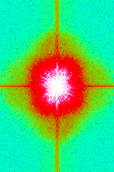
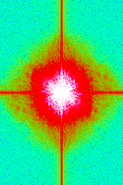
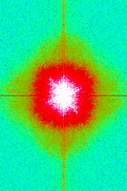
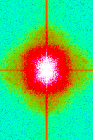
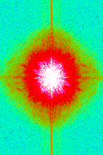
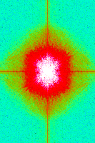
Supporting a model with data

Slide 69
Grand Challenges in Structural Biology
Phase Problem
spots, but no maps
Amplitude Problem
    Crystals, but no spots
R-factor Gap
    Can’t/shouldn’t publish

Slide 70
Is this good enough?
d_{max} = 4.5 Å
R_{cryst} = 27%
R_{free} = 38%

Slide 71
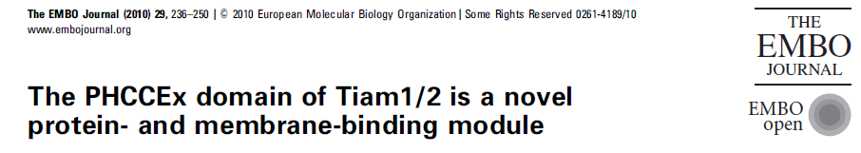
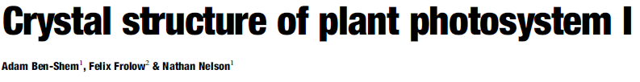
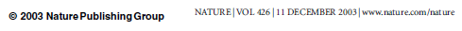
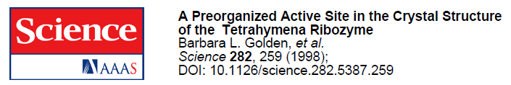
Is this good enough?
3a8n 4.5 Å R_{merge} = 0.15 R/R_{free} = 0.306/0.396
1qzv 4.44 Å R_{merge} = 0.099 R/R_{free} = 0.41/0.42
1grz 5 Å R_{merge} = 0.052 R/R_{free} = 0.369/0.428

Slide 72
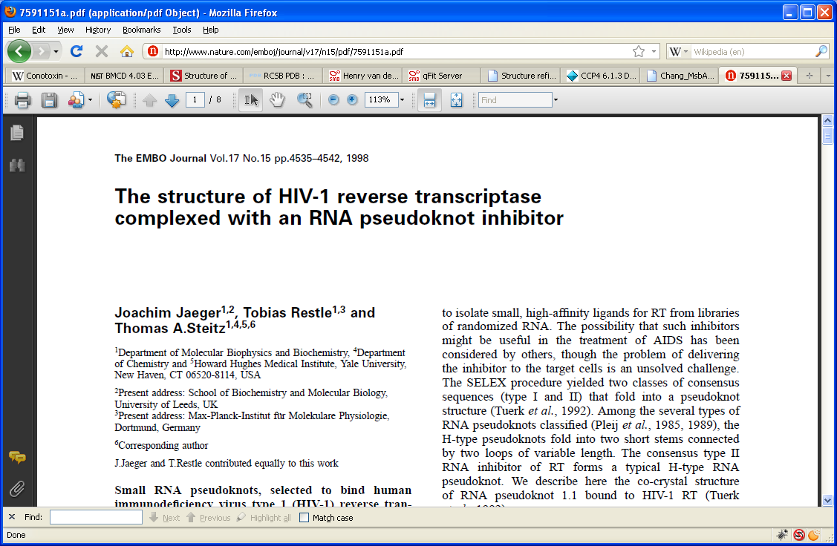
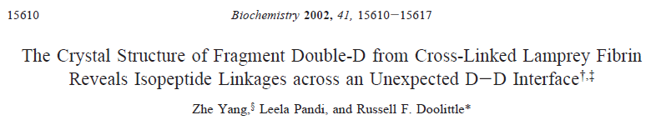
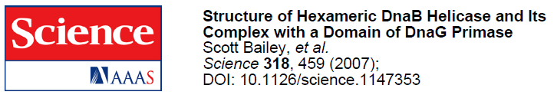
Is this good enough?
1hvu 4.75 Å R_{merge} = 0.064 R/R_{free} = 0.34/0.413
1n8e 4.5 Å R_{merge} = 0.138 R/R_{free} = 0.415/0.416
2r6e 5.02 Å R_{merge} = 0.058 R/R_{free} = 0.394/0.397

Slide 73
R-factor Gap?
Publication criterion for chemical crystallography:
R1 < 2*R_{sigma}
R1 = F_{o} vs F_{c} for I/σ(I) > 3
R_{sigma} = <σ(I)>/<I>
There are no PDB entries that pass this test!
Holton et al. (2014). FEBS J. 281, 4046-60.

Slide 74
“R-factor Gap” for macromolecules
R_{merge} = 3%
R_{work} = 20%
R_{free} = 24%
Experimental
error
“systematic”
error
20% of carbon atom = 1.2 e⁻
5% of carbon atom = 0.3 e⁻
Closing the R-factor gap will enable study of 1-electron changes

Slide 75
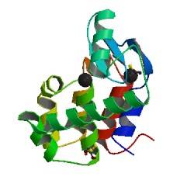
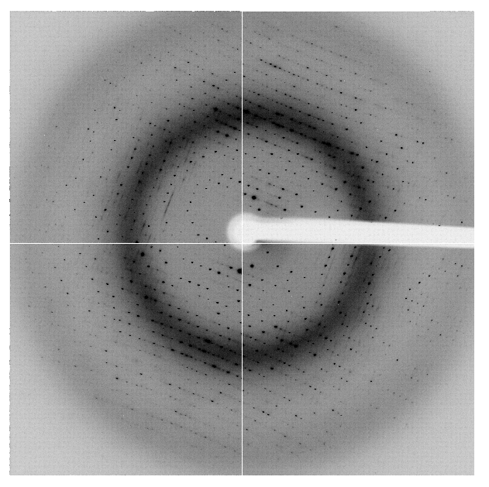
The R-factor Gap
multi-conformer PDB file
R_{merge} = 6%
R_{cryst} = 17%
R_{free} = 20%
MLFSOM
Elves
1H87
Holton, Classen, Frankel & Tainer (2014)."The R-factor gap in macromolecular crystallography: an untapped potential for insights on accurate structures", FEBS J. 281, 4046-4060.

Slide 76
The R-factor Gap
multi-conformer PDB file
R_{merge} = 6%
R_{cryst} = 7%
R_{free} = 8%
MLFSOM
Elves
1H87
Holton, Classen, Frankel & Tainer (2014)."The R-factor gap in macromolecular crystallography: an untapped potential for insights on accurate structures", FEBS J. 281, 4046-4060.

Slide 77
The R-factor Gap
single-conformer PDB file
R_{merge} = 6%
R_{cryst} = 7%
R_{free} = 8%
MLFSOM
Elves
1H87; conf “A”
Holton, Classen, Frankel & Tainer (2014)."The R-factor gap in macromolecular crystallography: an untapped potential for insights on accurate structures", FEBS J. 281, 4046-4060.

Slide 78
“R-factor Gap” for macromolecules
MX data quality is not limiting
Hypotheses:
  Hidden systematic error?
  Model-building problem?
  Representation problem?

Slide 79
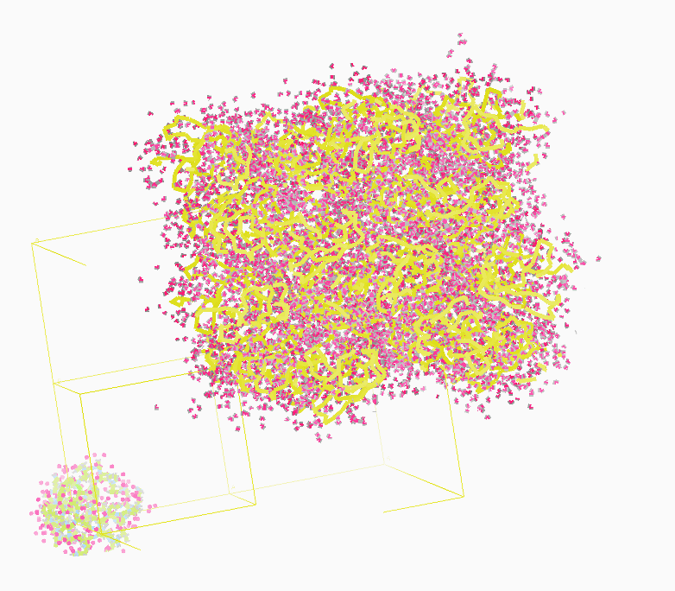
Molecular Dynamics Simulation
using real
crystal’s lattice
1aho
Scorpion toxin
0.96 Å resolution
64 residues
Solvent: H₂0 + acetate
Cerutti et al. (2010).J. Phys. Chem. B 114, 12811-12824.

Slide 80

30 conformers from 24,000

Slide 81

Electron density from 24,000 conformers

Slide 82

Electron density from 24,000 conformers

Slide 83

2F_{sim}-F_{calc} and F_{sim}-F_{calc} maps
1.0 Å data
R_{cryst}= 0.137
R_{free} = 0.159
1 “sigma” 2F_{sim}-F_{c}
2.5 “sigma” F_{sim}-F_{c}

Slide 84

2F_{sim}-F_{calc} and (F_{sim} Φ_{sim}) - (F_{calc} Φ_{calc}) maps
1.0 Å data
R_{cryst}= 0.137
R_{free} = 0.159
1 “sigma” 2F_{sim}-F_{c}
F_{right} – (2F_{sim}-F_{c})

Slide 85

Regular model with real data!
1.0 Å data
R_{cryst}= 0.116
R_{free} = 0.135
1 “sigma” 2F_{sim}-F_{c}
2.5 “sigma” F_{sim}-F_{c}

Slide 86

MD: predicted density for one atom

Slide 87

How many conformers are there?
Answer: 40
R_{cryst} = 0.0506
R_{free} = 0.0556
vs F_{sim}

Slide 88

How many conformers are there?
Answer: 8
R_{cryst} = 0.0297
R_{free} = 0.0293
vs F_{sim}

Slide 89

How many conformers are there?
Answer: 2-14
R_{cryst} = 0.0441
R_{free} = 0.0516
vs F_{sim}

Slide 90

How many conformers are there?
Answer: 1-7
R_{cryst} = 0.1546
R_{free} = 0.1749
vs F_{obs}
1aho:
R_{cryst} = 0.1630
R_{free} = n/d

Slide 91

How many conformers are there?
All difference
features
are in
the solvent!
real data

Slide 92

How “rough” is the solvent?
R_{cryst} = 0.0309
R_{free} = 0.0678
vs F_{sim}

Slide 93
RISM model for “bulk” solvent
Method | R_{work} | R_{free}
Default refmac5: flat bulk solvent | .1784 | .1898
RISM – self-consistent density field based on electrostatics | .1640 | .1808
Explicit MD solvent, protein fixed | .1523 | .1690
RISM – protein fixed multi-conformer weighted | .1578 | .1739
Explicit – protein fixed multi-conformer weighted | .1440 | .1666

Slide 94
Grand Challenges in Structural Biology
Phase Problem
“true” multiplicity detector calibration
SINBAD for XFEL S-SAD?
Amplitude Problem
Disorder > everything Revolution in sample handling?
deconvolute non-isomorphism?
R-factor Gap
1 electron changes? 2D data vs 4D models?
http://bl831.als.lbl.gov/~jamesh/powerpoint/Janelia_thresholds_2015.pptx

Slide 95
What good are low energies?
Carbon 284
Nitrogen 402
Oxygen 537
Fluorine 685
Neon 866
Sodium 1072
Magnesium 1304
Aluminum 1559
Silicon 1838
Phosphorous 2148
Sulfur 2475
Chlorine 2825
Argon 3205
Potassium 3610
Calcium 4041
Scandium 4495

Slide 96

scattering from a crystal structure
False color intensity
sample
detector

Slide 97

scattering from a crystal structure
False color intensity
sample
detector

Slide 98

scattering from a crystal structure
False color intensity
sample
detector

