Slide 1
Acknowledgements
Robert Stroud James Fraser John Spence
Chris Nielsen Clemens Schulze-Briese Aina Cohen Ana Gonzalez
UCSF LBNL SLAC
ALS 8.3.1 creator: Tom Alber
Center for Structure of Membrane Proteins (CSMP)
Membrane Protein Expression Center II (MPEC)
Center for HIV Accessory and Regulatory Complexes (HARC)
UC Multicampus Research Programs and Initiatives (MRPI)
UCSF Program for Breakthrough Biomedical Research (PBBR) Integrated Diffraction Analysis Technologies (IDAT)
Plexxikon, Inc.
M D Anderson CRC
Synchrotron Radiation Structural Biology Resource (SLAC)
The Advanced Light Source is supported by the Director, Office of Science, Office of Basic Energy Sciences, Materials Sciences Division, of the US Department of Energy under contract No. DE-AC02-05CH11231 at Lawrence Berkeley National Laboratory.

Slide 2
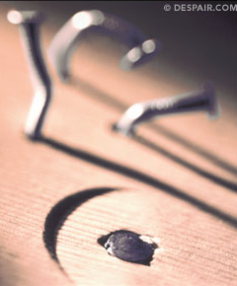
Grand Challenges in Structural Biology
Phase Problem
native elements - universally
Amplitude Problem
    Improving resolution
R-factor Gap
    Publishing / being right

Slide 3
Grand Challenges in Structural Biology
Phase Problem
detector calibration
Amplitude Problem
    disorder
R-factor Gap
    Limited representation

Slide 4
Grand Challenges in Structural Biology
Phase Problem
detector calibration
Amplitude Problem
    disorder
R-factor Gap
    Limited representation

Slide 5
Can you count to 1,000,000 ?
sqrt(1,000,000)
1,000,000
Theoretically:
= 0.1%
R_{meas} ≈ 0.1% ?
ISa = 1000
In reality:
ISa ~ 33
R_{meas =} ≈ 3%
sqrt(1,000)
1,000
= 3%
photon
spot
> 1000 is a waste!

Slide 6
Threshold of a revolution in phasing
Current
technology
Goal
Solve-able proteins (%)
Required signal-to-noise (I/σ)

Slide 7
Threshold of a revolution in phasing
Source of error | realistic simulation | No SHSSS | Perfect detector
Photon counting | + | + | +
Shutter jitter | + | + | -
Beam flicker | + | + | -
Sample absorption | + | + | -
Radiation damage | + | + | -
Imperfect spindle | + | + | -
vignette | + | + | -
Corner correction | + | + | -
SHSSS | + | - | -
R_{meas} (∞-10 Å) | 2.8% | 0.7% | 0.7%
I/σ asymptotic | 26.8 | 74.2 | 81.0
Holton et al (2014) "R-factor gap", FEBS Journal 281, 4046-4060.

Slide 8
Spatial Heterogeneity in Sharp Spot Sensitivity
Relative spot intensity
Spot centroid position (pixels)

Slide 9
Spatial Heterogeneity in Sharp Spot Sensitivity
Relative spot intensity
Spot centroid position (pixels)

Slide 10
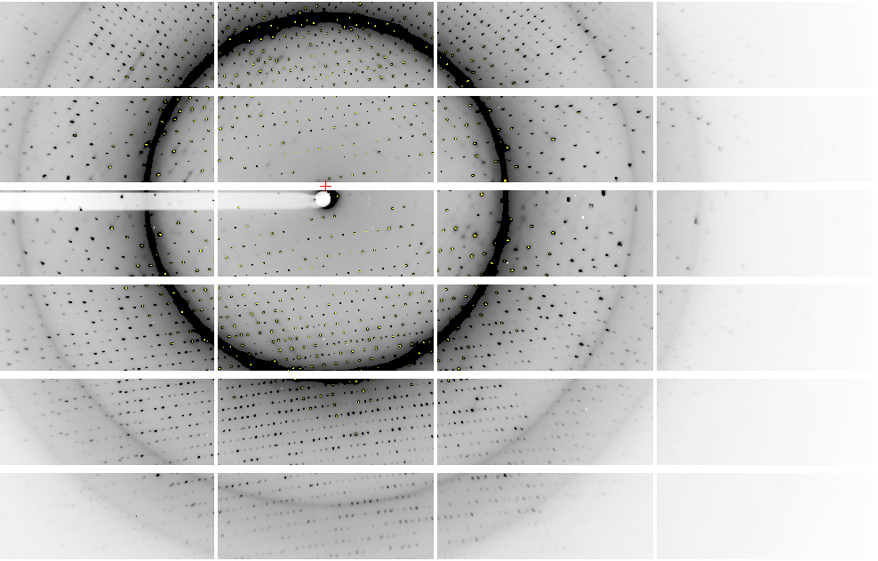
Pilatus: 1-module shift

Slide 11
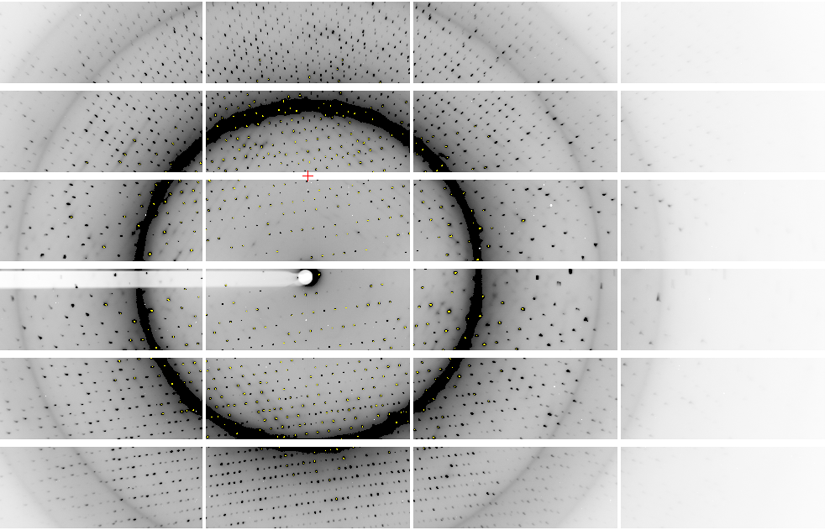
Pilatus: 1-module shift

Slide 12
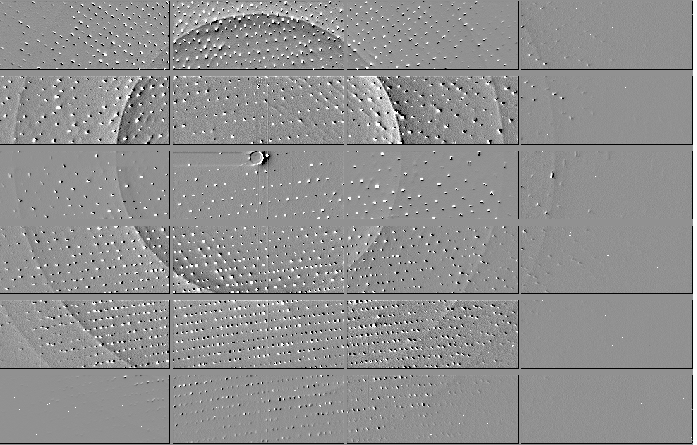
Pilatus: 1-module shift

Slide 13
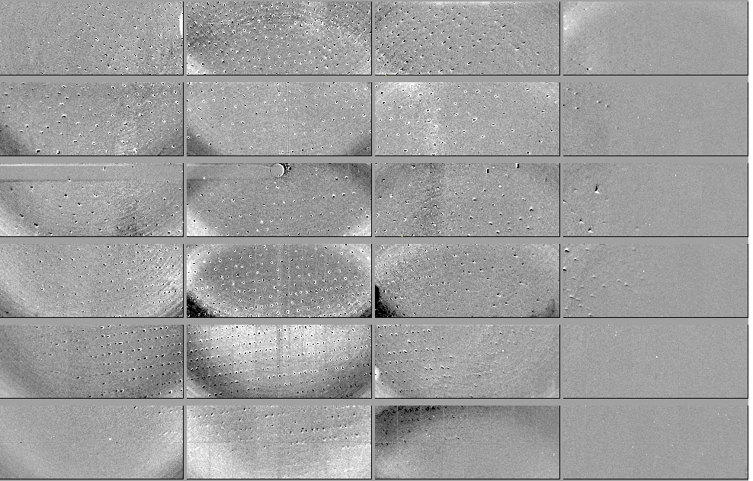
Pilatus: 1-module shift - aligned

Slide 14
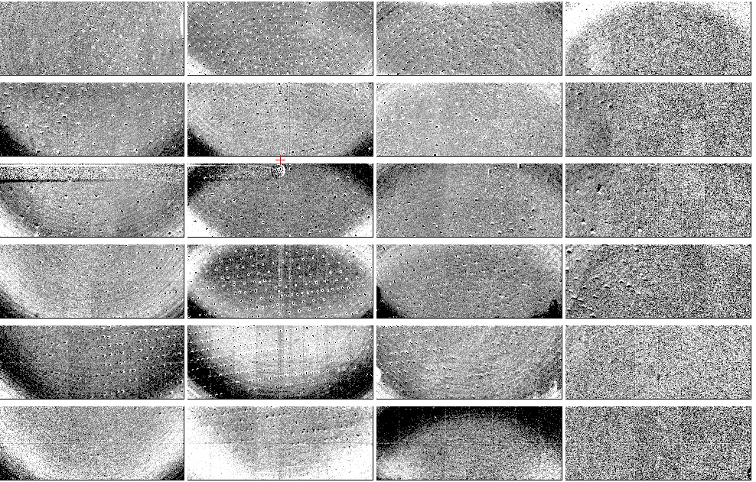
Pilatus: 1-module shift - ratio
3% high
average
3% low

Slide 15
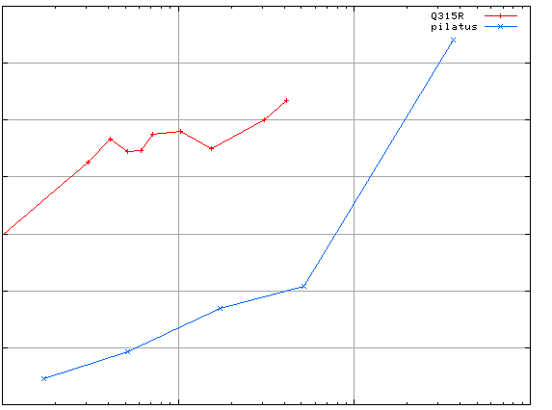
3.5
3.0
2.5
2.0
1.5
1.0
0.5
CCD detector
different
modules
anomalous mates are always on
different modules
SHSSS
Systematic component of R_{sseparate} (%)
Pilatus
SN001
Pilatus
SN113
0.1 1 10 100
distance between spots (mm)

Slide 16

Pilatus: subtract smooth baseline
~3x10⁵ photon/pixel
Bragg
glitch
“tree rings”
Pick-up tool mark
oxygen
inclusions
1% high
average
1% low

Slide 17
PAD: need more than flood-field
θ
incoming
photon
λ
detection
event
N
N
N

Slide 18
PAD: need more than flood-field
θ
Bragg
glitch
width
incoming
photon
λ
oxygen
inclusion
thickness
detection
event
N
N
N

Slide 19
PAD: need more than flood-field
θ
Bragg
glitch
width
incoming
photon
λ
charge-
sharing
zone
oxygen
inclusion
thickness
detection
event
trim
trim
trim
N
N
N

Slide 20
Grand Challenges in Structural Biology
Phase Problem
Calibrate it out boost the signal average over it
Amplitude Problem
R-factor Gap
http://bl831.als.lbl.gov/~jamesh/powerpoint/Janelia_thresholds_2015.pptx

Slide 21
Grand Challenges in Structural Biology
Phase Problem
Calibrate it out boost the signal average over it
Amplitude Problem
R-factor Gap
http://bl831.als.lbl.gov/~jamesh/powerpoint/Janelia_thresholds_2015.pptx

Slide 22
2472.7 2473.5
Anomalous f” (electrons)
Photon Energy (eV)
Bohic et al. Anal. Chem. 2008; 80(24):9557. doi: 10.1021/ac801817k

Slide 23
Current
detectors
Solve-able proteins (%)
Required signal-to-noise (I/σ)

Slide 24
Where do photons go?
100 μm
thick
protein
97%
transmitted
1 Å x-rays
beamstop
attenuation correction
error cannot be > ~3%

Slide 25
Where do photons go?
100 μm
thick
protein
2%
transmitted
5 Å x-rays
beamstop
attenuation correction
error can be ~98%

Slide 26
Where do photons go?
1 μm
thick
protein
96%
transmitted
5 Å x-rays
beamstop
attenuation correction
error cannot be > ~4%

Slide 27
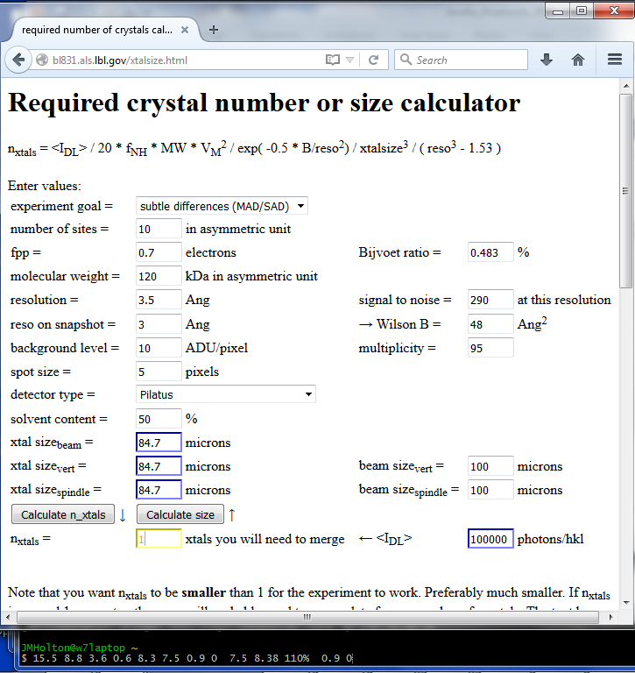

Slide 28
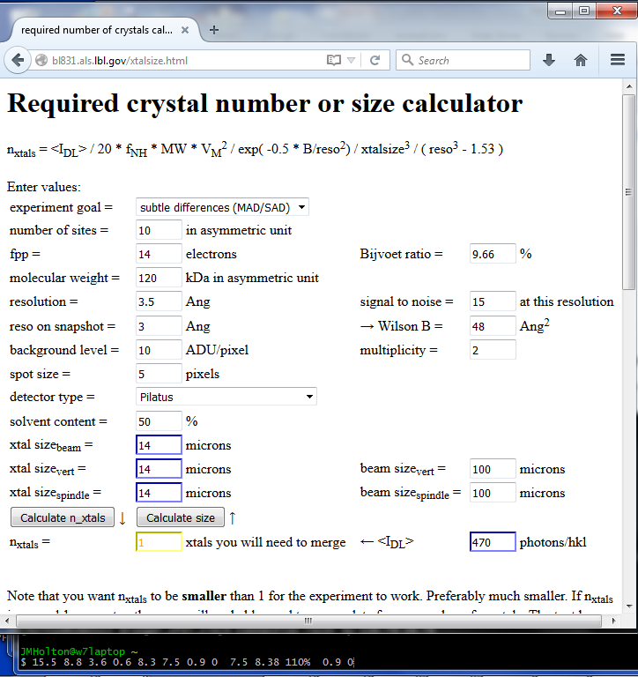

Slide 29
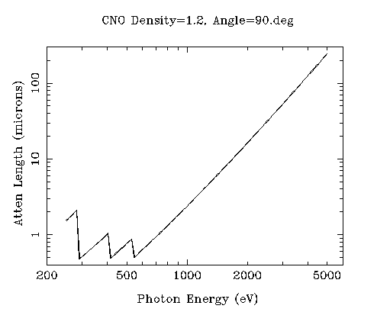
“sweet spot” for sample size ?
Ca
Ar
Cl
K
S
P
2 Å
2sin(90°)
Mg
C
Na
Se
Ne
3 Å
2sin(90°)
N
O
F
4 Å
2sin(90°)

Slide 30
Dose-rate dependence of damage
maximum useful dose (MGy)
dose rate (kGy/s)

Slide 31
The “partiality problem”
0.006°
1 μm xtal
1 Å x-rays

Slide 32
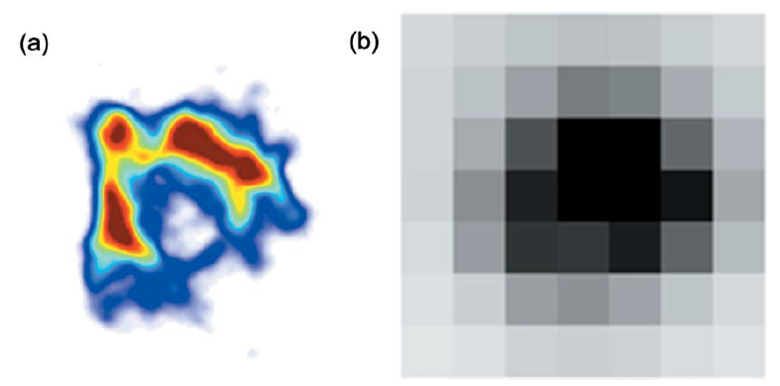
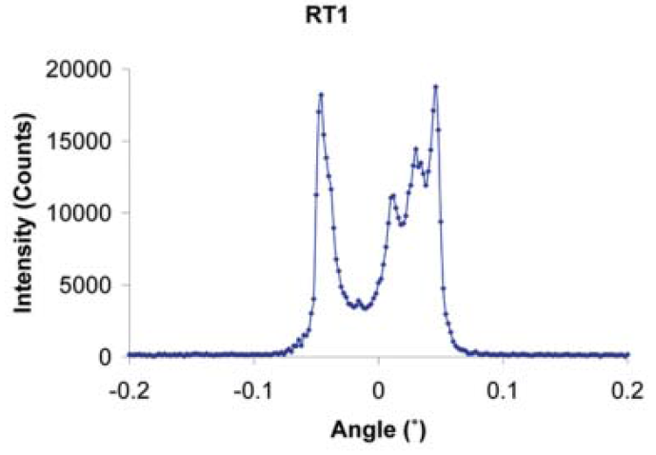
The true nature of “mosaic spread”
Any function can be approximated by a family of Gaussians
Lovelace JJ, Murphy CR, Pahl R, Brister K & Borgstahl GEO (2006)."Tracking reflections through cryogenic cooling with topography", J. Appl. Cryst. 39, 425-432.

Slide 33
(h,k,l)
Ewald sphere 2
λ*
diffracted ray
d*
θ
λ*
λ*
θ
d*
diffracted ray
λ*
Ewald sphere
1
(-h,-k,-l)

Slide 34
Si(111)
52.87deg
Si(111)
2 Multilayer mirrors
d=2nm, W/B4C
KB Horiz focus
KB vertical focus
Si(111)
Detector
Detector
λ = 5 Å
h,k,l
sample
injector
-h,-k,-l
Si(111)
Detector
Detector
~ 1m
Si(111)
Si(111)
Notes:
Proposed 5-crystal monochromator for colliding-beam crystallography. The generation of two opposing Ewald spheres means that for every h,k,l index reflected from the protein crystal, the Friedel mate is reflected in the opposite direction, allowing for very accurate anomalous difference measurements. The wavelength need not be set precisely at the sulfur or phosphorous edge, but merely at a wavelength where the f” of those elements are strong. For fs-class pulses, the distances above will have to be precise to withing ~3 microns, and for accurate reproduction of the partiality of the Friedel mates, the angular precision of the colliding beams must be within ~1% of the sample crystal’s rocking width, or ~100 microrads.

Slide 35
Grand Challenges in Structural Biology
Phase Problem
Calibrate it out boost the signal average over it
Amplitude Problem
R-factor Gap
http://bl831.als.lbl.gov/~jamesh/powerpoint/Janelia_thresholds_2015.pptx

Slide 36
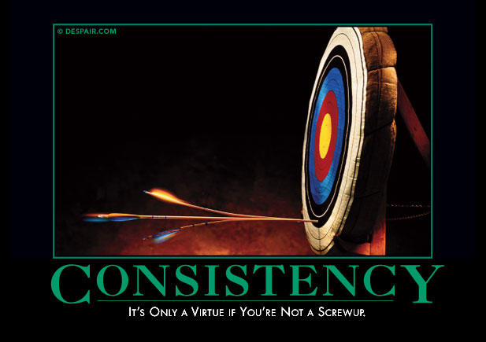
Systematic error does not “average out”

Slide 37
Required averaging for anomalous
^{mult >} (—)²
~3%
<ΔF/F>

Slide 38
140-fold multiplicity: 16 crystals, 360° each, inverse beam, 7235 eV
RESOLUTION COMPLETENESS R-FACTOR I/SIGMA R-meas CC(1/2) Anomal SigAno Nano
LIMIT OF DATA observed Corr
9.17 99.1% 3.9% 257.47 3.9% 100.0* 91* 5.024 450
6.49 100.0% 5.2% 214.33 5.2% 100.0* 86* 3.836 882
5.30 100.0% 7.2% 165.13 7.2% 100.0* 76* 3.257 1175
4.59 100.0% 7.2% 175.42 7.3% 100.0* 67* 2.589 1403
4.10 99.9% 7.7% 174.13 7.7% 100.0* 59* 2.264 1594
3.74 99.9% 9.4% 143.09 9.4% 100.0* 49* 1.953 1783
3.47 100.0% 11.2% 120.17 11.2% 100.0* 39* 1.696 1942
3.24 100.0% 14.1% 91.14 14.1% 100.0* 30* 1.333 2103
3.06 99.9% 19.5% 65.79 19.5% 100.0* 23* 1.117 2214
2.90 99.9% 29.0% 44.85 29.1% 99.9* 17* 1.008 2369
2.77 99.9% 40.5% 32.58 40.6% 99.8* 11* 0.901 2493
2.65 99.9% 52.8% 25.16 52.9% 99.8* 10* 0.866 2605
2.54 100.0% 67.4% 19.47 67.6% 99.6* 2 0.804 2705
2.45 100.0% 88.9% 14.58 89.2% 99.2* 4 0.831 2859
2.37 100.0% 109.3% 9.97 109.7% 98.1* 5 0.829 2925
2.29 100.0% 138.2% 6.87 138.9% 96.1* 1 0.760 3037
2.22 100.0% 197.1% 4.03 198.6% 83.5* -1 0.721 3159
2.16 100.0% 227.3% 2.41 230.8% 46.9* -1 0.677 3224
2.10 61.2% 154.4% 1.28 163.6% 47.0* -2 0.660 1999
2.05 47.9% 170.1% 0.68 196.5% 25.7* 3 0.629 1578
total 93.3% 15.7% 54.30 15.8% 100.0* 12* 1.217 42499

Slide 39
140-fold multiplicity: 16 crystals, 360° each, inverse beam, 7235 eV
RESOLUTION COMPLETENESS R-FACTOR I/SIGMA R-meas CC(1/2) Anomal SigAno Nano
LIMIT OF DATA observed Corr
9.17 99.1% 3.9% 257.47 3.9% 100.0* 91* 5.024 450
6.49 100.0% 5.2% 214.33 5.2% 100.0* 86* 3.836 882
5.30 100.0% 7.2% 165.13 7.2% 100.0* 76* 3.257 1175
4.59 100.0% 7.2% 175.42 7.3% 100.0* 67* 2.589 1403
4.10 99.9% 7.7% 174.13 7.7% 100.0* 59* 2.264 1594
3.74 99.9% 9.4% 143.09 9.4% 100.0* 49* 1.953 1783
3.47 100.0% 11.2% 120.17 11.2% 100.0* 39* 1.696 1942
3.24 100.0% 14.1% 91.14 14.1% 100.0* 30* 1.333 2103
3.06 99.9% 19.5% 65.79 19.5% 100.0* 23* 1.117 2214
2.90 99.9% 29.0% 44.85 29.1% 99.9* 17* 1.008 2369
2.77 99.9% 40.5% 32.58 40.6% 99.8* 11* 0.901 2493
2.65 99.9% 52.8% 25.16 52.9% 99.8* 10* 0.866 2605
2.54 100.0% 67.4% 19.47 67.6% 99.6* 2 0.804 2705
2.45 100.0% 88.9% 14.58 89.2% 99.2* 4 0.831 2859
2.37 100.0% 109.3% 9.97 109.7% 98.1* 5 0.829 2925
2.29 100.0% 138.2% 6.87 138.9% 96.1* 1 0.760 3037
2.22 100.0% 197.1% 4.03 198.6% 83.5* -1 0.721 3159
2.16 100.0% 227.3% 2.41 230.8% 46.9* -1 0.677 3224
2.10 61.2% 154.4% 1.28 163.6% 47.0* -2 0.660 1999
2.05 47.9% 170.1% 0.68 196.5% 25.7* 3 0.629 1578
total 93.3% 15.7% 54.30 15.8% 100.0* 12* 1.217 42499

Slide 40
Gadox calibration vs energy
same = good!
Relative absorption depth
bad!
photon energy (keV)

Slide 41
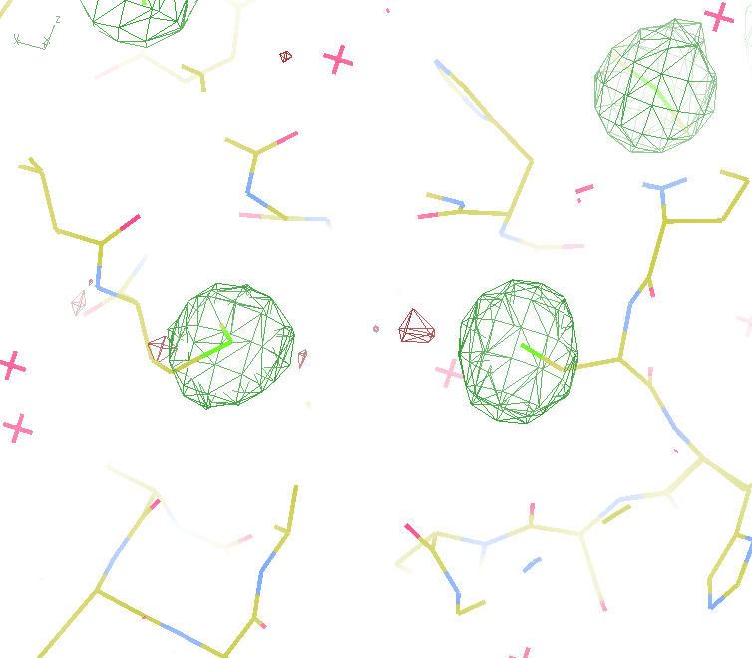
140-fold multiplicity
18 σ
16 σ
Phased anomalous difference Fourier

Slide 42
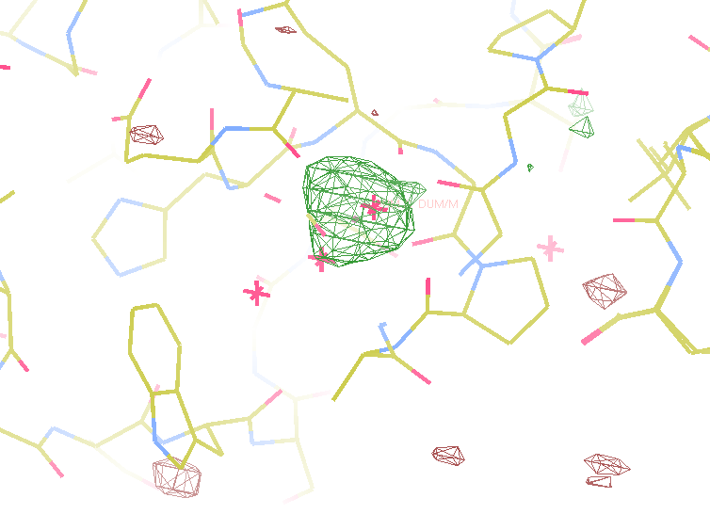
140-fold multiplicity
8.2σ = Mg?
DELFAN residual anomalous difference

Slide 43
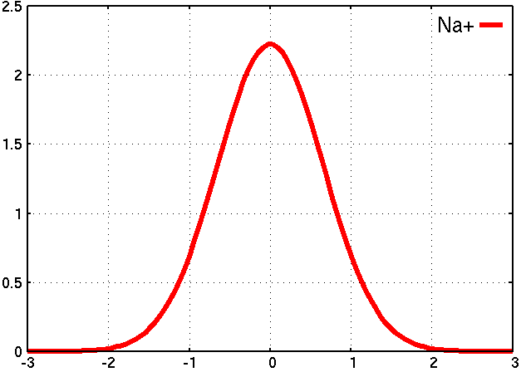
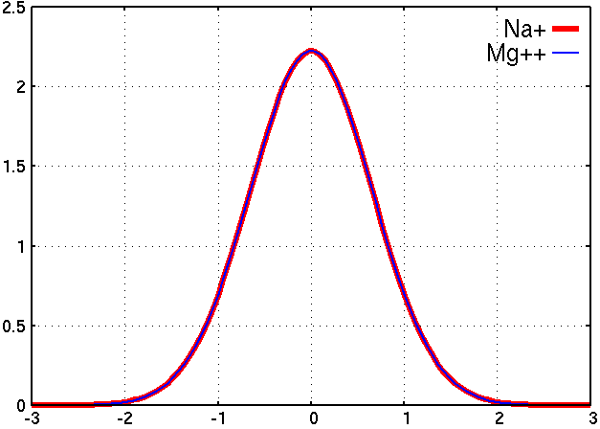
Metal site: is it Mg⁺⁺ ? Or Na⁺ ?
Electron density (e⁻/ Å³)
Position (Å)
A
B

Slide 44
Metal site: is it Mg⁺⁺ ? Or Na⁺ ?
DELFAN peak height (σ)
N
O
F
Ne
Na
Mg
f’’ (electrons)

Slide 45
non-isomorphism
Why doesn’t everyone do this?

Slide 46
non-isomorphism
Why doesn’t everyone do this?
not same structure thing

Slide 47
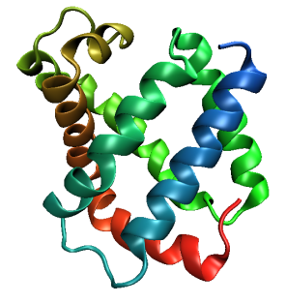
Same structure, different cell
0.5% cell change → 15%
Crick & Magdoff (1956) “theory method isomorphous replacement”, Acta Cryst. 9, 901-8.

Slide 48
Same structure, different cell
0.5% cell change → 15%
Crick & Magdoff (1956) “theory method isomorphous replacement”, Acta Cryst. 9, 901-8.

Slide 49
Same cell, rotated protein
0.5° rotation → 16%
Crick & Magdoff (1956) “theory method isomorphous replacement”, Acta Cryst. 9, 901-8.

Slide 50
Same cell, rotated protein
0.5° rotation → 16%
Crick & Magdoff (1956) “theory method isomorphous replacement”, Acta Cryst. 9, 901-8.

Slide 51
Uniform stretch
5% change → 0%

Slide 52
Uniform stretch
5% change → 0%

Slide 53

Non-isomorphism in lysozyme
RMSD = 0.18 Å
Δcell = 0.7 %
R_{iso} = 44.5%
3aw6
3aw7
RH: 84.2%
vs 71.9%

Slide 54
X-ray Data Sets
Singular values & vectors
data
set
h,k,l | structure factors (F)
 | #1 | #2 | #3 | #4
5,3,4 | 523.7 | 559.8 | 579.9 | 603.2
5,4,4 | 168.2 | 166.6 | 177.2 | 196.1
5,5,4 | 34.9 | 26.4 | 19.2 | 17.3
6,1,4 | 305.7 | 301.1 | 298.1 | 296.3
6,2,4 | 353.0 | 353.9 | 356.2 | 366.9
6,3,4 | 300.9 | 285.3 | 273.5 | 259.4
6,3,5 | 223.8 | 226.3 | 234.6 | 251.4
… | … | … | … | …
h,k,l | 100% | 17 % | 13 % | 9 %
 | 1st | 2nd | 3rd | 4th
5,3,4 | -1.46 | -0.02 | 1.84 | -0.72
5,4,4 | -0.88 | -0.29 | -0.34 | 0.15
5,5,4 | -0.42 | -0.65 | 1.02 | 1.47
6,1,4 | -0.90 | -0.85 | 1.44 | -0.40
6,2,4 | -1.20 | -0.37 | 0.67 | 0.01
6,3,4 | -0.75 | 0.31 | 0.48 | 0.00
6,3,5 | -0.75 | -0.85 | 0.72 | -0.82
… | … | … | … | …
value
vector
Singular value decomp.
SVD
-0.68
-0.24
0.32 …
CC1
Data sets
Positioned
in
“Correlation
Space”
Correlation
Coefficients
CC1 CC2 CC3
CC2
data set #1
data set #2
data set #3
CC3

Slide 55
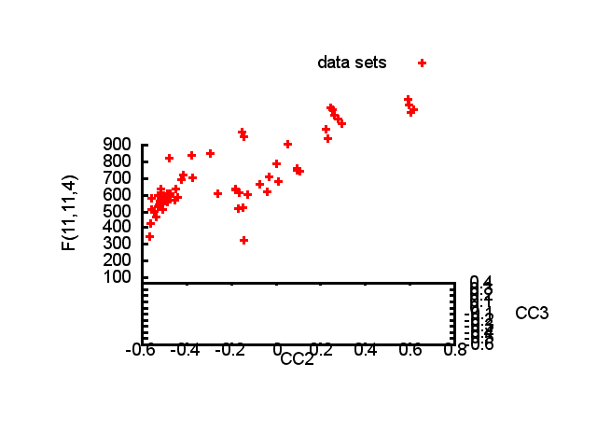

Slide 56
Structure factor (electrons)
Correlation to 2nd & 3rd singular vectors

Slide 57
Structure factor (electrons)
Correlation to 2nd & 3rd singular vectors

Slide 58
Structure factor (electrons)
Correlation to 2nd & 3rd singular vectors

Slide 59
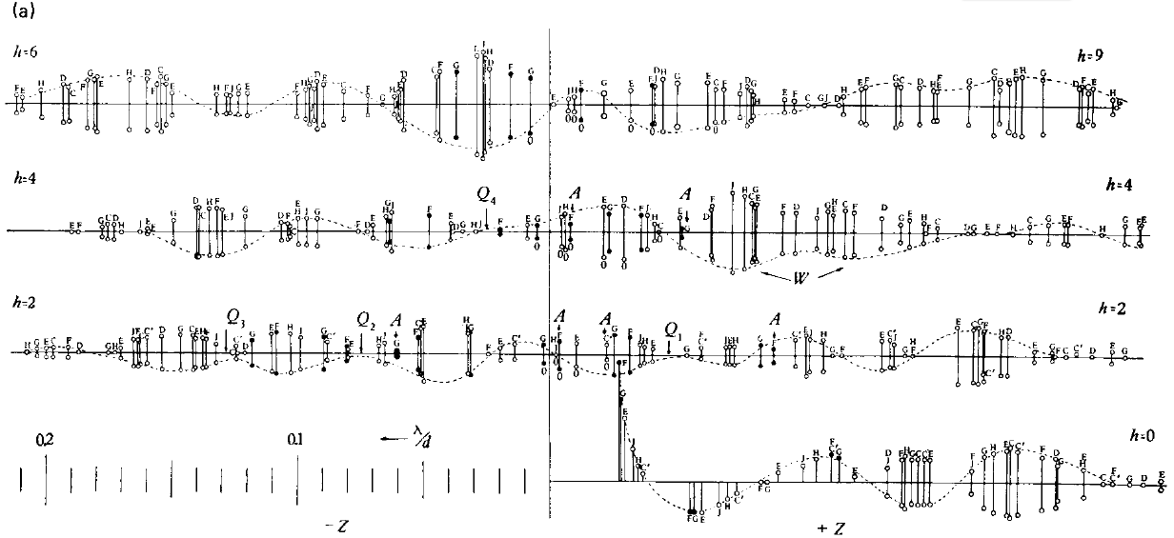
Bragg’s “minimum wavelength principle”
Perutz (1985). “Early Days of Cryst…” Methods in Enzymology, Vol. 114, 3-18.
Bragg & Perutz (1952)."external form haemoglobin I", Acta Cryst. 5, 277-283.

Slide 60
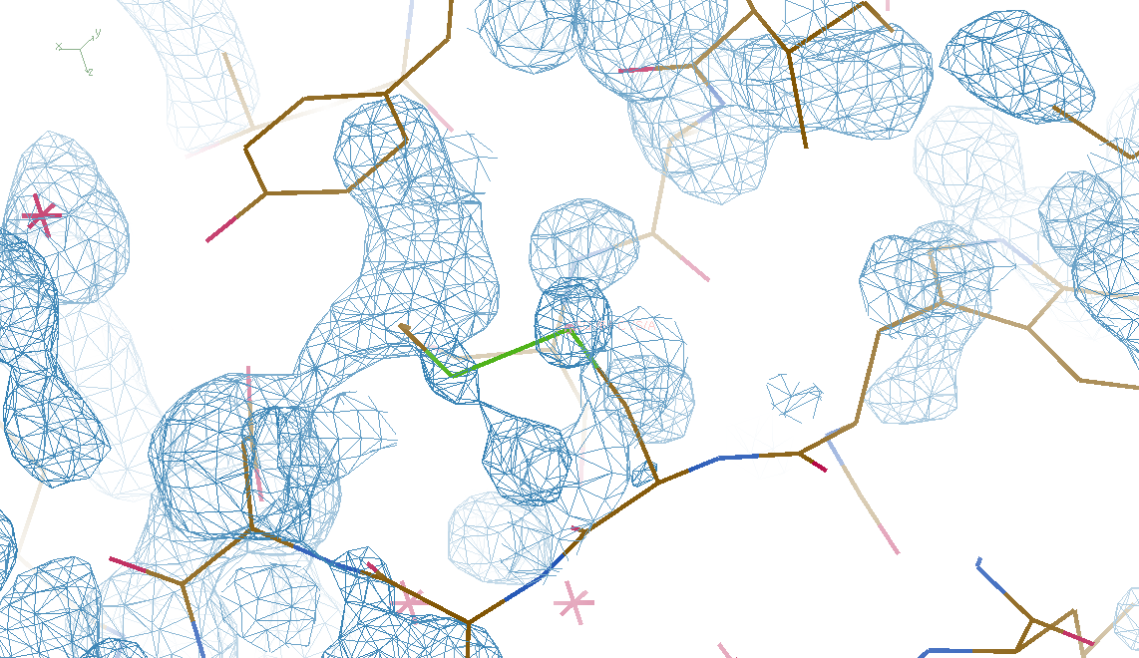
DMMULTI – fake data
4 deg rotation: 8 “xtals”: before
CC = 0.02

Slide 61
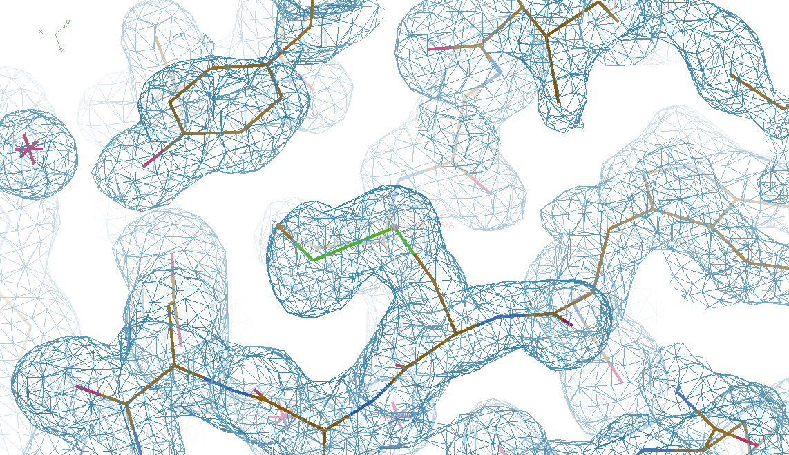
DMMULTI – fake data
4 deg rotation: 8 “xtals”: after
CC = 0.8

Slide 62
Grand Challenges in Structural Biology
Phase Problem
detector calibration
Amplitude Problem
    disorder
R-factor Gap
    Limited representation

Slide 63
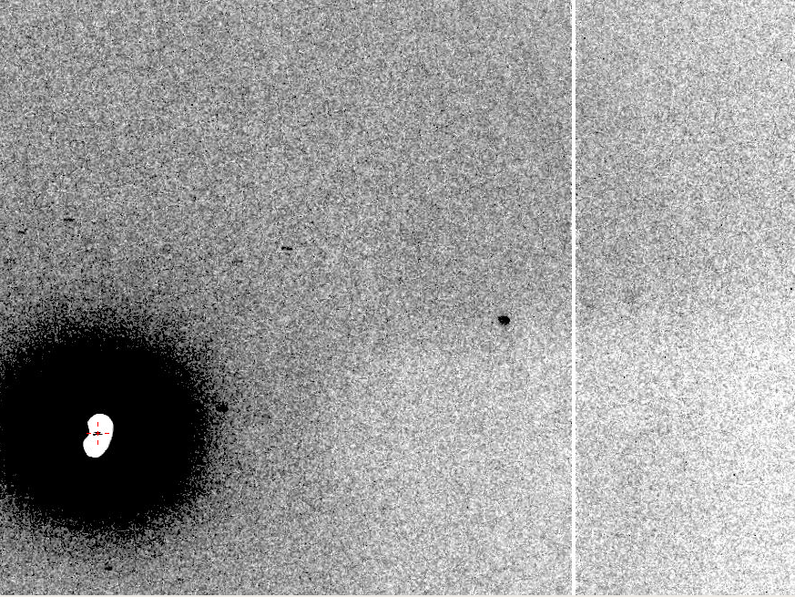
The Amplitude Problem
10 Å

Slide 64
Match beam size to crystal size
Resolution (Å)
too big
too small
just right
X-ray beam size (μm)

Slide 65
Self-calibrated damage limit
Where:
⟨I⟩_{DL} - average damage-limited intensity (photons/hkl) at a given resolution
10⁵ - converting R from μm to m, r_{e} from m to Å, ρ from g/cm³ to kg/m³ and MGy to Gy
r_{e} - classical electron radius (2.818 x 10⁻¹⁵ m/electron)
h - Planck’s constant (6.626 x 10⁻³⁴ J∙s)
c - speed of light (299792458 m/s)
f_{decayed} - fractional progress toward completely faded spots at end of data set
ρ - density of crystal (~1.2 g/cm³)
R - radius of the spherical crystal (μm)
λ - X-ray wavelength (Å)
f_{NH} - the Nave & Hill (2005) dose capture fraction (1 for large crystals)
n_{ASU} - number of proteins in the asymmetric unit
M_{r} - molecular weight of the protein (Daltons or g/mol)
V_{M} - Matthews’s coefficient (~2.4 Å³/Dalton)
H - Howells’s criterion (10 MGy/Å)
θ - Bragg angle
⟨ƒ_{a}²⟩ - number-averaged squared structure factor per protein atom (electron²)
⟨M_{a}⟩ - number-averaged atomic weight of a protein atom (~7.1 Daltons)
B - average (Wilson) temperature factor (Å²)
μ - attenuation coefficient of sphere material (m⁻¹)
μ_{en} - mass energy-absorption coefficient of sphere material (m⁻¹)
No flux
No symmetry
Holton & Frankel (2010) Acta D 66 393-408.

Slide 66
Self-calibrated damage limit
Where:
⟨I⟩_{DL} - average damage-limited intensity (photons/hkl) at a given resolution
10⁵ - converting R from μm to m, r_{e} from m to Å, ρ from g/cm³ to kg/m³ and MGy to Gy
r_{e} - classical electron radius (2.818 x 10⁻¹⁵ m/electron)
h - Planck’s constant (6.626 x 10⁻³⁴ J∙s)
c - speed of light (299792458 m/s)
f_{decayed} - fractional progress toward completely faded spots at end of data set
ρ - density of crystal (~1.2 g/cm³)
R - radius of the spherical crystal (μm)
λ - X-ray wavelength (Å)
f_{NH} - the Nave & Hill (2005) dose capture fraction (1 for large crystals)
n_{ASU} - number of proteins in the asymmetric unit
M_{r} - molecular weight of the protein (Daltons or g/mol)
V_{M} - Matthews’s coefficient (~2.4 Å³/Dalton)
H - Howells’s criterion (10 MGy/Å)
θ - Bragg angle
⟨ƒ_{a}²⟩ - number-averaged squared structure factor per protein atom (electron²)
⟨M_{a}⟩ - number-averaged atomic weight of a protein atom (~7.1 Daltons)
B - average (Wilson) temperature factor (Å²)
μ - attenuation coefficient of sphere material (m⁻¹)
μ_{en} - mass energy-absorption coefficient of sphere material (m⁻¹)
Holton & Frankel (2010) Acta D 66 393-408.

Slide 67
Bigger is better, but not by much
B = 20
B = 60
B = 0
B = 170
B = 330
B = 560
Resolution (Å)
B = 850
Crystal diameter (micron)

Slide 68
Predicting resolution limits
Synchrotron Resolution (Å)
Home Lab Resolution (Å)

Slide 69
Predicting resolution limits
XFEL Resolution (Å)
Synchrotron Resolution (Å)

Slide 70
Diffraction Take-Home Lesson:
Disorder
Trumps
Everything!

Slide 71

lysozyme: real and reciprocal

Slide 72
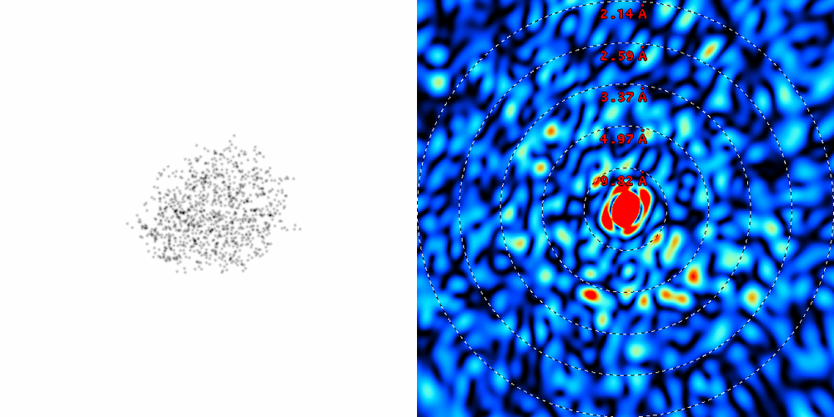
lysozyme: thermal motion

Slide 73
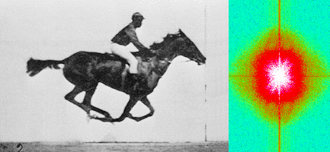
Muybridge’s galloping horse (1878)
“Time-resolved” diffraction
Real space
reciprocal

Slide 74
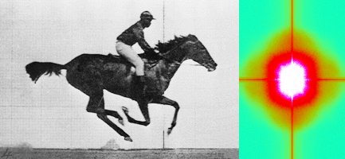
Muybridge’s galloping horse (1878)
Average intensity
Real space
reciprocal

Slide 75
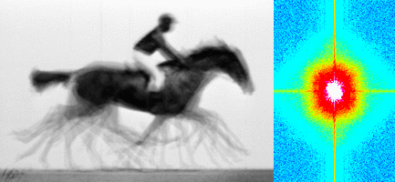
Muybridge’s galloping horse (1878)
Average electron density
Real space
reciprocal

Slide 76
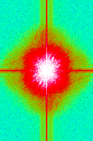
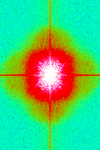
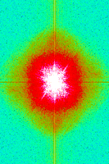
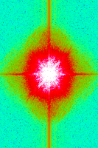
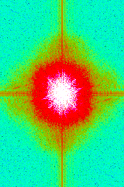
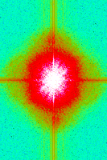
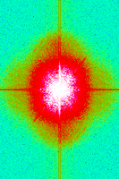
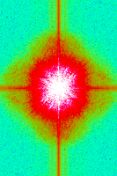
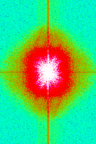
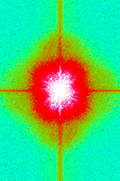
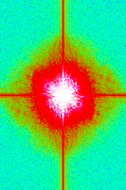
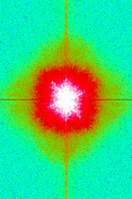
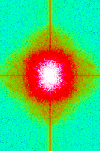
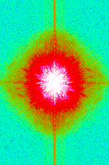
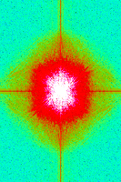
Supporting a model with data

Slide 77

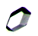
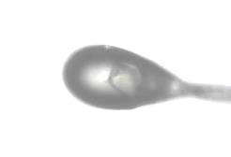
Dissecting the Amplitude Problem
purify
protein
grow
crystal
cryo
MX
micro
beam
XFEL
Give up

Slide 78
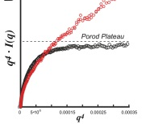
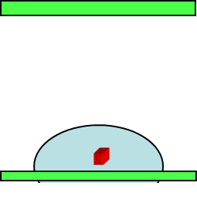
Dissecting the Amplitude Problem
SAXS
order/disorder
In solution
design
new clone /
conditions
purify
protein
XFP
xtal packing
interfaces
grow
crystal
traditional
approach
in-situ MX
Control for handling
-
RT MX
Control for cryo
cryo
MX
+
B factor
high
low
micro
beam

Slide 79


SAXS assay for intrinsic order

Slide 80

Dissecting the Amplitude Problem
SAXS
order/disorder
In solution
design
new clone /
conditions
purify
protein
XFP
xtal packing
interfaces
grow
crystal
traditional
approach
in-situ MX
Control for handling
-
RT MX
Control for cryo
cryo
MX
+
B factor
high
Rapid RT
high multiplicity
low
micro
beam
XFEL

Slide 81
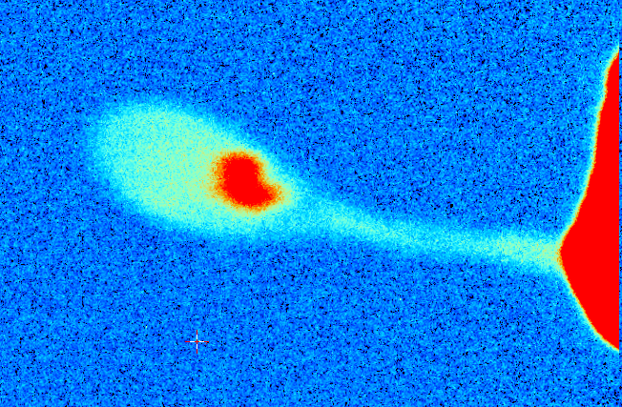


3%
2%
1%
0
ADSC
area
detector
beam center
crystal in loop
Cu foil
X-ray excited
fluorescent
X-ray source
x-ray beam

Slide 82
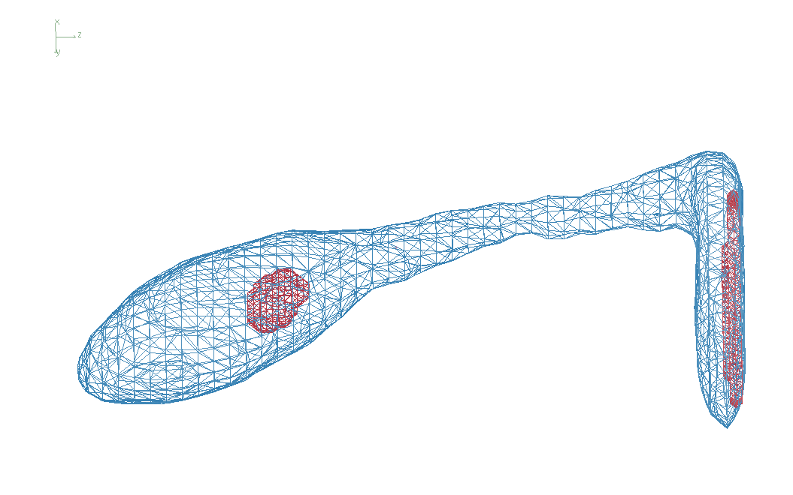
Cone-Beam Online X-ray Absorption Radiograph

Slide 83


Dissecting the Amplitude Problem
SAXS
order/disorder
In solution
design
new clone /
conditions
purify
protein
XFP
xtal packing
interfaces
grow
crystal
traditional
approach
in-situ MX
Control for handling
-
RT MX
Control for cryo
cryo
MX
+
CBOXAR
& raster
xtal size, shape & location
B factor
high
Rapid RT
high multiplicity
AUORA
auto optical
re-alignment
low
micro
beam
XFEL

Slide 84
Grand Challenges in Structural Biology
Phase Problem
detector calibration
Amplitude Problem
    disorder
R-factor Gap
    Limited representation

Slide 85
Is this good enough?
d_{max} = 4.5 Å
R_{cryst} = 27%
R_{free} = 38%

Slide 86
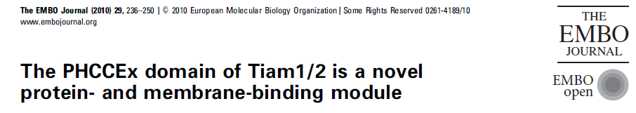
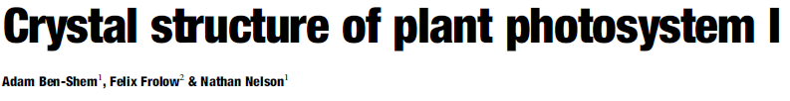


Is this good enough?
3a8n 4.5 Å R_{merge} = 0.15 R/R_{free} = 0.306/0.396
1qzv 4.44 Å R_{merge} = 0.099 R/R_{free} = 0.41/0.42
1grz 5 Å R_{merge} = 0.052 R/R_{free} = 0.369/0.428

Slide 87



Is this good enough?
1hvu 4.75 Å R_{merge} = 0.064 R/R_{free} = 0.34/0.413
1n8e 4.5 Å R_{merge} = 0.138 R/R_{free} = 0.415/0.416
2r6e 5.02 Å R_{merge} = 0.058 R/R_{free} = 0.394/0.397

Slide 88
The R-factor Gap
Publication criterion for chemical crystallography:
R1 < 2*R_{sigma}
R1 = F_{o} vs F_{c} for I/σ(I) > 3
R_{sigma} = <σ(I)>/<I>
There are no PDB entries that pass this test!
Holton et al. (2014). FEBS J. 281, 4046-60.

Slide 89
The R-factor Gap
R_{merge} = 3%
R_{work} = 20%
R_{free} = 24%
Experimental
error
“systematic”
error
20% of carbon atom = 1.2 e⁻
5% of carbon atom = 0.3 e⁻
Closing the R-factor gap will enable study of 1-electron changes

Slide 90


The R-factor Gap
multi-conformer PDB file
R_{merge} = 6%
R_{cryst} = 17%
R_{free} = 20%
MLFSOM
Elves
1H87
Holton, Classen, Frankel & Tainer (2014)."The R-factor gap in macromolecular crystallography: an untapped potential for insights on accurate structures", FEBS J. 281, 4046-4060.

Slide 91
The R-factor Gap
multi-conformer PDB file
R_{merge} = 6%
R_{cryst} = 7%
R_{free} = 8%
MLFSOM
Elves
1H87
Holton, Classen, Frankel & Tainer (2014)."The R-factor gap in macromolecular crystallography: an untapped potential for insights on accurate structures", FEBS J. 281, 4046-4060.

Slide 92
The R-factor Gap
single-conformer PDB file
R_{merge} = 6%
R_{cryst} = 7%
R_{free} = 8%
MLFSOM
Elves
ARP/wARP
1H87; conf “A”
Holton, Classen, Frankel & Tainer (2014)."The R-factor gap in macromolecular crystallography: an untapped potential for insights on accurate structures", FEBS J. 281, 4046-4060.

Slide 93
The R-factor Gap
MX data quality is not limiting
Hypotheses:
  Hidden systematic error?
  Model-building problem?
  Representation problem?

Slide 94

Molecular Dynamics Simulation
using real
crystal’s lattice
1aho
Scorpion toxin
0.96 Å resolution
64 residues
Solvent: H₂0 + acetate
Cerutti et al. (2010).J. Phys. Chem. B 114, 12811-12824.

Slide 95

30 conformers from 24,000

Slide 96

Electron density from 24,000 conformers

Slide 97

Electron density from 24,000 conformers

Slide 98

2F_{sim}-F_{calc} and F_{sim}-F_{calc} maps
1.0 Å data
R_{cryst}= 0.137
R_{free} = 0.159
1 “sigma” 2F_{sim}-F_{c}
2.5 “sigma” F_{sim}-F_{c}

Slide 99

2F_{sim}-F_{calc} and (F_{sim} Φ_{sim}) - (F_{calc} Φ_{calc}) maps
1.0 Å data
R_{cryst}= 0.137
R_{free} = 0.159
1 “sigma” 2F_{sim}-F_{c}
F_{right} – (2F_{sim}-F_{c})

Slide 100
30 conformers from 24,000

Slide 101

Regular model with real data!
1.0 Å data
R_{cryst}= 0.116
R_{free} = 0.135
1 “sigma” 2F_{sim}-F_{c}
2.5 “sigma” F_{sim}-F_{c}

Slide 102

MD: predicted density for one atom

Slide 103

How many conformers are there?
Answer: 8
R_{cryst} = 0.0297
R_{free} = 0.0293
vs F_{sim}

Slide 104

How many conformers are there?
Answer: 2-14
R_{cryst} = 0.0441
R_{free} = 0.0516
vs F_{sim}

Slide 105

How many conformers are there?
Answer: 1-7
R_{cryst} = 0.1546
R_{free} = 0.1749
vs F_{obs}
1aho:
R_{cryst} = 0.1630
R_{free} = n/d

Slide 106

How many conformers are there?
All difference
features
are in
the solvent!
real data

Slide 107

How “rough” is the solvent?
R_{cryst} = 0.0309
R_{free} = 0.0678
vs F_{sim}

Slide 108
RISM model for “bulk” solvent
Method | R_{work} | R_{free}
Default refmac5: flat bulk solvent | .1784 | .1898
RISM – self-consistent density field based on electrostatics | .1640 | .1808
Explicit MD solvent, protein fixed | .1523 | .1690
RISM – protein fixed multi-conformer weighted | .1578 | .1739
Explicit – protein fixed multi-conformer weighted | .1440 | .1666

Slide 109
Grand Challenges in Structural Biology
Phase Problem
Calibrate it out boost the signal average over it
Non-isomorphism phasing (NIP)
Amplitude Problem
Disorder > everything Dissect sample prep
Revolution in sample handling?
R-factor Gap
1 electron =chemistry validate dynamics
2D data vs 4D models
http://bl831.als.lbl.gov/~jamesh/powerpoint/Janelia_thresholds_2015.pptx

Slide 110
What good are low energies?
Carbon 284
Nitrogen 402
Oxygen 537
Fluorine 685
Neon 866
Sodium 1072
Magnesium 1304
Aluminum 1559
Silicon 1838
Phosphorous 2148
Sulfur 2475
Chlorine 2825
Argon 3205
Potassium 3610
Calcium 4041
Scandium 4495

Slide 111

What is the “molecular transform”?
False color intensity
sample
detector

Slide 112

What is the “molecular transform”?
False color intensity
sample
detector

Slide 113

What is the “molecular transform”?
False color intensity
sample
detector

Slide 114

Two-color experiment (1930)

Slide 115

Two-color experiment (ca 1914)
aka “rotating anode”
20 eV

