Slide 1
Acknowledgements
Robert Stroud James Fraser Aina Cohen Ana Gonzalez
Axel Brunger Monarin Uervirojnangkoorn Artem Lyubimov Nick Sauter
UCSF LBNL SLAC
ALS 8.3.1 creator: Tom Alber
UC Multicampus Research Programs and Initiatives (MRPI)
UCSF Program for Breakthrough Biomedical Research (PBBR)
one-time NIH-DOE Inter-agency agreement (IAA)
Integrated Diffraction Analysis Technologies (IDAT)
Plexxikon, Inc.
M D Anderson CRC
Synchrotron Radiation Structural Biology Resource (SLAC)
The Advanced Light Source is supported by the Director, Office of Science, Office of Basic Energy Sciences, Materials Sciences Division, of the US Department of Energy under contract No. DE-AC02-05CH11231 at Lawrence Berkeley National Laboratory.

Slide 2
Acknowledgements
Robert Stroud James Fraser Aina Cohen Ana Gonzalez
Axel Brunger Monarin Uervirojnangkoorn Artem Lyubimov Nick Sauter
UCSF LBNL SLAC
ALS 8.3.1 creator: Tom Alber
UC Multicampus Research Programs and Initiatives (MRPI)
UCSF Program for Breakthrough Biomedical Research (PBBR)
one-time NIH-DOE Inter-agency agreement (IAA)
Integrated Diffraction Analysis Technologies (IDAT)
Plexxikon, Inc.
M D Anderson CRC
Synchrotron Radiation Structural Biology Resource (SLAC)
The Advanced Light Source is supported by the Director, Office of Science, Office of Basic Energy Sciences, Materials Sciences Division, of the US Department of Energy under contract No. DE-AC02-05CH11231 at Lawrence Berkeley National Laboratory.

Slide 3

Systematic Error vs Random Noise

Slide 4
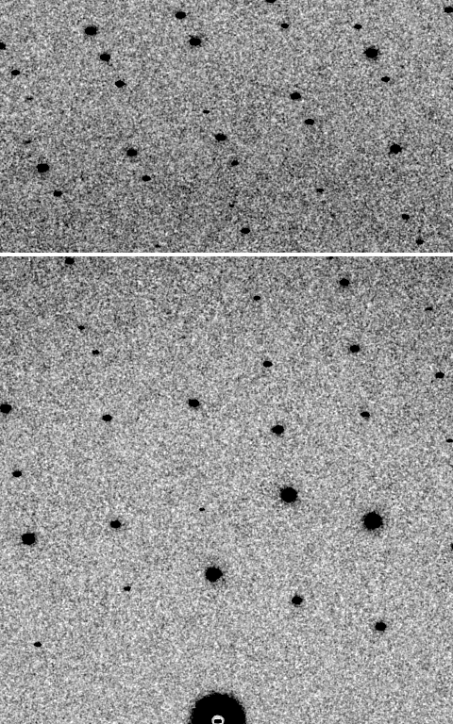
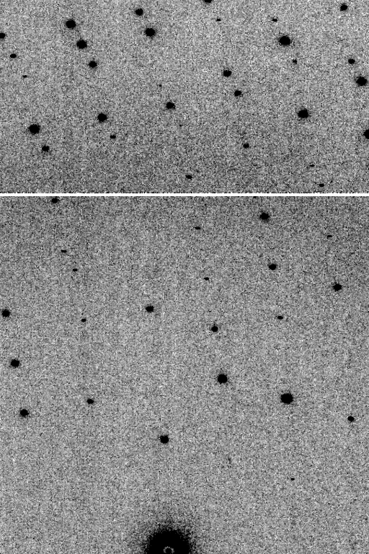
Is it Real? Or is it MLFSOM
simulated
real
Holton et al (2014) "R-factor gap", FEBS Journal 281, 4046-4060.

Slide 5
Sources of error
Source of error | realistic simulation | No SHSSS | Perfect detector
Photon counting | + | + | +
Shutter jitter | + | + | -
Beam flicker | + | + | -
Sample absorption | + | + | -
Radiation damage | + | + | -
Imperfect spindle | + | + | -
vignette | + | + | -
Corner correction | + | + | -
SHSSS | + | - | -
R_{meas} (∞-10 Å) | 2.8% | 0.7% | 0.7%
I/σ asymptotic | 26.8 | 74.2 | 81.0
Holton et al (2014) "R-factor gap", FEBS Journal 281, 4046-4060.

Slide 6
Spatial Heterogeneity in Sharp Spot Sensitivity
Relative spot intensity
Spot centroid position (pixels)

Slide 7
Spatial Heterogeneity in Sharp Spot Sensitivity
Relative spot intensity
Spot centroid position (pixels)

Slide 8

Pilatus: subtract smooth baseline
~3x10⁵ photon/pixel
Bragg
glitch
“tree rings”
Pick-up tool mark
oxygen
inclusions
1% high
average
1% low

Slide 9

Spatial Heterogeneity in Sharp Spot Sensitivity

Slide 10
Spatial Heterogeneity in Sharp Spot Sensitivity
down

Slide 11
Spatial Heterogeneity in Sharp Spot Sensitivity
down
up

Slide 12
Spatial Heterogeneity in Sharp Spot Sensitivity
down
up
R_{separate}

Slide 13
Spatial Heterogeneity in Sharp Spot Sensitivity
odd
even
R_{mixed}

Slide 14
Spatial Heterogeneity in Sharp Spot Sensitivity
separate:
2.5%

Slide 15
Spatial Heterogeneity in Sharp Spot Sensitivity
separate:
mixed:
2.5%
0.9%

Slide 16
Spatial Heterogeneity in Sharp Spot Sensitivity
separate:
mixed:
2.5%
0.9%
2.5%²-0.9%² = 2.3%²

Slide 17
Threshold of a revolution in phasing
Current
technology
Goal
Solve-able proteins (%)
Required signal-to-noise (I/σ)

Slide 18
What if…
we knew everything?
  how would we store it?
we had a hotter beam?
we had more coherence?
we had a perfect detector?
…
we knew what we are doing wrong?

Slide 19
Diffraction Simulators
1. MLFSOM
- rotation data with maximum realism in noise
2. nearBragg
- first-principles scattering from atoms in space
3. nanoBragg
- optimized for nanocrystal/single-particle stills
4. nonBragg
- non-crystalline, centrosymmetric (SAXS)

Slide 20
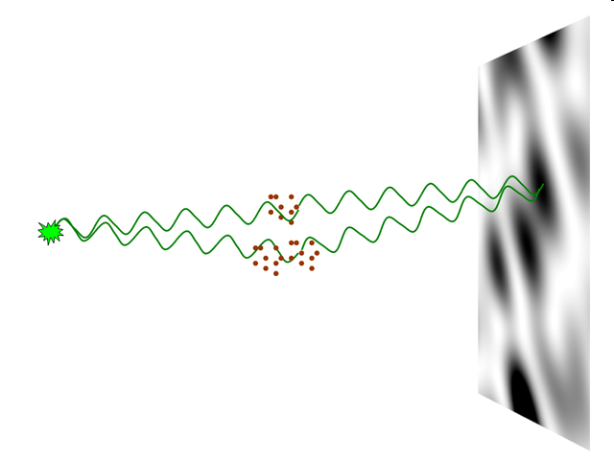
nearBragg program
http://bl831.als.lbl.gov/~jamesh/nearBragg/
“assumption-free” total scattering
no Fourier Transform
no unit cells
no “mosaicity”
arbitrary “atoms”
arbitrary “source”
coherent or not

Slide 21
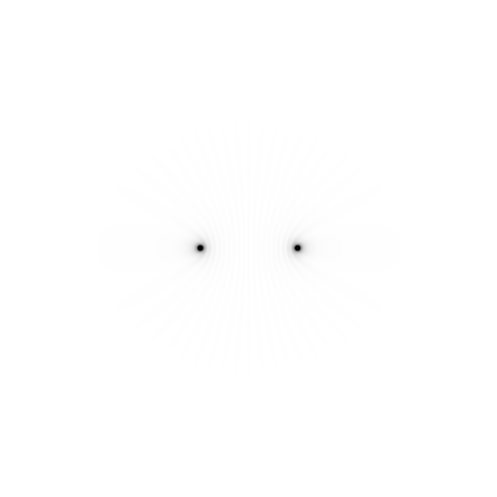
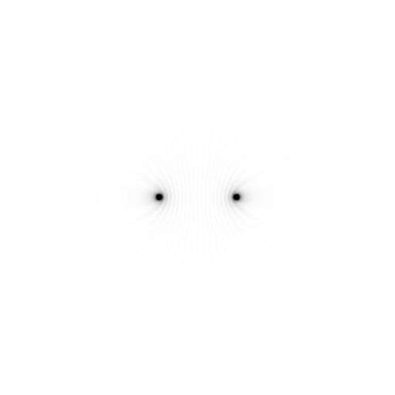
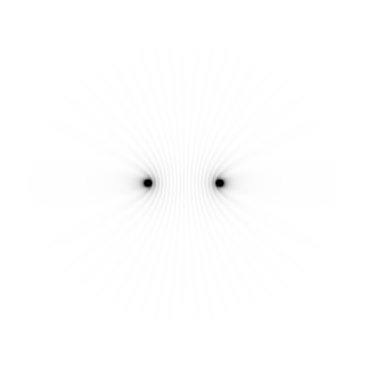
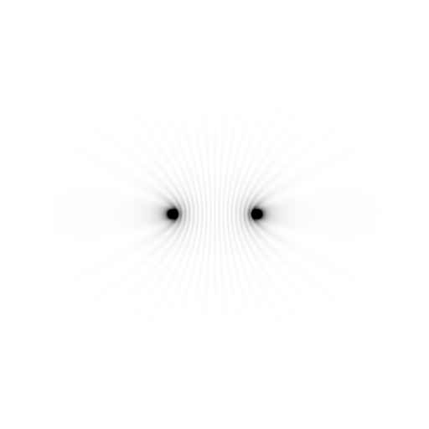
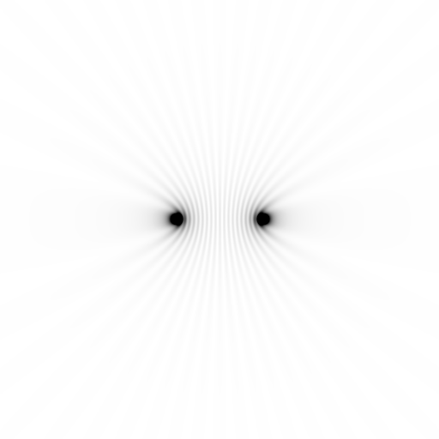
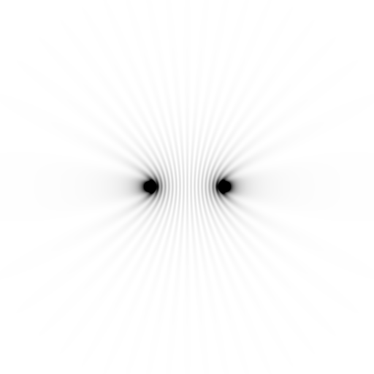
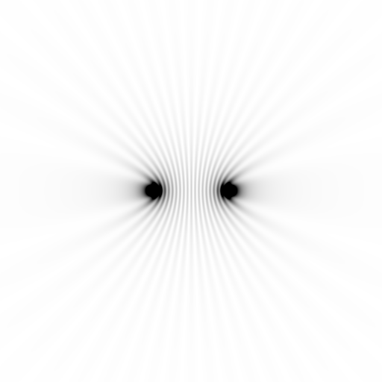
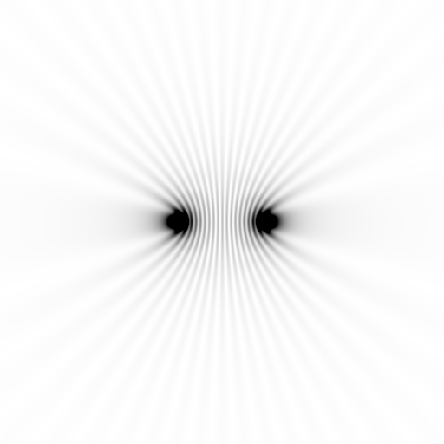
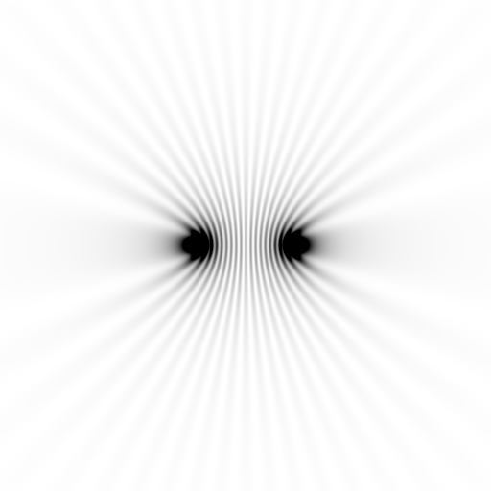
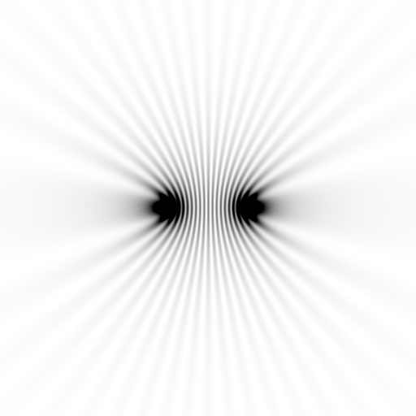
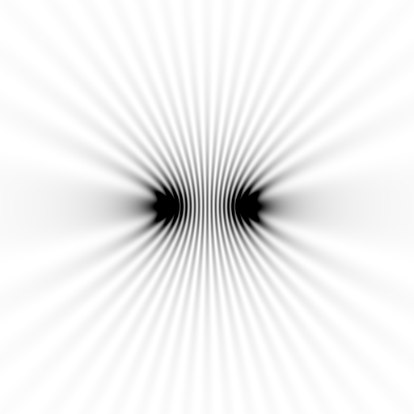
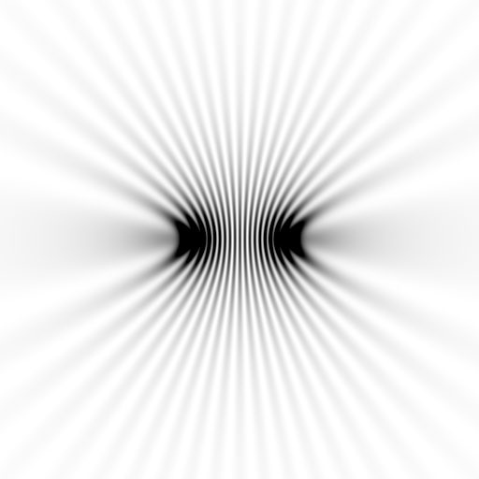
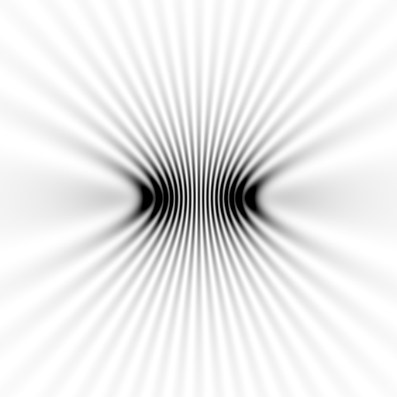
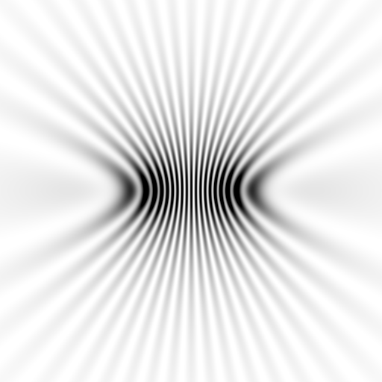
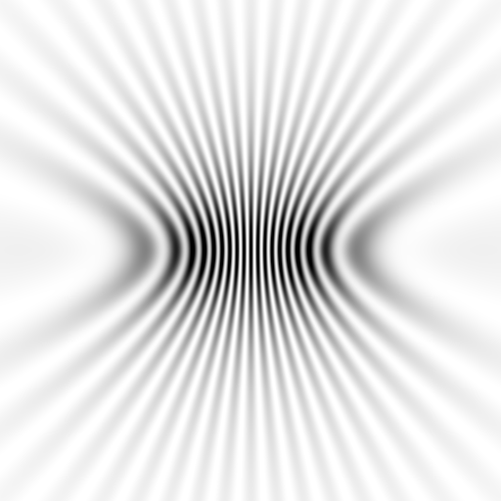
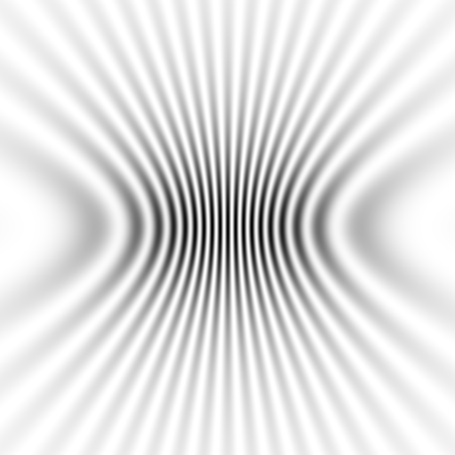
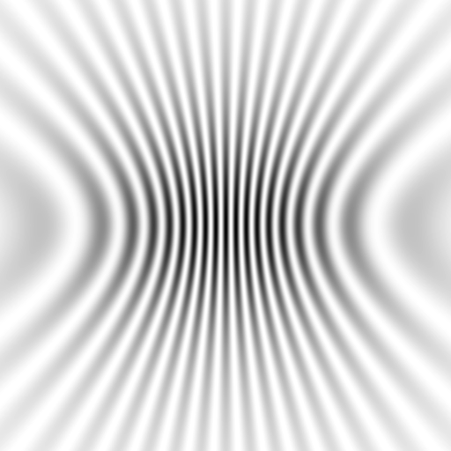
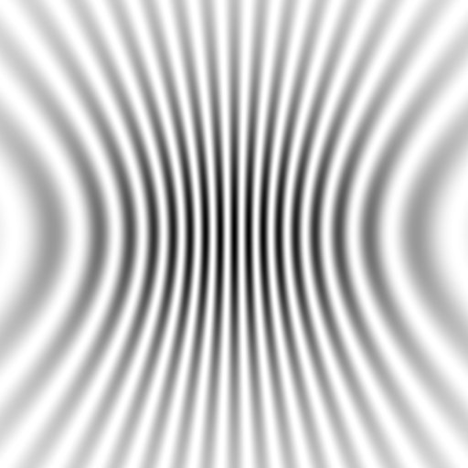
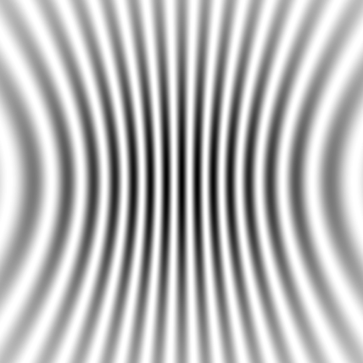
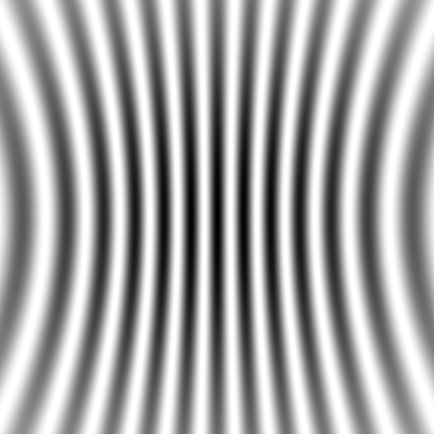



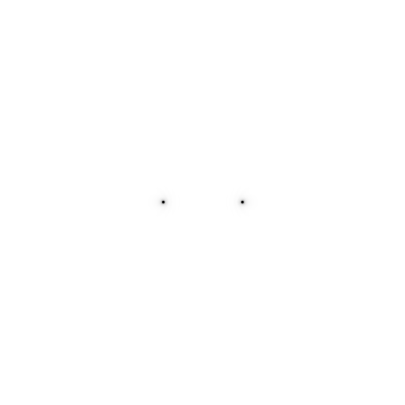
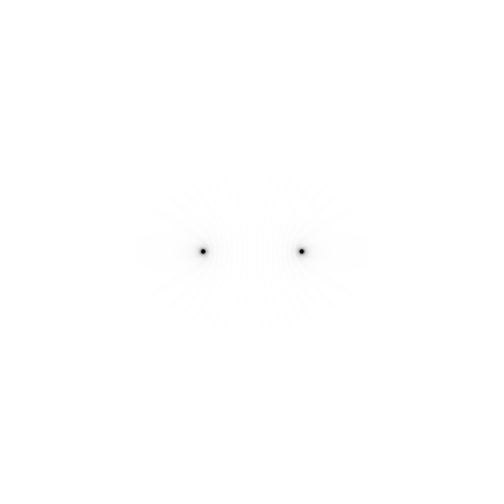
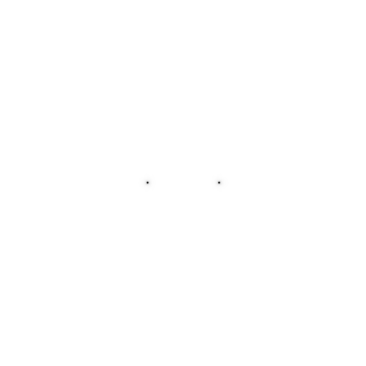

Slide 22




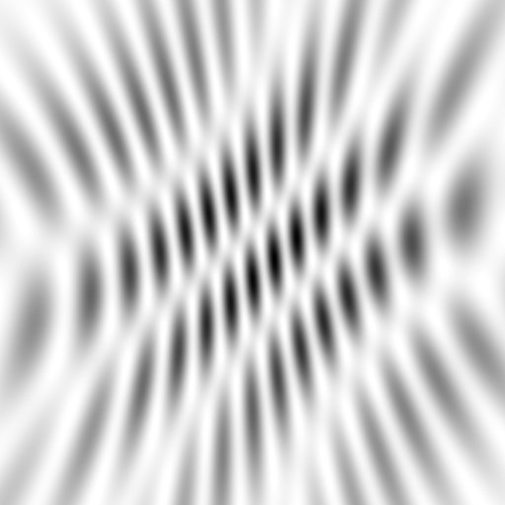
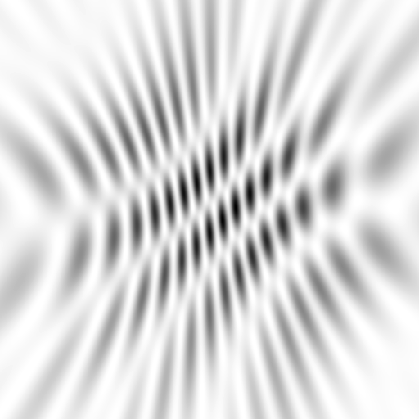
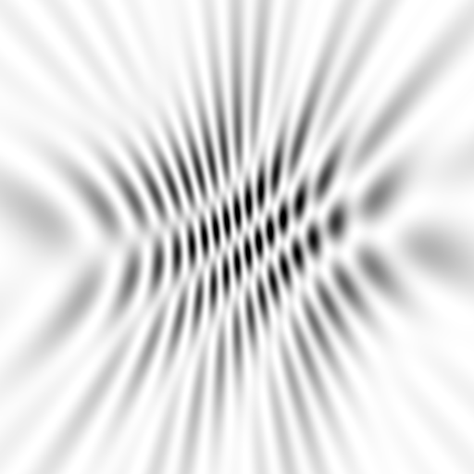
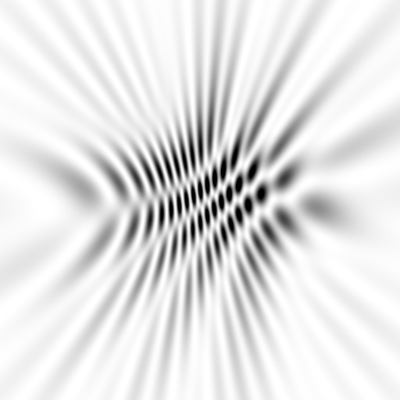
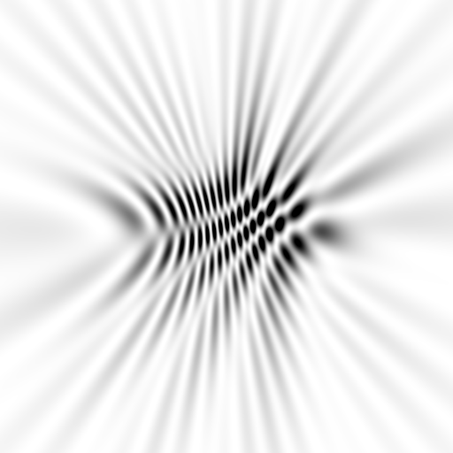
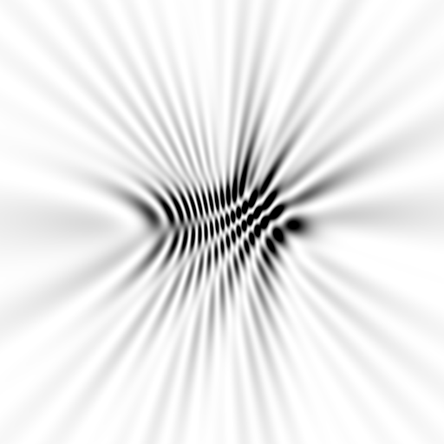
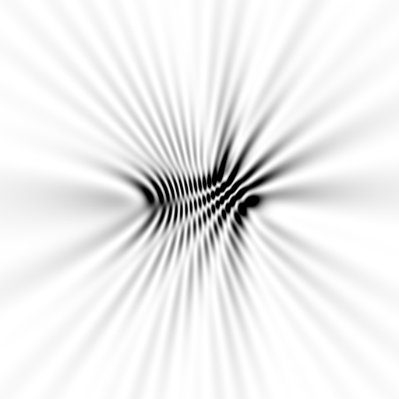
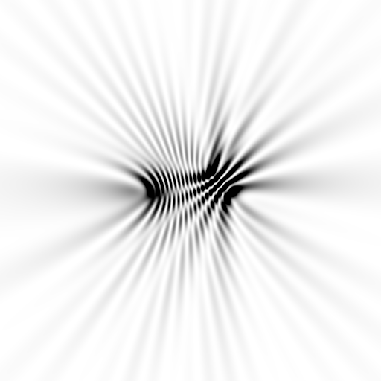
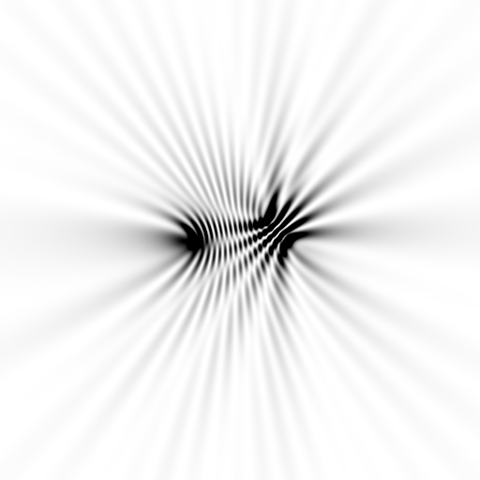
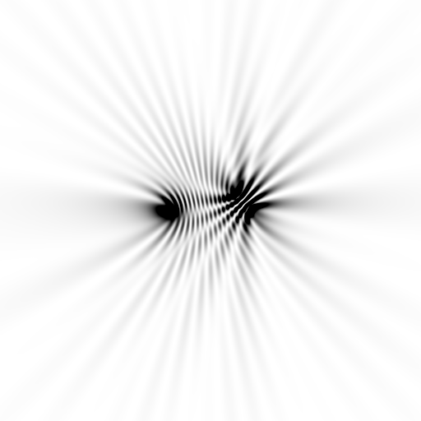
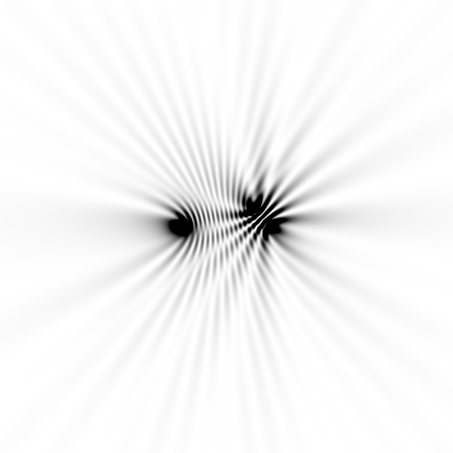






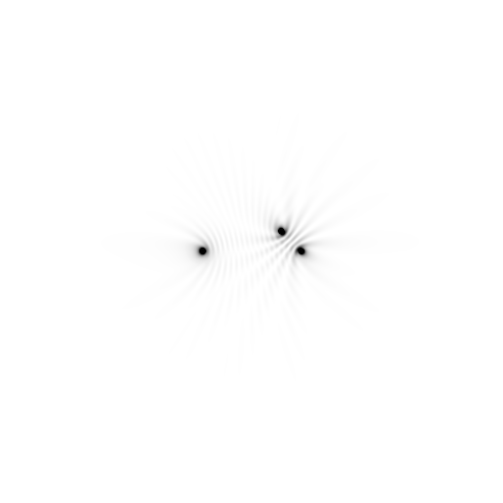





Slide 23
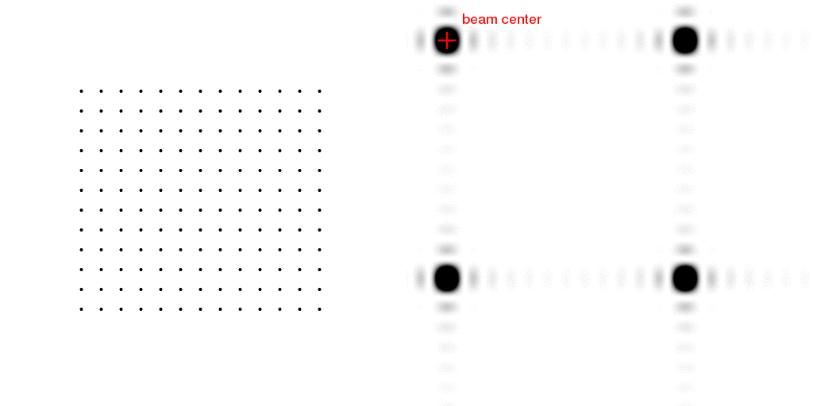
Meaning of “coherence length”
http://bl831.als.lbl.gov/~jamesh/nearBragg/collision/

Slide 24
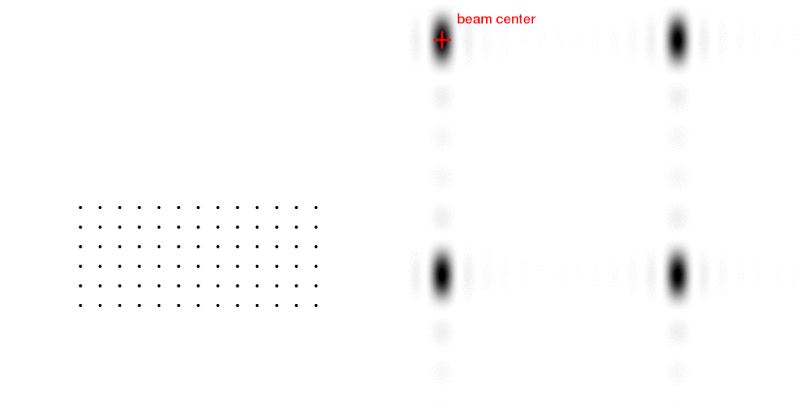
Meaning of “coherence length”
http://bl831.als.lbl.gov/~jamesh/nearBragg/collision/

Slide 25
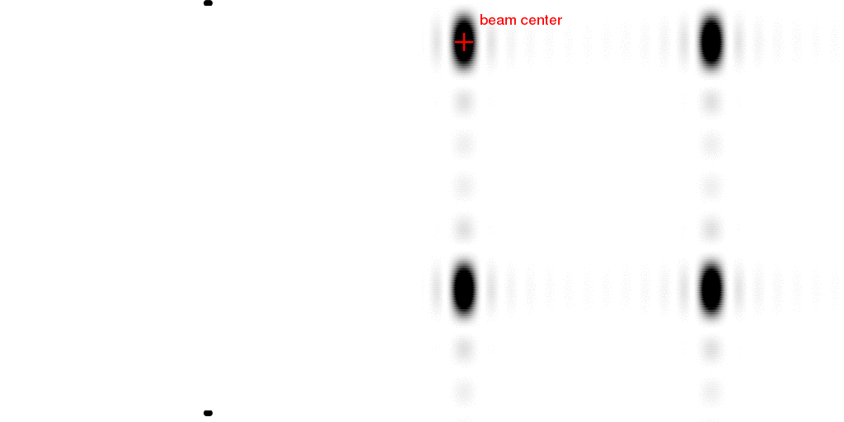
Meaning of “coherence length”
http://bl831.als.lbl.gov/~jamesh/nearBragg/collision/

Slide 26
Meaning of “coherence length”
http://bl831.als.lbl.gov/~jamesh/nearBragg/collision/

Slide 27
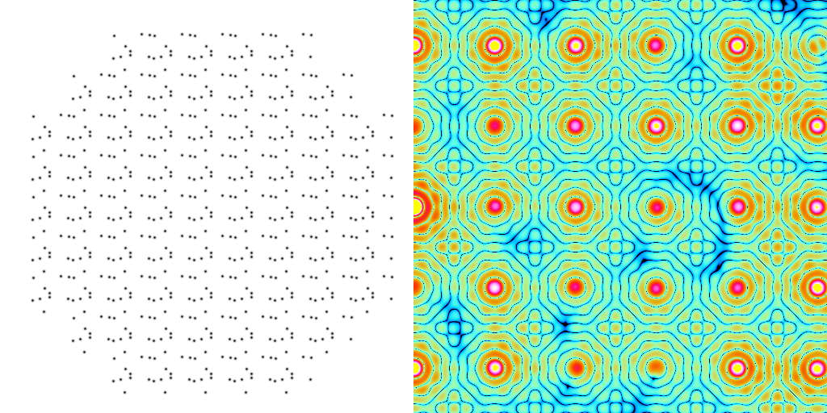
Meaning of “Molecular Transform”
False color intensity
sample
detector

Slide 28
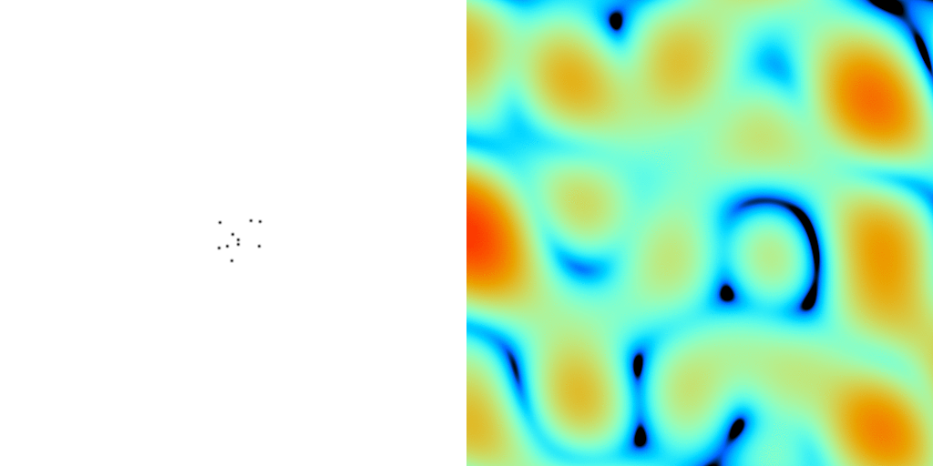
Definition of unit cell defines DS
False color intensity
sample
detector

Slide 29
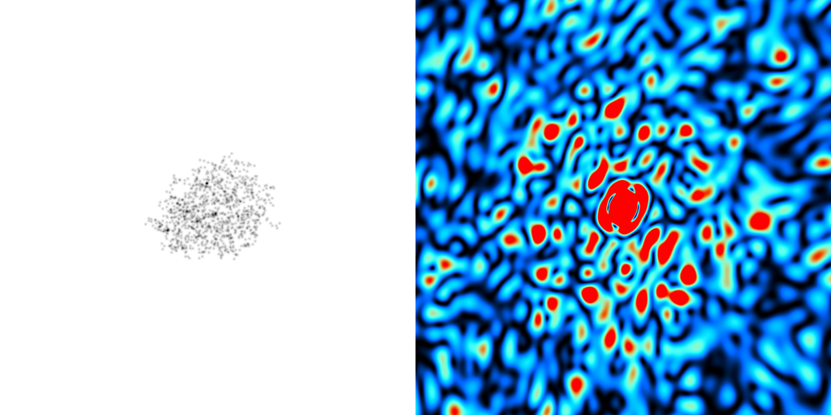
Definition of unit cell defines MT
False color intensity
sample
detector

Slide 30
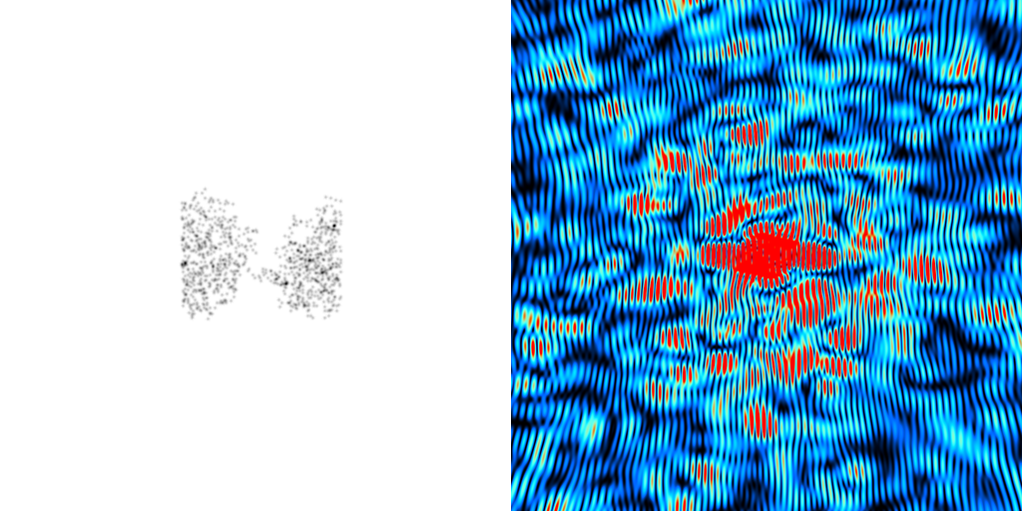
Definition of unit cell defines MT
False color intensity
sample
detector

Slide 31
How to install: nearBragg
wget http://bl831.als.lbl.gov/
~jamesh/nearBragg/nearBragg.c
gcc –o nearBragg nearBragg.c –lm
./nearBragg
usage: nearBragg -file atom_list.txt
options:
-file filename.txt text file containing point scatterer coordinates in Angstrom relative to the origin.
-distance from origin to detector center in mm
-detsize detector size in mm. may also use -detsize_x -detsize_y
-detpixels detector size in pixels. may also use -detpixels_x -detpixels_y
-pixel detector pixel size in mm.

Slide 32
How to run: nearBragg for single particle
egrep “^ATOM|^HETAT” lysozyme.pdb |\
awk ‘{print substr($0,31,36)}’ |\
cat >! atoms.txt
wget bl831.als.lbl.gov/~jamesh/nearBragg/rotate.awk
./rotate.awk -v phix=10 -v phiy=20 -v phiz=30 atoms.txt >! rotated.txt
nearBragg –atoms rotated.txt -lambda 1 -distance 1000 -detsize 100 -fluence 1e32
(200s)
adxv intimage.img

Slide 33
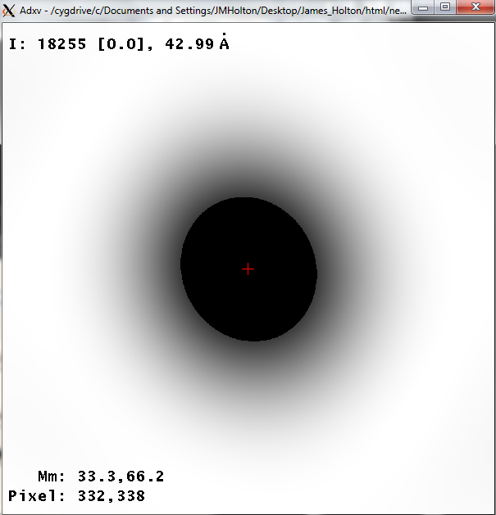
How to run: nearBragg for single particle
egrep “^ATOM|^HETAT” lysozyme.pdb |\
awk ‘{print substr($0,31,36)}’ |\
cat >! atoms.txt
wget bl831.als.lbl.gov/~jamesh/nearBragg/rotate.awk
./rotate.awk -v phix=10 -v phiy=20 -v phiz=30 atoms.txt >! rotated.txt
nearBragg –atoms rotated.txt -lambda 1 -distance 1000 -detsize 100 -fluence 1e32
(200s)
adxv intimage.img

Slide 34
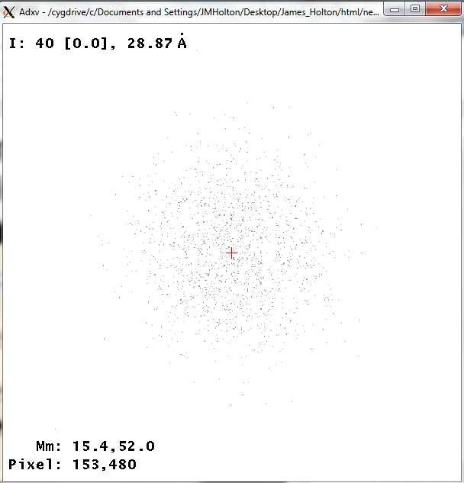
How to run: nearBragg for single particle
egrep “^ATOM|^HETAT” lysozyme.pdb |\
awk ‘{print substr($0,31,36)}’ |\
cat >! atoms.txt
wget bl831.als.lbl.gov/~jamesh/nearBragg/rotate.awk
./rotate.awk -v phix=10 -v phiy=20 -v phiz=30 atoms.txt >! rotated.txt
nearBragg –atoms rotated.txt -lambda 1 -distance 1000 -detsize 100 -fluence 1e32
(200s)
adxv noiseimage.img

Slide 35
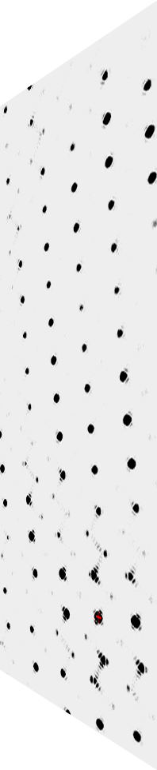
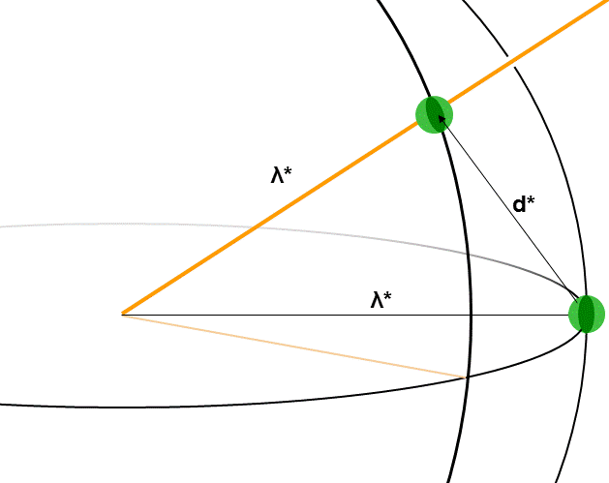
nanoBragg program
http://bl831.als.lbl.gov/~jamesh/nanoBragg/
Optimized for nanocrystals
Square or round
Takes h,k,l and F
Supports 1 unit cell
explicit “mosaicity”
arbitrary source
explicit “phi” steps

Slide 36
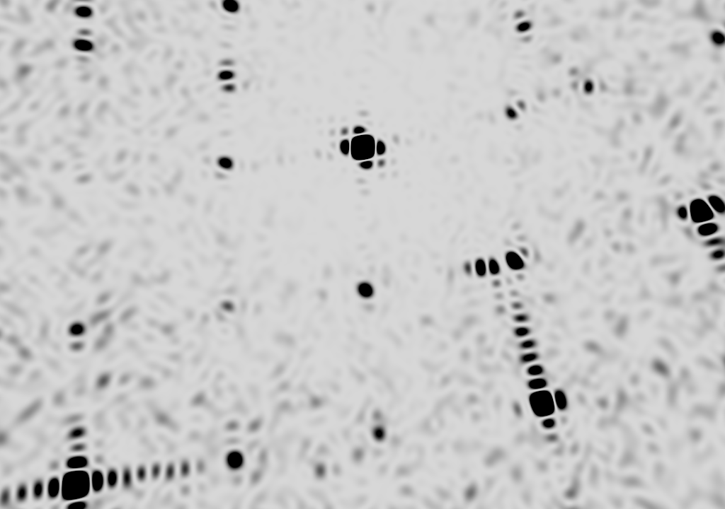
square

Slide 37

round

Slide 38
How to run: nanoBragg for single particle
pdbset xyzin lysozyme.pdb xyzout bigcell.pdb << EOF
CELL 250 250 250 90 90 90
SPACEGROUP 1
EOF
phenix.fmodel bigcell.pdb high_resolution=10 k_sol=0.35 b_sol=46.5 mask.solvent_radius=0.5 mask.shrink_truncation_radius=0.16
mtz_to_P1hkl.com bigcell.pdb.mtz
nanoBragg –cell 250 250 250 90 90 90 –misset 10 20 30 -hkl P1.hkl -lambda 1 -distance 1000 -detsize 100 -fluence 1e32 -N 1
adxv noiseimage.img

Slide 39

How to run: nanoBragg for single particle
pdbset xyzin lysozyme.pdb xyzout bigcell.pdb << EOF
CELL 250 250 250 90 90 90
SPACEGROUP 1
EOF
phenix.fmodel bigcell.pdb high_resolution=10 k_sol=0.35 b_sol=46.5 mask.solvent_radius=0.5 mask.shrink_truncation_radius=0.16
mtz_to_P1hkl.com bigcell.pdb.mtz
nanoBragg –cell 250 250 250 90 90 90 –misset 10 20 30 -hkl P1.hkl -lambda 1 -distance 1000 -detsize 100 -fluence 1e32 -N 1
adxv noiseimage.img

Slide 40


Realistic single-particle prediction
10¹² photon/pulse
100 nm focus

Slide 41

Realistic single-particle prediction
10¹² photon/pulse
3 nm focus

Slide 42
How to run: nonBragg for SAXS
pdbset xyzin lysozyme.pdb xyzout bigcell.pdb << EOF
CELL 250 250 250 90 90 90
SPACEGROUP 1
EOF
phenix.fmodel bigcell.pdb high_resolution=10 k_sol=0.35 b_sol=46.5 mask.solvent_radius=0.5 mask.shrink_truncation_radius=0.16
mtz_to_stol.com bigcell.pdb.mtz
nonBragg -stol mtz.stol -lambda 1 -dispersion 0 \
-distance 1000 -detsize 100 -pixel 0.172 \
-flux 1e13 -thick 1.2 -MW 14000 -density 0.01
adxv noiseimage.img

Slide 43

How to run: nonBragg for SAXS
pdbset xyzin lysozyme.pdb xyzout bigcell.pdb << EOF
CELL 250 250 250 90 90 90
SPACEGROUP 1
EOF
phenix.fmodel bigcell.pdb high_resolution=10 k_sol=0.35 b_sol=46.5 mask.solvent_radius=0.5 mask.shrink_truncation_radius=0.16
mtz_to_stol.com bigcell.pdb.mtz
nonBragg -stol mtz.stol -lambda 1 -dispersion 0 \
-distance 1000 -detsize 100 -pixel 0.172 \
-flux 1e13 -thick 1.2 -MW 14000 -density 0.01
adxv noiseimage.img

Slide 44



nonBragg extracts background
spot remover
Flux
Exposure
Density
Thickness
Gain, offset

Slide 45
Pilatus: subtract smooth baseline
~3x10⁵ photon/pixel
Bragg
glitch
“tree rings”
Pick-up tool mark
oxygen
inclusions
1% high
average
1% low

Slide 46
“fit” simulation to reality
Dispersion
Divergence
Mosaicity
Wavelength
Unit cell parameters (3)
Crystal orientation (3)
Mosaic domain size (3)
Beam center (2)
Beam direction (2)
Detector distance

Slide 47

Real XFEL still

Slide 48

Simulation of XFEL still

Slide 49



Simulation of XFEL still
phix
phiy
phiz
real
VS
phix
phiy
phiz

Slide 50
Fitting individual “mosaic domains”
Fraction pixels predicted
Best of
262,140 trials
Angle about y axis (°)

Slide 51

The “Lorentz zone”

Slide 52

Simulation of XFEL stills
Sauter (2015). JSR 22, 239.
Beam center from autoindexing

Slide 53

Now What?
10 Å

Slide 54
The number of photons scattered
before crystal is dead
is independent
of data collection time
1 um³ = 10⁵ photons (roomT)
1 um³ = 10⁶ photons (synch)
1 um³ = 10⁸ photons (XFEL)
(synch)
Henderson, 1990; Gonzalez & Nave, 1994; Glaeser et al., 2000; Sliz et al., 2003; Leiros et al., 2006; Owen et al., 2006; Garman & McSweeney, 2006; Garman & Nave, 2009; Holton, 2009

Slide 55
Self-calibrated damage limit
Where:
⟨I⟩_{DL} - average damage-limited intensity (photons/hkl) at a given resolution
10⁵ - converting R from μm to m, r_{e} from m to Å, ρ from g/cm³ to kg/m³ and MGy to Gy
r_{e} - classical electron radius (2.818 x 10⁻¹⁵ m/electron)
h - Planck’s constant (6.626 x 10⁻³⁴ J∙s)
c - speed of light (299792458 m/s)
f_{decayed} - fractional progress toward completely faded spots at end of data set
ρ - density of crystal (~1.2 g/cm³)
R - radius of the spherical crystal (μm)
λ - X-ray wavelength (Å)
f_{NH} - the Nave & Hill (2005) dose capture fraction (1 for large crystals)
n_{ASU} - number of proteins in the asymmetric unit
M_{r} - molecular weight of the protein (Daltons or g/mol)
V_{M} - Matthews’s coefficient (~2.4 Å³/Dalton)
H - Howells’s criterion (10 MGy/Å)
θ - Bragg angle
⟨ƒ_{a}²⟩ - number-averaged squared structure factor per protein atom (electron²)
⟨M_{a}⟩ - number-averaged atomic weight of a protein atom (~7.1 Daltons)
B - average (Wilson) temperature factor (Å²)
μ - attenuation coefficient of sphere material (m⁻¹)
μ_{en} - mass energy-absorption coefficient of sphere material (m⁻¹)
No flux
No symmetry
Holton & Frankel (2010) Acta D 66 393-408.

Slide 56
Bigger is better, but not by much
B = 20
B = 60
B = 0
B = 170
B = 330
B = 560
Resolution (Å)
B = 850
Crystal diameter (micron)

Slide 57

B factor from image analysis
B = 500

Slide 58

B factor from image analysis
B = 20

Slide 59
Predicting resolution limits
XFEL Resolution (Å)
Synchrotron Resolution (Å)

Slide 60
Is it Real? Or is it MLFSOM
simulated
real
Holton et al (2014) "R-factor gap", FEBS Journal 281, 4046-4060.

Slide 61

The R-factor Gap
Holton et al. (2014) "The R-factor gap", FEBS J. 281, 4046-4060.

Slide 62

The R-factor Gap
Last “right”
atom added
Holton et al. (2014) "The R-factor gap", FEBS J. 281, 4046-4060.

Slide 63

30 conformers from 24,000

Slide 64

2F_{sim}-F_{calc} and F_{sim}-F_{calc} maps
1.0 Å data
R_{cryst}= 0.137
R_{free} = 0.159
1 “sigma” 2F_{sim}-F_{c}
2.5 “sigma” F_{sim}-F_{c}

Slide 65

2F_{sim}-F_{calc} and (F_{sim} Φ_{sim}) - (F_{calc} Φ_{calc}) maps
1.0 Å data
R_{cryst}= 0.137
R_{free} = 0.159
1 “sigma” 2F_{sim}-F_{c}
F_{right} – (2F_{sim}-F_{c})

Slide 66
30 conformers from 24,000

Slide 67

Muybridge’s galloping horse (1878)
Structural and Dynamical Information Beyond Bragg
Real space
reciprocal

Slide 68

Muybridge’s multi-camera

Slide 69

Muybridge’s galloping horse (1878)
Average electron density
Real space
reciprocal

Slide 70

Muybridge’s galloping horse (1878)
Average electron density: 1 sigma contour
Real space
reciprocal

Slide 71

lysozyme: real and reciprocal

Slide 72

lysozyme: thermal motion

Slide 73















Supporting a model with data

Slide 74
URLs & Summary
http://bl831.als.lbl.gov/~jamesh/powerpoint/
IGBMC_XFELsim_2016.pptx
http://bl831.als.lbl.gov/~jamesh/bin_stuff/
http://bl831.als.lbl.gov/~jamesh/mlfsom/
MLFSOM for rotation data
nonBragg for background
nanoBragg for stills
nearBragg for coherence
Phasing limit is calibration
Resolution limited by “disorder”

Slide 75
How to install: MLFSOM
wget http://bl831.als.lbl.gov/~jamesh/
mlfsom/development_snapshot.tgz
tar xvzf development_snapshot.tgz
wget http://ftp.esrf.eu/pub/expg/FIT2D/
fit2d_10.132_i686_linuxV2.2.10
ln –sf fit2d_* fit2d
yum install gnuplot
gedit example.com mlfsom.params
./ano_sfall.com lysozyme.pdb
mv ideal_ano.mtz pristine.mtz
./mlfsom.com frames=100

Slide 76
What if…
You only have a few small crystals?
Should you:
  Collect 360° from each?
  Collect 10° from each at 36x exposure?
  Glue 36 xtals together, then collect 360° ?
  Glue together and do 12960° ?

Slide 77
processing procedure | collection scenario
 | fine | coarse | glue | glue_fine
XDS/XSCALE | 3.03874 | 3.02970 | 3.0270 | 3.02948
XDS/aimless | 3.13351 | 3.03531 | 3.02638 | 3.05292
XDS/noscale | 3.01449 | 3.03048 | 3.02576 | 3.31013
MOSFLM-defaults | x | x | x | x
MOSFLM-cheat | 3.51254 | 3.04355 | 3.08244 | x
MOSFLM/noscale | 3.51311 | 3.04287 | 3.21664 | x
HKL2000-defaults | x | x | x | x
HKL2000-cheat | 3.04147 | 3.01415 | 3.01415 | 3.03948
DIALS-defaults | x | x | 3.32378 | x
DIALS-cheat | 2.92007 | x | 2.98204 | 2.92007
DIALS-noscale | 2.96392 | x | 3.26126 | 5.14852
d*Trek | ? | ? | ? | ?
EVAL15 | ? | ? | ? | ?

Slide 78
30 conformers from 24,000

Slide 79

How many conformers are there?
Answer: 2-14
R_{cryst} = 0.0441
R_{free} = 0.0516
vs F_{sim}

Slide 80

How many conformers are there?
Answer: 1-7
R_{cryst} = 0.1546
R_{free} = 0.1749
vs F_{obs}
1aho:
R_{cryst} = 0.1630
R_{free} = n/d

Slide 81

How many conformers are there?
All difference
features
are in
the solvent!
real data

Slide 82
The R-factor Gap
MX data quality is not limiting
Hypotheses:
  Hidden systematic error?
  Model-building problem?
  Representation problem?

Slide 83
RISM model for “bulk” solvent
Method | R_{work} | R_{free}
Default refmac5: flat bulk solvent | .1784 | .1898
RISM – self-consistent density field based on electrostatics | .1640 | .1808
Explicit MD solvent, protein fixed | .1523 | .1690
RISM – protein fixed multi-conformer weighted | .1578 | .1739
Explicit – protein fixed multi-conformer weighted | .1440 | .1666

Slide 84
How to install: nanoBragg
wget http://bl831.als.lbl.gov/
~jamesh/nanoBragg/nanoBragg.c
gcc –o nanoBragg nanoBragg.c -lm

Slide 85
How to install: nonBragg
wget http://bl831.als.lbl.gov/
~jamesh/nonBragg/nonBragg.c
gcc –o nonBragg nonBragg.c -lm

Slide 86
How to install: ancillaries
wget http://bl831.als.lbl.gov/
~jamesh/nanoBragg/noisify.c
wget http://bl831.als.lbl.gov/
~jamesh/nanoBragg/float_add.c
wget http://bl831.als.lbl.gov/
~jamesh/nanoBragg/float_func.c
gcc –o noisify noisify.c –lm
gcc –o float_add float_add.c –lm
gcc –o float_func float_func.c –lm

Slide 87
How to run: nanoBragg for single particle
UBtoA.awk << EOF > A.mat
CELL 250 250 250 90 90 90
RANDOM
EOF
nanoBragg -hkl P1.hkl -lambda 1 -distance 1000 -detsize 100 -fluence 1e32 -N 1 –mat A.mat
adxv noiseimage.img
UBtoA.awk << EOF > A.mat
CELL 250 250 250 90 90 90
MISSET 10 20 30
RANDOM 1 12345
EOF

