Slide 1
PowerPoint File available:
http://bl831.als.lbl.gov/
~jamesh/powerpoint/
IGBMC_SvN_2016.pptx

Slide 2
Acknowledgements
Robert Stroud James Fraser John Spence
Chris Nielsen Clemens Schulze-Briese Aina Cohen Ana Gonzalez
UCSF LBNL SLAC
ALS 8.3.1 creator: Tom Alber
UC Multicampus Research Programs and Initiatives (MRPI)
UCSF Program for Breakthrough Biomedical Research (PBBR)
one-time NIH-DOE Inter-agency agreement (IAA)
Integrated Diffraction Analysis Technologies (IDAT)
Plexxikon, Inc.
M D Anderson CRC
Synchrotron Radiation Structural Biology Resource (SLAC)
The Advanced Light Source is supported by the Director, Office of Science, Office of Basic Energy Sciences, Materials Sciences Division, of the US Department of Energy under contract No. DE-AC02-05CH11231 at Lawrence Berkeley National Laboratory.

Slide 3
Decisions, Decisions, Decisions
Exposure time
Number of images
Wavelengths
Beam: size, flux, divergence, bandpass
Inverse beam?
Kappa? - overlaps
Multiple crystals? - non-isomorphism
Run Strategy

Slide 4
The “success rate” of structure determination
100 s/dataset
200 days/year
~150 beamlines
~26,000,000 datasets/year
9333 PDBs in 2015

Slide 5
signal vs noise
“If you don’t have
good data,
then you have
no data at all.”
-Sung-Hou Kim

Slide 6
signal vs noise
easy
hard
impossible

Slide 7
signal vs noise
easy
hard
impossible
threshold of “solvability”

Slide 8
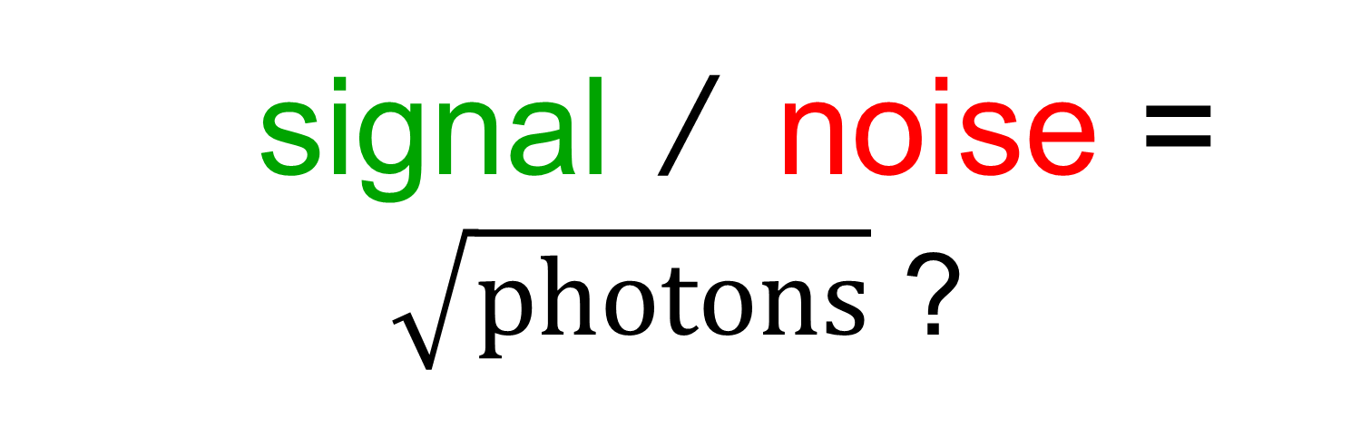
signal / noise = $\sqrt{photons}$ ?
none sqrt proportional
CCD
Read-out
Photon
counting
Detector calibration
attenuation
partiality
Non-isomorphism
Radiation damage
none
1/sqrt
1/prop.
Time
Beam flicker
Shutter jitter
Sample vibration
Pile-up

Slide 9
signal vs noise
“If you don’t have
good data,
then you must
learn statistics.”
-James Holton

Slide 10
Adding noise

Slide 11
Adding noise
1² + 1² = 1.4²

Slide 12
Adding noise
1² + 1² = 1.4²
3² + 1² = 3.2²
σ_{total}² = σ₁² + σ₂²

Slide 13
Adding noise
1² + 1² = 1.4²
3² + 1² = 3.2²
σ_{total}² = σ₁² + σ₂²

Slide 14
Adding noise
1² + 1² = 1.4²
3² + 1² = 3.2²
σ_{total}² = σ₁² + σ₂²

Slide 15
Adding noise
1² + 1² = 1.4²
3² + 1² = 3.2²
10² + 1² = 10.05²

Slide 16

100% SeMet incorporation
Trivial to solve

Slide 17

100% S -Met incorporation
Impossible to solve

Slide 18
Phase Problem: Se vs S
correlation coefficient
1.0 - fraction Se

Slide 19
Phase Problem: Se vs S
correlation coefficient
1.0 - fraction Se

Slide 20
Phase Problem: Se vs S
correlation coefficient
1.0 - fraction Se

Slide 21
Phase Problem: Se vs S
correlation coefficient
1.0 - fraction Se

Slide 22
Phase Problem: Se vs S
correlation coefficient
1.0 - fraction Se

Slide 23
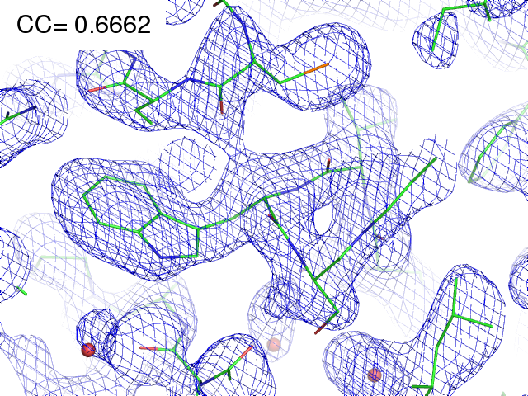
29% Se 71% S

Slide 24
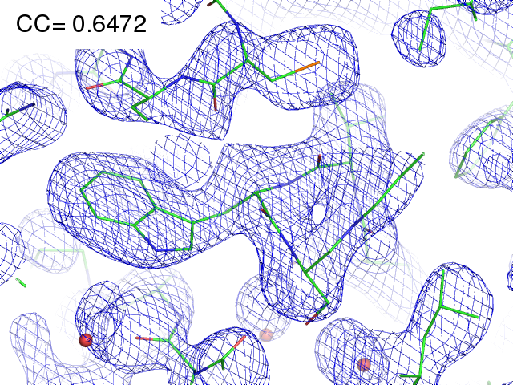
28% Se 72% S

Slide 25
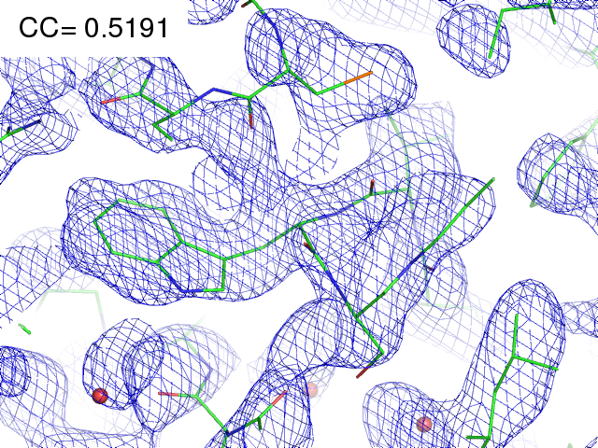
21% Se 79% S

Slide 26
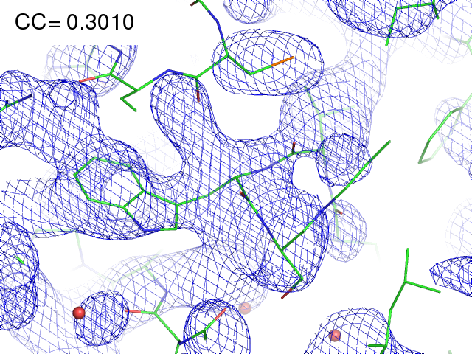
11% Se 89% S

Slide 27
MR simulation
corrupted model
Correlation coefficient to correct density
Rmsd from perfect search model (Å)

Slide 28
The transitions are sharp!
How can we predict success/failure?
Know Thy Experiment

Slide 29
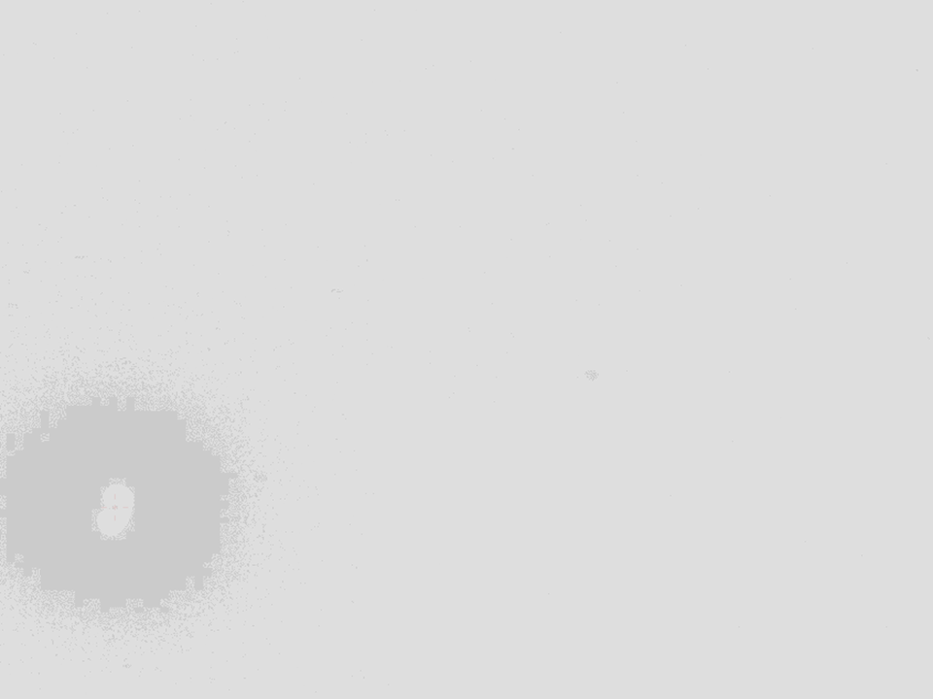
Basic Principles
“Hell, there are NO RULES here - we're trying to accomplish something.”
Thomas A. Edison – inventor
“You’ve got to have an ASSAY.”
Arthur Kornberg – Nobel Laureate
“Control, control, you must learn CONTROL!”
Yoda – Jedi Master

Slide 30
Where do photons go?
Protein
1A x-rays
Transmitted (98%)
beamstop

Slide 31
Where do photons go?
Protein
1A x-rays
Transmitted (98%)
beamstop
2% total → error < 2%

Slide 32
attenuation factor
μ
I_{T}
I_{beam}
A = = exp(-μt)
t
Bouguer, P. (1729). Essai d'optique sur la gradation de la lumière.
Lambert, J. H. (1760). Photometria: sive De mensura et gradibus luminis, colorum et umbrae. E. Klett.
Beer, A. (1852)."Bestimmung der Absorption des rothen Lichts in farbigen Flüssigkeiten", Ann. Phys. Chem 86, 78-90.

Slide 33
attenuation factor
μ
t_{out}
t_{in}
I_{T}
I_{beam}
I_{T}
I_{beam}
A = = exp(-μ(t_{in}+ t_{out}))
A = = exp(-μt)
t
Bouguer, P. (1729). Essai d'optique sur la gradation de la lumière.
Lambert, J. H. (1760). Photometria: sive De mensura et gradibus luminis, colorum et umbrae. E. Klett.
Beer, A. (1852)."Bestimmung der Absorption des rothen Lichts in farbigen Flüssigkeiten", Ann. Phys. Chem 86, 78-90.

Slide 34
attenuation factor
t_{out}
t_{in}
μ
t_{out}
t_{in}
t_{out}
I_{T}
I_{beam}
t_{in}
A = = exp(-μ(t_{in}+ t_{out}))
Bouguer, P. (1729). Essai d'optique sur la gradation de la lumière.
Lambert, J. H. (1760). Photometria: sive De mensura et gradibus luminis, colorum et umbrae. E. Klett.
Beer, A. (1852)."Bestimmung der Absorption des rothen Lichts in farbigen Flüssigkeiten", Ann. Phys. Chem 86, 78-90.

Slide 35
attenuation factor
μ_{solvent}
t_{so}
t_{xo}
t_{si}
t_{xi}
μ_{xtal}
t_{so}
t_{xo}
t_{si}
t_{xi}
t_{so}
t_{xo}
I_{T}
I_{beam}
t_{si}
t_{xi}
A = = exp[-μ_{xtal}(t_{xi}+ t_{xo})
-μ_{solvent}(t_{si} + t_{so})]
Bouguer, P. (1729). Essai d'optique sur la gradation de la lumière.
Lambert, J. H. (1760). Photometria: sive De mensura et gradibus luminis, colorum et umbrae. E. Klett.
Beer, A. (1852)."Bestimmung der Absorption des rothen Lichts in farbigen Flüssigkeiten", Ann. Phys. Chem 86, 78-90.

Slide 36
Decisions, Decisions, Decisions
Exposure time
Number of images
Wavelengths
Beam: size, flux, divergence, bandpass
Inverse beam?
Kappa? - overlaps
Multiple crystals? - non-isomorphism
Run Strategy

Slide 37
Elastic scattering

Slide 38
Elastic scattering

Slide 39

Where do photons go?
Protein
1A x-rays
elastic scattering (6%)
Transmitted (98%)
beamstop

Slide 40
Elastic scattering

Slide 41
Inelastic scattering

Slide 42
Where do photons go?
Protein
1A x-rays
elastic scattering (6%)
Transmitted (98%)
beamstop

Slide 43
Where do photons go?
Protein
1A x-rays
elastic scattering (6%)
Transmitted (98%)
beamstop
inelastic scattering (7%)

Slide 44
Where do photons go?
Protein
1A x-rays
elastic scattering (6%)
Transmitted (98%)
beamstop
inelastic scattering (7%)
Re-emitted (99%)
Absorbed (~0%)

Slide 45
Photoelectric absorption

Slide 46
Photoelectric absorption
e⁻
+

Slide 47
Fluorescence
+

Slide 48
Fluorescence
e⁻
+

Slide 49
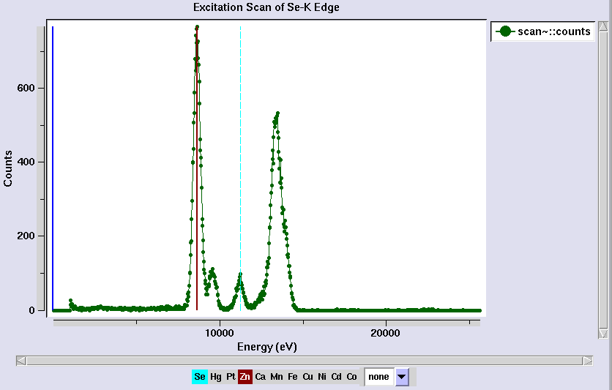
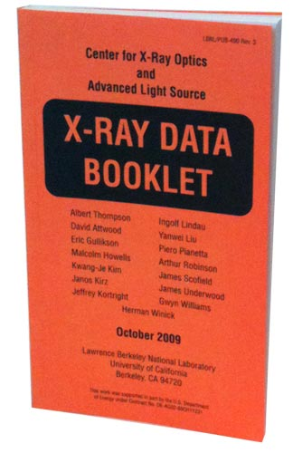
Metal identification

Slide 50
Auger emission
+

Slide 51
Auger emission
e⁻
++

Slide 52
Where do photons go?
Protein
1A x-rays
elastic scattering (6%)
Transmitted (98%)
beamstop
inelastic scattering (7%)
Re-emitted (99%)
Absorbed (~0%)

Slide 53
Where do photons go?
Protein
1A x-rays
elastic scattering (6%)
Transmitted (98%)
beamstop
inelastic scattering (7%)
Photoelectric (87%)
Re-emitted (99%)
Absorbed (~0%)

Slide 54
Where do photons go?
Protein
1A x-rays
elastic scattering (6%)
Transmitted (98%)
beamstop
inelastic scattering (7%)
Photoelectric (87%)
Re-emitted (99%)
Absorbed (~0%)
Re-emitted (~0%)
Absorbed (99%)

Slide 55
Where do photons go?
Protein
1A x-rays
elastic scattering (6%)
Transmitted (98%)
beamstop
inelastic scattering (7%)
Photoelectric (87%)
Re-emitted (99%)
Absorbed (~0%)
Re-emitted (~0%)
Absorbed (99%)
useful/absorbed energy: 7.3%

Slide 56
Photoelectric absorption

Slide 57
Photoelectric absorption
e⁻
+

Slide 58
Secondary ionization
e⁻

Slide 59
Secondary ionization
+
e⁻
e⁻

Slide 60
Excitation
e⁻

Slide 61
Excitation
e⁻

Slide 62
Excitation
e⁻

Slide 63
Excitation

Slide 64
Electron attachment
e⁻

Slide 65
Electron attachment
-

Slide 66
Sample atoms

Slide 67
Sample atoms

Slide 68
Primary ionization
e⁻
+

Slide 69
Secondary ionizations
e⁻
e⁻
+
e⁻
e⁻
+
+
+
+
+
e⁻
e⁻

Slide 70
Ionization track
e⁻
e⁻
e⁻
e⁻
+
e⁻
+
+
+
e⁻
e⁻
+
+
+
+
+
e⁻
+
e⁻
e⁻

Slide 71
Ionization track
e⁻
e⁻
e⁻
e⁻
+
e⁻
+
+
+
e⁻
e⁻
+
+
+
+
+
e⁻
+
e⁻
e⁻

Slide 72
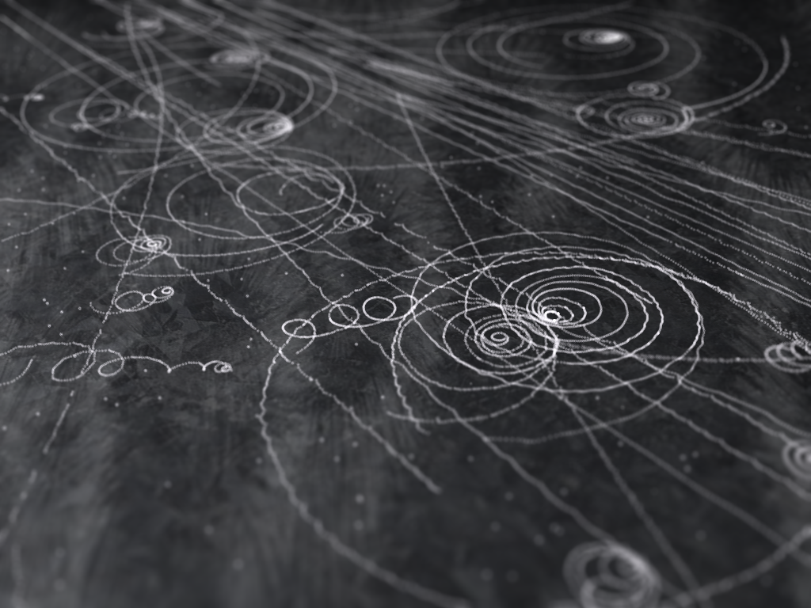
Ionization track

Slide 73
Ionization track

Slide 74
Ionization track
3 μm

Slide 75
Ionization track
Linear Energy Transfer

Slide 76
initial effects
e⁻
e⁻
e⁻
e⁻
+
e⁻
+
+
+
e⁻
e⁻
+
+
+
+
+
e⁻
+
e⁻
e⁻

Slide 77
initial effects
e⁻
e⁻
e⁻
e⁻
+
e⁻
+
+
+
e⁻
neutralization
e⁻
+
+
+
+
+
e⁻
+
e⁻
e⁻

Slide 78
initial effects
e⁻
e⁻
e⁻
e⁻
+
e⁻
+
+
neutralization
e⁻
+
+
+
+
+
e⁻
+
e⁻
e⁻

Slide 79
initial effects
e⁻
e⁻
e⁻
e⁻
+
neutralization
+
e⁻
+
+
+
+
+
neutralization
e⁻
e⁻

Slide 80
initial effects
e⁻
e⁻
e⁻
e⁻
+
+
e⁻
+
+
+
+
+
e⁻
attachment
e⁻

Slide 81
initial effects
e⁻
e⁻
e⁻
e⁻
+
+
e⁻
+
+
+
+
+
-
attachment
e⁻

Slide 82
initial effects
e⁻
e⁻
e⁻
attachment
e⁻
+
+
e⁻
+
+
+
+
+
-
e⁻
attachment

Slide 83
initial effects
e⁻
-
e⁻
e⁻
+
+
e⁻
+
+
+
+
+
-
-

Slide 84
initial effects
-
-
-
e⁻
+
+
+
+
+
+
-
-

Slide 85
initial effects
-
-
-
e⁻
solvation
+
+
+
+
+
+
-
-

Slide 86
initial effects
-
-
-
solvation
+
e⁻
+
+
+
+
+
-
-

Slide 87
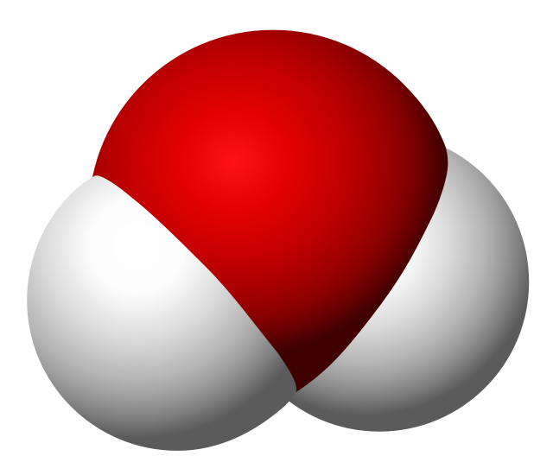
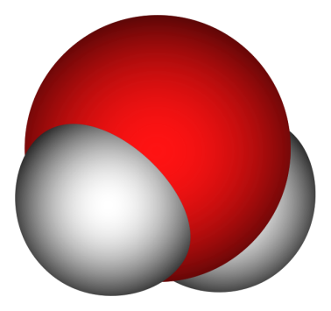
Solvated electron
e⁻

Slide 88
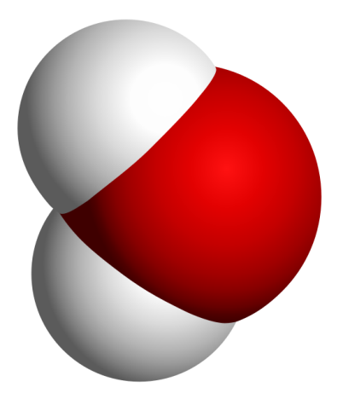
Solvated electron
e⁻

Slide 89
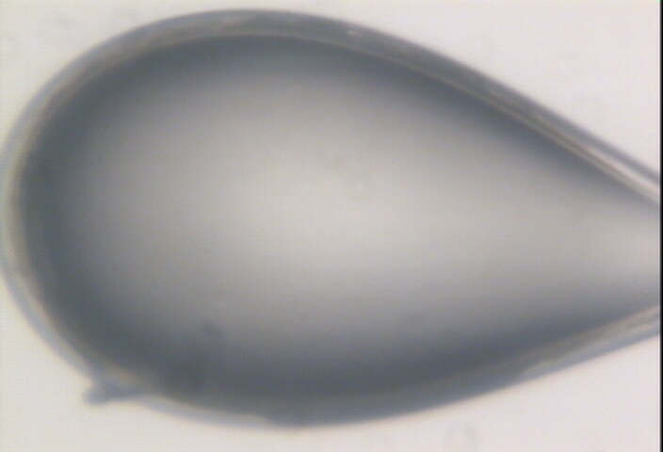

Slide 90
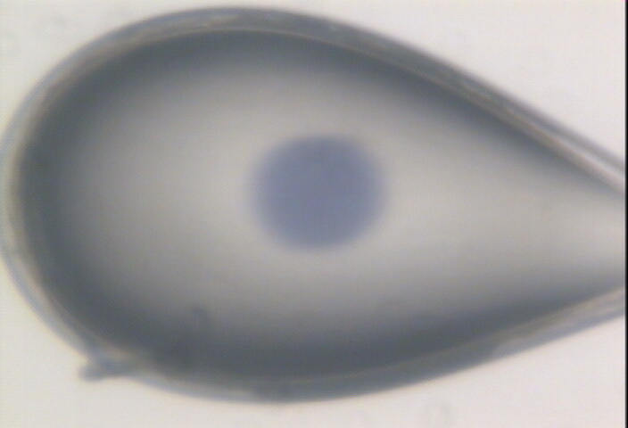

Slide 91
initial effects
-
-
-
+
e⁻
+
+
+
+
+
-
-

Slide 92
initial effects
-
-
-
+
e⁻
+
+
+
+
+
-
-

Slide 93
initial effects
-
-
+
e⁻
+
+
+
+
-
-

Slide 94
initial effects
e⁻
+
+
+
-
-

Slide 95
initial effects
e⁻
+
+
-

Slide 96
Excitation transfer

Slide 97
Excitation transfer
UV photon

Slide 98
Excitation transfer

Slide 99
Excitation transfer
r⁻⁶
Förster transfer

Slide 100
Excitation transfer

Slide 101
t = 0 s

Slide 102
t ≈ 10⁻¹⁴ s
e⁻
+
+
-

Slide 103
Timescales of radiation damage
Garret et. al. (2005) Chem. Rev. 105, 355-389

Slide 104
Timescales of radiation damage
LCLS
ALS
bunch
Garret et. al. (2005) Chem. Rev. 105, 355-389

Slide 105
Ionization track
Heterogeneous reactions
Homogeneous reactions

Slide 106
Rough values of energy quanta
1 MeV 100 GJ/mol Medical radiation therapy
100 keV 10 GJ/mol Medical imaging
10 keV 1 GJ/mol X-ray crystallography
1 keV 100 MJ/mol S and P K-edges
100 eV 10 MJ/mol “water window”
10 eV 1 MJ/mol C≡C bond
1 eV 100 kJ/mol C-C bond, visible light
100 meV 10 kJ/mol hydrogen bond
10 meV 1 kJ/mol heat (~300 K)

Slide 107

Energy Transfer Analogy
37 C

Slide 108
Damage is done
by dose (MGy)
proportional to photons/area
not time
not heat
Sliz P, Harrison SC & Rosenbaum G (2003). Structure 11, 13-19.
Garman EF & McSweeney SM (2006). J. Sync. Rad. 14, 1-3.
Owen RL, Rudino-Pinera E & Garman EF (2006). PNAS 103, 4912-4917.
Leiros et al. (2006). Acta Cryst. D 62, 125-132.
Holton JM (2007). J. Synch Rad. 14, 51-72.

Slide 109
what the is a MGy?
1 MGy = 10⁶ J/kg
http://bl831.als.lbl.gov/
damage_rates.pdf
Holton J. M. (2009) J. Synchrotron Rad. 16 133-42

Slide 110
How long will my crystal last?
synch line type flux beamsize flux density dose max xtal min site
ph/s μm ph/μm2/s rate lifetime lifetime
ALS 4.2.2 MAD 2.2e11 75x80 3.7e+07 27.3 kGy/s 18 m 73 s
ALS 5.0.1 mono 1.6e11 100 2.0e+07 10.4 kGy/s 48 m 3.2 m
ALS 5.0.2 MAD 8e11 100 1.0e+08 51.8 kGy/s 9.6 m 39 s
ALS 5.0.3 mono 1.7e11 100 2.2e+07 11 kGy/s 45 m 3 m
ALS 8.2.1 MAD 1.8e11 100 2.3e+07 11.7 kGy/s 43 m 2.9 m
ALS 8.2.2 MAD 2.3e11 100 2.9e+07 14.9 kGy/s 34 m 2.2 m
ALS 8.3.1 MAD 9e11 70 2.3e+08 119 kGy/s 4.2 m 17 s
ALS 8.3.1 typical 6e11 70 1.6e+08 115 kGy/s 4.3 m 17 s
ALS 12.3.1 MAD 1.8e11 100 2.3e+07 11.7 kGy/s 43 m 2.9 m
ALS 12.3.1 ML 4.0e12 100 5.1e+08 513 kGy/s 58 s 3.9 s
APS 8-BM MAD 1e11 200 2.5e+06 1.27 kGy/s 6.6 h 26 m
APS 14-BM-C mono 5.8e10 200 1.4e+06 738 Gy/s 11 h 45 m
APS 14-BM-D MAD 3.3e9 200 8.2e+04 42 Gy/s 8.3 d 13 h
APS 14-ID-B MAD 6.0e10 200 1.5e+06 763 Gy/s 11 h 44 m
APS 17-BM MAD 1.1e11 200 2.8e+06 1.4 kGy/s 6 h 24 m
APS 17-ID MAD 2.3e11 200 5.8e+06 2.93 kGy/s 2.8 h 11 m
APS 19-BM MAD 2.0e11 70x60 4.8e+07 24.2 kGy/s 21 m 83 s
APS 19-ID MAD 1.3e13 80x40 4.1e+09 2.07 MGy/s 15 s 0.97 s
APS 19-ID typical 5.5e11 100x100 5.5e+07 28 kGy/s 18 m 71 s
APS 22-BM MAD 7e12 80x40 2.2e+09 1.23 MGy/s 24 s 1.6 s
APS 22-ID MAD 7e12 80x40 2.2e+09 1.23 MGy/s 24 s 1.6 s
APS 22-ID typical 1.5e12 80 2.3e+08 119 kGy/s 4.2 m 17 s
APS 23-ID-B MAD 1e13 75x25 5.3e+09 3.01 MGy/s 10 s 0.66 s
APS 23-ID typical 1.5e12 80 2.3e+08 119 kGy/s 4.2 m 17 s
APS 24-ID-C MAD 1.3e13 20x60 1.1e+10 5.23 MGy/s 5.7 s 0.38 s
APS 24-ID-E MAD 0.5e13 20x100 2.5e+09 1.19 MGy/s 25 s 1.7 s
APS 31-ID MAD 2e12 70 4.1e+08 194 kGy/s 2.6 m 10 s

Slide 111
resolution dependence of global damage
10³
100
maximum tolerable dose (MGy)
10
1
1 2 3 5 7 10 20 40 70 100
resolution (Å)
Howells et al. (2009) J. Electron. Spectrosc. Relat. Phenom. 170 4-12

Slide 112
resolution dependence of global damage
10³
10 MGy/Å
100
maximum tolerable dose (MGy)
10
1
1 2 3 5 7 10 20 40 70 100
resolution (Å)
Howells et al. (2009) J. Electron. Spectrosc. Relat. Phenom. 170 4-12

Slide 113
R_{iso} vs dose
R_{iso} (%)
change in dose (MGy)
data taken from Banumathi, et al. (2004) Acta Cryst. D 60, 1085-1093.

Slide 114
R_{iso} vs dose
R_{iso} ≈ 0.7 %/MGy
R_{iso} (%)
change in dose (MGy)
data taken from Banumathi, et al. (2004) Acta Cryst. D 60, 1085-1093.

Slide 115
Dose-doubling concentration
molar, at the Se edge based on RADDOSE
Na | 44
Mg | 27
P | 9
S | 7
Cl | 5
K | 3.3
Ca | 2.7
Fe | 1.0
Cu | 0.67
Zn | 0.58
As | 0.44
Se | 0.42
Br | 2.9
I | 0.47
Gd | 0.21
Ta | 0.13
Pt | 0.17
Au | 0.16
Hg | 0.16
U | 0.23

Slide 116
Dose-doubling concentration
molar, at the Se edge based on RADDOSE
Na | 44
Mg | 27
P | 9
S | 7
Cl | 5
K | 3.3
Ca | 2.7
Fe | 1.0
Cu | 0.67
Zn | 0.58
As | 0.44
Se | 0.42
Br | 2.9
I | 0.47
Gd | 0.21
Ta | 0.13
Pt | 0.17
Au | 0.16
Hg | 0.16
U | 0.23

Slide 117
Specific Damage
World Records
MGy reaction reference
~45 global damage Owen et al. (2006)
5 Se-Met Holton (2007)
4 Hg-S Ramagopal et al. (2004)
3 S-S Murray et al. (2002)
1 Br-RNA Olieric et al. (2007)
? Cl-C ???
0.5 Mn in PS II Yano et al. (2005)
0.02 Fe in myoglobin Denisov et al. (2007)
Holton (2009) J. Synchrotron Rad. 16 133-42

Slide 118
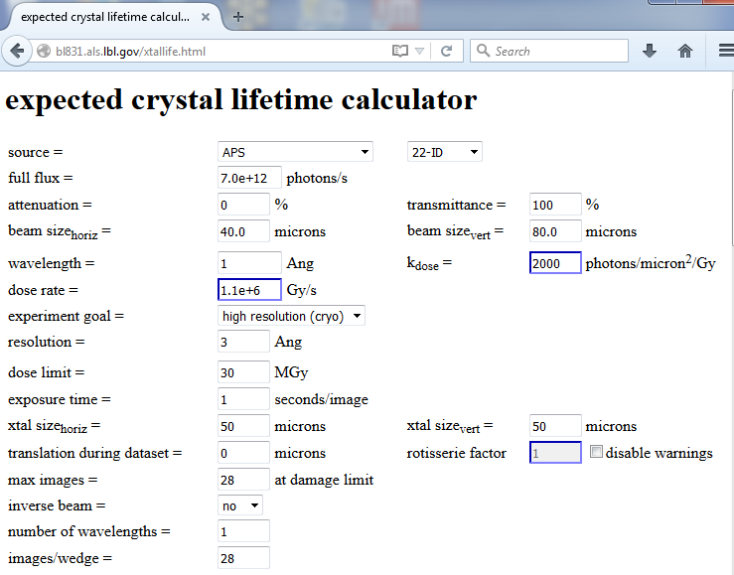

Slide 119

Holton & Frankel (2010) Acta D 66 393-408.

Slide 120
The number of photons you get
before a given crystal dies
is independent
of data collection time
1 um³ = 10⁶ photons
http://www.nist.gov/pml/data/xcom/

Slide 121
Decisions, Decisions, Decisions
Exposure time
Number of images
Wavelengths
Beam: size, flux, divergence, bandpass
Inverse beam?
Kappa? - overlaps
Multiple crystals? - non-isomorphism
Run Strategy

Slide 122

Dose slicing
unacceptable
damage
N
photons
crystal’s useful life
N
photons
unacceptable
read noise
N
photons

Slide 123
What if…
You only have a few small crystals?
Should you:
  Collect 360° from each?
  Collect 10° from each at 36x exposure?
  Glue 36 xtals together, then collect 360° ?
  Glue together and do 12960° ?

Slide 124
“true” resolution limit
CC vs right answer
Resolution (Å)

Slide 125
“true” resolution vs strategy
processing procedure | Dose slice collection scenario
 | fine | coarse | glue | gluefine
XDS/XSCALE | 3.03874 | 3.02970 | 3.0270 | 3.02948
XDS/aimless | 3.13351 | 3.03531 | 3.02638 | 3.05292
XDS/noscale | 3.01449 | 3.03048 | 3.02576 | 3.31013
301,640,334 photons

Slide 126
processing procedure | collection scenario
 | fine | coarse | glue | glue_fine
XDS/XSCALE | 3.03874 | 3.02970 | 3.0270 | 3.02948
XDS/aimless | 3.13351 | 3.03531 | 3.02638 | 3.05292
XDS/noscale | 3.01449 | 3.03048 | 3.02576 | 3.31013
MOSFLM-defaults | x | x | x | x
MOSFLM-cheat | 3.51254 | 3.04355 | 3.08244 | x
MOSFLM/noscale | 3.51311 | 3.04287 | 3.21664 | x
HKL2000-defaults | x | x | x | x
HKL2000-cheat | 3.04147 | 3.01415 | 3.01415 | 3.03948
DIALS-defaults | x | x | 3.32378 | x
DIALS-cheat | 2.92007 | x | 2.98204 | 2.92007
DIALS-noscale | 2.96392 | x | 3.26126 | 5.14852
d*Trek | ? | ? | ? | ?
EVAL15 | ? | ? | ? | ?

Slide 127
Self-calibrated damage limit
Where:
⟨I⟩_{DL} - average damage-limited intensity (photons/hkl) at a given resolution
10⁵ - converting R from μm to m, r_{e} from m to Å, ρ from g/cm³ to kg/m³ and MGy to Gy
r_{e} - classical electron radius (2.818 x 10⁻¹⁵ m/electron)
h - Planck’s constant (6.626 x 10⁻³⁴ J∙s)
c - speed of light (299792458 m/s)
f_{decayed} - fractional progress toward completely faded spots at end of data set
ρ - density of crystal (~1.2 g/cm³)
R - radius of the spherical crystal (μm)
λ - X-ray wavelength (Å)
f_{NH} - the Nave & Hill (2005) dose capture fraction (1 for large crystals)
n_{ASU} - number of proteins in the asymmetric unit
M_{r} - molecular weight of the protein (Daltons or g/mol)
V_{M} - Matthews’s coefficient (~2.4 Å³/Dalton)
H - Howells’s criterion (10 MGy/Å)
θ - Bragg angle
⟨ƒ_{a}²⟩ - number-averaged squared structure factor per protein atom (electron²)
⟨M_{a}⟩ - number-averaged atomic weight of a protein atom (~7.1 Daltons)
B - average (Wilson) temperature factor (Å²)
μ - attenuation coefficient of sphere material (m⁻¹)
μ_{en} - mass energy-absorption coefficient of sphere material (m⁻¹)
No flux
No symmetry
Holton & Frankel (2010) Acta D 66 393-408.

Slide 128
Bigger is better, but not by much
B = 20
B = 60
B = 0
B = 170
B = 330
B = 560
Resolution (Å)
B = 850
Crystal diameter (micron)

Slide 129
Predicting resolution limits
Synchrotron Resolution (Å)
Home Lab Resolution (Å)

Slide 130
Predicting resolution limits
XFEL Resolution (Å)
Synchrotron Resolution (Å)

Slide 131
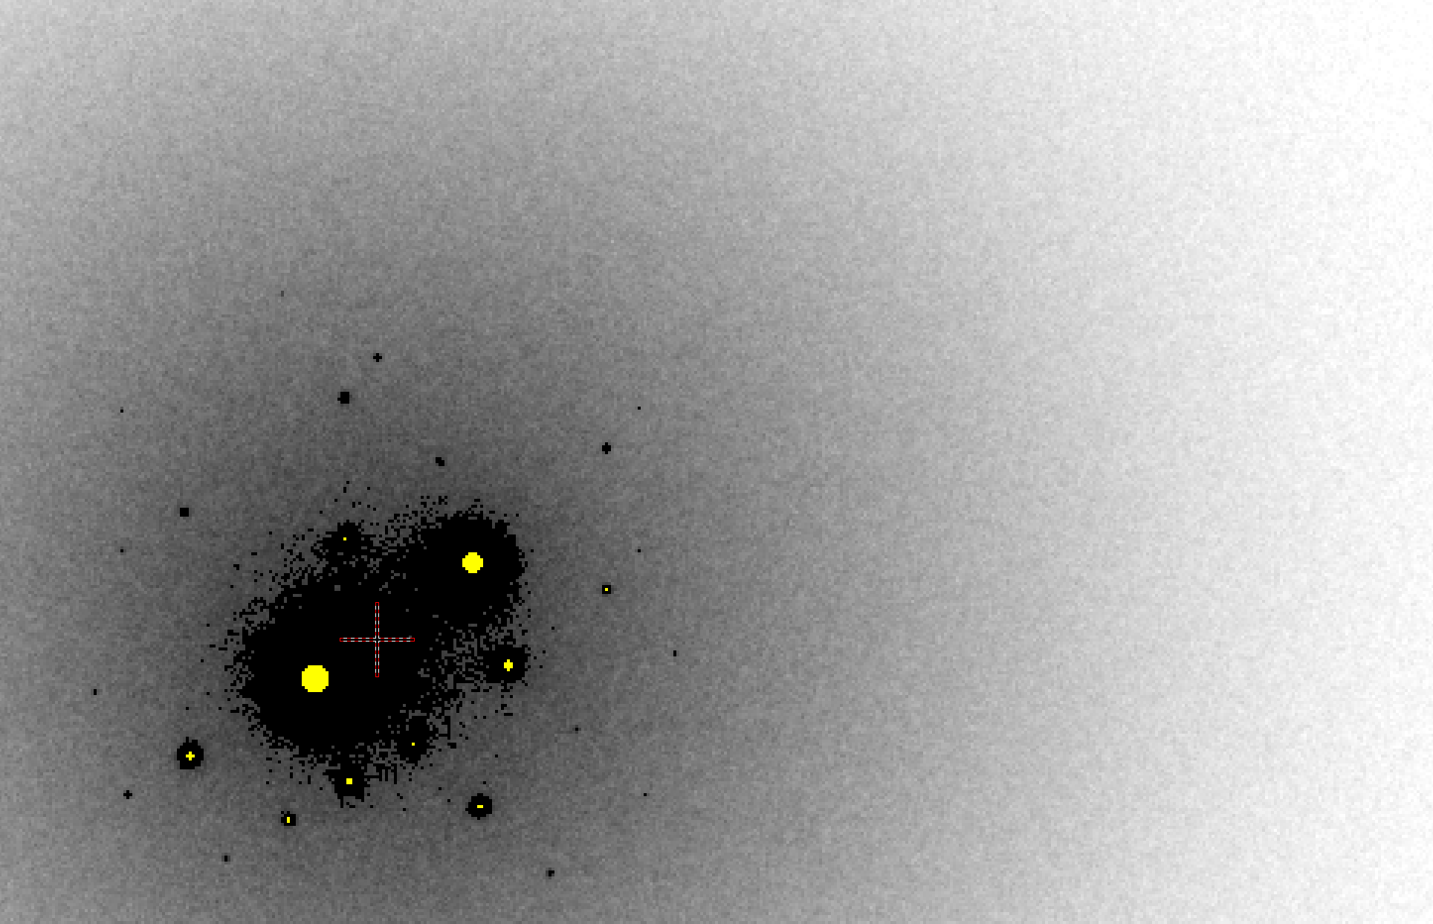
B factor from image analysis
B = 500

Slide 132
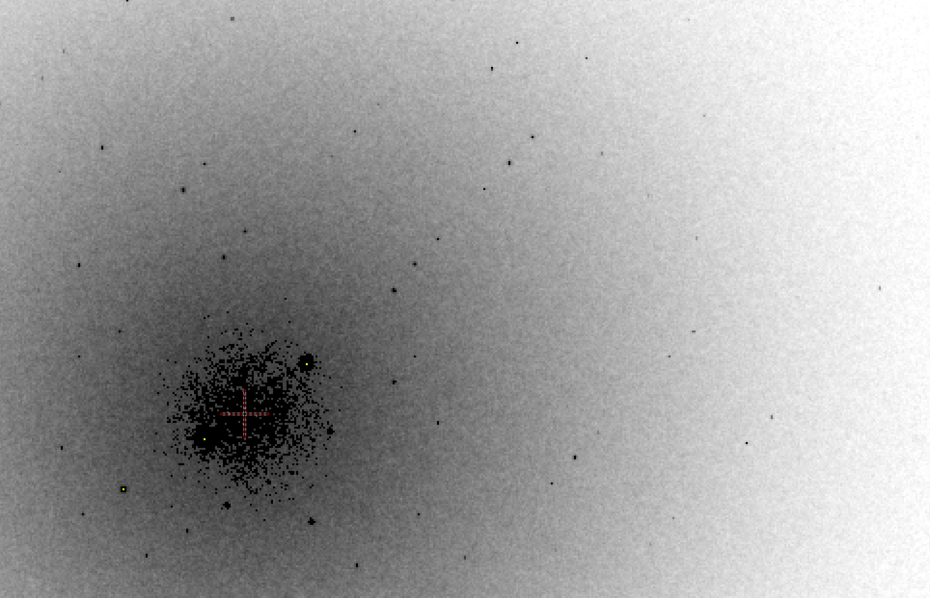
B factor from image analysis
B = 20

Slide 133
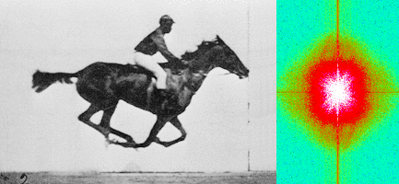
Muybridge’s galloping horse (1878)
“Time-resolved” diffraction
Real space
reciprocal

Slide 134
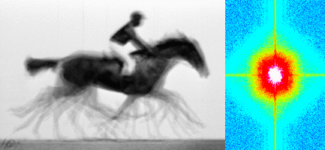
Muybridge’s galloping horse (1878)
Average electron density
Real space
reciprocal

Slide 135
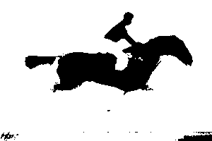
Muybridge’s galloping horse (1878)
Average electron density: 1 sigma contour
Real space
reciprocal

Slide 136

lysozyme: real and reciprocal

Slide 137
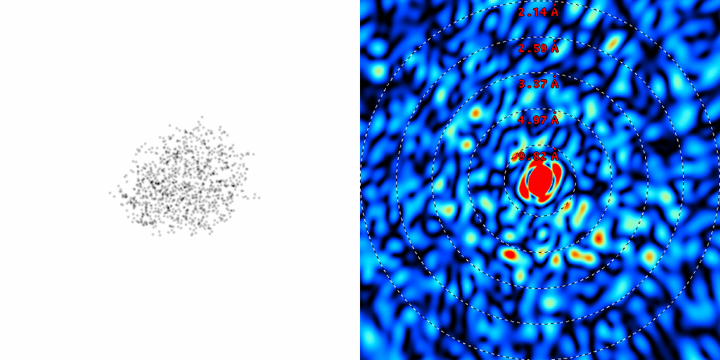
lysozyme: thermal motion

Slide 138
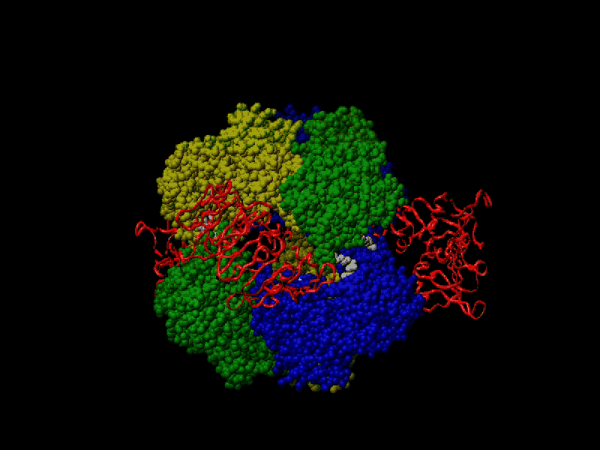
Proteins move!
Your crystal may be trying to tell you something…
Beernink, Endrizzi, Alber & Schachman (1999). PNAS USA 96, 5388-5393.

Slide 139
At the beamline…
Resolution
  problem: background
  solution: use as few pixels as possible
Phases
  problem: fractional errors
  solution: use as many pixels as possible

Slide 140
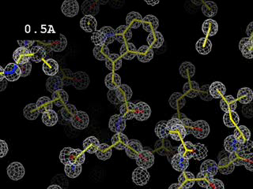
Resolution
http://bl831.als.lbl.gov/~jamesh/movies/resolution.mpeg

Slide 141
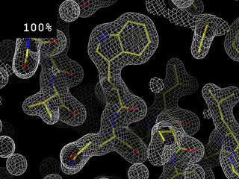
Completeness: random deletion
http://bl831.als.lbl.gov/~jamesh/movies/completeness.mpeg

Slide 142
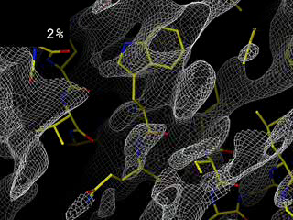
Completeness: missing wedge
http://bl831.als.lbl.gov/~jamesh/movies/osc.mpeg

Slide 143
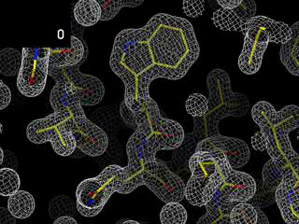
Overloads
http://bl831.als.lbl.gov/~jamesh/movies/overloads.mpeg

Slide 144
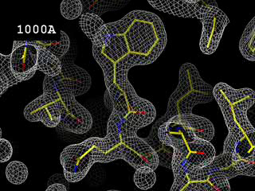
Resolution: low-angle cutoff
http://bl831.als.lbl.gov/~jamesh/movies/lo_cut.mpeg

Slide 145
The truth about x-ray beams
Term units significance
Flux photons/s duration of experiment
Beam Size μm match to crystal
Divergence mrad spot size vs distance
Wavelength Å resolution and absorption
Dispersion Δλ/λ spot size
Flux density ph/s/area scattering/damage rate
Fluence ph/area scattering/damage

Slide 146
The truth about x-ray beams
Term units significance
Flux photons/s duration of experiment
Beam Size μm match to crystal
Divergence mrad spot size vs distance
Wavelength Å resolution and absorption
Dispersion Δλ/λ spot size
Flux density ph/s/area scattering/damage rate
Fluence ph/area scattering/damage

Slide 147
The truth about x-ray beams
quantity | units | home source | MX2
flux | Photons/second | 2.5 x 10⁹ | 2 x 10¹²
exposure | seconds | 400 | 1

Slide 148
Decisions, Decisions, Decisions
Exposure time
Number of images
Wavelengths
Beam: size, flux, divergence, bandpass
Inverse beam?
Kappa? - overlaps
Multiple crystals? - non-isomorphism
Run Strategy

Slide 149
The truth about x-ray beams
quantity | units | home source | MX2
flux | Photons/second | 2.5 x 10⁹ | 2 x 10¹²
exposure | seconds | 400 | 1
Dispersion | wavelength range / wavelength | 0.2% (Kα₁ - Kα₂) | 0.014% (Si111)
Divergence | milliRadian | 4.8 | 1.8 (h) 0.18 (v)
Beam size | microns | 100 | 24 (h) 12 (v)
Spectral brightness | Photons/s/mm²/ mR²/0.1%BW | 5.4 x 10⁹ | 1.5 x 10¹⁷

Slide 150
The truth about x-ray beams
quantity | units | home source | MX2
flux | Photons/second | 72 x 10⁶ | 2 x 10¹²
exposure | time | 4 hours | 1 second
Dispersion | wavelength range / wavelength | 0.2% (Kα₁ - Kα₂) | 0.014% (Si111)
Divergence | milliRadian | 4.8 | 1.8 (h) 0.18 (v)
Beam size | microns | 17 | 24 (h) 12 (v)
Spectral brightness | Photons/s/mm²/ mR²/0.1%BW | 5.4 x 10⁹ | 1.5 x 10¹⁷

Slide 151
The truth about x-ray beams
quantity | units | home source | MX2
flux | Photons/second | 1 x 10⁶ | 2 x 10¹²
exposure | time | 10 days | 1 second
Dispersion | wavelength range / wavelength | 0.2% (Kα₁ - Kα₂) | 0.014% (Si111)
Divergence | milliRadian | 0.6 | 1.8 (h) 0.18 (v)
Beam size | microns | 17 | 24 (h) 12 (v)
Spectral brightness | Photons/s/mm²/ mR²/0.1%BW | 5.4 x 10⁹ | 1.5 x 10¹⁷

Slide 152
The truth about x-ray beams
quantity | units | home source | MX2
flux | Photons/second | 8 x 10⁴ | 2 x 10¹²
exposure | time | 5 months | 1 second
Dispersion | wavelength range / wavelength | 0.014% (Si111) | 0.014% (Si111)
Divergence | milliRadian | 0.6 | 1.8 (h) 0.18 (v)
Beam size | microns | 17 | 24 (h) 12 (v)
Spectral brightness | Photons/s/mm²/ mR²/0.1%BW | 5.4 x 10⁹ | 1.5 x 10¹⁷

Slide 153
The truth about x-ray beams
Term units significance
Flux photons/s duration of experiment
Beam Size μm match to crystal
Divergence mrad spot size vs distance
Wavelength Å resolution and absorption
Dispersion Δλ/λ spot size
Flux density ph/s/area scattering/damage rate
Fluence ph/area scattering/damage

Slide 154
spectral dispersion
Ewald sphere
Φ circle
(h,k,l)
λ*
d*
spindle axis
diffracted ray
λ*

Slide 155
spectral dispersion
Ewald sphere
Φ circle
(h,k,l)
λ’*
d*
spindle axis
diffracted ray
λ’*

Slide 156
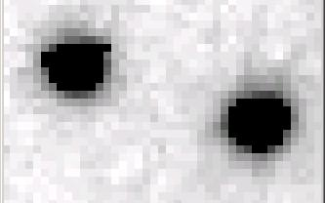
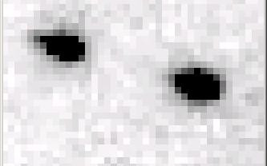
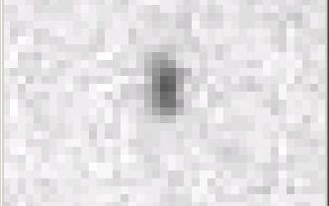
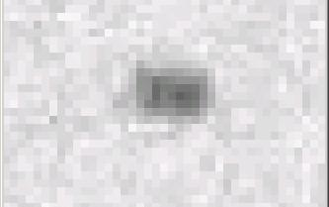
Si(111) vs multilayers
0.014%
Si(111)
spectral
dispersion
1%
multilayer
4 Å
resolution
1.9 Å

Slide 157
Wide-bandpass MX?
Mono | Si(111) | multilayer | Difference (%) | good
Energy (eV) | 11111 | 12027.5 | +8.2 | Same
Scale | 1.0000 | 1.0964 | +9.6 | Yes
R_{merge} (%) | 7.5 | 8.4 | +12 | No
R_{anom} (%) | 5.6 | 5.5 | -1.8 | Same
I/sd | 13.2 | 12.3 | -6.8 | Same
I/sd (1.5Å) | 2.3 | 1.8 | -21.7 | No
Ano Patt | 5.96 | 4.75 | -20.3 | Same
Ano Phased | 41 | 39.33 | -4.1 | Same
FOM | 0.238 | 0.192 | -19.3 | Same
CC | 0.555 | 0.647 | -6.1 | Yes
R_{cryst} (%) | 26.70 | 26.48 | -0.2 | Same
Ligand peak | 8.213 | 8.250 | +0.4 | Same

Slide 158
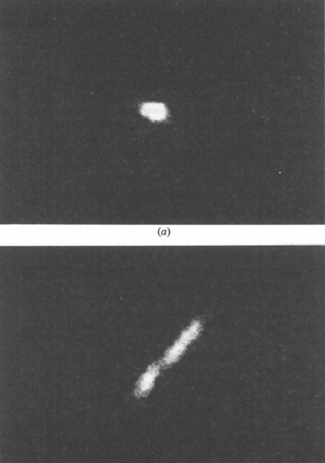

Wide bandpass reveals mosaicity from a still
low mosaic
high mosaic
Δ_{radial} = 2ηD/cos²2θ
Snell EH, Weisgerber S, Helliwell JR, Holzer K & Schroer K (1995)."Improvements in lysozyme protein crystal perfection through microgravity growth", Acta crystallographica. Section D, Biological crystallography 51, 1099-1102.

Slide 159
Decisions, Decisions, Decisions
Exposure time
Number of images
Wavelengths
Beam: size, flux, divergence, bandpass
Inverse beam?
Kappa? - overlaps
Multiple crystals? - non-isomorphism
Run Strategy

Slide 160
The truth about x-ray beams
Term units significance
Flux photons/s duration of experiment
Beam Size μm match to crystal
Divergence mrad spot size vs distance
Wavelength Å resolution and absorption
Dispersion Δλ/λ spot size
Flux density ph/s/area scattering/damage rate
Fluence ph/area scattering/damage

Slide 161
beam divergence
Ewald sphere
Φ circle
(h,k,l)
λ*
d*
spindle axis
diffracted ray
λ*

Slide 162
beam divergence
Ewald sphere
Φ circle
(h,k,l)
d*
λ*
diffracted ray
spindle axis
λ*

Slide 163
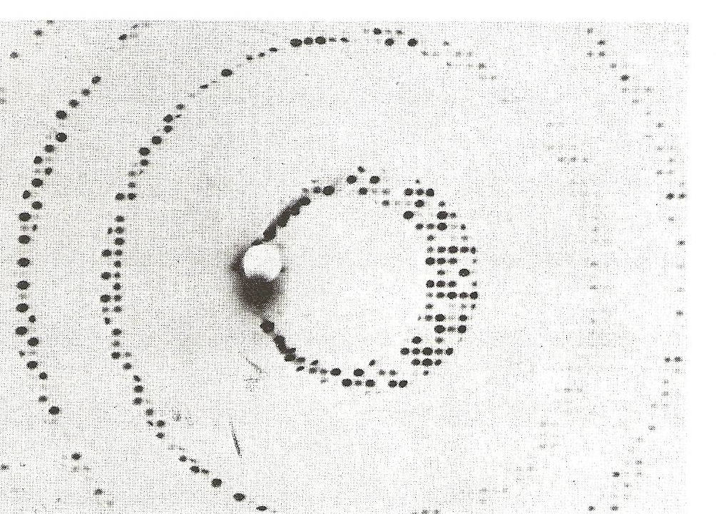
Divergence
Arndt & Wonacott (1977)

Slide 164
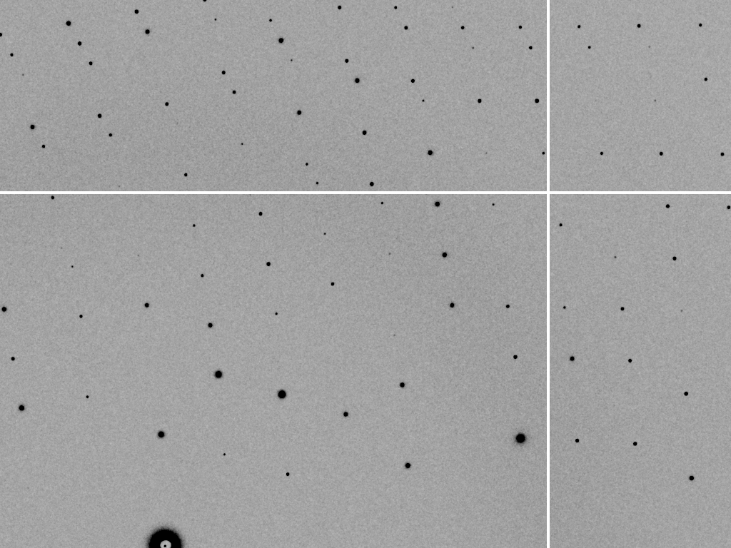
divergence = 0 º

Slide 165
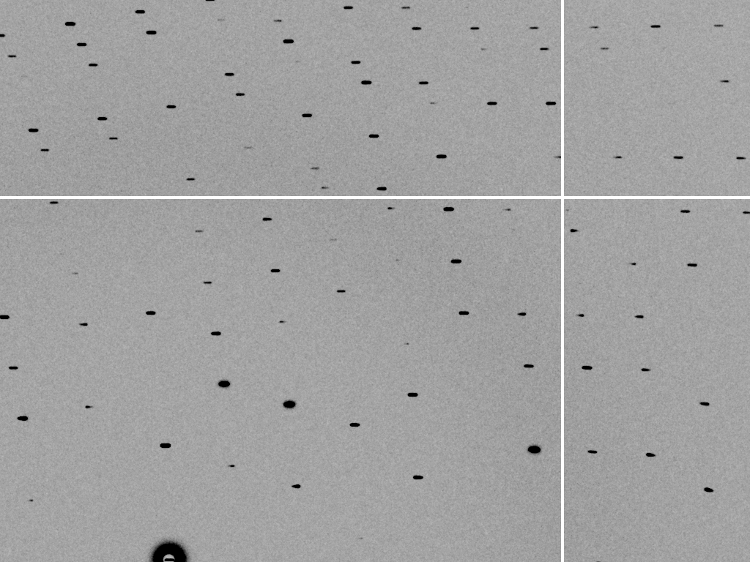
divergence = 0.3 º

Slide 166
The truth about x-ray beams
Term units significance
Flux photons/s duration of experiment
Beam Size μm match to crystal
Divergence mrad spot size vs distance
Wavelength Å resolution and absorption
Dispersion Δλ/λ spot size
Flux density ph/s/area scattering/damage rate
Fluence ph/area scattering/damage

Slide 167
Air absorption
transmittance
Distance from sample (mm)

Slide 168
The truth about x-ray beams
Term units significance
Flux photons/s duration of experiment
Beam Size μm match to crystal
Divergence mrad spot size vs distance
Wavelength Å resolution and absorption
Dispersion Δλ/λ spot size
Flux density ph/s/area scattering/damage rate
Fluence ph/area scattering/damage

Slide 169
Decisions, Decisions, Decisions
Exposure time
Number of images
Wavelengths
Beam: size, flux, divergence, bandpass
Inverse beam?
Kappa? - overlaps
Multiple crystals? - non-isomorphism
Run Strategy

Slide 170
beam size vs xtal size
  Put your crystal into the beam

Slide 171
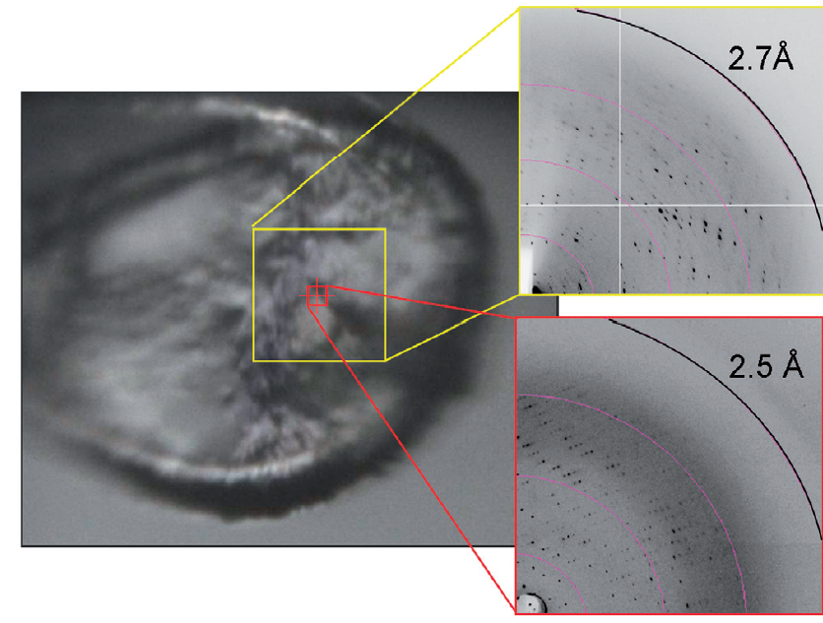
Put the “crystal” into the beam
Evans et al. (2011)."Macromolecular microcrystallography", Crystallography Reviews 17, 105-142.

Slide 172
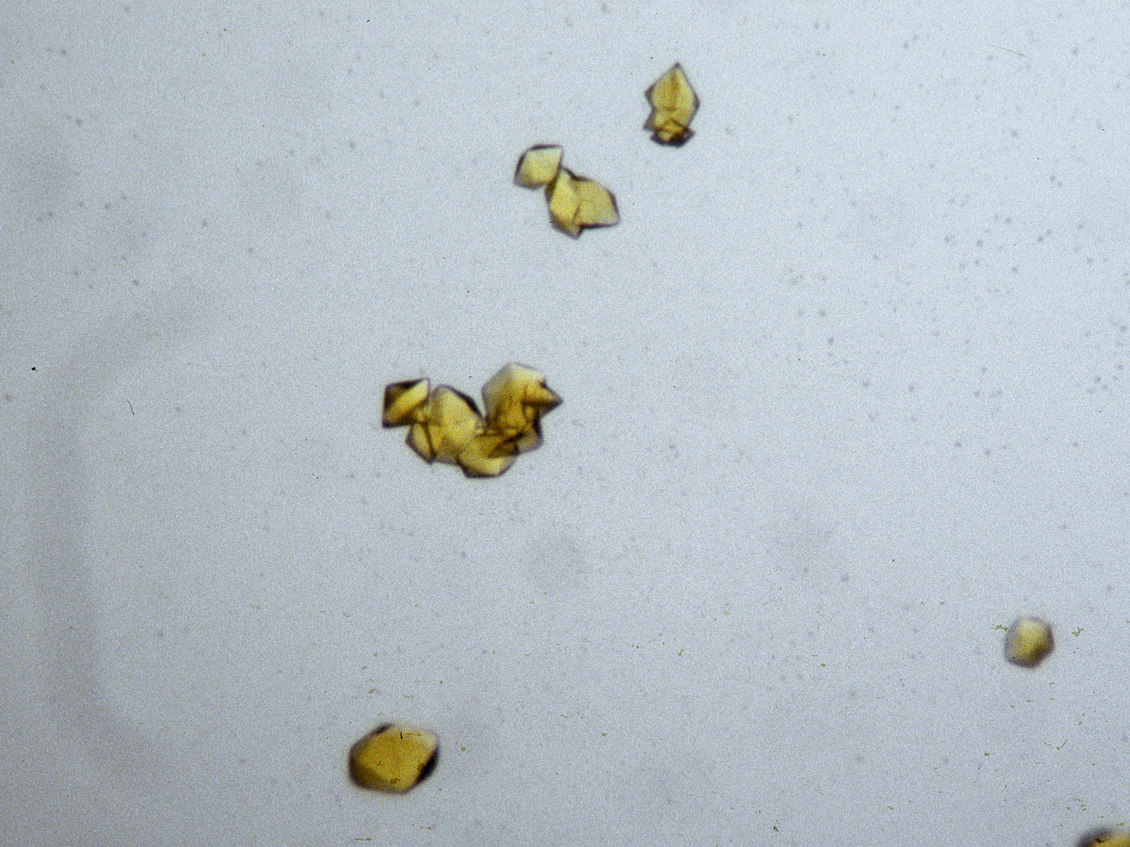
“crystal” = thing you want to shoot
Membrane Protein Expression Center © 2012

Slide 173
beam size vs xtal size
  Put your crystal into the beam
  Shoot the whole crystal

Slide 174
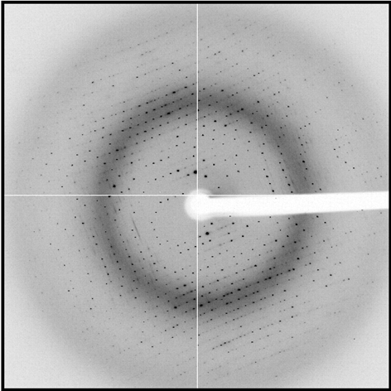
shoot the whole crystal

Slide 175
shoot the whole crystal

Slide 176
shoot the whole crystal

Slide 177
How many crystals do you see?
Shoot the “crystal” (singular)

Slide 178
mosaic spread
Ewald sphere
Φ circle
(h,k,l)
λ*
d*
diffracted ray
d*
spindle axis
λ*

Slide 179
mosaic spread
Ewald sphere
Φ circle
(h,k,l)
d*
diffracted rays
d*
spindle axis

Slide 180

mosaic spread = 0 º

Slide 181

mosaic spread = 0.1º

Slide 182

mosaic spread = 0.2º

Slide 183

mosaic spread = 0.4º

Slide 184

mosaic spread = 0.6º

Slide 185

mosaic spread = 0.8º

Slide 186

mosaic spread = 1.0º

Slide 187

mosaic spread = 1.5º

Slide 188

mosaic spread = 2.0º

Slide 189

mosaic spread = 2.5º

Slide 190

mosaic spread = 3.2º

Slide 191

mosaic spread = 6.4º

Slide 192

mosaic spread = 12.8º

Slide 193
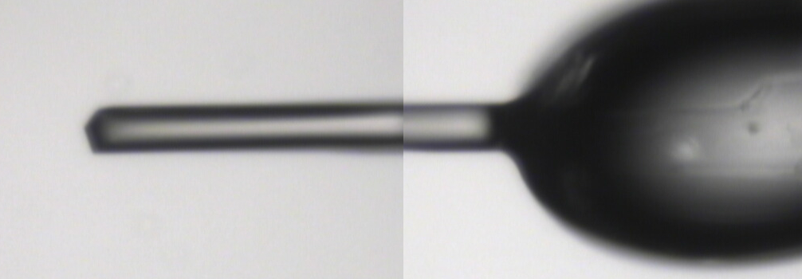
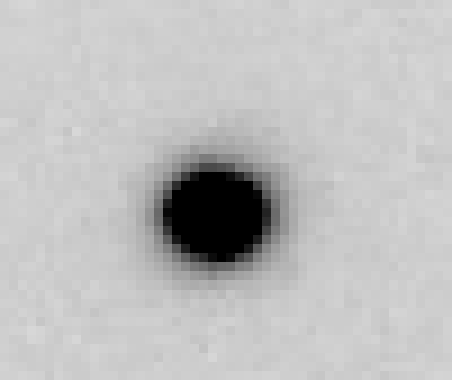
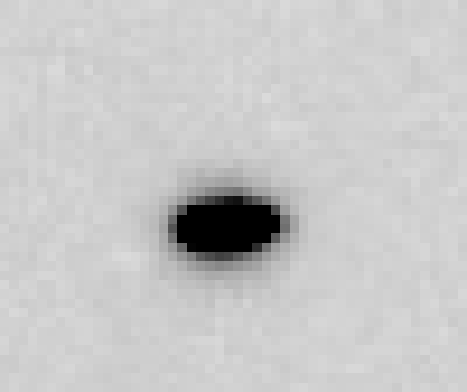
~0 MGy

Slide 194
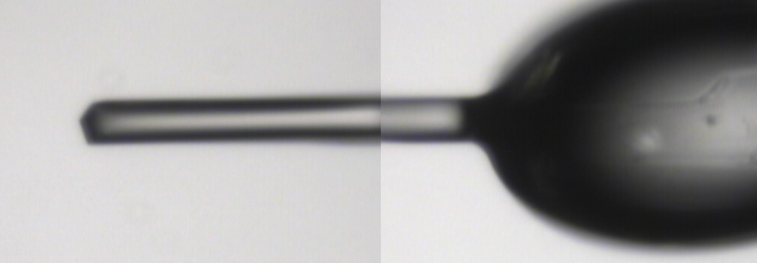
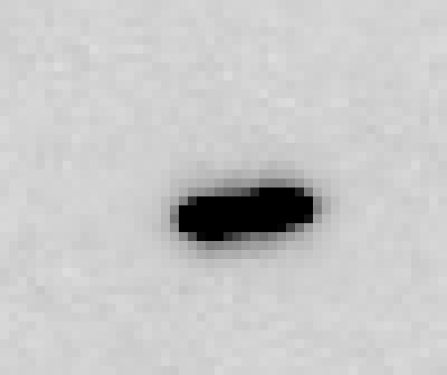
5 MGy

Slide 195
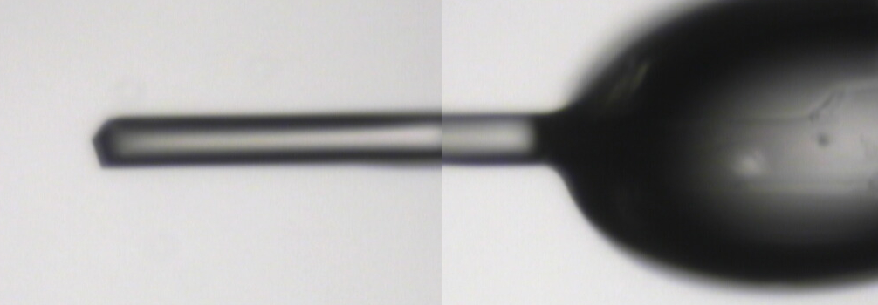
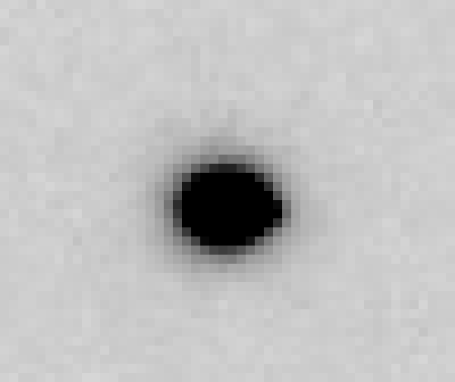
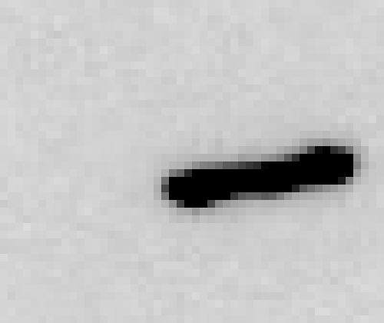
11 MGy

Slide 196
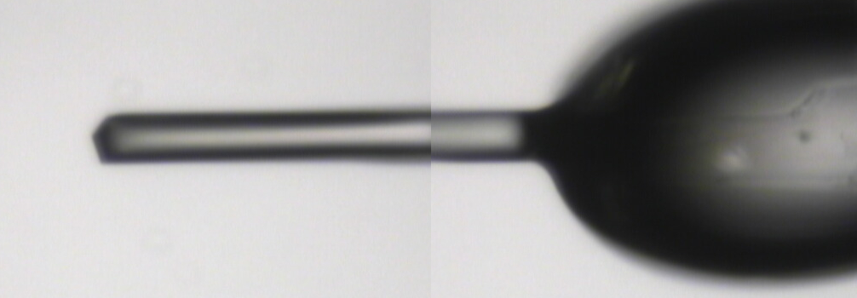
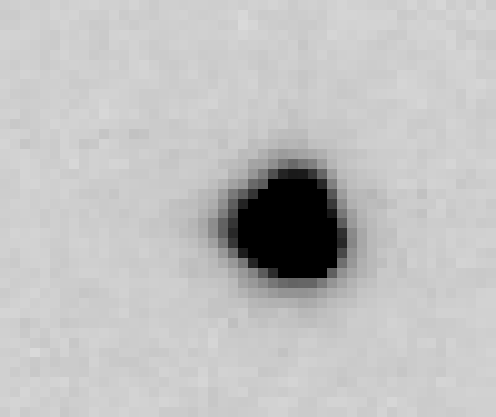
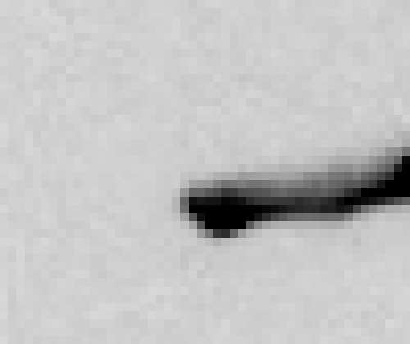
16 MGy

Slide 197
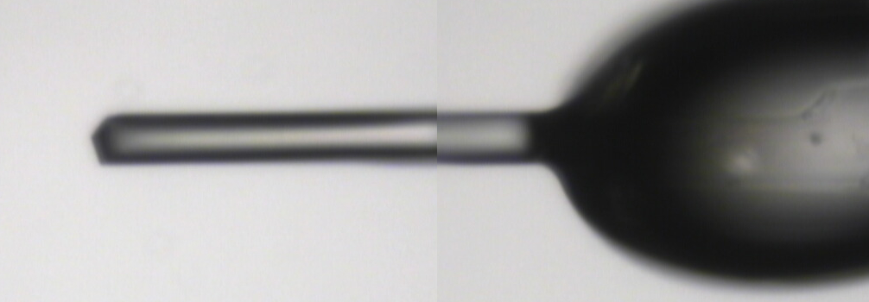


22 MGy

Slide 198



26 MGy

Slide 199
shoot the whole crystal
Do not bend!

Slide 200
platy crystals

Slide 201
platy crystals

Slide 202

MiTeGen MicroMesh grids
http://www.mitegen.com/products/micromeshes/micromeshes.shtml

Slide 203

platy crystals

Slide 204
platy crystals

Slide 205
platy crystals

Slide 206
beam size vs xtal size
  Put your crystal into the beam
  Shoot the whole crystal
  Shoot nothing but the crystal

Slide 207
shoot nothing but the crystal

Slide 208
shoot nothing but the crystal

Slide 209
Resolution (Å)
too big
too small
just right
X-ray beam size (μm)

Slide 210

Gaussian beam
50% of flux
the other 50%

Slide 211

Collimated beam
100% of flux
0%

Slide 212

shoot nothing but the crystal

Slide 213
shoot nothing but the crystal

Slide 214
shoot nothing but the crystal

Slide 215
X-ray scattering “rules”:
Optimum: support thickness = crystal thickness
1 μm crystal ≈ 1 μm water
≈ 1 μm plastic
≈ 0.1 μm glass
≈ 1000 μm air
~ 50 mm He
≈ 370 mm sat water vapor @ 4C

Slide 216
beam size vs xtal size
  Put your crystal into the beam
  Shoot the whole crystal
  Shoot nothing but the crystal
  Back off!

Slide 217
Mosquito tips cost $0.15 each
So do Pilatus pixels!
We bought 6,224,001
Use them!
(they are reusable)

Slide 218
Background scattering

Slide 219

Background scattering
$100,000.00
$100,000.00
$100,000.00
real estate is
expensive
use it!
$100,000.00
$100,000.00
$100,000.00
$100,000.00
$100,000.00

Slide 220
Fine Slicing
background
background
Pflugrath, J. W. (1999)."The finer things in X-ray diffraction data collection", Acta Cryst. D 55, 1718-1725.

Slide 221

Pilatus pile-up for RT MX? same photons, different speeds
Sum of 193 shots with
193-fold attenuation

Slide 222

Pilatus pile-up for RT MX? same photons, different speeds
1 shot with
no attenuation

Slide 223

Pilatus pile-up for RT MX? same photons, different speeds
0.016° mosaic

Slide 224

Pilatus pile-up for RT MX? same photons, different speeds
20 deg/s
0.016 deg mosaic

Slide 225

Pilatus pile-up for RT MX? same photons, different speeds

Slide 226
Classes of error in MX
Dependence on signal
none sqrt proportional
CCD
Read-out
Photon
counting
Detector calibration
attenuation
partiality
Non-isomorphism
Radiation damage
none
1/sqrt
1/prop.
Time
Beam flicker
Shutter jitter
Sample vibration
Pile-up

Slide 227
Beam Flicker
pinhole
removed
normalized flux through pinhole
time (seconds)

Slide 228

This is an Aperture!

Slide 229
Classes of error in MX
Dependence on signal
none sqrt proportional
CCD
Read-out
Photon
counting
Detector calibration
attenuation
partiality
Non-isomorphism
Radiation damage
none
1/sqrt
1/prop.
Time
Beam flicker
Shutter jitter
Sample vibration
Pile-up

Slide 230

Optimal exposure time
(faint spots on CCD)
t_{hr} Optimal exposure time for data set (s)
t_{ref} exposure time of reference image (s)
bg_{ref} background level near weak spots on
reference image (ADU)
bg₀ ADC offset of detector (ADU)
bg_{hr} optimal background level (via t_{hr})
σ₀ rms read-out noise (ADU)
gain ADU/photon
m multiplicity of data set (including partials)
adjust exposure
so this is ~100

Slide 231
Optimal exposure time
(faint spots on PAD)
t_{hr} Optimal exposure time for data set (s)
t_{ro} read-out time (s)
2.03 ms on PILATUS3 S
3 μs on EIGER

Slide 232
Optimal exposure time
(anomalous on PAD)
t_{hr} Optimal exposure time for data set (s)
t_{ro} read-out time (s)
2.03 ms on PILATUS3 S
3 μs on EIGER

Slide 233
Decisions, Decisions, Decisions
Exposure time
Number of images
Wavelengths
Beam: size, flux, divergence, bandpass
Inverse beam?
Kappa? - overlaps
Multiple crystals? - non-isomorphism
Run Strategy

Slide 234
How to avoid time-dependent error?
Attenu-wait!
Apply 10x attenuation
Expose 10x longer
Number of photons should be the same!
Damage will also be the same!

Slide 235
beam size vs xtal size
  Put your crystal into the beam
  Shoot the whole crystal
  Shoot nothing but the crystal
  Back off!
  The crystal must rotate

Slide 236
The crystal rotates!

Slide 237
The crystal rotates!
Membrane Protein Expression Center © 2012

Slide 238
Shoot nothing but the “crystal”
Evans et al. (2011)."Macromolecular microcrystallography", Crystallography Reviews 17, 105-142.

Slide 239
Decisions, Decisions, Decisions
Exposure time
Number of images
Wavelengths
Beam: size, flux, divergence, bandpass
Inverse beam?
Kappa? - overlaps
Multiple crystals? - non-isomorphism
Run Strategy

Slide 240


avoiding overlaps
c
c

Slide 241

avoiding overlaps
c

Slide 242

SmarAct’s
“SmarGon”
Commercialized
PRIGo

Slide 243
At the beamline…
Resolution
  problem: background
  solution: use as few pixels as possible
Phases
  problem: fractional errors
  solution: use as many pixels as possible

Slide 244

R-factor
http://bl831.als.lbl.gov/~jamesh/movies/rfactor.mpeg

Slide 245

Figure of Merit
http://bl831.als.lbl.gov/~jamesh/movies/dephase.mpeg

Slide 246
anomalous signal
ΔF
F
√
# sites
MW (Da)
≈ 1.2 f”
World record!
ΔF/F = 0.5%
Wang, Dauter & Dauter (2006) Acta Cryst. D 62, 1475-1483.
Crick, F. H. C. & Magdoff, B. S. (1956) Acta Crystallogr. 9, 901-908.
Hendrickson, W. A. & Teeter, M. M. (1981) Nature 290, 107-113.

Slide 247
Fractional error
^{mult >} (—)²
~3%
<ΔF/F>

Slide 248
Holton & Frankel (2010) Acta D 66 393-408.

Slide 249

Systematic error does not “average out”

Slide 250
Can you count to 1,000,000 ?
sqrt(1,000,000)
1,000,000
Theoretically:
= 0.1%
R_{meas} ≈ 0.1% ?
ISa = 1000
In reality:
ISa ~ 33
R_{meas =} ≈ 3%
sqrt(1,000)
1,000
= 3%
photon
spot
> 1000 is a waste!

Slide 251
Threshold of a revolution in phasing
Current
technology
Goal
Solve-able proteins (%)
Required signal-to-noise (I/σ)

Slide 252
Threshold of a revolution in phasing
Source of error | realistic simulation | No SHSSS | Perfect detector
Photon counting | + | + | +
Shutter jitter | + | + | -
Beam flicker | + | + | -
Sample absorption | + | + | -
Radiation damage | + | + | -
Imperfect spindle | + | + | -
vignette | + | + | -
Corner correction | + | + | -
SHSSS | + | - | -
R_{meas} (∞-10 Å) | 2.8% | 0.7% | 0.7%
I/σ asymptotic | 26.8 | 74.2 | 81.0
Holton et al (2014) "R-factor gap", FEBS Journal 281, 4046-4060.

Slide 253
Spatial Heterogeneity in Sharp Spot Sensitivity

Slide 254
Spatial Heterogeneity in Sharp Spot Sensitivity

Slide 255
Spatial Heterogeneity in Sharp Spot Sensitivity
Relative spot intensity
Spot centroid position (pixels)

Slide 256
Spatial Heterogeneity in Sharp Spot Sensitivity
Relative spot intensity
Spot centroid position (pixels)

Slide 257
SHSSS!
The dominant source of error for anomalous difference measurements
Spatial
Heterogeneity in
Sharp
Spot
Sensitivity
Flat
Field

Slide 258
SHSSS!
The dominant source of error for anomalous difference measurements
Spatial
Heterogeneity in
Sharp
Spot
Sensitivity
Flat
Field
90%
110%
x 1.11 =
100%
x 0.91 =
100%

Slide 259
SHSSS!
The dominant source of error for anomalous difference measurements
Spatial
Heterogeneity in
Sharp
Spot
Sensitivity
Sharp
Spot
20%
110%
x 1.11 =
22%
x 0.91 =
100%

Slide 260
SHSSS!
The dominant source of error for anomalous difference measurements
Spatial
Heterogeneity in
Sharp
Spot
Sensitivity
Sharp
Spot
90%
30%
Integral: 127.3
x 1.11 =
100%
x 0.91 =
27.3%

Slide 261
SHSSS!
The dominant source of error for anomalous difference measurements
Spatial
Heterogeneity in
Sharp
Spot
Sensitivity
Sharp
Spot
20%
110%
Integral: 122.2
x 1.11 =
22.2%
x 0.91 =
100%

Slide 262
SHSSS!
The dominant source of error for anomalous difference measurements
Spatial
Heterogeneity in
Sharp
Spot
Sensitivity
Sharp
Spot
90%
30%
Integral: 127.3
x 1.11 =
100%
x 0.91 =
27.3%

Slide 263
Spatial Heterogeneity in Sharp Spot Sensitivity

Slide 264
Spatial Heterogeneity in Sharp Spot Sensitivity
down

Slide 265
Spatial Heterogeneity in Sharp Spot Sensitivity
down
up

Slide 266
Spatial Heterogeneity in Sharp Spot Sensitivity
down
up
R_{separate}

Slide 267
Spatial Heterogeneity in Sharp Spot Sensitivity
odd
even
R_{mixed}

Slide 268
Spatial Heterogeneity in Sharp Spot Sensitivity
separate:
2.5%

Slide 269
Spatial Heterogeneity in Sharp Spot Sensitivity
separate:
mixed:
2.5%
0.9%

Slide 270


Slide 271


Slide 272


Slide 273
Spatial Heterogeneity in Sharp Spot Sensitivity
separate:
mixed:
2.5%
0.9%
2.5%²-0.9%² = 2.3%²

Slide 274

Spatial Heterogeneity in Sharp Spot Sensitivity
3.5
3.0
2.5
2.0
1.5
1.0
0.5
CCD detector
different
modules
anomalous mates are always on
different modules
SHSSS
Systematic component of R_{sseparate} (%)
Pilatus
SN001
0.1 1 10 100
distance between spots (mm)
Notes:
Comparision of SHSSS measured by the detector-shift experiment on three different detectors:
The Q315R in ALS 8.3.1
The first Pilatus detector at the Swiss Light Soruce
A newer Pilatus detector at Stanford
Improvements in calibration technology have finally made
Pilatus competitive with calibration on CCDs

Slide 275

Pilatus: 1-module shift
Notes:
Insulin diffraction recorded at Swiss light source detector centered on beam

Slide 276

Pilatus: 1-module shift
Notes:
Same insulin pattern, but with detector raised by one module width. This image can then be “digitally shifted” to overlay the same spots on top of one another, but recorded by different pixels.

Slide 277

Pilatus: 1-module shift
Notes:
Subtraction of equivalent pixels after shifting the detector
Note that some modules are mis-aligned relative to a perfect grid. These sub-pixel shifts can be resolved with “triangle binning”

Slide 278

Pilatus: 1-module shift - aligned
Notes:
Subtracted image after correcting for sub-pixel shifts

Slide 279

Pilatus: 1-module shift - ratio
3% high
average
3% low
Notes:
Ratio image: difference divided by average, again after correcting for sub-pixel shifts
Note: range of calibration error from module to module is RMS 3%

Slide 280
3.5
3.0
2.5
2.0
1.5
1.0
0.5
CCD detector
different
modules
anomalous mates are always on
different modules
SHSSS
Systematic component of R_{sseparate} (%)
Pilatus
SN001
Pilatus
SN113
0.1 1 10 100
distance between spots (mm)
Notes:
Comparision of SHSSS measured by the detector-shift experiment on three different detectors:
The Q315R in ALS 8.3.1
The first Pilatus detector at the Swiss Light Soruce
A newer Pilatus detector at Stanford
Improvements in calibration technology have finally made
Pilatus competitive with calibration on CCDs

Slide 281

Pilatus: subtract smooth baseline
~3x10⁵ photon/pixel
Bragg
glitch
“tree rings”
Pick-up tool mark
oxygen
inclusions
1% high
average
1% low

Slide 282
PAD: need more than flood-field
θ
incoming
photon
λ
detection
event
N
N
N

Slide 283
PAD: need more than flood-field
θ
Bragg
glitch
width
incoming
photon
λ
oxygen
inclusion
thickness
detection
event
N
N
N

Slide 284

CCD calibration: 7235 eV

Slide 285

CCD calibration: 7247 eV

Slide 286
Gadox calibration vs energy
same = good!
Relative absorption depth
bad!
photon energy (keV)

Slide 287
Data collection parameters:
16 crystals
360° each, inverse beam
7235 eV photon energy
< 1 MGy per xtal
Australian Synchrotron MX1
  35 kGy/s into 100 μm x 100 μm

Slide 288
140-fold multiplicity: 16 crystals, 360° each, inverse beam, 7235 eV
RESOLUTION COMPLETENESS R-FACTOR I/SIGMA R-meas CC(1/2) Anomal SigAno Nano
LIMIT OF DATA observed Corr
9.17 99.1% 3.9% 257.47 3.9% 100.0* 91* 5.024 450
6.49 100.0% 5.2% 214.33 5.2% 100.0* 86* 3.836 882
5.30 100.0% 7.2% 165.13 7.2% 100.0* 76* 3.257 1175
4.59 100.0% 7.2% 175.42 7.3% 100.0* 67* 2.589 1403
4.10 99.9% 7.7% 174.13 7.7% 100.0* 59* 2.264 1594
3.74 99.9% 9.4% 143.09 9.4% 100.0* 49* 1.953 1783
3.47 100.0% 11.2% 120.17 11.2% 100.0* 39* 1.696 1942
3.24 100.0% 14.1% 91.14 14.1% 100.0* 30* 1.333 2103
3.06 99.9% 19.5% 65.79 19.5% 100.0* 23* 1.117 2214
2.90 99.9% 29.0% 44.85 29.1% 99.9* 17* 1.008 2369
2.77 99.9% 40.5% 32.58 40.6% 99.8* 11* 0.901 2493
2.65 99.9% 52.8% 25.16 52.9% 99.8* 10* 0.866 2605
2.54 100.0% 67.4% 19.47 67.6% 99.6* 2 0.804 2705
2.45 100.0% 88.9% 14.58 89.2% 99.2* 4 0.831 2859
2.37 100.0% 109.3% 9.97 109.7% 98.1* 5 0.829 2925
2.29 100.0% 138.2% 6.87 138.9% 96.1* 1 0.760 3037
2.22 100.0% 197.1% 4.03 198.6% 83.5* -1 0.721 3159
2.16 100.0% 227.3% 2.41 230.8% 46.9* -1 0.677 3224
2.10 61.2% 154.4% 1.28 163.6% 47.0* -2 0.660 1999
2.05 47.9% 170.1% 0.68 196.5% 25.7* 3 0.629 1578
total 93.3% 15.7% 54.30 15.8% 100.0* 12* 1.217 42499

Slide 289

140-fold multiplicity
18 σ
16 σ
Phased anomalous difference Fourier

Slide 290

140-fold multiplicity
15σ = PO₄
Phased anomalous difference Fourier

Slide 291

140-fold multiplicity
~2σ = Mg?
Phased anomalous difference Fourier

Slide 292

140-fold multiplicity
8.2σ = Mg or Na
DELFAN residual anomalous difference

Slide 293
non-isomorphism
Why doesn’t everyone do this?

Slide 294

Non-isomorphism in lysozyme
RMSD = 0.18 Å
Δcell = 0.7 %
R_{iso} = 44.5%
3aw6
3aw7
RH: 84.2%
vs 71.9%

Slide 295
X-ray Data Sets
Singular values & vectors
data
set
h,k,l | structure factors (F)
 | #1 | #2 | #3 | #4
5,3,4 | 523.7 | 559.8 | 579.9 | 603.2
5,4,4 | 168.2 | 166.6 | 177.2 | 196.1
5,5,4 | 34.9 | 26.4 | 19.2 | 17.3
6,1,4 | 305.7 | 301.1 | 298.1 | 296.3
6,2,4 | 353.0 | 353.9 | 356.2 | 366.9
6,3,4 | 300.9 | 285.3 | 273.5 | 259.4
6,3,5 | 223.8 | 226.3 | 234.6 | 251.4
… | … | … | … | …
h,k,l | 100% | 17 % | 13 % | 9 %
 | 1st | 2nd | 3rd | 4th
5,3,4 | -1.46 | -0.02 | 1.84 | -0.72
5,4,4 | -0.88 | -0.29 | -0.34 | 0.15
5,5,4 | -0.42 | -0.65 | 1.02 | 1.47
6,1,4 | -0.90 | -0.85 | 1.44 | -0.40
6,2,4 | -1.20 | -0.37 | 0.67 | 0.01
6,3,4 | -0.75 | 0.31 | 0.48 | 0.00
6,3,5 | -0.75 | -0.85 | 0.72 | -0.82
… | … | … | … | …
value
vector
Singular value decomp.
SVD
-0.68
-0.24
0.32 …
CC1
Data sets
Positioned
in
“Correlation
Space”
Correlation
Coefficients
CC1 CC2 CC3
CC2
data set #1
data set #2
data set #3
CC3

Slide 296


Slide 297
Structure factor (electrons)
Correlation to 2nd & 3rd singular vectors

Slide 298
Structure factor (electrons)
Correlation to 2nd & 3rd singular vectors

Slide 299
Structure factor (electrons)
Correlation to 2nd & 3rd singular vectors

Slide 300

Bragg’s “minimum wavelength principle”
Perutz (1985). “Early Days of Cryst…” Methods in Enzymology, Vol. 114, 3-18.
Bragg & Perutz (1952)."external form haemoglobin I", Acta Cryst. 5, 277-283.

Slide 301

DMMULTI – fake data
4 deg rotation: 8 “xtals”: before
CC = 0.02

Slide 302

DMMULTI – fake data
4 deg rotation: 8 “xtals”: after
CC = 0.8

Slide 303
Suggested anomalous protocol:
360° in < 5 MGy
move detector
4X exposure
goto 2
2 wavelengths are better than 1
- (peak + inf)/2, and remote
MAD, not M-SAD!

Slide 304
Decisions, Decisions, Decisions
Exposure time
Number of images
Wavelengths
Beam: size, flux, divergence, bandpass
Inverse beam?
Kappa? - overlaps
Multiple crystals? - non-isomorphism
Run Strategy

Slide 305
Optimal exposure time
(CCD)
t_{hr} Optimal exposure time for data set (s)
t_{ref} exposure time of reference image (s)
bg_{ref} background level near weak spots on
reference image (ADU)
bg₀ ADC offset of detector (ADU)
bg_{hr} optimal background level (via t_{hr})
σ₀ rms read-out noise (ADU)
gain ADU/photon
m multiplicity of data set (including partials)
adjust exposure
so this is ~100

Slide 306
Optimal exposure time
(PAD)
t_{hr} Optimal exposure time for data set (s)
t_{ro} read-out time (s)
2.03 ms on PILATUS3 S
3 μs on EIGER

Slide 307
Decisions, Decisions, Decisions
Exposure time
Number of images
Wavelengths
Beam: size, flux, divergence, bandpass
Inverse beam?
Kappa? - overlaps
Multiple crystals? - non-isomorphism
Run Strategy

Slide 309
Decisions, Decisions, Decisions
Exposure time
Number of images
Wavelengths
Beam: size, flux, divergence, bandpass
Inverse beam?
Kappa? - overlaps
Multiple crystals? - non-isomorphism
Run Strategy

Slide 310
Gadox calibration vs energy
same = good!
Relative absorption depth
bad!
photon energy (keV)

Slide 311
attenuation factor
μ_{solvent}
t_{so}
t_{xo}
t_{si}
t_{xi}
μ_{xtal}
t_{so}
t_{xo}
t_{si}
t_{xi}
t_{so}
t_{xo}
I_{T}
I_{beam}
t_{si}
t_{xi}
A = = exp[-μ_{xtal}(t_{xi}+ t_{xo})
-μ_{solvent}(t_{si} + t_{so})]
Bouguer, P. (1729). Essai d'optique sur la gradation de la lumière.
Lambert, J. H. (1760). Photometria: sive De mensura et gradibus luminis, colorum et umbrae. E. Klett.
Beer, A. (1852)."Bestimmung der Absorption des rothen Lichts in farbigen Flüssigkeiten", Ann. Phys. Chem 86, 78-90.

Slide 312
Decisions, Decisions, Decisions
Exposure time
Number of images
Wavelengths
Beam: size, flux, divergence, bandpass
Inverse beam?
Kappa? - overlaps
Multiple crystals? - non-isomorphism
Run Strategy

Slide 313
Resolution (Å)
too big
too small
just right
X-ray beam size (μm)

Slide 314
Decisions, Decisions, Decisions
Exposure time
Number of images
Wavelengths
Beam: size, flux, divergence, bandpass
Inverse beam?
Kappa? - overlaps
Multiple crystals? - non-isomorphism
Run Strategy

Slide 315
Systematic error does not “average out”

Slide 316
Decisions, Decisions, Decisions
Exposure time
Number of images
Wavelengths
Beam: size, flux, divergence, bandpass
Inverse beam?
Kappa? - overlaps
Multiple crystals? - non-isomorphism
Run Strategy

Slide 317
SmarAct’s
“SmarGon”
Commercialized
PRIGo

Slide 318
Decisions, Decisions, Decisions
Exposure time
Number of images
Wavelengths
Beam: size, flux, divergence, bandpass
Inverse beam?
Kappa? - overlaps
Multiple crystals? - non-isomorphism
Run Strategy

Slide 319
Structure factor (electrons)
Correlation to 2nd & 3rd singular vectors

Slide 320
Decisions, Decisions, Decisions
Exposure time
Number of images
Wavelengths
Beam: size, flux, divergence, bandpass
Inverse beam?
Kappa? - overlaps
Multiple crystals? - non-isomorphism
Run Strategy

Slide 321
URL Summary
http://bl831.als.lbl.gov/~jamesh/powerpoint/
IGBMC_SvN_2016.pptx
http://bl831.als.lbl.gov/xtalsize.html
http://bl831.als.lbl.gov/xtallife.html
100 ADU/pixel
10 μm for lysozyme
~3% error per spot, 1%/MGy
7235 eV for S-SAD on CCDs
“Attenu-wait” & dose slicing

