Slide 1
Global “success rate” of structure determination
100 s/dataset
200 days/year
~150 beamlines
~26,000,000 datasets/year
~10,000 PDBs in 2018
0.04% “success”

Slide 2
What went wrong?
MAD/SAD data 2001 - 2006
Number | Description | Percent
682712 | Images (~10 TB)
3331 | Data sets | 47% ph
709 | High quality data | 21%
322 | Same as published (PDB) | 46%
123 | Published form, non-iso | 17%
45 | Known struct, Unk form | 6%
219 | Unique and unsolvable | 31%

Slide 3
MAD/SAD datasets
non-isomorphous
Unsolved
R_{iso} vs PDB deposit
Published
best R_{cryst} after rigid-body refinement

Slide 4
What went wrong?
MAD/SAD data 2001 - 2006
Number | Description | Percent
219 | Unique but unsolvable | 57%
36 | twinned | 16%
45 | Unpublished forms | 100%
6 | twinning | 13%
13 | Pseudo-translation | 29%
211/148k | Twinning in PDB | 0.14%

Slide 5
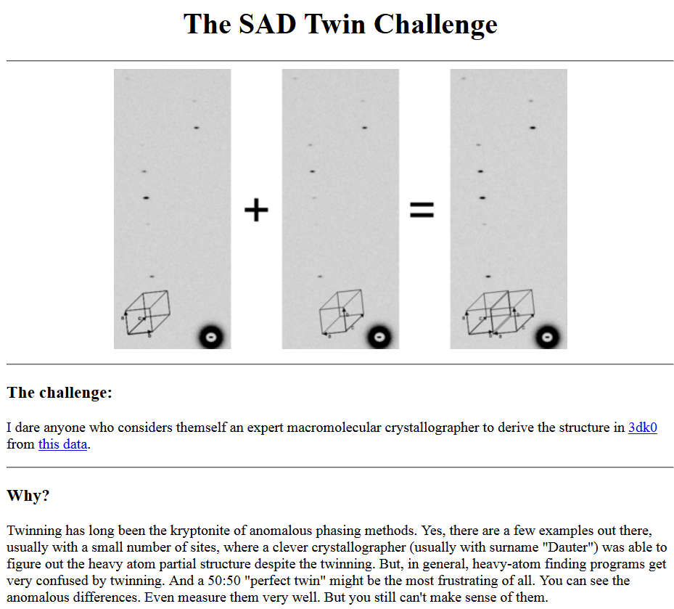

Slide 6
What is your problem?
Common stumbling blocks in structural biology
Structure won’t solve
Radiation damage
Solution: better detector
Solution: average over more sample
Resolution is too poor
Disorder – lattice, molecule, function
Solution: screening
R-factor is too high
Disorder – lattice, molecule, function
Solution: better models

Slide 7
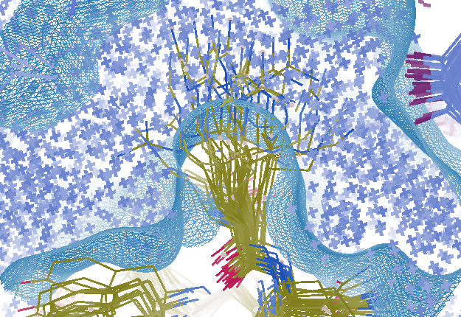
Minimal-complexity macromolecular model
R_{work} = 0.0309
R_{free} = 0.0678
vs F_{sim}
Problem: diverges with more cycles

Slide 8
“R-factor Gap” small vs macro molecules
Publication criterion for chemical crystallography:
R1 < 2*R_{sigma}
R1 = F_{o} vs F_{c} for I/σ(I) > 3
R_{sigma} = <σ(I)>/<I>
There are no PDB entries that pass this test!
Holton, Classen, Tainer (2014) "The R-factor gap", FEBS J. 281, 4046-4060.

Slide 9
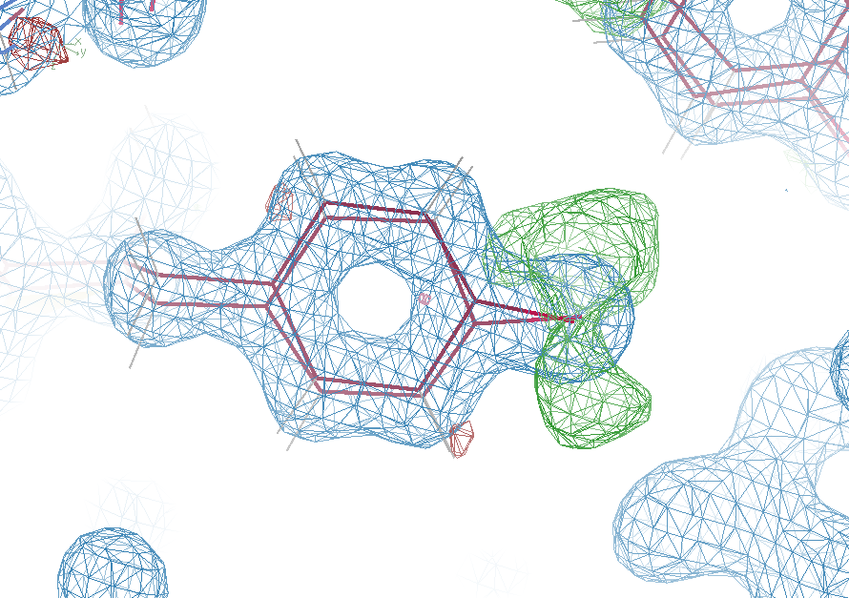
Why low R factors matter
0.5 electron
change
visible!
R_{work} = 0.0390
R_{free} = 0.0498

Slide 10
MGy reaction reference
~45 global damage Owen et al. (2006)
10/Å global damage Howells et al. (2009)
5 Se-Met Holton (2007)
4 Hg-S Ramagopal et al. (2004)
4 R-C-COOH Garman et al. (2015)
3 S-S Murray et al. (2002)
1 Br-RNA Olieric et al. (2007)
~1? Cl-C ???
0.5 Mn in PS II Yano et al. (2005)
0.06 putidaredoxin Corbett et al. (2007)
0.02 Fe in myoglobin Denisov et al. (2007)
Radiation Damage World Records
Holton (2009) J. Synchrotron Rad. 16 133-42

Slide 11
Specific damage
final, refined phases

Slide 12
Global damage
Howells, et al. (2009) J. Electron Spectrosc. Relat. Phenom. 170, 4-12.

Slide 13
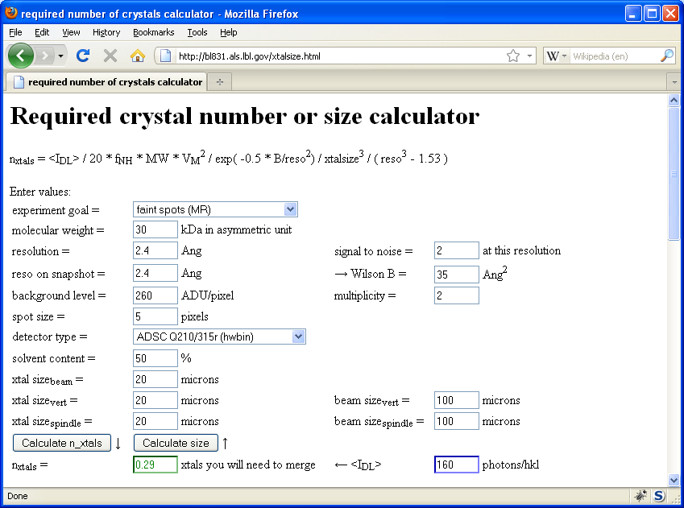
Will my experiment work?
Holton & Frankel (2010) Acta D 66 393-408.

Slide 14
ALS 8.3.1 – MX for IDAT
Hardware capabilities
Pilatus³ 6M = raster, shutterless, S-SAD
Upgraded mirror = 4.5X flux – 200 s datasets
Routine physiological temperature data collection
Universal sample compatibility
BLU-ICE: Software collaboration with SLAC
shutterless, raster, helical, automation
GPU-based image interpretation & simulation
Robust multi-crystal merge
Data management
Eternal image archive (LTO6, USB3, NetApp)
Retrospective data analysis = steers methods dev

Slide 15
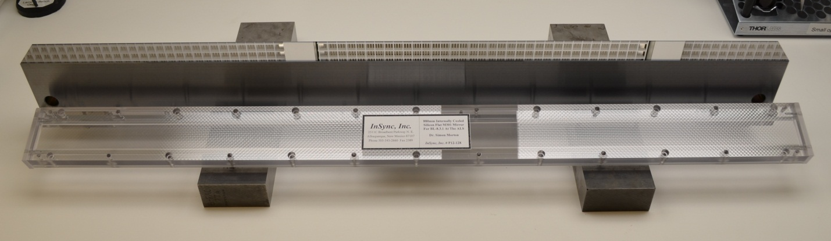
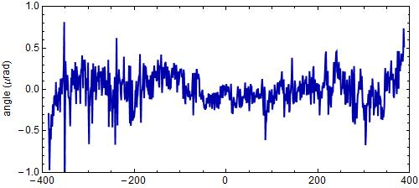
“The flattest thing we have ever seen”
- LBNL Metrology Group
Old mirror: 800 nRad
New mirror: < 200 nRad
Dec 17 2014
Flux at
460%

Slide 16
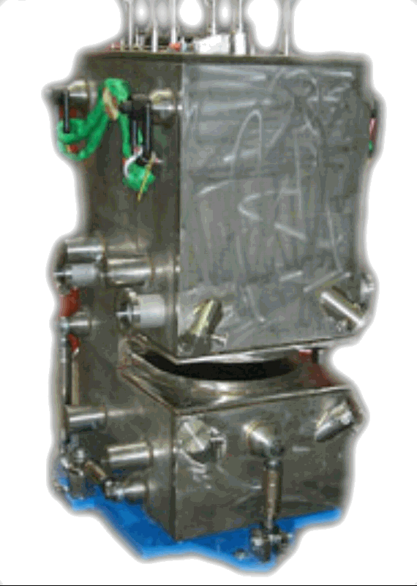
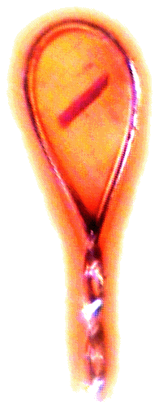
ALS 8.3.1 / 12.3.1 optics
Superbend
pinhole
Scatter
guard
Plane
Parabolic
mirror
Torroidal
mirror
Dectris Pilatus3 6M
divergence
slits
Si(111)
monochromator
Protein Crystal
MacDowell et. al. (2004) J. Sync. Rad. 11 447-455
Notes:
Most notable acheivements are high brightness with very little “wasted” light. The discovery made by Howard Padmore? At ALS showed that a 2:1 demagnification cancels nearly all of the spherical abberations in the parabolic/torroid system. 30-50% of the total x-ray intensity passes through the 100um pinhole. The flux through the 100um pinhole at the superbend beamlines is comparable to that of the 5.0.2 wiggler or an APS bending magnet, but only 150 Watts of power must be dissipated by the beamline optics. In contrast, wiggler beamlines must disipate kilowatts. The optics here are much simpler and not exotic in any way. The system is stable and robust. There is never a need to re-focus the beam at a new wavelength. Only a 2-minute automatic tuneup is recommended for very large energy changes (more than 1-2 keV).

Slide 17
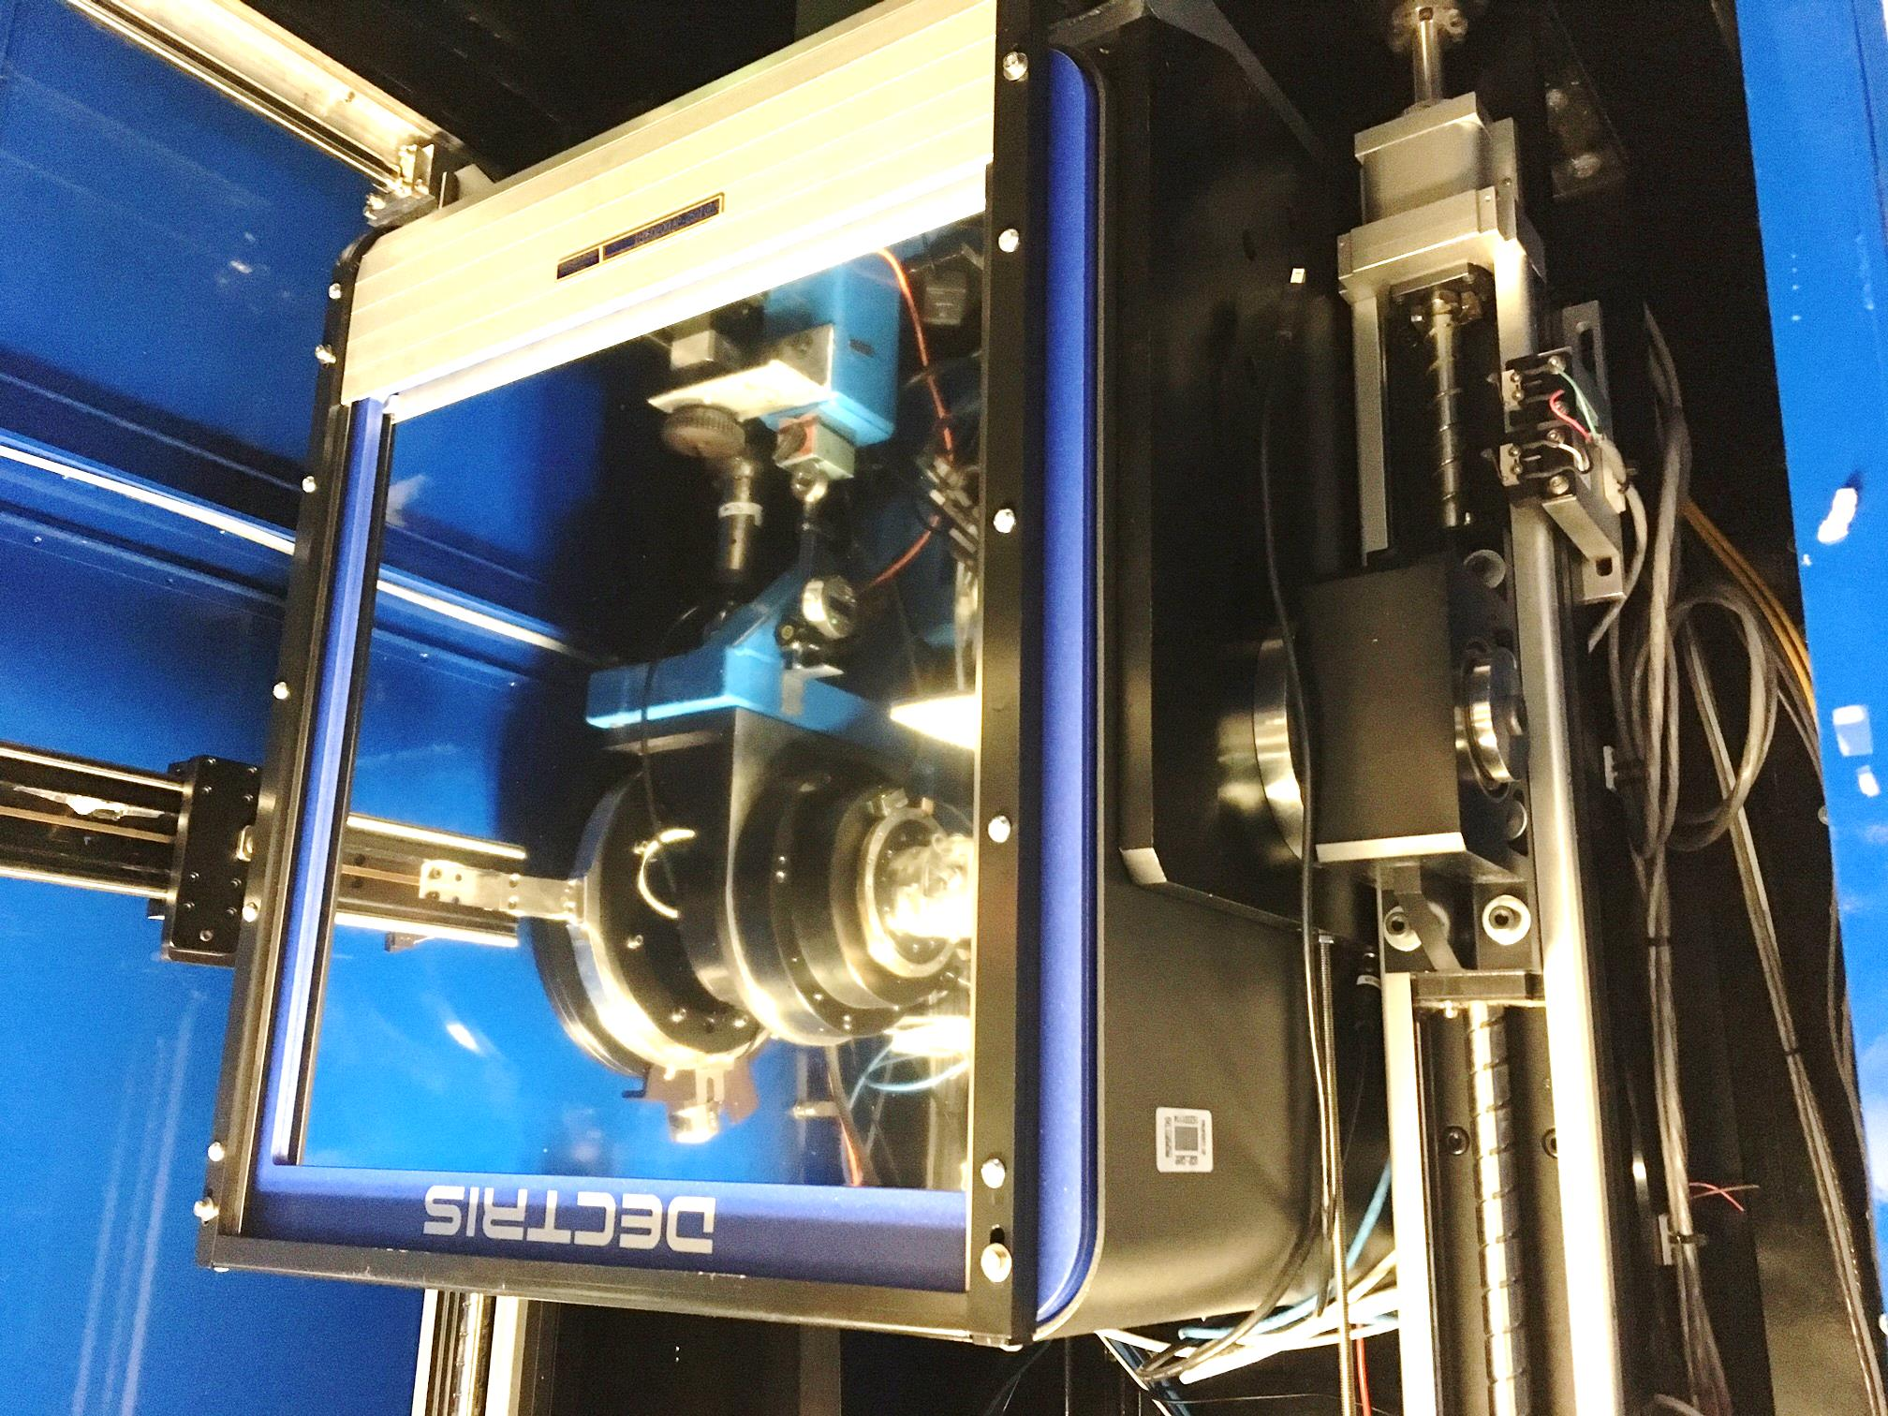
Pilatus³ S 6M
Pixel Array
Detector
6x10⁶ pixels
$0.15/each
Single-photon
counting
25 Hz images

Slide 18
ALS 8.3.1 data collection history
images x 10⁶

Slide 19
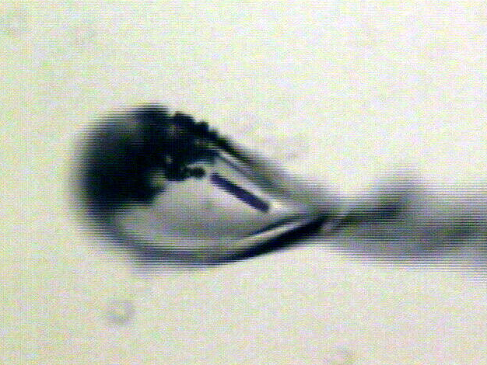
Shutterless rastering now available
X-ray beam
ice
Membrane
protein crystal

Slide 20
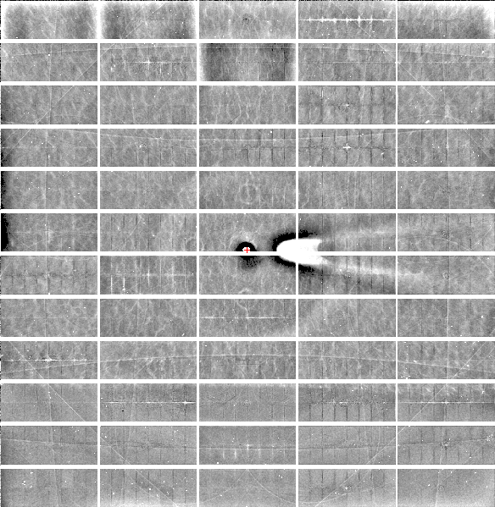
Relative Pixel
Calibration
ALS 8.3.1
Pilatus3 6M
0.9793 Å x-rays
RMS = 0.8%
1% high
average
1% low

Slide 21
S-SAD merging 20 xtals
Knott et al. (2017). "Guide-bound CRISPR-Cas13a." Nature S&MB 24: 825

Slide 22
Multi- micro crystal challenge
5 µm xtals
5 µm beam
~ 5 img / xtal
P2₁2₁2₁
XDS thinks:
P422
http://bl831.als.lbl.gov/~jamesh/challenge/microfocus/

Slide 23
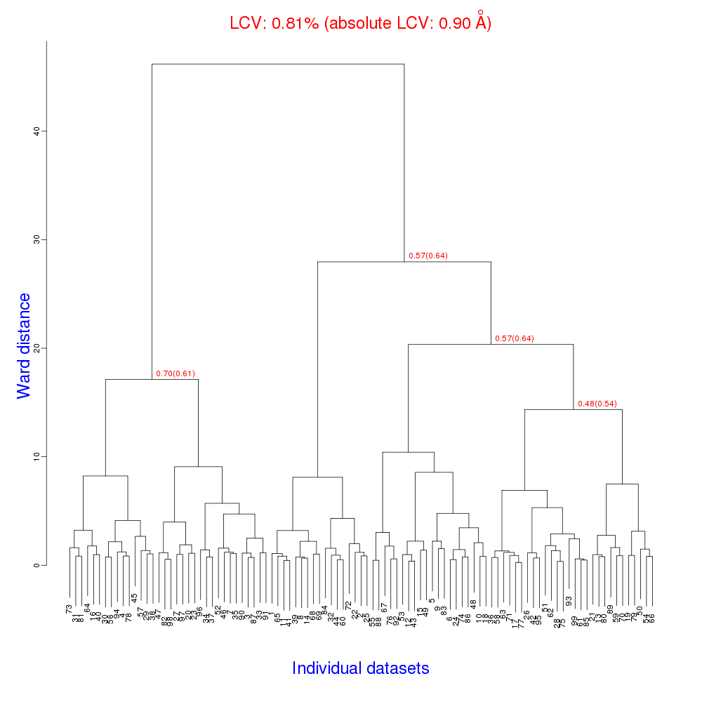
Cell clustering: 100 datasets
Reality:
Perfect isomorphism
(simulated data)

Slide 24
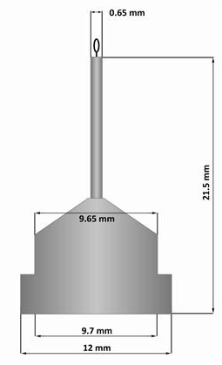
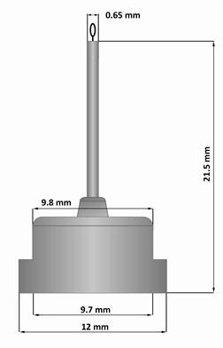
Pin compatibility
SLAC
ALS
SPINE

Slide 25
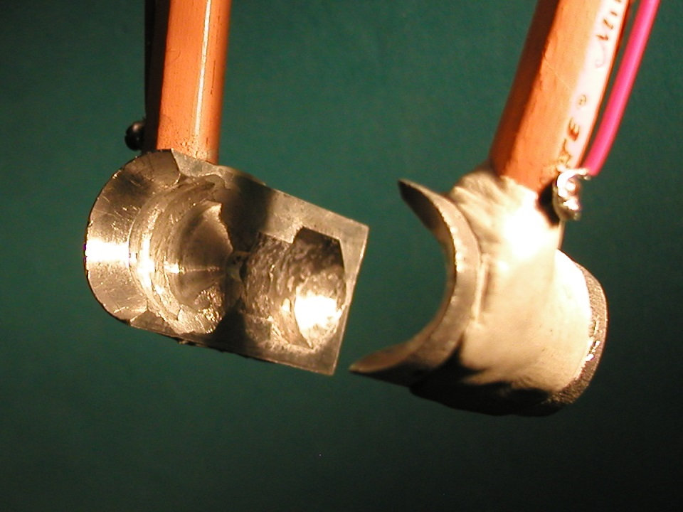
SuperTong

Slide 26
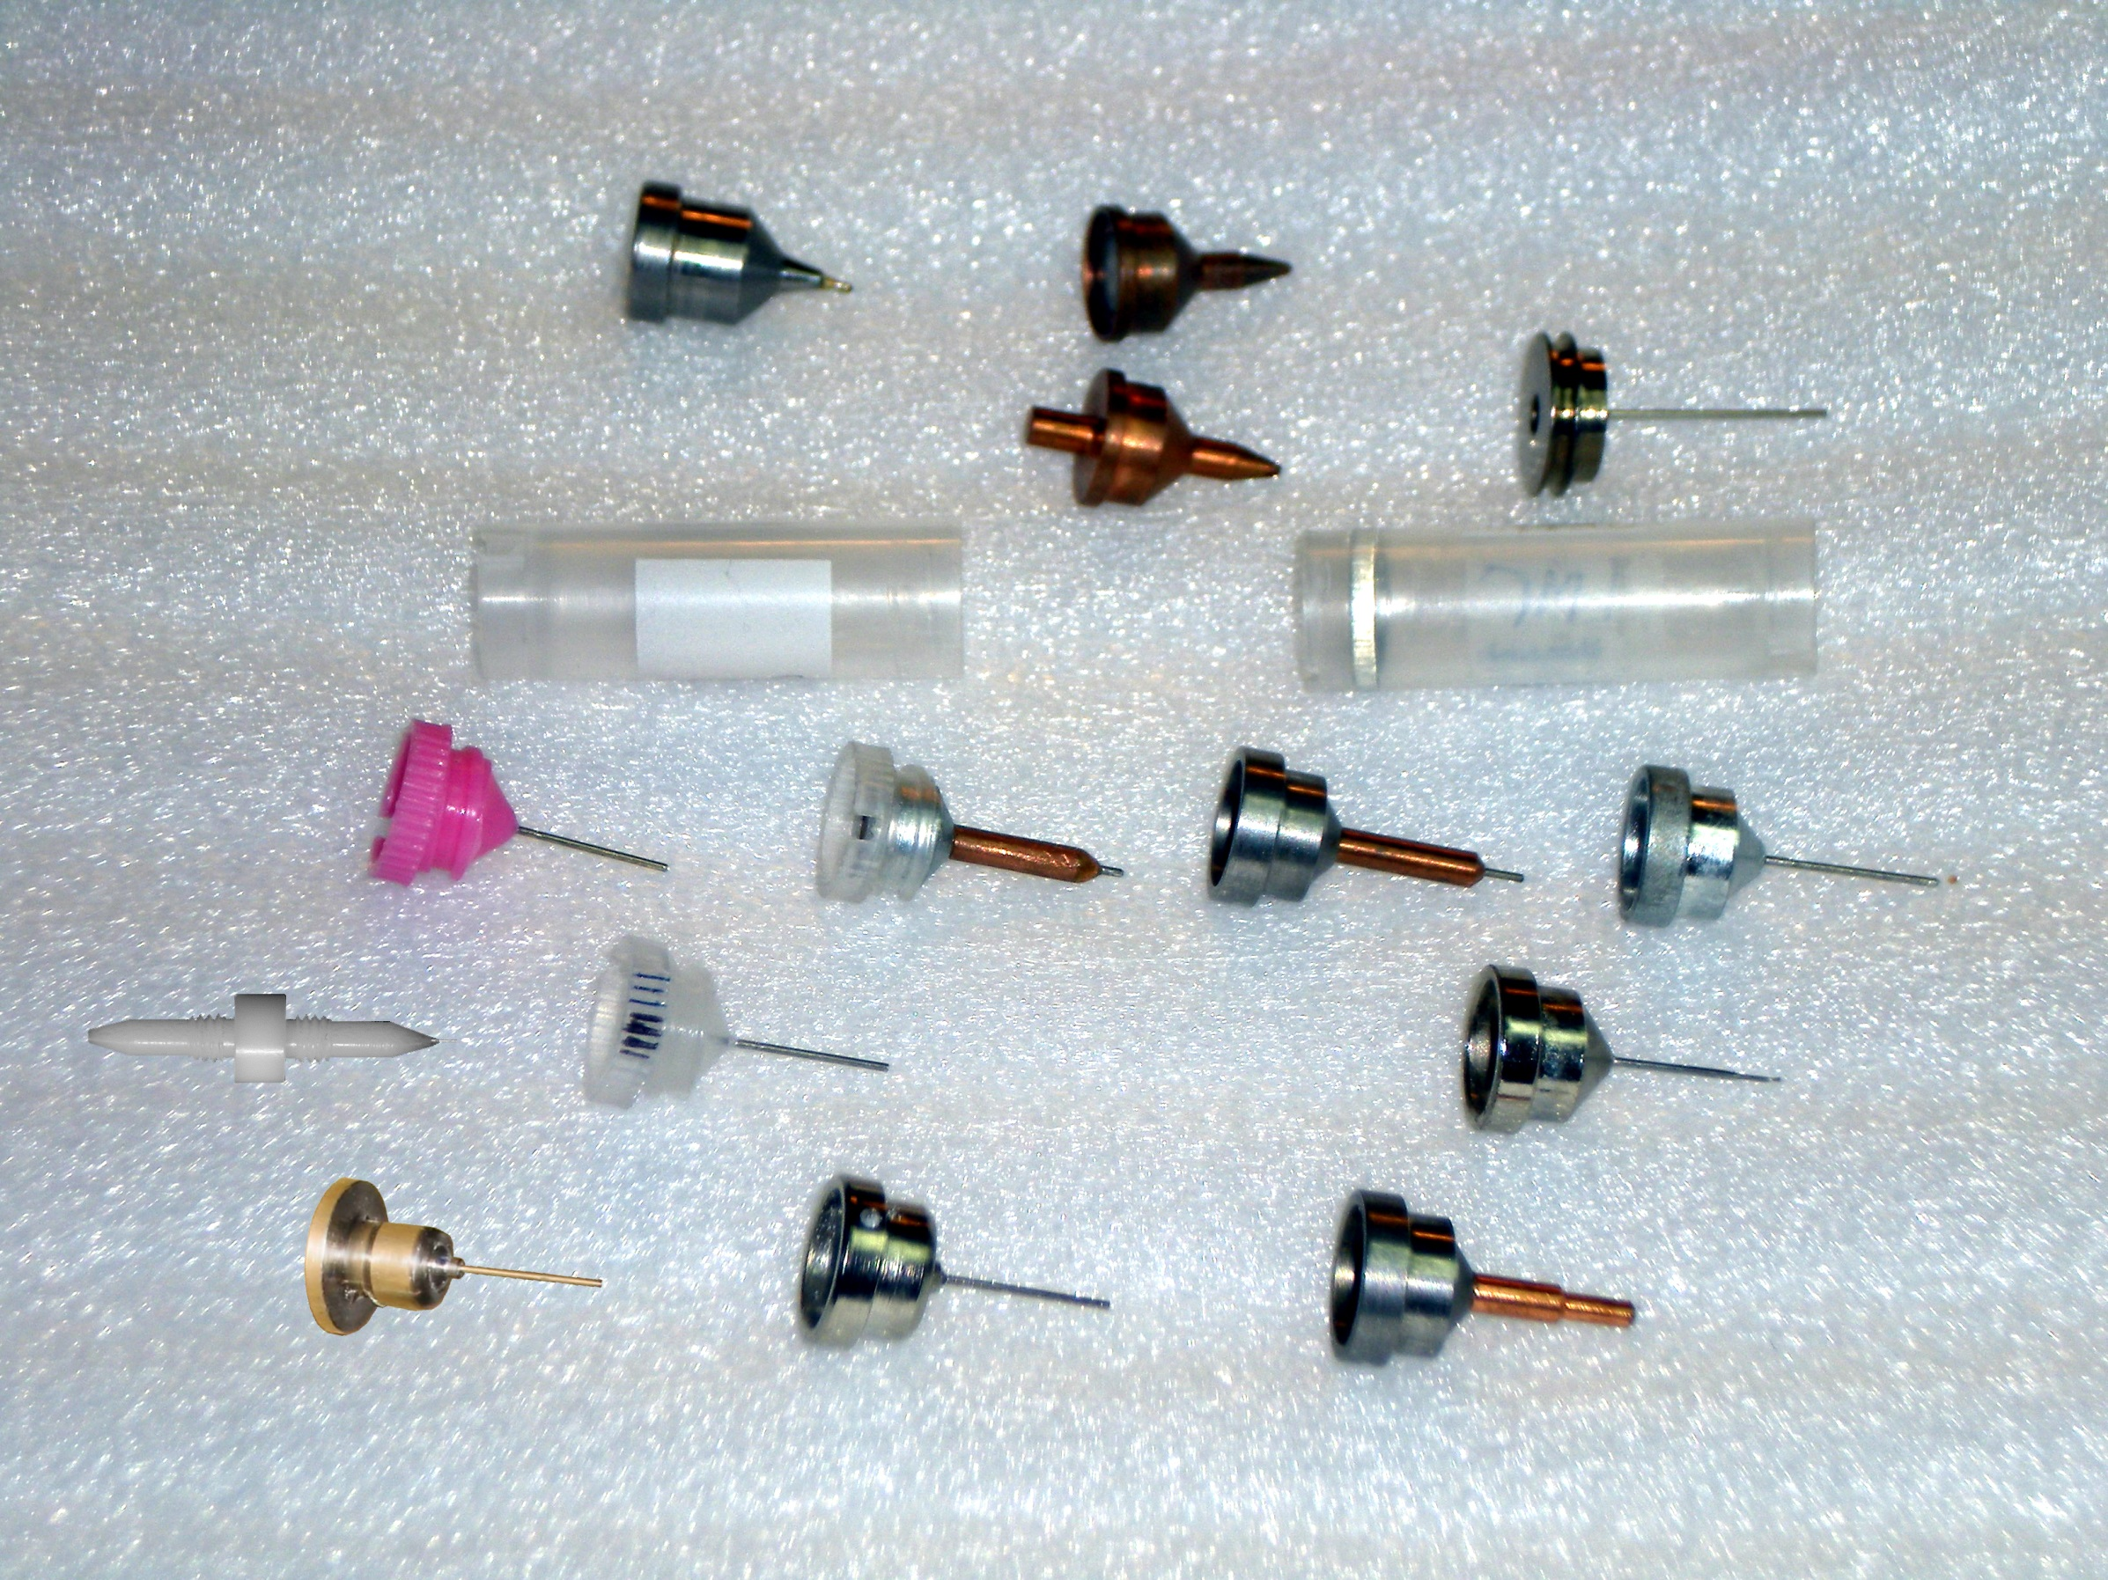
Broad compatibility fosters collaboration
Caltech
SSRL
Yale
Hampton screw cap
Hampton magnetic
H. colored
H. copper
H. magnetic
H. hybrid
H. screw cap
Syrrx
SPring-8
Oxford
SPINE
MiTeGen RT

Slide 27
“infinite capacity” sample carousel

Slide 28
SBS
format
crystallization
tray
mirror
pinhole
microscope
Notes:
Inspired by the ESRF microcrystal camera, the superbend endstations are all equipped with zero-paralax optics. The user sees their sample from the point of view of the x-ray beam. Sample alignment is not only more stable but more intuitive than an off-axis camera. Placing the crystal into the microscope crosshairs gaurantees that it will be hit by the beam.

Slide 29
in-situ diffraction trays
~50 μm tape
~50 μm tape
~50 μm tape
PDMS
PDMS
250 μm
100 μm
25 μm
200 μm
1000 μm
Fluidigm
Topaz® DC
Microlytic
Crystal Former™
NatX-ray
CrystalQuick™ X
MiTeGen
in-situ-1
CrystalDirect
Notes:
Next slide please

Slide 30
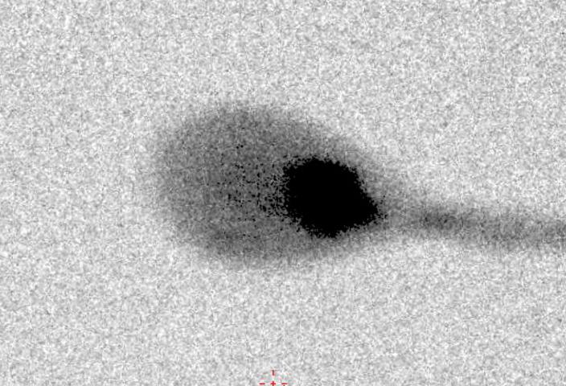
Inline x-ray radiography
X-ray

Slide 31
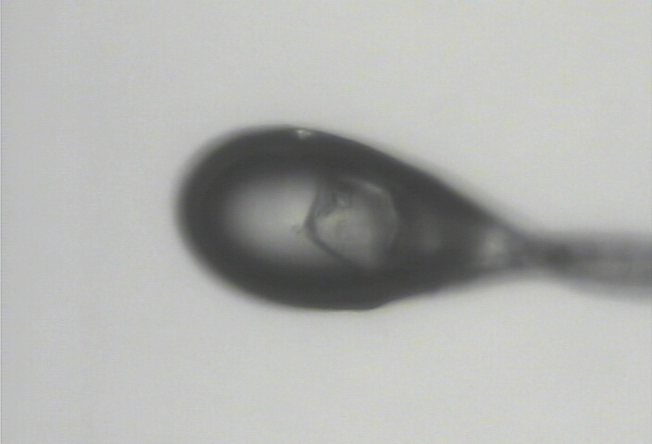
Inline x-ray radiography
visible light

Slide 32
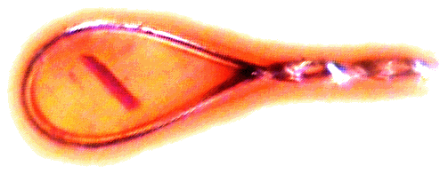
Automatic and Unattended Optical Re-Alignment (AUORA)
~12 s mount→shutter Accuracy: ~2 pix ~1-2 °

Slide 33
Solving the problems:
fast, accurate & big detector
optimal dose rate for room temperature
Broad sample holder compatibility
Rastering: robust crystal centering
CBOXAR: X-ray contrast to find crystal
AUORA: key to inter-beamline migration
First-principles simulators of diffraction
robust multi-crystal combination

