Slide 1
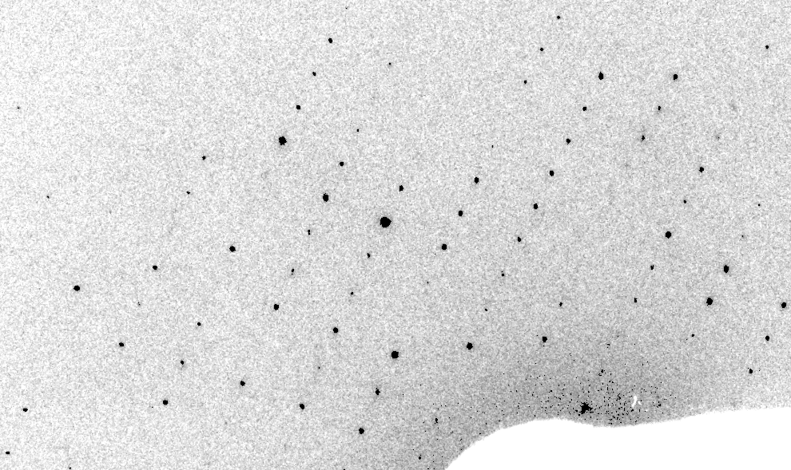
Real XFEL still
Lyubimov et al. (2016).
eLife 5, e18740.

Slide 2
XFEL: “fit” simulation to reality
Dispersion
Divergence
Mosaicity
Wavelength
Unit cell parameters (3)
Crystal orientation (3)
Mosaic domain size (3)
Beam center (2)
Beam direction (2)
Detector distance

Slide 3
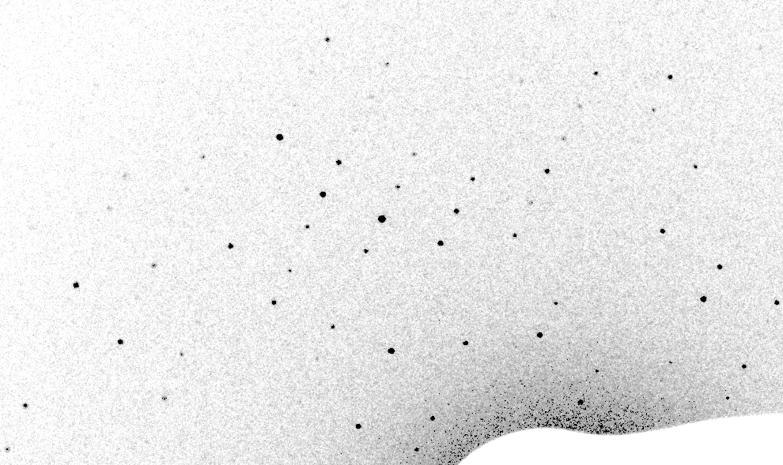
Simulation of XFEL still
Lyubimov et al. (2016).
eLife 5, e18740.

Slide 4
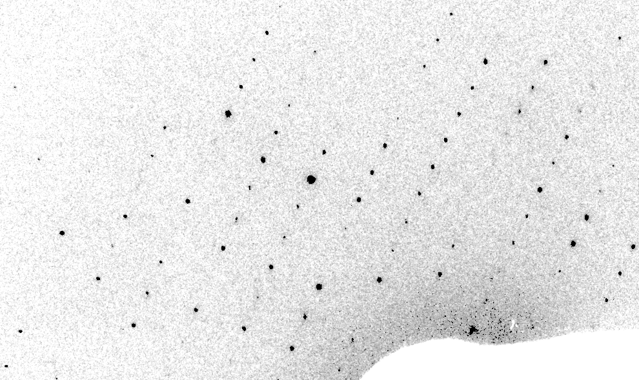
Real XFEL still
Lyubimov et al. (2016).
eLife 5, e18740.

Slide 5
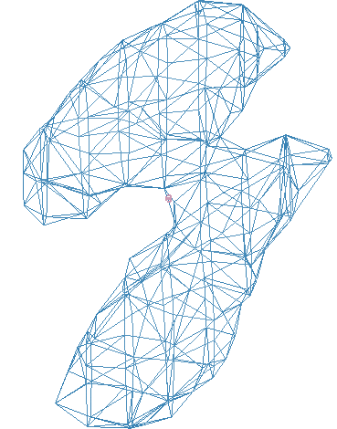
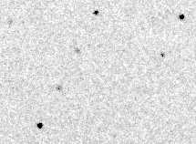
Simulation of XFEL still
phix
phiy
phiz
real
VS
phix
phiy
phiz

Slide 6
Fitting individual “mosaic domains”
Fraction pixels predicted
Best of
262,140 trials
Angle about y axis (°)

Slide 7
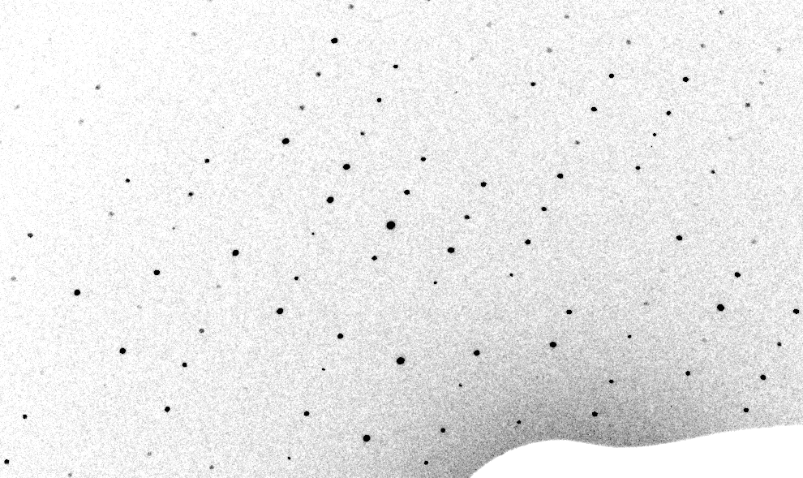
3-domain Simulation of XFEL still

Slide 8
Real XFEL still
Lyubimov et al. (2016).
eLife 5, e18740.

Slide 9
1-domain Simulation of XFEL still

Slide 10
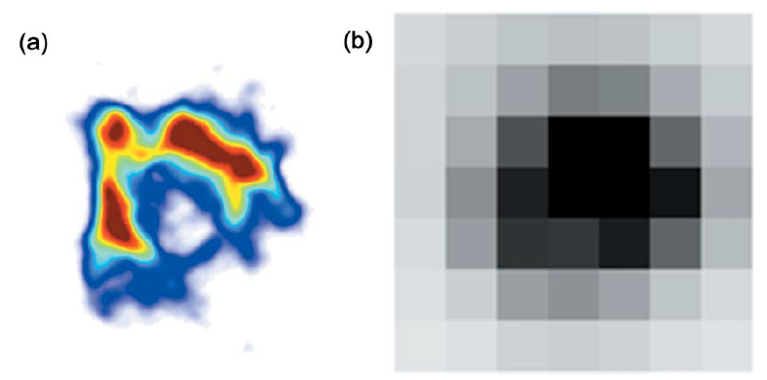
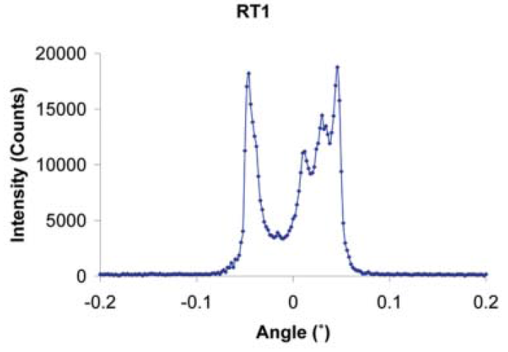
The true nature of “mosaic spread”
Any function can be approximated by a family of Gaussians
Lovelace JJ, Murphy CR, Pahl R, Brister K & Borgstahl GEO (2006)."Tracking reflections through cryogenic cooling with topography", J. Appl. Cryst. 39, 425-432.

Slide 11
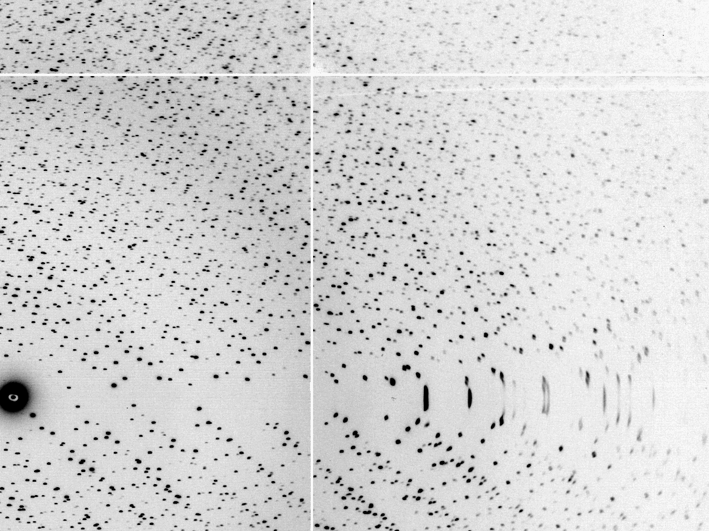
The “Lorentz zone”

Slide 12
Coming Soon in CCTBX / DIALS!
At-scale simulation coupled to
data processing
https://github.com/cctbx

Slide 13
Optimum resolution cutoff is:
Too optimistic: add nothing but noise
Too pessimistic: series-termination error
Happy medium?
Simulate:
  Random atoms, compute F²
  Add Gaussian noise, RMS = 1
  Truncate
  Subtract “right” map, RMS difference

Slide 14
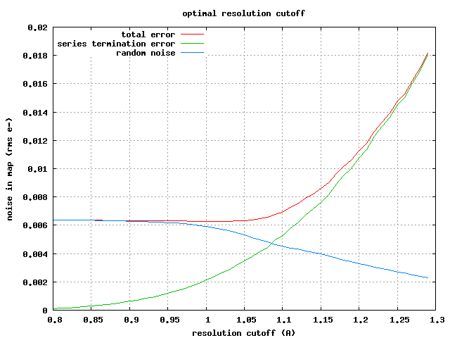

Slide 15
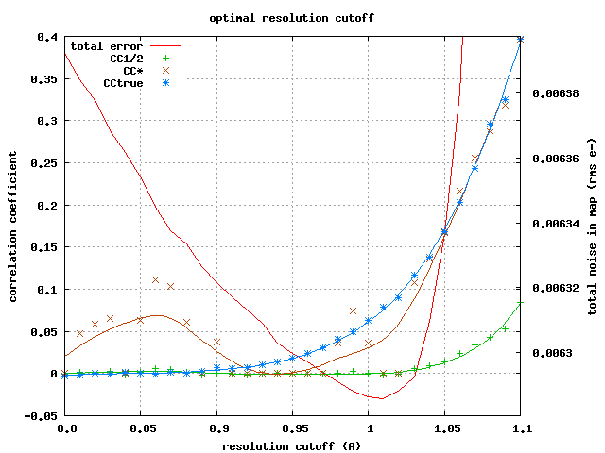

Slide 16
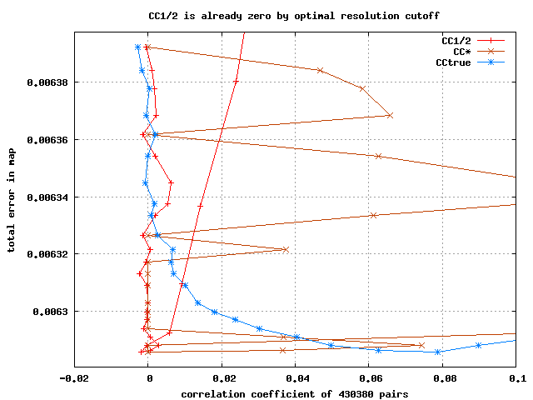

Slide 17
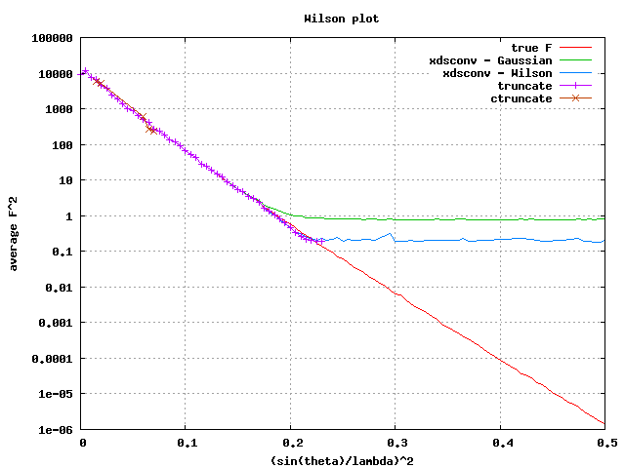

Slide 19
Optimum resolution cutoff is:
0.0 Å

Slide 20
What if…
You only have a few small crystals?
Should you:
  Collect 360° from each?
  Collect 10° from each at 36x exposure?
  Glue 36 xtals together, then collect 360° ?
  Glue together and do 12960° ?
  http://bl1231.als.lbl.gov/~jamesh/dose_slice/results.html

Slide 21
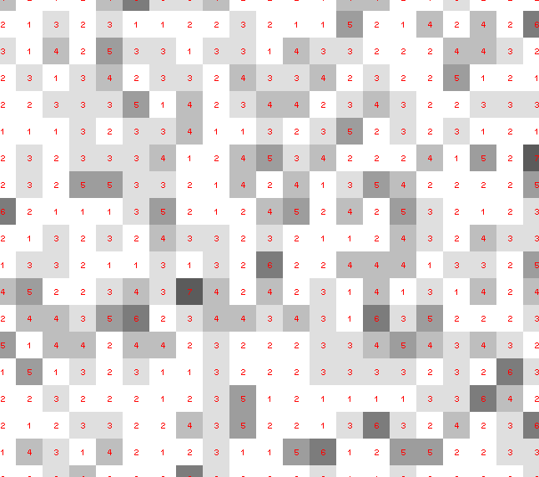
Dose slicing: is that a spot?

Slide 22
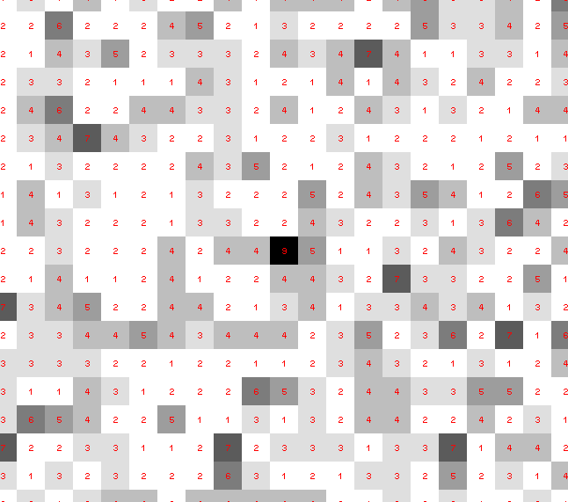
Dose slicing: is that a spot?

Slide 23
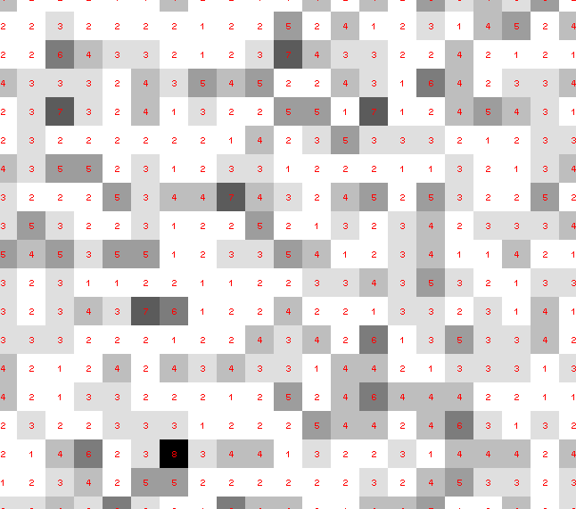
Dose slicing: is that a spot?

Slide 24
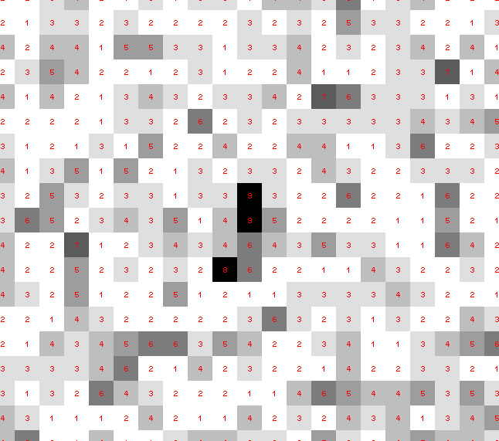
Dose slicing: is that a spot?

Slide 25
Dose slicing: is that a spot?

Slide 26
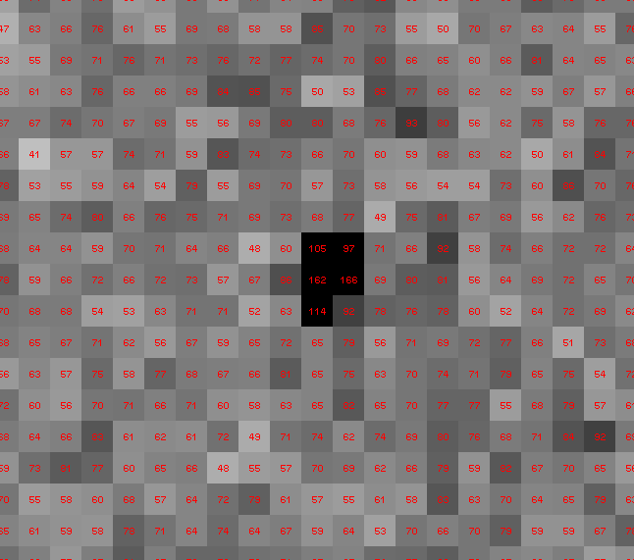
Dose slicing: is that a spot?

Slide 27
“true” resolution limit
CC vs right answer
Resolution (Å)

Slide 28
“true” resolution vs strategy
Dose slice collection scenario
fine | coarse | glue | Glue & fine
3.17700 | 3.14057 | 3.17604 | 3.12086
301,640,334 photons/xtal

Slide 29
processing procedure | resolution limit
 | fine | coarse | glue | glue&fine
XDS/XSCALE | 3.17700 | 3.14057 | 3.17604 | 3.12086
XDS/aimless | 3.16251 | 3.15922 | 3.16675 | 3.12162
XDS/noscale | 3.27289 | 3.15617 | 3.38929 | 3.12162
MOSFLM-defaults | x | x | x | x
MOSFLM-cheat | 3.19755 | 3.18166 | 3.20354 | 3.19755
HKL2000-defaults | x | x | x | x
HKL2000-expert | 3.21803 | 3.12646 | 3.11551 | 3.21803
HKL2000-cheat | 3.16119 | 3.10338 | 3.10338 | 3.16300
DIALS-defaults | x | x | 3.42125 | x
DIALS-expert | 3.10296 | 3.09547 | 3.07653 | 3.08465
d*Trek | ? | ? | 4.34076 | ?
EVAL15 | 3.14352 | 3.10383 | 3.09936 | 3.14105
EVAL15-sadabs | 3.13920 | 3.10797 | 3.10171 | 3.13700

