Slide 1
Acknowledgements
Robert Stroud James Fraser Paul Adams John Tainer
Chris Nielsen Clemens Schulze-Briese Aina Cohen Ana Gonzalez
UCSF LBNL SLAC
ALS 8.3.1: TomAlberTron
UC Multicampus Research Programs and Initiatives (MRPI)
NIH NIGMS R01 GM124149
NIH NIGMS P50 GM082250
NIH NIGMS P30 GM124169
Integrated Diffraction Analysis Technologies (IDAT)
Plexxikon, Inc.
Synchrotron Radiation Structural Biology Resource (SLAC)
The Advanced Light Source is supported by the Director, Office of Science, Office of Basic Energy Sciences, Materials Sciences Division, of the US Department of Energy under contract No. DE-AC02-05CH11231 at Lawrence Berkeley National Laboratory.

Slide 2
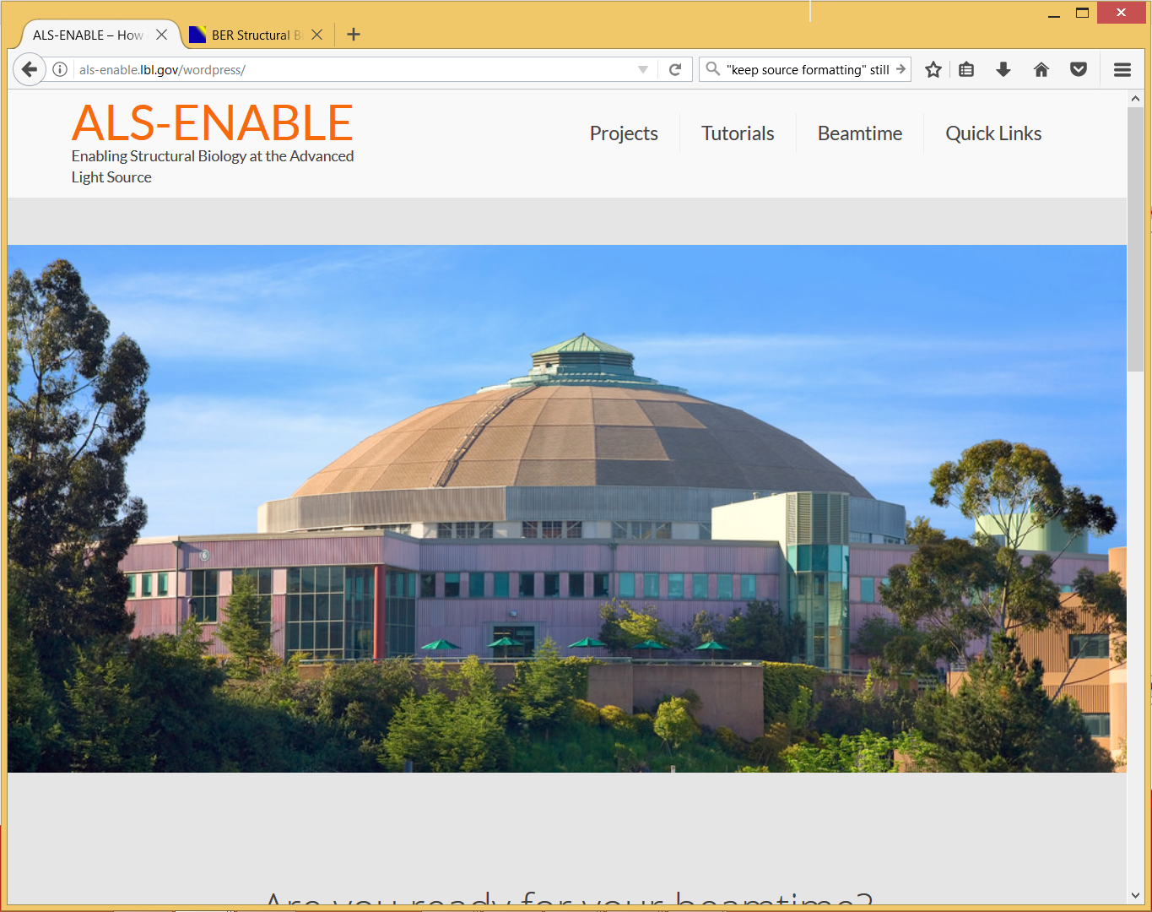
als-enable.lbl.gov

Slide 3
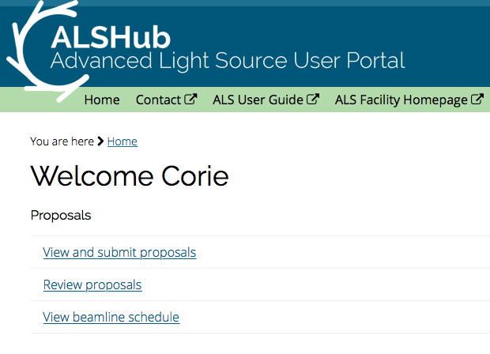
ALS-ENABLE site and data access
Applying for beamtime
Data archiving
Data portal

Slide 4
ber
structural
bio
portal.org

Slide 5
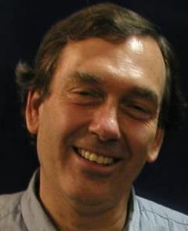
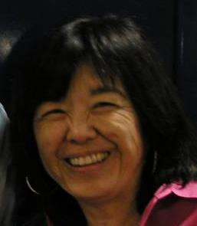
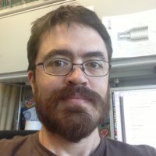
What is ALS Beamline 8.3.1 ?
Macromolecular Crystallography (MX)
MAD, 1x10¹² ph/s, Pilatus 6M
Technology development
Room temp, Elves, multi-crystal
Staff: Holton, Meigs, Tanamachi, Classen
Landmark and highly productive facility
1st ALS SuperBend beamline – constructed 2001
1 of 10 in USA with >1000 PDBs/10 years running
Others: 2 at SSRL, 7 at APS
8% of all membrane protein structures
996 distinct users from 57 institutions
1511 structures, 636 pubs, 227 high-impact
Meigs
Tanamachi
Classen
Notes:
ALS 8.3.1 is a very productive facility. Our focus is on maximizing efficiency of the user experience.
The MRPI funds are not just to maintain this facility, but to upgrade it. The new detector is 50x faster, more sensitive and more accurate than the existing detector, and an optics upgrade will match these capabilities.
We will exceed the modern standard of screening and data collection by offering completely automated mail-in raster-based screening
This will position ALS 8.3.1 as the centerpiece of structural biology for the UC system

Slide 6
It’s Official

Slide 7
8.3.1 Recent Improvements
Dectris Pilatus3 6M installation - May 2016
25 Hz framing, 2 ms dead time, previously 0.3 Hz
0.8% calibration error, previously 2.5%
Complete control system update
Shutterless data collection
“Rastering” automated sample alignment
Screening Tab workflow for efficient sample evaluation
Coming soon: Raster centering for unattended operation
Overhaul of data archiving infrastructure
LTO4 to LTO6, support USB3 user hard drives
First remote data collection – Apr 2017

Slide 8
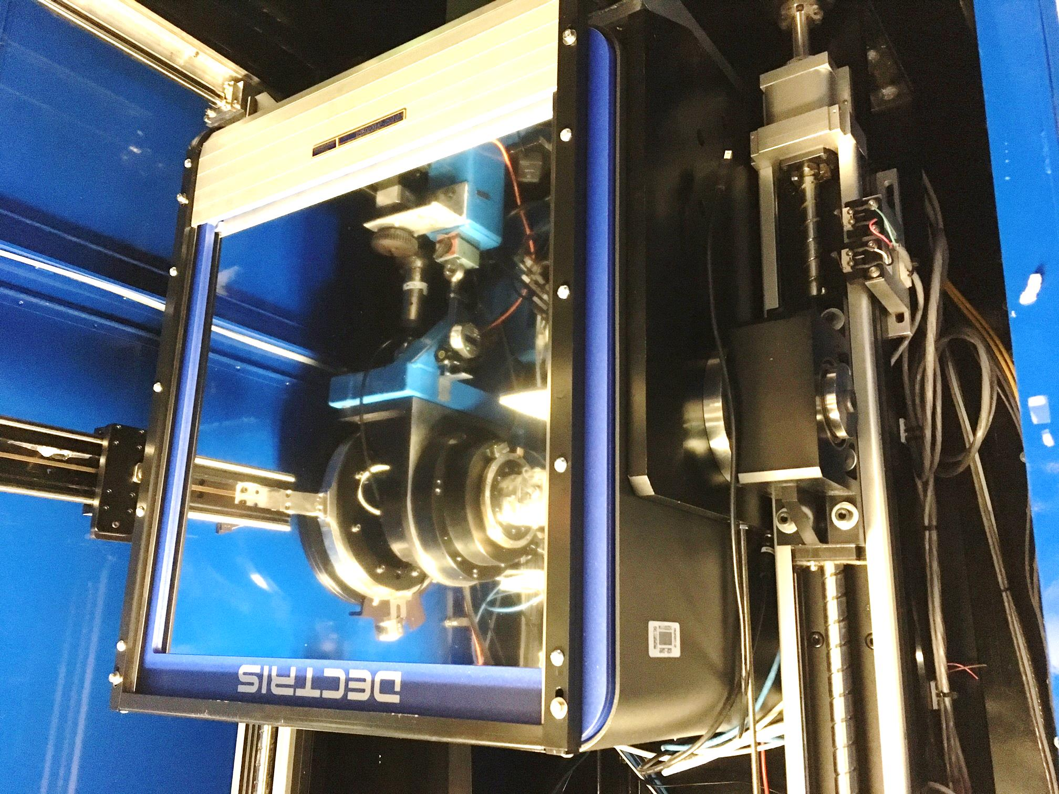
Pilatus³ S 6M
Pixel Array
Detector
6x10⁶ pixels
$0.15/each
Single-photon
counting
25 Hz images

Slide 9
ALS 8.3.1 data collection history
images x 10⁶

Slide 10
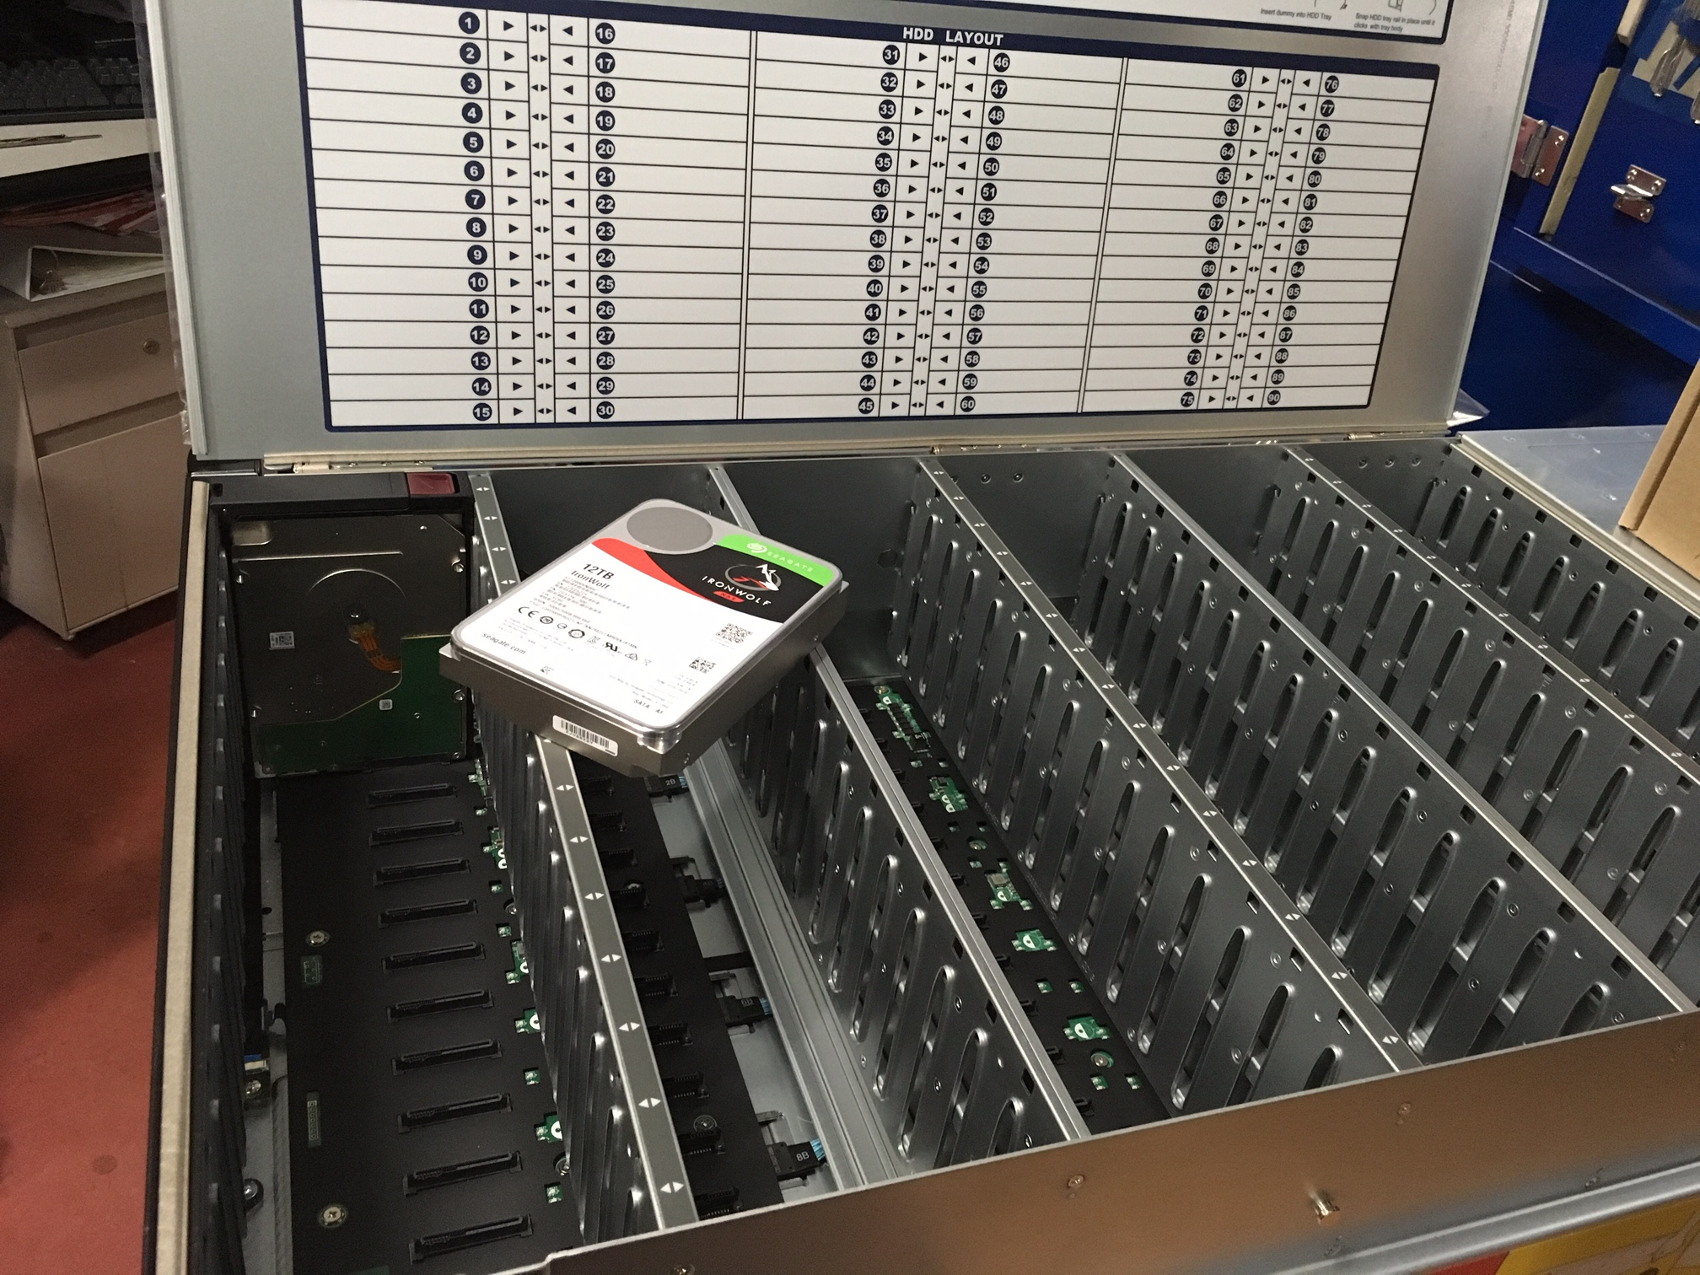
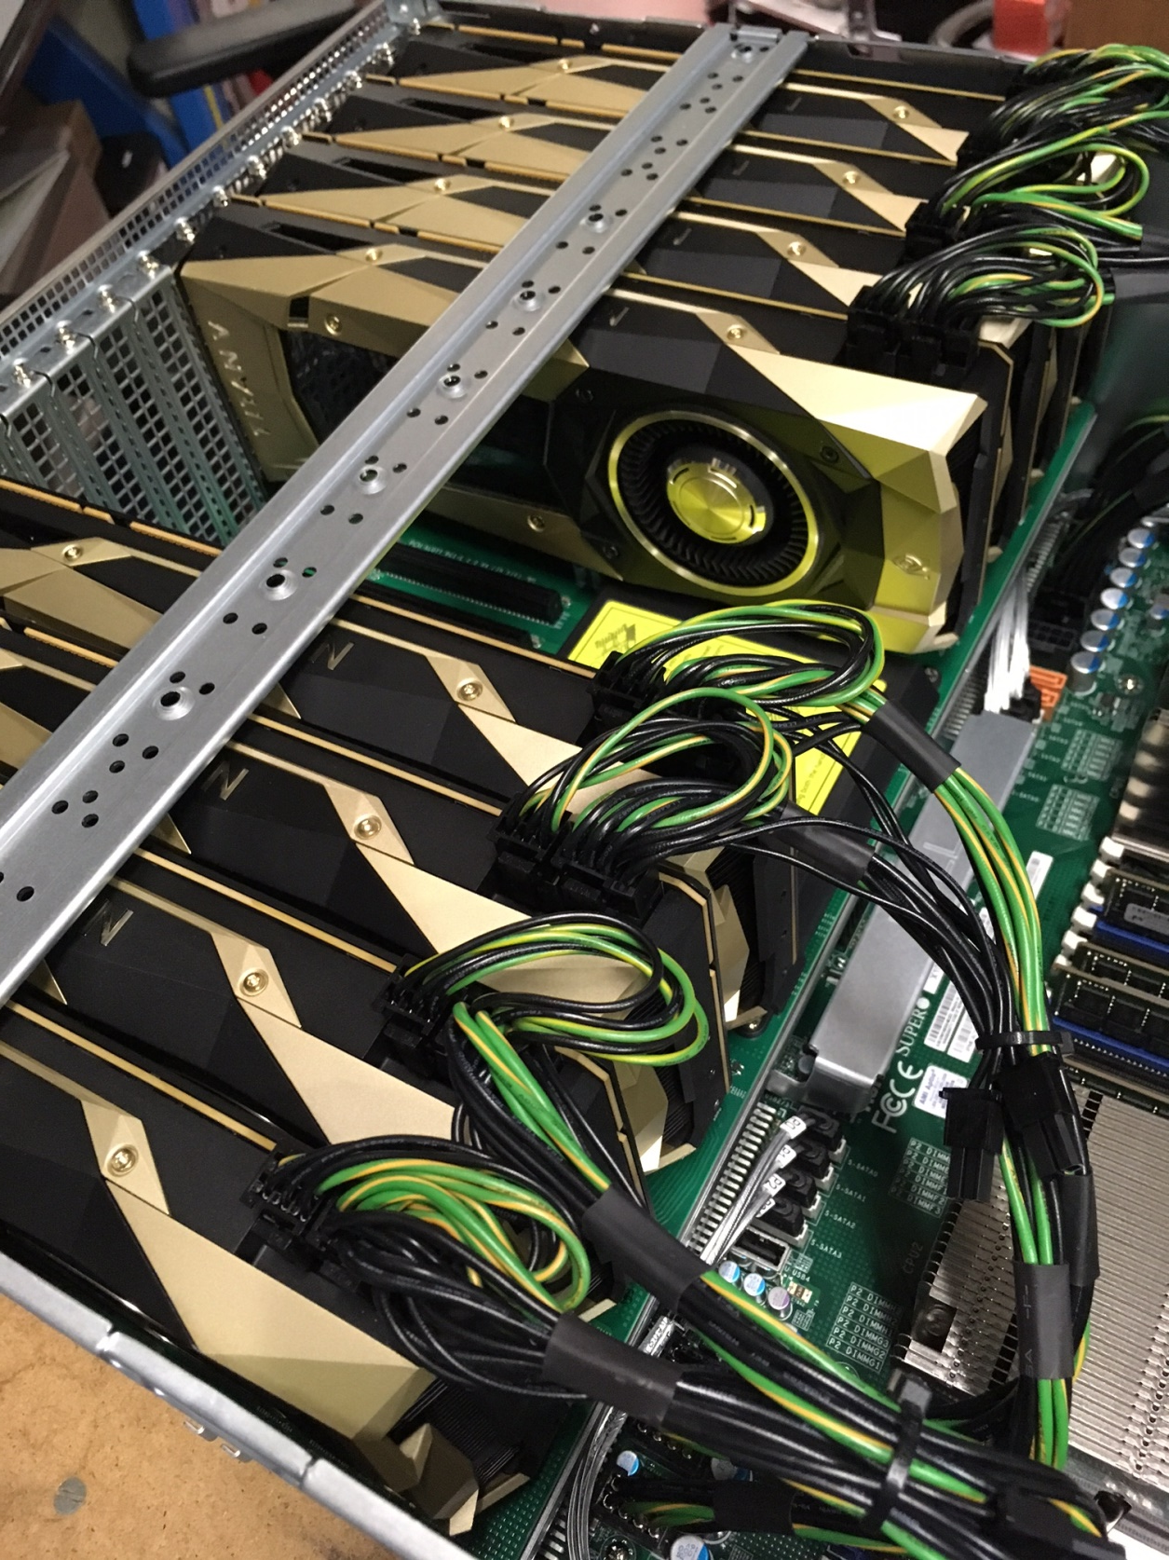
“petabyte”
voltron

Slide 11
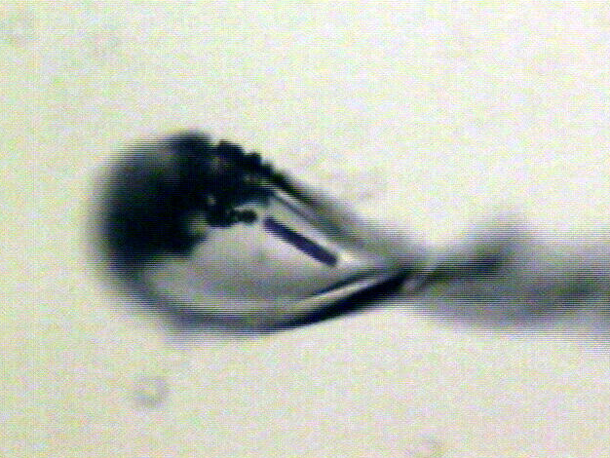
Shutterless rastering now available
X-ray beam
ice
Membrane
protein crystal

Slide 12
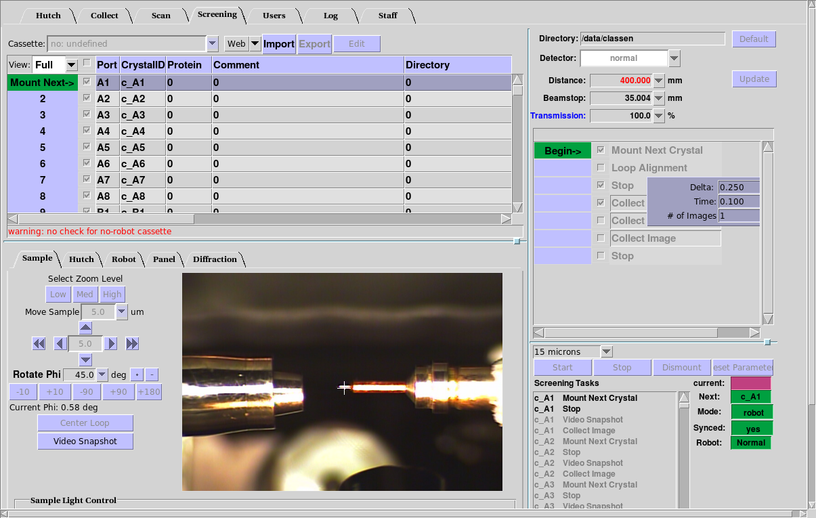
BLU-ICE “screening tab” ready for testing

Slide 13
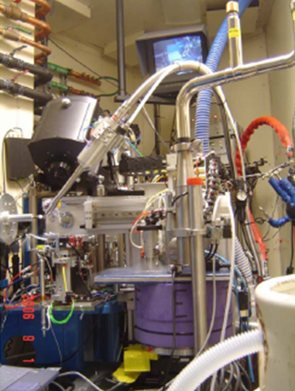
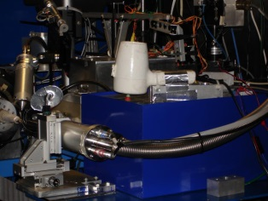
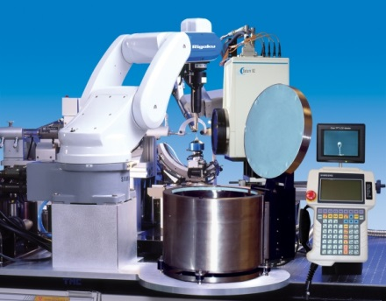
ALS robots
8.2.1
ACTOR
Berkeley
Auto-
Mounter
8.2.2
8.3.1
Cool Hand Luke
5.0.2
5.0.3
5.0.1
MBC 4.2.2
ACTOR
ALS MX robots
Stanford
Auto-
Mounter
12.3.1 SIBYLS

Slide 14
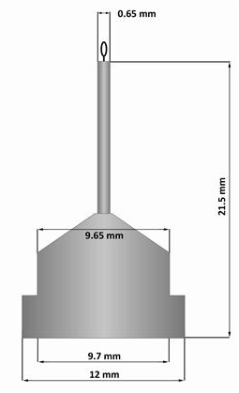
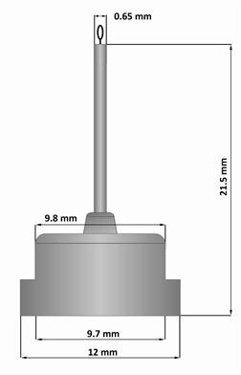
Pin compatibility
SLAC
ALS
SPINE

Slide 15
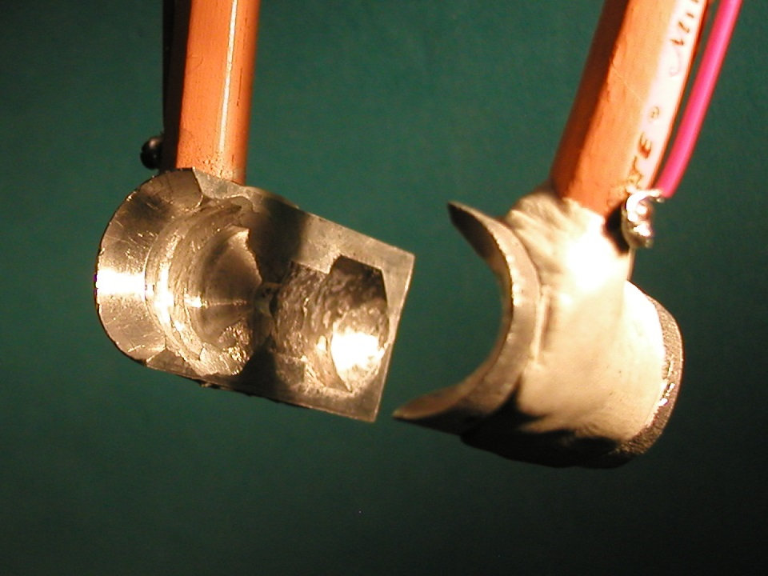
SuperTong

Slide 16
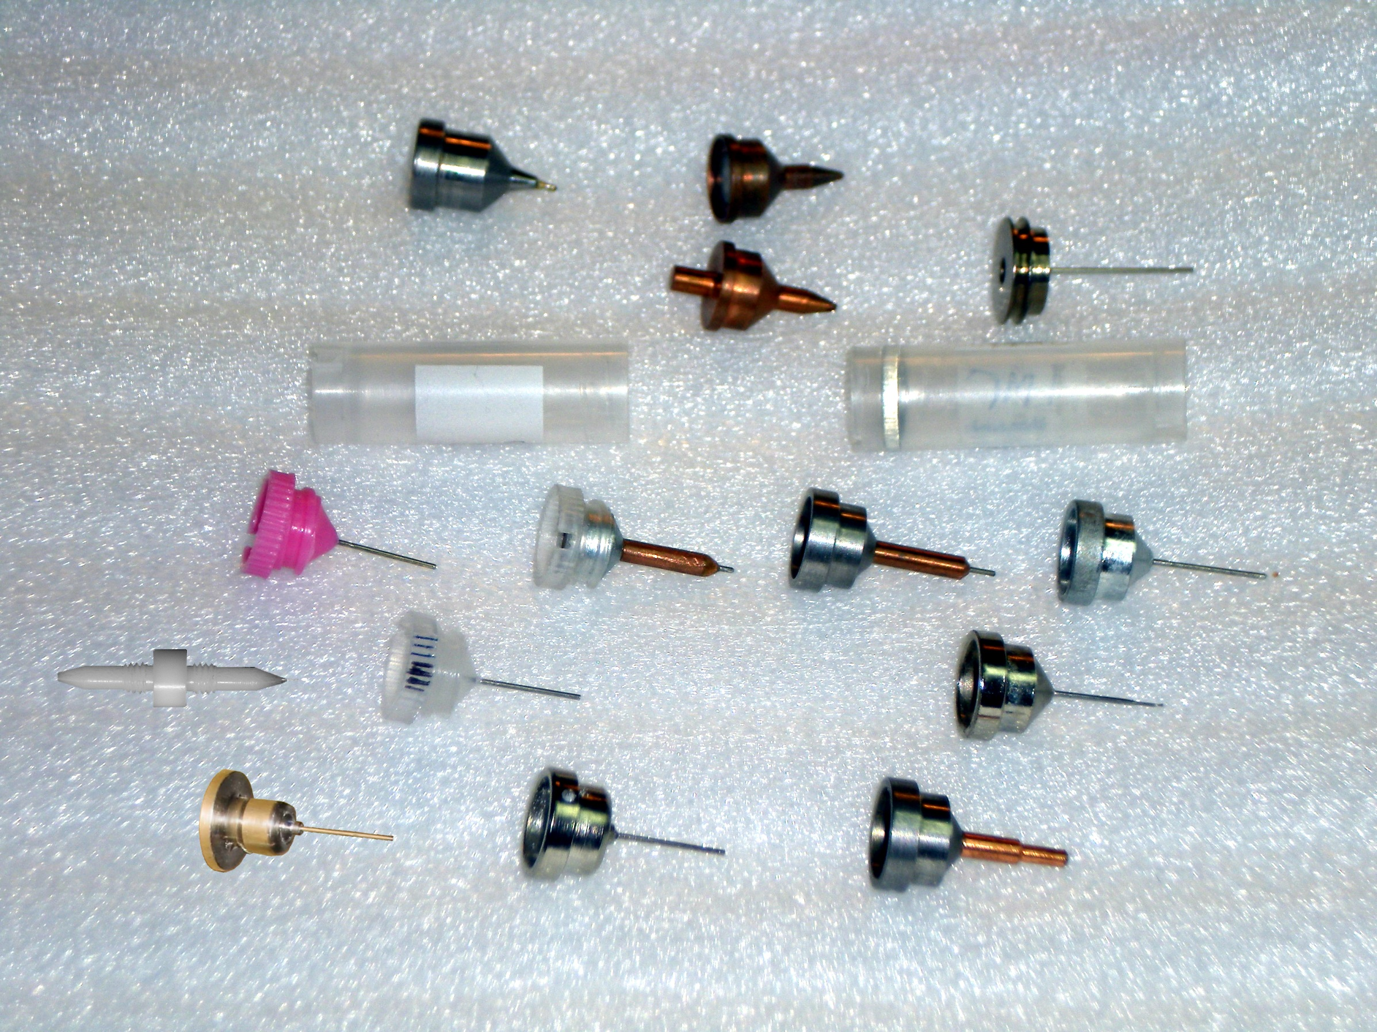
What if we didn’t have to choose?
Caltech
SSRL
Yale
Hampton screw cap
Hampton magnetic
H. colored
H. copper
H. magnetic
H. hybrid
H. screw cap
Syrrx
SPring-8
Oxford
SPINE
MiTeGen RT

Slide 17
“infinite capacity” sample carousel

Slide 18
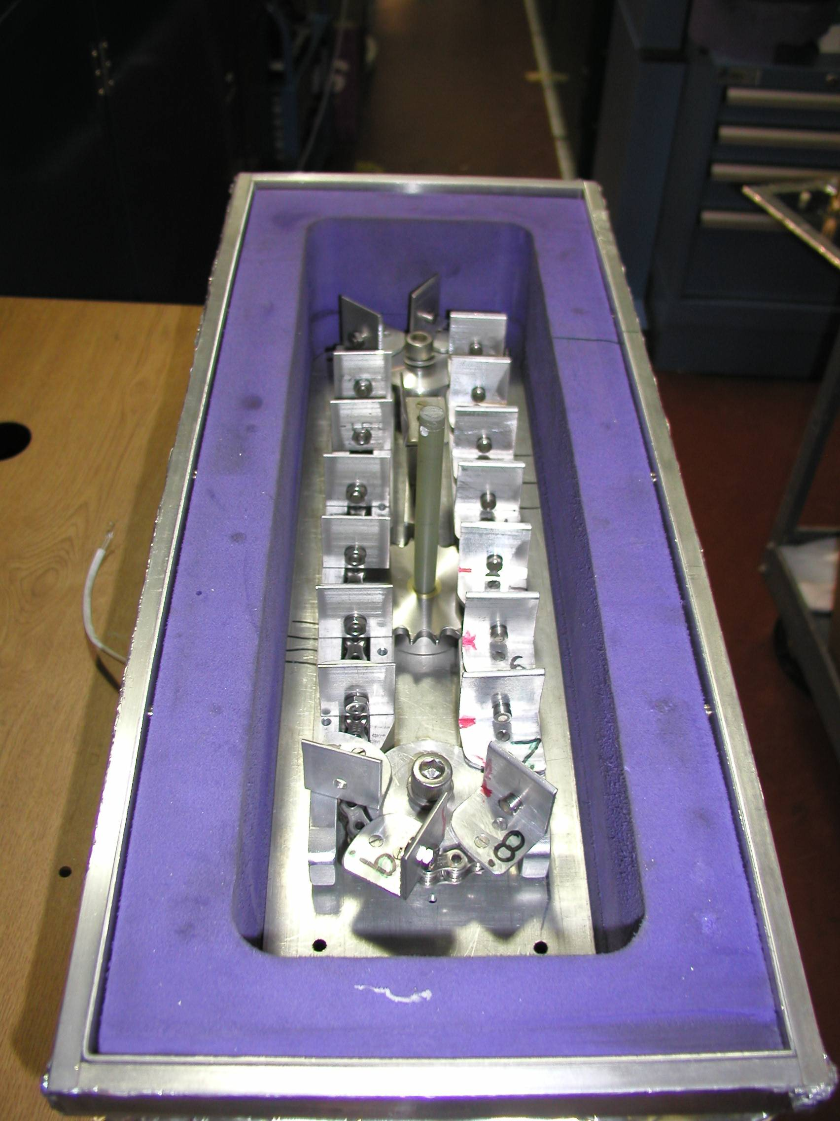
Carousel open

Slide 19
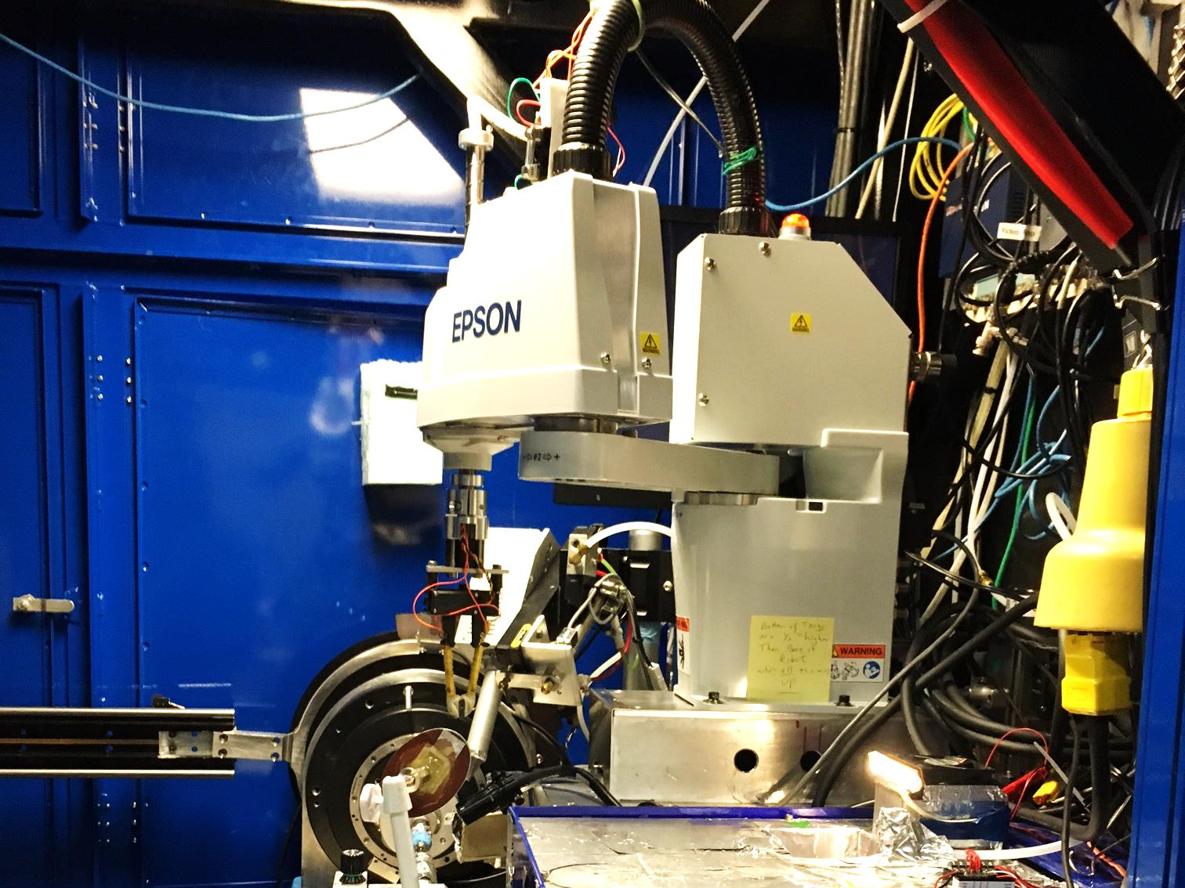

Slide 21
SBS
format
crystallization
tray
mirror
pinhole
microscope
Notes:
Inspired by the ESRF microcrystal camera, the superbend endstations are all equipped with zero-paralax optics. The user sees their sample from the point of view of the x-ray beam. Sample alignment is not only more stable but more intuitive than an off-axis camera. Placing the crystal into the microscope crosshairs gaurantees that it will be hit by the beam.

Slide 22
in-situ diffraction trays
~50 μm tape
~50 μm tape
~50 μm tape
PDMS
PDMS
250 μm
100 μm
25 μm
200 μm
1000 μm
Fluidigm
Topaz® DC
Microlytic
Crystal Former™
NatX-ray
CrystalQuick™ X
MiTeGen
in-situ-1
CrystalDirect
Notes:
Next slide please

Slide 23
scattering/absorptoin “rules”:
1 μm crystal ≈ 1 μm water
≈ 1 μm plastic
≈ 0.1 μm glass
≈ 1000 μm air
Optimum: support thickness = crystal thickness

Slide 24
Match crystal to beam
Resolution (Å)
too big
too small
just right
X-ray beam size (μm)

Slide 25
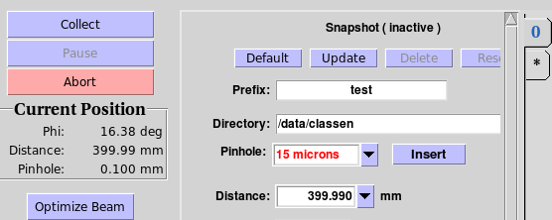
“8-shooter” adjustable beam size
rotary
pinholes:
300
100
75
50
30
25
15

Slide 26
Crystal lifetime vs pinhole
pinhole (µm) | beam size | Cryo (min) | Room T (s)
100 | 60x80 | 4 | 1.7
75 | 60x78 | 5 | 2.0
50 | 60x54 | 8 | 3.4
30 | 54x34 | 6 | 2.3
20 | 44x24 | 6 | 2.4
15 | 40x19 | 7 | 2.8
10 | 34x14 | 10 | 4.1

Slide 27
MGy reaction reference
~45 global damage Owen et al. (2006)
10/Å global damage Howells et al. (2009)
5 Se-Met Holton (2007)
4 Hg-S Ramagopal et al. (2004)
4 R-C-COOH Garman et al. (2015)
3 S-S Murray et al. (2002)
1 Br-RNA Olieric et al. (2007)
~1? Cl-C ???
0.5 Mn in PS II Yano et al. (2005)
0.06 putidaredoxin Corbett et al. (2007)
0.02 Fe in myoglobin Denisov et al. (2007)
Radiation Damage World Records
Holton (2009) J. Synchrotron Rad. 16 133-42

Slide 28
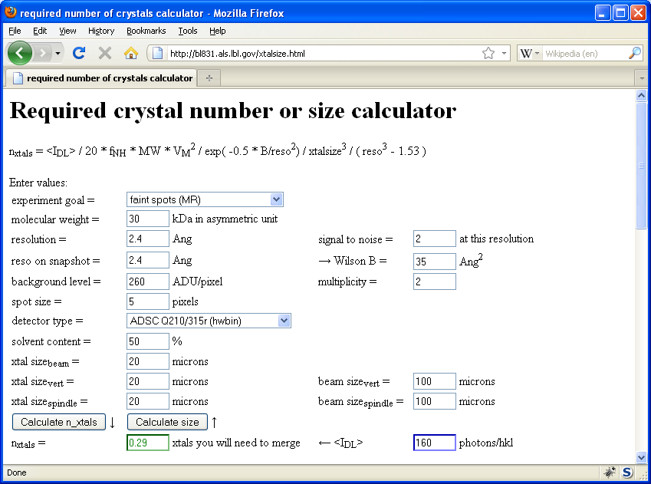
Will my experiment work?
Holton & Frankel (2010) Acta D 66 393-408.

Slide 29
Optimal exposure time (anomalous on a PAD)
2.03 ms
intensity
time

Slide 30
Optimal exposure time (anomalous on a PAD)
Pilatus S
>0.2 s/frame
Upgrade:
>0.1 s/frame
t_{mad} Optimal exposure time (s)
t_{ro} read-out time (s)
2.03 ms on Pilatus³ S
0.95 ms on Pilatus³ X
8.3.1 is too
hot for Pilatus
Attenuate for MAD

Slide 31
% exposure_time.com
The last tune up was at 11111.0 eV (1.11587 A) convergance: 2 x 0.35
with Dose Rate 47280 Gy/s
Based on a Dose Rate of 4.73e+04 Grays/Sec at 2 mRad with slits 100.00% flux, the Dose Rate now at 2.0000 mRad, or 100.00% flux, is 4.73e+04 Grays/Sec
What is the current, or expected dose rate (Gy/s) [4.73e+04] : -->
Expected 1/2 life dose of typical protein crystals
Native 2e+7
MAD 5e+6
S SAD 3e+6
Br/I/RNA 1e+6
RT 2e+5
What is the Max total dose YOU want: [2e+7] -->
Total time for dataset must not exceed 422.8 seconds
How many frames will be in this data set [1800]: -->
Based on these parameters, the exposure time can be up to 0.235 seconds/frame, or 4.73e+04 Gy/s

Slide 32
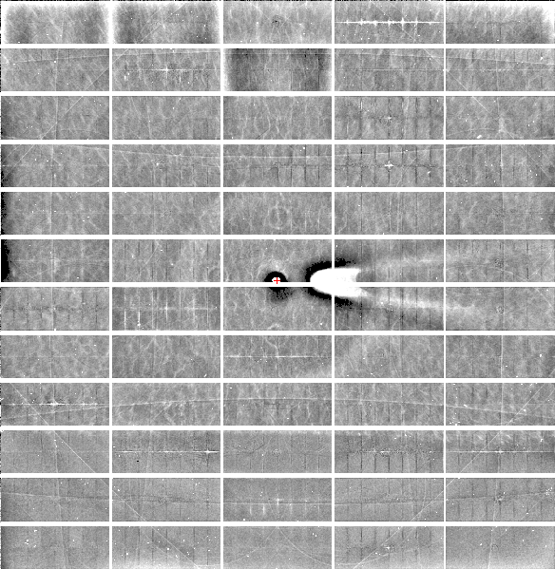
Relative Pixel
Calibration
ALS 8.3.1
Pilatus3 6M
0.9793 Å x-rays
RMS = 0.8%
1% high
average
1% low

Slide 33
Threshold of a revolution in phasing
CCD
old Pilatus
Goal
Solve-able proteins (%)
8.3.1’s Pilatus
Required signal-to-noise (I/σ)

Slide 34
S-SAD merging 20 xtals
Knott et al. (2017). "Guide-bound CRISPR-Cas13a." Nature S&MB online

Slide 35
Systematic vs random error
intensity
observation

Slide 36
ALS 8.3.1 capabilities
200s data sets in shutterless mode
Support for room temperature
in-situ screening from trays
15-100 μm beam sizes
True BLU-ICE interface
Excellent detector calibration
Infinite capacity sample carousel
Automated data backup
Remote operation

Slide 37
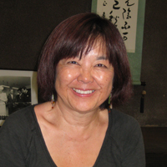
How do I get time on ALS 8.3.1?
Check for available shifts on the schedule:
http://bl831.als.lbl.gov/
Contact Jane Tanamachi!
JTanamachi@LBL.GOV
510-495-2404
No proposals, no reviews, no kidding

Slide 38
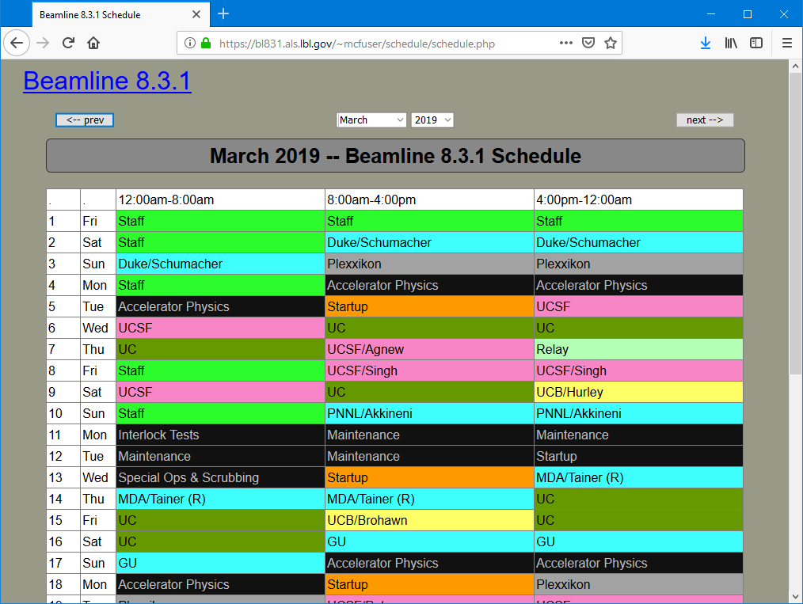
BL8.3.1 online schedule

Slide 39
ALS 8.3.1 beam time allocation
PRT Member | allocation | Details
General Users | 25% | Mandated by DOE
Staff | 9% | development & testing
Plexxikon | 5% | 5-year contract just renewed
UC | 36% total | 7.2% each
UCSF | 25% | Sandler, ETAC & NIH
Total | 600 shifts | 200 days/year

Slide 40
Please Acknowledge!
UCOP MRPI grant MR‐15‐328599
and the “Program for Breakthrough Biomedical Research (PBBR), which is partially funded by the Sandler Foundation”
NIH grants: P50 GM082250
R01 GM124149
P30 GM124169

Slide 41
Multi-bend Achromat (MBA) gradual bend = smaller beam
ALS
https://als.lbl.gov/als-u/als-u-approach/

Slide 42
Multi-bend Achromat (MBA) gradual bend = smaller beam
ALS-U
ALS
https://als.lbl.gov/als-u/als-u-approach/

Slide 43
Multi-bend Achromat (MBA) gradual bend = smaller beam
https://als.lbl.gov/als-u/als-u-approach/

Slide 44
Multi-bend Achromat (MBA) gradual bend = smaller beam
https://als.lbl.gov/als-u/als-u-approach/

Slide 45
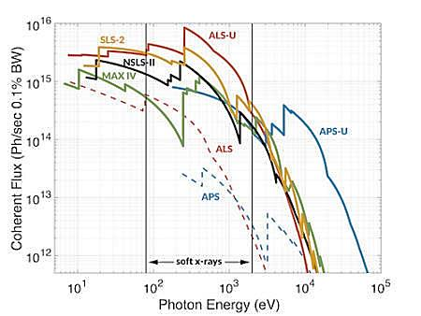
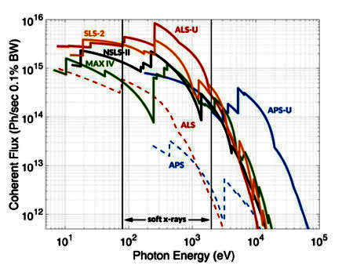
ALS-U priority: soft X-rays
Se Met

Slide 46
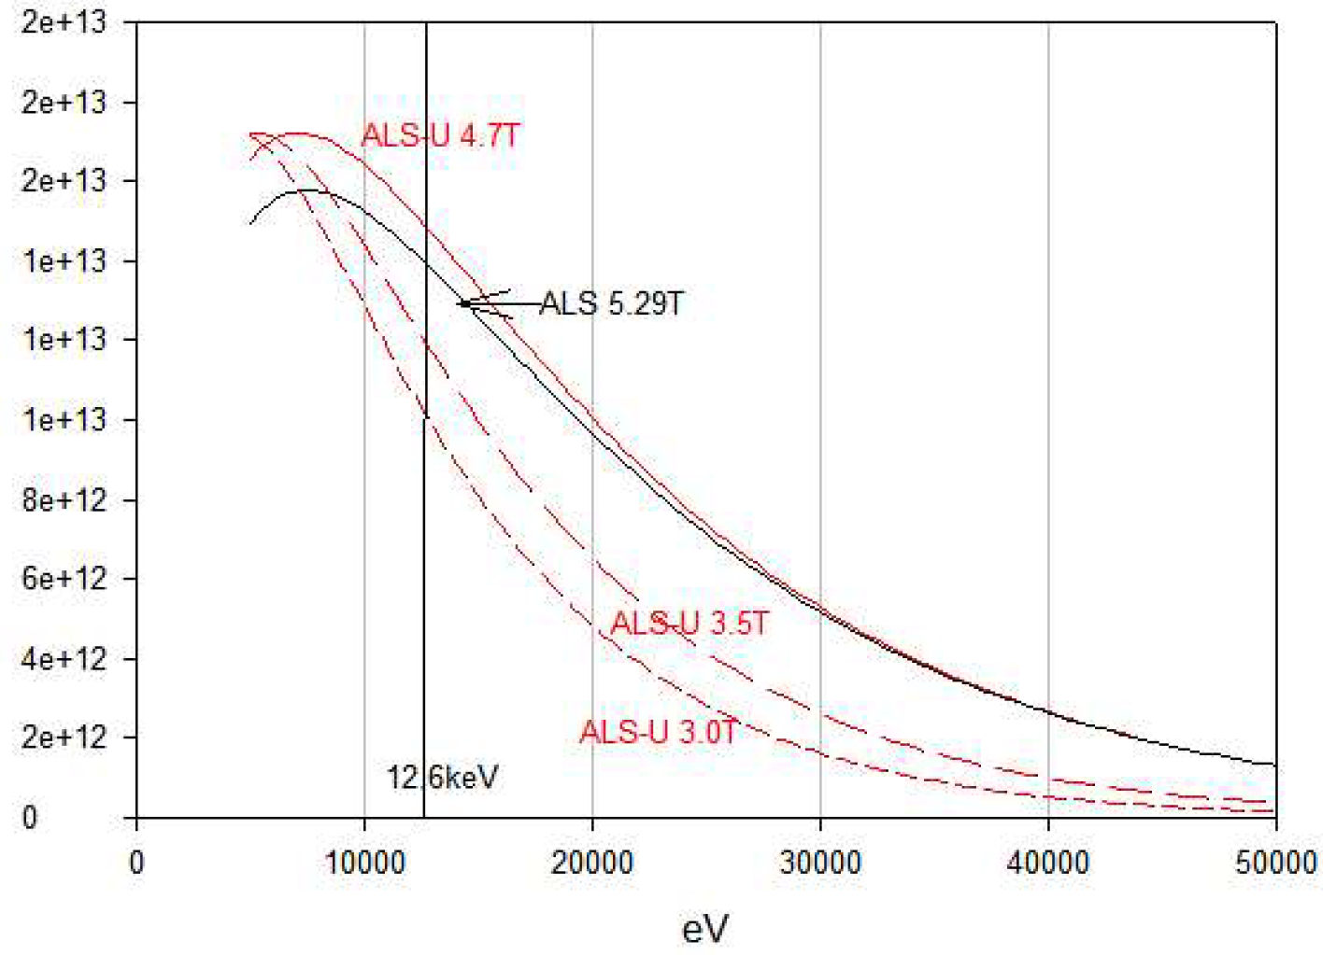
Flux at 8.3.1 before & after “upgrade”
1.4e12
1.3e12
6% better
needs justification
1.1e12
1.0e12
Right now
15%-30% worse
Will happen if
we remain quiet
8.5e11
7.1e11
Photons/s on sample
5.7e11
4.3e11
2.9e11
1.4e11

Slide 47
ALS-U: July 2024
~$300M project
$5M awarded FY17 (Critical Decision 0)
$30M awarded FY18 (CD1)
CD2 is next. DOE Instructions:
“Prioritize bend beamline and super bend investment taking into consideration realignment team access, resource limitations, and beamline scientific productivity and competitiveness in a post ALS-U synchrotron environment, due June 1, 2019.”
Feb 13 2019 9am Workshop: BioSci @ ALS
LBL Building 15 Room 235CR
https://lbl.zoom.us/J/5104864225

Slide 48
What is the “best” beam size?

Slide 49
“dose contrast” effects
before

Slide 50
“dose contrast” effects
after

Slide 51
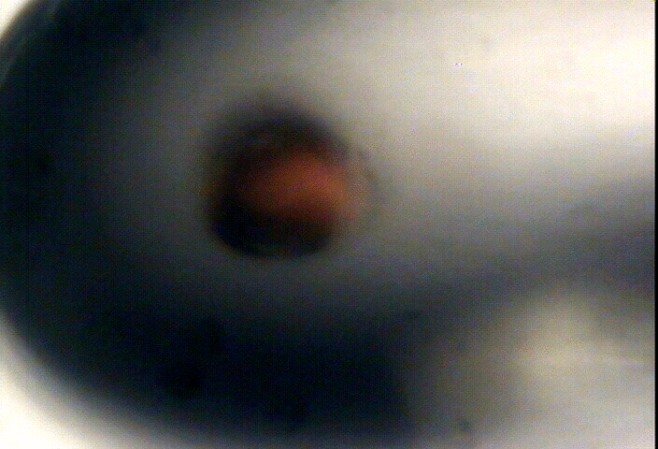
“dose contrast” effects

Slide 52
“dose contrast” effects

Slide 53
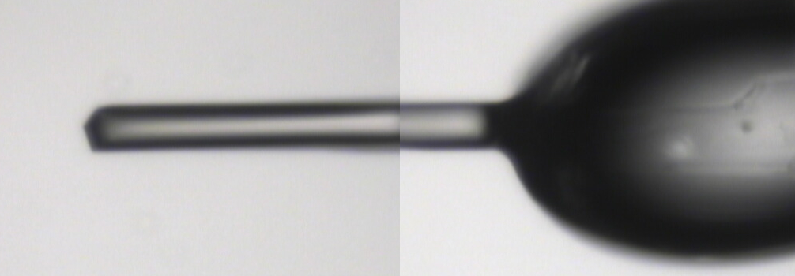
~0 MGy

Slide 54
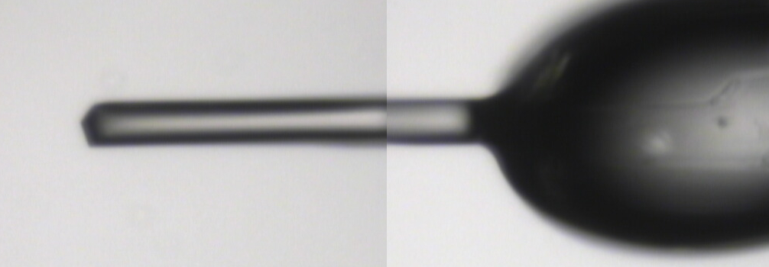
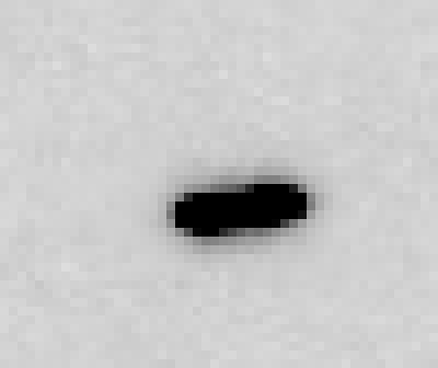
5 MGy

Slide 55
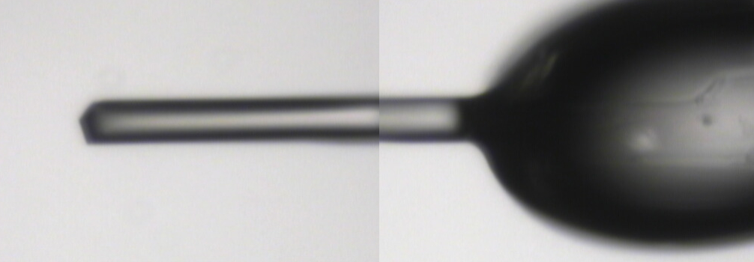
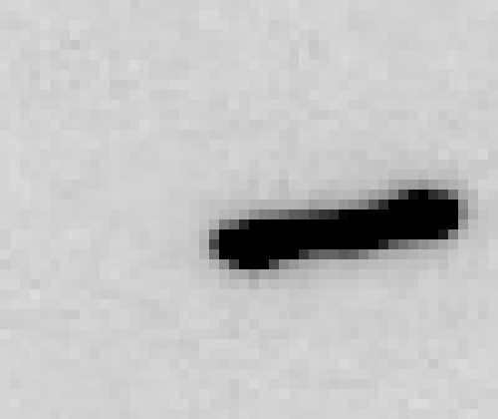
11 MGy

Slide 56
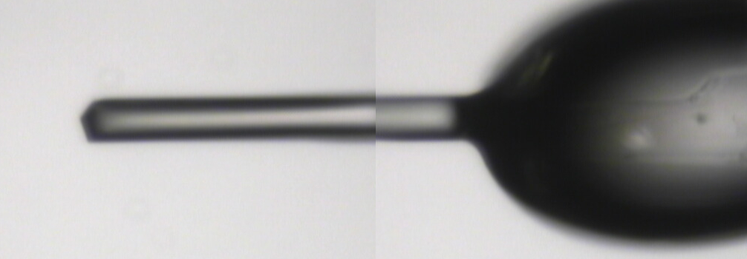
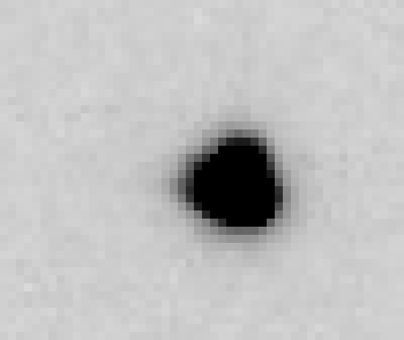
16 MGy

Slide 57
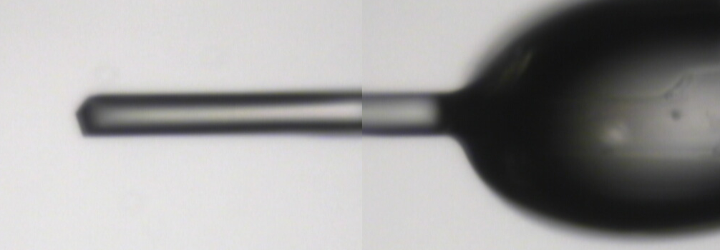
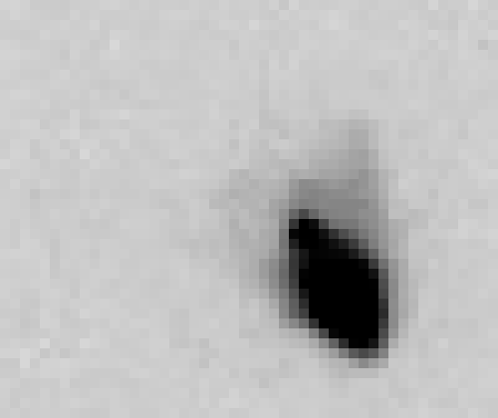
22 MGy

Slide 58
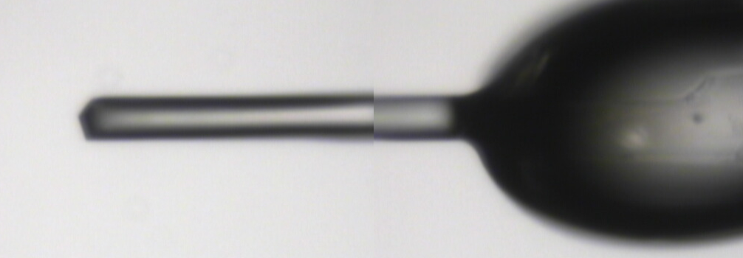
26 MGy

Slide 59
“rastering” to find the crystal
X-ray beam
ice
Membrane
protein crystal

Slide 60
“rastering” for flat dose

Slide 61
“rastering” for virtual beam

Slide 62
How many images?
360° / 0.1° * ( 100 µm / 1 µm )²
⁼ 36x10⁶
28,000 ph/image

Slide 63
The Entropy Limit
bits
s
= log₂(N_{pixels}) * flux * t_{sample} * 1.2x10⁻⁵
minimum data rate with no information loss
N_{pixels} = 4150*4371 for Eiger
flux = photons/s onto the sample
t_{sample} = sample thickness in µm
1.2x10⁻⁵ = 10⁻⁴ cm/µm * cross section of oxygen (0.2 cm²/g)
* density of protein crystal (1.2 g/cm³ )
* ~1/2 of total scattering intersects detector
E.G. 3.4 GByte/s for 10¹² photons/s and 100 µm thick

Slide 64
How to loose information
long exposures
>1 photon/image = order of arrivals
Wide phi slice
sum over angle
Large beams
sum over area
Pink/divergent beam
sum over lambda/angle
Background
non-crystal stuff
Systematics
Dose contrast

Slide 65
How long will it take?
Damage & diffraction = flux / area
Gy/s = ph/s /2000 / um²
Example: 30 MGy, 1 mm² area, flux= 10¹² ph/s
1x1 μm beam: 60 ms
100x100 μm beam: 600 s x 10x10 shots =
1x1 mm beam: 60,000 s x 1 shot = 17 hours
x 1000x1000 shots =
17 hours
17 hours
10¹³ ph/s → 1.7 h/mm²
10¹³ ph/s @ RT → 40 s/mm²
Holton (2009)."beginner's guide rad dam", J. Synch. Rad. 16, 133-142.

Slide 66
Summary
http://bl831.als.lbl.gov/~jamesh/powerpoint/
HARC_screening_2019.pptx
ALS 8.3.1 at your service
Native SAD phasing
In-situ screening of trays
Remote operation
ALS-U: get involved!
Future: “painting” with X-rays

