Slide 1
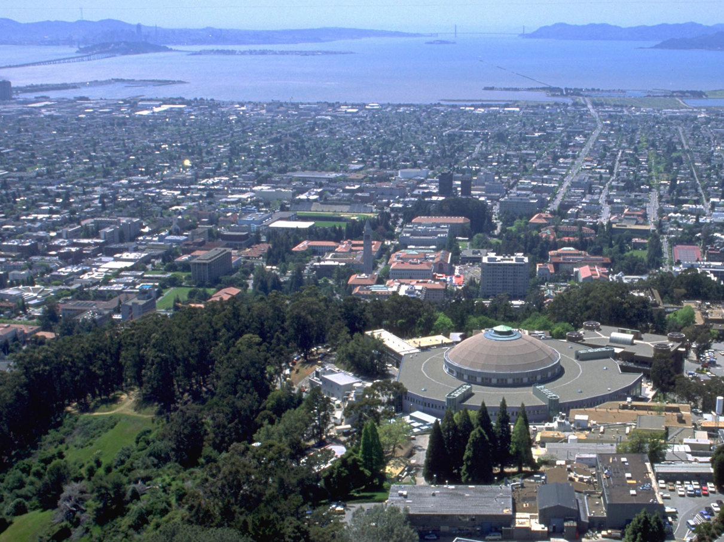
Acknowledgements
HARC Core 6: diffraction
Advanced Light Source
Robert Stroud
James Fraser
Nevan Krogan
Paul Adams
Greg Hura
Aina Cohen
Mike Soltis
UCSF LBNL SLAC
ALS 8.3.1: TomAlberTron
NIH NIAID P50 AI150476
NIH NIGMS R01 GM124149
NIH NIGMS P30 GM124169
Integrated Diffraction Analysis Technologies (IDAT)
Plexxikon, Inc.
Synchrotron Radiation Structural Biology Resource (SLAC)
The Advanced Light Source is supported by the Director, Office of Science, Office of Basic Energy Sciences, Materials Sciences Division, of the US Department of Energy under contract No. DE-AC02-05CH11231 at Lawrence Berkeley National Laboratory.

Slide 2
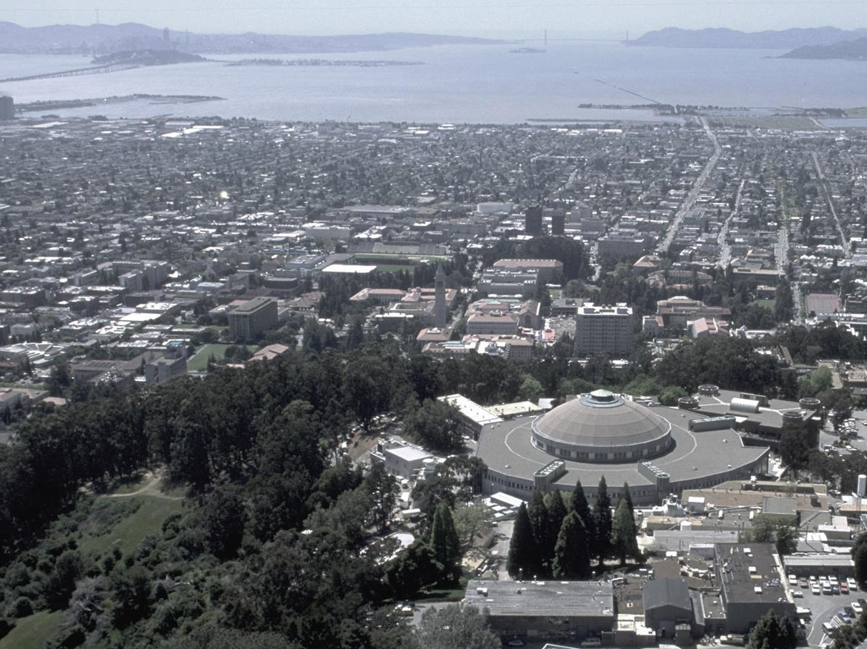
Advanced Light Source
8.2.1
Berkeley
Center for
Structural
Biology
8.2.2
8.3.1
UC
SF
5.0.2
5.0.3
5.0.1
ALS
Structural Biology
2021
MBC 4.2.2
12.3.1 SIBYLS
MX & SAXS
2.1
NCXT
2.0.1 Gemini

Slide 3
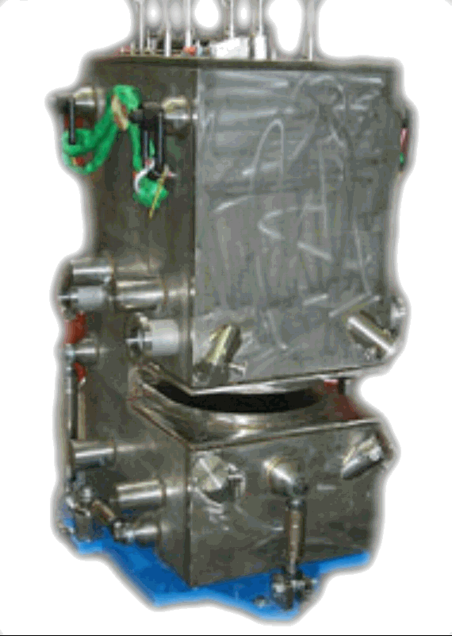
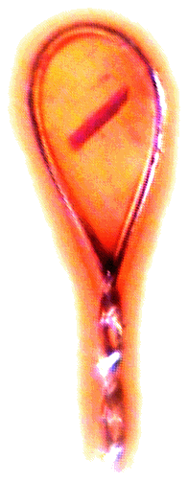
ALS 8.3.1 optics
MacDowell et. al. (2004) J. Sync. Rad. 11 447-455
Superbend
pinhole
Scatter
guard
Plane
Parabolic
mirror
Torroidal
mirror
ADSC Quantum 315r
divergence
slits
Si(111)
monochromator
Protein Crystal
2:1 demagnification cancels spherical aberrations
Pt/Rh mirrors 1.3 x 10⁸ ph/s/μm² ≈ 300 s/xtal
total power dissipation: 100 W
Notes:
Most notable acheivements are high brightness with very little “wasted” light. The discovery made by Howard Padmore? At ALS showed that a 2:1 demagnification cancels nearly all of the spherical abberations in the parabolic/torroid system. 30-50% of the total x-ray intensity passes through the 100um pinhole. The flux through the 100um pinhole at the superbend beamlines is comparable to that of the 5.0.2 wiggler or an APS bending magnet, but only 150 Watts of power must be dissipated by the beamline optics. In contrast, wiggler beamlines must disipate kilowatts. The optics here are much simpler and not exotic in any way. The system is stable and robust. There is never a need to re-focus the beam at a new wavelength. Only a 2-minute automatic tuneup is recommended for very large energy changes (more than 1-2 keV).

Slide 4
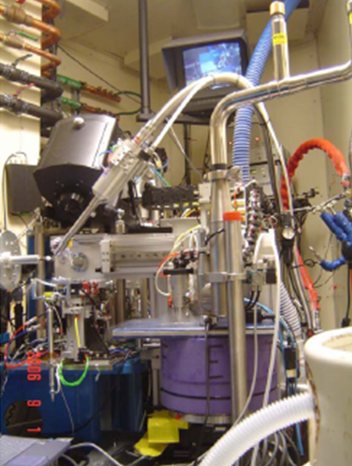
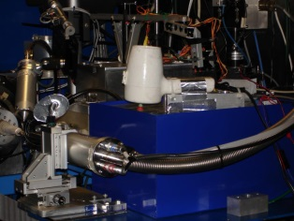
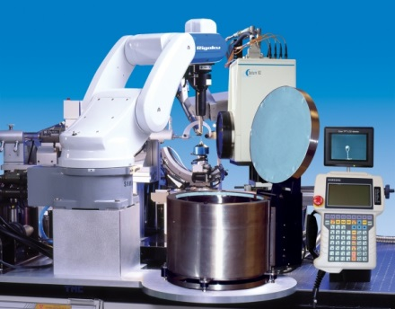
ALS robots
8.2.1
ACTOR
Berkeley
Auto-
Mounter
8.2.2
8.3.1
Cool Hand Luke
5.0.2
5.0.3
5.0.1
MBC 4.2.2
ACTOR
ALS MX robots
12.3.1 SIBYLS

Slide 5
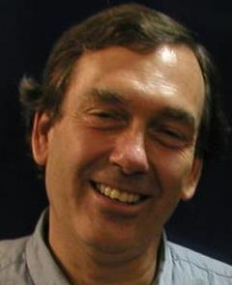
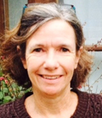
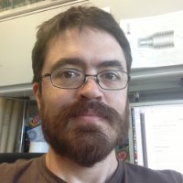
What is ALS Beamline 8.3.1 ?
Macromolecular Crystallography (MX)
MAD, 1x10¹² ph/s, Pilatus 6M 50 Hz
Technology development
Room temp, Elves, multi-crystal
Staff: Holton, Meigs, Burnett, Classen
Landmark and highly productive facility
1st SuperBend – $16M invested since 2001
1826 structures, 720 pubs, 250 high-impact
8% of all membrane protein structures
1000+ distinct users from 60+ institutions
76% utilization
George
Kathryn
Scott
Notes:
ALS 8.3.1 is a very productive facility. Our focus is on maximizing efficiency of the user experience.
The MRPI funds are not just to maintain this facility, but to upgrade it. The new detector is 50x faster, more sensitive and more accurate than the existing detector, and an optics upgrade will match these capabilities.
We will exceed the modern standard of screening and data collection by offering completely automated mail-in raster-based screening
This will position ALS 8.3.1 as the centerpiece of structural biology for the UC system

Slide 6
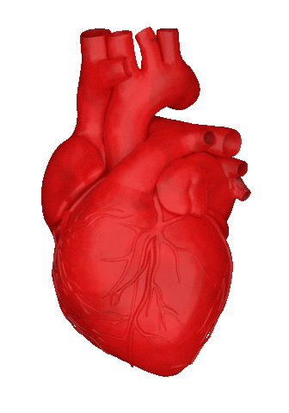
TomAlberTron’s User Community
1000+ users, 60+ institutions
PRT investment: $16 M since 2001
Return: 1826 PDB 720 pubs 250 hi-impact
$132+ M (NIH) $935+ M (Plexxikon)
Beam time utilization : 76%
Median visit-to-next-visit interval:
11 ± 8 days

Slide 7
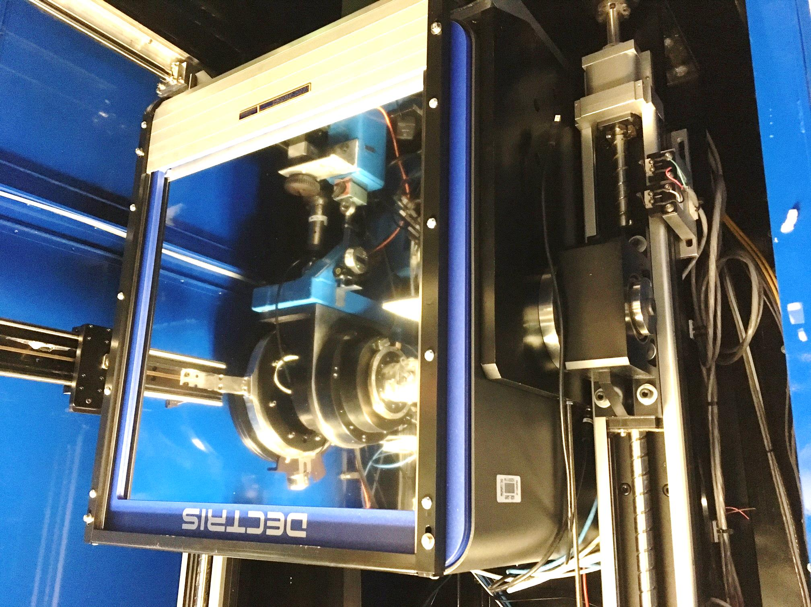
Pilatus³ M 6M
Pixel Array
Detector
6x10⁶ pixels
$0.15/each
1 ms readout
50 Hz images

Slide 8
ALS 8.3.1 data collection history
images x 10⁶

Slide 9
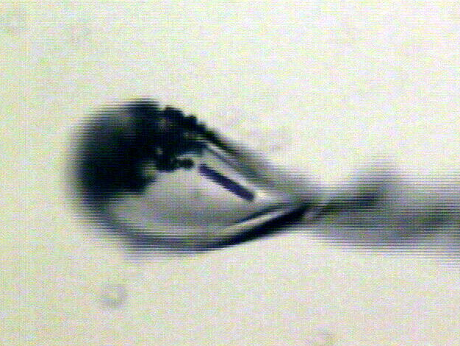
Shutterless rastering now available
X-ray beam
ice
Membrane
protein crystal

Slide 10
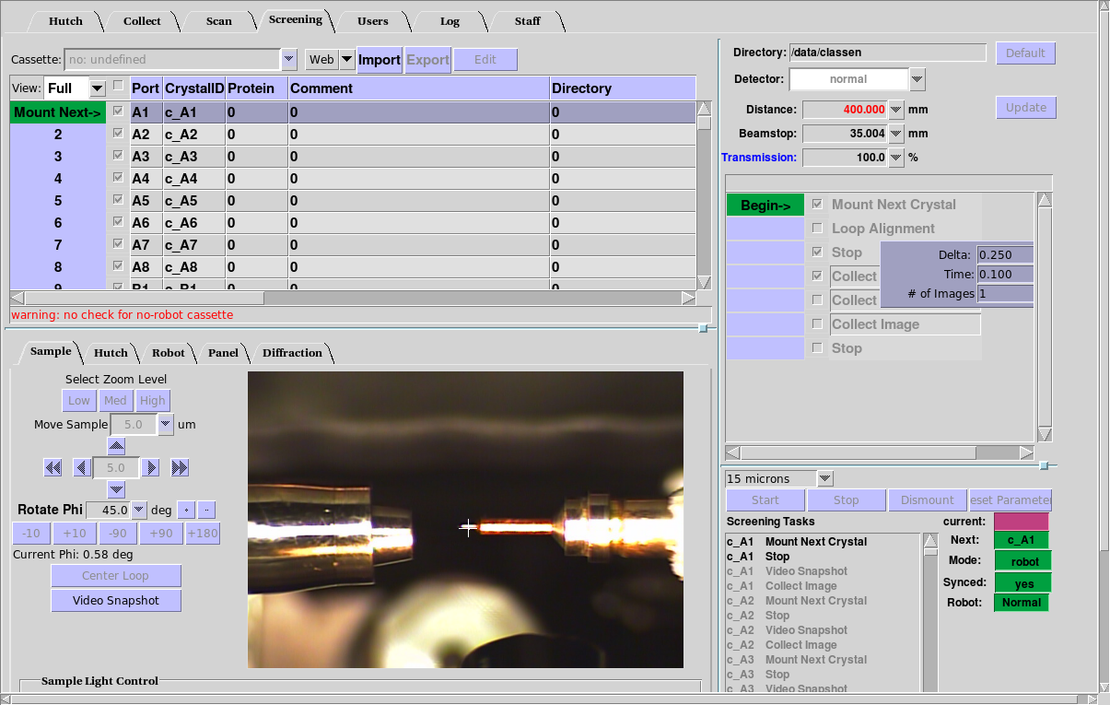
BLU-ICE w unattended data collection

Slide 11
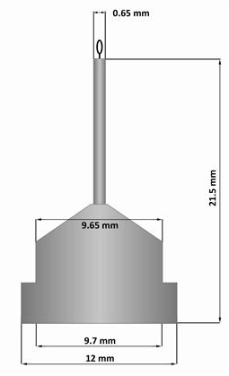
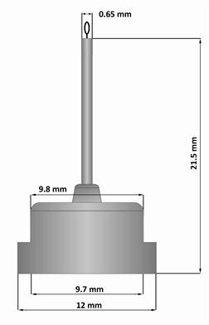
Pin compatibility
SLAC
ALS
SPINE

Slide 12
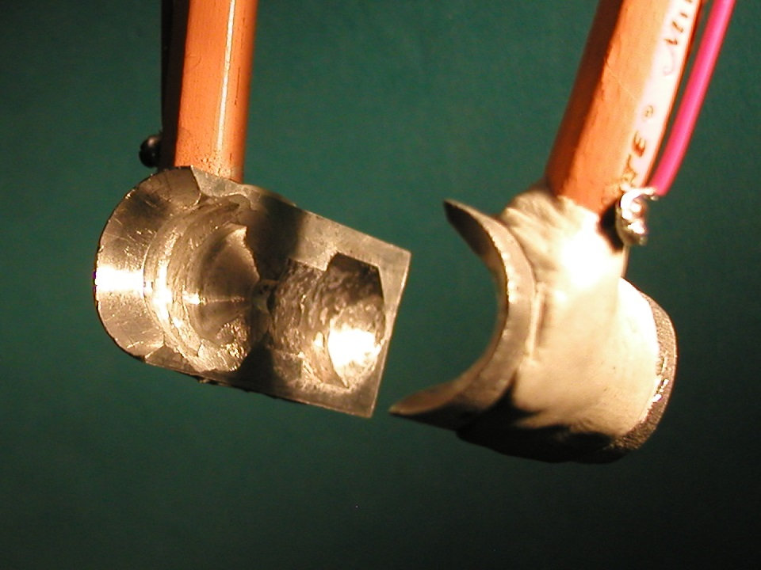
SuperTong

Slide 13
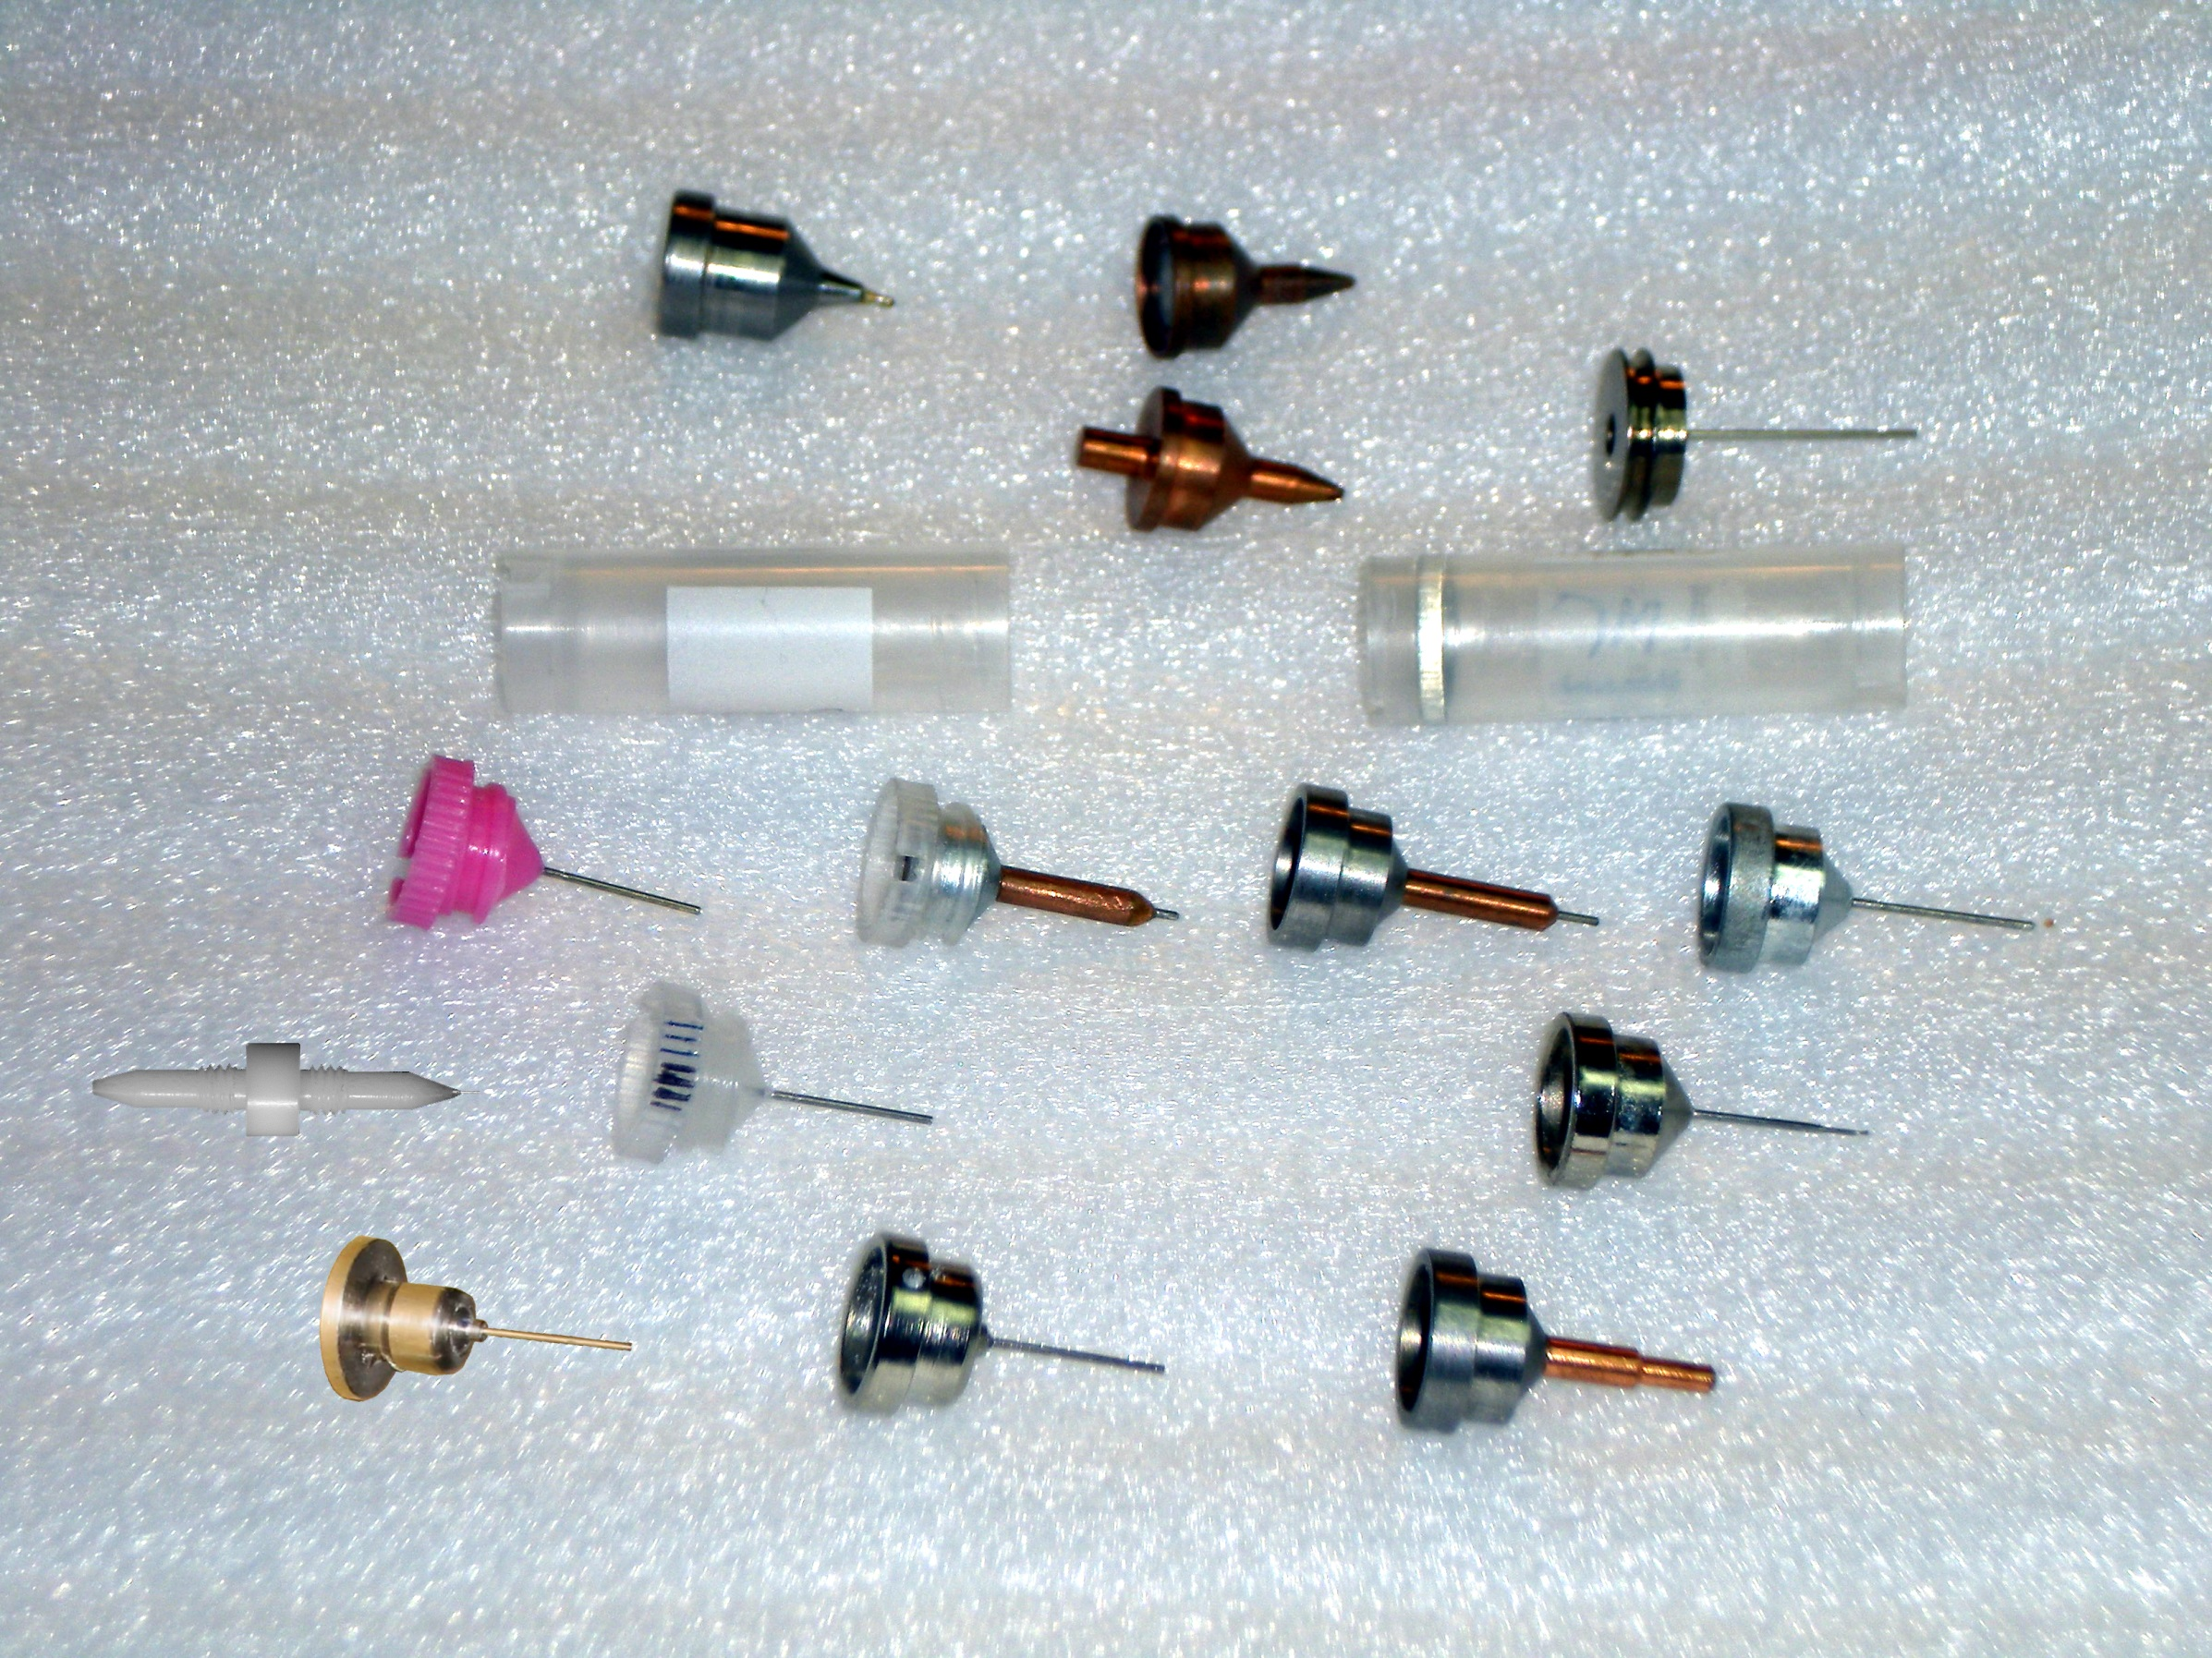
Sample pin compatibility
Caltech
SSRL
Yale
Hampton screw cap
Hampton magnetic
H. colored
H. copper
H. magnetic
H. hybrid
H. screw cap
Syrrx
SPring-8
Oxford
SPINE
MiTeGen RT

Slide 14
“infinite capacity” sample carousel

Slide 15
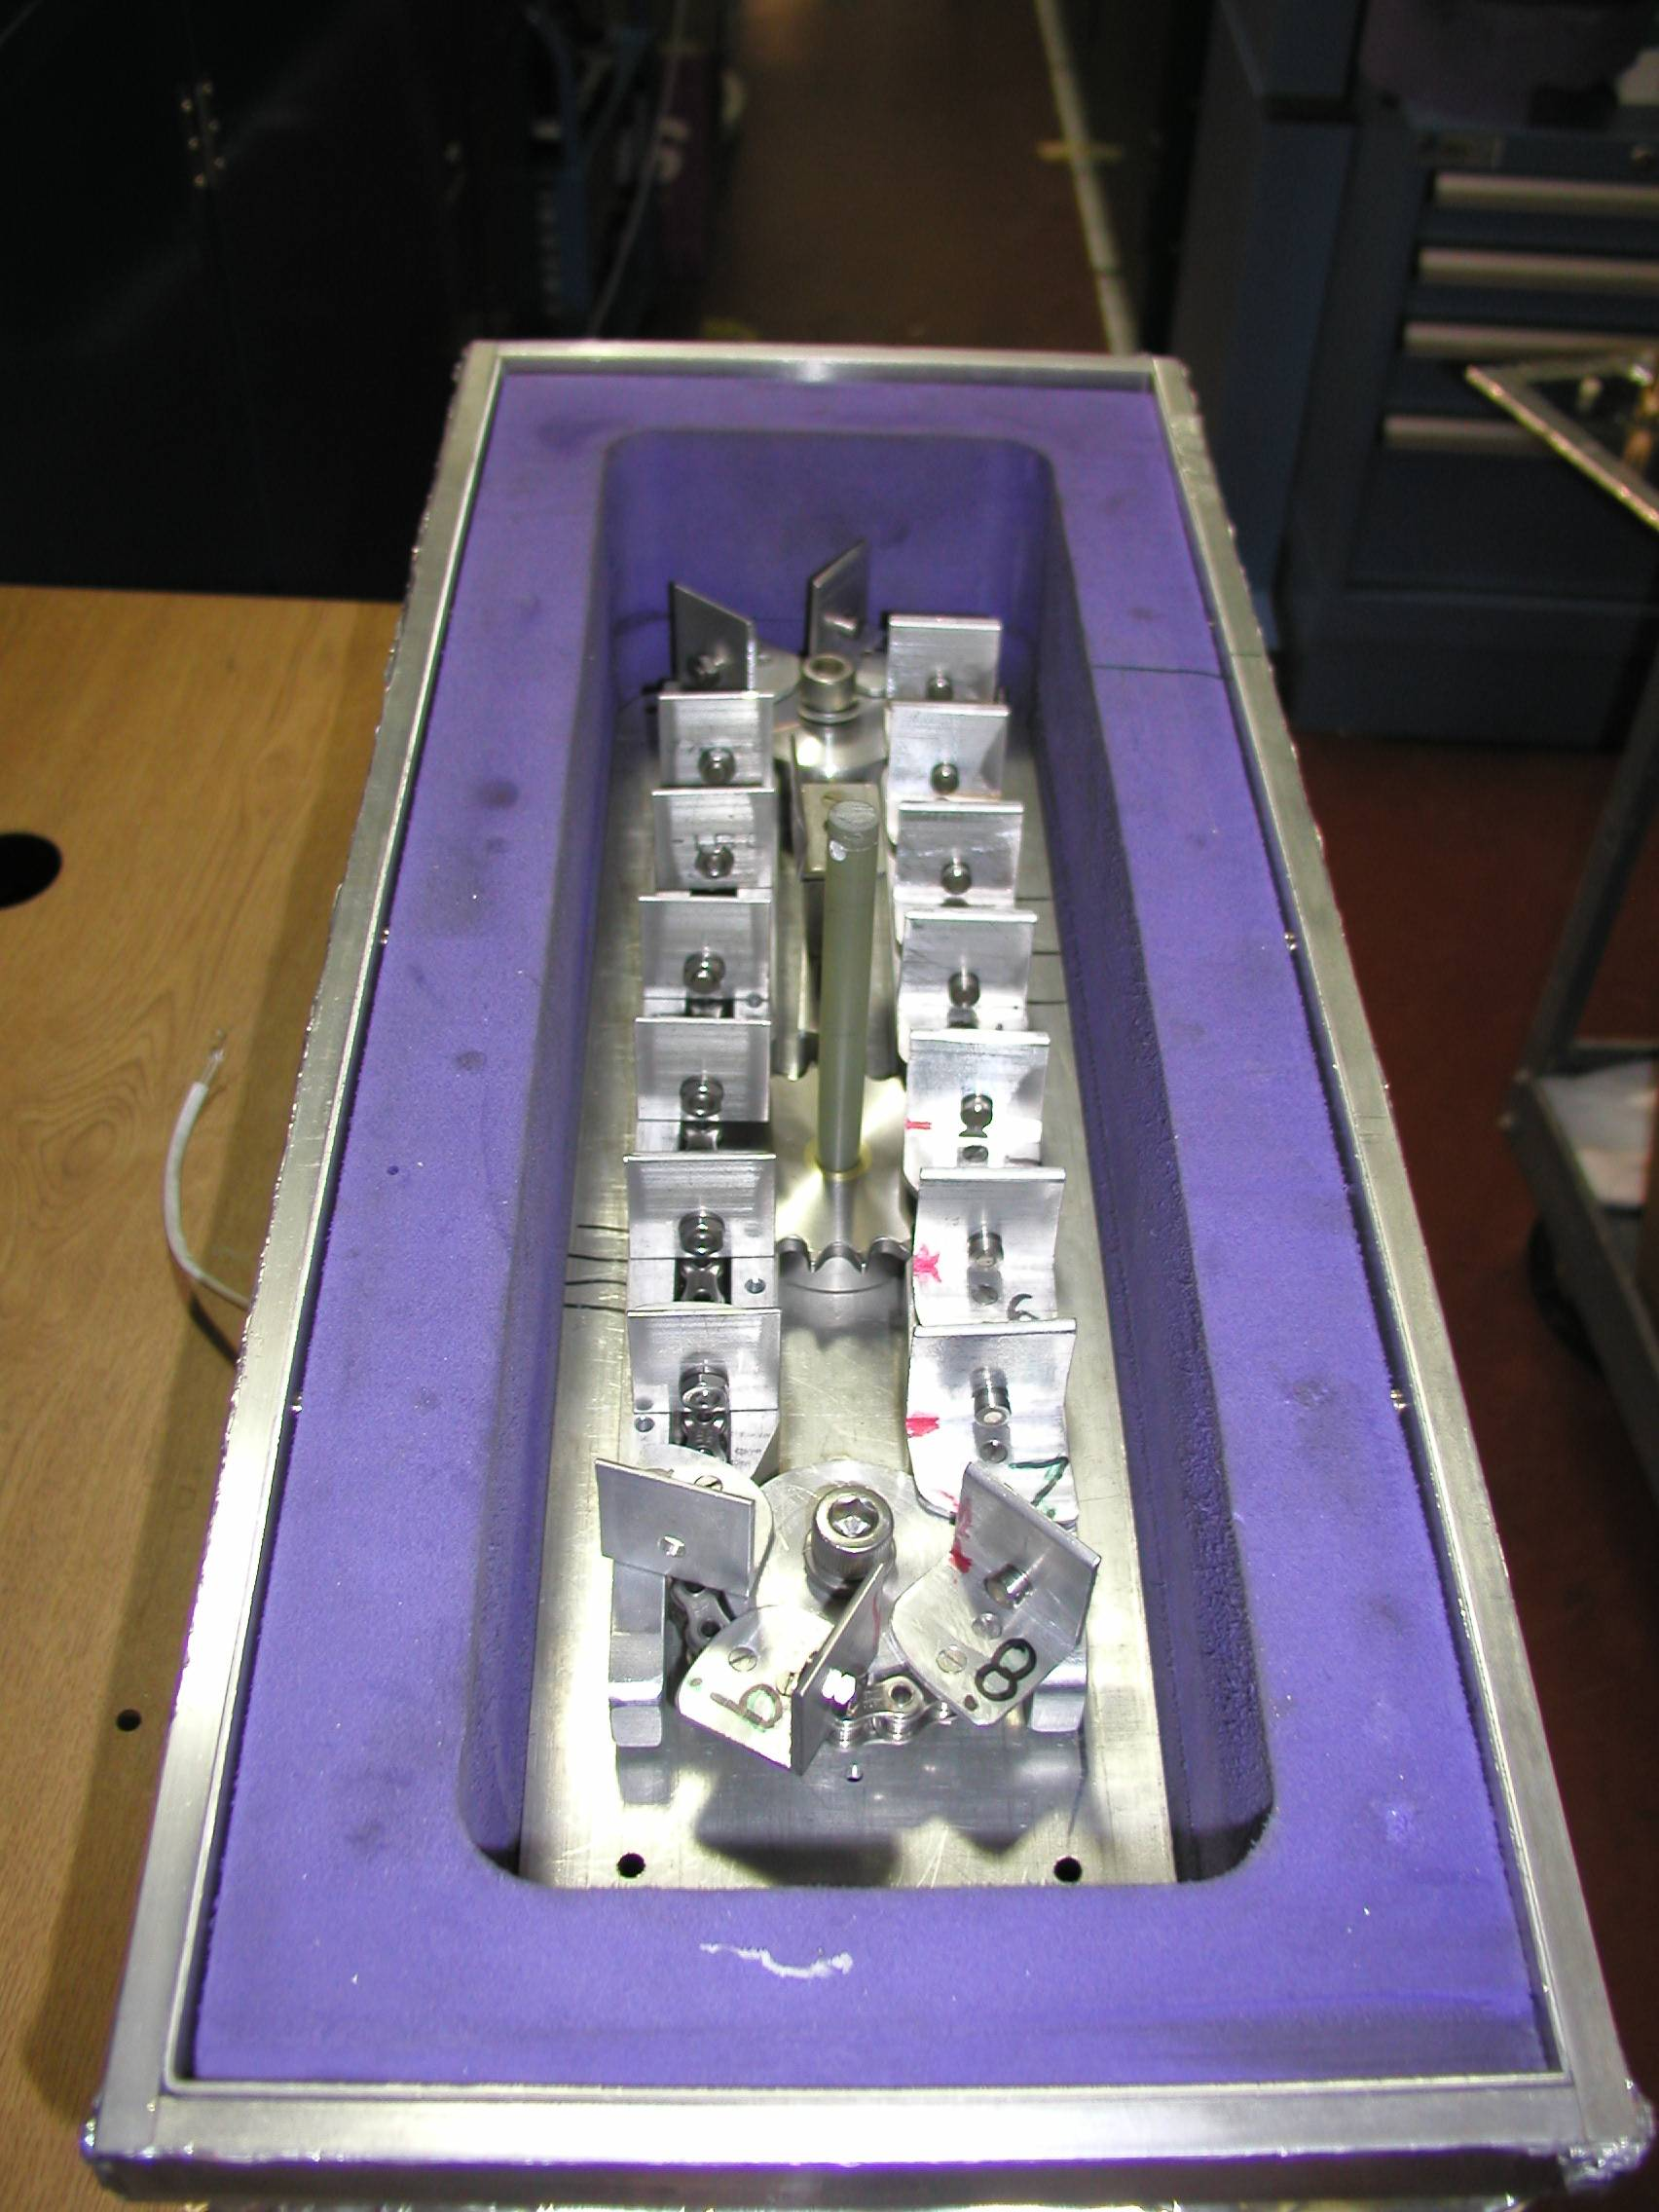
Carousel open

Slide 16
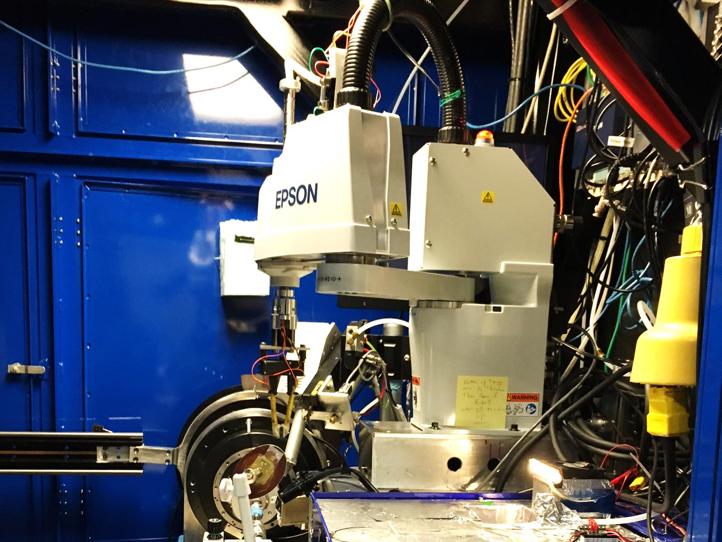

Slide 18
SBS
format
crystallization
tray
mirror
pinhole
microscope
Notes:
Inspired by the ESRF microcrystal camera, the superbend endstations are all equipped with zero-paralax optics. The user sees their sample from the point of view of the x-ray beam. Sample alignment is not only more stable but more intuitive than an off-axis camera. Placing the crystal into the microscope crosshairs gaurantees that it will be hit by the beam.

Slide 19
in-situ diffraction trays
~50 μm tape
~50 μm tape
~50 μm tape
PDMS
PDMS
250 μm
100 μm
25 μm
200 μm
1000 μm
Fluidigm
Topaz® DC
Microlytic
Crystal Former™
NatX-ray
CrystalQuick™ X
MiTeGen
in-situ-1
CrystalDirect
Notes:
Next slide please

Slide 20
scattering/absorptoin “rules”:
1 μm crystal ≈ 1 μm water
≈ 1 μm plastic
≈ 0.1 μm glass
≈ 1000 μm air
Optimum: support thickness = crystal thickness

Slide 21
Crystal lifetime vs pinhole
pinhole (µm) | beam size | Cryo (min) | Room T (s)
100 | 60x80 | 4 | 1.7
75 | 60x78 | 5 | 2.0
50 | 60x54 | 8 | 3.4
30 | 54x34 | 6 | 2.3
20 | 44x24 | 6 | 2.4
15 | 40x19 | 7 | 2.8
10 | 34x14 | 10 | 4.1

Slide 22
MGy reaction reference
~45 global damage Owen et al. (2006)
10/Å global damage Howells et al. (2009)
5 Se-Met Holton (2007)
4 Hg-S Ramagopal et al. (2004)
4 R-C-COOH Garman et al. (2015)
3 S-S Murray et al. (2002)
1 Br-RNA Olieric et al. (2007)
~1? Cl-C ???
0.5 Mn in PS II Yano et al. (2005)
0.06 putidaredoxin Corbett et al. (2007)
0.02 Fe in myoglobin Denisov et al. (2007)
Radiation Damage World Records
Holton (2009) J. Synchrotron Rad. 16 133-42

Slide 23
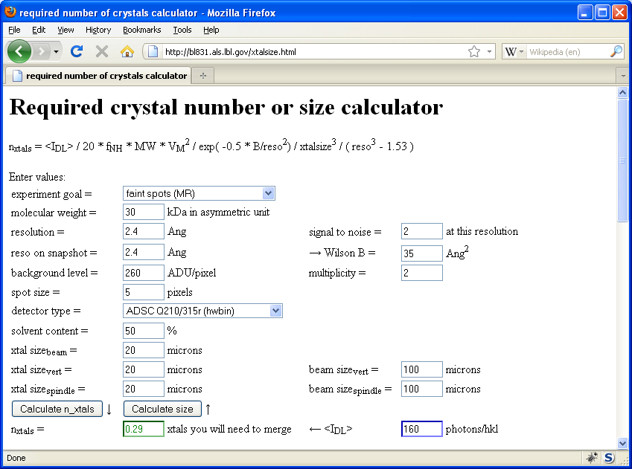
Will my experiment work?
Holton & Frankel (2010) Acta D 66 393-408.

Slide 24
S-SAD merging 20 xtals
Knott et al. (2017). "Guide-bound CRISPR-Cas13a." Nature S&MB online

Slide 25
ALS 8.3.1 capabilities
200s data sets in shutterless mode
Support for room temperature
in-situ screening from trays
15-100 μm beam sizes
True BLU-ICE interface
Excellent detector calibration
Infinite capacity sample carousel
Automated data backup
Remote operation

Slide 26
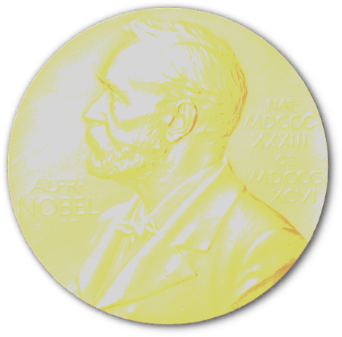
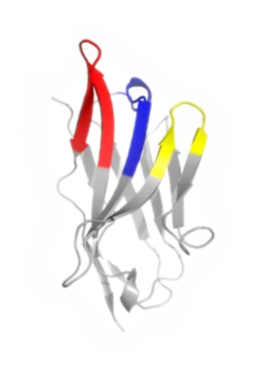
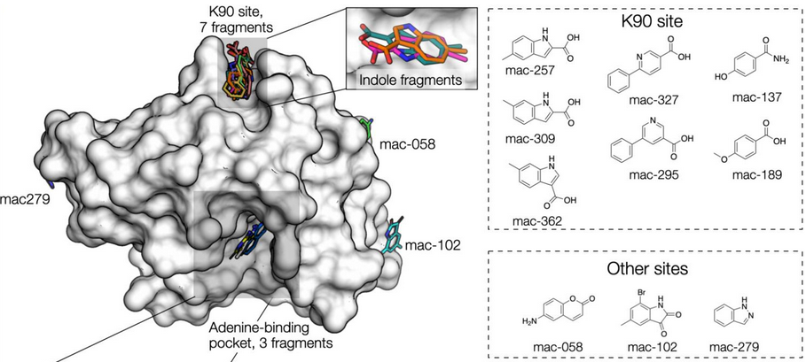
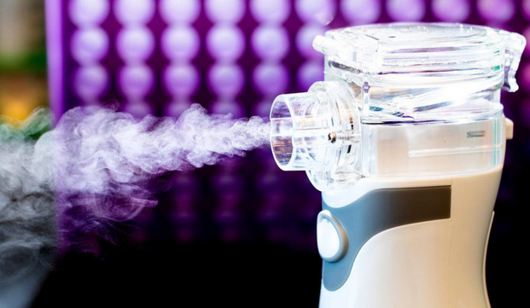
Recent Highlights
Doudna
CRISPR PDBs
6
8.3.1
6
cryoEM
2
SLS
COVID protection:
nanobody aerosol
UCSF-Oxford SARS-CoV-2
fragment screen
Schoof et al., Science 370 (2020)
Schuller et al., Science Advances in press (2021)

Slide 27
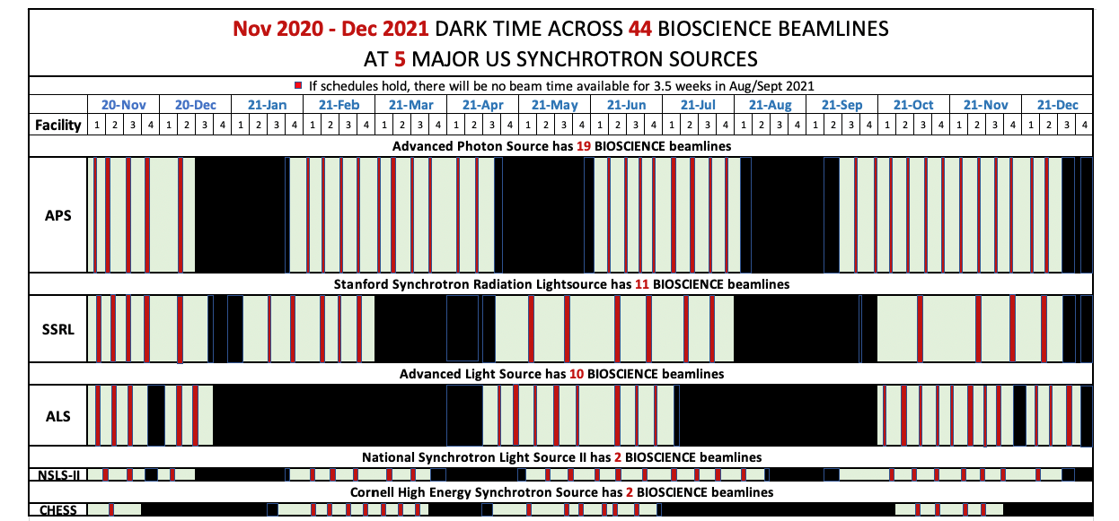
The Future of Light
APS-U shutdown 2023
APS-U shutdown 2022

Slide 28
Summary
Leading in MX methods
Universal pin compatibility
In-situ screening of trays
Unattended data collection
Future: less light → more innovation
Questions? JMHolton@lbl.gov

Slide 29
8.3.1 Recent Improvements
Dectris Pilatus3 6M installation - 2018
50 Hz framing, 1 ms dead time, previously 25 Hz
0.8% calibration error, previously 2.5%
Complete control system update
Shutterless data collection
“Rastering” automated sample alignment
Screening Tab workflow for efficient sample evaluation
Raster centering for unattended operation
Overhaul of data archiving infrastructure
LTO4 to LTO6, support USB3 user hard drives
First remote data collection – Apr 2017

