Slide 1
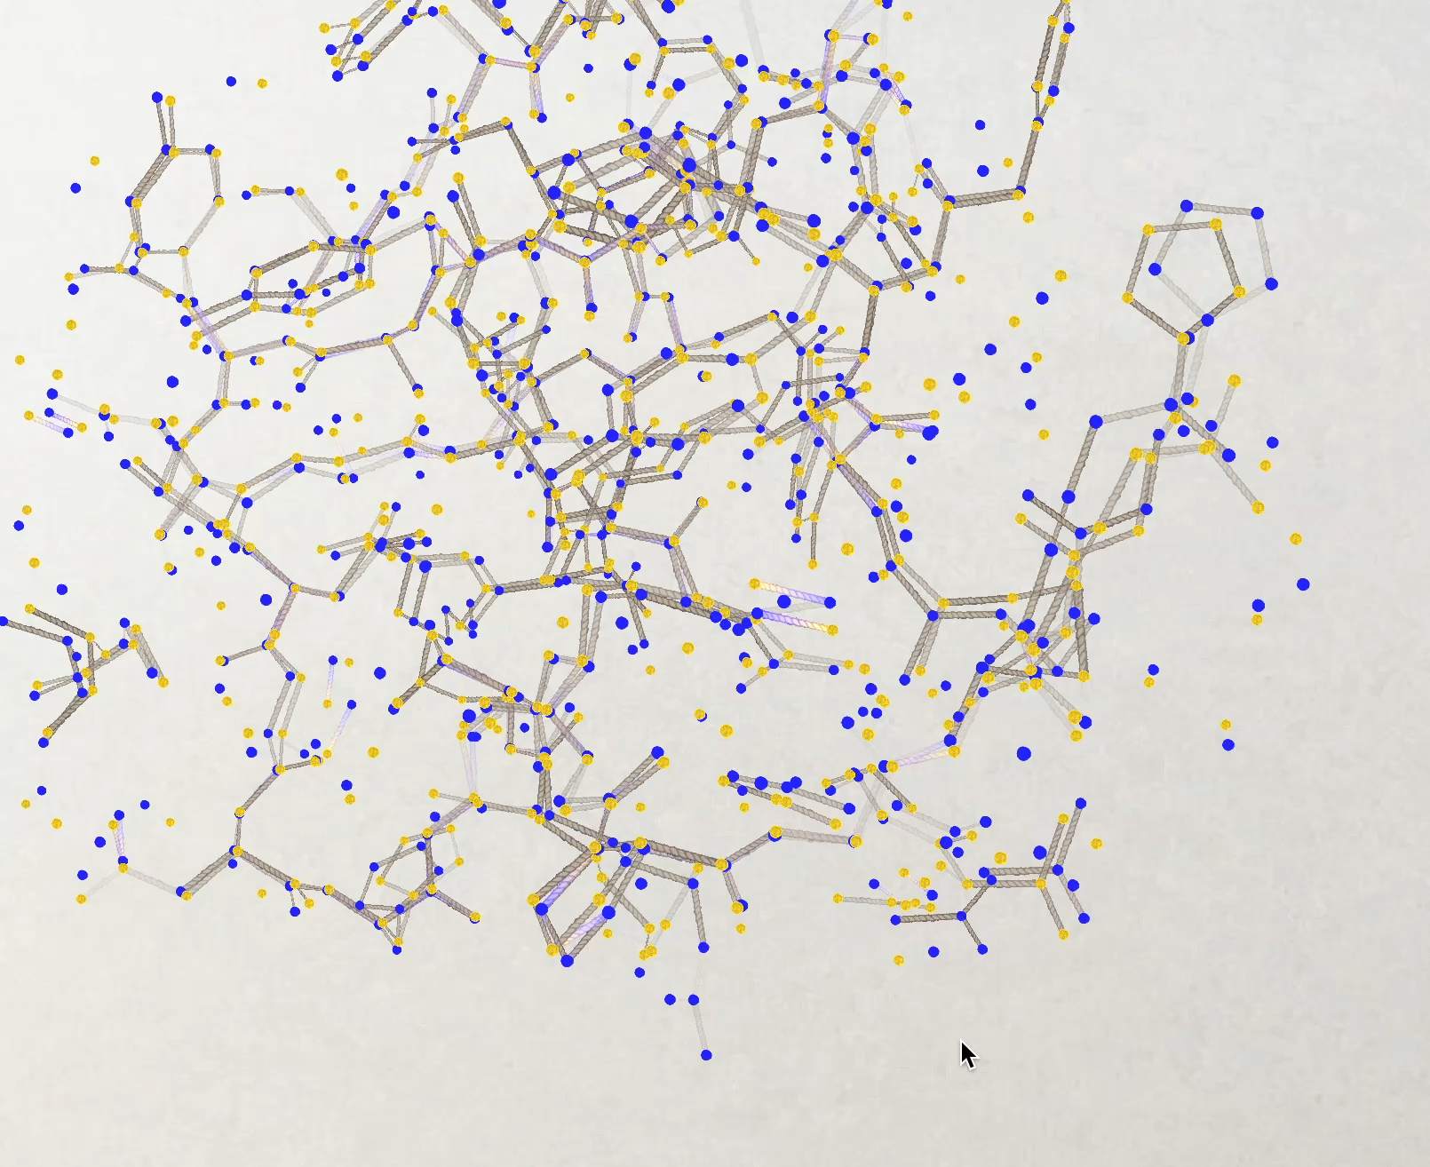
New tools!
Helen Ginn ROPE-based program
GUI showing both conformers A and B and bonds drawn between them according to the following rules:
good geometry, for
or
bad geometry, for
or
good geometry, for
or
bad geometry, for
or
Conformer A
Conformer B
This indicates the bottom atom conformers need untangling. Clicking on the atoms flips the conformers over right to the end of the chain.

Slide 2
GUI showing both conformers A and B and bonds drawn between them according to the following rules:
good geometry, for
or
bad geometry, for
or
good geometry, for
or
bad geometry, for
or
Conformer A
Conformer B
This indicates the bottom atom conformers need untangling. Clicking on the atoms flips the conformers over right to the end of the chain.

