Slide 1
Diffraction Methods in Structural Biology (GRC)
2022
Conference chair: James Holton
Conference vice chair: Janet Newman
Notes:
On behalf of GRC and the Board of Trustees, it is our pleasure to welcome you today.

Slide 2
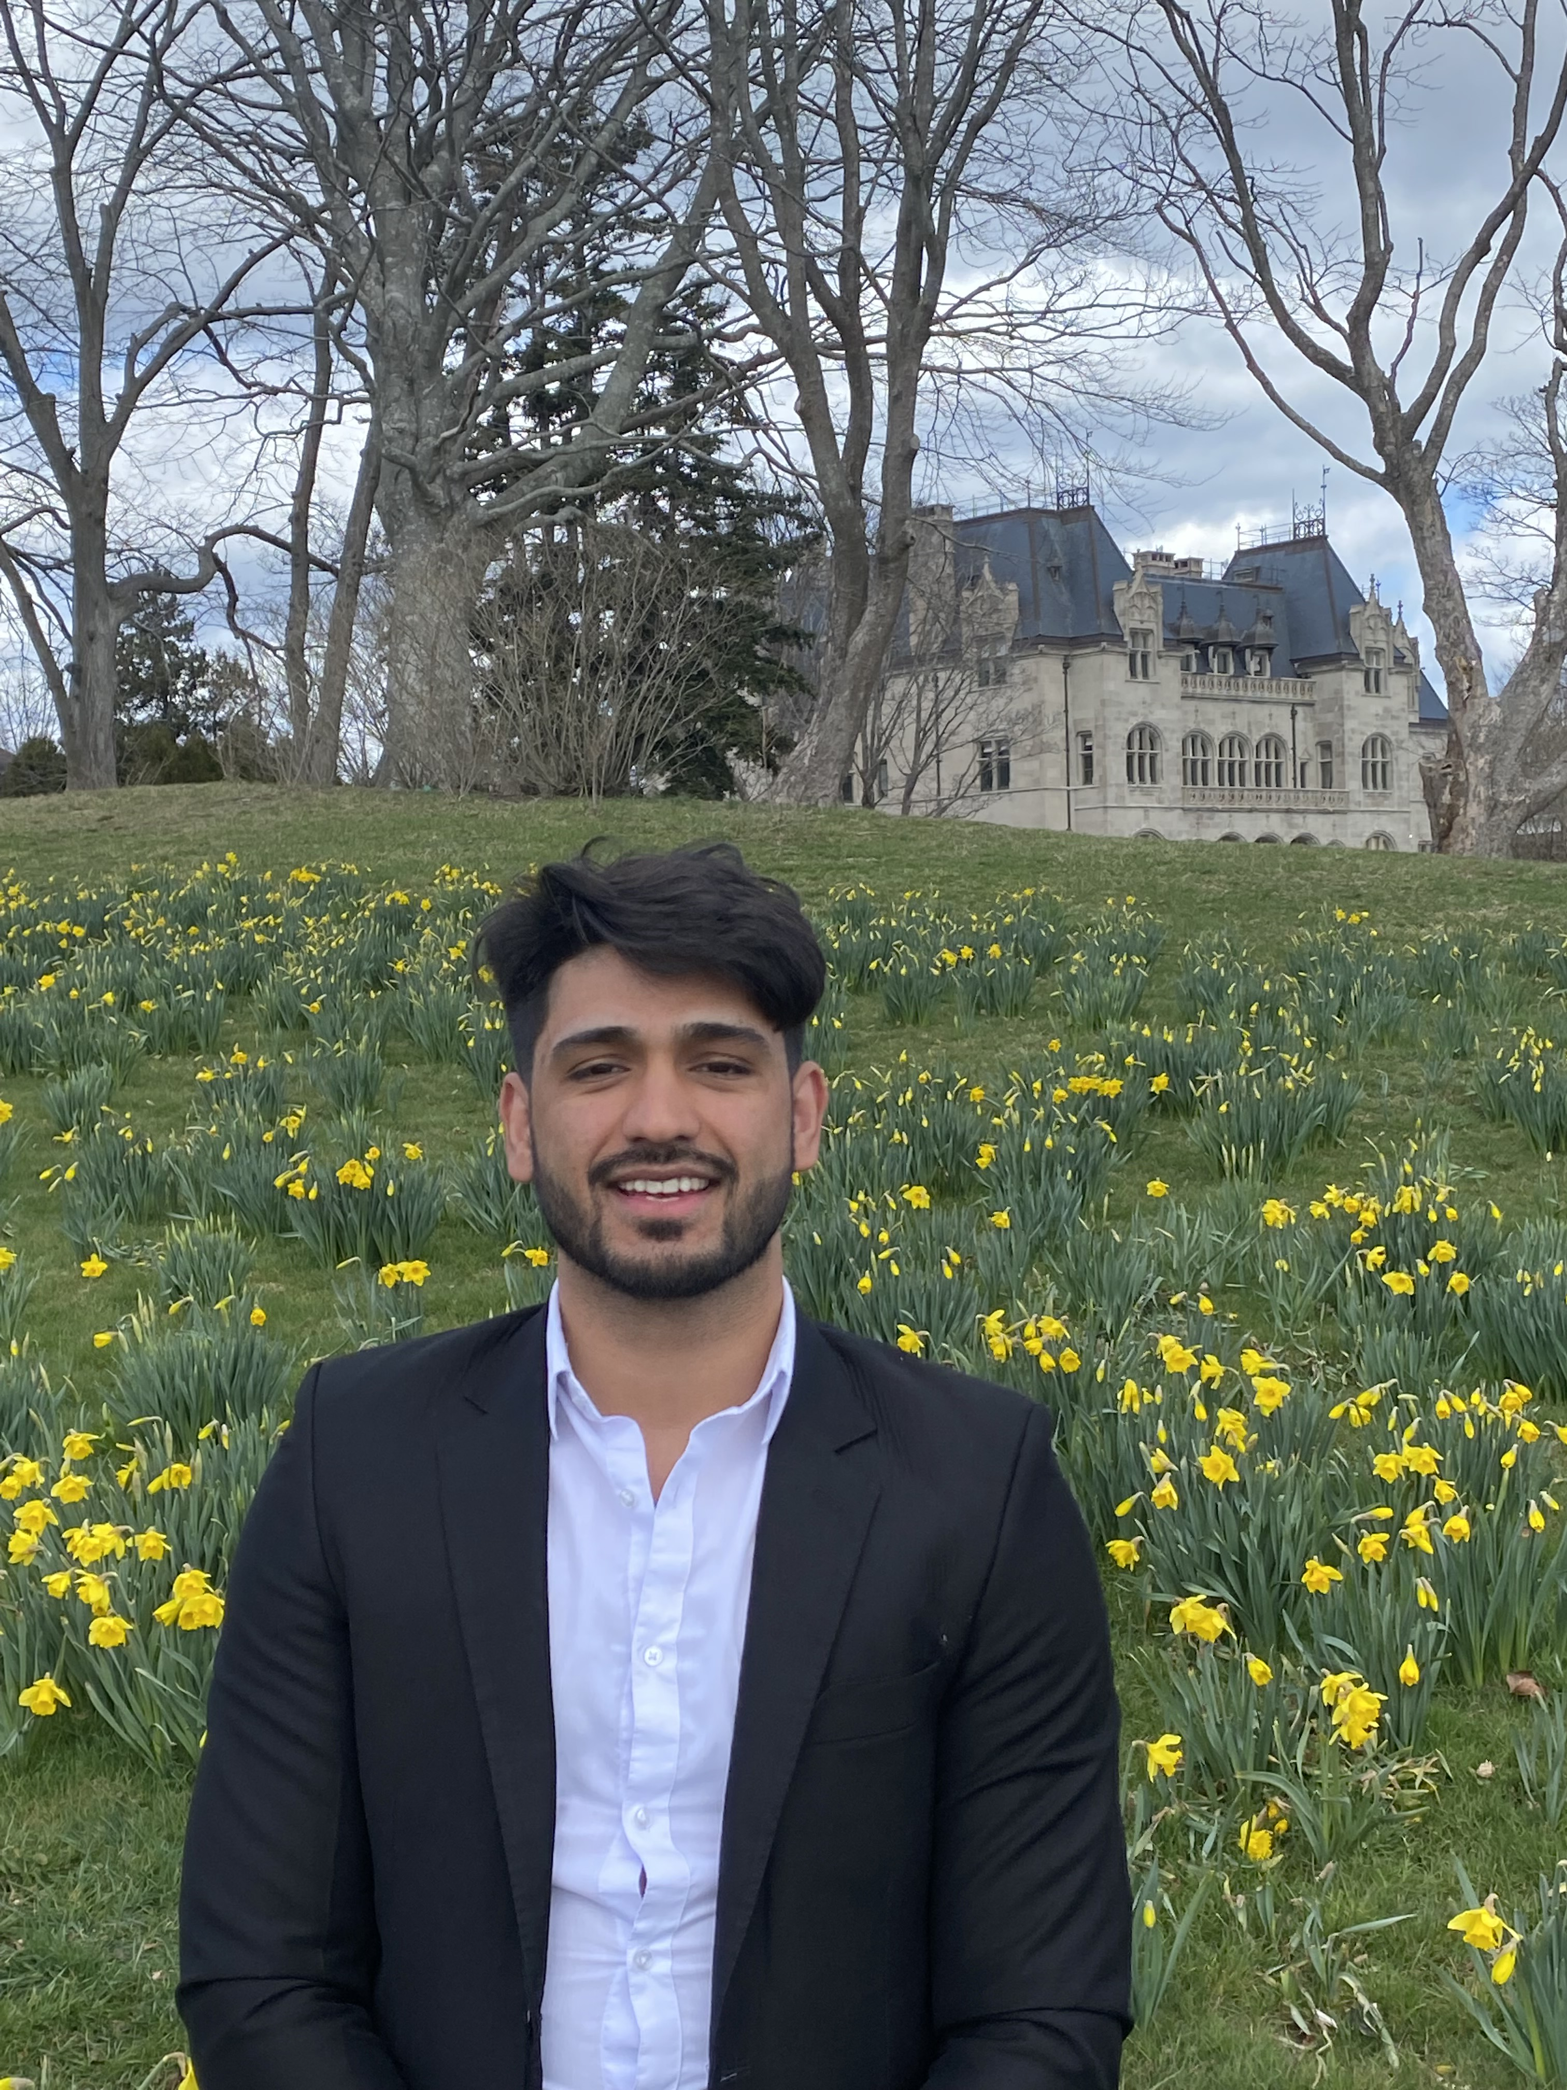
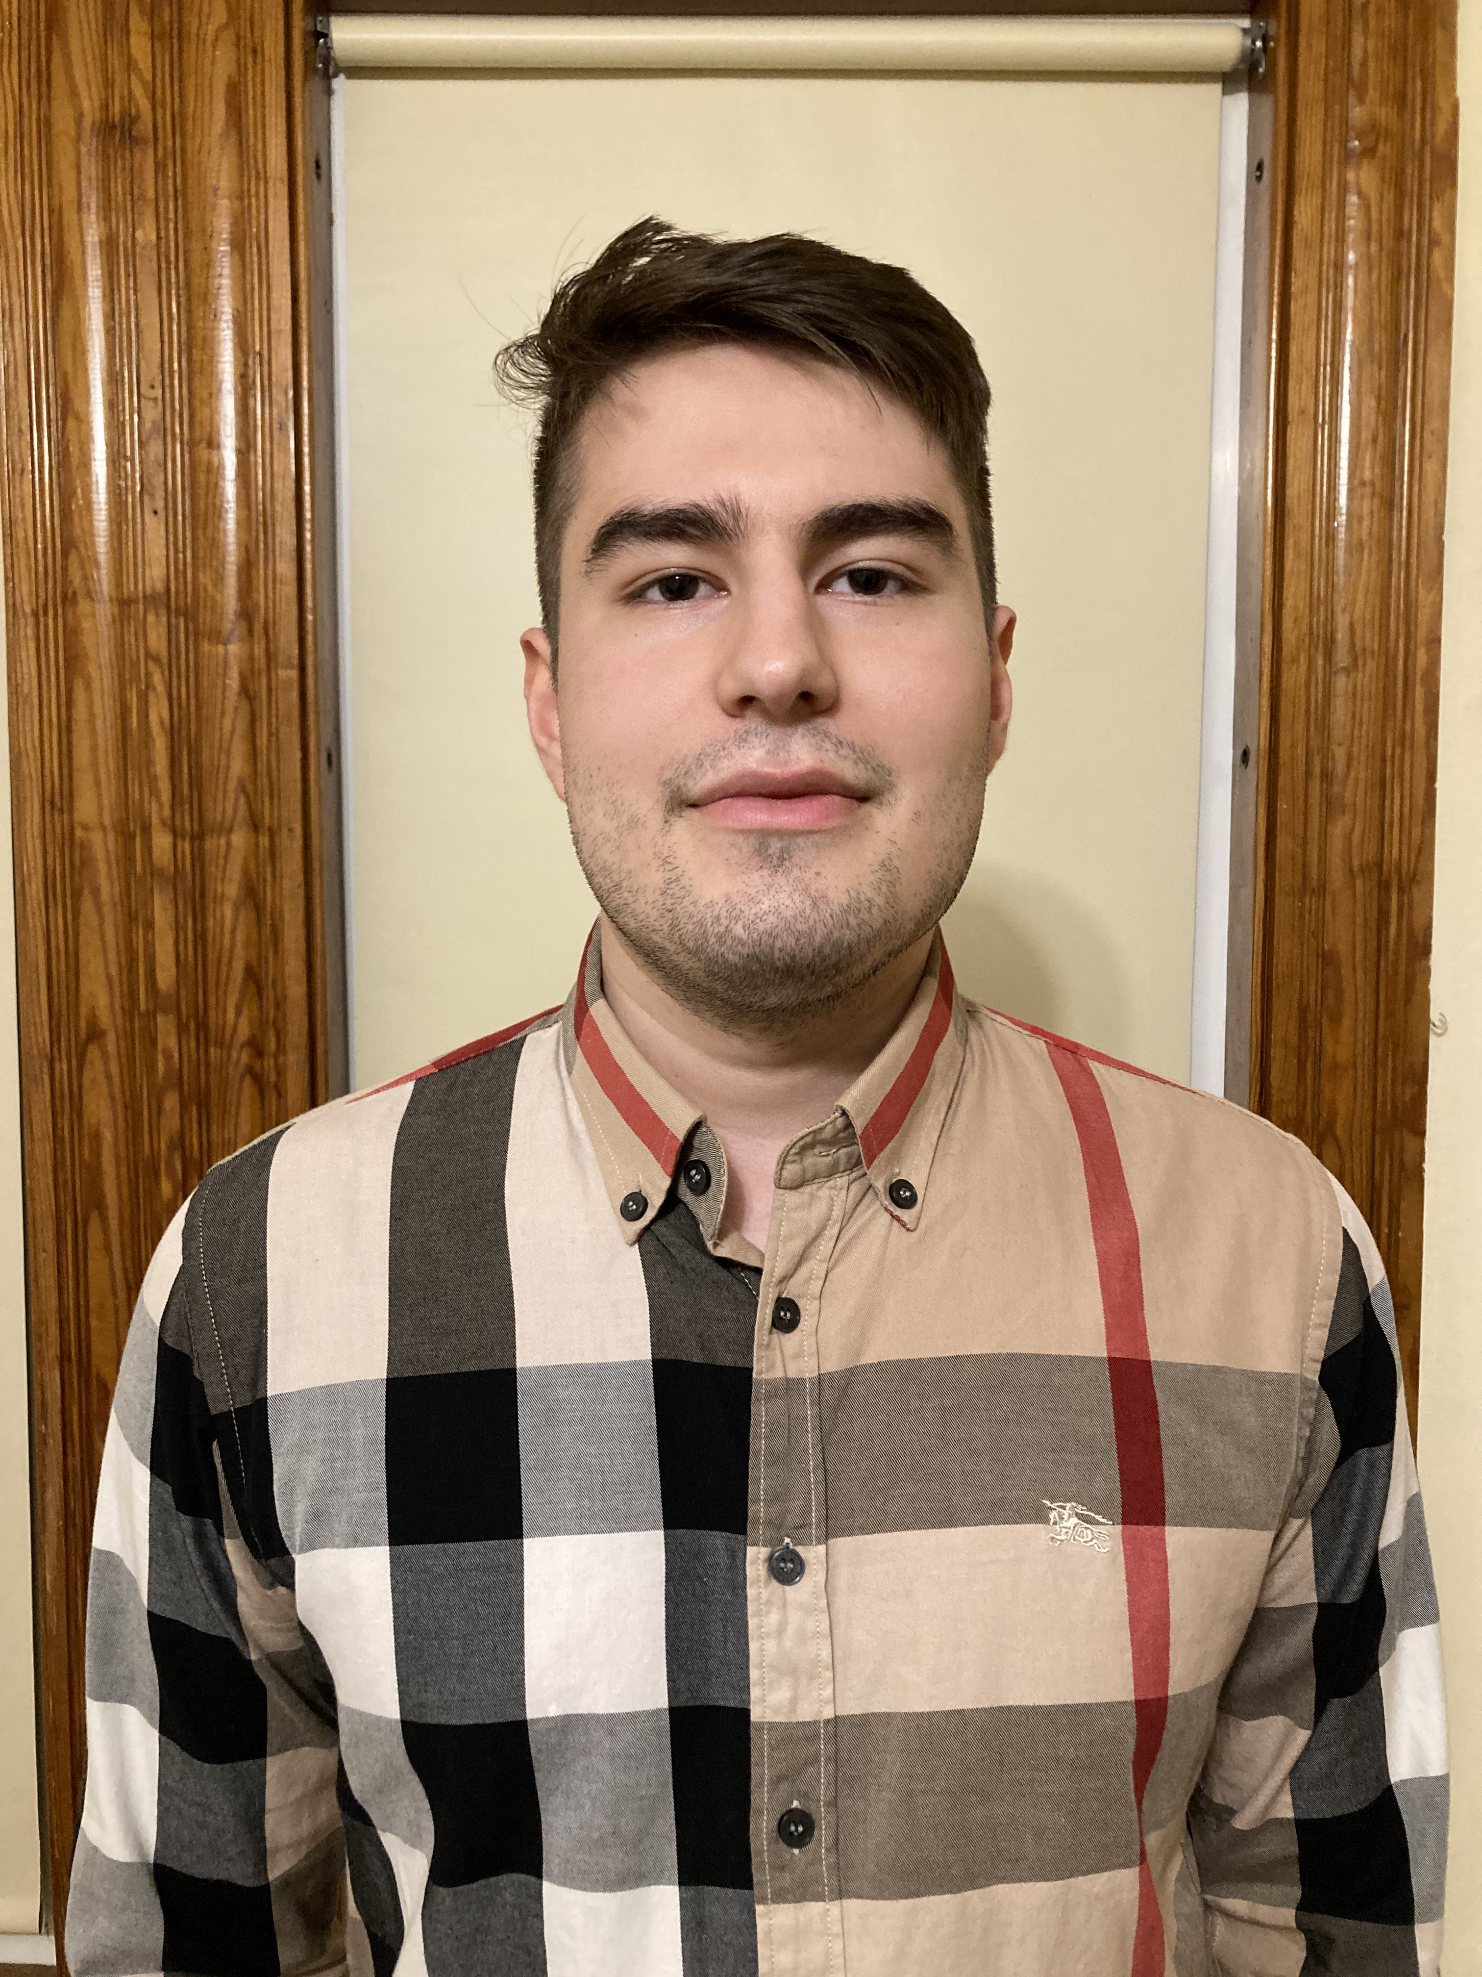
The GRC On-Site Team
Conference Venue Manager
Jamshid Ahmadi
AV Manager
Eric Pacific
For any questions please visit the GRC office-we’re here to help!
Notes:
Introduce and point yourselves out to the audience. Remember to point out the A/V station so people know where to find the A/V Manager.

Slide 3
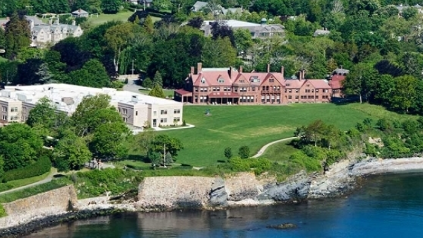
Conference Event Locations
GRC Office | Commons Building Second floor, room 211
Poster Area | Pettengill Hall
Meals Schedule | Breakfast: 7:30 – 8:30 am Lunch: 12:30 -1:30 pm Dinner: 6:00 pm – 7:00 pm
Conference Photo Location | Monday at 8:30 am – 9:30 am Back of Olin Arts Center
Notes:
Point out the areas where people will go for the Office, Poster Area, Meals and the Conference Photo.

Slide 4
GRC Office Hours and Contact Information
GRC Office Hours
Sunday | 12:00pm – 8:00 pm
Monday – Thursday Friday | 8:00am – 4:00pm 8:00am – 10:00 am
Saturday (GRS only) | 12:00pm – 5:00pm
WIFI Information: Bates Open
Email: Bates_SM@grc.org
Notes:
Briefly explain the office hours for the GRC

Slide 5
Schedule and Reminders
Monday
Power Hour 3:00-4:00pm
For All Attendees!
4th Floor Kalperis Hall
Receipts due for Travel Expenses
Upload to your myGRC account
Tuesday
Business Meeting Wednesday 7:00 pm
Olin Arts Center
Vice Chair Election for GRC
Venue Selection
Evaluation Forms
Wednesday
Notes:
Briefly go over reminders

Slide 6
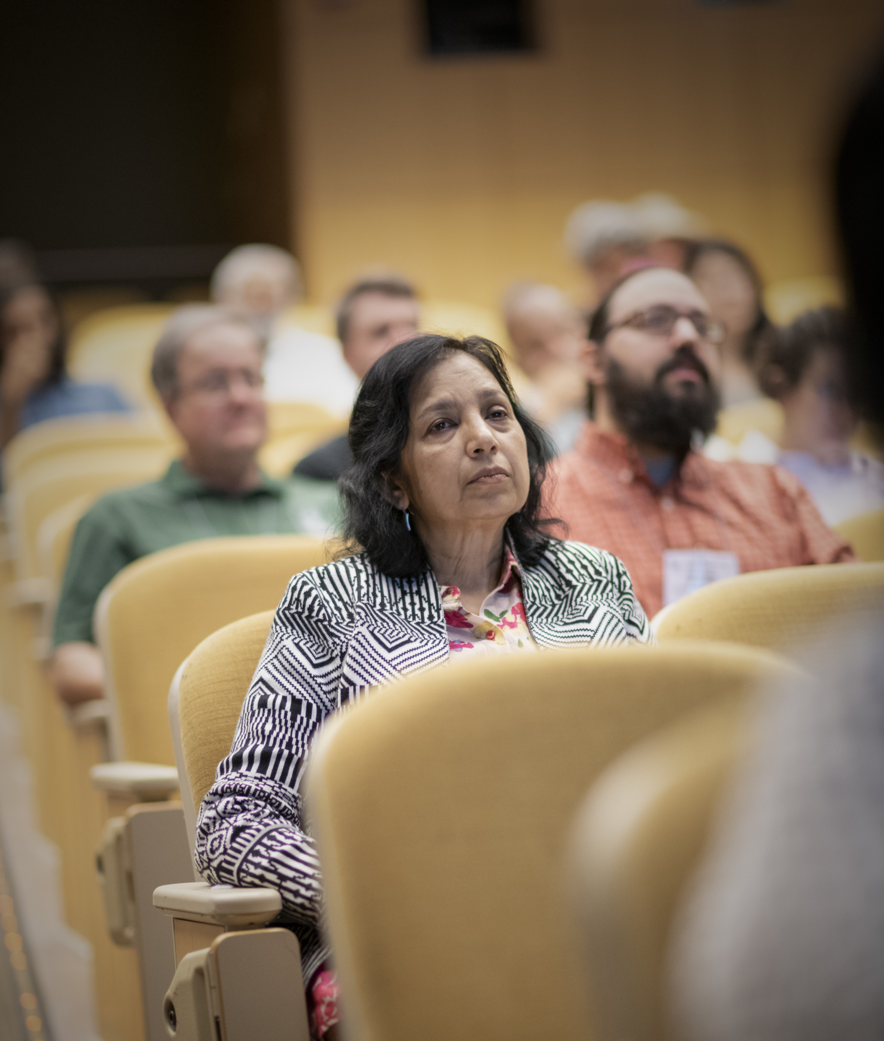
GRC’s Policy: Science and Poster Sessions are Off the Record
Notes:
To encourage open communication, each attendee agrees that any information presented is not for public use. Any audio or video recording or quoting of formal talks, posters or discussions is prohibited along with sharing this information on social media.

Slide 7
Scientific Misconduct Policy
Falsification
Although the GRC Board of Trustees does not believe scientific misconduct is a large issue at GRCs/GRSs,
they have approved a policy to assure every GRC community that scientific research misconduct will not be tolerated.
Plagiarism
Notes:
Although the Board of Trustees does not believe scientific research misconduct is an issue within the GRC community, a policy was established in the unlikely event that it should take place during the conference. Scientific research misconduct will not be tolerated. Please bring any allegations to the attention of the conference chair and/or GRC staff.

Slide 8
Inappropriate Behavior Policy
Falsification
GRC does not tolerate illegal or inappropriate behavior at any conference site, including violations of laws pertaining to alcohol, destruction of property, or harassment of any kind. GRC condemns inappropriate or suggestive acts and/ or comments that demean another person by reason of: gender, gender identity or expression, race, religion, ethnicity, age, or disability. Or that are unwelcome or offensive to other members of the community, or their guests.
Plagiarism
Notes:
To maintain an open and respectful community of scientists, GRC does not tolerate illegal or inappropriate behavior at any conference site, including violations of laws pertaining to alcohol, destruction of property, or harassment of any kind. GRC condemns inappropriate or suggestive acts and/ or comments that demean another person by reason of: gender, gender identity or expression, race, religion, ethnicity, age, or disability. Or that are unwelcome or offensive to other members of the community, or their guests.

Slide 9
Inappropriate Behavior Policy
and Reporting Process
If you believe you have been subjected to or experienced behavior that violates
GRC’s Acceptable Behavior Policy,
please see the chair, vice chair or Conference Venue Staff so that steps can be taken to address the situation immediately.
Notes:
If you become aware of allegations or witness illegal or inappropriate behavior at the conference, please report such information to GRC Staff or notify the President and CEO, Dr. Nancy Ryan Gray using the Report Inappropriate Behavior form located in your myGRC account.

Slide 10
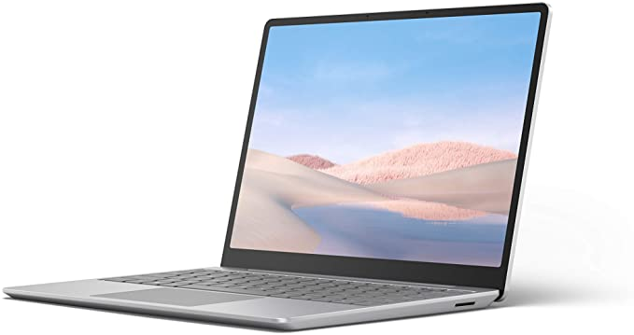
Best Practices
Speakers and Discussion Leaders
Please arrive 30 minutes before the session start time with your laptop or devices
GRC
All Attendees
Please place all devices on silent or do not disturb
Notes:
If you are a speaker or discussion leader, please arrive 30 minutes prior to the beginning of each session to work with the A/V Manager. Be sure to bring your own devices or a portable drive to display your slides. During each session, please turn your devices on mute or do not disturb to avoid any interruptions. If you have any questions regarding these policies or need any assistance, please speak with GRC staff.

Slide 11
COVID-19 Policies and Procedures
Masks are required in all conference spaces, except when
eating or drinking. Please practice social distancing as much
as possible during the science sessions, poster sessions and
social time.
Notes:
Face coverings must be worn in all GRC conference spaces regardless of vaccination status. Please practice social distancing. If you do not have a face mask or lose your face mask, please talk to the Site Manager or the A/V Manager for a GRC mask.

Slide 12
COVID-19 Policies and Procedures
If you feel ill or are experiencing any symptoms of COVID-19, please self-quarantine in your hotel room, and inform GRC venue staff via email.
Information on local testing facilities for those experiencing symptoms can be found on the GRC website.
Notes:
If you are experiencing any symptoms of illness, please self-isolate in your hotel accommodations, and do not attend the conference. Please email on-site GRC staff to notify us you are ill, and we will provide you with resources to arrange transportation to a nearby testing site. This information can also be found on the GRC website, on the (YOUR VENUE NAME HERE) Information Sheet.

Slide 13
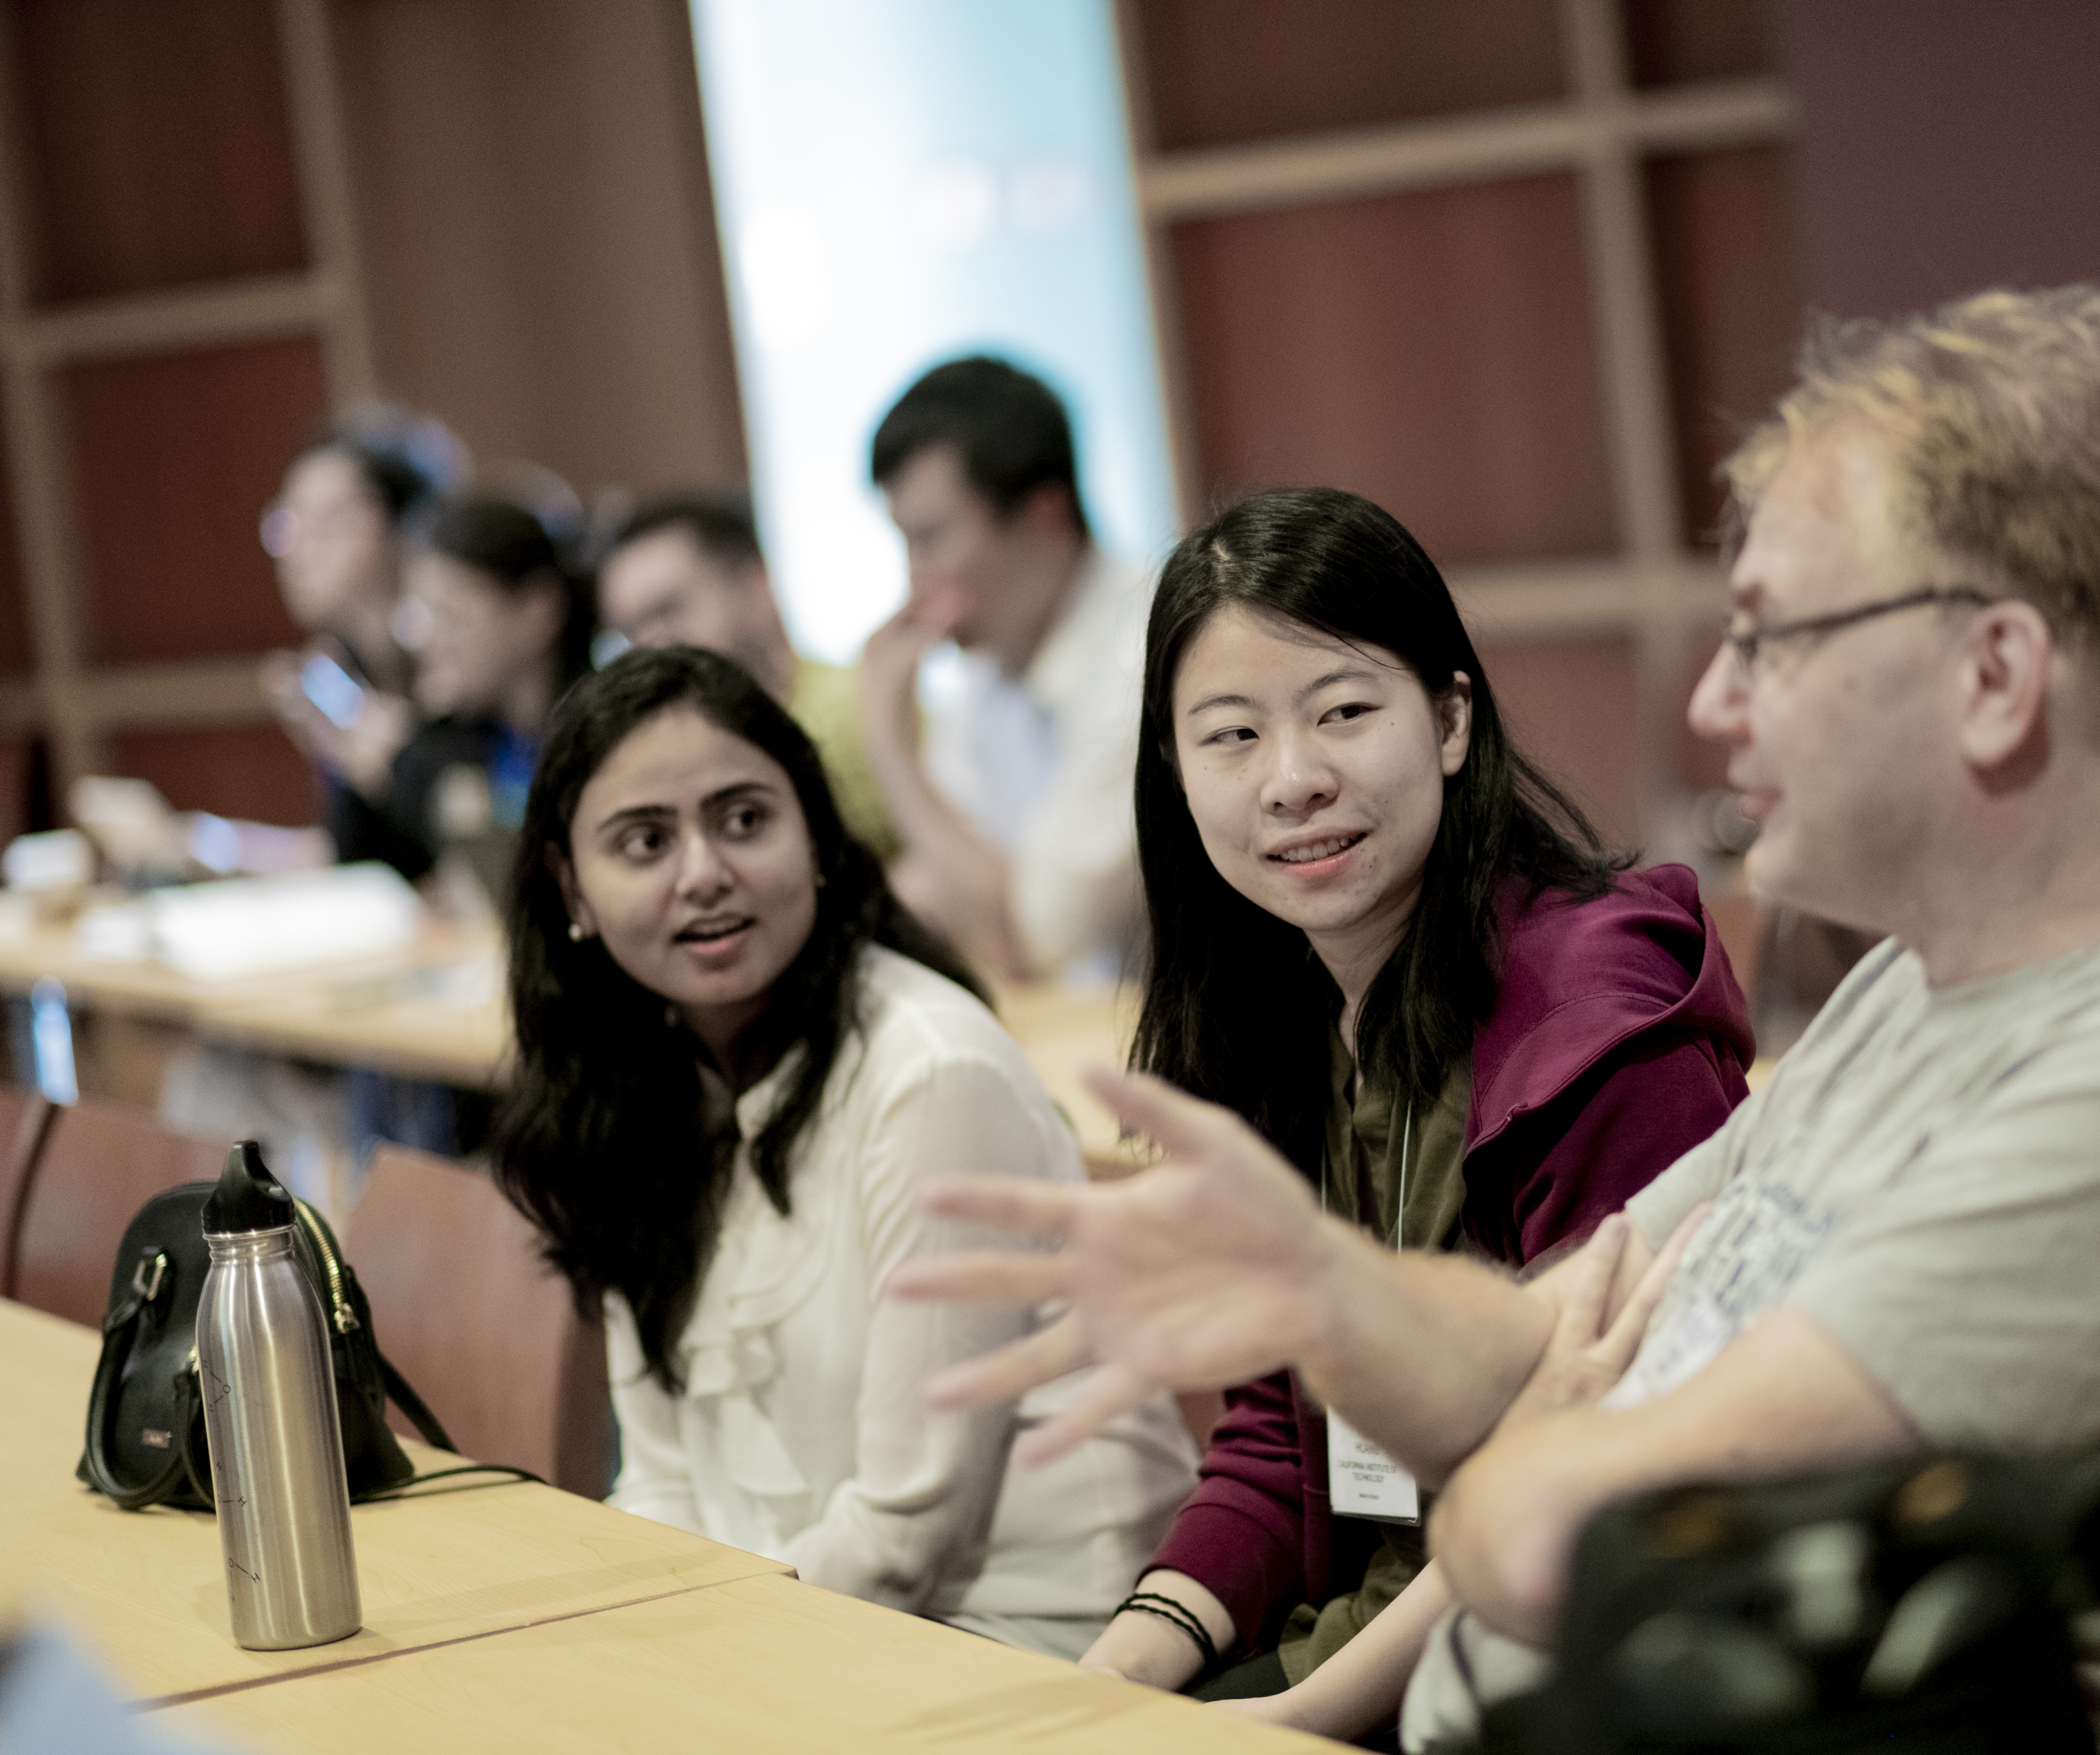
Thank You
Notes:
Throughout this week you will respond to the needs of the worldwide scientific community while diversifying your field and encouraging young scientists as they continue to establish their own career paths. Our hope is by the end of this conference, you leave feeling inspired and proud to be part of a community that is advancing the frontiers of science. Thank you again for joining us and we hope you have a wonderful week.

Slide 14
Diffraction Methods in Structural Biology (GRC) gratefully acknowledges support from these contributors:

Slide 15
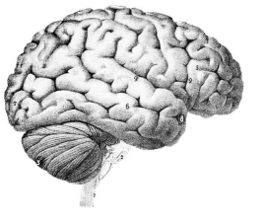
Critical Challenges in Structural Biology
$$$
Predicting crystallization outcomes
Getting crystals to diffract better
Is the ligand there or not?
Anisotropic diffraction
Radiation damage
Phase problem
Metals (anaerobic)
What is “resolution”
Serial crystallography (processing)
Non-isomorphism & multi-crystal methods
?

Slide 16
What is a trillion dollars?
80 T
5.0 T
4.5 T
3.6 T
1 T
~1 T
700 G
300 G
45 G
5.6 G
gross world product
CARES + HEROES Acts
USA Federal Budget (2019)
USA health care (2018)
Apple Inc. (2018)
3 yr∙life∙salary cancer & heart
USA Department of Defense
NASA Apollo program (adj $)
National Institutes of Health
mentions "cancer"

Slide 17
A trillion dollars for NIH
Fund all applications (5 yr)
1000 XFELs & 10⁵ Titan Krios
$10 M / biologist
PI, postdoc, student, tech
Q: would that solve
all your problems?
?

Slide 18
How to end a pandemic?
R_{e} < 1
Until # cases < 1
i.e. 90% effective every week for ~16 weeks
Need ~10⁹ tests/day

Slide 19
Seven billion tests for seven billion dollars (How to end a pandemic in 16 weeks)
Problem
$1000/test is infeasible
PPE
Centralization -> logistics
Specialized equipment
Specialized skills
Antibodies unreliable?
Solution
$1 test
Self-test
decentralize
Pre-distributed hw
YouTube training
Robust reagents

Slide 20
1/2” ID black rubber tubing
3/8” ID black rubber tubing
smart
phone
lens
1 cm
dia.
acrylic
ball bearing
Blue
filter
Green
filter
smart
phone
lens
sample
flash
LED
CMOS sensor
flash
LED
Rubber gasket
(disk with hole in middle)
CMOS sensor

Slide 21
Massively Manufacturable Fluorimeter
sample
cover
AA battery
cutting guide
Excitation stage
Emission
stage
Sample
holder
Final ball
lens
2nd filter
Focal
spot at
sample
AAA
battery
cutting
guide

Slide 22
Goals of Methods Development
Impossible → Expensive
Expensive → Cheaper
Difficult → Easier

Slide 23
Magic Microscope
Visualize a single molecule
spatial resolution 1 Å
temporal resolution: ~100 fs
Watch same molecule indefinitely
No damage to molecule/patient
Ability to tap / tug
Handheld & common
Q: what would you look at first?
Q2: how long before end of disease?
second

Slide 24
Critical Challenges in Structural Biology
$$$
Predicting crystallization outcomes
Getting crystals to diffract better
Is the ligand there or not?
Anisotropic diffraction
Radiation damage
Phase problem
Metals (anaerobic)
What is “resolution”
Serial crystallography (processing)
Non-isomorphism & multi-crystal methods

Slide 25
If I had a trillion dollars …
Predict crystallization conditions
from sequence
$ 500 M
$ 131 B
$ 527 B
$ 335 B
$ 1.0 T
10x
Re-do all structures in PDB
Buy Google
Buy Facebook
10 zettaflops
Success? → impact?

