Slide 1
FY23 LDRD Presentation
Ken Goldberg & James Holton
Faculty Associate
Optimized Protein Crystallography Beamlines for ALS and ALS-U

Slide 2
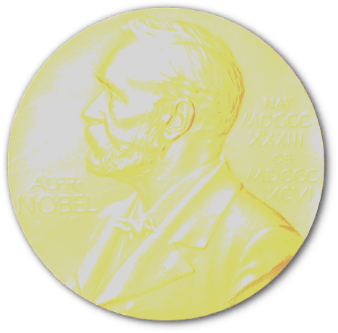
Crystallography: best tech for visualizing chemistry of biology ligands, metabolites & engineering function
High-profile programs at ALS PX beamlines
30x brightness possible @ALS-U (5x @ALS)
Small beam → more information (resolve time & space)
current optics: less intensity at ALS-U
Better optics are now possible!
high-impact science
wide range of uses
Atomic visualization:
metabolites – JBEI, JGI
engineering function – JBEI
Nanomaterials – MF
Physiological temperature
diverse user community
free to academic
>170 pubs/year
Doudna
CRISPR structures
6
ALS
8.3.1
6
cryoEM
2
SLS

Slide 3
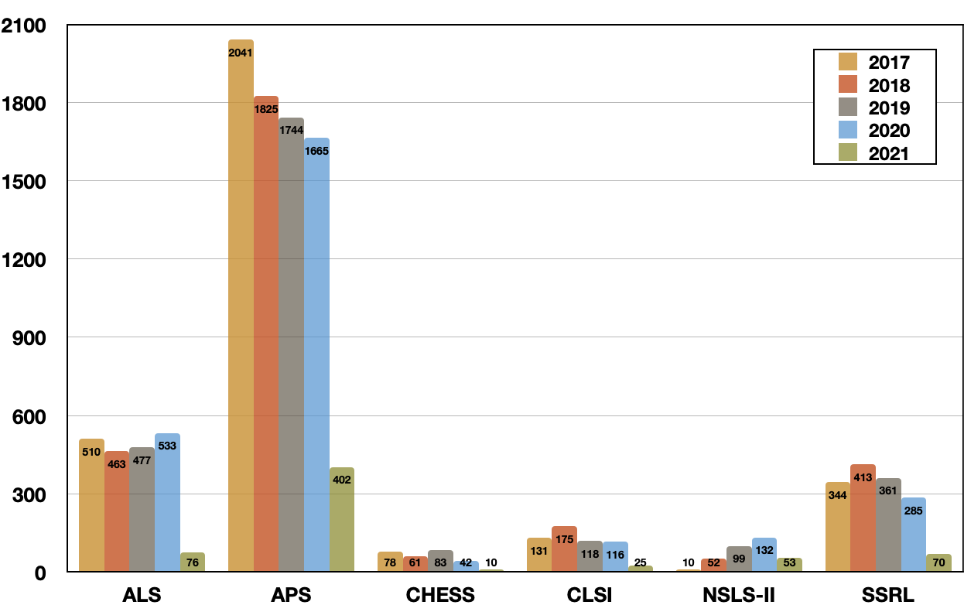
Updating biological beamlines is required for LBNL’s leadership in crystallography and science. (e.g. Doudna)
Impact: LBNL gains forefront capability
APS dark Apr 2023 → spike in demand
4 bioscience beamlines directly benefit
20 hard X-ray beamlines at LBNL (~10 bio)
Opportunities for future funding
Both NIH, NSF have well-funded programs for shared instrumentation
mostly geared towards turnkey commercial equipment
difficult to justify with no design nor preliminary results in hand
this LDRD will provide key proof of principle, blueprints and plans
Structures published

Slide 4
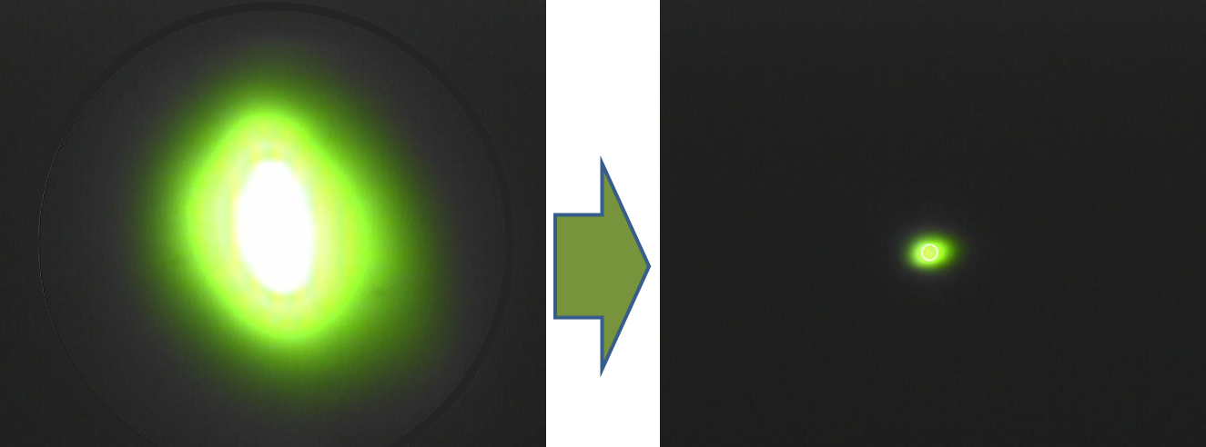
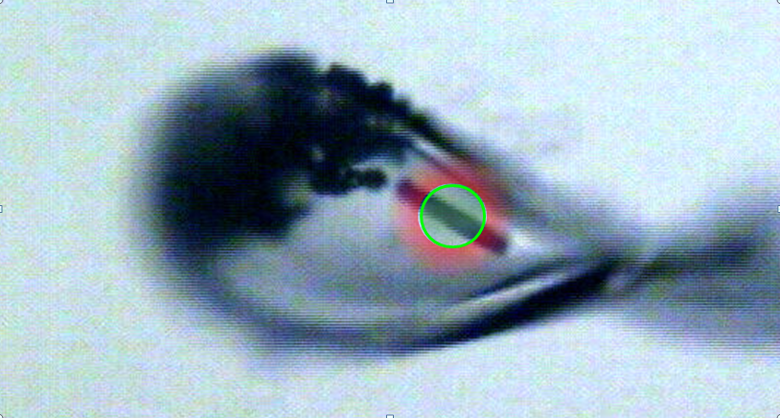
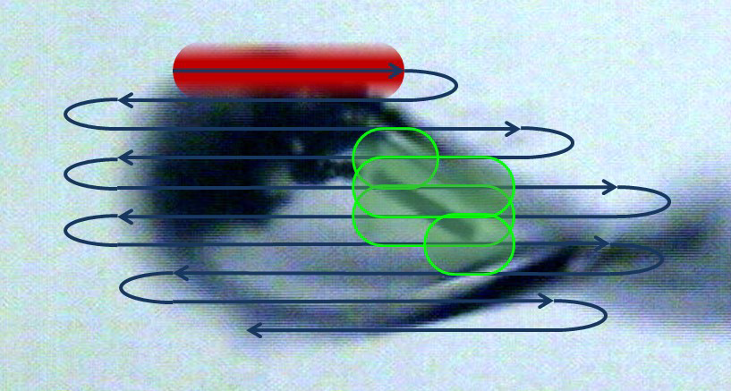
100x information enables radiation damage correction revealing biologically relevant chemistry
Old way
Average image
Radiation damage uncorrectable
increases with time
Bits ~ 1/size²
Time & space info + linear corrections
New way

Slide 5
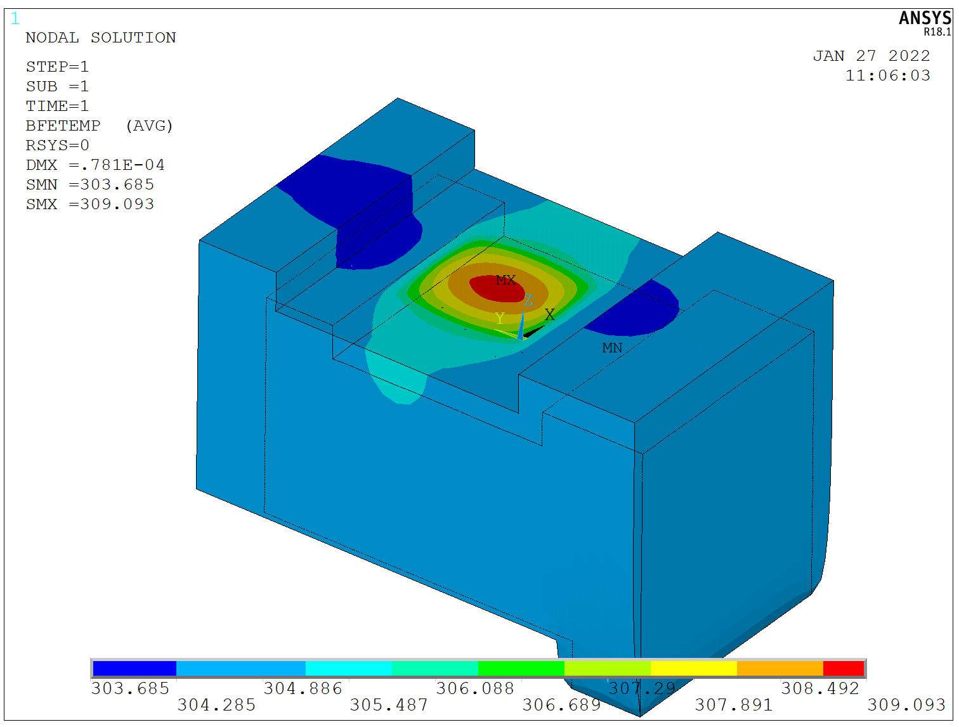
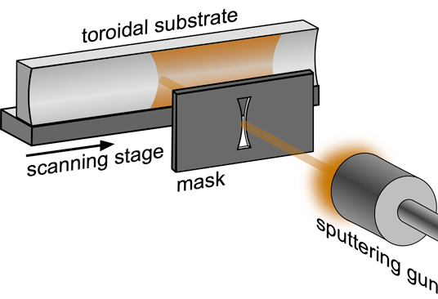
How to make the beam smaller: leverage $650M investment
Thermo-mechanical engineering and advanced figuring will support nearly ideal optical performance from monochromator crystals.
Ideal beam-focusing properties
Focusing using an optimally shaped mirror. Mirror fabricated with differential deposition. Metrology performed with a new visible-light measurement system.
FEA thermal model
Re-engineered cooling designs benefit from ALS-U development.
The reduced x-ray source size reveals strong aberrations in existing mirrors. A new class of mirrors optimizes the focus.
650 million to make the beam smaller

Slide 6
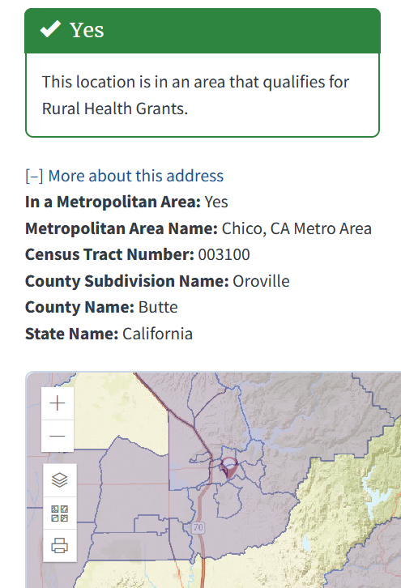
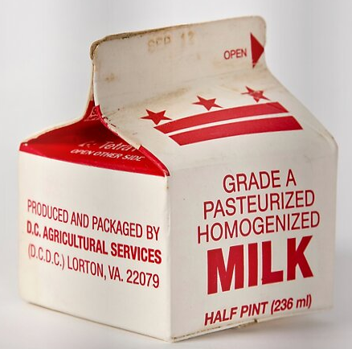
Incorporation of diverse voices in a safe space is required for success in complex, multi-disciplinary projects
Past
NIH NOT-OD-20-031
Individual from disadvantaged background
Caltech
2020/22 Gordon Conference
Diverse beamline User base
Present
Lab Ambassador Program
Future
Postdoc - engineering
“Handshake” via talent.lbl.gov

Slide 7
Optimized Protein Crystallography Beamlines for ALS and ALS-U
PI(s) | ALS: Kenneth Goldberg; (G. Cutler) Collab: H. Padmore, D. Cocco, A. MacDowell, A. Doran MBIB: James Holton; (George Meigs) ALS: Postdoc Step 1
Budget | Total FY23 request = $364k 68:32 split ALS:MBIB $46k M&S + $318k labor (0.32-FTE PI + 0.3-FTE staff + 1.0 FTE Postdoc) MBIB: 0.3 FTE + $140k non-LDRD (NIH equipment supplement)
Challenge Statement | Transform data collection in x-ray protein crystallography by applying developments in modern x-ray optical design, thermo-mechanical engineering, and data processing.
Scientific Goals | FY’23: Demonstrate in existing beamline. FY’23: Demonstrate differential deposition mirrors. FY’23: Demonstrate novel visible-light metrology on highly curved optics FY’24: Complete proposal for BL replacement.
Benefit to LBNL | timely advantage over other National Labs catalyzed by APS-U secure future @LBNL – atomic res bio-imaging, metabolites, ligands, pathogen defense design + precedent = external funding

