Slide 1
Acknowledgements
http://bl831.als.lbl.gov/~jamesh/powerpoint/ESRF_noniso_2020.pptx
Robert Stroud James Fraser
Paul Adams John Tainer Greg Hura Nick Sauter
Aina Cohen Jenny Wierman Art Lyubimov Sabine Hollatz
UCSF LBNL SLAC
ALS 8.3.1: TomAlberTron
NIH NIGMS R01 GM124149 NIAID P50 AI150476
NIH NIGMS P30 GM124169 R01 GM117126
DOE-BER Integrated Diffraction Analysis Technologies (IDAT)
Plexxikon, Inc. Relay Therapeutics
NIH NIGMS P41 GM103393, NSF DBI-1625906
The Advanced Light Source is supported by the Director, Office of Science, Office of Basic Energy Sciences, Materials Sciences Division, of the US Department of Energy under contract No. DE-AC02-05CH11231 at Lawrence Berkeley National Laboratory.

Slide 2
Structural Biology
with a
Trillion Dollars

Slide 3
Non-isomorphism
ancient enemy? or blessing in disguise?

Slide 4
Multi-crystal strategies
Kendrew et al. (1960) "Structure of Myoglobin” Nature 185, 422-427.

Slide 5
Multi-crystal strategies
Kendrew et al. (1960) "Structure of Myoglobin” Nature 185, 422-427.

Slide 6
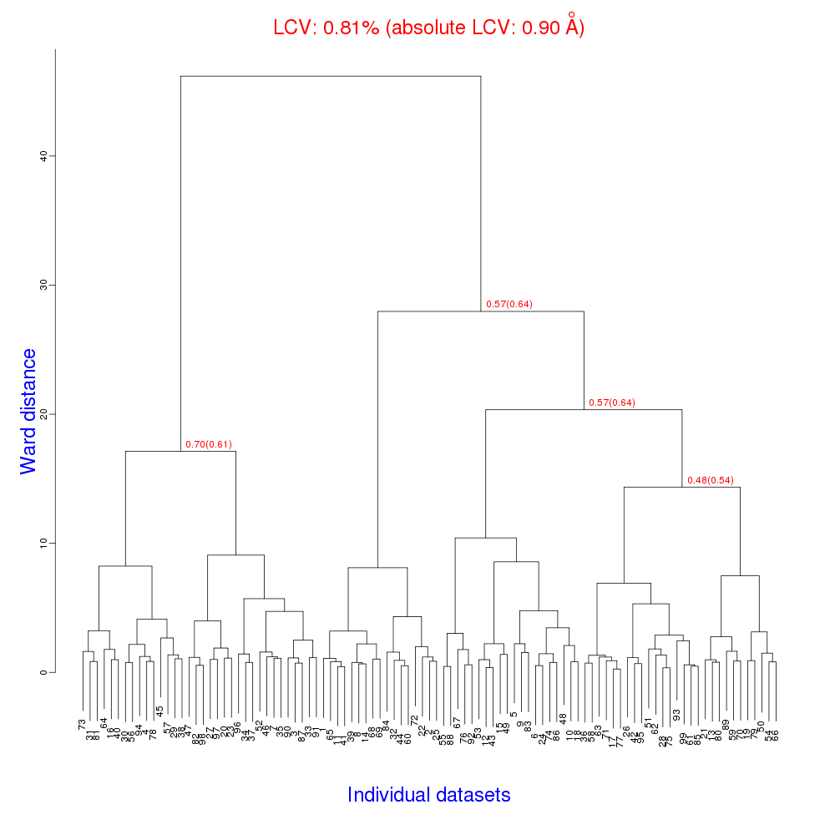
Cell clustering: 100 datasets
Reality:
Perfect isomorphism
(simulated data)

Slide 7
Micro-focus challenge
5 µm xtals
5 µm beam
~ 5 img / xtal
P2₁2₁2₁
XDS thinks:
P422
Holton, J. (2019). Acta Cryst. D 75, 113-122.

Slide 8
Magdoff & Crick (1955) “Ribonuclease II. Accuracy of measurement and shrinkage”, Acta Cryst. 8, 461-8.
Crick & Magdoff (1956) “The theory of the method of isomorphous replacement for protein crystals”, Acta Cryst. 9, 901-8.

Slide 9
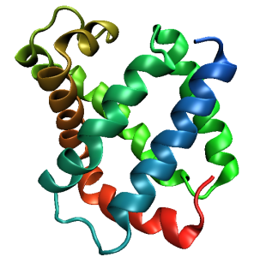
Same structure, different cell
0.5% cell change → 15%
Crick & Magdoff (1956) “theory method isomorphous replacement”, Acta Cryst. 9, 901-8.

Slide 10
Same structure, different cell
0.5% cell change → 15%
Crick & Magdoff (1956) “theory method isomorphous replacement”, Acta Cryst. 9, 901-8.

Slide 11
Same cell, rotated protein
0.5° rotation → 16%
Crick & Magdoff (1956) “theory method isomorphous replacement”, Acta Cryst. 9, 901-8.

Slide 12
Same cell, rotated protein
0.5° rotation → 16%
Crick & Magdoff (1956) “theory method isomorphous replacement”, Acta Cryst. 9, 901-8.

Slide 13
Uniform stretch
5% change → 0%

Slide 14
Uniform stretch
5% change → 0%

Slide 15
Non-isomorphism in lysozyme
Dear James
The story of the two forms of lysozyme crystals goes back to about 1964 when it was found that the diffraction patterns from different crystals could be placed in one of two classes depending on their intensities. This discovery was a big set back at the time and I can remember a lecture title being changed from the 'The structure of lysozyme' to 'The structure of lysozyme two steps forward and one step back'. Thereafter the crystals were screened based on intensities of the (11,11,l) rows to distinguish them (e.g. 11,11,4 > 11,11,5 in one form and vice versa in another). Data were collected only for those that fulfilled the Type II criteria. (These reflections were easy to measure on the linear diffractometer because crystals were mounted to rotate about the diagonal axis). As I recall both Type I and Type II could be found in the same crystallisation batch . Although sometimes the external morphology allowed recognition this was not infallible.
The structure was based on Type II crystals. Later a graduate student Helen Handoll examined Type I. The work, which was in the early days and before refinement programmes, seemed to suggest that the differences lay in the arrangement of water or chloride molecules (Lysozyme was crystallised from NaCl). But the work was never written up. Keith Wilson at one stage was following this up as lysozyme was being used to test data collection strategies but I do not know the outcome.
An account of this is given in International Table Volume F (Rossmann and Arnold edited 2001) p760.
Tony North was much involved in sorting this out and if you wanted more info he would be the person to contact. I hope this is helpful. Do let me know if you need more.
Best wishes
Louise

Slide 16
Non-isomorphism in lysozyme
Structure factor (e⁻)
Johnson’s ratio

Slide 17
Non-isomorphism in lysozyme
Structure factor (e⁻)
Johnson’s ratio

Slide 18
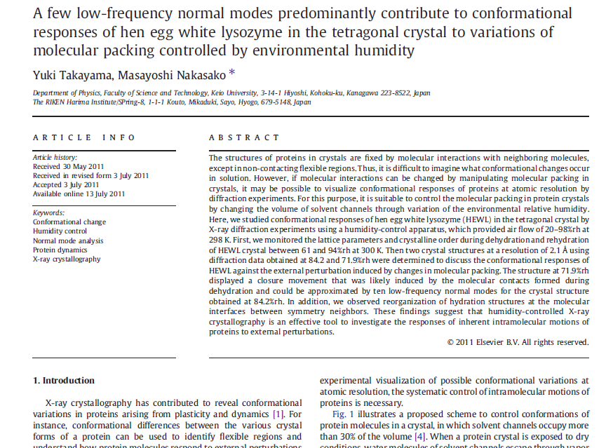

Slide 19
Non-isomorphism in lysozyme
RMSD = 1.70 Å
Δcell = 0.7 %
R_{iso} = 44.5%
RMSD = 0.18 Å
RH: 84.2%
vs 71.9%
3aw6
3aw7

Slide 20
Elastic deformation = non-isomorphism

Slide 21
Elastic deformation = non-isomorphism

Slide 22
Plastic deformation = poor diffraction

Slide 23
Plastic deformation = poor diffraction

Slide 24
Non-isomorphism in lysozyme
RMSD = 1.70 Å
Δcell = 0.7 %
R_{iso} = 44.5%
RMSD = 0.18 Å
RH: 84.2%
vs 71.9%
3aw6
3aw7

Slide 25
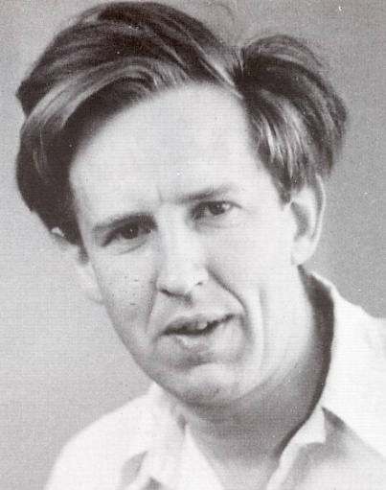
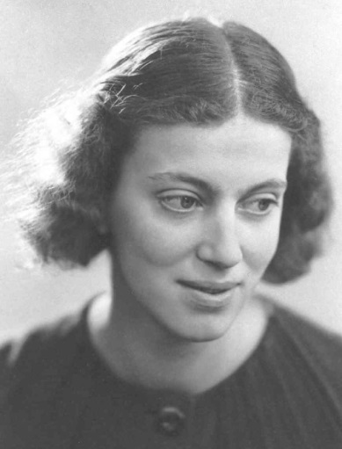
First diffraction from protein xtal
1934
Bernal, J. & Crowfoot, D. (1934). "X-ray photographs of crystalline pepsin", Nature 133, 794-795.

Slide 26
Dehydration: 1934
and 2018?
= 1.5 μL
100 μm
= 1.0 nL
2 mm
= 1.0 pL
10 μm
= 1.0 fL
1 μm

Slide 27
opened drop: you have ~30 seconds!
equilibrated drop

Slide 28
X-ray scattering “rules”:
Optimum: support thickness = crystal thickness
1 μm crystal ≈ 1 μm water
≈ 1 μm plastic
≈ 0.1 μm glass
≈ 1000 μm air
~ 50 mm He
≈ 370 mm sat water vapor @ 4C

Slide 29
Hygrostatic gradients
high
water activity
low
jet
loop

Slide 30
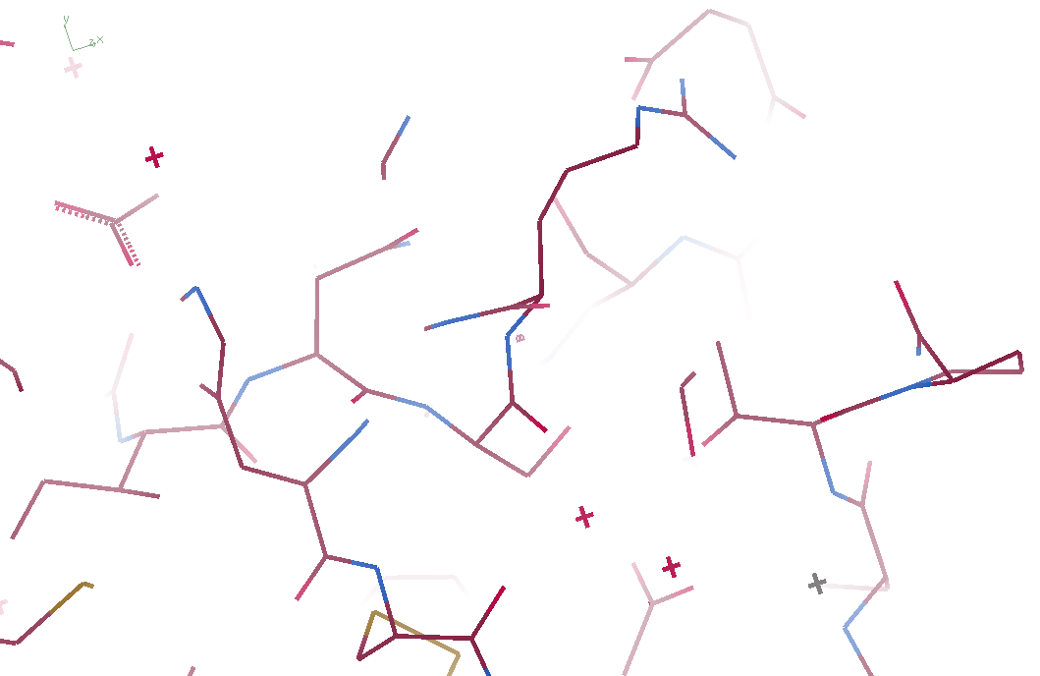
3aw6

Slide 31
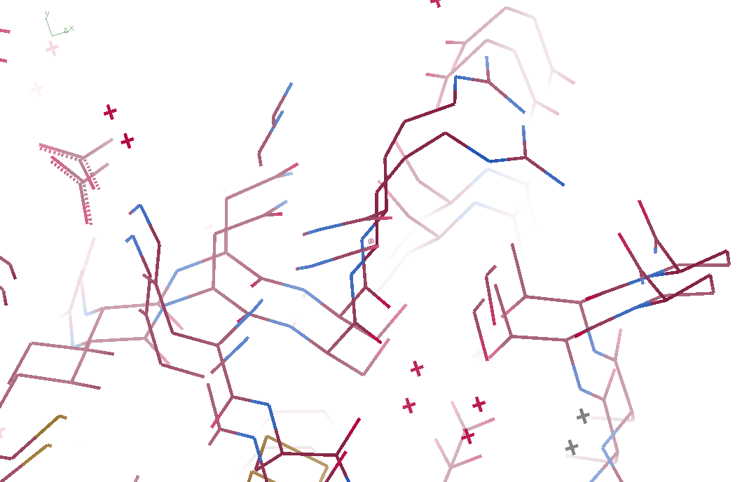
3aw6 3aw7

Slide 32
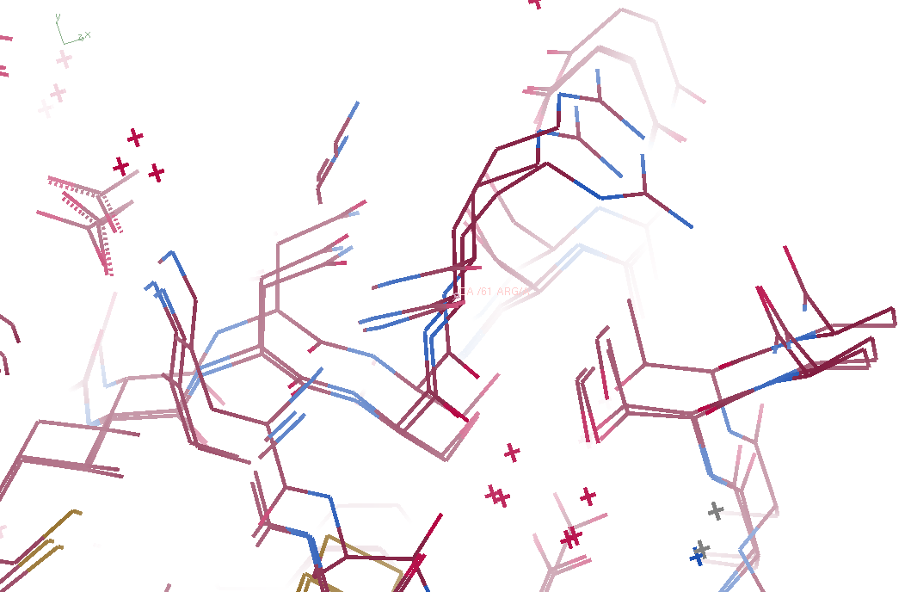
3aw6, 3aw7, “bent” 3aw6

Slide 33
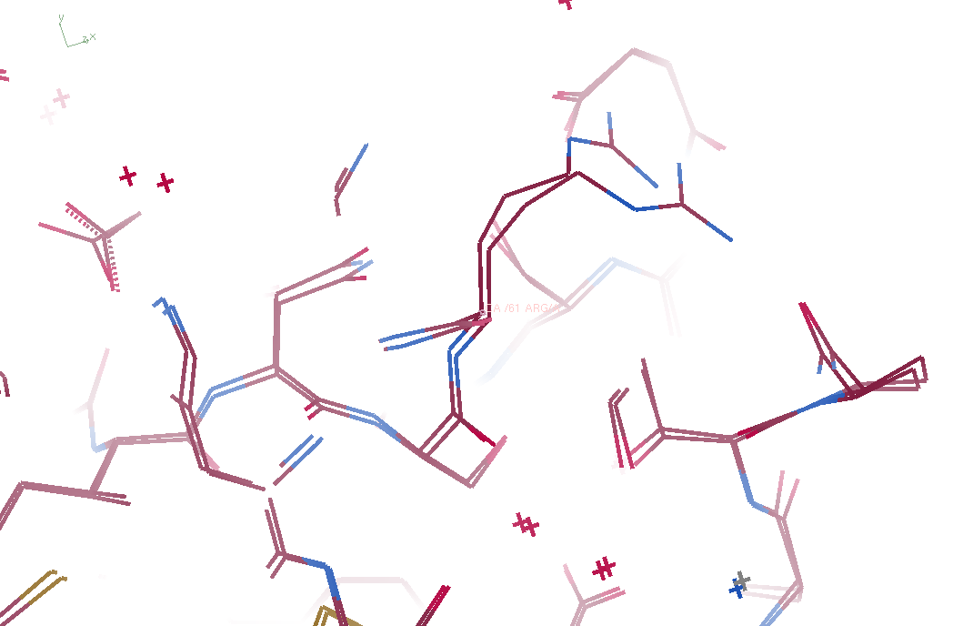
3aw7, “bent” 3aw6

Slide 34
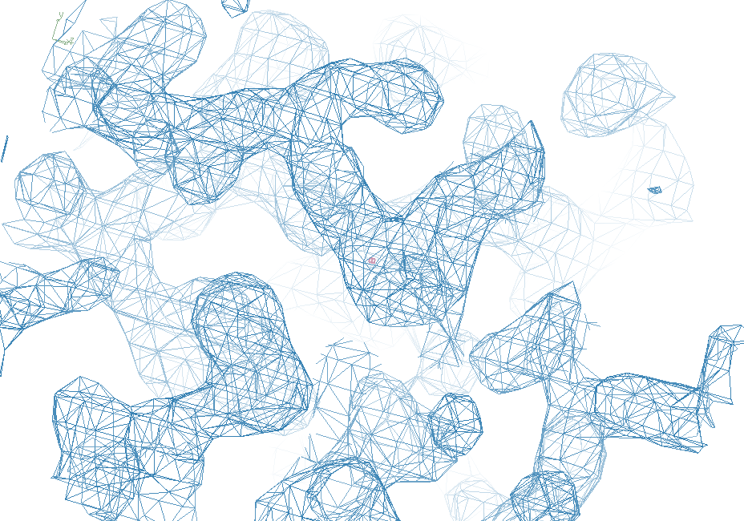
3aw6

Slide 35
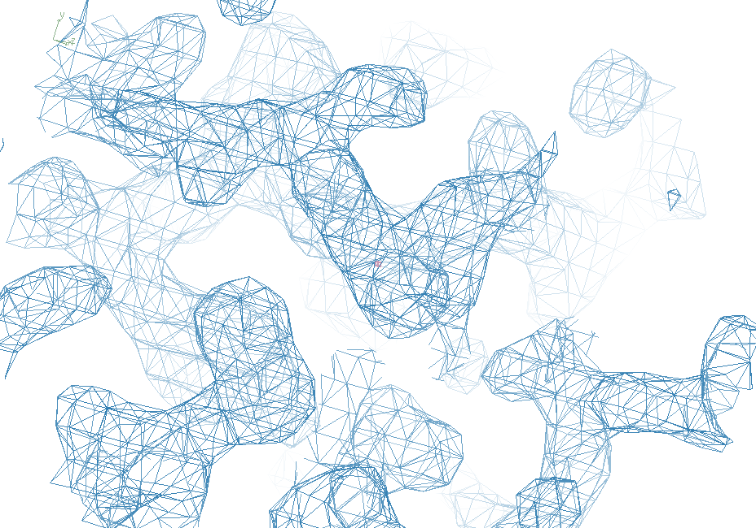
“bent” 3aw7

Slide 36
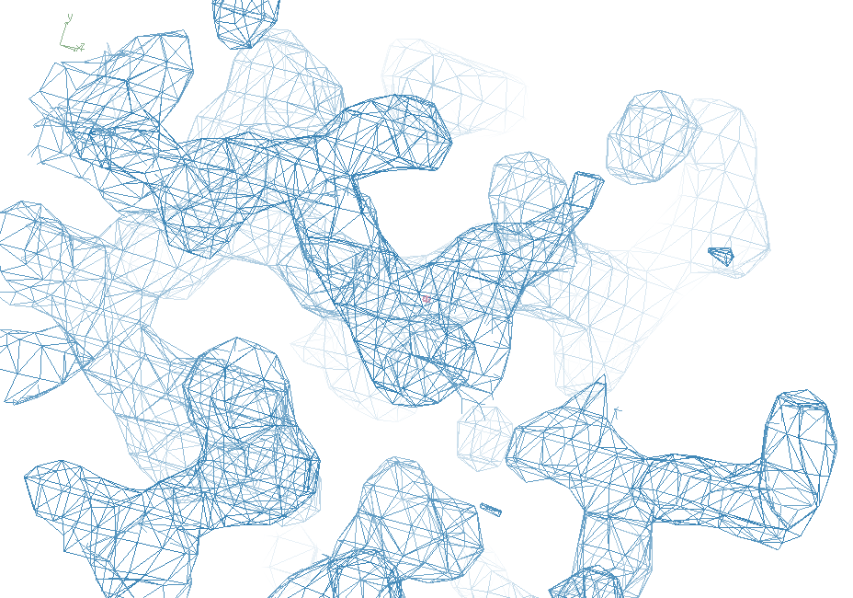
3aw7

Slide 37
Photosystem O=O bond?
Suga, M., et al., site of O=O bond formation in PSII
caught by XFEL. Nature, 2017. 543: p. 131.

Slide 38
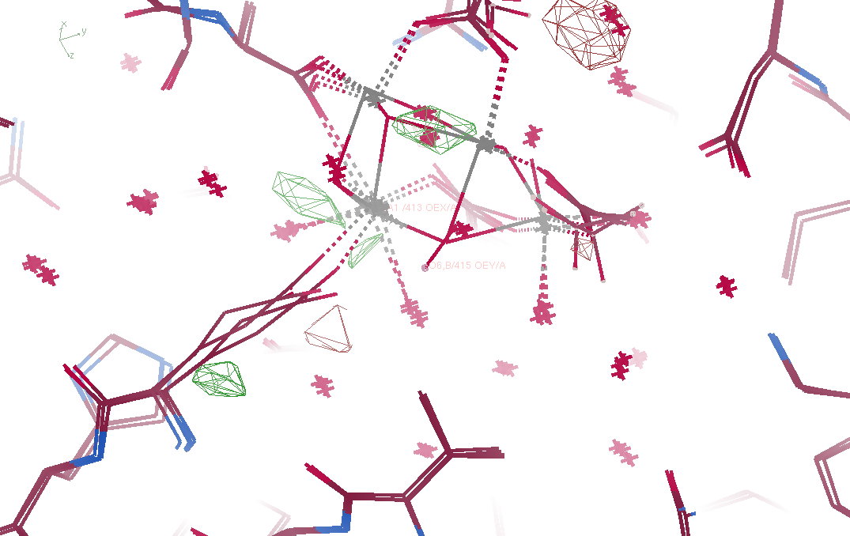
Fo – Fc maps
5ws5 vs 5ws6

Slide 39
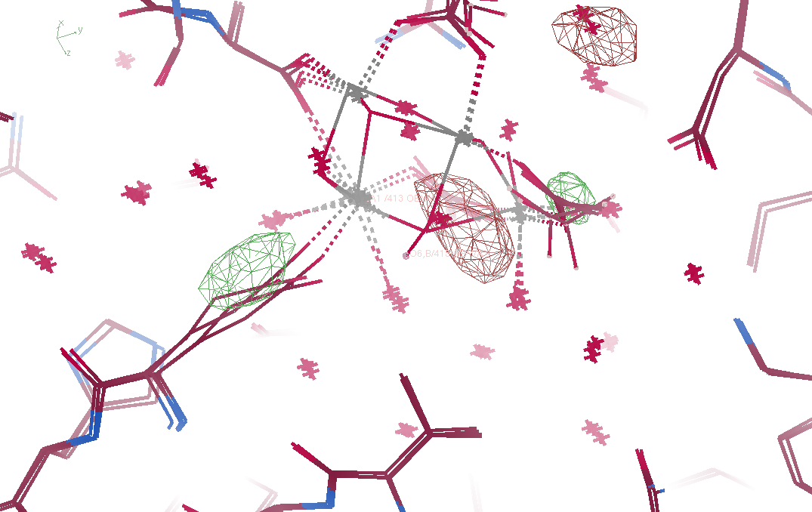
Fo – Fo maps
5ws5 vs 5ws6

Slide 40
“map bender” procedure
Convert to fractional coordinates
Basis functions: spatial sin waves

Slide 41
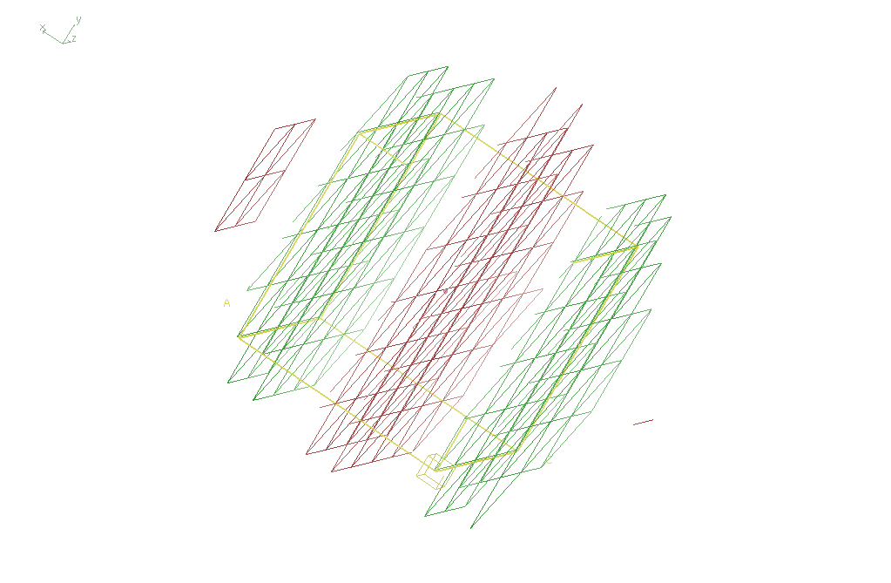
Basis function 1 0 0

Slide 42
“map bender” procedure
Convert to fractional coordinates
Basis functions: spatial sin waves
Repeats with unit cell
Low-order h,k,l indices first
Fit function to Δx vs x,y,z across P1 cell
Repeat with Δy, Δz
Apply to PDB file and interpolate map grid
Usually 3-5 orders comparable to LSQ

Slide 43
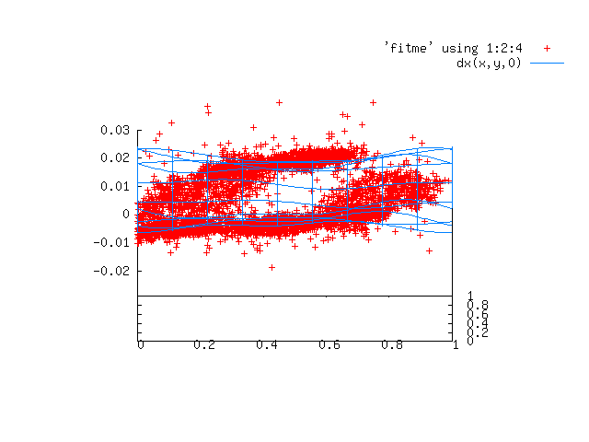

Slide 44
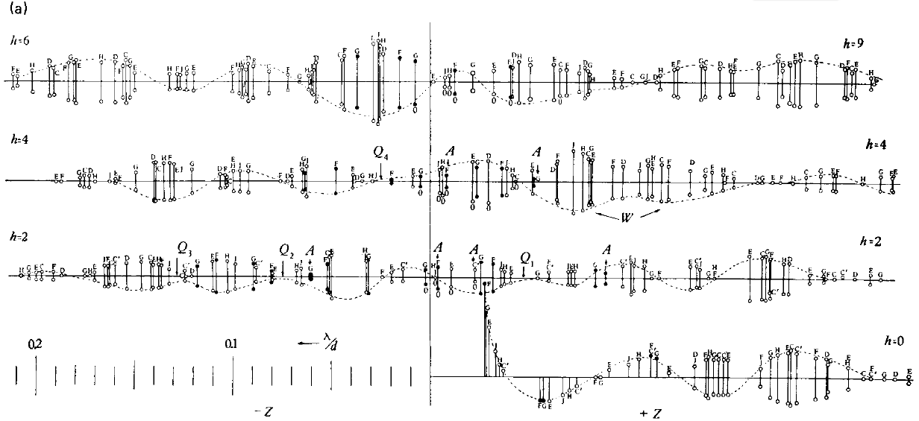
Bragg’s “minimum wavelength principle”
Perutz (1985). “Early Days of Cryst…” Methods in Enzymology, Vol. 114, 3-18.
Bragg & Perutz (1952)."external form haemoglobin I", Acta Cryst. 5, 277-283.

Slide 45
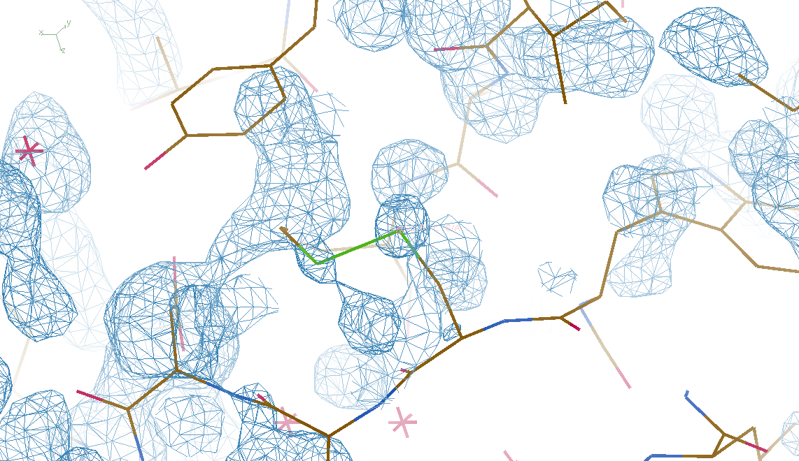
DMMULTI – fake data 4 deg rotation: 8 “xtals”: before
CC = 0.02

Slide 46
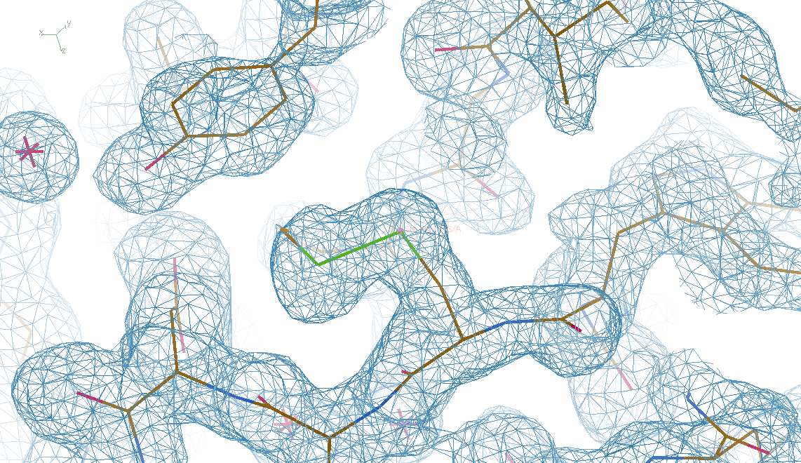
DMMULTI – fake data 4 deg rotation: 8 “xtals”: after
CC = 0.8

Slide 47
S-SAD merging 20 xtals
Knott et al. (2017). "Guide-bound CRISPR-Cas13a." Nature S&MB 24, 825

Slide 48
Systematic vs random error
intensity
observation

Slide 49
URLs & Summary
https://bl831.als.lbl.gov/~jamesh/powerpoint/
ESRF_noniso_2020.pptx
https://github.com/fraser-lab/holton_scripts/
tree/master/map_bender/
Cell does not always tell
humidity (& other vapors)
May reveal function
Re-sample molecular transform (NIP)
Ignore & merge?

Slide 50
Multi-crystal merge preparation
Take each pair of datasets
“othercell” to find all possible re-indexings
Apply all re-indexing operators in turn
Evaluate best agreement (R, CC)
Cluster by acceptable distance (20-30%)
Re-index clusters to common lattice
Apply xscale_isocluster, CODGAS, others?

Slide 51
Multi-crystal problem
< 20% = merge
% diff
% diff
% diff
% diff

Slide 52
Multi-crystal problem
< 20% = merge
comparisons
= (sets² )/2
* symops
Need
HPC

Slide 53
Trick Question: What is the space group?
a = 63 b = 63 c = 63
α = 90 β = 90 γ = 90

Slide 54
Pitfalls: sub-space groups
P622
What else?
P6₁22 P6₅22 P6₂22 P6₄22 P6₃22
P6 P6₁ P6₅ P6₂ P6₄ P6₃
P3₁2 P321 P3₁12 P3₁21 P3₂12 P3₂21
P3 P3₁ P3₂
P2 P2₁ C2 C222 C222₁
P1

