Slide 1
Is the ESRF UP for MX?
What do the users need?
they need their crystals to diffract
they want to study function!
What can ESRF provide?
~1 μm beams, 1 ms datasets
How do we connect the two?

Slide 3
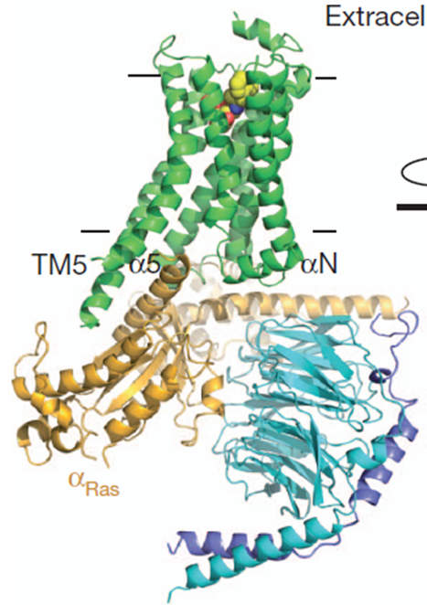
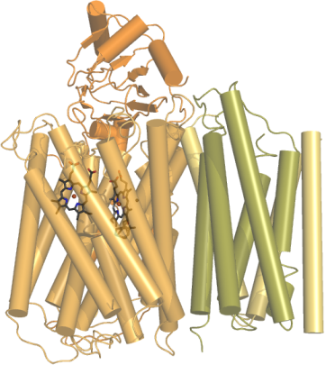
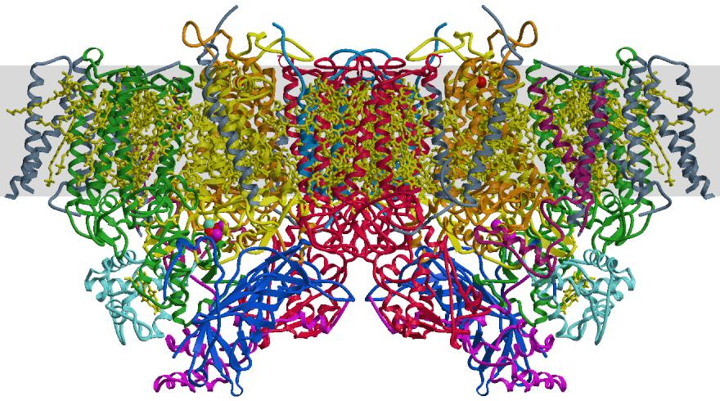
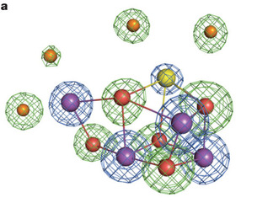
Types of questions
Are structural changes critical to proton pumping by terminal oxidases as oxygen is reduced to water?
Are structural changes important in light driven water splitting by photosystem II to create molecular oxygen?
Transient binding of G-proteins to GPCRs.
Oxidase
Photosystem II
GPCRs

Slide 4
Seeing is believing: the future of Structural Biology
Industry perspective:
Structural biology has played and will continue to play a critical role in medical research and drug discovery and any improvement or step change in technologies in this area will have a direct impact .
Structural biology has a defining role in understanding disease biology at the molecular level.
Structure based drug design and fragment based lead generation has become an integral part of drug discovery and easy and rapid access to state to the-of- the-art beam lines is critical.
New ways to screen fragment libraries or conditions for ligand binding would of course be highly valuable.
We constantly look for new technologies that can enable quicker access to structures and functional studies of challenging drug targets, particularly in the areas of membrane-bound, partially structured/highly dynamic and large, multi-subunit complex targets.
Mounting evidence suggests that conformational dynamics, in both the target and the ligand, can play an important and hitherto largely under-appreciated role in defining on- and off-target activity and access. Despite long-standing recognition of the dynamic nature of biological macromolecules, our understanding of how to get and use such information at the protein target level is still in its infancy.
Increasingly we are also studying off-target biological effects of our drugs candidates such as absorption, transport and metabolism involving functional studies of membranes, transporter proteins and enzymes.
A ‘holy grail’ of structural biology is the ability to obtain high-resolution structural and mechanistic information on biological molecules in their native cellular environment.
Implicit in our vision of a more diverse platform of structural and biophysical tools as a means to address future ‘grand challenges’ is the recognition that individual companies, universities or even nations cannot build expertise and infrastructure in all these techniques, we need to collaborate.
As Pharmaceutical companies adjust to the new financial reality and new ways of working more and more of the early drug discovery will be done in collaboration with biotech companies and academia.

Slide 5
Proteins Move

Slide 6
What the is “emittance”?

Slide 7
What the is “emittance”?

Slide 8
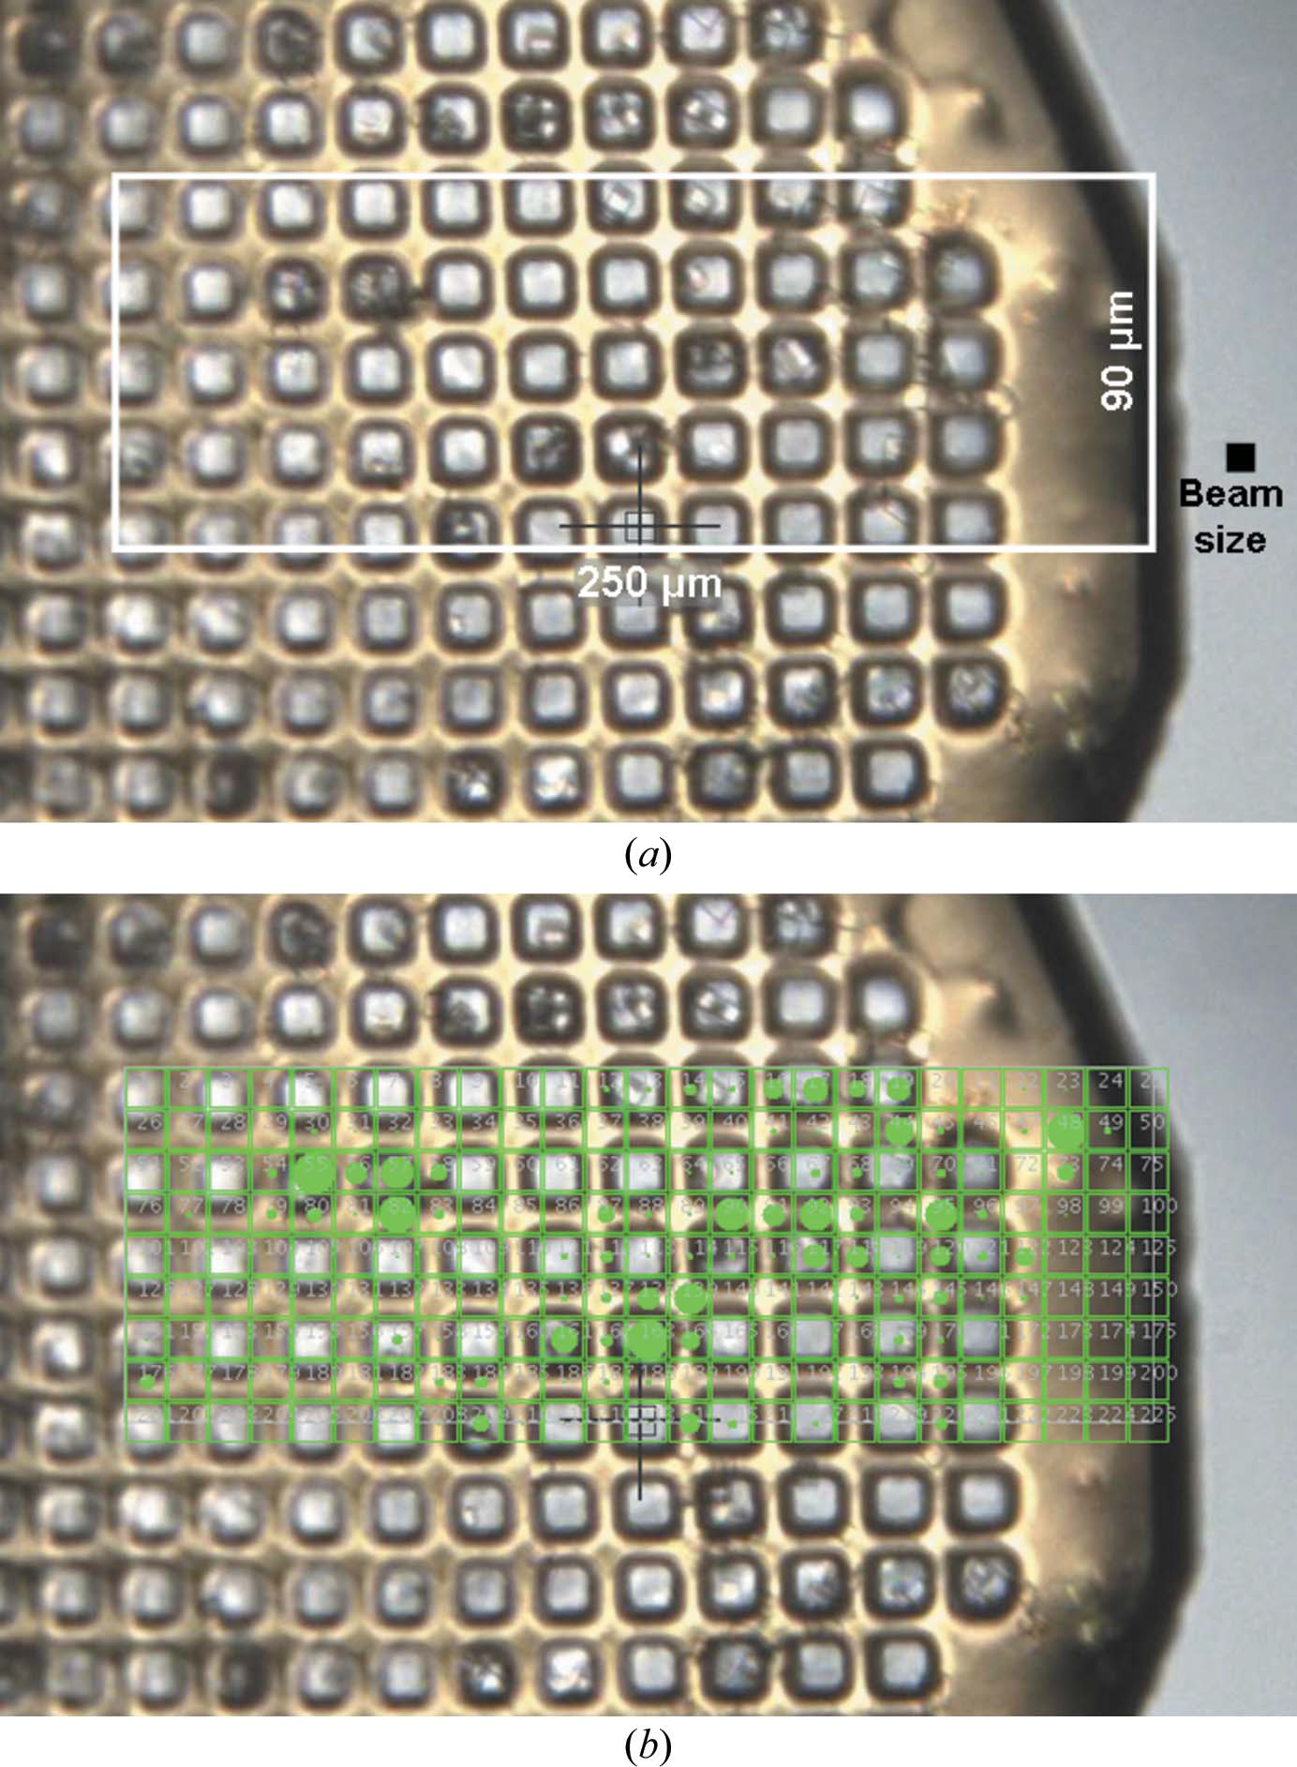
What the is “emittance”?

Slide 9
Damage is done
by photons/area
proportional to dose (MGy)
not time
not heat

Slide 10
Modelling of radiation damage at room and cryogenic temperatures
RD sensitivity measurement is a “one click” task
Simple intensity decay rate models are accurate within the range of interest
Fully equivalent set of metrics:
Decay rates, (β, γ) for optimizing data collection
Half-dose, D_{1/2} (β, γ) for comparing different systems, conditions, etc.
Negligible variation in sensitivities at 100K. Apparent variations reflect experimental conditions.
100 K: β*≈ 0.7 10⁻⁶ Å²Gy⁻¹, γ <10⁻⁷ Gy⁻¹ – negligible
D_{1/2} ≈ 2 10⁷
Strong variation in sensitivities at 300K
300 K: β≈ 10⁻⁵ ÷10⁻⁴ Å²Gy⁻¹, γ ≈ 10⁻⁷ ÷10⁻⁵ Gy⁻¹
D_{1/2} ≈ 10⁵ ÷ 10⁶ Gy
(The only) systematic dependency is
on the solvent content at 300K
Intensity variation: 15 structures @ RT
* beware uncertainty in absolute calibration

Slide 11
Dose-rate dependence of damage
maximum useful dose (MGy)
dose rate (kGy/s)

Slide 12
Dose-rate dependence of damage
maximum useful dose (MGy)
dose rate (kGy/s)

Slide 13
6-millisecond MX datasets…
Jet is too fast

Slide 15
6-millisecond MX datasets…
Jet is too fast
99.999% of sample is wasted
Mounting robots are too slow
Assay volume: 100 μm = 1 nL
1μm = 1 fL
How many “samples” can fit on the head of a pin?

Slide 16
How many “samples”?

Slide 17
What users want to do
Improve diffraction:
new xtal form
bind a ligand
new construct
new chemical environment
Study function:
Many structures: movies!
Mechanism = kinetics = time-resolved data
Small xtals good for triggering

Slide 18
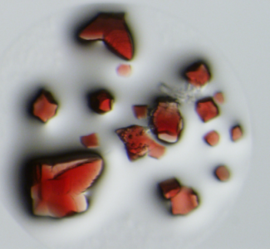
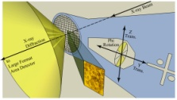
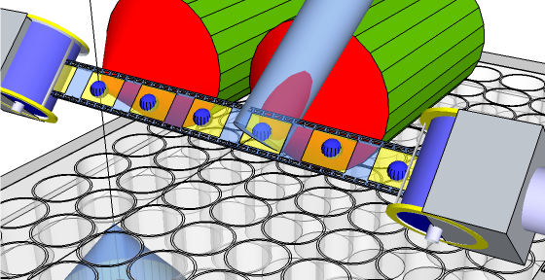
Beam line | Data / min. | Beam Size | Cap
Highly automated | ~1 | 5-30μm | N
Micro focus | < 1 | 1-5μm | N
Highly automated | 10-60 | 30μm | N
Micro focus | 60+ | 5-30μm | Y
In-situ
Multi-Xtal
Ligand search
Xtal injector
Ligand
Mesh
µ Xtal
µ Xtals

Slide 19
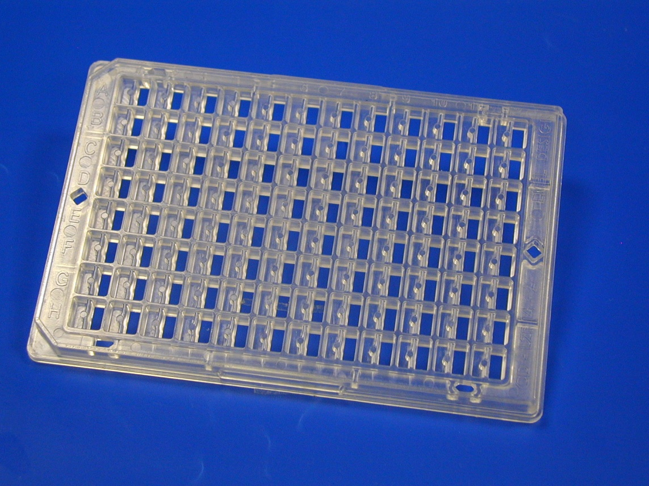
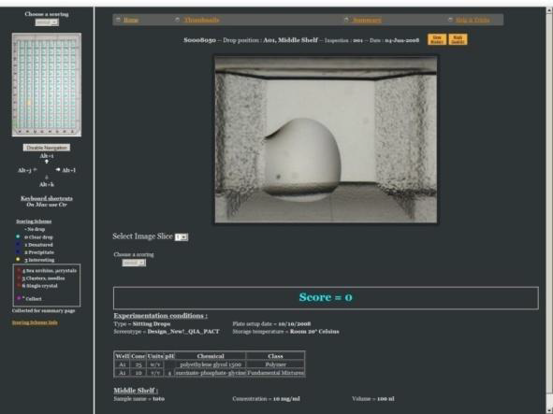
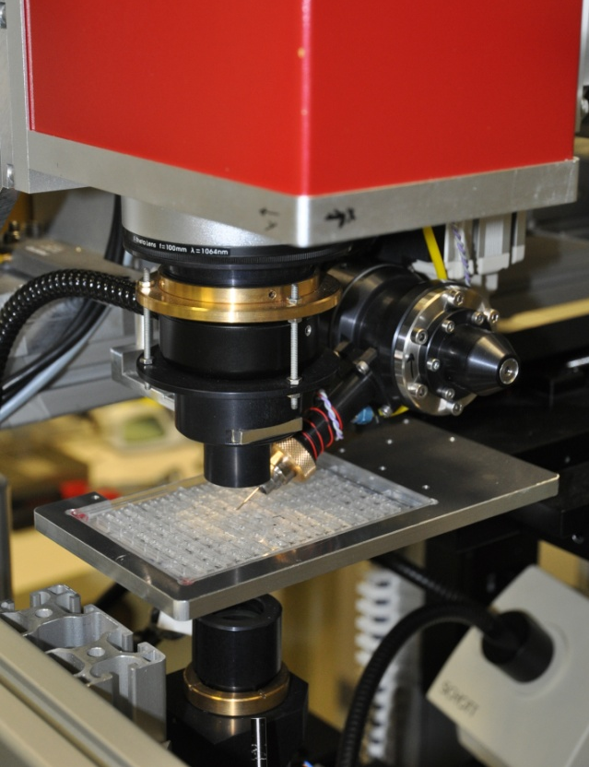
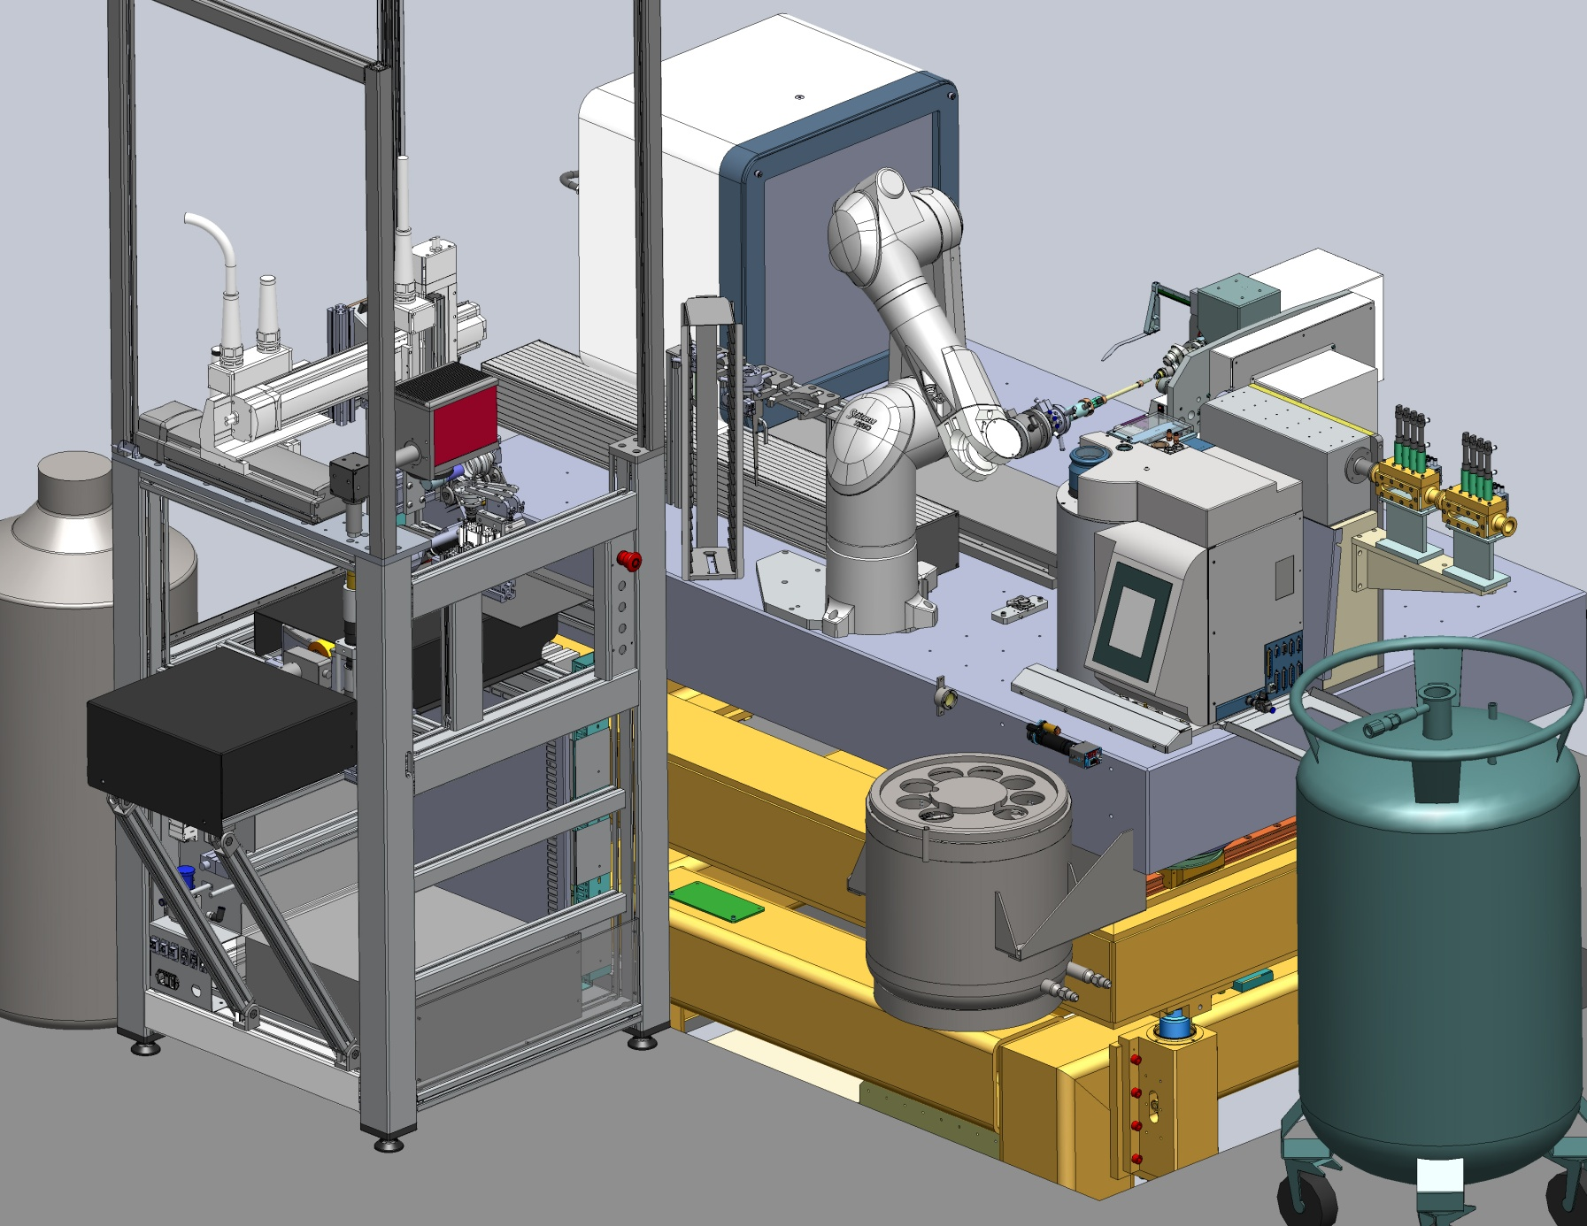
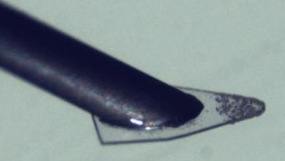
CrystalDirect Integration of Crystallization and data collection
CD plate
In situ data collection
CRIMS
Crystals grow on ultra thin film
Low background
Crystal soaking Cryo-protection Ligands...
Automated Harvesting
Serial data collection
Micro-crystals►

Slide 20
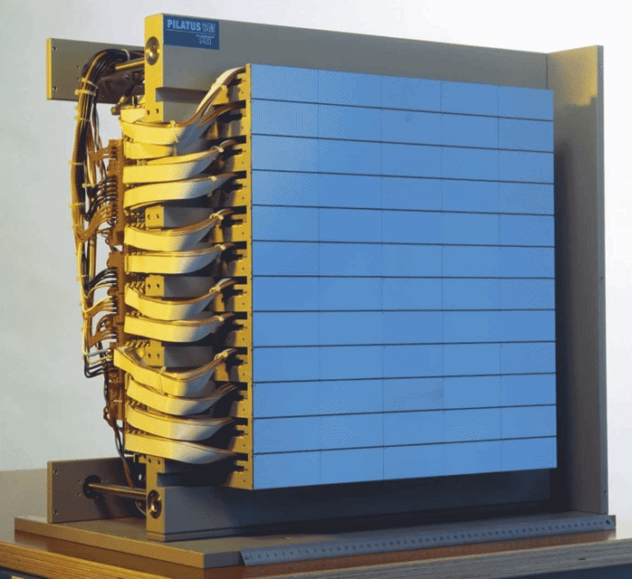
Detectors of the future:
Datasets in milliseconds
Dynamic range + fast = hard
Counting detectors don’t like XFELs
Not an XFEL
Stills vs oscillations
100% hit rate vs 0.001%
Will do “regular” crystallography

Slide 21
Concerns raised
Can we still do “normal” crystallography?
YES!
Resources to modify beamlines?
Software for new experiments
New models for spot shape
Management of all that data!
Communicating back and forth to users

Slide 22
Is the ESRF UP for MX?
What do the users need?
they need their crystals to diffract
they want to study function!
What can ESRF provide?
~1 μm beams, 1 ms datasets
How do we connect the two?
10,000x more “screening”

Slide 23
The Best Assay

Slide 24
The Best Assay?

Slide 25
Detectors of the Future
Use rapid-readout detectors to achieve μs time-resolution.
Combine with novel-reaction triggering protocols.
Microfluidic mixing & chemical triggering.
Thermal jumps.
Datasets in milliseconds
Dynamic range + fast = hard

Slide 26
Not an XFEL
Stills vs oscillations
100% hit rate vs 0.001%
Will do “regular” crystallography

Slide 27
What will the source do for me?
Workshop lineup
Need to do hard experiments on soft crystals
Smaller beams, diffraction optimization
Time-resolved enabled by microxtals
detectors
Software

