Slide 1
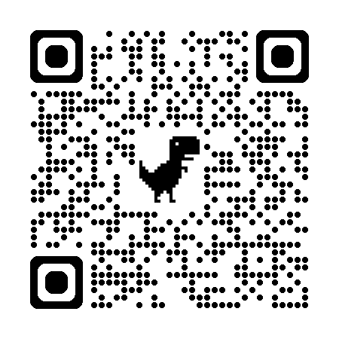
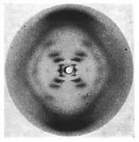
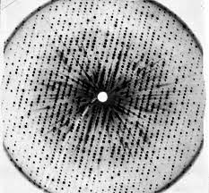
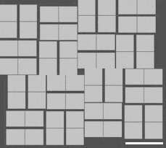
Data processing
https://bl831.als.lbl.gov/~jamesh/powerpoint/DiffMet_2024.pptx
How did we get here?

Slide 2
Key advances to date
Understanding radiation damage
Sample preparation
Sample introduction
  robots, trays & serial
Background reduction
  Elimination of “read-out” noise
  Tighter beams: size, stability and speed
  detector calibration
Population of “fold space”

Slide 3
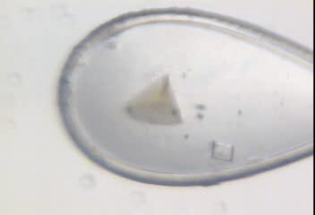
Radiation damage

Slide 4
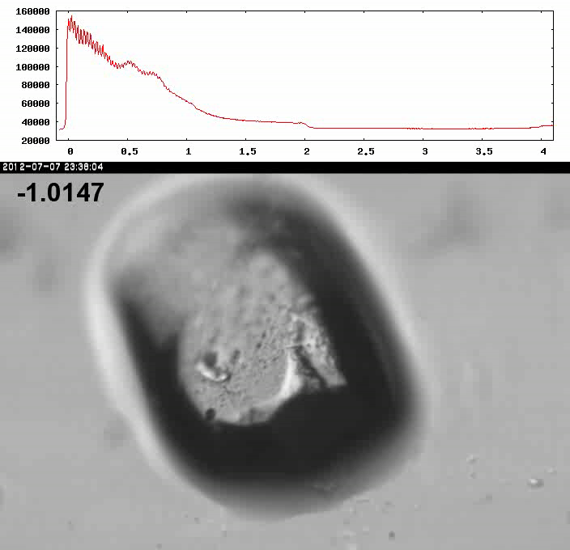
Xtal5_t1 graph

Slide 5
Dose-rate dependence of damage
maximum useful dose (MGy)
dose rate (kGy/s)

Slide 6
Key advances to date
Understanding radiation damage
Sample preparation
Sample introduction
  robots, trays & serial
Background reduction
  Elimination of “read-out” noise
  Tighter beams: size, stability and speed

Slide 7
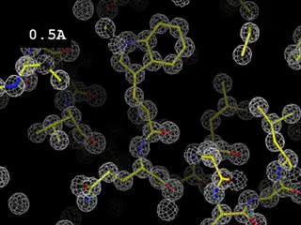
Resolution
http://bl831.als.lbl.gov/~jamesh/movies/resolution.mpeg

Slide 8
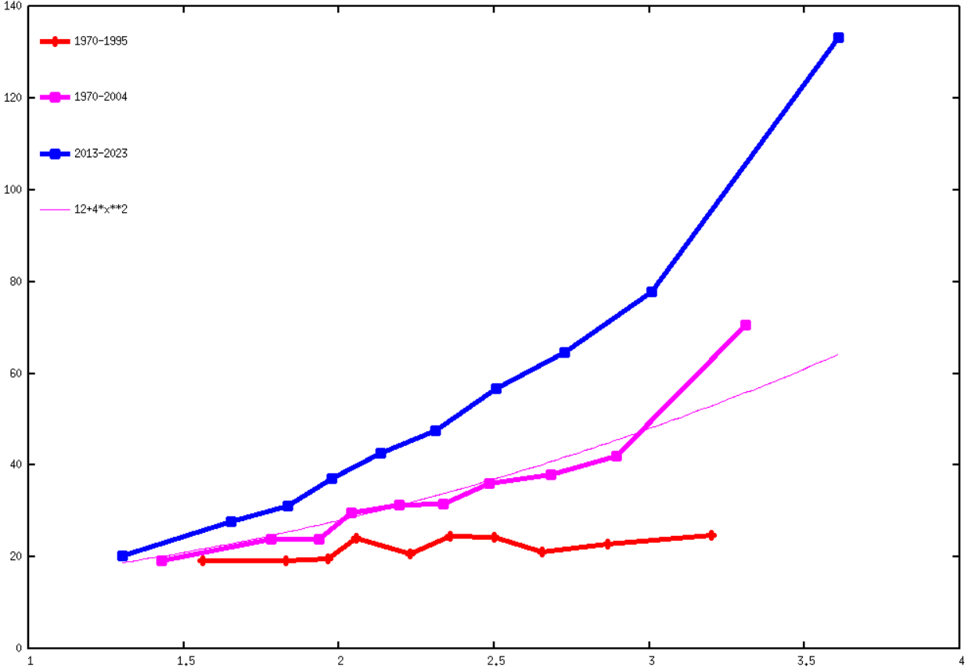
Resolution vs B factor
140
120
100
90
60
40
20
0
1970-1995
1970-2004
2013-2023
4*d^2+12
Average atomic B factor
1 1.5 2 2.5 3 3.5 4
Reported resolution (Å)

Slide 9
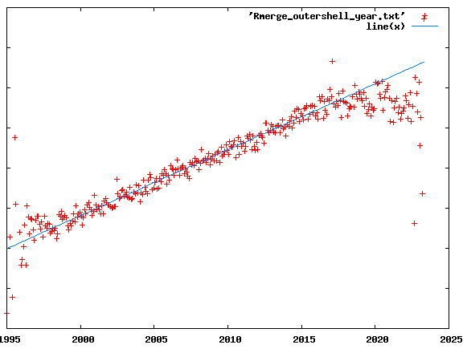
R_{merge} at the resolution limit in PDB
0.8
0.7
0.6
0.5
0.4
0.3
0.2
0.1
0
Average outer-shell R_{merge}
Year

Slide 10
Expected R_{merge} as I_{obs} → 0

Slide 11
Optimum resolution cutoff is:
Too optimistic: add nothing but noise
Too pessimistic: series-termination error
Happy medium?
Simulate:
  Random atoms, compute F²
  Add Gaussian noise, RMS = 1
  Truncate
  Subtract “right” map, RMS difference

Slide 12
Optimal resolution cutoff
Error in map (rms e⁻)
Resolution cutoff (Å)

Slide 13
Optimal resolution cutoff
Correlation Coefficient
Resolution cutoff (Å)

Slide 14
Optimal resolution cutoff
Correlation Coefficient
Resolution cutoff (Å)

Slide 15
Wilson Plot
2
log( intensity )
8
2.2 1.6 1.3 1.1 1.0 0.9 0.85 0.8 0.75 0.7
resolution (Å)

Slide 16
Optimum resolution cutoff is:
0.0 Å
after straightening Wilson plot

Slide 17
what is “partiality”?
F(h,k,l)
Ewald sphere
λ₁*
λ₂*
F(h,k,l)
F(0,0,0)

Slide 18
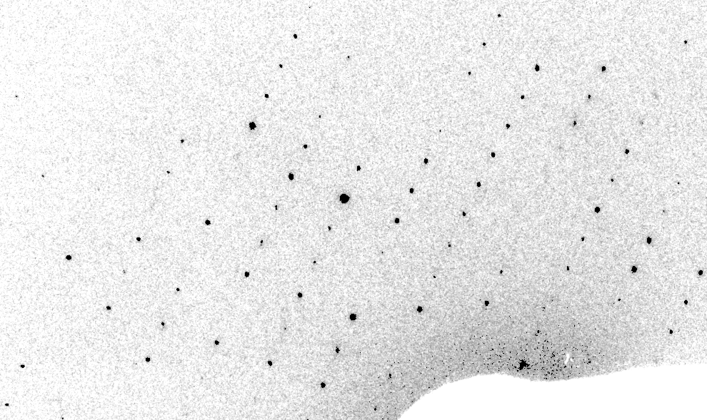
Real XFEL still
Lyubimov et al. (2016).
eLife 5, e18740.

Slide 19
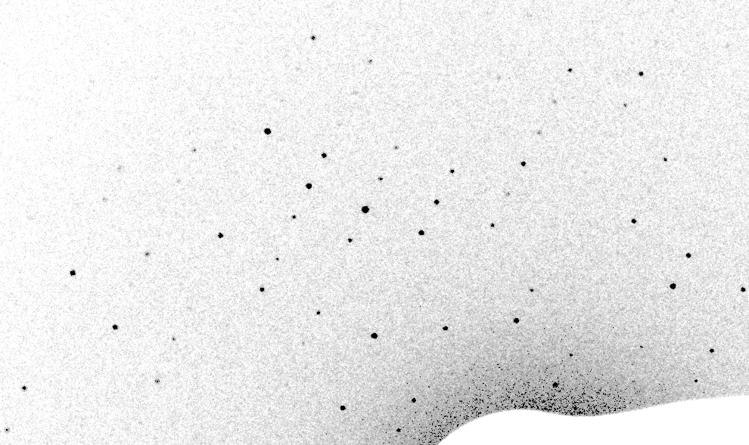
Best-fit Simulation of XFEL still

Slide 20
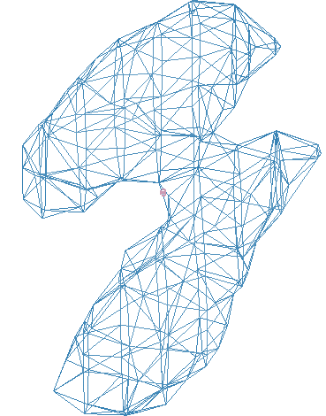
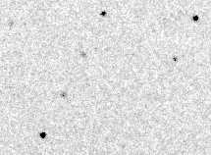
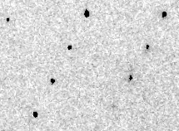
Simulation of XFEL still
phix
phiy
phiz
real
VS
phix
phiy
phiz

Slide 21
Fitting multiple clusters is stable!
Fraction pixels predicted
Best of
262,140 trials
Angle about y axis (°)

Slide 22
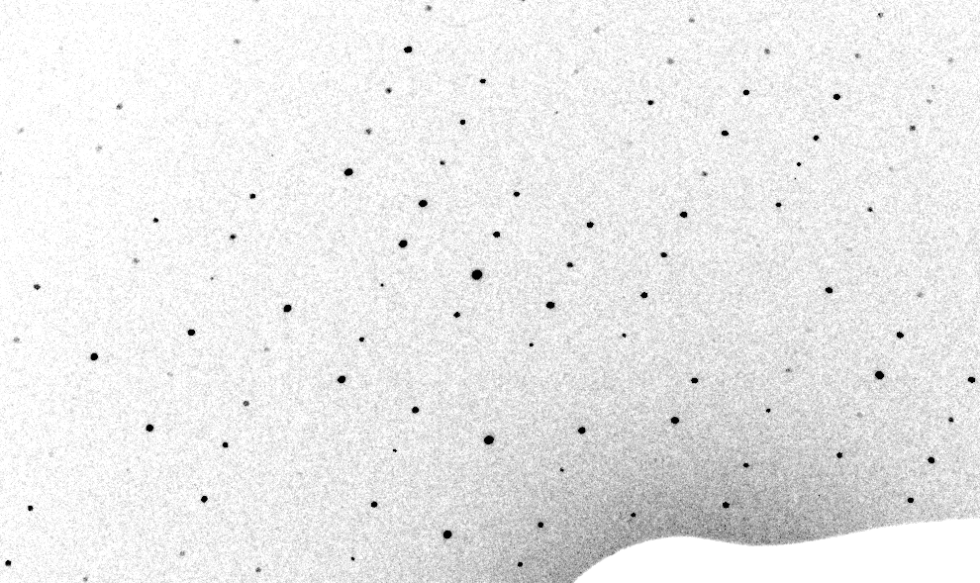
3-cluster mosaic simulation

Slide 23
Real XFEL still
Lyubimov et al. (2016).
eLife 5, e18740.

Slide 24
1-cluster Simulation of XFEL still

Slide 25
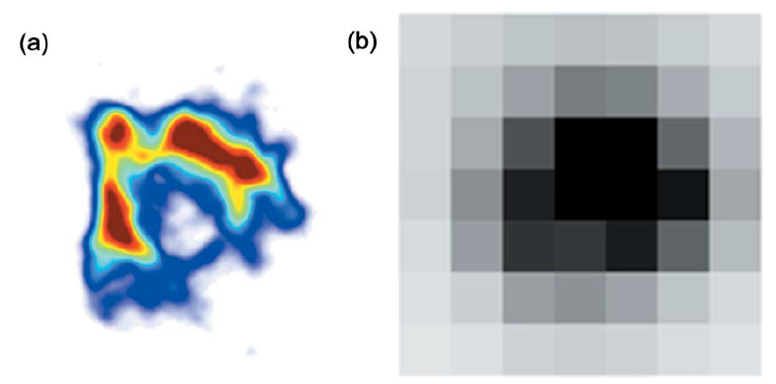
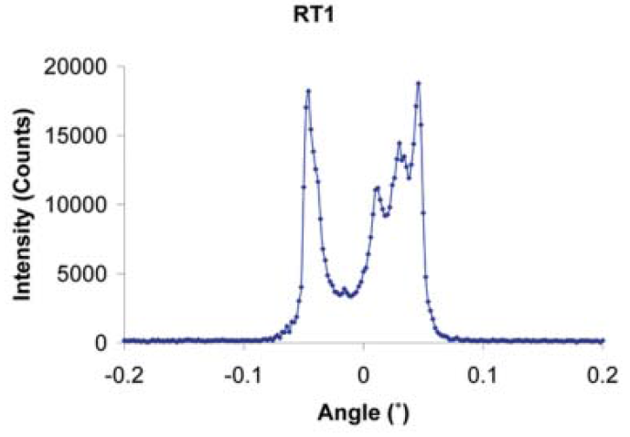
The true nature of “mosaic spread”
Any function can be approximated by a family of Gaussians
Lovelace JJ, Murphy CR, Pahl R, Brister K & Borgstahl GEO (2006)."Tracking reflections through cryogenic cooling with topography", J. Appl. Cryst. 39, 425-432.

Slide 26
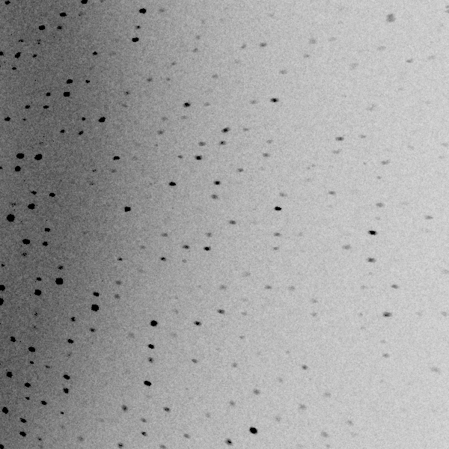
3 domains within 1°

Slide 27
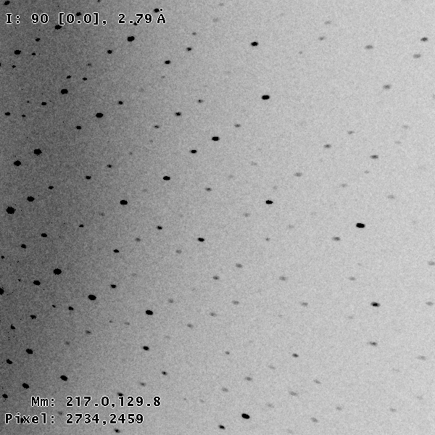
3 domains within 0.2°

Slide 28
Texture sufficient for poor stats
500 images Results from iota: cctbx & prime
texture | 1 cluster | 3 clusters
R_{true}* | 4% | 16%
*Agreement with F value fed into simulation

Slide 29
Texture sufficient for poor stats
500 images Results from iota: cctbx & prime
texture | 1 cluster | 3 clusters
R_{true}* | 4% | 16%
R_{merge} | 23% | 66%
*Agreement with F value fed into simulation

Slide 30
Texture sufficient for poor stats
500 images Results from iota: cctbx & prime
texture | 1 cluster | 3 clusters
R_{true}* | 4% | 16%
R_{merge} | 23% | 66%
I/σ | 32 (1.1) | 19 (1.2)
*Agreement with F value fed into simulation

Slide 31
Texture sufficient for poor stats
500 images Results from iota: cctbx & prime
texture | 1 cluster | 3 clusters
R_{true}* | 4% | 16%
R_{merge} | 23% | 66%
I/σ | 32 (1.1) | 19 (1.2)
CC_{1/2} | 99 (69) | 99 (58)
*Agreement with F value fed into simulation

Slide 32
Texture sufficient for poor stats
500 images Results from iota: cctbx & prime
texture | 1 cluster | 3 clusters
R_{true}* | 4% | 16%
R_{merge} | 23% | 66%
I/σ | 32 (1.1) | 19 (1.2)
CC_{1/2} | 99 (69) | 99 (58)
resolution | 1.55 | 1.94
*Agreement with F value fed into simulation

Slide 33
Key advances to date
Understanding radiation damage
Sample preparation
Sample introduction
  robots, trays & serial
Background reduction
  Elimination of “read-out” noise
  Tighter beams: size, stability and speed
  detector calibration

Slide 34
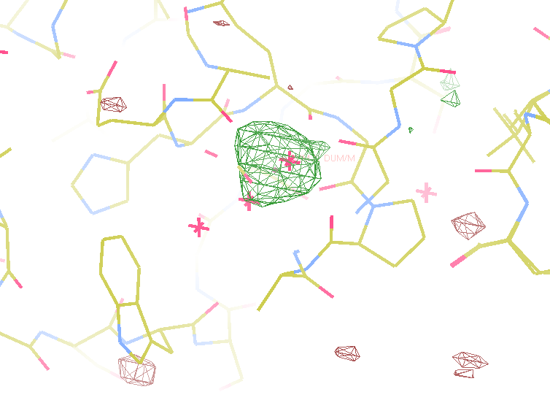
140-fold multiplicity
8.2σ = Na
DELFAN residual anomalous difference

Slide 35
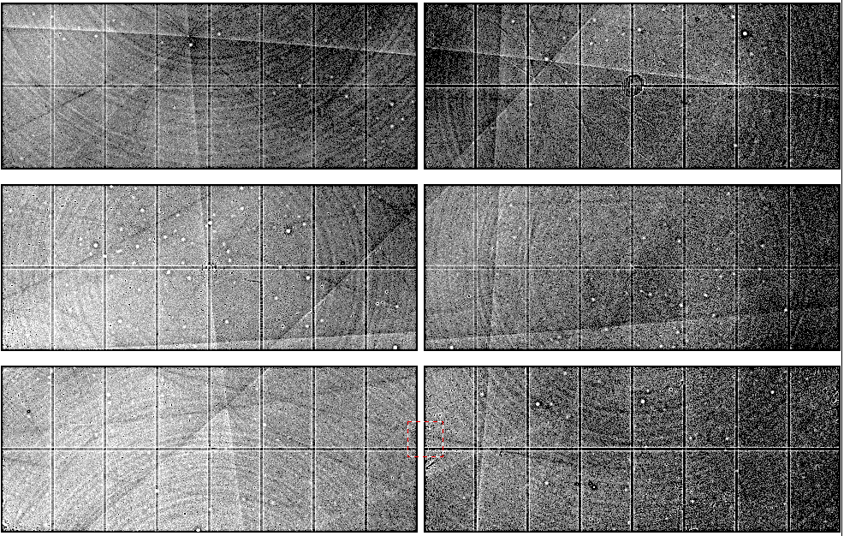
Pilatus: subtract smooth baseline
~3x10⁵ photon/pixel
Bragg
glitch
“tree rings”
Pick-up tool mark
oxygen
inclusions
1% high
average
1% low

Slide 36
140-fold multiplicity: 16 crystals, 360° each, inverse beam, 7235 eV
RESOLUTION COMPLETENESS R-FACTOR I/SIGMA R-meas CC(1/2) Anomal SigAno Nano
LIMIT OF DATA observed Corr
9.17 99.1% 3.9% 257.47 3.9% 100.0* 91* 5.024 450
6.49 100.0% 5.2% 214.33 5.2% 100.0* 86* 3.836 882
5.30 100.0% 7.2% 165.13 7.2% 100.0* 76* 3.257 1175
4.59 100.0% 7.2% 175.42 7.3% 100.0* 67* 2.589 1403
4.10 99.9% 7.7% 174.13 7.7% 100.0* 59* 2.264 1594
3.74 99.9% 9.4% 143.09 9.4% 100.0* 49* 1.953 1783
3.47 100.0% 11.2% 120.17 11.2% 100.0* 39* 1.696 1942
3.24 100.0% 14.1% 91.14 14.1% 100.0* 30* 1.333 2103
3.06 99.9% 19.5% 65.79 19.5% 100.0* 23* 1.117 2214
2.90 99.9% 29.0% 44.85 29.1% 99.9* 17* 1.008 2369
2.77 99.9% 40.5% 32.58 40.6% 99.8* 11* 0.901 2493
2.65 99.9% 52.8% 25.16 52.9% 99.8* 10* 0.866 2605
2.54 100.0% 67.4% 19.47 67.6% 99.6* 2 0.804 2705
2.45 100.0% 88.9% 14.58 89.2% 99.2* 4 0.831 2859
2.37 100.0% 109.3% 9.97 109.7% 98.1* 5 0.829 2925
2.29 100.0% 138.2% 6.87 138.9% 96.1* 1 0.760 3037
2.22 100.0% 197.1% 4.03 198.6% 83.5* -1 0.721 3159
2.16 100.0% 227.3% 2.41 230.8% 46.9* -1 0.677 3224
2.10 61.2% 154.4% 1.28 163.6% 47.0* -2 0.660 1999
2.05 47.9% 170.1% 0.68 196.5% 25.7* 3 0.629 1578
total 93.3% 15.7% 54.30 15.8% 100.0* 12* 1.217 42499

Slide 37
Key advances to date
Understanding radiation damage
Sample preparation
Sample introduction
  robots, trays & serial
Background reduction
  Elimination of “read-out” noise
  Tighter beams: size, stability and speed
  detector calibration
Population of “fold space”

Slide 38
MR simulation
corrupted model
Correlation coefficient to correct density
Rmsd from perfect search model (Å)

Slide 39
Key advances to come
Firehose of testable hypotheses
Physiological temperature
  Time-resolved, complex sample environment
  Plates, jets, magnets, and lasers!
Serial comes of age
  stills should be better
  End of the era of beams missing crystals
Painting with X-rays

Slide 40
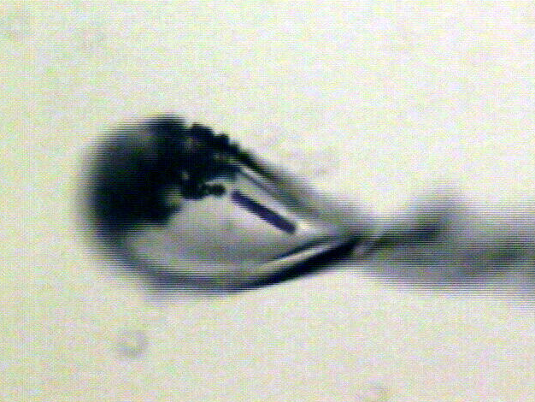
“rastering” to find the crystal
X-ray beam
ice
Membrane
protein crystal

Slide 41
“painting” for flat dose

Slide 42
“painting” for virtual beam

Slide 43
Painting with X-rays
0°
img_000045

Slide 44
Painting with X-rays
0.2°
img_000100

Slide 45
Painting with X-rays
30°
img_015000

Slide 46
Painting with X-rays
90°
img_045000

Slide 47
Painting with X-rays
360°
img_180000

Slide 48
Painting with X-rays
1080°
img_540000

Slide 49
Beam Shape Dichotomy
Flat-top beam
  Uniform dose in illuminated region
  Sharp edges: sensitive to drift
Gaussian beam
  Softer edges
  High dose contrast
Best of both?
  “dose flattening”

Slide 50
How many images?
360° / 0.1° * ( 100 µm / 1 µm )²
⁼ 36x10⁶
28,000 photons/image

Slide 51
Key advances to come
Firehose of testable hypotheses
Physiological temperature
  Time-resolved, complex sample environment
  Plates, jets, magnets, and lasers!
Serial comes of age
  stills should be better
  End of the era of beams missing crystals
Painting with X-rays
Weak-image limit

Slide 52
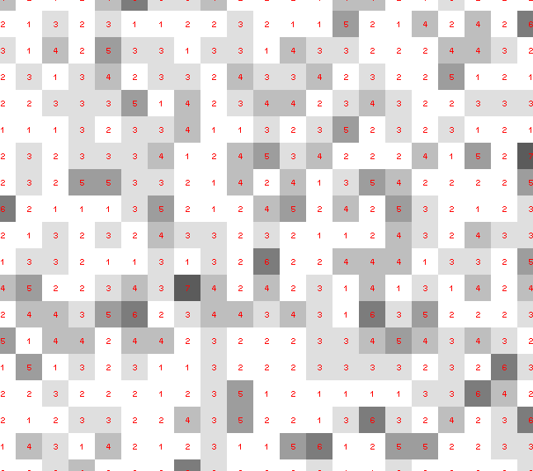
Weak-image limit: is that a spot?

Slide 53
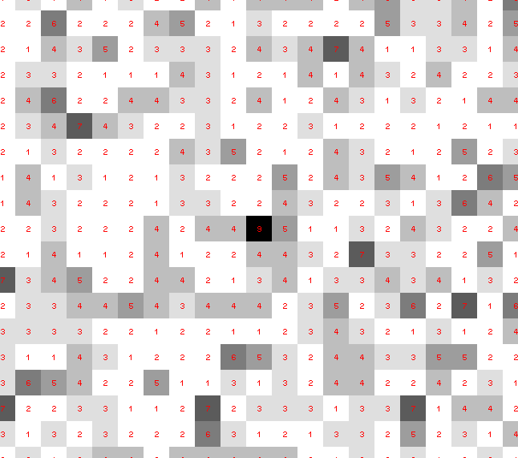
Weak-image limit: is that a spot?

Slide 54
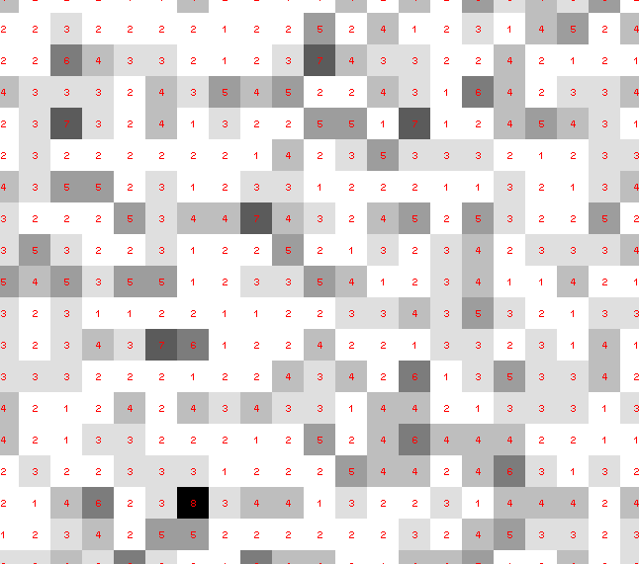
Weak-image limit: is that a spot?

Slide 55
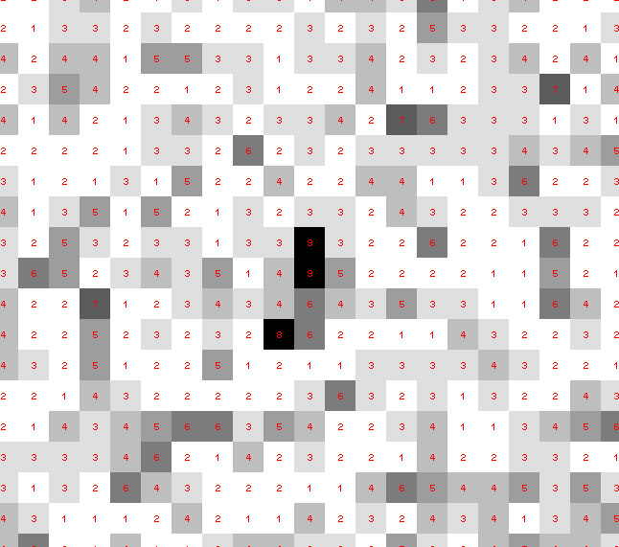
Weak-image limit: is that a spot?

Slide 56
Weak-image limit: is that a spot?

Slide 57
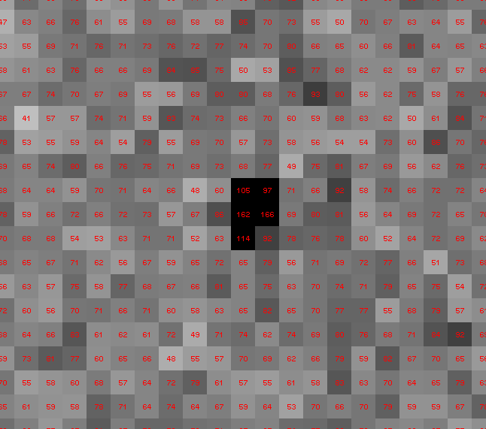
Weak-image limit: is that a spot?

Slide 58
Single Photons Carry Information
About Radiation Damage
4
4
photons
photons
0
0
4
4
photons
photons
0
0
time
time

Slide 59
We should stop using lossy compression!
long exposures
  >1 photon/image = order of arrivals
Wide phi slice
  sum over angle
Large beams
  sum over profile area
Pink/divergent beam
  sum over lambda/angle
Background
  non-crystal stuff
Systematics
  Dose contrast, drift, read-out gap

Slide 60
Lossless data rate
bits
s
= log₂(pixels) * flux * thick * 1.2x10⁻⁵
where:
bits/s = entropy-limited compressed data rate
pixels = number of pixels in the detector
flux = photons/s onto the sample
thick = sample thickness in microns
EG: 1e12 ph/s * 100um thick = 3.4 GBytes/s
The 1.2e-5 scattered photons per incident photon can be derived form the cross section of oxygen (0.2 cm^2/g) and the rough density of protein crystals (1.2 g/cm^3), and the fact that about half of all scattered photons hit a flat detector: 0.2*1.2*1e-4/2 = 1.155e-5
That is, flux*thickness*1.2e-5 is the rate of photon arrivals and log2(pixels) is the number of bits required to store the location of one photon in the entropy-limited regime. Lossless compression cannot be better than this because individual photon arrivals are genuinely random.

Slide 61
To discuss later…
Resolution cut-off?
Blue sausages?
Detector calibration?
Weak image limit?

Slide 62
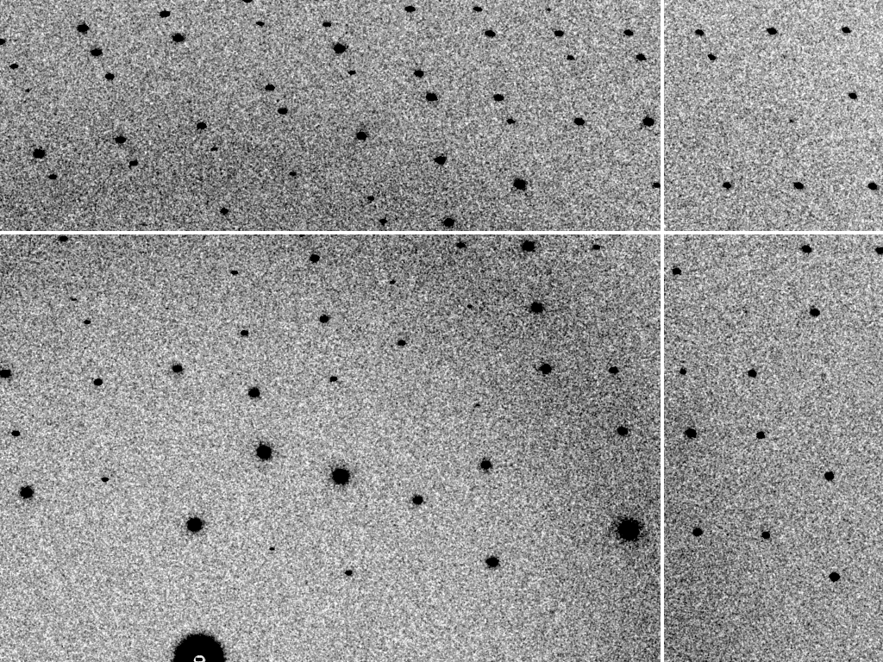
read noise = 2 photons

Slide 63
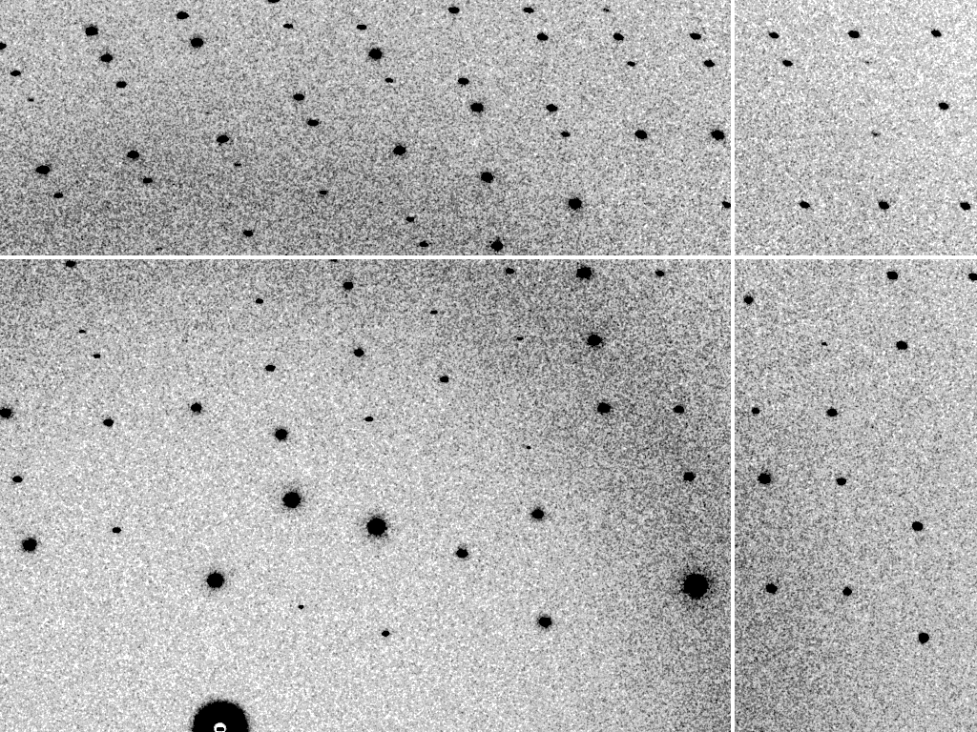
read noise = 0 photons

Slide 64
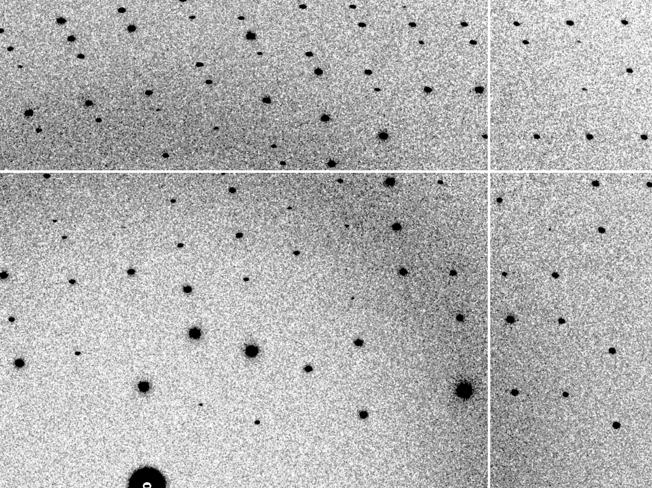
read noise = 0.07 photons

Slide 65
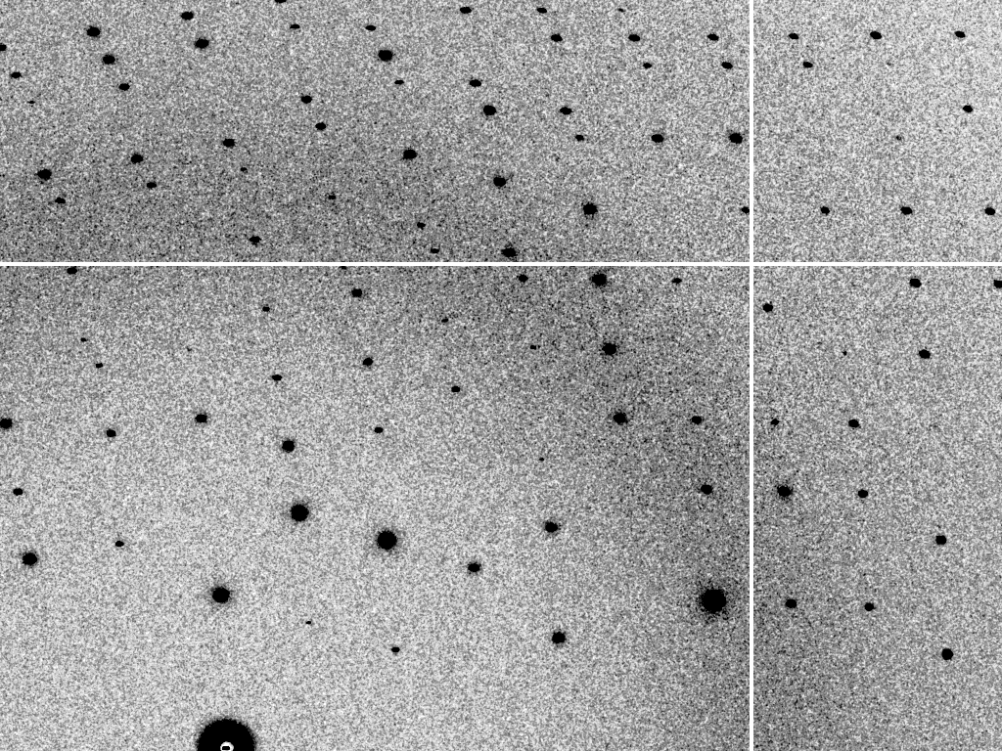
read noise = 0.5 photons

Slide 66
read noise = 2 photons

Slide 67
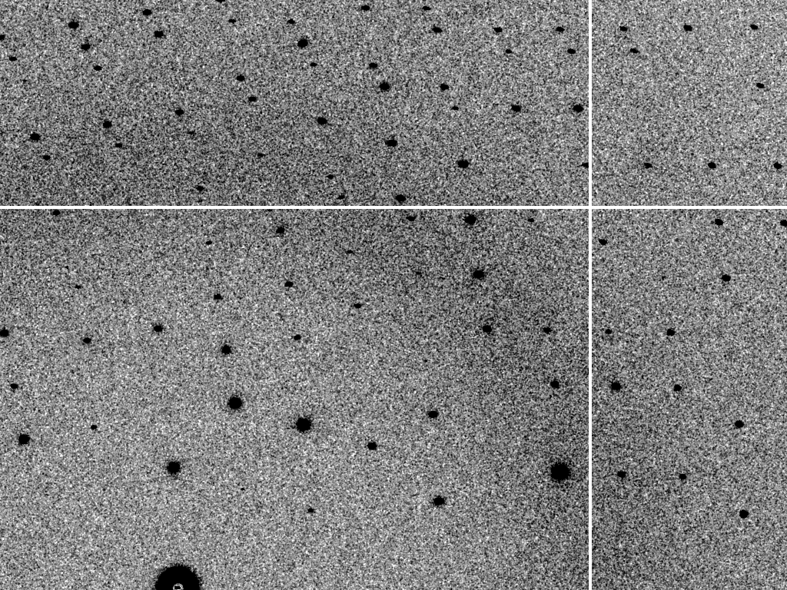
read noise = 7.5 photons

Slide 68
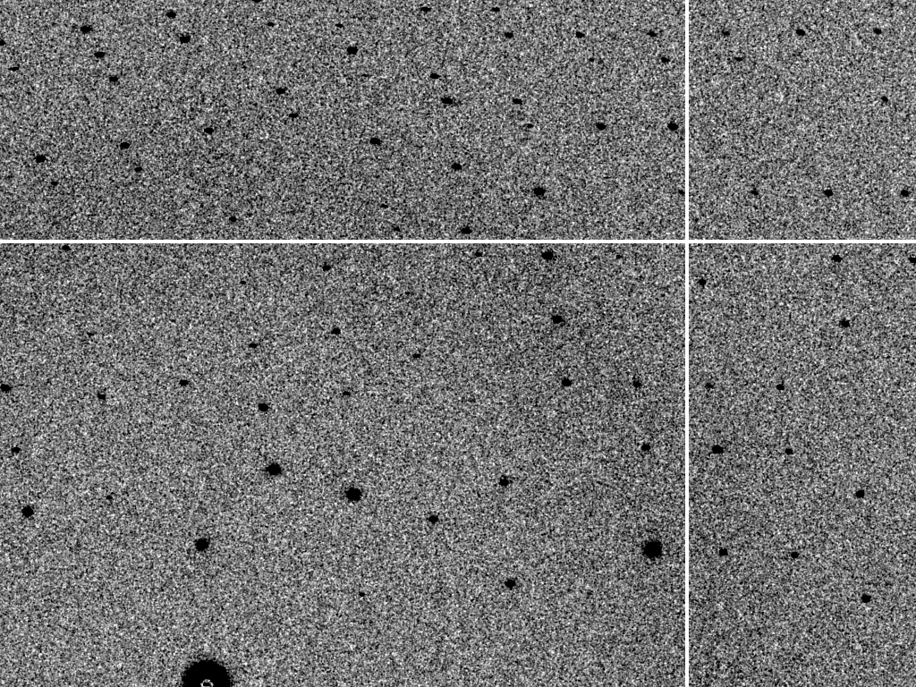
read noise = 47 photons

Slide 69
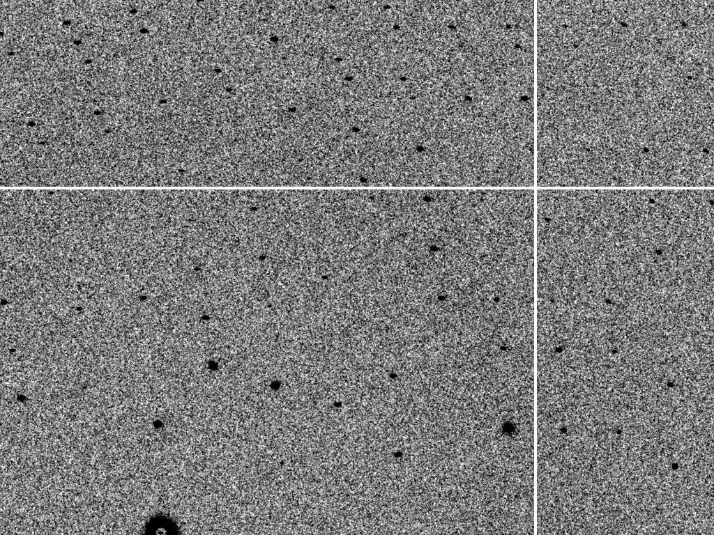
read noise = 190 photons

Slide 70
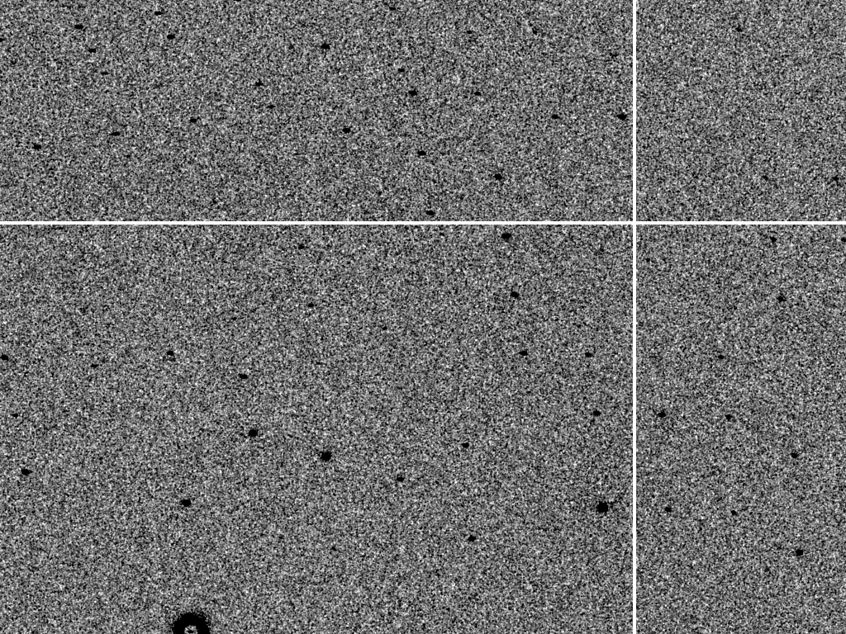
read noise = 750 photons

Slide 71
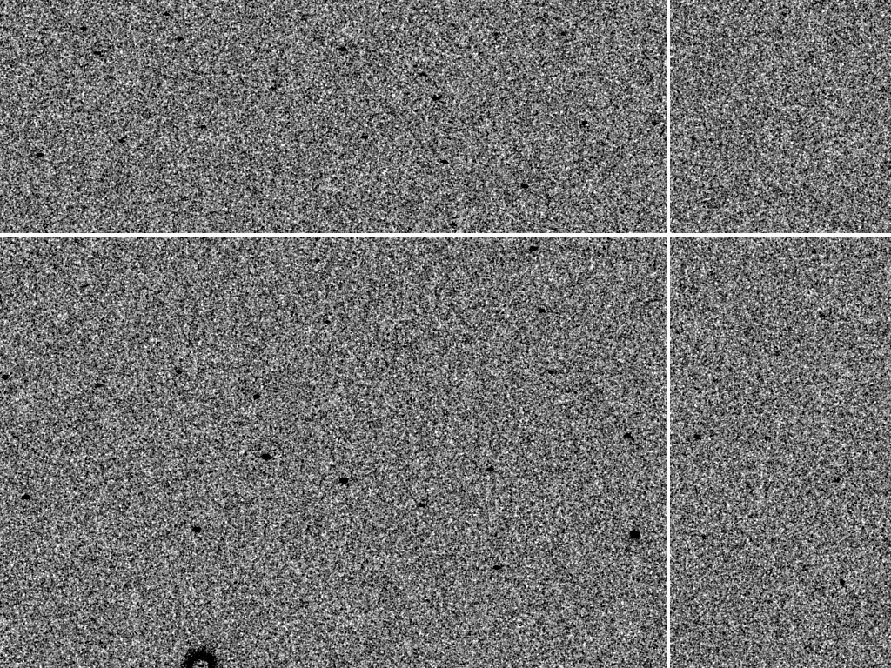
read noise = 4700 photons

Slide 72
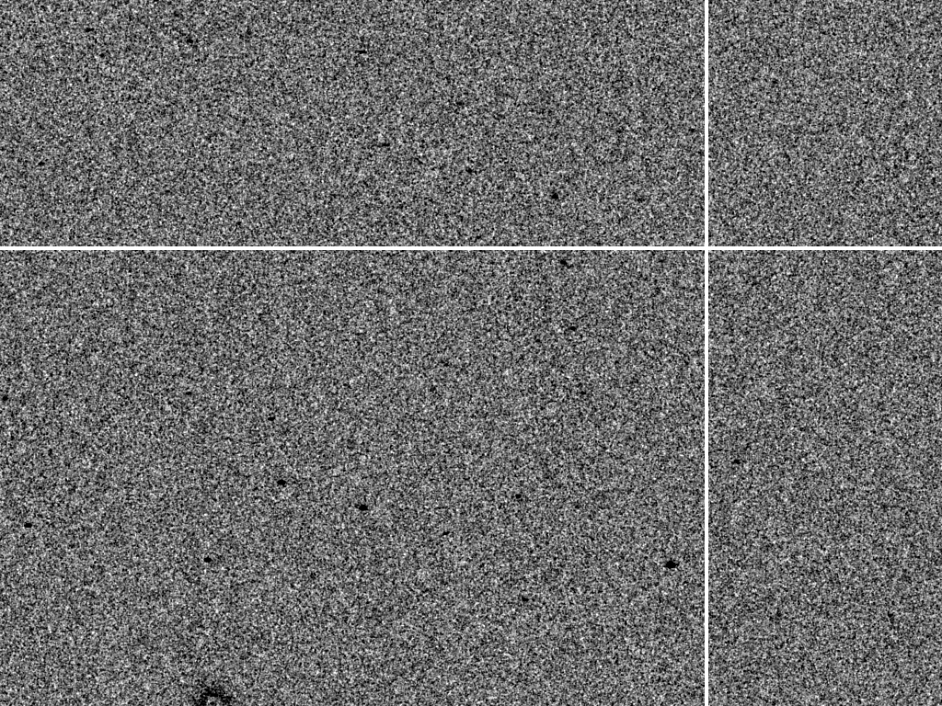
read noise = 19000 photons

Slide 73
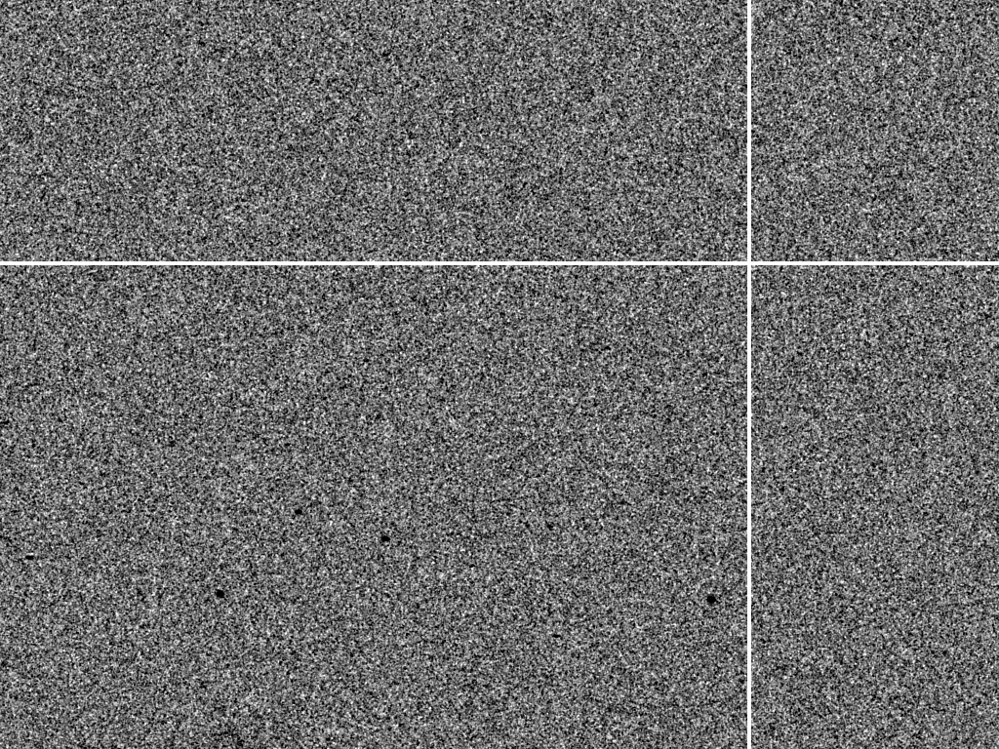
read noise = 75000 photons

Slide 74
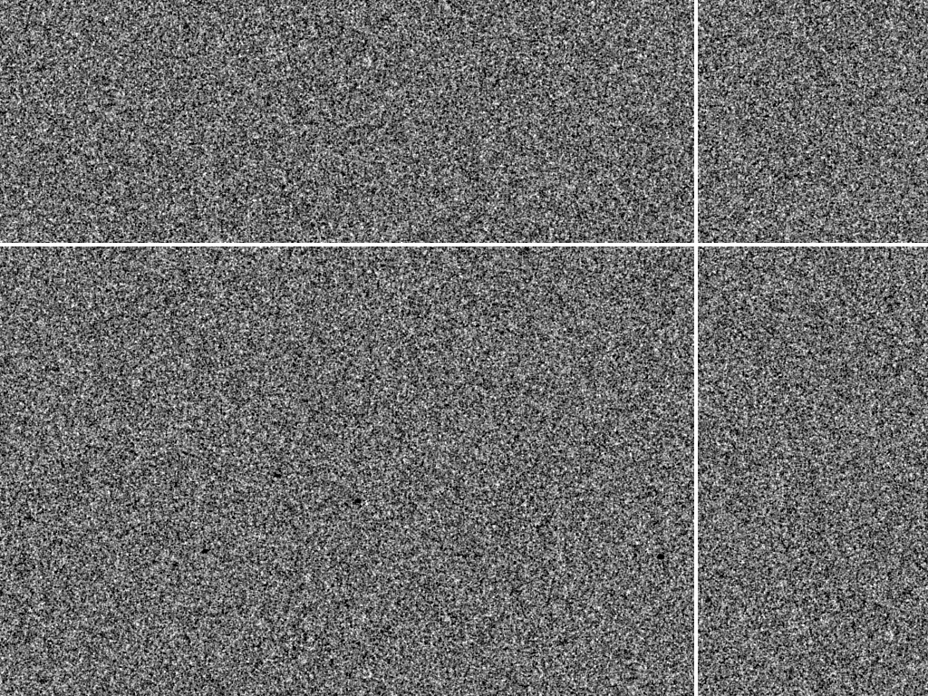
read noise = 470000 photons

Slide 75
read-out noise
normalized peak height
Mar
325HE
Q315r
Q315
Pilatus
0.1 1 10 100 10³ 10⁴ 10⁵ 10⁶
read-out noise (“extra” photons)

Slide 76
Beam Flicker
pinhole
removed
normalized flux
time (seconds)

Slide 77
Beam Flicker
CC to correct model
flicker noise (%/√Hz)

Slide 78
Shutter Jitter
CC to correct model
rms timing error (% exposure)

Slide 79
Shutter Jitter
open
closed

Slide 80
Shutter Jitter
open
closed

Slide 81
Shutter Jitter
open
closed

Slide 82
Shutter Jitter
open
closed

Slide 83
Shutter Jitter
open
closed

Slide 84
Shutter Jitter
open
closed

Slide 85
Shutter Jitter
open
closed

Slide 86
Shutter Jitter
open
closed

Slide 87
Shutter Jitter
open
closed

Slide 88
Shutter Jitter
open
closed

Slide 89
Shutter Jitter
open
closed
shutter jitter

Slide 90
“Shutterless” full vs partial
1 ms
intensity
time

Slide 91
Rough values of energy quanta
1 MeV 100 GJ/mol Medical radiation therapy
100 keV 10 GJ/mol Medical imaging
10 keV 1 GJ/mol X-ray crystallography
1 keV 100 MJ/mol S and P K-edges
100 eV 10 MJ/mol “water window”
10 eV 1 MJ/mol C≡C bond
1 eV 100 kJ/mol C-C bond, visible light
100 meV 10 kJ/mol hydrogen bond
10 meV 1 kJ/mol heat (~300 K)

Slide 92
signal vs noise
“If you don’t have
good data,
then you have
no data at all.”
-Sung-Hou Kim

Slide 93
signal vs noise
easy
hard
impossible

Slide 94
signal vs noise
easy
hard
impossible
threshold of “solvability”

Slide 95
signal vs noise
“If you don’t have
good data,
then you must
learn statistics.”
-James Holton

Slide 96
Adding noise

Slide 97
Adding noise
1² + 1² = 1.4²

Slide 98
Adding noise
1² + 1² = 1.4²
3² + 1² = 3.2²
σ_{total}² = σ₁² + σ₂²

Slide 99
Adding noise
1² + 1² = 1.4²
3² + 1² = 3.2²
σ_{total}² = σ₁² + σ₂²

Slide 100
Adding noise
1² + 1² = 1.4²
3² + 1² = 3.2²
σ_{total}² = σ₁² + σ₂²

Slide 101
Adding noise
1² + 1² = 1.4²
3² + 1² = 3.2²
10² + 1² = 10.05²

Slide 102
The number of photons scattered
before crystal is dead
is independent
of flux & time
1 um³ = 10⁵ photons (roomT)
1 um³ = 10⁶ photons (synch)
1 um³ = 10⁸ photons (XFEL)
(synch)
Henderson, 1990; Gonzalez & Nave, 1994; Glaeser et al., 2000; Sliz et al., 2003; Leiros et al., 2006; Owen et al., 2006; Garman & McSweeney, 2006; Garman & Nave, 2009; Holton, 2009

Slide 103
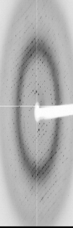
Dose slicing
low
completeness
N
photons
crystal’s useful life
N
photons
Can’t process?
N
photons

Slide 104
resolution vs dose slice
Same number of photons
fine | coarse
3.177 | 3.140
Damage correctable | Damage uncorrectable

