Slide 1
Acknowledgements
Robert Stroud James Fraser John Spence
Chris Nielsen Clemens Schulze-Briese Aina Cohen Ana Gonzalez
UCSF LBNL SLAC
ALS 8.3.1: TomAlberTron
UC Multicampus Research Programs and Initiatives (MRPI)
NIH NIGMS R01 GM124149
NIH NIGMS P30 GM124169
Integrated Diffraction Analysis Technologies (IDAT)
Plexxikon, Inc.
Synchrotron Radiation Structural Biology Resource (SLAC)
The Advanced Light Source is supported by the Director, Office of Science, Office of Basic Energy Sciences, Materials Sciences Division, of the US Department of Energy under contract No. DE-AC02-05CH11231 at Lawrence Berkeley National Laboratory.

Slide 2
The “success rate” of structure determination
100 s/dataset
200 days/year
~150 beamlines
~26,000,000 datasets/year
~10,000 PDBs in 2016

Slide 3
signal vs noise
“If you don’t have good data, then you have no data at all.”
-Sung-Hou Kim

Slide 4
signal vs noise
easy
hard
impossible
threshold of “solvability”

Slide 5
Adding noise
1² + 1² = 1.4²
3² + 1² = 3.2²
10² + 1² = 10.05²

Slide 6
And the dominant source of error is…
Resolution
Disorder (including Radiation Damage)
Background
Phases
Non-isomorphism (including Radiation Damage)
Vibration (beam, xtal, spindle, etc.)
Detector calibration

Slide 7
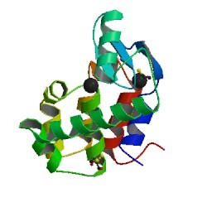
What is “disorder”?
order
order
B-factor
disorder

Slide 8
“B” factors
ATOM 122 N LEU A 13 -3.244 25.808 19.998 1.00 16.96 N
ATOM 123 CA LEU A 13 -2.877 25.448 21.355 1.00 15.29 C
ATOM 124 C LEU A 13 -2.792 23.966 21.561 1.00 17.54 C
ATOM 125 O LEU A 13 -1.814 23.493 22.143 1.00 16.35 O
ATOM 126 CB LEU A 13 -3.907 26.164 22.268 1.00 18.72 C
ATOM 127 CG LEU A 13 -3.577 25.982 23.738 1.00 21.19 C
ATOM 128 CD1 LEU A 13 -2.283 26.820 24.019 1.00 19.43 C
ATOM 129 CD2 LEU A 13 -4.702 26.474 24.639 1.00 24.65 C
ATOM 130 N SER A 14 -3.677 23.149 20.979 1.00 15.96 N
ATOM 131 CA SER A 14 -3.646 21.711 21.061 1.00 18.26 C
ATOM 132 C SER A 14 -2.373 21.203 20.360 1.00 18.71 C
ATOM 133 O SER A 14 -1.747 20.315 20.930 1.00 17.47 O
ATOM 134 CB SER A 14 -4.875 21.077 20.419 1.00 17.62 C
ATOM 135 OG ASER A 14 -4.825 19.665 20.388 0.50 20.89 O
ATOM 136 OG BSER A 14 -6.027 21.408 21.164 0.50 18.67 O
ATOM 137 N LYS A 15 -2.045 21.772 19.215 1.00 18.03 N
ATOM 138 CA LYS A 15 -0.799 21.361 18.555 1.00 18.12 C
ATOM 139 C LYS A 15 0.446 21.707 19.351 1.00 18.81 C
ATOM 140 O LYS A 15 1.400 20.948 19.411 1.00 17.77 O
ATOM 141 CB LYS A 15 -0.700 22.034 17.177 1.00 14.49 C
ATOM 142 CG LYS A 15 -1.727 21.368 16.256 1.00 16.12 C
ATOM 143 CD LYS A 15 -1.663 22.147 14.936 1.00 19.40 C
ATOM 144 CE ALYS A 15 -2.725 21.614 13.986 0.50 17.42 C
ATOM 145 CE BLYS A 15 -1.750 21.211 13.750 0.50 17.01 C
ATOM 146 NZ ALYS A 15 -2.346 21.674 12.559 0.50 18.61 N
ATOM 147 NZ BLYS A 15 -3.052 20.513 13.741 0.50 18.76 N

Slide 9
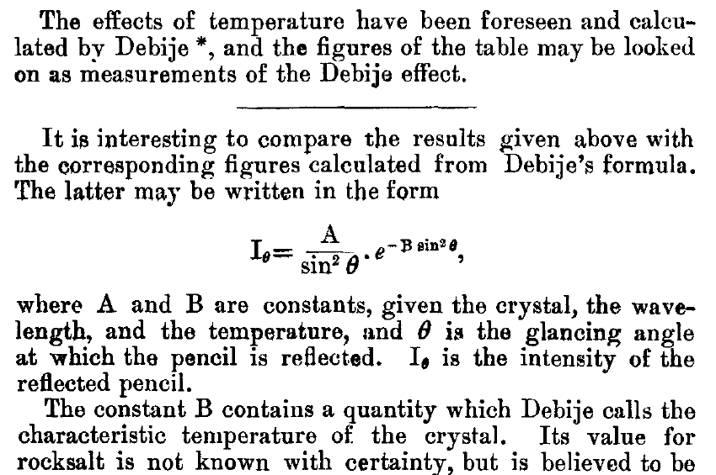
The B factor
Bragg, W. H. (1914)."XCVII. The intensity of reflexion of X rays by crystals", Philosophical Magazine Series 6 27, 881-899. Published May 1 1914

Slide 10
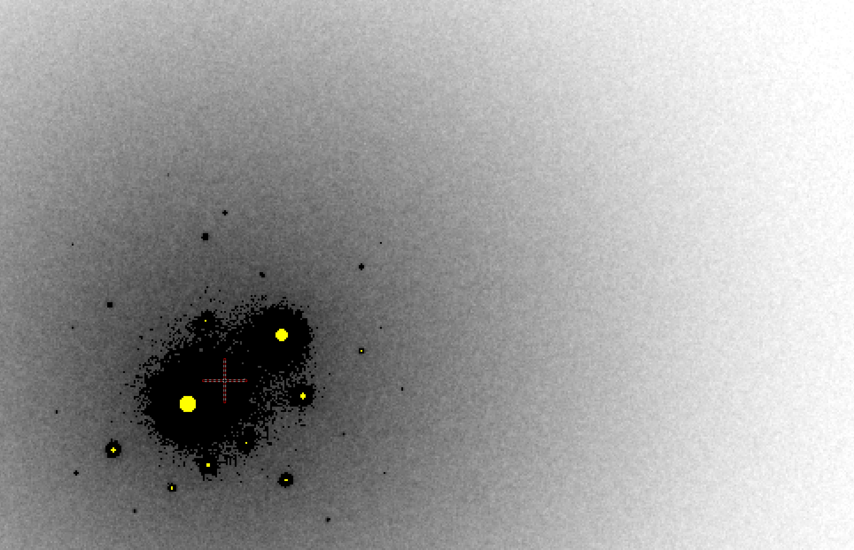
B factor from image analysis
B = 500

Slide 11
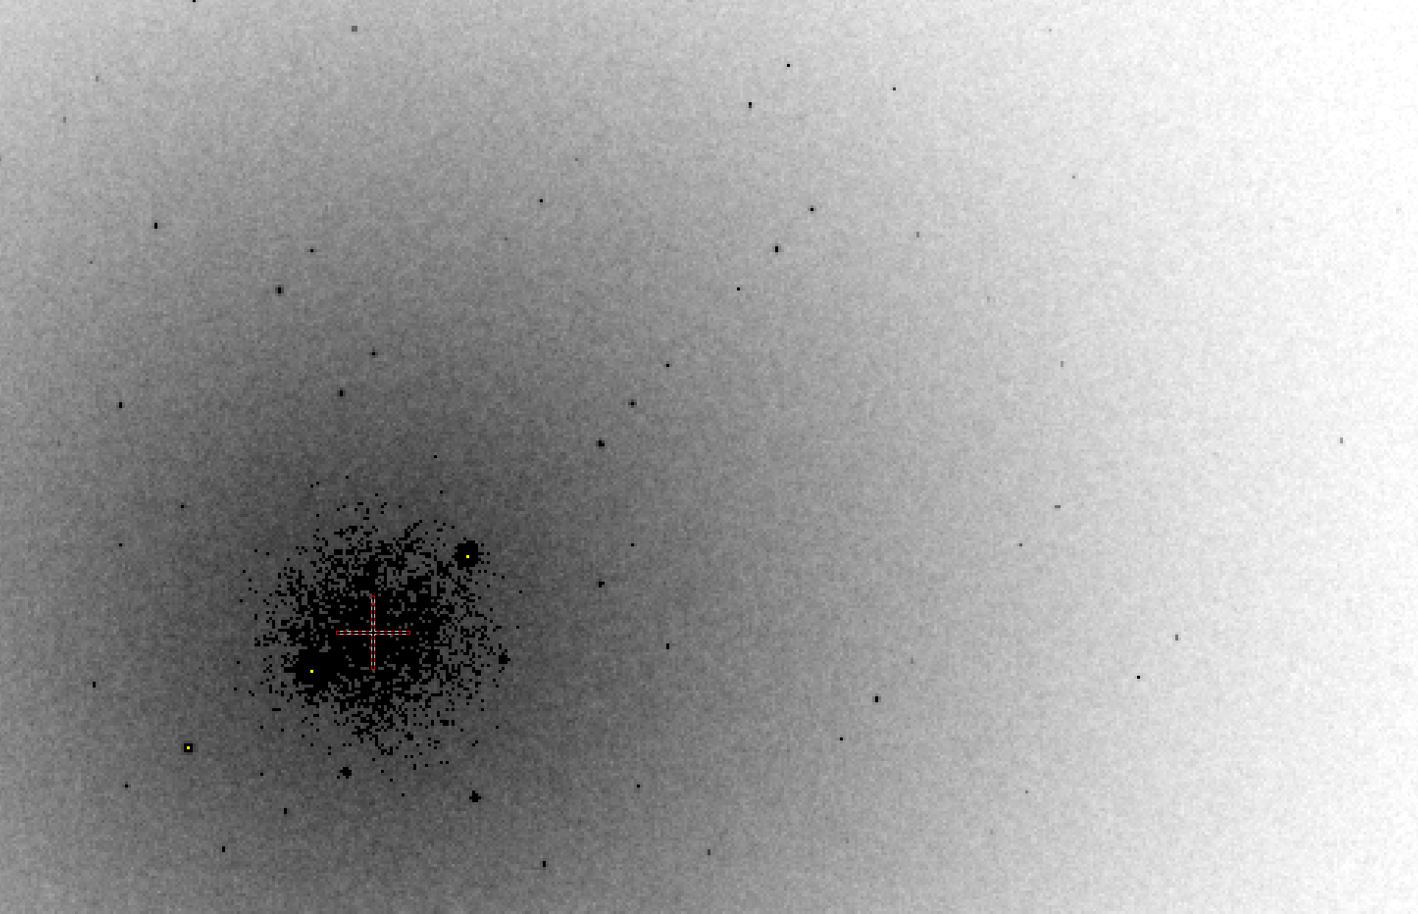
B factor from image analysis
B = 20

Slide 12
Bigger is better, but not by much
B = 20
B = 60
B = 0
B = 170
B = 330
B = 560
Resolution (Å)
B = 850
Crystal diameter (micron)

Slide 13
Diffraction Take-Home Lesson:
disorder
+ averaging
= poor resolution

Slide 14
What Causes Disorder?
Function
Radiation damage
Mosaicity
Strain
Xtal abuse
Dehydration

Slide 15
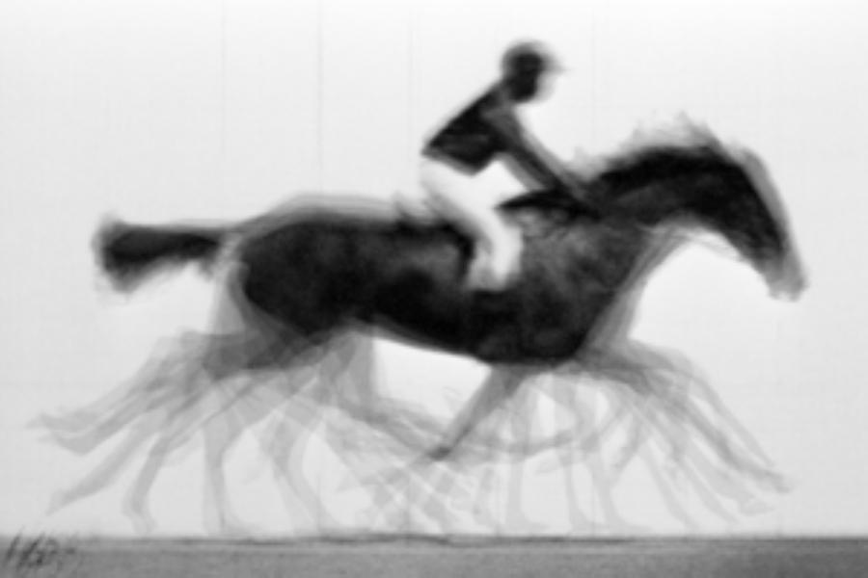
average structure: galloping horse

Slide 16
Types of radiation damage
Global
scale factor
B factor
non-isomorphism
Specific
depends on chemistry
destroys phasing signal

Slide 17
resolution dependence of global damage
10³
10 MGy/Å
100
maximum tolerable dose (MGy)
10
1
1 2 3 5 7 10 20 40 70 100
resolution (Å)
Howells et al. (2009) J. Electron. Spectrosc. Relat. Phenom. 170 4-12

Slide 19
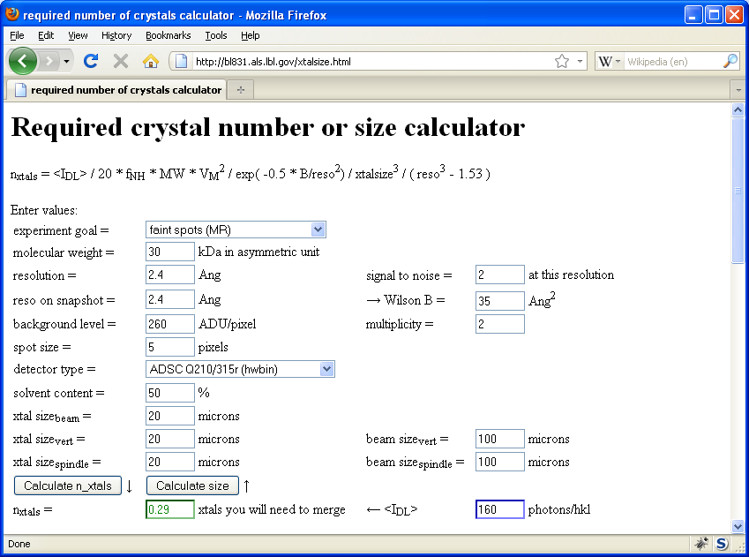
Holton & Frankel (2010) Acta D 66 393-408.

Slide 20
1.0
fraction
unconverted
0.0
Holton, J. M. (2007) J. Synch. Rad. 14, 51-72.

Slide 21
MGy reaction reference
~45 global damage Owen et al. (2006)
10/Å global damage Howells et al. (2009)
5 Se-Met Holton (2007)
4 Hg-S Ramagopal et al. (2004)
4 R-C-COOH Garman et al. (2015)
3 S-S Murray et al. (2002)
1 Br-RNA Olieric et al. (2007)
~1? Cl-C ???
0.5 Mn in PS II Yano et al. (2005)
0.06 putidaredoxin Corbett et al. (2007)
0.02 Fe in myoglobin Denisov et al. (2007)
Radiation Damage World Records
Holton (2009) J. Synchrotron Rad. 16 133-42

Slide 22
Life-halving concentration
molar, at the Se edge based on RADDOSE
Na | 44
Mg | 27
P | 9
S | 7
Cl | 5
K | 3.3
Ca | 2.7
Fe | 1.0
Cu | 0.67
Zn | 0.58
As | 0.44
Se | 0.42
Br | 2.9
I | 0.47
Gd | 0.21
Ta | 0.13
Pt | 0.17
Au | 0.16
Hg | 0.16
U | 0.23

Slide 23
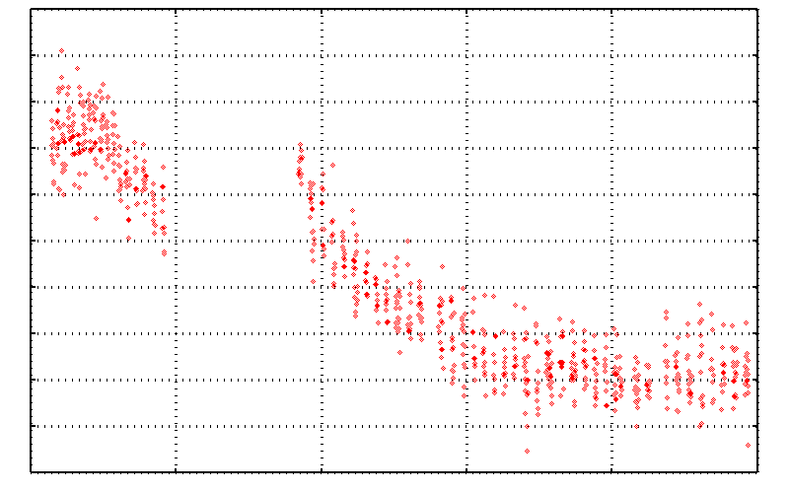
No Damage in the Dark!
4.6 5.0 5.4 5.8 6.2 6.6
Peak absorbance (electrons)
0 5 10 15 20 25
Experiment time (hours)

Slide 24
The number of photons scattered
before crystal is dead
is independent
of flux & time
1 um³ = 10⁵ photons (roomT)
1 um³ = 10⁶ photons (synch)
1 um³ = 10⁸ photons (XFEL)
(synch)
Henderson, 1990; Gonzalez & Nave, 1994; Glaeser et al., 2000; Sliz et al., 2003; Leiros et al., 2006; Owen et al., 2006; Garman & McSweeney, 2006; Garman & Nave, 2009; Holton, 2009

Slide 25
Dose slicing
unacceptable
completeness
N
photons
crystal’s useful life
N
photons
unacceptable
read noise
N
photons

Slide 26
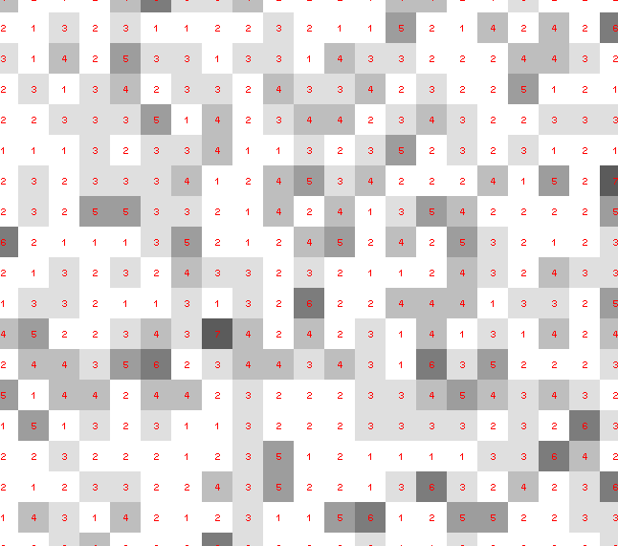
Dose slicing: is that a spot?

Slide 27
What if?
You only have a few small crystals…
Should you:
Collect 360° from each?
Collect 10° from each at 36x exposure?
Glue 36 xtals together, then collect 360° ?
Glue, and do 12960° faint exposures?

Slide 28
“true” resolution limit
CC vs right answer
Resolution (Å)

Slide 29
“true” resolution vs strategy
Dose slice collection scenario
fine | coarse | glue | Glue & fine
3.17700 | 3.14057 | 3.17604 | 3.12086
301,640,334 photons/xtal

Slide 30
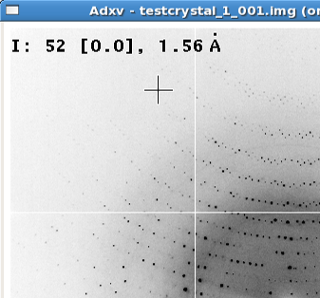
Optimum exposure time:
~1 photon/pixel
XDS, DIALS
~10 photon/pixel
HKL2000, MOSFLM
~30 photon/pixel
CCD detector
adjust exposure
so this is ~100

Slide 31
Ewald’s “mosaic” picture

Slide 32
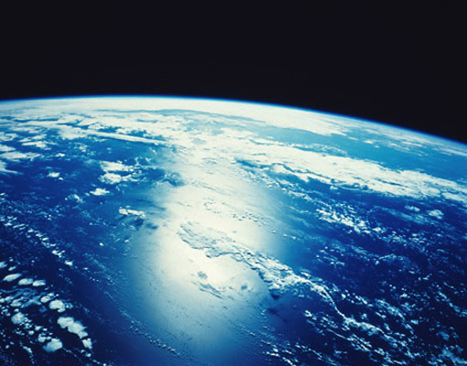
“mosaicity” with visible light

Slide 33
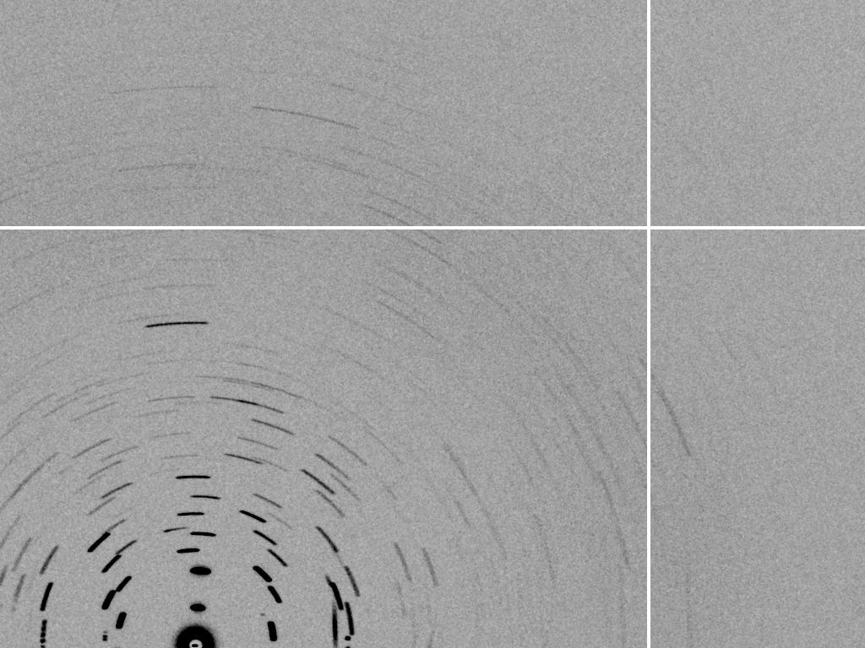
mosaic spread = 12.8º

Slide 34
Ways to improve diffraction
New crystal form
Purify
- add a column
- heat shock
Bind something
- Known ligand
- Silver bullets
Change the clone
- chop off floppy bits
- homolog
- Ala -> Lys mutants
Make Protein Sit Still!!!
Newman J. (2006) Acta Cryst. D62 27-31.

Slide 35
Basic Principles
“Hell, there are NO RULES here - we're trying to accomplish something.”
Thomas A. Edison – inventor
“You’ve got to have an ASSAY.”
Arthur Kornberg – Nobel Laureate
“Control, control, you must learn CONTROL!”
Yoda – Jedi Master

Slide 36
beam size vs xtal size
Put your crystal into the beam
Shoot the whole crystal
Shoot nothing but the crystal
Back off!
The crystal must rotate

Slide 37
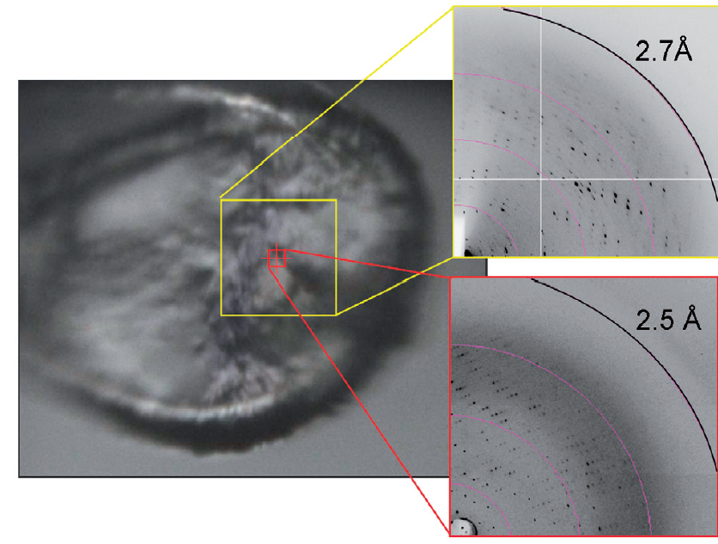
Get thee to a microbeam?
Evans et al. (2011)."Macromolecular microcrystallography", Crystallography Reviews 17, 105-142.

Slide 38
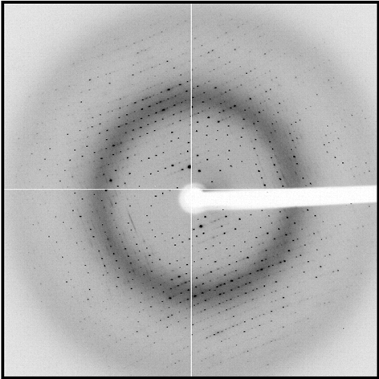
shoot the whole crystal

Slide 39
shoot nothing but the crystal

Slide 40
shoot nothing but the crystal

Slide 41
X-ray scattering “rules”:
1 μm crystal ≈ 1 μm water
≈ 1 μm plastic
≈ 0.1 μm glass
≈ 1000 μm air

Slide 42
Resolution (Å)
too big
too small
just right
X-ray beam size (μm)

Slide 43
Gaussian beam
50% of flux
the other 50%

Slide 44
Collimated beam
100% of flux
0%

Slide 45
Tipping point for µfocus:
10 µm
~1 mrad =0.06°
~10 mm

Slide 46
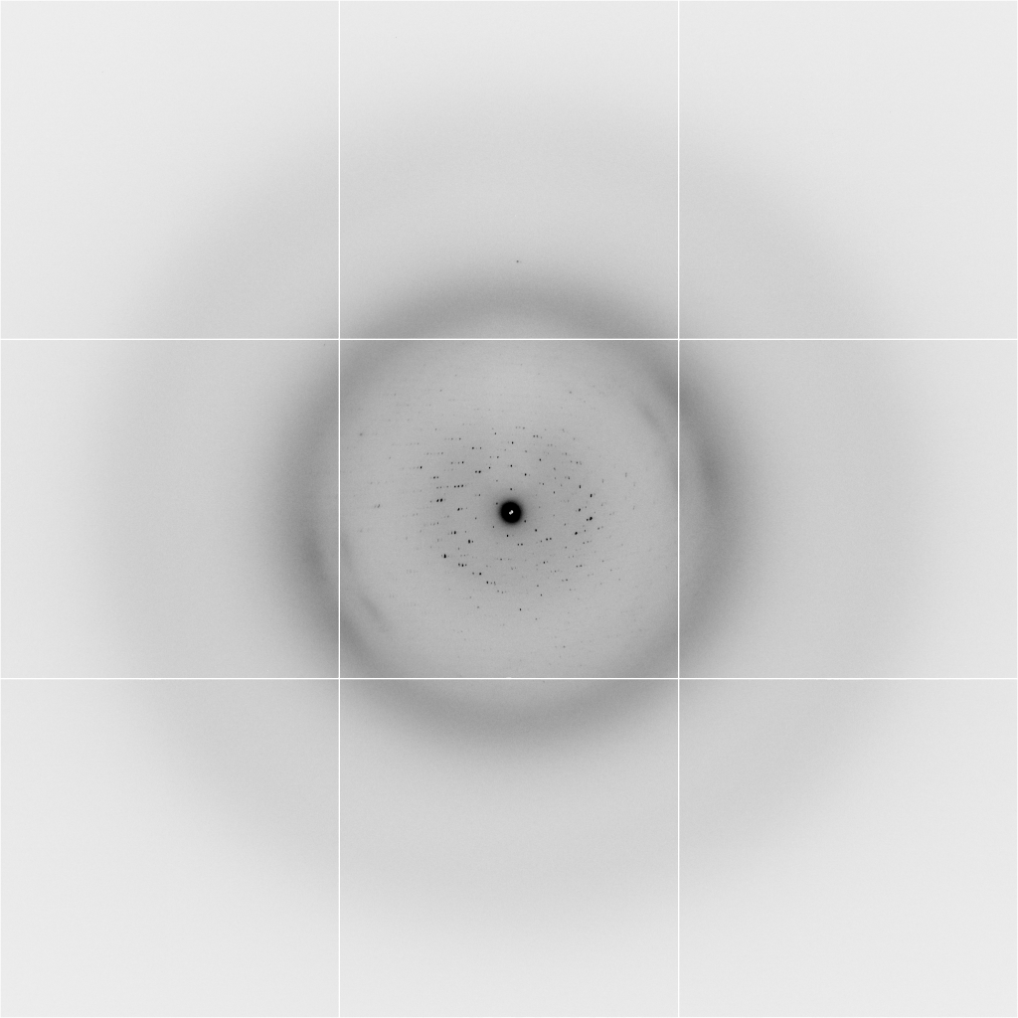
Background scattering
$100,000.00
$100,000.00
$100,000.00
real estate is
expensive
use it!
$100,000.00
$100,000.00
$100,000.00
$100,000.00
$100,000.00

Slide 47
Fine Slicing
background
background
Pflugrath, J. W. (1999)."The finer things in X-ray diffraction data collection", Acta Cryst. D 55, 1718-1725.

Slide 48
anomalous signal
ΔF
F
√
# sites
MW (Da)
≈ 1.2 f”
World record!
ΔF/F = 0.5%
Wang, Dauter & Dauter (2006) Acta Cryst. D 62, 1475-1483.
Crick, F. H. C. & Magdoff, B. S. (1956) Acta Crystallogr. 9, 901-908.
Hendrickson, W. A. & Teeter, M. M. (1981) Nature 290, 107-113.

Slide 49
Threshold of a revolution in phasing
CCD
old Pilatus
Goal
Solve-able proteins (%)
Best
Pilatus
Required signal-to-noise (I/σ)

Slide 50
S-SAD merging 20 xtals
Knott et al. (2017). "Guide-bound CRISPR-Cas13a." Nature S&MB online

Slide 51
Systematic vs random error
intensity
observation

Slide 52
R_{iso} vs dose
R_{iso} ≈ 0.7 %/MGy
R_{iso} (%)
change in dose (MGy)
data taken from Banumathi, et al. (2004) Acta Cryst. D 60, 1085-1093.

Slide 53
Optimal exposure time (anomalous on a PAD)
2.03 ms
intensity
time

Slide 54
Optimal exposure time (anomalous on a PAD)
PILATUS
>0.2 s/frame
EIGER
>0.0003 s/frame
t_{mad} Optimal exposure time (s)
t_{ro} read-out time (s)
2.03 ms on Pilatus³ S
0.95 ms on Pilatus³ X
0.003 ms on Eiger
= 20,000 frames
350 GB/dataset
Attenuate for MAD

Slide 55
Gadox calibration vs energy
same = good!
Relative absorption depth
bad!
photon energy (keV)

Slide 56
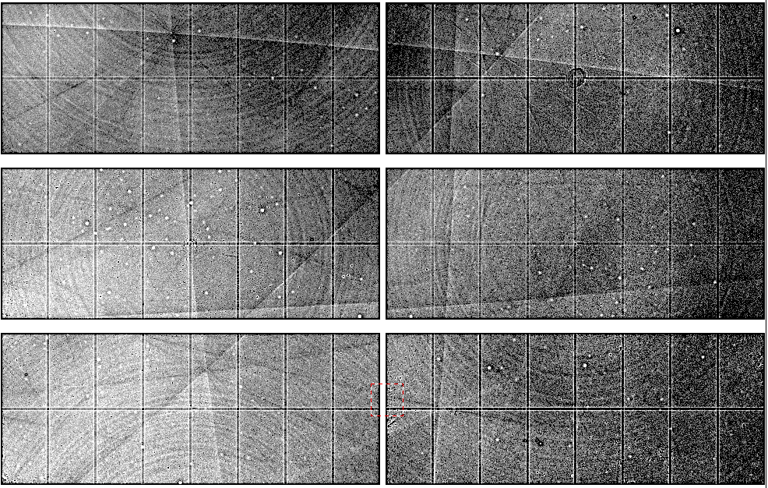
Spatial Heterogeneity in Sharp Spot Sensitivity
~3x10⁵ photon/pixel Pilatus detector
Bragg
glitch
“tree rings”
Pick-up tool mark
oxygen
inclusions
1% high
average
1% low

Slide 57
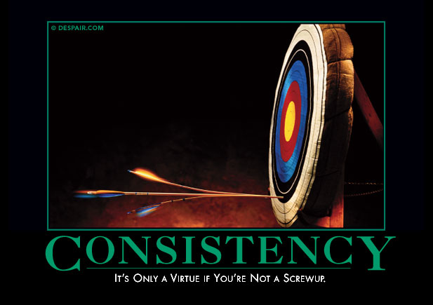
Systematic error does not “average out”

Slide 58
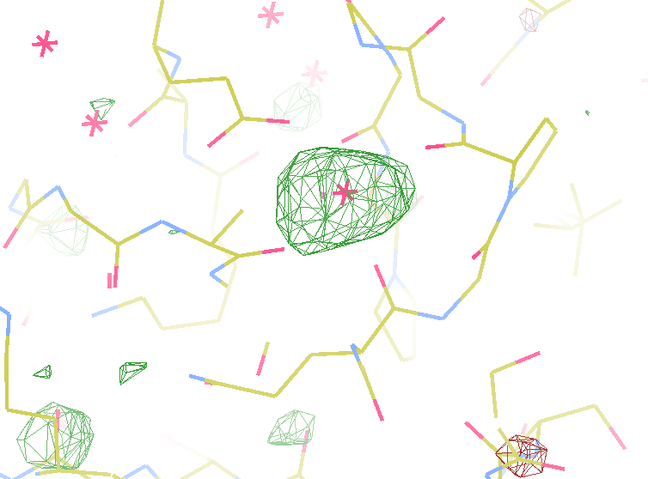
140-fold multiplicity
7.4σ = Na
DELFAN residual anomalous difference

Slide 59
Suggested anomalous protocol:
360° in < 5 MGy
move detector
4X exposure
goto 2
2 wavelengths are better than 1
- (peak + inf)/2, and remote
MAD, not M-SAD!

Slide 60
Summary
http://bl831.als.lbl.gov/xtalsize.html
http://bl831.als.lbl.gov/xtallife.html
http://bl831.als.lbl.gov/damage_rates.pdf
http://bl831.als.lbl.gov/~jamesh/powerpoint/CSHL_tipsNtrick_2017.pptx
15 ADU/pixel
10 μm for lysozyme
~3% error per spot, 1%/MGy
7235 eV for S-SAD on CCD
“Attenu-wait”: dose slicing

