Slide 1
PowerPoint File available:
http://bl831.als.lbl.gov/
~jamesh/powerpoint/
CSHL_tipsNtrick_2017.pptx

Slide 2
Acknowledgements
Robert Stroud James Fraser John Spence
Chris Nielsen Clemens Schulze-Briese Aina Cohen Ana Gonzalez
UCSF LBNL SLAC
ALS 8.3.1: TomAlberTron
UC Multicampus Research Programs and Initiatives (MRPI)
NIH NIGMS R01 GM124149
NIH NIGMS P30 GM124169
Integrated Diffraction Analysis Technologies (IDAT)
Plexxikon, Inc.
Synchrotron Radiation Structural Biology Resource (SLAC)
The Advanced Light Source is supported by the Director, Office of Science, Office of Basic Energy Sciences, Materials Sciences Division, of the US Department of Energy under contract No. DE-AC02-05CH11231 at Lawrence Berkeley National Laboratory.

Slide 3
The “success rate” of structure determination
100 s/dataset
200 days/year
~150 beamlines
~26,000,000 datasets/year
~10,000 PDBs in 2016

Slide 4
signal vs noise
“If you don’t have
good data,
then you have
no data at all.”
-Sung-Hou Kim

Slide 5
signal vs noise
easy
hard
impossible

Slide 6
signal vs noise
easy
hard
impossible
threshold of “solvability”

Slide 7
signal vs noise
“If you don’t have
good data,
then you must
learn statistics.”
-James Holton

Slide 8
Adding noise

Slide 9
Adding noise
1² + 1² = 1.4²

Slide 10
Adding noise
1² + 1² = 1.4²
3² + 1² = 3.2²
σ_{total}² = σ₁² + σ₂²

Slide 11
Adding noise
1² + 1² = 1.4²
3² + 1² = 3.2²
σ_{total}² = σ₁² + σ₂²

Slide 12
Adding noise
1² + 1² = 1.4²
3² + 1² = 3.2²
σ_{total}² = σ₁² + σ₂²

Slide 13
Adding noise
1² + 1² = 1.4²
3² + 1² = 3.2²
10² + 1² = 10.05²

Slide 14
The
“threshold of solvability” is sharp!
How can we predict success/failure?
Know Thy Experiment

Slide 15
What do we want?
Resolution
Mosaicity
Nice, round spots
No overlaps
No twinning
Lots of crystals
…

Slide 16
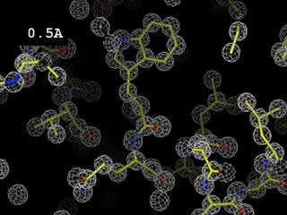

Slide 17
What do we want?
Resolution
Mosaicity
Nice, round spots
No overlaps
No twinning
Lots of crystals
…
2. Phases

Slide 18
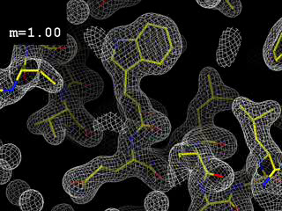
Phases
http://bl831.als.lbl.gov/~jamesh/movies/dephase.mpeg

Slide 19
And the dominant source of error is…
Resolution
  Disorder (including Radiation Damage)
  Background
Phases
  Non-isomorphism (including Radiation Damage)
  Vibration (beam, xtal, spindle, etc.)
  Detector calibration

Slide 20
What is “disorder”?

Slide 21
What is “disorder”?

Slide 22
What is “disorder”?

Slide 23

What is “disorder”?
order
order
B-factor
disorder

Slide 24
“B” factors
ATOM 122 N LEU A 13 -3.244 25.808 19.998 1.00 16.96 N
ATOM 123 CA LEU A 13 -2.877 25.448 21.355 1.00 15.29 C
ATOM 124 C LEU A 13 -2.792 23.966 21.561 1.00 17.54 C
ATOM 125 O LEU A 13 -1.814 23.493 22.143 1.00 16.35 O
ATOM 126 CB LEU A 13 -3.907 26.164 22.268 1.00 18.72 C
ATOM 127 CG LEU A 13 -3.577 25.982 23.738 1.00 21.19 C
ATOM 128 CD1 LEU A 13 -2.283 26.820 24.019 1.00 19.43 C
ATOM 129 CD2 LEU A 13 -4.702 26.474 24.639 1.00 24.65 C
ATOM 130 N SER A 14 -3.677 23.149 20.979 1.00 15.96 N
ATOM 131 CA SER A 14 -3.646 21.711 21.061 1.00 18.26 C
ATOM 132 C SER A 14 -2.373 21.203 20.360 1.00 18.71 C
ATOM 133 O SER A 14 -1.747 20.315 20.930 1.00 17.47 O
ATOM 134 CB SER A 14 -4.875 21.077 20.419 1.00 17.62 C
ATOM 135 OG ASER A 14 -4.825 19.665 20.388 0.50 20.89 O
ATOM 136 OG BSER A 14 -6.027 21.408 21.164 0.50 18.67 O
ATOM 137 N LYS A 15 -2.045 21.772 19.215 1.00 18.03 N
ATOM 138 CA LYS A 15 -0.799 21.361 18.555 1.00 18.12 C
ATOM 139 C LYS A 15 0.446 21.707 19.351 1.00 18.81 C
ATOM 140 O LYS A 15 1.400 20.948 19.411 1.00 17.77 O
ATOM 141 CB LYS A 15 -0.700 22.034 17.177 1.00 14.49 C
ATOM 142 CG LYS A 15 -1.727 21.368 16.256 1.00 16.12 C
ATOM 143 CD LYS A 15 -1.663 22.147 14.936 1.00 19.40 C
ATOM 144 CE ALYS A 15 -2.725 21.614 13.986 0.50 17.42 C
ATOM 145 CE BLYS A 15 -1.750 21.211 13.750 0.50 17.01 C
ATOM 146 NZ ALYS A 15 -2.346 21.674 12.559 0.50 18.61 N
ATOM 147 NZ BLYS A 15 -3.052 20.513 13.741 0.50 18.76 N

Slide 25
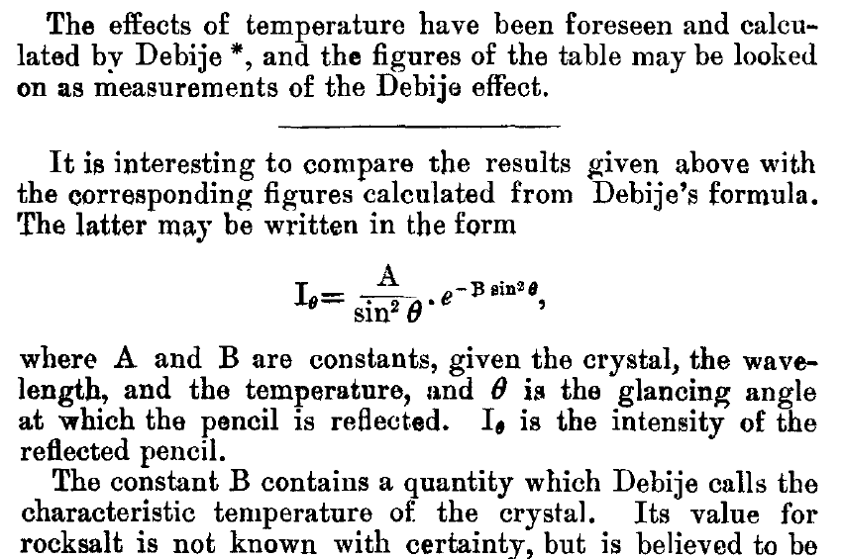
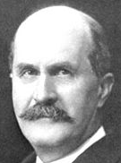
The B factor
Bragg, W. H. (1914)."XCVII. The intensity of reflexion of X rays by crystals", Philosophical Magazine Series 6 27, 881-899. Published May 1 1914

Slide 26
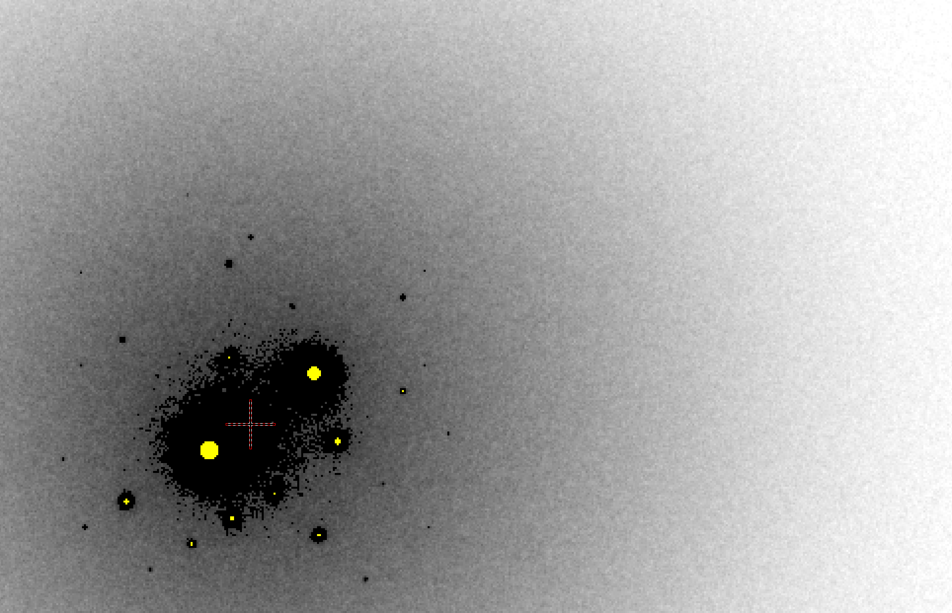
B factor from image analysis
B = 500

Slide 27
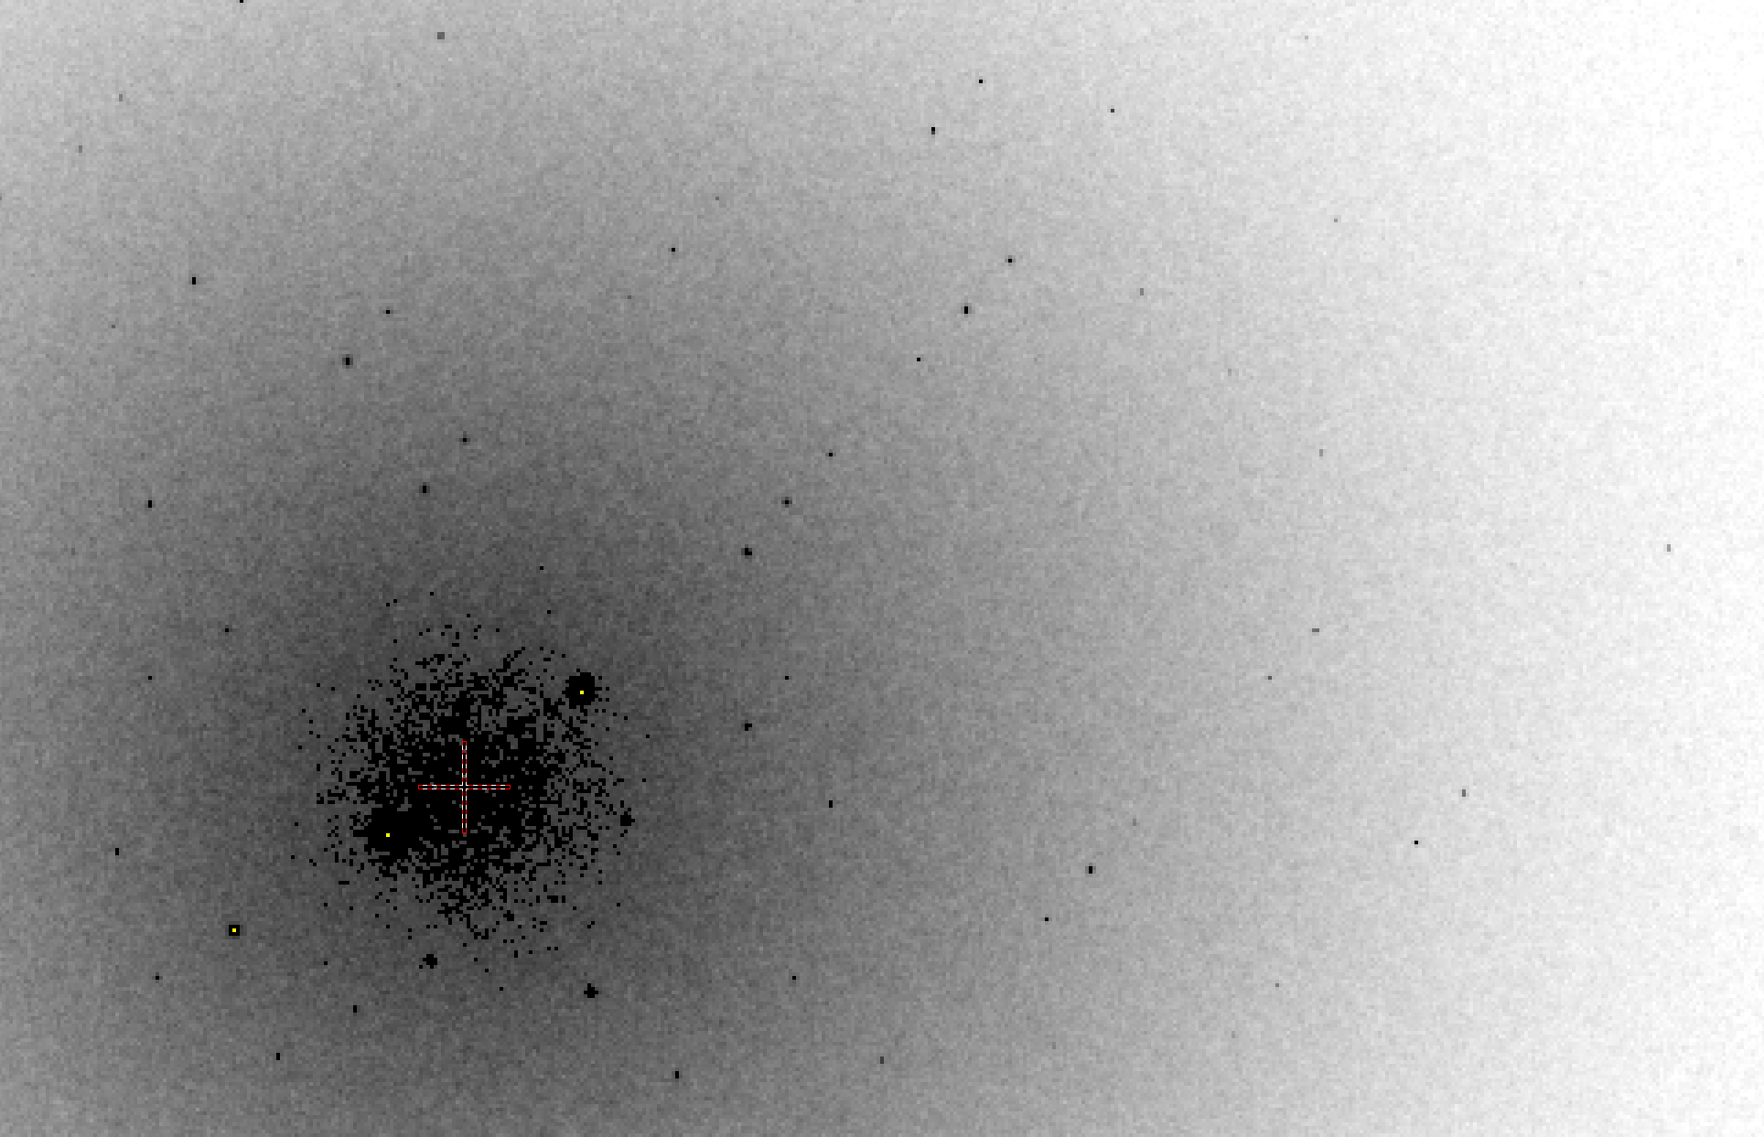
B factor from image analysis
B = 20

Slide 28
Bigger is better, but not by much
B = 20
B = 60
B = 0
B = 170
B = 330
B = 560
Resolution (Å)
B = 850
Crystal diameter (micron)

Slide 29
Diffraction Take-Home Lesson:
disorder
+ averaging
= poor resolution

Slide 30
What Causes Disorder?
Function
Radiation damage
Mosaicity
Strain
Xtal abuse
Dehydration

Slide 31
What Causes Disorder?
Function
Radiation damage
Mosaicity
Strain
Xtal abuse
Dehydration

Slide 32

Muybridge’s galloping horse (1878)

Slide 33
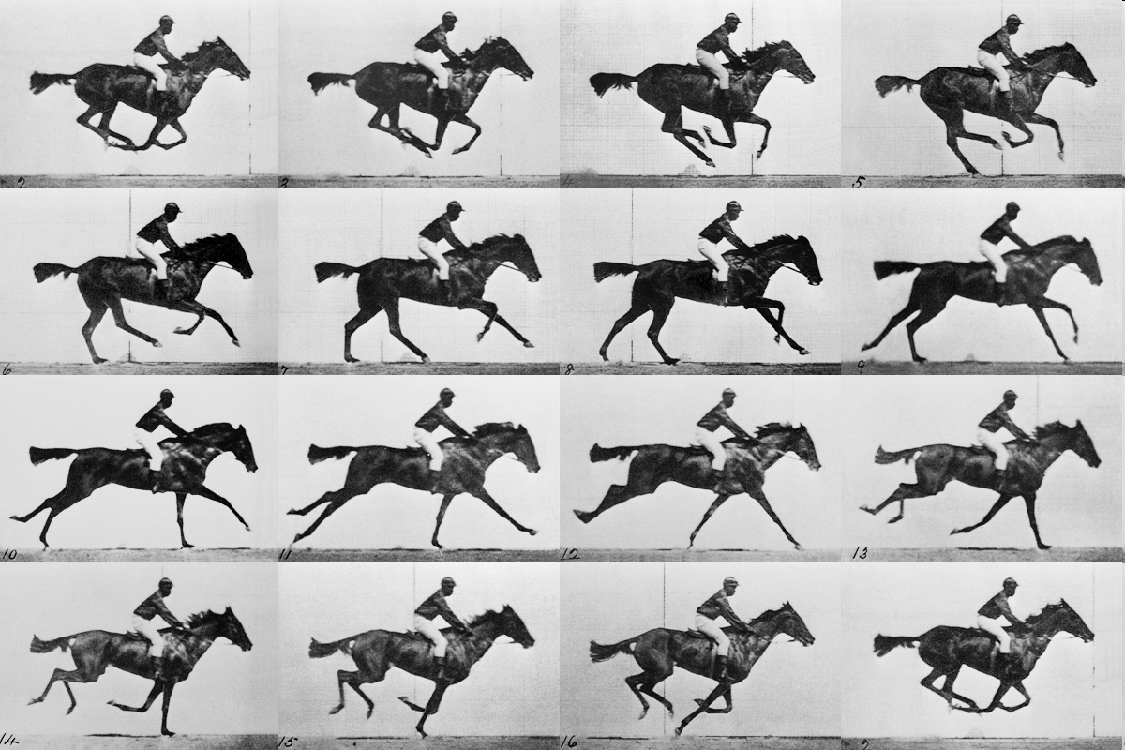
realistic “crystal” of horses

Slide 34
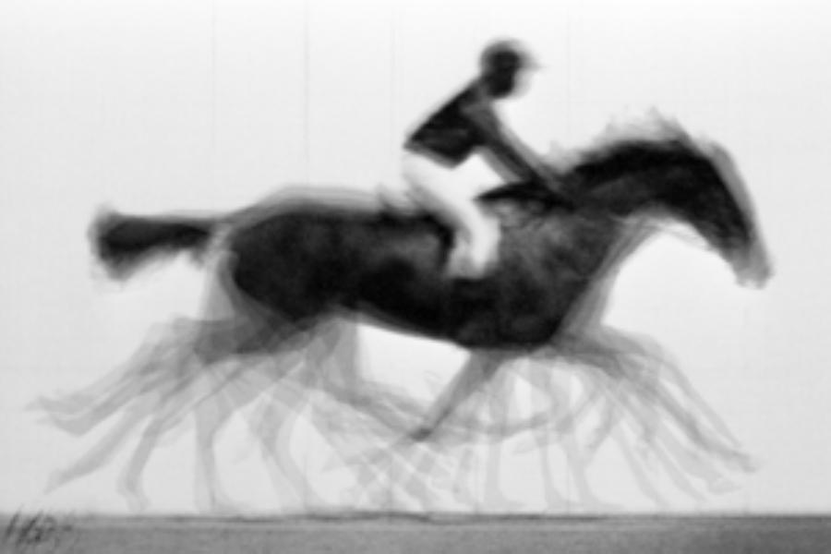
average structure: galloping horse

Slide 35

Ways to improve order
New crystal form
Purify
  - add a column
  - heat shock
Bind something
  - Known ligand
  - Silver bullets
Change the clone
  - chop off floppy bits
  - homolog
  - Ala -> Lys mutants
Make Protein Sit Still!!!
8000 cases in PDB of resolution improvement
80% of these are different crystal forms
> 1 Å improvement → 94% different forms
Newman J. (2006) Acta Cryst. D62 27-31.

Slide 36
What Causes Disorder?
Function
Radiation damage
Mosaicity
Strain
Xtal abuse
Dehydration

Slide 37
Types of radiation damage
Global
Specific

Slide 38
Types of radiation damage
Global
  scale factor
  B factor
  non-isomorphism
Specific
  depends on chemistry
  destroys phasing signal

Slide 39
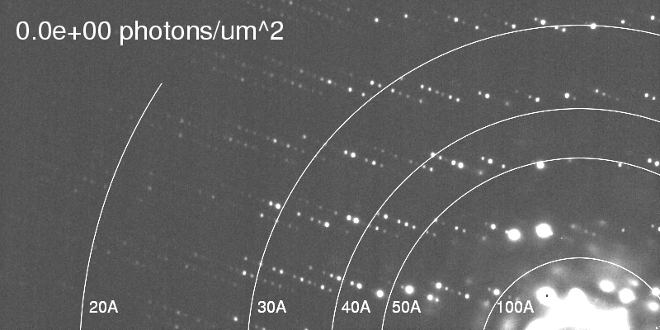
Global damage
Howells, et al. (2009) J. Electron Spectrosc. Relat. Phenom. 170, 4-12.

Slide 40
resolution dependence of global damage
10³
100
maximum tolerable dose (MGy)
10
1
1 2 3 5 7 10 20 40 70 100
resolution (Å)
Howells et al. (2009) J. Electron. Spectrosc. Relat. Phenom. 170 4-12

Slide 41
resolution dependence of global damage
10³
10 MGy/Å
100
maximum tolerable dose (MGy)
10
1
1 2 3 5 7 10 20 40 70 100
resolution (Å)
Howells et al. (2009) J. Electron. Spectrosc. Relat. Phenom. 170 4-12

Slide 42
what the is a MGy?
1 MGy = 10⁶ J/kg
http://bl831.als.lbl.gov/
damage_rates.pdf
Holton J. M. (2009) J. Synchrotron Rad. 16 133-42

Slide 43
How long will my crystal last?
synch line type flux beamsize flux density dose max xtal min site
ph/s μm ph/μm2/s rate lifetime lifetime
ALS 4.2.2 MAD 2.2e11 75x80 3.7e+07 27.3 kGy/s 18 m 73 s
ALS 5.0.1 mono 1.6e11 100 2.0e+07 10.4 kGy/s 48 m 3.2 m
ALS 5.0.2 MAD 8e11 100 1.0e+08 51.8 kGy/s 9.6 m 39 s
ALS 5.0.3 mono 1.7e11 100 2.2e+07 11 kGy/s 45 m 3 m
ALS 8.2.1 MAD 1.8e11 100 2.3e+07 11.7 kGy/s 43 m 2.9 m
ALS 8.2.2 MAD 2.3e11 100 2.9e+07 14.9 kGy/s 34 m 2.2 m
ALS 8.3.1 MAD 9e11 70 2.3e+08 119 kGy/s 4.2 m 17 s
ALS 8.3.1 typical 6e11 70 1.6e+08 115 kGy/s 4.3 m 17 s
ALS 12.3.1 MAD 1.8e11 100 2.3e+07 11.7 kGy/s 43 m 2.9 m
ALS 12.3.1 ML 4.0e12 100 5.1e+08 513 kGy/s 58 s 3.9 s
APS 8-BM MAD 1e11 200 2.5e+06 1.27 kGy/s 6.6 h 26 m
APS 14-BM-C mono 5.8e10 200 1.4e+06 738 Gy/s 11 h 45 m
APS 14-BM-D MAD 3.3e9 200 8.2e+04 42 Gy/s 8.3 d 13 h
APS 14-ID-B MAD 6.0e10 200 1.5e+06 763 Gy/s 11 h 44 m
APS 17-BM MAD 1.1e11 200 2.8e+06 1.4 kGy/s 6 h 24 m
APS 17-ID MAD 2.3e11 200 5.8e+06 2.93 kGy/s 2.8 h 11 m
APS 19-BM MAD 2.0e11 70x60 4.8e+07 24.2 kGy/s 21 m 83 s
APS 19-ID MAD 1.3e13 80x40 4.1e+09 2.07 MGy/s 15 s 0.97 s
APS 19-ID typical 5.5e11 100x100 5.5e+07 28 kGy/s 18 m 71 s
APS 22-BM MAD 7e12 80x40 2.2e+09 1.23 MGy/s 24 s 1.6 s
APS 22-ID MAD 7e12 80x40 2.2e+09 1.23 MGy/s 24 s 1.6 s
APS 22-ID typical 1.5e12 80 2.3e+08 119 kGy/s 4.2 m 17 s
APS 23-ID-B MAD 1e13 75x25 5.3e+09 3.01 MGy/s 10 s 0.66 s
APS 23-ID typical 1.5e12 80 2.3e+08 119 kGy/s 4.2 m 17 s
APS 24-ID-C MAD 1.3e13 20x60 1.1e+10 5.23 MGy/s 5.7 s 0.38 s
APS 24-ID-E MAD 0.5e13 20x100 2.5e+09 1.19 MGy/s 25 s 1.7 s
APS 31-ID MAD 2e12 70 4.1e+08 194 kGy/s 2.6 m 10 s

Slide 44
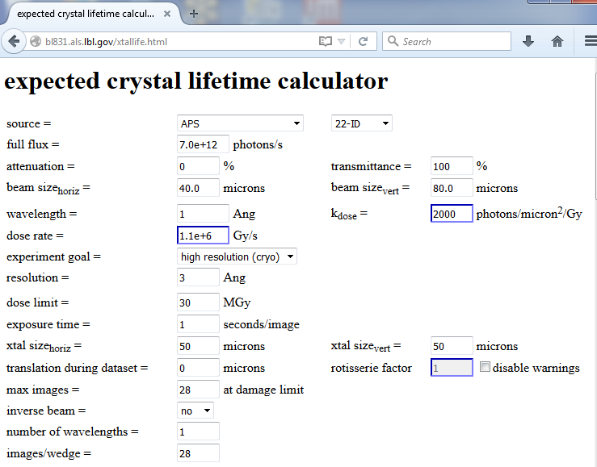

Slide 45
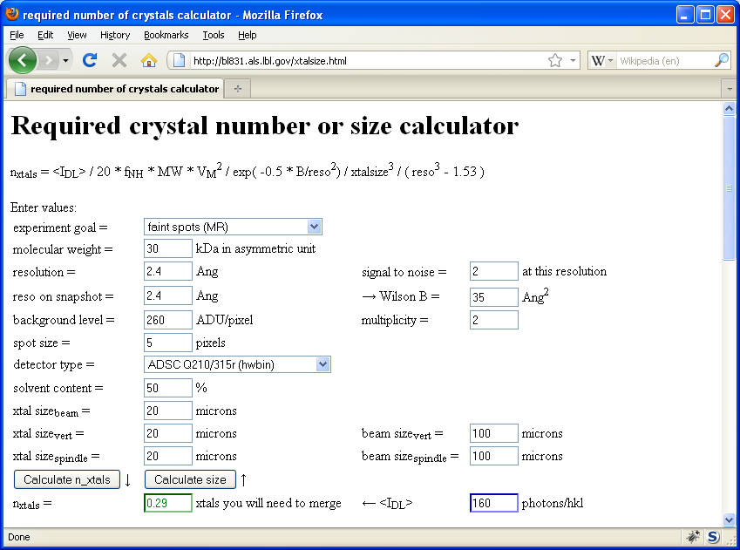
Holton & Frankel (2010) Acta D 66 393-408.

Slide 46
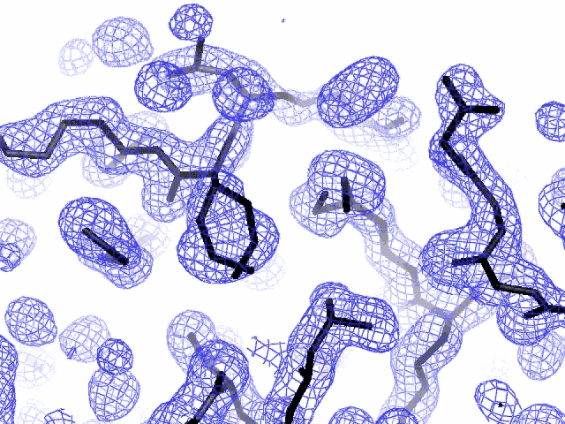
Specific damage
final, refined phases

Slide 47
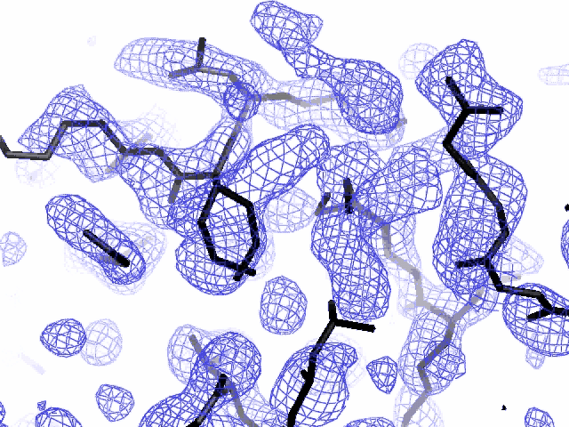
Specific damage
experimentally-obtained phases

Slide 48
Holton, J. M. (2007) J. Synch. Rad. 14, 51-72.

Slide 49
1.0
fraction
unconverted
0.0
Holton, J. M. (2007) J. Synch. Rad. 14, 51-72.

Slide 50
MGy reaction reference
~45 global damage Owen et al. (2006)
10/Å global damage Howells et al. (2009)
5 Se-Met Holton (2007)
4 Hg-S Ramagopal et al. (2004)
4 R-C-COOH Garman et al. (2015)
3 S-S Murray et al. (2002)
1 Br-RNA Olieric et al. (2007)
~1? Cl-C ???
0.5 Mn in PS II Yano et al. (2005)
0.06 putidaredoxin Corbett et al. (2007)
0.02 Fe in myoglobin Denisov et al. (2007)
Radiation Damage World Records
Holton (2009) J. Synchrotron Rad. 16 133-42

Slide 51
Life-halving concentration
molar, at the Se edge based on RADDOSE
Na | 44
Mg | 27
P | 9
S | 7
Cl | 5
K | 3.3
Ca | 2.7
Fe | 1.0
Cu | 0.67
Zn | 0.58
As | 0.44
Se | 0.42
Br | 2.9
I | 0.47
Gd | 0.21
Ta | 0.13
Pt | 0.17
Au | 0.16
Hg | 0.16
U | 0.23

Slide 52
Life-halving concentration
molar, at the Se edge based on RADDOSE
Na | 44
Mg | 27
P | 9
S | 7
Cl | 5
K | 3.3
Ca | 2.7
Fe | 1.0
Cu | 0.67
Zn | 0.58
As | 0.44
Se | 0.42
Br | 2.9
I | 0.47
Gd | 0.21
Ta | 0.13
Pt | 0.17
Au | 0.16
Hg | 0.16
U | 0.23

Slide 53
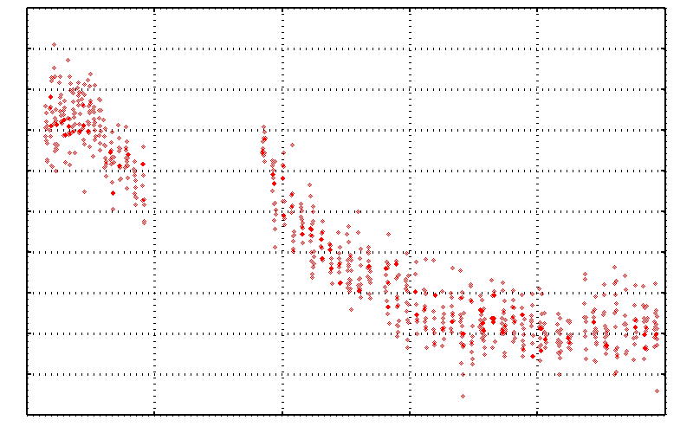
No Damage in the Dark!
4.6 5.0 5.4 5.8 6.2 6.6
Peak absorbance (electrons)
0 5 10 15 20 25
Experiment time (hours)

Slide 54
The number of photons scattered
before crystal is dead
is independent
of flux & time
1 um³ = 10⁵ photons (roomT)
1 um³ = 10⁶ photons (synch)
1 um³ = 10⁸ photons (XFEL)
(synch)
Henderson, 1990; Gonzalez & Nave, 1994; Glaeser et al., 2000; Sliz et al., 2003; Leiros et al., 2006; Owen et al., 2006; Garman & McSweeney, 2006; Garman & Nave, 2009; Holton, 2009

Slide 55

Dose slicing
unacceptable
completeness
N
photons
crystal’s useful life
N
photons
unacceptable
read noise
N
photons

Slide 56
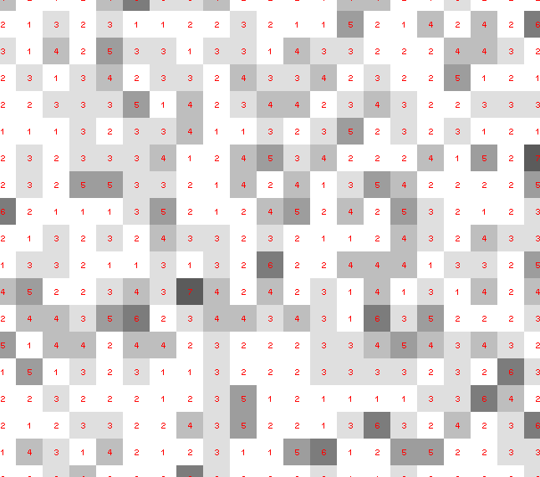
Dose slicing: is that a spot?

Slide 57
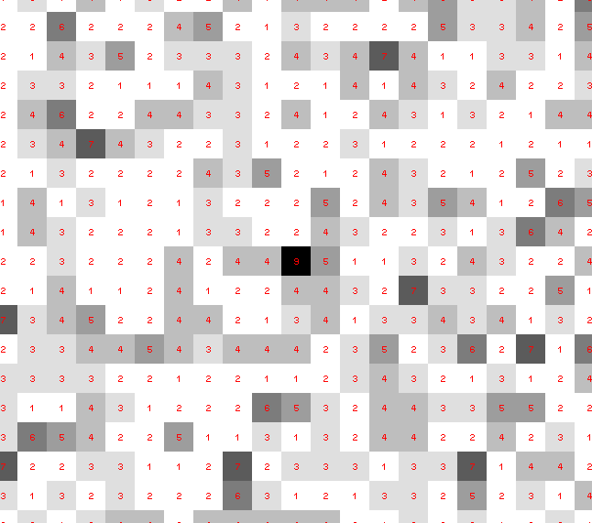
Dose slicing: is that a spot?

Slide 58
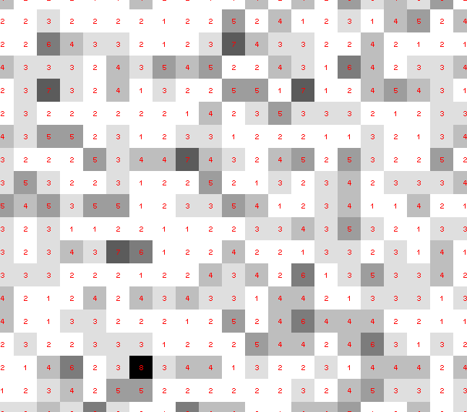
Dose slicing: is that a spot?

Slide 59
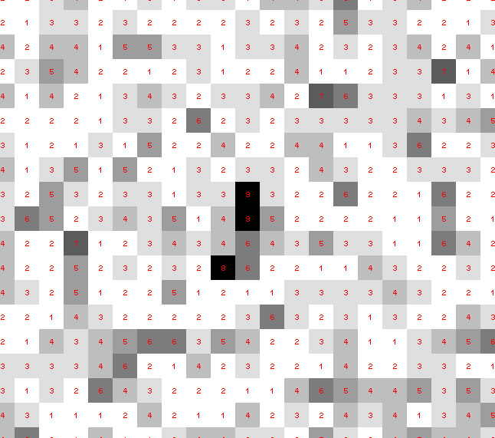
Dose slicing: is that a spot?

Slide 60
Dose slicing: is that a spot?

Slide 61
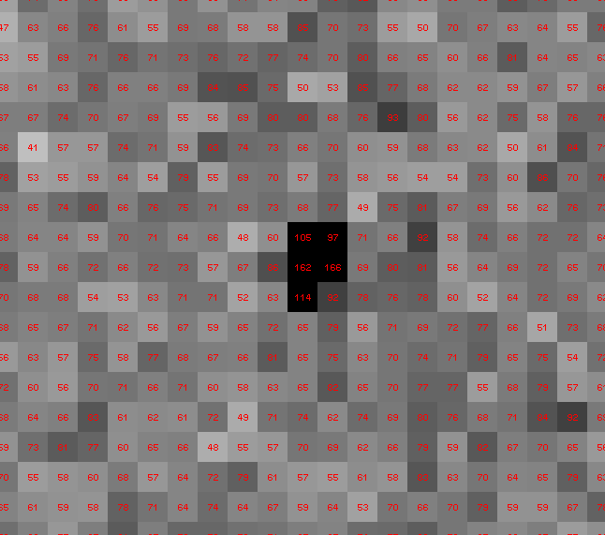
Dose slicing: is that a spot?

Slide 62
What if?
You only have a few small crystals…
Should you:
  Collect 360° from each?
  Collect 10° from each at 36x exposure?
  Glue 36 xtals together, then collect 360° ?
  Glue, and do 12960° faint exposures?

Slide 63
“true” resolution limit
CC vs right answer
Resolution (Å)

Slide 64
“true” resolution vs strategy
Dose slice collection scenario
fine | coarse | glue | Glue & fine
3.17700 | 3.14057 | 3.17604 | 3.12086
301,640,334 photons/xtal

Slide 65
processing procedure | resolution limit
 | fine | coarse | glue | glue&fine
XDS/XSCALE | 3.17700 | 3.14057 | 3.17604 | 3.12086
XDS/aimless | 3.16251 | 3.15922 | 3.16675 | 3.12162
XDS/noscale | 3.27289 | 3.15617 | 3.38929 | 3.12162
MOSFLM-defaults | x | x | x | x
MOSFLM-cheat | 3.19755 | 3.18166 | 3.20354 | 3.19755
HKL2000-defaults | x | x | x | x
HKL2000-expert | 3.21803 | 3.12646 | 3.11551 | 3.21803
HKL2000-cheat | 3.16119 | 3.10338 | 3.10338 | 3.16300
DIALS-defaults | x | x | 3.42125 | x
DIALS-expert | 3.10296 | 3.09547 | 3.07653 | 3.08465
d*Trek | ? | ? | 4.34076 | ?
EVAL15 | 3.14352 | 3.10383 | 3.09936 | 3.14105
EVAL15-sadabs | 3.13920 | 3.10797 | 3.10171 | 3.13700

Slide 66

Minimum exposure time:
~1 photon/pixel
  PAD w XDS, DIALS
~10 photon/pixel
PAD w HKL2k, MOSFLM
~30 photon/pixel
CCD detector
adjust exposure
so this is ~15
(Rayonix)

Slide 67
What Causes Disorder?
Function
Radiation damage
Mosaicity
Strain
Xtal abuse
Dehydration

Slide 68
Ewald’s “mosaic” picture

Slide 69
Ewald’s “mosaic” picture

Slide 70
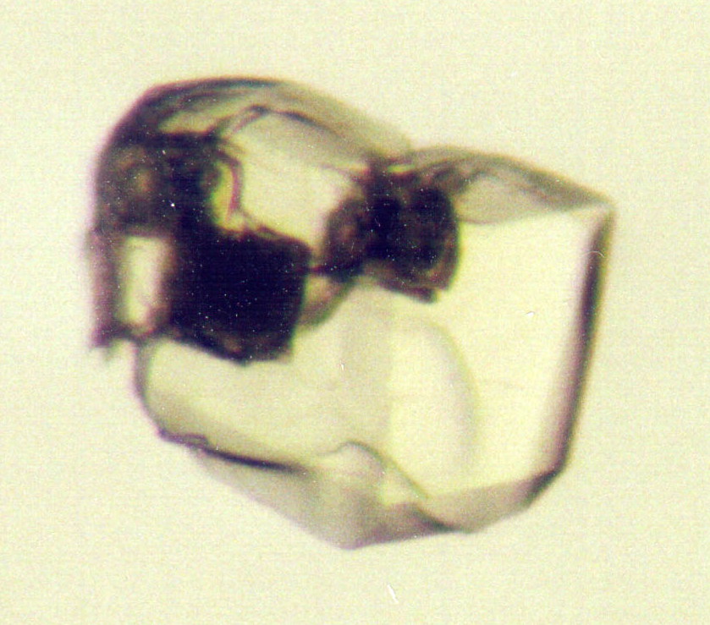
Ewald’s “mosaic” picture
What is
this stuff?

Slide 71
Darwin’s original picture

Slide 72
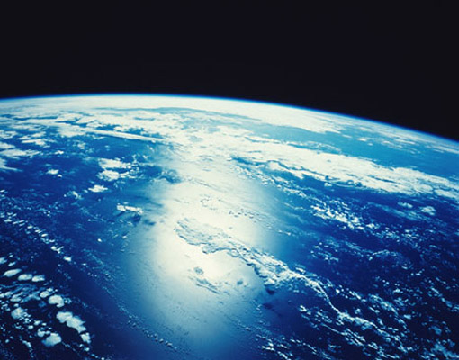
“mosaicity” with visible light

Slide 73

mosaic spread = 0 º

Slide 74

mosaic spread = 0.1º

Slide 75

mosaic spread = 0.2º

Slide 76

mosaic spread = 0.4º

Slide 77

mosaic spread = 0.6º

Slide 78

mosaic spread = 0.8º

Slide 79

mosaic spread = 1.0º

Slide 80

mosaic spread = 1.5º

Slide 81

mosaic spread = 2.0º

Slide 82

mosaic spread = 2.5º

Slide 83

mosaic spread = 3.2º

Slide 84

mosaic spread = 6.4º

Slide 85

mosaic spread = 12.8º

Slide 86
What Causes Disorder?
Function
Radiation damage
Mosaicity
Strain
Xtal abuse
Dehydration

Slide 87
stress and strain
What about
undamaged crystals?
radiation damage = defects

Slide 88
Purity is crucial!
important for
resolution
McPherson, A., Malkin, A. J., Kuznetsov, Y. G. & Plomp, M. (2001)."Atomic force microscopy applications in macromolecular crystallography", Acta Cryst. D 57, 1053-1060.
not important for
initial hits

Slide 89
What can I improve?
Purity!
is 95% good enough? 99%?
Purity!
conformational (homogeneous)
Purity!
kinetic (stable over time)

Slide 90
What Causes Disorder?
Function
Radiation damage
Mosaicity (η) > ~3 μm
Strain (B) < ~3 μm
Xtal abuse
Dehydration

Slide 91
What Causes Disorder?
Function
Radiation damage
Mosaicity > ~3 μm
Strain < ~3 μm
Xtal abuse
Dehydration

Slide 92
Xtal Abuse
physical contact
don’t touch the part you intend to shoot
osmotic shock
equilibrate, or calculate matching solution
changes in dielectric constant
Petsko (1975) J. Mol. Biol. 96, 381-388.
cooled density mismatch
Juers & Matthews (2004) Acta Cryst. D 60, 412-421.
basically: no sudden moves!

Slide 93
What Causes Disorder?
Function
Radiation damage
Mosaicity > ~3 μm
Strain < ~3 μm
Xtal abuse
Dehydration

Slide 94
opened drop: you have ~30 seconds!
equilibrated drop

Slide 95
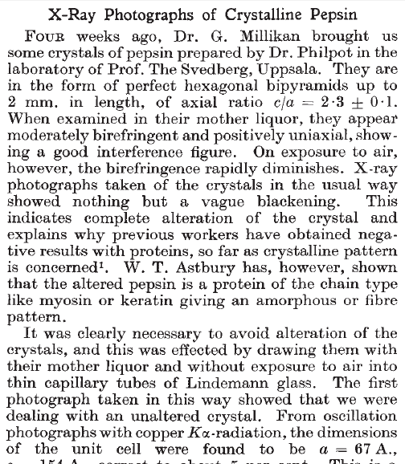
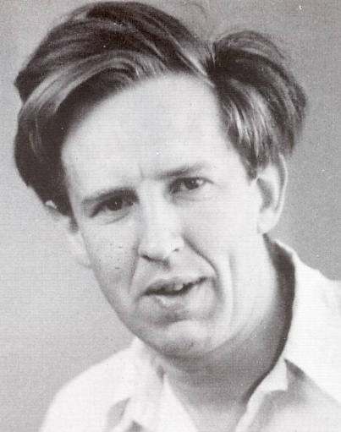
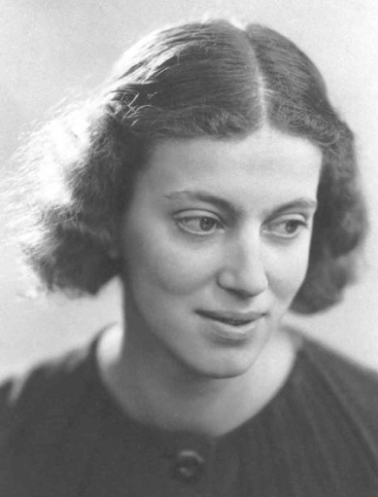
First diffraction from protein xtal
1934
Bernal, J. & Crowfoot, D. (1934). "X-ray photographs of crystalline pepsin", Nature 133, 794-795.

Slide 96
Dehydration: 1934
and 2017?
= 1.5 μL
100 μm
= 1.0 nL
2 mm
= 1.0 pL
10 μm
= 1.0 fL
1 μm

Slide 97
Non-isomorphism in lysozyme
Dear James
The story of the two forms of lysozyme crystals goes back to about 1964 when it was found that the diffraction patterns from different crystals could be placed in one of two classes depending on their intensities. This discovery was a big set back at the time and I can remember a lecture title being changed from the 'The structure of lysozyme' to 'The structure of lysozyme two steps forward and one step back'. Thereafter the crystals were screened based on intensities of the (11,11,l) rows to distinguish them (e.g. 11,11,4 > 11,11,5 in one form and vice versa in another). Data were collected only for those that fulfilled the Type II criteria. (These reflections were easy to measure on the linear diffractometer because crystals were mounted to rotate about the diagonal axis). As I recall both Type I and Type II could be found in the same crystallisation batch . Although sometimes the external morphology allowed recognition this was not infallible.
The structure was based on Type II crystals. Later a graduate student Helen Handoll examined Type I. The work, which was in the early days and before refinement programmes, seemed to suggest that the differences lay in the arrangement of water or chloride molecules (Lysozyme was crystallised from NaCl). But the work was never written up. Keith Wilson at one stage was following this up as lysozyme was being used to test data collection strategies but I do not know the outcome.
An account of this is given in International Table Volume F (Rossmann and Arnold edited 2001) p760.
Tony North was much involved in sorting this out and if you wanted more info he would be the person to contact. I hope this is helpful. Do let me know if you need more.
Best wishes
Louise

Slide 98
Non-isomorphism in lysozyme
Structure factor (e⁻)
Johnson’s ratio

Slide 99
Non-isomorphism in lysozyme
Structure factor (e⁻)
Johnson’s ratio

Slide 100
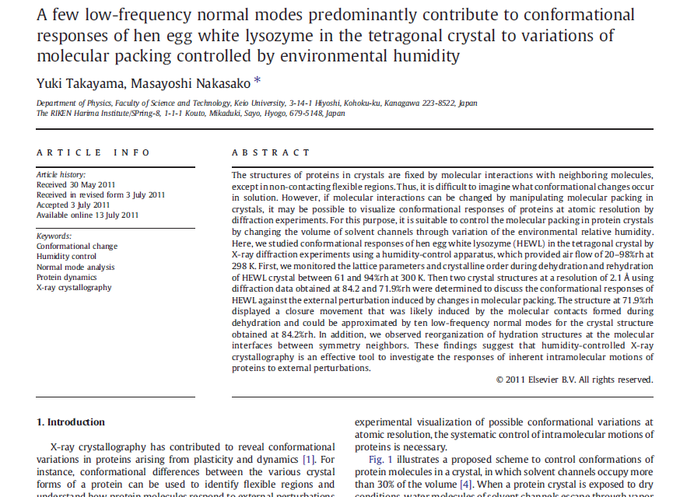

Slide 101

Non-isomorphism in lysozyme
RMSD = 1.70 Å
Δcell = 0.7 %
R_{iso} = 44.5%
RMSD = 0.18 Å
3aw6
3aw7
RH: 84.2%
vs 71.9%

Slide 102
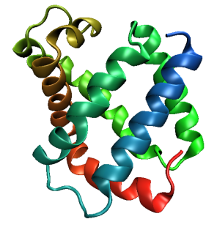
Same structure, different cell
0.5% cell change → 15%
Crick & Magdoff (1956) “theory method isomorphous replacement”, Acta Cryst. 9, 901-8.

Slide 103
Same structure, different cell
0.5% cell change → 15%
Crick & Magdoff (1956) “theory method isomorphous replacement”, Acta Cryst. 9, 901-8.

Slide 104
Same cell, rotated protein
0.5° rotation → 16%
Crick & Magdoff (1956) “theory method isomorphous replacement”, Acta Cryst. 9, 901-8.

Slide 105
Same cell, rotated protein
0.5° rotation → 16%
Crick & Magdoff (1956) “theory method isomorphous replacement”, Acta Cryst. 9, 901-8.

Slide 106
Uniform stretch
5% change → 0%

Slide 107
Uniform stretch
5% change → 0%

Slide 108
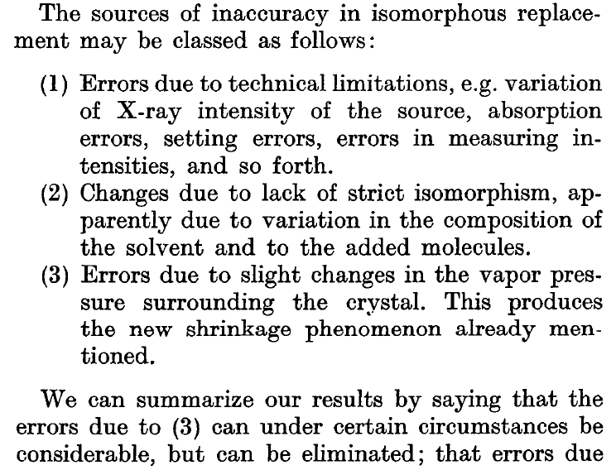
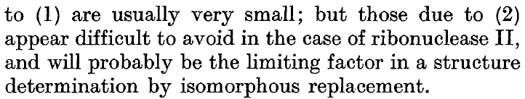
Magdoff & Crick (1955) “Ribonuclease II. Accuracy of measurement and shrinkage”, Acta Cryst. 8, 461-8.
Crick & Magdoff (1956) “The theory of the method of isomorphous replacement for protein crystals”, Acta Cryst. 9, 901-8.

Slide 109
Elastic deformation
= non-isomorphism

Slide 110
Elastic deformation
= non-isomorphism

Slide 111
Plastic deformation
= poor diffraction

Slide 112
Plastic deformation
= poor diffraction

Slide 113
OK! OK!
Now I am afraid!
What should I do?

Slide 114
Basic Principles
“Hell, there are NO RULES here - we're trying to accomplish something.”
Thomas A. Edison – inventor
“You’ve got to have an ASSAY.”
Arthur Kornberg – Nobel Laureate
“Control, control, you must learn CONTROL!”
Yoda – Jedi Master

Slide 115
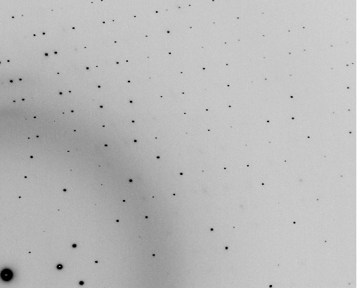
The Best Assay

Slide 116
And the dominant source of error is…
Resolution
  Disorder (including Radiation Damage)
  Background
Phases
  Non-isomorphism (including Radiation Damage)
  Vibration (beam, xtal, spindle, etc.)
  Detector calibration

Slide 117
beam size vs xtal size
  Put your crystal into the beam

Slide 118
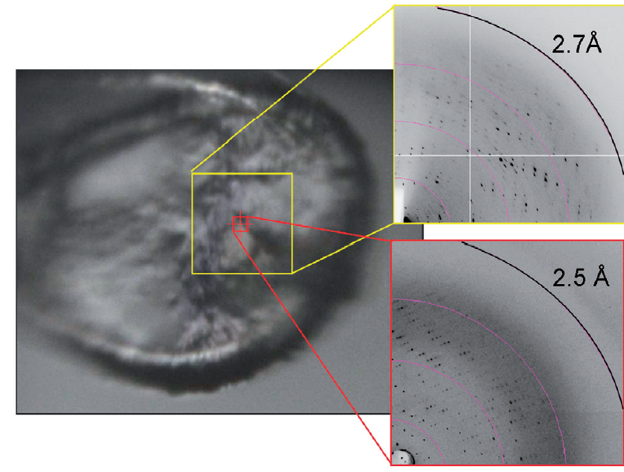
Get thee to a microbeam?
Evans et al. (2011)."Macromolecular microcrystallography", Crystallography Reviews 17, 105-142.

Slide 119
beam size vs xtal size
  Put your crystal into the beam
  Shoot the whole crystal

Slide 120
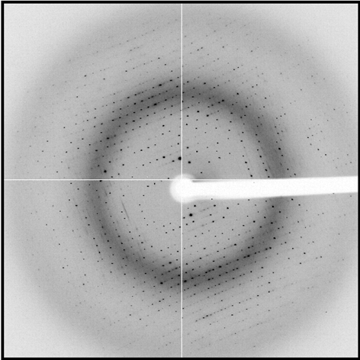
shoot the whole crystal

Slide 121
shoot the whole crystal

Slide 122
shoot the whole crystal

Slide 123
beam size vs xtal size
  Put your crystal into the beam
  Shoot the whole crystal
  Shoot nothing but the crystal

Slide 124
shoot nothing but the crystal

Slide 125
shoot nothing but the crystal

Slide 126
X-ray scattering “rules”:
1 μm crystal ≈ 1 μm water
≈ 1 μm plastic
≈ 0.1 μm glass
≈ 1000 μm air

Slide 127
Resolution (Å)
too big
too small
just right
X-ray beam size (μm)

Slide 128
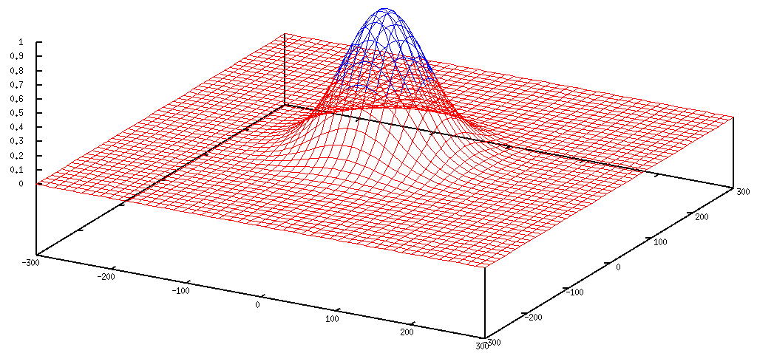
Gaussian beam
50% of flux
the other 50%

Slide 129
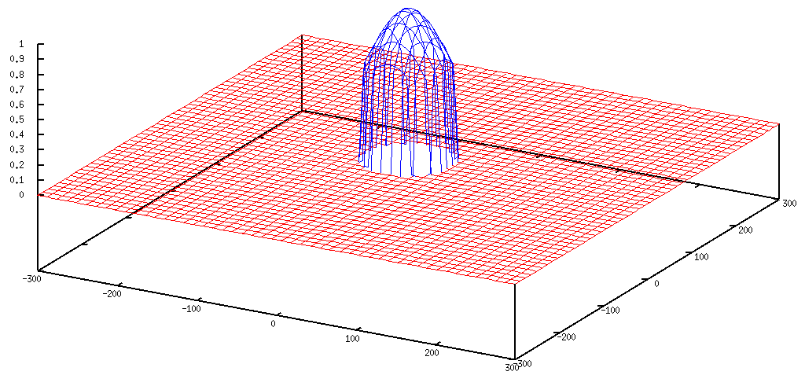
Collimated beam
100% of flux
0%

Slide 130
Tipping point for µfocus:
10 µm
~1 mrad =0.06°
~10 mm

Slide 131
beam size vs xtal size
  Put your crystal into the beam
  Shoot the whole crystal
  Shoot nothing but the crystal
  Back off!

Slide 132
Background scattering

Slide 133
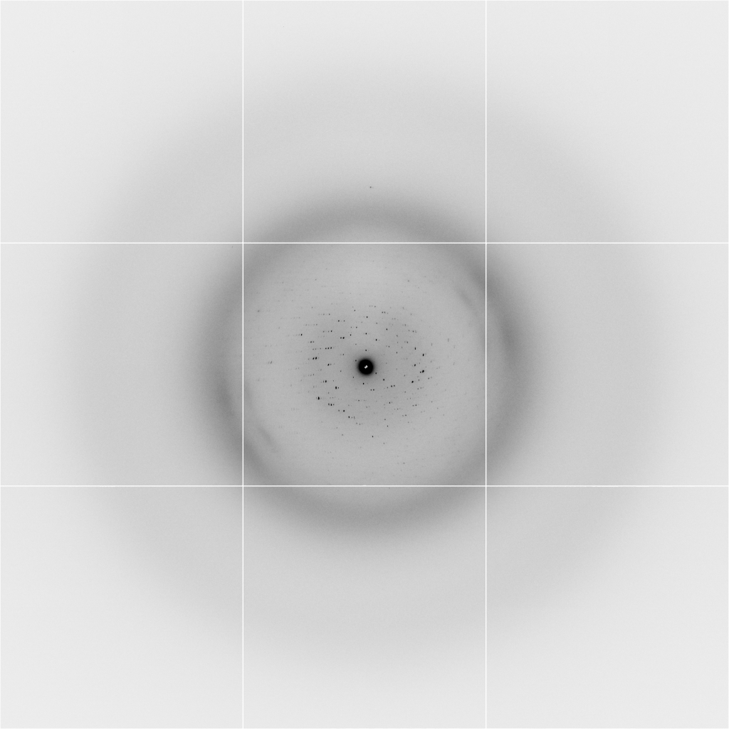
Background scattering
$100,000.00
$100,000.00
$100,000.00
real estate is
expensive
use it!
$100,000.00
$100,000.00
$100,000.00
$100,000.00
$100,000.00

Slide 134
Fine Slicing
background
background
Pflugrath, J. W. (1999)."The finer things in X-ray diffraction data collection", Acta Cryst. D 55, 1718-1725.

Slide 135
beam size vs xtal size
  Put your crystal into the beam
  Shoot the whole crystal
  Shoot nothing but the crystal
  Back off!
  The crystal must rotate

Slide 136
Get thee to a microbeam?
Evans et al. (2011)."Macromolecular microcrystallography", Crystallography Reviews 17, 105-142.

Slide 137
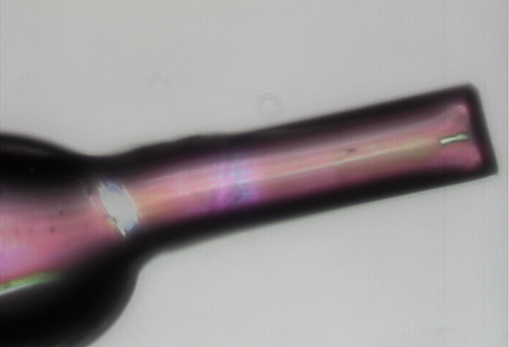
naked xtal

Slide 138
And the dominant source of error is…
Resolution
  Disorder (including Radiation Damage)
  Background
Phases
  Non-isomorphism (including Radiation Damage)
  Vibration (beam, xtal, spindle, etc.)
  Detector calibration

Slide 139
anomalous signal
ΔF
F
√
# sites
MW (Da)
≈ 1.2 f”
World record!
ΔF/F = 0.5%
Wang, Dauter & Dauter (2006) Acta Cryst. D 62, 1475-1483.
Crick, F. H. C. & Magdoff, B. S. (1956) Acta Crystallogr. 9, 901-908.
Hendrickson, W. A. & Teeter, M. M. (1981) Nature 290, 107-113.

Slide 140
R_{iso} vs dose
R_{iso} (%)
change in dose (MGy)
data taken from Banumathi, et al. (2004) Acta Cryst. D 60, 1085-1093.

Slide 141
R_{iso} vs dose
R_{iso} ≈ 0.7 %/MGy
R_{iso} (%)
change in dose (MGy)
data taken from Banumathi, et al. (2004) Acta Cryst. D 60, 1085-1093.

Slide 142
Threshold of a revolution in phasing
CCD
old Pilatus
Goal
Solve-able proteins (%)
Best
Pilatus
Required signal-to-noise (I/σ)

Slide 143
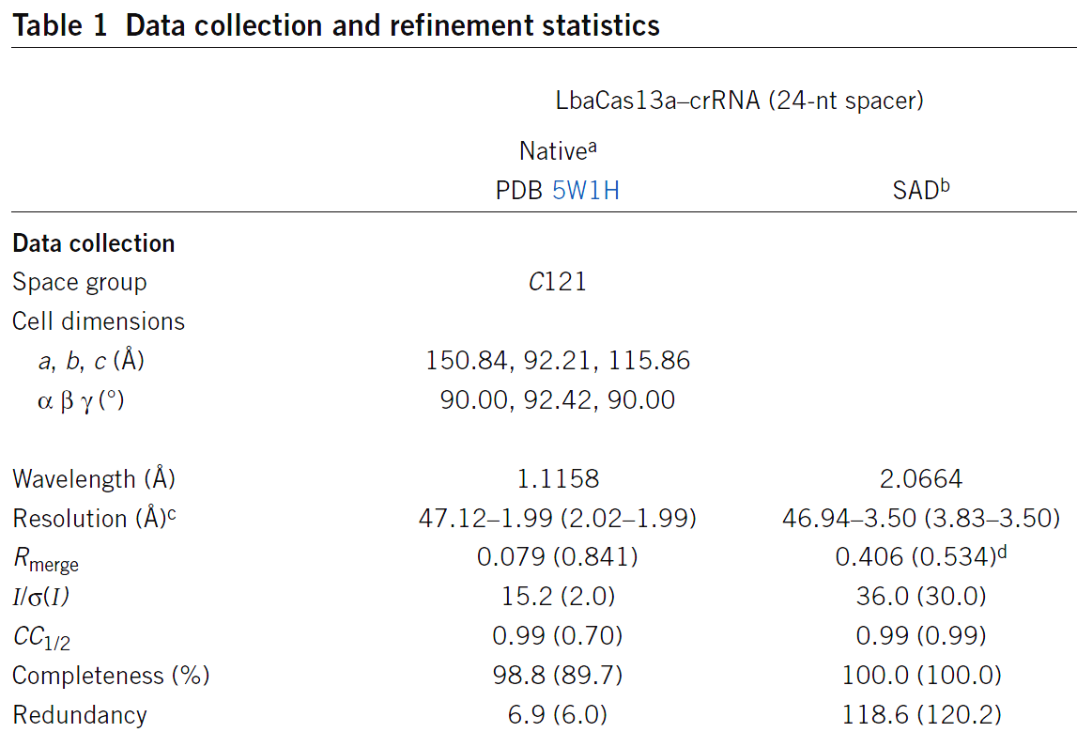
S-SAD merging 20 xtals
Knott et al. (2017). "Guide-bound CRISPR-Cas13a." Nature S&MB online

Slide 144
Systematic vs random error
intensity
observation

Slide 145
And the dominant source of error is…
Resolution
  Disorder (including Radiation Damage)
  Background
Phases
  Non-isomorphism (including Radiation Damage)
  Vibration (beam, xtal, spindle, etc.)
  Detector calibration

Slide 146
Optimal exposure time
(anomalous on a PAD)
2.03 ms
intensity
time

Slide 147
PAD full vs partial
Summed intensity
iteration

Slide 148
Optimal exposure time
(anomalous on a PAD)
PILATUS
>0.2 s/frame
EIGER
>0.0003 s/frame
t_{mad} Optimal exposure time (s)
t_{ro} read-out time (s)
2.03 ms on Pilatus³ S
0.95 ms on Pilatus³ X
0.003 ms on Eiger
= 20,000 frames
350 GB/dataset
Attenuate for MAD

Slide 149
And the dominant source of error is…
Resolution
  Disorder (including Radiation Damage)
  Background
Phases
  Non-isomorphism (including Radiation Damage)
  Vibration (beam, xtal, spindle, etc.)
  Detector calibration

Slide 150
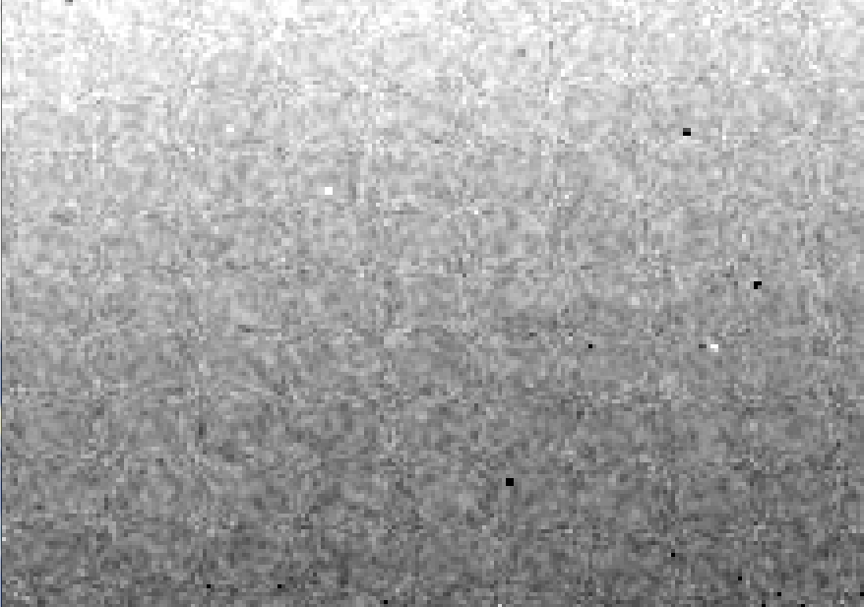
Detector calibration: 7235 eV

Slide 151
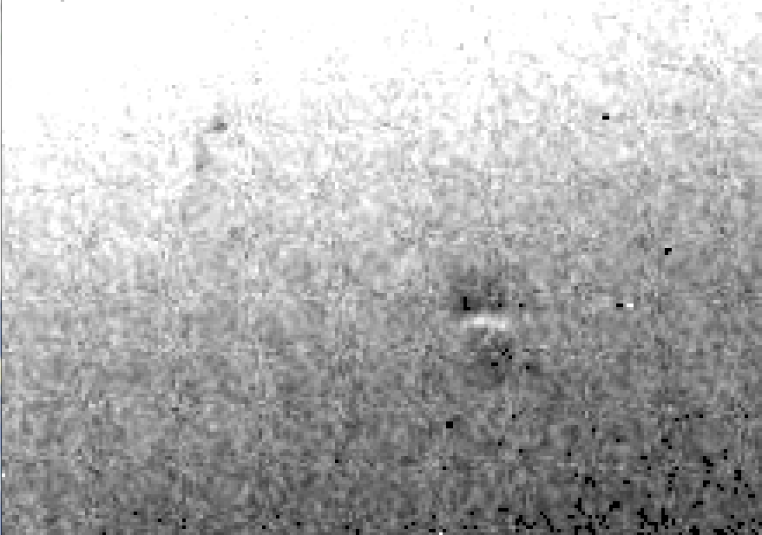
Detector calibration: 7247 eV

Slide 152
Gadox calibration vs energy
same = good!
Relative absorption depth
bad!
photon energy (keV)

Slide 153

Spatial Heterogeneity in Sharp Spot Sensitivity
~3x10⁵ photon/pixel Pilatus detector
Bragg
glitch
“tree rings”
Pick-up tool mark
oxygen
inclusions
1% high
average
1% low

Slide 154

Systematic error does not “average out”

Slide 155
Fractional error
^{mult >} (—)²
~3%
<ΔF/F>

Slide 156

Holton & Frankel (2010) Acta D 66 393-408.

Slide 157
Data collection parameters:
16 crystals
360° each, inverse beam
7235 eV photon energy
< 1 MGy per xtal
Australian Synchrotron MX1
  35 kGy/s into 100 μm x 100 μm

Slide 158
140-fold multiplicity: 16 crystals, 360° each, inverse beam, 7235 eV
RESOLUTION COMPLETENESS R-FACTOR I/SIGMA R-meas CC(1/2) Anomal SigAno Nano
LIMIT OF DATA observed Corr
9.17 99.1% 3.9% 257.47 3.9% 100.0* 91* 5.024 450
6.49 100.0% 5.2% 214.33 5.2% 100.0* 86* 3.836 882
5.30 100.0% 7.2% 165.13 7.2% 100.0* 76* 3.257 1175
4.59 100.0% 7.2% 175.42 7.3% 100.0* 67* 2.589 1403
4.10 99.9% 7.7% 174.13 7.7% 100.0* 59* 2.264 1594
3.74 99.9% 9.4% 143.09 9.4% 100.0* 49* 1.953 1783
3.47 100.0% 11.2% 120.17 11.2% 100.0* 39* 1.696 1942
3.24 100.0% 14.1% 91.14 14.1% 100.0* 30* 1.333 2103
3.06 99.9% 19.5% 65.79 19.5% 100.0* 23* 1.117 2214
2.90 99.9% 29.0% 44.85 29.1% 99.9* 17* 1.008 2369
2.77 99.9% 40.5% 32.58 40.6% 99.8* 11* 0.901 2493
2.65 99.9% 52.8% 25.16 52.9% 99.8* 10* 0.866 2605
2.54 100.0% 67.4% 19.47 67.6% 99.6* 2 0.804 2705
2.45 100.0% 88.9% 14.58 89.2% 99.2* 4 0.831 2859
2.37 100.0% 109.3% 9.97 109.7% 98.1* 5 0.829 2925
2.29 100.0% 138.2% 6.87 138.9% 96.1* 1 0.760 3037
2.22 100.0% 197.1% 4.03 198.6% 83.5* -1 0.721 3159
2.16 100.0% 227.3% 2.41 230.8% 46.9* -1 0.677 3224
2.10 61.2% 154.4% 1.28 163.6% 47.0* -2 0.660 1999
2.05 47.9% 170.1% 0.68 196.5% 25.7* 3 0.629 1578
total 93.3% 15.7% 54.30 15.8% 100.0* 12* 1.217 42499

Slide 159
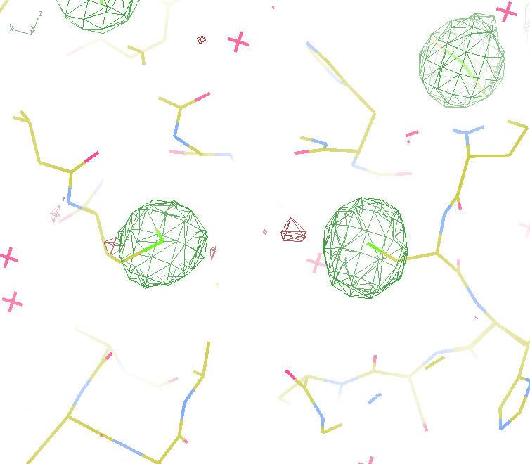
140-fold multiplicity
18 σ
16 σ
Phased anomalous difference Fourier

Slide 160
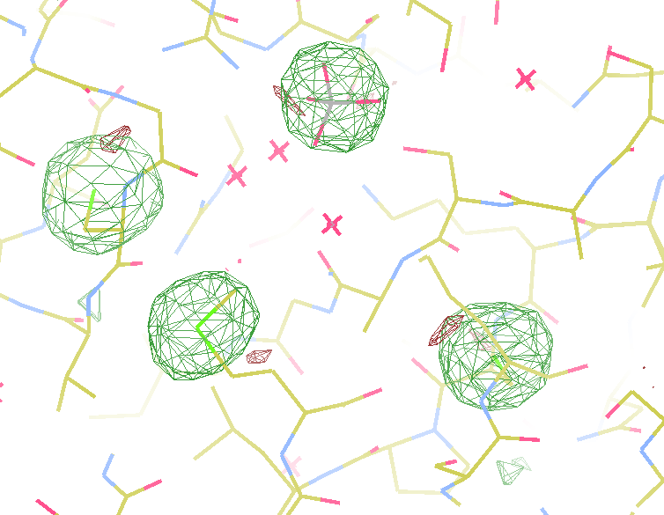
140-fold multiplicity
15σ = PO₄
Phased anomalous difference Fourier

Slide 161
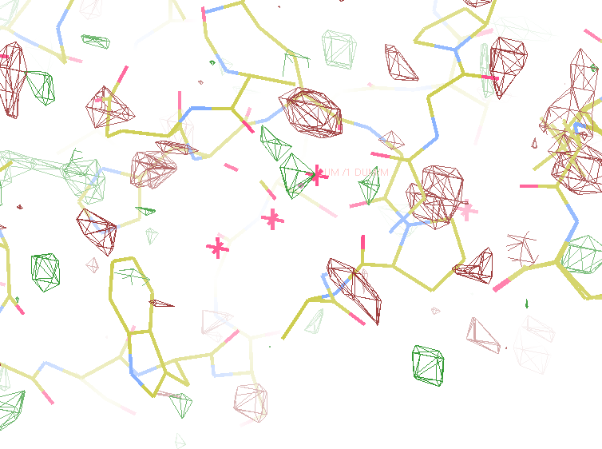
140-fold multiplicity
~2σ = Mg?
Phased anomalous difference Fourier

Slide 162
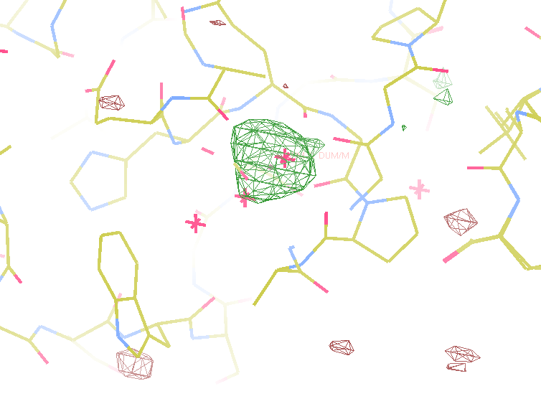
140-fold multiplicity
8.2σ = Mg?
DELFAN residual anomalous difference

Slide 163
Discerning Na⁺ from Mg⁺⁺
DELFAN peak height (σ)
N
O
F
Ne
Na
Mg
f’’ (electrons)

Slide 164
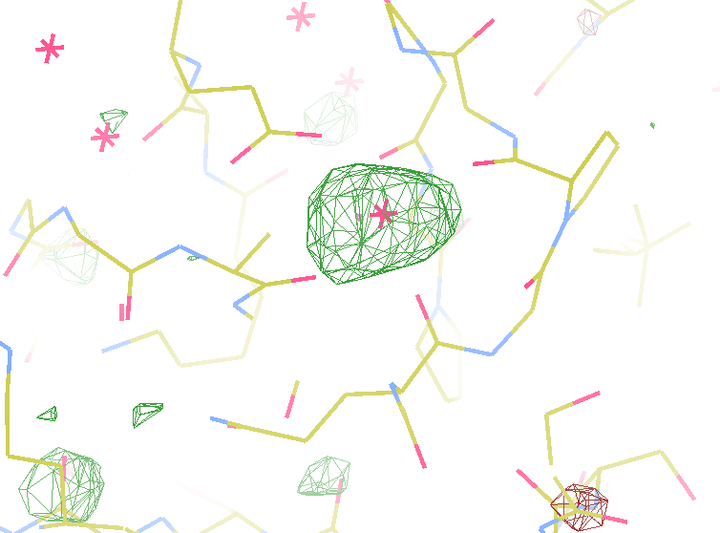
140-fold multiplicity
7.4σ = Na
DELFAN residual anomalous difference

Slide 165
Suggested anomalous protocol:
360° in < 5 MGy
move detector
4X exposure
goto 2
2 wavelengths are better than 1
- (peak + inf)/2, and remote
MAD, not M-SAD!

Slide 166
Summary
http://bl831.als.lbl.gov/xtalsize.html
http://bl831.als.lbl.gov/~jamesh/mlfsom/
http://bl831.als.lbl.gov/~jamesh/powerpoint/ACMC_GBU_2013.ppt
100 ADU/pixel
10 μm for lysozyme
~3% error per spot, 1%/MGy
7235 eV for S-SAD
“Attenu-wait”: dose slicing

Slide 167
Summary
http://bl831.als.lbl.gov/xtalsize.html
http://bl831.als.lbl.gov/xtallife.html
http://bl831.als.lbl.gov/~jamesh/damage_rates.pdf
http://bl831.als.lbl.gov/~jamesh/powerpoint/CSHL_tipsNtrick_2017.pptx
15 ADU/pixel on Rayonix HS 300
> 0.1 s exposures (HS 300)
10 μm for lysozyme
~3% error per spot, 1%/MGy
7235 eV for S-SAD on CCD
“Attenu-wait”: dose slicing

Slide 168
Why harvest at all?
Radiation damage
  10-100x reduced at ~100 K
Background scatter
    tray >> xtal
Timing
    nothing lasts forever
Shipping
    cryo samples are glass beads

Slide 169
Why harvest at all?
Radiation damage
  10-100x reduced at ~100 K
Background scatter
    tray >> xtal
Timing
    nothing lasts forever
Shipping
    cryo samples are glass beads

Slide 170
X-ray transmission of materials
air
water
protein
crystal
transmission
glass
Depth into material (μm)

Slide 171
X-ray scattering of materials
glass
Differential cross section
(scattered photons/solid angle/incident photon/meter thickness)
plastic
paratone-N oil
25% glycerol
water
∞ 7.5 3.8 2.5 1.9 1.5
d-spacing (Ǻ)

Slide 172
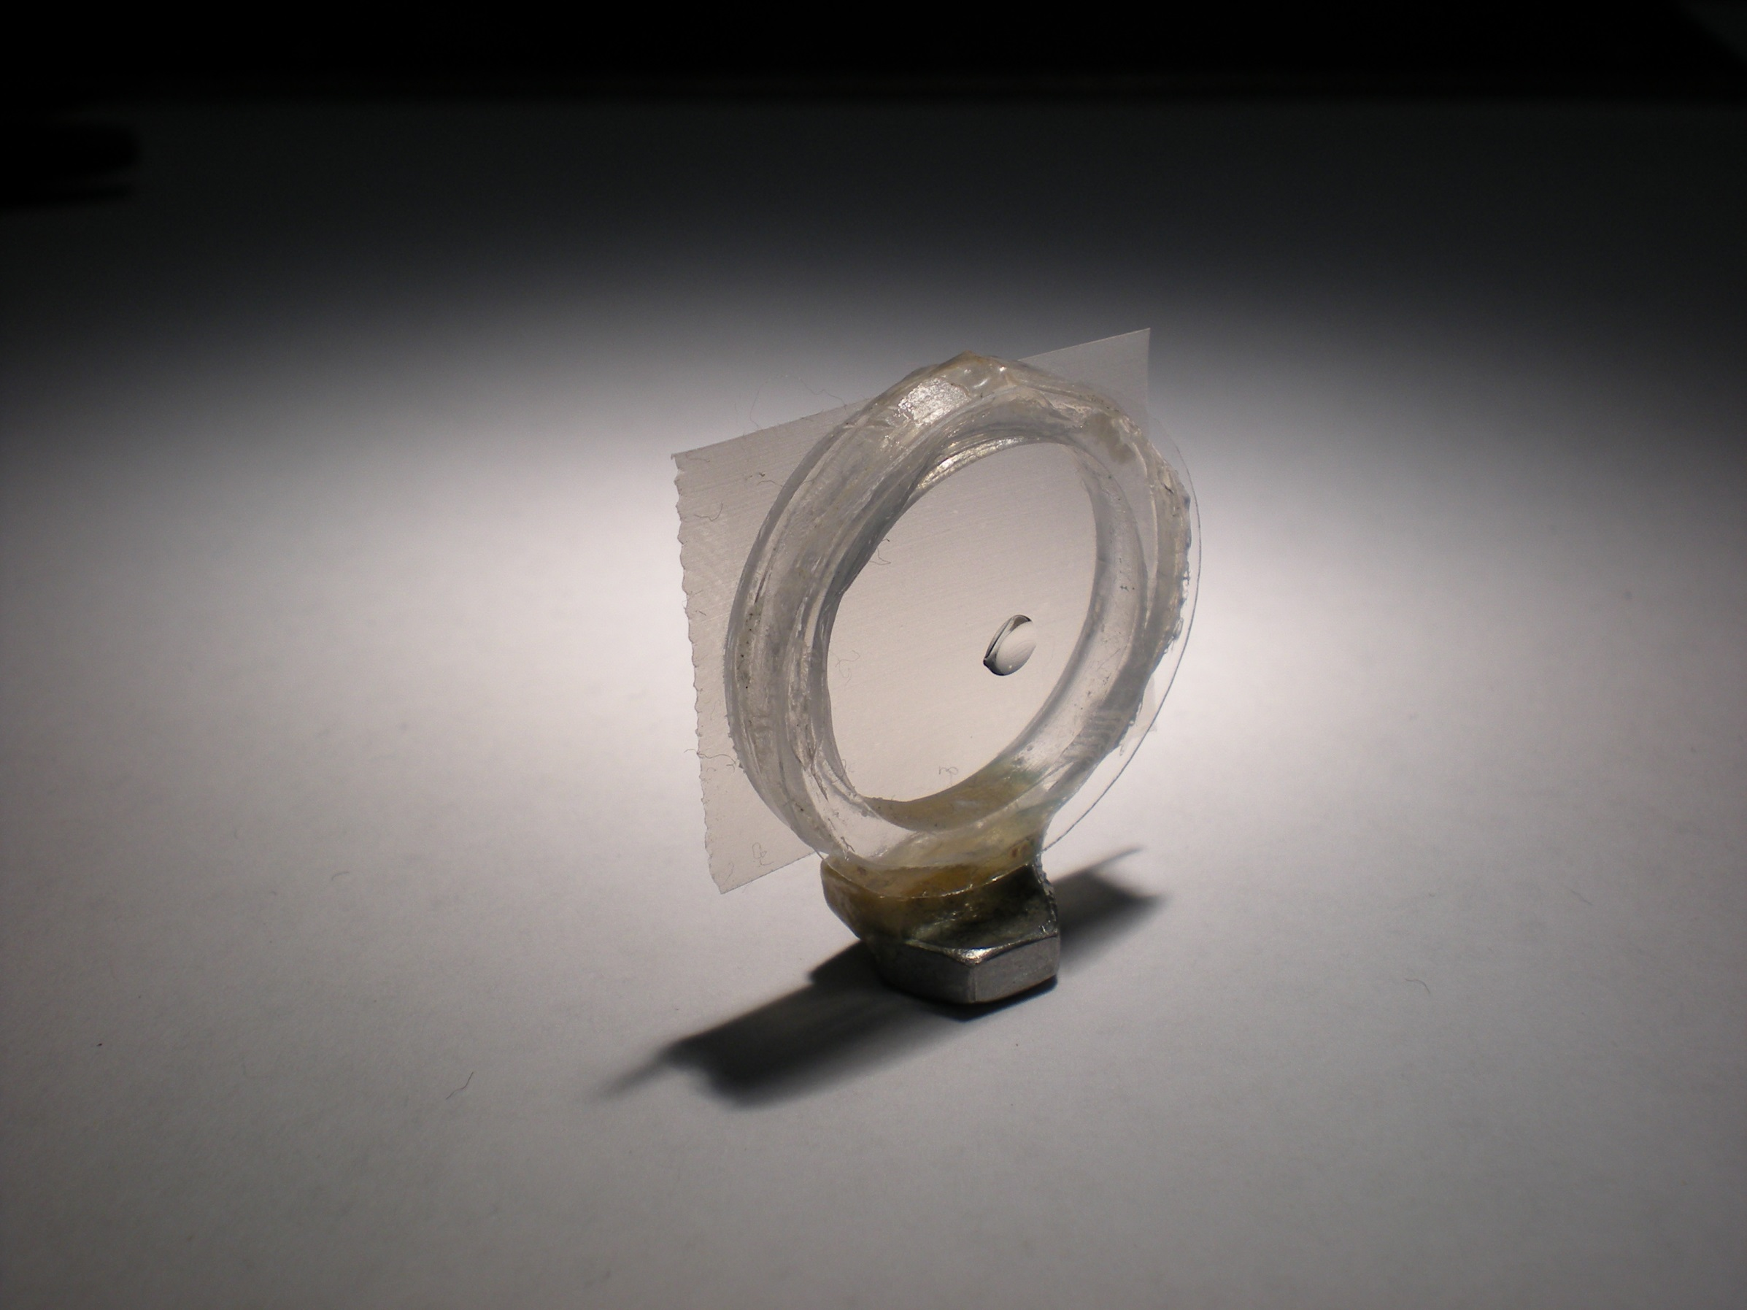
Crowfoot Cell

Slide 173
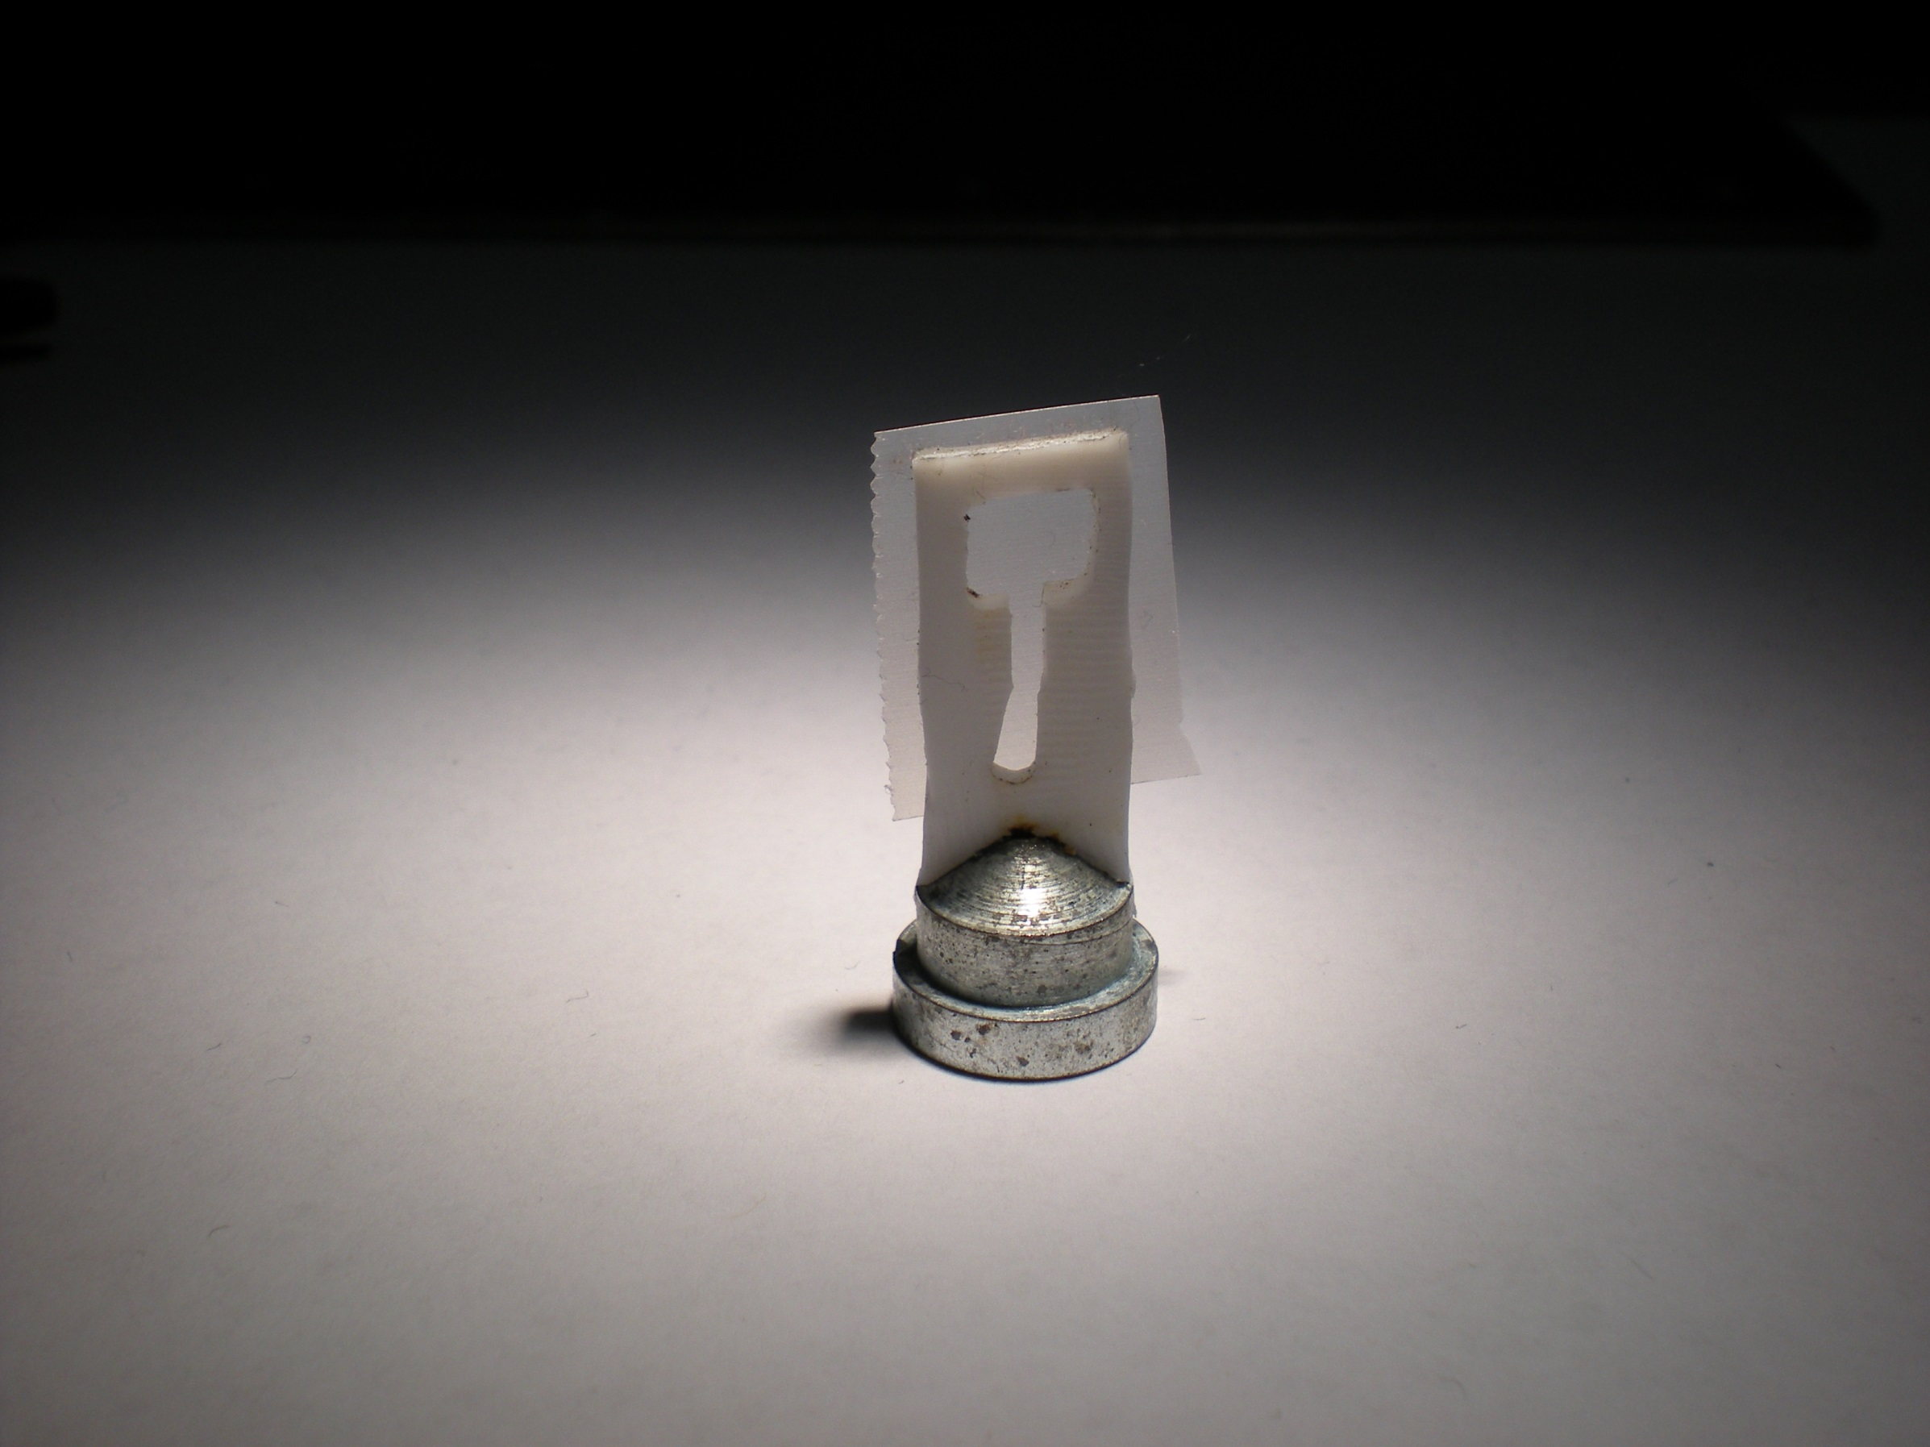
Crowfoot Cell

Slide 174
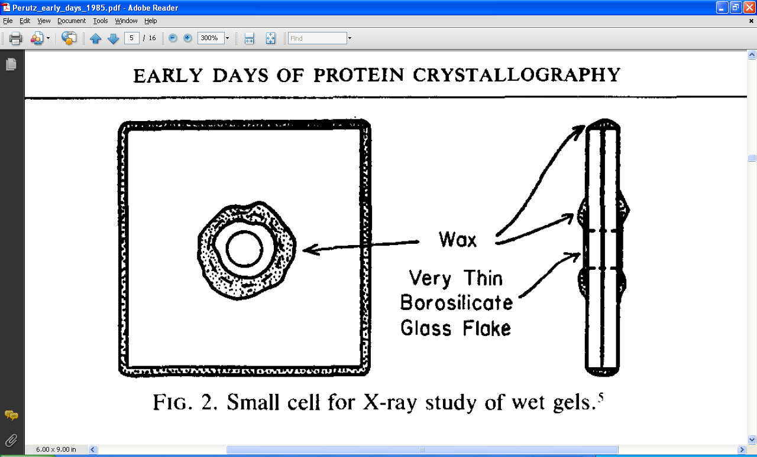
Crowfoot Cell
J. D. Bernal and D. Crowfoot, Nature (London) 133, 794 (1934).

Slide 175
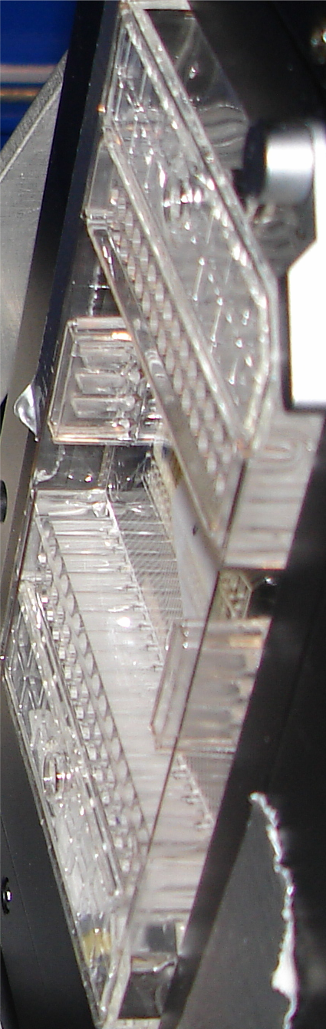
SBS
format
crystallization
tray
mirror
pinhole
microscope
Notes:
Inspired by the ESRF microcrystal camera, the superbend endstations are all equipped with zero-paralax optics. The user sees their sample from the point of view of the x-ray beam. Sample alignment is not only more stable but more intuitive than an off-axis camera. Placing the crystal into the microscope crosshairs gaurantees that it will be hit by the beam.

Slide 176
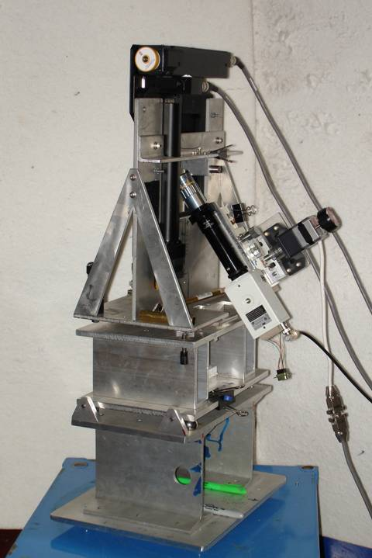
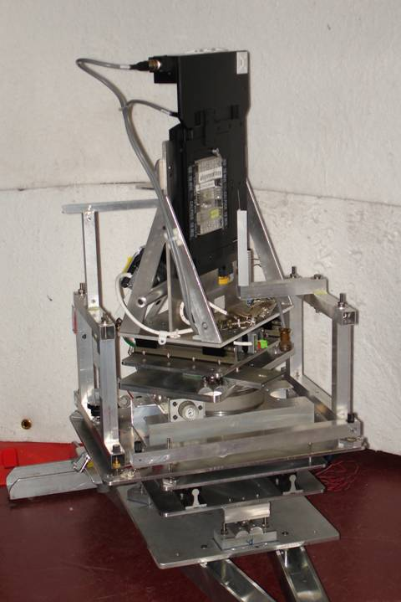
Plate goniometers
Notes:
The non-rotating “plate goniometer” (left) was developed last year. A new incarnation for taking rotation-camera data is now being developed (right). Either of these devices will accept most any crystallization tray that can be rotated 90 degrees to gravity and probe arbitrary points in each crystallization drop with a 50 um x-ray beam. Installing a plate goniometer takes ~30 minutes and the location ~300 mm downbeam from the “normal” protein crystallography sample mounting point makes this technology transferable to most any beamline.
Current status is that a 95% complete data set has been collected from a 50 um lysozyme crystal at room temperature, and trials are now underway to collect data sets from “real” crystals.

Slide 177
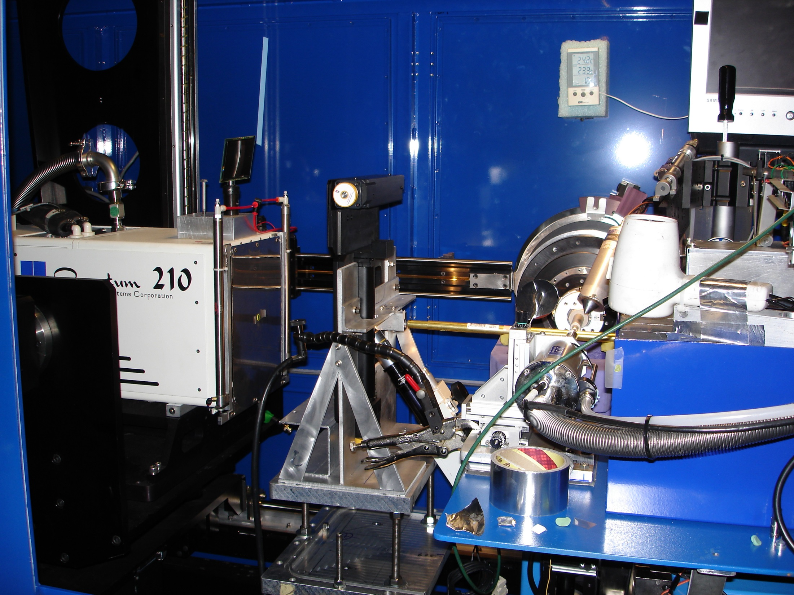
Notes:
non-rotating tray goniometer stage installed in ALS 8.3.1. Note that the “normal” cryo-pin goniometer on the left is still in place and a brass flight tube has been added to contain the air scatter from the main beam on its way to the tray goniometer.

Slide 178


Slide 179
in-situ diffraction systems
25 μm wall
~50 μm tape
~50 μm tape
~50 μm tape
PDMS
PDMS
250 μm
100 μm
25 μm
200 μm
25 μm wall
MiTeGen
MicroRT™
Fluidigm
Topaz® DC
NatX-ray
CrystalQuick™ X
MiTeGen
in-situ-1
Crystal DirectTM
http://www.mitegen.com/products/micrort/micrort.shtml
http://www.fluidigm.com/home/fluidigm/docs/Datasheet_1.96DC.pdf
Soliman, A. et al. (2011). Acta Cryst. D 67, 646-656.
http://www.mitegen.com/mic_catalog.php?c=insituplates
Márquez, J. & Cipriani, F. (2014) Structural Genomics (Chen, Y. W., ed) pp. 197-203.
Notes:
Next slide please

Slide 180
What do we need?
Thin plastic = water = protein
Light low atomic number
Tight evaporation = nonisomorphism
Cheap $1-20/tray

Slide 181


What we really need
Thin
Light
Tight
Cheap
GRAPHENE

Slide 182
Why harvest at all?
Radiation damage
  10-100x reduced at ~100 K
Background scatter
    tray >> xtal
Timing
    nothing lasts forever
Shipping
    cryo samples are glass beads

Slide 183


Slide 184

8000 Gy/s

Slide 185



Example Data
lysozyme
50 μm beam
37 Gy/s (0.775 Å)
30s exposures at 20C
90° of data, 97% complete
I/σ = 1.5 at 1.9 Å
R_{merge} 18% (overall) 5% (low)
ΔB same as 20 min at 100K
2
1
0
scale vs batch
B factor
-2
-4
-6

Slide 186
Why harvest at all?
Radiation damage
  10-100x reduced at ~100 K
Background scatter
    tray >> xtal
Timing
    nothing lasts forever
Shipping
    cryo samples are glass beads

Slide 187
Why harvest at all?
Radiation damage
  10-100x reduced at ~100 K
Background scatter
    tray >> xtal
Timing
    nothing lasts forever
Shipping
    cryo samples are glass beads

Slide 188


MiTeGen RT cell
http://www.mitegen.com/products/micrort/micrort.shtml

Slide 189
Summary
assay, control and open mind
purity, purity, purity
oil is your friend
Warkentin method
try room temp!
http://bl831.als.lbl.gov/~jamesh/powerpoint/
CSHL_tipsNtricks_2015.pptx

