Slide 1
PowerPoint File available:
http://bl831.als.lbl.gov/
~jamesh/powerpoint/
CSHL_tipsNtricks_2015.pptx

Slide 2
Acknowledgements
Robert Stroud James Fraser John Spence
Chris Nielsen Clemens Schulze-Briese Aina Cohen Ana Gonzalez
UCSF LBNL SLAC
ALS 8.3.1 creator: Tom Alber
Center for Structure of Membrane Proteins (CSMP)
Membrane Protein Expression Center II (MPEC)
Center for HIV Accessory and Regulatory Complexes (HARC)
UC Multicampus Research Programs and Initiatives (MRPI)
UCSF Program for Breakthrough Biomedical Research (PBBR) Integrated Diffraction Analysis Technologies (IDAT)
Plexxikon, Inc.
M D Anderson CRC
Synchrotron Radiation Structural Biology Resource (SLAC)
The Advanced Light Source is supported by the Director, Office of Science, Office of Basic Energy Sciences, Materials Sciences Division, of the US Department of Energy under contract No. DE-AC02-05CH11231 at Lawrence Berkeley National Laboratory.

Slide 3
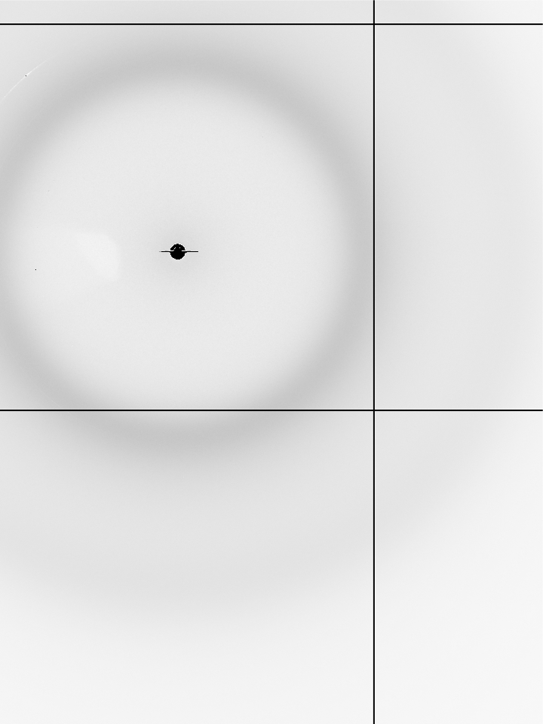
Now What?
don’t forget: spin 180°

Slide 4
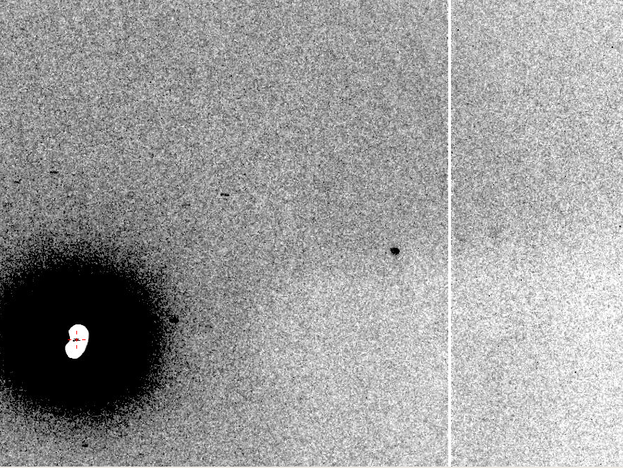
Now What?
10 Å

Slide 5
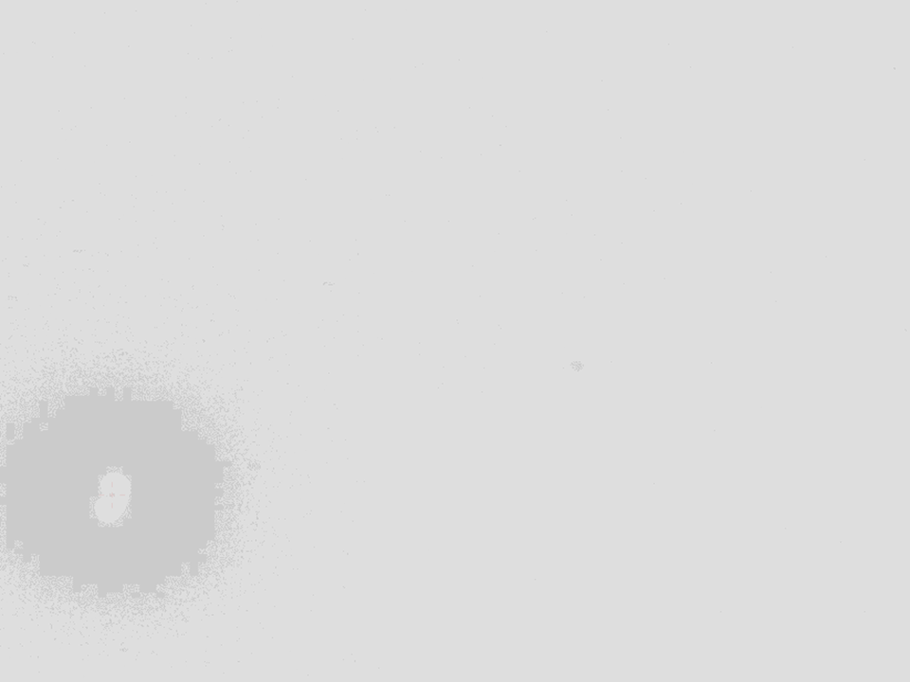
Ways to improve diffraction
New crystal form
Purify
  - add a column
  - heat shock
Bind something
  - Known ligand
  - Silver bullets
Change the clone
  - chop off floppy bits
  - homolog
  - Ala -> Lys mutants
Make Protein Sit Still!!!
Newman J. (2006) Acta Cryst. D62 27-31.

Slide 6
Basic Principles
“Hell, there are NO RULES here - we're trying to accomplish something.”
Thomas A. Edison – inventor
“You’ve got to have an ASSAY.”
Arthur Kornberg – Nobel Laureate
“Control, control, you must learn CONTROL!”
Yoda – Jedi Master

Slide 7
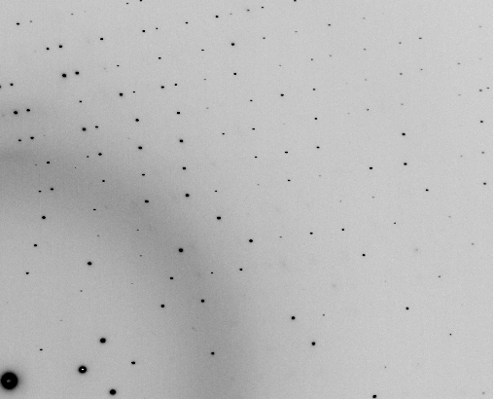
The Best Assay

Slide 8
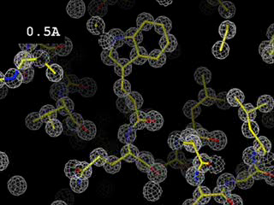

Slide 9
The Best Assay?

Slide 10
What is the primary goal?
Resolution
  problem: disorder
  solution: make protein sit still
Phases
  problem: small difference
  solution: averaging

Slide 11
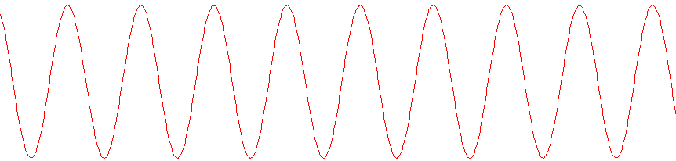
strong reflection
What is “disorder”?

Slide 12
weak reflection
What is “disorder”?

Slide 13
What is “disorder”?

Slide 14
What is “disorder”?

Slide 15
What is “disorder”?

Slide 16

What is “disorder”?
order
order
B-factor
disorder

Slide 17
“B” factors
ATOM 122 N LEU A 13 -3.244 25.808 19.998 1.00 16.96 N
ATOM 123 CA LEU A 13 -2.877 25.448 21.355 1.00 15.29 C
ATOM 124 C LEU A 13 -2.792 23.966 21.561 1.00 17.54 C
ATOM 125 O LEU A 13 -1.814 23.493 22.143 1.00 16.35 O
ATOM 126 CB LEU A 13 -3.907 26.164 22.268 1.00 18.72 C
ATOM 127 CG LEU A 13 -3.577 25.982 23.738 1.00 21.19 C
ATOM 128 CD1 LEU A 13 -2.283 26.820 24.019 1.00 19.43 C
ATOM 129 CD2 LEU A 13 -4.702 26.474 24.639 1.00 24.65 C
ATOM 130 N SER A 14 -3.677 23.149 20.979 1.00 15.96 N
ATOM 131 CA SER A 14 -3.646 21.711 21.061 1.00 18.26 C
ATOM 132 C SER A 14 -2.373 21.203 20.360 1.00 18.71 C
ATOM 133 O SER A 14 -1.747 20.315 20.930 1.00 17.47 O
ATOM 134 CB SER A 14 -4.875 21.077 20.419 1.00 17.62 C
ATOM 135 OG ASER A 14 -4.825 19.665 20.388 0.50 20.89 O
ATOM 136 OG BSER A 14 -6.027 21.408 21.164 0.50 18.67 O
ATOM 137 N LYS A 15 -2.045 21.772 19.215 1.00 18.03 N
ATOM 138 CA LYS A 15 -0.799 21.361 18.555 1.00 18.12 C
ATOM 139 C LYS A 15 0.446 21.707 19.351 1.00 18.81 C
ATOM 140 O LYS A 15 1.400 20.948 19.411 1.00 17.77 O
ATOM 141 CB LYS A 15 -0.700 22.034 17.177 1.00 14.49 C
ATOM 142 CG LYS A 15 -1.727 21.368 16.256 1.00 16.12 C
ATOM 143 CD LYS A 15 -1.663 22.147 14.936 1.00 19.40 C
ATOM 144 CE ALYS A 15 -2.725 21.614 13.986 0.50 17.42 C
ATOM 145 CE BLYS A 15 -1.750 21.211 13.750 0.50 17.01 C
ATOM 146 NZ ALYS A 15 -2.346 21.674 12.559 0.50 18.61 N
ATOM 147 NZ BLYS A 15 -3.052 20.513 13.741 0.50 18.76 N

Slide 18
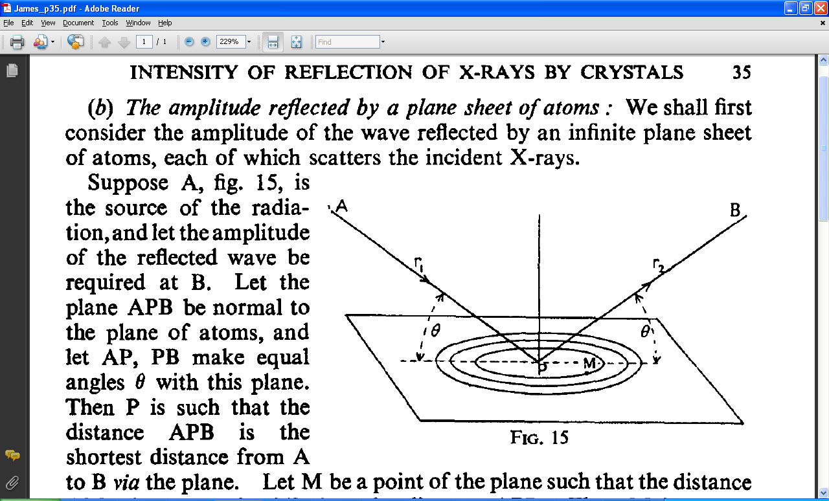
“B” factors
B = 8π² u_{x}²
u_{x} = RMS variation perpendicular to plane

Slide 19
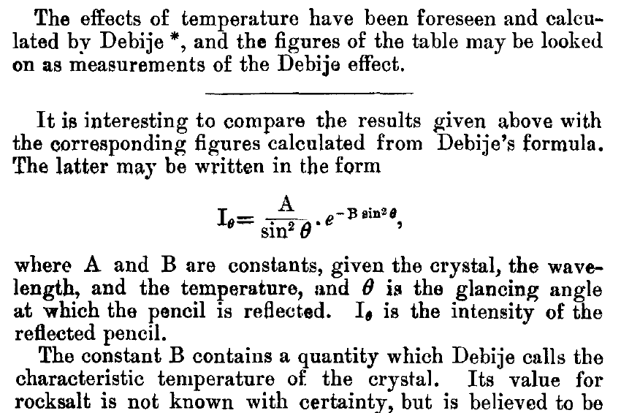
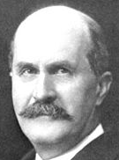
The B factor
Bragg, W. H. (1914)."XCVII. The intensity of reflexion of X rays by crystals", Philosophical Magazine Series 6 27, 881-899. Published May 1 1914

Slide 20
“B” factors
electron density (e⁻/Å³)
position (Å)

Slide 21
“B” factors
electron density (e⁻/Å³)
position (Å)

Slide 22
“B” factors
electron density (e⁻/Å³)
position (Å)

Slide 23
“B” factors
electron density (e⁻/Å³)
position (Å)

Slide 24
“B” factors
electron density (e⁻/Å³)
position (Å)

Slide 25
“B” factors
electron density (e⁻/Å³)
position (Å)

Slide 26
“B” factors
electron density (e⁻/Å³)
position (Å)

Slide 27
“B” factors
electron density (e⁻/Å³)
position (Å)

Slide 29
A Fourier view of scattering
density (ρ)
intensity
distance (Å)
angle (°)

Slide 30
A Fourier view of scattering
density (ρ)
intensity
distance (Å)
angle (°)

Slide 31
A Fourier view of scattering
density (ρ)
intensity
distance (Å)
angle (°)

Slide 32
A Fourier view of scattering
density (ρ)
intensity
distance (Å)
angle (°)

Slide 33
Darwin’s Formula
V_{xtal}
λ³ L
I_{spot} = I_{beam} r_{e}²
P A | F₀e^{-Bs2} |²
V_{cell}
ωV_{cell}
I_{spot} - photons/spot (fully-recorded)
I_{beam} - incident (photons/s/m² )
r_{e} - classical electron radius (2.818x10⁻¹⁵ m)
V_{xtal} - volume of crystal (in m³)
V_{cell} - volume of unit cell (in m³)
λ - x-ray wavelength (in meters!)
ω - rotation speed (radians/s)
L - Lorentz factor (speed/speed)
P - polarization factor
A - attenuation factor
F₀ - structure factor at T = 0
B - Debye-Waller-Ott factor
s - 0.5/d-spacing
C. G. Darwin (1914)

Slide 34
Darwin’s Formula
V_{xtal}
λ³ L
I_{spot} = I_{beam} r_{e}²
P A | F₀e^{-Bs2} |²
V_{cell}
ωV_{cell}
I_{spot} - photons/spot (fully-recorded)
I_{beam} - incident (photons/s/m² )
r_{e} - classical electron radius (2.818x10⁻¹⁵ m)
V_{xtal} - volume of crystal (in m³)
V_{cell} - volume of unit cell (in m³)
λ - x-ray wavelength (in meters!)
ω - rotation speed (radians/s)
L - Lorentz factor (speed/speed)
P - polarization factor
A - attenuation factor
F₀ - structure factor at T = 0
B - Debye-Waller-Ott factor
s - 0.5/d-spacing
C. G. Darwin (1914)

Slide 35
Darwin’s Formula
V_{xtal}
λ³ L
I_{spot} = I_{beam} r_{e}²
P A | F₀e^{-Bs2} |²
V_{cell}
ωV_{cell}
I_{spot} - photons/spot (fully-recorded)
I_{beam} - incident (photons/s/m² )
r_{e} - classical electron radius (2.818x10⁻¹⁵ m)
V_{xtal} - volume of crystal (in m³)
V_{cell} - volume of unit cell (in m³)
λ - x-ray wavelength (in meters!)
ω - rotation speed (radians/s)
L - Lorentz factor (speed/speed)
P - polarization factor
A - attenuation factor
F₀ - structure factor at T = 0
B - Debye-Waller-Ott factor
s - 0.5/d-spacing
C. G. Darwin (1914)

Slide 36
Darwin’s Formula
V_{xtal}
λ³ L
I_{spot} = I_{beam} r_{e}²
P A | F₀e^{-Bs2} |²
V_{cell}
ωV_{cell}
I_{spot} - photons/spot (fully-recorded)
I_{beam} - incident (photons/s/m² )
r_{e} - classical electron radius (2.818x10⁻¹⁵ m)
V_{xtal} - volume of crystal (in m³)
V_{cell} - volume of unit cell (in m³)
λ - x-ray wavelength (in meters!)
ω - rotation speed (radians/s)
L - Lorentz factor (speed/speed)
P - polarization factor
A - attenuation factor
F₀ - structure factor at T = 0
B - Debye-Waller-Ott factor
s - 0.5/d-spacing
C. G. Darwin (1914)

Slide 37
Darwin’s Formula
V_{xtal}
λ³ L
I_{spot} = I_{beam} r_{e}²
P A | F₀e^{-Bs2} |²
V_{cell}
ωV_{cell}
I_{spot} - photons/spot (fully-recorded)
I_{beam} - incident (photons/s/m² )
r_{e} - classical electron radius (2.818x10⁻¹⁵ m)
V_{xtal} - volume of crystal (in m³)
V_{cell} - volume of unit cell (in m³)
λ - x-ray wavelength (in meters!)
ω - rotation speed (radians/s)
L - Lorentz factor (speed/speed)
P - polarization factor
A - attenuation factor
F₀ - structure factor at T = 0
B - Debye-Waller-Ott factor
s - 0.5/d-spacing
C. G. Darwin (1914)

Slide 38
Wavelength Does Not Matter!
crystal diameter (μm)
Holton & Frankel (2010) Acta D 66 393-408.

Slide 39
Self-calibrated damage limit
Where:
⟨I⟩_{DL} - average damage-limited intensity (photons/hkl) at a given resolution
10⁵ - converting R from μm to m, r_{e} from m to Å, ρ from g/cm³ to kg/m³ and MGy to Gy
r_{e} - classical electron radius (2.818 x 10⁻¹⁵ m/electron)
h - Planck’s constant (6.626 x 10⁻³⁴ J∙s)
c - speed of light (299792458 m/s)
f_{decayed} - fractional progress toward completely faded spots at end of data set
ρ - density of crystal (~1.2 g/cm³)
R - radius of the spherical crystal (μm)
λ - X-ray wavelength (Å)
f_{NH} - the Nave & Hill (2005) dose capture fraction (1 for large crystals)
n_{ASU} - number of proteins in the asymmetric unit
M_{r} - molecular weight of the protein (Daltons or g/mol)
V_{M} - Matthews’s coefficient (~2.4 Å³/Dalton)
H - Howells’s criterion (10 MGy/Å)
θ - Bragg angle
⟨ƒ_{a}²⟩ - number-averaged squared structure factor per protein atom (electron²)
⟨M_{a}⟩ - number-averaged atomic weight of a protein atom (~7.1 Daltons)
B - average (Wilson) temperature factor (Å²)
μ - attenuation coefficient of sphere material (m⁻¹)
μ_{en} - mass energy-absorption coefficient of sphere material (m⁻¹)
No flux
No symmetry
Holton & Frankel (2010) Acta D 66 393-408.

Slide 40
Self-calibrated damage limit
Where:
⟨I⟩_{DL} - average damage-limited intensity (photons/hkl) at a given resolution
10⁵ - converting R from μm to m, r_{e} from m to Å, ρ from g/cm³ to kg/m³ and MGy to Gy
r_{e} - classical electron radius (2.818 x 10⁻¹⁵ m/electron)
h - Planck’s constant (6.626 x 10⁻³⁴ J∙s)
c - speed of light (299792458 m/s)
f_{decayed} - fractional progress toward completely faded spots at end of data set
ρ - density of crystal (~1.2 g/cm³)
R - radius of the spherical crystal (μm)
λ - X-ray wavelength (Å)
f_{NH} - the Nave & Hill (2005) dose capture fraction (1 for large crystals)
n_{ASU} - number of proteins in the asymmetric unit
M_{r} - molecular weight of the protein (Daltons or g/mol)
V_{M} - Matthews’s coefficient (~2.4 Å³/Dalton)
H - Howells’s criterion (10 MGy/Å)
θ - Bragg angle
⟨ƒ_{a}²⟩ - number-averaged squared structure factor per protein atom (electron²)
⟨M_{a}⟩ - number-averaged atomic weight of a protein atom (~7.1 Daltons)
B - average (Wilson) temperature factor (Å²)
μ - attenuation coefficient of sphere material (m⁻¹)
μ_{en} - mass energy-absorption coefficient of sphere material (m⁻¹)
Holton & Frankel (2010) Acta D 66 393-408.

Slide 41
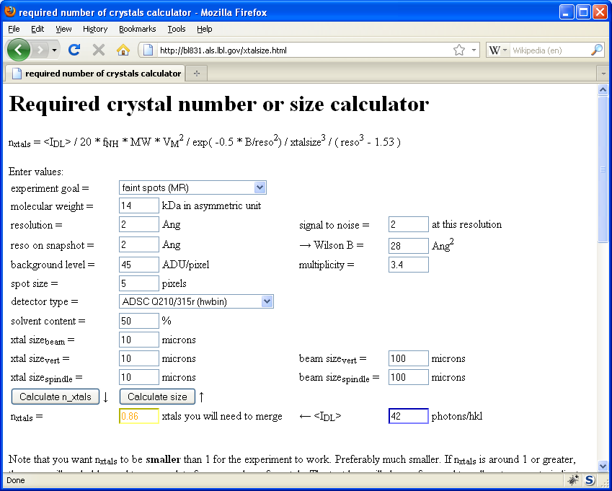
Holton & Frankel (2010) Acta D 66 393-408.

Slide 42
Bigger is better, but not by much
B = 20
B = 60
B = 0
B = 170
B = 330
B = 560
Resolution (Å)
B = 850
Crystal diameter (micron)

Slide 43
Predicting resolution limits
Synchrotron Resolution (Å)
Home Lab Resolution (Å)

Slide 44
Predicting resolution limits
XFEL Resolution (Å)
Synchrotron Resolution (Å)

Slide 45
Diffraction Take-Home Lesson:
Disorder
Trumps
Everything!

Slide 46
What Causes Disorder?
Function
Radiation damage
Mosaicity
Strain
Xtal abuse
Dehydration

Slide 47
What Causes Disorder?
Function
Radiation damage
Mosaicity
Strain
Xtal abuse
Dehydration

Slide 48

Muybridge’s galloping horse (1878)

Slide 49
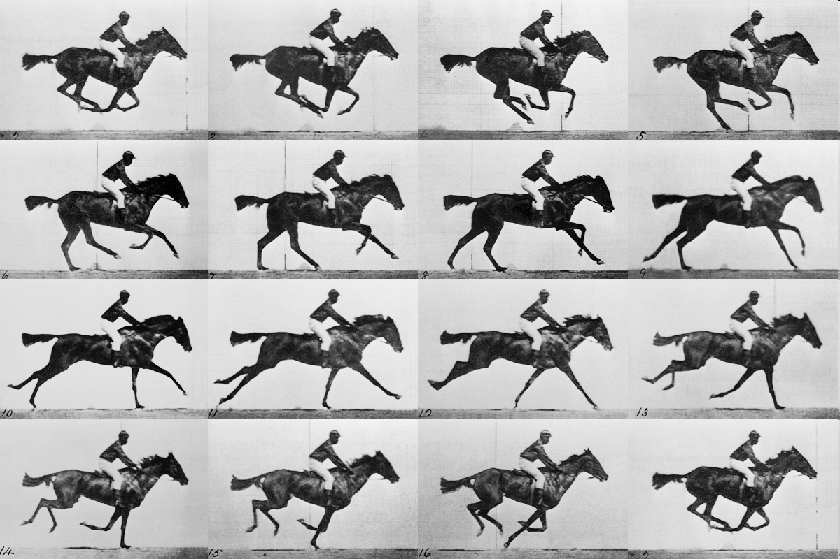
realistic “crystal” of horses

Slide 50
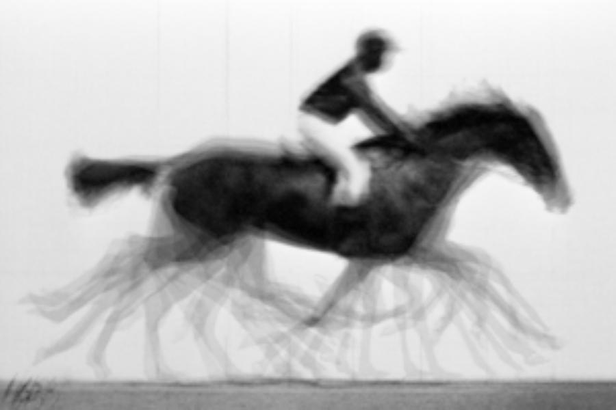
average structure: galloping horse

Slide 51
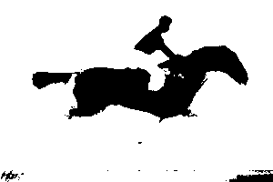
average structure: 1-sigma contour

Slide 52
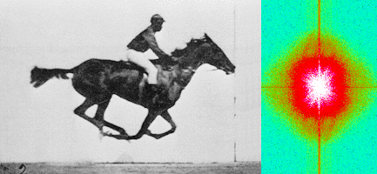
Muybridge’s galloping horse (1878)
“Time-resolved” diffraction
Real space
reciprocal

Slide 53
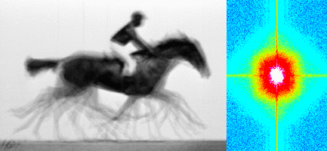
Muybridge’s galloping horse (1878)
Average electron density
Real space
reciprocal

Slide 54

lysozyme: real and reciprocal

Slide 55
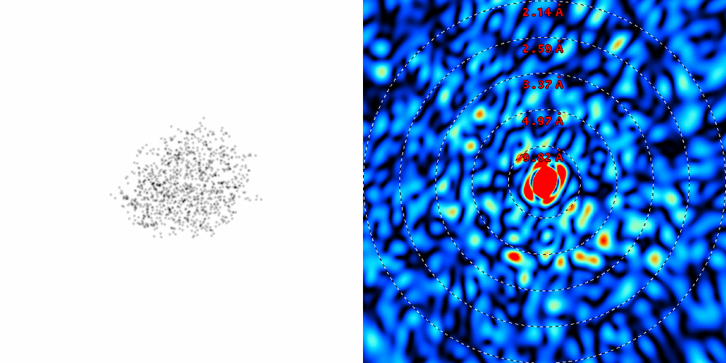
lysozyme: thermal motion
RMS displacement from B factors

Slide 56
What Causes Disorder?
Function
Radiation damage
Mosaicity
Strain
Xtal abuse
Dehydration

Slide 57
Damage is done
by dose (MGy)
proportional to photons/area
not time
not heat

Slide 58
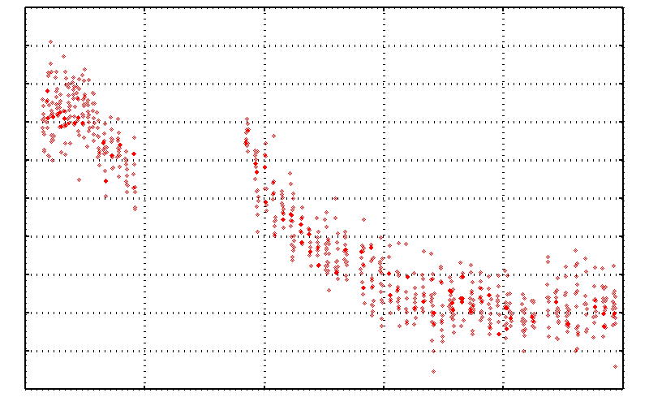
No Damage in the Dark!
4.6 5.0 5.4 5.8 6.2 6.6
Peak absorbance (electrons)
0 5 10 15 20 25
Experiment time (hours)

Slide 59
Dose-rate dependence of damage
maximum useful dose (MGy)
dose rate (kGy/s)

Slide 60
Rough values of energy quanta
1 MeV 100 GJ/mol Medical radiation therapy
100 keV 10 GJ/mol Medical imaging
10 keV 1 GJ/mol X-ray crystallography
1 keV 100 MJ/mol S and P K-edges
100 eV 10 MJ/mol “water window”
10 eV 1 MJ/mol C≡C bond
1 eV 100 kJ/mol C-C bond, visible light
100 meV 10 kJ/mol hydrogen bond
10 meV 1 kJ/mol heat (~300 K)

Slide 61

Energy Transfer Analogy
37 C

Slide 62
Types of radiation damage
Global
Specific

Slide 63
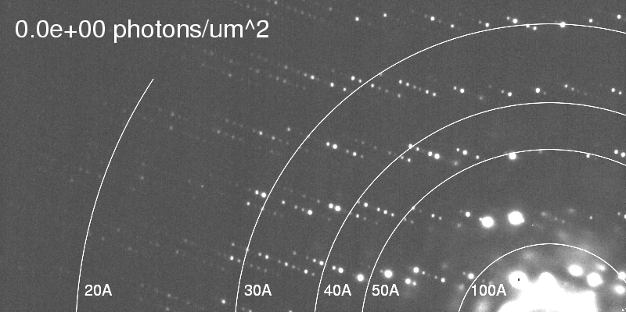
Global damage
Howells, et al. (2009) J. Electron Spectrosc. Relat. Phenom. 170, 4-12.

Slide 64
Types of radiation damage
Global
  scale factor
  B factor
Specific

Slide 65
Global Damage: scale
normalized total intensity
accumulated dose (MGy)

Slide 66
Types of radiation damage
Global
  scale factor
  B factor
Specific

Slide 67
Global Damage: B factor
data taken from Kmetko et. al. 2006
~ 1.0 B/MGy
relative B factor
accumulated dose (MGy)

Slide 68
Global damage
10³
100
maximum tolerable dose (MGy)
10
1
1 2 3 5 7 10 20 40 70 100
resolution (Å)
Howells et al. (2009) J. Electron. Spectrosc. Relat. Phenom. 170 4-12

Slide 69
Global damage
10³
10 MGy/Å
100
maximum tolerable dose (MGy)
10
1
1 2 3 5 7 10 20 40 70 100
resolution (Å)
Howells et al. (2009) J. Electron. Spectrosc. Relat. Phenom. 170 4-12

Slide 70
10 MGy/Å
what the is a MGy?
http://bl831.als.lbl.gov/
damage_rates.pdf
Holton J. M. (2009) J. Synchrotron Rad. 16 133-42

Slide 71
How long will my crystal last?
synch line type flux beamsize flux density dose max xtal min site
ph/s μm ph/μm2/s rate lifetime lifetime
ALS 4.2.2 MAD 2.2e11 75x80 3.7e+07 27.3 kGy/s 18 m 73 s
ALS 5.0.1 mono 1.6e11 100 2.0e+07 10.4 kGy/s 48 m 3.2 m
ALS 5.0.2 MAD 8e11 100 1.0e+08 51.8 kGy/s 9.6 m 39 s
ALS 5.0.3 mono 1.7e11 100 2.2e+07 11 kGy/s 45 m 3 m
ALS 8.2.1 MAD 1.8e11 100 2.3e+07 11.7 kGy/s 43 m 2.9 m
ALS 8.2.2 MAD 2.3e11 100 2.9e+07 14.9 kGy/s 34 m 2.2 m
ALS 8.3.1 MAD 1.6e11 100 2.0e+07 10.4 kGy/s 48 m 3.2 m
ALS 8.3.1 typical 1.1e11 100 1.4e+07 10.3 kGy/s 48 m 3.2 m
ALS 12.3.1 MAD 1.8e11 100 2.3e+07 11.7 kGy/s 43 m 2.9 m
ALS 12.3.1 ML 4.0e12 100 5.1e+08 513 kGy/s 58 s 3.9 s
APS 8-BM MAD 1e11 200 2.5e+06 1.27 kGy/s 6.6 h 26 m
APS 14-BM-C mono 5.8e10 200 1.4e+06 738 Gy/s 11 h 45 m
APS 14-BM-D MAD 3.3e9 200 8.2e+04 42 Gy/s 8.3 d 13 h
APS 14-ID-B MAD 6.0e10 200 1.5e+06 763 Gy/s 11 h 44 m
APS 17-BM MAD 1.1e11 200 2.8e+06 1.4 kGy/s 6 h 24 m
APS 17-ID MAD 2.3e11 200 5.8e+06 2.93 kGy/s 2.8 h 11 m
APS 19-BM MAD 2.0e11 70x60 4.8e+07 24.2 kGy/s 21 m 83 s
APS 19-ID MAD 1.3e13 80x40 4.1e+09 2.07 MGy/s 15 s 0.97 s
APS 19-ID typical 5.5e11 100x100 5.5e+07 28 kGy/s 18 m 71 s
APS 22-BM MAD 7e12 80x40 2.2e+09 1.23 MGy/s 24 s 1.6 s
APS 22-ID MAD 7e12 80x40 2.2e+09 1.23 MGy/s 24 s 1.6 s
APS 22-ID typical 1.5e12 80 2.3e+08 119 kGy/s 4.2 m 17 s
APS 23-ID-B MAD 1e13 75x25 5.3e+09 3.01 MGy/s 10 s 0.66 s
APS 23-ID typical 1.5e12 80 2.3e+08 119 kGy/s 4.2 m 17 s
APS 24-ID-C MAD 1.3e13 20x60 1.1e+10 5.23 MGy/s 5.7 s 0.38 s
APS 24-ID-E MAD 0.5e13 20x100 2.5e+09 1.19 MGy/s 25 s 1.7 s
APS 31-ID MAD 2e12 70 4.1e+08 194 kGy/s 2.6 m 10 s

Slide 72
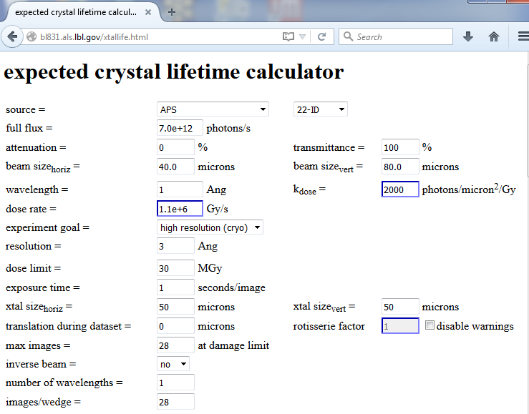

Slide 73
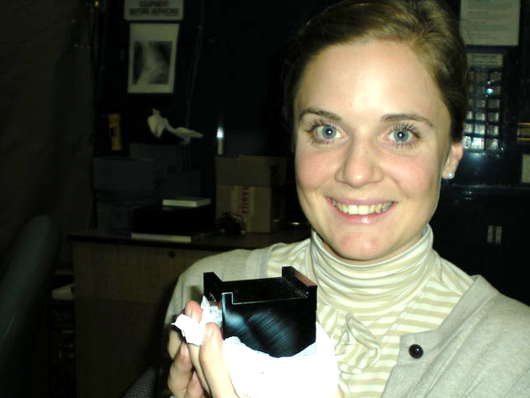
D_{1/2} ~ 10 Gy
D_{1/2} >> 10¹² Gy

Slide 74
Dose-doubling concentration
molar, at the Se edge based on RADDOSE
Na | 44
Mg | 27
P | 9
S | 7
Cl | 5
K | 3.3
Ca | 2.7
Fe | 1.0
Cu | 0.67
Zn | 0.58
As | 0.44
Se | 0.42
Br | 2.9
I | 0.47
Gd | 0.21
Ta | 0.13
Pt | 0.17
Au | 0.16
Hg | 0.16
U | 0.23

Slide 75
Dose-doubling concentration
molar, at the Se edge based on RADDOSE
Na | 44
Mg | 27
P | 9
S | 7
Cl | 5
K | 3.3
Ca | 2.7
Fe | 1.0
Cu | 0.67
Zn | 0.58
As | 0.44
Se | 0.42
Br | 2.9
I | 0.47
Gd | 0.21
Ta | 0.13
Pt | 0.17
Au | 0.16
Hg | 0.16
U | 0.23

Slide 76
Types of radiation damage
Global
  scale factor
  B factor
  non-isomorphism
Specific

Slide 77
R_{iso} vs dose
R_{iso} (%)
change in dose (MGy)
data taken from Banumathi, et al. (2004) Acta Cryst. D 60, 1085-1093.

Slide 78
R_{iso} vs dose
R_{iso} ≈ 0.7 %/MGy
R_{iso} (%)
change in dose (MGy)
data taken from Banumathi, et al. (2004) Acta Cryst. D 60, 1085-1093.

Slide 79
Types of radiation damage
Global
  scale factor
  B factor
  non-isomorphism
Specific
  depends on chemistry

Slide 80
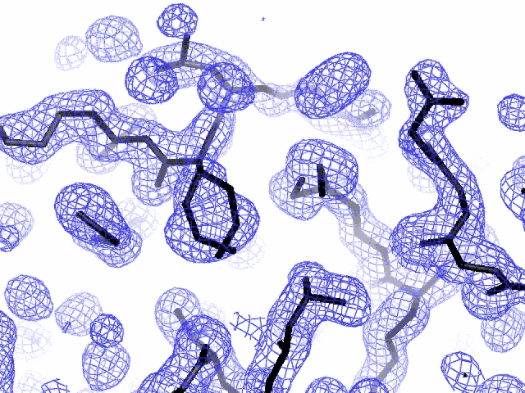
Specific damage
final, refined phases

Slide 81
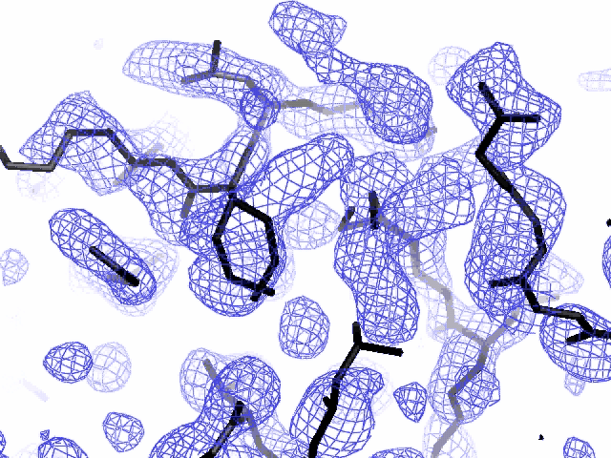
Specific damage
experimentally-obtained phases

Slide 82
Holton, J. M. (2007) J. Synch. Rad. 14, 51-72.

Slide 83
1.0
fraction
unconverted
0.0
Holton, J. M. (2007) J. Synch. Rad. 14, 51-72.

Slide 84
Specific damage rates
world records:
MGy reaction reference
~45 global damage Owen et al. (2006)
5 Se-Met Holton (2007)
4 Hg-S Ramagopal et al. (2004)
3 S-S Murray et al. (2002)
1 Br-RNA Olieric et al. (2007)
? Cl-C ???
0.5 Mn in PS II Yano et al. (2005)
0.02 Fe in myoglobin Denisov et al. (2007)
Holton (2009) J. Synchrotron Rad. 16 133-42

Slide 86
Types of radiation damage
Global
  scale factor
  B factor
  non-isomorphism
Specific
  depends on chemistry
  destroys phasing signal

Slide 87
What Causes Disorder?
Function
Radiation damage
Mosaicity
Strain
Xtal abuse
Dehydration

Slide 88
Spot Shape
Ewald sphere
(h,k,l)

Slide 89
Spot Shape
Ewald sphere
(h,k,l)
d*

Slide 90
Spot Shape
Ewald sphere
(h,k,l)
spindle axis
d*

Slide 91
Spot Shape
Ewald sphere
Φ circle
(h,k,l)
spindle axis

Slide 92
Spot Shape
Ewald sphere
Φ circle
(h,k,l)
spindle axis

Slide 93
Spot Shape
Ewald sphere
Φ circle
(h,k,l)
diffracted ray
spindle axis

Slide 94
Spot Shape
Ewald sphere
Φ circle
(h,k,l)
λ*
d*
spindle axis
diffracted ray
λ*

Slide 95
Spot Shape
Ewald sphere
Φ circle
(h,k,l)
λ*
d*
spindle axis
diffracted ray
θ
λ*
λ = 2 d sin(θ)

Slide 96
mosaic spread
Ewald sphere
Φ circle
(h,k,l)
λ*
d*
diffracted ray
d*
spindle axis
λ*

Slide 97
mosaic spread
Ewald sphere
Φ circle
(h,k,l)
d*
diffracted rays
d*
spindle axis

Slide 98

mosaic spread = 0 º

Slide 99

mosaic spread = 0.1º

Slide 100

mosaic spread = 0.2º

Slide 101

mosaic spread = 0.4º

Slide 102

mosaic spread = 0.6º

Slide 103

mosaic spread = 0.8º

Slide 104

mosaic spread = 1.0º

Slide 105

mosaic spread = 1.5º

Slide 106

mosaic spread = 2.0º

Slide 107

mosaic spread = 2.5º

Slide 108

mosaic spread = 3.2º

Slide 109

mosaic spread = 6.4º

Slide 110

mosaic spread = 12.8º

Slide 111
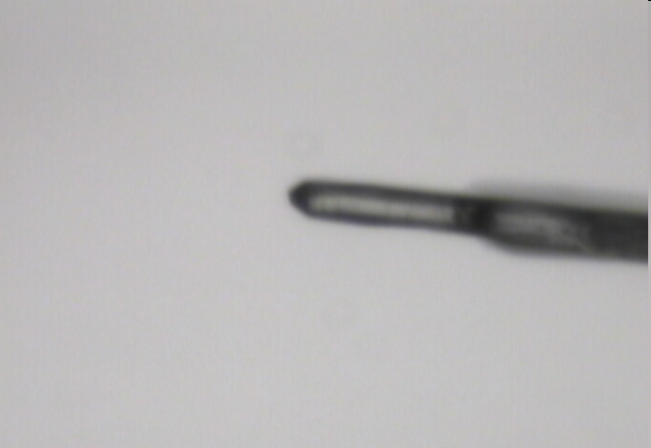
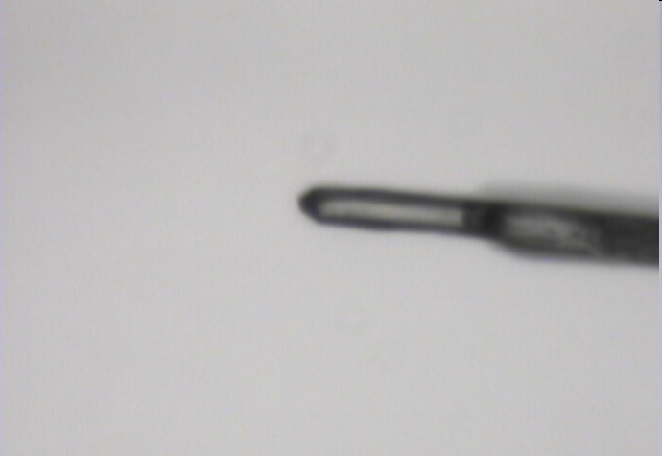
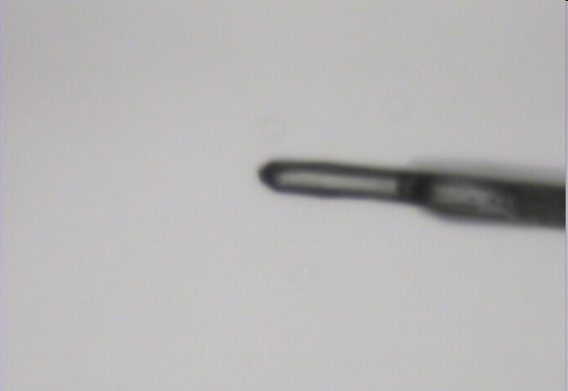
Radiation Damage
48 MGy
20 MGy
2 MGy

Slide 112
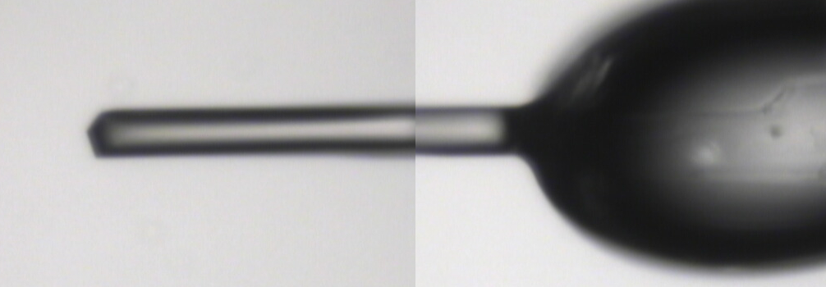
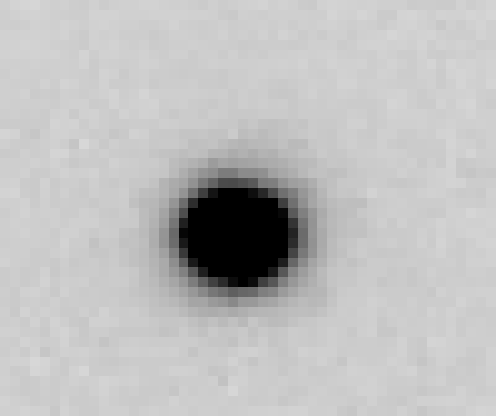
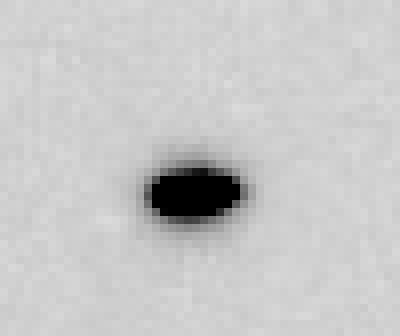
~0 MGy

Slide 113
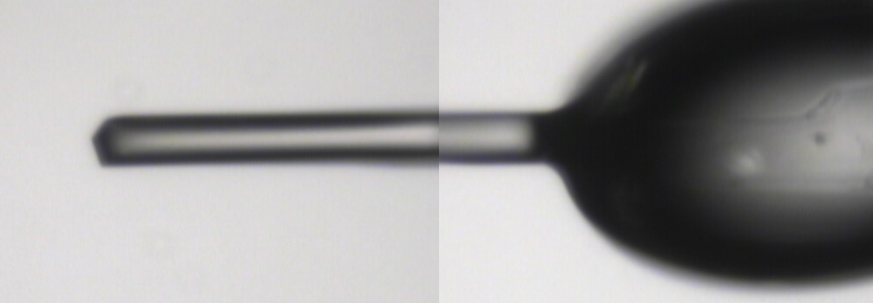
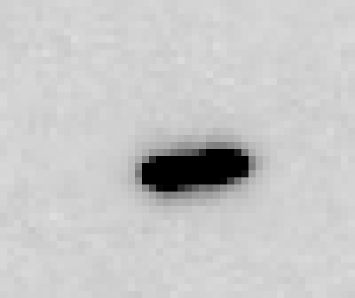
5 MGy

Slide 114
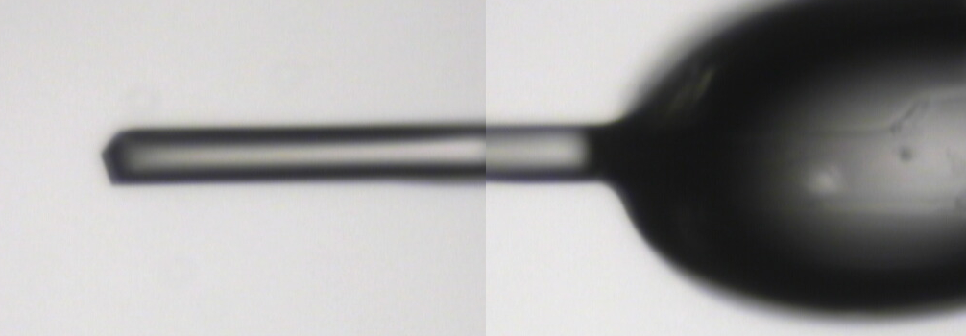
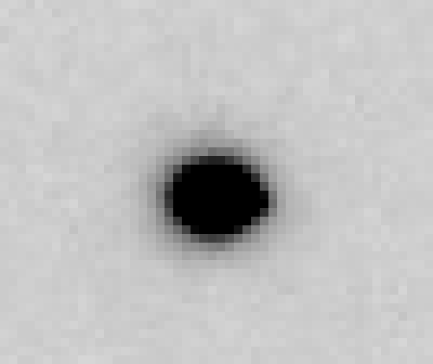
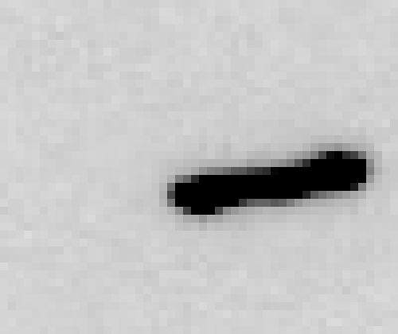
11 MGy

Slide 115
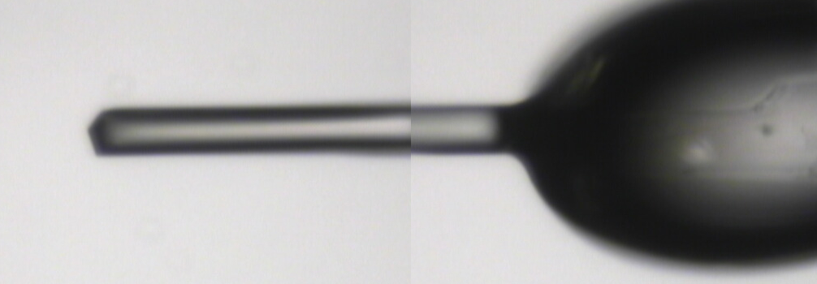
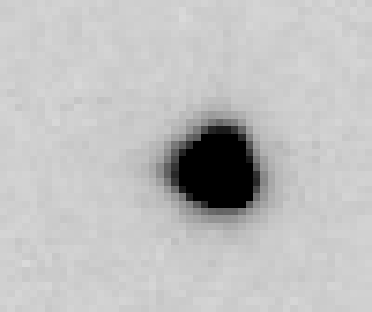
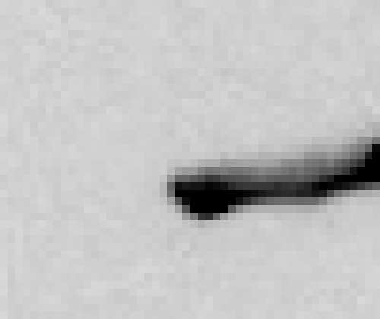
16 MGy

Slide 116
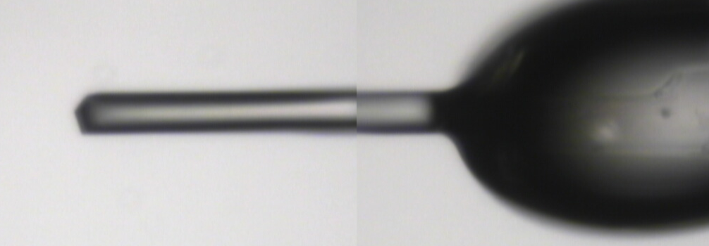
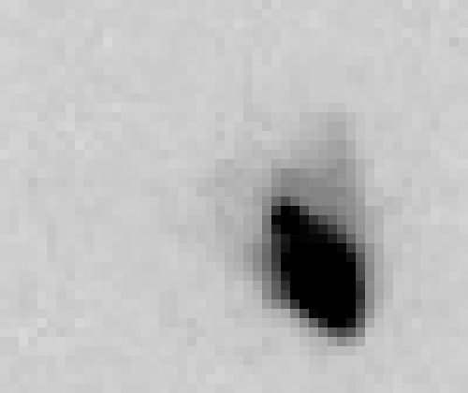
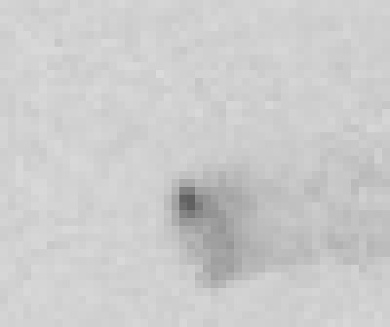
22 MGy

Slide 117
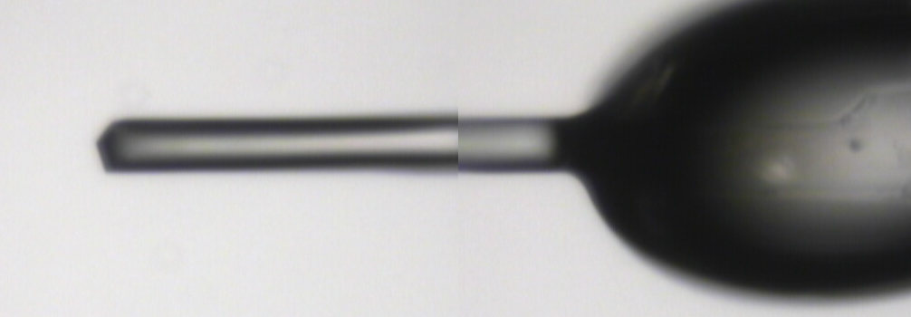
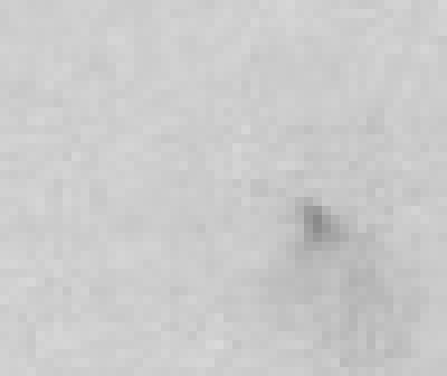
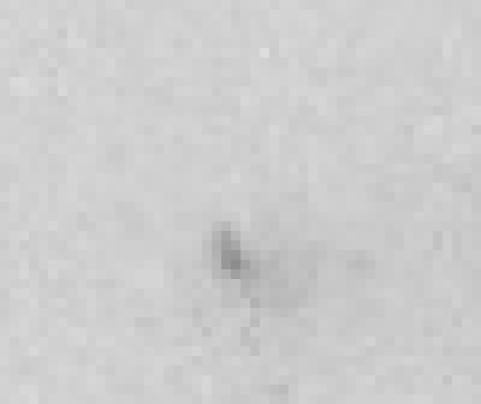
26 MGy

Slide 118
What Causes Disorder?
Function
Radiation damage
Mosaicity
Strain
Xtal abuse
Dehydration

Slide 119
stress and strain
What about
undamaged crystals?
radiation damage = defects

Slide 120
Purity is crucial!
important for
resolution
McPherson, A., Malkin, A. J., Kuznetsov, Y. G. & Plomp, M. (2001)."Atomic force microscopy applications in macromolecular crystallography", Acta Cryst. D 57, 1053-1060.
not important for
initial hits

Slide 121
What can I improve?
Purity!
is 95% good enough? 99%?
Purity!
conformational (homogeneous)
Purity!
kinetic (stable over time)

Slide 122
What can I improve?
add a column
fractional recrystallization
heat shock
mutate Lys
avoid stress
Newman J. (2006) Acta Cryst. D62 27-31.

Slide 123
What Causes Disorder?
Function
Radiation damage
Mosaicity > ~3 μm
Strain < ~3 μm
Xtal abuse
Dehydration

Slide 124
Ewald’s “mosaic” picture

Slide 125
Ewald’s “mosaic” picture

Slide 126
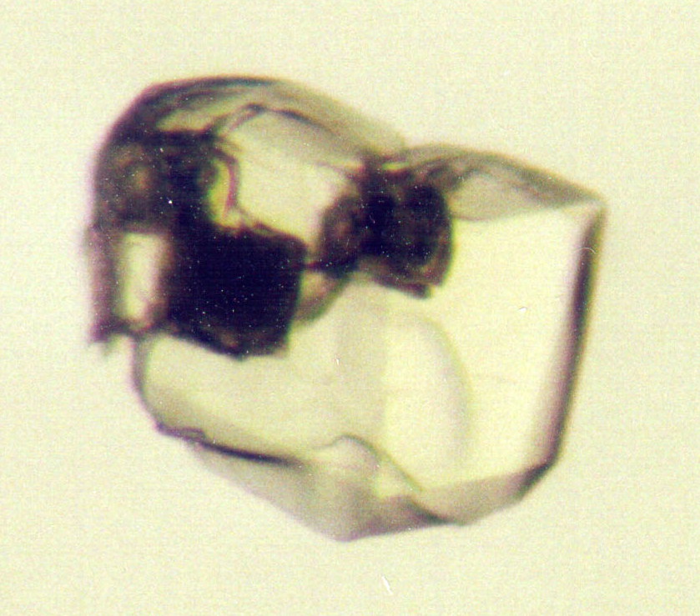
Ewald’s “mosaic” picture
What is
this stuff?

Slide 127
Darwin’s original picture

Slide 128
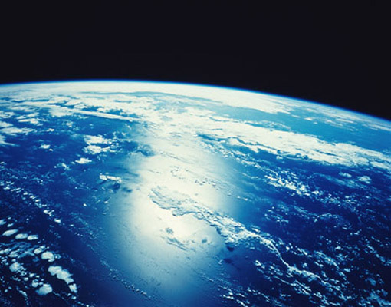
“mosaicity” with visible light

Slide 129
“near”-ly Bragg’s Law
detector
atom #1
source
d
atom #2

Slide 130
mosaicity vs Wilson B
x-ray beam
peak
intensity
integrated
intensity
“crystal”
detector

Slide 131
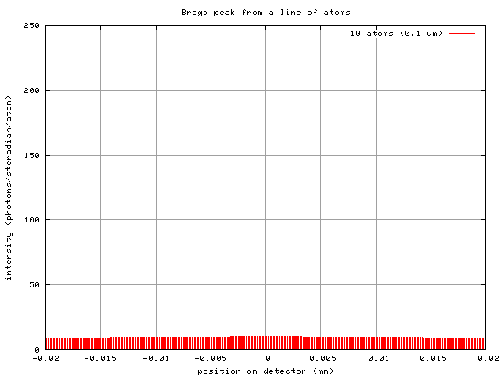
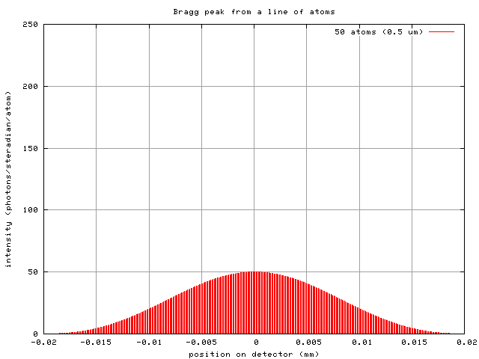
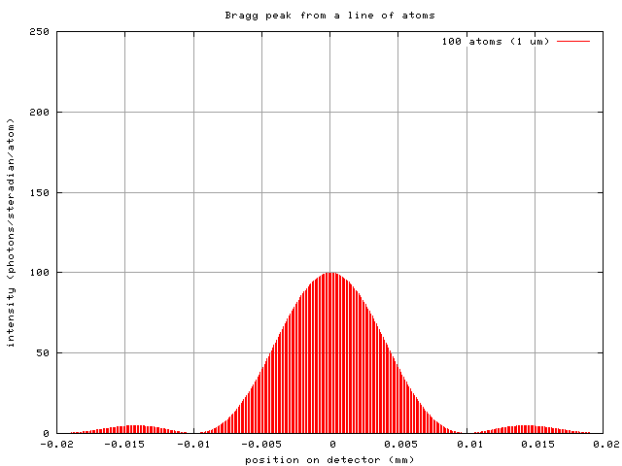
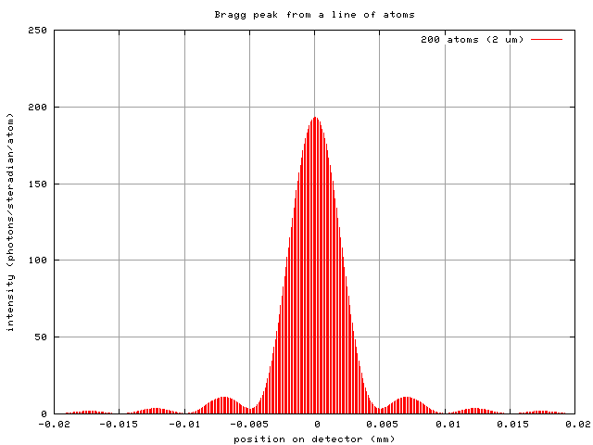
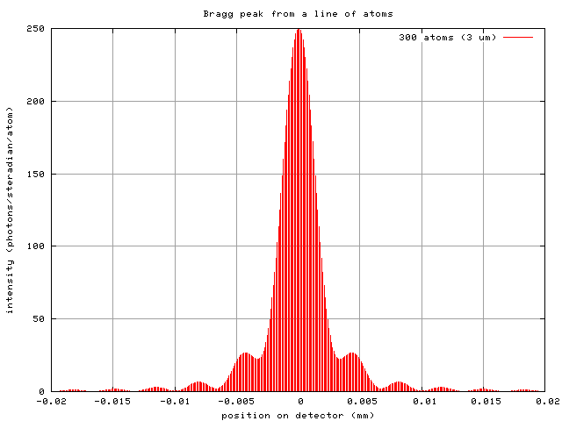
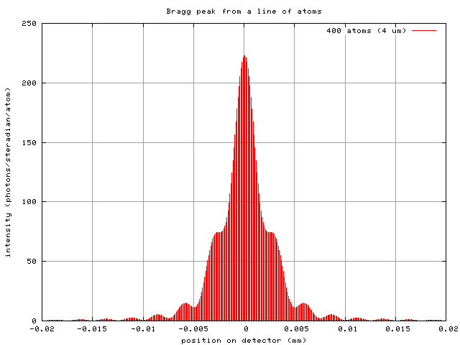


mosaicity vs Wilson B
10 atoms
50 atoms
100 atoms
200 atoms
300 atoms
400 atoms
500 atoms
1000 atoms
0.1 μm
0.5 μm
1 μm
2 μm
3 μm
4 μm
5 μm
10 μm
intensity (photons/SR/atom)
position on detector (mm)

Slide 132

mosaicity vs Wilson B
mosaic
spread
intensity (photons/SR)
B factor
number of atoms in line

Slide 133
16 MGy

Slide 134
What Causes Disorder?
Function
Radiation damage
Mosaicity > ~3 μm
Strain < ~3 μm
Xtal abuse
Dehydration

Slide 135


Slide 136

Icky Skin Stuff

Slide 137


Hampton crystal surgery tools

Slide 138


MiTeGen MicroTools
http://www.mitegen.com/products/microtools/microtools_kit1.shtml

Slide 139
Xtal Abuse
physical contact
don’t touch the part you intend to shoot
osmotic shock
equilibrate, or calculate matching solution
changes in dielectric constant
Petsko (1975) J. Mol. Biol. 96, 381-388.
cooled density mismatch
Juers & Matthews (2004) Acta Cryst. D 60, 412-421.
basically: no sudden moves!

Slide 140
Xtal Abuse
physical contact
don’t touch the part you intend to shoot
osmotic shock
equilibrate, or calculate matching solution
changes in dielectric constant
Petsko (1975) J. Mol. Biol. 96, 381-388.
cooled density mismatch
Juers & Matthews (2004) Acta Cryst. D 60, 412-421.

Slide 141


Vicker’s hardness
Tachibana et al. (1999) J. Cryst. Growth 198, 661-664.
Koizumi et al. (2009) Physical Review E 79, 61917.

Slide 142

platy crystals

Slide 143
platy crystals

Slide 144
How many crystals do you see?
Shoot the crystal (singular)

Slide 145

Get thee to a microbeam?
Evans et al. (2011)."Macromolecular microcrystallography", Crystallography Reviews 17, 105-142.

Slide 146
platy crystals

Slide 147
platy crystals

Slide 148
X-ray scattering “rules”:
1 μm crystal ≈ 1 μm water
≈ 1 μm plastic
≈ 0.1 μm glass
≈ 1000 μm air

Slide 149

MiTeGen MicroMesh grids
http://www.mitegen.com/products/micromeshes/micromeshes.shtml

Slide 150

platy crystals

Slide 151
platy crystals

Slide 152
platy crystals

Slide 153

acupuncture needles

Slide 154

acupuncture needles

Slide 155
xtal stuck on tray
?

Slide 156
xtal stuck on tray

Slide 157
xtal stuck on tray

Slide 158
xtal stuck on tray

Slide 159
xtal stuck on tray

Slide 160
xtal stuck on tray

Slide 161
xtal stuck on tray

Slide 162
MiTeGen MicroSaw
10 μm thick!
http://www.mitegen.com/products/microtools/microtools_kit1.shtml

Slide 163
xtal stuck on tray

Slide 164
xtal stuck on tray

Slide 165
xtal stuck on tray

Slide 166
xtal stuck on tray

Slide 167

crystals too fragile? cross-link them!
Lusty (1999) J. Appl. Crystallogr. 32, 106-112.
McWhirter, et al. (1999) PNAS USA 96, 8408-8413.

Slide 168
Xtal Abuse
physical contact
don’t touch the part you intend to shoot
osmotic shock
equilibrate, or calculate matching solution
changes in dielectric constant
Petsko (1975) J. Mol. Biol. 96, 381-388.
cooled density mismatch
Juers & Matthews (2004) Acta Cryst. D 60, 412-421.

Slide 169
cryo assay 1 does your crystal “like” it?

Slide 170
Osmolarity matching
Look up osmotic pressure of mother liquor in CRC Handbook of Physics and Chemistry, Section D-232. 11th column is O: Os/kg
Look up o.p. of cryoprotectant agent.
Modify conc. of mother liquor to minimize change in osmotic pressure.

Slide 171
matching osmolarity

Slide 172
Xtal Abuse
physical contact
don’t touch the part you intend to shoot
osmotic shock
equilibrate, or calculate matching solution
changes in dielectric constant
Petsko (1975) J. Mol. Biol. 96, 381-388.
cooled density mismatch
Juers & Matthews (2004) Acta Cryst. D 60, 412-421.

Slide 173

Dielectric matching
Travers & Douzou (1970) J. of Phys. Chem. 74, 2243-2244.
Petsko (1975) J. Mol. Biol. 96, 381-388.
Douzou (1977) Cryobiochemistry. Academic Press.

Slide 174
Tris buffer vs temperature
pH
Temperature (C)

Slide 175
Tris buffer under cryo
pH*
Temperature (K)
Douzou (1977) Cryobiochemistry. Academic Press.

Slide 176
matching dielectric const.

Slide 177
matching dielectric const.

Slide 178
matching dielectric const.

Slide 179
matching dielectric const.

Slide 180

My crystal “dissolved” in the oil!
no, it didn’t…

Slide 181
Xtal Abuse
physical contact
don’t touch the part you intend to shoot
osmotic shock
equilibrate, or calculate matching solution
changes in dielectric constant
Petsko (1975) J. Mol. Biol. 96, 381-388.
cooled density mismatch
Juers & Matthews (2004) Acta Cryst. D 60, 412-421.

Slide 182
ice = bad

Slide 183
ice = bad

Slide 184


stress and strain
intensity
∞ 10 5 3 2.7 2.5 2.0 1.8 1.5
resolution (Å)

Slide 185
stress and strain
intensity
∞ 10 5 3 2.7 2.5 2.0 1.8 1.5
resolution (Å)

Slide 186


cryo assay
does it “freeze clear”?
vs.

Slide 187
You do not need a cryostream to check your cryo!
liquid N₂

Slide 188

clear drop, right?

Slide 189

cubic ice
0.92 g/cm³

Slide 190


hexagonal ice
0.92 g/cm³

Slide 191


nano-crystalline cubic ice
~0.93 g/cm³

Slide 192


amorphous ice
0.94 g/cm³

Slide 193
annealing
easiest way to change your cryo
WATCH droplet melt before re-cooling
snapshots only!
Juers & Matthews (2004) Acta Cryst. D 60, 412-421.

Slide 194

annealing gone wrong

Slide 195
annealing – in slo-mo

Slide 196
What Causes Disorder?
Function
Radiation damage
Mosaicity > ~3 μm
Strain < ~3 μm
Xtal abuse
Dehydration

Slide 197
opened drop: you have ~30 seconds!
equilibrated drop

Slide 198



First diffraction from protein xtal
1934
Bernal, J. & Crowfoot, D. (1934). "X-ray photographs of crystalline pepsin", Nature 133, 794-795.

Slide 199
Dehydration: 1934
and 2015?
= 1.5 μL
100 μm
= 1.0 nL
2 mm
= 1.0 pL
10 μm
= 1.0 fL
1 μm

Slide 200
Non-isomorphism in lysozyme
Dear James
The story of the two forms of lysozyme crystals goes back to about 1964 when it was found that the diffraction patterns from different crystals could be placed in one of two classes depending on their intensities. This discovery was a big set back at the time and I can remember a lecture title being changed from the 'The structure of lysozyme' to 'The structure of lysozyme two steps forward and one step back'. Thereafter the crystals were screened based on intensities of the (11,11,l) rows to distinguish them (e.g. 11,11,4 > 11,11,5 in one form and vice versa in another). Data were collected only for those that fulfilled the Type II criteria. (These reflections were easy to measure on the linear diffractometer because crystals were mounted to rotate about the diagonal axis). As I recall both Type I and Type II could be found in the same crystallisation batch . Although sometimes the external morphology allowed recognition this was not infallible.
The structure was based on Type II crystals. Later a graduate student Helen Handoll examined Type I. The work, which was in the early days and before refinement programmes, seemed to suggest that the differences lay in the arrangement of water or chloride molecules (Lysozyme was crystallised from NaCl). But the work was never written up. Keith Wilson at one stage was following this up as lysozyme was being used to test data collection strategies but I do not know the outcome.
An account of this is given in International Table Volume F (Rossmann and Arnold edited 2001) p760.
Tony North was much involved in sorting this out and if you wanted more info he would be the person to contact. I hope this is helpful. Do let me know if you need more.
Best wishes
Louise

Slide 201
Non-isomorphism in lysozyme
Structure factor (e⁻)
Johnson’s ratio

Slide 202
Non-isomorphism in lysozyme
Structure factor (e⁻)
Johnson’s ratio

Slide 203


Slide 204

Non-isomorphism in lysozyme
3aw6
3aw7
RH 84.2% vs 71.9%
RMSD = 0.18 Å
R_{iso} = 44.5%

Slide 205
“same drop” ?

Slide 206


Magdoff & Crick (1955) “Ribonuclease II. Accuracy of measurement and shrinkage”, Acta Cryst. 8, 461-8.
Crick & Magdoff (1956) “The theory of the method of isomorphous replacement for protein crystals”, Acta Cryst. 9, 901-8.

Slide 207
Elastic deformation
= non-isomorphism

Slide 208
Elastic deformation
= non-isomorphism

Slide 209
Plastic deformation
= poor diffraction

Slide 210
Plastic deformation
= poor diffraction

Slide 211

Xtal5_t1 graph
Spot intensity

Slide 212

Spot intensity

Slide 213
How much H₂ are we making?
Meents et al. (2010) claimed:
"400 molecules of H2 for every 12.5 keV photon“
= 3.3x10⁻⁷ mol/J
200 kGy to 100 um³ = 0.24 J
= 1.2x10⁻⁸ mol H₂
100 um³ of water = 6.7x10⁻⁸ mol
→ 18% of water has reacted!

Slide 214
OK! OK!
Now I am afraid!
What should I do?

Slide 215




oil is your friend

Slide 216
opened drop: you have ~30 seconds!
oil

Slide 217
oiled drop: you have ~3 hours
oil

Slide 218
Dabbing to remove excess
clean surface

Slide 219
Dabbing to remove excess
clean surface

Slide 220
Dabbing to remove excess
clean surface

Slide 221
Dabbing to remove excess
clean surface

Slide 222
Dabbing to remove excess
clean surface

Slide 223
Dabbing to remove excess
clean surface

Slide 224
Dabbing to remove excess
clean surface

Slide 225
Crystal fishing demystified
“Lasso” method

Slide 226
Crystal fishing demystified

Slide 227
Crystal fishing demystified

Slide 228
Crystal fishing demystified

Slide 229
Crystal fishing demystified

Slide 230
Crystal fishing demystified

Slide 231
Crystal fishing demystified

Slide 232
Crystal fishing demystified
“Soup Spoon” method

Slide 233
Crystal fishing demystified

Slide 234
Crystal fishing demystified

Slide 235
Crystal fishing demystified

Slide 236
Crystal fishing demystified

Slide 237
Crystal fishing demystified

Slide 238
Crystal fishing demystified

Slide 239
plunge cooling
warm, moist air
ice
cold N₂
liquid N₂
foam insulation

Slide 240
plunge cooling
warm, moist air
ice
cold N₂
liquid N₂
foam insulation

Slide 241
Warkentin method
liquid N₂
foam insulation
Warkentin (2006) J. Appl. Crystallogr. 39, 805-811.

Slide 242
COMBINE cryoprotectants!
organic + hyperquenching
malonate + glycerol
“confusion principle”
~30% glycerol is not as good as:
5% glycerol +
5% PEG400 +
5% MPD +
5% sucrose +
5% sorbitol +
5% ethylene glycol

Slide 243
COMBINE cryoprotectants!
organic + hyperquenching
malonate + glycerol
“confusion principle”
~30% glycerol is not as good as:
25% glycerol +
1% PEG400 +
1% MPD +
1% sucrose +
1% sorbitol +
1% ethylene glycol

Slide 244

Pressure as a cryoprotectant
Fig. 1. Equipment for freezing at 2500 atm. (1) Steel cylinder, (2) and (3) pistons which can be coupled to a hydraulic press, (4) Teflon cell, (5) vessel for liquid nitrogen, (6) steel tube used for pushing cell (4) out of cylinder (1), (7) steel rings. Scale is in mm. A-A : direction of the force.
Thomanek et al. (1973)
Acta Cryst. A 29, 263-265.

Slide 245
Pressure as a cryoprotectant
High-pressure cooling apparatus. (a) Sample pin. An oil-coated crystal in a cryoloop is inserted into one end (right) of a brass tube (2.5 cm long) and a
steel piano wire in the other end (left). (b) High-pressure tubing assembly in a LN2 container. A sample is loaded into the top of each 30 cm long tube
and is held in place by a magnet outside the tube. Three crystals can be pressure-cooled at a time.
Kim et al. (2005) Acta Cryst. D 61, 881-890.

Slide 246

Pressure as a cryoprotectant
Balzers HPM 010 High Pressure Freezer
The Bal-Tec HPM 010 is a high pressure freezing machine that is designed to freeze non-cryoprotected samples up to 0.5mm in thickness without significant ice crystal damage. Samples can then be processed for TEM using the freeze substitution protocol. These two methods are the state-of-the-art for TEM specimen preparation.
http://www.leica-microsystems.com/products/
electron-microscope-sample-preparation/
industrial-materials/cryo-preparation/
details/product/leica-em-pact2/

Slide 247

Pressure as a cryoprotectant

Slide 248

Response to dehydration
www.proteros.de

Slide 249

Response to dehydration
www.proteros.de

Slide 250

Response to dehydration
www.proteros.de

Slide 251

Response to dehydration
www.proteros.de

Slide 252

Response to dehydration
www.proteros.de

Slide 253

Response to dehydration
www.proteros.de

Slide 254

Response to dehydration
www.proteros.de

Slide 255

Response to dehydration
www.proteros.de

Slide 256

Ostwald Ripening
http://xray.bmc.uu.se/terese/tutorial6.html

Slide 257
… but does it work for membrane proteins?
CCP4BB:
“We used it for a large membrane protein complex and diffraction improved from ~7 to 2.7 A. The crystal is fished out and put into mother liquor solution in the button, sealed with dialysis membrane and the button is then placed into about 5 mls of mother liquor with slightly higher PEG concentration. Then you just exchange outside buffer every day or so for solutions containing higher concentrations of PEG. We went from ~9 to 30 % PEG4000 in about a week. You can easily observe crystal under microscope and if it cracks - you went too far/too quickly with PEG and need to use a bit less next time. Also, this method allows you to control all other components of the dehydrating solution - we needed to decrease salt concentration at the same time as increasing PEG. You can also introduce/increase cryo-protectant concentration at the same time. With these crystals, otherwise excellent dehydration machines already mentioned did not work, possibly because the process had to be really slow.”
Efremov, R. G. & Sazanov, L. A. (2011)."Structure of the membrane domain of respiratory complex I", Nature 476, 414-420.
“To improve diffraction properties, crystals were slowly cooled to 4 C, placed into micro-dialysis buttons, and mother liquor was exchanged by dialysis for 0.1 M sodium acetate (pH 4.8), 0.15 M sodium tartrate (pH 5.0), 30% PEG4000, 0.1% sodium cholate and 12.5% glycerol over a period of 5 days.”

Slide 258
At the beamline…
Resolution
  problem: background
  solution: use as few pixels as possible
Phases
  problem: fractional errors
  solution: use as many pixels as possible

Slide 259
beam size vs xtal size
  Put your crystal into the beam

Slide 260
Get thee to a microbeam?
Evans et al. (2011)."Macromolecular microcrystallography", Crystallography Reviews 17, 105-142.

Slide 261
beam size vs xtal size
  Put your crystal into the beam
  Shoot the whole crystal

Slide 262

shoot the whole crystal

Slide 263
shoot the whole crystal

Slide 264
shoot the whole crystal

Slide 265
beam size vs xtal size
  Put your crystal into the beam
  Shoot the whole crystal
  Shoot nothing but the crystal

Slide 266
shoot nothing but the crystal

Slide 267
shoot nothing but the crystal

Slide 268
X-ray scattering “rules”:
1 μm crystal ≈ 1 μm water
≈ 1 μm plastic
≈ 0.1 μm glass
≈ 1000 μm air

Slide 269
Resolution (Å)
too big
too small
just right
X-ray beam size (μm)

Slide 270
beam size vs xtal size
  Put your crystal into the beam
  Shoot the whole crystal
  Shoot nothing but the crystal
  Back off!

Slide 271
Background scattering

Slide 272

Background scattering
$100,000.00
$100,000.00
$100,000.00
real estate is
expensive
use it!
$100,000.00
$100,000.00
$100,000.00
$100,000.00
$100,000.00

Slide 273
Fine Slicing
background
background
Pflugrath, J. W. (1999)."The finer things in X-ray diffraction data collection", Acta Cryst. D 55, 1718-1725.

Slide 274
Classes of error in MX
Dependence on signal
none sqrt proportional
CCD
Read-out
Photon
counting
Detector calibration
attenuation
partiality
Non-isomorphism
Radiation damage
none
1/sqrt
1/prop.
Time
Beam flicker
Shutter jitter
Sample vibration

Slide 275

Optimal exposure time
(faint spots)
t_{hr} Optimal exposure time for data set (s)
t_{ref} exposure time of reference image (s)
bg_{ref} background level near weak spots on
reference image (ADU)
bg₀ ADC offset of detector (ADU)
bg_{hr} optimal background level (via t_{hr})
σ₀ rms read-out noise (ADU)
gain ADU/photon
m multiplicity of data set (including partials)
adjust exposure
so this is ~15

Slide 276
beam size vs xtal size
  Put your crystal into the beam
  Shoot the whole crystal
  Shoot nothing but the crystal
  Back off!
  The crystal must rotate

Slide 277
Get thee to a microbeam?
Evans et al. (2011)."Macromolecular microcrystallography", Crystallography Reviews 17, 105-142.

Slide 278
At the beamline…
Resolution
  problem: background
  solution: use as few pixels as possible
Phases
  problem: fractional errors
  solution: use as many pixels as possible

Slide 279
anomalous signal
ΔF
F
√
# sites
MW (Da)
≈ 1.2 f”
World record!
ΔF/F = 0.5%
Wang, Dauter & Dauter (2006) Acta Cryst. D 62, 1475-1483.
Crick, F. H. C. & Magdoff, B. S. (1956) Acta Crystallogr. 9, 901-908.
Hendrickson, W. A. & Teeter, M. M. (1981) Nature 290, 107-113.

Slide 280

Detector calibration: 7235 eV

Slide 281

Detector calibration: 7247 eV

Slide 282
Gadox calibration vs energy
same = good!
Relative absorption depth
bad!
photon energy (keV)

Slide 283

Spatial Heterogeneity in Sharp Spot Sensitivity
~3x10⁵ photon/pixel Pilatus detector
Bragg
glitch
“tree rings”
Pick-up tool mark
oxygen
inclusions
1% high
average
1% low

Slide 284

Spatial Heterogeneity in Sharp Spot Sensitivity (SHSSS): Q315r vs Pilatus
3.5
3.0
2.5
2.0
1.5
1.0
0.5
different
modules
Q315r
average change in spot intensity (%)
anomalous mates typically
> 100 mm apart
Pilatus
0.1 1 10 100
distance between spots (mm)

Slide 285

Systematic error does not “average out”

Slide 286
Fractional error
^{mult >} (—)²
~3%
<ΔF/F>

Slide 287

Holton & Frankel (2010) Acta D 66 393-408.

Slide 288

Dose slicing
unacceptable
damage
N
photons
crystal’s useful life
N
photons
unacceptable
read noise
N
photons

Slide 289
Data collection parameters:
16 crystals
360° each, inverse beam
7235 eV photon energy
< 1 MGy per xtal
Australian Synchrotron MX1
  35 kGy/s into 100 μm x 100 μm

Slide 290
140-fold multiplicity: 16 crystals, 360° each, inverse beam, 7235 eV
RESOLUTION COMPLETENESS R-FACTOR I/SIGMA R-meas CC(1/2) Anomal SigAno Nano
LIMIT OF DATA observed Corr
9.17 99.1% 3.9% 257.47 3.9% 100.0* 91* 5.024 450
6.49 100.0% 5.2% 214.33 5.2% 100.0* 86* 3.836 882
5.30 100.0% 7.2% 165.13 7.2% 100.0* 76* 3.257 1175
4.59 100.0% 7.2% 175.42 7.3% 100.0* 67* 2.589 1403
4.10 99.9% 7.7% 174.13 7.7% 100.0* 59* 2.264 1594
3.74 99.9% 9.4% 143.09 9.4% 100.0* 49* 1.953 1783
3.47 100.0% 11.2% 120.17 11.2% 100.0* 39* 1.696 1942
3.24 100.0% 14.1% 91.14 14.1% 100.0* 30* 1.333 2103
3.06 99.9% 19.5% 65.79 19.5% 100.0* 23* 1.117 2214
2.90 99.9% 29.0% 44.85 29.1% 99.9* 17* 1.008 2369
2.77 99.9% 40.5% 32.58 40.6% 99.8* 11* 0.901 2493
2.65 99.9% 52.8% 25.16 52.9% 99.8* 10* 0.866 2605
2.54 100.0% 67.4% 19.47 67.6% 99.6* 2 0.804 2705
2.45 100.0% 88.9% 14.58 89.2% 99.2* 4 0.831 2859
2.37 100.0% 109.3% 9.97 109.7% 98.1* 5 0.829 2925
2.29 100.0% 138.2% 6.87 138.9% 96.1* 1 0.760 3037
2.22 100.0% 197.1% 4.03 198.6% 83.5* -1 0.721 3159
2.16 100.0% 227.3% 2.41 230.8% 46.9* -1 0.677 3224
2.10 61.2% 154.4% 1.28 163.6% 47.0* -2 0.660 1999
2.05 47.9% 170.1% 0.68 196.5% 25.7* 3 0.629 1578
total 93.3% 15.7% 54.30 15.8% 100.0* 12* 1.217 42499

Slide 291

140-fold multiplicity
18 σ
16 σ
Phased anomalous difference Fourier

Slide 292

140-fold multiplicity
15σ = PO₄
Phased anomalous difference Fourier

Slide 293

140-fold multiplicity
~2σ = Mg?
Phased anomalous difference Fourier

Slide 294

140-fold multiplicity
8.2σ = Mg?
DELFAN residual anomalous difference

Slide 295
Discerning Na⁺ from Mg⁺⁺
DELFAN peak height (σ)
N
O
F
Ne
Na
Mg
f’’ (electrons)

Slide 296

140-fold multiplicity
7.4σ = Na
DELFAN residual anomalous difference

Slide 297
Suggested anomalous protocol:
360° in < 5 MGy
move detector
4X exposure
goto 2
2 wavelengths are better than 1
- (peak + inf)/2, and remote
MAD, not M-SAD!

Slide 298
Summary
http://bl831.als.lbl.gov/xtalsize.html
http://bl831.als.lbl.gov/~jamesh/mlfsom/
http://bl831.als.lbl.gov/~jamesh/powerpoint/ACMC_GBU_2013.ppt
100 ADU/pixel
10 μm for lysozyme
~3% error per spot, 1%/MGy
7235 eV for S-SAD
“Attenu-wait”: dose slicing

Slide 299
Summary
http://bl831.als.lbl.gov/xtalsize.html
http://bl831.als.lbl.gov/xtallife.html
http://bl831.als.lbl.gov/~jamesh/mlfsom/
http://bl831.als.lbl.gov/~jamesh/powerpoint/CSHL_tipsNtricks_2015.pptx
15 ADU/pixel
10 μm for lysozyme
~3% error per spot, 1%/MGy
8014 eV for S-SAD on Mar
“Attenu-wait”: dose slicing

Slide 300
Why harvest at all?
Radiation damage
  10-100x reduced at ~100 K
Background scatter
    tray >> xtal
Timing
    nothing lasts forever
Shipping
    cryo samples are glass beads

Slide 301
Why harvest at all?
Radiation damage
  10-100x reduced at ~100 K
Background scatter
    tray >> xtal
Timing
    nothing lasts forever
Shipping
    cryo samples are glass beads

Slide 302
X-ray transmission of materials
air
water
protein
crystal
transmission
glass
Depth into material (μm)

Slide 303
X-ray scattering of materials
glass
Differential cross section
(scattered photons/solid angle/incident photon/meter thickness)
plastic
paratone-N oil
25% glycerol
water
∞ 7.5 3.8 2.5 1.9 1.5
d-spacing (Ǻ)

Slide 304

naked xtal

Slide 305

Crowfoot Cell

Slide 306

Crowfoot Cell

Slide 307

Crowfoot Cell
J. D. Bernal and D. Crowfoot, Nature (London) 133, 794 (1934).

Slide 308

Fluidigm RT/cryo mount
“Diffraction Capable” chip
http://www.fluidigm.com/products/topaz-chips.html

Slide 309


Plate goniometers
Notes:
The non-rotating “plate goniometer” (left) was developed last year. A new incarnation for taking rotation-camera data is now being developed (right). Either of these devices will accept most any crystallization tray that can be rotated 90 degrees to gravity and probe arbitrary points in each crystallization drop with a 50 um x-ray beam. Installing a plate goniometer takes ~30 minutes and the location ~300 mm downbeam from the “normal” protein crystallography sample mounting point makes this technology transferable to most any beamline.
Current status is that a 95% complete data set has been collected from a 50 um lysozyme crystal at room temperature, and trials are now underway to collect data sets from “real” crystals.

Slide 310

Notes:
non-rotating tray goniometer stage installed in ALS 8.3.1. Note that the “normal” cryo-pin goniometer on the left is still in place and a brass flight tube has been added to contain the air scatter from the main beam on its way to the tray goniometer.

Slide 311


Slide 312
Why harvest at all?
Radiation damage
  10-100x reduced at ~100 K
Background scatter
    tray >> xtal
Timing
    nothing lasts forever
Shipping
    cryo samples are glass beads

Slide 313


Slide 314

8000 Gy/s

Slide 315



Example Data
lysozyme
50 μm beam
37 Gy/s (0.775 Å)
30s exposures at 20C
90° of data, 97% complete
I/σ = 1.5 at 1.9 Å
R_{merge} 18% (overall) 5% (low)
ΔB same as 20 min at 100K
2
1
0
scale vs batch
B factor
-2
-4
-6

Slide 316
Room temperature damage rates
dose at half intensity (MGy)
dose rate (kGy/s)

Slide 317
Room temperature damage rates
dose at half intensity (MGy)
dose rate (kGy/s)

Slide 318
Every spot is an unpaired partial!
I_{spot} = k N_{cells}²
Ewald sphere
range

Slide 319
Every spot is an unpaired partial!
I_{spot} = k N_{cells}¹
Ewald sphere
range
Woolfson, M. M. (1997). An introduction to X-ray crystallography. Ch. 2 & 6

Slide 320


Internal consistency of data
1,850,000 images
112,000 > 10 peaks
33,000 indexed
16,500 good preds
rigid-body:
R_{cryst} = 0.252
R_{free} = 0.232

Slide 321
what is “partiality”?
F(h,k,l)
Ewald sphere
λ₁*
λ₂*
F(h,k,l)
F(0,0,0)

Slide 322
Why harvest at all?
Radiation damage
  10-100x reduced at ~100 K
Background scatter
    tray >> xtal
Timing
    nothing lasts forever
Shipping
    cryo samples are glass beads

Slide 323
Why harvest at all?
Radiation damage
  10-100x reduced at ~100 K
Background scatter
    tray >> xtal
Timing
    nothing lasts forever
Shipping
    cryo samples are glass beads

Slide 324


MiTeGen RT cell
http://www.mitegen.com/products/micrort/micrort.shtml

Slide 325



Free-mounting system
http://www.proteros.de/

Slide 326
Summary
assay, control and open mind
purity, purity, purity
oil is your friend
Warkentin method
try room temp!
http://bl831.als.lbl.gov/~jamesh/powerpoint/
CSHL_tipsNtricks_2015.pptx

Slide 327


avoiding overlaps
c
c

Slide 328

avoiding overlaps
c

Slide 329
At the beamline…
Resolution
  problem: background
  solution: use as few pixels as possible
Phases
  problem: fractional errors
  solution: use as many pixels as possible

Slide 330
mosaic block = “coherence length”
James R. W. (1962) Optical Principles of the Diffraction of X rays. Ox Bow press.

Slide 331
scattering
x-ray beam
sample
detector
detector

Slide 332



























Slide 333



























Slide 334


Snapshot from single virus particle
2 keV LCLS 200 fs Mimi virus single-shot.
_{200 nm}
_{Reconstructed image}
_{Resolution 20nm}
_{TEM}
Seibert, et al. (2011). Nature 470, 78-81.
Notes:
what limits single-particle resolution ?
get 100 times more photons/shot if correctly focussed beam
get 100 times more with submicron beam focus on CXI chamber
Problem – scattering goes from N^2 to N (Wilson statistics).
So use a-priori information – modelling Axel Brummer
Make beam smaller than jet to elliminate streak
₃₃₄

