Slide 1
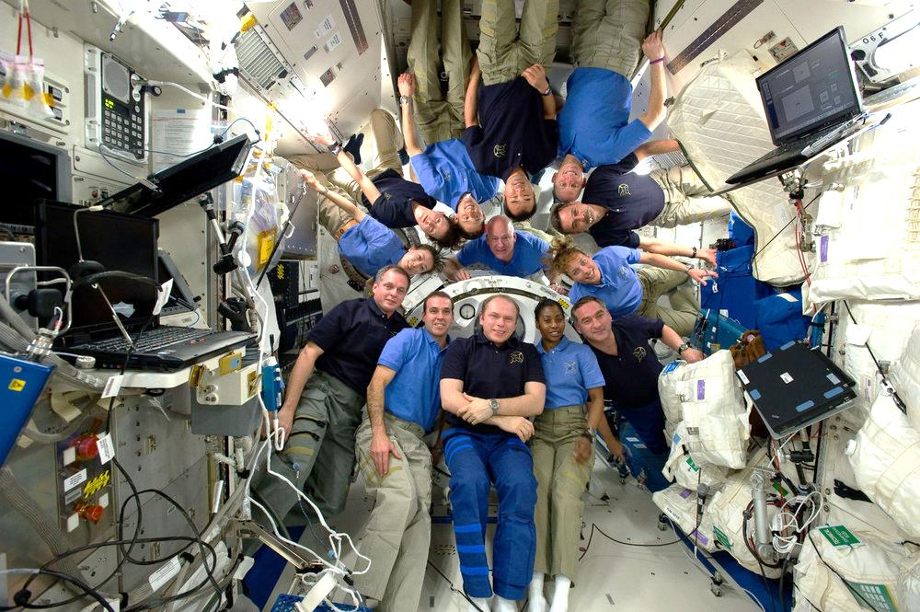
What is your Space Group?
the first question asked and the last question answered

Slide 2
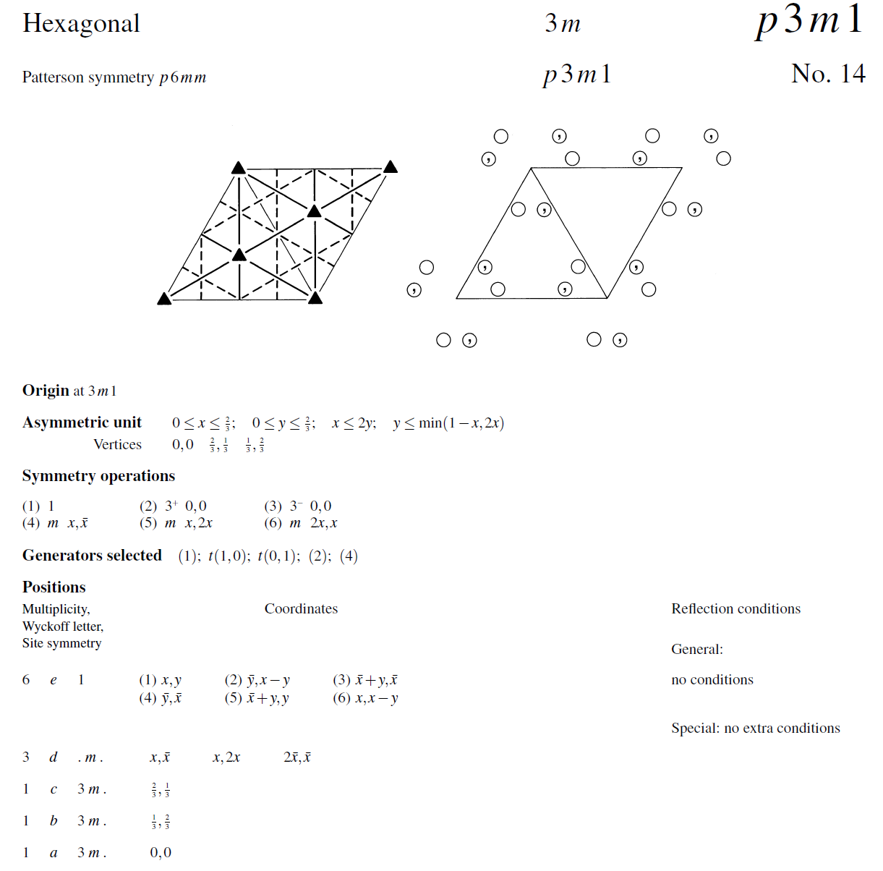
International Tables, Vol A

Slide 3
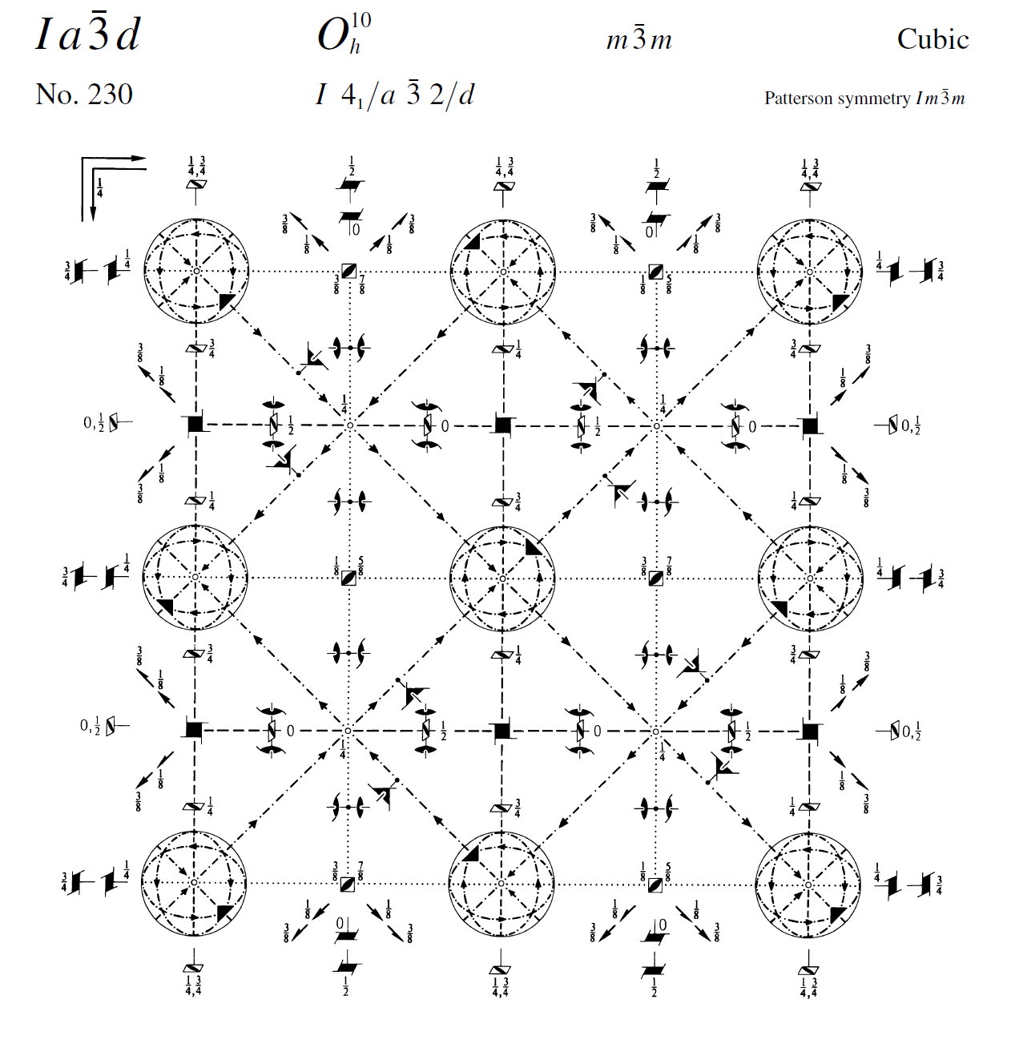
International Tables, Vol A

Slide 4
What you know when:
Autoindexing: Lattice (14)
Scaling: Point Group (43)
Refinement: Space Group (84)

Slide 5
Unit Cell
Smallest part of the crystal
that you can use to build up the rest of the crystal
with translation symmetry only

Slide 6
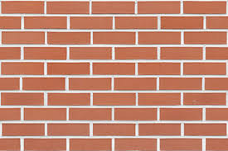
Unit cell?

Slide 7
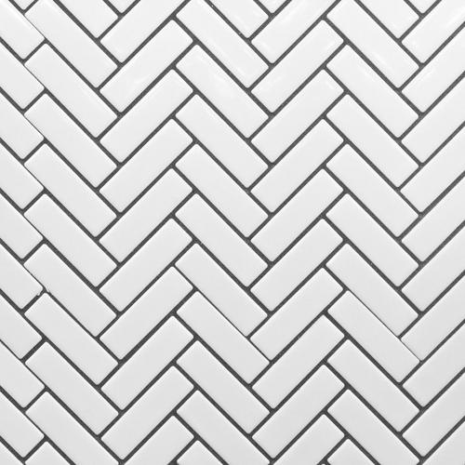
Where’s the unit cell?

Slide 8

Where’s the unit cell?

Slide 9
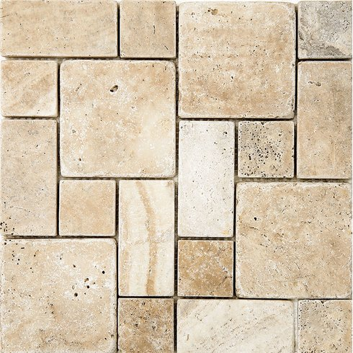
Where’s the unit cell?

Slide 10
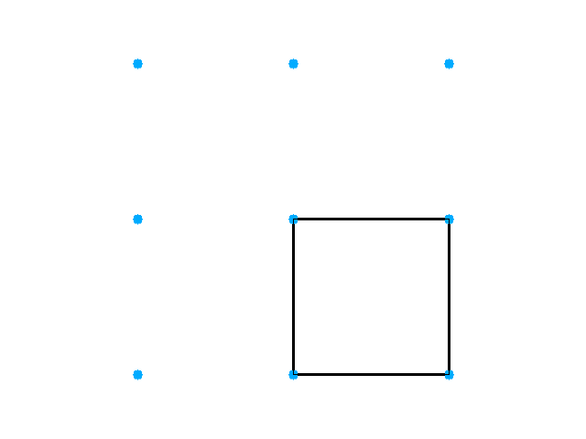
Primitive, cubic lattice

Slide 11
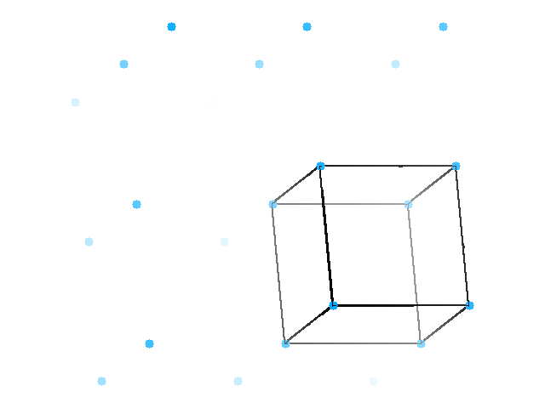
Primitive, cubic lattice

Slide 12
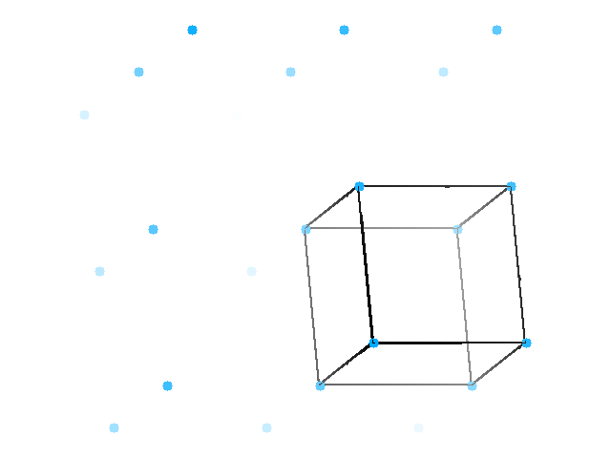
Primitive, cubic lattice

Slide 13
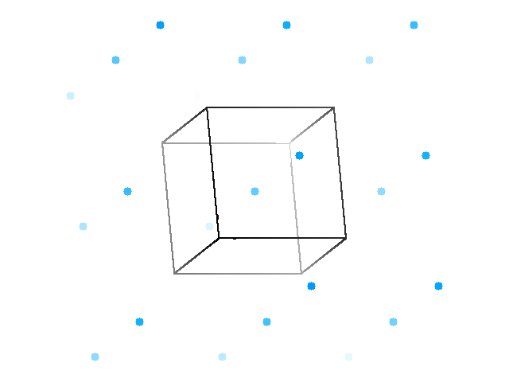
Primitive, cubic lattice, half-way unit cell

Slide 14
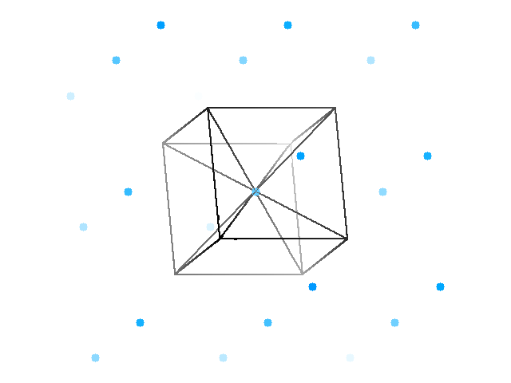
Body-centered cell

Slide 15
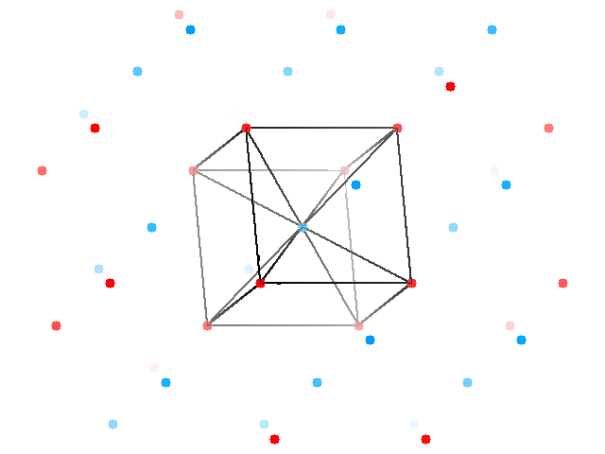
Two staggered lattices

Slide 16
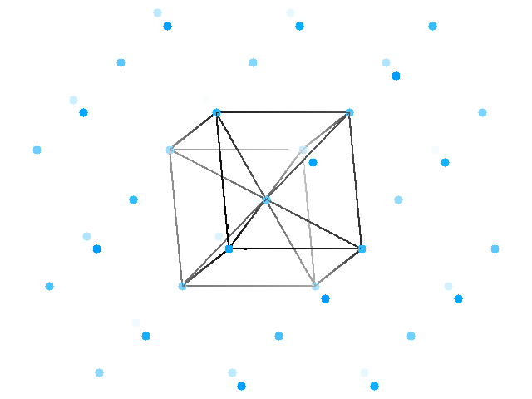
Body-centered lattice

Slide 17
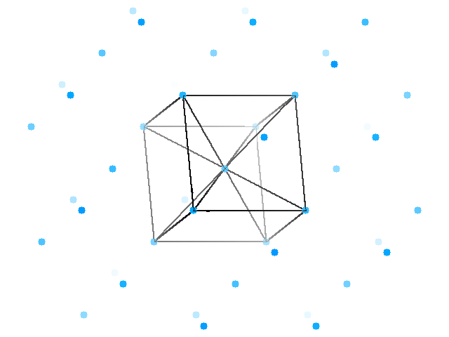
Body-centered lattice

Slide 18
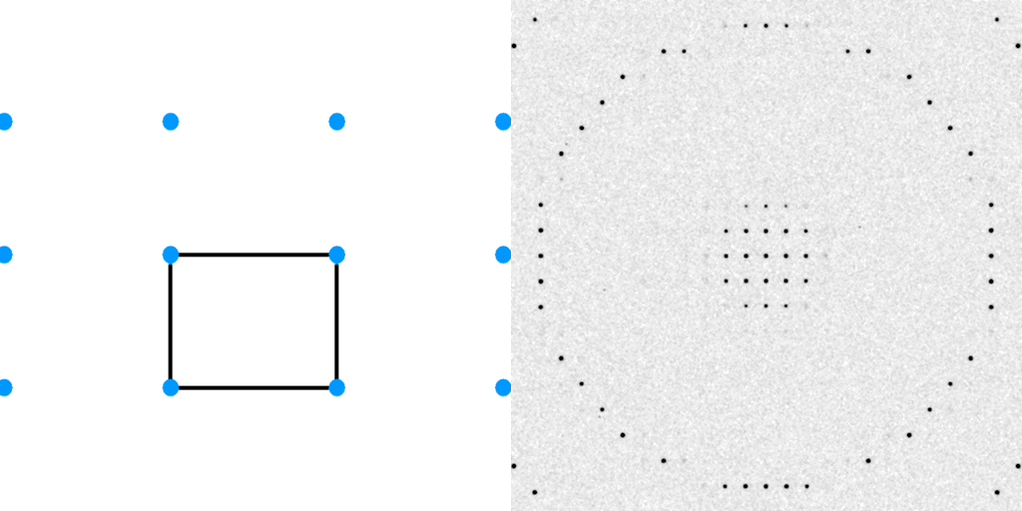
Diffraction from a 3D lattice
+
real space
reciprocal space

Slide 19
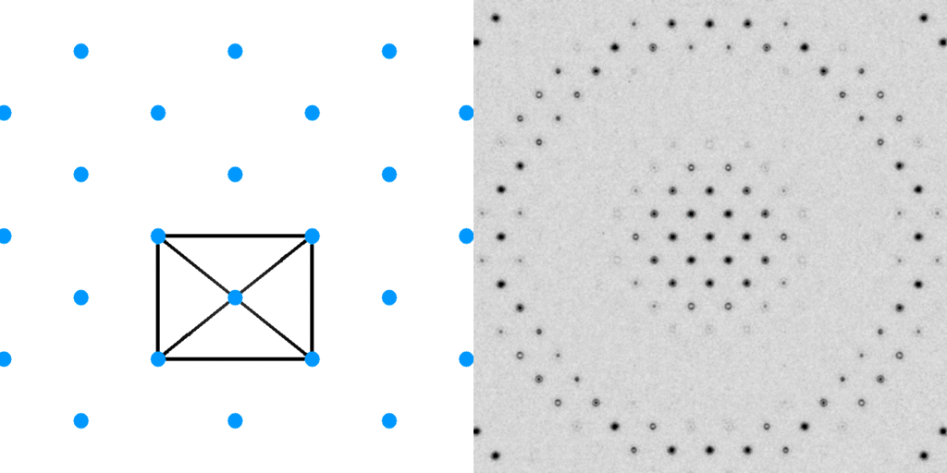
Diffraction from a 3D lattice
+
+
real space
reciprocal space

Slide 20
Diffraction from a 3D lattice
+
real space
reciprocal space

Slide 21
Diffraction from a 3D lattice
+
+
real space
reciprocal space

Slide 22
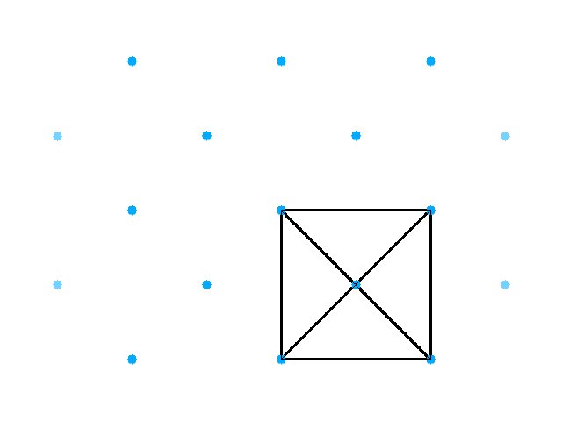
Base-centered lattice

Slide 23
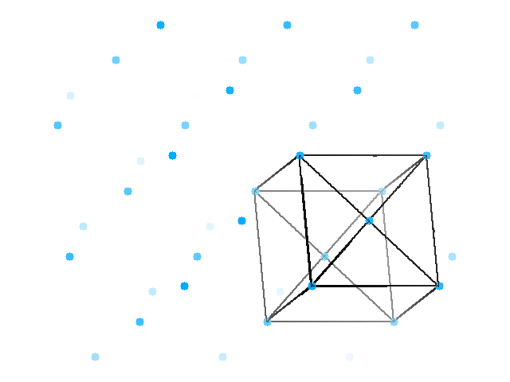
Base-centered lattice

Slide 24
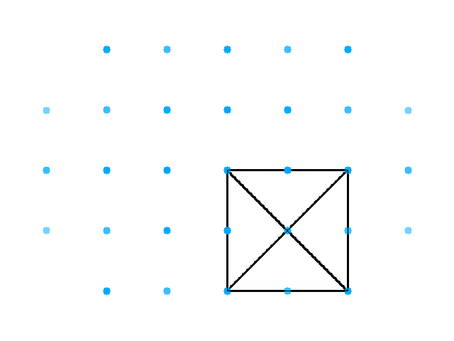
Face-centered lattice

Slide 25
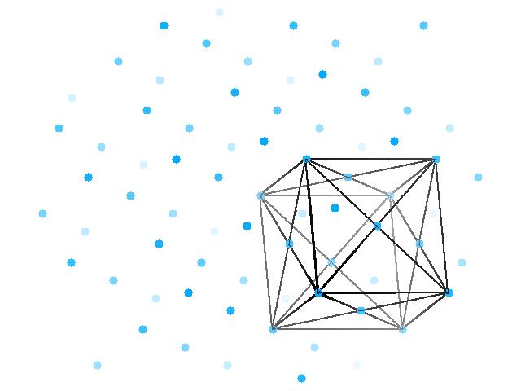
Face-centered lattice

Slide 26
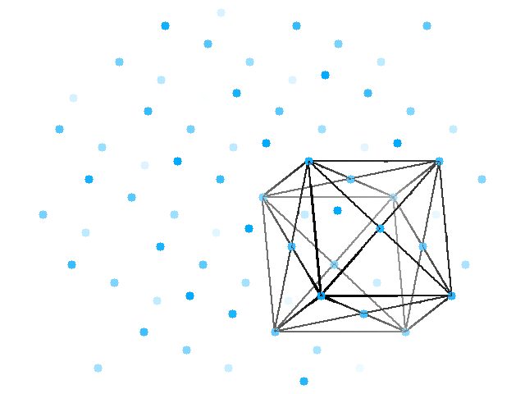
Face-centered lattice

Slide 27
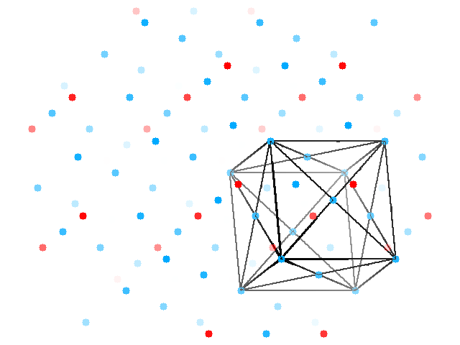
Face-centered lattice
Body-centered lattice

Slide 28
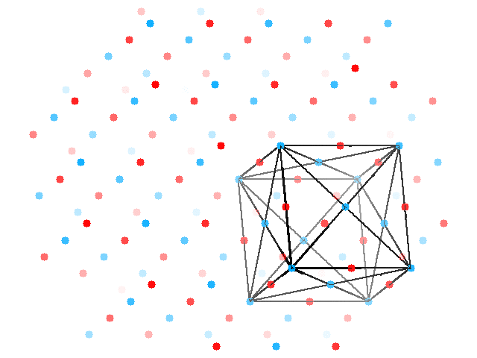
Face-centered lattice
All half-way points

Slide 29
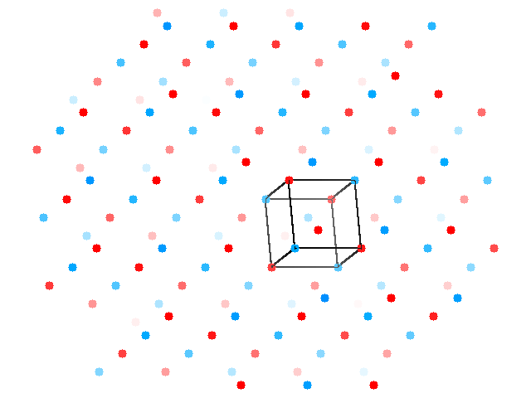
Face-centered lattice
All half-way points

Slide 30
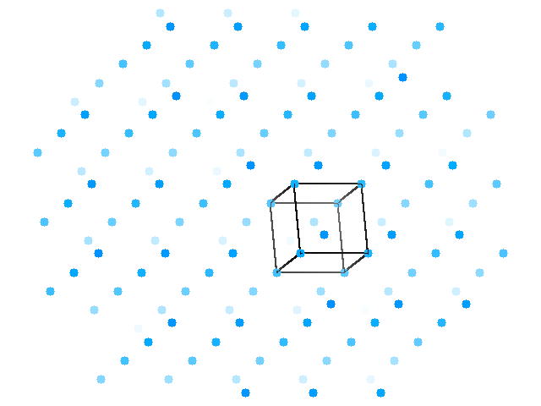
cubic lattice

Slide 31
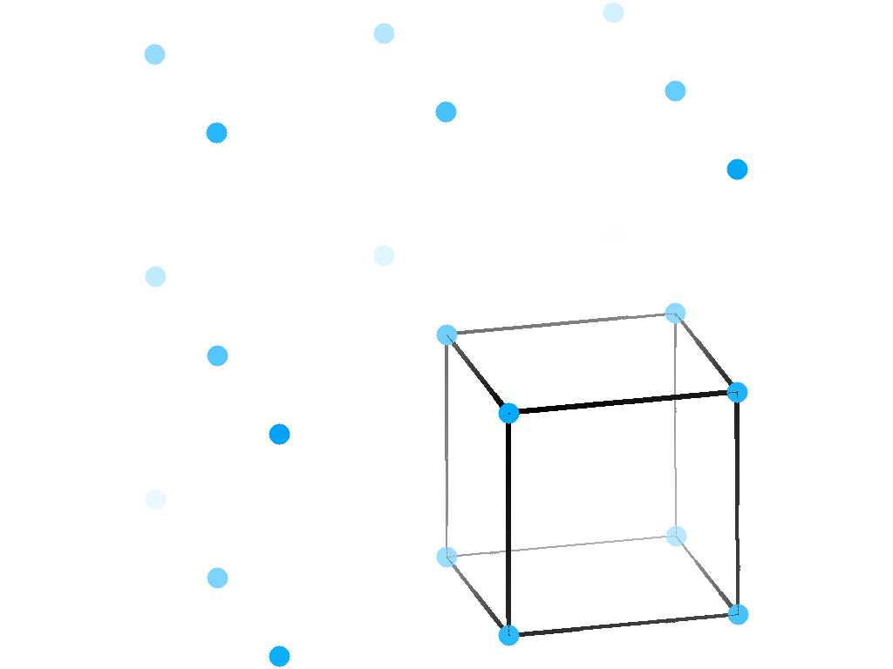
rhombohedral lattice

Slide 32

rhombohedral lattice

Slide 33
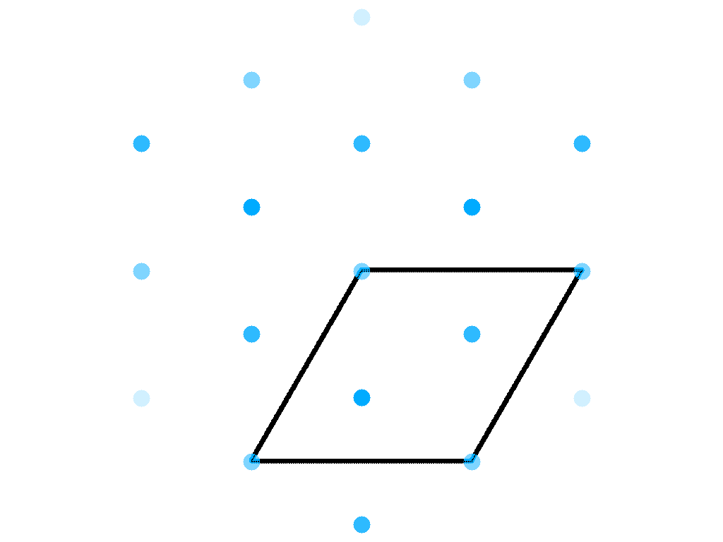
Hexagonal version of rhombohedral lattice

Slide 34
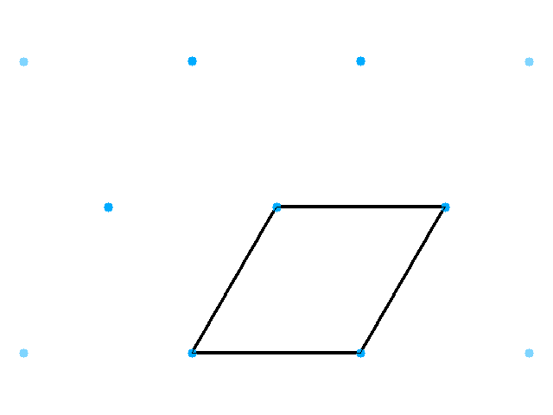
Hexagonal/triclinic lattice

Slide 35
Hexagonal lattice

Slide 36






Only 5 kinds of centering
None Primitive
ABC Base
I Body
F Face
R Rhombo
No restrictions
at least two 90° angles
All angles 90°
All angles 90°
Also fits:

Slide 37
Asymmetric Unit (ASU)
Unit Cell
Smallest part of the crystal
that you can use to build up the rest of the crystal
with translation symmetry only
Smallest part of the crystal
that you can use to build up the rest of the crystal
with symmetry operations

Slide 38
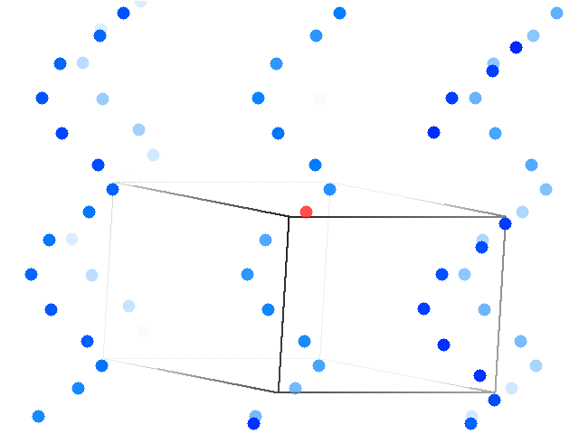
6-fold screw operator (hexagonal)

Slide 39
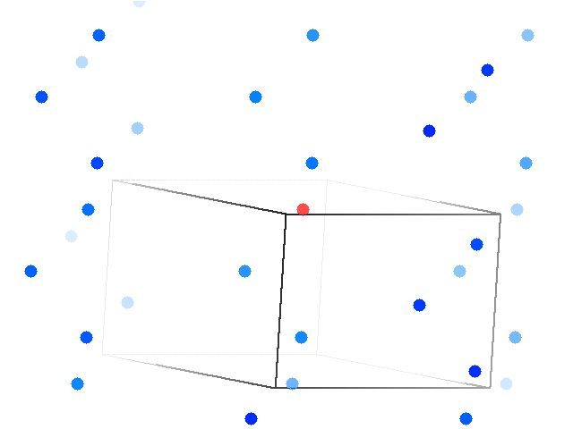
3-fold screw operator (trigonal)

Slide 40
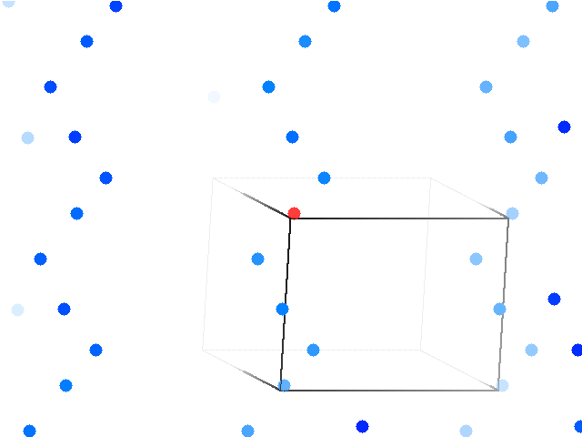
4-fold screw operator (tetragonal)

Slide 41
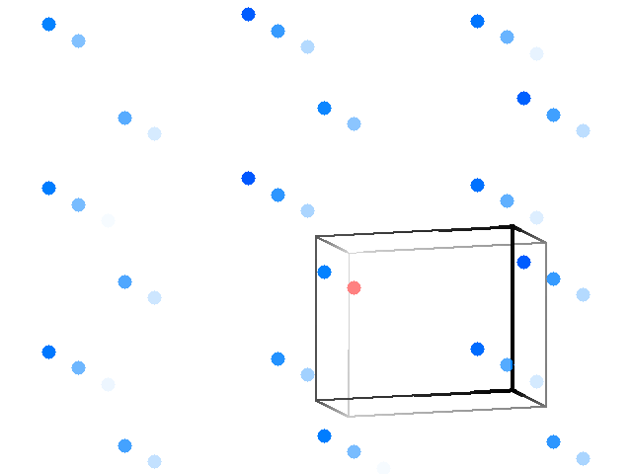
2-fold screw operator

Slide 42
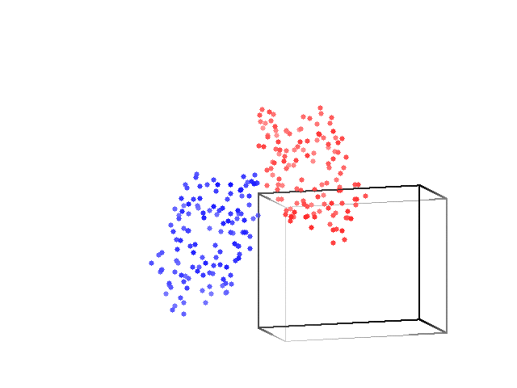
2-fold screw operator: monoclinic lysozyme

Slide 43
Only 4 kinds of rotation operators
3 4 6
2*2 2*3

Slide 44
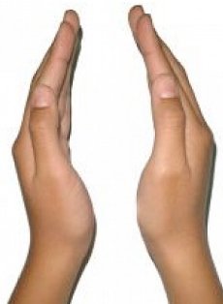
Enantiomorphic operators
3₁ 3₂
4₁ 4₃
6₁ 6₅
6₂ 6₄

Slide 45
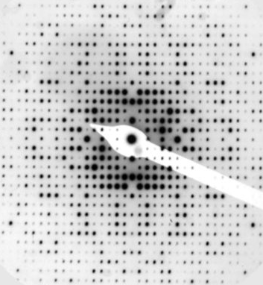
Systematic absences
How to interpret:
Every 2nd
2₁ 4₂ 6₃
Every 3rd
3₁ 3₂
Every 4th
4₁ 4₃
Every 6th
6₁ 6₅

Slide 46
Asymmetric Unit (ASU)
Unit Cell
Smallest part of the crystal
that you can use to build up the rest of the crystal
with translation symmetry only
Smallest part of the crystal
that you can use to build up the rest of the crystal
with symmetry operations
“NCS ASU”
Builds ASU with Non-crystallographic symmetry operations

Slide 47
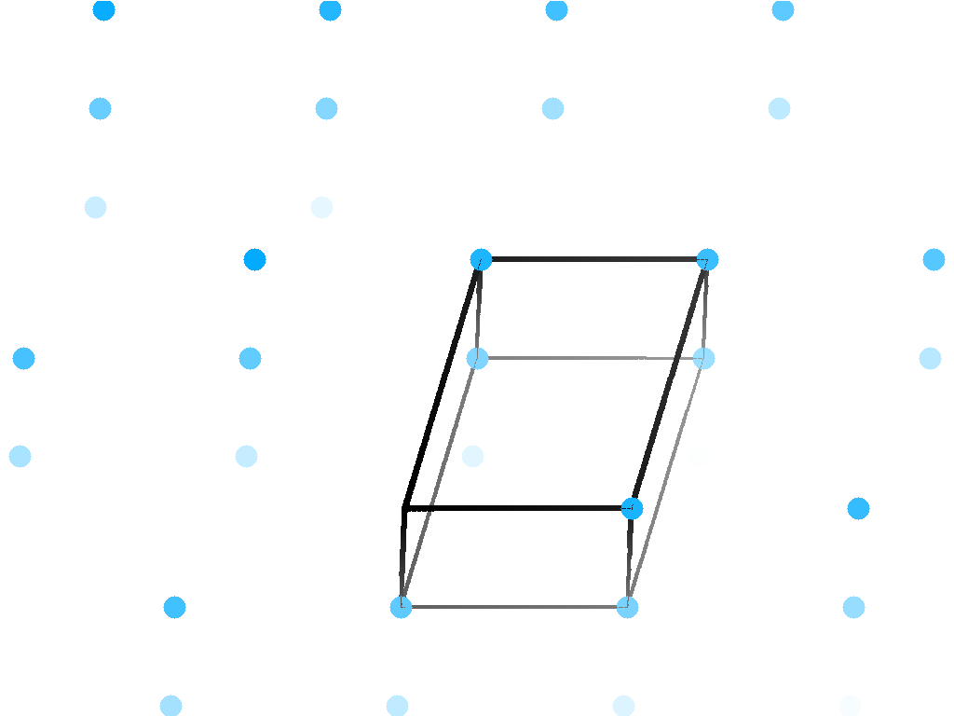
a few lysozyme crystal forms

Slide 48
What you know when:
Autoindexing: Lattice (14)
Scaling: Point Group (43)
Refinement: Space Group (84)

Slide 49
What is a “point group”?
Essentially:
A point group is a space group
without all the subscripts

Slide 50
What you know when:
Autoindexing: Lattice (14)
Scaling: Point Group (43)
Refinement: Space Group (84)

Slide 51





Only 7 lattice systems
Triclinic
Monoclinic
Orthorhombic
Tetragonal
Hexagonal
Rhombohedral
Cubic
No restrictions
2x 90° angles
All angles 90°
All 90°; square top
90° 90° 120°; a = b
angles same, a=b=c
All 90°; a = b = c

Slide 52
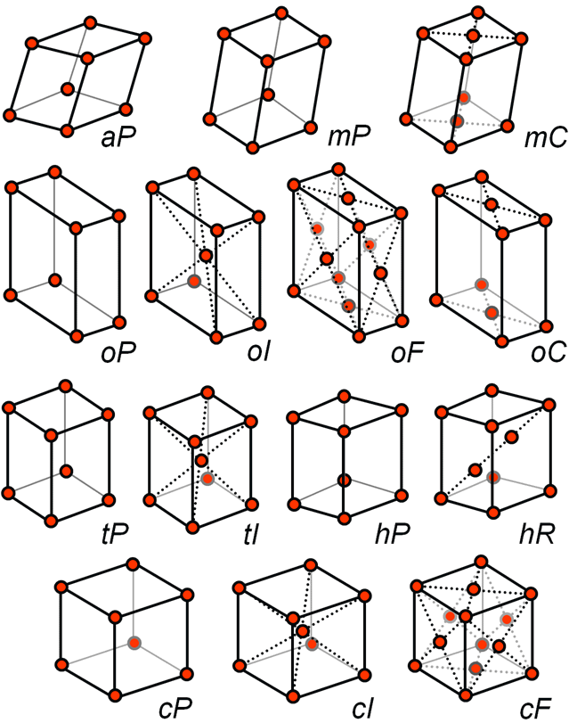
Only 14 lattice types (in 3D)
Lattice system
a asymmetric
m monoclinic
o orthorhombic
t tetragonal
h hexagonal
c cubic
Centering
P primitive (no centering)
C base (A,B not used)
I body (extra in middle)
F face (extra on each)
R rhombohedral
(two diagonal extras)
Bravais (1848)
www.ruppweb.com

Slide 53
What you know when:
Autoindexing: Lattice (14)
Scaling: Point Group (43)
Refinement: Space Group (84)

Slide 54
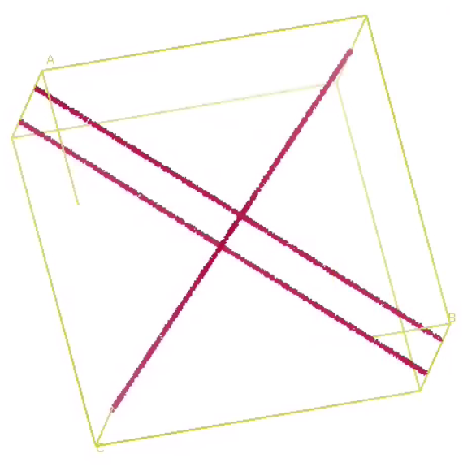
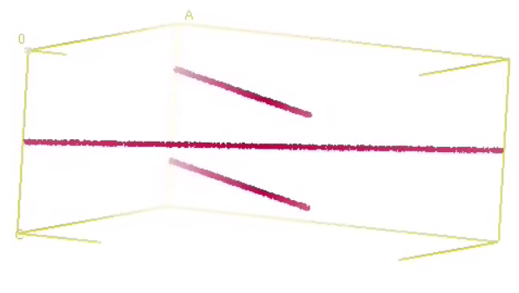
Special Positions in P4₃2₁2

Slide 55
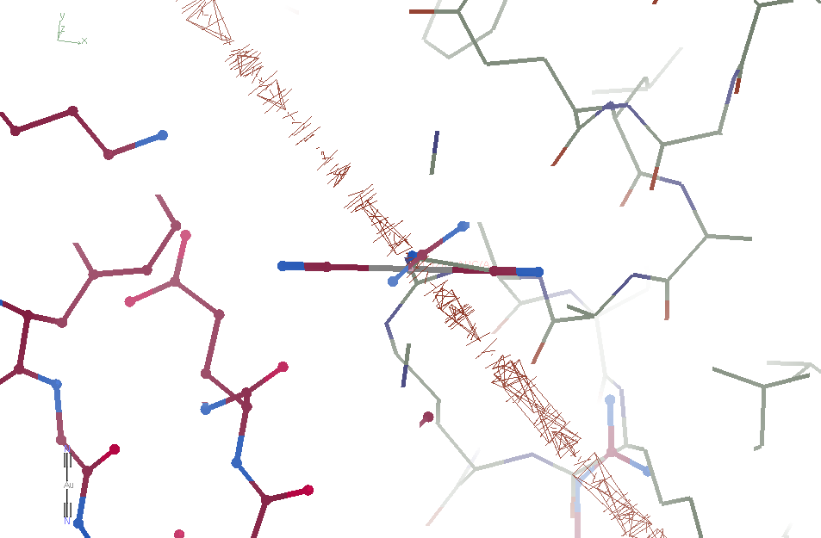
Special Positions

Slide 56
Special Position Issues
Mathematical:
clash?
Occupancy?
Hidden Patterson Peaks
Reduced signal
Increased noise

Slide 57
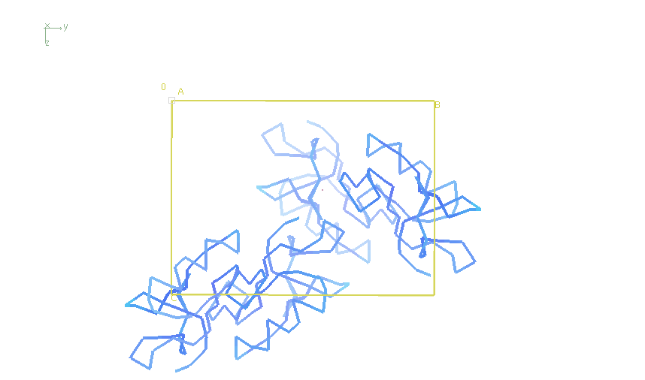
Origin shift in P2₁2₁2₁

Slide 58
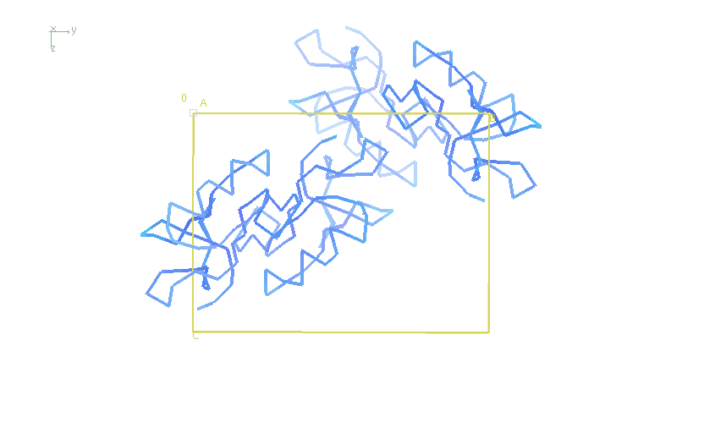
Origin shift in P2₁2₁2₁

Slide 59
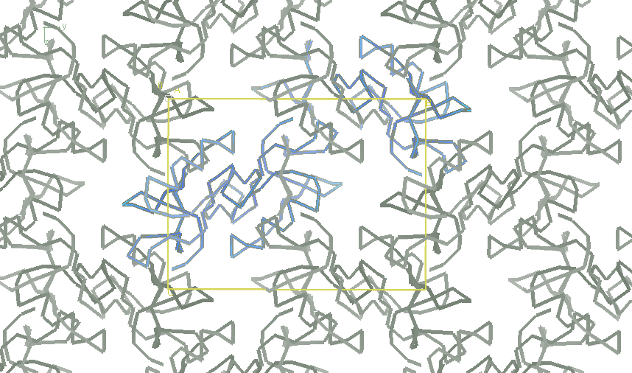
Origin shift in P2₁2₁2₁

Slide 60
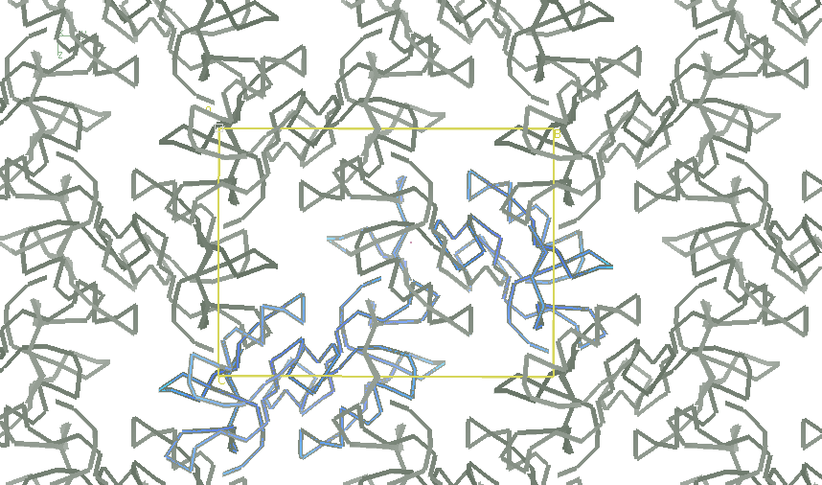
Origin shift in P2₁2₁2₁

Slide 61
Origin shift in P2₁2₁2₁

Slide 62
Allowed origin shifts
P1
x y z
P2x C2
0 y 0
0 y 1/2
1/2 y 0
1/2 y 1/2
P4x I4x
0 0 z
1/2 1/2 z
P4x22 I4x22
0 0 1/2
1/2 1/2 0
1/2 1/2 1/2
P3x
0 0 z
1/3 2/3 z
2/3 1/3 z
P6x
0 0 z
P3x12
0 0 0
0 0 1/2
1/3 2/3 0
2/3 1/3 0
1/3 2/3 1/2
2/3 1/3 1/2
P3x21 P6x22
0 0 0
0 0 1/2
R3
x=y=z
R32
0 0 0
1/2 1/2 1/2
H3
0 0 z
1/3 2/3 z
2/3 1/3 z
H32
0 0 0
0 0 1/2
1/3 2/3 2/3
2/3 1/3 1/3
1/3 2/3 1/6
2/3 1/3 5/6
P2x2x2x
I2x2x2x C222x
F4x32
0 0 0
0 0 1/2
0 1/2 0
0 1/2 1/2
-1/2 0 0
1/2 0 0
1/2 0 1/2
1/2 1/2 0
1/2 1/2 ½
P2x3 P4x32 I4x32
0 0 0
1/2 1/2 1/2
F222 F23
0 0 0
0 0 1/2
0 1/2 0
0 1/2 1/2
1/2 0 0
1/2 0 1/2
1/2 1/2 0
1/2 1/2 1/2
1/4 1/4 1/4
1/4 1/4 3/4
1/4 3/4 1/4
1/4 3/4 3/4
3/4 1/4 1/4
3/4 1/4 3/4
3/4 3/4 1/4
3/4 3/4 3/4

Slide 63
Origin shift programs
reforigin (CCP4)
needs reference model
phenix.find_alt_orig_sym_mate
align to reference after MR
pointless xyzin
re-index merged data to match pdb file
phenix.emma
for heavy atom sites
http://bl831.als.lbl.gov/~jamesh/scripts/origins.com
can use map correlation
phaser (overkill)
tries to be consistent, but not always possible

Slide 64
Pitfalls: alternate indexing
http://www.ccp4.ac.uk/html/reindexing.html
Dangerous ones:
P6_{x}
P4_{x} I4_{x}
P3_{x} R3_{x} P3_{x}XX

Slide 65
Hermann-Mauguin symbol
P 1
Primitive
No centering
And that’s all
Also tells you: Bravais lattice = aP ; point group: 1
Unit cell can be anything

Slide 66
Hermann-Mauguin symbol
P 4₃ 2₁ 2
Primitive
No centering
Yay!
2-fold
on 3rd axis
4-fold screw
on “main”
axis
2-fold screw
on 2nd axis
Also tells you: Bravais lattice = tP ; point group: 422
tetragonal system a == b and a & b are equivalent

Slide 67
Hermann-Mauguin symbol
C 1 2 1
Base centered
On face opposite
c-axis
redundant
redundant
2-fold screw
on 2nd axis
Also tells you: Bravais lattice = mC ; point group: 2
Angles α & γ = 90°, β can be anything

Slide 68
Hermann-Mauguin symbol
C2
Base centered
On face opposite
c-axis
2-fold screw
on 2nd axis
Also tells you: Bravais lattice = mC ; point group: 2
Angles α & γ = 90°, β can be anything

Slide 69
Hermann-Mauguin symbol
F23
3-fold after
2-fold means
Cubic
(3-fold diagonal)
Face centered
2-fold
Also tells you: Bravais lattice = cF ; point group: 23
All edges same legnth, all angles α β γ = 90°

Slide 70
Space Group Thought Process
Angles
for >= 2 angles
>~0.5° off from
90° 60/120°
90°
90°
90°
angles
all same
90° 90° 60/120
90°
90°
*
no
no
no
no
yes
yes
yes
yes
yes
P1
4*/2?2?2?
R*/H*
P3*/P6*
P2?/C2
Edges
a, b, c
all same
a,b,c
two same
a,b,c all
different
no
no
yes
yes
yes
cubic
3* 4* 6*
P2?/*2?2?2?

Slide 71
Pitfalls: the “screwies”
P2₁2₁2
P2₁22₁
P22₁2₁
P222₁
P22₁2
P2₁22

Slide 72
Frequency of Space Groups in PDB
13007 | P2₁2₁2₁ | 566 | R32 | 191 | P6₃22 | 74 | P4₃22 | 36 | P3₂12
9629 | P2₁ | 491 | P6₅22 | 187 | P2₁3 | 71 | P4₁22 | 30 | P622
5300 | C2 | 474 | P6₁ | 161 | P6 | 70 | P6₄ | 24 | F4₁32
3021 | P2₁2₁2 | 421 | P6₅ | 144 | P42₁2 | 70 | P6₂22 | 22 | P4₃32
2543 | C222₁ | 353 | P4₁ | 142 | I23 | 67 | P6₄22 | 22 | P422
2109 | P1 | 351 | P6₃ | 132 | F432 | 66 | F222 | 22 | P23
2030 | P4₃2₁2 | 286 | P3₁ | 124 | P321 | 63 | P6₂ | 19 | P3₁12
1565 | P3₂21 | 257 | I422 | 115 | I4₁ | 59 | P4₁32 | 18 | P4₂22
1359 | P4₁2₁2 | 253 | P4₂2₁2 | 103 | P3 | 46 | P222₁ | 18 | I4₁32
1198 | P3₁21 | 249 | I4 | 99 | I2₁3 | 43 | P4 | 16 | P432
1147 | I222 | 246 | P4₃ | 94 | C222 | 43 | I432 | 8 | P4₂32
825 | R3 | 239 | I4₁22 | 93 | P2 | 40 | P4₂ | 3 | P222
620 | P6₁22 | 193 | P3₂ | 82 | I2₁2₁2₁ | 37 | F23 | 2 | P312

Slide 73
Pitfalls: sub-space groups
P622
What else?
P6₁22 P6₅22 P6₂22 P6₄22 P6₃22
P6 P6₁ P6₅ P6₂ P6₄ P6₃
P3₁2 P321 P3₁12 P3₁21 P3₂12 P3₂21
P3 P3₁ P3₂
P2 P2₁ C2 C222 C222₁
P1

Slide 74
Trick Question: What is the space group?
a = 63 b = 63 c = 63
α = 90 β = 90 γ = 90

Slide 75
What is your Space Group?
Don’t need to know! (unless problem)
What is a crystal?
What is a lattice?
What is a unit cell?
What is a symmetry operator?
What is an asymmetric unit?
Pitfalls: the “screwies”, C vs P3, alternate index
Do not run phaser (unless you have to)

Slide 76
“B” factors
ATOM 122 N LEU A 13 -3.244 25.808 19.998 1.00 16.96 N
ATOM 123 CA LEU A 13 -2.877 25.448 21.355 1.00 15.29 C
ATOM 124 C LEU A 13 -2.792 23.966 21.561 1.00 17.54 C
ATOM 125 O LEU A 13 -1.814 23.493 22.143 1.00 16.35 O
ATOM 126 CB LEU A 13 -3.907 26.164 22.268 1.00 18.72 C
ATOM 127 CG LEU A 13 -3.577 25.982 23.738 1.00 21.19 C
ATOM 128 CD1 LEU A 13 -2.283 26.820 24.019 1.00 19.43 C
ATOM 129 CD2 LEU A 13 -4.702 26.474 24.639 1.00 24.65 C
ATOM 130 N SER A 14 -3.677 23.149 20.979 1.00 15.96 N
ATOM 131 CA SER A 14 -3.646 21.711 21.061 1.00 18.26 C
ATOM 132 C SER A 14 -2.373 21.203 20.360 1.00 18.71 C
ATOM 133 O SER A 14 -1.747 20.315 20.930 1.00 17.47 O
ATOM 134 CB SER A 14 -4.875 21.077 20.419 1.00 17.62 C
ATOM 135 OG ASER A 14 -4.825 19.665 20.388 0.50 20.89 O
ATOM 136 OG BSER A 14 -6.027 21.408 21.164 0.50 18.67 O
ATOM 137 N LYS A 15 -2.045 21.772 19.215 1.00 18.03 N
ATOM 138 CA LYS A 15 -0.799 21.361 18.555 1.00 18.12 C
ATOM 139 C LYS A 15 0.446 21.707 19.351 1.00 18.81 C
ATOM 140 O LYS A 15 1.400 20.948 19.411 1.00 17.77 O
ATOM 141 CB LYS A 15 -0.700 22.034 17.177 1.00 14.49 C
ATOM 142 CG LYS A 15 -1.727 21.368 16.256 1.00 16.12 C
ATOM 143 CD LYS A 15 -1.663 22.147 14.936 1.00 19.40 C
ATOM 144 CE ALYS A 15 -2.725 21.614 13.986 0.50 17.42 C
ATOM 145 CE BLYS A 15 -1.750 21.211 13.750 0.50 17.01 C
ATOM 146 NZ ALYS A 15 -2.346 21.674 12.559 0.50 18.61 N
ATOM 147 NZ BLYS A 15 -3.052 20.513 13.741 0.50 18.76 N

Slide 77
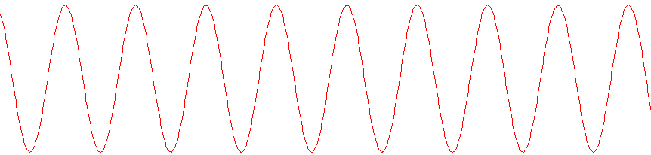
strong reflection

Slide 78
weak reflection

Slide 79
What is a "B factor"?

Slide 80
What is a "B factor"?

Slide 81
What is a "B factor"?

Slide 82
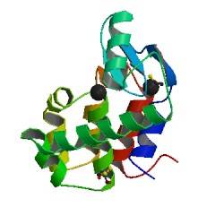
What is a "B factor"?
order
order
B-factor
disorder

Slide 83
“B” factors
electron density (e⁻/Å³)
position (Å)

Slide 84
“B” factors
electron density (e⁻/Å³)
position (Å)

Slide 85
“B” factors
electron density (e⁻/Å³)
position (Å)

Slide 86
“B” factors
electron density (e⁻/Å³)
position (Å)

Slide 87
“B” factors
electron density (e⁻/Å³)
position (Å)

Slide 88
“B” factors
electron density (e⁻/Å³)
position (Å)

Slide 89
“B” factors
electron density (e⁻/Å³)
position (Å)

Slide 90
“B” factors
electron density (e⁻/Å³)
position (Å)

Slide 91
A Fourier view of scattering
density (ρ)
intensity
distance (Å)
angle (°)

Slide 92
A Fourier view of scattering
density (ρ)
intensity
distance (Å)
angle (°)

Slide 93
A Fourier view of scattering
density (ρ)
intensity
distance (Å)
angle (°)

Slide 94
A Fourier view of scattering
density (ρ)
intensity
distance (Å)
angle (°)

Slide 95
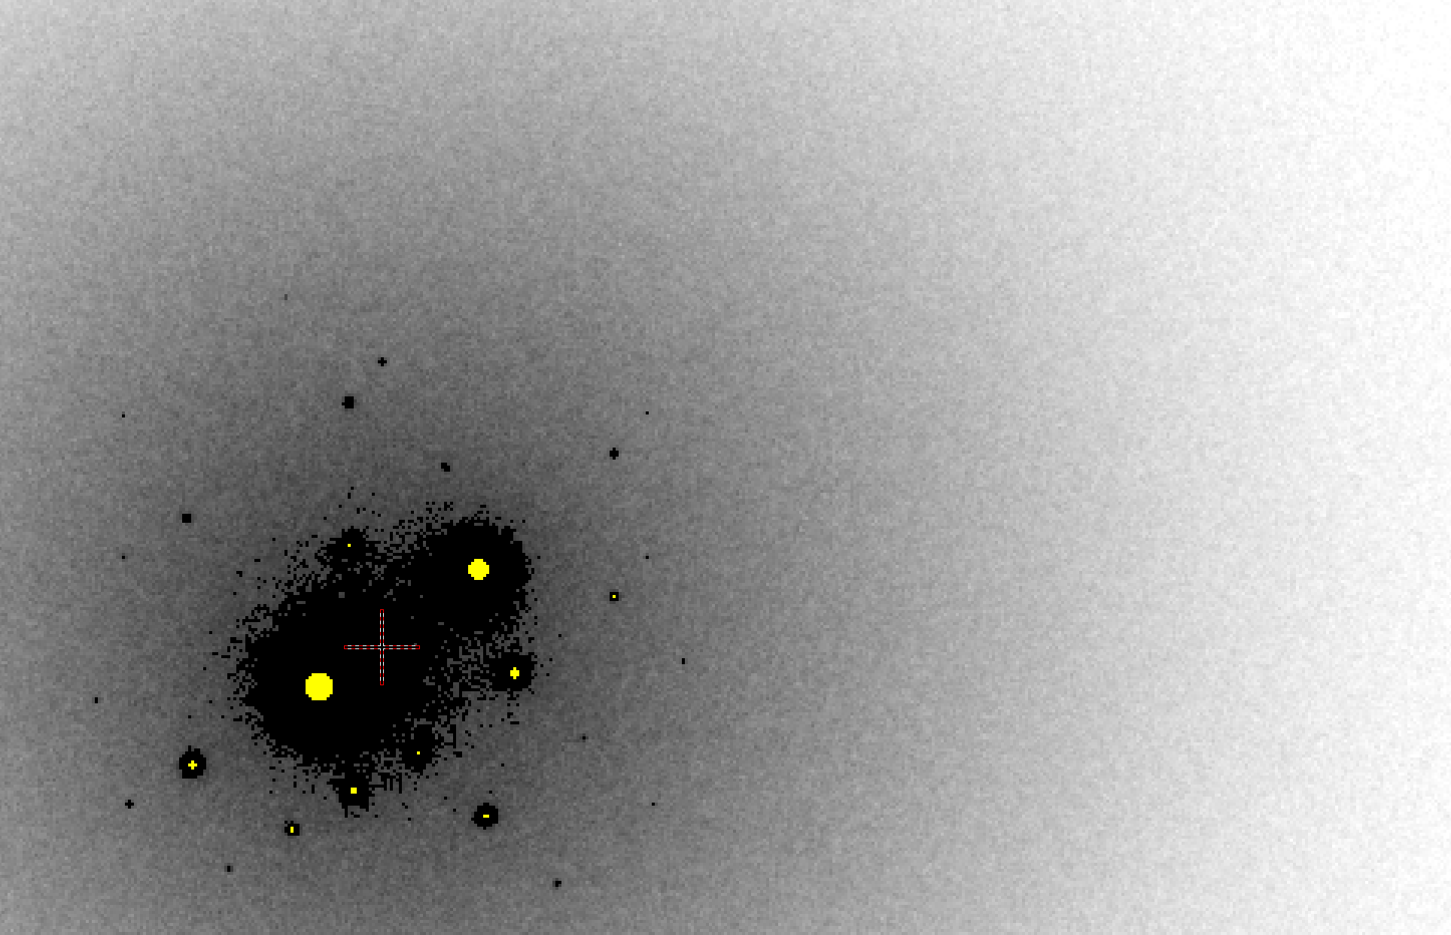
B factor from image analysis
B = 500

Slide 96
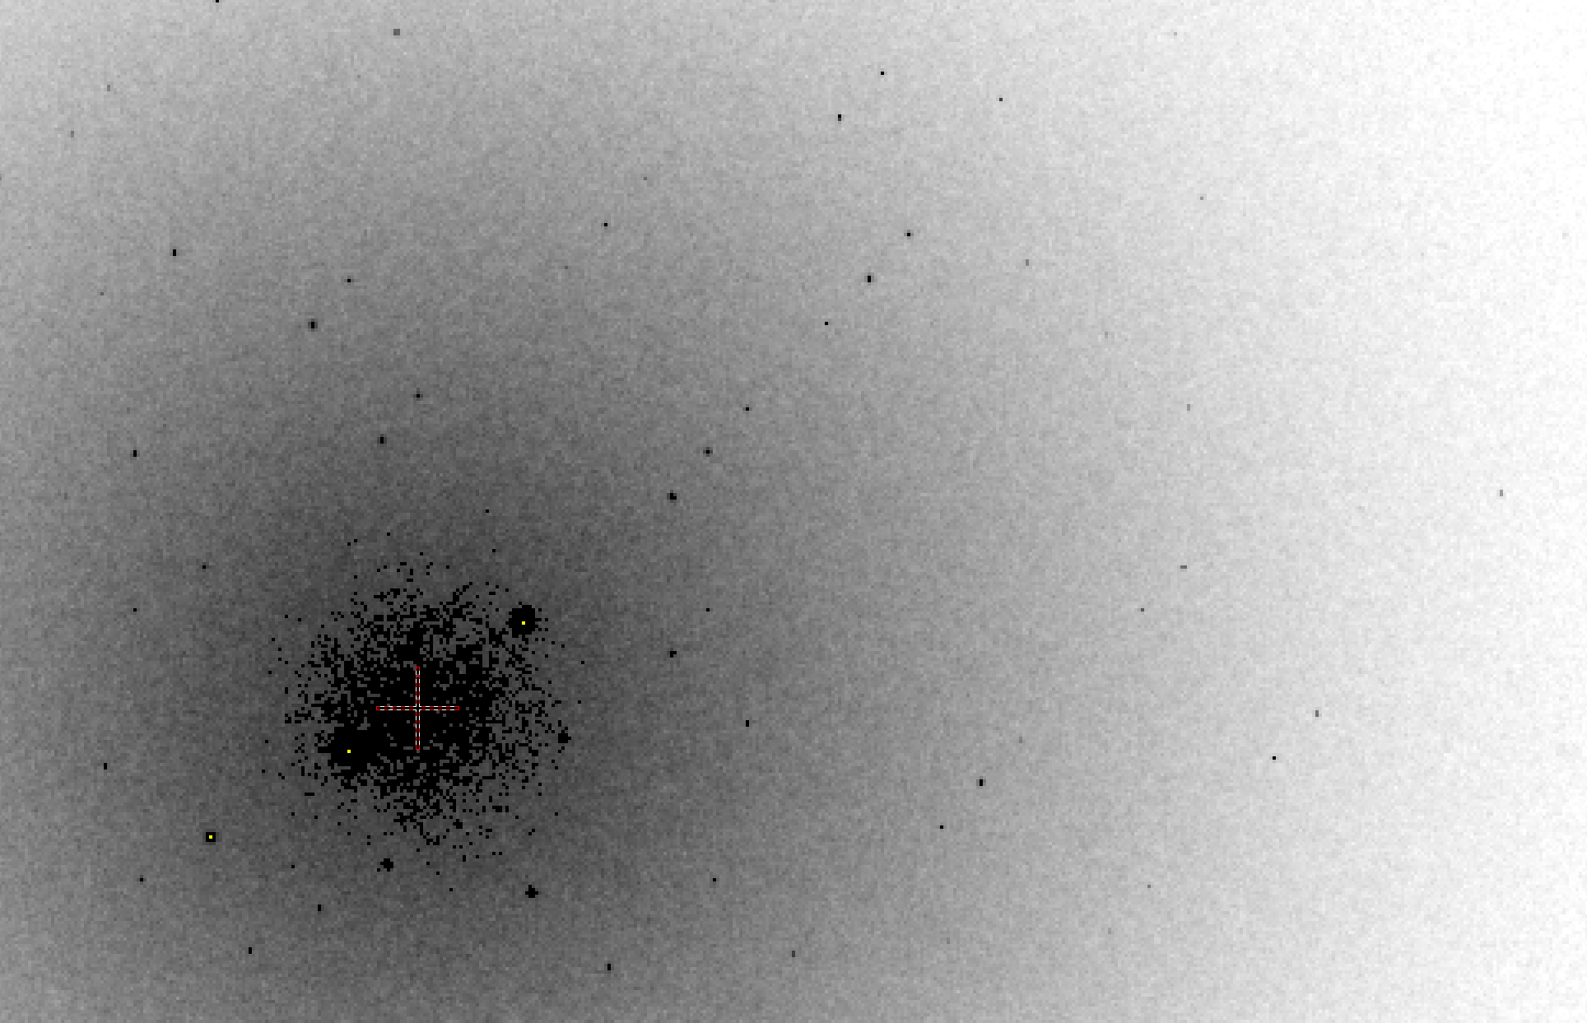
B factor from image analysis
B = 20

Slide 97
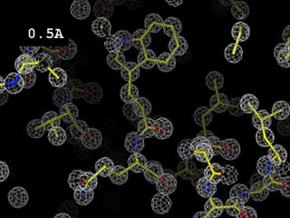
Resolution
http://bl831.als.lbl.gov/~jamesh/movies/resolution.mpeg

Slide 98
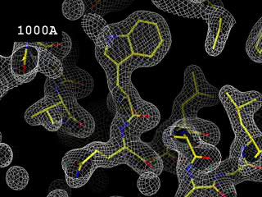
Resolution: low-angle cutoff
http://bl831.als.lbl.gov/~jamesh/movies/lo_cut.mpeg

Slide 99

R-factor
http://bl831.als.lbl.gov/~jamesh/movies/rfactor.mpeg

Slide 100

Figure of Merit
http://bl831.als.lbl.gov/~jamesh/movies/dephase.mpeg

Slide 101

Overloads
http://bl831.als.lbl.gov/~jamesh/movies/overloads.mpeg

Slide 102

Completeness: missing wedge
http://bl831.als.lbl.gov/~jamesh/movies/osc.mpeg

Slide 103

Completeness: random deletion
http://bl831.als.lbl.gov/~jamesh/movies/completeness.mpeg

Slide 104
“R” factors
R = % error

Slide 105
“R” factors
completely random: 0.59
starting MR solution: 0.4-0.55
something still wrong?: > 0.3
correct chain trace: < 0.2
small molecule: ~ 0.05

Slide 106
“R” factors
R_{cryst} (or just “R”)
observed vs calculated data (Fs)
R_{free}
cross-check with “random” subset of data
should be < 0.3 and < R_{cryst} + 0.1

Slide 107
“R” factors
R_{cryst} (or just “R”)
observed vs calculated data (Fs)
R_{free}
cross-check with “random” subset of data
should be < 0.3 and < R_{cryst} + 0.1
R_{sym} = R_{merge} (self-consistency of data: Is)

Slide 108
R_{merge}
blows up
as I_{obs} → 0
completely random: 0.59
weak data (high angle): 0.7- ∞
wrong symmetry choice?: ~0.2-0.55
small or disordered crystal: ~0.1-0.2
typical: ~ 0.05

Slide 109
“R” factors
R_{cryst} (or just “R”)
observed vs calculated data (Fs)
R_{free}
cross-check with “random” subset of data
should be < 0.3 and < R_{cryst} + 0.1
R_{sym} = R_{merge} (self-consistency of data: Is)
R_{rim} R_{pim} R_{meas}
R_{iso} R_{anom}
R_{diff}
R_{sym} is “unfair” to high multiplicity

Slide 110
Is the structure any good?
Molecular replacement:
R/R_{free} (compare with R_{merge})
MAD/SAD/MIR
R and FOM
All cases
does the map look like the model?!

Slide 111

Twinning?!?
Evil
and pseudo symmetry

Slide 112
Definitions:
Twinning:
Two (or more) crystals of the same species joined together with different orientations
Twin law:
Symmetry operator that rotates one crystal lattice onto the other (common: k,h,-l)
Twin fraction ( α ):
Mixing ratio: Iobs_{hkl} = α I_{hkl} + (1-α) I_{kh-l}
Thanks to: Andrea Thorn

Slide 113
Types of twinning
Merohedral
Twin law is symmetry operator for lattice,
but not the true point group
Pseudo-merohedral
Twin law not symmetry operator for lattice
Non-merohedral
Lattices don’t perfectly overlap
4. Epitaxial
Crystals randomly stuck together
Thanks to: Andrea Thorn

Slide 114


Slide 115


Slide 116



Can you tell by looking?
Macroscopic twin
Microscopic twin
Disecting apart might give a single crystal!
Crystal looks fine, but is twinned.
Images property of Andrea Thorn
and Claudia Egerer-Sieber

Slide 117

Twinning: how can you tell?

Slide 118
Make a histogram of your data
Counts/bin
Spot intensity

Slide 119
Make a histogram of your data
Counts/bin
Spot intensity

Slide 120
Twinning: how can you tell?
Intensity distribution is abnormal
H test, L test
R_{merge} for higher symmetry
< 50% → might be twin
< 10% → could be 50:50 twin
one of the “usual suspects”
P622, P6, P321, P312, P422, P43
http://www.ccp4.ac.uk/html/twinning.html
4. can’t solve it

Slide 121
Find the twin law?
refine in REFMAC
Automatically checks all possible twin laws!
copy twin law into other programs:
phenix.refine, etc.
Pick R_{free} flags in highest symmetry
i.e. P622 if true SG is P3
Do not “twin refine” if not twinned
control: swap non-twin operator

Slide 122
Twinning: what do I do?
Integrate with low-symmetry SG
Yes, all possible ones
try to solve it
Yes, in all possible SGs
MR: good chance if copies = 1
MAD: maybe
S-SAD: no way
MIR: if you’re lucky
Thanks to: Andrea Thorn

