Slide 1
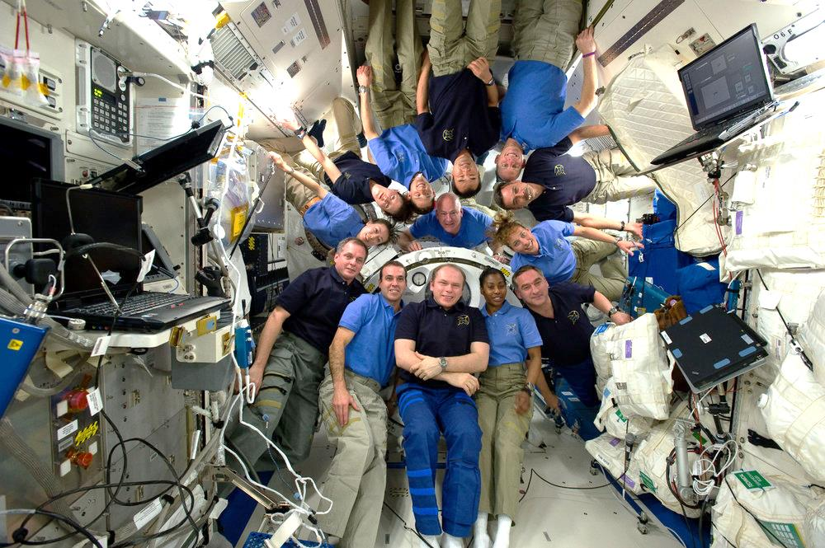
What is your Space Group?
the first question asked and the last to be answered

Slide 2
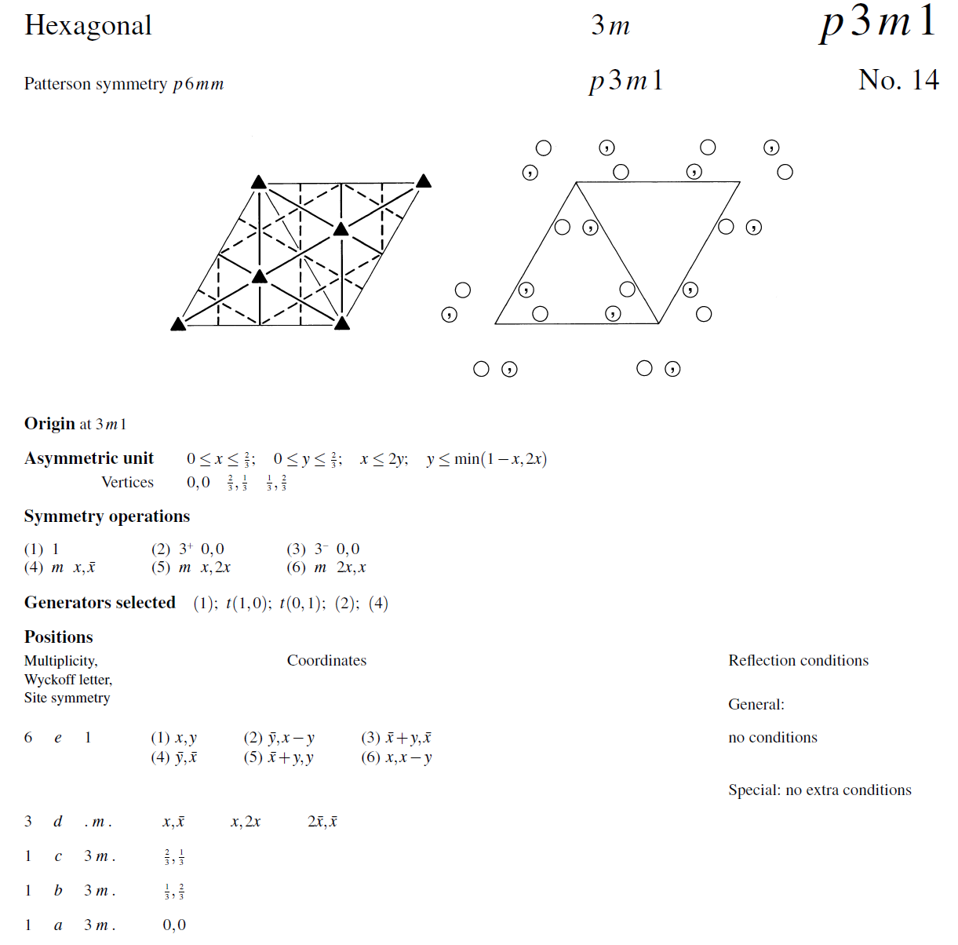
International Tables, Vol A

Slide 3
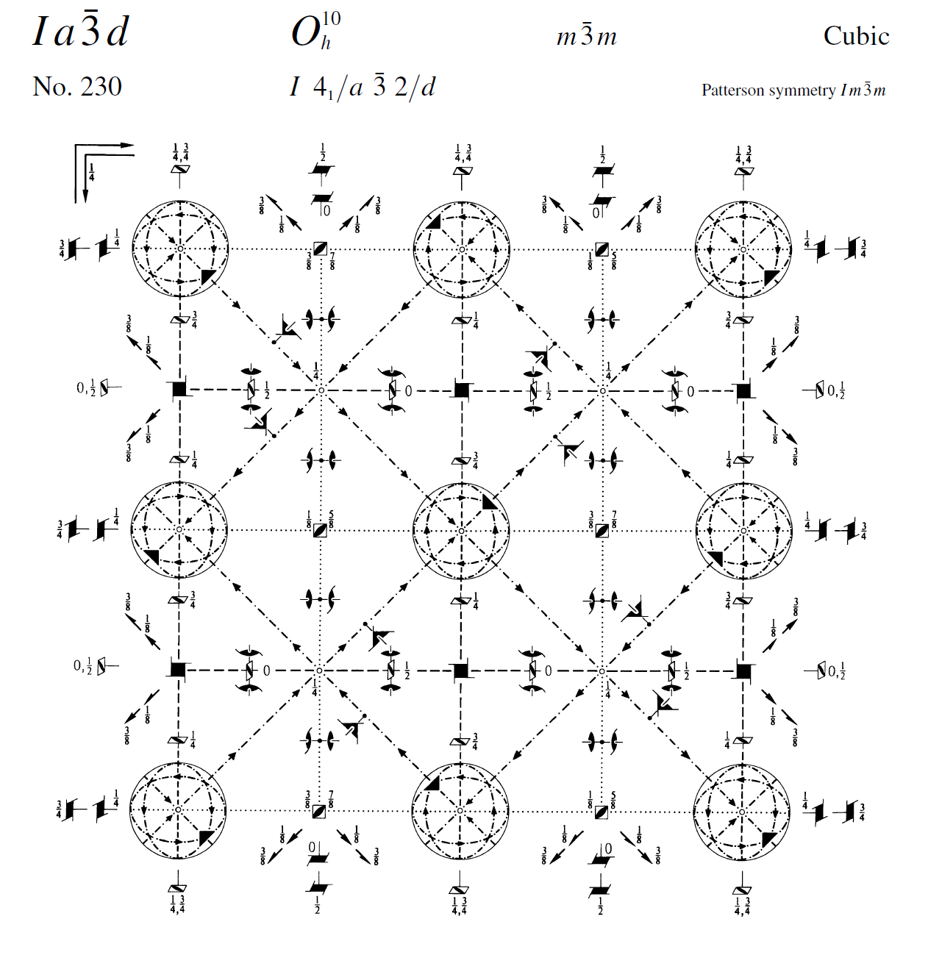
International Tables, Vol A

Slide 4
What is your Space Group?
What is a crystal?
What is a lattice?
What is a unit cell?
What is a symmetry operator?
What is an asymmetric unit?
Pitfalls: the “screwies”, C vs P3, alternate index
How will I know?

Slide 5
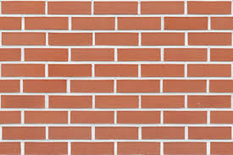
Unit cell?

Slide 6
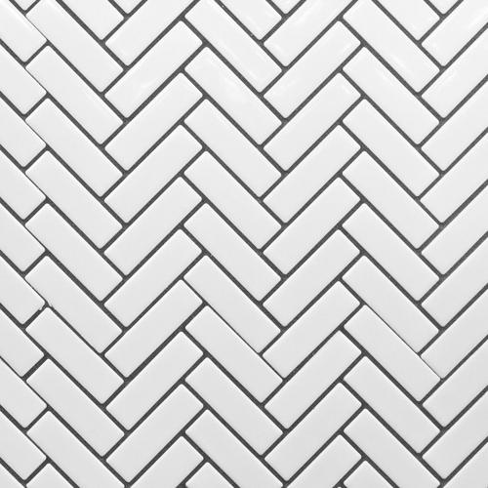
Where’s the unit cell?

Slide 7
Where’s the unit cell?

Slide 8
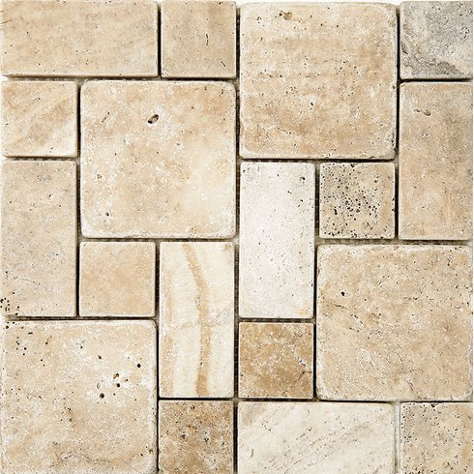
Where’s the unit cell?

Slide 9
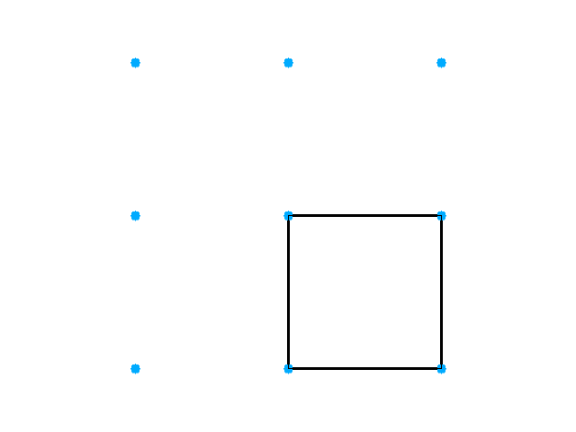
Primitive, cubic lattice

Slide 10
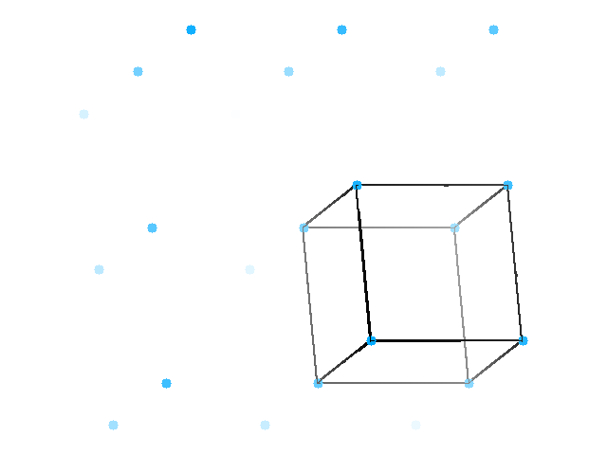
Primitive, cubic lattice

Slide 11
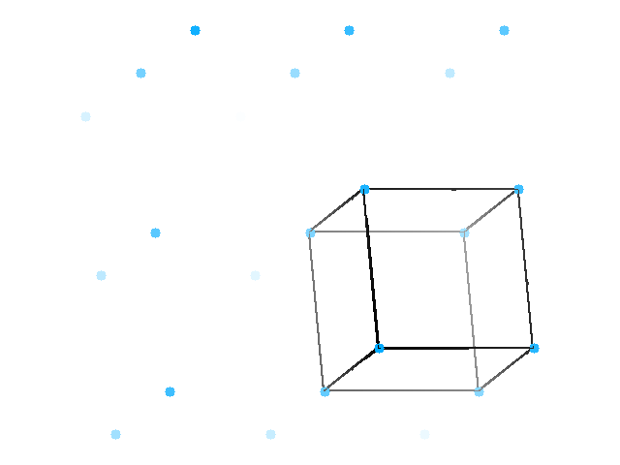
Primitive, cubic lattice

Slide 12
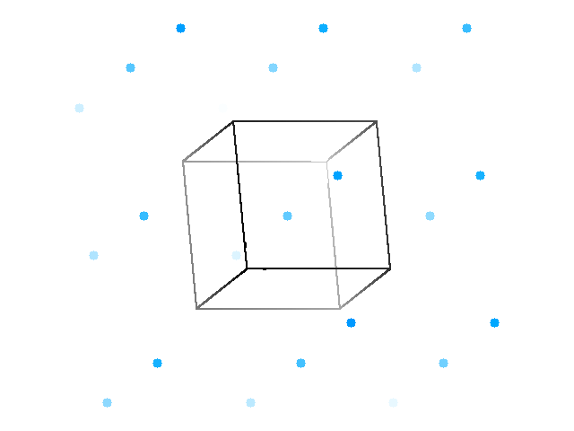
Primitive, cubic lattice, half-way unit cell

Slide 13
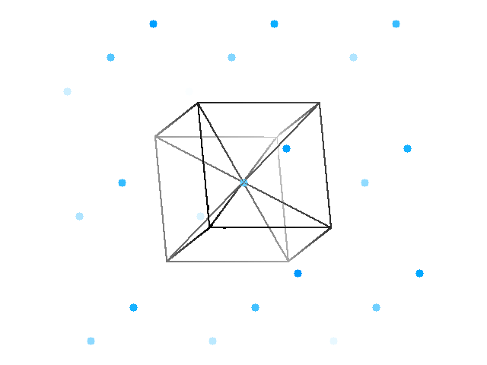
Body-centered cell

Slide 14
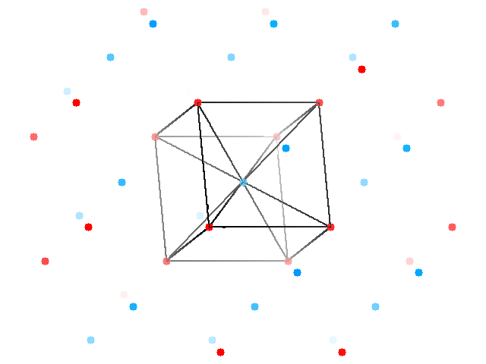
Two staggered lattices

Slide 15
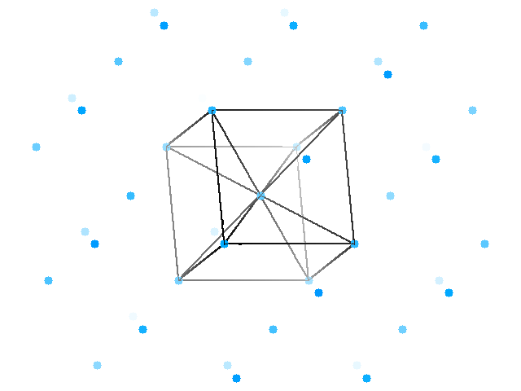
Body-centered lattice

Slide 16
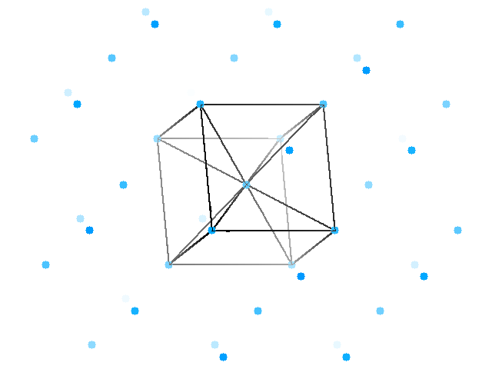
Body-centered lattice

Slide 17
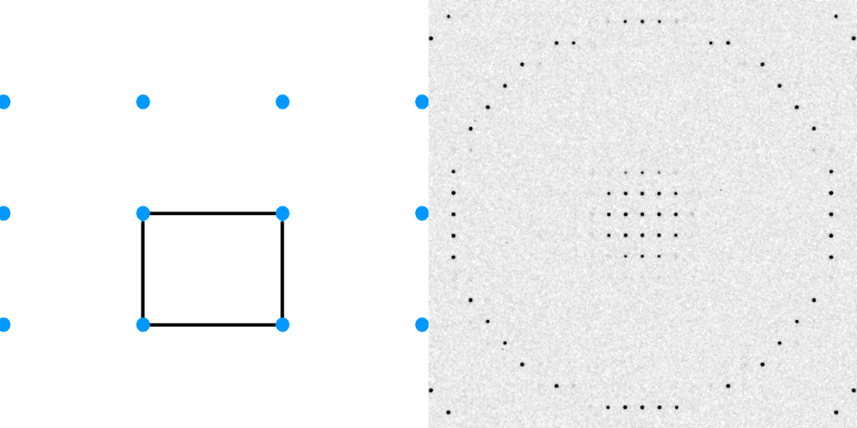
Diffraction from a 3D lattice
+
real space
reciprocal space

Slide 18
Diffraction from a 3D lattice
+
real space
reciprocal space

Slide 19
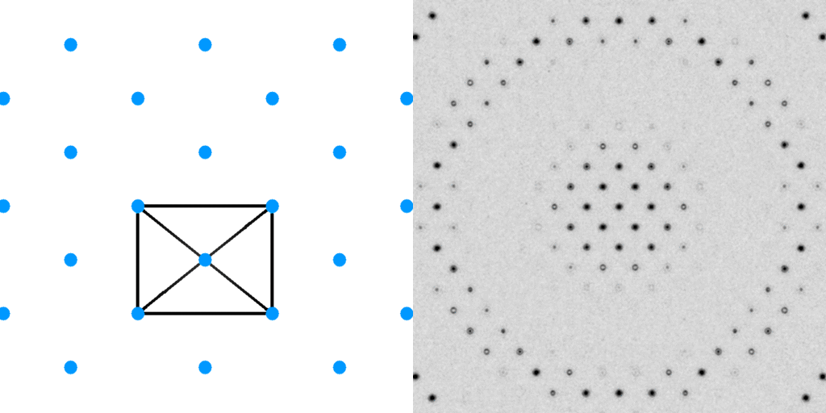
Diffraction from a 3D lattice
+
+
real space
reciprocal space

Slide 20
Diffraction from a 3D lattice
+
+
real space
reciprocal space

Slide 21
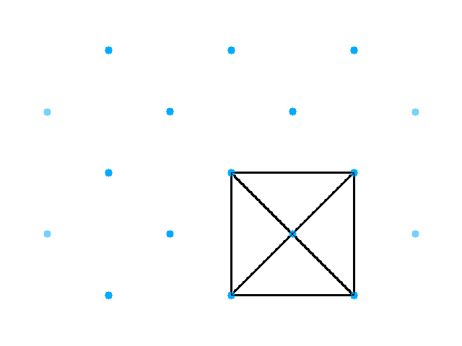
Base-centered lattice

Slide 22
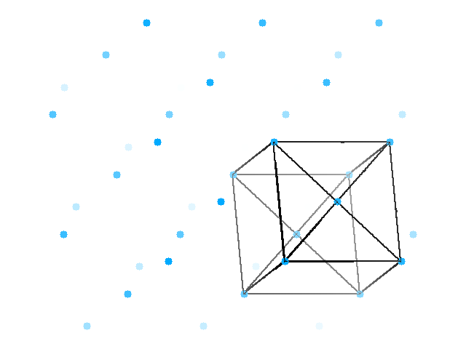
Base-centered lattice

Slide 23
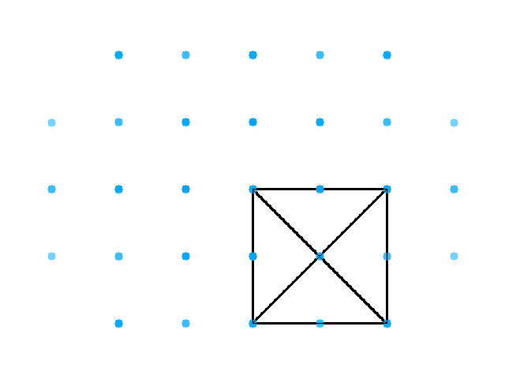
Face-centered lattice

Slide 24
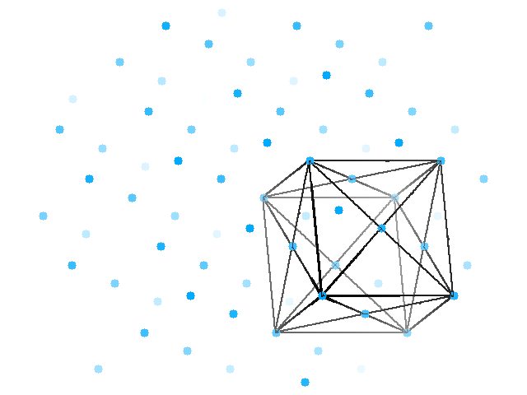
Face-centered lattice

Slide 25
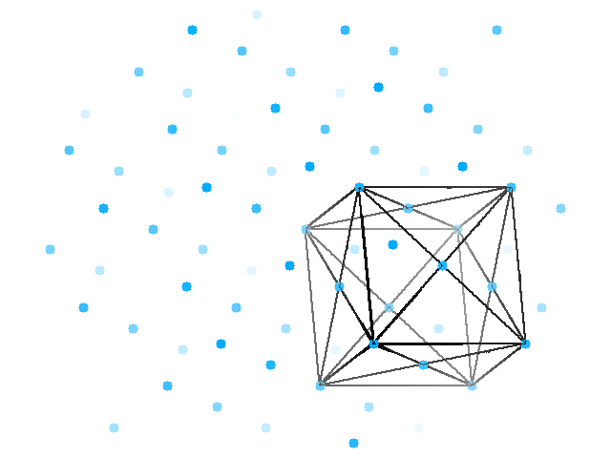
Face-centered lattice

Slide 26
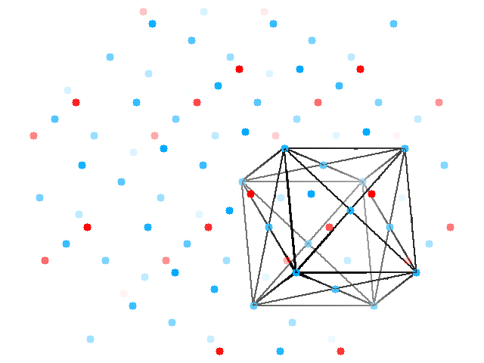
Face-centered lattice
Body-centered lattice

Slide 27
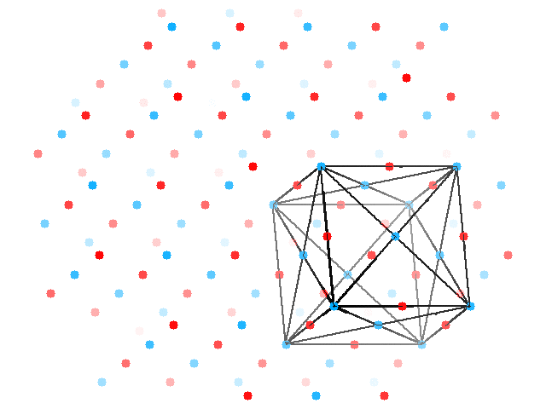
Face-centered lattice
All half-way points

Slide 28
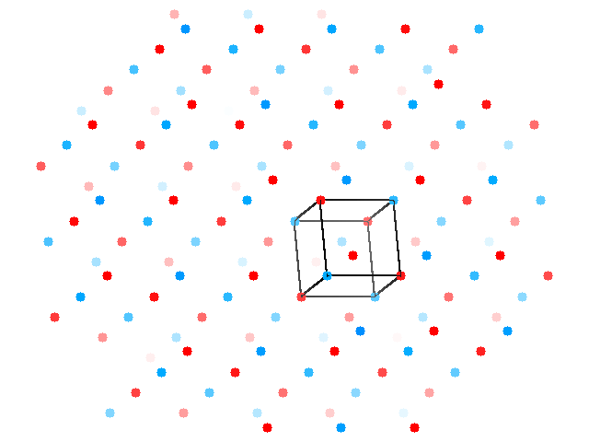
Face-centered lattice
All half-way points

Slide 29
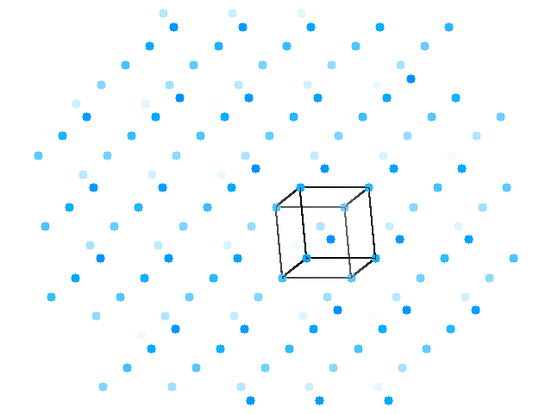
cubic lattice

Slide 30
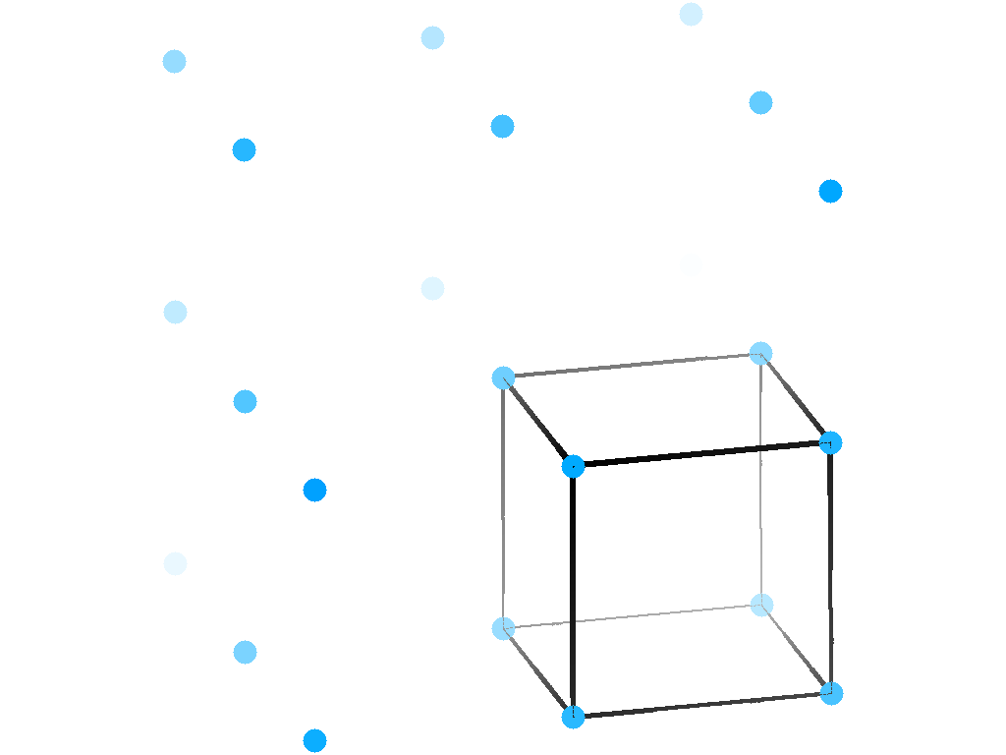
rhombohedral lattice

Slide 31
rhombohedral lattice

Slide 32
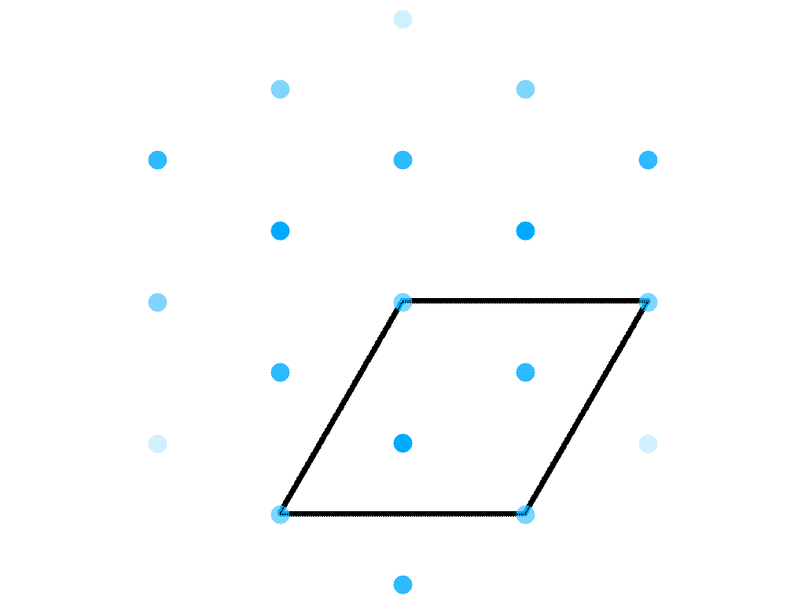
Hexagonal version of rhombohedral lattice

Slide 33
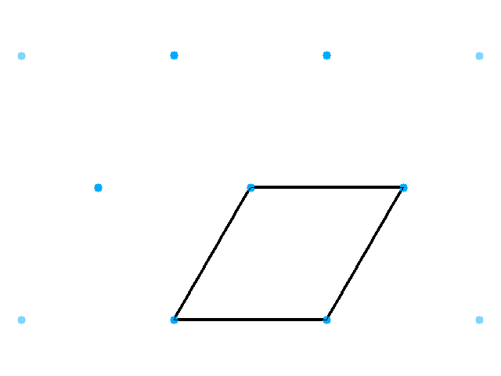
Hexagonal/triclinic lattice

Slide 34
Hexagonal lattice

Slide 35
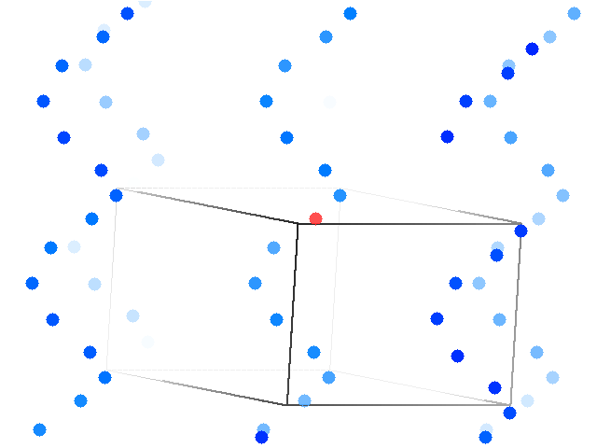
6-fold screw operator (hexagonal)

Slide 36
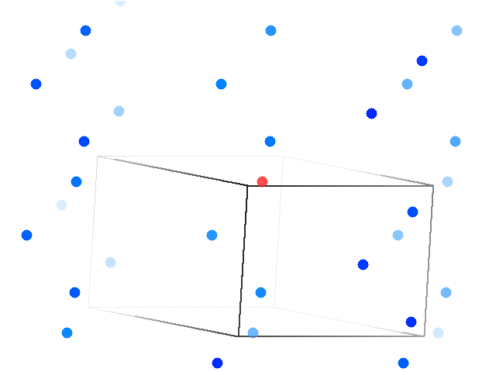
3-fold screw operator (trigonal)

Slide 37
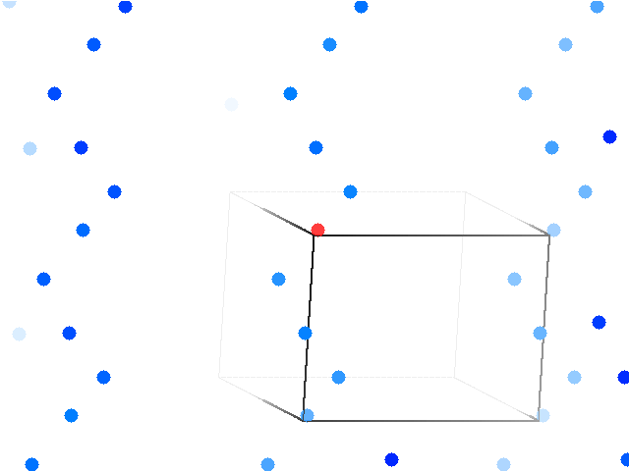
4-fold screw operator (tetragonal)

Slide 38
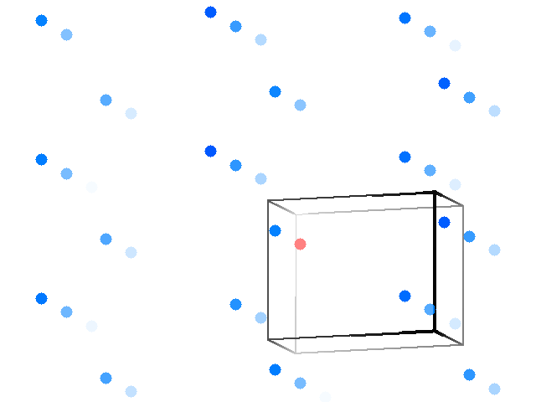
2-fold screw operator

Slide 39
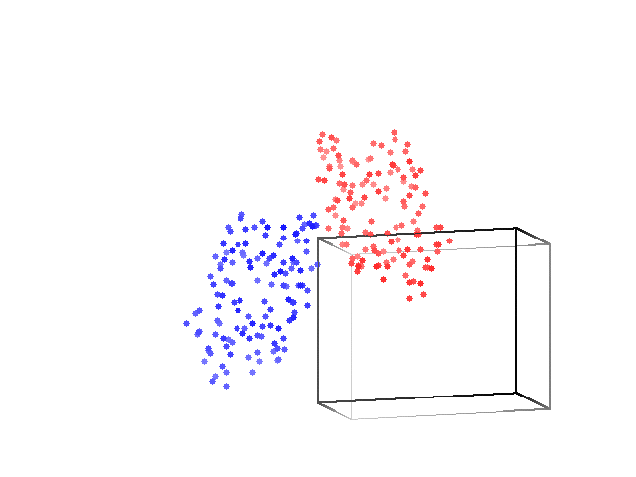
2-fold screw operator: monoclinic lysozyme

Slide 40
Only 4 kinds of rotation operators
3 4 6
2*2 2*3

Slide 41
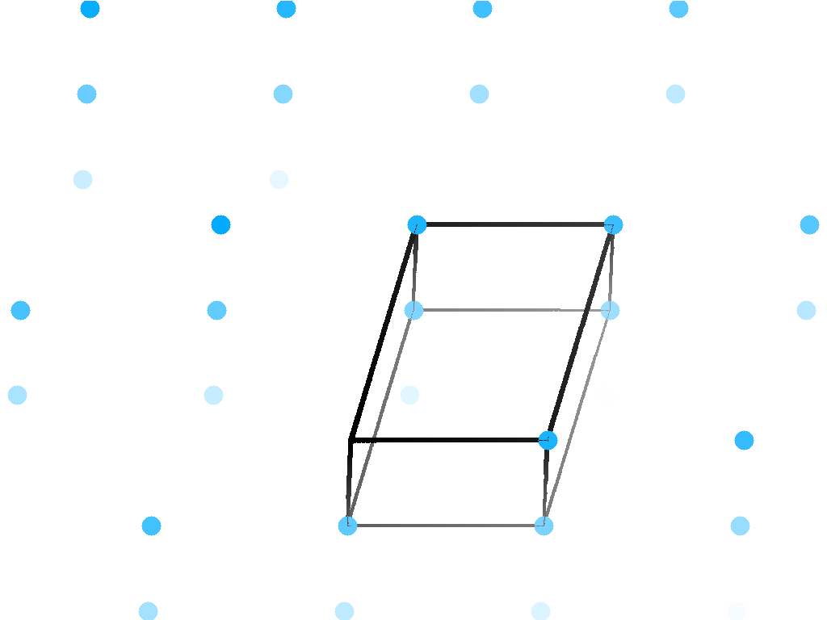
a few lysozyme crystal forms

Slide 42
Only 5 kinds of centering
None Primitive
ABC Base
I Body
F Face
R Rhombo
No restrictions
at least two 90° angles
All angles 90°
All angles 90°
Also fits:

Slide 43
Only 7 lattice systems
Triclinic
Monoclinic
Orthorhombic
Tetragonal
Hexagonal
Rhombohedral
Cubic
No restrictions
2x 90° angles
All angles 90°
All 90°; square top
90° 90° 120°; a = b
angles same, a=b=c
All 90°; a = b = c

Slide 44
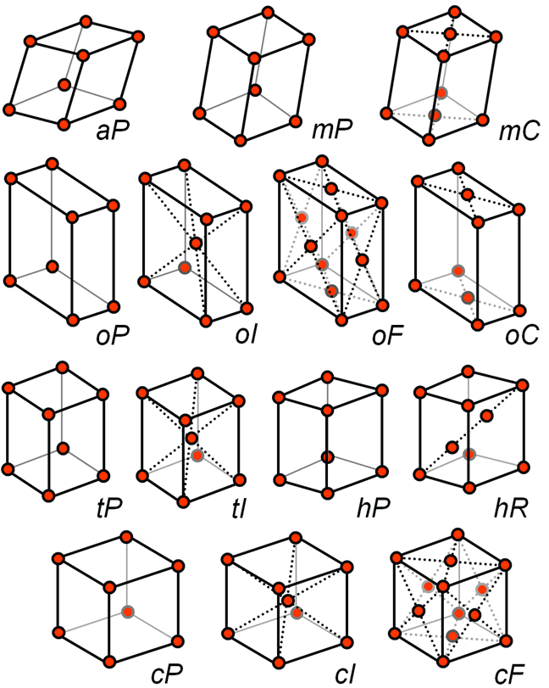
Only 14 lattice types in 3D
Lattice system
a asymmetric
m monoclinic
o orthorhombic
t tetragonal
h hexagonal
c cubic
Centering
P primitive (no centering)
C base (A,B not used)
I body (extra in middle)
F face (extra on each)
R rhombohedral
(two diagonal extras)
Bravais (1848)
www.ruppweb.com

Slide 45
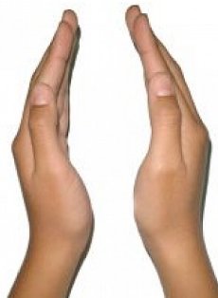
Enantiomorphic operators
3₁ 3₂
4₁ 4₃
6₁ 6₅
6₂ 6₄

Slide 46
Systematic absences
How to interpret:
Every 2nd
2₁ 4₂ 6₃
Every 3rd
3₁ 3₂
Every 4th
4₁ 4₃
Every 6th
6₁ 6₅

Slide 47
What you know when:
Autoindexing: Lattice (14)
Scaling: Point Group (43)
Refinement: Space Group (84)

Slide 48
Hermann-Mauguin symbol
P 1
Primitive
No centering
And that’s all
Also tells you: Bravais lattice = aP ; point group: 1
Unit cell can be anything

Slide 49
Hermann-Mauguin symbol
P 4₃ 2₁ 2
Primitive
No centering
Yay!
2-fold
on 3rd axis
4-fold screw
on “main”
axis
2-fold screw
on 2nd axis
Also tells you: Bravais lattice = tP ; point group: 422
tetragonal system a == b and a & b are equivalent

Slide 50
Hermann-Mauguin symbol
C 1 2 1
Base centered
On face opposite
c-axis
redundant
redundant
2-fold screw
on 2nd axis
Also tells you: Bravais lattice = mC ; point group: 2
Angles α & γ = 90°, β can be anything

Slide 51
Hermann-Mauguin symbol
C2
Base centered
On face opposite
c-axis
2-fold screw
on 2nd axis
Also tells you: Bravais lattice = mC ; point group: 2
Angles α & γ = 90°, β can be anything

Slide 52
Hermann-Mauguin symbol
F23
3-fold after
2-fold means
Cubic
(3-fold diagonal)
Face centered
2-fold
Also tells you: Bravais lattice = cF ; point group: 23
All edges same legnth, all angles α β γ = 90°

Slide 53
What is a “point group”?
Essentially:
A point group is a space group
without all the subscripts

Slide 54
Pitfalls: the “screwies”
P2₁2₁2
P2₁22₁
P22₁2₁
P222₁
P22₁2
P2₁22

Slide 55
Pitfalls: sub-space groups
P622
What else?
P6₁22 P6₅22 P6₂22 P6₄22 P6₃22
P6 P6₁ P6₅ P6₂ P6₄ P6₃
P3₁2 P321 P3₁12 P3₁21 P3₂12 P3₂21
P3 P3₁ P3₂
P2 P2₁ C2 C222 C222₁
P1

Slide 56
Pitfalls: alternate indexing
http://www.ccp4.ac.uk/html/reindexing.html
Dangerous ones:
P6_{x}
P4_{x} I4_{x}
P3_{x} R3_{x} P3_{x}XX

Slide 57
Asymmetric Unit (ASU)
Unit Cell
Smallest part of the crystal
that you can use to build up the rest of the crystal
with translation symmetry only
Smallest part of the crystal
that you can use to build up the rest of the crystal
with symmetry operations
“NCS ASU”
Builds ASU with Non-crystallographic symmetry operations

Slide 58
Frequency of Space Groups in PDB
13007 | P2₁2₁2₁ | 566 | R32 | 191 | P6₃22 | 74 | P4₃22 | 36 | P3₂12
9629 | P2₁ | 491 | P6₅22 | 187 | P2₁3 | 71 | P4₁22 | 30 | P622
5300 | C2 | 474 | P6₁ | 161 | P6 | 70 | P6₄ | 24 | F4₁32
3021 | P2₁2₁2 | 421 | P6₅ | 144 | P42₁2 | 70 | P6₂22 | 22 | P4₃32
2543 | C222₁ | 353 | P4₁ | 142 | I23 | 67 | P6₄22 | 22 | P422
2109 | P1 | 351 | P6₃ | 132 | F432 | 66 | F222 | 22 | P23
2030 | P4₃2₁2 | 286 | P3₁ | 124 | P321 | 63 | P6₂ | 19 | P3₁12
1565 | P3₂21 | 257 | I422 | 115 | I4₁ | 59 | P4₁32 | 18 | P4₂22
1359 | P4₁2₁2 | 253 | P4₂2₁2 | 103 | P3 | 46 | P222₁ | 18 | I4₁32
1198 | P3₁21 | 249 | I4 | 99 | I2₁3 | 43 | P4 | 16 | P432
1147 | I222 | 246 | P4₃ | 94 | C222 | 43 | I432 | 8 | P4₂32
825 | R3 | 239 | I4₁22 | 93 | P2 | 40 | P4₂ | 3 | P222
620 | P6₁22 | 193 | P3₂ | 82 | I2₁2₁2₁ | 37 | F23 | 2 | P312

