Slide 1
Acknowledgements
http://bl831.als.lbl.gov/~jamesh/powerpoint/CSHL_recipspace_2025.pptx
Robert Stroud James Fraser
Paul Adams Greg Hura
Aina Cohen Keith Hodgson
UCSF LBNL SLAC
ALS 8.3.1: TomAlberTron
NIH NIGMS R35 GM158447 to Holton
NIH NIAID P50 AI150476 to Krogan
NIH NIAID U19 AI171110 to Krogan
NIH NIGMS P30 GM124169 to Adams
DOE-BER IDAT to Hura
NIH NIGMS P41 GM103393 to Hodgson
The Advanced Light Source is supported by the Director, Office of Science, Office of Basic Energy Sciences, Materials Sciences Division, of the US Department of Energy under contract No. DE-AC02-05CH11231 at Lawrence Berkeley National Laboratory.

Slide 2
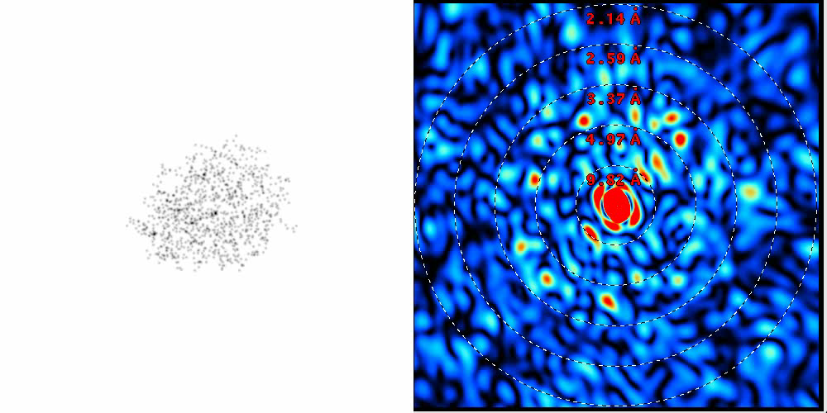
Reciprocal Space

Slide 3
Reciprocal Space
http://bl831.als.lbl.gov/~jamesh/powerpoint/CSHL_recipspace_2025.pptx
. 1/distance
. λ = 2d sin(θ)
. Gaussian → Gaussian
. Lattice → lattice
. Duck → Blobs
Convolution → product
. Rotations same
. “angle space”

Slide 4
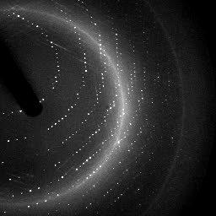
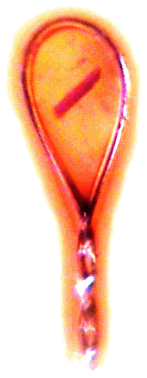
X-ray data are 3D!

Slide 5
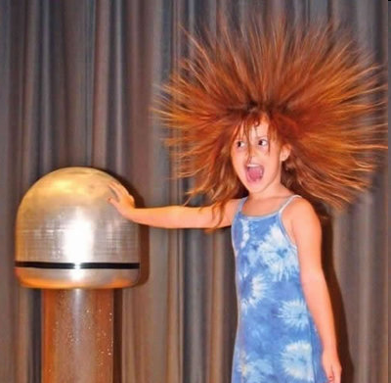
Electric charge
-
-
-
-
-
-
+ + + + + +

Slide 6
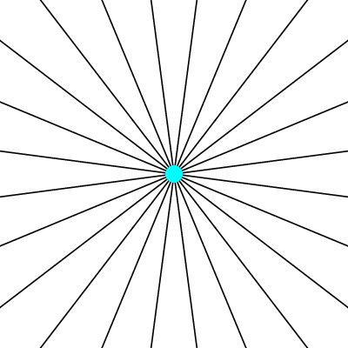
Electric field of a moving charge

Slide 7
Electric field of a moving charge
accelerating charges
make
electromagnetic waves
(light)

Slide 8
scattering
x-ray beam
sample
detector

Slide 9
scattering
x-ray beam
sample
detector

Slide 10
scattering
x-ray beam
sample
detector

Slide 11
scattering
x-ray beam
sample
detector

Slide 12
Bragg’s Law
to detector
nλ = 2d sin(θ)
atom #1
θ
d
to source
atom #2
d∙sin(θ)

Slide 13
Bragg’s Law
to detector
nλ = 2d sin(θ)
atom #1
θ
to source
d
atom #2
d∙sin(θ)

Slide 14
anomalous scattering
x-ray beam
sample
detector

Slide 15
anomalous scattering
x-ray beam
sample
detector

Slide 16
anomalous scattering
x-ray beam
sample
detector

Slide 17
anomalous scattering
x-ray beam
sample
detector

Slide 18
anomalous scattering
x-ray beam
sample
detector

Slide 19
scattering
x-ray beam
sample
detector
detector

Slide 20
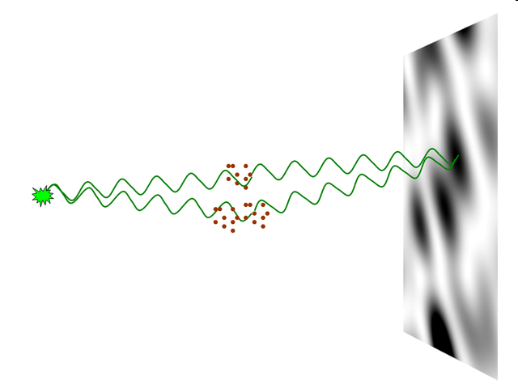
nearBragg program
http://bl831.als.lbl.gov/~jamesh/nearBragg/
“assumption-free” total scattering
no Fourier Transform
no unit cells
no “mosaicity”
arbitrary “atoms”
arbitrary “source”
coherent or not

Slide 21
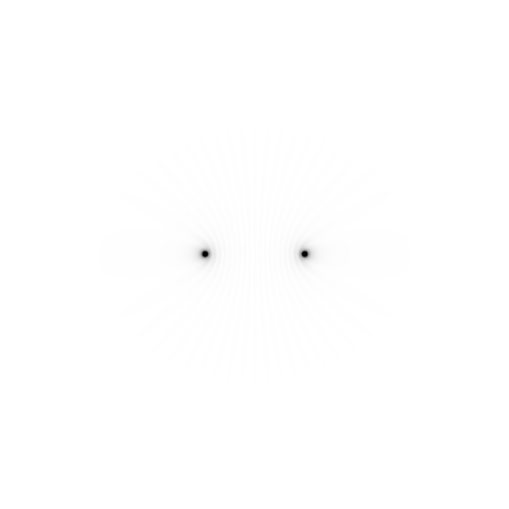
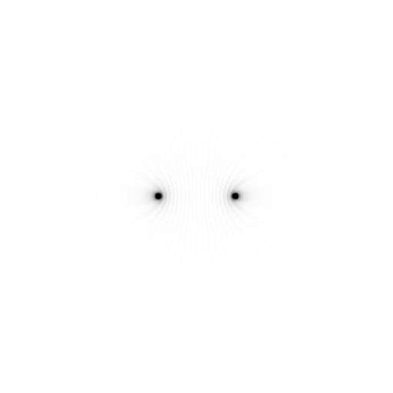
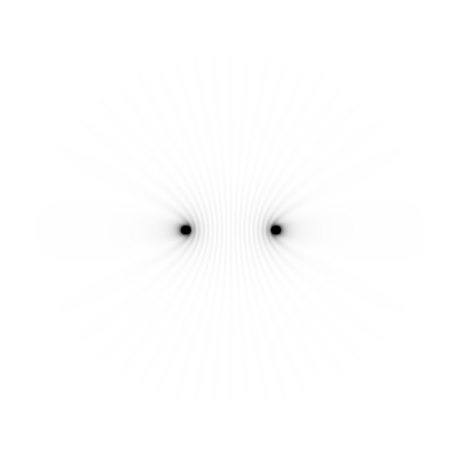
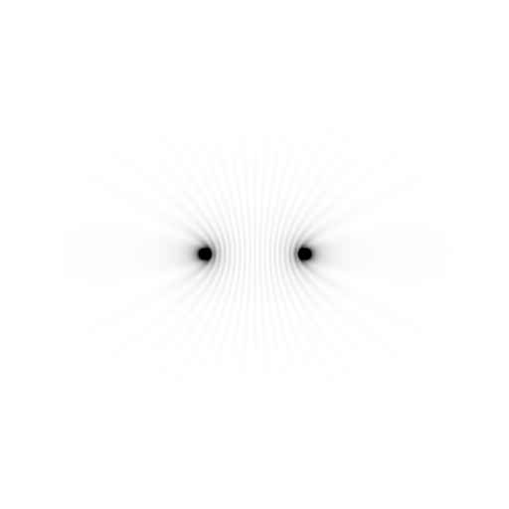
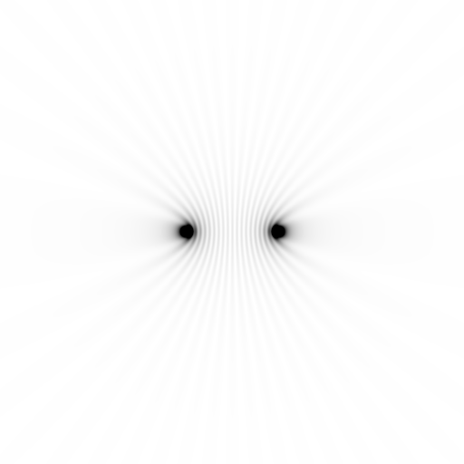
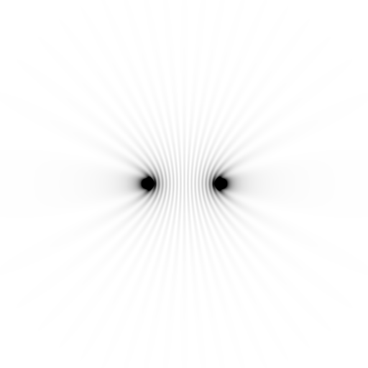
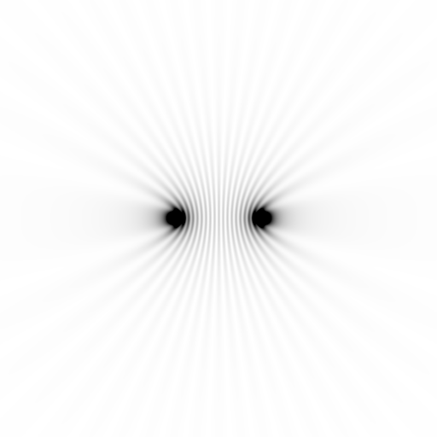
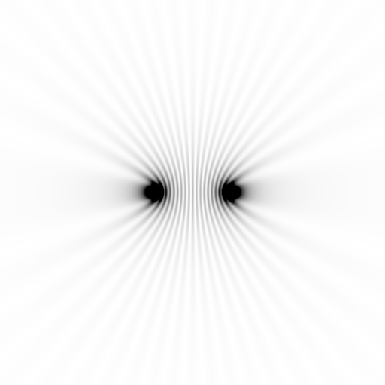
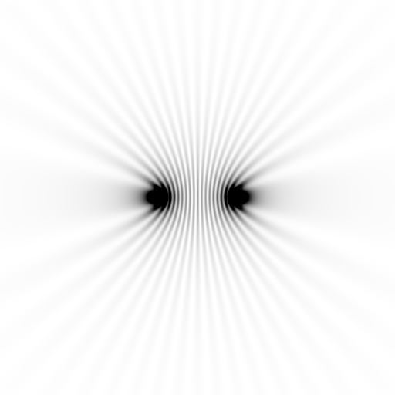
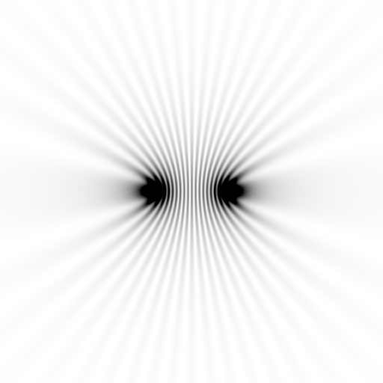
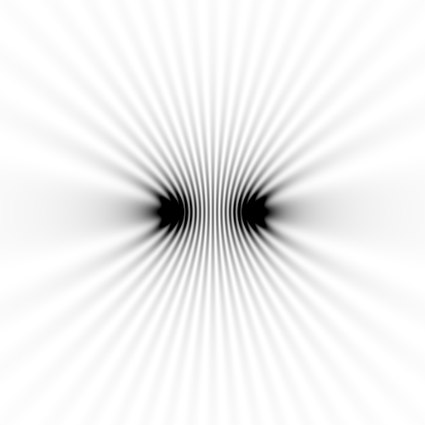
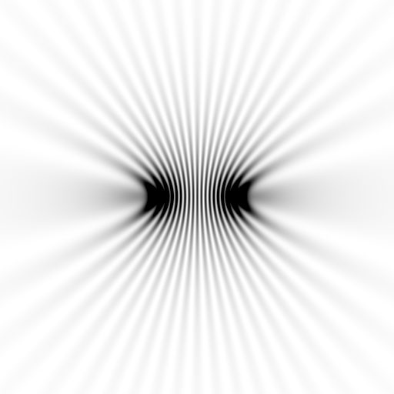
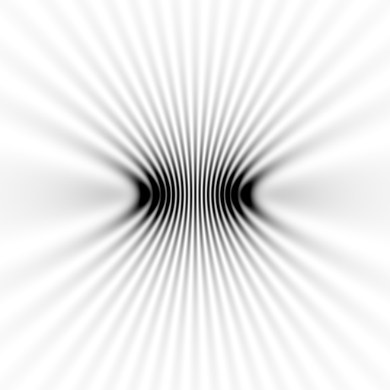
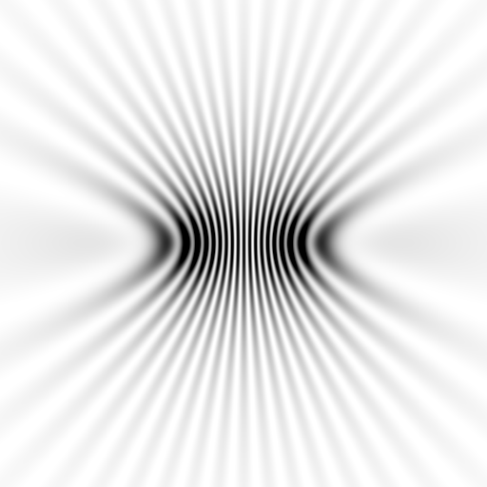
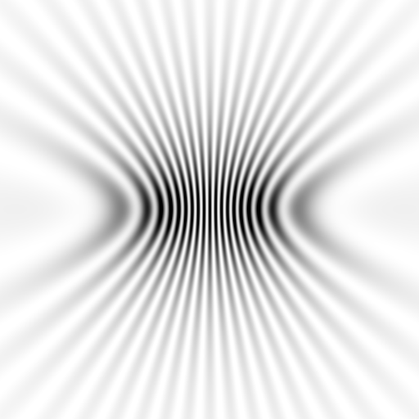
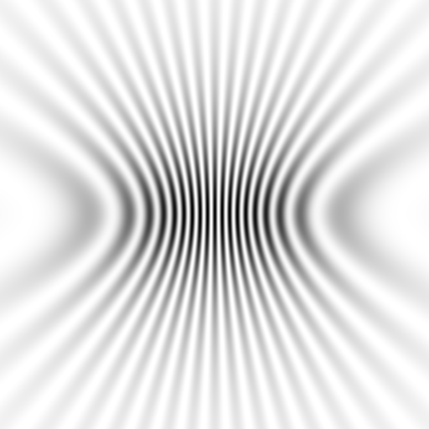
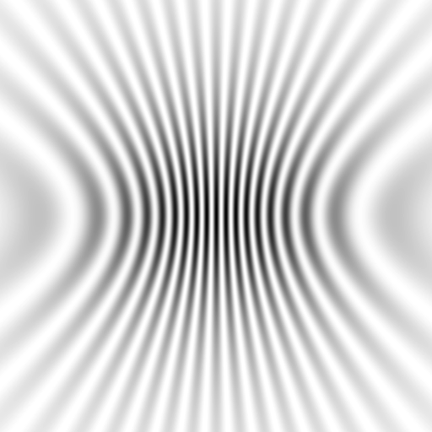
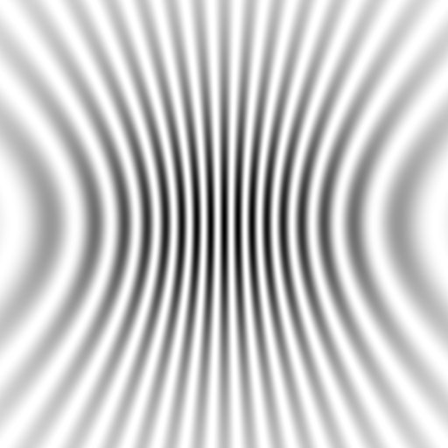
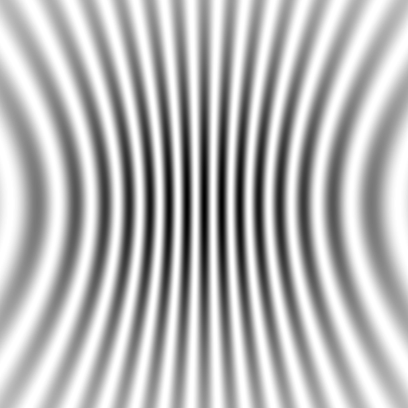
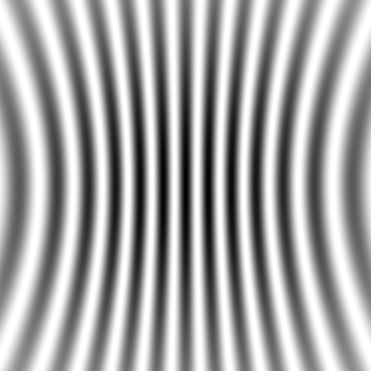
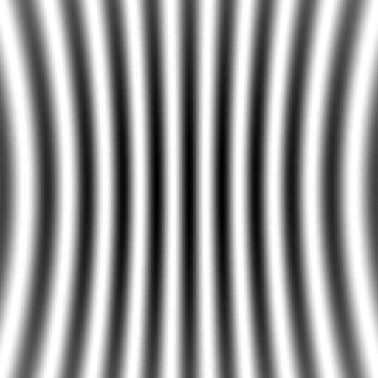
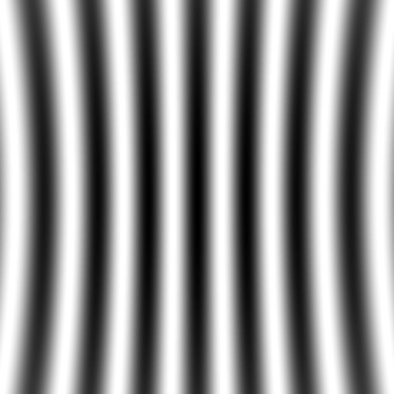
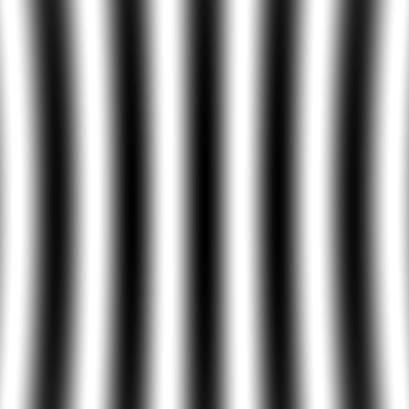
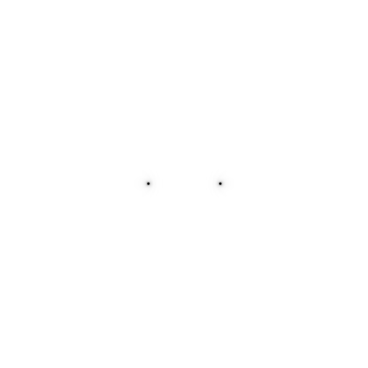
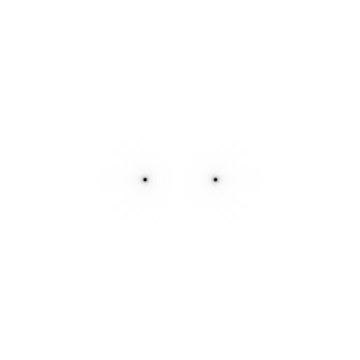
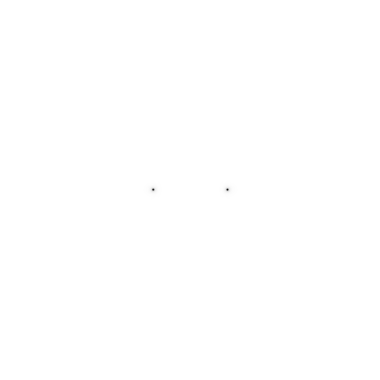

Slide 22
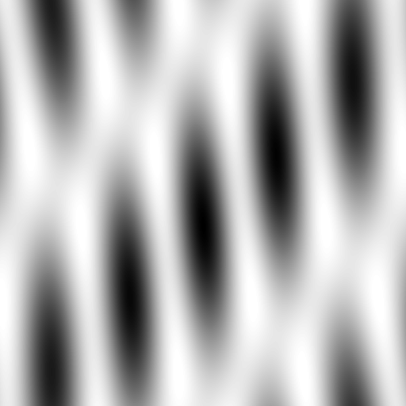
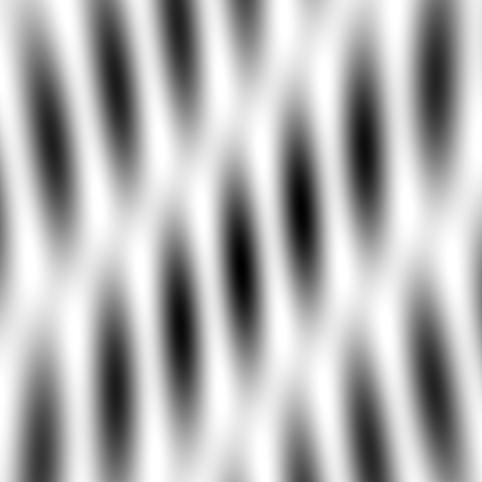
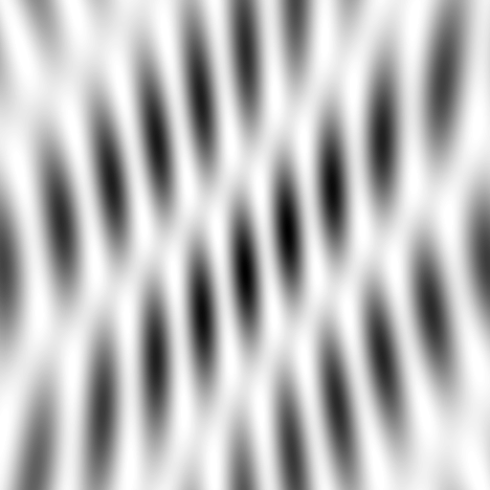
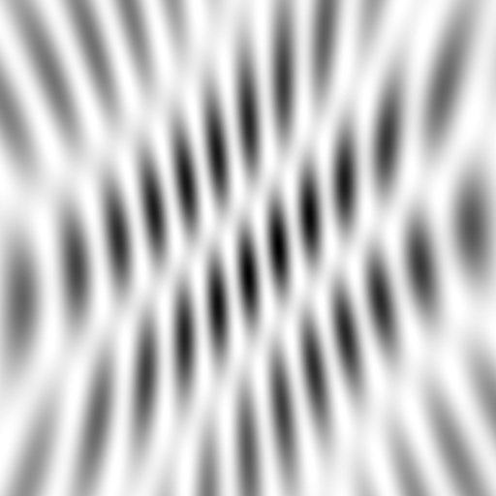
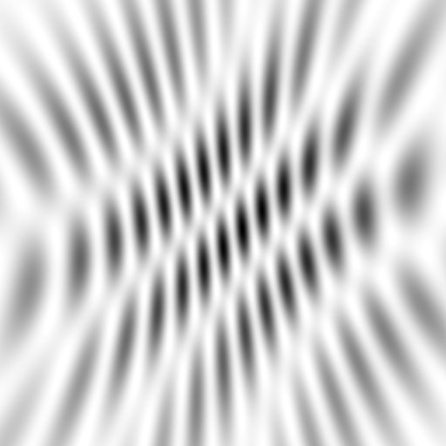
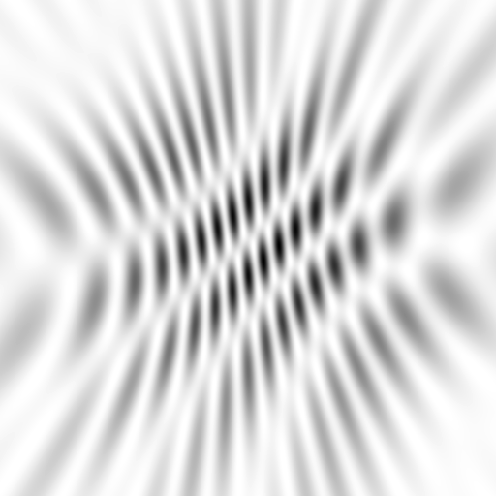
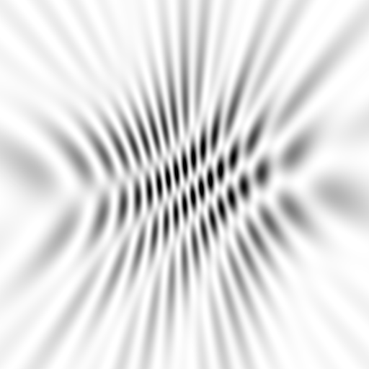
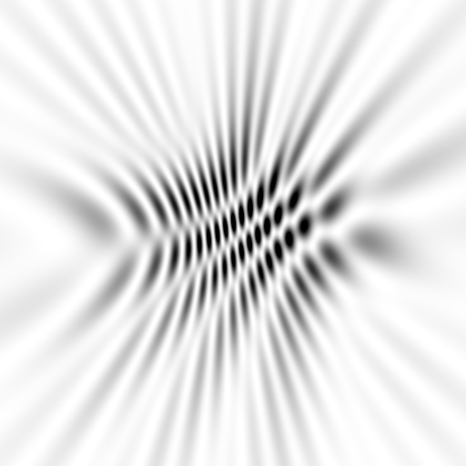
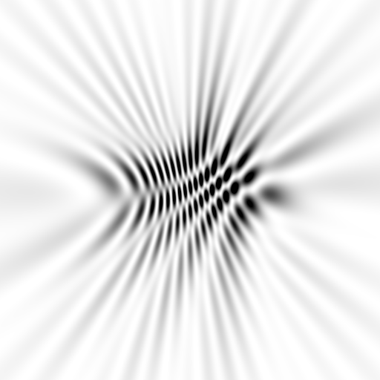
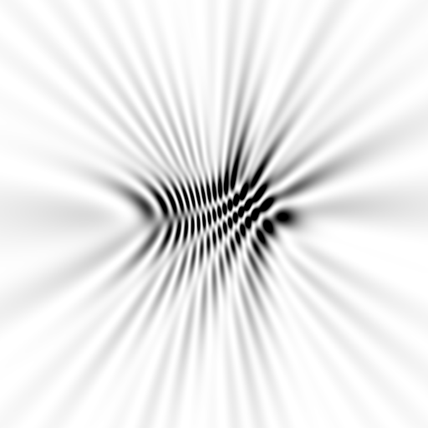
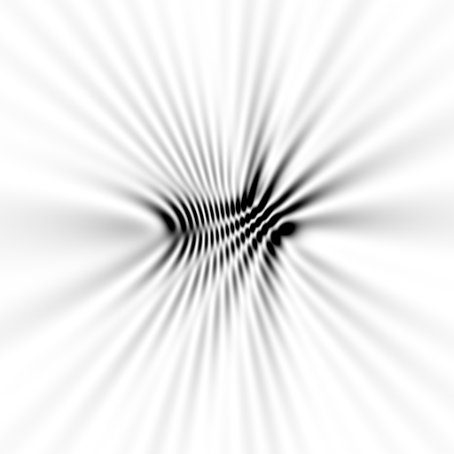
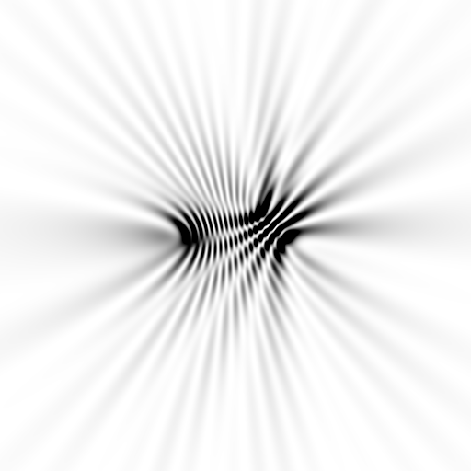
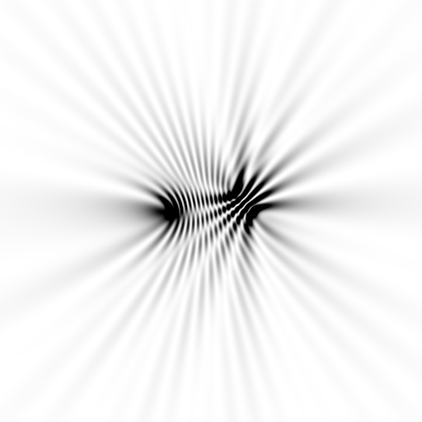
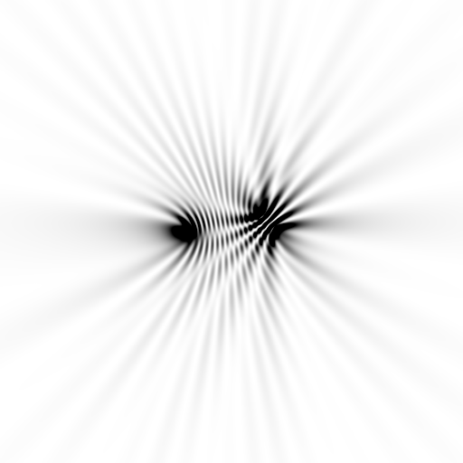
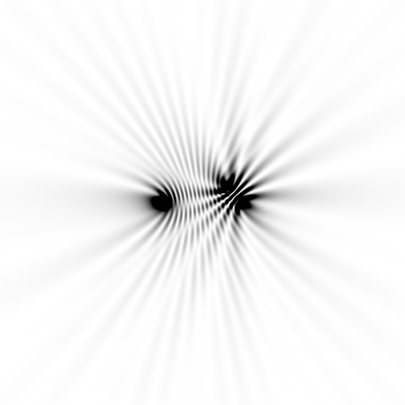






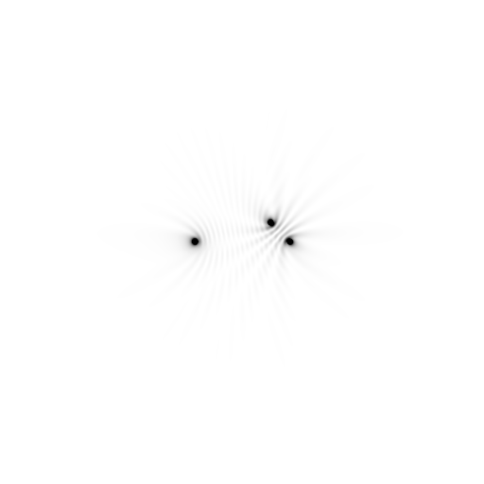





Slide 23
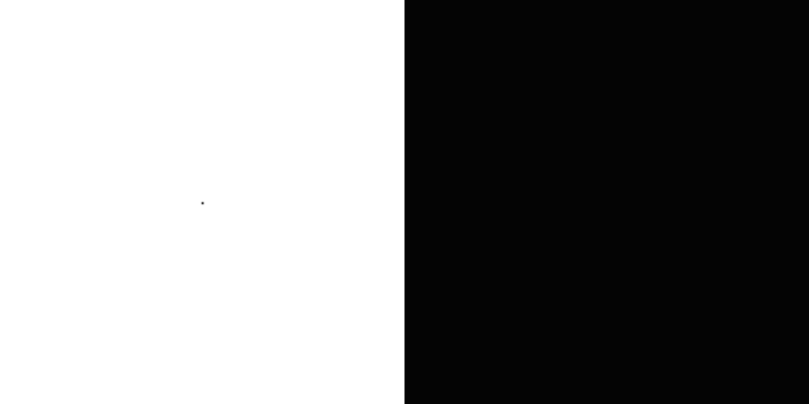
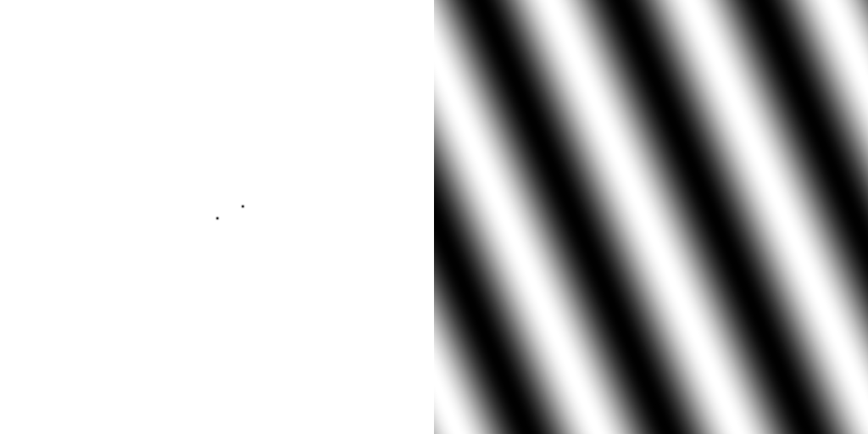








scattering from a structure
sample
detector
beam center
+

Slide 24

forward Fourier Transform
inverse Fourier Transform
no phase
+

Slide 25











inverse Fourier Transform
scattering from a structure
colored by phase
sample
detector
+

Slide 26




scattering from a lattice
colored by phase
sample
detector
beam center
+

Slide 27

scattering from a lattice
colored by phase
sample
detector
beam center
+

Slide 28

scattering from a lattice
colored by phase
sample
detector
beam center
+

Slide 29

scattering from a crystal structure
colored by phase
sample
detector
beam center
+

Slide 30

Muybridge’s galloping horse (1878)
“Time-resolved” diffraction
+
Real space
reciprocal
space

Slide 31


Snapshot from single virus particle
2 keV LCLS 200 fs Mimi virus single-shot.
_{200 nm}
_{Reconstructed image}
_{Resolution 20nm}
_{TEM}
Seibert, et al. (2011). Nature 470, 78-81.
Notes:
what limits single-particle resolution ?
get 100 times more photons/shot if correctly focussed beam
get 100 times more with submicron beam focus on CXI chamber
Problem – scattering goes from N^2 to N (Wilson statistics).
So use a-priori information – modelling Axel Brummer
Make beam smaller than jet to elliminate streak
₃₁

Slide 32


Realistic single-particle prediction
+
10¹² photon/pulse
100 nm focus

Slide 33

Realistic single-particle prediction
+
10¹² photon/pulse
3 nm focus

Slide 34
lysozyme: real and reciprocal
+
+

Slide 35

Meaning of “Molecular Transform”
False color intensity
sample
detector
+

Slide 36

Meaning of “Molecular Transform”
False color intensity
sample
detector
+

Slide 37

Meaning of “Molecular Transform”
False color intensity
sample
detector
+

Slide 38

Meaning of “Molecular Transform”
False color intensity
sample
detector
+

Slide 39

Meaning of “Molecular Transform”
False color intensity
sample
detector

Slide 40

Diffraction from a 3D lattice
+
real space
reciprocal space

Slide 41
Diffraction from a 3D lattice
+
real space
reciprocal space

Slide 42
Ewald Sphere
Ewald sphere
(h,k,l)

Slide 43
Ewald Sphere
Ewald sphere
(h,k,l)
d*

Slide 44
Ewald Sphere
Ewald sphere
(h,k,l)
spindle axis
d*

Slide 45
Ewald Sphere
Ewald sphere
Φ circle
(h,k,l)
spindle axis

Slide 46
Ewald Sphere
Ewald sphere
Φ circle
(h,k,l)
spindle axis

Slide 47
Ewald Sphere
Ewald sphere
Φ circle
(h,k,l)
diffracted ray
spindle axis

Slide 48
Ewald Sphere
Ewald sphere
Φ circle
(h,k,l)
λ*
d*
spindle axis
diffracted ray
λ*

Slide 49
Ewald Sphere
Ewald sphere
Φ circle
(h,k,l)
λ*
d*
spindle axis
diffracted ray
θ
λ*
λ = 2 d sin(θ)

Slide 50
beam divergence
Ewald sphere
F(h,k,l)
λ*
d*
diffracted ray
λ*
F(0,0,0)

Slide 51
beam divergence
Ewald sphere
λ*
d*
diffracted ray
F(0,0,0)
λ*

Slide 52

Divergence Arndt & Wonacott (1977)

Slide 53

divergence = 0 º

Slide 54

divergence = 0.3 º

Slide 55
spectral dispersion
Ewald sphere
F(h,k,l)
λ*
d*
diffracted ray
λ*
F(0,0,0)

Slide 56
spectral dispersion
Ewald sphere
F(h,k,l)
λ’*
d*
diffracted ray
λ’*
F(0,0,0)

Slide 57

dispersion = 0

Slide 58

dispersion = 0.014% (Si 111)

Slide 59

dispersion = 0.25% (CuK_{α})

Slide 60

dispersion = 0.6%

Slide 61

dispersion = 1.3%

Slide 62

dispersion = 2.6%

Slide 63

dispersion = 5.1%

Slide 64
What if crystal is bent?

Slide 65
What if crystal is bent?

Slide 66
Ewald’s “mosaic” picture

Slide 67
Ewald’s “mosaic” picture

Slide 68

Ewald’s “mosaic” picture
What is
this stuff?

Slide 69
Darwin’s original picture

Slide 70

“mosaicity” with visible light

Slide 71
mosaic spread
Ewald sphere
Φ circle
(h,k,l)
λ*
d*
diffracted ray
d*
spindle axis
λ*

Slide 72
mosaic spread
Ewald sphere
Φ circle
(h,k,l)
d*
diffracted rays
d*
spindle axis

Slide 73

mosaic spread = 0 º

Slide 74

mosaic spread = 0.1º

Slide 75

mosaic spread = 0.2º

Slide 76

mosaic spread = 0.4º

Slide 77

mosaic spread = 0.6º

Slide 78

mosaic spread = 0.8º

Slide 79

mosaic spread = 1.0º

Slide 80

mosaic spread = 1.5º

Slide 81

mosaic spread = 2.0º

Slide 82

mosaic spread = 2.5º

Slide 83

mosaic spread = 3.2º

Slide 84

mosaic spread = 6.4º

Slide 85

mosaic spread = 12.8º

Slide 86

spot shape
Ewald sphere
Ewald sphere
Ewald sphere
Ewald sphere
Φ circle
Φ circle
Φ circle
Φ circle
(h,k,l)
(h,k,l)
(h,k,l)
(h,k,l)
λ’*
λ*
d*
d*
d*
λ*
d*
spindle axis
spindle axis
spindle axis
diffracted rays
d*
spindle axis
diffracted ray
diffracted ray
diffracted ray
λ’*
λ*
λ*

Slide 87
“near”-ly Bragg’s Law
detector
atom #1
source
d
atom #2

Slide 88
mosaicity vs coherence length
x-ray beam
peak
intensity
integrated
intensity
“crystal”
detector

Slide 89








mosaicity vs coherence length
10 atoms
50 atoms
100 atoms
200 atoms
300 atoms
400 atoms
500 atoms
1000 atoms
0.1 μm
0.5 μm
1 μm
2 μm
3 μm
4 μm
5 μm
10 μm
intensity (photons/SR/atom)
position on detector (mm)

Slide 90

Meaning of “coherence length”
http://bl831.als.lbl.gov/~jamesh/nearBragg/collision/

Slide 91

Meaning of “coherence length”
http://bl831.als.lbl.gov/~jamesh/nearBragg/collision/

Slide 92

Meaning of “coherence length”
http://bl831.als.lbl.gov/~jamesh/nearBragg/collision/

Slide 93
Meaning of “coherence length”
http://bl831.als.lbl.gov/~jamesh/nearBragg/collision/

Slide 94

mosaicity vs coherence length
mosaic
spread
intensity (photons/SR)
B factor
number of atoms in line

Slide 95
“B” factors
ATOM 122 N LEU A 13 -3.244 25.808 19.998 1.00 16.96 N
ATOM 123 CA LEU A 13 -2.877 25.448 21.355 1.00 15.29 C
ATOM 124 C LEU A 13 -2.792 23.966 21.561 1.00 17.54 C
ATOM 125 O LEU A 13 -1.814 23.493 22.143 1.00 16.35 O
ATOM 126 CB LEU A 13 -3.907 26.164 22.268 1.00 18.72 C
ATOM 127 CG LEU A 13 -3.577 25.982 23.738 1.00 21.19 C
ATOM 128 CD1 LEU A 13 -2.283 26.820 24.019 1.00 19.43 C
ATOM 129 CD2 LEU A 13 -4.702 26.474 24.639 1.00 24.65 C
ATOM 130 N SER A 14 -3.677 23.149 20.979 1.00 15.96 N
ATOM 131 CA SER A 14 -3.646 21.711 21.061 1.00 18.26 C
ATOM 132 C SER A 14 -2.373 21.203 20.360 1.00 18.71 C
ATOM 133 O SER A 14 -1.747 20.315 20.930 1.00 17.47 O
ATOM 134 CB SER A 14 -4.875 21.077 20.419 1.00 17.62 C
ATOM 135 OG ASER A 14 -4.825 19.665 20.388 0.50 20.89 O
ATOM 136 OG BSER A 14 -6.027 21.408 21.164 0.50 18.67 O
ATOM 137 N LYS A 15 -2.045 21.772 19.215 1.00 18.03 N
ATOM 138 CA LYS A 15 -0.799 21.361 18.555 1.00 18.12 C
ATOM 139 C LYS A 15 0.446 21.707 19.351 1.00 18.81 C
ATOM 140 O LYS A 15 1.400 20.948 19.411 1.00 17.77 O
ATOM 141 CB LYS A 15 -0.700 22.034 17.177 1.00 14.49 C
ATOM 142 CG LYS A 15 -1.727 21.368 16.256 1.00 16.12 C
ATOM 143 CD LYS A 15 -1.663 22.147 14.936 1.00 19.40 C
ATOM 144 CE ALYS A 15 -2.725 21.614 13.986 0.50 17.42 C
ATOM 145 CE BLYS A 15 -1.750 21.211 13.750 0.50 17.01 C
ATOM 146 NZ ALYS A 15 -2.346 21.674 12.559 0.50 18.61 N
ATOM 147 NZ BLYS A 15 -3.052 20.513 13.741 0.50 18.76 N

Slide 96

strong reflection

Slide 97
weak reflection

Slide 98
What is a "B factor"?

Slide 99
What is a "B factor"?

Slide 100
What is a "B factor"?

Slide 101

What is a "B factor"?
order
order
B-factor
disorder

Slide 102
“B” factors
electron density (e⁻/Å³)
position (Å)

Slide 103
“B” factors
electron density (e⁻/Å³)
position (Å)

Slide 104
“B” factors
electron density (e⁻/Å³)
position (Å)

Slide 105
“B” factors
electron density (e⁻/Å³)
position (Å)

Slide 106
“B” factors
electron density (e⁻/Å³)
position (Å)

Slide 107
“B” factors
electron density (e⁻/Å³)
position (Å)

Slide 108
“B” factors
electron density (e⁻/Å³)
position (Å)

Slide 109
“B” factors
electron density (e⁻/Å³)
position (Å)

Slide 110
A Fourier view of scattering
density (ρ)
intensity
distance (Å)
angle (°)

Slide 111
A Fourier view of scattering
density (ρ)
intensity
distance (Å)
angle (°)

Slide 112
A Fourier view of scattering
density (ρ)
intensity
distance (Å)
angle (°)

Slide 113
A Fourier view of scattering
density (ρ)
intensity
distance (Å)
angle (°)

Slide 114

B factor from image analysis
B = 500

Slide 115

B factor from image analysis
B = 20

Slide 116
Reciprocal Space
http://bl831.als.lbl.gov/~jamesh/powerpoint/CSHL_recipspace_2025.pptx
. 1/distance
. λ = 2d sin(θ)
. Gaussian → Gaussian
. Lattice → lattice
. Convolution → product
. Rotations same
. “angle space”

Slide 117


The B factor
Bragg, W. H. (1914)."XCVII. The intensity of reflexion of X rays by crystals", Philosophical Magazine Series 6 27, 881-899. Published May 1 1914

Slide 118

Temperature is not enough
Debye, P. J. W. (1914)."Interferenz von Röntgenstrahlen und Wärmebewegung", Annalen der Physik 348, 49-92.

Slide 119


Dawn of the Age of Uncertainty

Slide 120



Temperature is not enough
Debye
35
Scherrer
30
Debye, P. J. W. & Scherrer, P. (1918)."Atomic structure", Physikalische Zeitschrift 19, 474-483.

Slide 121

1928: the last straw for determinism
Davisson-Germer Experiment
Single electron interferes with itself.
Otherwise, diffraction cannot work!
Davisson, C. J. (1928). "The diffraction of electrons by a crystal of nickel", Bell System Technical Journal, The 7, 90-105.

Slide 122

Resolution
http://bl831.als.lbl.gov/~jamesh/movies/resolution.mpeg

Slide 123

Resolution: low-angle cutoff
http://bl831.als.lbl.gov/~jamesh/movies/lo_cut.mpeg

Slide 124

R-factor
http://bl831.als.lbl.gov/~jamesh/movies/rfactor.mpeg

Slide 125

Figure of Merit
http://bl831.als.lbl.gov/~jamesh/movies/dephase.mpeg

Slide 126

Overloads
http://bl831.als.lbl.gov/~jamesh/movies/overloads.mpeg

Slide 127

Completeness: missing wedge
http://bl831.als.lbl.gov/~jamesh/movies/osc.mpeg

Slide 128

Completeness: random deletion
http://bl831.als.lbl.gov/~jamesh/movies/completeness.mpeg

Slide 129
Bigger is better, but not by much
B = 20
B = 60
B = 0
B = 170
B = 330
B = 560
Resolution (Å)
B = 850
Crystal diameter (micron)

Slide 130
Diffraction Take-Home Lesson:
disorder
+ averaging
= poor resolution

Slide 131
Reciprocal Space
http://bl831.als.lbl.gov/~jamesh/powerpoint/CSHL_recipspace_2025.pptx
. 1/distance
. λ = 2d sin(θ)
. Gaussian → Gaussian
. Lattice → lattice
. Convolution → product
. Rotations same
. “angle space”

Slide 132



Laue’s diffraction photograph (not to be confused with Laue diffraction)
“In 1910, when I began work on my thesis, there was no quantitative proof for the internal periodicity of crystals. My teacher Sommerfeld had the idea that … a lattice, would produce observable double refraction”
Submitted
June 8 1912
Friedrich, W., Knipping, P. &
Laue, M. (1913). "Interferenzerscheinungen bei Röntgenstrahlen", Annalen der Physik
346, 971-988.
Ewald, P. (1979).
"A review of my papers on crystal optics 1912 to 1968", Acta Cryst. A 35, 1-9.
ZnS

Slide 133


W. L. Bragg on Spot Shape
nλ = 2d sin θ
Bragg, W. L. (1912). “On the diffraction of short electromagnetic waves by a crystal” Proc. Cambridge Philos. Soc. 17, 43-57
23 years old

