Slide 1
Acknowledgements
http://bl831.als.lbl.gov/~jamesh/powerpoint/CSHL_recipspace_2022.pptx
Robert Stroud James Fraser
Paul Adams Greg Hura
Aina Cohen Keith Hodgson
UCSF LBNL SLAC
ALS 8.3.1: TomAlberTron
NIH NIGMS R01 GM124149 to Holton
NIH NIAID P50 AI150476 to Krogan
NIH NIAID U19 AI171110 to Krogan
NIH NIGMS P30 GM124169 to Adams
DOE-BER IDAT to Hura
NIH NIGMS P41 GM103393 to Hodgson
The Advanced Light Source is supported by the Director, Office of Science, Office of Basic Energy Sciences, Materials Sciences Division, of the US Department of Energy under contract No. DE-AC02-05CH11231 at Lawrence Berkeley National Laboratory.

Slide 2

Reciprocal Space

Slide 3
Reciprocal Space
http://bl831.als.lbl.gov/~jamesh/powerpoint/CSHL_recipspace_2022.pptx
. 1/distance
. λ = 2d sin(θ)
. Gaussian → Gaussian
. Lattice → lattice
. Duck → Blobs
Convolution → product
. Rotations same
. “angle space”

Slide 4
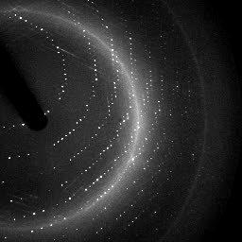

X-ray data are 3D!

Slide 5
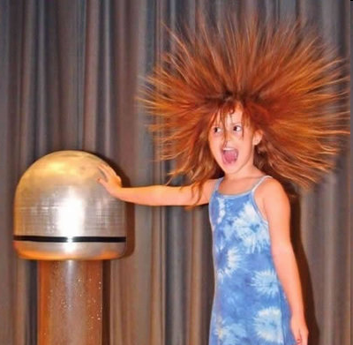
Electric charge
-
-
-
-
-
-
+ + + + + +

Slide 6
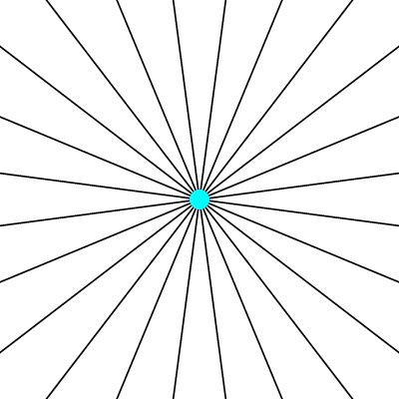
Electric field of a moving charge

Slide 7
Electric field of a moving charge
accelerating charges
make
electromagnetic waves
(light)

Slide 8
scattering
x-ray beam
sample
detector

Slide 9
scattering
x-ray beam
sample
detector

Slide 10
scattering
x-ray beam
sample
detector

Slide 11
scattering
x-ray beam
sample
detector

Slide 12
Bragg’s Law
to detector
nλ = 2d sin(θ)
atom #1
θ
d
to source
atom #2
d∙sin(θ)

Slide 13
Bragg’s Law
to detector
nλ = 2d sin(θ)
atom #1
θ
to source
d
atom #2
d∙sin(θ)

Slide 14
anomalous scattering
x-ray beam
sample
detector

Slide 15
anomalous scattering
x-ray beam
sample
detector

Slide 16
anomalous scattering
x-ray beam
sample
detector

Slide 17
anomalous scattering
x-ray beam
sample
detector

Slide 18
anomalous scattering
x-ray beam
sample
detector

Slide 19
scattering
x-ray beam
sample
detector
detector

Slide 20
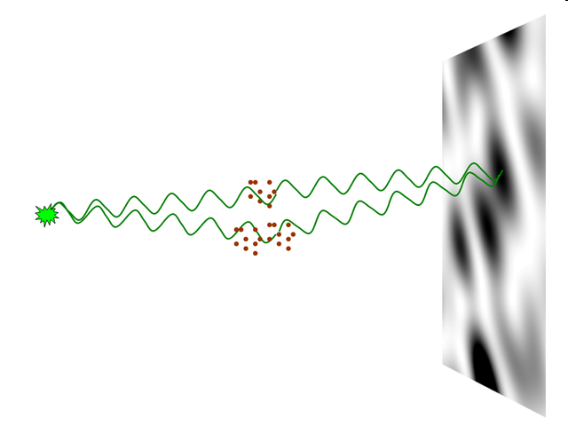
nearBragg program
http://bl831.als.lbl.gov/~jamesh/nearBragg/
“assumption-free” total scattering
no Fourier Transform
no unit cells
no “mosaicity”
arbitrary “atoms”
arbitrary “source”
coherent or not

Slide 21
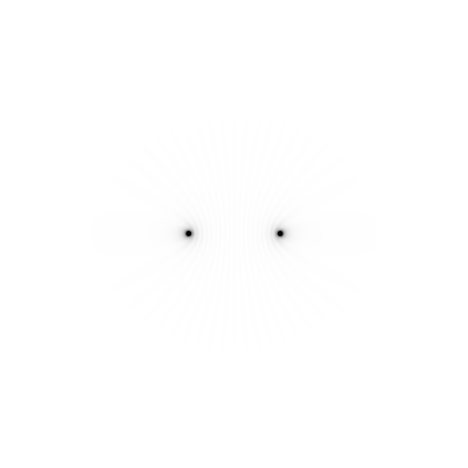
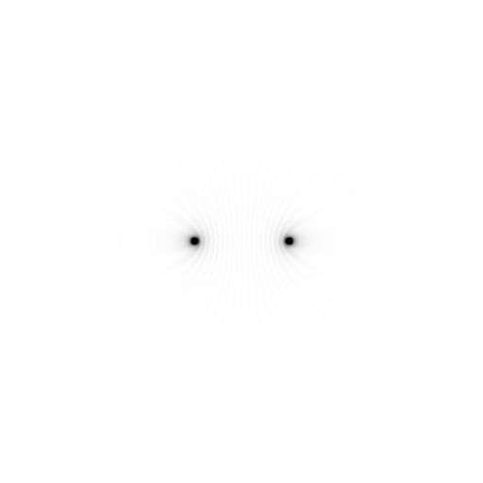
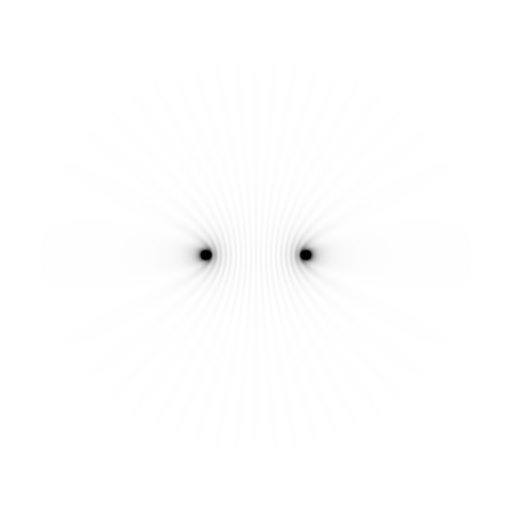
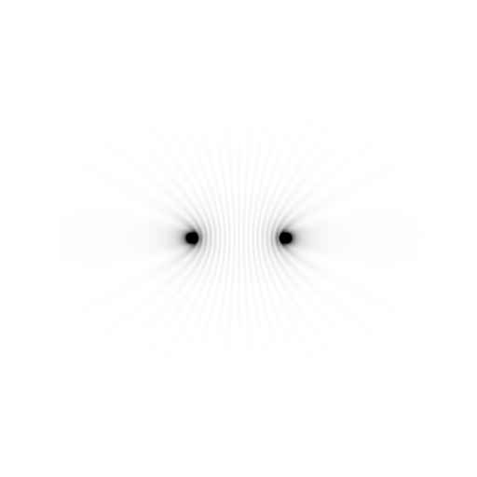
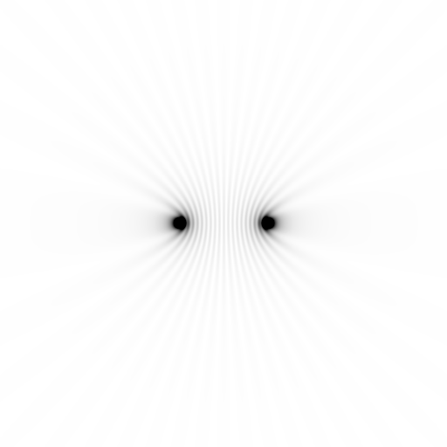
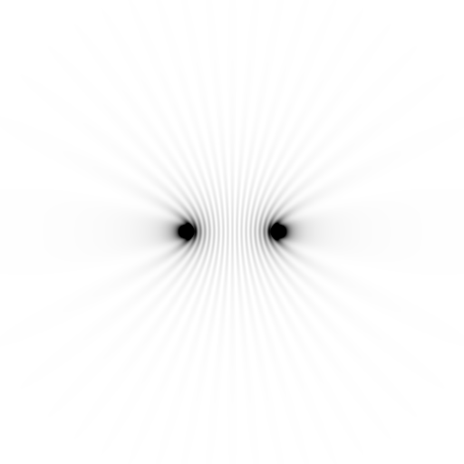
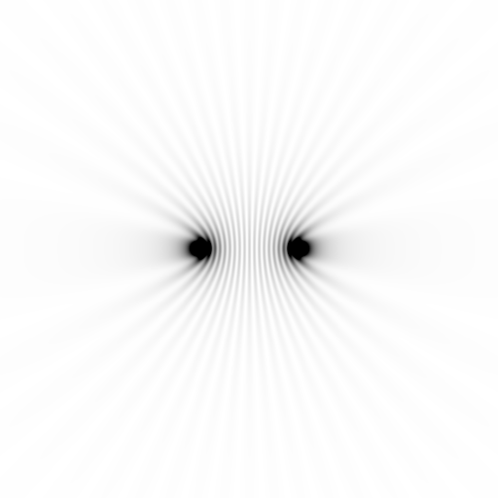
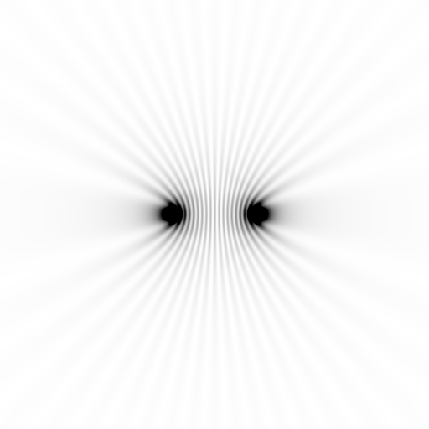
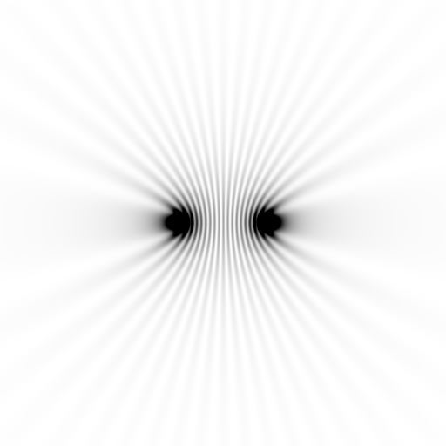
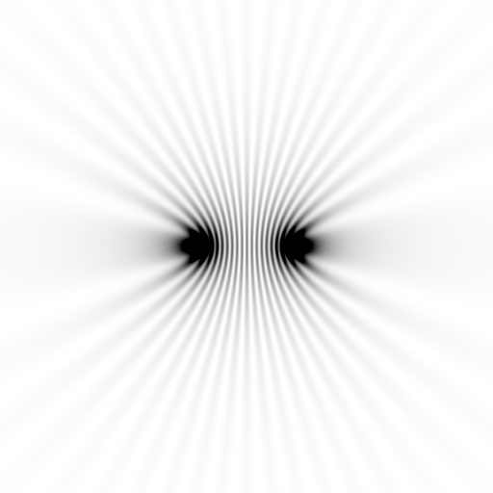
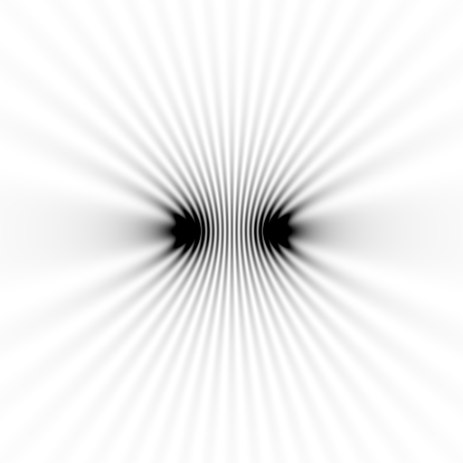
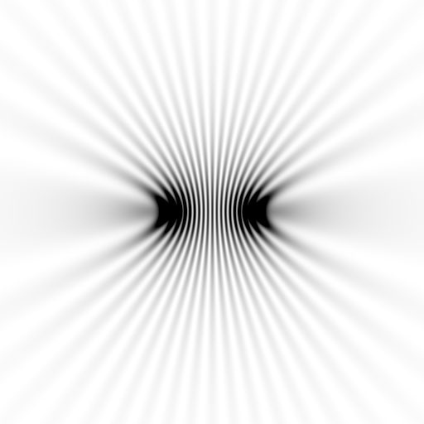
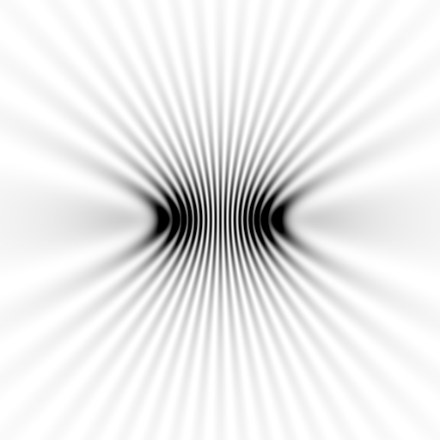
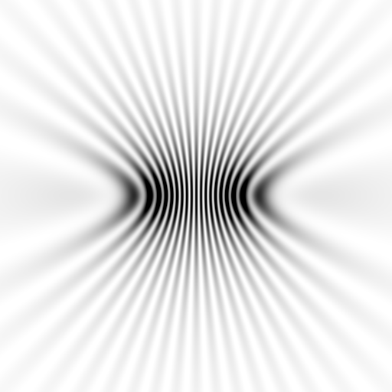
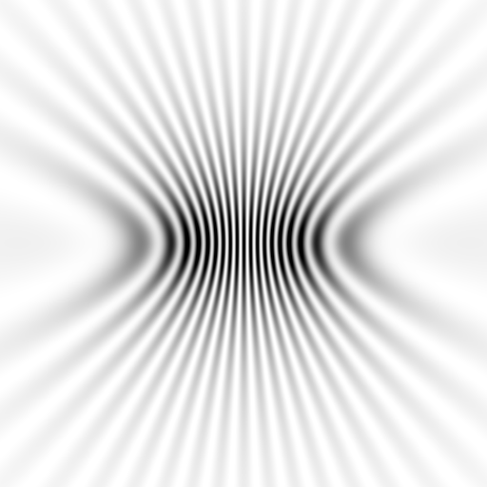
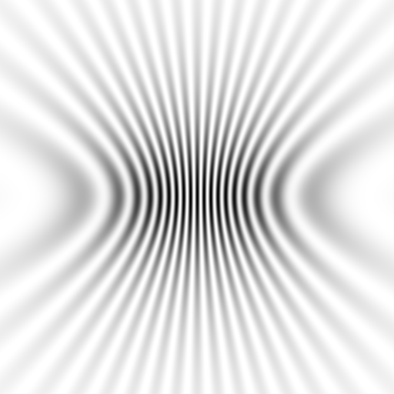
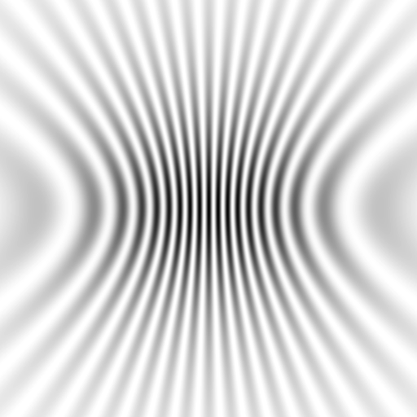
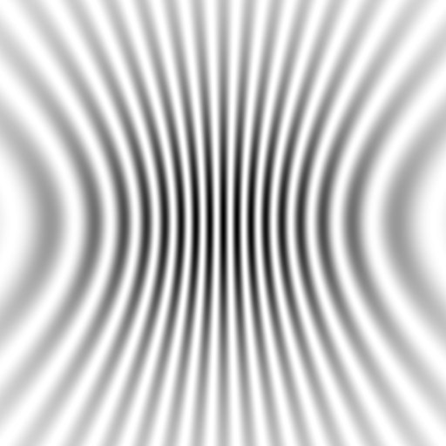
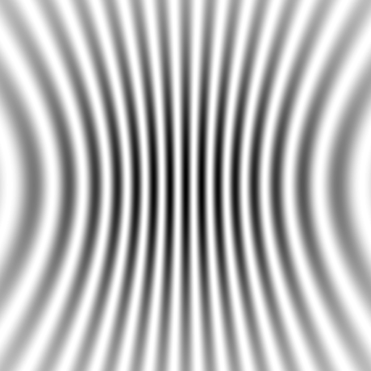
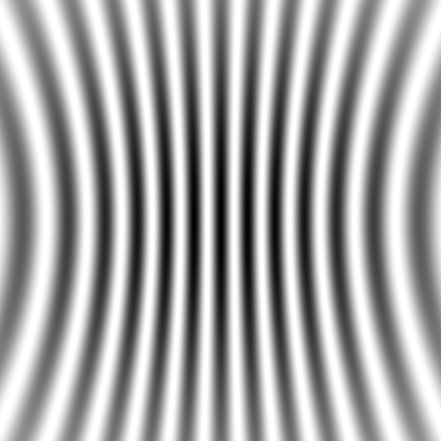
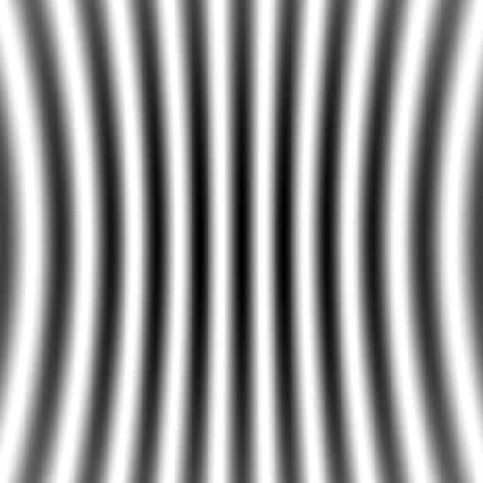


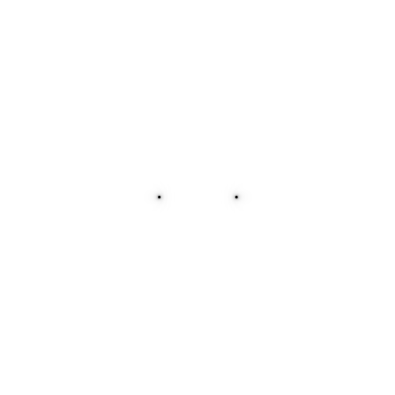
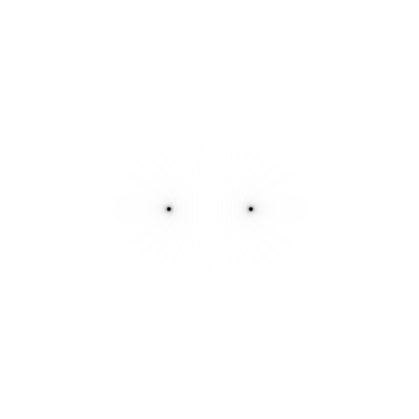


Slide 22
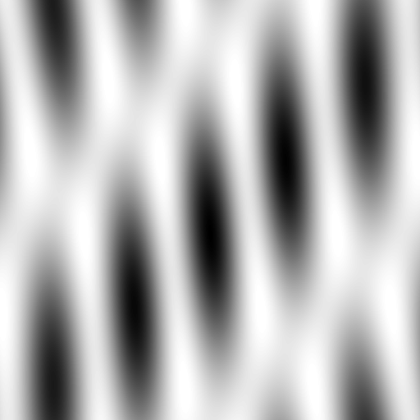



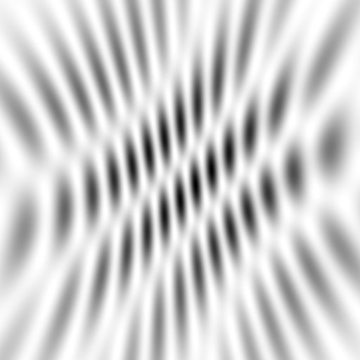
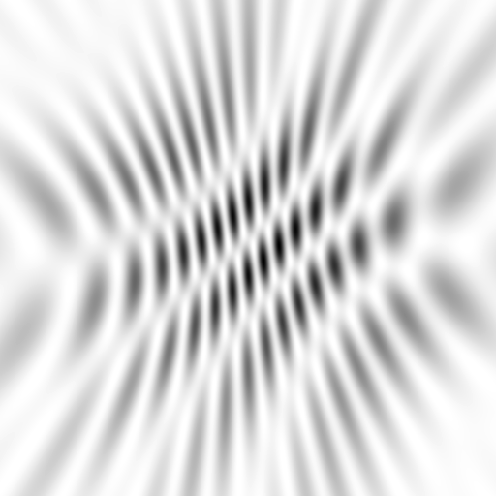
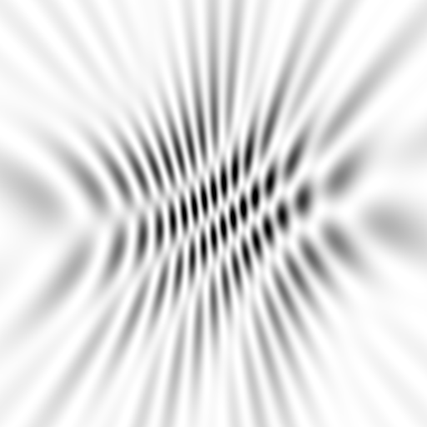
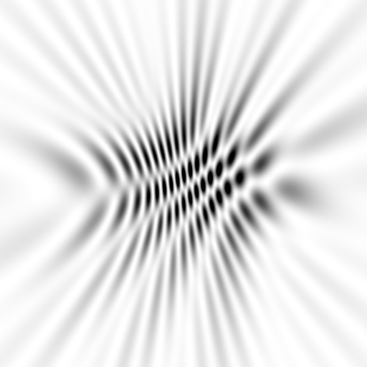
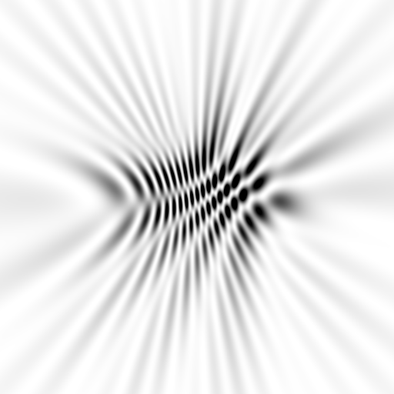
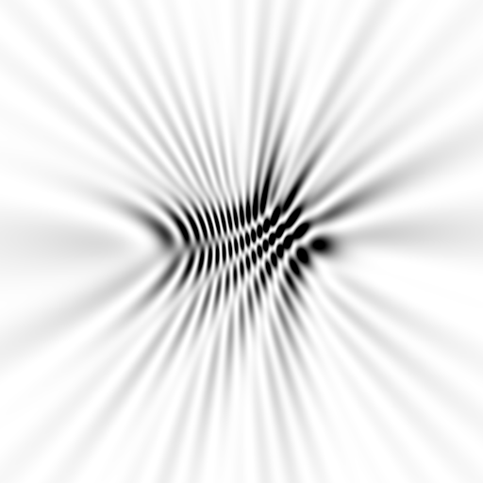
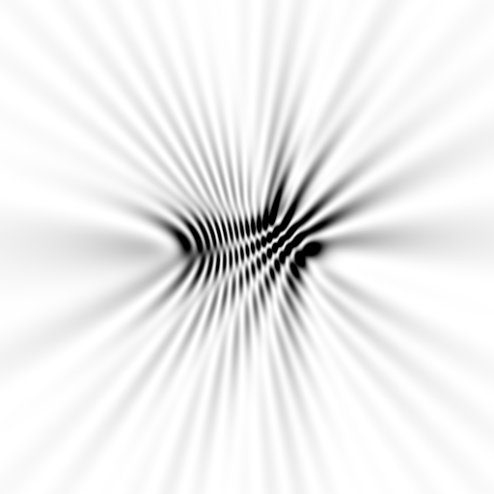
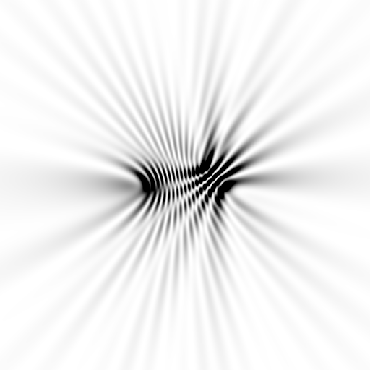
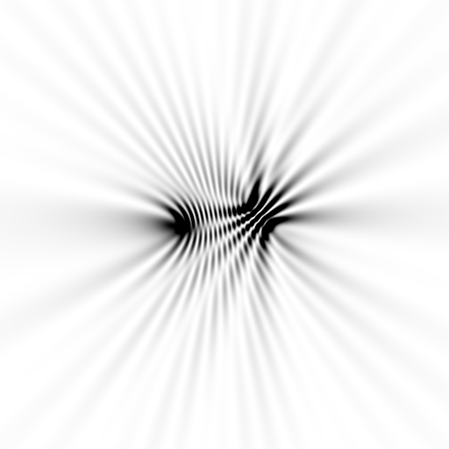
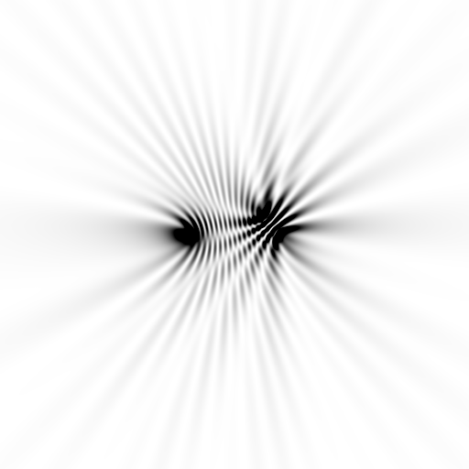
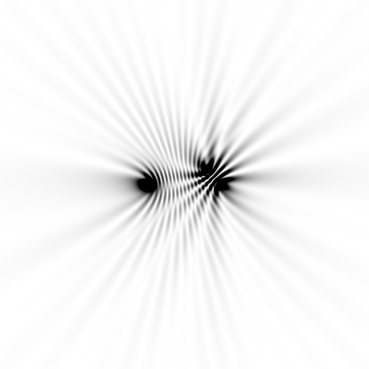






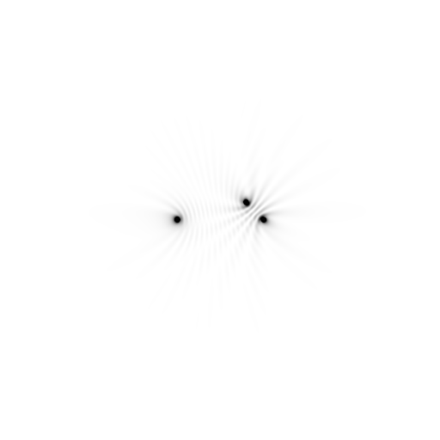





Slide 23



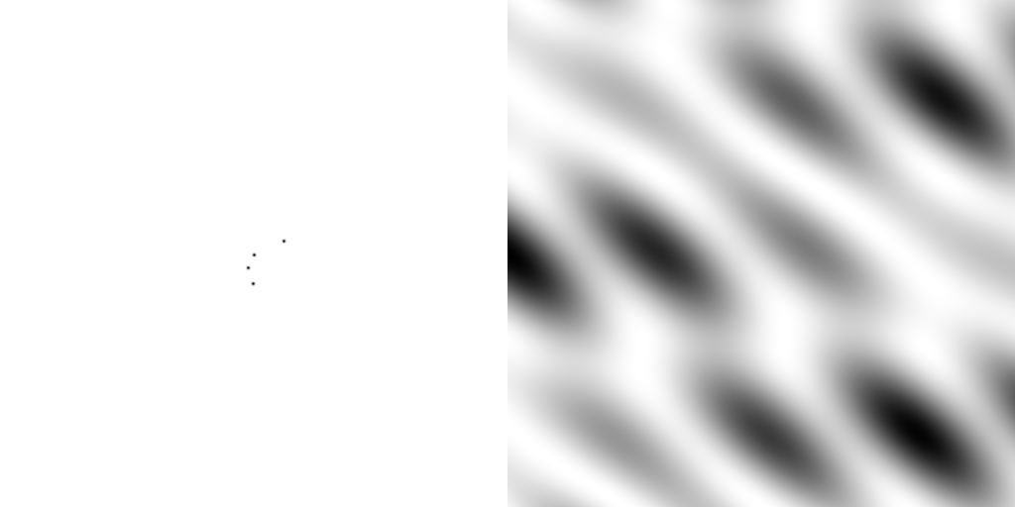
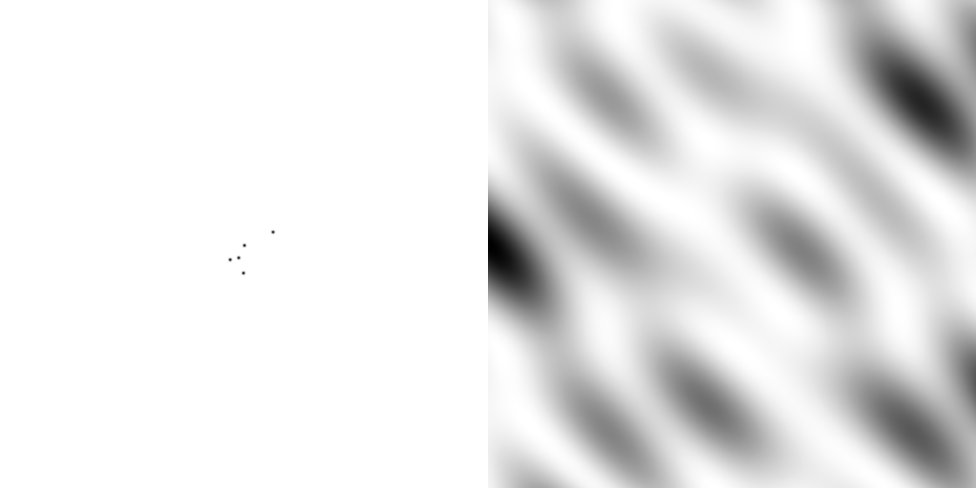
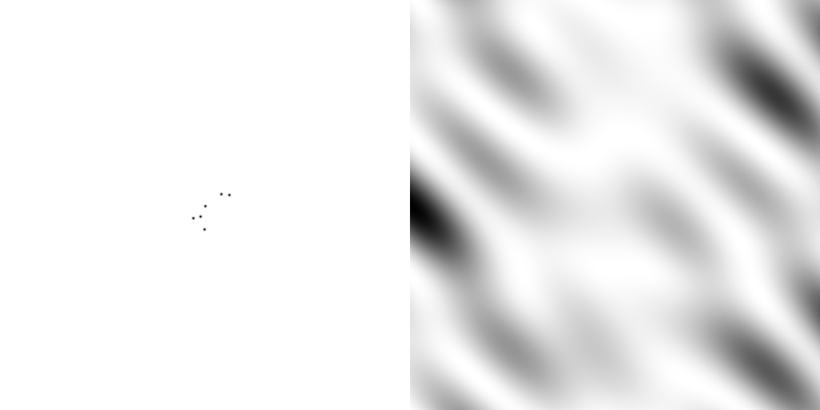
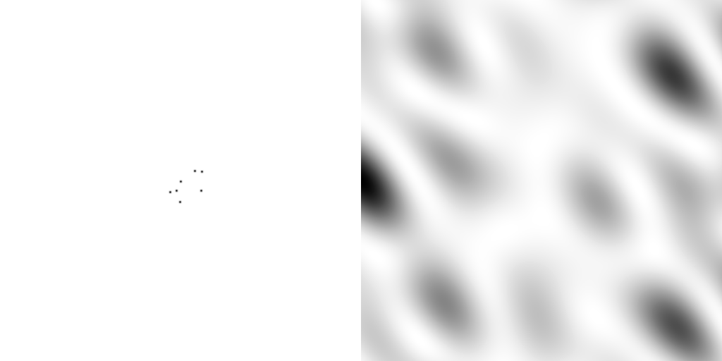
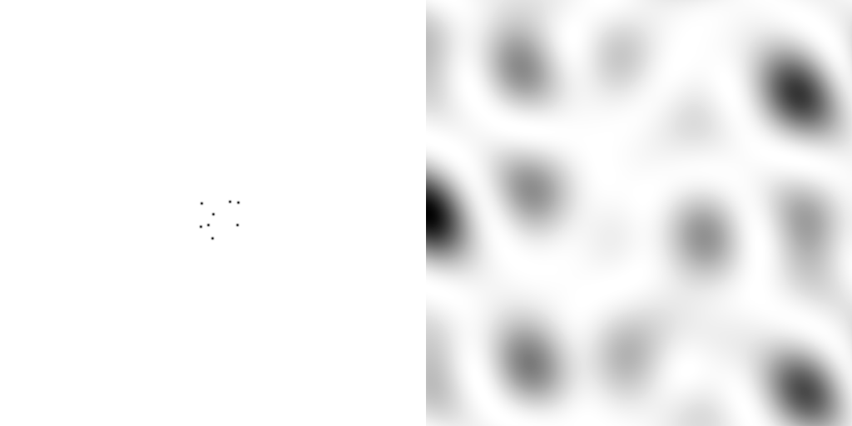
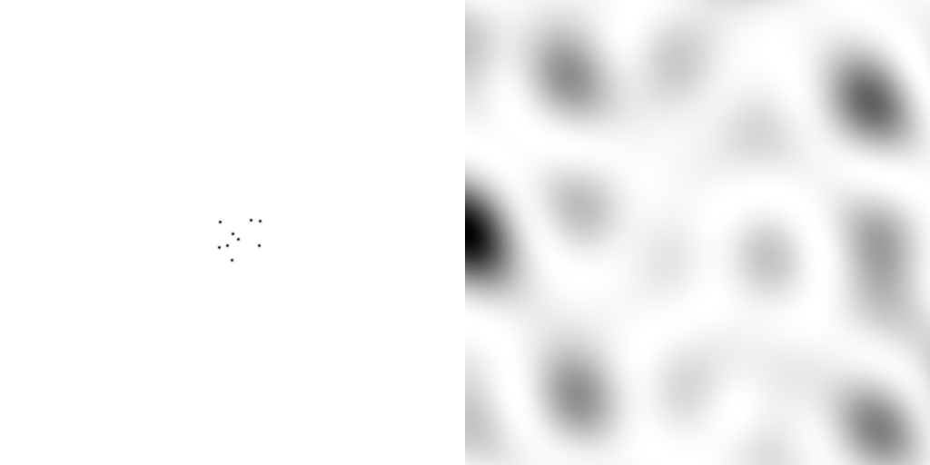
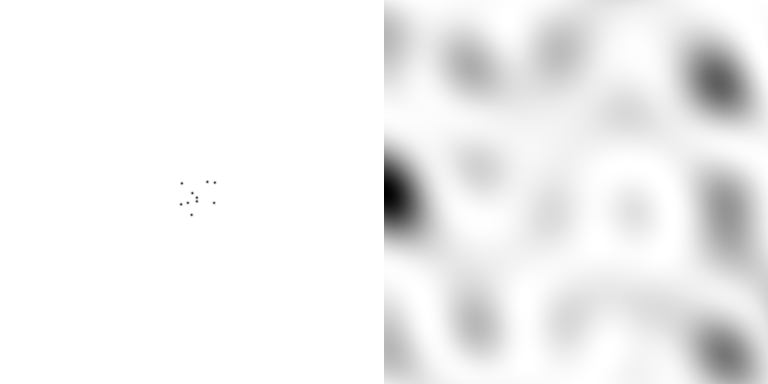
scattering from a structure
sample
detector
beam center
+

Slide 24
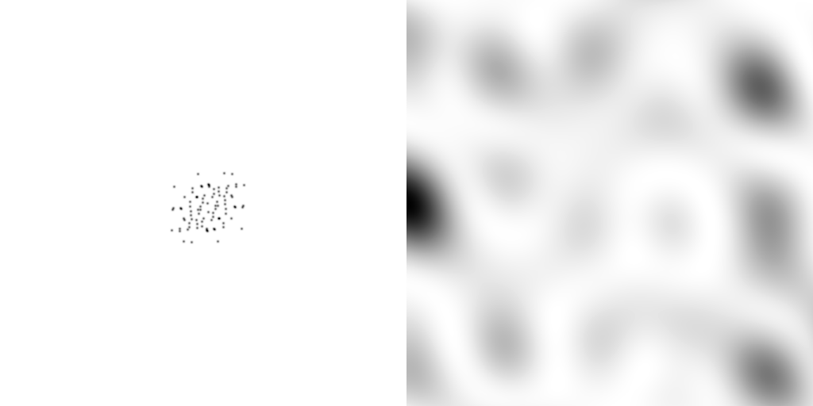
forward Fourier Transform
inverse Fourier Transform
no phase
+

Slide 25
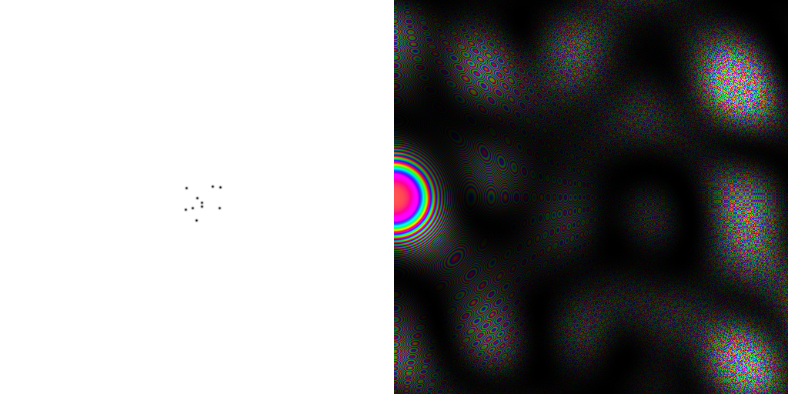





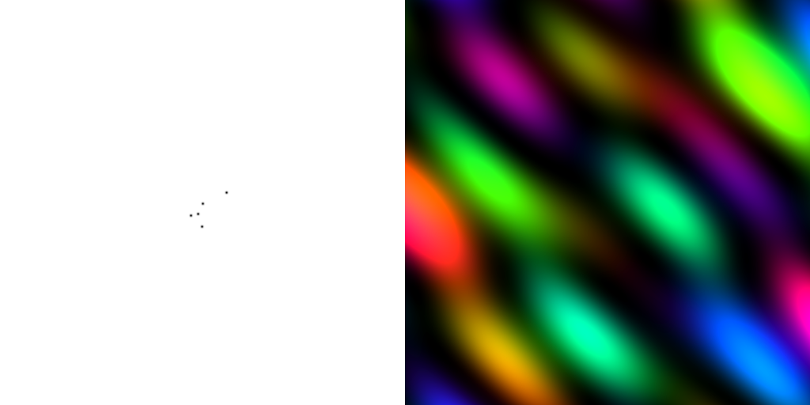




inverse Fourier Transform
scattering from a structure
colored by phase
sample
detector
+

Slide 26




scattering from a lattice
colored by phase
sample
detector
beam center
+

Slide 27

scattering from a lattice
colored by phase
sample
detector
beam center
+

Slide 28

scattering from a lattice
colored by phase
sample
detector
beam center
+

Slide 29

scattering from a crystal structure
colored by phase
sample
detector
beam center
+

Slide 30

Muybridge’s galloping horse (1878)
“Time-resolved” diffraction
+
Real space
reciprocal
space

Slide 31


Snapshot from single virus particle
2 keV LCLS 200 fs Mimi virus single-shot.
_{200 nm}
_{Reconstructed image}
_{Resolution 20nm}
_{TEM}
Seibert, et al. (2011). Nature 470, 78-81.
Notes:
what limits single-particle resolution ?
get 100 times more photons/shot if correctly focussed beam
get 100 times more with submicron beam focus on CXI chamber
Problem – scattering goes from N^2 to N (Wilson statistics).
So use a-priori information – modelling Axel Brummer
Make beam smaller than jet to elliminate streak
₃₁

Slide 32


Realistic single-particle prediction
+
10¹² photon/pulse
100 nm focus

Slide 33

Realistic single-particle prediction
+
10¹² photon/pulse
3 nm focus

Slide 34
lysozyme: real and reciprocal
+
+

Slide 35

Meaning of “Molecular Transform”
False color intensity
sample
detector
+

Slide 36

Meaning of “Molecular Transform”
False color intensity
sample
detector
+

Slide 37

Meaning of “Molecular Transform”
False color intensity
sample
detector
+

Slide 38

Meaning of “Molecular Transform”
False color intensity
sample
detector
+

Slide 39

Meaning of “Molecular Transform”
False color intensity
sample
detector

Slide 40

Diffraction from a 3D lattice
+
real space
reciprocal space

Slide 41
Diffraction from a 3D lattice
+
real space
reciprocal space

Slide 42
Ewald Sphere
Ewald sphere
(h,k,l)

Slide 43
Ewald Sphere
Ewald sphere
(h,k,l)
d*

Slide 44
Ewald Sphere
Ewald sphere
(h,k,l)
spindle axis
d*

Slide 45
Ewald Sphere
Ewald sphere
Φ circle
(h,k,l)
spindle axis

Slide 46
Ewald Sphere
Ewald sphere
Φ circle
(h,k,l)
spindle axis

Slide 47
Ewald Sphere
Ewald sphere
Φ circle
(h,k,l)
diffracted ray
spindle axis

Slide 48
Ewald Sphere
Ewald sphere
Φ circle
(h,k,l)
λ*
d*
spindle axis
diffracted ray
λ*

Slide 49
Ewald Sphere
Ewald sphere
Φ circle
(h,k,l)
λ*
d*
spindle axis
diffracted ray
θ
λ*
λ = 2 d sin(θ)

Slide 50
beam divergence
Ewald sphere
F(h,k,l)
λ*
d*
diffracted ray
λ*
F(0,0,0)

Slide 51
beam divergence
Ewald sphere
λ*
d*
diffracted ray
F(0,0,0)
λ*

Slide 52

Divergence
Arndt & Wonacott (1977)

Slide 53

divergence = 0 º

Slide 54

divergence = 0.3 º

Slide 55
spectral dispersion
Ewald sphere
F(h,k,l)
λ*
d*
diffracted ray
λ*
F(0,0,0)

Slide 56
spectral dispersion
Ewald sphere
F(h,k,l)
λ’*
d*
diffracted ray
λ’*
F(0,0,0)

Slide 57

dispersion = 0

Slide 58

dispersion = 0.014% (Si 111)

Slide 59

dispersion = 0.25% (CuK_{α})

Slide 60

dispersion = 0.6%

Slide 61

dispersion = 1.3%

Slide 62

dispersion = 2.6%

Slide 63

dispersion = 5.1%

Slide 64
What if crystal is bent?

Slide 65
What if crystal is bent?

Slide 66
mosaic spread
Ewald sphere
Φ circle
(h,k,l)
λ*
d*
diffracted ray
d*
spindle axis
λ*

Slide 67
mosaic spread
Ewald sphere
Φ circle
(h,k,l)
d*
diffracted rays
d*
spindle axis

Slide 68

mosaic spread = 0 º

Slide 69

mosaic spread = 0.1º

Slide 70

mosaic spread = 0.2º

Slide 71

mosaic spread = 0.4º

Slide 72

mosaic spread = 0.6º

Slide 73

mosaic spread = 0.8º

Slide 74

mosaic spread = 1.0º

Slide 75

mosaic spread = 1.5º

Slide 76

mosaic spread = 2.0º

Slide 77

mosaic spread = 2.5º

Slide 78

mosaic spread = 3.2º

Slide 79

mosaic spread = 6.4º

Slide 80

mosaic spread = 12.8º

Slide 81

spot shape
Ewald sphere
Ewald sphere
Ewald sphere
Ewald sphere
Φ circle
Φ circle
Φ circle
Φ circle
(h,k,l)
(h,k,l)
(h,k,l)
(h,k,l)
λ’*
λ*
d*
d*
d*
λ*
d*
spindle axis
spindle axis
spindle axis
diffracted rays
d*
spindle axis
diffracted ray
diffracted ray
diffracted ray
λ’*
λ*
λ*

Slide 82
Ewald’s “mosaic” picture

Slide 83
Ewald’s “mosaic” picture

Slide 84

Ewald’s “mosaic” picture
What is
this stuff?

Slide 85
Darwin’s original picture

Slide 86

“mosaicity” with visible light

Slide 87
“near”-ly Bragg’s Law
detector
atom #1
source
d
atom #2

Slide 88
mosaicity vs coherence length
x-ray beam
peak
intensity
integrated
intensity
“crystal”
detector

Slide 89








mosaicity vs coherence length
10 atoms
50 atoms
100 atoms
200 atoms
300 atoms
400 atoms
500 atoms
1000 atoms
0.1 μm
0.5 μm
1 μm
2 μm
3 μm
4 μm
5 μm
10 μm
intensity (photons/SR/atom)
position on detector (mm)

Slide 90

Meaning of “coherence length”
http://bl831.als.lbl.gov/~jamesh/nearBragg/collision/

Slide 91

Meaning of “coherence length”
http://bl831.als.lbl.gov/~jamesh/nearBragg/collision/

Slide 92

Meaning of “coherence length”
http://bl831.als.lbl.gov/~jamesh/nearBragg/collision/

Slide 93
Meaning of “coherence length”
http://bl831.als.lbl.gov/~jamesh/nearBragg/collision/

Slide 94

mosaicity vs coherence length
mosaic
spread
intensity (photons/SR)
B factor
number of atoms in line

Slide 95
“B” factors
ATOM 122 N LEU A 13 -3.244 25.808 19.998 1.00 16.96 N
ATOM 123 CA LEU A 13 -2.877 25.448 21.355 1.00 15.29 C
ATOM 124 C LEU A 13 -2.792 23.966 21.561 1.00 17.54 C
ATOM 125 O LEU A 13 -1.814 23.493 22.143 1.00 16.35 O
ATOM 126 CB LEU A 13 -3.907 26.164 22.268 1.00 18.72 C
ATOM 127 CG LEU A 13 -3.577 25.982 23.738 1.00 21.19 C
ATOM 128 CD1 LEU A 13 -2.283 26.820 24.019 1.00 19.43 C
ATOM 129 CD2 LEU A 13 -4.702 26.474 24.639 1.00 24.65 C
ATOM 130 N SER A 14 -3.677 23.149 20.979 1.00 15.96 N
ATOM 131 CA SER A 14 -3.646 21.711 21.061 1.00 18.26 C
ATOM 132 C SER A 14 -2.373 21.203 20.360 1.00 18.71 C
ATOM 133 O SER A 14 -1.747 20.315 20.930 1.00 17.47 O
ATOM 134 CB SER A 14 -4.875 21.077 20.419 1.00 17.62 C
ATOM 135 OG ASER A 14 -4.825 19.665 20.388 0.50 20.89 O
ATOM 136 OG BSER A 14 -6.027 21.408 21.164 0.50 18.67 O
ATOM 137 N LYS A 15 -2.045 21.772 19.215 1.00 18.03 N
ATOM 138 CA LYS A 15 -0.799 21.361 18.555 1.00 18.12 C
ATOM 139 C LYS A 15 0.446 21.707 19.351 1.00 18.81 C
ATOM 140 O LYS A 15 1.400 20.948 19.411 1.00 17.77 O
ATOM 141 CB LYS A 15 -0.700 22.034 17.177 1.00 14.49 C
ATOM 142 CG LYS A 15 -1.727 21.368 16.256 1.00 16.12 C
ATOM 143 CD LYS A 15 -1.663 22.147 14.936 1.00 19.40 C
ATOM 144 CE ALYS A 15 -2.725 21.614 13.986 0.50 17.42 C
ATOM 145 CE BLYS A 15 -1.750 21.211 13.750 0.50 17.01 C
ATOM 146 NZ ALYS A 15 -2.346 21.674 12.559 0.50 18.61 N
ATOM 147 NZ BLYS A 15 -3.052 20.513 13.741 0.50 18.76 N

Slide 96

strong reflection

Slide 97
weak reflection

Slide 98
What is a "B factor"?

Slide 99
What is a "B factor"?

Slide 100
What is a "B factor"?

Slide 101

What is a "B factor"?
order
order
B-factor
disorder

Slide 102
“B” factors
electron density (e⁻/Å³)
position (Å)

Slide 103
“B” factors
electron density (e⁻/Å³)
position (Å)

Slide 104
“B” factors
electron density (e⁻/Å³)
position (Å)

Slide 105
“B” factors
electron density (e⁻/Å³)
position (Å)

Slide 106
“B” factors
electron density (e⁻/Å³)
position (Å)

Slide 107
“B” factors
electron density (e⁻/Å³)
position (Å)

Slide 108
“B” factors
electron density (e⁻/Å³)
position (Å)

Slide 109
“B” factors
electron density (e⁻/Å³)
position (Å)

Slide 110
A Fourier view of scattering
density (ρ)
intensity
distance (Å)
angle (°)

Slide 111
A Fourier view of scattering
density (ρ)
intensity
distance (Å)
angle (°)

Slide 112
A Fourier view of scattering
density (ρ)
intensity
distance (Å)
angle (°)

Slide 113
A Fourier view of scattering
density (ρ)
intensity
distance (Å)
angle (°)

Slide 114

B factor from image analysis
B = 500

Slide 115

B factor from image analysis
B = 20

Slide 116


The B factor
Bragg, W. H. (1914)."XCVII. The intensity of reflexion of X rays by crystals", Philosophical Magazine Series 6 27, 881-899. Published May 1 1914

Slide 117

Resolution
http://bl831.als.lbl.gov/~jamesh/movies/resolution.mpeg

Slide 118

Resolution: low-angle cutoff
http://bl831.als.lbl.gov/~jamesh/movies/lo_cut.mpeg

Slide 119

R-factor
http://bl831.als.lbl.gov/~jamesh/movies/rfactor.mpeg

Slide 120

Figure of Merit
http://bl831.als.lbl.gov/~jamesh/movies/dephase.mpeg

Slide 121

Overloads
http://bl831.als.lbl.gov/~jamesh/movies/overloads.mpeg

Slide 122

Completeness: missing wedge
http://bl831.als.lbl.gov/~jamesh/movies/osc.mpeg

Slide 123

Completeness: random deletion
http://bl831.als.lbl.gov/~jamesh/movies/completeness.mpeg

Slide 124
Bigger is better, but not by much
B = 20
B = 60
B = 0
B = 170
B = 330
B = 560
Resolution (Å)
B = 850
Crystal diameter (micron)

Slide 125
Diffraction Take-Home Lesson:
disorder
+ averaging
= poor resolution

Slide 126



Lorentz factor: note added in proof
Debye, P. J. W. (1914)."Interferenz von Röntgenstrahlen und Wärmebewegung", Annalen der Physik 348, 49-92.
Lorentz

Slide 127
Lorentz Factor
Ewald sphere
Φ circle
(h,k,l)
diffracted ray
spindle axis

Slide 128
Lorentz Factor
Ewald sphere
diffracted ray
spindle axis

Slide 129
Lorentz Factor
Ewald sphere
diffracted ray
spindle axis

Slide 130
Lorentz Factor
Ewald sphere
diffracted ray
spindle axis

Slide 131

The “Lorentz zone”

Slide 132

Lorentz factor
1.2x
3x
550x
10x
+
50x

Slide 133

Polarization factor
1.0
0.45
+

Slide 134
attenuation factor
μ_{solvent}
t_{so}
t_{xo}
t_{si}
t_{xi}
μ_{xtal}
t_{so}
t_{xo}
t_{si}
t_{xi}
t_{so}
t_{xo}
I_{T}
I_{beam}
t_{si}
t_{xi}
A = = exp[-μ_{xtal}(t_{xi}+ t_{xo})
-μ_{solvent}(t_{si} + t_{so})]
Bouguer, P. (1729). Essai d'optique sur la gradation de la lumière.
Lambert, J. H. (1760). Photometria: sive De mensura et gradibus luminis, colorum et umbrae. E. Klett.
Beer, A. (1852)."Bestimmung der Absorption des rothen Lichts in farbigen Flüssigkeiten", Ann. Phys. Chem 86, 78-90.

Slide 135
Where do photons go?
100 µm Protein
1 Å X-rays
98%
Transmitted
beamstop
error < total < 2%

Slide 136
Air absorption
transmittance
Distance from sample (mm)

Slide 137

Spatial Heterogeneity in Sharp Spot Sensitivity
~3x10⁵ photon/pixel Pilatus detector
Bragg
glitch
“tree rings”
Pick-up tool mark
oxygen
inclusions
1% high
average
1% low

Slide 138

A few other corrections…
Meisburger, et. al. Nat Commun 11, 1271 (2020). https://doi.org/10.1038

Slide 139



CORRECT – after all the “factors”

Slide 140
Reciprocal Space
http://bl831.als.lbl.gov/~jamesh/powerpoint/CSHL_recipspace_2022.pptx
. 1/distance
. λ = 2d sin(θ)
. Gaussian → Gaussian
. Lattice → lattice
. Convolution → product
. Rotations same
. “angle space”

Slide 141

Temperature is not enough
Debye, P. J. W. (1914)."Interferenz von Röntgenstrahlen und Wärmebewegung", Annalen der Physik 348, 49-92.

Slide 142


Dawn of the Age of Uncertainty

Slide 143



Temperature is not enough
Debye
35
Scherrer
30
Debye, P. J. W. & Scherrer, P. (1918)."Atomic structure", Physikalische Zeitschrift 19, 474-483.

Slide 144

1928: the last straw for determinism
Davisson-Germer Experiment
Single electron interferes with itself.
Otherwise, diffraction cannot work!
Davisson, C. J. (1928). "The diffraction of electrons by a crystal of nickel", Bell System Technical Journal, The 7, 90-105.

Slide 145
How to install: nearBragg
wget http://bl831.als.lbl.gov/
~jamesh/nearBragg/nearBragg.c
gcc –o nearBragg nearBragg.c –lm
./nearBragg
usage: nearBragg -file atom_list.txt
options:
-file filename.txt text file containing point scatterer coordinates in Angstrom relative to the origin.
-distance from origin to detector center in mm
-detsize detector size in mm. may also use -detsize_x -detsize_y
-detpixels detector size in pixels. may also use -detpixels_x -detpixels_y
-pixel detector pixel size in mm.

Slide 146
How to run: nearBragg for single particle
egrep “^ATOM|^HETAT” lysozyme.pdb |\
awk ‘{print substr($0,31,36)}’ |\
cat >! atoms.txt
wget bl831.als.lbl.gov/~jamesh/nearBragg/rotate.awk
./rotate.awk -v phix=10 -v phiy=20 -v phiz=30 atoms.txt >! rotated.txt
nearBragg –atoms rotated.txt -lambda 1 -distance 1000 -detsize 100 -fluence 1e32
(200s)
adxv intimage.img

Slide 147

How to run: nearBragg for single particle
egrep “^ATOM|^HETAT” lysozyme.pdb |\
awk ‘{print substr($0,31,36)}’ |\
cat >! atoms.txt
wget bl831.als.lbl.gov/~jamesh/nearBragg/rotate.awk
./rotate.awk -v phix=10 -v phiy=20 -v phiz=30 atoms.txt >! rotated.txt
nearBragg –atoms rotated.txt -lambda 1 -distance 1000 -detsize 100 -fluence 1e32
(200s)
adxv intimage.img

Slide 148

How to run: nearBragg for single particle
egrep “^ATOM|^HETAT” lysozyme.pdb |\
awk ‘{print substr($0,31,36)}’ |\
cat >! atoms.txt
wget bl831.als.lbl.gov/~jamesh/nearBragg/rotate.awk
./rotate.awk -v phix=10 -v phiy=20 -v phiz=30 atoms.txt >! rotated.txt
nearBragg –atoms rotated.txt -lambda 1 -distance 1000 -detsize 100 -fluence 1e32
(200s)
adxv noiseimage.img

Slide 149
How to run: nanoBragg for single particle
pdbset xyzin lysozyme.pdb xyzout bigcell.pdb << EOF
CELL 250 250 250 90 90 90
SPACEGROUP 1
EOF
phenix.fmodel bigcell.pdb high_resolution=10 k_sol=0.35 b_sol=46.5 mask.solvent_radius=0.5 mask.shrink_truncation_radius=0.16
mtz_to_P1hkl.com bigcell.pdb.mtz
nanoBragg –cell 250 250 250 90 90 90 –misset 10 20 30 -hkl P1.hkl -lambda 1 -distance 1000 -detsize 100 -fluence 1e32 -N 1
adxv noiseimage.img

Slide 150

How to run: nanoBragg for single particle
pdbset xyzin lysozyme.pdb xyzout bigcell.pdb << EOF
CELL 250 250 250 90 90 90
SPACEGROUP 1
EOF
phenix.fmodel bigcell.pdb high_resolution=10 k_sol=0.35 b_sol=46.5 mask.solvent_radius=0.5 mask.shrink_truncation_radius=0.16
mtz_to_P1hkl.com bigcell.pdb.mtz
nanoBragg –cell 250 250 250 90 90 90 –misset 10 20 30 -hkl P1.hkl -lambda 1 -distance 1000 -detsize 100 -fluence 1e32 -N 1
adxv noiseimage.img

Slide 151
How to run: nonBragg for SAXS
pdbset xyzin lysozyme.pdb xyzout bigcell.pdb << EOF
CELL 250 250 250 90 90 90
SPACEGROUP 1
EOF
phenix.fmodel bigcell.pdb high_resolution=10 k_sol=0.35 b_sol=46.5 mask.solvent_radius=0.5 mask.shrink_truncation_radius=0.16
mtz_to_stol.com bigcell.pdb.mtz
nonBragg -stol mtz.stol -lambda 1 -dispersion 0 \
-distance 1000 -detsize 100 -pixel 0.172 \
-flux 1e13 -thick 1.2 -MW 14000 -density 0.01
adxv noiseimage.img

Slide 152

How to run: nonBragg for SAXS
pdbset xyzin lysozyme.pdb xyzout bigcell.pdb << EOF
CELL 250 250 250 90 90 90
SPACEGROUP 1
EOF
phenix.fmodel bigcell.pdb high_resolution=10 k_sol=0.35 b_sol=46.5 mask.solvent_radius=0.5 mask.shrink_truncation_radius=0.16
mtz_to_stol.com bigcell.pdb.mtz
nonBragg -stol mtz.stol -lambda 1 -dispersion 0 \
-distance 1000 -detsize 100 -pixel 0.172 \
-flux 1e13 -thick 1.2 -MW 14000 -density 0.01
adxv noiseimage.img

Slide 153



Laue’s diffraction photograph
(not to be confused with Laue diffraction)
“In 1910, when I began work on my thesis, there was no quantitative proof for the internal periodicity of crystals. My teacher Sommerfeld had the idea that … a lattice, would produce observable double refraction”
Submitted
June 8 1912
Friedrich, W., Knipping, P. &
Laue, M. (1913). "Interferenzerscheinungen bei Röntgenstrahlen", Annalen der Physik
346, 971-988.
Ewald, P. (1979).
"A review of my papers on crystal optics 1912 to 1968", Acta Cryst. A 35, 1-9.
ZnS

Slide 154


W. L. Bragg on Spot Shape
nλ = 2d sin θ
Bragg, W. L. (1912). “On the diffraction of short electromagnetic waves by a crystal” Proc. Cambridge Philos. Soc. 17, 43-57
23 years old

Slide 155
Reciprocal Space
http://bl831.als.lbl.gov/~jamesh/powerpoint/CSHL_recipspace_2022.pptx
. 1/distance
. λ = 2d sin(θ)
. Gaussian → Gaussian
. Lattice → lattice
. Convolution → product
. Rotations same
. “angle space”

Slide 156
What you know when:
Autoindexing: Lattice (14)
Scaling: Point Group (43)
Phasing: Space Group (84)

Slide 157
Asymmetric Unit (ASU)
Unit Cell
Smallest part of the crystal
that you can use to build up the rest of the crystal
with translation symmetry only
Smallest part of the crystal
that you can use to build up the rest of the crystal
with symmetry operations
“NCS ASU”
Builds ASU with Non-crystallographic symmetry operations

Slide 158
Frequency of Space Groups in PDB
13007 | P2₁2₁2₁ | 566 | R32 | 191 | P6₃22 | 74 | P4₃22 | 36 | P3₂12
9629 | P2₁ | 491 | P6₅22 | 187 | P2₁3 | 71 | P4₁22 | 30 | P622
5300 | C2 | 474 | P6₁ | 161 | P6 | 70 | P6₄ | 24 | F4₁32
3021 | P2₁2₁2 | 421 | P6₅ | 144 | P42₁2 | 70 | P6₂22 | 22 | P4₃32
2543 | C222₁ | 353 | P4₁ | 142 | I23 | 67 | P6₄22 | 22 | P422
2109 | P1 | 351 | P6₃ | 132 | F432 | 66 | F222 | 22 | P23
2030 | P4₃2₁2 | 286 | P3₁ | 124 | P321 | 63 | P6₂ | 19 | P3₁12
1565 | P3₂21 | 257 | I422 | 115 | I4₁ | 59 | P4₁32 | 18 | P4₂22
1359 | P4₁2₁2 | 253 | P4₂2₁2 | 103 | P3 | 46 | P222₁ | 18 | I4₁32
1198 | P3₁21 | 249 | I4 | 99 | I2₁3 | 43 | P4 | 16 | P432
1147 | I222 | 246 | P4₃ | 94 | C222 | 43 | I432 | 8 | P4₂32
825 | R3 | 239 | I4₁22 | 93 | P2 | 40 | P4₂ | 3 | P222
620 | P6₁22 | 193 | P3₂ | 82 | I2₁2₁2₁ | 37 | F23 | 2 | P312

Slide 159
Pitfalls: sub-space groups
P622
What else?
P6₁22 P6₅22 P6₂22 P6₄22 P6₃22
P6 P6₁ P6₅ P6₂ P6₄ P6₃
P3₁2 P321 P3₁12 P3₁21 P3₂12 P3₂21
P3 P3₁ P3₂
P2 P2₁ C2 C222 C222₁
P1
zanuda

Slide 160
Trick Question:
What is the space group?
a = 63 b = 63 c = 63
α = 90 β = 90 γ = 90

