Slide 1
Acknowledgements
http://bl831.als.lbl.gov/~jamesh/powerpoint/CSHL_raddam_2023.pptx
Robert Stroud James Fraser
Paul Adams Greg Hura
Aina Cohen Keith Hodgson
UCSF LBNL SLAC
ALS 8.3.1: TomAlberTron
NIH NIGMS R01 GM124149 to Holton
NIH NIAID P50 AI150476 to Krogan
NIH NIAID U19 AI171110 to Krogan
NIH NIGMS P30 GM124169 to Adams
DOE-BER IDAT to Hura
NIH NIGMS P41 GM103393 to Hodgson
The Advanced Light Source is supported by the Director, Office of Science, Office of Basic Energy Sciences, Materials Sciences Division, of the US Department of Energy under contract No. DE-AC02-05CH11231 at Lawrence Berkeley National Laboratory.

Slide 2
PowerPoint File available:
http://bl831.als.lbl.gov/
~jamesh/powerpoint/
CSHL_raddam_2023.pptx

Slide 3
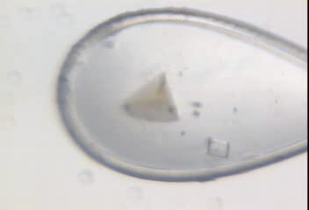
Radiation damage

Slide 4
Radiation damage

Slide 5
What you need to know:
Limits “data photons”
Caveat for active site
Cannot be outrun
Cannot be prevented
Can be corrected
Can be predicted

Slide 6

Life-halving concentration
molar, at the Se edge (RADDOSE)
Na | 44
Mg | 27
P | 9
S | 7
Cl | 5
K | 3.3
Ca | 2.7
Fe | 1.0
Cu | 0.67
Zn | 0.58
As | 0.44
Se | 0.42
Br | 2.9
I | 0.47
Gd | 0.21
Ta | 0.13
Pt | 0.17
Au | 0.16
Hg | 0.16
U | 0.23
Holton JSR 2009

Slide 7
MGy reaction reference
~45 global damage Owen et al. (2006)
10/Å global damage Howells et al. (2009)
5 Se-Met Holton (2007)
4 Hg-S Ramagopal et al. (2004)
4 R-C-COOH Garman et al. (2015)
3 S-S Murray et al. (2002)
1 Br-RNA Olieric et al. (2007)
~1? Cl-C ???
0.5 Mn in PS II Yano et al. (2005)
0.06 putidaredoxin Corbett et al. (2007)
0.02 Fe in myoglobin Denisov et al. (2007)
Radiation Damage World Records
Holton (2009) J. Synchrotron Rad. 16 133-42

Slide 8
What if I’m not on the list?
Rule of thumb:
is it a “good leaving group” ?
  Br
  COO⁻
  S-CH₂-
  CH₃
  H₂

Slide 9

what the is a MGy?
1 MGy = 10⁶ J/kg
http://bl831.als.lbl.gov/
damage_rates.pdf
Holton J. M. (2009) J. Synch Rad. 16 133-42

Slide 10
How long will my crystal last?
synch line type flux beamsize flux density dose max xtal min site
ph/s μm ph/μm2/s rate lifetime lifetime
home FR-E+ Cu 1.2e9 100 1.5e+05 310 Gy/s 27 h 1.8 h
ALS 2.0.1 MAD 2e12 15x15 8.9e+09 4.5 MGy/s 6.7 s 0.44 s
ALS 4.2.2 MAD 1e12 85x55 2.1e+08 108 kGy/s 4.6 m 18 s
ALS 5.0.1 MONO 3.0e11 100 3.8e+07 19.4 kGy/s 26 m 1.7 m
ALS 5.0.2 MAD 1.5e12 100 1.5e+08 130 kGy/s 3.9 m 15 s
ALS 5.0.3 MONO 5.0e11 100 6.4e+07 32.3 kGy/s 15 m 62 s
ALS 8.2.1 MAD 2e12 100x50 4.0e+08 203 kGy/s 2.5 m 9.9 s
ALS 8.2.2 MAD 6e11 75x40 2.0e+08 101 kGy/s 4.9 m 20 s
ALS 8.3.1 MAD 1.0e12 60x80 2.1e+08 154 kGy/s 3.3 m 13 s
ALS 12.3.1 SAXS 4e13 200? 1.0e+09 707 kGy/s 42 s 2.8 s
SSRL BL6-2 XAFS 2e13 400x150 3.3e+08 241 kGy/s 2.1 m 8.3 s
SSRL BL7-1 MAD 3e10 200 7.5e+05 558 Gy/s 15 h 60 m
SSRL BL7-3 XAS 1e12 20x2 2.5e+10 4.07 MGy/s 7.4 s 0.49 s
SSRL BL9-2 MAD 8e11 200 2.0e+07 9.66 kGy/s 52 m 3.5 m
SSRL BL9-3 EXAFS 2e12 20x300 3.3e+08 469 kGy/s 64 s 4.3 s
SSRL BL12-2 MAD 4.0e12 100x200 2.0e+08 96.6 kGy/s 5.2 m 21 s
SSRL BL11-3 MONO 5e10 200 1.2e+06 582 Gy/s 14 h 57 m
SSRL BL14-1 MAD 2e11 200 5.0e+06 4.32 kGy/s 1.9 h 7.7 m
SSRL BL4-3 XAFS 1e12 20x20 2.5e+09 769 kGy/s 39 s 2.6 s
SSRL BL2-3 EXAFS 1e10 2 2.5e+09 804 kGy/s 37 s 2.5 s
SSRL BL14-3 EXAFS 2e10 5 8.0e+08 6.99 MGy/s 4.3 s 0.29 s
CHESS F1 MONO 3.0e11 100 3.0e+07 14.2 kGy/s 35 m 2.3 m
CHESS F2 MAD 8e11 3x944 2.3e+08 148 kGy/s 3.4 m 14 s
CHESS F3 SAD 4e9 300 4.4e+04 37.8 Gy/s 9.2 d 15 h
synch line type flux beamsize flux density dose max xtal min site
ph/s μm ph/μm2/s rate lifetime lifetime

Slide 11
How long will my crystal last?
synch line type flux beamsize flux density dose max xtal min site
ph/s μm ph/μm2/s rate lifetime lifetime
APS 5ID-B POWDER 5e12 1000x300 1.7e+07 8.25 kGy/s 61 m 4 m
APS 8-BM MAD 1e11 200 2.5e+06 858 Gy/s 9.7 h 39 m
APS 14-BM-C MONO 6e11 130x200 2.3e+07 11 kGy/s 46 m 3 m
APS 14-ID-B LAUE 7e13 15x20 2.3e+11 132 MGy/s 0.23 s 0.015 s
APS 17-BM POWDER 8e11 200 2.0e+07 8.72 kGy/s 57 m 3.8 m
APS 17-ID MAD 7e11 200 1.8e+07 9.87 kGy/s 51 m 3.4 m
APS 18-ID SAXS 2e13 50x150 2.7e+09 2.69 MGy/s 11 s 0.74 s
APS 19-BM MAD 6e+08 60x50 2.0e+05 77.3 Gy/s 4.5 d 7.2 h
APS 19-ID MAD 3e+10 100x20 1.5e+07 7.81 kGy/s 64 m 4.3 m
APS 21-ID-D MAD 5e12 50 2.0e+09 1.13 MGy/s 27 s 1.8 s
APS 21-ID-F MONO 1e12 50 4.0e+08 190 kGy/s 2.6 m 11 s
APS 21-ID-G MONO 1e12 50 4.0e+08 190 kGy/s 2.6 m 11 s
APS 22-BM MAD 7e12 40x80 2.2e+09 750 kGy/s 40 s 2.7 s
APS 22-ID MAD 7e12 40x80 2.2e+09 750 kGy/s 40 s 2.7 s
APS 23-BM-B MAD 2e11 200? 5.0e+06 2.47 kGy/s 3.4 h 13 m
APS 23-ID-B MAD 6e12 80x20 3.8e+09 2.11 MGy/s 14 s 0.95 s
APS 23-ID-D MAD 1e13 75x25 5.3e+09 3.01 MGy/s 10 s 0.66 s
APS 24-ID-C MAD 2.5e12 40x60 1.0e+09 357 kGy/s 84 s 5.6 s
APS 24-ID-E MONO 2.85e12 20x120 1.2e+09 563 kGy/s 53 s 3.5 s
APS 31-ID MAD 2.6e12 120x80 2.7e+08 105 kGy/s 4.8 m 19 s
NSLS-II 17-ID-1 MAD 5e12 7x5 1.4e+11 67 MGy/s 0.45 s 0.03 s
NSLS-II 17-ID-2 MAD 2e12 1x1 1.3e+12 626 MGy/s 0.048 s 0.0032 s
NSLS X3A MAD 3.8e10 200 9.5e+05 451 Gy/s 18 h 74 m
NSLS X3B EXAFS 9e11 200x700 6.4e+06 6.48 kGy/s 77 m 5.1 m
NSLS X4A MAD 2e10 300 2.2e+05 136 Gy/s 61 h 4.1 h
NSLS X6A MAD 1.5e12 100x500 3.0e+07 10.3 kGy/s 49 m 3.2 m
NSLS X8C MAD 1.1e10 200? 2.8e+05 204 Gy/s 41 h 2.7 h

Slide 12
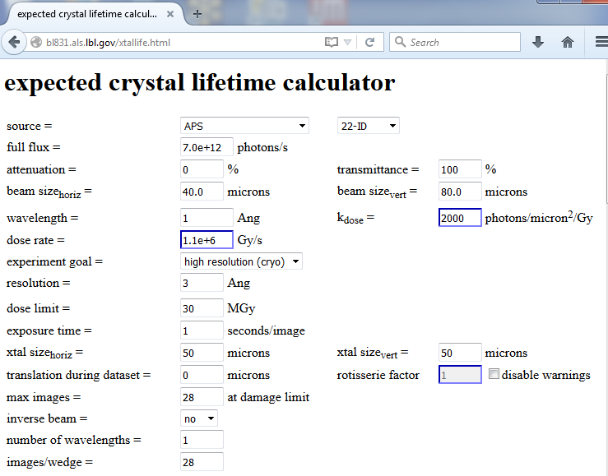


Slide 13
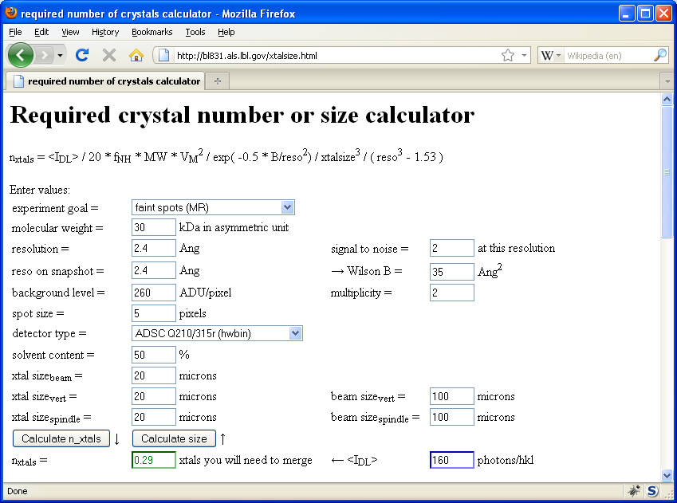

Holton & Frankel (2010) Acta D 66 393-408.

Slide 14
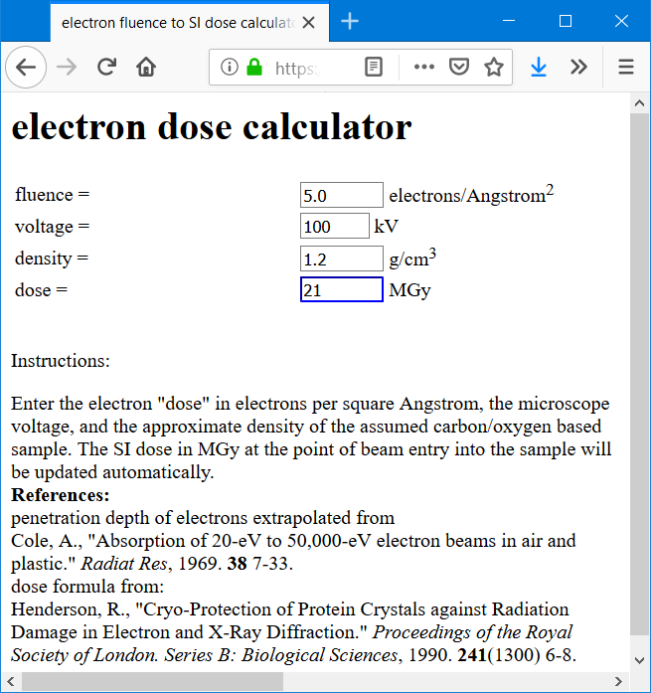
https://bl831.als.lbl.gov/~jamesh/dose2dose.html

Slide 15
The number of photons scattered
before crystal is dead
is independent
of flux & time
1 um³ = 10⁵ photons (roomT)
1 um³ = 10⁶ photons (synch)
1 um³ = 10⁸ photons (XFEL)
(synch)
Henderson, 1990; Gonzalez & Nave, 1994; Glaeser et al., 2000; Sliz et al., 2003; Leiros et al., 2006; Owen et al., 2006; Garman & McSweeney, 2006; Garman & Nave, 2009; Holton, 2009

Slide 16
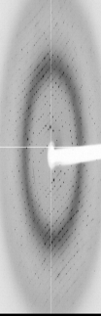
Dose slicing
low
completeness
N
photons
crystal’s useful life
N
photons
Can’t process?
N
photons

Slide 17
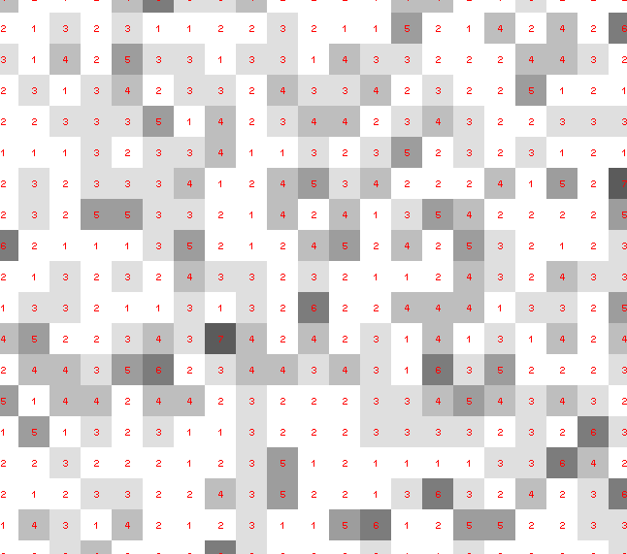
Dose slicing: is that a spot?

Slide 18
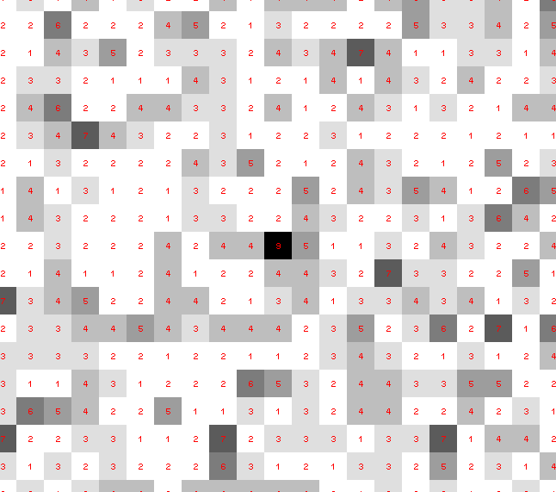
Dose slicing: is that a spot?

Slide 19
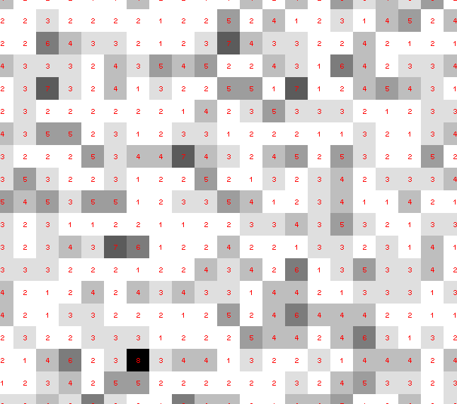
Dose slicing: is that a spot?

Slide 20
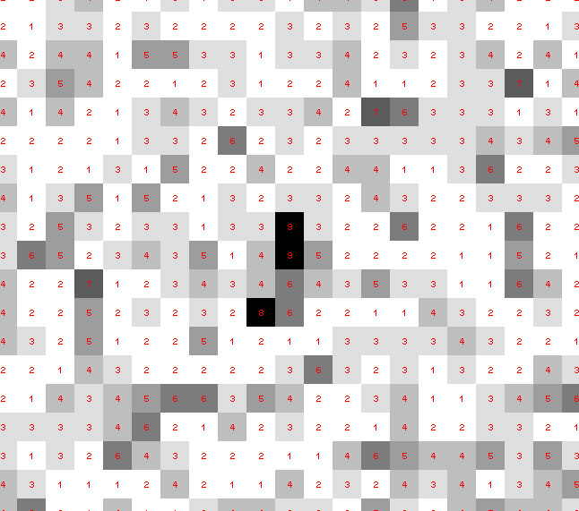
Dose slicing: is that a spot?

Slide 21
Fine dose slicing

Slide 22
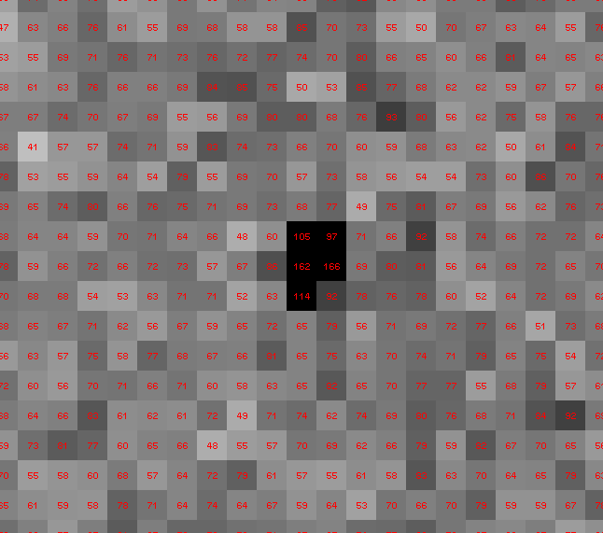
Coarse dose slicing

Slide 23
resolution vs dose slice
Same number of photons
fine | coarse
3.177 | 3.140
Damage correctable | Damage uncorrectable

Slide 24
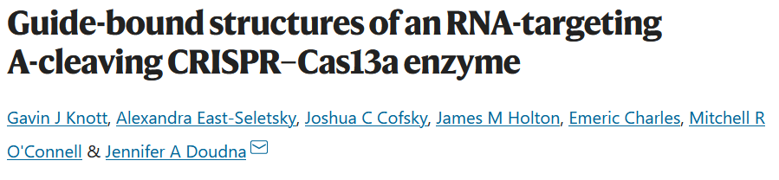
Optimal exposure time:
~1 photon/pixel
PAD detector
Processing with XDS or DIALS

Slide 25
Where do photons go?
Protein
1A x-rays
Transmitted (98%)
beamstop

Slide 26
Elastic scattering

Slide 27
Elastic scattering

Slide 28

Where do photons go?
Protein
1A x-rays
elastic scattering (6%)
Transmitted (98%)
beamstop

Slide 29
Elastic scattering

Slide 30
Inelastic scattering

Slide 31
Where do photons go?
Protein
1A x-rays
elastic scattering (6%)
Transmitted (98%)
beamstop

Slide 32
Where do photons go?
Protein
1A x-rays
elastic scattering (6%)
Transmitted (98%)
beamstop
inelastic scattering (7%)

Slide 33
Where do photons go?
Protein
1A x-rays
elastic scattering (6%)
Transmitted (98%)
beamstop
inelastic scattering (7%)
Re-emitted (99%)
Absorbed (~0%)

Slide 34
Where do photons go?
Protein
1A x-rays
elastic scattering (6%)
Transmitted (98%)
beamstop
inelastic scattering (7%)
Re-emitted (99%)
Absorbed (~0%)

Slide 35
Where do photons go?
Protein
1A x-rays
elastic scattering (6%)
Transmitted (98%)
beamstop
inelastic scattering (7%)
Photoelectric (87%)
Re-emitted (99%)
Absorbed (~0%)

Slide 36
Where do photons go?
Protein
1A x-rays
elastic scattering (6%)
Transmitted (98%)
beamstop
inelastic scattering (7%)
Photoelectric (87%)
Re-emitted (99%)
Absorbed (~0%)
Re-emitted (~0%)
Absorbed (99%)

Slide 37
Where do photons go?
Protein
1A x-rays
elastic scattering (6%)
Transmitted (98%)
beamstop
inelastic scattering (7%)
Photoelectric (87%)
Re-emitted (99%)
Absorbed (~0%)
Re-emitted (~0%)
Absorbed (99%)
useful/absorbed energy: 7.3%

Slide 38
Photoelectric absorption

Slide 39
Photoelectric absorption
e⁻
+

Slide 40
Secondary ionization
e⁻

Slide 41
Secondary ionization
+
e⁻
e⁻

Slide 42
Excitation
e⁻

Slide 43
Excitation
e⁻

Slide 44
Excitation
e⁻

Slide 45
Excitation

Slide 46
Electron attachment
e⁻

Slide 47
Electron attachment
-

Slide 48
Sample atoms

Slide 49
Sample atoms

Slide 50
Primary ionization
e⁻
+

Slide 51
Secondary ionizations
e⁻
e⁻
+
e⁻
e⁻
+
+
+
+
+
e⁻
e⁻

Slide 52
Ionization track
e⁻
e⁻
e⁻
e⁻
+
e⁻
+
+
+
e⁻
e⁻
+
+
+
+
+
e⁻
+
e⁻
e⁻

Slide 53
Ionization track
e⁻
e⁻
e⁻
e⁻
+
e⁻
+
+
+
e⁻
e⁻
+
+
+
+
+
e⁻
+
e⁻
e⁻

Slide 54
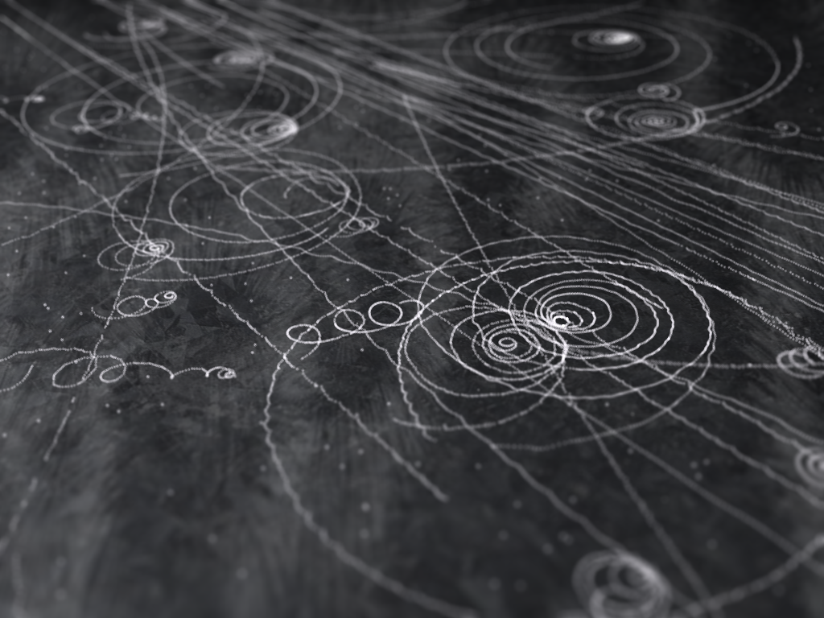
Ionization track

Slide 55
Ionization track

Slide 56
Ionization track
3 μm

Slide 57
Ionization track
Linear Energy Transfer

Slide 58
initial effects
e⁻
e⁻
e⁻
e⁻
+
e⁻
+
+
+
e⁻
e⁻
+
+
+
+
+
e⁻
+
e⁻
e⁻

Slide 59
initial effects
e⁻
e⁻
e⁻
e⁻
+
e⁻
+
+
+
e⁻
neutralization
e⁻
+
+
+
+
+
e⁻
+
e⁻
e⁻

Slide 60
initial effects
e⁻
e⁻
e⁻
e⁻
+
e⁻
+
+
neutralization
e⁻
+
+
+
+
+
e⁻
+
e⁻
e⁻

Slide 61
initial effects
e⁻
e⁻
e⁻
e⁻
+
neutralization
+
e⁻
+
+
+
+
+
neutralization
e⁻
e⁻

Slide 62
initial effects
e⁻
e⁻
e⁻
e⁻
+
+
e⁻
+
+
+
+
+
e⁻
attachment
e⁻

Slide 63
initial effects
e⁻
e⁻
e⁻
e⁻
+
+
e⁻
+
+
+
+
+
-
attachment
e⁻

Slide 64
initial effects
e⁻
e⁻
e⁻
attachment
e⁻
+
+
e⁻
+
+
+
+
+
-
e⁻
attachment

Slide 65
initial effects
e⁻
-
e⁻
e⁻
+
+
e⁻
+
+
+
+
+
-
-

Slide 66
initial effects
-
-
-
e⁻
+
+
+
+
+
+
-
-

Slide 67
initial effects
-
-
-
e⁻
solvation
+
+
+
+
+
+
-
-

Slide 68
initial effects
-
-
-
solvation
+
e⁻
+
+
+
+
+
-
-

Slide 69
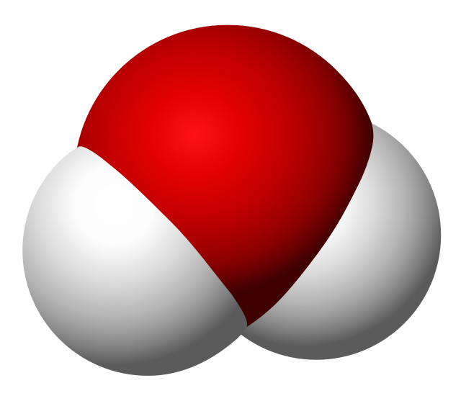
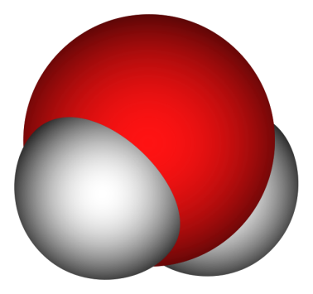
Solvated electron
e⁻

Slide 70
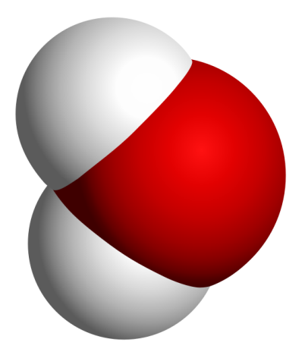
Solvated electron
e⁻

Slide 71
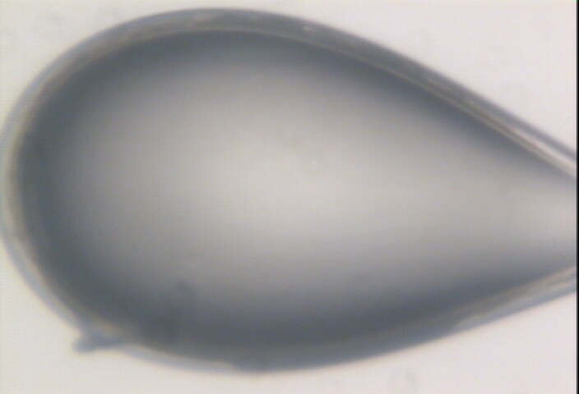

Slide 72
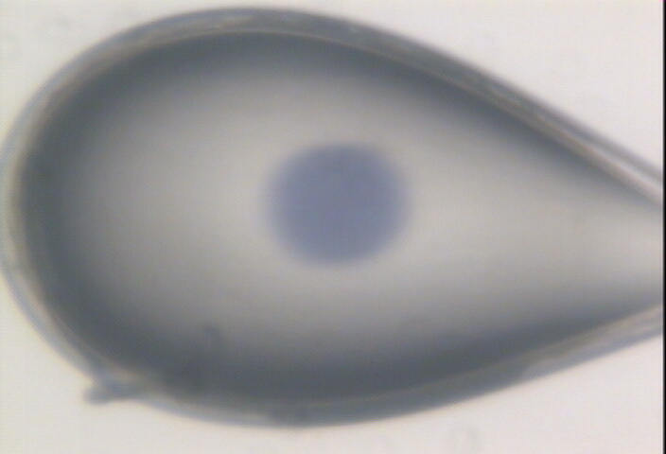

Slide 73
initial effects
-
-
-
+
e⁻
+
+
+
+
+
-
-

Slide 74
initial effects
-
-
-
+
e⁻
+
+
+
+
+
-
-

Slide 75
initial effects
-
-
+
e⁻
+
+
+
+
-
-

Slide 76
initial effects
e⁻
+
+
+
-
-

Slide 77
initial effects
e⁻
+
+
-

Slide 78
Excitation transfer

Slide 79
Excitation transfer
UV photon

Slide 80
Excitation transfer

Slide 81
Excitation transfer
r⁻⁶
Förster transfer

Slide 82
Excitation transfer

Slide 83
t = 0 s

Slide 84
t ≈ 10⁻¹⁴ s
e⁻
+
+
-

Slide 85
Timescales of radiation damage
Garret et. al. (2005) Chem. Rev. 105, 355-389

Slide 86
Timescales of radiation damage
XFEL
synch
bunch
Garret et. al. (2005) Chem. Rev. 105, 355-389

Slide 87
Ionization track
Heterogeneous reactions
Homogeneous reactions

Slide 88
Rough values of energy quanta
1 MeV 100 GJ/mol Medical radiation therapy
100 keV 10 GJ/mol Medical imaging
10 keV 1 GJ/mol X-ray crystallography
1 keV 100 MJ/mol S and P K-edges
100 eV 10 MJ/mol “water window”
10 eV 1 MJ/mol C≡C bond
1 eV 100 kJ/mol C-C bond, visible light
100 meV 10 kJ/mol hydrogen bond
10 meV 1 kJ/mol heat (~300 K)

Slide 89
Types of radiation damage
Global
Specific

Slide 90
Types of radiation damage
Global
Specific
  depends on chemistry

Slide 91
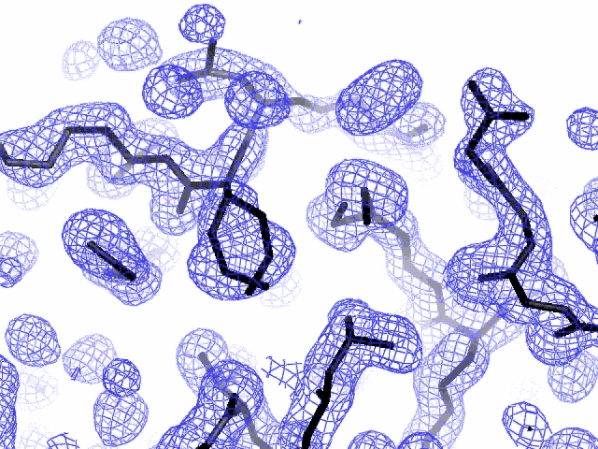
Specific damage
final, refined phases

Slide 92
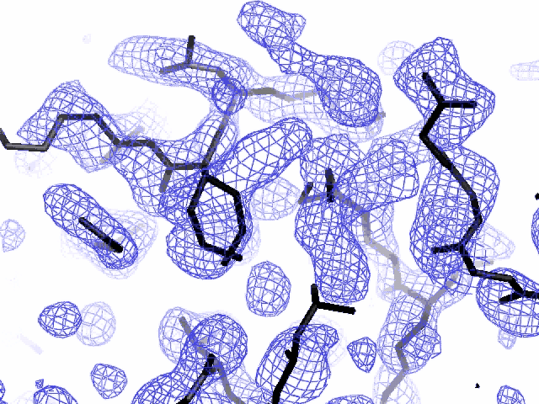
Specific damage
experimentally-obtained phases

Slide 93
Types of radiation damage
Global
Specific
  depends on chemistry
  destroys phasing signal

Slide 94
Holton, J. M. (2007) J. Synch. Rad. 14, 51-72.

Slide 95
1.0
fraction
unconverted
0.0
Holton, J. M. (2007) J. Synch. Rad. 14, 51-72.

Slide 96
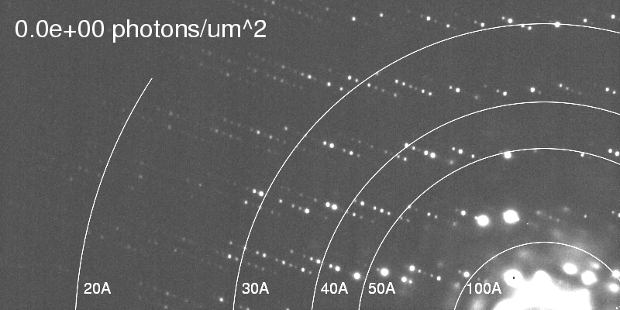
Global damage
Howells, et al. (2009) J. Electron Spectrosc. Relat. Phenom. 170, 4-12.

Slide 97
resolution dependence of global damage
10³
100
maximum tolerable dose (MGy)
10
1
1 2 3 5 7 10 20 40 70 100
resolution (Å)
Howells et al. (2009) J. Electron. Spectrosc. Relat. Phenom. 170 4-12

Slide 98
resolution dependence of global damage
10³
10 MGy/Å
100
maximum tolerable dose (MGy)
10
1
1 2 3 5 7 10 20 40 70 100
resolution (Å)
Howells et al. (2009) J. Electron. Spectrosc. Relat. Phenom. 170 4-12

Slide 99
what the is a MGy?
1 MGy = 10⁶ J/kg
http://bl831.als.lbl.gov/
damage_rates.pdf
Holton J. M. (2009) J. Synchrotron Rad. 16 133-42

Slide 100
MGy reaction reference
~45 global damage Owen et al. (2006)
10/Å global damage Howells et al. (2009)
5 Se-Met Holton (2007)
4 Hg-S Ramagopal et al. (2004)
4 R-C-COOH Garman et al. (2015)
3 S-S Murray et al. (2002)
1 Br-RNA Olieric et al. (2007)
~1? Cl-C ???
0.5 Mn in PS II Yano et al. (2005)
0.06 putidaredoxin Corbett et al. (2007)
0.02 Fe in myoglobin Denisov et al. (2007)
Radiation Damage World Records
Holton (2009) J. Synchrotron Rad. 16 133-42

Slide 101
Radiation damage

Slide 102
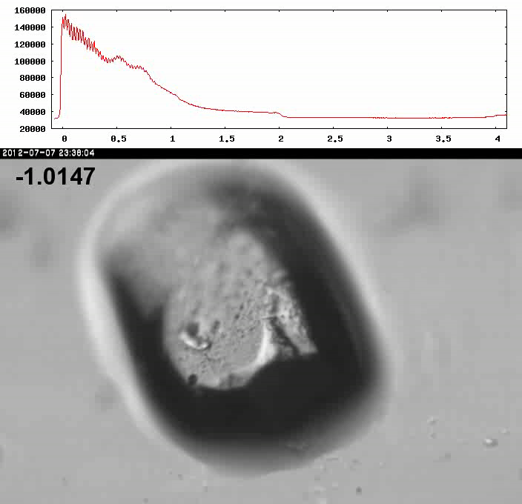
Xtal5_t1 graph

Slide 103
How much water are we burning?
Meents et al. (2010) claimed:
"400 molecules of H2 for every 12.5 keV photon“
= 3.3x10⁻⁷ mol/J
200 kGy to 100 um³ = 0.24 J
= 1.2x10⁻⁸ mol H₂
100 um³ of water = 6.7x10⁻⁸ mol
→ 18% of water has reacted!

Slide 104
Life-halving concentration
molar, at the Se edge based on RADDOSE
Na | 44
Mg | 27
P | 9
S | 7
Cl | 5
K | 3.3
Ca | 2.7
Fe | 1.0
Cu | 0.67
Zn | 0.58
As | 0.44
Se | 0.42
Br | 2.9
I | 0.47
Gd | 0.21
Ta | 0.13
Pt | 0.17
Au | 0.16
Hg | 0.16
U | 0.23

Slide 105
Life-halving concentration
molar, at the Se edge based on RADDOSE
Na | 44
Mg | 27
P | 9
S | 7
Cl | 5
K | 3.3
Ca | 2.7
Fe | 1.0
Cu | 0.67
Zn | 0.58
As | 0.44
Se | 0.42
Br | 2.9
I | 0.47
Gd | 0.21
Ta | 0.13
Pt | 0.17
Au | 0.16
Hg | 0.16
U | 0.23

Slide 106
wavelength dependence of required crystal size
Å
crystal diameter (μm)
Holton & Frankel (2010) Acta D 66 393-408.

Slide 107
Does wavelength make a difference? not really

Slide 108
660%
Protective Measure
Holton, J. M. (2007) J. Synch. Rad. 14, 51-72.

Slide 109
Can radiation damage be prevented?
Yes! By keeping dose low

Slide 110
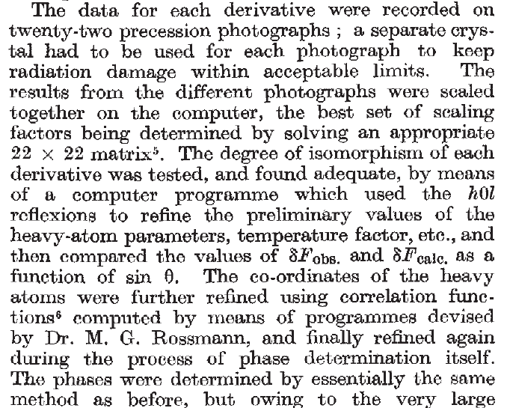
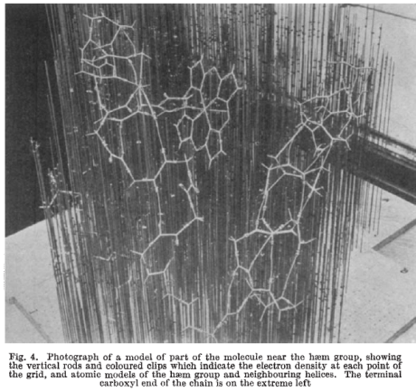
Multi-crystal strategies
Kendrew et al. (1960) "Structure of Myoglobin” Nature 185, 422-427.

Slide 111
Can radiation damage be “outrun”?

Slide 112
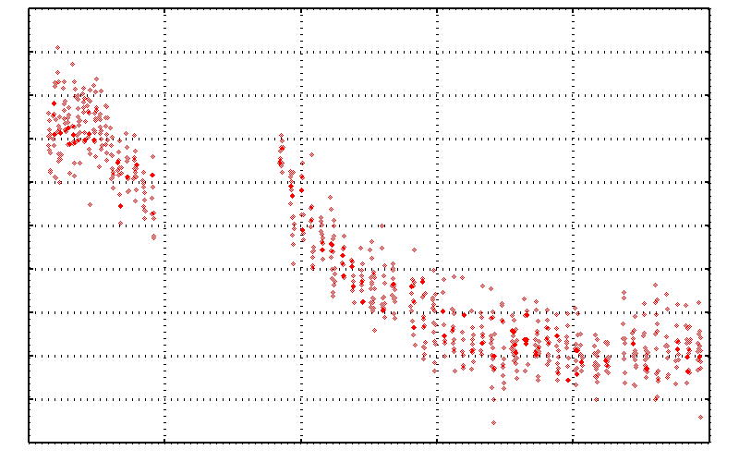
No Damage in the Dark!
4.6 5.0 5.4 5.8 6.2 6.6
Peak absorbance (electrons)
0 5 10 15 20 25
Experiment time (hours)

Slide 113
Double-tap: no dark progression at 675 kGy/s
Intensity (photons)
Time (seconds)

Slide 114
Dose-rate dependence of damage
maximum useful dose (MGy)
dose rate (kGy/s)

Slide 115
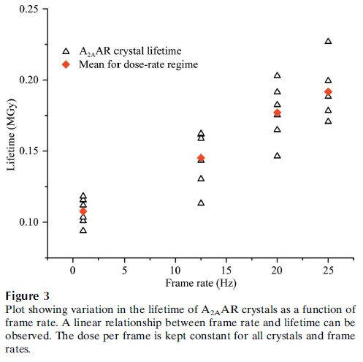
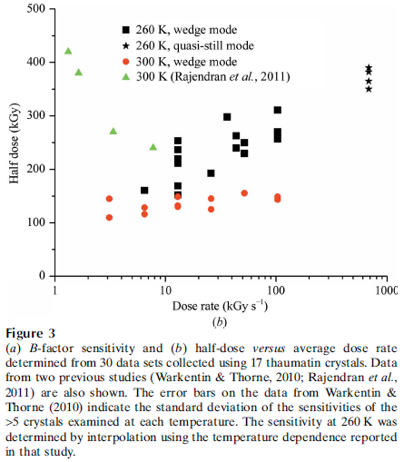
Dose-rate effect at Room Temp?
Owen RL, Axford D, Nettleship JE, Owens RJ, Robinson JI, Morgan AW, Dore AS, Lebon G, Tate CG, Fry EE, Ren J, Stuart DI & Evans G (2012)."Outrunning free radicals in room-temperature macromolecular crystallography", Acta Cryst. D 68, 810-818.
Warkentin M, Badeau R, Hopkins JB, Mulichak AM, Keefe LJ & Thorne RE (2012)."Global radiation damage at 300 and 260 K with dose rates approaching 1 MGy s-1", Acta Cryst. D 68, 124-133.

Slide 116
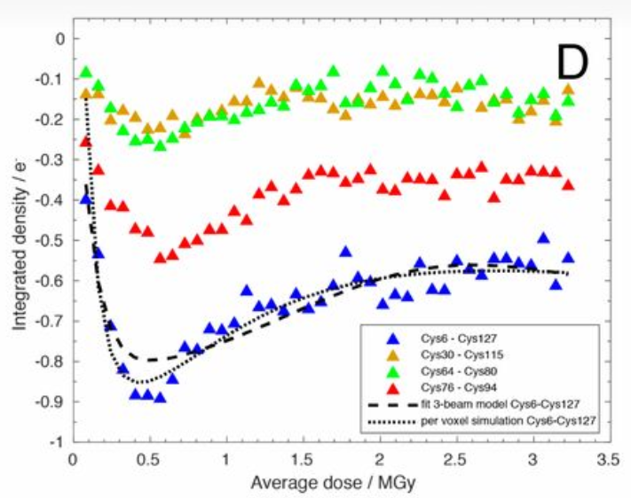
Damage reversal? No.
https://doi.org/10.1073/pnas.1821522117

Slide 117
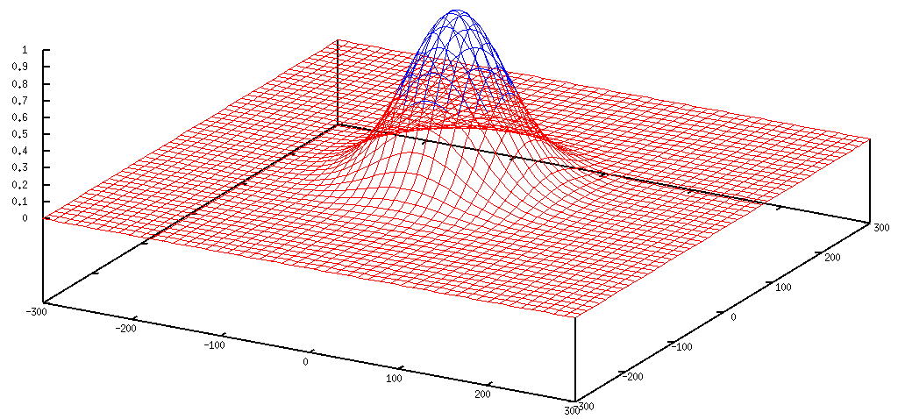
Gaussian beam
50% of flux
the other 50%

Slide 118
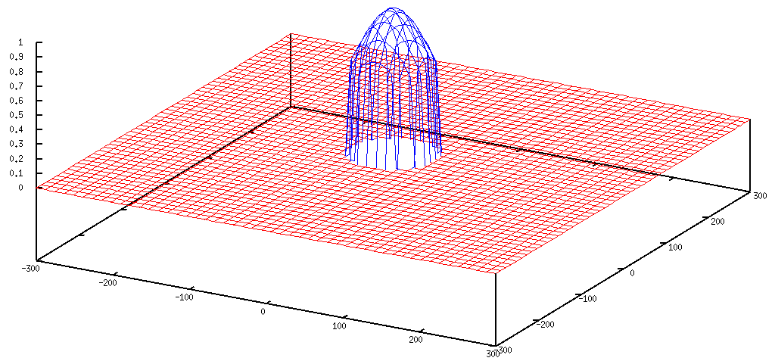
Collimated beam
100% of flux
0%

Slide 119
Tipping point for µfocus:
10 µm
~1 mrad =0.06°
~10 mm

Slide 120
Can radiation damage be “outrun”?
not really

Slide 121
Can radiation damage be corrected?
Yes, if you have enough information

Slide 122
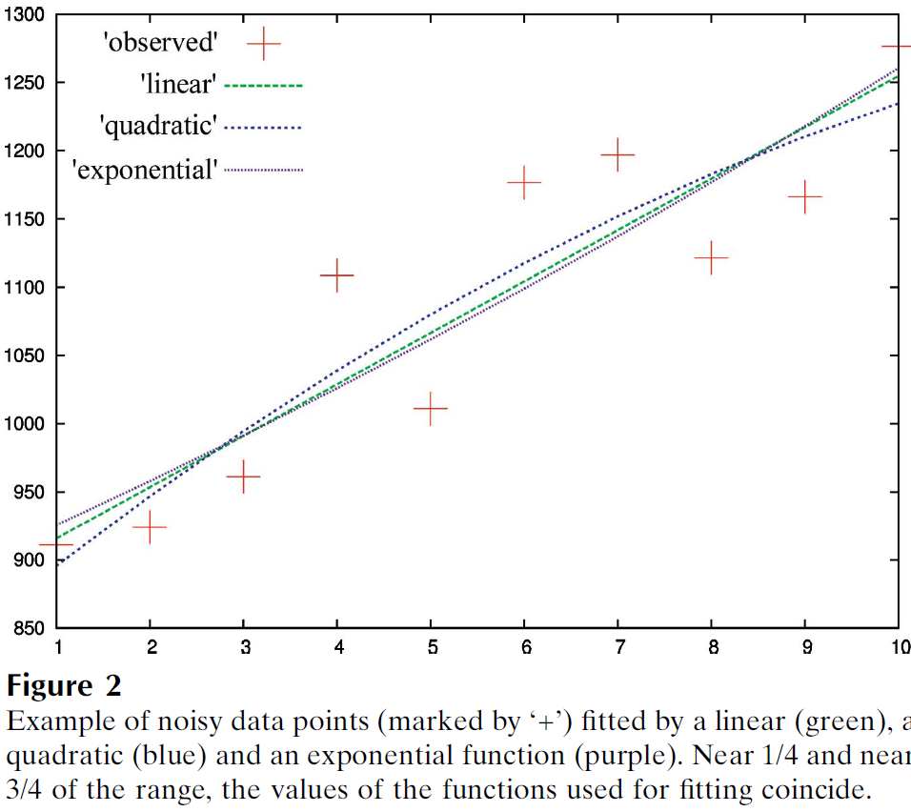
Zero-dose extrapolation (ZDE)
Diederichs, K. (2006). "Some aspects of quantitative analysis and correction of radiation damage." Acta Cryst. D 62(1): 96-101.

Slide 123
How to lose information
long exposures
  >1 photon/image = order of arrivals
Wide phi slice
  sum over angle
Large beams
  sum over area
Pink/divergent beam
  sum over lambda/angle
Background
  non-crystal stuff
Systematics
  Dose contrast

Slide 124
The Entropy Limit
bits
s
= log₂(N_{pixels}) * flux * t_{sample} * 1.2x10⁻⁵
minimum data rate with no information loss
N_{pixels} = 4150*4371 for Eiger
flux = photons/s onto the sample
t_{sample} = sample thickness in µm
1.2x10⁻⁵ = 10⁻⁴ cm/µm * cross section of oxygen (0.2 cm²/g)
* density of protein crystal (1.2 g/cm³ )
* ~1/2 of total scattering intersects detector
E.G. 34 GByte/s for 10¹³ photons/s and 100 µm thick

Slide 125
Optimal exposure time
Dose of dataset (MGy) <= half-reaction point

Slide 126
Types of radiation damage
Global
  scale factor
  B factor
  non-isomorphism
Specific
  depends on chemistry
  destroys phasing signal

Slide 127
Types of radiation damage
Global
  scale factor
  B factor
  non-isomorphism
Specific
  depends on chemistry
  destroys phasing signal

Slide 128
R_{iso} vs dose
R_{iso} (%)
change in dose (MGy)
data taken from Banumathi, et al. (2004) Acta Cryst. D 60, 1085-1093.

Slide 129
R_{iso} vs dose
R_{iso} ≈ 0.7 %/MGy
R_{iso} (%)
change in dose (MGy)
data taken from Banumathi, et al. (2004) Acta Cryst. D 60, 1085-1093.

Slide 130
anomalous signal
ΔF
F
√
# sites
MW (Da)
≈ 1.2 f”
World record!
ΔF/F = 0.5%
Wang, Dauter & Dauter (2006) Acta Cryst. D 62, 1475-1483.
Crick, F. H. C. & Magdoff, B. S. (1956) Acta Crystallogr. 9, 901-908.
Hendrickson, W. A. & Teeter, M. M. (1981) Nature 290, 107-113.

Slide 131
Optimal exposure time
Dose of dataset (MGy)
<=
anomalous signal (%)

Slide 132
Radiation Damage
http://bl831.als.lbl.gov/xtalsize.html
http://bl831.als.lbl.gov/xtallife.html
http://bl831.als.lbl.gov/~jamesh/powerpoint/Rapidata_raddam_2023.pptx
Know your dose! (MGy)
Avoid World Records
disorder dominates everything
“Attenu-wait”: dose slicing
Stay hydrated!

Slide 133
Radiation Damage
Know your dose! (MGy)
Avoid World Records
Keep your atoms light
“Attenu-wait”: fine dose slicing
Keep on spinning

Slide 134
… but does it work for membrane proteins?
CCP4BB:
“We used it for a large membrane protein complex and diffraction improved from ~7 to 2.7 A. The crystal is fished out and put into mother liquor solution in the button, sealed with dialysis membrane and the button is then placed into about 5 mls of mother liquor with slightly higher PEG concentration. Then you just exchange outside buffer every day or so for solutions containing higher concentrations of PEG. We went from ~9 to 30 % PEG4000 in about a week. You can easily observe crystal under microscope and if it cracks - you went too far/too quickly with PEG and need to use a bit less next time. Also, this method allows you to control all other components of the dehydrating solution - we needed to decrease salt concentration at the same time as increasing PEG. You can also introduce/increase cryo-protectant concentration at the same time. With these crystals, otherwise excellent dehydration machines already mentioned did not work, possibly because the process had to be really slow.”
Efremov, R. G. & Sazanov, L. A. (2011)."Structure of the membrane domain of respiratory complex I", Nature 476, 414-420.
“To improve diffraction properties, crystals were slowly cooled to 4 C, placed into micro-dialysis buttons, and mother liquor was exchanged by dialysis for 0.1 M sodium acetate (pH 4.8), 0.15 M sodium tartrate (pH 5.0), 30% PEG4000, 0.1% sodium cholate and 12.5% glycerol over a period of 5 days.”

