Slide 1
Acknowledgements
Robert Stroud James Fraser John Spence
Chris Nielsen Clemens Schulze-Briese Aina Cohen Ana Gonzalez
UCSF LBNL SLAC
ALS 8.3.1: TomAlberTron
UC Multicampus Research Programs and Initiatives (MRPI)
NIH NIGMS R01 GM124149
NIH NIGMS P30 GM124169
Integrated Diffraction Analysis Technologies (IDAT)
Plexxikon, Inc.
Synchrotron Radiation Structural Biology Resource (SLAC)
The Advanced Light Source is supported by the Director, Office of Science, Office of Basic Energy Sciences, Materials Sciences Division, of the US Department of Energy under contract No. DE-AC02-05CH11231 at Lawrence Berkeley National Laboratory.

Slide 2
PowerPoint File available:
http://bl831.als.lbl.gov/
~jamesh/powerpoint/
CSHL_raddam_2018.pptx

Slide 3
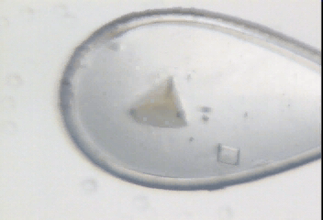
Radiation damage

Slide 4
Where do photons go?
Protein
1A x-rays
Transmitted (98%)
beamstop

Slide 5
Elastic scattering

Slide 6
Elastic scattering

Slide 7

Where do photons go?
Protein
1A x-rays
elastic scattering (6%)
Transmitted (98%)
beamstop

Slide 8
Elastic scattering

Slide 9
Inelastic scattering

Slide 10
Where do photons go?
Protein
1A x-rays
elastic scattering (6%)
Transmitted (98%)
beamstop

Slide 11
Where do photons go?
Protein
1A x-rays
elastic scattering (6%)
Transmitted (98%)
beamstop
inelastic scattering (7%)

Slide 12
Where do photons go?
Protein
1A x-rays
elastic scattering (6%)
Transmitted (98%)
beamstop
inelastic scattering (7%)
Re-emitted (99%)
Absorbed (~0%)

Slide 13
Photoelectric absorption

Slide 14
Photoelectric absorption
e⁻
+

Slide 15
Secondary ionization
e⁻

Slide 16
Secondary ionization
+
e⁻
e⁻

Slide 17
Excitation
e⁻

Slide 18
Excitation
e⁻

Slide 19
Excitation
e⁻

Slide 20
Excitation

Slide 21
Electron attachment
e⁻

Slide 22
Electron attachment
-

Slide 23
Sample atoms

Slide 24
Sample atoms

Slide 25
Primary ionization
e⁻
+

Slide 26
Secondary ionizations
e⁻
e⁻
+
e⁻
e⁻
+
+
+
+
+
e⁻
e⁻

Slide 27
Ionization track
e⁻
e⁻
e⁻
e⁻
+
e⁻
+
+
+
e⁻
e⁻
+
+
+
+
+
e⁻
+
e⁻
e⁻

Slide 28
Ionization track
e⁻
e⁻
e⁻
e⁻
+
e⁻
+
+
+
e⁻
e⁻
+
+
+
+
+
e⁻
+
e⁻
e⁻

Slide 29
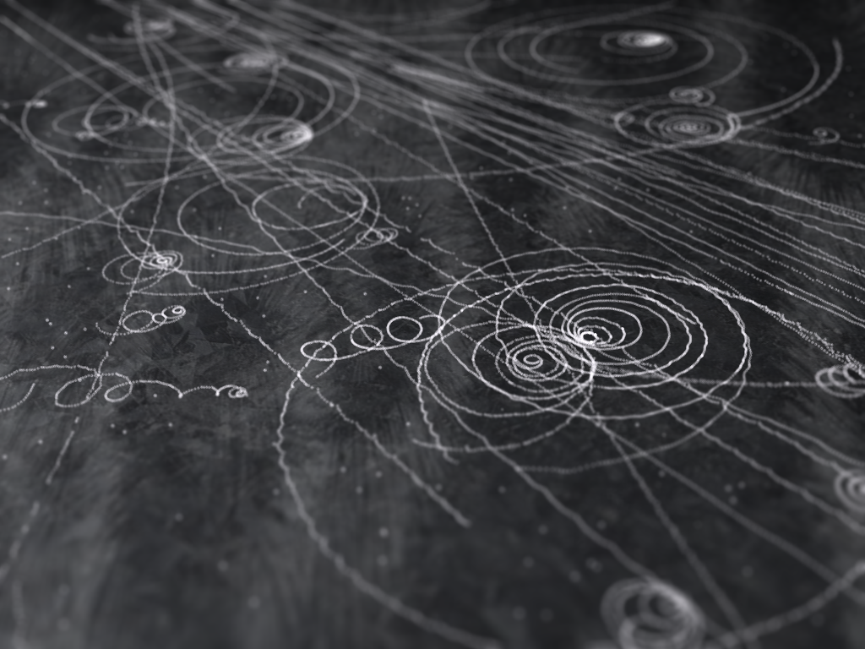
Ionization track

Slide 30
Ionization track

Slide 31
Ionization track
3 μm

Slide 32
Ionization track
Linear Energy Transfer

Slide 33
initial effects
e⁻
e⁻
e⁻
e⁻
+
e⁻
+
+
+
e⁻
e⁻
+
+
+
+
+
e⁻
+
e⁻
e⁻

Slide 34
initial effects
e⁻
e⁻
e⁻
e⁻
+
e⁻
+
+
+
e⁻
neutralization
e⁻
+
+
+
+
+
e⁻
+
e⁻
e⁻

Slide 35
initial effects
e⁻
e⁻
e⁻
e⁻
+
e⁻
+
+
neutralization
e⁻
+
+
+
+
+
e⁻
+
e⁻
e⁻

Slide 36
initial effects
e⁻
e⁻
e⁻
e⁻
+
neutralization
+
e⁻
+
+
+
+
+
neutralization
e⁻
e⁻

Slide 37
initial effects
e⁻
e⁻
e⁻
e⁻
+
+
e⁻
+
+
+
+
+
e⁻
attachment
e⁻

Slide 38
initial effects
e⁻
e⁻
e⁻
e⁻
+
+
e⁻
+
+
+
+
+
-
attachment
e⁻

Slide 39
initial effects
e⁻
e⁻
e⁻
attachment
e⁻
+
+
e⁻
+
+
+
+
+
-
e⁻
attachment

Slide 40
initial effects
e⁻
-
e⁻
e⁻
+
+
e⁻
+
+
+
+
+
-
-

Slide 41
initial effects
-
-
-
e⁻
+
+
+
+
+
+
-
-

Slide 42
initial effects
-
-
-
e⁻
solvation
+
+
+
+
+
+
-
-

Slide 43
initial effects
-
-
-
solvation
+
e⁻
+
+
+
+
+
-
-

Slide 44
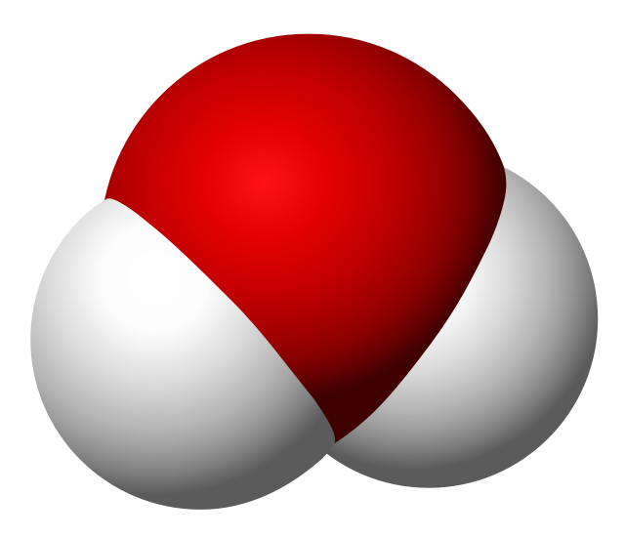
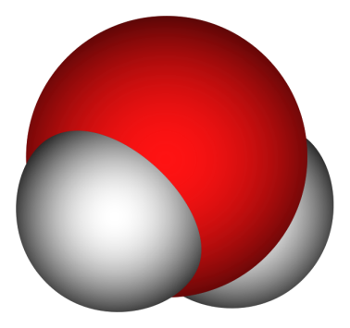
Solvated electron
e⁻

Slide 45
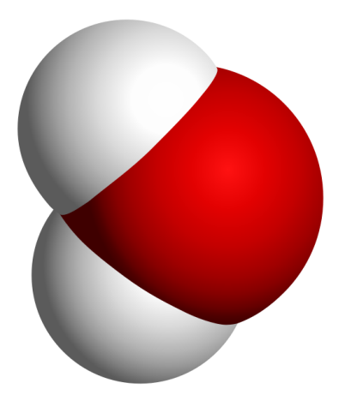
Solvated electron
e⁻

Slide 46
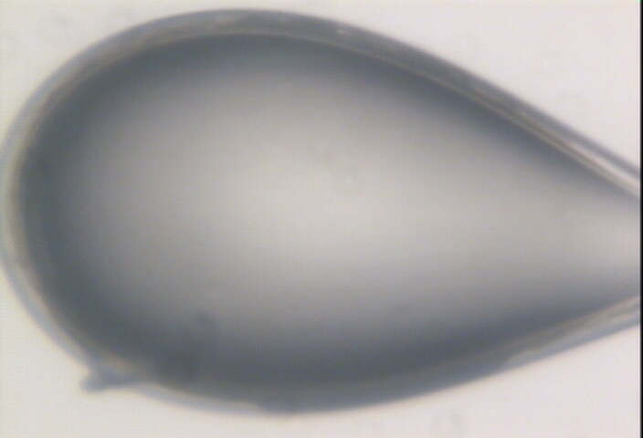

Slide 47
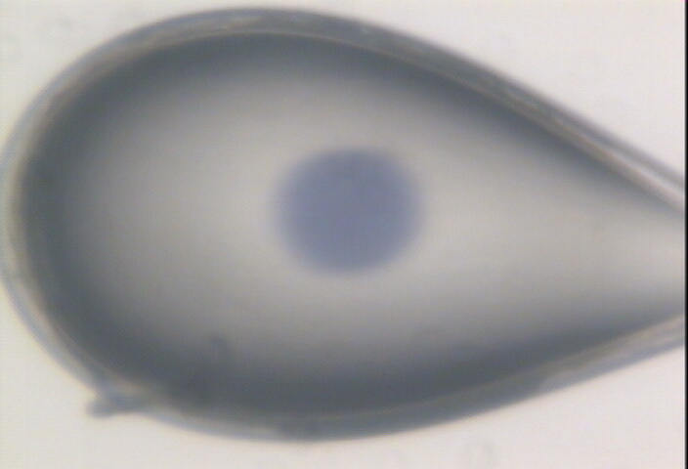

Slide 48
initial effects
-
-
-
+
e⁻
+
+
+
+
+
-
-

Slide 49
initial effects
-
-
-
+
e⁻
+
+
+
+
+
-
-

Slide 50
initial effects
-
-
+
e⁻
+
+
+
+
-
-

Slide 51
initial effects
e⁻
+
+
+
-
-

Slide 52
initial effects
e⁻
+
+
-

Slide 53
Excitation transfer

Slide 54
Excitation transfer
UV photon

Slide 55
Excitation transfer

Slide 56
Excitation transfer
r⁻⁶
Förster transfer

Slide 57
Excitation transfer

Slide 58
t = 0 s

Slide 59
t ≈ 10⁻¹⁴ s
e⁻
+
+
-

Slide 60
Timescales of radiation damage
Garret et. al. (2005) Chem. Rev. 105, 355-389

Slide 61
Timescales of radiation damage
LCLS
ALS
bunch
Garret et. al. (2005) Chem. Rev. 105, 355-389

Slide 62
Ionization track
Heterogeneous reactions
Homogeneous reactions

Slide 63
Where do photons go?
Protein
1A x-rays
elastic scattering (6%)
Transmitted (98%)
beamstop
inelastic scattering (7%)
Re-emitted (99%)
Absorbed (~0%)

Slide 64
Where do photons go?
Protein
1A x-rays
elastic scattering (6%)
Transmitted (98%)
beamstop
inelastic scattering (7%)
Photoelectric (87%)
Re-emitted (99%)
Absorbed (~0%)

Slide 65
Where do photons go?
Protein
1A x-rays
elastic scattering (6%)
Transmitted (98%)
beamstop
inelastic scattering (7%)
Photoelectric (87%)
Re-emitted (99%)
Absorbed (~0%)
Re-emitted (~0%)
Absorbed (99%)

Slide 66
Where do photons go?
Protein
1A x-rays
elastic scattering (6%)
Transmitted (98%)
beamstop
inelastic scattering (7%)
Photoelectric (87%)
Re-emitted (99%)
Absorbed (~0%)
Re-emitted (~0%)
Absorbed (99%)
useful/absorbed energy: 7.3%

Slide 67
Types of radiation damage
Global
Specific

Slide 68
Types of radiation damage
Global
Specific
  depends on chemistry

Slide 69
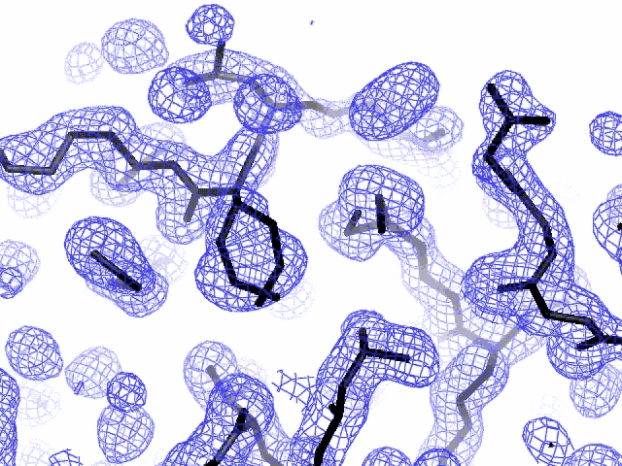
Specific damage
final, refined phases

Slide 70
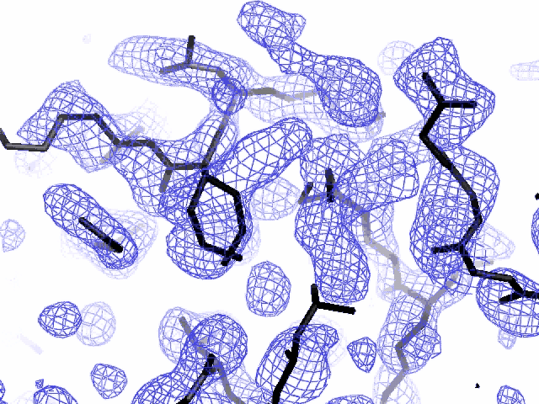
Specific damage
experimentally-obtained phases

Slide 71
Types of radiation damage
Global
Specific
  depends on chemistry
  destroys phasing signal

Slide 72
Holton, J. M. (2007) J. Synch. Rad. 14, 51-72.

Slide 73
1.0
fraction
unconverted
0.0
Holton, J. M. (2007) J. Synch. Rad. 14, 51-72.

Slide 74
MGy reaction reference
~45 global damage Owen et al. (2006)
10/Å global damage Howells et al. (2009)
5 Se-Met Holton (2007)
4 Hg-S Ramagopal et al. (2004)
4 R-C-COOH Garman et al. (2015)
3 S-S Murray et al. (2002)
1 Br-RNA Olieric et al. (2007)
~1? Cl-C ???
0.5 Mn in PS II Yano et al. (2005)
0.06 putidaredoxin Corbett et al. (2007)
0.02 Fe in myoglobin Denisov et al. (2007)
Radiation Damage World Records
Holton (2009) J. Synchrotron Rad. 16 133-42

Slide 75
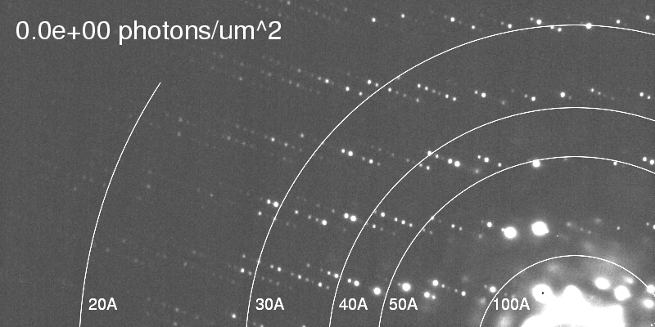
Global damage
Howells, et al. (2009) J. Electron Spectrosc. Relat. Phenom. 170, 4-12.

Slide 76
resolution dependence of global damage
10³
100
maximum tolerable dose (MGy)
10
1
1 2 3 5 7 10 20 40 70 100
resolution (Å)
Howells et al. (2009) J. Electron. Spectrosc. Relat. Phenom. 170 4-12

Slide 77
resolution dependence of global damage
10³
10 MGy/Å
100
maximum tolerable dose (MGy)
10
1
1 2 3 5 7 10 20 40 70 100
resolution (Å)
Howells et al. (2009) J. Electron. Spectrosc. Relat. Phenom. 170 4-12

Slide 78
what the is a MGy?
1 MGy = 10⁶ J/kg
http://bl831.als.lbl.gov/
damage_rates.pdf
Holton J. M. (2009) J. Synchrotron Rad. 16 133-42

Slide 79
How long will my crystal last?
synch line type flux beamsize flux density dose max xtal min site
ph/s μm ph/μm2/s rate lifetime lifetime
APS 5ID-B POWDER 5e12 1000x300 1.7e+07 8.25 kGy/s 61 m 4 m
APS 8-BM MAD 1e11 200 2.5e+06 858 Gy/s 9.7 h 39 m
APS 14-BM-C MONO 6e11 130x200 2.3e+07 11 kGy/s 46 m 3 m
APS 14-ID-B LAUE 7e13 15x20 2.3e+11 132 MGy/s 0.23 s 0.015 s
APS 17-BM POWDER 8e11 200 2.0e+07 8.72 kGy/s 57 m 3.8 m
APS 17-ID MAD 7e11 200 1.8e+07 9.87 kGy/s 51 m 3.4 m
APS 18-ID SAXS 2e13 50x150 2.7e+09 2.69 MGy/s 11 s 0.74 s
APS 19-BM MAD 6e+08 60x50 2.0e+05 77.3 Gy/s 4.5 d 7.2 h
APS 19-ID MAD 3e+10 100x20 1.5e+07 7.81 kGy/s 64 m 4.3 m
APS 21-ID-D MAD 5e12 50 2.0e+09 1.13 MGy/s 27 s 1.8 s
APS 21-ID-F MONO 1e12 50 4.0e+08 190 kGy/s 2.6 m 11 s
APS 21-ID-G MONO 1e12 50 4.0e+08 190 kGy/s 2.6 m 11 s
APS 22-BM MAD 7e12 40x80 2.2e+09 750 kGy/s 40 s 2.7 s
APS 22-ID MAD 7e12 40x80 2.2e+09 750 kGy/s 40 s 2.7 s
APS 23-BM-B MAD 2e11 200? 5.0e+06 2.47 kGy/s 3.4 h 13 m
APS 23-ID-B MAD 6e12 80x20 3.8e+09 2.11 MGy/s 14 s 0.95 s
APS 23-ID-D MAD 1e13 75x25 5.3e+09 3.01 MGy/s 10 s 0.66 s
APS 24-ID-C MAD 2.5e12 40x60 1.0e+09 357 kGy/s 84 s 5.6 s
APS 24-ID-E MONO 2.85e12 20x120 1.2e+09 563 kGy/s 53 s 3.5 s
APS 31-ID MAD 2.6e12 120x80 2.7e+08 105 kGy/s 4.8 m 19 s
NSLS-II 17-ID-1 MAD 5e12 7x5 1.4e+11 67 MGy/s 0.45 s 0.03 s
NSLS-II 17-ID-2 MAD 2e12 1x1 1.3e+12 626 MGy/s 0.048 s 0.0032 s
NSLS X3A MAD 3.8e10 200 9.5e+05 451 Gy/s 18 h 74 m
NSLS X3B EXAFS 9e11 200x700 6.4e+06 6.48 kGy/s 77 m 5.1 m
NSLS X4A MAD 2e10 300 2.2e+05 136 Gy/s 61 h 4.1 h
NSLS X6A MAD 1.5e12 100x500 3.0e+07 10.3 kGy/s 49 m 3.2 m
NSLS X8C MAD 1.1e10 200? 2.8e+05 204 Gy/s 41 h 2.7 h

Slide 80
Life-halving concentration
molar, at the Se edge based on RADDOSE
Na | 44
Mg | 27
P | 9
S | 7
Cl | 5
K | 3.3
Ca | 2.7
Fe | 1.0
Cu | 0.67
Zn | 0.58
As | 0.44
Se | 0.42
Br | 2.9
I | 0.47
Gd | 0.21
Ta | 0.13
Pt | 0.17
Au | 0.16
Hg | 0.16
U | 0.23

Slide 81
Life-halving concentration
molar, at the Se edge based on RADDOSE
Na | 44
Mg | 27
P | 9
S | 7
Cl | 5
K | 3.3
Ca | 2.7
Fe | 1.0
Cu | 0.67
Zn | 0.58
As | 0.44
Se | 0.42
Br | 2.9
I | 0.47
Gd | 0.21
Ta | 0.13
Pt | 0.17
Au | 0.16
Hg | 0.16
U | 0.23

Slide 82
660%

Slide 83
Can radiation damage be prevented?
Yes! By keeping dose low

Slide 84
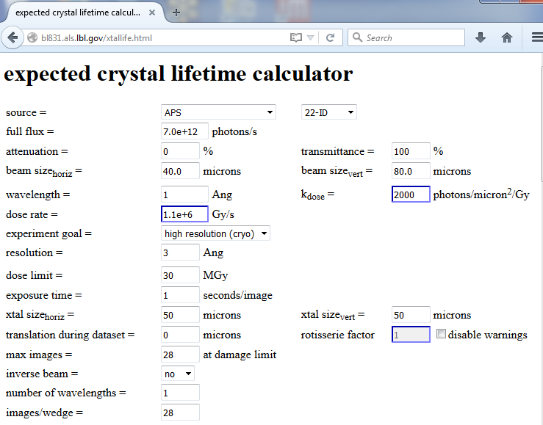

Slide 85
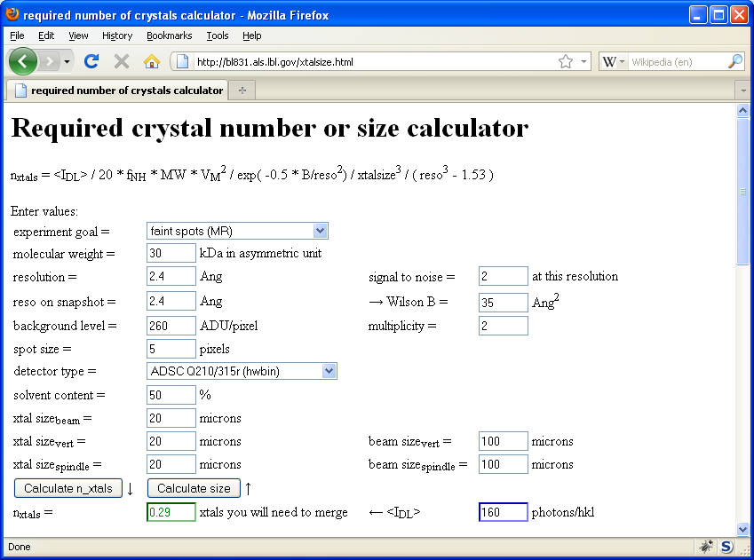
Holton & Frankel (2010) Acta D 66 393-408.

Slide 86
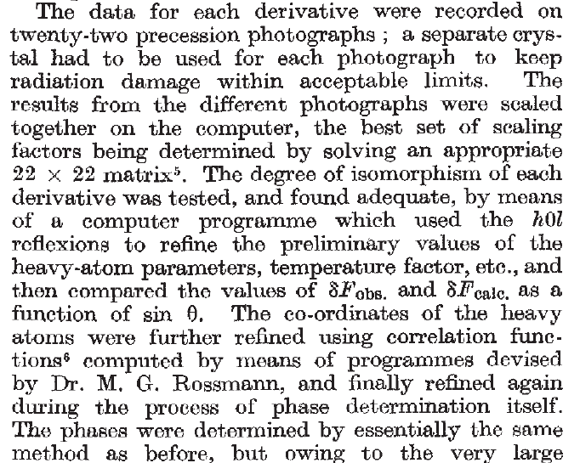
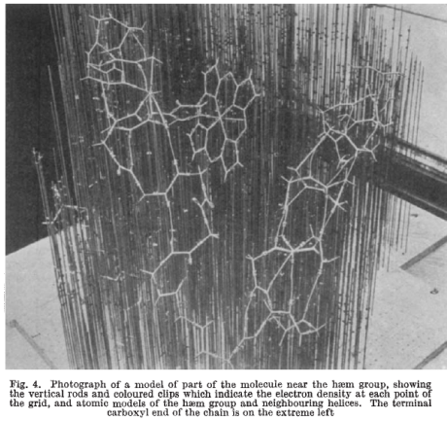
Multi-crystal strategies
Kendrew et al. (1960) "Structure of Myoglobin” Nature 185, 422-427.

Slide 87
Can radiation damage be “outrun”?

Slide 88
Dose-rate dependence of damage
maximum useful dose (MGy)
dose rate (kGy/s)

Slide 89
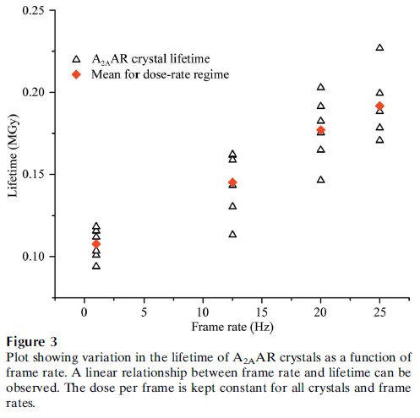
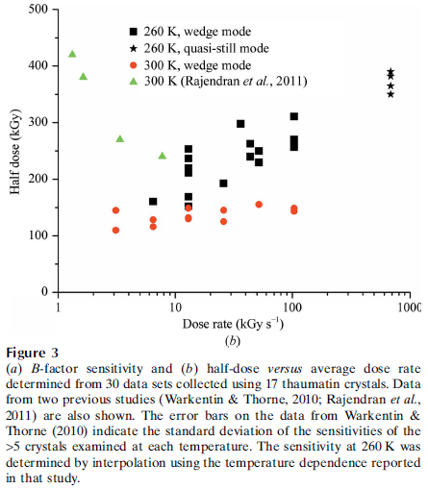
Dose-rate effect at Room Temp?
Owen RL, Axford D, Nettleship JE, Owens RJ, Robinson JI, Morgan AW, Dore AS, Lebon G, Tate CG, Fry EE, Ren J, Stuart DI & Evans G (2012)."Outrunning free radicals in room-temperature macromolecular crystallography", Acta Cryst. D 68, 810-818.
Warkentin M, Badeau R, Hopkins JB, Mulichak AM, Keefe LJ & Thorne RE (2012)."Global radiation damage at 300 and 260 K with dose rates approaching 1 MGy s-1", Acta Cryst. D 68, 124-133.

Slide 90
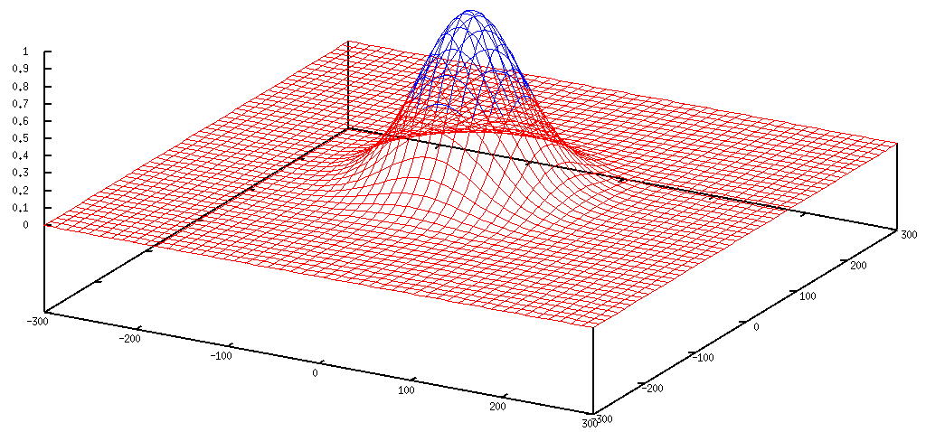
Gaussian beam
50% of flux
the other 50%

Slide 91
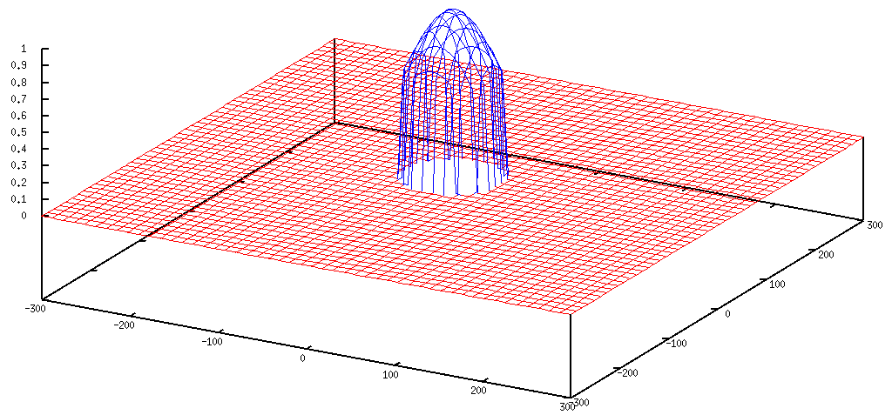
Collimated beam
100% of flux
0%

Slide 92
Tipping point for µfocus:
10 µm
~1 mrad =0.06°
~10 mm

Slide 93
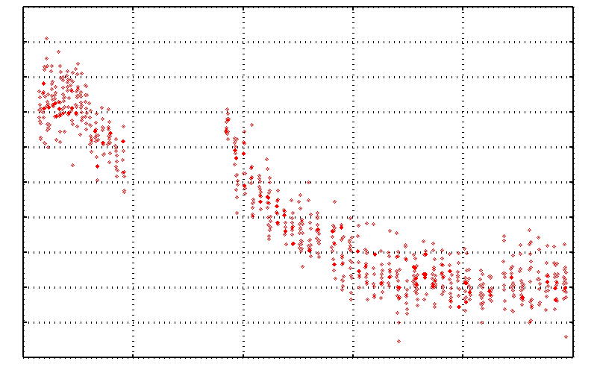
No Damage in the Dark!
4.6 5.0 5.4 5.8 6.2 6.6
Peak absorbance (electrons)
0 5 10 15 20 25
Experiment time (hours)

Slide 94
Double-tap: no dark progression at 675 kGy/s
Intensity (photons)
Time (seconds)

Slide 95
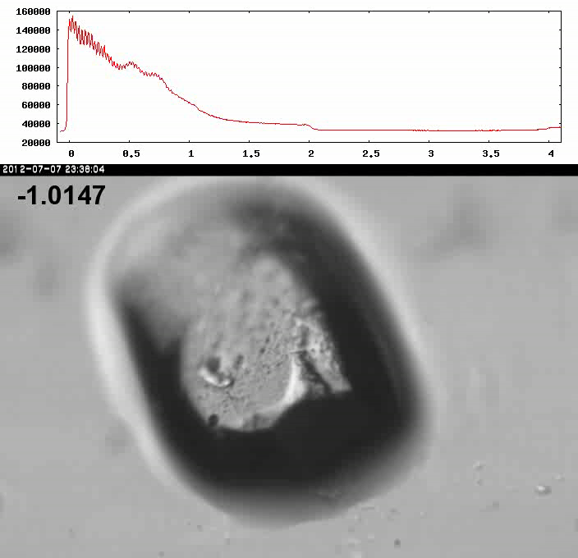
Xtal5_t1 graph

Slide 96
How much water are we burning?
Meents et al. (2010) claimed:
"400 molecules of H2 for every 12.5 keV photon“
= 3.3x10⁻⁷ mol/J
200 kGy to 100 um³ = 0.24 J
= 1.2x10⁻⁸ mol H₂
100 um³ of water = 6.7x10⁻⁸ mol
→ 18% of water has reacted!

Slide 97
thaw
Radiation damage

Slide 98
Can radiation damage be “outrun”?
not really

Slide 99
Self-calibrated damage limit
Where:
⟨I⟩_{DL} - average damage-limited intensity (photons/hkl) at a given resolution
10⁵ - converting R from μm to m, r_{e} from m to Å, ρ from g/cm³ to kg/m³ and MGy to Gy
r_{e} - classical electron radius (2.818 x 10⁻¹⁵ m/electron)
h - Planck’s constant (6.626 x 10⁻³⁴ J∙s)
c - speed of light (299792458 m/s)
f_{decayed} - fractional progress toward completely faded spots at end of data set
ρ - density of crystal (~1.2 g/cm³)
R - radius of the spherical crystal (μm)
λ - X-ray wavelength (Å)
f_{NH} - the Nave & Hill (2005) dose capture fraction (1 for large crystals)
n_{ASU} - number of proteins in the asymmetric unit
M_{r} - molecular weight of the protein (Daltons or g/mol)
V_{M} - Matthews’s coefficient (~2.4 Å³/Dalton)
H - Howells’s criterion (10 MGy/Å)
θ - Bragg angle
⟨ƒ_{a}²⟩ - number-averaged squared structure factor per protein atom (electron²)
⟨M_{a}⟩ - number-averaged atomic weight of a protein atom (~7.1 Daltons)
B - average (Wilson) temperature factor (Å²)
μ - attenuation coefficient of sphere material (m⁻¹)
μ_{en} - mass energy-absorption coefficient of sphere material (m⁻¹)
No flux
No symmetry
No exposure time
Holton & Frankel (2010) Acta D 66 393-408.

Slide 100
The number of photons scattered
before crystal is dead
is independent
of flux & time
1 um³ = 10⁵ photons (roomT)
1 um³ = 10⁶ photons (synch)
1 um³ = 10⁸ photons (XFEL)
(synch)
Henderson, 1990; Gonzalez & Nave, 1994; Glaeser et al., 2000; Sliz et al., 2003; Leiros et al., 2006; Owen et al., 2006; Garman & McSweeney, 2006; Garman & Nave, 2009; Holton, 2009

Slide 101

Dose slicing
unacceptable
completeness
N
photons
crystal’s useful life
N
photons
unacceptable
read noise
N
photons

Slide 102
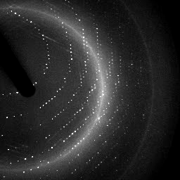

X-ray data are 3D!

Slide 103
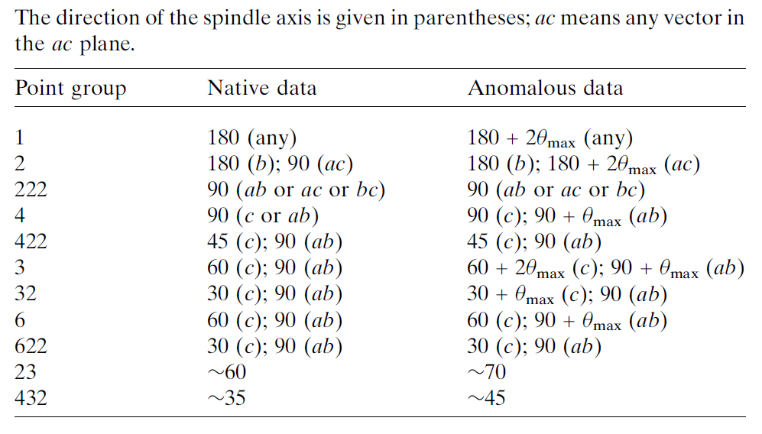
Data collection “strategy”
The “American Method”:
360° no matter what
(shoot first, questions later)
Dauter, Z. (1999). "Data-collection strategies." Acta Cryst. D 55(10): 1703-1717.

Slide 104
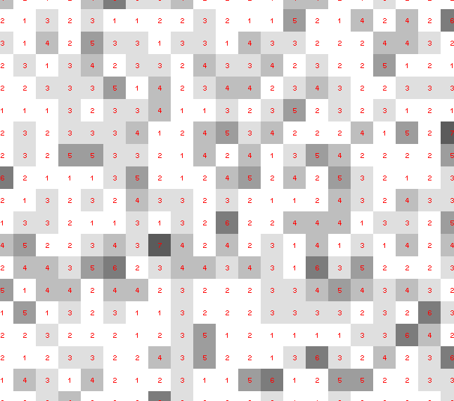
Dose slicing: is that a spot?

Slide 105
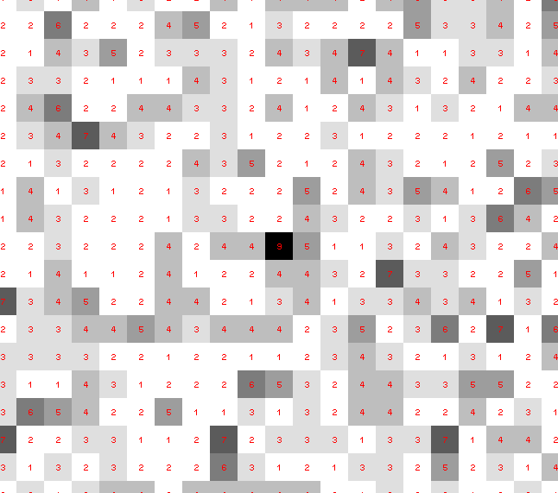
Dose slicing: is that a spot?

Slide 106
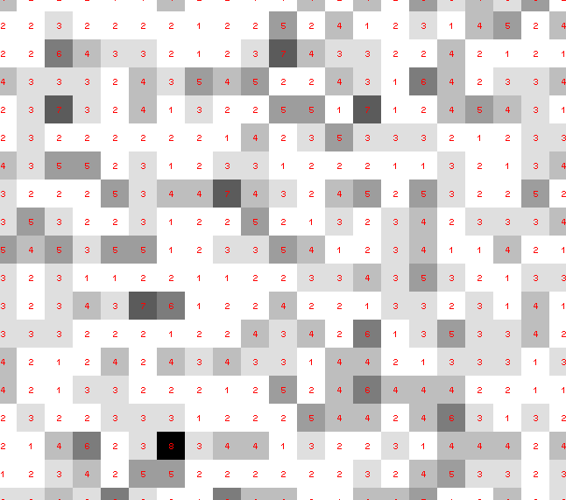
Dose slicing: is that a spot?

Slide 107
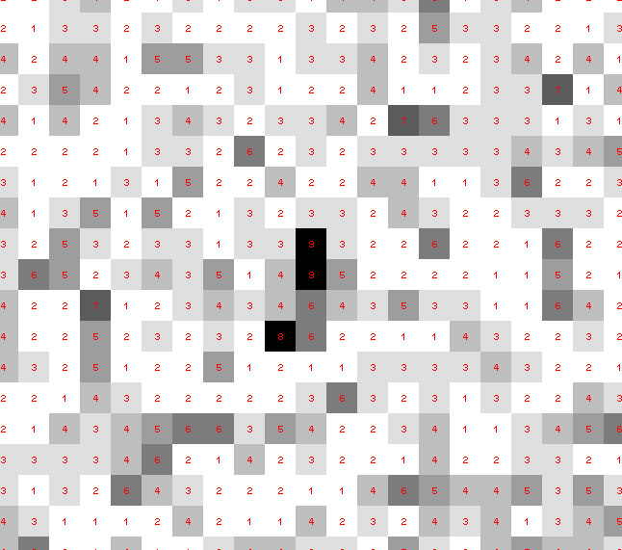
Dose slicing: is that a spot?

Slide 108
Dose slicing: is that a spot?

Slide 109
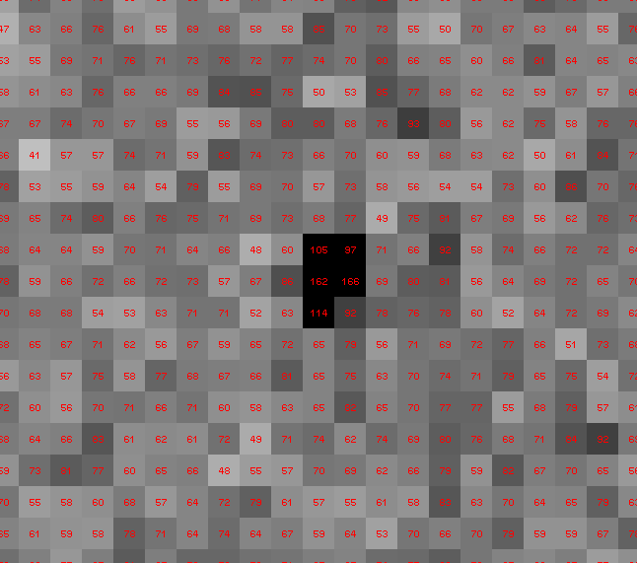
Dose slicing: is that a spot?

Slide 110
What if?
You only have a few small crystals…
Should you:
  Collect 360° from each?
  Collect 10° from each at 36x exposure?
  Glue 36 xtals together, then collect 360° ?

Slide 111
“true” resolution limit
CC vs right answer
Resolution (Å)

Slide 112
“true” resolution vs strategy
Dose slice collection scenario
fine | coarse | glue
3.17700 | 3.14057 | 3.17604
301,640,334 photons/xtal

Slide 113
processing procedure | resolution limit
 | fine | coarse | glue | glue&fine
XDS/XSCALE | 3.17700 | 3.14057 | 3.17604 | 3.12086
XDS/aimless | 3.16251 | 3.15922 | 3.16675 | 3.12162
XDS/noscale | 3.27289 | 3.15617 | 3.38929 | 3.12162
MOSFLM-defaults | x | x | x | x
MOSFLM-cheat | 3.19755 | 3.18166 | 3.20354 | 3.19755
HKL2000-defaults | x | x | x | x
HKL2000-expert | 3.21803 | 3.12646 | 3.11551 | 3.21803
HKL2000-cheat | 3.16119 | 3.10338 | 3.10338 | 3.16300
DIALS-defaults | x | x | 3.42125 | x
DIALS-expert | 3.10296 | 3.09547 | 3.07653 | 3.08465
d*Trek | ? | ? | 4.34076 | ?
EVAL15 | 3.14352 | 3.10383 | 3.09936 | 3.14105
EVAL15-sadabs | 3.13920 | 3.10797 | 3.10171 | 3.13700

Slide 114
Minimum exposure time:
~1 photon/pixel
  PAD w XDS, DIALS
~10 photon/pixel
PAD w HKL2k, MOSFLM
~30 photon/pixel
CCD detector

Slide 115
Can radiation damage be corrected?
Yes, if you have enough information

Slide 116
How to loose information
long exposures
  >1 photon/image = order of arrivals
Wide phi slice
  sum over angle
Large beams
  sum over area
Pink/divergent beam
  sum over lambda/angle
Background
  non-crystal stuff
Systematics
  Dose contrast

Slide 117
The Entropy Limit
bits
s
= log₂(N_{pixels}) * flux * t_{sample} * 1.2x10⁻⁵
minimum data rate with no information loss
N_{pixels} = 4150*4371 for Eiger
flux = photons/s onto the sample
t_{sample} = sample thickness in µm
1.2x10⁻⁵ = 10⁻⁴ cm/µm * cross section of oxygen (0.2 cm²/g)
* density of protein crystal (1.2 g/cm³ )
* ~1/2 of total scattering intersects detector
E.G. 34 GByte/s for 10¹³ photons/s and 100 µm thick

Slide 118
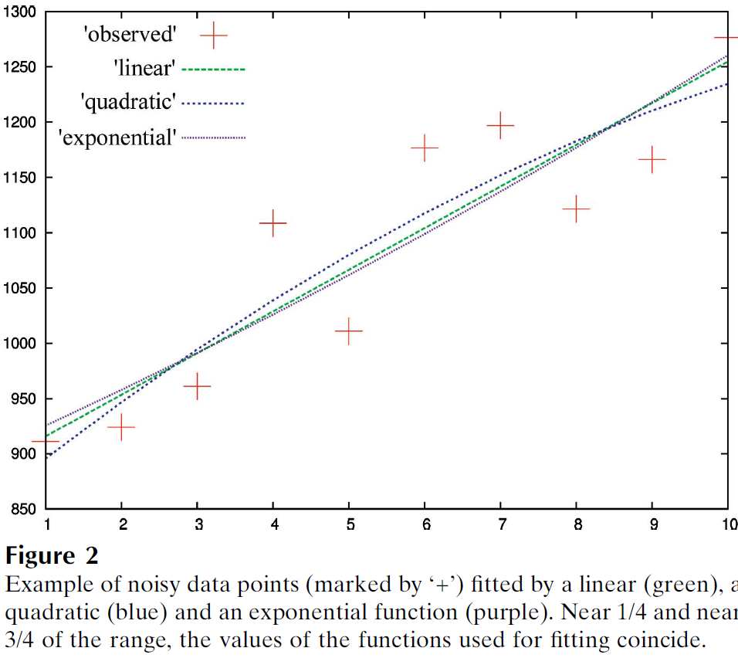
Zero-dose extrapolation (ZDE)
Diederichs, K. (2006). "Some aspects of quantitative analysis and correction of radiation damage." Acta Cryst. D 62(1): 96-101.

Slide 119
Optimal exposure time
Dose of dataset (MGy) <= half-reaction point

Slide 120
Types of radiation damage
Global
  scale factor
  B factor
  non-isomorphism
Specific
  depends on chemistry
  destroys phasing signal

Slide 121
What is “disorder”?

Slide 122
What is “disorder”?

Slide 123
What is “disorder”?

Slide 124

What is “disorder”?
order
order
B-factor
disorder

Slide 125
“B” factors
ATOM 122 N LEU A 13 -3.244 25.808 19.998 1.00 16.96 N
ATOM 123 CA LEU A 13 -2.877 25.448 21.355 1.00 15.29 C
ATOM 124 C LEU A 13 -2.792 23.966 21.561 1.00 17.54 C
ATOM 125 O LEU A 13 -1.814 23.493 22.143 1.00 16.35 O
ATOM 126 CB LEU A 13 -3.907 26.164 22.268 1.00 18.72 C
ATOM 127 CG LEU A 13 -3.577 25.982 23.738 1.00 21.19 C
ATOM 128 CD1 LEU A 13 -2.283 26.820 24.019 1.00 19.43 C
ATOM 129 CD2 LEU A 13 -4.702 26.474 24.639 1.00 24.65 C
ATOM 130 N SER A 14 -3.677 23.149 20.979 1.00 15.96 N
ATOM 131 CA SER A 14 -3.646 21.711 21.061 1.00 18.26 C
ATOM 132 C SER A 14 -2.373 21.203 20.360 1.00 18.71 C
ATOM 133 O SER A 14 -1.747 20.315 20.930 1.00 17.47 O
ATOM 134 CB SER A 14 -4.875 21.077 20.419 1.00 17.62 C
ATOM 135 OG ASER A 14 -4.825 19.665 20.388 0.50 20.89 O
ATOM 136 OG BSER A 14 -6.027 21.408 21.164 0.50 18.67 O
ATOM 137 N LYS A 15 -2.045 21.772 19.215 1.00 18.03 N
ATOM 138 CA LYS A 15 -0.799 21.361 18.555 1.00 18.12 C
ATOM 139 C LYS A 15 0.446 21.707 19.351 1.00 18.81 C
ATOM 140 O LYS A 15 1.400 20.948 19.411 1.00 17.77 O
ATOM 141 CB LYS A 15 -0.700 22.034 17.177 1.00 14.49 C
ATOM 142 CG LYS A 15 -1.727 21.368 16.256 1.00 16.12 C
ATOM 143 CD LYS A 15 -1.663 22.147 14.936 1.00 19.40 C
ATOM 144 CE ALYS A 15 -2.725 21.614 13.986 0.50 17.42 C
ATOM 145 CE BLYS A 15 -1.750 21.211 13.750 0.50 17.01 C
ATOM 146 NZ ALYS A 15 -2.346 21.674 12.559 0.50 18.61 N
ATOM 147 NZ BLYS A 15 -3.052 20.513 13.741 0.50 18.76 N

Slide 126
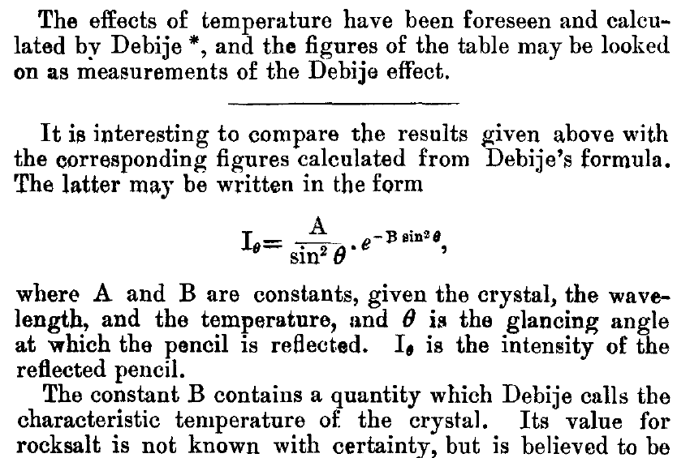
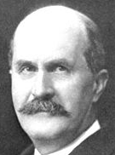
The B factor
Bragg, W. H. (1914)."XCVII. The intensity of reflexion of X rays by crystals", Philosophical Magazine Series 6 27, 881-899. Published May 1 1914

Slide 127
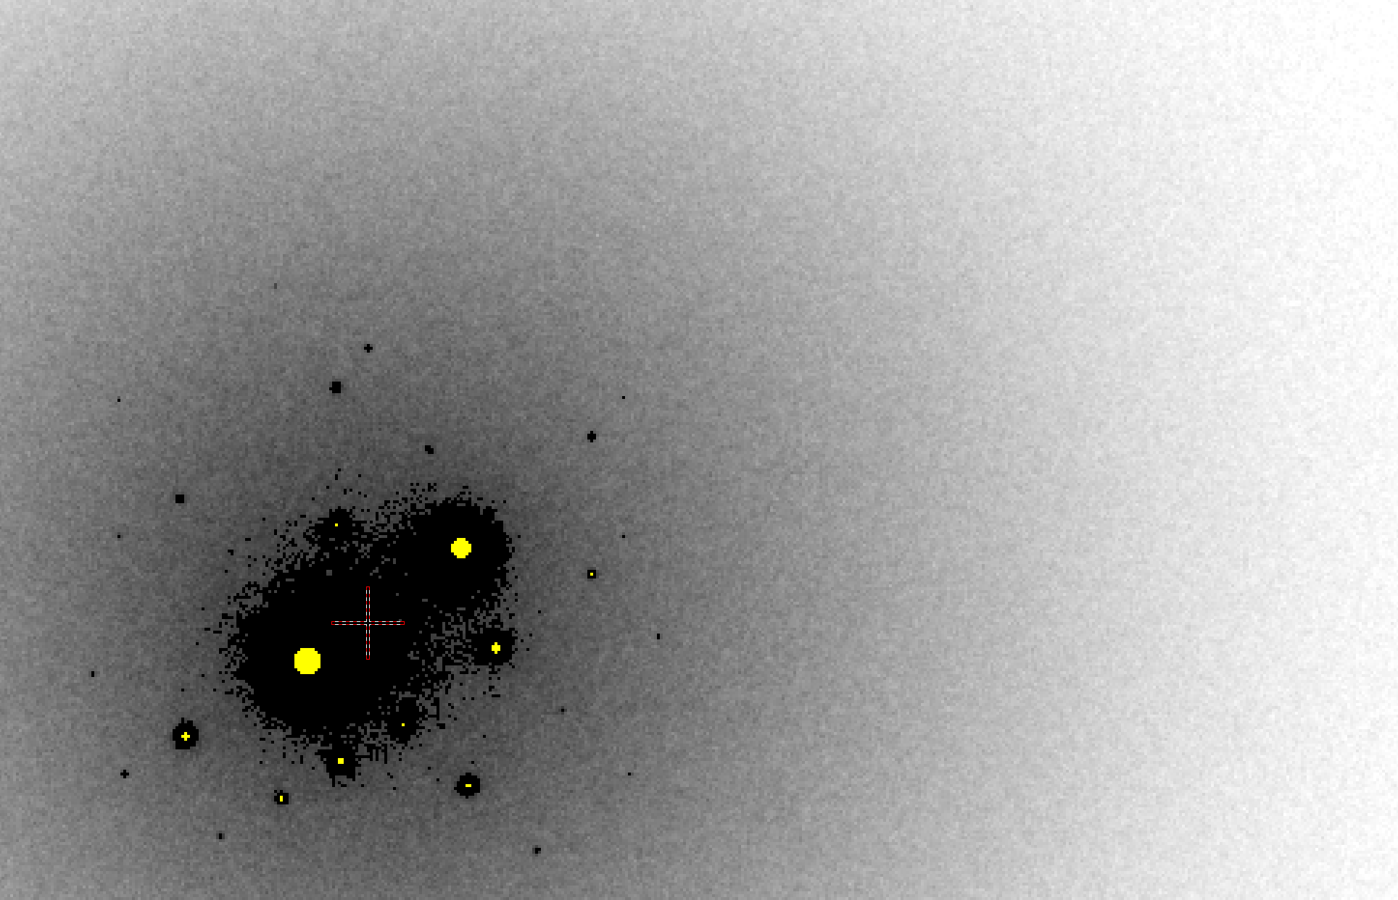
B factor from image analysis
B = 500

Slide 128
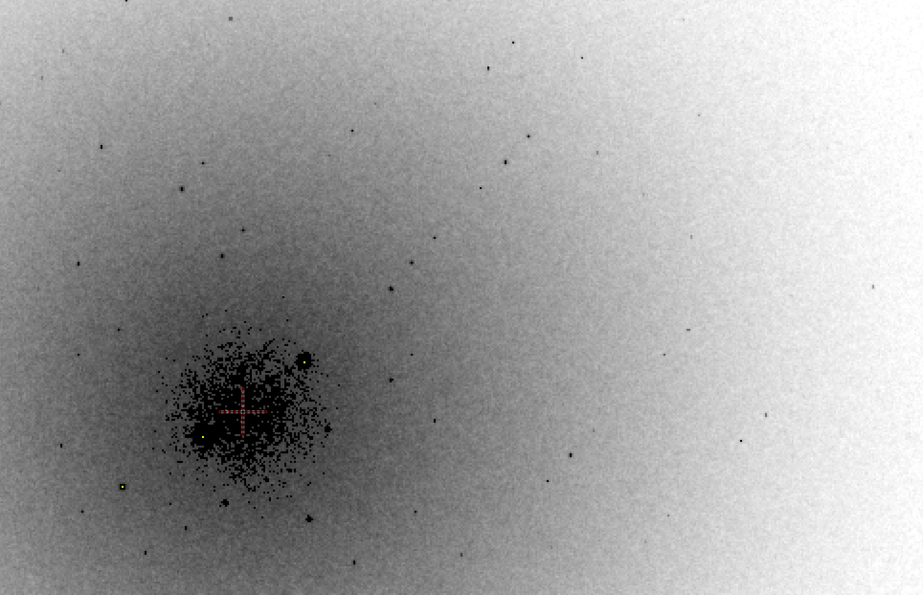
B factor from image analysis
B = 20

Slide 129
Bigger is better, but not by much
B = 20
B = 60
B = 0
B = 170
B = 330
B = 560
Resolution (Å)
B = 850
Crystal diameter (micron)

Slide 130
Diffraction Take-Home Lesson:
disorder
+ averaging
= poor resolution

Slide 131
What Causes Disorder?
Function
Radiation damage
Mosaicity
Strain
Xtal abuse
Dehydration

Slide 132
What Causes Disorder?
Function
Radiation damage
Mosaicity
Strain
Xtal abuse
Dehydration

Slide 133

Muybridge’s galloping horse (1878)

Slide 134
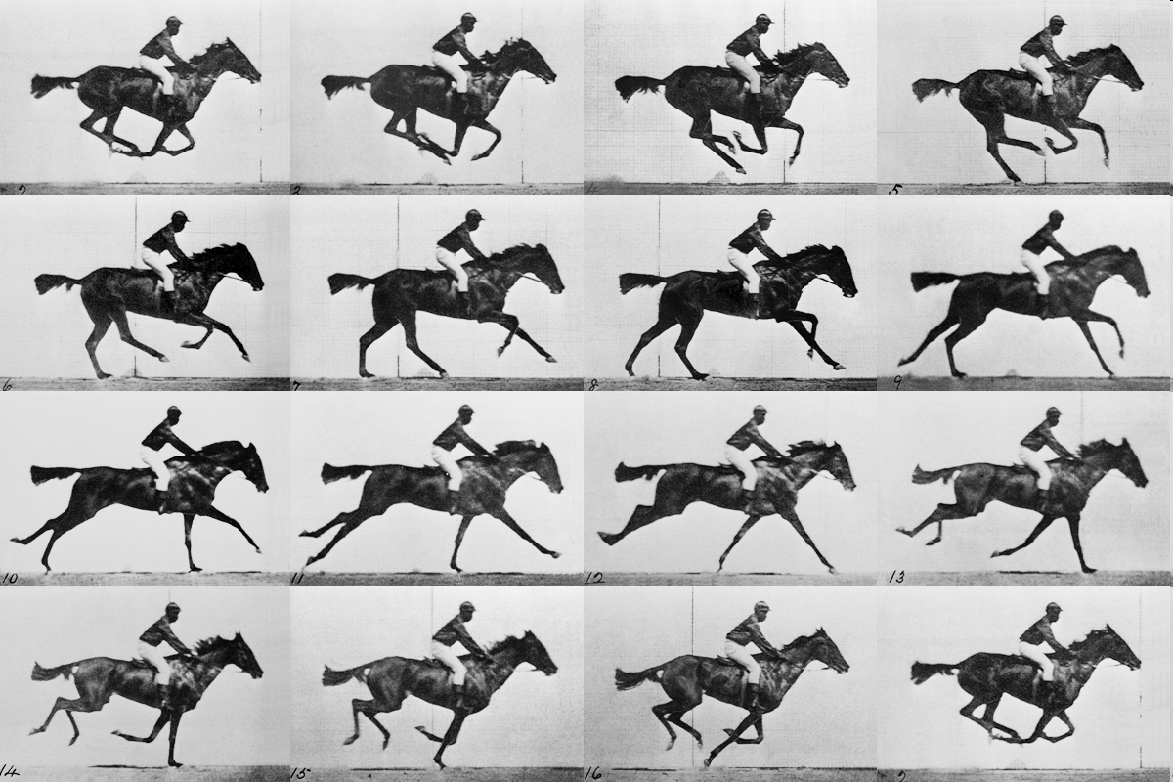
realistic “crystal” of horses

Slide 135
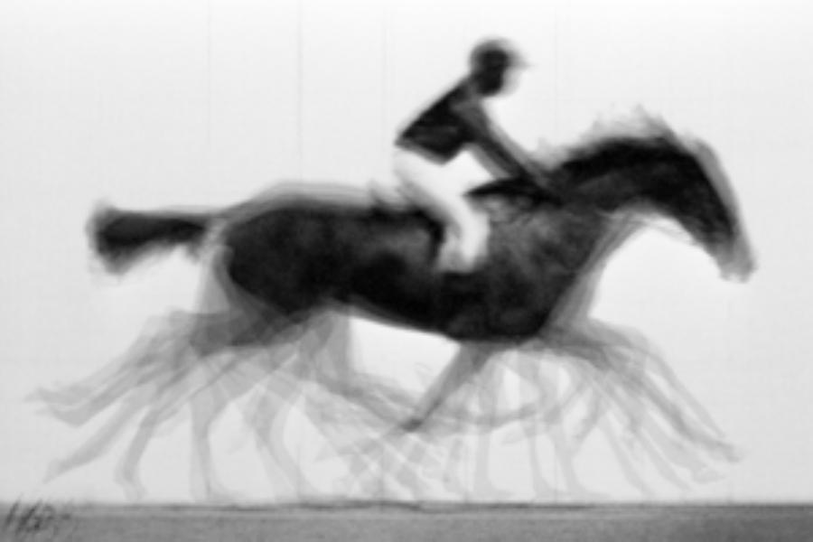
average structure: galloping horse

Slide 136

Ways to improve order
New crystal form
Purify
  - add a column
  - heat shock
Bind something
  - Known ligand
  - Silver bullets
Change the clone
  - chop off floppy bits
  - homolog
  - Ala -> Lys mutants
Make Protein Sit Still!!!
8000 cases in PDB of resolution improvement
80% of these are different crystal forms
> 1 Å improvement → 94% different forms
Newman J. (2006) Acta Cryst. D62 27-31.

Slide 137
What Causes Disorder?
Function
Radiation damage
Mosaicity
Strain
Xtal abuse
Dehydration

Slide 138
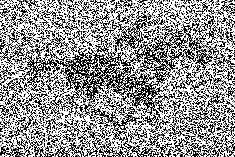
not enough signal

Slide 139
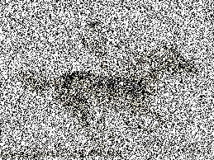
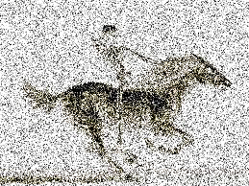
brighter light

Slide 140
even brighter

Slide 141
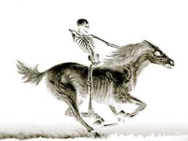
very bright light

Slide 142
Correct structure

Slide 143
Types of radiation damage
Global
  scale factor
  B factor
  non-isomorphism
Specific
  depends on chemistry
  destroys phasing signal

Slide 144
R_{iso} vs dose
R_{iso} (%)
change in dose (MGy)
data taken from Banumathi, et al. (2004) Acta Cryst. D 60, 1085-1093.

Slide 145
R_{iso} vs dose
R_{iso} ≈ 0.7 %/MGy
R_{iso} (%)
change in dose (MGy)
data taken from Banumathi, et al. (2004) Acta Cryst. D 60, 1085-1093.

Slide 146
anomalous signal
ΔF
F
√
# sites
MW (Da)
≈ 1.2 f”
World record!
ΔF/F = 0.5%
Wang, Dauter & Dauter (2006) Acta Cryst. D 62, 1475-1483.
Crick, F. H. C. & Magdoff, B. S. (1956) Acta Crystallogr. 9, 901-908.
Hendrickson, W. A. & Teeter, M. M. (1981) Nature 290, 107-113.

Slide 147
Optimal exposure time
Dose of dataset (MGy) <= anomalous signal (%)

Slide 148
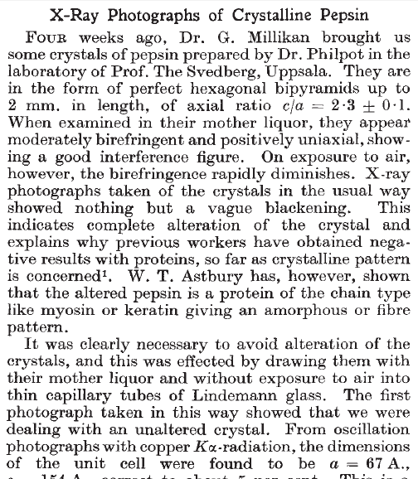
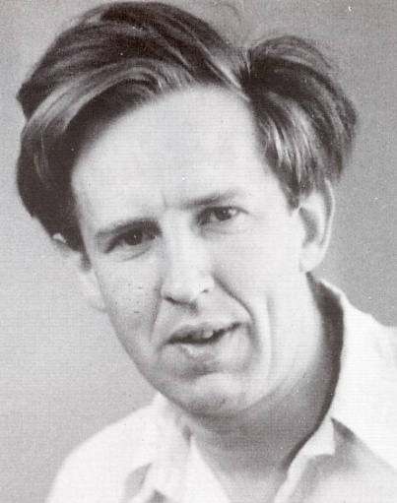
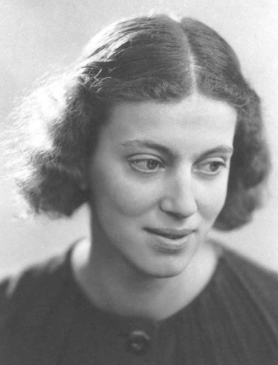
First diffraction from protein xtal
1934
Bernal, J. & Crowfoot, D. (1934). "X-ray photographs of crystalline pepsin", Nature 133, 794-795.

Slide 149
Dehydration: 1934
and 2017?
= 1.5 μL
100 μm
= 1.0 nL
2 mm
= 1.0 pL
10 μm
= 1.0 fL
1 μm

Slide 150
Non-isomorphism in lysozyme
Dear James
The story of the two forms of lysozyme crystals goes back to about 1964 when it was found that the diffraction patterns from different crystals could be placed in one of two classes depending on their intensities. This discovery was a big set back at the time and I can remember a lecture title being changed from the 'The structure of lysozyme' to 'The structure of lysozyme two steps forward and one step back'. Thereafter the crystals were screened based on intensities of the (11,11,l) rows to distinguish them (e.g. 11,11,4 > 11,11,5 in one form and vice versa in another). Data were collected only for those that fulfilled the Type II criteria. (These reflections were easy to measure on the linear diffractometer because crystals were mounted to rotate about the diagonal axis). As I recall both Type I and Type II could be found in the same crystallisation batch . Although sometimes the external morphology allowed recognition this was not infallible.
The structure was based on Type II crystals. Later a graduate student Helen Handoll examined Type I. The work, which was in the early days and before refinement programmes, seemed to suggest that the differences lay in the arrangement of water or chloride molecules (Lysozyme was crystallised from NaCl). But the work was never written up. Keith Wilson at one stage was following this up as lysozyme was being used to test data collection strategies but I do not know the outcome.
An account of this is given in International Table Volume F (Rossmann and Arnold edited 2001) p760.
Tony North was much involved in sorting this out and if you wanted more info he would be the person to contact. I hope this is helpful. Do let me know if you need more.
Best wishes
Louise

Slide 151
Non-isomorphism in lysozyme
Structure factor (e⁻)
Johnson’s ratio

Slide 152
Non-isomorphism in lysozyme
Structure factor (e⁻)
Johnson’s ratio

Slide 153
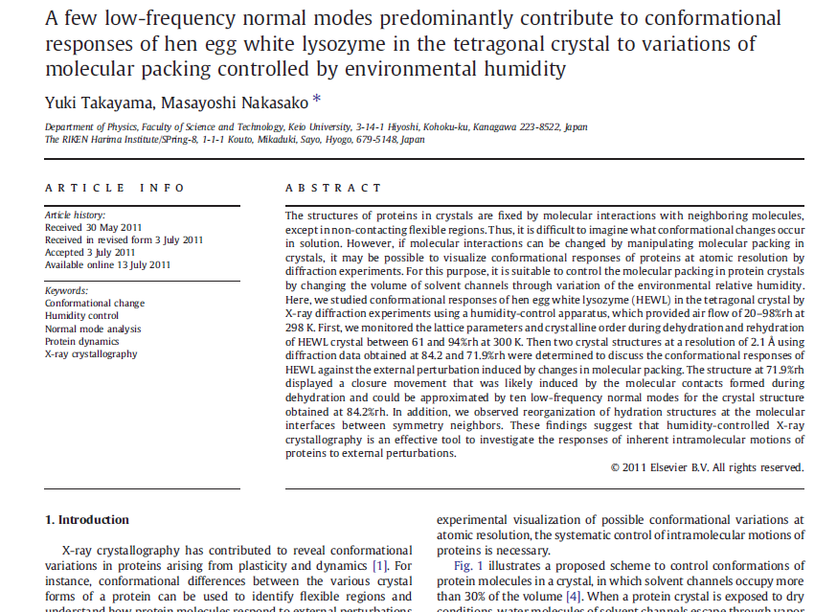

Slide 154
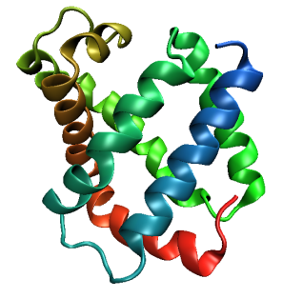
Same structure, different cell
0.5% cell change → 15%
Crick & Magdoff (1956) “theory method isomorphous replacement”, Acta Cryst. 9, 901-8.

Slide 155
Same structure, different cell
0.5% cell change → 15%
Crick & Magdoff (1956) “theory method isomorphous replacement”, Acta Cryst. 9, 901-8.

Slide 156
Same cell, rotated protein
0.5° rotation → 16%
Crick & Magdoff (1956) “theory method isomorphous replacement”, Acta Cryst. 9, 901-8.

Slide 157
Same cell, rotated protein
0.5° rotation → 16%
Crick & Magdoff (1956) “theory method isomorphous replacement”, Acta Cryst. 9, 901-8.

Slide 158
Uniform stretch
5% change → 0%

Slide 159
Uniform stretch
5% change → 0%

Slide 160

Non-isomorphism in lysozyme
RMSD = 1.70 Å
Δcell = 0.7 %
R_{iso} = 44.5%
RMSD = 0.18 Å
3aw6
3aw7
RH: 84.2%
vs 71.9%

Slide 161
Elastic deformation
= non-isomorphism

Slide 162
Elastic deformation
= non-isomorphism

Slide 163
Plastic deformation
= poor diffraction

Slide 164
Plastic deformation
= poor diffraction

Slide 165
… but does it work for membrane proteins?
CCP4BB:
“We used it for a large membrane protein complex and diffraction improved from ~7 to 2.7 A. The crystal is fished out and put into mother liquor solution in the button, sealed with dialysis membrane and the button is then placed into about 5 mls of mother liquor with slightly higher PEG concentration. Then you just exchange outside buffer every day or so for solutions containing higher concentrations of PEG. We went from ~9 to 30 % PEG4000 in about a week. You can easily observe crystal under microscope and if it cracks - you went too far/too quickly with PEG and need to use a bit less next time. Also, this method allows you to control all other components of the dehydrating solution - we needed to decrease salt concentration at the same time as increasing PEG. You can also introduce/increase cryo-protectant concentration at the same time. With these crystals, otherwise excellent dehydration machines already mentioned did not work, possibly because the process had to be really slow.”
Efremov, R. G. & Sazanov, L. A. (2011)."Structure of the membrane domain of respiratory complex I", Nature 476, 414-420.
“To improve diffraction properties, crystals were slowly cooled to 4 C, placed into micro-dialysis buttons, and mother liquor was exchanged by dialysis for 0.1 M sodium acetate (pH 4.8), 0.15 M sodium tartrate (pH 5.0), 30% PEG4000, 0.1% sodium cholate and 12.5% glycerol over a period of 5 days.”

Slide 166
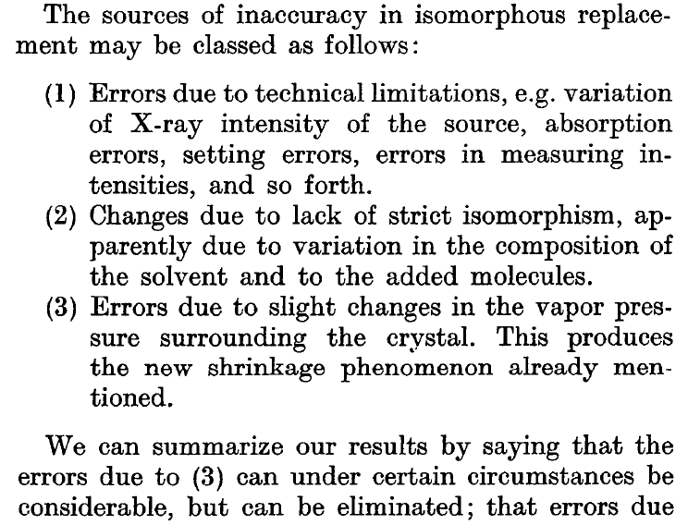
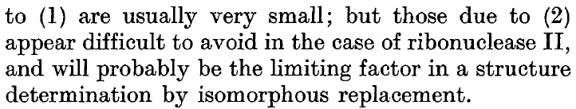
Magdoff & Crick (1955) “Ribonuclease II. Accuracy of measurement and shrinkage”, Acta Cryst. 8, 461-8.
Crick & Magdoff (1956) “The theory of the method of isomorphous replacement for protein crystals”, Acta Cryst. 9, 901-8.

Slide 167
Hygrostatic gradients
high
water activity
low
loop

Slide 168
Radiation Damage
http://bl831.als.lbl.gov/xtalsize.html
http://bl831.als.lbl.gov/xtallife.html
http://bl831.als.lbl.gov/~jamesh/powerpoint/CSHL_raddam_2018.pptx
Know your dose! (MGy)
Avoid World Records
disorder dominates everything
“Attenu-wait”: dose slicing
Stay hydrated!

Slide 169
scattering
x-ray beam
sample
detector

Slide 170
scattering
x-ray beam
sample
detector

Slide 171
scattering
x-ray beam
sample
detector

Slide 172
scattering
x-ray beam
sample
detector

Slide 173
Bragg’s Law
to detector
nλ = 2d sin(θ)
atom #1
θ
d
to source
atom #2
d∙sin(θ)

Slide 174
Bragg’s Law
to detector
nλ = 2d sin(θ)
atom #1
θ
to source
d
atom #2
d∙sin(θ)

Slide 175
anomalous scattering
x-ray beam
sample
detector

Slide 176
anomalous scattering
x-ray beam
sample
detector

Slide 177
anomalous scattering
x-ray beam
sample
detector

Slide 178
anomalous scattering
x-ray beam
sample
detector

Slide 179
anomalous scattering
x-ray beam
sample
detector

Slide 180
scattering
x-ray beam
sample
detector
detector

Slide 181
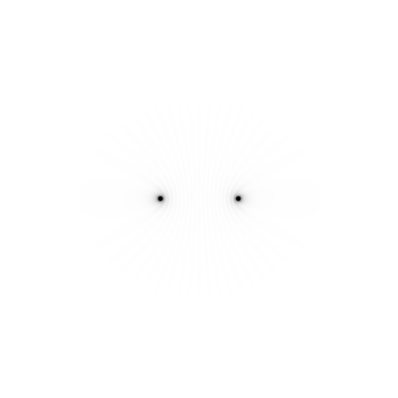
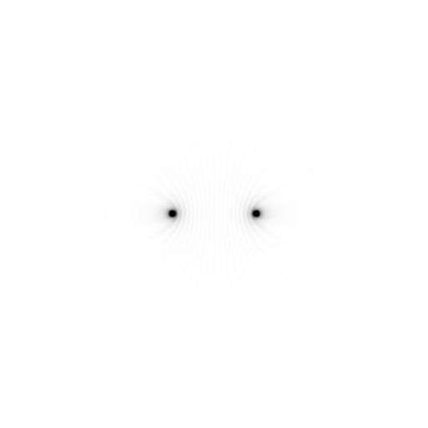
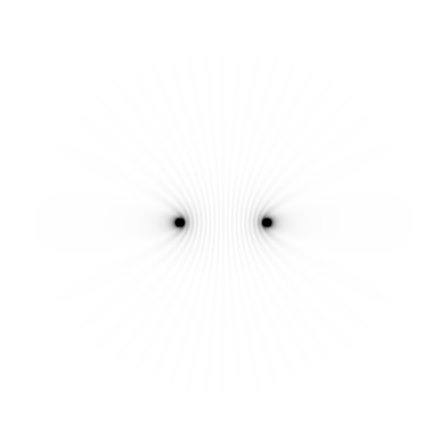
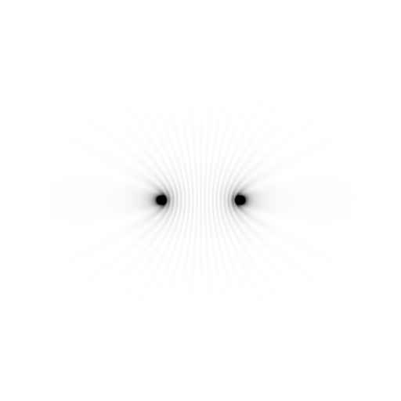
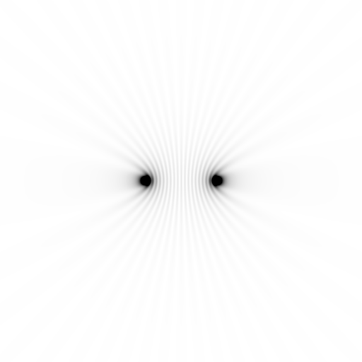






















Slide 182



























Slide 183










scattering from a structure
sample
detector

Slide 184

forward Fourier Transform
inverse Fourier Transform
no phase

Slide 185











inverse Fourier Transform
scattering from a structure
colored by phase
sample
detector

Slide 186




scattering from a lattice
colored by phase
sample
detector

Slide 187

scattering from a lattice
colored by phase
sample
detector

Slide 188

scattering from a lattice
colored by phase
sample
detector

Slide 189

scattering from a crystal structure
colored by phase
sample
detector

Slide 190
But my reviewer says…
R_{merge} in high-resolution bin is >100% !
Answer: this is expected

Slide 191
Expected R_{merge} as I_{obs} → 0

Slide 192
Averaging Gaussian error
Average value
Number of samples averaged

Slide 193
Averaging Gauss/Gauss error
Average value
Number of samples averaged

Slide 194
R_{merge} at the resolution limit in PDB
Average outer-shell R_{merge}
Year

Slide 195
Take-home lesson:
R factors are
undefined
as I_{obs} → 0
Report as “ – “ in outer bin

Slide 196

Re-indexing cheat sheet
Dauter, Z. (1999). "Data-collection strategies." Acta Cryst. D 55(10): 1703-1717.

Slide 197
CCP4: aimless log
$TABLE: Analysis against resolution, XDSdataset:
$GRAPHS:I/sigma, Mean Mn(I)/sd(Mn(I)):0|0.216023x0|137.14:2,13,14:
:Rmerge, Rfull, Rmeas, Rpim v Resolution:0|0.216023x0|1.70834:2,4,5,6,7:
:Average I, RMSdeviation and Sd:0|0.216023x0|1650.8:2,10,11,12:
:Fractional bias:0|0.216023x0|0:2,15:
$$
N 1/d^2 Dmid Rmrg Rfull Rcum Rmeas Rpim Nmeas AvI RMSdev sd I/RMS Mn(I/sd) FrcBias $$ $$
1 0.0064 12.55 0.020 0.020 0.020 0.021 0.006 13115 1651 57 42 29.2 137.1 -
2 0.0191 7.24 0.027 0.027 0.024 0.028 0.008 24753 1171 47 42 25.0 105.2 -
3 0.0318 5.61 0.038 0.038 0.029 0.040 0.012 32197 857 46 43 18.4 79.6 -
4 0.0445 4.74 0.034 0.034 0.031 0.035 0.010 37743 1212 57 53 21.4 91.2 -
5 0.0572 4.18 0.036 0.036 0.032 0.038 0.011 42642 1181 59 57 19.9 83.8 -
6 0.0699 3.78 0.049 0.049 0.036 0.052 0.015 47224 883 59 57 15.1 65.1 -
7 0.0826 3.48 0.065 0.065 0.040 0.068 0.020 51052 685 59 58 11.7 50.9 -
8 0.0953 3.24 0.096 0.096 0.045 0.100 0.029 54636 448 56 56 8.0 35.0 -
9 0.1080 3.04 0.151 0.151 0.050 0.158 0.046 58072 268 53 53 5.1 22.7 -
10 0.1207 2.88 0.229 0.229 0.056 0.240 0.070 60731 171 51 51 3.3 15.4 -
11 0.1334 2.74 0.314 0.314 0.063 0.329 0.097 63807 125 51 51 2.4 11.3 -
12 0.1461 2.62 0.406 0.406 0.070 0.425 0.125 66241 98 51 52 1.9 8.7 -
13 0.1588 2.51 0.537 0.537 0.078 0.562 0.166 68272 76 53 53 1.4 6.5 -
14 0.1715 2.41 0.685 0.685 0.084 0.727 0.237 54170 61 53 54 1.1 4.4 -
15 0.1843 2.33 0.886 0.886 0.088 0.950 0.333 39781 48 55 56 0.9 3.1 -
16 0.1970 2.25 1.249 1.249 0.092 1.355 0.508 29754 35 57 59 0.6 2.1 -

Slide 198
CCP4: aimless log
$TABLE: Correlations CC(1/2) within dataset, XDSdataset:
$GRAPHS: Anom & Imean CCs v resolution:0|0.216023x0|1:2,4,7:
: RMS correlation ratio :0|0.216023x0|2.20344:2,6:
$$
N 1/d^2 Dmid CCanom Nanom RCRanom CC1/2 NImean $$ $$
1 0.0064 12.55 0.659 499 2.203 1.000 669
2 0.0191 7.24 0.550 975 1.853 1.000 1155
3 0.0318 5.61 0.527 1295 1.798 1.000 1479
16 0.1970 2.25 0.037 2123 1.038 0.711 2275
17 0.2097 2.18 0.043 1682 1.044 0.460 1877

Slide 199
XDS: CORRECT.LP or XSCALE.LP
SUBSET OF INTENSITY DATA WITH SIGNAL/NOISE >= -3.0 AS FUNCTION OF RESOLUTION
RESOLUTION NUMBER OF REFLECTIONS COMPLETENESS R-FACTOR R-FACTOR COMPARED I/SIGMA R-meas CC(1/2) Anomal SigAno Nano
LIMIT OBSERVED UNIQUE POSSIBLE OF DATA observed expected Corr
6.39 4103 2517 3135 80.3% 1.7% 1.8% 3018 33.77 2.3% 99.9* 21* 1.012 533
4.54 7339 4970 5544 89.6% 2.6% 2.6% 4585 22.56 3.6% 99.8* 9 0.914 796
3.72 9442 6724 7186 93.6% 2.8% 2.9% 5327 19.99 4.0% 99.7* 9 0.859 877
3.22 11077 7997 8486 94.2% 4.8% 4.9% 6094 12.27 6.8% 99.3* -1 0.784 913
2.88 12408 8851 9595 92.2% 10.0% 10.1% 7068 6.01 14.2% 97.8* -2 0.799 1012
2.63 13673 9561 10662 89.7% 20.8% 20.8% 8185 3.10 29.4% 88.8* -4 0.776 1274
2.44 14360 9852 11510 85.6% 34.5% 34.7% 8981 1.90 48.8% 75.9* 2 0.765 1525
2.28 9501 6495 12416 52.3% 61.8% 59.6% 5991 1.14 87.3% 53.5* -2 0.722 1031
2.15 4567 3307 13210 25.0% 120.5% 120.3% 2520 0.59 170.4% 21.9* 4 0.693 408
total 86470 60274 81744 73.7% 6.7% 6.7% 51769 8.97 9.5% 99.5* 2 0.804 8369

Slide 200
XDS: CORRECT.LP or XSCALE.LP
******************************************************************************
CORRECTION PARAMETERS FOR THE STANDARD ERROR OF REFLECTION INTENSITIES
******************************************************************************
The variance v0(I) of the intensity I obtained from counting statistics is
replaced by v(I)=a*(v0(I)+b*I^2). The model parameters a, b are chosen to
minimize the discrepancies between v(I) and the variance estimated from
sample statistics of symmetry related reflections. This model implicates
an asymptotic limit ISa=1/SQRT(a*b) for the highest I/Sigma(I) that the
experimental setup can produce (Diederichs (2010) Acta Cryst D66, 733-740).
a b ISa
3.806E+00 1.080E-04 49.32

Slide 201
Rough values of energy quanta
1 MeV 100 GJ/mol Medical radiation therapy
100 keV 10 GJ/mol Medical imaging
10 keV 1 GJ/mol X-ray crystallography
1 keV 100 MJ/mol S and P K-edges
100 eV 10 MJ/mol “water window”
10 eV 1 MJ/mol C≡C bond
1 eV 100 kJ/mol C-C bond, visible light
100 meV 10 kJ/mol hydrogen bond
10 meV 1 kJ/mol heat (~300 K)

