Slide 1
PowerPoint File available:
http://bl831.als.lbl.gov/
~jamesh/powerpoint/
CSHL_cryo_2017.pptx

Slide 2
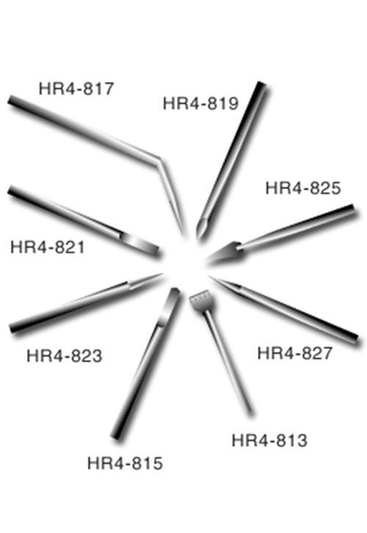
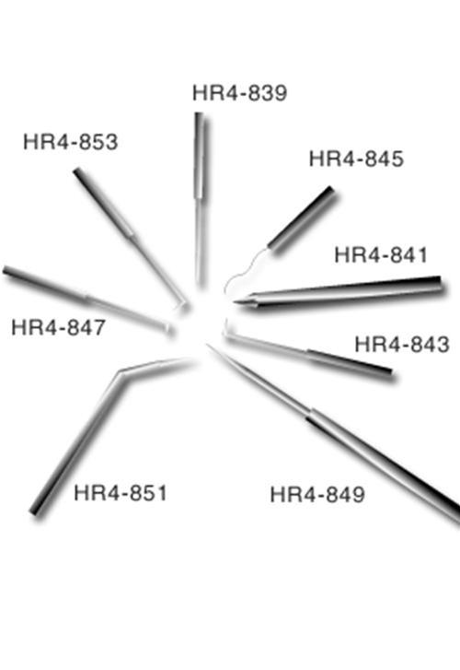
Hampton crystal surgery tools

Slide 3
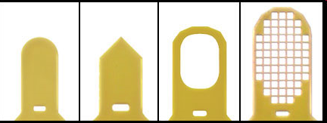
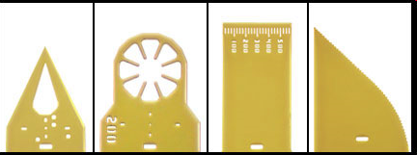
MiTeGen MicroTools
http://www.mitegen.com/products/microtools/microtools_kit1.shtml

Slide 4
Harvesting dos and don'ts
physical contact
don’t touch the part you intend to shoot
osmotic shock
equilibrate, or calculate matching solution
changes in dielectric constant
Petsko (1975) J. Mol. Biol. 96, 381-388.
cooled density mismatch
Juers & Matthews (2004) Acta Cryst. D 60, 412-421.

Slide 5
How many “crystals” do you see?
Shoot the crystal (singular)

Slide 6
platy crystals

Slide 7
X-ray scattering “rules”:
1 μm crystal ≈ 1 μm water
≈ 1 μm plastic
≈ 0.1 μm glass
≈ 1000 μm air

Slide 8
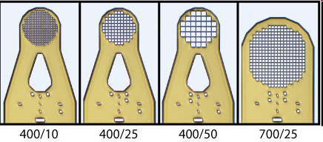
MiTeGen MicroMesh grids
http://www.mitegen.com/products/micromeshes/micromeshes.shtml

Slide 9
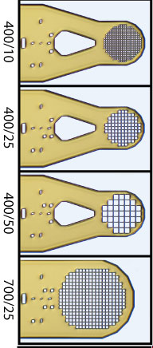
platy crystals

Slide 10
xtal stuck on tray

Slide 11
xtal stuck on tray

Slide 12
MiTeGen MicroSaw
10 μm thick!
http://www.mitegen.com/products/microtools/microtools_kit1.shtml

Slide 13
xtal stuck on tray

Slide 14
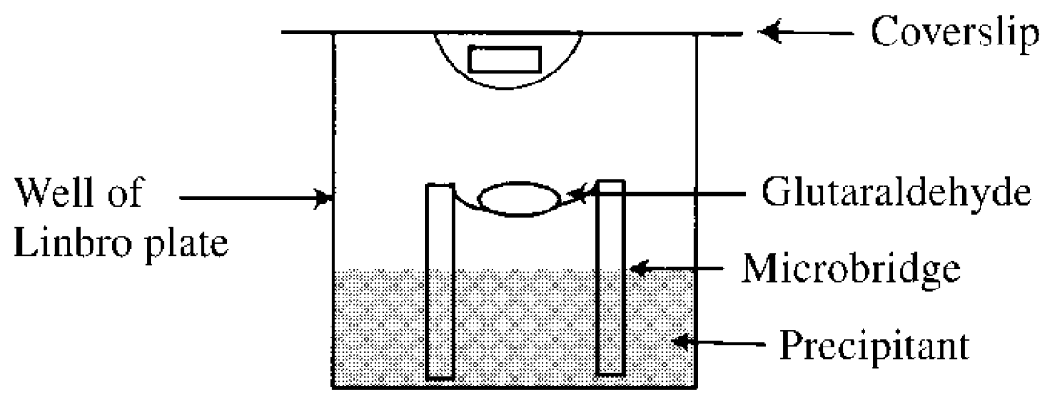
crystals too fragile? cross-link them!
Lusty (1999) J. Appl. Crystallogr. 32, 106-112.
McWhirter, et al. (1999) PNAS USA 96, 8408-8413.

Slide 15
Osmolarity matching
Look up osmotic pressure of mother liquor in CRC Handbook of Physics and Chemistry, Section D-232. 11th column is O: Os/kg
Look up o.p. of cryoprotectant agent.
Modify conc. of mother liquor to minimize change in osmotic pressure.
OR: just re-seal the tray!

Slide 16
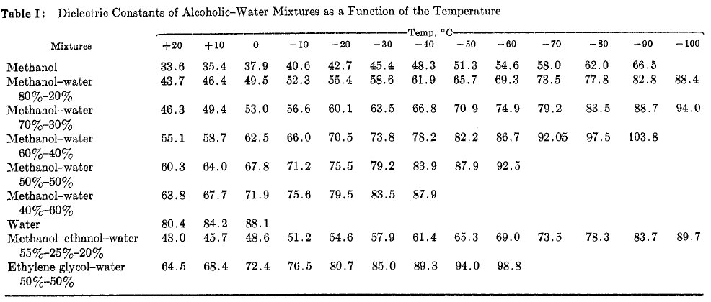
Dielectric matching
Travers & Douzou (1970) J. of Phys. Chem. 74, 2243-2244.
Petsko (1975) J. Mol. Biol. 96, 381-388.
Douzou (1977) Cryobiochemistry. Academic Press.

Slide 17
matching dielectric const.

Slide 18
You do not need a cryostream to check your cryo!
liquid N₂

Slide 19
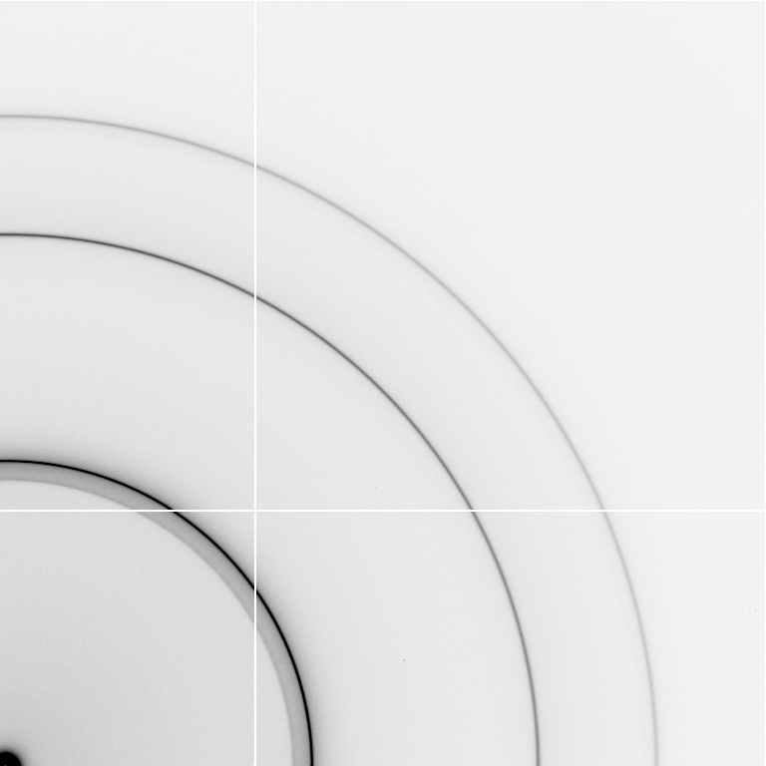
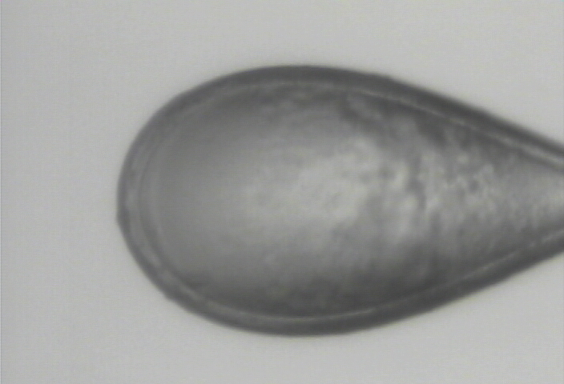
cubic ice
0.92 g/cm³

Slide 20
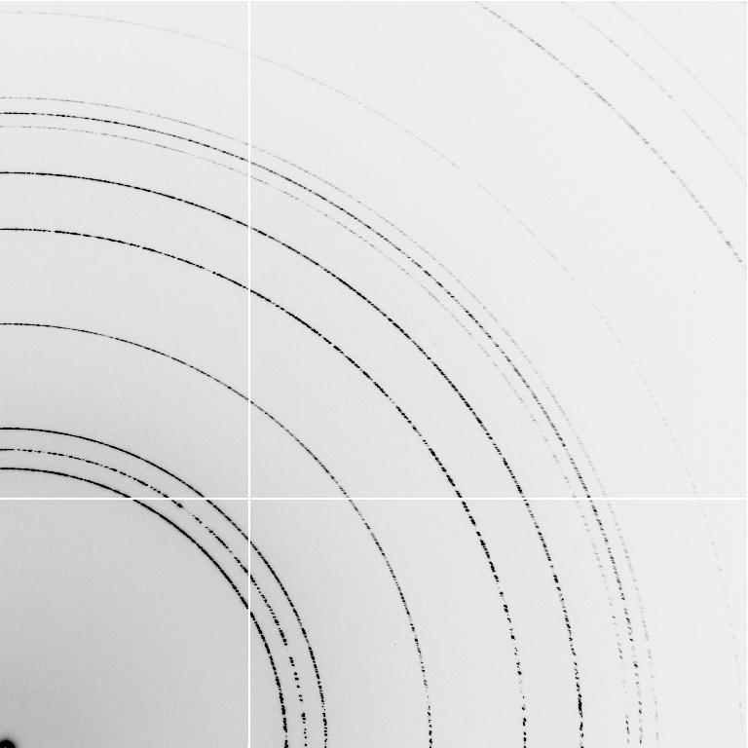
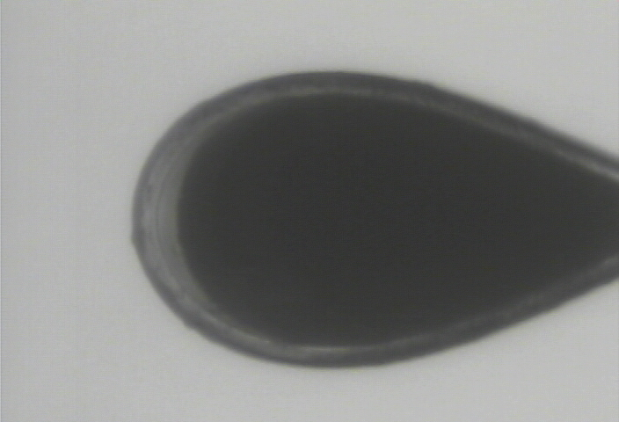
hexagonal ice
0.92 g/cm³

Slide 21
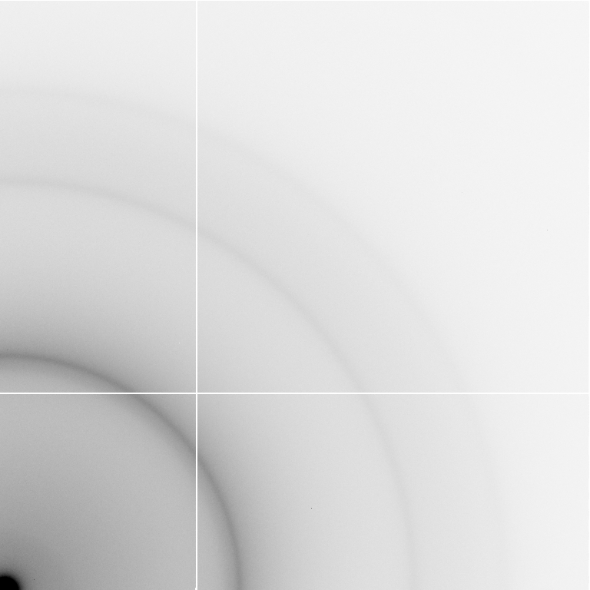
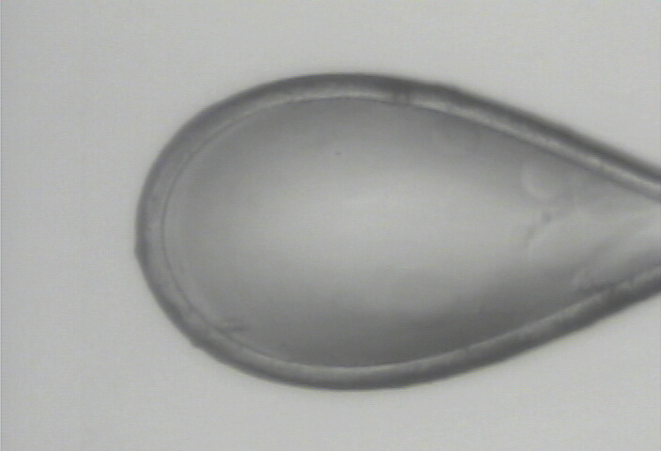
nano-crystalline cubic ice
~0.93 g/cm³

Slide 22
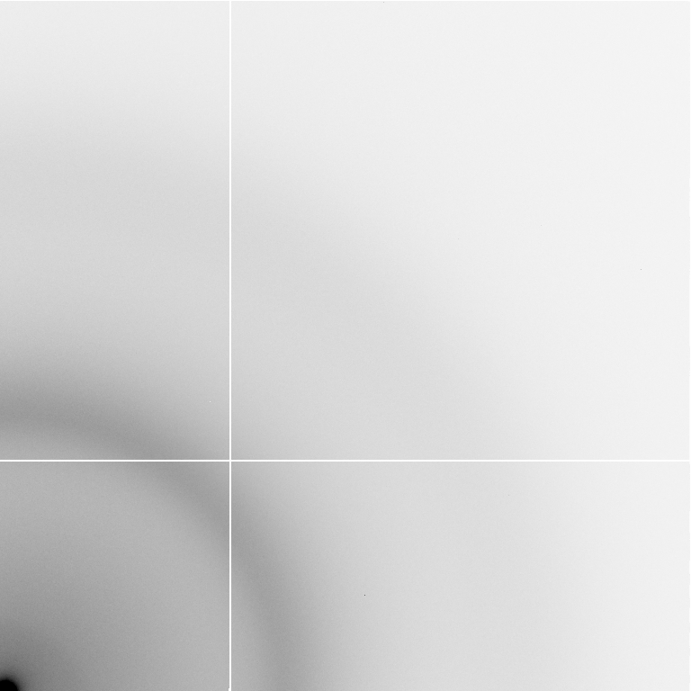
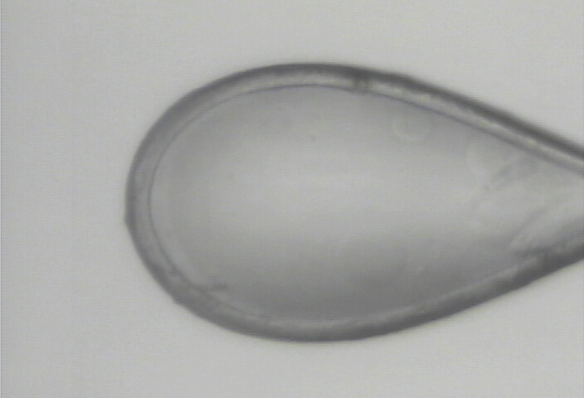
amorphous ice
0.94 g/cm³

Slide 23
annealing
easiest way to change your cryo
WATCH droplet melt before re-cooling
snapshots only!
Juers & Matthews (2004) Acta Cryst. D 60, 412-421.

Slide 24
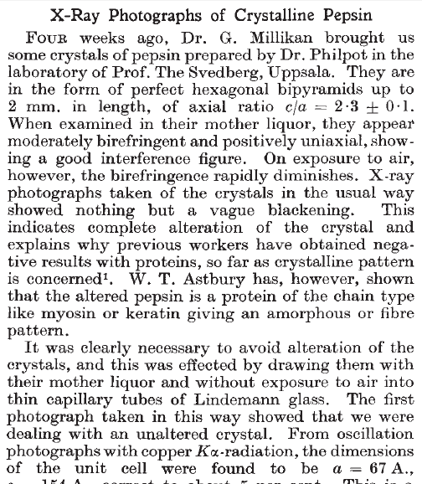
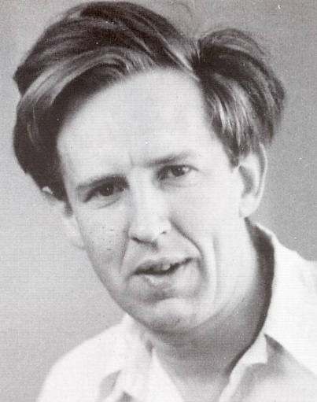
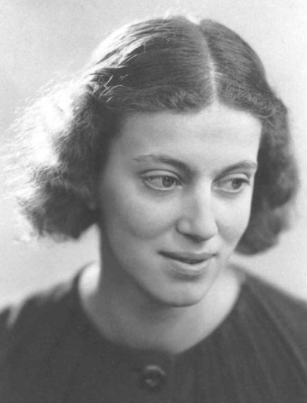
First diffraction from protein xtal
1934
Bernal, J. & Crowfoot, D. (1934). "X-ray photographs of crystalline pepsin", Nature 133, 794-795.

Slide 25
Dehydration: 1934
and 2017?
= 1.5 μL
100 μm
= 1.0 nL
2 mm
= 1.0 pL
10 μm
= 1.0 fL
1 μm

Slide 26

Non-isomorphism in lysozyme
RMSD = 1.70 Å
Δcell = 0.7 %
R_{iso} = 44.5%
RMSD = 0.18 Å
3aw6
3aw7
RH: 84.2%
vs 71.9%

Slide 27
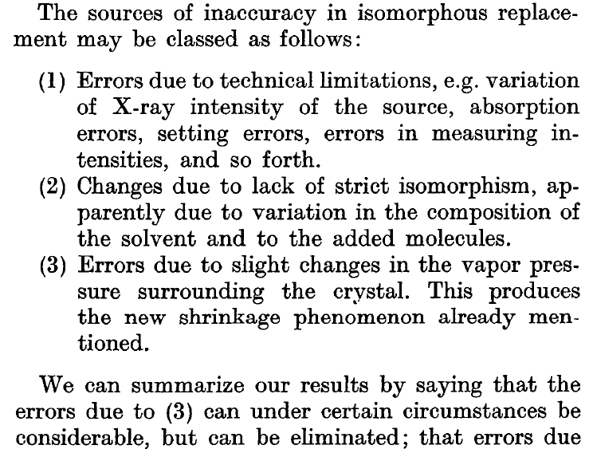
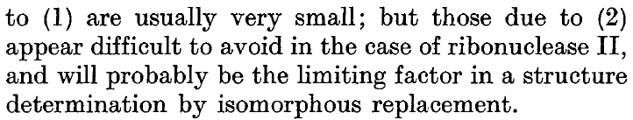
Magdoff & Crick (1955) “Ribonuclease II. Accuracy of measurement and shrinkage”, Acta Cryst. 8, 461-8.
Crick & Magdoff (1956) “The theory of the method of isomorphous replacement for protein crystals”, Acta Cryst. 9, 901-8.

Slide 28
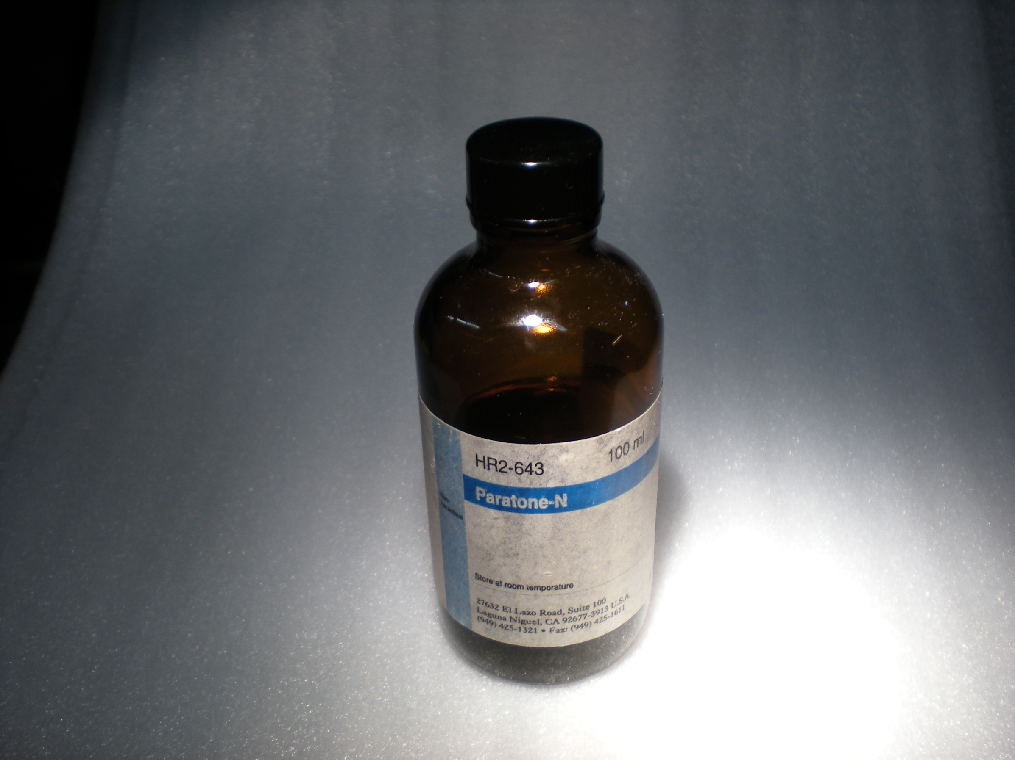
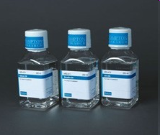
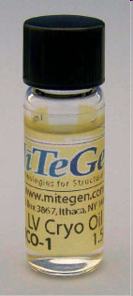
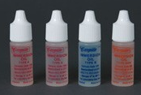
oil is your friend

Slide 29
oiled drop: you have ~3 hours
oil

Slide 30
Dabbing to remove excess
clean surface

Slide 31
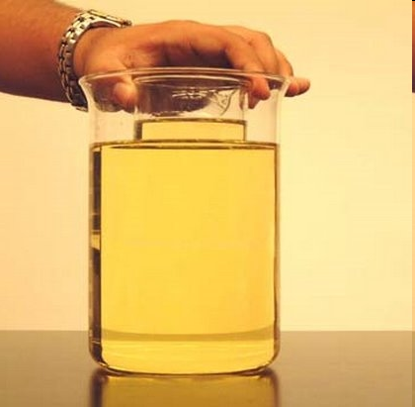
My crystal “dissolved” in the oil!
no, it didn’t…

Slide 32
Crystal fishing demystified

Slide 33
Crystal fishing demystified

Slide 34
Warkentin method
liquid N₂
foam insulation
Warkentin (2006) J. Appl. Crystallogr. 39, 805-811.

Slide 35
COMBINE cryoprotectants!
organic + hyperquenching
malonate + glycerol
“confusion principle”
~30% glycerol is not as good as:
25% glycerol +
1% PEG400 +
1% MPD +
1% sucrose +
1% sorbitol +
1% ethylene glycol

Slide 36
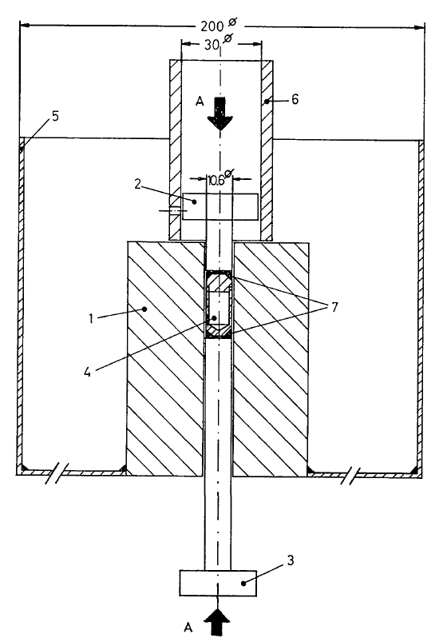
Pressure as a cryoprotectant
Fig. 1. Equipment for freezing at 2500 atm. (1) Steel cylinder, (2) and (3) pistons which can be coupled to a hydraulic press, (4) Teflon cell, (5) vessel for liquid nitrogen, (6) steel tube used for pushing cell (4) out of cylinder (1), (7) steel rings. Scale is in mm. A-A : direction of the force.
Thomanek et al. (1973)
Acta Cryst. A 29, 263-265.

Slide 37
Pressure as a cryoprotectant
High-pressure cooling apparatus. (a) Sample pin. An oil-coated crystal in a cryoloop is inserted into one end (right) of a brass tube (2.5 cm long) and a
steel piano wire in the other end (left). (b) High-pressure tubing assembly in a LN2 container. A sample is loaded into the top of each 30 cm long tube
and is held in place by a magnet outside the tube. Three crystals can be pressure-cooled at a time.
Kim et al. (2005) Acta Cryst. D 61, 881-890.

Slide 38
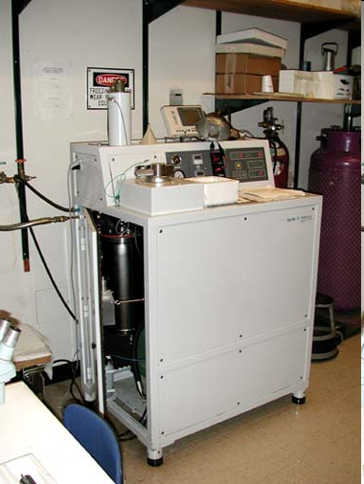
Pressure as a cryoprotectant
Balzers HPM 010 High Pressure Freezer
The Bal-Tec HPM 010 is a high pressure freezing machine that is designed to freeze non-cryoprotected samples up to 0.5mm in thickness without significant ice crystal damage. Samples can then be processed for TEM using the freeze substitution protocol. These two methods are the state-of-the-art for TEM specimen preparation.
http://www.leica-microsystems.com/products/
electron-microscope-sample-preparation/
industrial-materials/cryo-preparation/
details/product/leica-em-pact2/

Slide 39
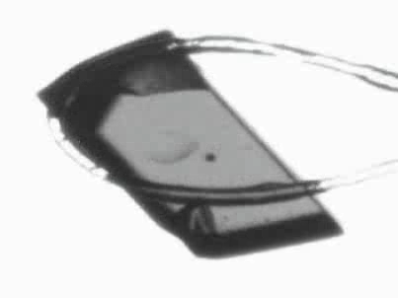
Response to dehydration
www.proteros.de

Slide 40
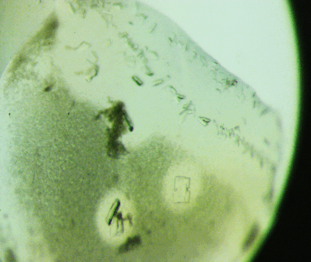
Ostwald Ripening
http://xray.bmc.uu.se/terese/tutorial6.html

Slide 41
… but does it work for membrane proteins?
CCP4BB:
“We used it for a large membrane protein complex and diffraction improved from ~7 to 2.7 A. The crystal is fished out and put into mother liquor solution in the button, sealed with dialysis membrane and the button is then placed into about 5 mls of mother liquor with slightly higher PEG concentration. Then you just exchange outside buffer every day or so for solutions containing higher concentrations of PEG. We went from ~9 to 30 % PEG4000 in about a week. You can easily observe crystal under microscope and if it cracks - you went too far/too quickly with PEG and need to use a bit less next time. Also, this method allows you to control all other components of the dehydrating solution - we needed to decrease salt concentration at the same time as increasing PEG. You can also introduce/increase cryo-protectant concentration at the same time. With these crystals, otherwise excellent dehydration machines already mentioned did not work, possibly because the process had to be really slow.”
Efremov, R. G. & Sazanov, L. A. (2011)."Structure of the membrane domain of respiratory complex I", Nature 476, 414-420.
“To improve diffraction properties, crystals were slowly cooled to 4 C, placed into micro-dialysis buttons, and mother liquor was exchanged by dialysis for 0.1 M sodium acetate (pH 4.8), 0.15 M sodium tartrate (pH 5.0), 30% PEG4000, 0.1% sodium cholate and 12.5% glycerol over a period of 5 days.”

Slide 42
Why harvest at all?
Radiation damage
  10-100x reduced at ~100 K
Background scatter
    tray >> xtal
Timing
    nothing lasts forever
Shipping
    cryo samples are glass beads

Slide 43
X-ray transmission of materials
air
water
protein
crystal
transmission
glass
Depth into material (μm)

Slide 44
X-ray scattering of materials
glass
Differential cross section
(scattered photons/solid angle/incident photon/meter thickness)
plastic
paratone-N oil
25% glycerol
water
∞ 7.5 3.8 2.5 1.9 1.5
d-spacing (Ǻ)

Slide 45
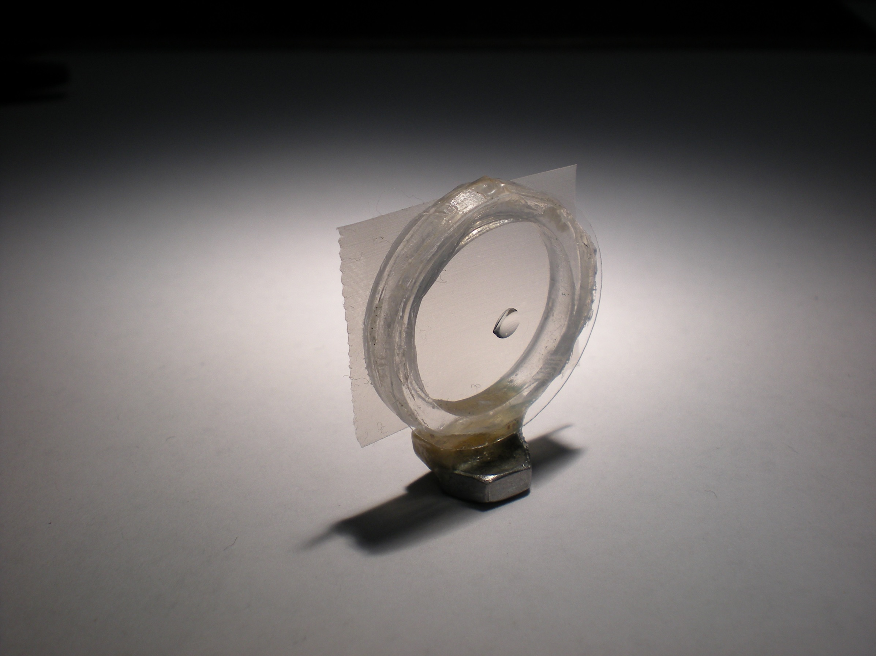
Crowfoot Cell

Slide 46
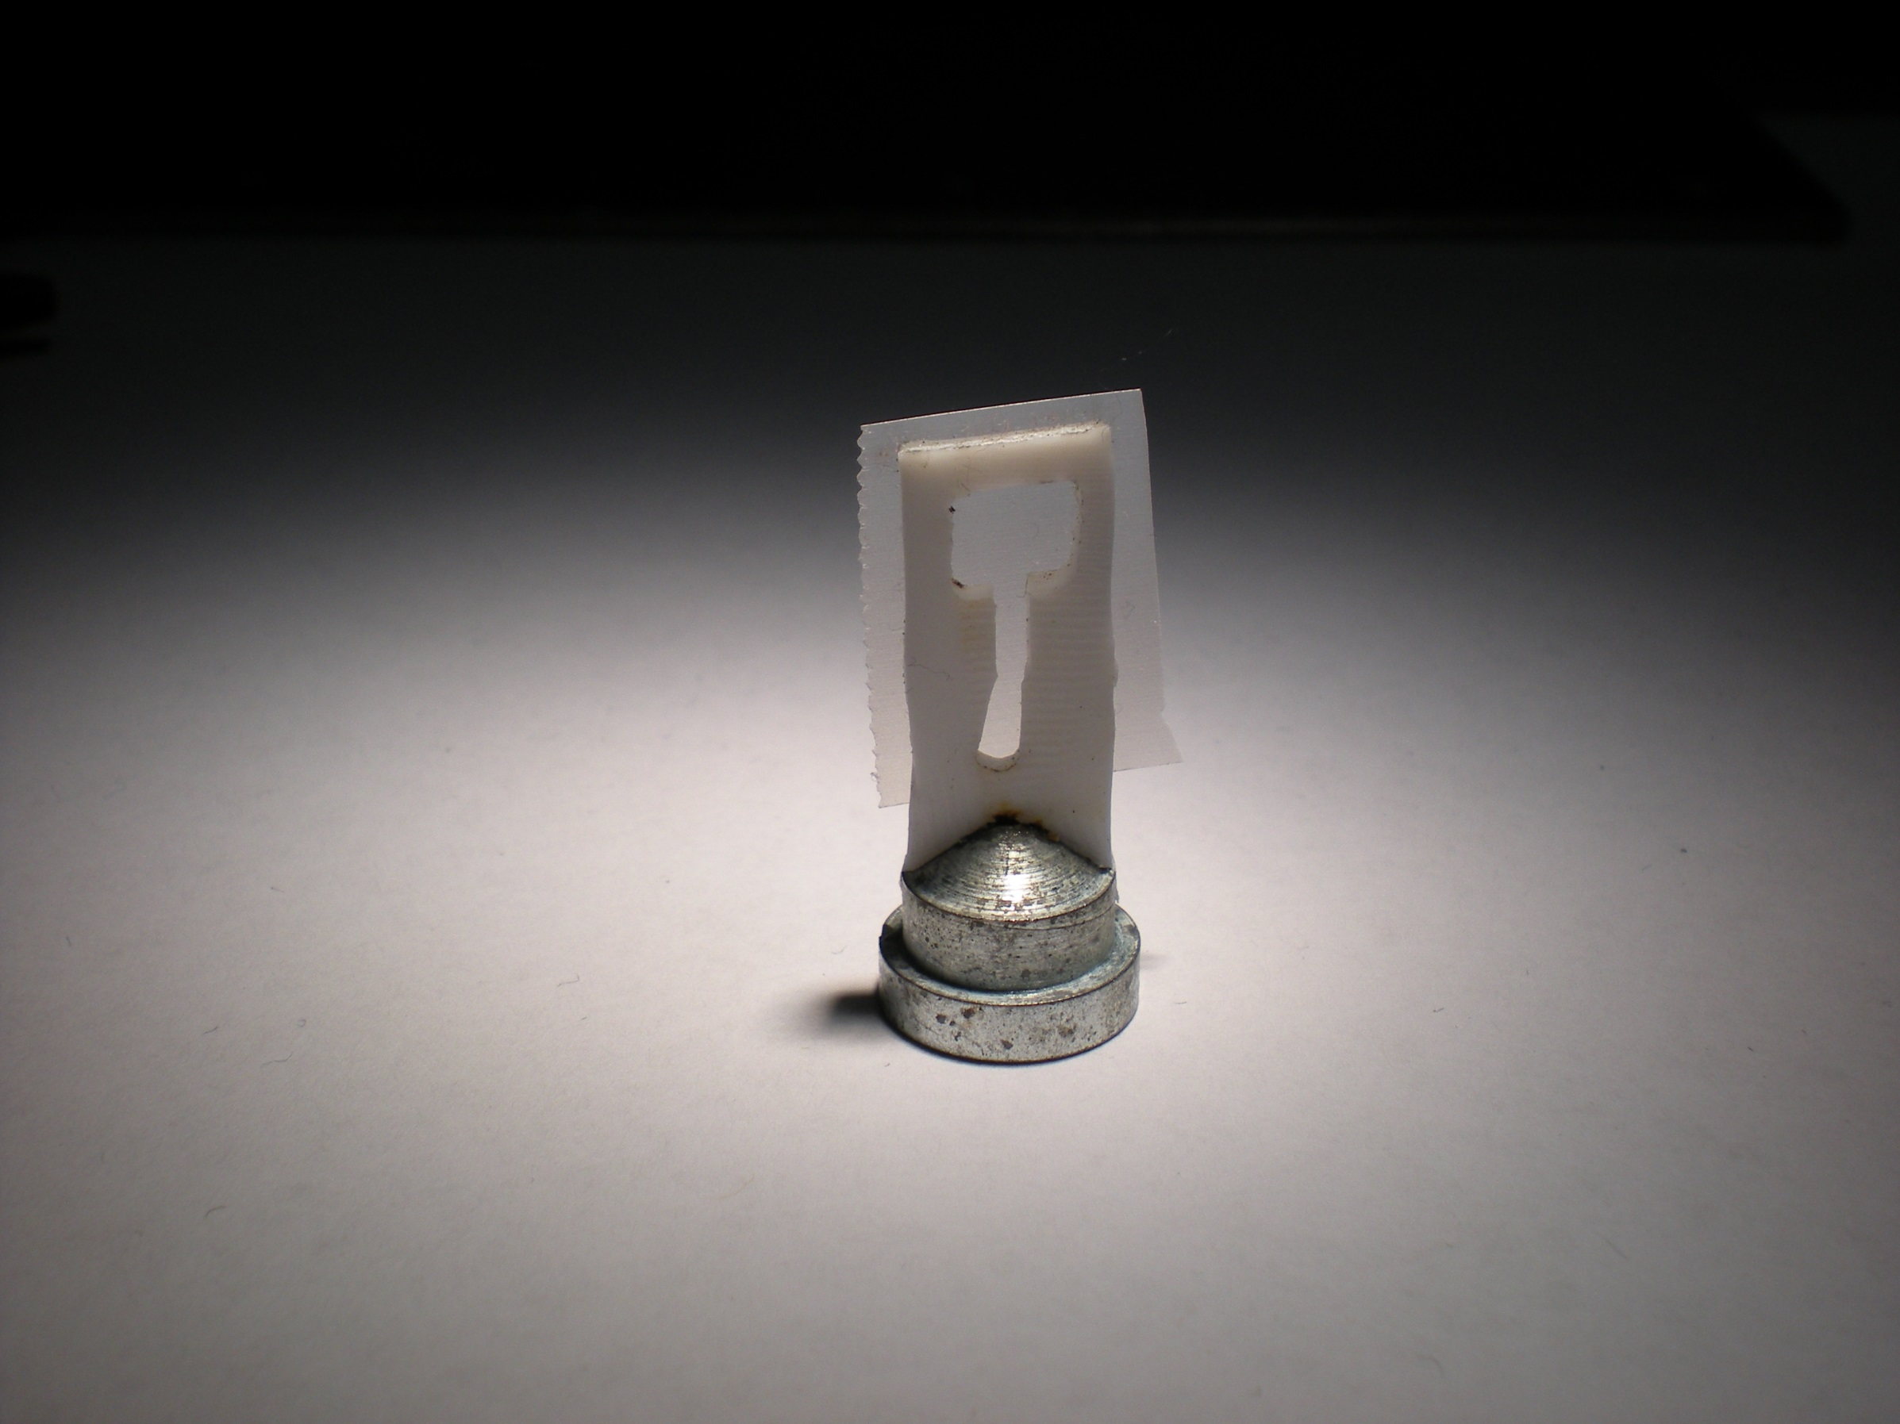
Crowfoot Cell

Slide 47
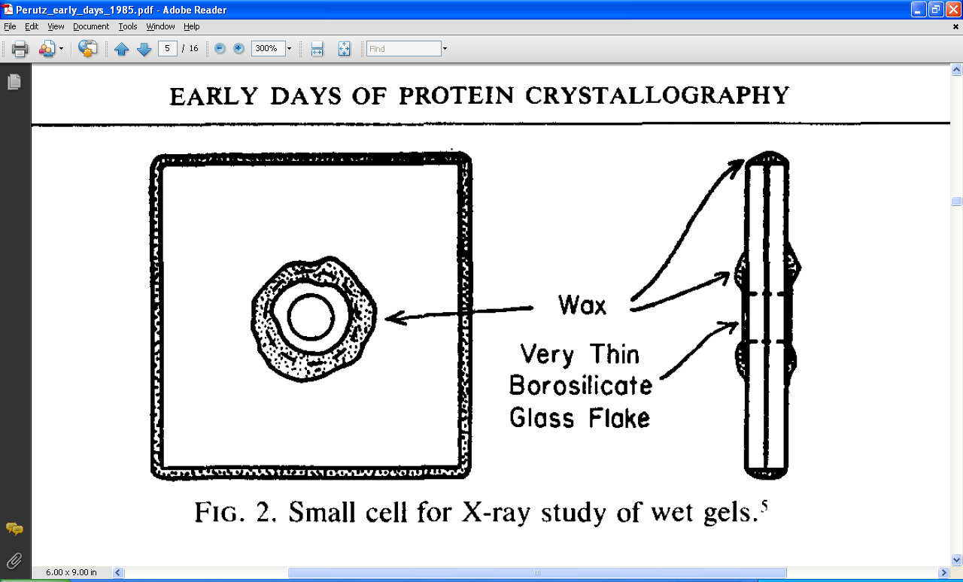
Crowfoot Cell
J. D. Bernal and D. Crowfoot, Nature (London) 133, 794 (1934).

Slide 48
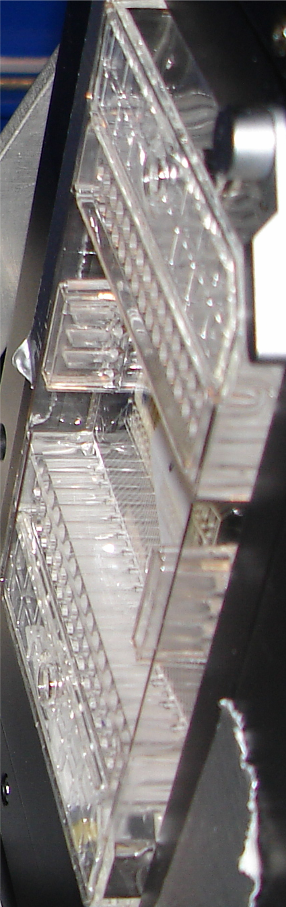
SBS
format
crystallization
tray
mirror
pinhole
microscope
Notes:
Inspired by the ESRF microcrystal camera, the superbend endstations are all equipped with zero-paralax optics. The user sees their sample from the point of view of the x-ray beam. Sample alignment is not only more stable but more intuitive than an off-axis camera. Placing the crystal into the microscope crosshairs gaurantees that it will be hit by the beam.

Slide 49
in-situ diffraction trays
~50 μm tape
~50 μm tape
~50 μm tape
PDMS
PDMS
250 μm
100 μm
25 μm
200 μm
1000 μm
Fluidigm
Topaz® DC
Microlytic
Crystal Former™
NatX-ray
CrystalQuick™ X
MiTeGen
in-situ-1
CrystalDirect
Notes:
Next slide please

Slide 50
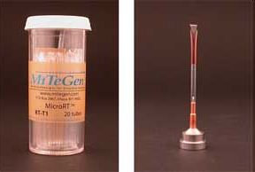
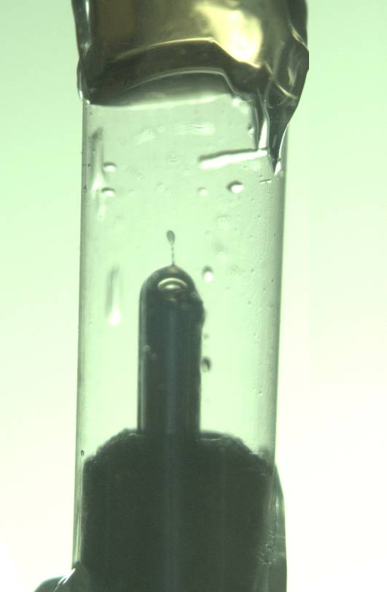
MiTeGen RT cell
http://www.mitegen.com/products/micrort/micrort.shtml

Slide 51
Summary
Don’t touch what you want to shoot
oil is your friend
do not bend
no sudden moves
Cross link?
Warkentin method
try room temp!
http://bl831.als.lbl.gov/~jamesh/powerpoint/CSHL_cryo_2017.pptx

