Slide 1
PowerPoint File available:
http://bl831.als.lbl.gov/
~jamesh/powerpoint/
CSHL_cryo_2017.pptx

Slide 2
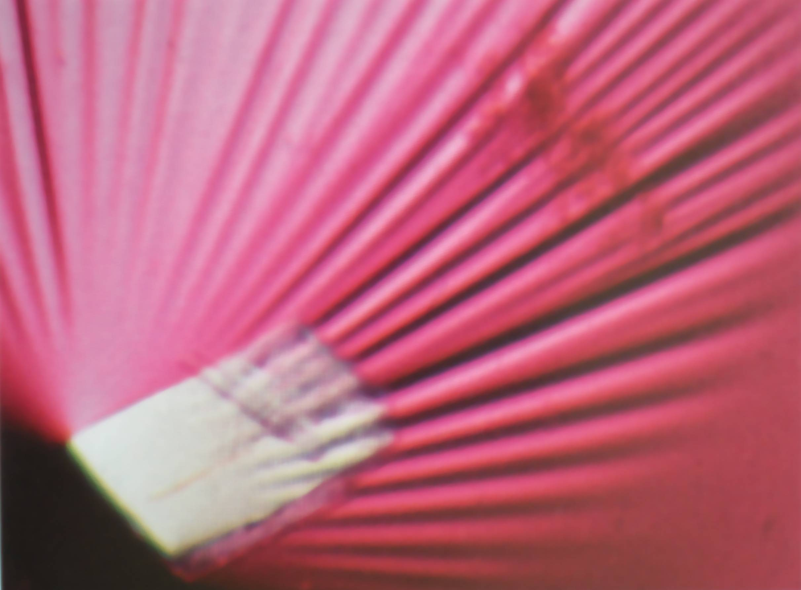
Icky Skin Stuff

Slide 3
X-ray scattering “rules”:
1 μm crystal ≈ 1 μm water
≈ 1 μm plastic
≈ 0.1 μm glass
≈ 1000 μm air

Slide 4
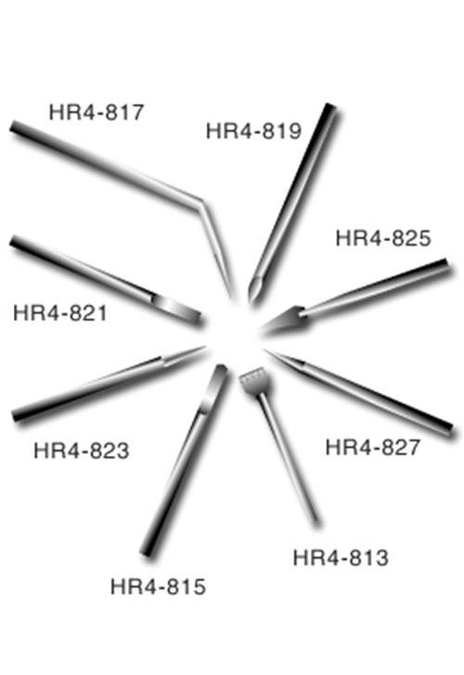
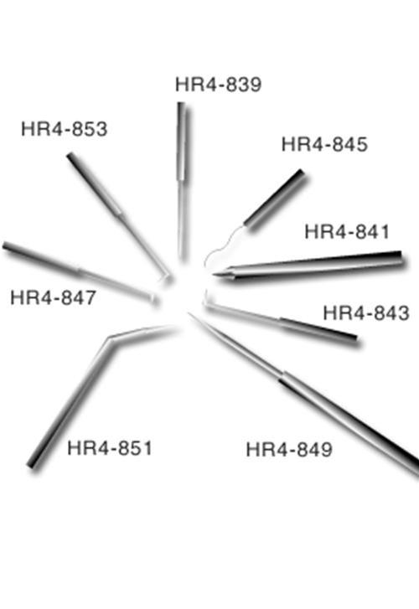
Hampton crystal surgery tools

Slide 5
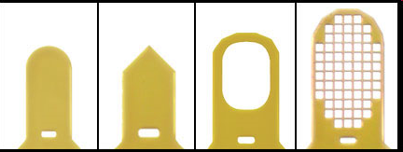
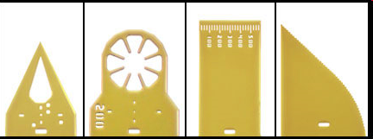
MiTeGen MicroTools
http://www.mitegen.com/products/microtools/microtools_kit1.shtml

Slide 6
Harvesting dos and don'ts
physical contact
don’t touch the part you intend to shoot
osmotic shock
equilibrate, or calculate matching solution
changes in dielectric constant
Petsko (1975) J. Mol. Biol. 96, 381-388.
cooled density mismatch
Juers & Matthews (2004) Acta Cryst. D 60, 412-421.

Slide 7
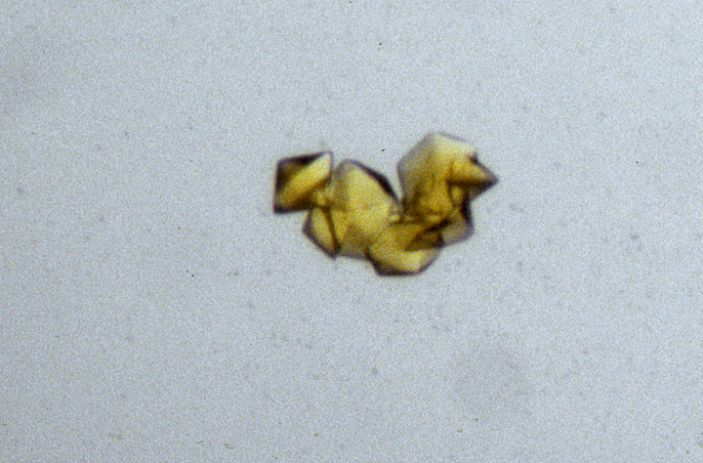
“crystal” = thing you want to shoot

Slide 8
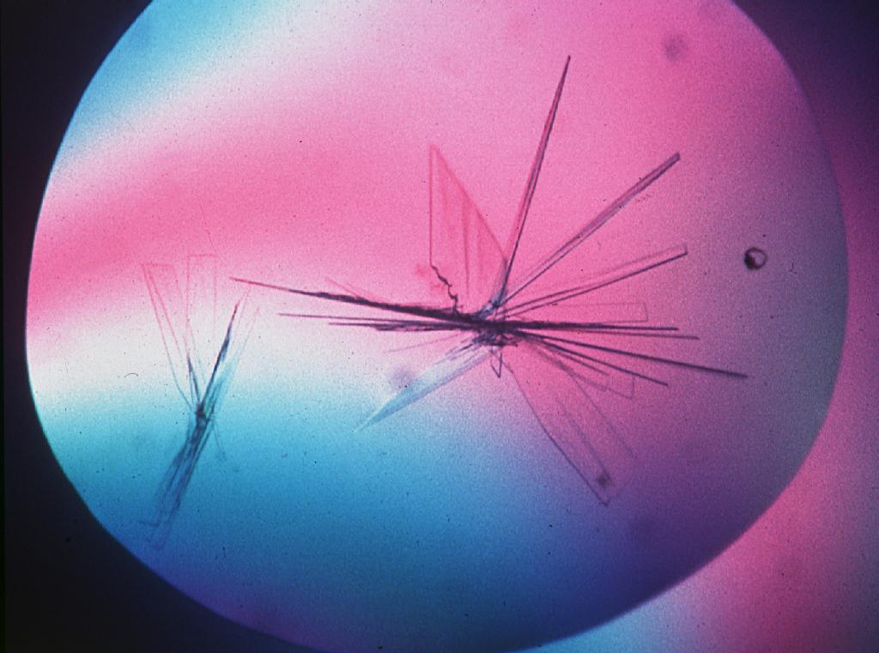
platy crystals

Slide 9
platy crystals

Slide 10
How many “crystals” do you see?
Shoot the crystal (singular)

Slide 11
platy crystals

Slide 12
platy crystals

Slide 13
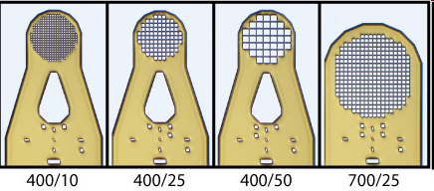
MiTeGen MicroMesh grids
http://www.mitegen.com/products/micromeshes/micromeshes.shtml

Slide 14
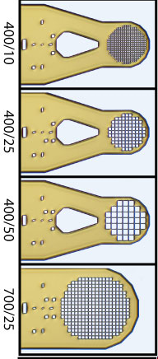
platy crystals

Slide 15
platy crystals

Slide 16
platy crystals

Slide 17
xtal stuck on tray
?

Slide 18
xtal stuck on tray

Slide 19
xtal stuck on tray

Slide 20
xtal stuck on tray

Slide 21
xtal stuck on tray

Slide 22
xtal stuck on tray

Slide 23
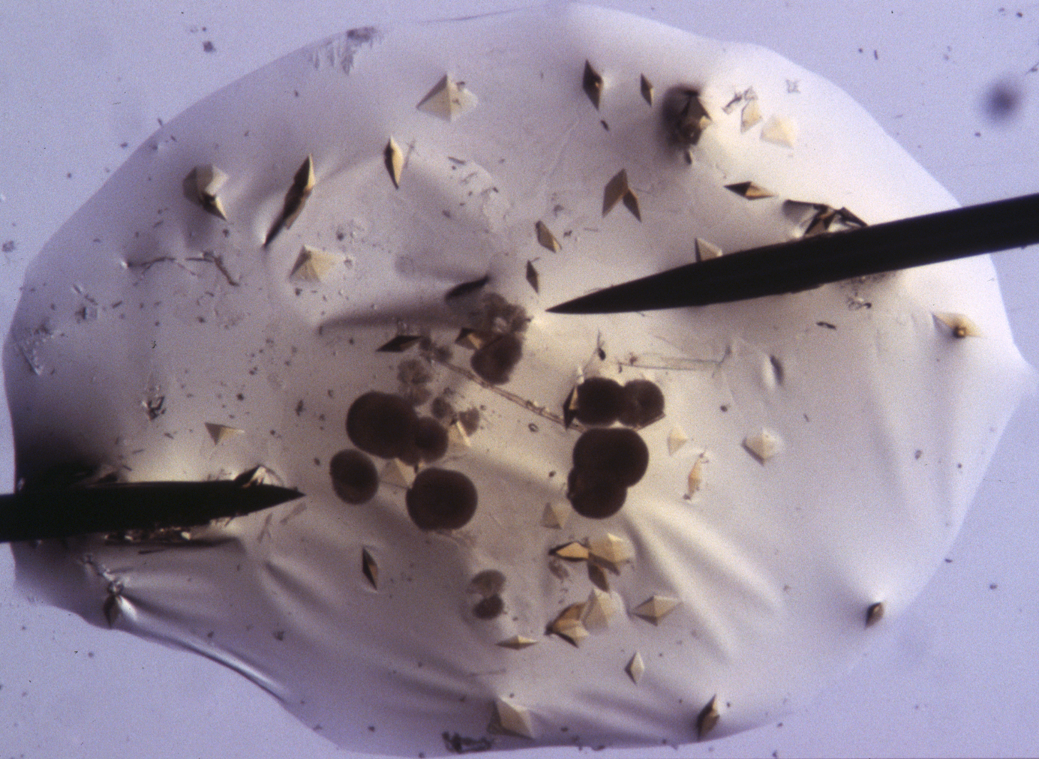
acupuncture needles

Slide 24
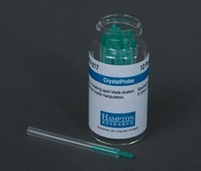
acupuncture needles

Slide 25
xtal stuck on tray

Slide 26
MiTeGen MicroSaw
10 μm thick!
http://www.mitegen.com/products/microtools/microtools_kit1.shtml

Slide 27
xtal stuck on tray

Slide 28
xtal stuck on tray

Slide 29
xtal stuck on tray

Slide 30
xtal stuck on tray

Slide 31
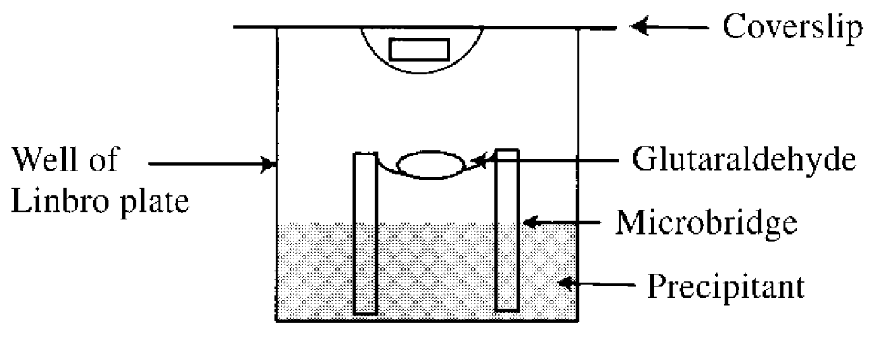
crystals too fragile? cross-link them!
Lusty (1999) J. Appl. Crystallogr. 32, 106-112.
McWhirter, et al. (1999) PNAS USA 96, 8408-8413.

Slide 32
Harvesting dos and don'ts
physical contact
don’t touch the part you intend to shoot
osmotic shock
equilibrate, or calculate matching solution
changes in dielectric constant
Petsko (1975) J. Mol. Biol. 96, 381-388.
cooled density mismatch
Juers & Matthews (2004) Acta Cryst. D 60, 412-421.

Slide 33
cryo assay 1 does your crystal “like” it?

Slide 34
Osmolarity matching
Look up osmotic pressure of mother liquor in CRC Handbook of Physics and Chemistry, Section D-232. 11th column is O: Os/kg
Look up o.p. of cryoprotectant agent.
Modify conc. of mother liquor to minimize change in osmotic pressure.

Slide 35
matching osmolarity

Slide 36
Harvesting dos and don'ts
physical contact
don’t touch the part you intend to shoot
osmotic shock
equilibrate, or calculate matching solution
changes in dielectric constant
Petsko (1975) J. Mol. Biol. 96, 381-388.
cooled density mismatch
Juers & Matthews (2004) Acta Cryst. D 60, 412-421.

Slide 37
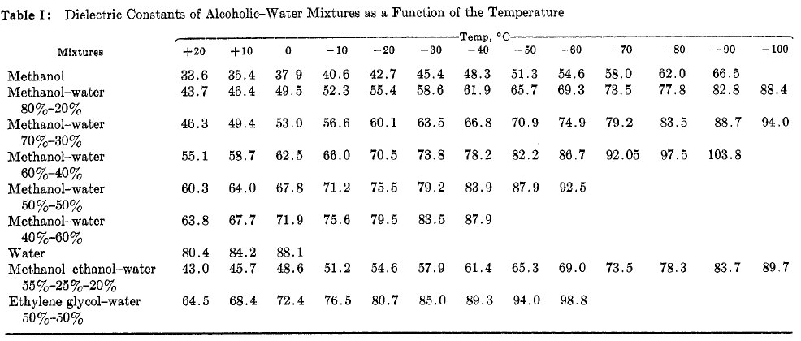
Dielectric matching
Travers & Douzou (1970) J. of Phys. Chem. 74, 2243-2244.
Petsko (1975) J. Mol. Biol. 96, 381-388.
Douzou (1977) Cryobiochemistry. Academic Press.

Slide 38
Tris buffer vs temperature
pH
Temperature (C)

Slide 39
Tris buffer under cryo
pH*
Temperature (K)
Douzou (1977) Cryobiochemistry. Academic Press.

Slide 40
matching dielectric const.

Slide 41
matching dielectric const.

Slide 42
matching dielectric const.

Slide 43
matching dielectric const.

Slide 44
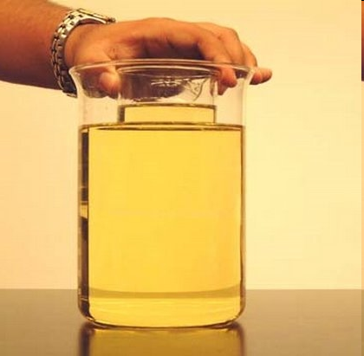
My crystal “dissolved” in the oil!
no, it didn’t…

Slide 45
Harvesting dos and don'ts
physical contact
don’t touch the part you intend to shoot
osmotic shock
equilibrate, or calculate matching solution
changes in dielectric constant
Petsko (1975) J. Mol. Biol. 96, 381-388.
cooled density mismatch
Juers & Matthews (2004) Acta Cryst. D 60, 412-421.

Slide 46

ice = bad

Slide 47
ice = bad

Slide 48
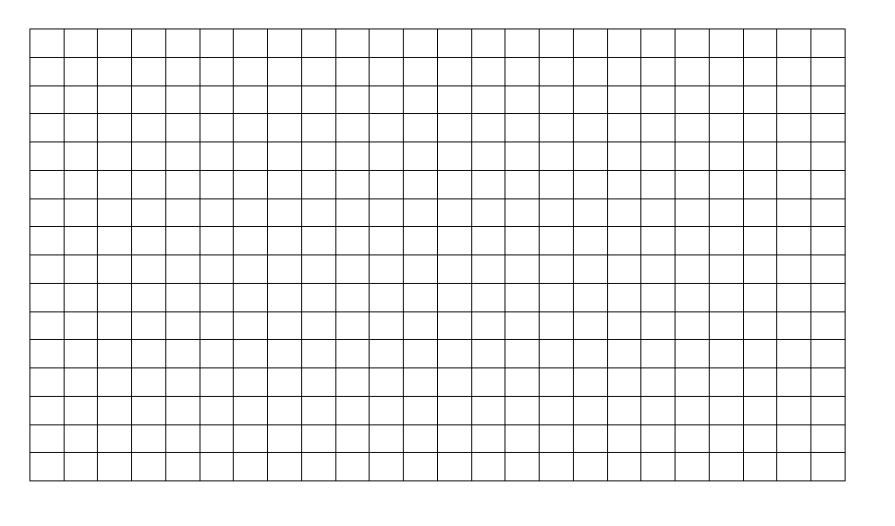
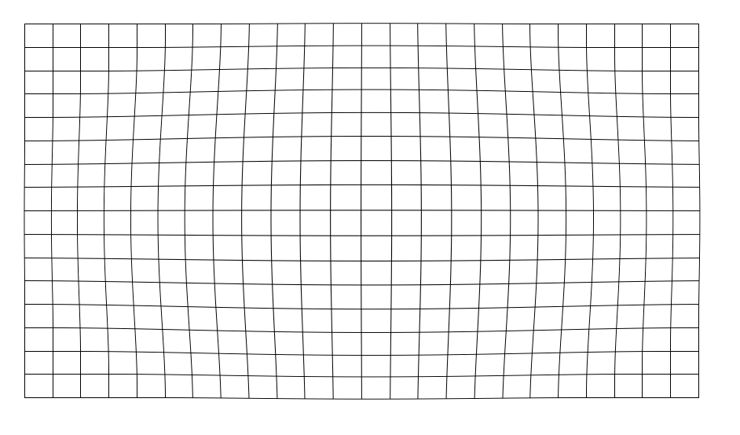
stress and strain
intensity
∞ 10 5 3 2.7 2.5 2.0 1.8 1.5
resolution (Å)

Slide 49
stress and strain
intensity
∞ 10 5 3 2.7 2.5 2.0 1.8 1.5
resolution (Å)

Slide 50
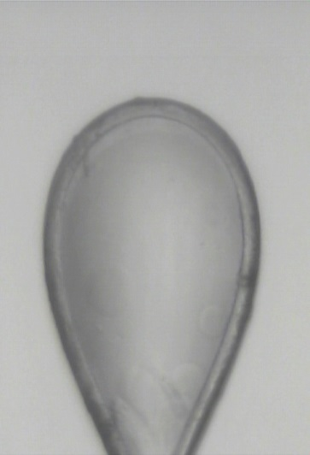
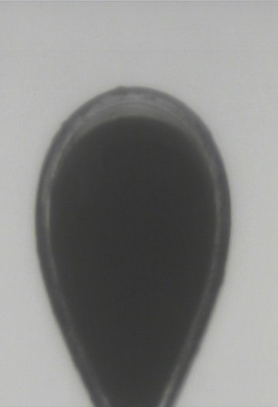
cryo assay
does it “freeze clear”?
vs.

Slide 51
You do not need a cryostream to check your cryo!
liquid N₂

Slide 52
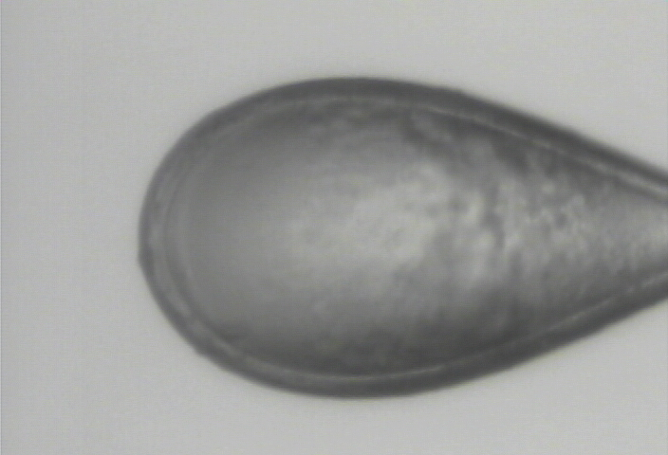
clear drop, right?

Slide 53
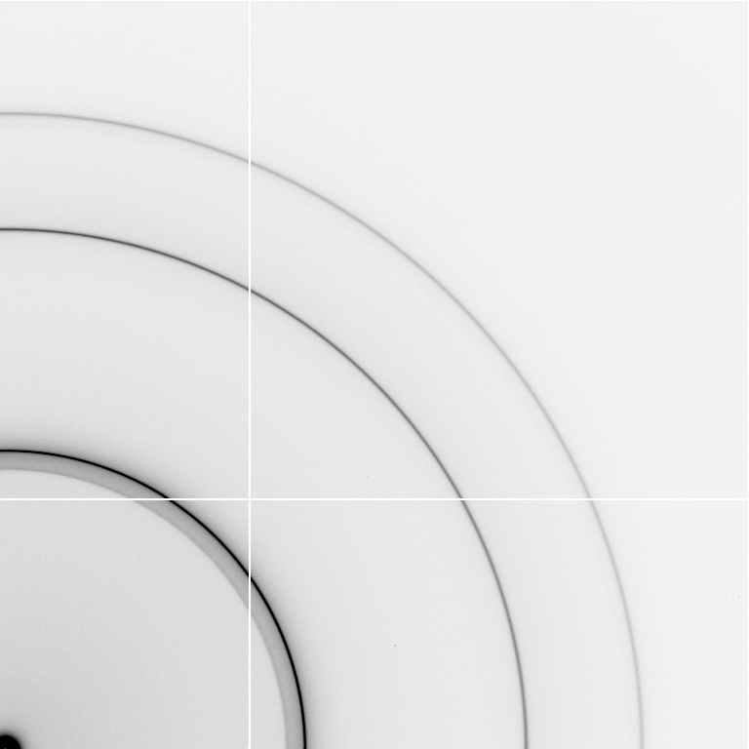
cubic ice
0.92 g/cm³

Slide 54
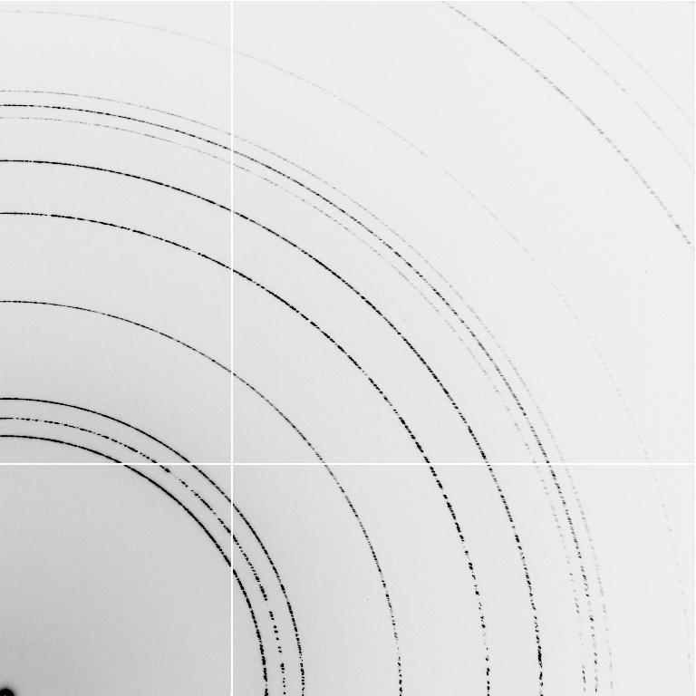
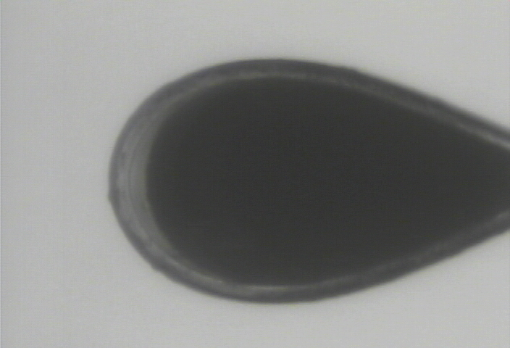
hexagonal ice
0.92 g/cm³

Slide 55
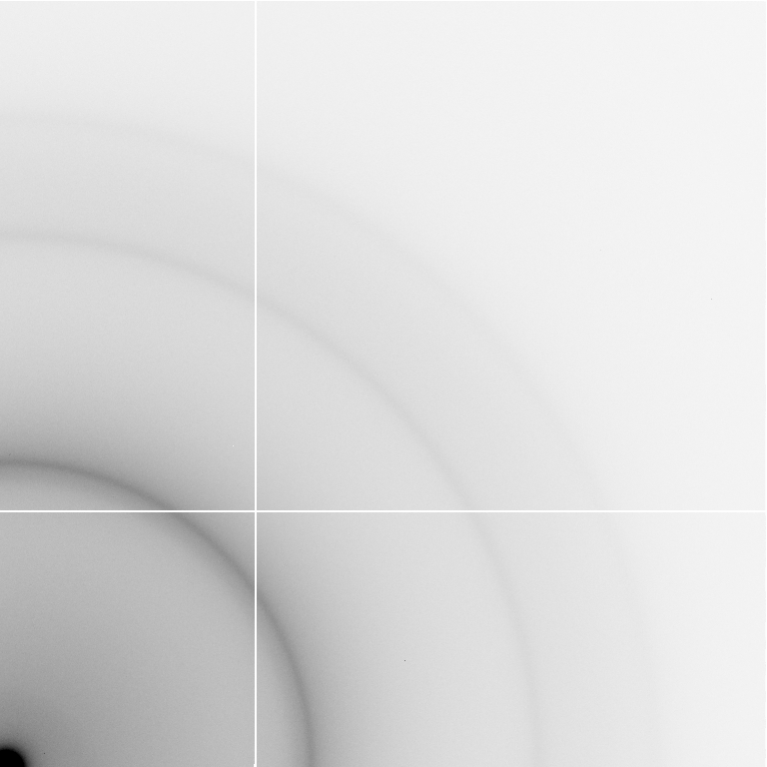
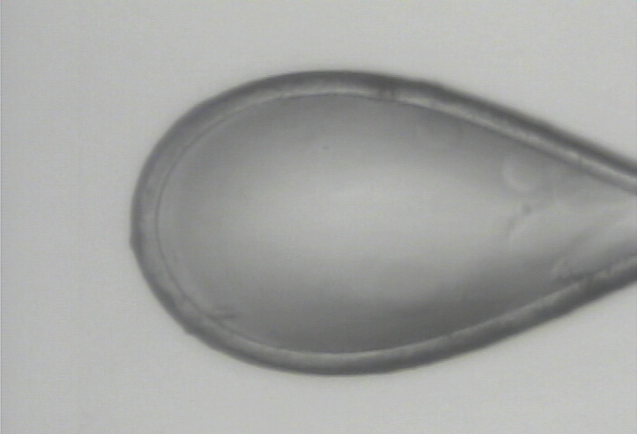
nano-crystalline cubic ice
~0.93 g/cm³

Slide 56
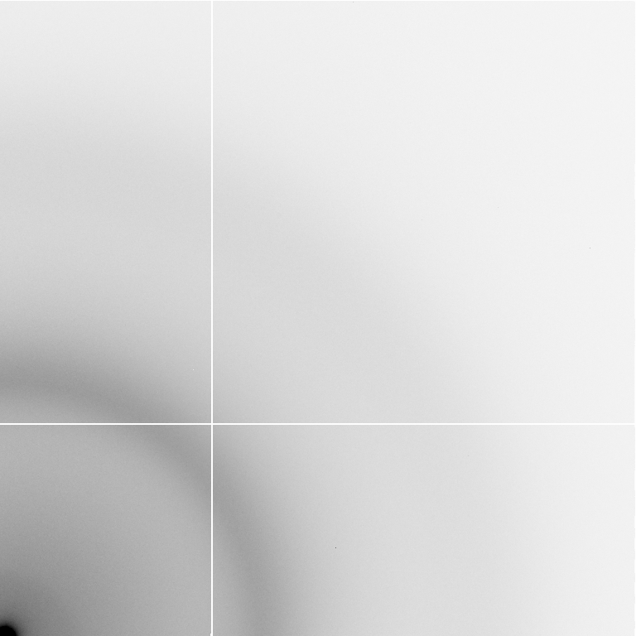
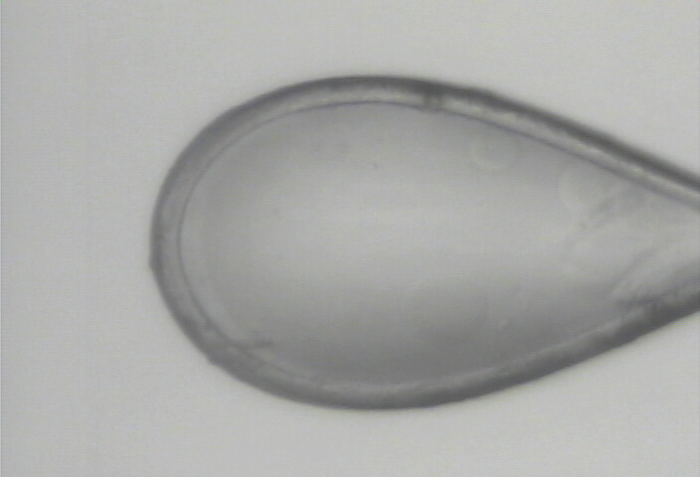
amorphous ice
0.94 g/cm³

Slide 57
annealing
easiest way to change your cryo
WATCH droplet melt before re-cooling
snapshots only!
Juers & Matthews (2004) Acta Cryst. D 60, 412-421.

Slide 58
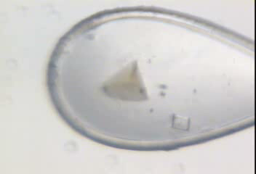
annealing gone wrong

Slide 59
annealing – in slo-mo

Slide 60
opened drop: you have ~30 seconds!
equilibrated drop

Slide 61
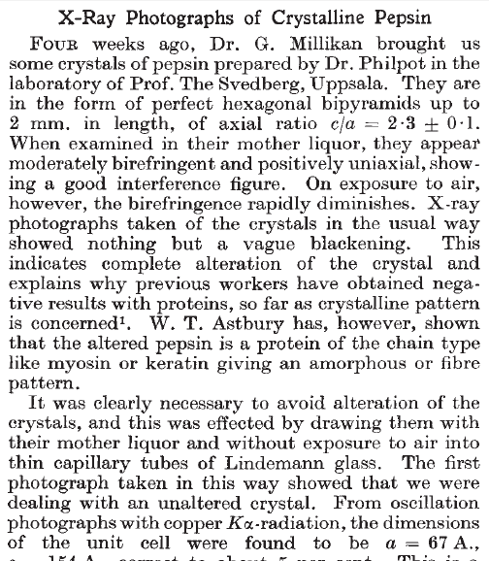
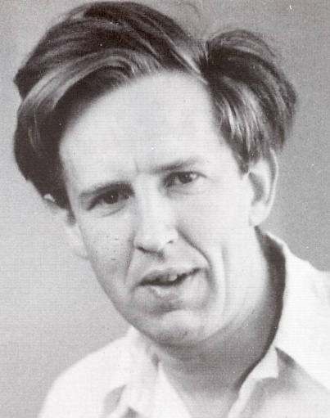
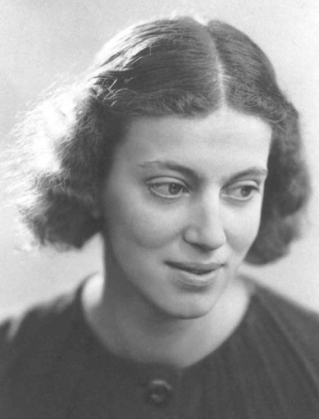
First diffraction from protein xtal
1934
Bernal, J. & Crowfoot, D. (1934). "X-ray photographs of crystalline pepsin", Nature 133, 794-795.

Slide 62
Dehydration: 1934
and 2017?
= 1.5 μL
100 μm
= 1.0 nL
2 mm
= 1.0 pL
10 μm
= 1.0 fL
1 μm

Slide 63
Non-isomorphism in lysozyme
Dear James
The story of the two forms of lysozyme crystals goes back to about 1964 when it was found that the diffraction patterns from different crystals could be placed in one of two classes depending on their intensities. This discovery was a big set back at the time and I can remember a lecture title being changed from the 'The structure of lysozyme' to 'The structure of lysozyme two steps forward and one step back'. Thereafter the crystals were screened based on intensities of the (11,11,l) rows to distinguish them (e.g. 11,11,4 > 11,11,5 in one form and vice versa in another). Data were collected only for those that fulfilled the Type II criteria. (These reflections were easy to measure on the linear diffractometer because crystals were mounted to rotate about the diagonal axis). As I recall both Type I and Type II could be found in the same crystallisation batch . Although sometimes the external morphology allowed recognition this was not infallible.
The structure was based on Type II crystals. Later a graduate student Helen Handoll examined Type I. The work, which was in the early days and before refinement programmes, seemed to suggest that the differences lay in the arrangement of water or chloride molecules (Lysozyme was crystallised from NaCl). But the work was never written up. Keith Wilson at one stage was following this up as lysozyme was being used to test data collection strategies but I do not know the outcome.
An account of this is given in International Table Volume F (Rossmann and Arnold edited 2001) p760.
Tony North was much involved in sorting this out and if you wanted more info he would be the person to contact. I hope this is helpful. Do let me know if you need more.
Best wishes
Louise

Slide 64
Non-isomorphism in lysozyme
Structure factor (e⁻)
Johnson’s ratio

Slide 65
Non-isomorphism in lysozyme
Structure factor (e⁻)
Johnson’s ratio

Slide 66
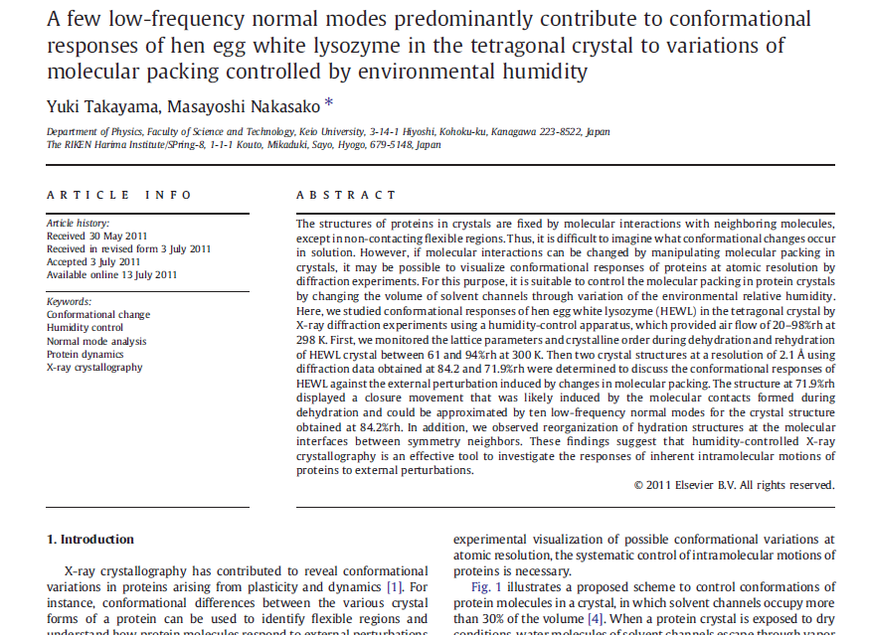

Slide 67

Non-isomorphism in lysozyme
RMSD = 1.70 Å
Δcell = 0.7 %
R_{iso} = 44.5%
RMSD = 0.18 Å
3aw6
3aw7
RH: 84.2%
vs 71.9%

Slide 68
“same drop” ?

Slide 69
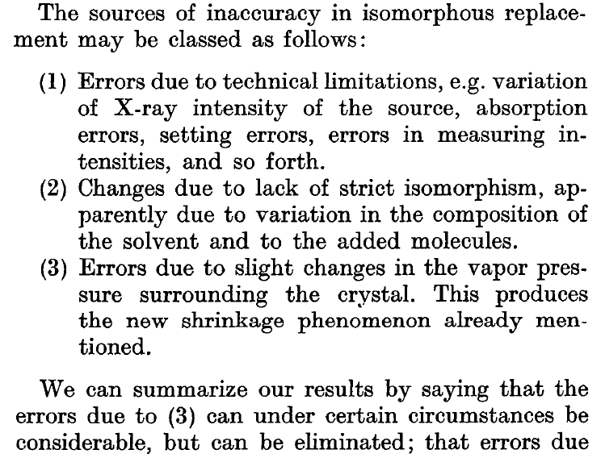
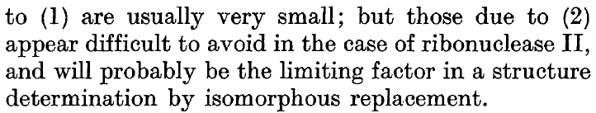
Magdoff & Crick (1955) “Ribonuclease II. Accuracy of measurement and shrinkage”, Acta Cryst. 8, 461-8.
Crick & Magdoff (1956) “The theory of the method of isomorphous replacement for protein crystals”, Acta Cryst. 9, 901-8.

Slide 70
Elastic deformation
= non-isomorphism

Slide 71
Elastic deformation
= non-isomorphism

Slide 72
Plastic deformation
= poor diffraction

Slide 73
Plastic deformation
= poor diffraction

Slide 74
OK! OK!
Now I am afraid!
What should I do?

Slide 75
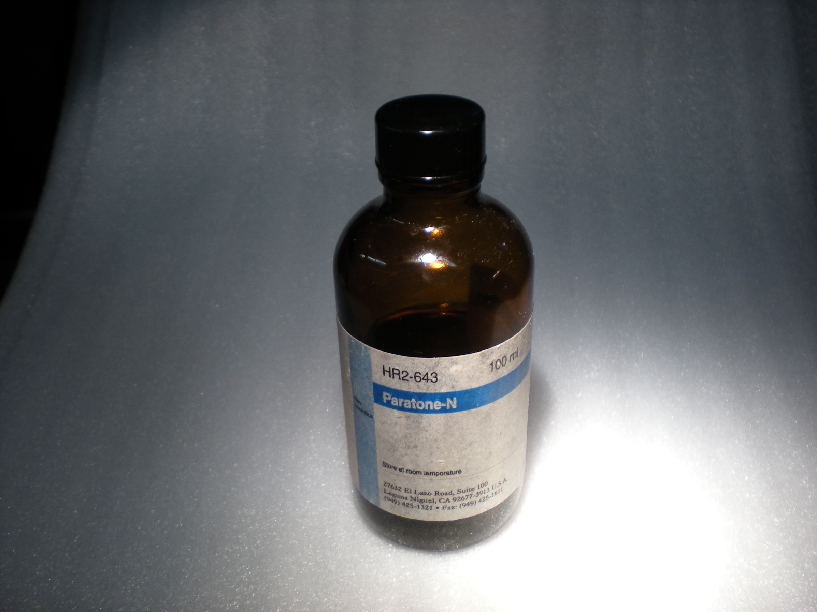
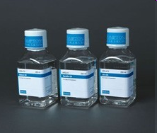
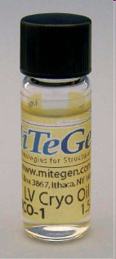
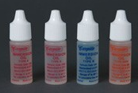
oil is your friend

Slide 76
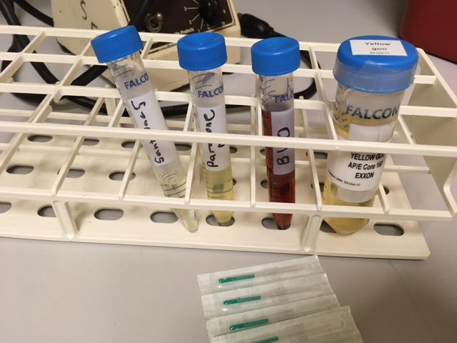
Oil is your friend

Slide 77
opened drop: you have ~30 seconds!
oil

Slide 78
oiled drop: you have ~3 hours
oil

Slide 79
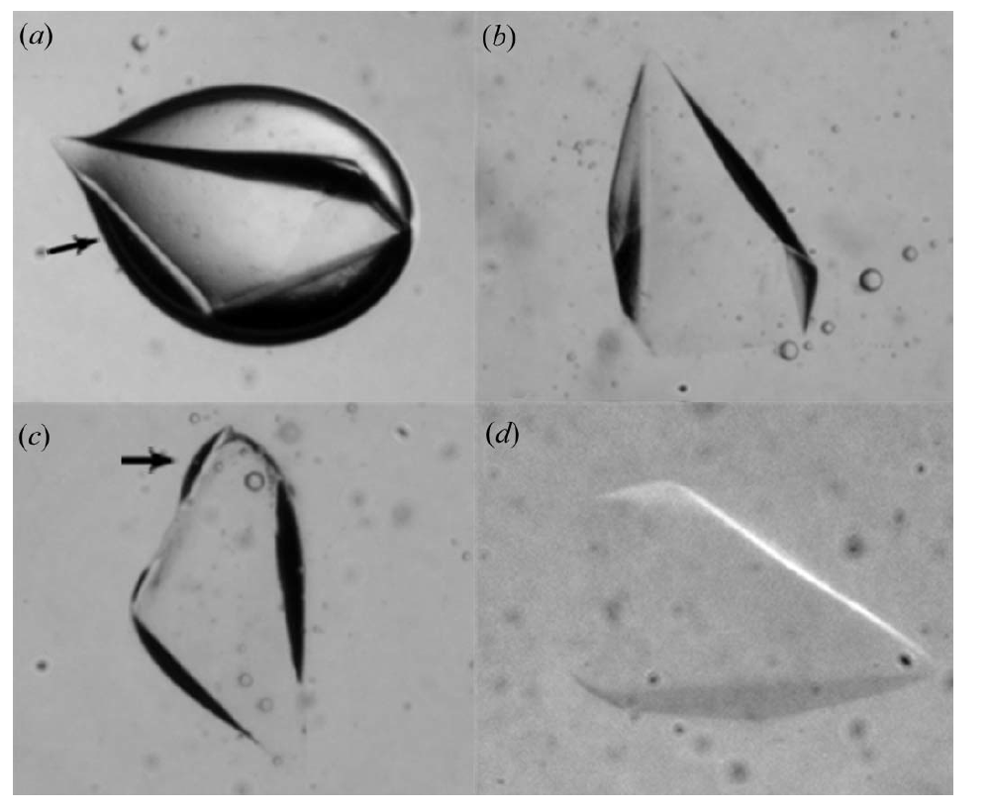
Water on surface?
Warkentin et al. J. Appl. Cryst. (2009). 42, 944–952

Slide 80
Remove Excess

Slide 81
Dabbing to remove excess
clean surface

Slide 82
Dabbing to remove excess
clean surface

Slide 83
Dabbing to remove excess
clean surface

Slide 84
Dabbing to remove excess
clean surface

Slide 85
Dabbing to remove excess
clean surface

Slide 86
Dabbing to remove excess
clean surface

Slide 87
Dabbing to remove excess
clean surface

Slide 88
Crystal fishing demystified
“Lasso” method

Slide 89
Crystal fishing demystified

Slide 90
Crystal fishing demystified

Slide 91
Crystal fishing demystified

Slide 92
Crystal fishing demystified

Slide 93
Crystal fishing demystified

Slide 94
Crystal fishing demystified

Slide 95
Crystal fishing demystified
“Soup Spoon” method

Slide 96
Crystal fishing demystified

Slide 97
Crystal fishing demystified

Slide 98
Crystal fishing demystified

Slide 99
Crystal fishing demystified

Slide 100
Crystal fishing demystified

Slide 101
Crystal fishing demystified

Slide 102
plunge cooling
warm, moist air
ice
cold N₂
liquid N₂
foam insulation

Slide 103
plunge cooling
warm, moist air
ice
cold N₂
liquid N₂
foam insulation

Slide 104
Warkentin method
liquid N₂
foam insulation
Warkentin (2006) J. Appl. Crystallogr. 39, 805-811.

Slide 105
COMBINE cryoprotectants!
organic + hyperquenching
malonate + glycerol
“confusion principle”
~30% glycerol is not as good as:
5% glycerol +
5% PEG400 +
5% MPD +
5% sucrose +
5% sorbitol +
5% ethylene glycol

Slide 106
COMBINE cryoprotectants!
organic + hyperquenching
malonate + glycerol
“confusion principle”
~30% glycerol is not as good as:
25% glycerol +
1% PEG400 +
1% MPD +
1% sucrose +
1% sorbitol +
1% ethylene glycol

Slide 107
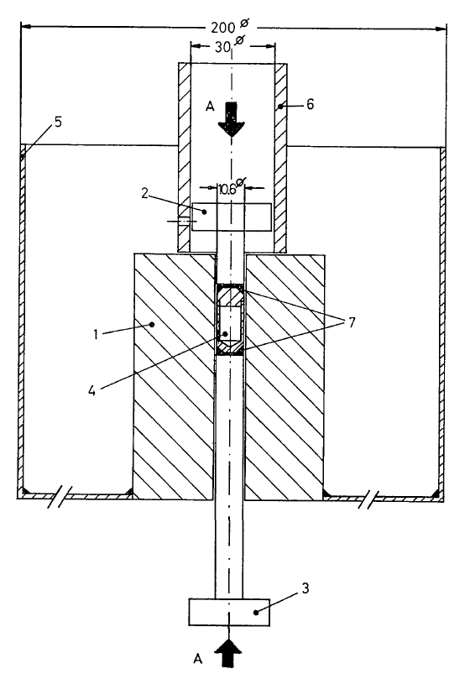
Pressure as a cryoprotectant
Fig. 1. Equipment for freezing at 2500 atm. (1) Steel cylinder, (2) and (3) pistons which can be coupled to a hydraulic press, (4) Teflon cell, (5) vessel for liquid nitrogen, (6) steel tube used for pushing cell (4) out of cylinder (1), (7) steel rings. Scale is in mm. A-A : direction of the force.
Thomanek et al. (1973)
Acta Cryst. A 29, 263-265.

Slide 108
Pressure as a cryoprotectant
High-pressure cooling apparatus. (a) Sample pin. An oil-coated crystal in a cryoloop is inserted into one end (right) of a brass tube (2.5 cm long) and a
steel piano wire in the other end (left). (b) High-pressure tubing assembly in a LN2 container. A sample is loaded into the top of each 30 cm long tube
and is held in place by a magnet outside the tube. Three crystals can be pressure-cooled at a time.
Kim et al. (2005) Acta Cryst. D 61, 881-890.

Slide 109
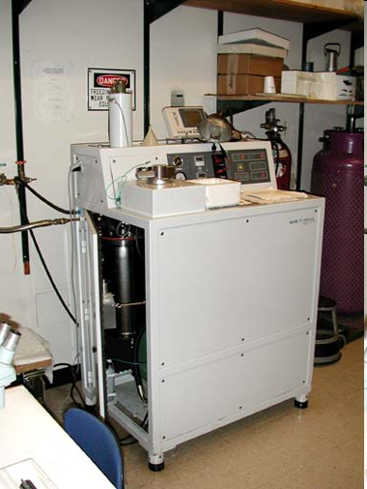
Pressure as a cryoprotectant
Balzers HPM 010 High Pressure Freezer
The Bal-Tec HPM 010 is a high pressure freezing machine that is designed to freeze non-cryoprotected samples up to 0.5mm in thickness without significant ice crystal damage. Samples can then be processed for TEM using the freeze substitution protocol. These two methods are the state-of-the-art for TEM specimen preparation.
http://www.leica-microsystems.com/products/
electron-microscope-sample-preparation/
industrial-materials/cryo-preparation/
details/product/leica-em-pact2/

Slide 110
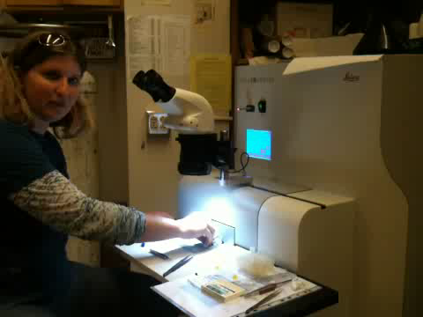
Pressure as a cryoprotectant

Slide 111
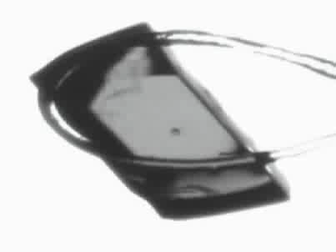
Response to dehydration
www.proteros.de

Slide 112
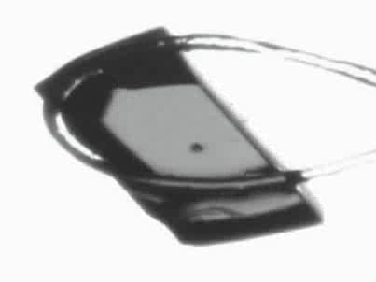
Response to dehydration
www.proteros.de

Slide 113
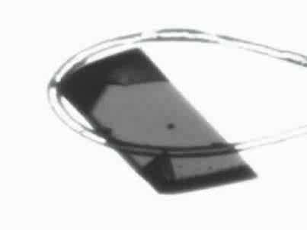
Response to dehydration
www.proteros.de

Slide 114
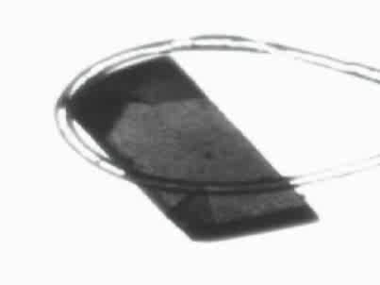
Response to dehydration
www.proteros.de

Slide 115
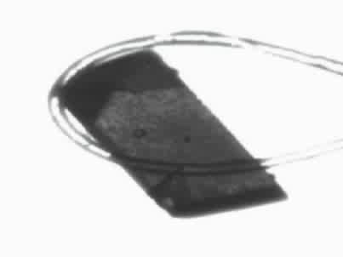
Response to dehydration
www.proteros.de

Slide 116
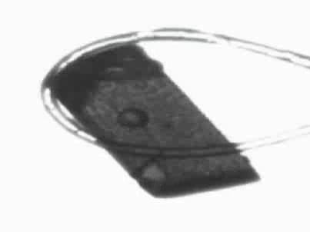
Response to dehydration
www.proteros.de

Slide 117
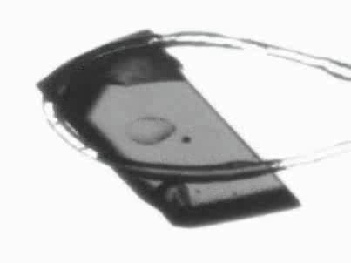
Response to dehydration
www.proteros.de

Slide 118
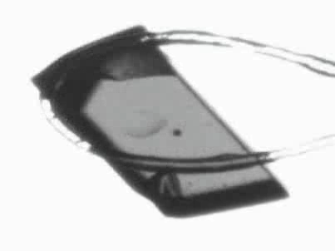
Response to dehydration
www.proteros.de

Slide 119

Ostwald Ripening
http://xray.bmc.uu.se/terese/tutorial6.html

Slide 120
… but does it work for membrane proteins?
CCP4BB:
“We used it for a large membrane protein complex and diffraction improved from ~7 to 2.7 A. The crystal is fished out and put into mother liquor solution in the button, sealed with dialysis membrane and the button is then placed into about 5 mls of mother liquor with slightly higher PEG concentration. Then you just exchange outside buffer every day or so for solutions containing higher concentrations of PEG. We went from ~9 to 30 % PEG4000 in about a week. You can easily observe crystal under microscope and if it cracks - you went too far/too quickly with PEG and need to use a bit less next time. Also, this method allows you to control all other components of the dehydrating solution - we needed to decrease salt concentration at the same time as increasing PEG. You can also introduce/increase cryo-protectant concentration at the same time. With these crystals, otherwise excellent dehydration machines already mentioned did not work, possibly because the process had to be really slow.”
Efremov, R. G. & Sazanov, L. A. (2011)."Structure of the membrane domain of respiratory complex I", Nature 476, 414-420.
“To improve diffraction properties, crystals were slowly cooled to 4 C, placed into micro-dialysis buttons, and mother liquor was exchanged by dialysis for 0.1 M sodium acetate (pH 4.8), 0.15 M sodium tartrate (pH 5.0), 30% PEG4000, 0.1% sodium cholate and 12.5% glycerol over a period of 5 days.”

Slide 121
Why harvest at all?
Radiation damage
  10-100x reduced at ~100 K
Background scatter
    tray >> xtal
Timing
    nothing lasts forever
Shipping
    cryo samples are glass beads

Slide 122
X-ray transmission of materials
air
water
protein
crystal
transmission
glass
Depth into material (μm)

Slide 123
X-ray scattering of materials
glass
Differential cross section
(scattered photons/solid angle/incident photon/meter thickness)
plastic
paratone-N oil
25% glycerol
water
∞ 7.5 3.8 2.5 1.9 1.5
d-spacing (Ǻ)

Slide 124

Crowfoot Cell

Slide 125

Crowfoot Cell

Slide 126

Crowfoot Cell
J. D. Bernal and D. Crowfoot, Nature (London) 133, 794 (1934).

Slide 127

SBS
format
crystallization
tray
mirror
pinhole
microscope
Notes:
Inspired by the ESRF microcrystal camera, the superbend endstations are all equipped with zero-paralax optics. The user sees their sample from the point of view of the x-ray beam. Sample alignment is not only more stable but more intuitive than an off-axis camera. Placing the crystal into the microscope crosshairs gaurantees that it will be hit by the beam.

Slide 128

Notes:
non-rotating tray goniometer stage installed in ALS 8.3.1. Note that the “normal” cryo-pin goniometer on the left is still in place and a brass flight tube has been added to contain the air scatter from the main beam on its way to the tray goniometer.

Slide 129
in-situ diffraction trays
~50 μm tape
~50 μm tape
~50 μm tape
PDMS
PDMS
250 μm
100 μm
25 μm
200 μm
1000 μm
Fluidigm
Topaz® DC
Microlytic
Crystal Former™
NatX-ray
CrystalQuick™ X
MiTeGen
in-situ-1
CrystalDirect
Notes:
Next slide please

Slide 130


Plate goniometers
Notes:
The non-rotating “plate goniometer” (left) was developed last year. A new incarnation for taking rotation-camera data is now being developed (right). Either of these devices will accept most any crystallization tray that can be rotated 90 degrees to gravity and probe arbitrary points in each crystallization drop with a 50 um x-ray beam. Installing a plate goniometer takes ~30 minutes and the location ~300 mm downbeam from the “normal” protein crystallography sample mounting point makes this technology transferable to most any beamline.
Current status is that a 95% complete data set has been collected from a 50 um lysozyme crystal at room temperature, and trials are now underway to collect data sets from “real” crystals.

Slide 131

Notes:
non-rotating tray goniometer stage installed in ALS 8.3.1. Note that the “normal” cryo-pin goniometer on the left is still in place and a brass flight tube has been added to contain the air scatter from the main beam on its way to the tray goniometer.

Slide 132


Slide 133


MiTeGen RT cell
http://www.mitegen.com/products/micrort/micrort.shtml

Slide 134
Summary
Don’t touch what you want to shoot
oil is your friend
do not bend
no sudden moves
Cross link?
Warkentin method
try room temp!
http://bl831.als.lbl.gov/~jamesh/powerpoint/CSHL_cryo_2017.pptx

