Slide 1
Basic unix commands that everyone should know
http://bl831.als.lbl.gov/~jamesh/powerpoint/CSHL_commands_2018.ppt
Slightly more advanced:
http://bl831.als.lbl.gov/~jamesh/elves/manual/tricks.html
(Even if you have a mac)

Slide 2
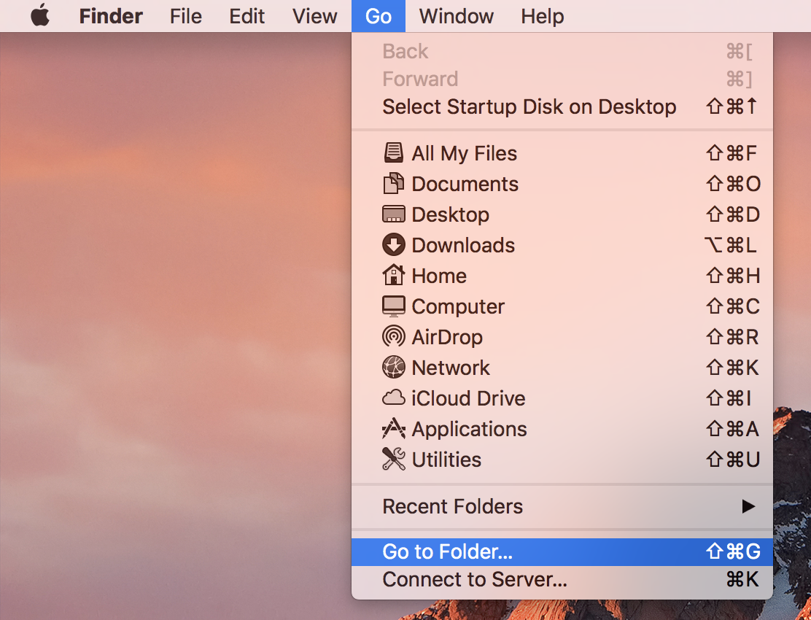
Left click
Left click

Slide 3
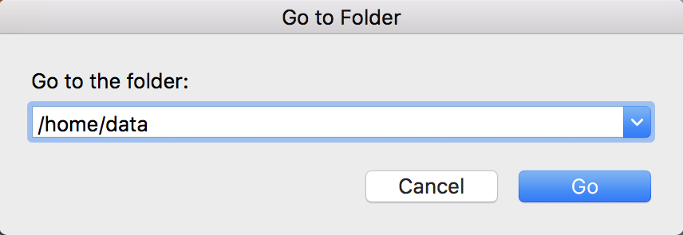
type
(with keyboard)

Slide 4
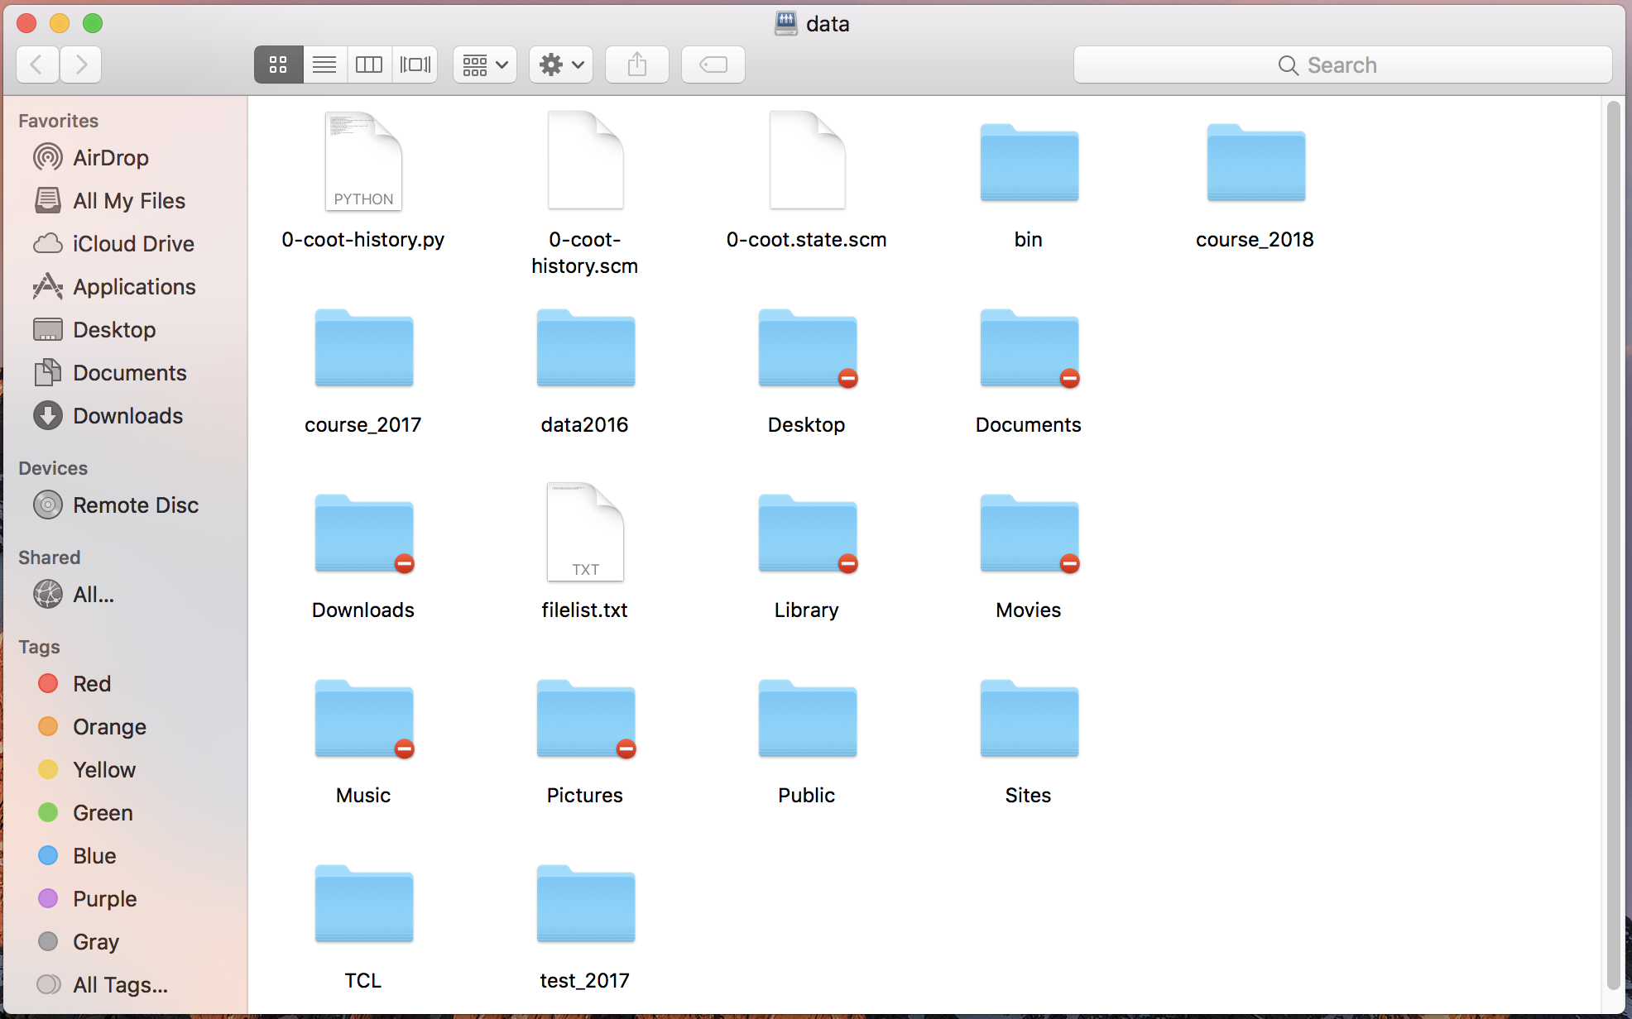
drag

Slide 5
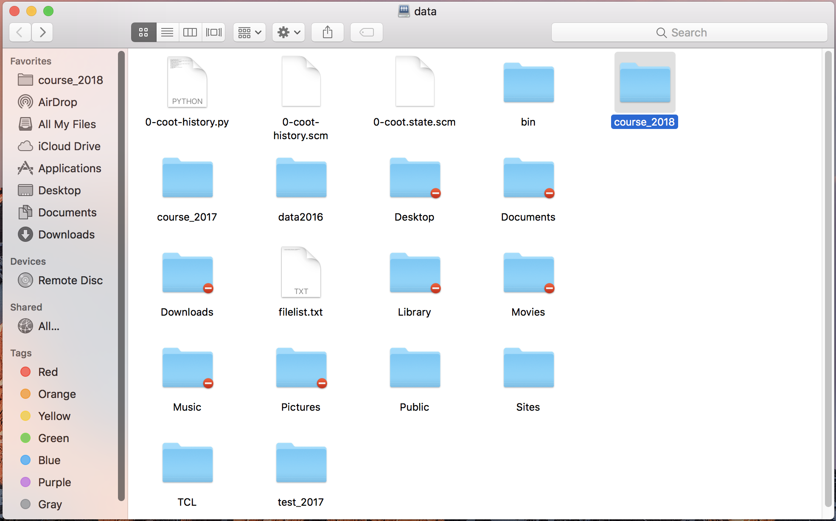

Slide 6
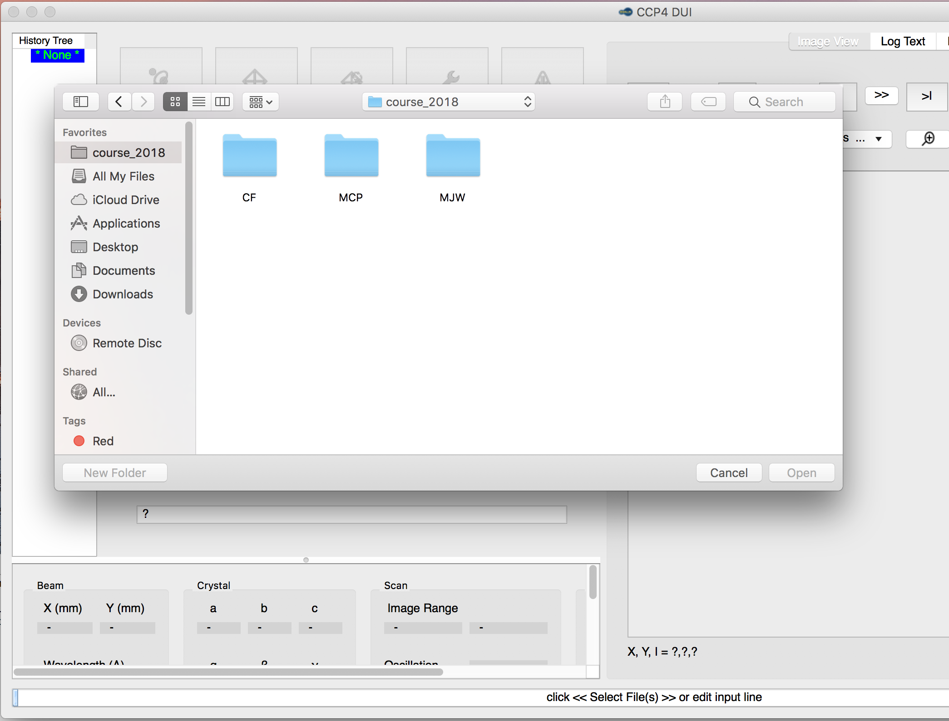

Slide 7
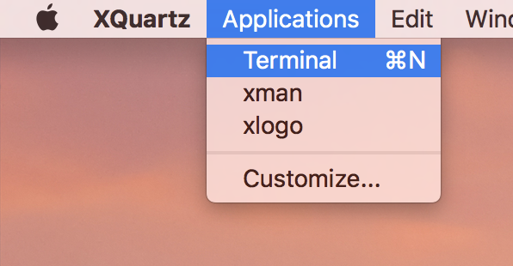

Slide 8
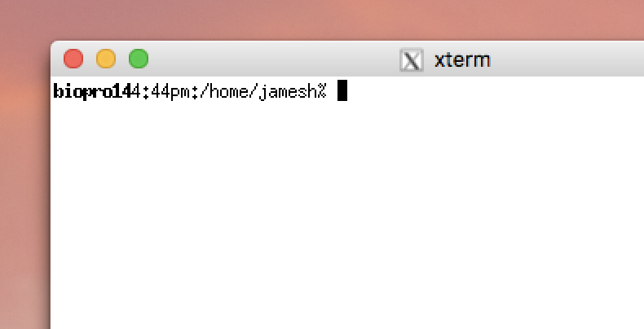
Cursor
does not move
with mouse
The “prompt”
Mouse
can be used
To select and paste
But all pasted text
Goes to the cursor

Slide 9
What the ~*&?!
~ “tilde” indicates your home directory: /home/you
* “star”: wildcard, matches anything
? wildcard, matches any one character
! History substitution, do not use
& run a job in the background, or redirect errors
#% special characters for most crystallography programs
`\([“’ back-quote, backslash, etc. special to shell
_ underscore, use this instead of spaces!!!

Slide 10
Where am I?
pwd
Print name of the “current working directory”
This is the default directory/folder where the shell program will look first for programs, files, etc. It is “where you are” in Unix space.

Slide 11
What is a directory?
/home/yourname/whatever
Directories are places you put files. They are represented as words connected by the “/” character. On Windows, they use a “\”, just to be different. On Mac, they are called “folders”. Whatever you do…
DO NOT PUT SPACES
In directory/file names!

Slide 12
What have we here?
ls
List contents of the current working directory
ls –l - long listing, with dates, owners, etc.
ls –lrt - above, but sorted by time
ls –lrt /home/yourname/something
- long-list a different directory

Slide 13
Go somewhere else?
cd
Change the current working directory
cd /tmp/yourname/
- go to your temporary directory
cd - - go back to where you just were
cd - no arguments, go back “home”
“home” is where your login starts

Slide 14
A new beginning…
mkdir
Create a new directory.
mkdir ./something - make it
cd ./something - go there
ls - check its is empty

Slide 15
How do I get help?
man
Display the manual for a given program
man ls - see manual for the “ls” command
man tcsh - learn about the C shell
man bash - learn about that other shell
man man - read the manual for the manual
to return to the command prompt, type “q”

Slide 16
Move it!
mv
Move or rename a file. If you think about it, these are the same thing.
mv stupidname.txt bettername.txt
- change name
mv stupidplace/file.txt ../betterplace/file.txt
- same name, different directory
mv stupidname_*.img bettername_*.img
Will not work! Never ever do this!

Slide 17
Copy machine
cp
Copy a file. This is just like “mv” except it does not delete the original.
cp stupidname.txt bettername.txt
- change name, keep original
rm stupidname.txt
- now this is the same as “mv”

Slide 18
“Permission denied” !?
chmod
Change the “permission” of a file.
chmod a+r filename.txt
- make it so everyone can read it
chmod u+rwx filename.txt
- make it you can read/write/execute it
chmod –R u+rw /some/random/place
- make it so you can read/write everything under
a directory

Slide 19
Destroy! Destroy!
rm
Remove a file forever. There is no “trash” or “undelete” in unix.
rm unwanted_file.txt
- delete file with that name
rm –f /tmp/yourname/*
- forcefully remove everything in your temporary directory.
Will not prompt for confirmation!

Slide 20
less is more
more
Display the contents of a text file, page by page
more filename.txt - display contents
less filename.txt - many installs now have a replacement for “more” called “less” which has nicer search features.
to return to the command prompt, type “q”

Slide 21
After the download…
gunzip
File compression and decompression
gunzip ~/Downloads/whatever.tar.gz
- decompress
gzip ~/Downloads/whatever.tar
- compress, creates file with .gz extension

Slide 22
Where the %$#& is it?
find
Search through directories, find files
find ./ -name ’important*.txt’
- look at everything under current working directory with name starting with “important” and ending in “.txt”
find / -name ’important*.txt’
- will always find it, but take a very long time!

Slide 23
Control! Control! You must learn Control!
<Ctrl>-C
Stop jobs that are running in the foreground. Note: <Ctrl> is that key on the keyboard that says “Ctrl”.
<Ctrl>-Z - get prompt back, but don’t kill the job
bg - after <Ctrl>-Z, put job in background
fg - I changed my mind! come back to foreground
<Ctrl>-A - go to beginning of the line

Slide 24
Did I run out of disk space?
df du
Check how much space is left on disks
df - look at space left on all disks
df . - look at space left in the current working directory
du –sk . | sort –g
- add up space taken up by all files and subdirectories, list biggest hog last

Slide 25
Why so slow?
ps top
Look for programs that may be eating up CPU or memory.
top - list processes in order of CPU usage
jobs - list jobs running in background of current terminal
ps –fHu yourname
- list jobs belonging to your account in order of what spawned what (leave out the H on a mac)

Slide 26
Die Die Die!
kill
Stop jobs that are running in the background
kill %1 - kill job [1], as listed in “jobs”
kill 1234 - kill job listed as 1234 by “ps” or “top”
kill -9 1234 - that was not a suggestion!
kill -9 -g 1234 – seriously kill that job and the program that launched it

Slide 27
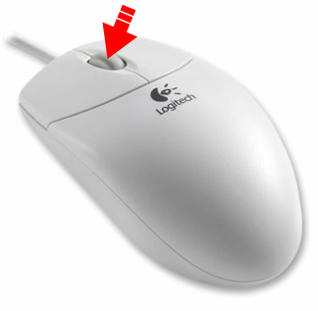
too… much… typing!
1) Make sure X11 is running
2) Select some text with mouse
3) Move mouse over to your terminal
4) Hit middle mouse button
5) No keyboard required!

Slide 28
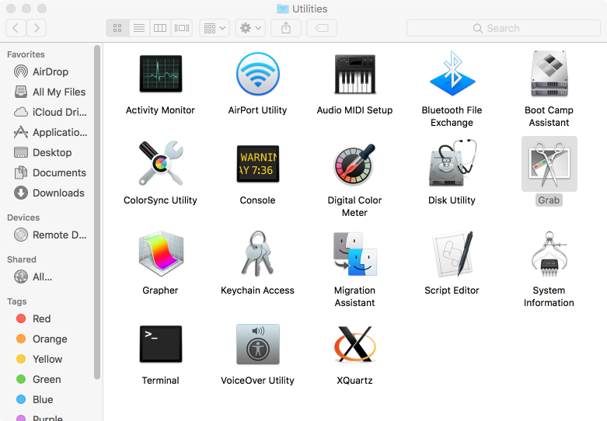

Slide 29
DIALS demo
prompt
Do not type!
underscore
~]$ cd
~]$ mkdir dials_tutorial
~]$ cd dials_tutorial
~]$ ln –sf /home/data/course_2018 .
~]$ dui
Space!
Enter
Space!

Slide 30
No free R flag?
$ echo symm P43212 |\
reindex hklin output_file_name.mtz hklout \
reindexed.mtz
$ uniqueify reindexed.mtz

Slide 31
No free R flag?
$ uniqueify reindexed.mtz

Slide 32
Occupancy refinement in refmac
$ echo “”| refmac5 hklin reindexed-unique.mtz \
xyzin phaser.1.pdb >! refmac.log

Slide 33
Occupancy refinement in refmac
$ echo “”| refmac5 hklin reindexed-unique.mtz \
hklout refmacout.mtz \
xyzin phaser.1.pdb xyzout refmacout.pdb \
>! refmac.log

Slide 34
Occupancy refinement in refmac
$ refmac5 hklin reindexed-unique.mtz \
hklout refmacout.mtz \
xyzin phaser.1.pdb xyzout refmacout.pdb << EOF |\
cat >! refmac.log
EOF

Slide 35
Occupancy refinement in refmac
$ refmac5 hklin reindexed-unique.mtz \
hklout refmacout.mtz \
xyzin phaser.1.pdb xyzout refmacout.pdb << EOF |\
tee refmac.log
EOF

Slide 36
Occupancy refinement in refmac
$ refmac5 hklin reindexed-unique.mtz \
hklout refmacout.mtz \
xyzin phaser.1.pdb xyzout refmacout.pdb << EOF |\
tee refmac.log
occupancy refine
occupancy group id 1 chain A residue 440 alt A
occupancy group id 2 chain A residue 440 alt B
occupancy group alts complete 1 2
EOF

Slide 37
Other Good Resources
http://bl831.als.lbl.gov/~jamesh/
elves/manual/tricks.html
https://bl831.als.lbl.gov/~jamesh/
beamline/moving_data.html
% man awk
% man tcsh

Slide 38
Trick Question: What is the space group?
a = 63 b = 63 c = 63
α = 90 β = 90 γ = 90

Slide 39
Pitfalls: sub-space groups
P622
What else?
P6₁22 P6₅22 P6₂22 P6₄22 P6₃22
P6 P6₁ P6₅ P6₂ P6₄ P6₃
P3₁2 P321 P3₁12 P3₁21 P3₂12 P3₂21
P3 P3₁ P3₂
P2 P2₁ C2 C222 C222₁
P1
zanuda

Slide 40
JMHolton@lbl.gov

