Slide 1
Acknowledgements
http://bl831.als.lbl.gov/~jamesh/powerpoint/CSHL_beamline_2023.pptx
Robert Stroud James Fraser
Paul Adams Greg Hura
Aina Cohen Keith Hodgson
UCSF LBNL SLAC
ALS 8.3.1: TomAlberTron
NIH NIGMS R01 GM124149 to Holton
NIH NIAID P50 AI150476 to Krogan
NIH NIAID U19 AI171110 to Krogan
NIH NIGMS P30 GM124169 to Adams
DOE-BER IDAT to Hura
NIH NIGMS P41 GM103393 to Hodgson
The Advanced Light Source is supported by the Director, Office of Science, Office of Basic Energy Sciences, Materials Sciences Division, of the US Department of Energy under contract No. DE-AC02-05CH11231 at Lawrence Berkeley National Laboratory.

Slide 2

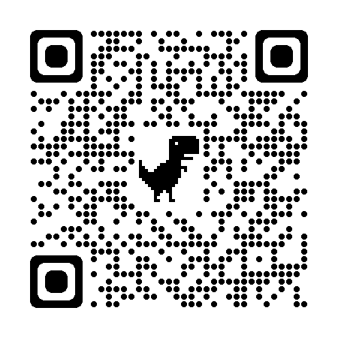

Slide 3
PowerPoint File available:
http://bl831.als.lbl.gov/
~jamesh/powerpoint/
CSHL_beamline_2023.pptx

Slide 4
The “success rate” of data collection
100 s/dataset
200 days/year
~150 beamlines
~26,000,000 datasets/year
~14,000 PDBs in 2022

Slide 5
signal vs noise
“If you don’t have
good data,
then you have
no data at all.”
-Sung-Hou Kim

Slide 6
signal vs noise
easy
hard
impossible

Slide 7
signal vs noise
easy
hard
impossible
threshold of “solvability”

Slide 8
signal vs noise
“If you don’t have
good data,
then you must
learn statistics.”
-James Holton

Slide 9
Adding noise

Slide 10
Adding noise
1² + 1² = 1.4²

Slide 11
Adding noise
1² + 1² = 1.4²
3² + 1² = 3.2²
σ_{total}² = σ₁² + σ₂²

Slide 12
Adding noise
1² + 1² = 1.4²
3² + 1² = 3.2²
σ_{total}² = σ₁² + σ₂²

Slide 13
Adding noise
1² + 1² = 1.4²
3² + 1² = 3.2²
σ_{total}² = σ₁² + σ₂²

Slide 14
Adding noise
1² + 1² = 1.4²
3² + 1² = 3.2²
10² + 1² = 10.05²

Slide 15
And the dominant source of error is…
Resolution
  Disorder (including Radiation Damage)
  Background
Phases
  Non-isomorphism (including Radiation Damage)
  Vibration (beam, xtal, spindle, etc.)
  Detector calibration

Slide 16
Data quality - simple rules:
  Put your crystal into the beam

Slide 17
Your sample is a lens!
(but not for x-rays)
90°

Slide 18
Your sample is a lens!
(but not for x-rays)
90°

Slide 19
Data quality - simple rules:
  Put your crystal into the beam
  Shoot the whole crystal

Slide 20
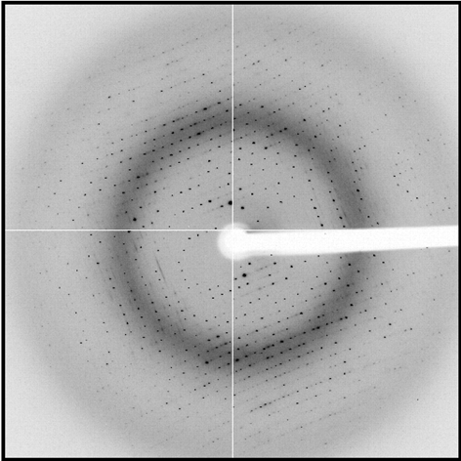
shoot the whole crystal

Slide 21
shoot the whole crystal

Slide 22
shoot the whole crystal

Slide 23
shoot the whole crystal

Slide 24
shoot the whole crystal

Slide 25
How many “crystals” do you see?
Shoot the crystal (singular)

Slide 26
Data quality - simple rules:
  Put your crystal into the beam
  Shoot the whole crystal
  Shoot nothing but the crystal

Slide 27
shoot nothing but the crystal

Slide 28
shoot nothing but the crystal

Slide 29
scattering/absorptoin “rules”:
1 μm crystal ≈ 1 μm water
≈ 1 μm plastic
≈ 0.1 μm glass
≈ 1000 μm air
Optimum: support thickness = crystal thickness
1 + 1 = 1.4

Slide 30
limited by
radiation
damage
limited by
excess
background
Resolution (Å)
too big
too small
just right
X-ray beam size (μm)

Slide 31
platy crystals

Slide 32
platy crystals

Slide 33
Data quality - simple rules:
  Put your crystal into the beam
  Shoot the whole crystal
  Shoot nothing but the crystal
  The crystal must rotate

Slide 34
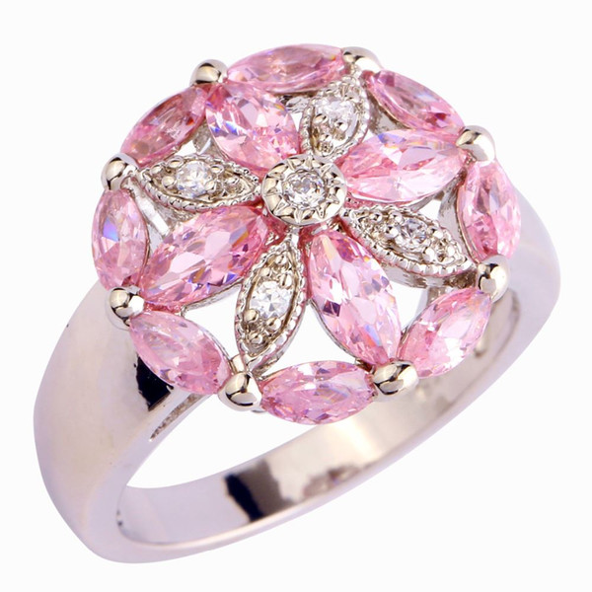
“pretty” crystals

Slide 35
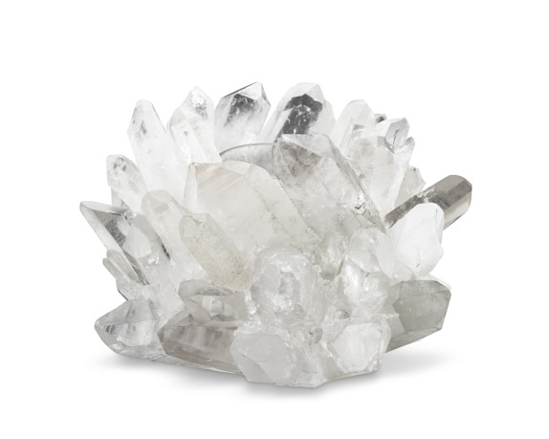
“pretty” crystals

Slide 36
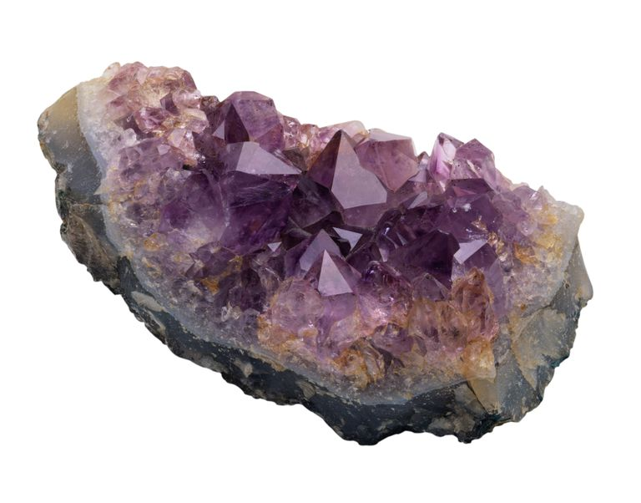
“pretty” crystals

Slide 37
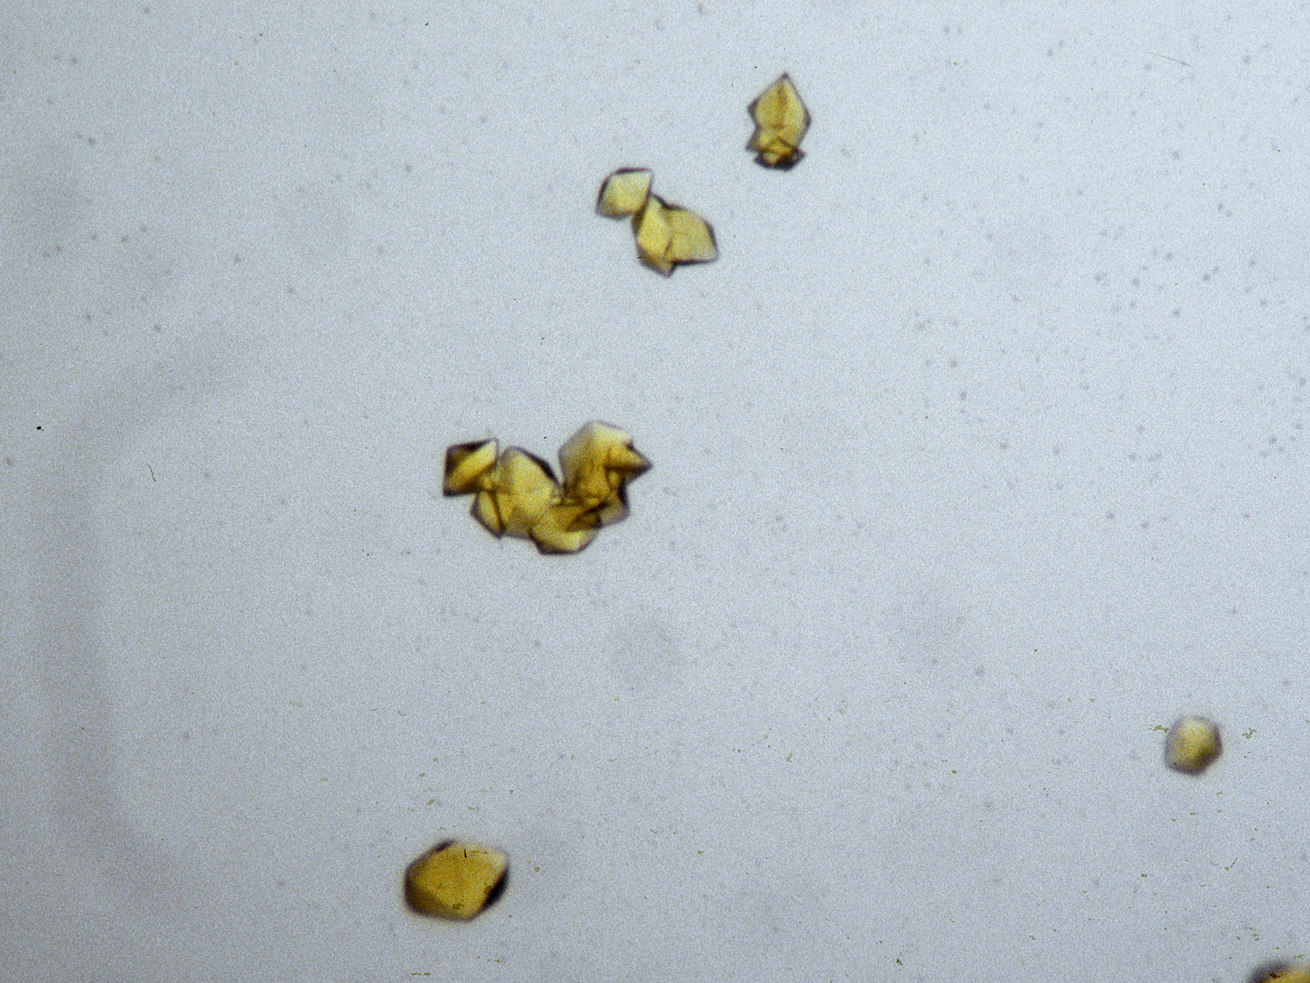
The crystal rotates!

Slide 38
The crystal rotates!

Slide 39
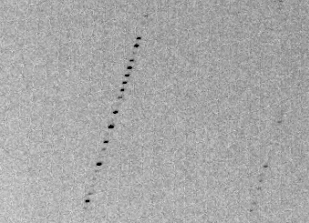
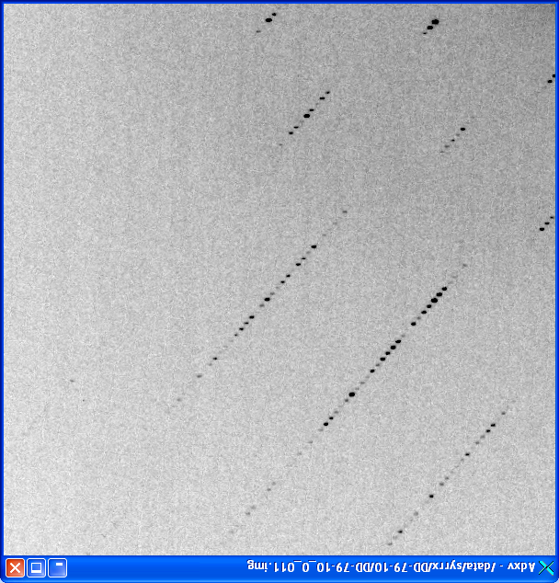
avoiding overlaps
c
c

Slide 40
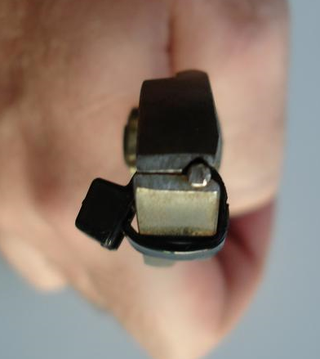
avoiding overlaps
c

Slide 41
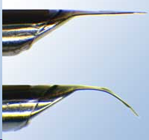
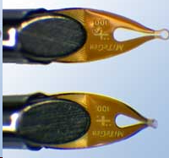
avoiding overlaps
c
http://www.mitegen.com/mic_catalog.php?c=DTMicroMounts

Slide 42
avoiding overlaps
c
http://www.mitegen.com/mic_catalog.php?c=orientedmounts

Slide 43
Data quality - simple rules:
  Put your crystal into the beam
  Shoot the whole crystal
  Shoot nothing but the crystal
  The crystal must rotate
  Back off!

Slide 44
Background scattering

Slide 45
Mosquito tips cost $0.15 each
So do detector pixels!
We bought 6,224,001
Use them!
(they are reusable)

Slide 46
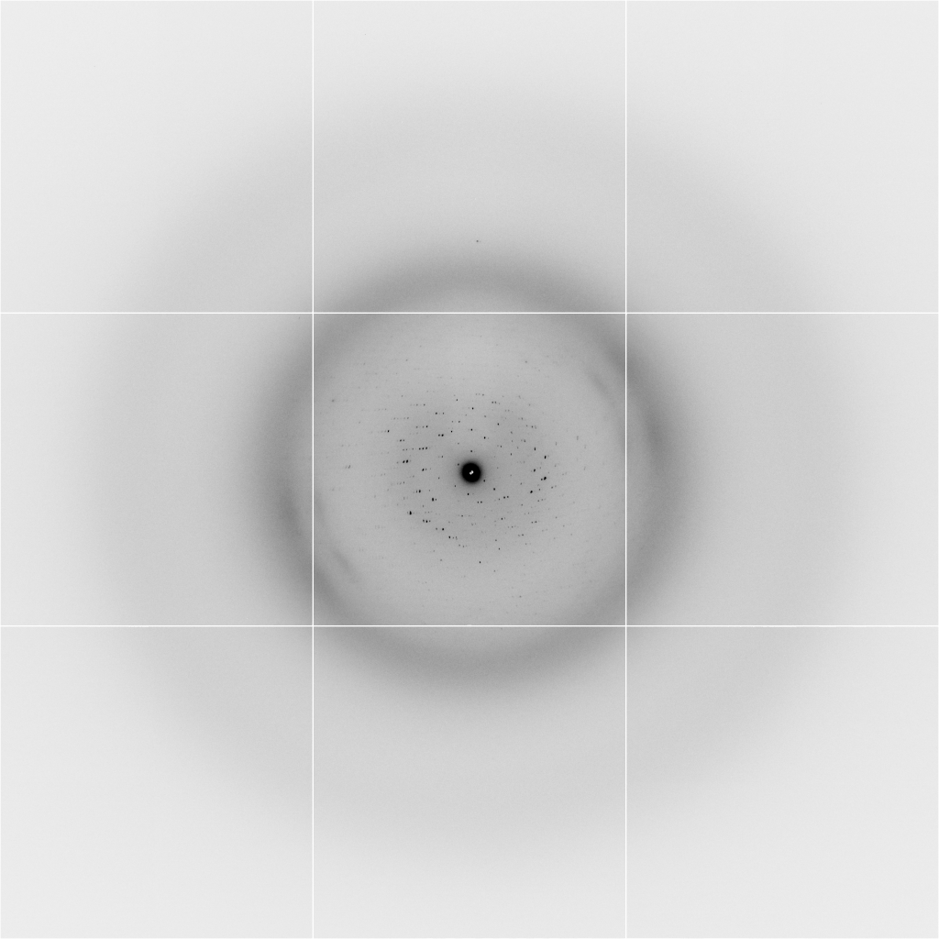
Background scattering
$100,000.00
$100,000.00
$100,000.00
real estate is
expensive
use it!
$100,000.00
$100,000.00
$100,000.00
$100,000.00
$100,000.00

Slide 47
Fine Slicing
background
background
Pflugrath, J. W. (1999)."The finer things in X-ray diffraction data collection", Acta Cryst. D 55, 1718-1725.

Slide 48
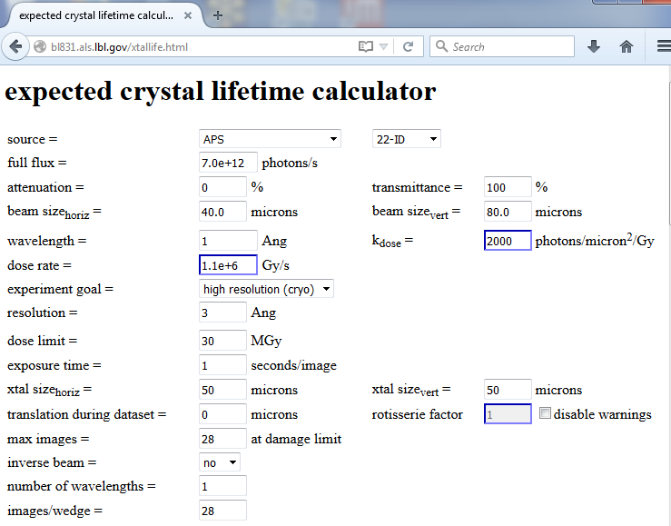

Slide 49
Optimal exposure time
(anomalous on a PAD)
PILATUS
>0.2 s/frame
EIGER
>0.0003 s/frame
t_{mad} Optimal exposure time (s)
t_{ro} read-out time (s)
2.03 ms on Pilatus³ S
0.95 ms on Pilatus³ X
0.003 ms on Eiger
Attenuate for MAD

Slide 50
Optimal exposure time
(anomalous on a PAD)
2.03 ms
intensity
time

Slide 51

Optimal exposure time
(faint spots on CCD detector)
t_{hr} Optimal exposure time for data set (s)
t_{ref} exposure time of reference image (s)
bg_{ref} background level near weak spots on
reference image (ADU)
bg₀ ADC offset of detector (ADU)
bg_{hr} optimal background level (via t_{hr})
σ₀ rms read-out noise (ADU)
gain ADU/photon
m multiplicity of data set (including partials)
adjust exposure
so this is ~100

Slide 52
And the dominant source of error is…
Resolution
  Disorder (including Radiation Damage)
  Background
Phases
  Non-isomorphism (including Radiation Damage)
  Vibration (beam, xtal, spindle, etc.)
  Detector calibration

Slide 53

Spatial Heterogeneity in Sharp Spot Sensitivity
~3x10⁵ photon/pixel Pilatus detector
Bragg
glitch
“tree rings”
Pick-up tool mark
oxygen
inclusions
1% high
average
1% low

Slide 54
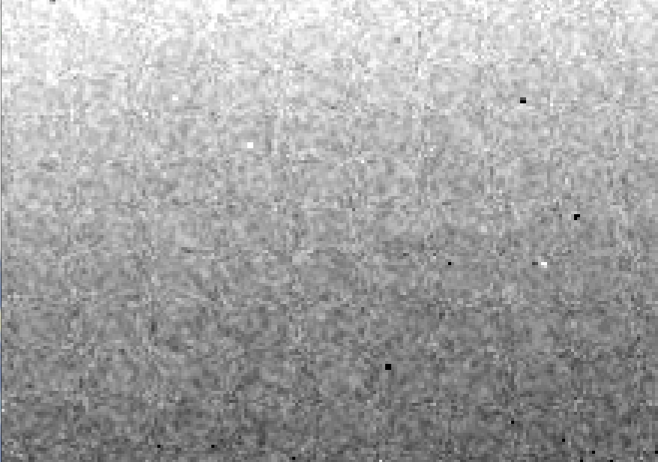
Detector calibration: 7235 eV

Slide 55
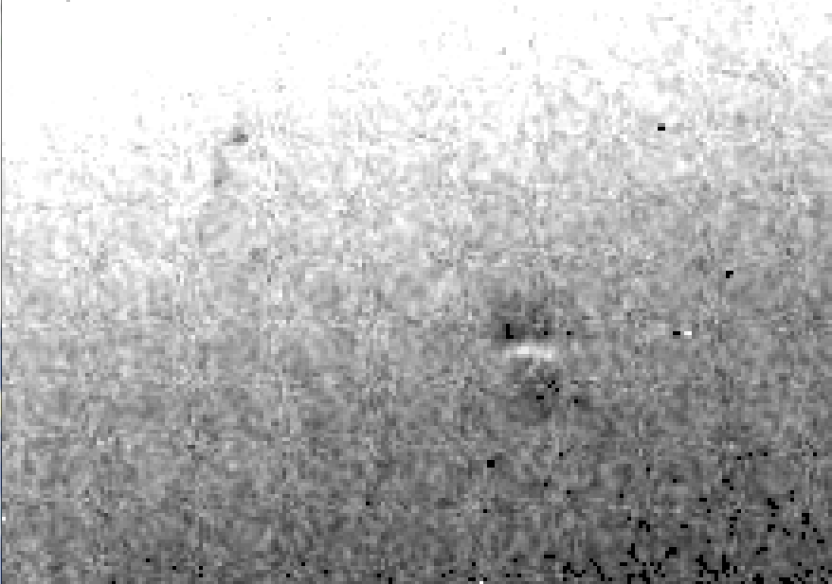
Detector calibration: 7247 eV

Slide 56
Gadox calibration vs energy
same = good!
Relative absorption depth
bad!
photon energy (keV)

Slide 57

Systematic error does not “average out”
Unless you can randomize their source

Slide 58
Fractional error
^{mult >} (—)²
~3%
<ΔF/F>

Slide 59
anomalous signal
ΔF
F
√
# sites
MW (Da)
≈ 1.2 f”
World record!
ΔF/F = 0.5%
Wang, Dauter & Dauter (2006) Acta Cryst. D 62, 1475-1483.
Crick, F. H. C. & Magdoff, B. S. (1956) Acta Crystallogr. 9, 901-908.
Hendrickson, W. A. & Teeter, M. M. (1981) Nature 290, 107-113.

Slide 60

Holton & Frankel (2010) Acta D 66 393-408.

Slide 61

100% SeMet incorporation
Trivial to solve

Slide 62

100% S -Met incorporation
Impossible to solve

Slide 63
Phase Problem: Se vs S
correlation coefficient
fraction not Selenium

Slide 64
Phase Problem: Se vs S
correlation coefficient
fraction not Selenium

Slide 65
Phase Problem: Se vs S
correlation coefficient
fraction not Selenium

Slide 66
Phase Problem: Se vs S
correlation coefficient
fraction not Selenium

Slide 67
Phase Problem: Se vs S
correlation coefficient
fraction not Selenium

Slide 68
One xtal, no idea?
Suggested native protocol:
Do strategy
Start at specified phi
100% fast as you can
Keep going to 360°
Move detector
Advance phi 10-30 deg
Increase photons/image 4x
goto 4

Slide 69
Suggested anomalous protocol:
360° in < ~5 MGy (for Se)
move detector
4X exposure
goto 2
2 wavelengths are better than 1
- (peak + inf)/2, and remote
MAD, not M-SAD!

Slide 70
The
“threshold of solvability” is sharp!
How can we predict success/failure?
Know Thy Experiment

Slide 71
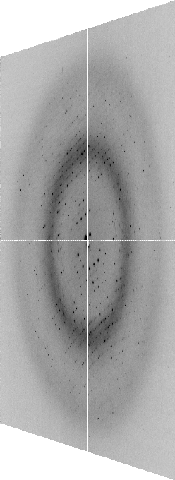

The “beam line”
X-ray
Source
Area Detector
Cite the “beamline paper!”
Protein Crystal
Notes:
Most notable acheivements are high brightness with very little “wasted” light. The discovery made by Howard Padmore? At ALS showed that a 2:1 demagnification cancels nearly all of the spherical abberations in the parabolic/torroid system. 30-50% of the total x-ray intensity passes through the 100um pinhole. The flux through the 100um pinhole at the superbend beamlines is comparable to that of the 5.0.2 wiggler or an APS bending magnet, but only 150 Watts of power must be dissipated by the beamline optics. In contrast, wiggler beamlines must disipate kilowatts. The optics here are much simpler and not exotic in any way. The system is stable and robust. There is never a need to re-focus the beam at a new wavelength. Only a 2-minute automatic tuneup is recommended for very large energy changes (more than 1-2 keV).

Slide 72
The “beam line”
focused
beam
slits
Scatter
guard
Secondary
mirror
Primary
mirror
Source
Area Detector
Unfocused
beam
slits
Si(111)
monochromator
Sample

Slide 73
The “beam line”
focused
beam
slits
Scatter
guard
Secondary
mirror
Primary
mirror
Source
Area Detector
Unfocused
beam
slits
Si(111)
monochromator
Sample
Notes:
Most notable acheivements are high brightness with very little “wasted” light. The discovery made by Howard Padmore? At ALS showed that a 2:1 demagnification cancels nearly all of the spherical abberations in the parabolic/torroid system. 30-50% of the total x-ray intensity passes through the 100um pinhole. The flux through the 100um pinhole at the superbend beamlines is comparable to that of the 5.0.2 wiggler or an APS bending magnet, but only 150 Watts of power must be dissipated by the beamline optics. In contrast, wiggler beamlines must disipate kilowatts. The optics here are much simpler and not exotic in any way. The system is stable and robust. There is never a need to re-focus the beam at a new wavelength. Only a 2-minute automatic tuneup is recommended for very large energy changes (more than 1-2 keV).

Slide 74
Where do the
X-rays come from?

Slide 75
The “Home source”
e⁻

Slide 76
The “Home source”
e⁻
e⁻
+

Slide 77
The “Home source”
+

Slide 78
The “Home source”
e⁻
+

Slide 79
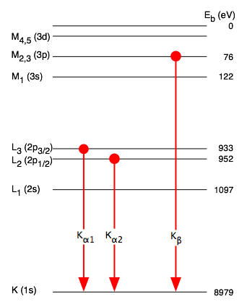
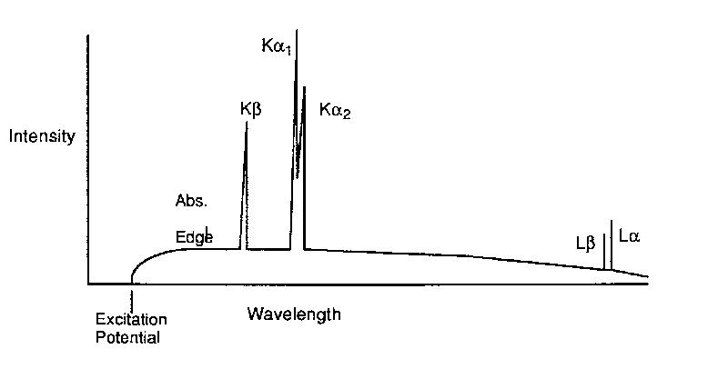
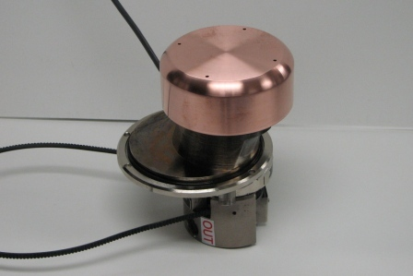
The “Home source”

Slide 80
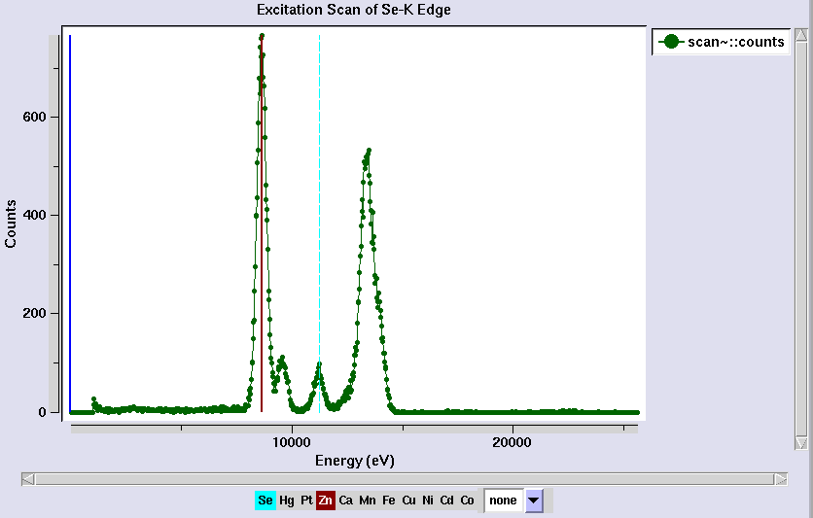
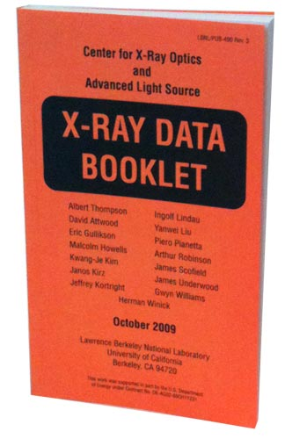
Metal identification
scattering
same
λ as
incident

Slide 81
“MAD scan” – absorption spectrum
fluorescence = yield * absorption
0.980888
0.980500
0.980113
0.979725
0.979338
0.978952
0.978565
0.978179
0.977794
0.977408
0.977023
0.976638
0.976254
“counts” (aka arbitrary units)
12398.42
energy
Wavelength (Å)

Slide 82
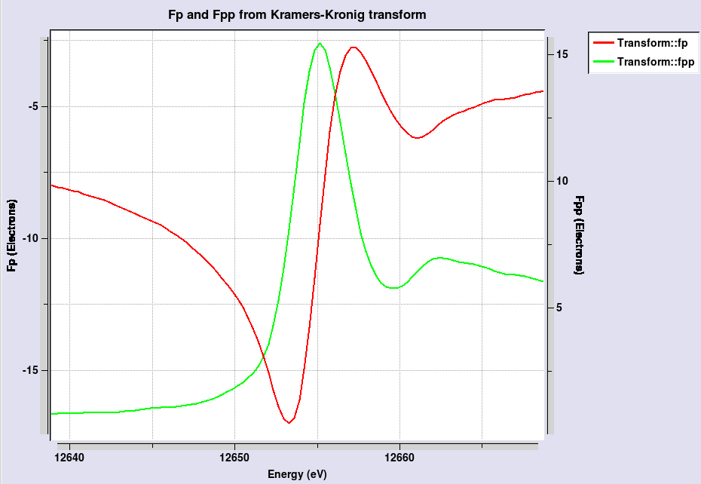
“MAD scan” – absorption spectrum
maximize
absolute
value of
f’’
maximize
difference
in f’

Slide 83
4-wavelength MAD

Slide 84
3-wavelength MAD

Slide 85
2-wavelength MAD

Slide 86
2-wavelength MAD

Slide 87
1-wavelength SAD

Slide 88
2-wavelength metal validation
phased
anomalous
difference
Fourier

Slide 89
The “beam line”
focused
beam
slits
Scatter
guard
Secondary
mirror
Primary
mirror
Source
Area Detector
Unfocused
beam
slits
Si(111)
monochromator
Sample
Notes:
Most notable acheivements are high brightness with very little “wasted” light. The discovery made by Howard Padmore? At ALS showed that a 2:1 demagnification cancels nearly all of the spherical abberations in the parabolic/torroid system. 30-50% of the total x-ray intensity passes through the 100um pinhole. The flux through the 100um pinhole at the superbend beamlines is comparable to that of the 5.0.2 wiggler or an APS bending magnet, but only 150 Watts of power must be dissipated by the beamline optics. In contrast, wiggler beamlines must disipate kilowatts. The optics here are much simpler and not exotic in any way. The system is stable and robust. There is never a need to re-focus the beam at a new wavelength. Only a 2-minute automatic tuneup is recommended for very large energy changes (more than 1-2 keV).

Slide 90
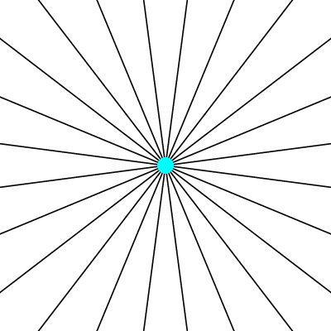
Electric field of a moving charge

Slide 91
Electric field of a moving charge
accelerating charges
make
electromagnetic waves
(light)

Slide 92
Bending Magnet
S
electron beam
X-rays !
N

Slide 93
Two Bending Magnets
S
N
electron beam
N
S
2x X-rays !

Slide 94
Wiggler
8x X-rays !
S
N
S
N
S
N
S
N
N
S
N
S
N
S
N
S

Slide 95
Undulator
> 8x X-rays !
S
N
S
N
S
N
S
N
N
S
N
S
N
S
N
S

Slide 96
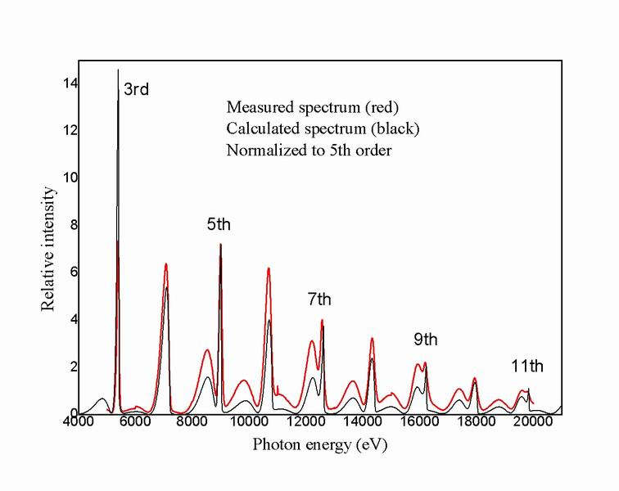
Undulator emission spectrum

Slide 97
XFEL Undulator
same X-rays
short pulse
S
N
S
N
S
N
S
N
S
N
S
N
S
N
S
N
N
S
N
S
N
S
N
S
N
S
N
S
N
S
N
S

Slide 98
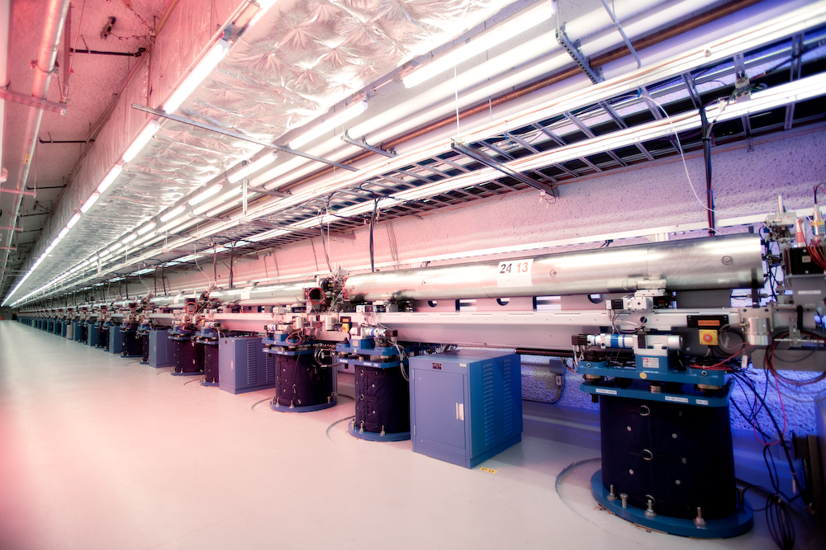
LCLS undulator hall

Slide 99
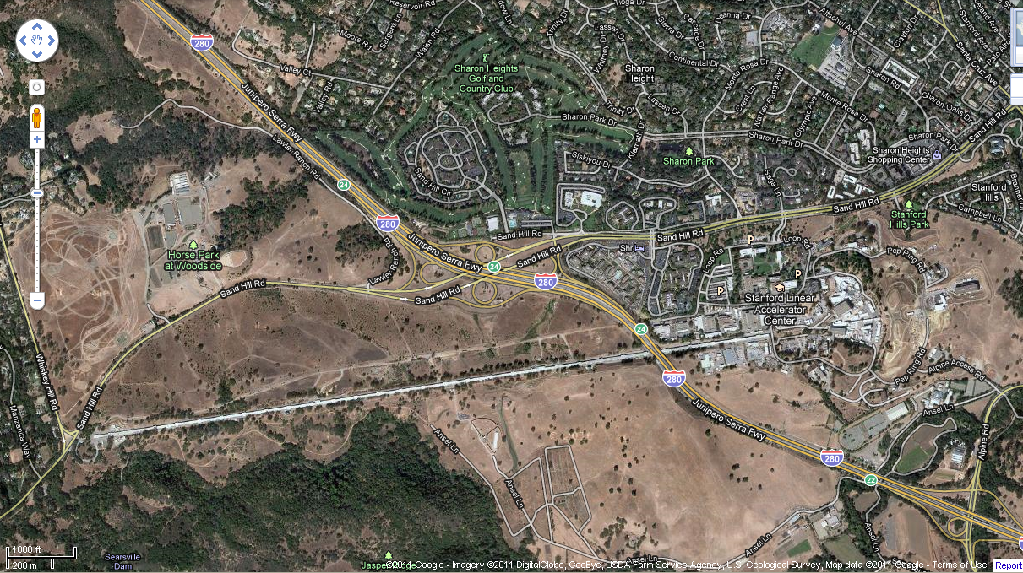
LCLS at SLAC

Slide 100
Accelerator-based light source terminology
Code name Translation
First Generation Bending Magnet
Second Generation Wiggler
Third Generation Undulator
Fourth Generation Free electron laser
..and diffraction-limited synchrotron

Slide 101
Diffraction-limited light source
λ ≈ 2 d sinθ
λ = x-ray wavelength
d = electron/x-ray beam size
θ = beam divergence
d = 1 Å / 100 µrad / 2 = 0.5 µm

Slide 102
The “beam line”
focused
beam
slits
Scatter
guard
Secondary
mirror
Primary
mirror
Source
Area Detector
Unfocused
beam
slits
Si(111)
monochromator
Sample
Notes:
Most notable acheivements are high brightness with very little “wasted” light. The discovery made by Howard Padmore? At ALS showed that a 2:1 demagnification cancels nearly all of the spherical abberations in the parabolic/torroid system. 30-50% of the total x-ray intensity passes through the 100um pinhole. The flux through the 100um pinhole at the superbend beamlines is comparable to that of the 5.0.2 wiggler or an APS bending magnet, but only 150 Watts of power must be dissipated by the beamline optics. In contrast, wiggler beamlines must disipate kilowatts. The optics here are much simpler and not exotic in any way. The system is stable and robust. There is never a need to re-focus the beam at a new wavelength. Only a 2-minute automatic tuneup is recommended for very large energy changes (more than 1-2 keV).

Slide 103
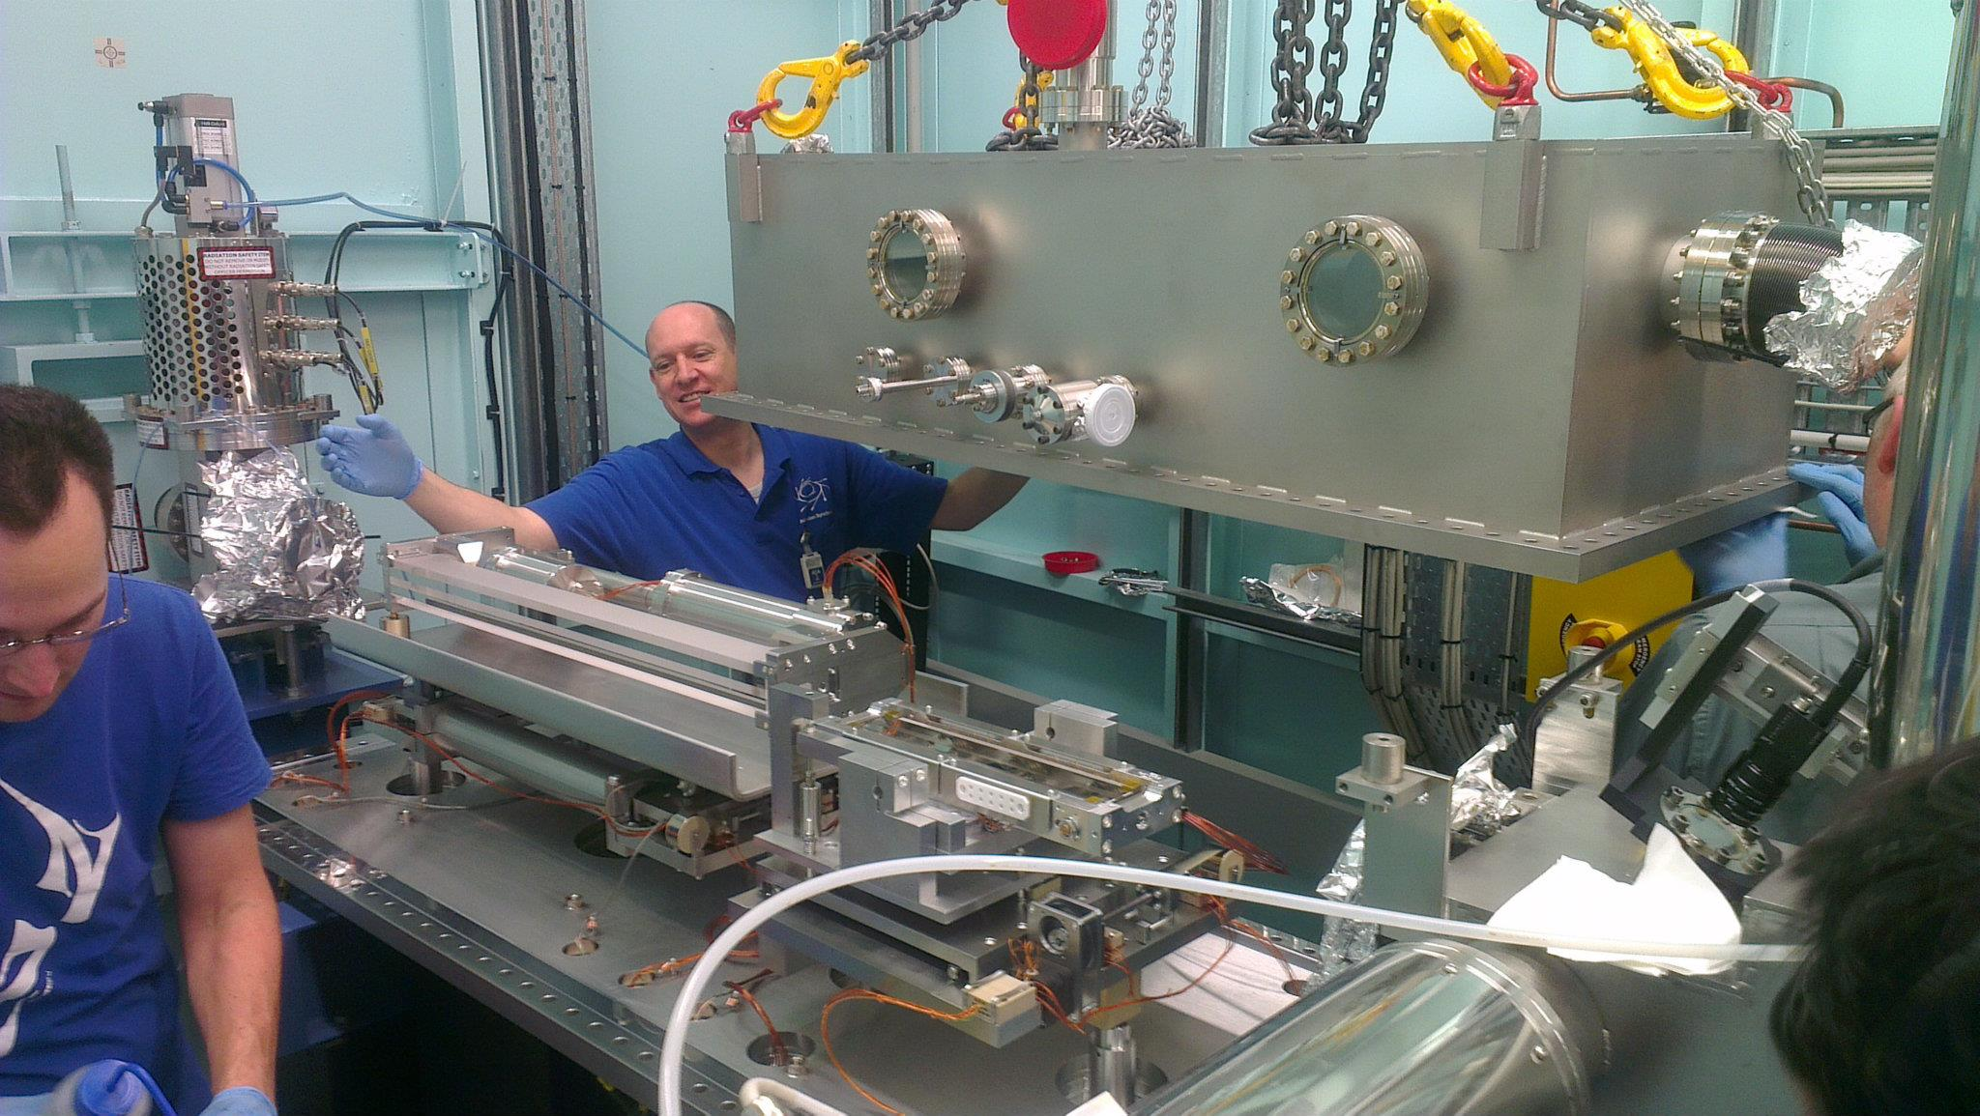
X-ray optics: mirrors
Notes:
Next slide please

Slide 104
Why are the mirrors so long?
Must be < 0.2°
3 mm
1000 mm
Notes:
Next slide please

Slide 105
There is a lens for X-rays!
0.1 mm
Be
1 mm
Notes:
Next slide please

Slide 106
The “beam line”
focused
beam
slits
Scatter
guard
Secondary
mirror
Primary
mirror
Source
Area Detector
Unfocused
beam
slits
Si(111)
monochromator
Sample
Notes:
Most notable acheivements are high brightness with very little “wasted” light. The discovery made by Howard Padmore At ALS showed that a 2:1 demagnification cancels nearly all of the spherical abberations in the parabolic/torroid system. 30-50% of the total x-ray intensity passes through the 100um pinhole. The flux through the 100um pinhole at the superbend beamlines is comparable to that of the 5.0.2 wiggler or an APS bending magnet, but only 150 Watts of power must be dissipated by the beamline optics. In contrast, wiggler beamlines must disipate kilowatts. The optics here are much simpler and not exotic in any way. The system is stable and robust. There is never a need to re-focus the beam at a new wavelength. Only a 2-minute automatic tuneup is recommended for very large energy changes (more than 1-2 keV).

Slide 107
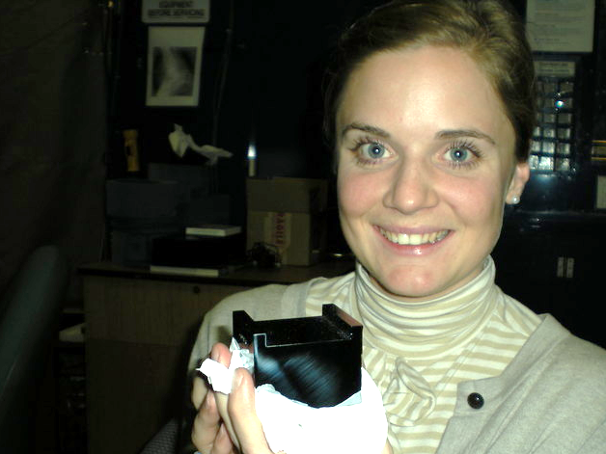
Single crystal

Slide 108
Monochromators
λ = 1 Å
Si
Notes:
Next slide please

Slide 109
Monochromators
nλ = 2d sin(θ)
λ = 1 Å
λ = 1 Å
Si
d = 3.135 Å
θ = 9.177°
Notes:
Next slide please

Slide 110
Monochromators
nλ = 2d sin(θ)
λ = 1.1 Å
Si
d = 3.135 Å
θ = 9.177°
Notes:
Next slide please

Slide 111
Monochromators
nλ = 2d sin(θ)
λ = 1.1 Å
λ = 1.1 Å
Si
d = 3.135 Å
θ = 10.104°
Notes:
Next slide please

Slide 112
Monochromators
nλ = 2d sin(θ)
λ = 1 Å
λ = 1 Å
Si
d = 3.135 Å
θ = 9.177°
Notes:
Next slide please

Slide 113
Monochromators
Si
λ = 1 Å
λ = 1 Å
Si
d = 3.135 Å
DCM = Double Crystal Monochromator
Notes:
Next slide please

Slide 114
Monochromators
Si
λ = 1.1 Å
λ = 1.1 Å
Si
d = 3.135 Å
DCM = Double Crystal Monochromator
Notes:
Next slide please

Slide 115
Monochromators
nλ = 2d sin(θ)
λ = 1.54 Å
λ = 1.54 Å
Mo/C
d = 24 Å
θ = 1.84°
Multilayer optics
Notes:
Next slide please

Slide 116
The truth about x-ray beams
Term units significance
Flux photons/s duration of experiment
Beam Size μm match to crystal
Divergence mrad spot size vs distance
Wavelength Å resolution and absorption
Dispersion Δλ/λ spot size
Flux density ph/s/area scattering/damage rate
Fluence ph/area scattering/damage

Slide 117
The truth about x-ray beams
Term units significance
Flux photons/s duration of experiment
Beam Size μm match to crystal
Divergence mrad spot size vs distance
Wavelength Å resolution and absorption
Dispersion Δλ/λ spot size
Flux density ph/s/area scattering/damage rate
Fluence ph/area scattering/damage

Slide 118
The number of photons scattered
before crystal is dead
is independent
of data collection time
1 um³ = 10⁶ photons
Henderson, 1990; Gonzalez & Nave, 1994; Glaeser et al., 2000; Sliz et al., 2003; Leiros et al., 2006; Owen et al., 2006; Garman & McSweeney, 2006; Garman & Nave, 2009; Holton, 2009

Slide 119
The truth about x-ray beams
quantity | units | home source | synchrotron
flux | Photons/second | 2.5 x 10⁹ | 2 x 10¹²
exposure | seconds | 400 | 1

Slide 120
The truth about x-ray beams
quantity | units | home source | synchrotron
flux | Photons/second | 2.5 x 10⁹ | 2 x 10¹²
exposure | seconds | 400 | 1
Dispersion | wavelength range / wavelength | 0.2% (Kα₁ - Kα₂) | 0.014% (Si111)
Divergence | milliRadian | 4.8 | 1.8 (h) 0.18 (v)
Beam size | microns | 100 | 24 (h) 12 (v)
Spectral brightness | Photons/s/mm²/ mR²/0.1%BW | 5.4 x 10⁹ | 1.5 x 10¹⁷

Slide 121
The truth about x-ray beams
quantity | units | home source | synchrotron
flux | Photons/second | 72 x 10⁶ | 2 x 10¹²
exposure | time | 4 hours | 1 second
Dispersion | wavelength range / wavelength | 0.2% (Kα₁ - Kα₂) | 0.014% (Si111)
Divergence | milliRadian | 4.8 | 1.8 (h) 0.18 (v)
Beam size | microns | 17 | 24 (h) 12 (v)
Spectral brightness | Photons/s/mm²/ mR²/0.1%BW | 5.4 x 10⁹ | 1.5 x 10¹⁷

Slide 122
The truth about x-ray beams
quantity | units | home source | synchrotron
flux | Photons/second | 1 x 10⁶ | 2 x 10¹²
exposure | time | 10 days | 1 second
Dispersion | wavelength range / wavelength | 0.2% (Kα₁ - Kα₂) | 0.014% (Si111)
Divergence | milliRadian | 0.6 | 1.8 (h) 0.18 (v)
Beam size | microns | 17 | 24 (h) 12 (v)
Spectral brightness | Photons/s/mm²/ mR²/0.1%BW | 5.4 x 10⁹ | 1.5 x 10¹⁷

Slide 123
The truth about x-ray beams
quantity | units | home source | synchrotron
flux | Photons/second | 8 x 10⁴ | 2 x 10¹²
exposure | time | 5 months | 1 second
Dispersion | wavelength range / wavelength | 0.014% (Si111) | 0.014% (Si111)
Divergence | milliRadian | 0.6 | 1.8 (h) 0.18 (v)
Beam size | microns | 17 | 24 (h) 12 (v)
Spectral brightness | Photons/s/mm²/ mR²/0.1%BW | 5.4 x 10⁹ | 1.5 x 10¹⁷

Slide 124
The truth about x-ray beams
Term units significance
Flux photons/s duration of experiment
Beam Size μm match to crystal
Divergence mrad spot size vs distance
Wavelength Å resolution and absorption
Dispersion Δλ/λ spot size
Flux density ph/s/area scattering/damage rate
Fluence ph/area scattering/damage

Slide 125
Out of time

Slide 126
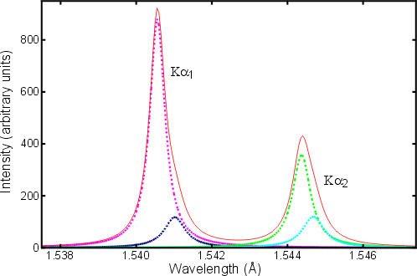
Two-color experiment (ca 1914)
(Cu source)
20 eV

Slide 127
spectral dispersion
Ewald sphere
Φ circle
(h,k,l)
λ*
d*
spindle axis
diffracted ray
λ*

Slide 128
spectral dispersion
Ewald sphere
Φ circle
(h,k,l)
λ’*
d*
spindle axis
diffracted ray
λ’*

Slide 129
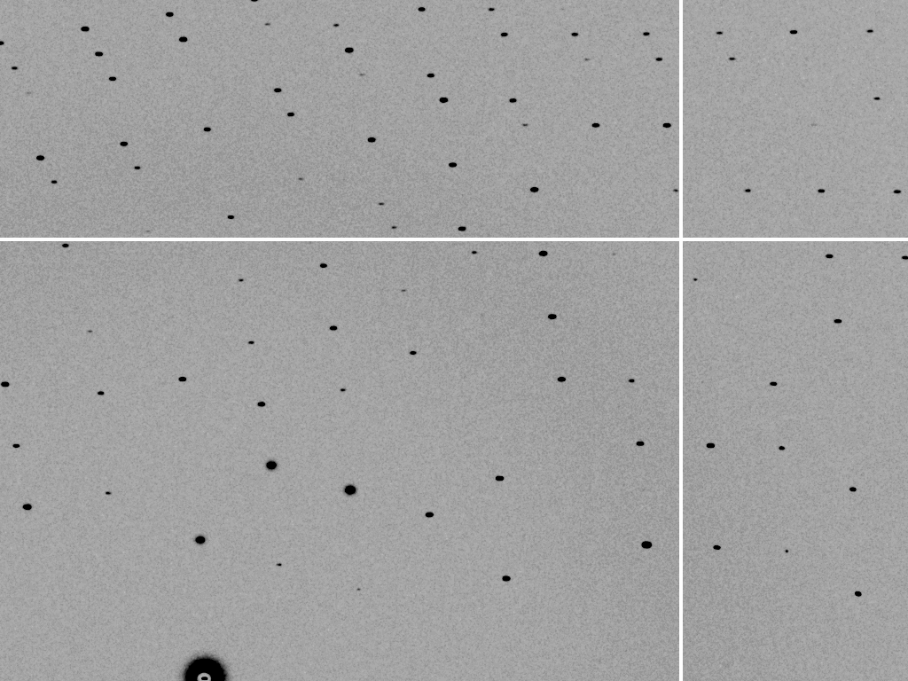
dispersion = 0

Slide 130

dispersion = 0.014% (Si 111)

Slide 131
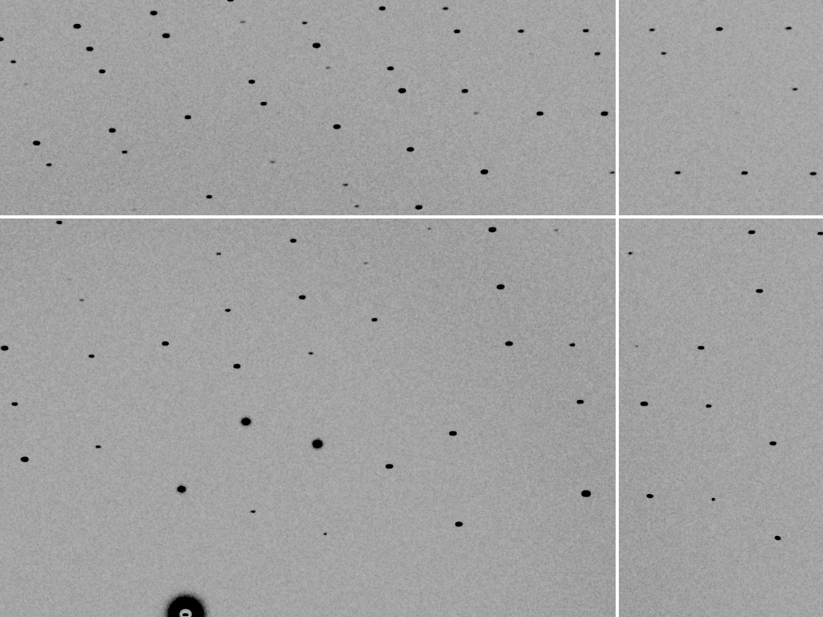
dispersion = 0.25% (CuK_{α})

Slide 132
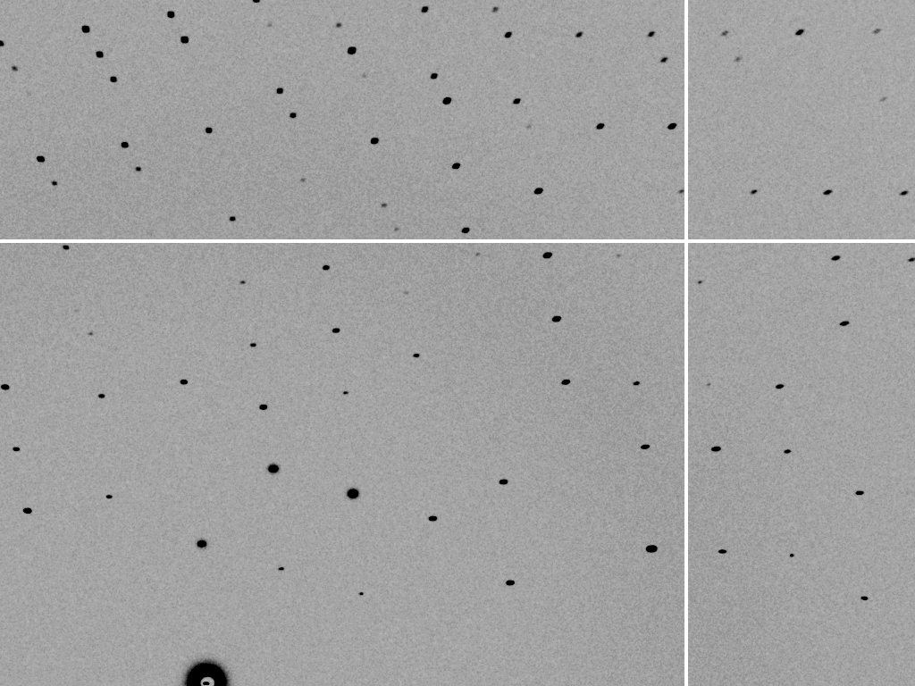
dispersion = 0.6%

Slide 133
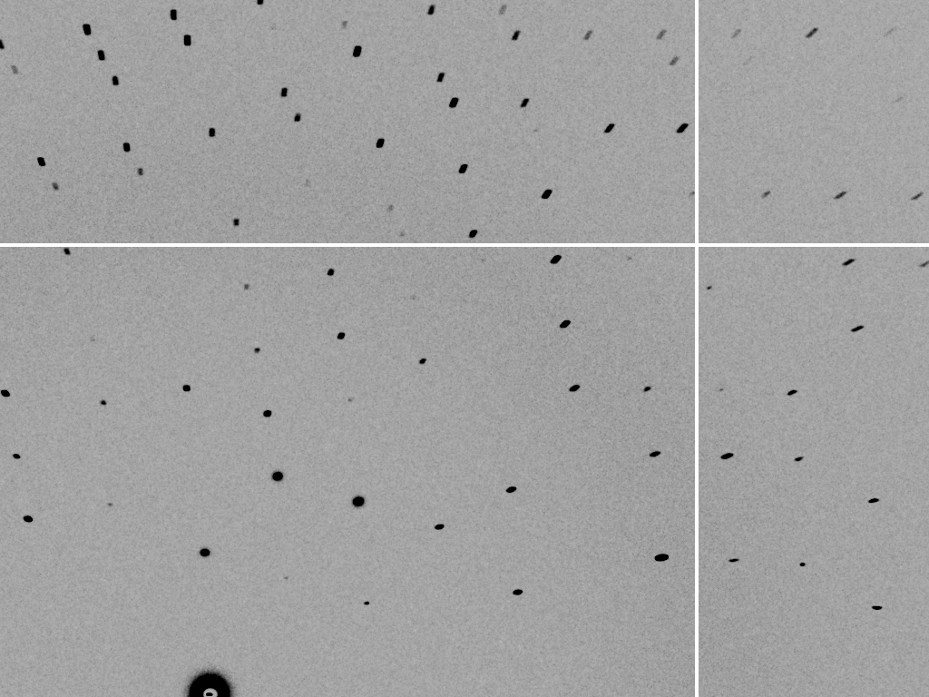
dispersion = 1.3%

Slide 134

dispersion = 2.6%

Slide 135
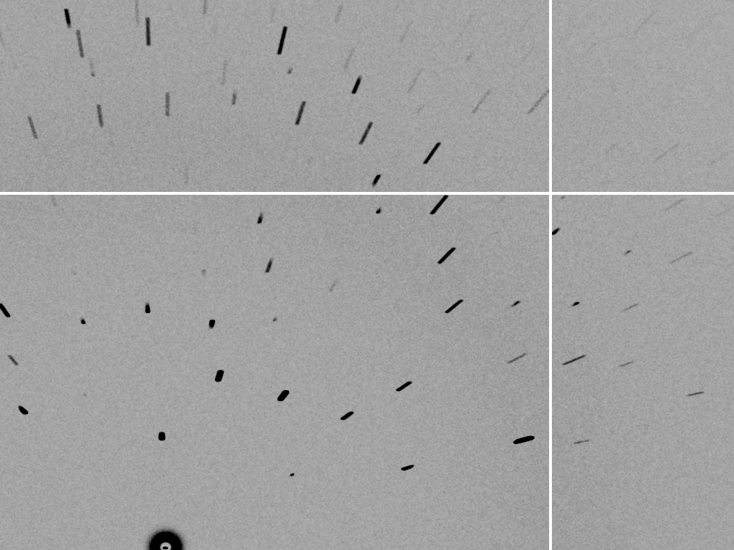
dispersion = 5.1%

Slide 136
The truth about x-ray beams
Term units significance
Flux photons/s duration of experiment
Beam Size μm match to crystal
Divergence mrad spot size vs distance
Wavelength Å resolution and absorption
Dispersion Δλ/λ spot size
Flux density ph/s/area scattering/damage rate
Fluence ph/area scattering/damage

Slide 137
beam divergence
Ewald sphere
Φ circle
(h,k,l)
λ*
d*
spindle axis
diffracted ray
λ*

Slide 138
beam divergence
Ewald sphere
Φ circle
(h,k,l)
d*
λ*
diffracted ray
spindle axis
λ*

Slide 139

divergence = 0 º

Slide 140

divergence = 0.3 º

Slide 141
mosaic spread
Ewald sphere
Φ circle
(h,k,l)
λ*
d*
diffracted ray
d*
spindle axis
λ*

Slide 142
mosaic spread
Ewald sphere
Φ circle
(h,k,l)
d*
diffracted rays
d*
spindle axis

Slide 143
The truth about x-ray beams
Term units significance
Flux photons/s duration of experiment
Beam Size μm match to crystal
Divergence mrad spot size vs distance
Wavelength Å resolution and absorption
Dispersion Δλ/λ spot size
Flux density ph/s/area scattering/damage rate
Fluence ph/area scattering/damage

Slide 144
Air absorption
transmittance
Distance from sample (mm)

Slide 145
Summary
1 + 1 = 1.4
Match beam to “crystal”
Match goop thickness to crystal
Better beam = less time
Look at your spots!
“true multiplicity” for anomalous
Crystal must rotate

Slide 146
Correct beam center
155.063 155.647
159.353 155.063
159.301 155.011
1512.73 1554.57
155.063 159.356 -250
ADXV
HKL2000
MOSFLM
XDS
DIALS

Slide 147
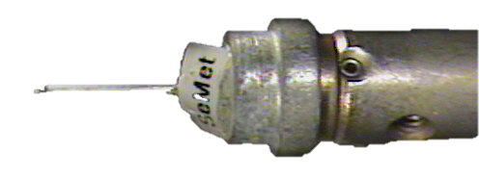
There are 16 different “beam centers”
Origin
Beam Y
Beam X

Slide 148


There are 16 different “beam centers”
Cameraman
View
Origin
Beam
View
Beam Y
Beam X

Slide 149
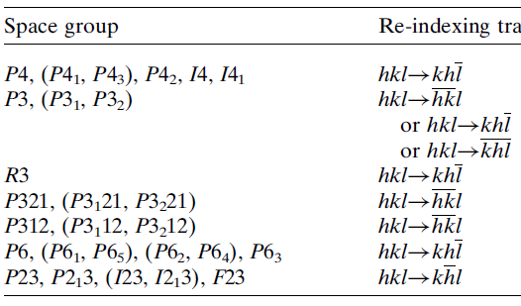
Re-indexing cheat sheet
Dauter, Z. (1999). "Data-collection strategies." Acta Cryst. D 55(10): 1703-1717.

Slide 150
CCP4: aimless log
$TABLE: Analysis against resolution, XDSdataset:
$GRAPHS:I/sigma, Mean Mn(I)/sd(Mn(I)):0|0.216023x0|137.14:2,13,14:
:Rmerge, Rfull, Rmeas, Rpim v Resolution:0|0.216023x0|1.70834:2,4,5,6,7:
:Average I, RMSdeviation and Sd:0|0.216023x0|1650.8:2,10,11,12:
:Fractional bias:0|0.216023x0|0:2,15:
$$
N 1/d^2 Dmid Rmrg Rfull Rcum Rmeas Rpim Nmeas AvI RMSdev sd I/RMS Mn(I/sd) FrcBias $$ $$
1 0.0064 12.55 0.020 0.020 0.020 0.021 0.006 13115 1651 57 42 29.2 137.1 -
2 0.0191 7.24 0.027 0.027 0.024 0.028 0.008 24753 1171 47 42 25.0 105.2 -
3 0.0318 5.61 0.038 0.038 0.029 0.040 0.012 32197 857 46 43 18.4 79.6 -
4 0.0445 4.74 0.034 0.034 0.031 0.035 0.010 37743 1212 57 53 21.4 91.2 -
5 0.0572 4.18 0.036 0.036 0.032 0.038 0.011 42642 1181 59 57 19.9 83.8 -
6 0.0699 3.78 0.049 0.049 0.036 0.052 0.015 47224 883 59 57 15.1 65.1 -
7 0.0826 3.48 0.065 0.065 0.040 0.068 0.020 51052 685 59 58 11.7 50.9 -
8 0.0953 3.24 0.096 0.096 0.045 0.100 0.029 54636 448 56 56 8.0 35.0 -
9 0.1080 3.04 0.151 0.151 0.050 0.158 0.046 58072 268 53 53 5.1 22.7 -
10 0.1207 2.88 0.229 0.229 0.056 0.240 0.070 60731 171 51 51 3.3 15.4 -
11 0.1334 2.74 0.314 0.314 0.063 0.329 0.097 63807 125 51 51 2.4 11.3 -
12 0.1461 2.62 0.406 0.406 0.070 0.425 0.125 66241 98 51 52 1.9 8.7 -
13 0.1588 2.51 0.537 0.537 0.078 0.562 0.166 68272 76 53 53 1.4 6.5 -
14 0.1715 2.41 0.685 0.685 0.084 0.727 0.237 54170 61 53 54 1.1 4.4 -
15 0.1843 2.33 0.886 0.886 0.088 0.950 0.333 39781 48 55 56 0.9 3.1 -
16 0.1970 2.25 1.249 1.249 0.092 1.355 0.508 29754 35 57 59 0.6 2.1 -

Slide 151
CCP4: aimless log
$TABLE: Correlations CC(1/2) within dataset, XDSdataset:
$GRAPHS: Anom & Imean CCs v resolution:0|0.216023x0|1:2,4,7:
: RMS correlation ratio :0|0.216023x0|2.20344:2,6:
$$
N 1/d^2 Dmid CCanom Nanom RCRanom CC1/2 NImean $$ $$
1 0.0064 12.55 0.659 499 2.203 1.000 669
2 0.0191 7.24 0.550 975 1.853 1.000 1155
3 0.0318 5.61 0.527 1295 1.798 1.000 1479
16 0.1970 2.25 0.037 2123 1.038 0.711 2275
17 0.2097 2.18 0.043 1682 1.044 0.460 1877

Slide 152
XDS: CORRECT.LP or XSCALE.LP
SUBSET OF INTENSITY DATA WITH SIGNAL/NOISE >= -3.0 AS FUNCTION OF RESOLUTION
RESOLUTION NUMBER OF REFLECTIONS COMPLETENESS R-FACTOR R-FACTOR COMPARED I/SIGMA R-meas CC(1/2) Anomal SigAno Nano
LIMIT OBSERVED UNIQUE POSSIBLE OF DATA observed expected Corr
6.39 4103 2517 3135 80.3% 1.7% 1.8% 3018 33.77 2.3% 99.9* 21* 1.012 533
4.54 7339 4970 5544 89.6% 2.6% 2.6% 4585 22.56 3.6% 99.8* 9 0.914 796
3.72 9442 6724 7186 93.6% 2.8% 2.9% 5327 19.99 4.0% 99.7* 9 0.859 877
3.22 11077 7997 8486 94.2% 4.8% 4.9% 6094 12.27 6.8% 99.3* -1 0.784 913
2.88 12408 8851 9595 92.2% 10.0% 10.1% 7068 6.01 14.2% 97.8* -2 0.799 1012
2.63 13673 9561 10662 89.7% 20.8% 20.8% 8185 3.10 29.4% 88.8* -4 0.776 1274
2.44 14360 9852 11510 85.6% 34.5% 34.7% 8981 1.90 48.8% 75.9* 2 0.765 1525
2.28 9501 6495 12416 52.3% 61.8% 59.6% 5991 1.14 87.3% 53.5* -2 0.722 1031
2.15 4567 3307 13210 25.0% 120.5% 120.3% 2520 0.59 170.4% 21.9* 4 0.693 408
total 86470 60274 81744 73.7% 6.7% 6.7% 51769 8.97 9.5% 99.5* 2 0.804 8369

Slide 153
XDS: CORRECT.LP or XSCALE.LP
******************************************************************************
CORRECTION PARAMETERS FOR THE STANDARD ERROR OF REFLECTION INTENSITIES
******************************************************************************
The variance v0(I) of the intensity I obtained from counting statistics is
replaced by v(I)=a*(v0(I)+b*I^2). The model parameters a, b are chosen to
minimize the discrepancies between v(I) and the variance estimated from
sample statistics of symmetry related reflections. This model implicates
an asymptotic limit ISa=1/SQRT(a*b) for the highest I/Sigma(I) that the
experimental setup can produce (Diederichs (2010) Acta Cryst D66, 733-740).
a b ISa
3.806E+00 1.080E-04 49.32

Slide 154
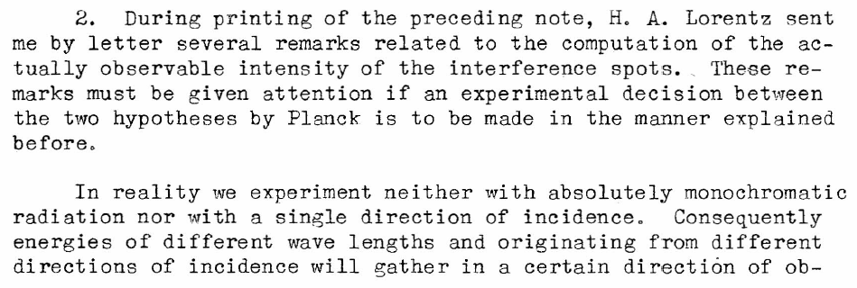
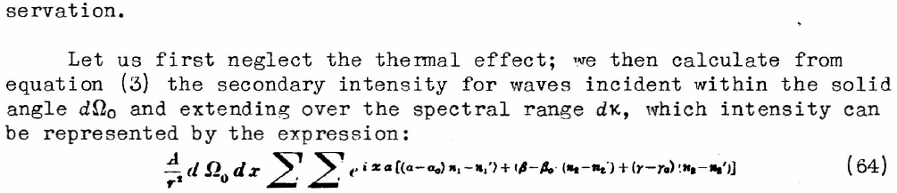
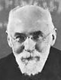
Lorentz factor: note added in proof
Debye, P. J. W. (1914)."Interferenz von Röntgenstrahlen und Wärmebewegung", Annalen der Physik 348, 49-92.
Lorentz

Slide 155
Lorentz Factor
Ewald sphere
Φ circle
(h,k,l)
diffracted ray
spindle axis

Slide 156
Lorentz Factor
Ewald sphere
diffracted ray
spindle axis

Slide 157
Lorentz Factor
Ewald sphere
diffracted ray
spindle axis

Slide 158
Lorentz Factor
Ewald sphere
diffracted ray
spindle axis

Slide 159
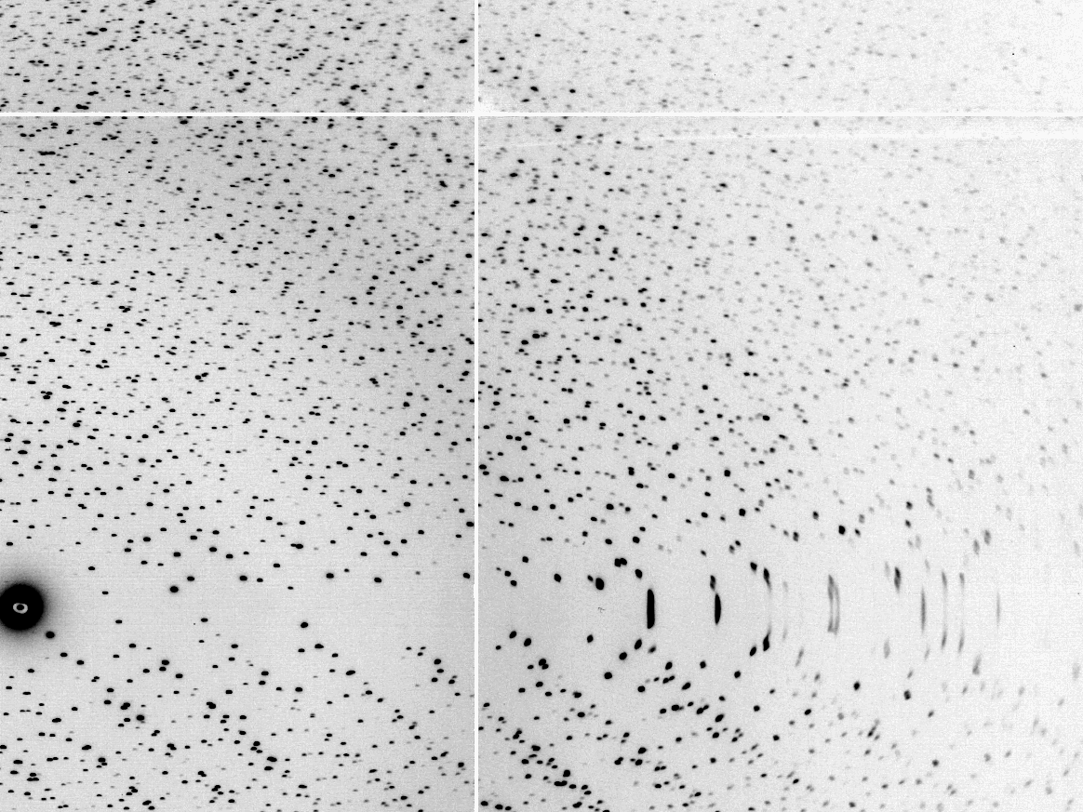
The “Lorentz zone”

Slide 160
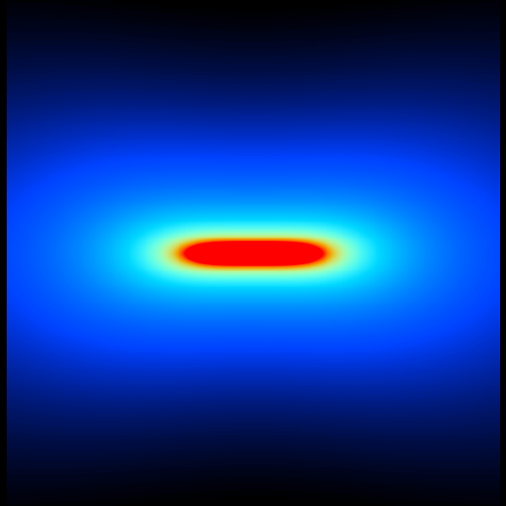
Lorentz factor
1.2x
3x
550x
10x
+
50x

Slide 161
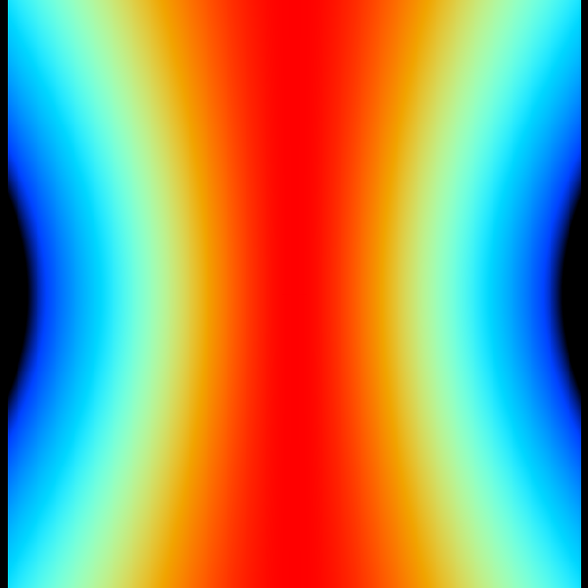
Polarization factor
1.0
0.45
+

Slide 162
attenuation factor
μ_{solvent}
t_{so}
t_{xo}
t_{si}
t_{xi}
μ_{xtal}
t_{so}
t_{xo}
t_{si}
t_{xi}
t_{so}
t_{xo}
I_{T}
I_{beam}
t_{si}
t_{xi}
A = = exp[-μ_{xtal}(t_{xi}+ t_{xo})
-μ_{solvent}(t_{si} + t_{so})]
Bouguer, P. (1729). Essai d'optique sur la gradation de la lumière.
Lambert, J. H. (1760). Photometria: sive De mensura et gradibus luminis, colorum et umbrae. E. Klett.
Beer, A. (1852)."Bestimmung der Absorption des rothen Lichts in farbigen Flüssigkeiten", Ann. Phys. Chem 86, 78-90.

Slide 163
Where do photons go?
100 µm Protein
1 Å X-rays
98%
Transmitted
beamstop
error < total < 2%

Slide 164
Air absorption
transmittance
Distance from sample (mm)

Slide 165
Spatial Heterogeneity in Sharp Spot Sensitivity
~3x10⁵ photon/pixel Pilatus detector
Bragg
glitch
“tree rings”
Pick-up tool mark
oxygen
inclusions
1% high
average
1% low

Slide 166
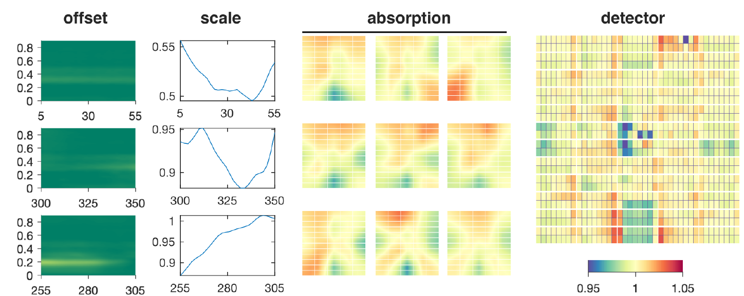
A few other corrections…
Meisburger, et. al. Nat Commun 11, 1271 (2020). https://doi.org/10.1038

Slide 167
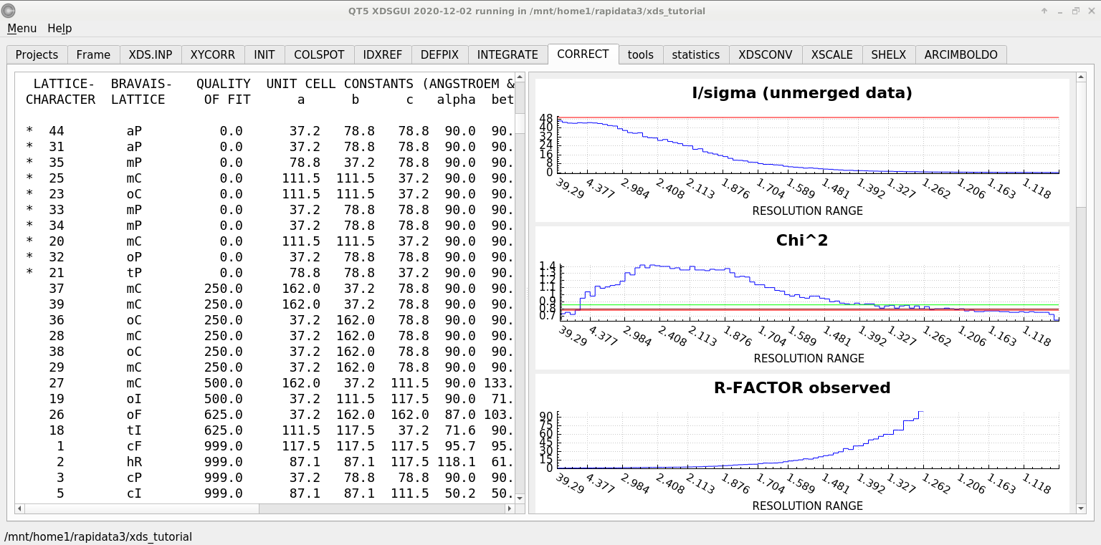
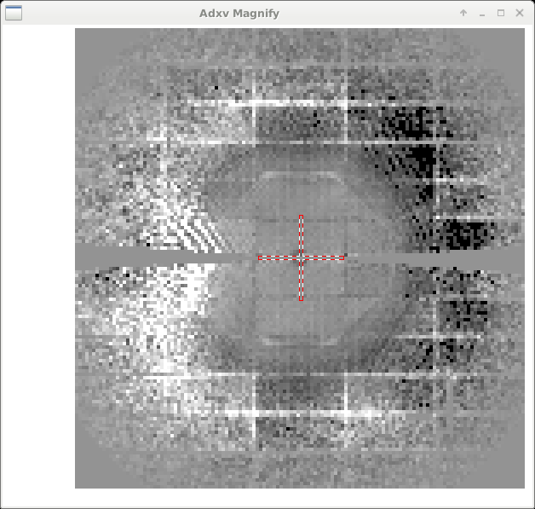
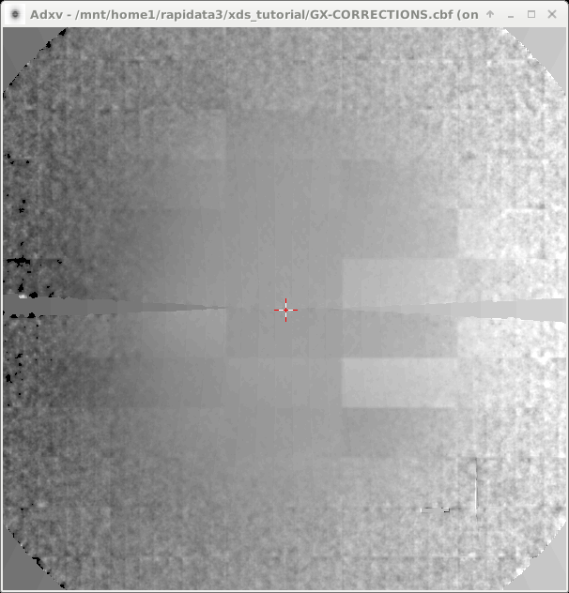
CORRECT – after all the “factors”

Slide 168
What you know when:
Autoindexing: Lattice (14)
Scaling: Point Group (43)
Phasing: Space Group (84)

Slide 169
Asymmetric Unit (ASU)
Unit Cell
Smallest part of the crystal
that you can use to build up the rest of the crystal
with translation symmetry only
Smallest part of the crystal
that you can use to build up the rest of the crystal
with symmetry operations
“NCS ASU”
Builds ASU with Non-crystallographic symmetry operations

Slide 170
Frequency of Space Groups in PDB
13007 | P2₁2₁2₁ | 566 | R32 | 191 | P6₃22 | 74 | P4₃22 | 36 | P3₂12
9629 | P2₁ | 491 | P6₅22 | 187 | P2₁3 | 71 | P4₁22 | 30 | P622
5300 | C2 | 474 | P6₁ | 161 | P6 | 70 | P6₄ | 24 | F4₁32
3021 | P2₁2₁2 | 421 | P6₅ | 144 | P42₁2 | 70 | P6₂22 | 22 | P4₃32
2543 | C222₁ | 353 | P4₁ | 142 | I23 | 67 | P6₄22 | 22 | P422
2109 | P1 | 351 | P6₃ | 132 | F432 | 66 | F222 | 22 | P23
2030 | P4₃2₁2 | 286 | P3₁ | 124 | P321 | 63 | P6₂ | 19 | P3₁12
1565 | P3₂21 | 257 | I422 | 115 | I4₁ | 59 | P4₁32 | 18 | P4₂22
1359 | P4₁2₁2 | 253 | P4₂2₁2 | 103 | P3 | 46 | P222₁ | 18 | I4₁32
1198 | P3₁21 | 249 | I4 | 99 | I2₁3 | 43 | P4 | 16 | P432
1147 | I222 | 246 | P4₃ | 94 | C222 | 43 | I432 | 8 | P4₂32
825 | R3 | 239 | I4₁22 | 93 | P2 | 40 | P4₂ | 3 | P222
620 | P6₁22 | 193 | P3₂ | 82 | I2₁2₁2₁ | 37 | F23 | 2 | P312

Slide 171
Pitfalls: sub-space groups
P622
What else?
P6₁22 P6₅22 P6₂22 P6₄22 P6₃22
P6 P6₁ P6₅ P6₂ P6₄ P6₃
P3₁2 P321 P3₁12 P3₁21 P3₂12 P3₂21
P3 P3₁ P3₂
P2 P2₁ C2 C222 C222₁
P1
zanuda

Slide 172
Trick Question:
What is the space group?
a = 63 b = 63 c = 63
α = 90 β = 90 γ = 90

Slide 173
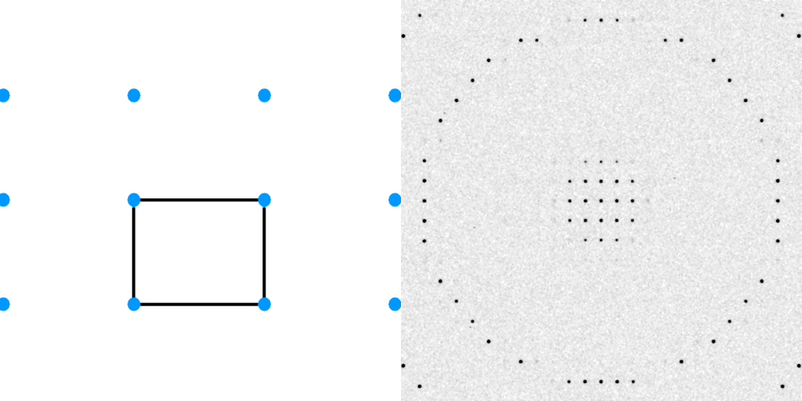
Diffraction from a 3D lattice
+
real space
reciprocal space

Slide 174
Diffraction from a 3D lattice
+
real space
reciprocal space

Slide 175
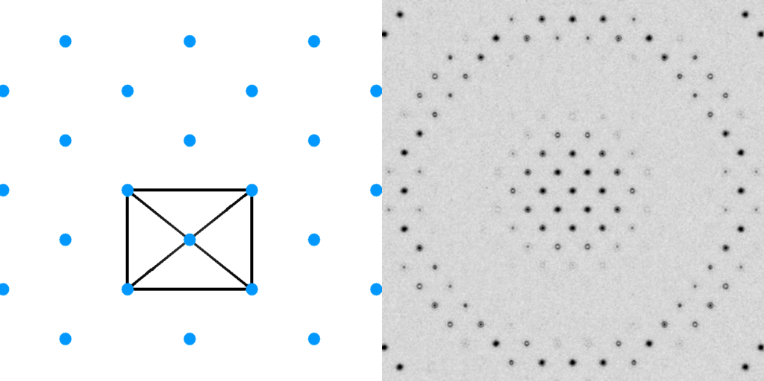
Diffraction from a 3D lattice
+
+
real space
reciprocal space

Slide 176
Diffraction from a 3D lattice
+
+
real space
reciprocal space

Slide 177
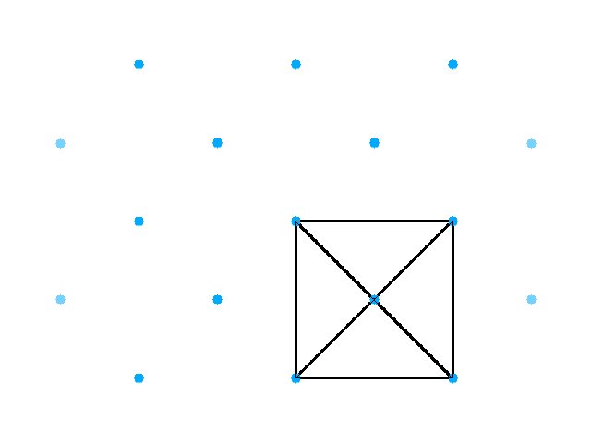
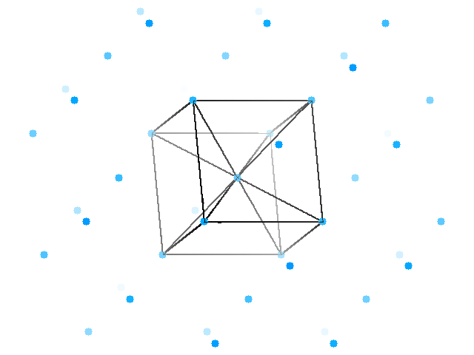
Base-centered lattice

Slide 178

Base-centered lattice

Slide 179

Face-centered lattice

Slide 180

Face-centered lattice

Slide 181

Face-centered lattice

Slide 182

Face-centered lattice
Body-centered lattice

Slide 183

Face-centered lattice
All half-way points

Slide 184

Face-centered lattice
All half-way points

Slide 185

cubic lattice

