Slide 1
Acknowledgements
Robert Stroud James Fraser
Paul Adams John Tainer Greg Hura Nick Sauter
Aina Cohen Art Lyubimov Sabine Hollatz
UCSF LBNL SLAC
ALS 8.3.1: TomAlberTron
NIH NIGMS R01 GM124149
NIH NIGMS P50 GM082250
NIH NIGMS P30 GM124169
NIH NIGMS R01 GM117126
DOE-BER Integrated Diffraction Analysis Technologies (IDAT)
Plexxikon, Inc.
NIH NIGMS P41 GM103393
NSF DBI-1625906
The Advanced Light Source is supported by the Director, Office of Science, Office of Basic Energy Sciences, Materials Sciences Division, of the US Department of Energy under contract No. DE-AC02-05CH11231 at Lawrence Berkeley National Laboratory.

Slide 2

ber
structural
bio
portal.org

Slide 3
PowerPoint File available:
http://bl831.als.lbl.gov/
~jamesh/powerpoint/
CSHL_beamline_2019.pptx

Slide 4
The “success rate” of data collection
100 s/dataset
200 days/year
~150 beamlines
~26,000,000 datasets/year
~11,000 PDBs in 2018

Slide 5
signal vs noise
“If you don’t have
good data,
then you have
no data at all.”
-Sung-Hou Kim

Slide 6
signal vs noise
easy
hard
impossible

Slide 7
signal vs noise
easy
hard
impossible
threshold of “solvability”

Slide 8
signal vs noise
“If you don’t have
good data,
then you must
learn statistics.”
-James Holton

Slide 9
Adding noise

Slide 10
Adding noise
1² + 1² = 1.4²

Slide 11
Adding noise
1² + 1² = 1.4²
3² + 1² = 3.2²
σ_{total}² = σ₁² + σ₂²

Slide 12
Adding noise
1² + 1² = 1.4²
3² + 1² = 3.2²
σ_{total}² = σ₁² + σ₂²

Slide 13
Adding noise
1² + 1² = 1.4²
3² + 1² = 3.2²
σ_{total}² = σ₁² + σ₂²

Slide 14
Adding noise
1² + 1² = 1.4²
3² + 1² = 3.2²
10² + 1² = 10.05²

Slide 15
And the dominant source of error is…
Resolution
  Disorder (including Radiation Damage)
  Background
Phases
  Non-isomorphism (including Radiation Damage)
  Vibration (beam, xtal, spindle, etc.)
  Detector calibration

Slide 16
Data quality - simple rules:
  Put your crystal into the beam

Slide 17
Your sample is a lens!
(but not for x-rays)
90°

Slide 18
Your sample is a lens!
(but not for x-rays)
90°

Slide 19
Data quality - simple rules:
  Put your crystal into the beam
  Shoot the whole crystal

Slide 20
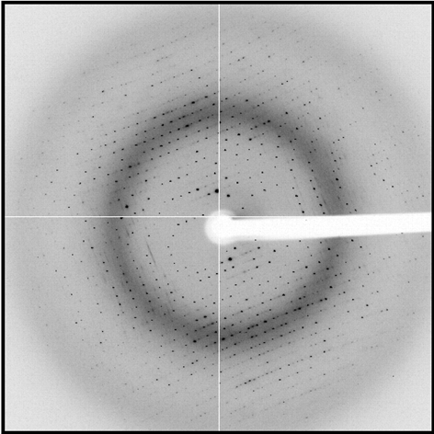
shoot the whole crystal

Slide 21
shoot the whole crystal

Slide 22
shoot the whole crystal

Slide 23
shoot the whole crystal

Slide 24
shoot the whole crystal

Slide 25
How many crystals do you see?
Shoot the crystal (singular)

Slide 26

mosaic spread = 0 º

Slide 27

mosaic spread = 0.1º

Slide 28

mosaic spread = 0.2º

Slide 29

mosaic spread = 0.4º

Slide 30

mosaic spread = 0.6º

Slide 31

mosaic spread = 0.8º

Slide 32

mosaic spread = 1.0º

Slide 33

mosaic spread = 1.5º

Slide 34

mosaic spread = 2.0º

Slide 35

mosaic spread = 2.5º

Slide 36

mosaic spread = 3.2º

Slide 37

mosaic spread = 6.4º

Slide 38

mosaic spread = 12.8º

Slide 39
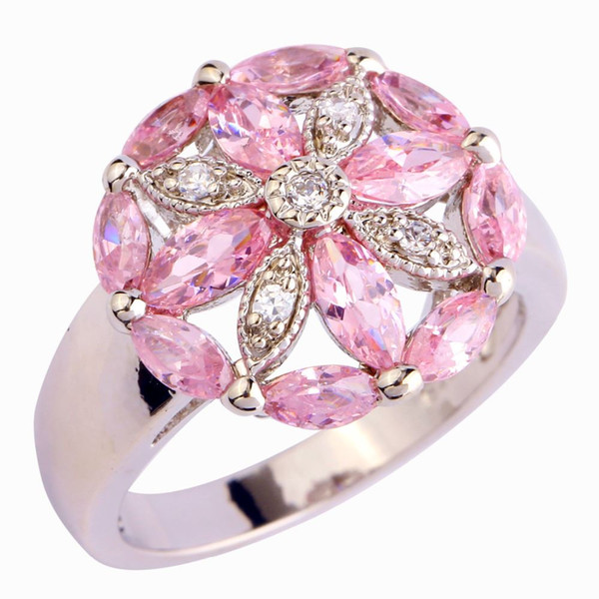
“pretty” crystals

Slide 40
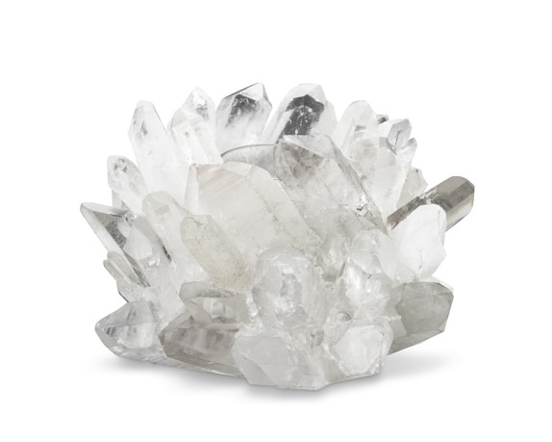
“pretty” crystals

Slide 41
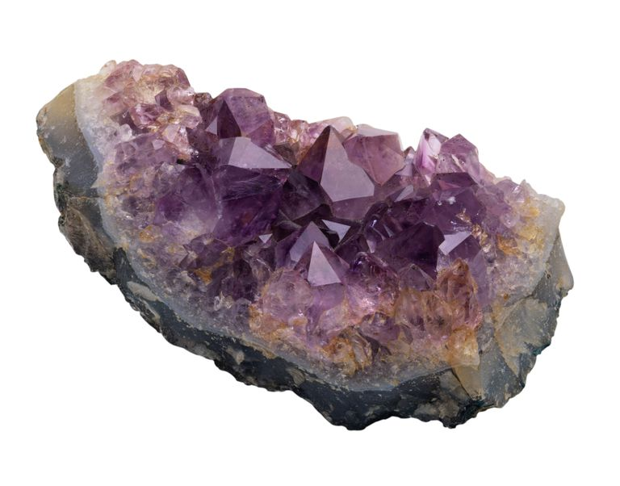
“pretty” crystals

Slide 42
Data quality - simple rules:
  Put your crystal into the beam
  Shoot the whole crystal
  Shoot nothing but the crystal

Slide 43
shoot nothing but the crystal

Slide 44
shoot nothing but the crystal

Slide 45
scattering/absorptoin “rules”:
1 μm crystal ≈ 1 μm water
≈ 1 μm plastic
≈ 0.1 μm glass
≈ 1000 μm air
Optimum: support thickness = crystal thickness
1 + 1 = 1.4

Slide 46
limited by
radiation
damage
limited by
excess
background
Resolution (Å)
too big
too small
just right
X-ray beam size (μm)

Slide 47
Data quality - simple rules:
  Put your crystal into the beam
  Shoot the whole crystal
  Shoot nothing but the crystal
  The crystal must rotate

Slide 48
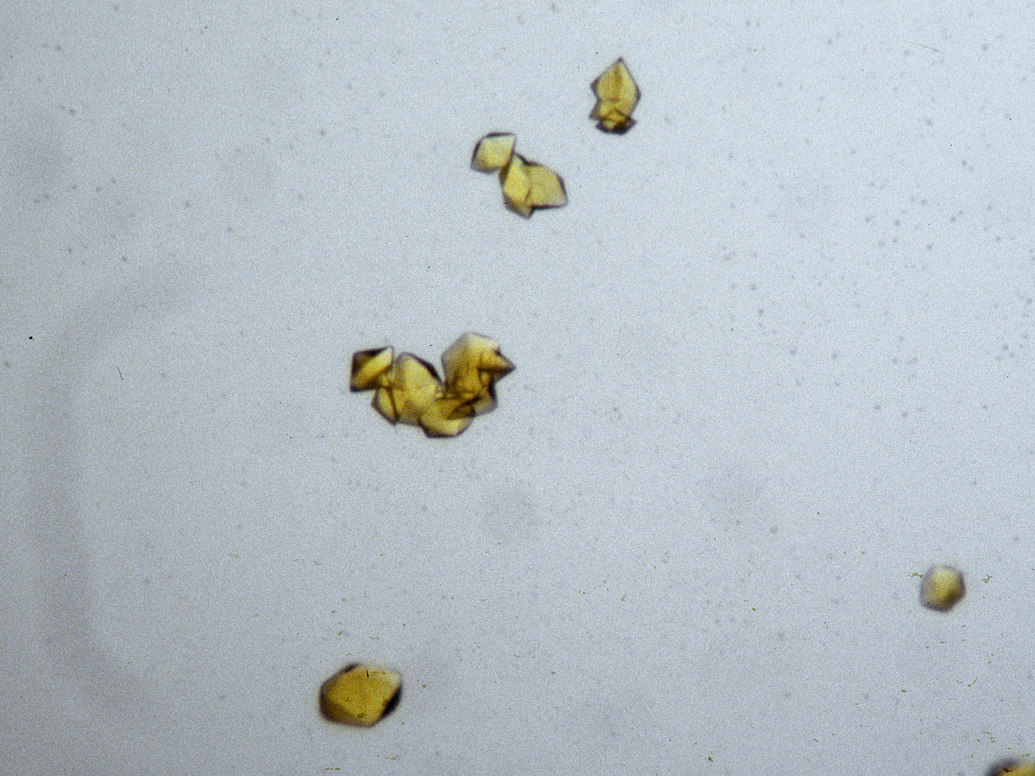
The crystal rotates!

Slide 49
The crystal rotates!
Membrane Protein Expression Center © 2012

Slide 50
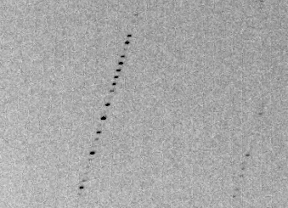
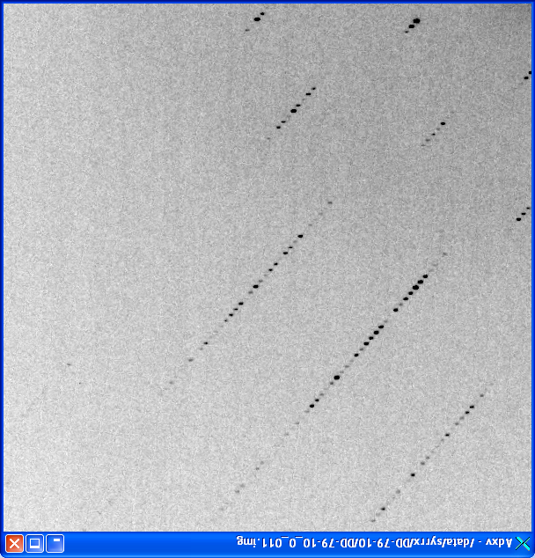
avoiding overlaps
c
c

Slide 51
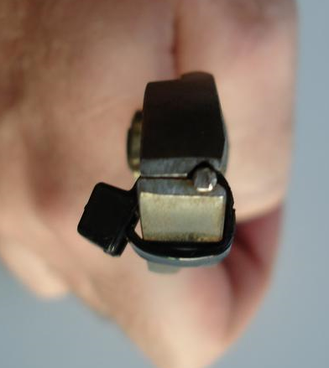
avoiding overlaps
c

Slide 52
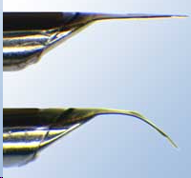
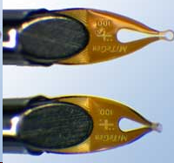
avoiding overlaps
c
http://www.mitegen.com/mic_catalog.php?c=DTMicroMounts

Slide 53
avoiding overlaps
c
http://www.mitegen.com/mic_catalog.php?c=orientedmounts

Slide 54
Data quality - simple rules:
  Put your crystal into the beam
  Shoot the whole crystal
  Shoot nothing but the crystal
  The crystal must rotate
  Back off!

Slide 55
Background scattering

Slide 56
Mosquito tips cost $0.15 each
So do detector pixels!
We bought 6,224,001
Use them!
(they are reusable)

Slide 57
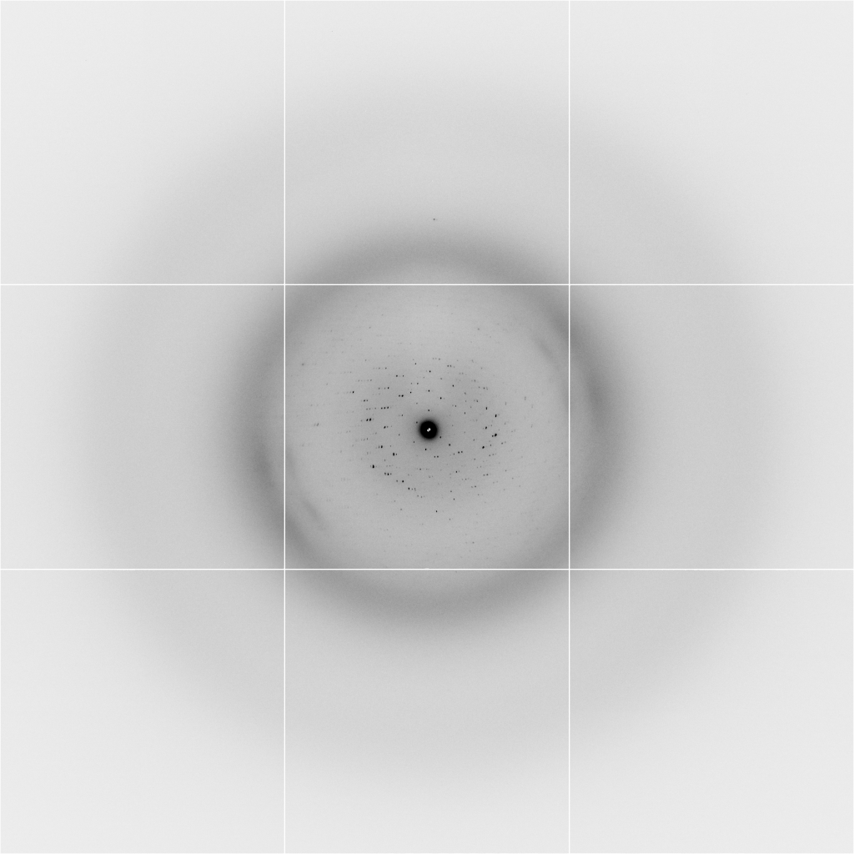
Background scattering
$100,000.00
$100,000.00
$100,000.00
real estate is
expensive
use it!
$100,000.00
$100,000.00
$100,000.00
$100,000.00
$100,000.00

Slide 58
Fine Slicing
background
background
Pflugrath, J. W. (1999)."The finer things in X-ray diffraction data collection", Acta Cryst. D 55, 1718-1725.

Slide 59
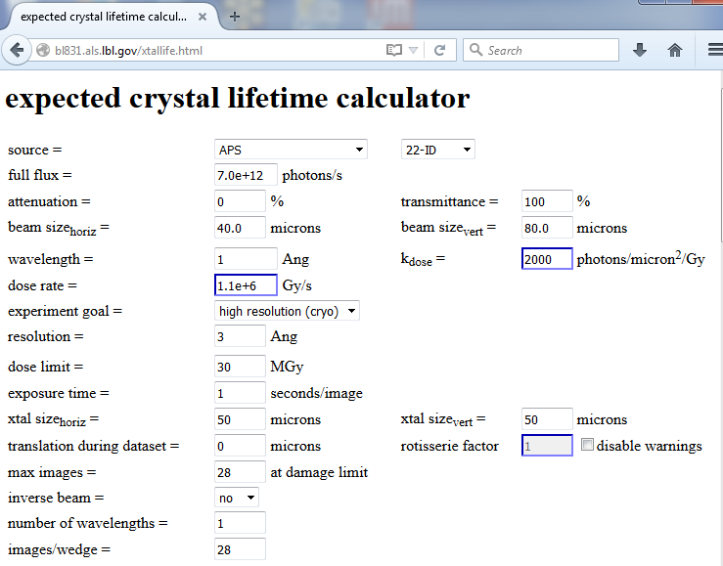

Slide 60
Optimal exposure time
(anomalous on a PAD)
PILATUS
>0.2 s/frame
EIGER
>0.0003 s/frame
t_{mad} Optimal exposure time (s)
t_{ro} read-out time (s)
2.03 ms on Pilatus³ S
0.95 ms on Pilatus³ X
0.003 ms on Eiger
Attenuate for MAD

Slide 61
Optimal exposure time
(anomalous on a PAD)
2.03 ms
intensity
time

Slide 62

Optimal exposure time
(faint spots on CCD detector)
t_{hr} Optimal exposure time for data set (s)
t_{ref} exposure time of reference image (s)
bg_{ref} background level near weak spots on
reference image (ADU)
bg₀ ADC offset of detector (ADU)
bg_{hr} optimal background level (via t_{hr})
σ₀ rms read-out noise (ADU)
gain ADU/photon
m multiplicity of data set (including partials)
adjust exposure
so this is ~100

Slide 63
And the dominant source of error is…
Resolution
  Disorder (including Radiation Damage)
  Background
Phases
  Non-isomorphism (including Radiation Damage)
  Vibration (beam, xtal, spindle, etc.)
  Detector calibration

Slide 64

Spatial Heterogeneity in Sharp Spot Sensitivity
~3x10⁵ photon/pixel Pilatus detector
Bragg
glitch
“tree rings”
Pick-up tool mark
oxygen
inclusions
1% high
average
1% low

Slide 65
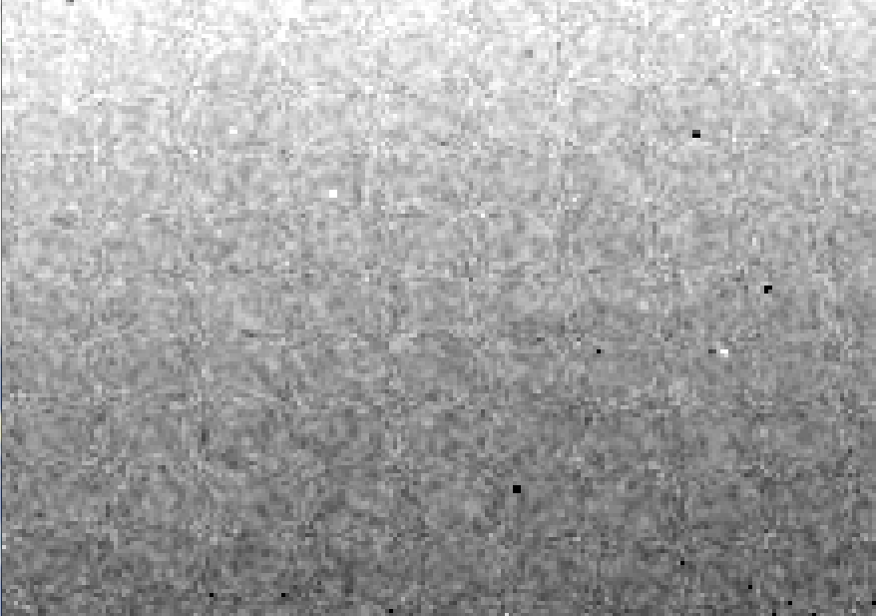
Detector calibration: 7235 eV

Slide 66
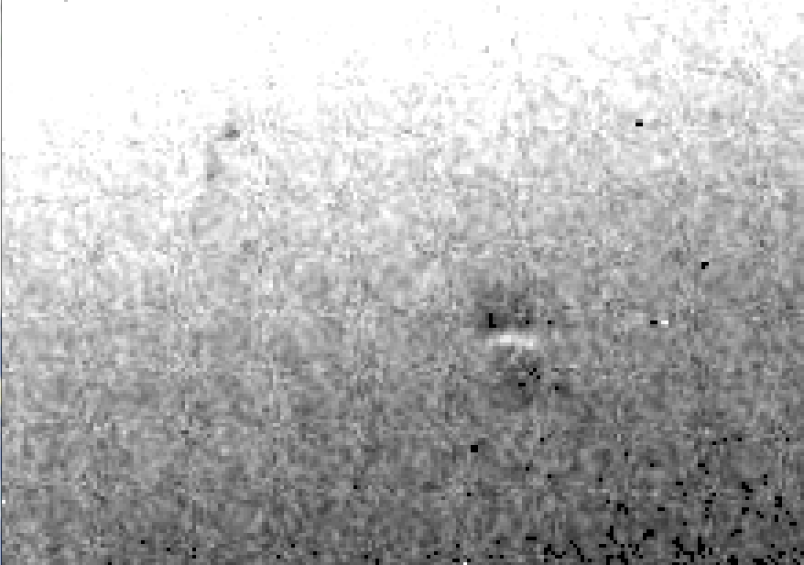
Detector calibration: 7247 eV

Slide 67
Gadox calibration vs energy
same = good!
Relative absorption depth
bad!
photon energy (keV)

Slide 68

Systematic error does not “average out”
Unless you can randomize their source

Slide 69
Fractional error
^{mult >} (—)²
~3%
<ΔF/F>

Slide 70
anomalous signal
ΔF
F
√
# sites
MW (Da)
≈ 1.2 f”
World record!
ΔF/F = 0.5%
Wang, Dauter & Dauter (2006) Acta Cryst. D 62, 1475-1483.
Crick, F. H. C. & Magdoff, B. S. (1956) Acta Crystallogr. 9, 901-908.
Hendrickson, W. A. & Teeter, M. M. (1981) Nature 290, 107-113.

Slide 71

Holton & Frankel (2010) Acta D 66 393-408.

Slide 72

100% SeMet incorporation
Trivial to solve

Slide 73

100% S -Met incorporation
Impossible to solve

Slide 74
Phase Problem: Se vs S
correlation coefficient
fraction not Selenium

Slide 75
Phase Problem: Se vs S
correlation coefficient
fraction not Selenium

Slide 76
Phase Problem: Se vs S
correlation coefficient
fraction not Selenium

Slide 77
Phase Problem: Se vs S
correlation coefficient
fraction not Selenium

Slide 78
Phase Problem: Se vs S
correlation coefficient
fraction not Selenium

Slide 79
One xtal, no idea?
Suggested native protocol:
Do strategy
Start at specified phi
Complete fast as you can
Keep going to 360°
Move detector
Advance phi 10-30 deg
Increase photons/image 4x
goto 4

Slide 80
Suggested anomalous protocol:
360° in < ~5 MGy (for Se)
move detector
4X exposure
goto 2
2 wavelengths are better than 1
- (peak + inf)/2, and remote
MAD, not M-SAD!

Slide 81
The
“threshold of solvability” is sharp!
How can we predict success/failure?
Know Thy Experiment

Slide 82
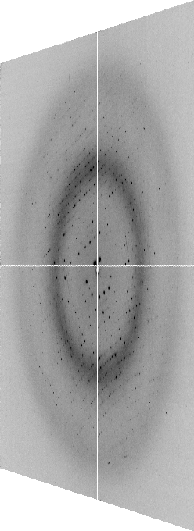

The “beam line”
X-ray
Source
Area Detector
Cite the “beamline paper!”
Protein Crystal
Notes:
Most notable acheivements are high brightness with very little “wasted” light. The discovery made by Howard Padmore? At ALS showed that a 2:1 demagnification cancels nearly all of the spherical abberations in the parabolic/torroid system. 30-50% of the total x-ray intensity passes through the 100um pinhole. The flux through the 100um pinhole at the superbend beamlines is comparable to that of the 5.0.2 wiggler or an APS bending magnet, but only 150 Watts of power must be dissipated by the beamline optics. In contrast, wiggler beamlines must disipate kilowatts. The optics here are much simpler and not exotic in any way. The system is stable and robust. There is never a need to re-focus the beam at a new wavelength. Only a 2-minute automatic tuneup is recommended for very large energy changes (more than 1-2 keV).

Slide 83
The “beam line”
focused
beam
slits
Scatter
guard
Secondary
mirror
Primary
mirror
Source
Area Detector
Unfocused
beam
slits
Si(111)
monochromator
Sample

Slide 84
The “beam line”
focused
beam
slits
Scatter
guard
Secondary
mirror
Primary
mirror
Source
Area Detector
Unfocused
beam
slits
Si(111)
monochromator
Sample
Notes:
Most notable acheivements are high brightness with very little “wasted” light. The discovery made by Howard Padmore? At ALS showed that a 2:1 demagnification cancels nearly all of the spherical abberations in the parabolic/torroid system. 30-50% of the total x-ray intensity passes through the 100um pinhole. The flux through the 100um pinhole at the superbend beamlines is comparable to that of the 5.0.2 wiggler or an APS bending magnet, but only 150 Watts of power must be dissipated by the beamline optics. In contrast, wiggler beamlines must disipate kilowatts. The optics here are much simpler and not exotic in any way. The system is stable and robust. There is never a need to re-focus the beam at a new wavelength. Only a 2-minute automatic tuneup is recommended for very large energy changes (more than 1-2 keV).

Slide 85
Where do the
X-rays come from?

Slide 86
The “Home source”
e⁻

Slide 87
The “Home source”
e⁻
e⁻
+

Slide 88
The “Home source”
+

Slide 89
The “Home source”
e⁻
+

Slide 90
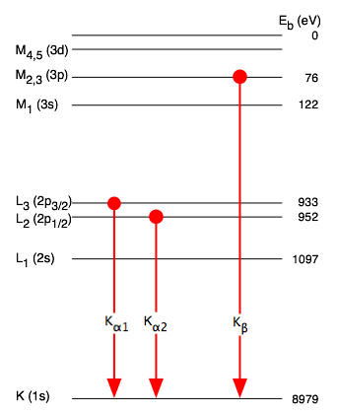
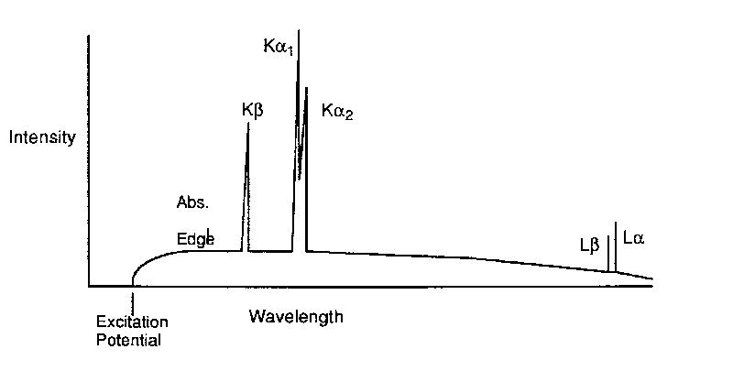
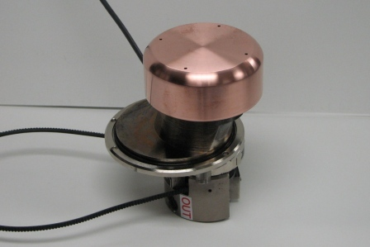
The “Home source”

Slide 91
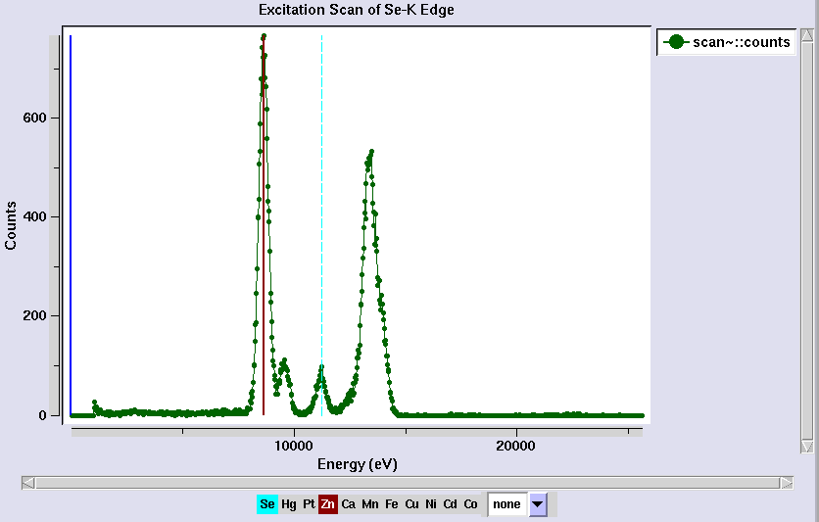
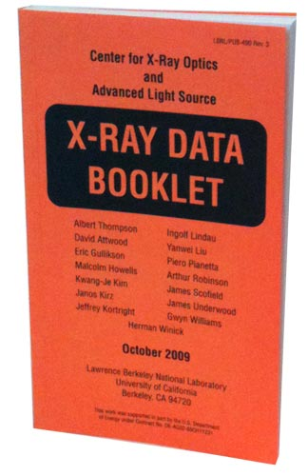
Metal identification
scattering
same
λ as
incident

Slide 92
“MAD scan” – absorption spectrum
fluorescence = yield * absorption
0.980888
0.980500
0.980113
0.979725
0.979338
0.978952
0.978565
0.978179
0.977794
0.977408
0.977023
0.976638
0.976254
“counts” (aka arbitrary units)
12398.42
energy
Wavelength (Å)

Slide 93
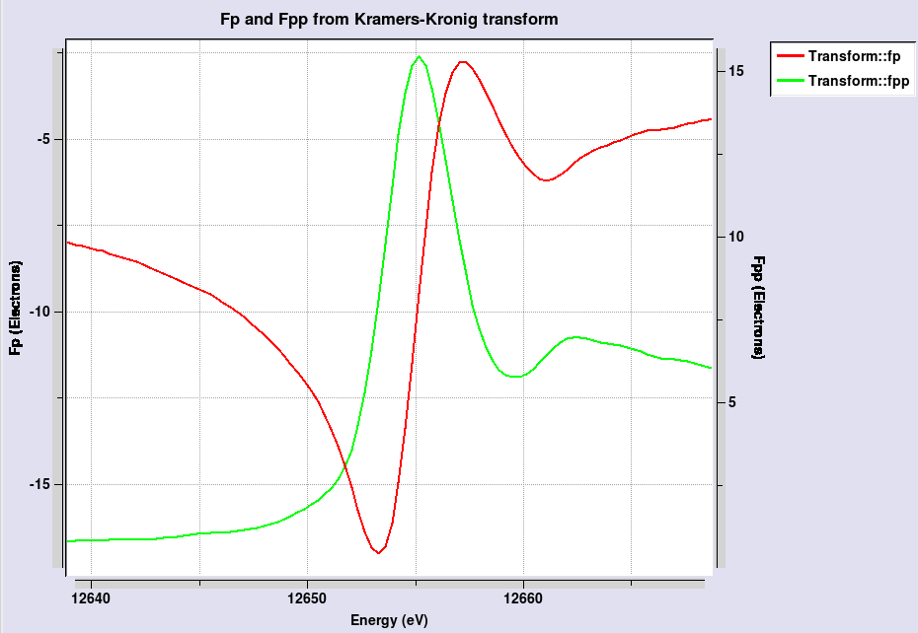
“MAD scan” – absorption spectrum
maximize
absolute
value of
f’’
maximize
difference
in f’

Slide 94
4-wavelength MAD

Slide 95
3-wavelength MAD

Slide 96
2-wavelength MAD

Slide 97
2-wavelength MAD

Slide 98
1-wavelength SAD

Slide 99
2-wavelength metal validation
phased
anomalous
difference
Fourier

Slide 100
The “beam line”
focused
beam
slits
Scatter
guard
Secondary
mirror
Primary
mirror
Source
Area Detector
Unfocused
beam
slits
Si(111)
monochromator
Sample
Notes:
Most notable acheivements are high brightness with very little “wasted” light. The discovery made by Howard Padmore? At ALS showed that a 2:1 demagnification cancels nearly all of the spherical abberations in the parabolic/torroid system. 30-50% of the total x-ray intensity passes through the 100um pinhole. The flux through the 100um pinhole at the superbend beamlines is comparable to that of the 5.0.2 wiggler or an APS bending magnet, but only 150 Watts of power must be dissipated by the beamline optics. In contrast, wiggler beamlines must disipate kilowatts. The optics here are much simpler and not exotic in any way. The system is stable and robust. There is never a need to re-focus the beam at a new wavelength. Only a 2-minute automatic tuneup is recommended for very large energy changes (more than 1-2 keV).

Slide 101
Bending Magnet
S
electron beam
X-rays !
N

Slide 102
Two Bending Magnets
S
N
electron beam
N
S
2x X-rays !

Slide 103
Wiggler
8x X-rays !
S
N
S
N
S
N
S
N
N
S
N
S
N
S
N
S

Slide 104
Undulator
> 8x X-rays !
S
N
S
N
S
N
S
N
N
S
N
S
N
S
N
S

Slide 105
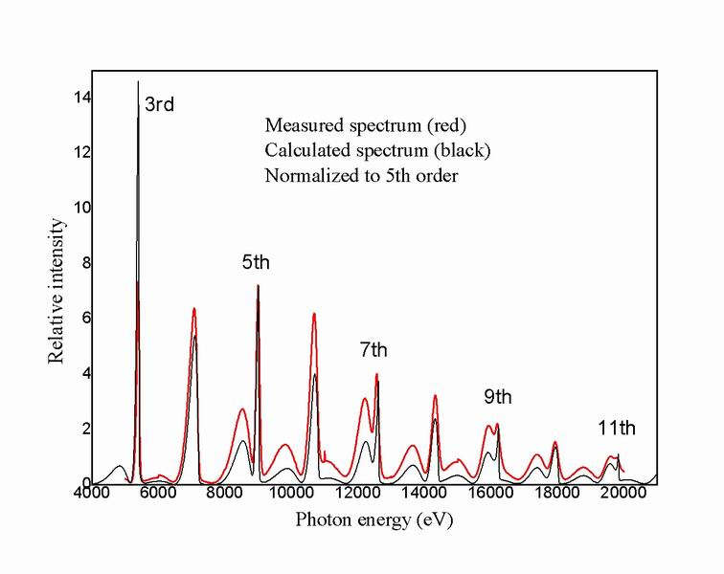
Undulator emission spectrum

Slide 106
XFEL Undulator
same X-rays
short pulse
S
N
S
N
S
N
S
N
S
N
S
N
S
N
S
N
N
S
N
S
N
S
N
S
N
S
N
S
N
S
N
S

Slide 107
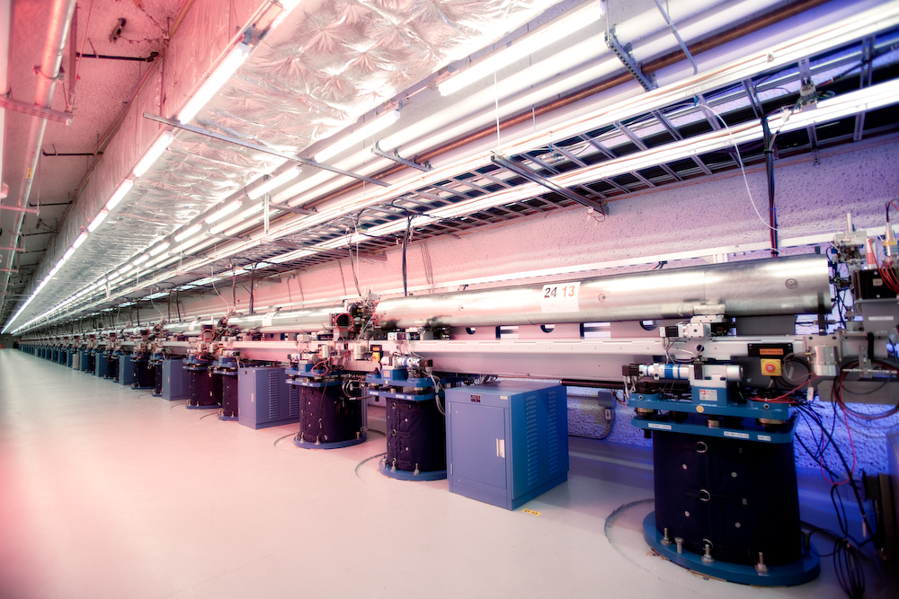
LCLS undulator hall

Slide 108
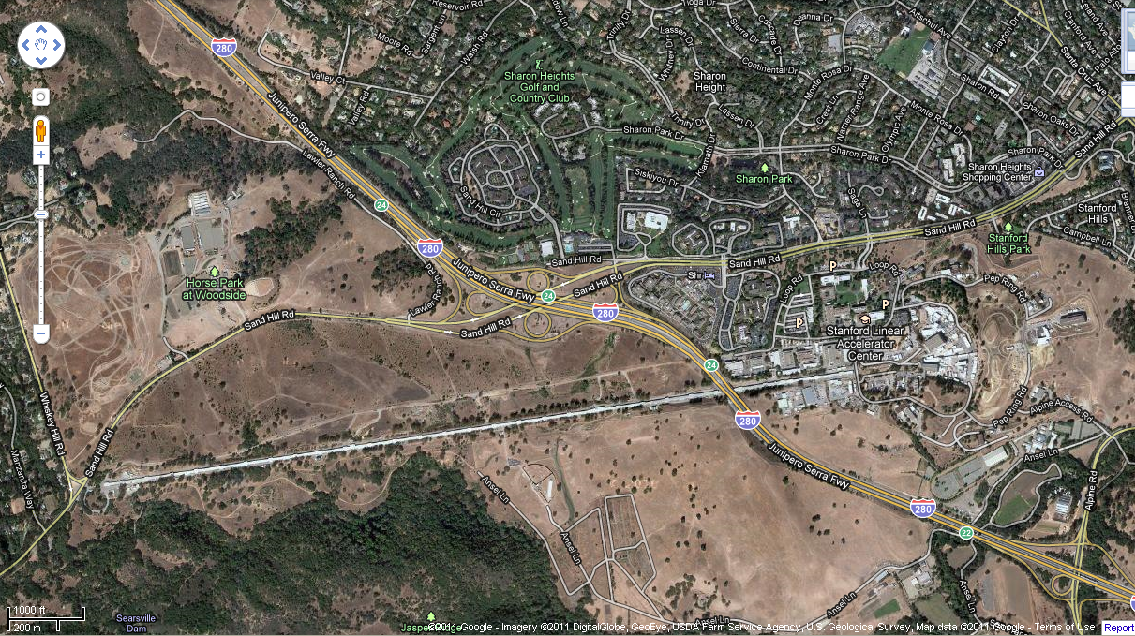
LCLS at SLAC

Slide 109
Accelerator-based light source terminology
Code name Translation
First Generation Bending Magnet
Second Generation Wiggler
Third Generation Undulator
Fourth Generation Free electron laser
..and diffraction-limited synchrotron

Slide 110
Diffraction-limited light source
λ ≈ 2 d sinθ
λ = x-ray wavelength
d = electron/x-ray beam size
θ = beam divergence
d = 1 Å / 100 µrad / 2 = 0.5 µm

Slide 111
The “beam line”
focused
beam
slits
Scatter
guard
Secondary
mirror
Primary
mirror
Source
Area Detector
Unfocused
beam
slits
Si(111)
monochromator
Sample
Notes:
Most notable acheivements are high brightness with very little “wasted” light. The discovery made by Howard Padmore? At ALS showed that a 2:1 demagnification cancels nearly all of the spherical abberations in the parabolic/torroid system. 30-50% of the total x-ray intensity passes through the 100um pinhole. The flux through the 100um pinhole at the superbend beamlines is comparable to that of the 5.0.2 wiggler or an APS bending magnet, but only 150 Watts of power must be dissipated by the beamline optics. In contrast, wiggler beamlines must disipate kilowatts. The optics here are much simpler and not exotic in any way. The system is stable and robust. There is never a need to re-focus the beam at a new wavelength. Only a 2-minute automatic tuneup is recommended for very large energy changes (more than 1-2 keV).

Slide 112
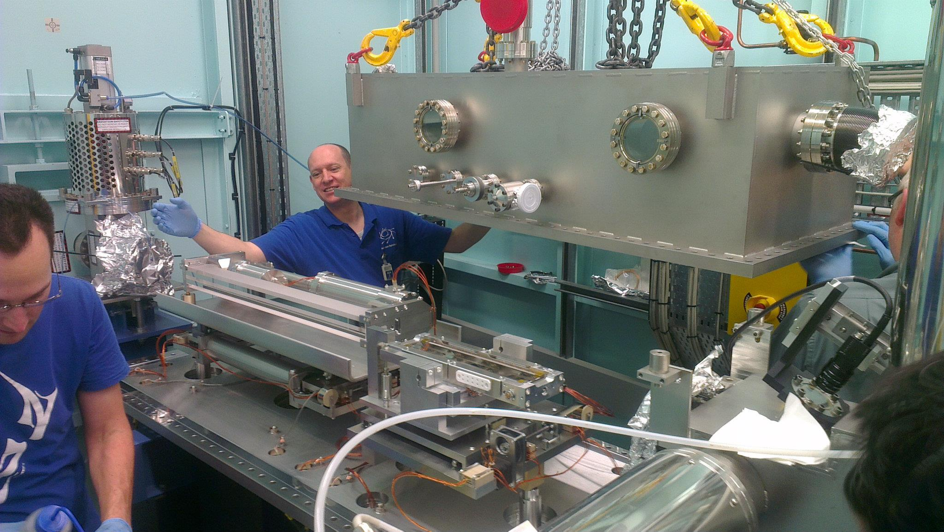
X-ray optics: mirrors
Notes:
Next slide please

Slide 113
Why are the mirrors so long?
Must be < 0.2°
3 mm
1000 mm
Notes:
Next slide please

Slide 114
There is a lens for X-rays!
0.1 mm
Be
1 mm
Notes:
Next slide please

Slide 115
The “beam line”
focused
beam
slits
Scatter
guard
Secondary
mirror
Primary
mirror
Source
Area Detector
Unfocused
beam
slits
Si(111)
monochromator
Sample
Notes:
Most notable acheivements are high brightness with very little “wasted” light. The discovery made by Howard Padmore At ALS showed that a 2:1 demagnification cancels nearly all of the spherical abberations in the parabolic/torroid system. 30-50% of the total x-ray intensity passes through the 100um pinhole. The flux through the 100um pinhole at the superbend beamlines is comparable to that of the 5.0.2 wiggler or an APS bending magnet, but only 150 Watts of power must be dissipated by the beamline optics. In contrast, wiggler beamlines must disipate kilowatts. The optics here are much simpler and not exotic in any way. The system is stable and robust. There is never a need to re-focus the beam at a new wavelength. Only a 2-minute automatic tuneup is recommended for very large energy changes (more than 1-2 keV).

Slide 116
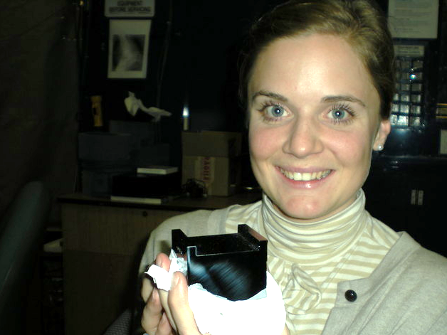
Single crystal

Slide 117
Monochromators
λ = 1 Å
Si
Notes:
Next slide please

Slide 118
Monochromators
nλ = 2d sin(θ)
λ = 1 Å
λ = 1 Å
Si
d = 3.135 Å
θ = 9.177°
Notes:
Next slide please

Slide 119
Monochromators
nλ = 2d sin(θ)
λ = 1.1 Å
Si
d = 3.135 Å
θ = 9.177°
Notes:
Next slide please

Slide 120
Monochromators
nλ = 2d sin(θ)
λ = 1.1 Å
λ = 1.1 Å
Si
d = 3.135 Å
θ = 10.104°
Notes:
Next slide please

Slide 121
Monochromators
nλ = 2d sin(θ)
λ = 1 Å
λ = 1 Å
Si
d = 3.135 Å
θ = 9.177°
Notes:
Next slide please

Slide 122
Monochromators
Si
λ = 1 Å
λ = 1 Å
Si
d = 3.135 Å
DCM = Double Crystal Monochromator
Notes:
Next slide please

Slide 123
Monochromators
Si
λ = 1.1 Å
λ = 1.1 Å
Si
d = 3.135 Å
DCM = Double Crystal Monochromator
Notes:
Next slide please

Slide 124
Monochromators
nλ = 2d sin(θ)
λ = 1.54 Å
λ = 1.54 Å
Mo/C
d = 24 Å
θ = 1.84°
Multilayer optics
Notes:
Next slide please

Slide 125
The truth about x-ray beams
Term units significance
Flux photons/s duration of experiment
Beam Size μm match to crystal
Divergence mrad spot size vs distance
Wavelength Å resolution and absorption
Dispersion Δλ/λ spot size
Flux density ph/s/area scattering/damage rate
Fluence ph/area scattering/damage

Slide 126
The truth about x-ray beams
Term units significance
Flux photons/s duration of experiment
Beam Size μm match to crystal
Divergence mrad spot size vs distance
Wavelength Å resolution and absorption
Dispersion Δλ/λ spot size
Flux density ph/s/area scattering/damage rate
Fluence ph/area scattering/damage

Slide 127
The number of photons scattered
before crystal is dead
is independent
of data collection time
1 um³ = 10⁶ photons
Henderson, 1990; Gonzalez & Nave, 1994; Glaeser et al., 2000; Sliz et al., 2003; Leiros et al., 2006; Owen et al., 2006; Garman & McSweeney, 2006; Garman & Nave, 2009; Holton, 2009

Slide 128
The truth about x-ray beams
quantity | units | home source | synchrotron
flux | Photons/second | 2.5 x 10⁹ | 2 x 10¹²
exposure | seconds | 400 | 1

Slide 129
The truth about x-ray beams
quantity | units | home source | synchrotron
flux | Photons/second | 2.5 x 10⁹ | 2 x 10¹²
exposure | seconds | 400 | 1
Dispersion | wavelength range / wavelength | 0.2% (Kα₁ - Kα₂) | 0.014% (Si111)
Divergence | milliRadian | 4.8 | 1.8 (h) 0.18 (v)
Beam size | microns | 100 | 24 (h) 12 (v)
Spectral brightness | Photons/s/mm²/ mR²/0.1%BW | 5.4 x 10⁹ | 1.5 x 10¹⁷

Slide 130
The truth about x-ray beams
quantity | units | home source | synchrotron
flux | Photons/second | 72 x 10⁶ | 2 x 10¹²
exposure | time | 4 hours | 1 second
Dispersion | wavelength range / wavelength | 0.2% (Kα₁ - Kα₂) | 0.014% (Si111)
Divergence | milliRadian | 4.8 | 1.8 (h) 0.18 (v)
Beam size | microns | 17 | 24 (h) 12 (v)
Spectral brightness | Photons/s/mm²/ mR²/0.1%BW | 5.4 x 10⁹ | 1.5 x 10¹⁷

Slide 131
The truth about x-ray beams
quantity | units | home source | synchrotron
flux | Photons/second | 1 x 10⁶ | 2 x 10¹²
exposure | time | 10 days | 1 second
Dispersion | wavelength range / wavelength | 0.2% (Kα₁ - Kα₂) | 0.014% (Si111)
Divergence | milliRadian | 0.6 | 1.8 (h) 0.18 (v)
Beam size | microns | 17 | 24 (h) 12 (v)
Spectral brightness | Photons/s/mm²/ mR²/0.1%BW | 5.4 x 10⁹ | 1.5 x 10¹⁷

Slide 132
The truth about x-ray beams
quantity | units | home source | synchrotron
flux | Photons/second | 8 x 10⁴ | 2 x 10¹²
exposure | time | 5 months | 1 second
Dispersion | wavelength range / wavelength | 0.014% (Si111) | 0.014% (Si111)
Divergence | milliRadian | 0.6 | 1.8 (h) 0.18 (v)
Beam size | microns | 17 | 24 (h) 12 (v)
Spectral brightness | Photons/s/mm²/ mR²/0.1%BW | 5.4 x 10⁹ | 1.5 x 10¹⁷

Slide 133
The truth about x-ray beams
Term units significance
Flux photons/s duration of experiment
Beam Size μm match to crystal
Divergence mrad spot size vs distance
Wavelength Å resolution and absorption
Dispersion Δλ/λ spot size
Flux density ph/s/area scattering/damage rate
Fluence ph/area scattering/damage

Slide 134
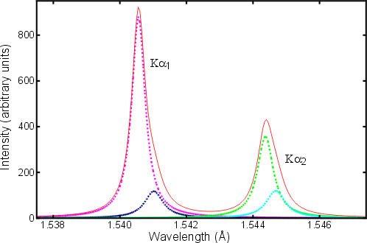
Two-color experiment (ca 1914)
(Cu source)
20 eV

Slide 135
scattering
x-ray beam
sample
detector

Slide 136
scattering
x-ray beam
sample
detector

Slide 137
scattering
x-ray beam
sample
detector

Slide 138
scattering
x-ray beam
sample
detector

Slide 139
Bragg’s Law
to detector
nλ = 2d sin(θ)
atom #1
θ
d
to source
atom #2
d∙sin(θ)

Slide 140
Bragg’s Law
to detector
nλ = 2d sin(θ)
atom #1
θ
to source
d
atom #2
d∙sin(θ)

Slide 141
anomalous scattering
x-ray beam
sample
detector

Slide 142
anomalous scattering
x-ray beam
sample
detector

Slide 143
anomalous scattering
x-ray beam
sample
detector

Slide 144
anomalous scattering
x-ray beam
sample
detector

Slide 145
anomalous scattering
x-ray beam
sample
detector

Slide 146
scattering
x-ray beam
sample
detector
detector

Slide 147
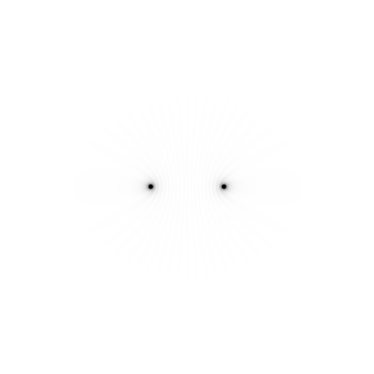
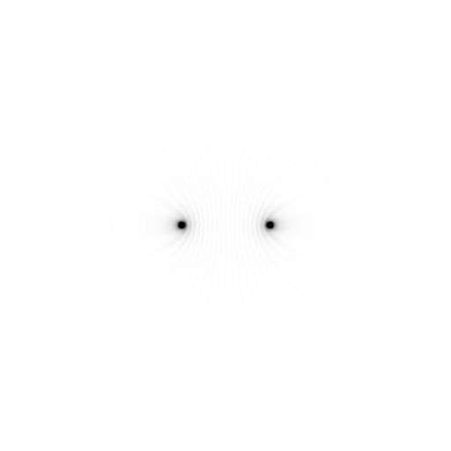
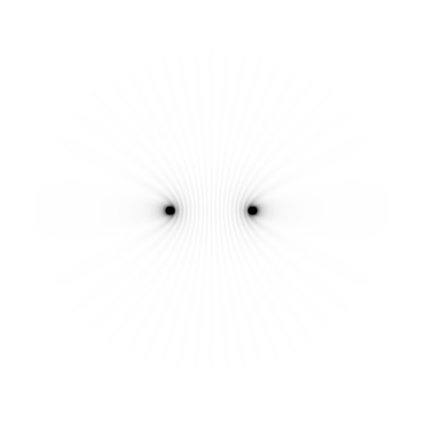
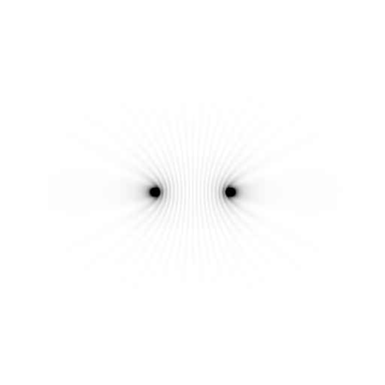
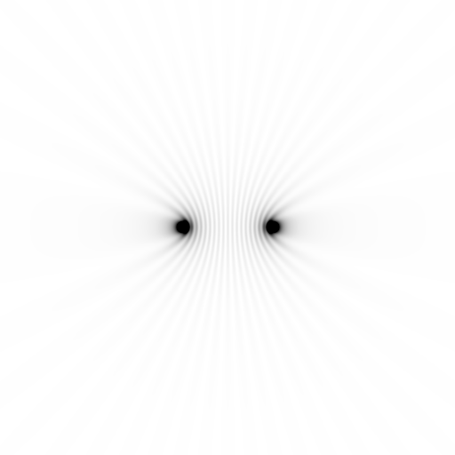
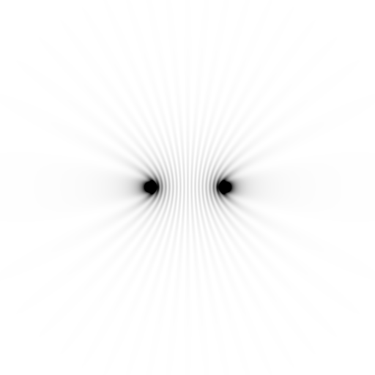
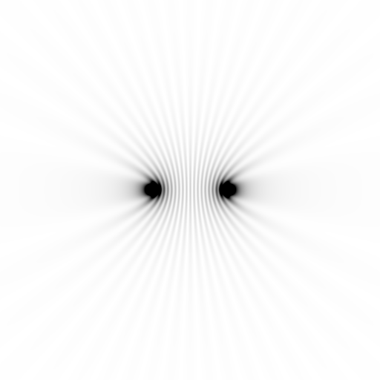
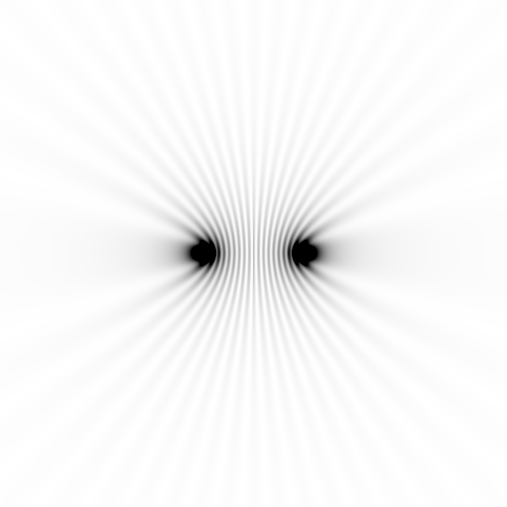
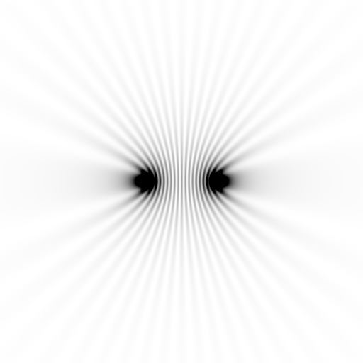
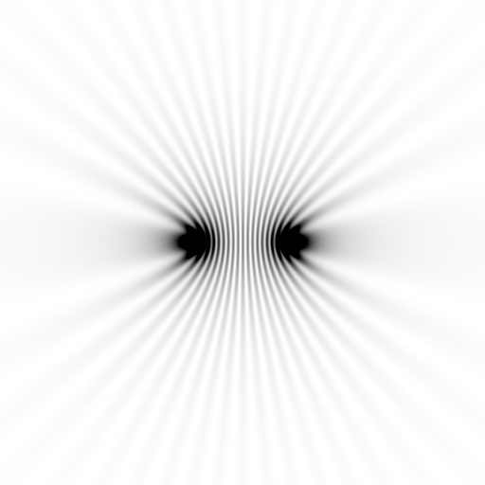
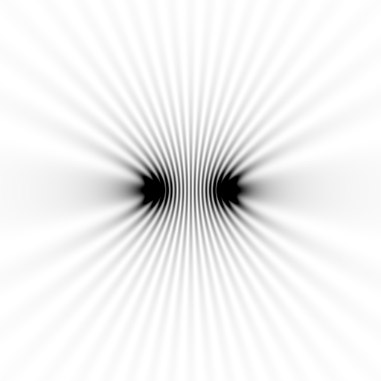
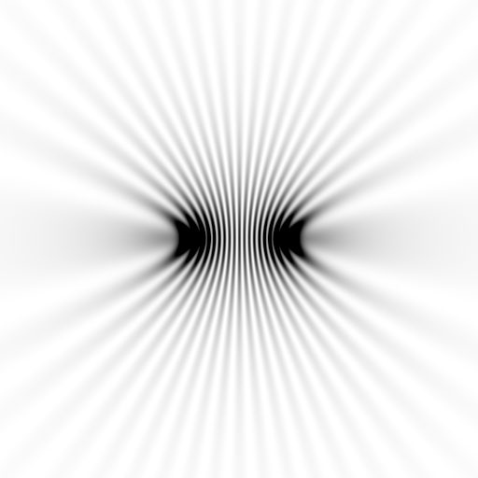
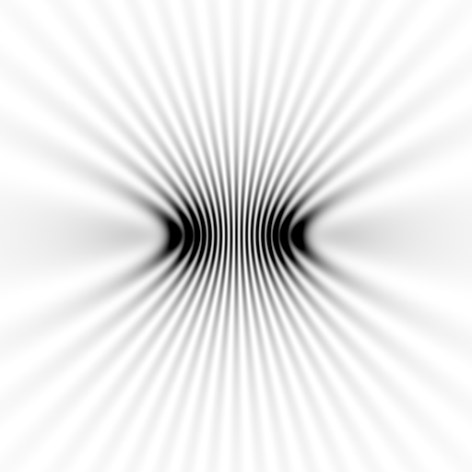
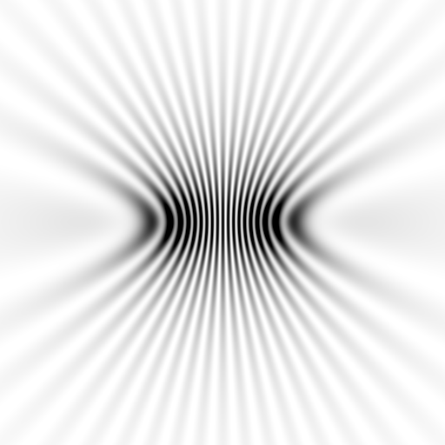
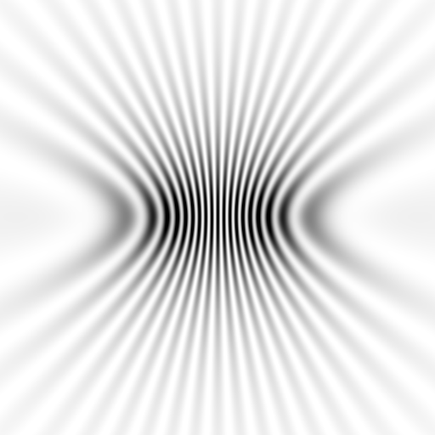
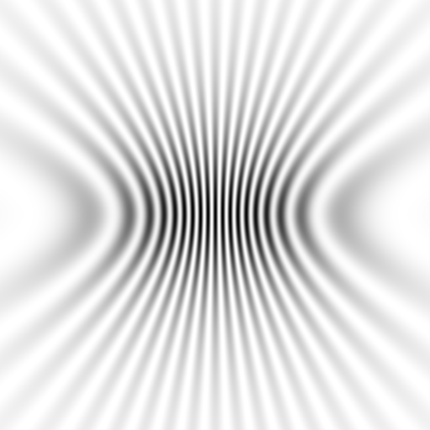
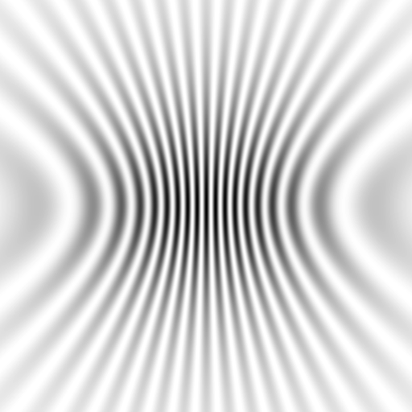
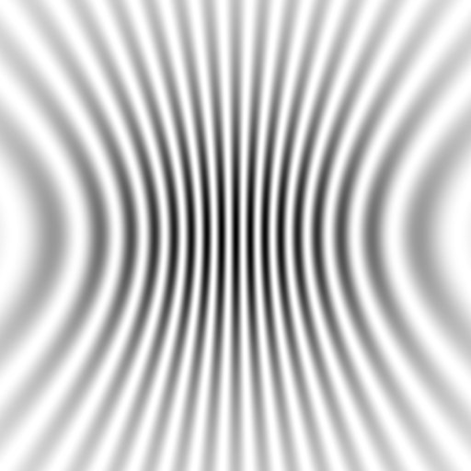
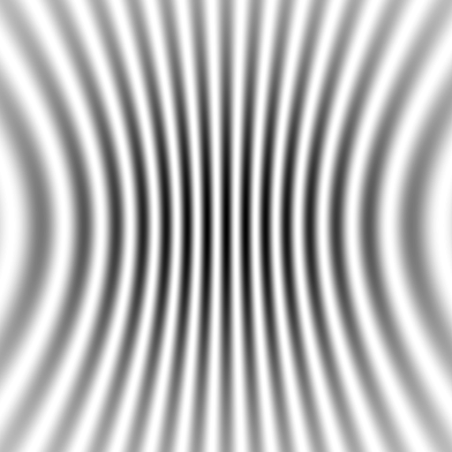
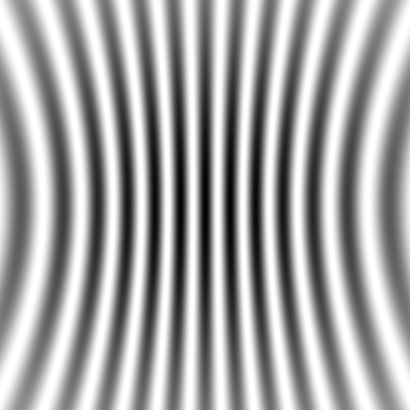



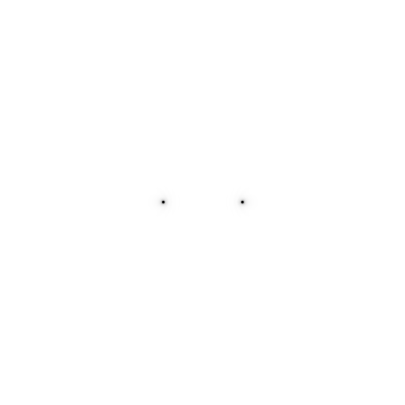
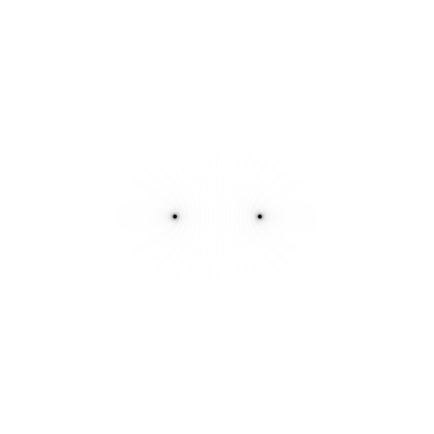


Slide 148
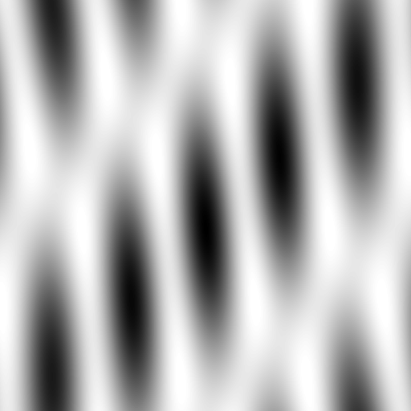


























Slide 149










scattering from a structure
sample
detector
beam center
+

Slide 150

forward Fourier Transform
inverse Fourier Transform
no phase
+

Slide 151











inverse Fourier Transform
scattering from a structure
colored by phase
sample
detector
+

Slide 152




scattering from a lattice
colored by phase
sample
detector
beam center
+

Slide 153

scattering from a lattice
colored by phase
sample
detector
beam center
+

Slide 154

scattering from a lattice
colored by phase
sample
detector
beam center
+

Slide 155

scattering from a crystal structure
colored by phase
sample
detector
beam center
+

Slide 156

lysozyme: real and reciprocal
+
+

Slide 157

Diffraction from a 3D lattice
+
real space
reciprocal space

Slide 158
Diffraction from a 3D lattice
+
real space
reciprocal space

Slide 159
Spot Shape
Ewald sphere
(h,k,l)

Slide 160
Spot Shape
Ewald sphere
(h,k,l)
d*

Slide 161
Spot Shape
Ewald sphere
(h,k,l)
spindle axis
d*

Slide 162
Spot Shape
Ewald sphere
Φ circle
(h,k,l)
spindle axis

Slide 163
Spot Shape
Ewald sphere
Φ circle
(h,k,l)
spindle axis

Slide 164
Spot Shape
Ewald sphere
Φ circle
(h,k,l)
diffracted ray
spindle axis

Slide 165
Spot Shape
Ewald sphere
Φ circle
(h,k,l)
λ*
d*
spindle axis
diffracted ray
λ*

Slide 166
Spot Shape
Ewald sphere
Φ circle
(h,k,l)
λ*
d*
spindle axis
diffracted ray
θ
λ*
λ = 2 d sin(θ)

Slide 167
spectral dispersion
Ewald sphere
Φ circle
(h,k,l)
λ*
d*
spindle axis
diffracted ray
λ*

Slide 168
spectral dispersion
Ewald sphere
Φ circle
(h,k,l)
λ’*
d*
spindle axis
diffracted ray
λ’*

Slide 169

dispersion = 0

Slide 170

dispersion = 0.014% (Si 111)

Slide 171

dispersion = 0.25% (CuK_{α})

Slide 172

dispersion = 0.6%

Slide 173

dispersion = 1.3%

Slide 174

dispersion = 2.6%

Slide 175

dispersion = 5.1%

Slide 176
The truth about x-ray beams
Term units significance
Flux photons/s duration of experiment
Beam Size μm match to crystal
Divergence mrad spot size vs distance
Wavelength Å resolution and absorption
Dispersion Δλ/λ spot size
Flux density ph/s/area scattering/damage rate
Fluence ph/area scattering/damage

Slide 177
beam divergence
Ewald sphere
Φ circle
(h,k,l)
λ*
d*
spindle axis
diffracted ray
λ*

Slide 178
beam divergence
Ewald sphere
Φ circle
(h,k,l)
d*
λ*
diffracted ray
spindle axis
λ*

Slide 179

divergence = 0 º

Slide 180

divergence = 0.3 º

Slide 181

Divergence
Arndt & Wonacott (1977)

Slide 182
Ewald’s “mosaic” picture

Slide 183
Ewald’s “mosaic” picture

Slide 184

Ewald’s “mosaic” picture
What is
this stuff?

Slide 185
Darwin’s original picture

Slide 186

“mosaicity” with visible light

Slide 187
mosaic spread = 0 º

Slide 188
mosaic spread = 0.1º

Slide 189
mosaic spread = 0.2º

Slide 190
mosaic spread = 0.4º

Slide 191
mosaic spread = 0.6º

Slide 192
mosaic spread = 0.8º

Slide 193
mosaic spread = 1.0º

Slide 194
mosaic spread = 1.5º

Slide 195
mosaic spread = 2.0º

Slide 196
mosaic spread = 2.5º

Slide 197
mosaic spread = 3.2º

Slide 198
mosaic spread = 6.4º

Slide 199
mosaic spread = 12.8º

Slide 200
mosaic spread
Ewald sphere
Φ circle
(h,k,l)
λ*
d*
diffracted ray
d*
spindle axis
λ*

Slide 201
mosaic spread
Ewald sphere
Φ circle
(h,k,l)
d*
diffracted rays
d*
spindle axis

Slide 202
The truth about x-ray beams
Term units significance
Flux photons/s duration of experiment
Beam Size μm match to crystal
Divergence mrad spot size vs distance
Wavelength Å resolution and absorption
Dispersion Δλ/λ spot size
Flux density ph/s/area scattering/damage rate
Fluence ph/area scattering/damage

Slide 203
Air absorption
transmittance
Distance from sample (mm)

Slide 204
Summary
1 + 1 = 1.4
Match beam to “crystal”
Match goop thickness to crystal
Better beam = less time
Look at your spots!
“true multiplicity” for anomalous
Crystal must rotate

Slide 205
Correct beam center
155.063 155.647
159.353 155.063
159.301 155.011
1512.73 1554.57
155.063 159.356 -250
ADXV
HKL2000
MOSFLM
XDS
DIALS

Slide 206

Re-indexing cheat sheet
Dauter, Z. (1999). "Data-collection strategies." Acta Cryst. D 55(10): 1703-1717.

Slide 207
CCP4: aimless log
$TABLE: Analysis against resolution, XDSdataset:
$GRAPHS:I/sigma, Mean Mn(I)/sd(Mn(I)):0|0.216023x0|137.14:2,13,14:
:Rmerge, Rfull, Rmeas, Rpim v Resolution:0|0.216023x0|1.70834:2,4,5,6,7:
:Average I, RMSdeviation and Sd:0|0.216023x0|1650.8:2,10,11,12:
:Fractional bias:0|0.216023x0|0:2,15:
$$
N 1/d^2 Dmid Rmrg Rfull Rcum Rmeas Rpim Nmeas AvI RMSdev sd I/RMS Mn(I/sd) FrcBias $$ $$
1 0.0064 12.55 0.020 0.020 0.020 0.021 0.006 13115 1651 57 42 29.2 137.1 -
2 0.0191 7.24 0.027 0.027 0.024 0.028 0.008 24753 1171 47 42 25.0 105.2 -
3 0.0318 5.61 0.038 0.038 0.029 0.040 0.012 32197 857 46 43 18.4 79.6 -
4 0.0445 4.74 0.034 0.034 0.031 0.035 0.010 37743 1212 57 53 21.4 91.2 -
5 0.0572 4.18 0.036 0.036 0.032 0.038 0.011 42642 1181 59 57 19.9 83.8 -
6 0.0699 3.78 0.049 0.049 0.036 0.052 0.015 47224 883 59 57 15.1 65.1 -
7 0.0826 3.48 0.065 0.065 0.040 0.068 0.020 51052 685 59 58 11.7 50.9 -
8 0.0953 3.24 0.096 0.096 0.045 0.100 0.029 54636 448 56 56 8.0 35.0 -
9 0.1080 3.04 0.151 0.151 0.050 0.158 0.046 58072 268 53 53 5.1 22.7 -
10 0.1207 2.88 0.229 0.229 0.056 0.240 0.070 60731 171 51 51 3.3 15.4 -
11 0.1334 2.74 0.314 0.314 0.063 0.329 0.097 63807 125 51 51 2.4 11.3 -
12 0.1461 2.62 0.406 0.406 0.070 0.425 0.125 66241 98 51 52 1.9 8.7 -
13 0.1588 2.51 0.537 0.537 0.078 0.562 0.166 68272 76 53 53 1.4 6.5 -
14 0.1715 2.41 0.685 0.685 0.084 0.727 0.237 54170 61 53 54 1.1 4.4 -
15 0.1843 2.33 0.886 0.886 0.088 0.950 0.333 39781 48 55 56 0.9 3.1 -
16 0.1970 2.25 1.249 1.249 0.092 1.355 0.508 29754 35 57 59 0.6 2.1 -

Slide 208
CCP4: aimless log
$TABLE: Correlations CC(1/2) within dataset, XDSdataset:
$GRAPHS: Anom & Imean CCs v resolution:0|0.216023x0|1:2,4,7:
: RMS correlation ratio :0|0.216023x0|2.20344:2,6:
$$
N 1/d^2 Dmid CCanom Nanom RCRanom CC1/2 NImean $$ $$
1 0.0064 12.55 0.659 499 2.203 1.000 669
2 0.0191 7.24 0.550 975 1.853 1.000 1155
3 0.0318 5.61 0.527 1295 1.798 1.000 1479
16 0.1970 2.25 0.037 2123 1.038 0.711 2275
17 0.2097 2.18 0.043 1682 1.044 0.460 1877

Slide 209
XDS: CORRECT.LP or XSCALE.LP
SUBSET OF INTENSITY DATA WITH SIGNAL/NOISE >= -3.0 AS FUNCTION OF RESOLUTION
RESOLUTION NUMBER OF REFLECTIONS COMPLETENESS R-FACTOR R-FACTOR COMPARED I/SIGMA R-meas CC(1/2) Anomal SigAno Nano
LIMIT OBSERVED UNIQUE POSSIBLE OF DATA observed expected Corr
6.39 4103 2517 3135 80.3% 1.7% 1.8% 3018 33.77 2.3% 99.9* 21* 1.012 533
4.54 7339 4970 5544 89.6% 2.6% 2.6% 4585 22.56 3.6% 99.8* 9 0.914 796
3.72 9442 6724 7186 93.6% 2.8% 2.9% 5327 19.99 4.0% 99.7* 9 0.859 877
3.22 11077 7997 8486 94.2% 4.8% 4.9% 6094 12.27 6.8% 99.3* -1 0.784 913
2.88 12408 8851 9595 92.2% 10.0% 10.1% 7068 6.01 14.2% 97.8* -2 0.799 1012
2.63 13673 9561 10662 89.7% 20.8% 20.8% 8185 3.10 29.4% 88.8* -4 0.776 1274
2.44 14360 9852 11510 85.6% 34.5% 34.7% 8981 1.90 48.8% 75.9* 2 0.765 1525
2.28 9501 6495 12416 52.3% 61.8% 59.6% 5991 1.14 87.3% 53.5* -2 0.722 1031
2.15 4567 3307 13210 25.0% 120.5% 120.3% 2520 0.59 170.4% 21.9* 4 0.693 408
total 86470 60274 81744 73.7% 6.7% 6.7% 51769 8.97 9.5% 99.5* 2 0.804 8369

Slide 210
XDS: CORRECT.LP or XSCALE.LP
******************************************************************************
CORRECTION PARAMETERS FOR THE STANDARD ERROR OF REFLECTION INTENSITIES
******************************************************************************
The variance v0(I) of the intensity I obtained from counting statistics is
replaced by v(I)=a*(v0(I)+b*I^2). The model parameters a, b are chosen to
minimize the discrepancies between v(I) and the variance estimated from
sample statistics of symmetry related reflections. This model implicates
an asymptotic limit ISa=1/SQRT(a*b) for the highest I/Sigma(I) that the
experimental setup can produce (Diederichs (2010) Acta Cryst D66, 733-740).
a b ISa
3.806E+00 1.080E-04 49.32

